Slide 1
Beam Condition Monitors and a Luminometer Based on Diamond Sensors
Wolfgang Lange, DESY Zeuthen and CMS BRIL Group
INSTR 2014 in Novosibirsk, February 25, 2014

Slide 2
Outline
Introduction
Beam Condition Monitors, CMS
BCM1F before the current shutdown
System design, performance, limitations
Upgrade in current shutdown
Description, design, test results
Conclusions

Slide 3
Outline
Introduction
Beam Condition Monitors, CMS
BCM1F before the current shutdown
System design, performance, limitations
Upgrade in current shutdown
Description, design, beam test results
Conclusions

Slide 4
Beam Condition Monitor
Context
LHC running at unprecedented beam energies and intensities
Even small beam losses may cause damage to CMS detector components
Purpose of Beam Condition Monitors
Monitor particle fluxes near the beam pipe
Ensure sufficiently low inner detector occupancy for data-taking
Detect beam loss conditions
Initiate reactions when necessary (beam abort)
CMS
Uses different beam condition monitors in its BRM system
Integrating monitors (signal current) → BCM1L, BCM2
Bunch by bunch monitors → scintillators and BCM1F
(later + Cherenkov Counters)

Slide 5
Outline
Introduction
Beam Condition Monitors, CMS
BCM1F before the current shutdown
System design, performance, limitations
Upgrade in current shutdown
Description, design, test results
Conclusions

Slide 6
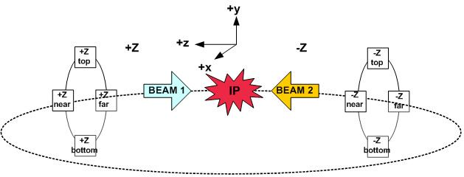
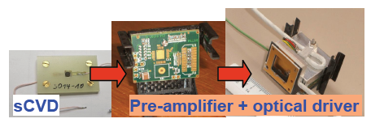
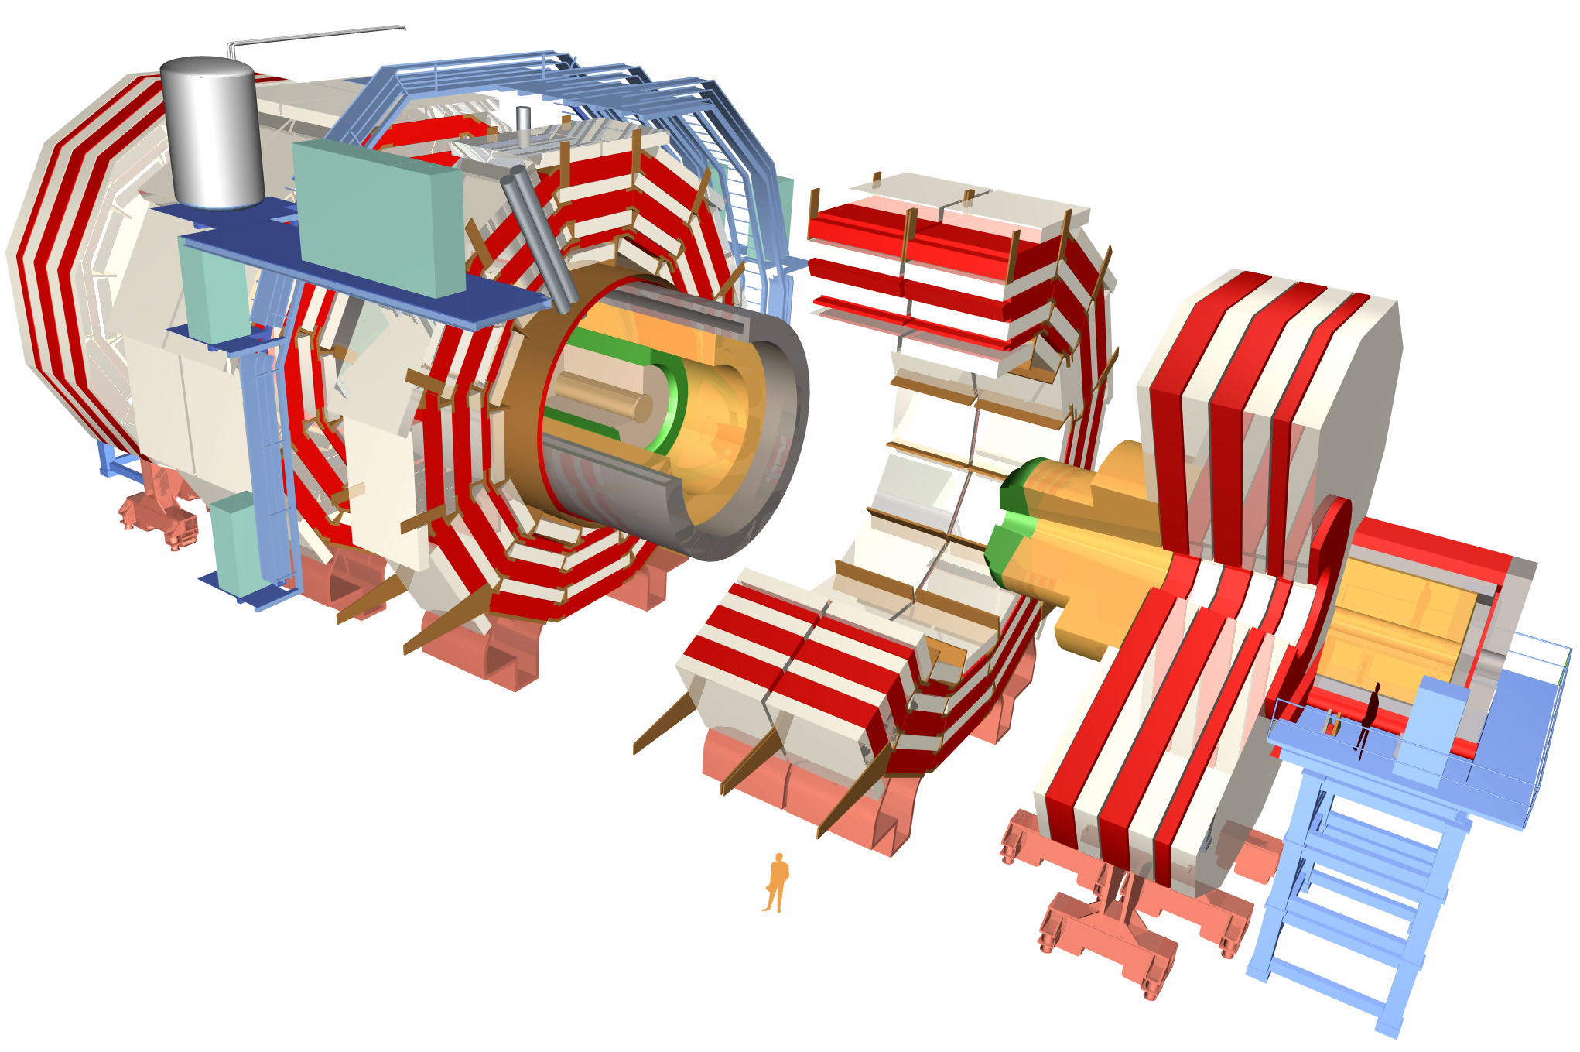
Fast Beam Condition Monitor BCM1F (up to 2012)
Module
LHC
CMS
8 single-crystal CVD diamonds (5 * 5 * 0.5 mm³, Element 6) positioned around the beam-pipe, radial distance 4.5 cm, 1.8 m from interaction point
Diamond → no cooling, robust, radiation-hard
Sensor module: diamond, radiation-hard preamplifier, optical driver
Bunch-by-bunch information on flux of beam halo and collision products
Monitor condition of beam: ensure low radiation for silicon tracker
Monitor luminosity
Readout independent of CMS DAQ

Slide 7
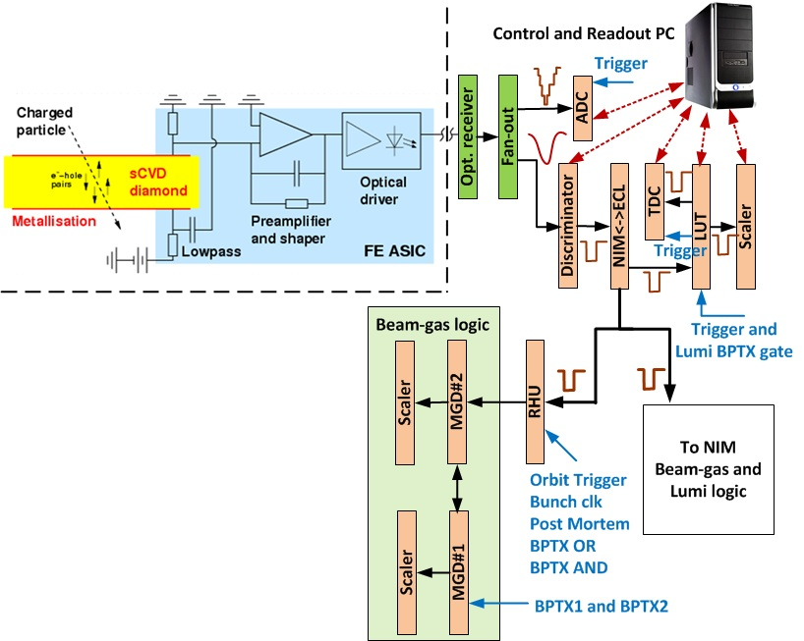
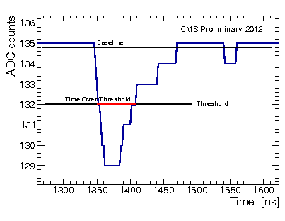
BCM1F Electronics (up to 2012)
Output:
analog spectra
ADC → monitoring
hit rates
Discriminator →
Look-up table
“LUT”
Recording
Histogram
Unit
“RHU”

Slide 8
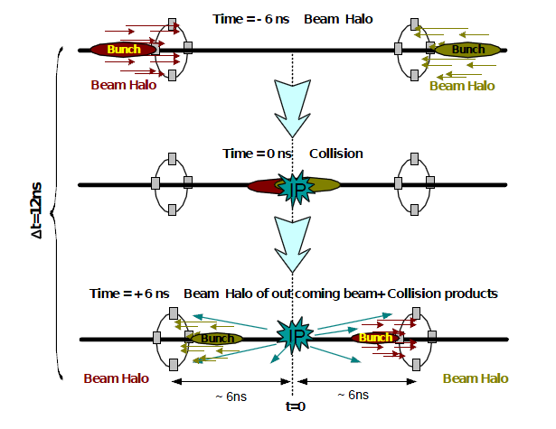
What can be seen with such a device?

Slide 9
Performance of BCM1F (up to 2012) - 1
Operated right from the start of LHC → first (splash) beam in LHC already seen
measures underground rates and time structure of beams
discovery of “Albedo Effect” (afterglow of slow particles)
delivers relevant background rates to CMS and to LHC control room
monitors online luminosity
Bunch structure of one full orbit inside LHC, abort gap on the right

Slide 10
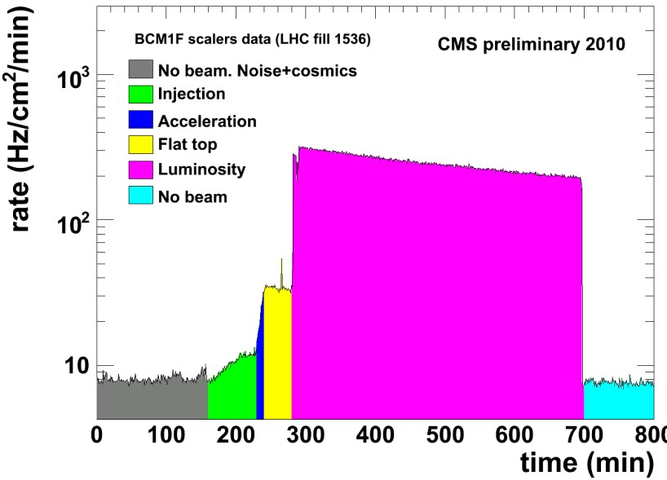
Performance of BCM1F (up to 2012) - 2
Operated right from the start of LHC: first (splash) beam in LHC seen
measures underground rates and time structure of beams
discovery of “Albedo Effect” (afterglow of slow particles)
delivers relevant background rates to CMS and to LHC control room
monitors online luminosity
“Life Cycle” of a fill in
the LHC

Slide 11
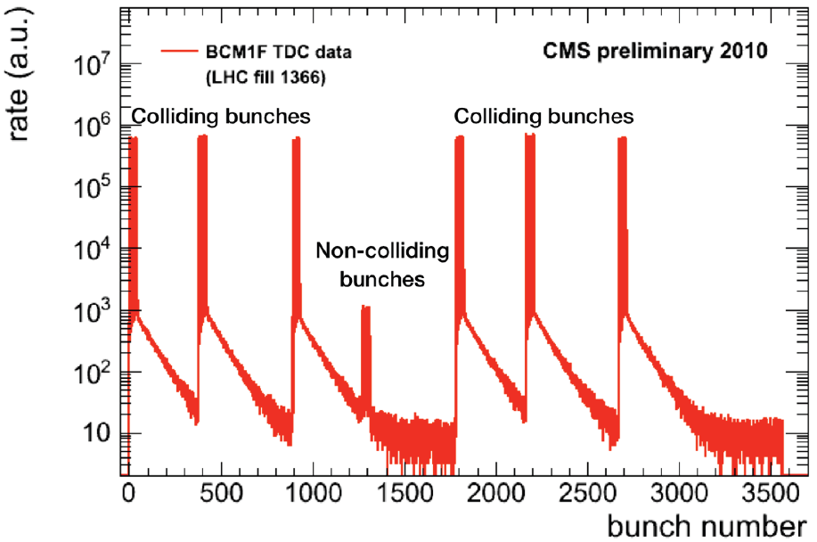
Performance of BCM1F (up to 2012) - 3
Operated right from the start of LHC: first (splash) beam in LHC seen
measures underground rates and time structure of beams
discovery of “Albedo Effect” (afterglow of slow particles)
delivers relevant background rates to CMS and to LHC control room
monitors online luminosity
Albedo Effect
after collisions:
particles hit CMS material
excitation of material
→ decays
slow remaining particles
lifetime ~2 µs

Slide 12
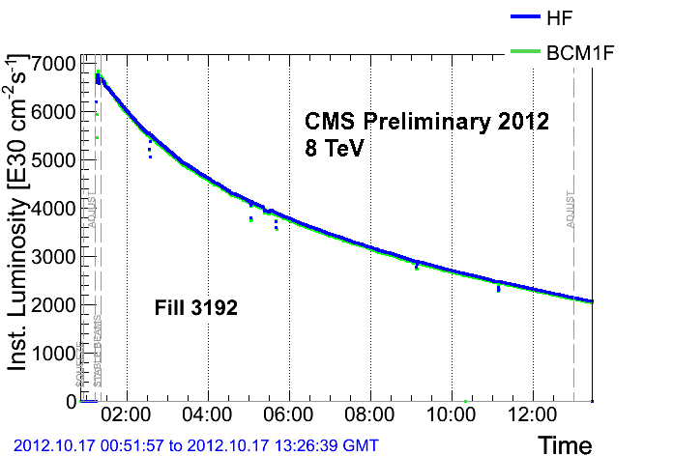
Performance of BCM1F (up to 2012) - 4
Operated right from the start of LHC: first (splash) beam in LHC seen
measures underground rates and time structure of beams
discovery of “Albedo Effect” (afterglow of slow particles)
delivers relevant background rates to CMS and to LHC control room
monitors online luminosity (relative measurement, calibration will give online luminosity)
Collision rates (LUT) are used for luminosity measurements:
Requires calibration
online luminosity in CMS done by
Hadron Forward Calorimeter (HF)
Test of BCM1F as online luminometer:
good agreement
validated with calculations of HF, pixels
has potential as online luminometer
advantage: decoupled from
CMS DAQ

Slide 13
Limitations of BCM1F (up to 2012)
preamp has 25 ns shaping time – to slow for 25 ns bunch spacing
preamp needs a long recovery time from large input signals (overdriven, saturated)
laser diodes (analog signal transmission) have radiation damage
diamond sensors show radiation damage → polarization → how to cure?
only 4 sensors on each side of the interaction point → saturation / pile-up problems

Slide 14
Outline
Introduction
Beam Condition Monitors, CMS
BCM1F before the current shutdown
System design, performance, limitations
Upgrade in current shutdown
Description, design, test results
Conclusions

Slide 15
Upgrade Program of BCM1F in the current Shutdown
preamp has 25 ns shaping time – to slow for 25 ns bunch spacing
preamp needs a long recovery time from large input signals (overdriven, saturated)
laser diodes (analog signal transmission) have radiation damage
diamond sensors show radiation damage → polarization → how to cure?
only 4 sensors on each side of the interaction point → saturation / pile-up problems
Design of a new preamp:
rise time below 12 ns
fast recovery from overdrive
differential outputs
No better laser diodes available:
Moving of laser diodes to a less exposed area
Adding slow control for current and gain (compensation
use of components with extended high voltage tolerance
metallization of sensors split into two pads
use of 12 sensors with two pads each → 24 channels per side

Slide 16
Upgrade Program of BCM1F in the current Shutdown
preamp has 25 ns shaping time – to slow for 25 ns bunch spacing
preamp needs a long recovery time from large input signals (overdriven, saturated)
laser diodes (analog signal transmission) have radiation damage
diamond sensors show radiation damage → polarization → how to cure?
only 4 sensors on each side of the interaction point → saturation / pile-up problems
Design of a new preamp:
rise time below 12 ns
fast recovery from overdrive
differential outputs
No better laser diodes available:
Moving of laser diodes to a less exposed area
Adding slow control for current and gain (compensation
use of components with extended high voltage tolerance
metallization of sensors split into two pads
use of 12 sensors with two pads each → 24 channels per side

Slide 17
Upgrade Program of BCM1F in the current Shutdown
preamp has 25 ns shaping time – to slow for 25 ns bunch spacing
preamp needs a long recovery time from large input signals (overdriven, saturated)
laser diodes (analog signal transmission) have radiation damage
diamond sensors show radiation damage → polarization → how to cure?
only 4 sensors on each side of the interaction point → saturation / pile-up problems
Design of a new preamp:
rise time below 12 ns
fast recovery from overdrive
differential outputs
No better laser diodes available:
Moving of laser diodes to a less exposed area
Adding slow control for current and gain (compensation
use of components with extended high voltage tolerance
metallization of sensors split into two pads
use of 12 sensors with two pads each → 24 channels per side

Slide 18
Upgrade Program of BCM1F in the current Shutdown
preamp has 25 ns shaping time – to slow for 25 ns bunch spacing
preamp needs a long recovery time from large input signals (overdriven, saturated)
laser diodes (analog signal transmission) have radiation damage
diamond sensors show radiation damage → polarization → how to cure?
only 4 sensors on each side of the interaction point → saturation / pile-up problems
Design of a new preamp:
rise time below 12 ns
fast recovery from overdrive
differential outputs
No better laser diodes available:
Moving of laser diodes to a less exposed area
Adding slow control for current and gain (compensation
use of components with extended high voltage tolerance
metallization of sensors split into two pads
use of 12 sensors with two pads each → 24 channels per side

Slide 19
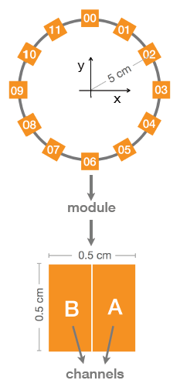
Upgrade Program of BCM1F in the current Shutdown
Implications of LHC upgrade for BCM1F
Radiation: Luminosity 10³⁴ cm⁻²s⁻¹
→ BCM1F expects charged particle flux ~3x10⁷ cm⁻²s⁻¹
25 ns bunch spacing
High hit rate
Summary of upgrade goals:
12 diamonds with 2 pads per diamond,
both sides of IP → 48 channels
Scale up full system from 8 channels to 48
Deal with radiation damage
Faster electronics (preamp)
Integrate readout with other luminosity subsystems

Slide 20
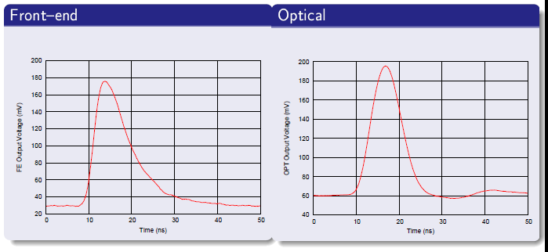
From Plans to Reality: the re-designed frontend chip
ASIC designed by AGH – Krakow (PL), Designer: Dominik Przyborowski
IBM CMOS-8RF-130nm technology (radiation hard, submitted via CERN)
~50 mV/fC charge gain
< 1k electrons ENC with sensor capacitance
Sophisticated calibration logic
4 channels on 1 chip
Laboratory measurements of the full readout chain of upgraded BCM1F

Slide 21
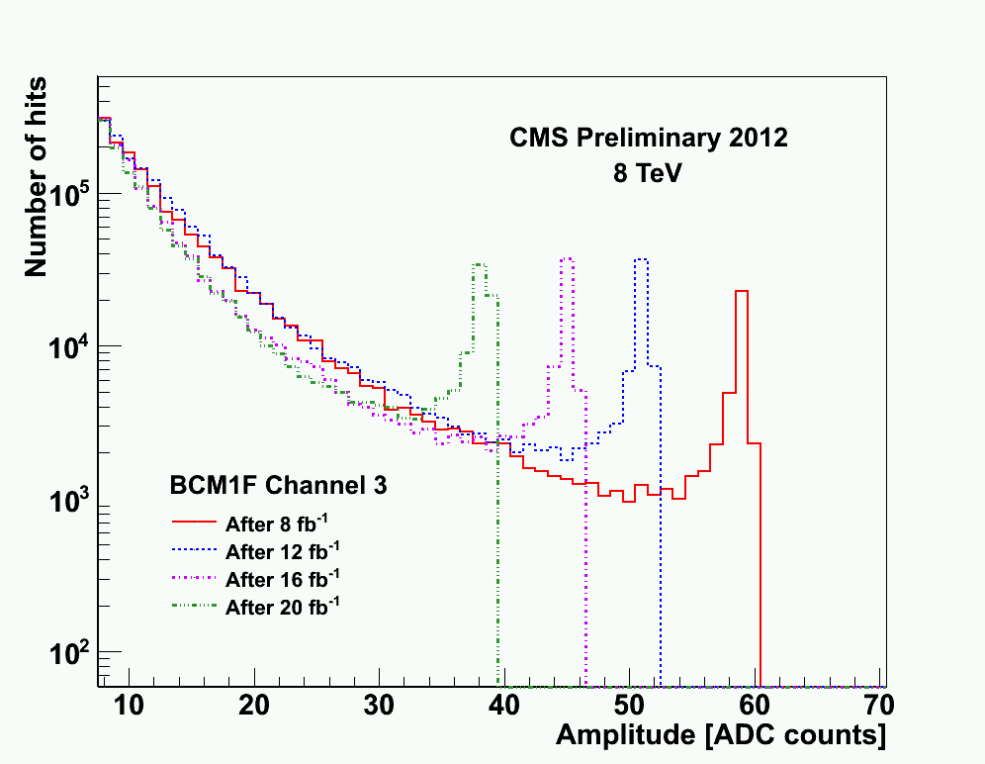
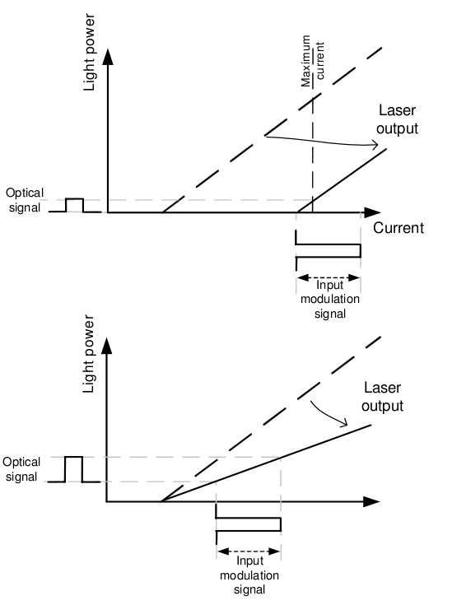
From Plans to Reality: improving the optical chain
Radiation damage of laser driver visible in decreasing signal amplitude:
• 25% gain lost in BCM1F optical transmission after 30 fb⁻¹
Countermeasures:
• Go away from the “hot” area
• Compensate the loss in gain
• Compensate for the
shifted laser threshold

Slide 22
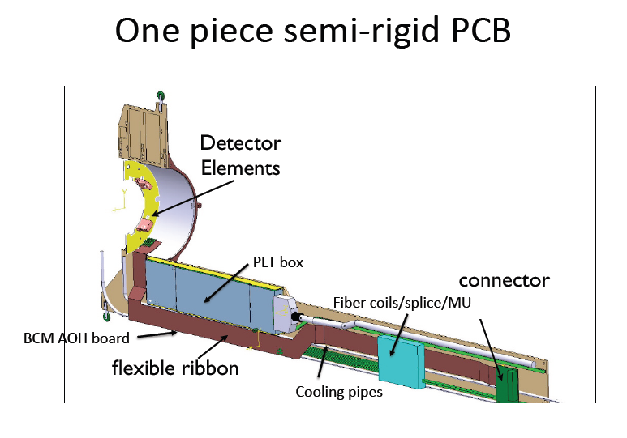
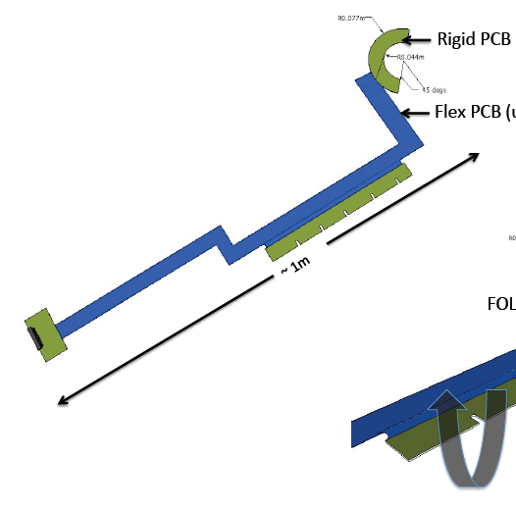
From Plans to Reality: the re-designed carriage
The C-shape carries sensors and preamps.
All wiring and support
will be located on a
one-piece-rigid-flexible PCB (Printed Circuit Board)
Laser drivers go further away (r, z).

Slide 23
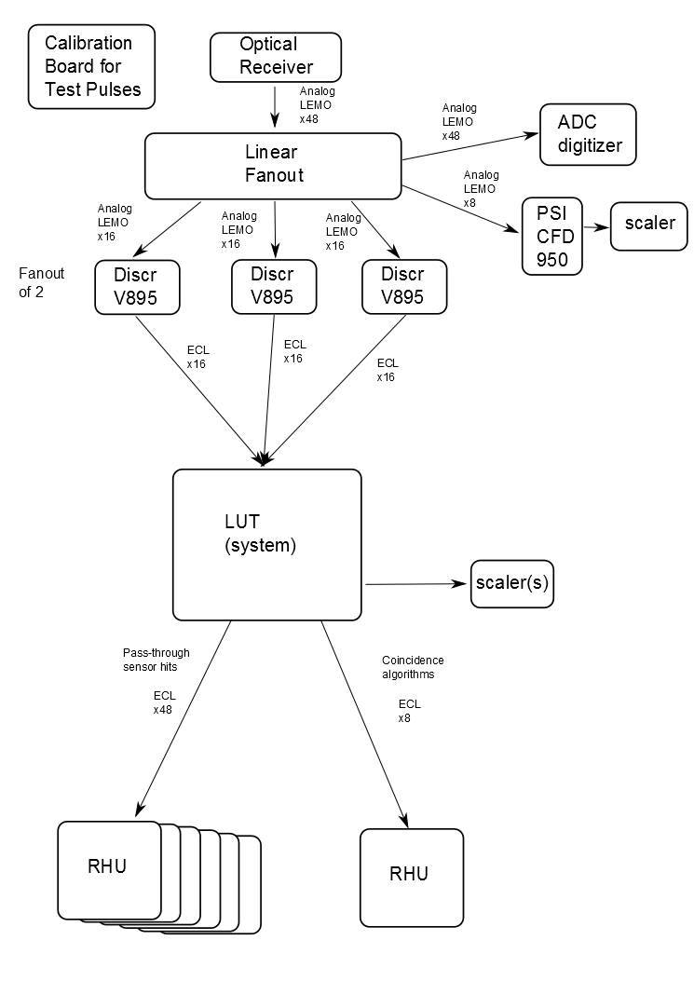
Upgrade of Backend Electronics
Use “tried and true” discriminator path for initial running while commissioning digitizer path
→ following slide
LUT: create coincidences between all 48 channels → patterns
RHU for readout (later slide) → dedicated histograms

Slide 24
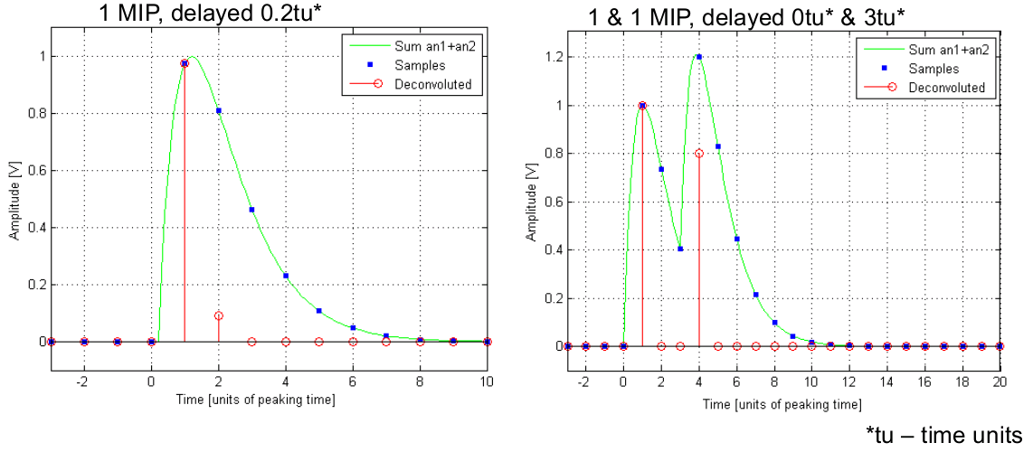
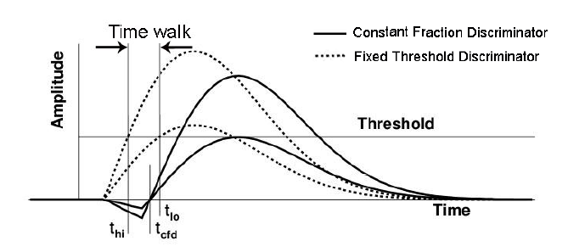
Signal Processing
Two parallel tracks to be followed:
Discriminators
Fixed-threshold vs. constant-fraction
Digitizer with fast peak-finding algorithms
Constant-fraction: better time resolution
Fixed-threshold: lower deadtime
Preliminary conclusion: deadtime outweighs resolution → use FTD (CAEN V895) for primary path but install CFD to run and test in parallel
Identify pulse arrival time and peak height, distinguish signals close in time (overlapping) “deconvolution”
Development of algorithms ongoing
Current hardware choice: uTCA ADC FMC mezzanine system. Multiple FMC candidates, to be tested

Slide 25
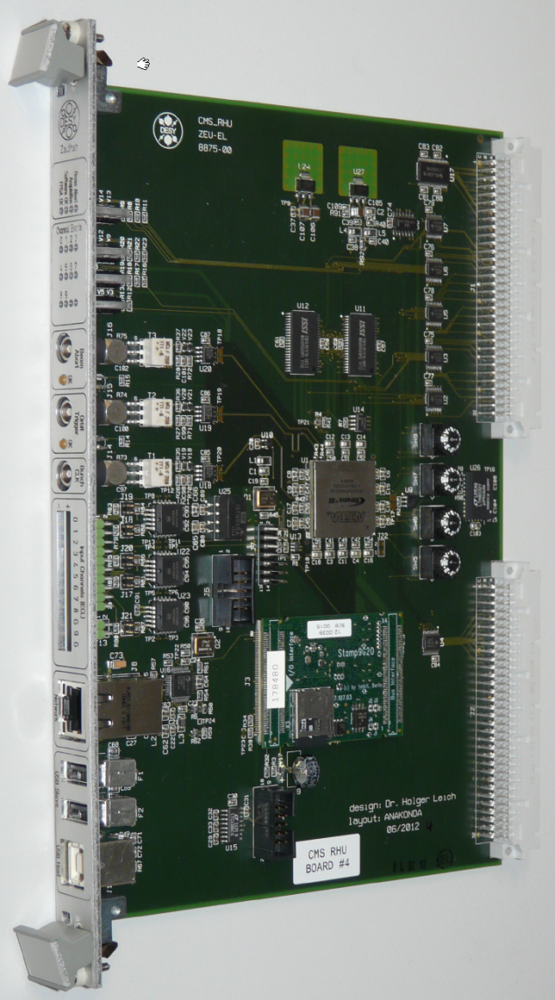
Recording Histogram Unit (RHU)
RHU: Readout of full-orbit histograms
No deadtime (buffered readout)
8 histogramming input channels
Bins of 6.25 ns = 4/bunch bucket (14k bins/orbit)
Bunch clock, orbit clock, beam abort
Configurable sampling period
Ethernet readout
Developed at DESY-Zeuthen
Prototype installed Sept. 2012,
validated during 2012-2013 run
Very flexible unit (FPGA based, own interface and OS)
Physics friendly data compression for direct access

Slide 26
Outline
Introduction
Beam Condition Monitors, CMS
BCM1F before the current shutdown
System design, performance, limitations
Upgrade in current shutdown
Description, design, test results
Conclusions

Slide 27
Conclusions and Outlook
Many improvements in the works to increase effectiveness
Carriage: 48 channels, single PCB
Diamond sensors: minimize effects of radiation damage using higher voltage
New fast front end ASIC to reduce inefficiencies
Optical chain: lower radiation for laser driver, multi-amplitude test pulses
Back end: Discriminator path in parallel with digitizer peak-finding
RHU for direct collection of hit rates
Algorithms for luminosity measurement
Outlook
Installation of 4 carriages (full system) planned begin of September
Comissioning of all subsystems soon after installation and recovery
of the LHC

Slide 28
What should I add?
Thank you for your attention!
Спасибо за вниманию!

Slide 29
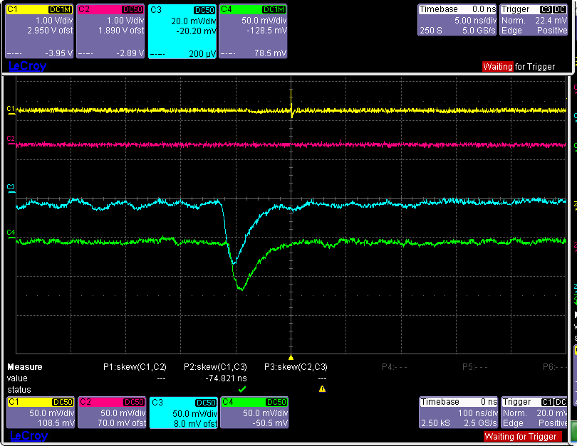
Backup Slides (1) - Very first beam in CMS
BPTX
- Z
+ Z

Slide 30
Backup Slides (2) – Luminosity Basics

Slide 31
Backup Slides (3) – Discriminators
Current discriminator: CAEN v258B fixed-threshold discriminator
- Does not discriminate pulses closer than ~12 ns: deadtime causes loss of consecutive signals
- Triggers pulses of different amplitudes at different times: “time walk” ΔT ~12 ns
Meanwhile tested: two constant-fraction discriminators: CAEN V812, PSI CFD950
Both CFDs significantly improve on FTD time walk
- V812: better time resolution for trigger of single pulse
- CFD950: better resolution between consecutive pulses

Slide 32
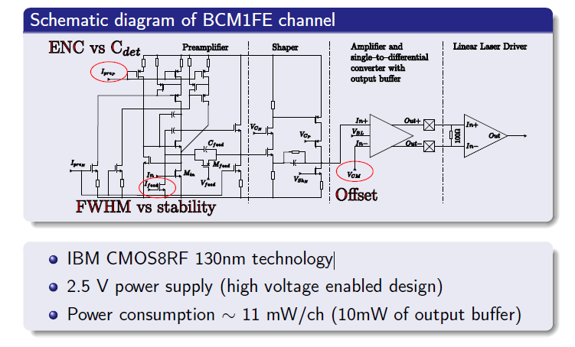
Backup Slides (4) – upgraded frontend ASIC

