Slide 1
Upgrade of trigger and DAQ for CsI at BelleII
Vladimir Zhulanov for BelleII ECL group
Budker INP, Novosibirsk
INSTR2014, Novosibirsk
2014/02/28

Slide 2
Outline
Overview of the ECL (CsI Electromagnetic CaLorimeter) readout electronics
Fitting algorithm and its realization
Interface with BelleII DAQ and trigger systems
Summary

Slide 3


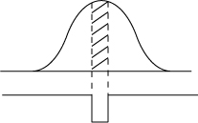

Waveform sampling readout
Shaper output signal
→ t
→ t
Signal charge
↓
Timing (leading/trailing edges) with range information by QtoT converter (MQT300A)
↓
Digitized by TDC
2MHz, 18bits digitizer,
waveform fit to get energy and timing (i.e. Digital Signal Processing)
Reduction factors;
×7 BG showers
×1.5~2 pileup noise
Gate width=100ns
From Miyabayashi’s slides
Notes:
Early today Miyabayashi-san presented the upgrade of the BelleII electromagnetic calorimeter and mentioned about the reasons to change the electronics architecture to the pipelined architecture.

Slide 4
ECL electronics
FAM
TMM
TMM
Global
trigger
ECLCollector
FTSW
ShaperDSP
Trigger&
timing
TTD
(Trigger & Timing Distribution)
ShaperDSP
ShaperDSP
PA
PA
belle2link
COPPER
HSLB
CPU
PA
HSLB
12 ShaperDSP
Modules
ShaperDSP serves
16 CsI counters
HSLB
HSLB
Event Builder
8736 CsI counters in total => 52 VME crates

Slide 5
ShaperDSP
Fast
shaper
DCPs
Fast out
Temperature
FAM
PA
Shaper
ADC
18 bit
DATA
Vref.
1
ADC
1
control
2
3
DDR
16
13
14
1
SCK - Clock,
RCK -Sync, conf
XILINX
Spartan
15
CYCLONE
16
Conf
ALTERA
16
2
ADC & Digital Pot Control
10
Ser
Interface
with
EclCollector
10
DeSer.

Slide 6
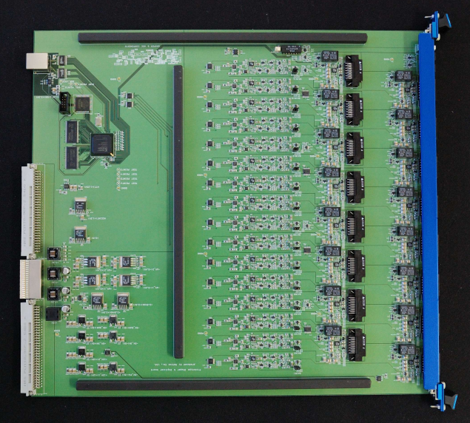
ShaperDSPb photo
I/F with
EclCollector
FPGA ALTERA
DDR memory
FPGA Xilinx
ADCs
Shapers
Connectors to PreAmps
(readout signal,
Calib, power supply)
LDO power converters
DCPs

Slide 7
Tasks of the ECL Collector module.
calib
FPGA
Xilinx
Virtex5
Or
Spartan6
Ethernet
Collect and merge data from 12 connected ShaperDSP modules
Provide interface with Belle II TTD and DAQ
Configure Xilinx FPGA on ShaperDSPb modules
Synchronization of sampling process in ShaperDSPb modules
Generation of a calibration signal
Ethernet interface for stand-alone operation and upload of DSP coefficients
Store coefficients for DSP processing
DAC
RocketIO
DAQ
LVDS
TTD
SER/DESER
JTAG over LVDS
SCK, RCK
Flash memory
512 MByte

Slide 8
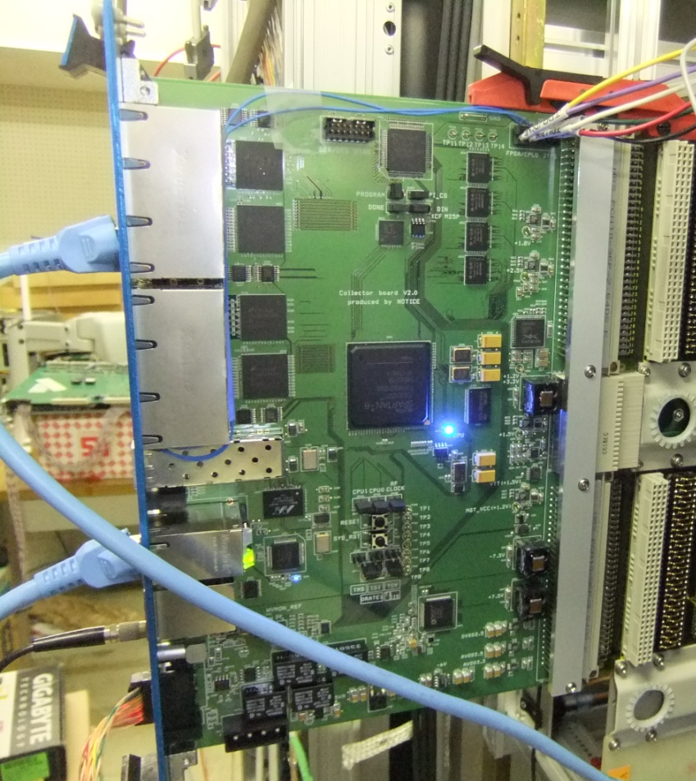
EclCollector photo
CPLD
IFC with ShaperDSP
Parallel flash
memory
Serializer/Deserializer
modules
TI SCAN928028
TI SCAN926260
FPGA Spartan6
XC6SLX150T-3
SFP connector
DAC for calibration
pulse generation
AD9726
16 bits @80 MHz
Calibration pulse is
Based on LUT – imitate
signal from PD
Ethernet, Trigger,
JTAG-over-LVDS
HV
Calib

Slide 9

Fitting algorithm

Slide 10
Parallel calculation
Iteration 1
Iteration 2
Iteration 3
Load coefs
MAC
DIV
Load coefs
MAC
DIV
Load coefs
MAC
DIV
Load coefs
MAC
DIV
Load coefs
MAC
DIV
Load coefs
MAC
DIV
Core 1
Load coefs
MAC
DIV
Load coefs
MAC
DIV
Load coefs
MAC
DIV
Load coefs
MAC
DIV
Load coefs
MAC
DIV
Load coefs
MAC
DIV
Load coefs
MAC
DIV
Load coefs
MAC
DIV
Load coefs
MAC
DIV
Core 2
Load coefs
MAC
DIV
Load coefs
MAC
DIV
Load coefs.
MAC
DIV
is calculated after the end of 3rd itertion and is compared to specified threshold => Data quality flag
Output: Amplitude (18 bits), Time (12 bits), Quality flags (2 bits)
ShaperDSP easily digitally processes 16 channels @ Trigger rate = 50 kHz
while the BelleII designed maximum TR=30 kHz, and maximum ECL channel occupancy = 1/3

Slide 11
ECL data processing
ShaperDSP
DDR 1
DDR 2
FPGA
ADC DATA BUFFER
+ buffer for
512 samples
16 ch.
Event data
DSP
PACKAGER
ADC1
DeSer
Collector
Event data
ADC12
HSLB
Trigger
Trigger Controller (FIFO)
Trigger
FTSW

Slide 12
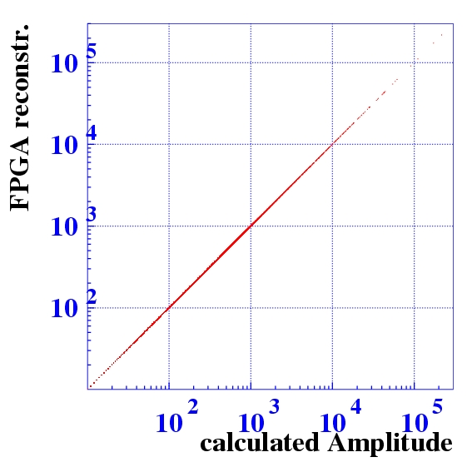
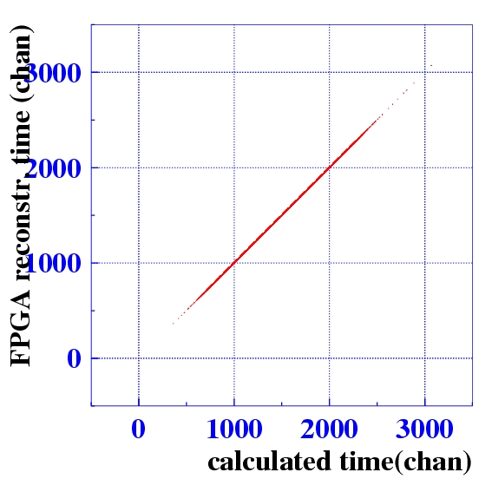
Algorithm comparison: HW vs SW
Hardware reconstruction algorithm fully corresponds to its software version
This is verified by reading out the raw ADC data together with reconstracted A, T and Q

Slide 13
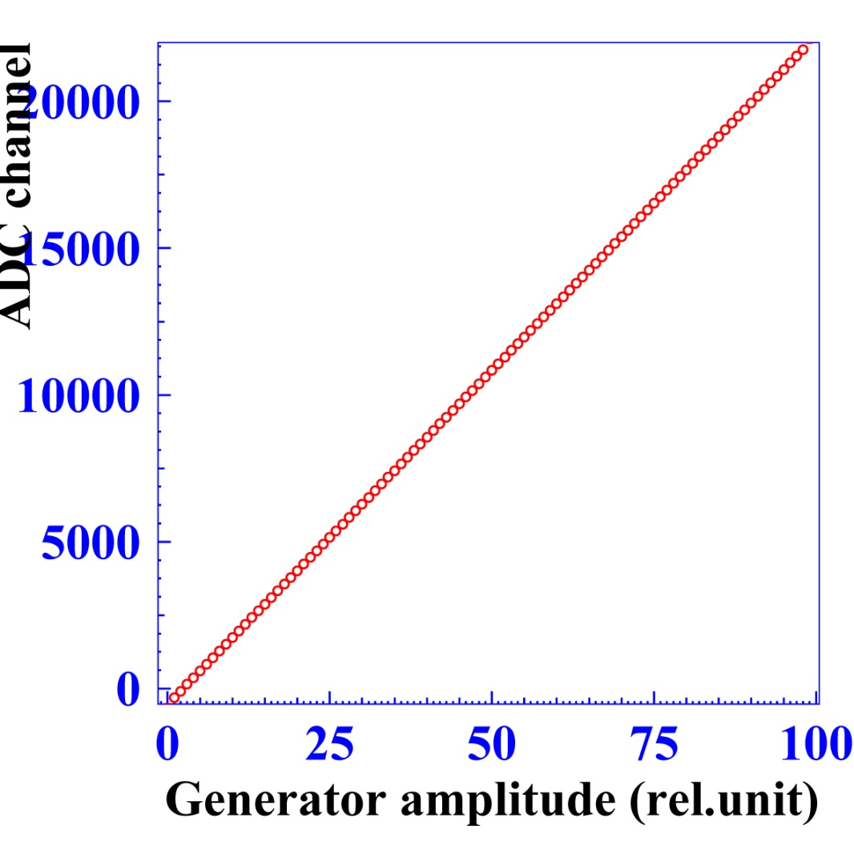
Linearity

Slide 14
Time resolution

Slide 15
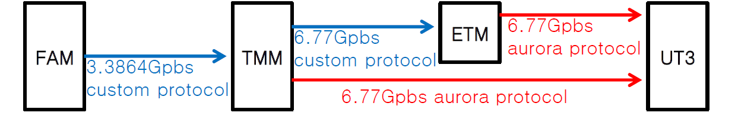
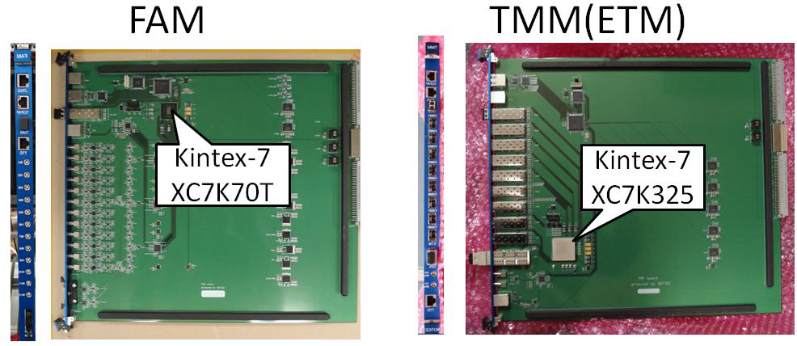
ECL TRG system
From Y.Unno’s slides

Slide 16
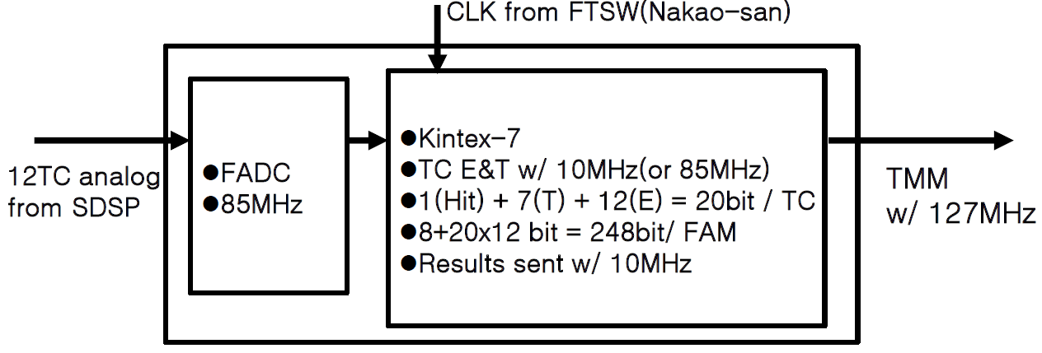
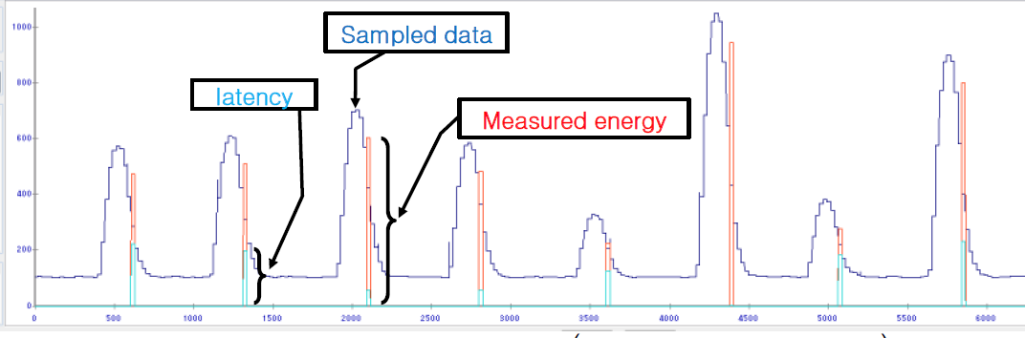
FAM
From Y.Unno’s slides

Slide 17
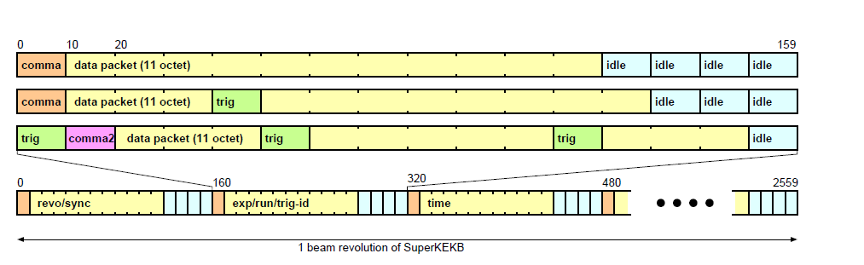
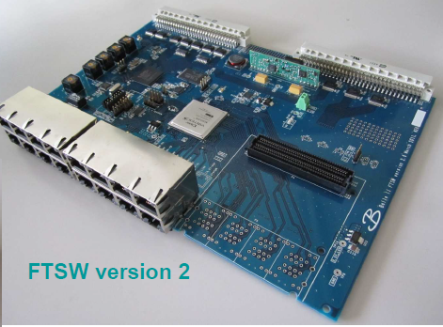
TTD system protocol
Trigger data is distributed over home-made TTD protocol
encoded with 8b/10b @ 127 MHz
FTSW board distributes trigger information between FEE
From M.Nakao’s slides

Slide 18
COPPER - COmmon Pipelined Platform for Electronics Readout
mezzanine
(add-on) modules
FIFO
Detector
I/F
PMC modules
PCI bus
PMC CPU
local bus
Detector
I/F
from detector
Bridge
Network I/F
to event builder
Detector
I/F
Detector
I/F
Trigger Module
4 HSLB (High-Speed Link Board) modules are installed in each COPPER.
HSLB – unified data collecting board
From T.Higuchi’s slides

Slide 19
Summary
The pipelined architecture for ECL electronics has been designed.
Algorithm tests at the Belle detector (before its shutdown for upgrade) were successfully carried out.
Currently the electronics mass production is in progress

Slide 20
Thank you

