Slide 1

Two-phase Cryogenic Avalanche Detectors
Andrey Sokolov
Budker Institute of Nuclear Physics, Novosibirsk, Russia
Novosibirsk State University, Russia
March 1, 2014

Slide 2
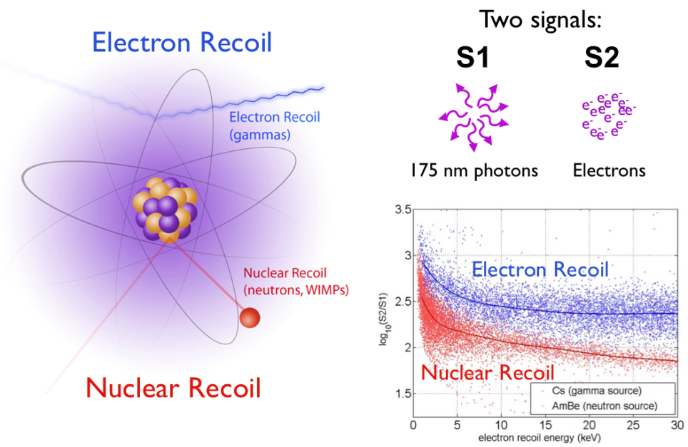
WIMP direct detection: two phase Xe
Top PMT Array
Gamma
Drift time
WIMP, neutron
Bottom PMT Array
S2/S1_{Gamma}>>S2/S1_{WIMP}
A. Lyashenko XENON1T collaboration

Slide 3
Outline
1. CRyogenic Avalanche Detector concepts.
2. Our ongoing project on two-phase CRADs for dark matter search and low-energy neutrino detection.
3. Two-phase CRAD R&D results:
- Two-phase CRADs with charge readout.
- Two-phase CRADS with optical readout.
4. Results on two-phase Ar CRADs with THGEM/GAPD-matrix optical readout
5. Neutron scattering on Ar nuclei and quenching factor mesurement
5. Summary.
Andrey Sokolov, INSTR14, March 1, 2014

Slide 4
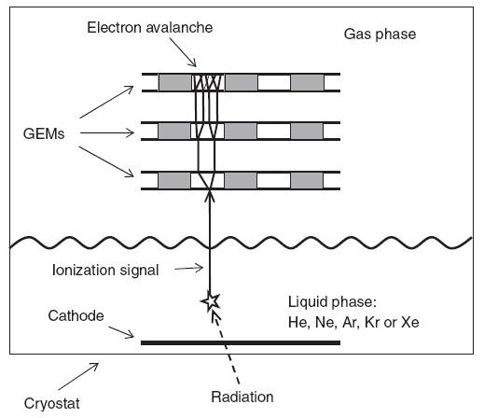
CRAD concepts
- Final goal: development of detectors of ultimate sensitivity (single-electron mode, with high spatial resolution, at extremely low noise) for rare-event experiments and other (i.e. medical) applications.
- Basic idea: combining hole-type MPGDs (GEMs and THGEMs) with cryogenic noble gas detectors, either in a gaseous, liquid or two-phase mode.
- We call such detectors “CRyogenic Avalanche Detectors”: CRADs.
This concept was further developed, in particular suggesting to provide CRADs with:
- THGEM multiplier charge readout
- MPGD-based Gaseous Photomultiplier (GPM) separated by window from noble liquid
- CCD optical readout of GEM multiplier
- Combined THGEM/GAPD multiplier optical readout (GAPD = Geiger-mode APD or SiPM)
Andrey Sokolov, INSTR14, March 1, 2014

Slide 5
Outline
1. CRyogenic Avalanche Detector concepts.
2. Our ongoing project on two-phase CRADs for dark matter search and low-energy neutrino detection.
3. Two-phase CRAD R&D results:
- Two-phase CRADs with charge readout.
- Two-phase CRADS with optical readout.
4. Results on two-phase Ar CRADs with THGEM/GAPD-matrix optical readout
5. Neutron scattering on Ar nuclei and quenching factor mesurement
5. Summary.
Andrey Sokolov, INSTR14, March 1, 2014

Slide 6
Our ongoing CRAD-related project
Accordingly, we need to develop
high-gain, extremely-low-noise and self-triggered two-phase CRADs having single-electron sensitivity, for 3 experiment types:
- Coherent Neutrino-Nucleus Scattering experiments;
- Dark Matter search experiments;
- low-energy nuclear-recoil calibration experiments.
Andrey Sokolov, INSTR14, March 1, 2014
6

Slide 7
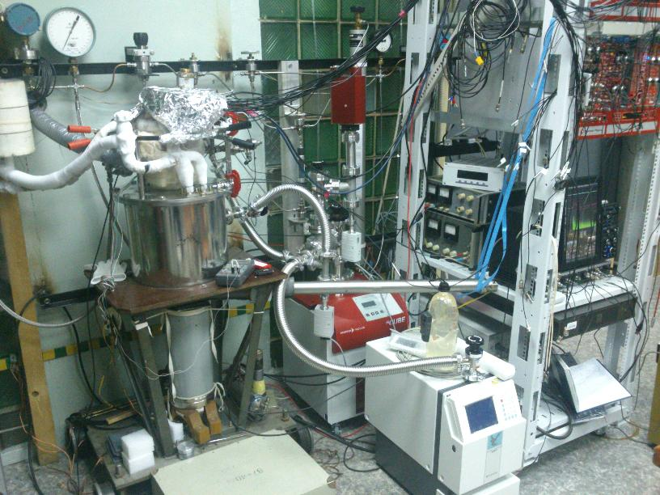
CRAD laboratory
Andrey Sokolov, INSTR14, March 1, 2014

Slide 8
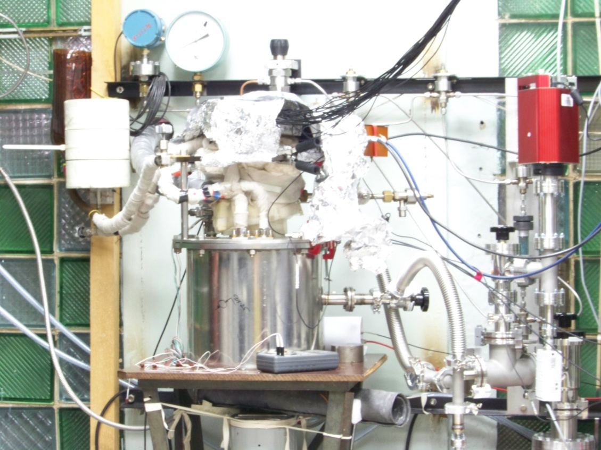
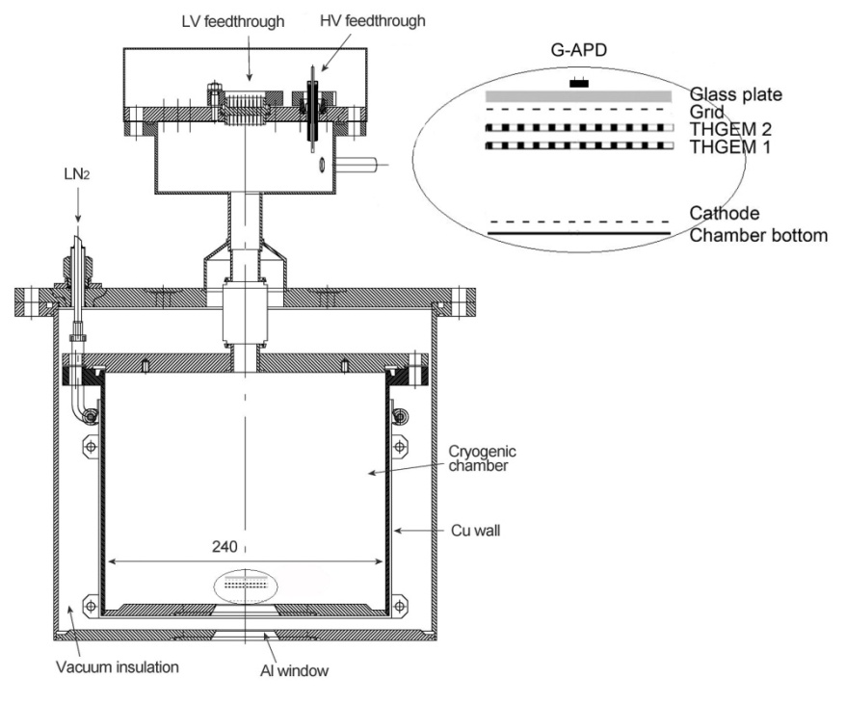
CRAD prototype
- 9 liters cryogenic chamber with 5cm-diameter Al X-ray windows
- ~0.5-2.5 liters of liquid Ar or Xe
- THGEM or THGEM/GAPD assembly inside
- Purification using Oxisorb: 20 µs e lifetime
- 1-day cooling cycle
- 1-3 hours liquid Ar collection time
Andrey Sokolov, INSTR14, March 1, 2014

Slide 9
Outline
1. CRyogenic Avalanche Detector concepts.
2. Our ongoing project on two-phase CRADs for dark matter search and low-energy neutrino detection.
3. Two-phase CRAD R&D results:
- Two-phase CRADs with charge readout.
- Two-phase CRADS with optical readout.
4. Results on two-phase Ar CRADs with THGEM/GAPD-matrix optical readout
5. Neutron scattering on Ar nuclei and quenching factor mesurement
5. Summary.
Andrey Sokolov, INSTR14, March 1, 2014

Slide 10
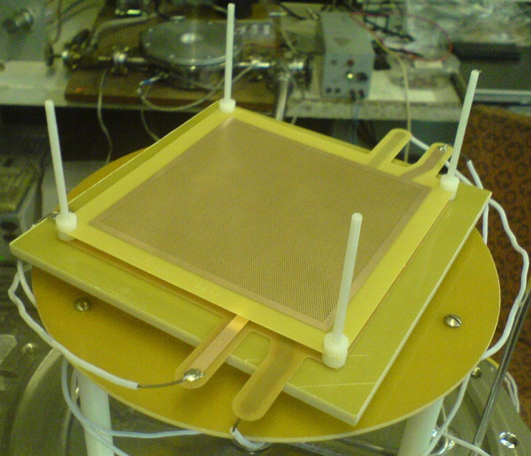
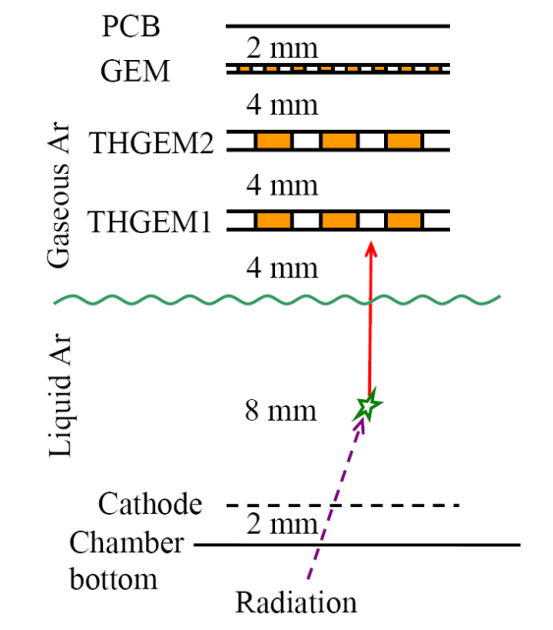
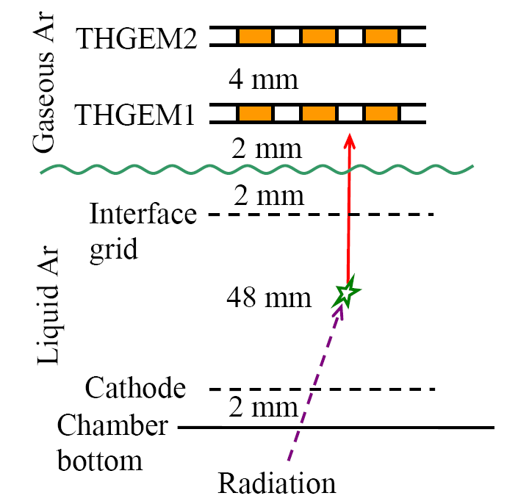
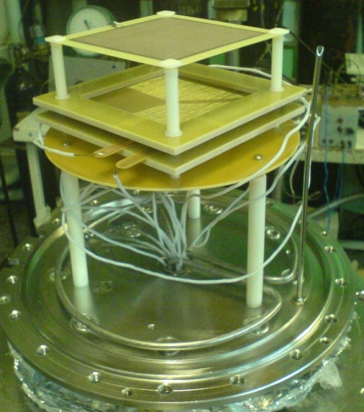
Two-phase CRADs in Ar with THGEM and hybrid THGEM/GEM multiplier (10×10 cm² active area)
- 1 or 5 cm thick LAr layer
- Electron life time in LAr ~ 13 μs
- THGEM geometry: p/d/h=0.9/0.5/1 mm
[NSU & Budker INP: A.Bondar et al, JINST 8 (2013) P02008]

Slide 11
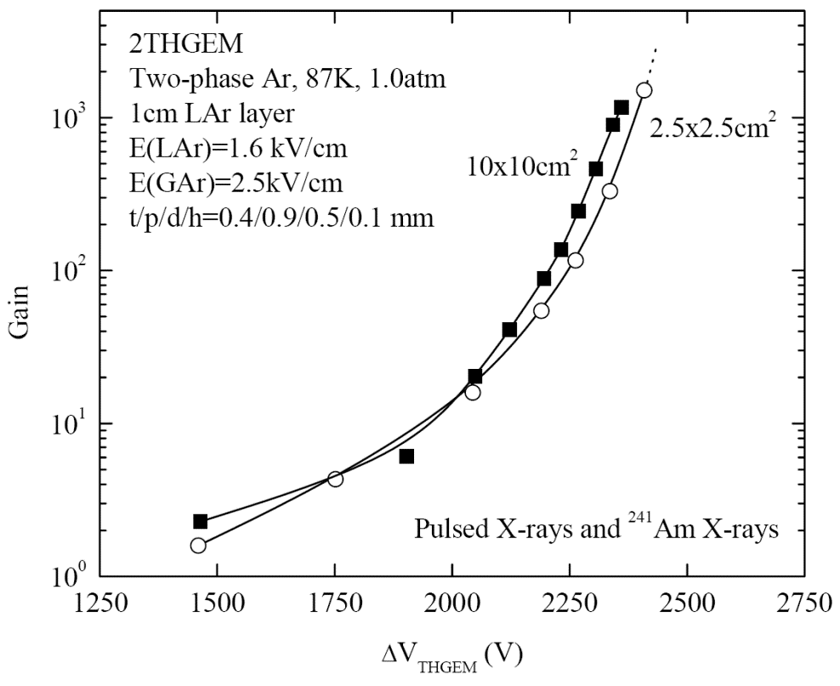
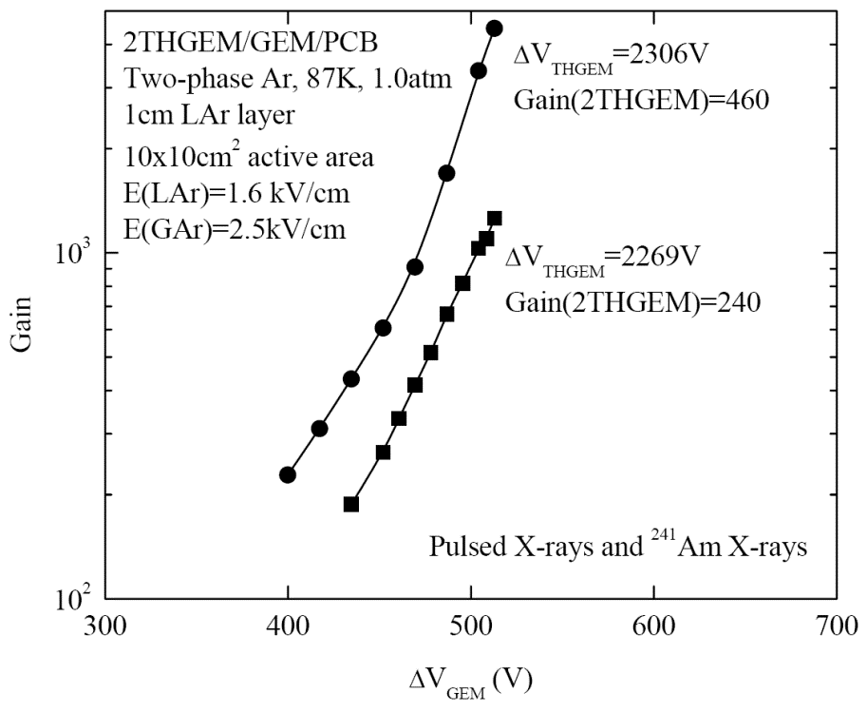
Two-phase CRAD in Ar with THGEM and hybrid THGEM/GEM multiplier
- Confirmed proper performance at high gains of two-phase Ar CRADs having practical size (10x10 cm2 active area and 1-5cm thick liquid layer)
- Gains reached 1000 with the 10x10cm2 double-THGEM multiplier
- Higher gains, of about 5000, have been attained in two-phase Ar CRADs with a hybrid triple-stage multiplier, comprising of a double-THGEM followed by a GEM (in 2THGEM/GEM/PCB readout mode, i.e. with patterned anode)
[NSU & Budker INP: A.Bondar et al, JINST 8 (2013) P02008]

Slide 12
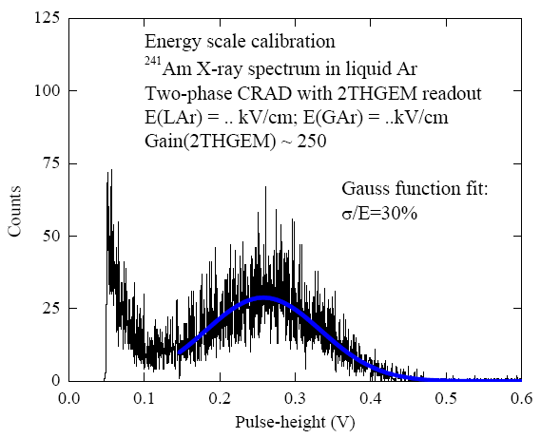
CRAD energy threshold
60 keV
Energy threshold of CRAD can be measured using ²⁴¹Am source with 60 keV photons. From the distribution threshold can be estimated as 11 keV±2 keV.

Slide 13
Concluding remarks to this section
Our general conclusion is that the maximum gains achieved in two-phase CRADs, of the order of 1000-5000 in Ar and 500 in Xe, might be sufficient for Giant LAr TPC and PET applications.
This however might not be sufficient for efficient single-electron counting, recording avalanche-charge in self-triggering mode (requiring gain values of 20,000-30,000). Accordingly, ways of increasing the overall gain should be looked for.
A possible solution is the optical readout of THGEM avalanches using Geiger Mode APDs (GAPDs); it is considered in the following.
Andrey Sokolov, INSTR14, March 1, 2014

Slide 14
Outline
1. CRyogenic Avalanche Detector concepts.
2. Our ongoing project on two-phase CRADs for dark matter search and low-energy neutrino detection.
3. Two-phase CRAD R&D results:
- Two-phase CRADs with charge readout.
- Two-phase CRADS with optical readout.
4. Results on two-phase Ar CRADs with THGEM/GAPD-matrix optical readout
5. Neutron scattering on Ar nuclei and quenching factor mesurement
5. Summary.
Andrey Sokolov, INSTR14, March 1, 2014

Slide 15
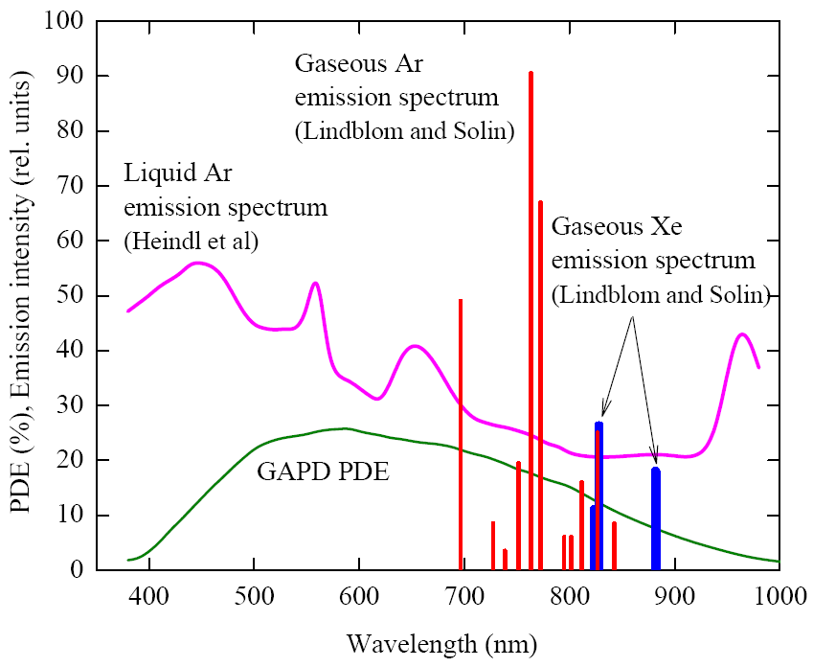
Optical readout of CRADs with combined THGEM/GAPD multiplier: motivation
- Visible and NIR emission spectra of gaseous Ar and Xe and liquid Ar - GAPD PDE
[A.Buzulutskov, JINST 7 (2012) C02025]
Noble gases have intense secondary scintillations both in VUV and NIR, while GAPDs have high quantum efficiency in the visible and NIR region. This results in two concepts of THGEM optical readout:
- using WLS-coated GAPD sensitive to the VUV;
- using uncoated GAPD sensitive to the NIR.
15

Slide 16
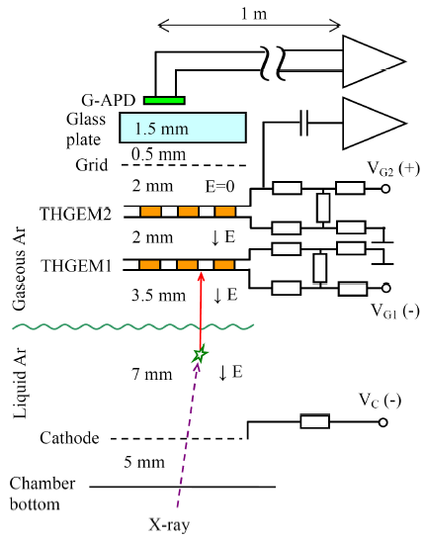
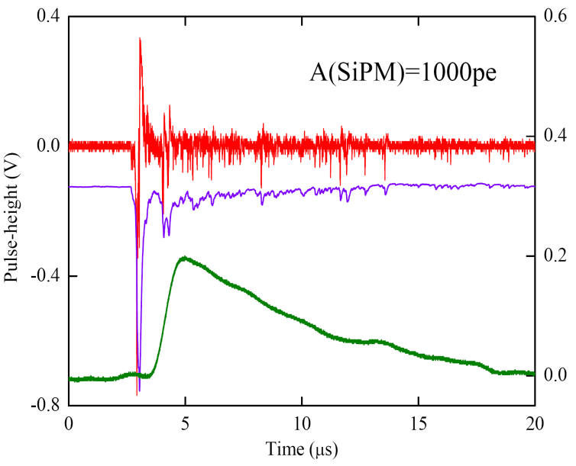
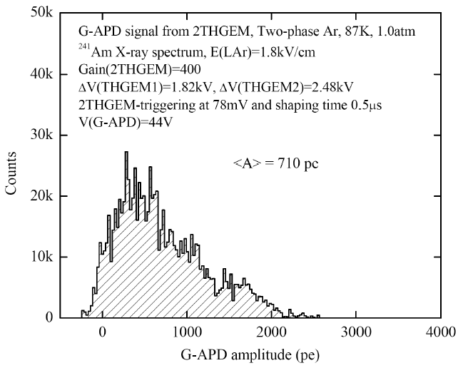
Two-phase Ar CRADs with THGEM/GAPD optical readout in the NIR: combined multiplier yield
Avalanche scintillations from THGEMs holes have been observed in the NIR using uncoated GAPDs.
GAPD bipolar
GAPD unipolar
THGEM
Combined multiplier yield =
= 700 pe per 60 keV X-ray at THGEM gain=400, i.e 12 pe/keV at this particular solid angle (±12mm field of view at a distance of 5 mm)
[Budker INP, ITEP, Weizmann Inst: A.Bondar et al, JINST 5 (2010) P08002; JINST 6 (2011) P07008]
16
16

Slide 17
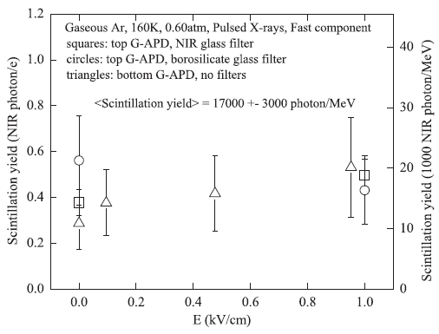
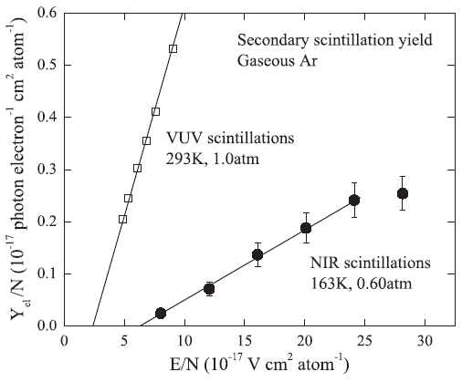
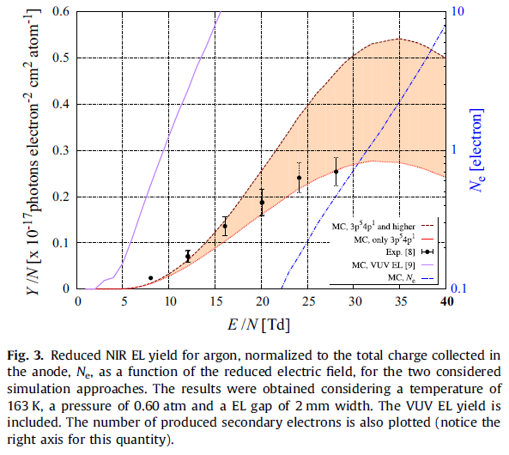
NIR scintillations in gaseous and liquid Ar: primary and secondary scintillation yield
Primary scintillation yield in the NIR has been measured:
- In gaseous Ar it amounted to
17000± 3000 photon/MeV in 690–1000 nm
- In liquid Ar it amounted to
510±90 photon/MeV in 400–1000 nm
- In GAr: secondary scintillations (electroluminescence) in the NIR were observed; fair agreement with simulation by [C.A.B.Oliveira et al., NIMA A722 (2013) 1]
- In LAr: no secondary scintillations in the NIR were observed up to 30 kV/cm
[Budker INP: A.Buzulutskov et al, EPL 94 (2011) 52001; A. Bondar et al. JINST 7 (2012) P06014]

Slide 18
Outline
1. CRyogenic Avalanche Detector concepts.
2. Our ongoing project on two-phase CRADs for dark matter search and low-energy neutrino detection.
3. Two-phase CRAD R&D results:
- Two-phase CRADs with charge readout.
- Two-phase CRADS with optical readout.
4. Results on two-phase Ar CRADs with THGEM/GAPD-matrix optical readout
5. Neutron scattering on Ar nuclei and quenching factor mesurement
5. Summary.
Andrey Sokolov, INSTR14, March 1, 2014

Slide 19
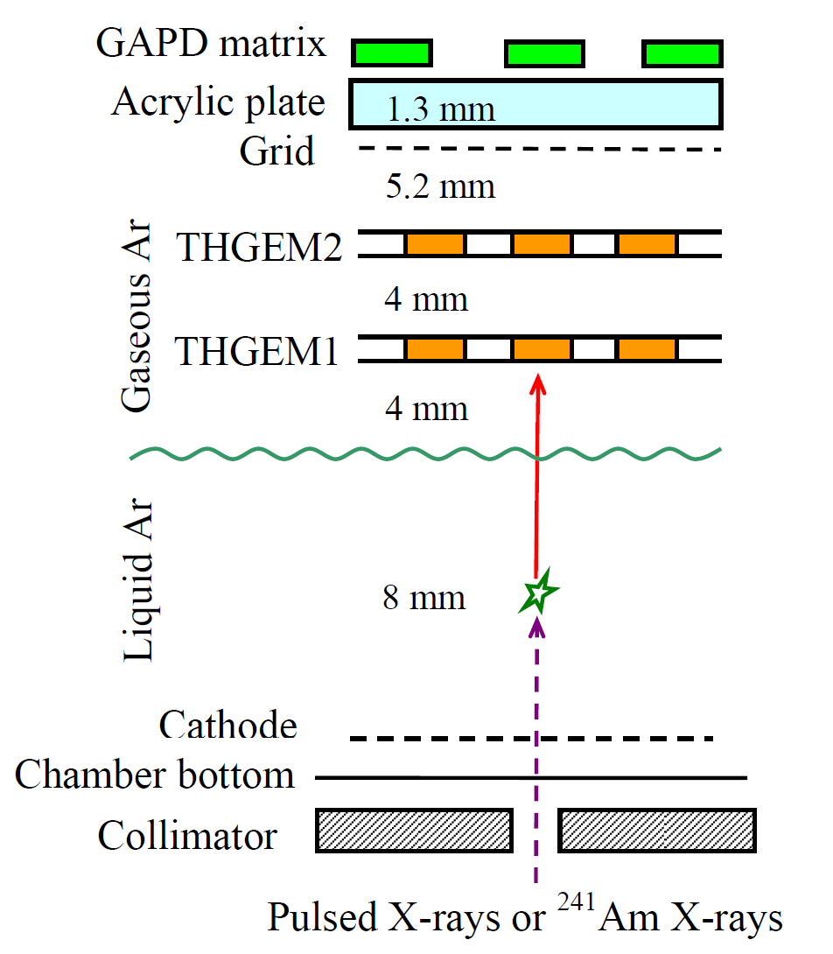
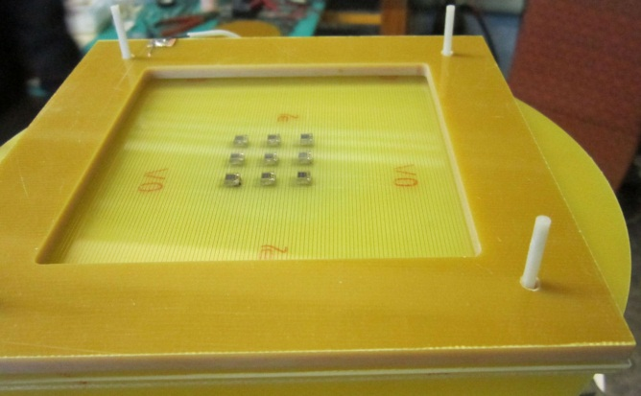
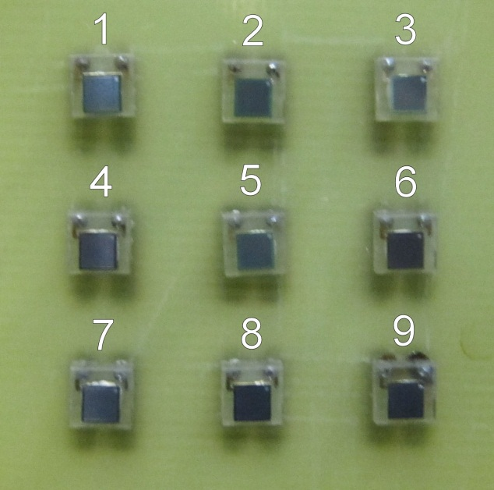
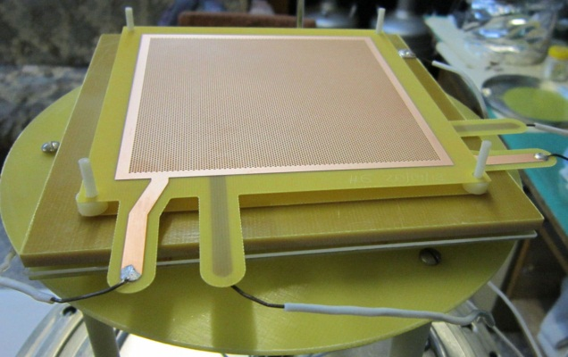
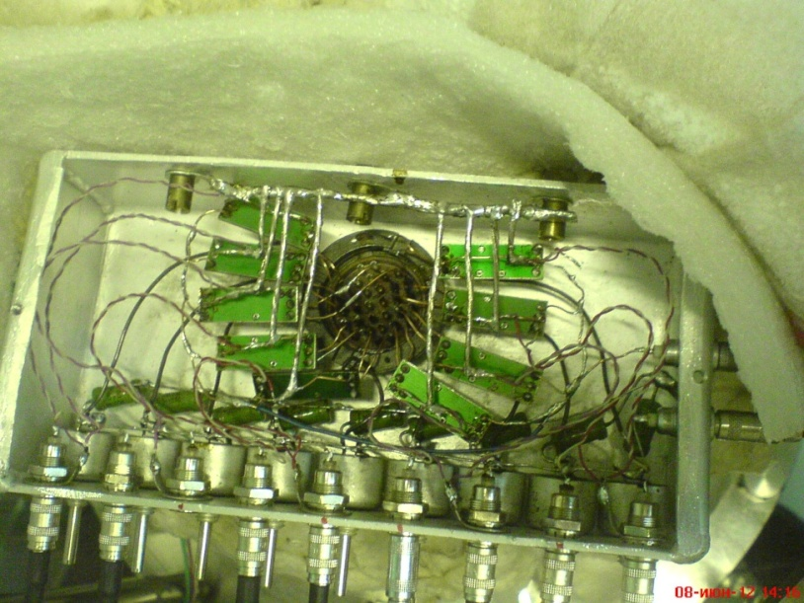
Two-phase Ar CRAD with THGEM/GAPD-matrix optical readout in the NIR: experimental setup
1 cm
- Double-THGEM multiplier in the gas phase
- 3x3 GAPD matrix (1 cm spacing) optical readout in the NIR
- Each GAPD (CPTA 149-35) having 2x2 mm2 active area
- 9 fast amplifiers (CPTA) outside the chamber
- Irradiated with pulsed X-rays (~20 keV, 240Hz) through a 2mm diameter collimator, to estimate spatial resolution
- Operated in single X-ray photon counting mode

Slide 20
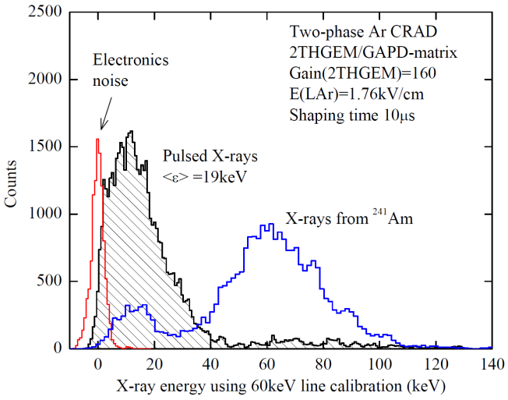
Two-phase Ar CRAD with THGEM/GAPD-matrix optical readout in the NIR: experimental setup
- Irradiated with pulsed X-rays (~20 keV, 240Hz) through a 2mm diameter collimator, to estimate spatial resolution
- Operated in single X-ray photon counting mode
Andrey Sokolov, INSTR14, March 1, 2014

Slide 21
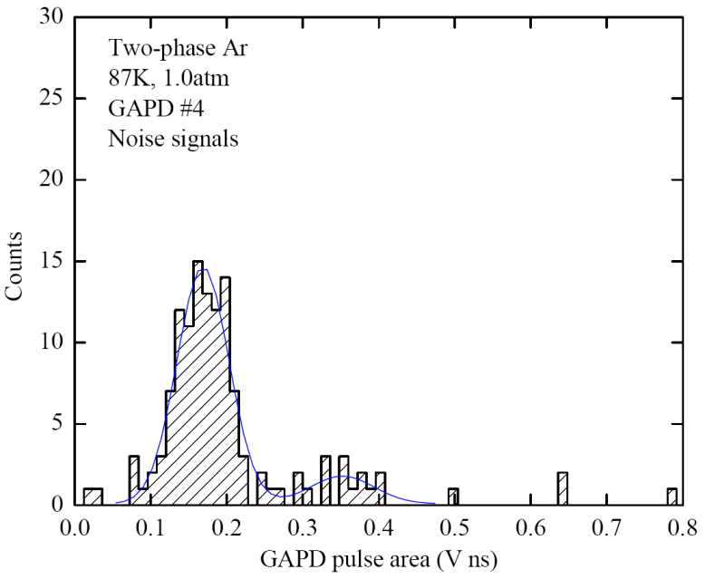
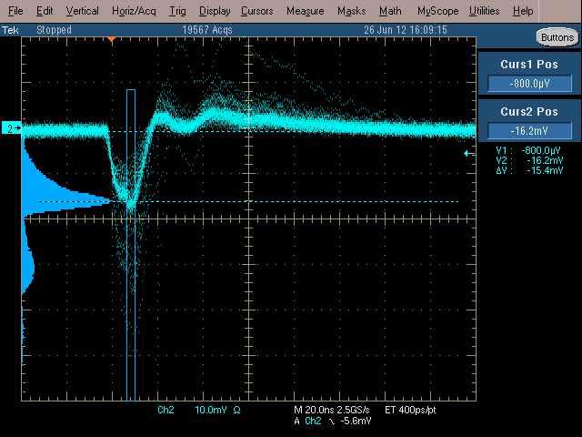
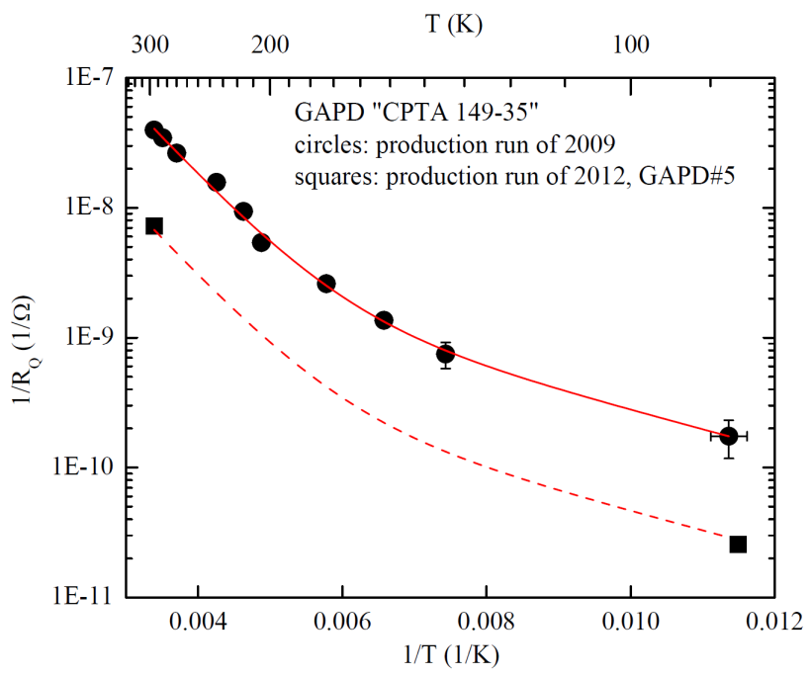
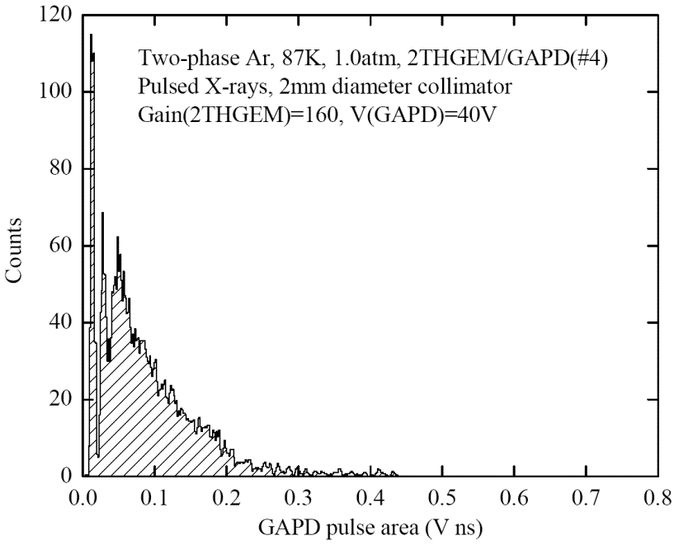
The problem of gain saturation at higher rates for CPTA GAPDs
The infrequent nose signals had a nominal GAPD pulse-area distribution: single-pixel peak is accompanied with secondary (cross-talk) peaks
- However, at higher rates (240Hz) and intense photon flux the single pixel pulse-area spectrum was degraded → Saturation and even reduction of the GAPD gain
-This is induced by considerable increase of the pixel quenching resistor at low T

Slide 22
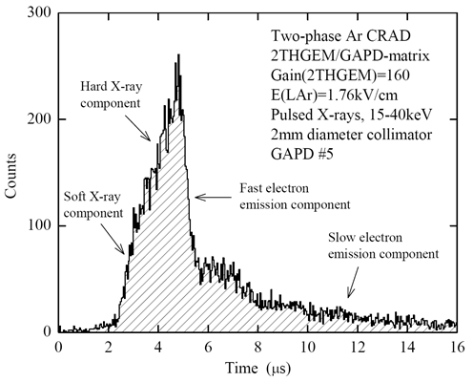
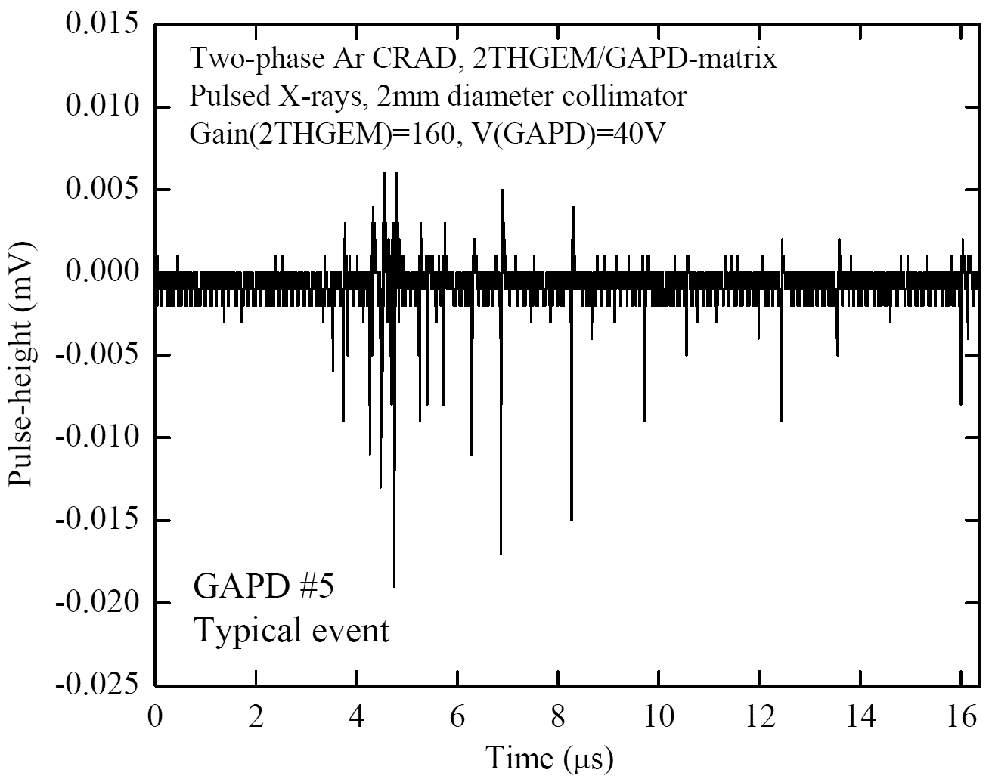
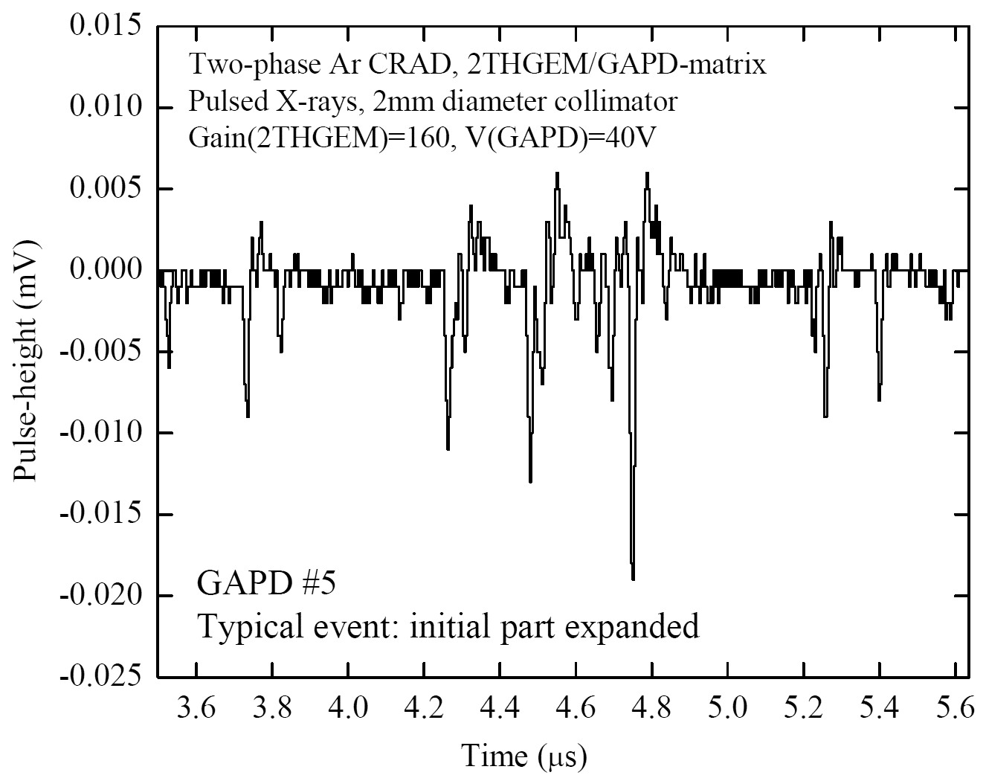
GAPD signal example and time properties
- Typical GAPD signal: ~20 pe per 20 keV X-ray
- Long (>16 μs) signal due to slow electron emission component presented in two-phase Ar systems → see signal time spectrum
- Measuring GAPD amplitude: counting the number of peaks using dedicated peak-finder algorithm
- Part of signal is lost under threshold due to GAPD rate-dependence problem → reduces the GAPD pe yield

Slide 23
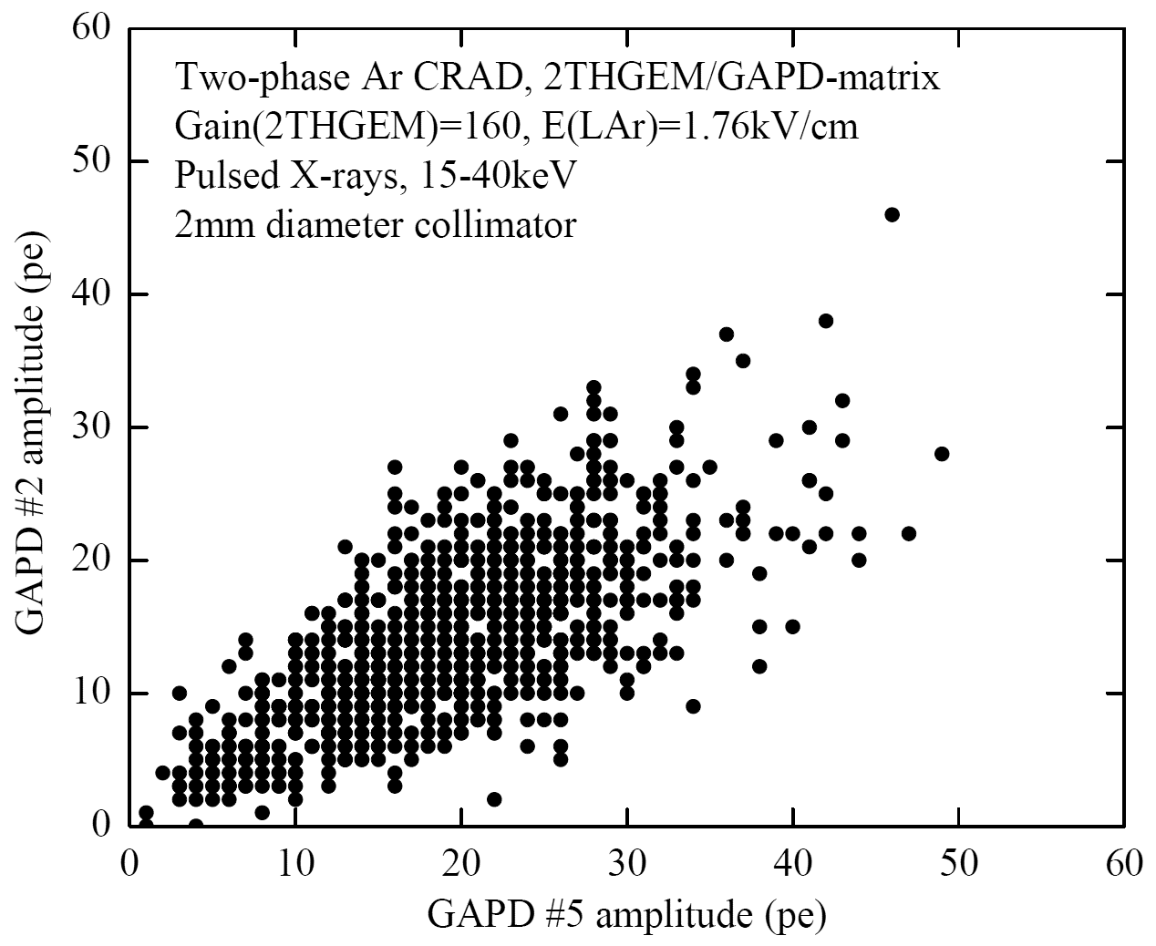
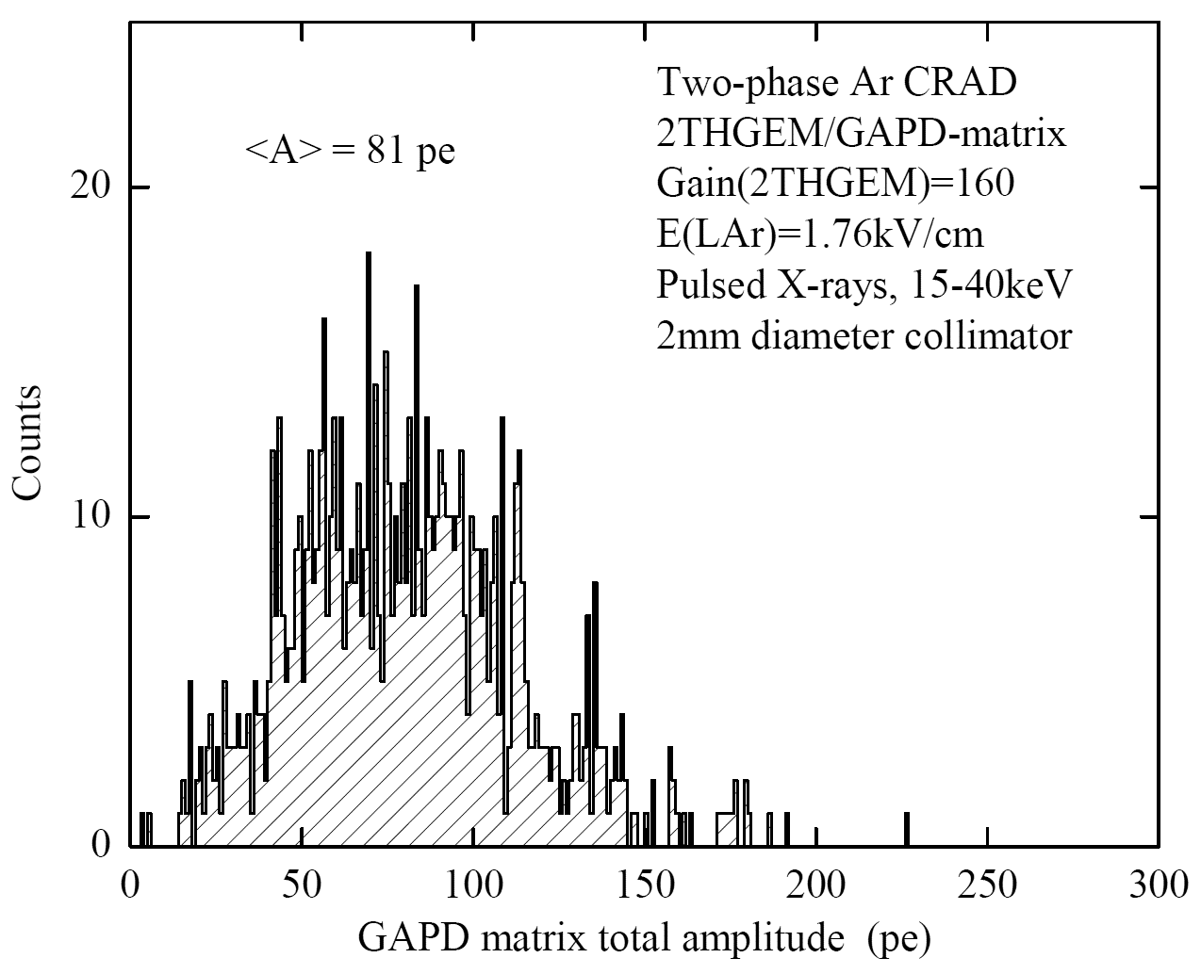
GAPD-matrix yield
- Correlation between GAPD channel amplitudes
- Total GAPD-matrix (7 active channels) amplitude: 80 pe per 20 keV X-ray, at charge gain of 160
- That means that we may still have reasonable GAPD matrix yield for low energy deposition: >10 pe per 1 keV at charge gain of 600
- Higher yield is expected when the GAPD rate problem will be solved

Slide 24
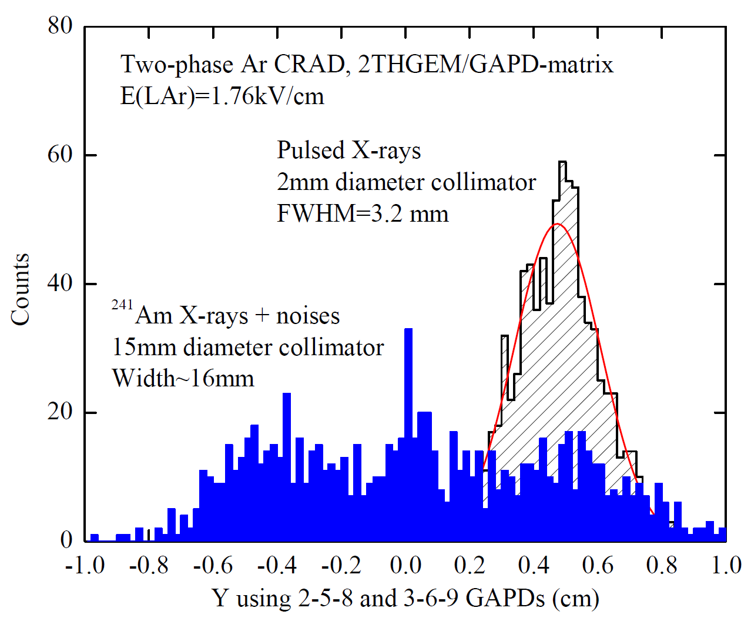
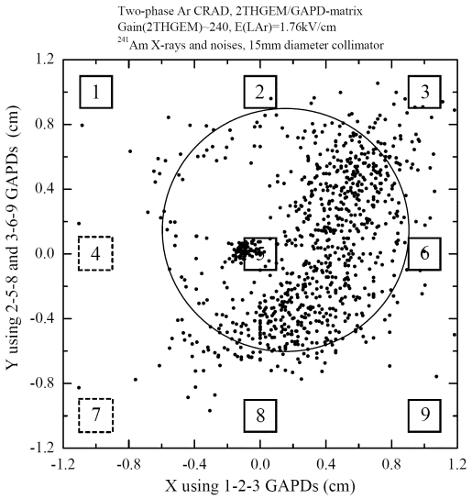
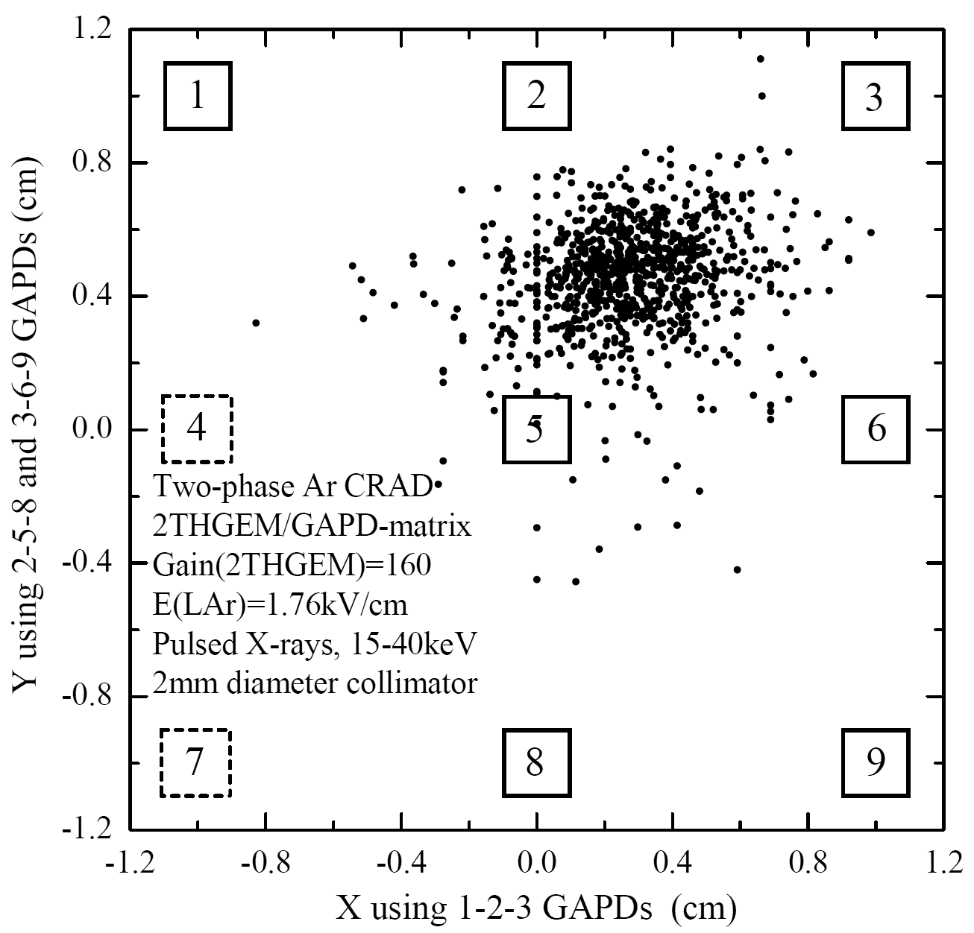
Two-phase Ar CRAD with THGEM/GAPD-matrix multiplier: spatial resolution
Our latest results on two-phase Ar CRAD with THGEM/GAPD-matrix optical readout:
NSU & Budker INP: A.Bondar et al, arXiv:1303.4817]
- Reconstructed image of X-ray conversion region (defined by 2 and 15 mm collimators) from GAPD-matrix amplitudes
- Using center-of-gravity algorithm corrected for simulation of light rays gives FWHM=3 mm → spatial resolution of THGEM/GAPD-matrix is 1 mm (σ).
- Spatial resolution of THGEM/GAPD-matrix readout is far superior compared to that of PMT-matrix: of the order of 1 mm, for deposited energy of 20 keV at charge gain of 160.
Andrey Sokolov, INSTR14, March 1, 2014

Slide 25
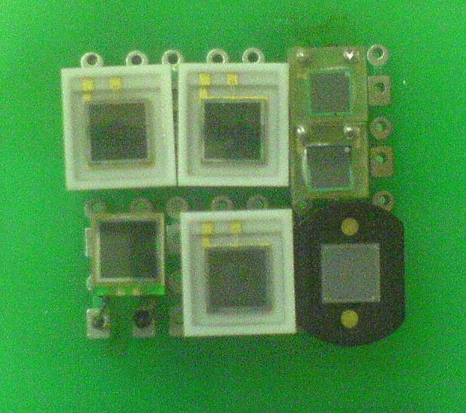
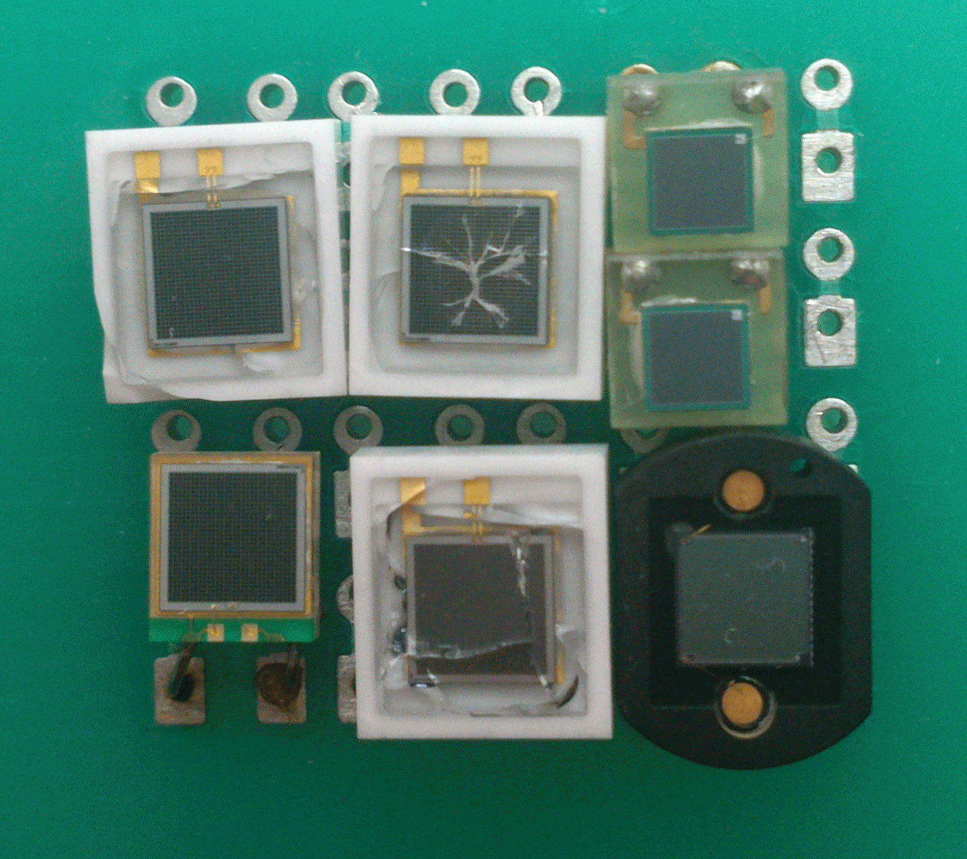
Selecting GAPD type
Hamamatsu MPPCs (3x3mm), CPTA MRS APDs (2.1x2.1 mm) and Sensl SiPM (3x3mm): before and after cryogenic runs
→ All those with ceramic package were cracked: should be avoided
GAPDs with plastic package should be used in cryogenic environment
Our choice for the future is Hamamatsu S10931-100P (3x3 mm)
Before test
After test
Andrey Sokolov, INSTR14, March 1, 2014

Slide 26
Outline
1. CRyogenic Avalanche Detector concepts.
2. Our ongoing project on two-phase CRADs for dark matter search and low-energy neutrino detection.
3. Two-phase CRAD R&D results:
- Two-phase CRADs with charge readout.
- Two-phase CRADS with optical readout.
4. Results on two-phase Ar CRADs with THGEM/GAPD-matrix optical readout
5. Neutron scattering on Ar nuclei and quenching factor mesurement
5. Summary.
Andrey Sokolov, INSTR14, March 1, 2014

Slide 27
WIMP Search Technology Zoo
Ionisation Detectors
Targets: Ge, Si, CS₂, CdTe
CoGeNT, DRIFT, DM-TPC
GENIUS, HDMS, IGEX, NEWAGE
Light & Ionisation Detectors
Targets: Xe, Ar
ArDM, LUX, WARP,
XENON, ZEPLIN
cold (LN₂)
Heat & Ionisation Bolometers
Targets: Ge,Si
CDMS, EDELWEISS
cryogenic (<50 mK)
ionisation
Q
Scintillators
Targets: NaI, Xe, Ar
ANAIS, CLEAN, DAMA,
DEAP, KIMS, LIBRA,
NAIAD, XMASS, ZEPLIN-I
L
scintillation
H
phonons
Bolometers
Targets: Ge, Si, Al₂O₃, TeO₂
CRESST-I, CUORE, CUORICINO
Bubbles & Droplets
CF₃Br, CF₃I, C₃F₈, C₄F₁₀
COUPP, PICASSO, SIMPLE
Light & Heat Bolometers
Targets: CaWO_{4,} BGO, Al₂O₃
CRESST, ROSEBUD
cryogenic (<50 mK)
(credit H.Araújo)
V. Chepel Dark Matter, Dark Energy and their Detection, Novosibirsk, 25 July 2013

Slide 28
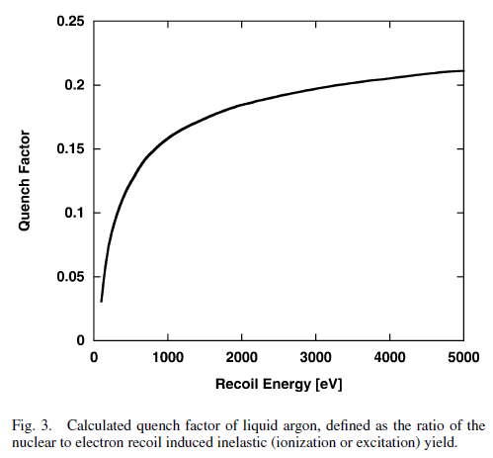
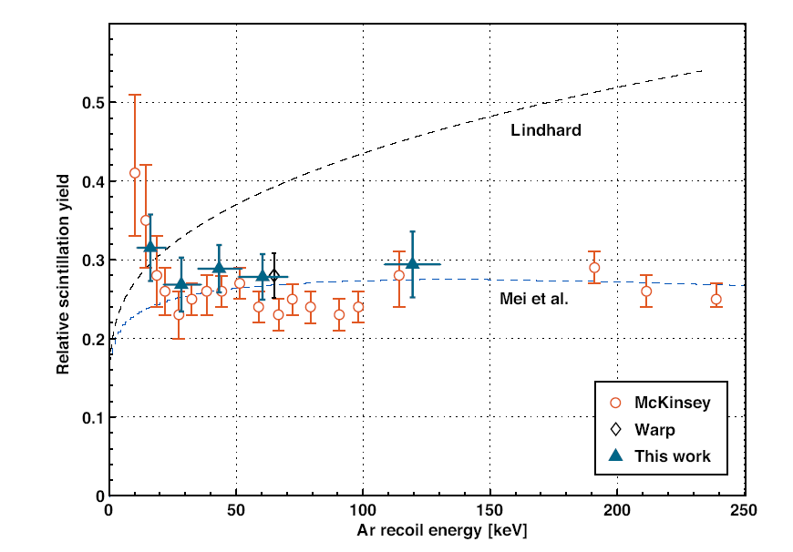
Nuclear recoil data in LAr
Total quenching factor for both ionization and excitation: LAr, theory [C. Hagmann, A. Bernstein IEEE Trans. Nucl. Sci. 51 (2004) 2151]
Scintillation quenching factor: LAr, experiment [Gastler et al. Phys. Rev. C 85, 065811 (2012); C. Regenfus et al. J. Phys. Conf. Series 375 (2012) 012019]
Andrey Sokolov, INSTR14, March 1, 2014
28
28

Slide 29
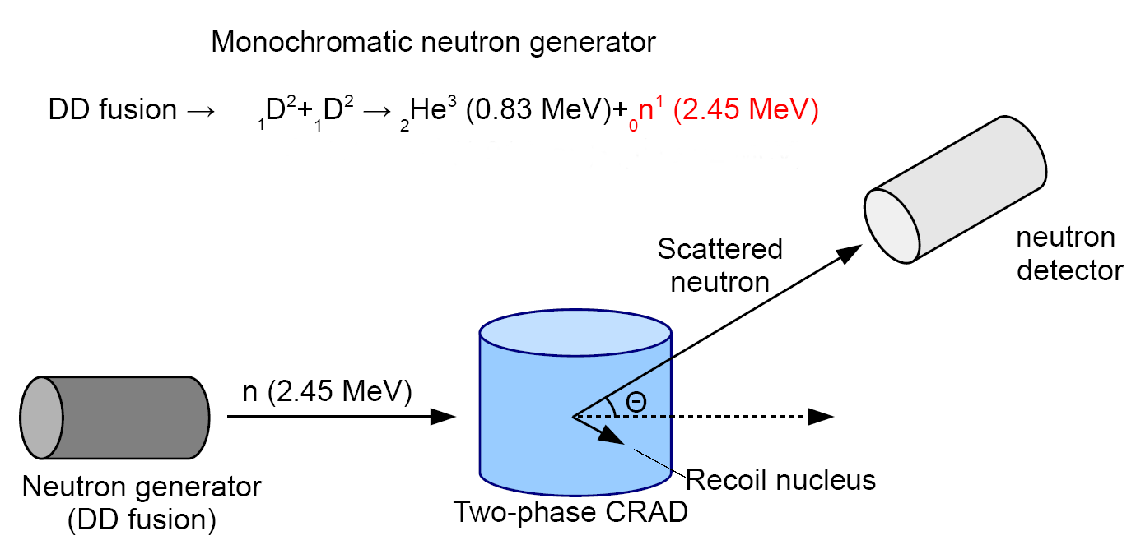
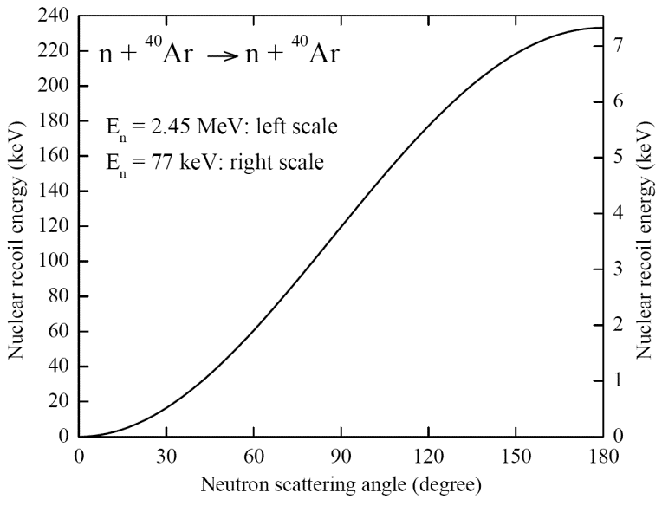
D-D neutron scattering systems
Two neutron scattering systems are being developed by Plasma Physics Division teams:
- DD generator (tube) of monochromatic 2.45 MeV neutrons + neutron counters [A. Burdakov, S. Polosatkin, E. Grishnyaev]
[A. Bondar et al. , Proposal for neutron scattering systems for calibration of dark matter search and low-energy neutrino detectors, in preparation]
Andrey Sokolov, INSTR14, March 1, 2014
29
Notes:
29

Slide 30
Neutron scattering system
CRAD cryostat
Neutron source
Neutron detector
Andrey Sokolov, INSTR14, March 1, 2014

Slide 31
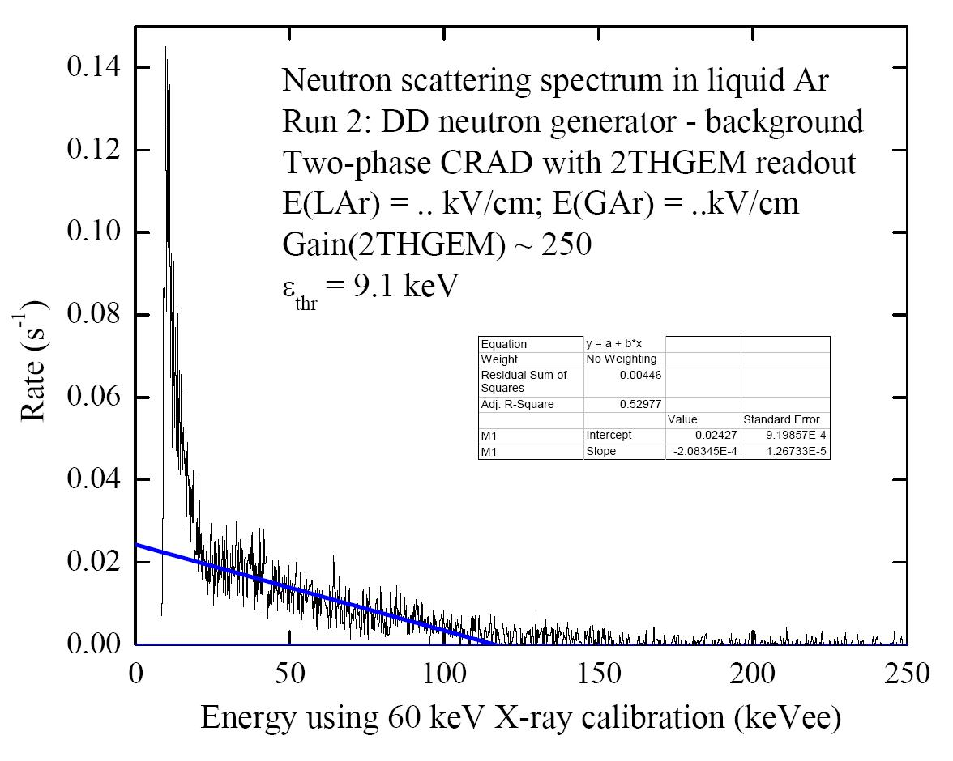
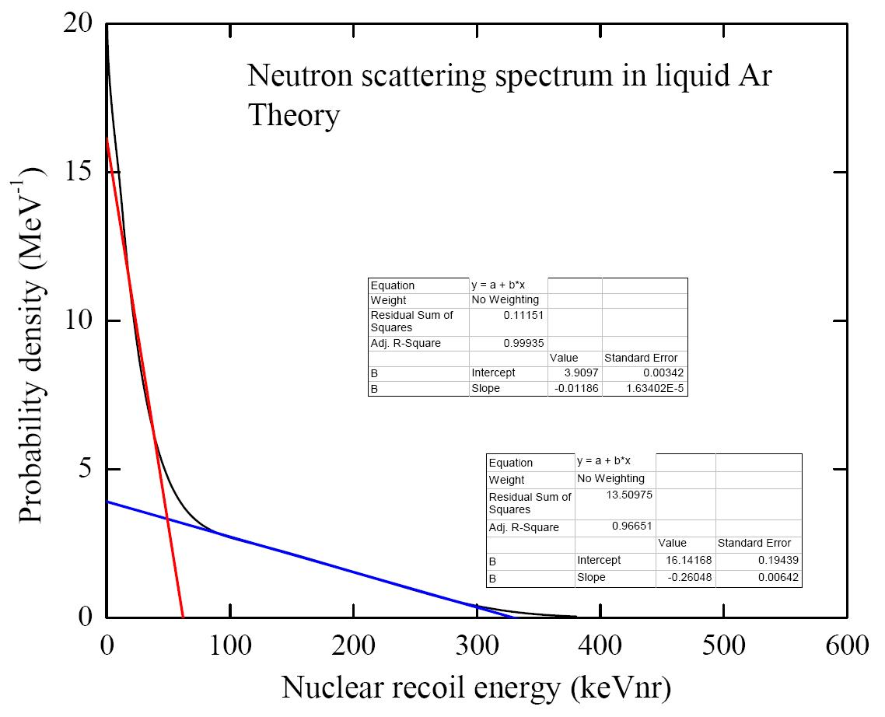
Neutron scattering spectrum
From the comparison the experimental and theoretical distributions one can conclude that ionization quenching factor equal 0,39±0.05 for the 330 keV recoil energy and 0,33±0.11 for the 75 keV.
Andrey Sokolov, INSTR14, March 1, 2014

Slide 32
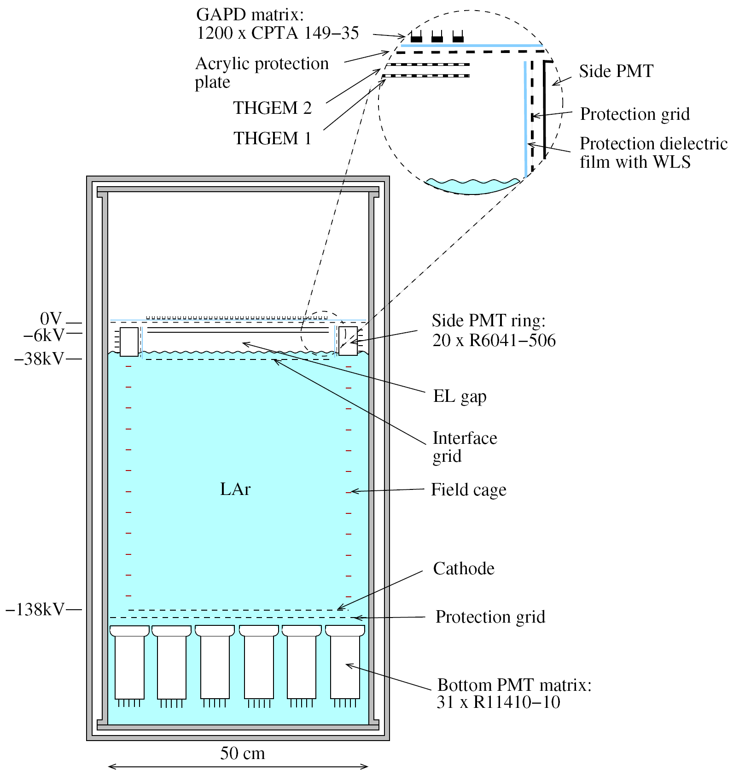
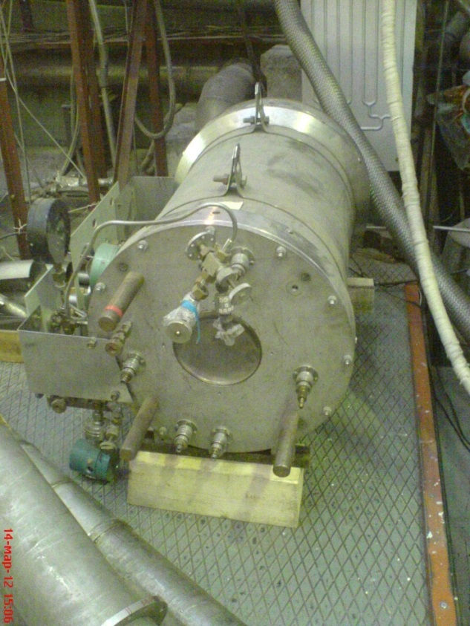
Two-phase CRAD in Ar with THGEM/GAPD-matrix optical readout
- Cryogenic chamber with 50 cm electron drift and 50 l active volume (70 kg of active LAr and 200 kg in total).
- 31 bottom and 20 side PMTs provide single-, double-, etc.- electron trigger for primary ionization.
- The EL gap, having a thickness of 4 cm, matches with the size of the side PMT.
- The total number of photoelectrons recorded by both PMT arrangements will be 23 pe. This is enough to make a selection between single- and double-electron events.
- Avalanche scintillations produced in the holes of the second THGEM are recorded in the NIR using a matrix of GAPDs: this will provide a high (sub-cm) spatial resolution.
[NSU & Budker INP: A. Bondar et al. JINST 7 (2012) P06014]

Slide 33
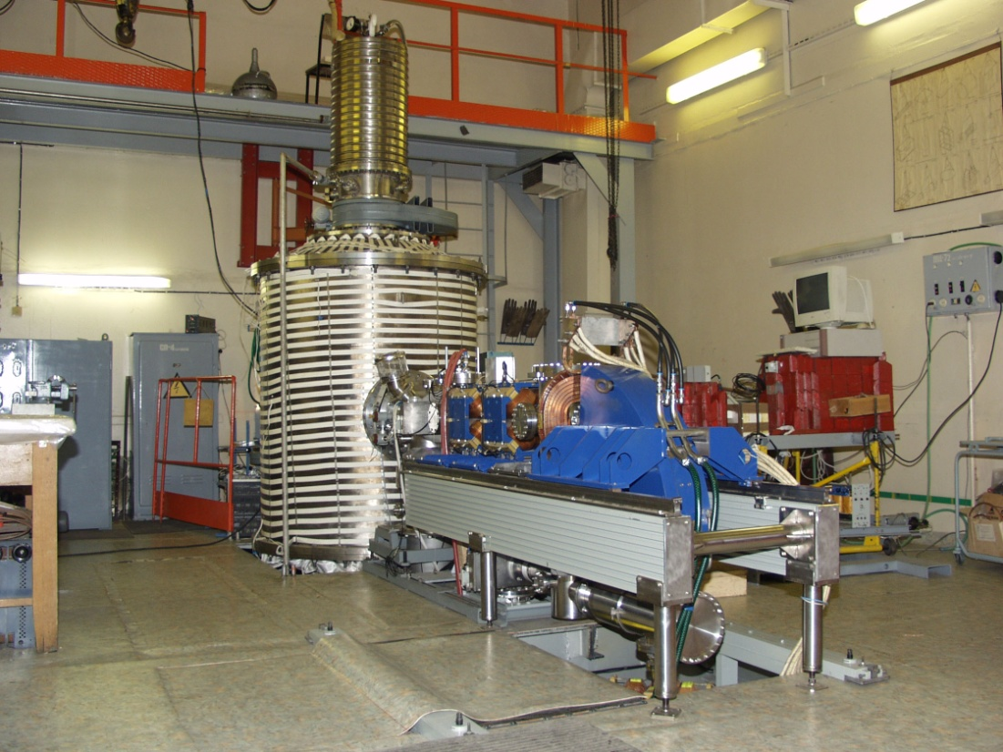
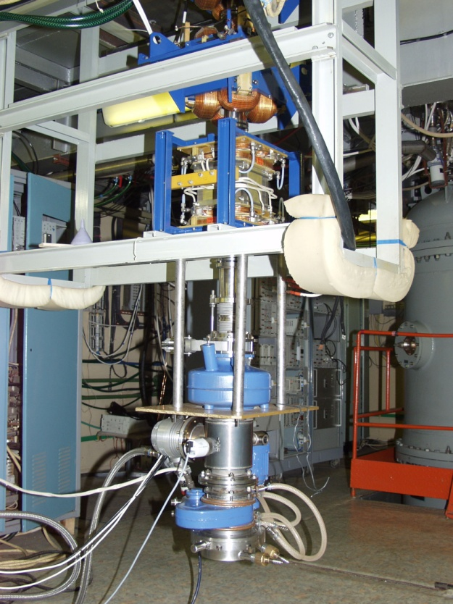
BNCT neutron facility at BINP
BNCT neutron facility consist of the tandem proton accelerator for 2 GeV and lithium target. It produce neutrons using ⁷Li(p,n)⁷Be threshold reaction. At the beam current 10 mA the neutron production rate will be 10¹¹s⁻¹. The neutron kinetic energy can be changed between 30 and 700 keV.
Andrey Sokolov, INSTR14, March 1, 2014

Slide 34
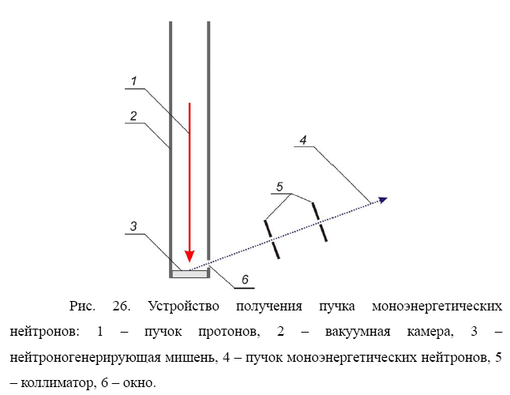
Neutron scattering systems
- ⁷Li(p,n)⁷Be monochromatic neutron beam (of 77 keV energy) using 2MeV proton accelerator and ⁷Li target [S. Taskaev et al.].
[A. Makarov, S. Taskaev, Pisma v JETF 97 (2013) 769]
Andrey Sokolov, INSTR14, March 1, 2014
34
Notes:
34

Slide 35
Summary
The idea of Cryogenic Avalanche Detectors (CRADs) had triggered intense and difficult R&D work in the course of last 10 years. This resulted in a variety of amazing CRAD concepts; for the time being the most intensively studied concepts are:
- two-phase CRADs with THGEM multiplier readout;
optical readout of CRADs with combined THGEM/GAPD-matrix multipliers.
Two-phase CRAD in Ar with THGEM/GAPD-matrix multiplier optical readout in the NIR showed excellent performance, namely high sensitivity (>100 pe per 20 keV at charge gain of ~100) and superior spatial resolution (~1 mm).
Such kinds of CRADs may come to be in great demand in rare-event experiments, such as those of Coherent Neutrino-Nucleus Scattering, Dark Matter Search and Giant LAr TPCs for (astrophysical) neutrino physics, as well as in medical imaging fields (e.g. PET).

Slide 36
Summary
The ionization quenching factor equals 0,33±0.11 and 0,39±0.05 for the 75 and 330 keV nuclear recoil, correspondingly.
The new layout of the CRAD detector is suggested for the precise measurement of the ionization quenching factor.
Andrey Sokolov, INSTR14, March 1, 2014

Slide 37
Budker INP and NSU teams of CRAD laboratory
CRAD lab location: Budker INP. CRAD lab is operated in the frame of Budker INP and NSU research programs.
Laboratory of Cosmology and Elementary Particles (NSU) and Cryogenic Avalanche Detectors “Laboratory” (Budker INP):
A. Dolgov (head of the lab). Experimental group:
A. Bondar, R. Belousov, A. Buzulutskov (coordinator), A. Chegodaev, A. Grebenuk, S. Peleganchuk, L. Shekhtman, E. Shemyakina,
R. Snopkov, A. Sokolov
We collaborate with two teams from Plasma Division of Budker INP on neutron scattering systems development: A. Burdakov, S. Polosatkin and E. Grishnyaev and S. Taskaev et al.
We also collaborate on CRAD R&D with A. Breskin (Weizmann Inst.) and D. Thers (Nantes Univ.), in the frame of RD51 collaboration.
This work supported in parts by Ministery of Science an Education of RF (grant 11.G34.31.0047) and Russian Foundation for Basic Research (12-02-91509-CERN_a and 12-02-12133-ofi_m)

Slide 38

Two-phase Ar CRAD with THGEM/GAPD-matrix multiplier: data acquisition
8 readout channels using fast flash ADC CAEN V1720 (250 MHz)

Slide 39






Two-phase CRAD: some elements of PMT, cryogenic, vacuum, DAQ, GAPD and electronics systems

