Slide 1
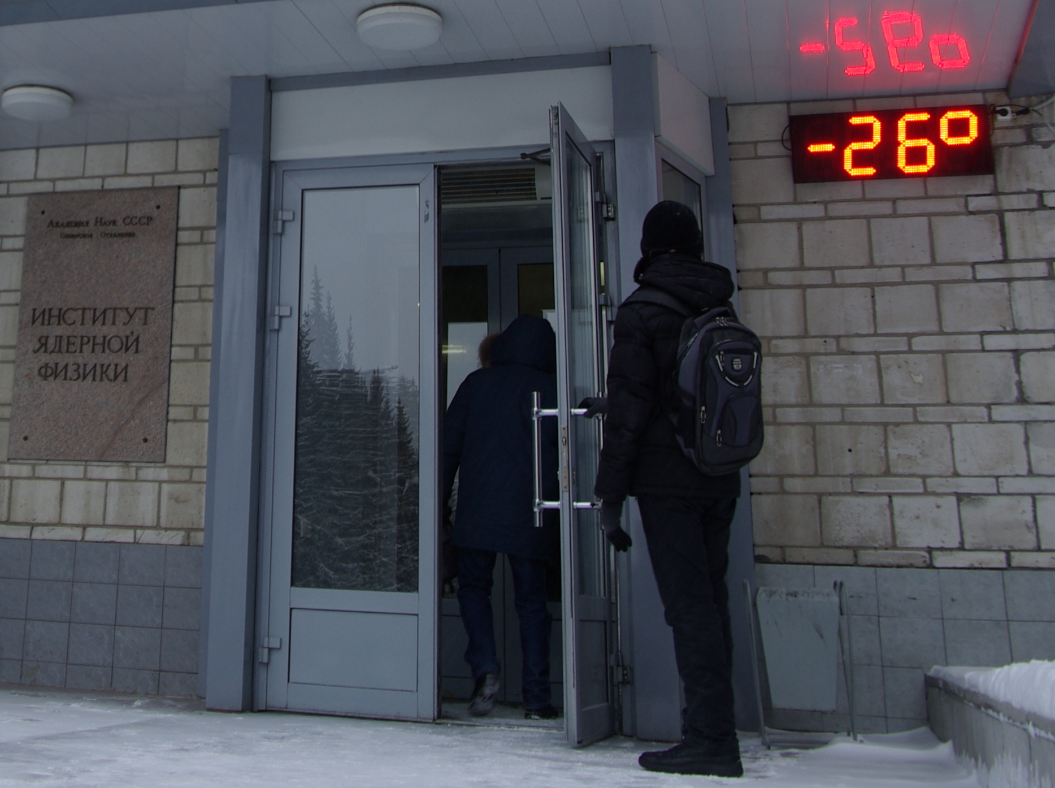
Performance of the ATLAS Tile Hadronic Calorimeter at LHC in Run I and planned upgrades
Oleg Solovyanov (IHEP, Protvino)
on behalf of the ATLAS Tile Calorimeter
INSTR14 Novosibirsk 24.02-01.03 2014

Slide 2
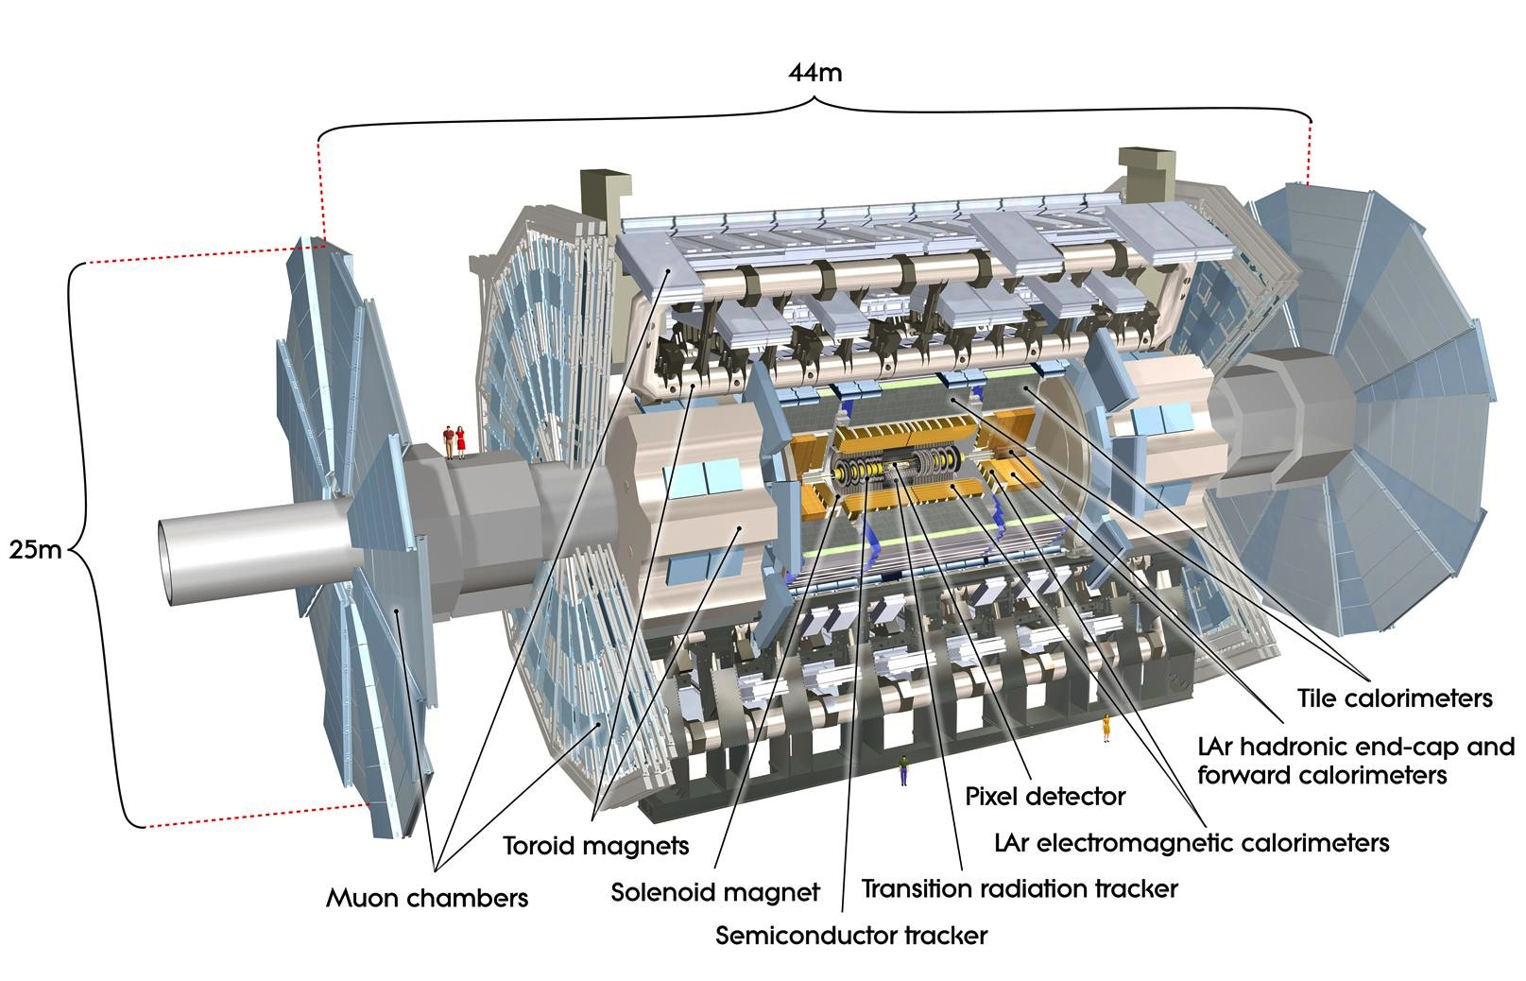
ATLAS Detector

Slide 3
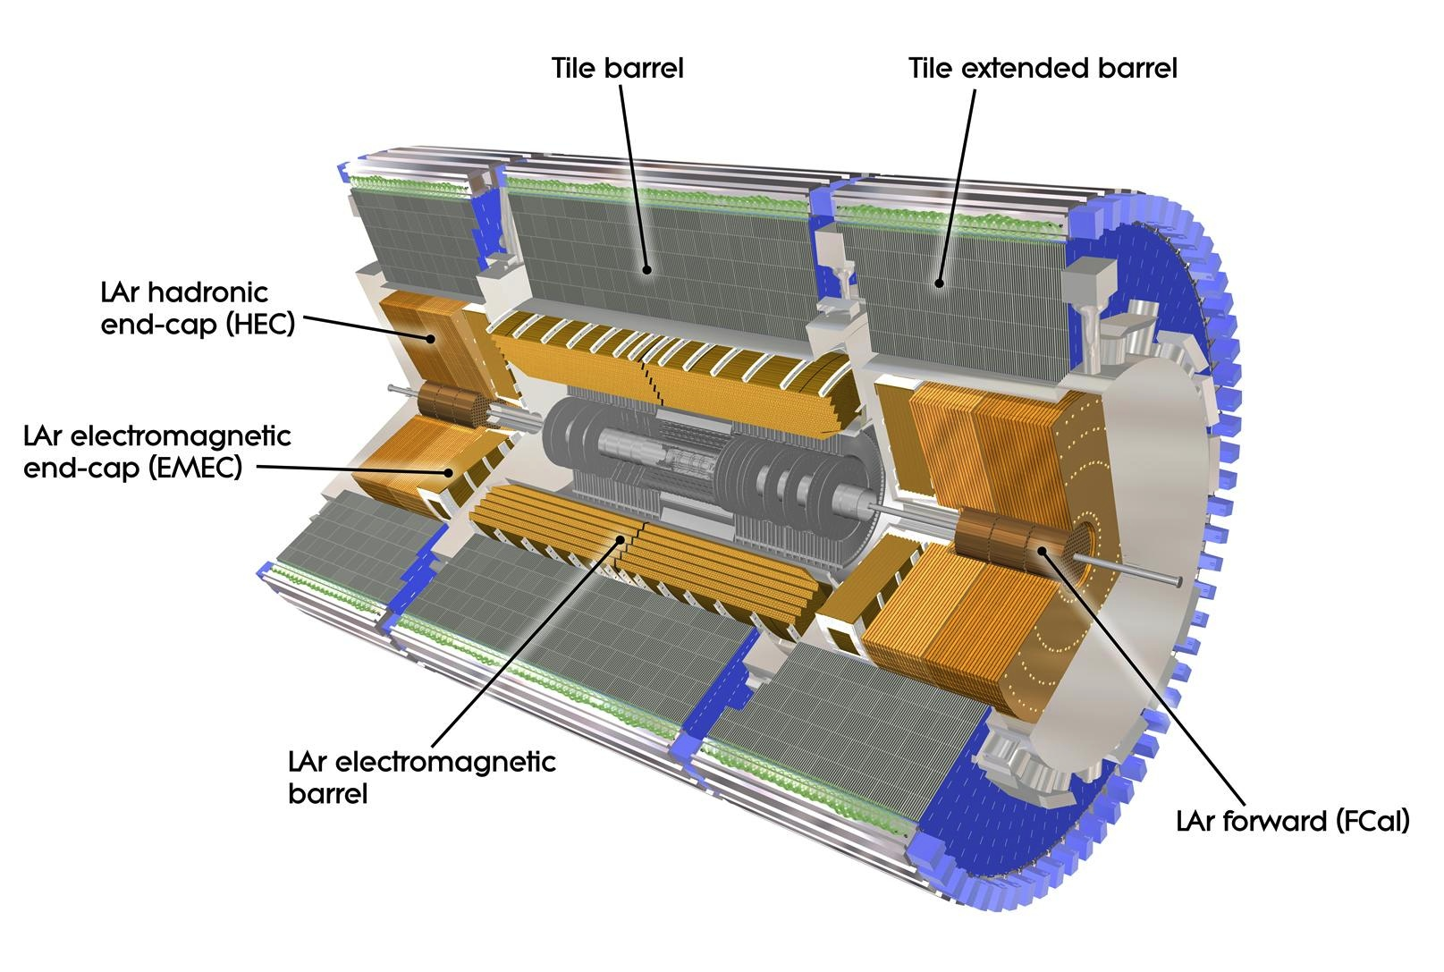
ATLAS Calorimetry
(LB)
(EB)

Slide 4
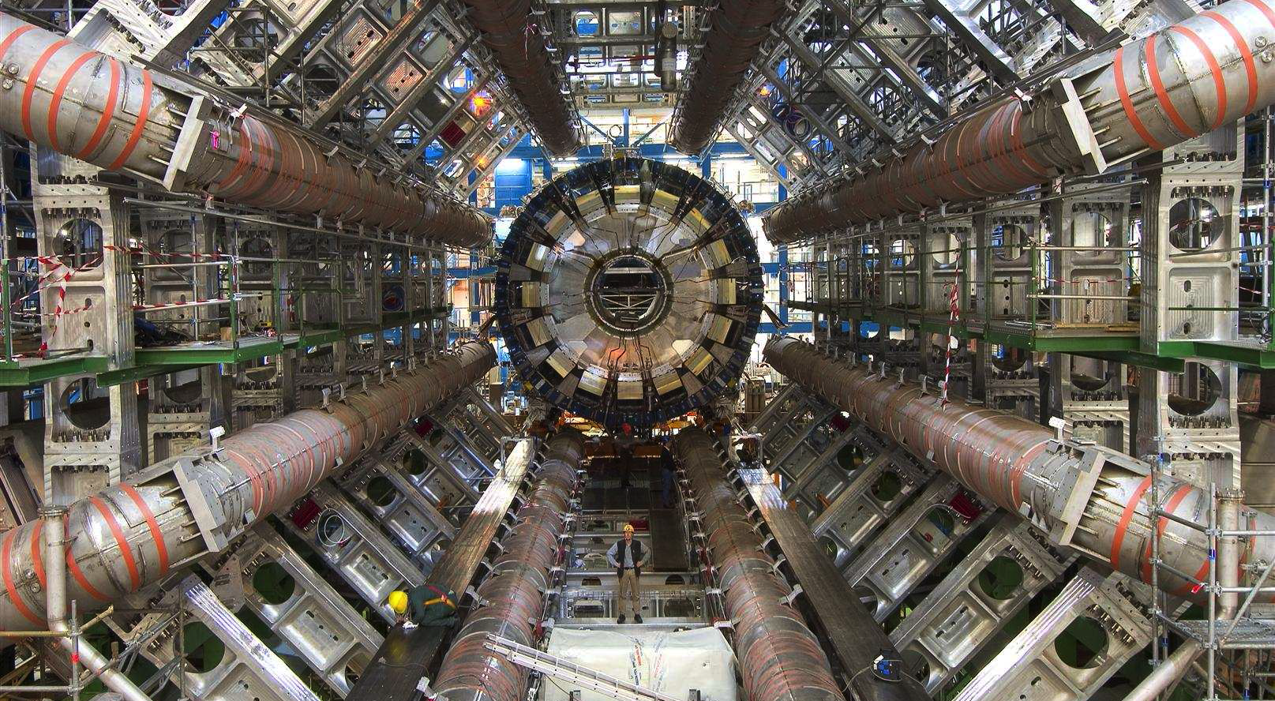
Calorimeter in the cavern
Barrel calorimeters moved to Z=0

Slide 5
Tile Hadron Calorimeter
Hadron non-compensating sampling calorimeter
  Steel as radiator
  Scintillating tiles as active medium
3 mm thick scintillating tiles (PSM, BASF polystyrene + dopants ) oriented perpendicular to beam axis, wrapped in Tyvek paper
Readout via green WLS fibres (Kuraray Y11) connected to both short edges of scintillating tiles
Hamamatsu R7877 PMTs, located in a module’s girder, collect light from the fibre bundles
3 cylinders: EB-A, LB, EB-C
64 modules in a cylinder
One module weighs 22 tons (LB)
Tile Calorimeter module design drawing

Slide 6
Calorimeter cell layout
Long barrel |η|<1.0, extended barrel 0.8 <|η|< 1.7
WLS fibre routing defines calorimeter cells
0.1x0.1 ΔηxΔφ cell granularity (0.2x0.1 for D layer cells)
Three longitudinal layers, total thickness of about 7λ
Pseudo-projective towers for first level trigger
Design resolution for jets ΔΕ/Ε = 50%/√Ε+3%

Slide 7
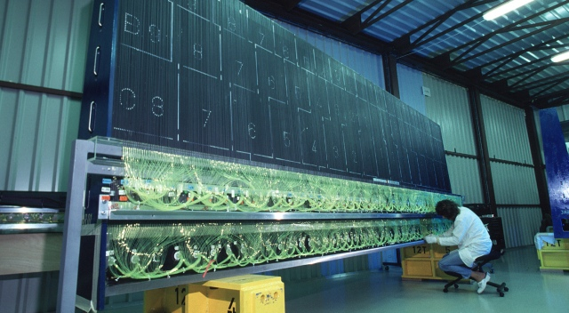
Calorimeter module
Instrumentation of the Tile Calorimeter barrel modules

Slide 8
Front-end electronics
PMTs signals are shaped and amplified with two gains (1:64)
Analogue tower sums are provided for level one trigger
Both gains are digitized in parallel by 40 MHz sampling 10-bit ADCs
Digitised samples are temporary stored in pipeline memory
Upon first level trigger decision the data of one of the gains are transferred to de-randomiser memory and then to the back-end electronics via readout fibres

Slide 9
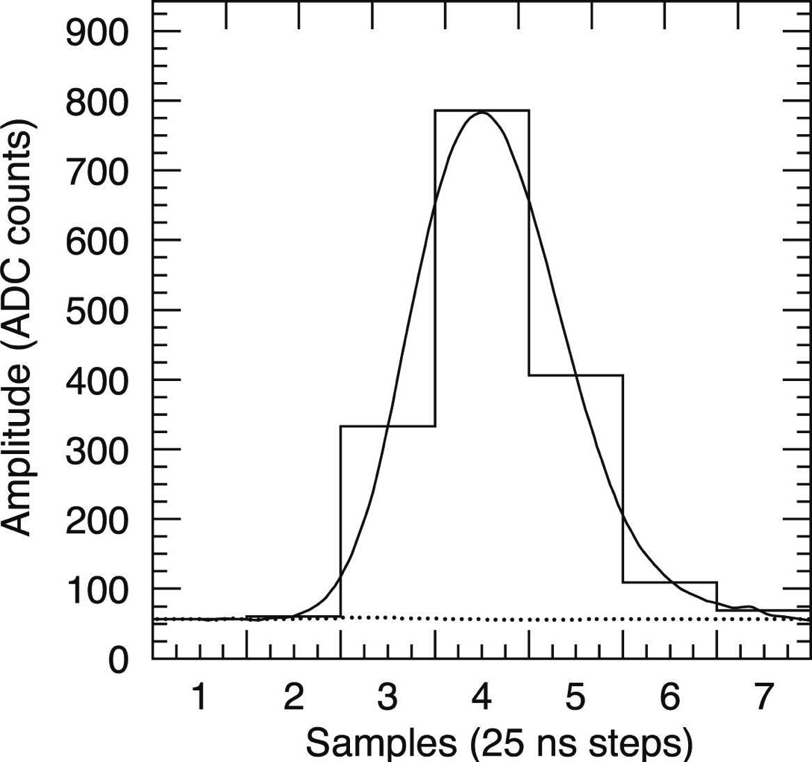
Signal reconstruction
Signal is reconstructed from 7 samples using optimal filtering
Energy, time and quality factor are extracted from the sampled signal
Amplitude of the signal is proportional to the energy (shaping)

Slide 10
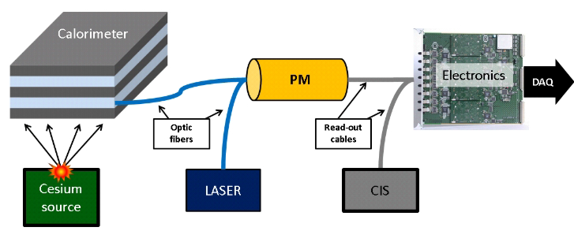
Calibration systems
To provide correct energy and time for data reconstruction an elaborate chain of calibration systems has been conceived:
  Charge inject system (CIS) to calibrate the response of the ADC
  Laser calibration system to measure the performance of the PMTs
  Cesium moving radioactive source system to calibrate the full optical path from scintillating tiles and WLS fibres down to integrated current of the PMT
  Minimum bias monitoring system (MBM) to monitor the response of the calorimeter online
About 11% of 192 Tile calorimeter modules were calibrated at the test beams and the EM scale was transferred to the final detector with the help of calibration systems

Slide 11
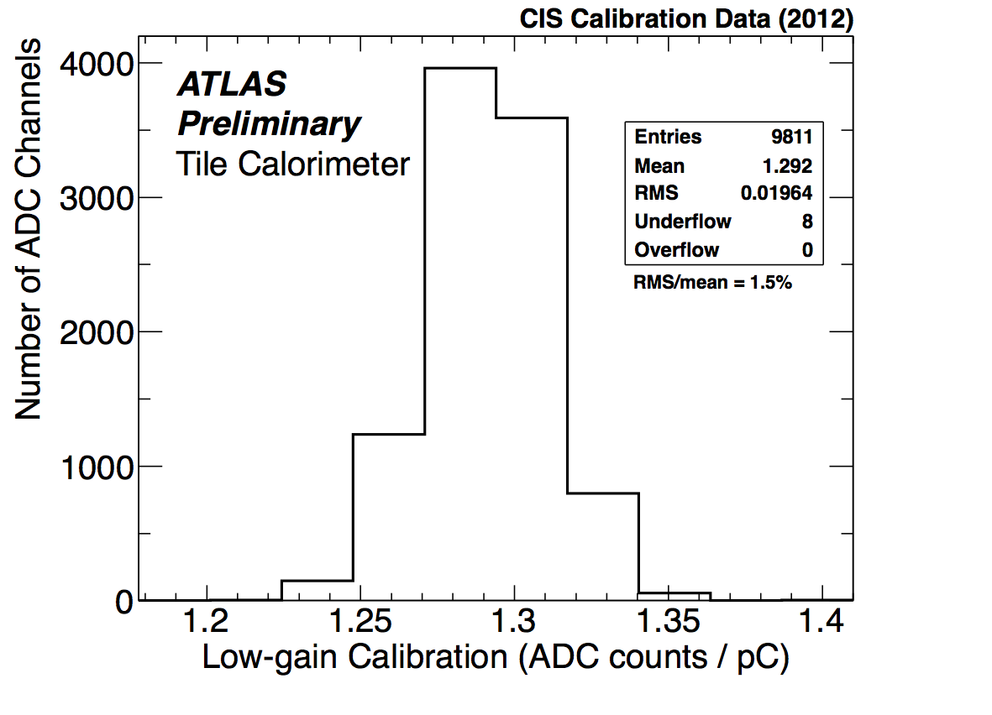
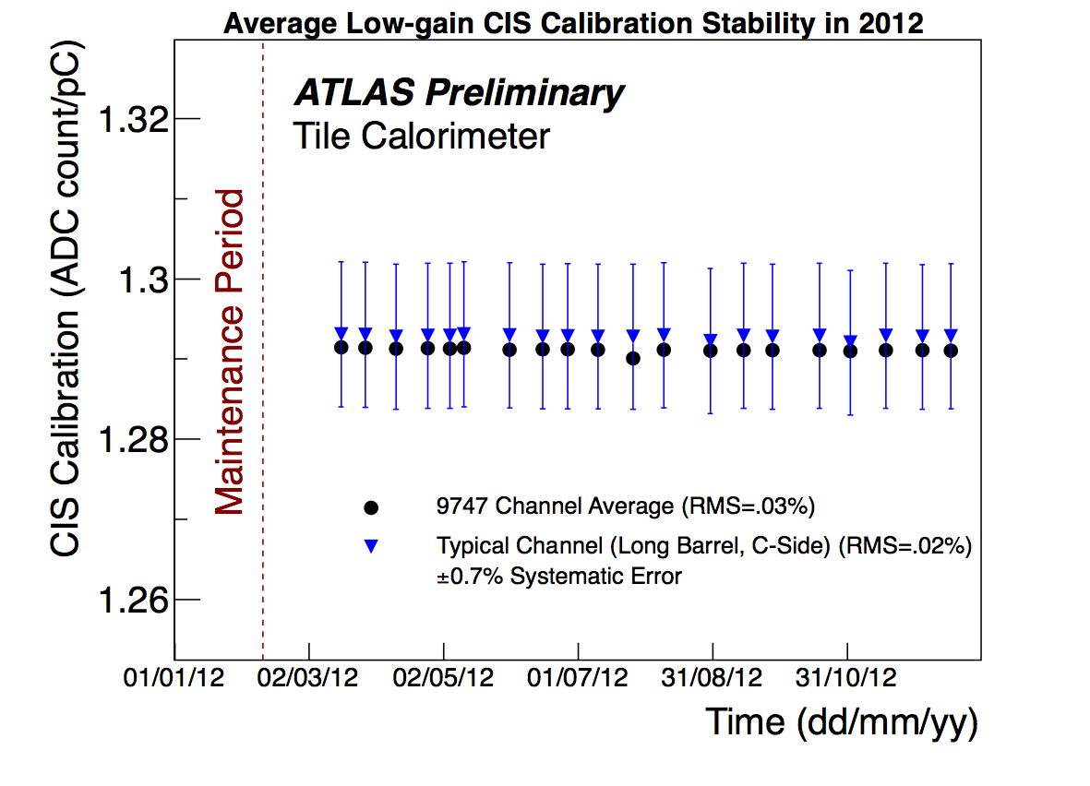
Calibration systems: CIS
Charge injection system (CIS) can inject a known charge into the shaper circuit. This pulse is then sampled by 40 MHz ADC like a physics signal
Amplitude of the pulse is used to calibrate the conversion from ADC counts to pC
The conversion factor is constant in time at the level of 0.02%
Runs are taken twice per week for monitoring purposes
Can be even used to simulate jets for L1 trigger

Slide 12
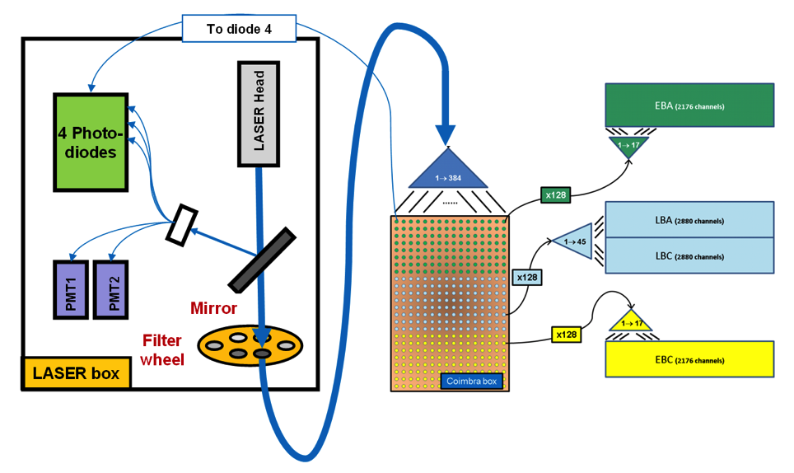
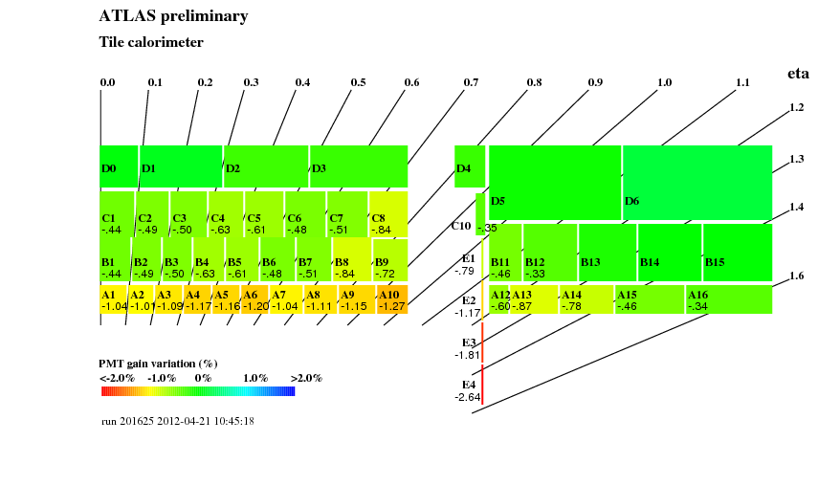
Calibration systems: Laser
Variation of the PMT gain
Laser calibration scheme
Laser system monitors the stability and the evolution of the PMT gain by sending calibrated laser pulses (532 nm) to all PMTs simultaneously via clear fibres
Follows the evolution of calorimeter response between Cs source scans, PMT gain drifts due with high current
Precision better than 0.5% on the gain variation, in a time period of one month
The largest drift is observed in A cells and gap/crack scintillators
Also used to adjust and verify timing settings

Slide 13
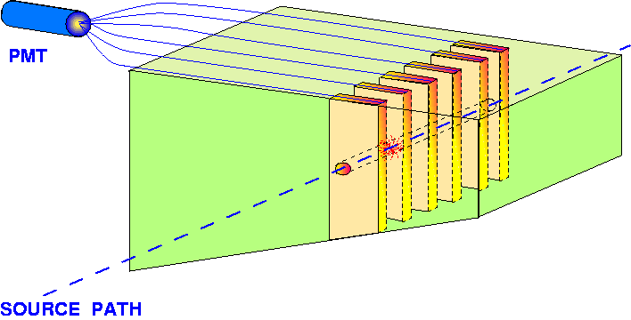
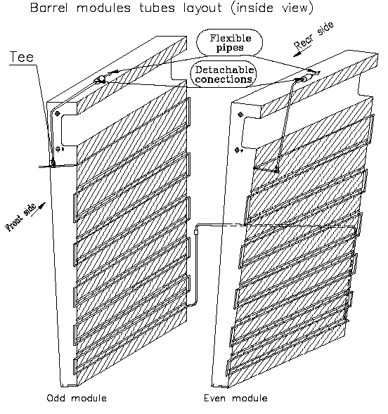
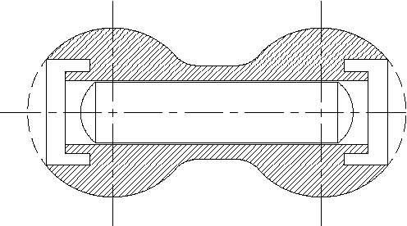
Calibration systems: Cs
ATLAS preliminary
Tile Calorimeter
Sample A
Cs system scans all scintillating tiles with moving ¹³⁷Cs (662 keV) radioactive source, reading integrated currents from PMTs
1-2 scans per month during beam-off time
Used to transport calibration scale from test beam measurements to running detector
Cs scan results are used to calculate and adjust HV for PMTs to equalize cell’s responses for better uniformity
Cs scans follow the evolution of response of full optical chain from scintillating tiles to PMTs

Slide 14
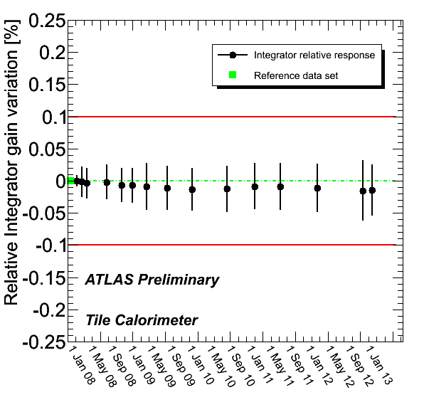
Calibration systems: MBM
Minimum bias monitoring system (MBM) reads integrated PMT currents of all PMTs during physics runs
Measures luminosity and pile-up conditions
Follows the response of the detector
Confirms detector response variation
Stability of each channel better than 0.05%, average stability is better than 0.01%

Slide 15
Run I performance

Slide 16
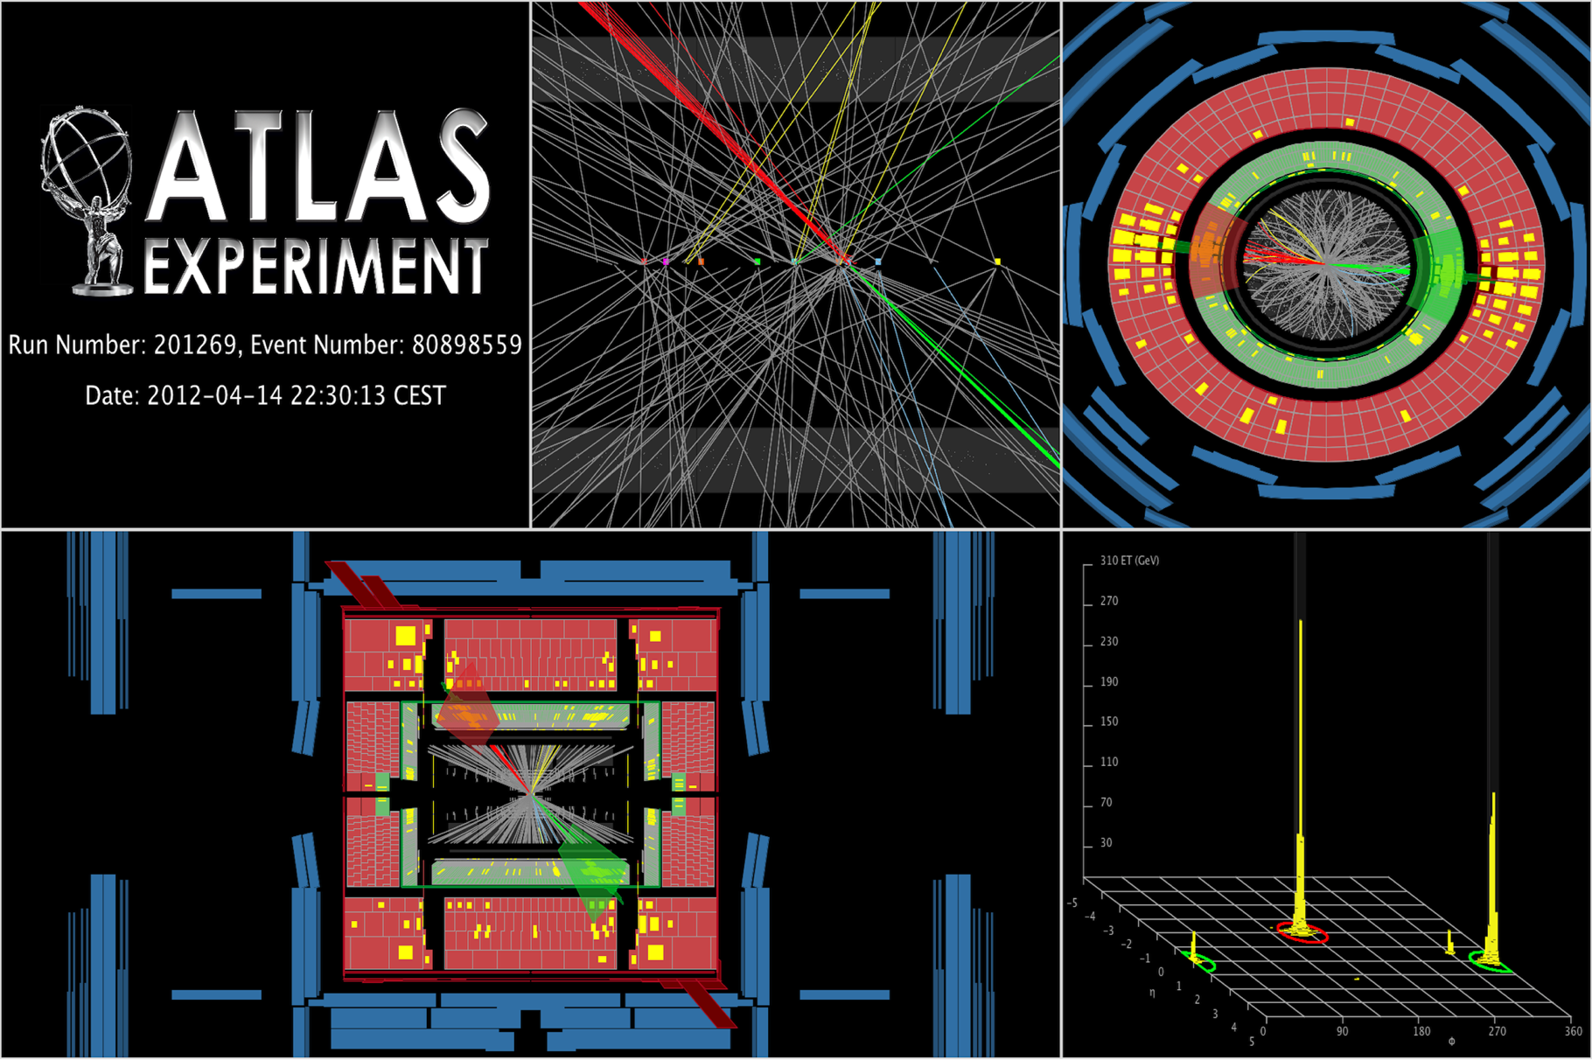
ATLAS event
Run-I event display with two central high-pT jets with an invariant mass of 4.23 TeV. The missing E_{T} in this event is 125 GeV

Slide 17
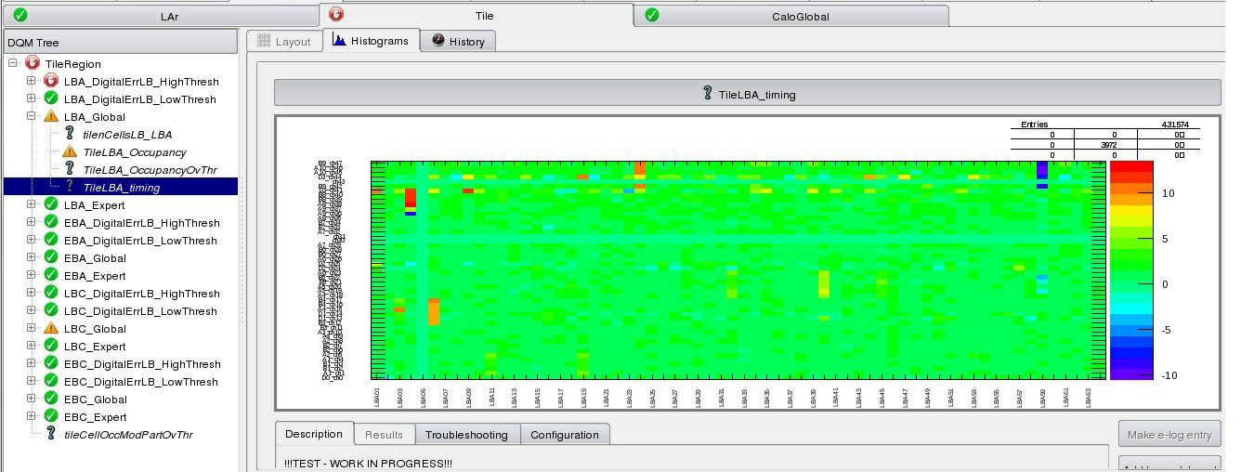
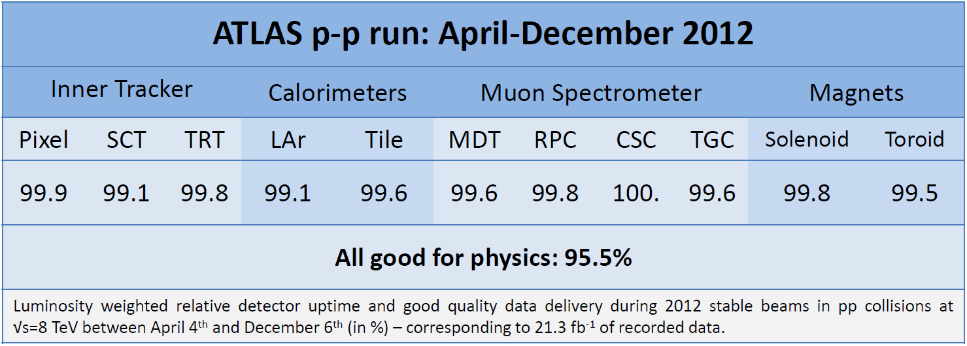
Data quality monitoring
Data quality monitoring framework (DQMF) monitors and collects the information of the quality of the data
Automated quality check based on test criteria on performance histograms
Visual control by shifters
Thanks to all the efforts the resulting quality of the Tile Calorimeter data is 99.6%

Slide 18
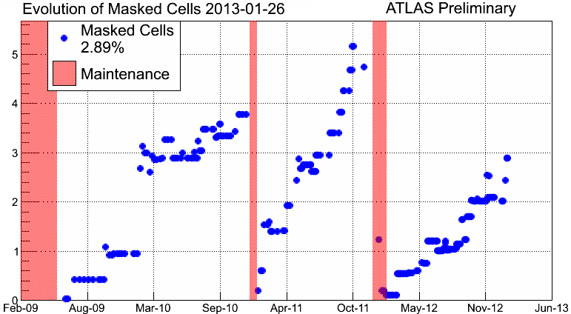
Detector status evolution
6 modules off (LVPS)
2.89% masked cells
Masked cell energy is interpolated from the neighboring cells
4 modules with bad HV
The bad HV cell’s EM scale is restored with Cs and laser calibration
The number of “bad” channels is increasing during data taking periods, mainly due to the failures of power supplies, taking the full module down
Most of the broken channels are fixed during maintenance campaigns, thanks to the possibility to access front-end electronics during shutdown time
Low voltage power supplies were replaced with upgraded ones that are more reliable and have lower noise

Slide 19
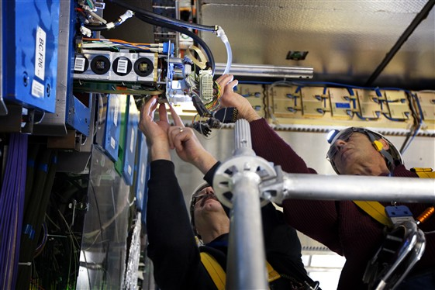
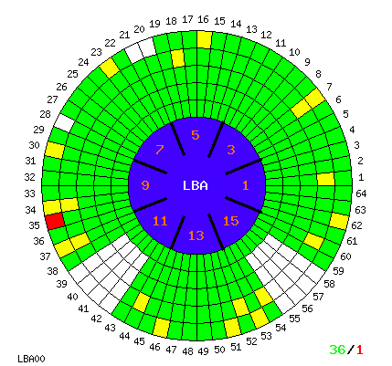
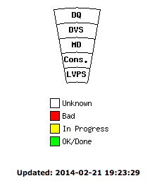
FE electronics maintenance
During shutdown, when ATLAS detector is opened
FE electronics “drawers” are extracted and bad components are replaced or fixed
Allows to operate with minimum number of bad channels to maximize the quality of the data
Data quality from consolidates modules is checked and the progress is tracked with web tools

Slide 20
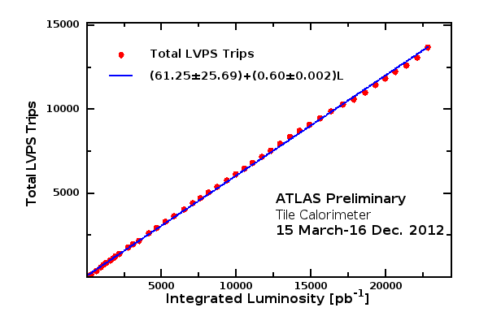
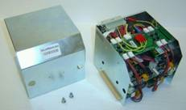
Low voltage power supplies
Finger LVPS box assembly
The on-detector FE electronics power-supplies were quite sensitive and exhibit numerous trips, proportional to the integrated luminosity
Automatic procedures to recover the tripped module were implemented in DCS and DAQ
The power supply design was modified and proved to be more reliable and have lower noise
  Just one trip from the sample of 40 new power supplies
  All power supplies were replaced with the new design before Run-II

Slide 21
PMT gain monitoring
HV stability over time
Unstable channel monitoring
With the gain proportional to HV (1V~1%), the stability of the HV system is crucial
Each channel’s HV is monitored
Unstable channels are monitored and corrected with laser calibration system

Slide 22
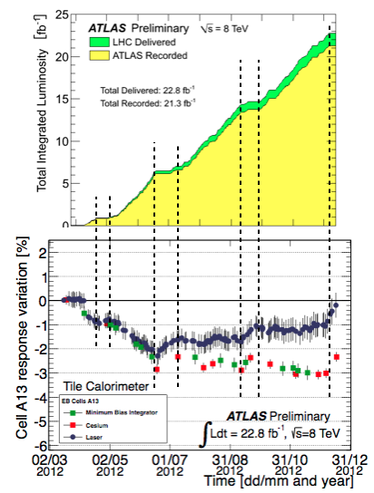
Calibration systems: combined performance
Full set of calibration systems allows reliable and accurate calibration of the calorimeter
Detector response drifts down with integrated luminosity and recovers back during accelerator technical stops
Calibration systems agree with each other and follow the calorimeter response behaviour

Slide 23
Noise
Cell noise width was affected by old power supplies and had to be modeled with two Gaussians
New, improved power supplies have lower noise and single-Gaussian shape
Pile-up noise simulation is in good agreement with data

Slide 24
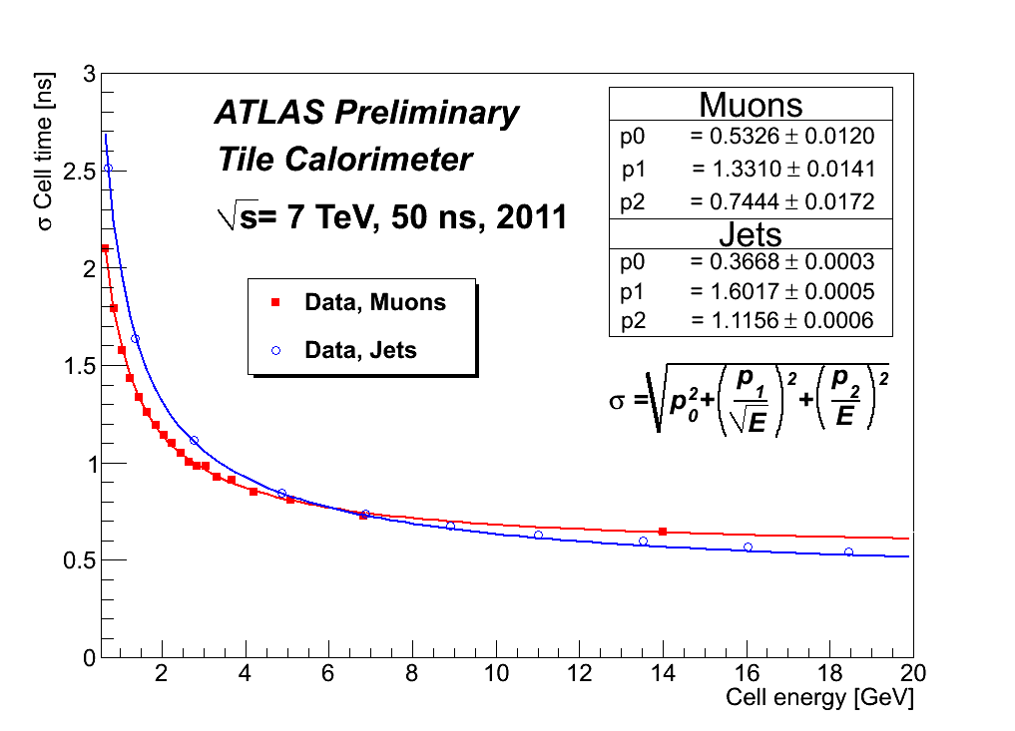
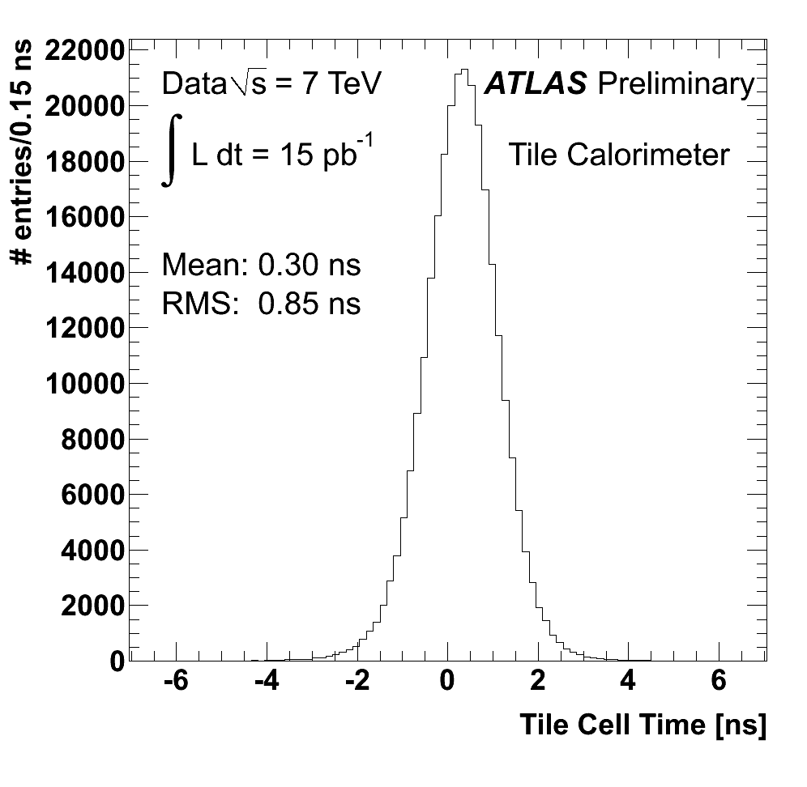
Timing
Initial time calibration done with laser, beam splashes and scraping beam
Good cell time performance and resolution

Slide 25
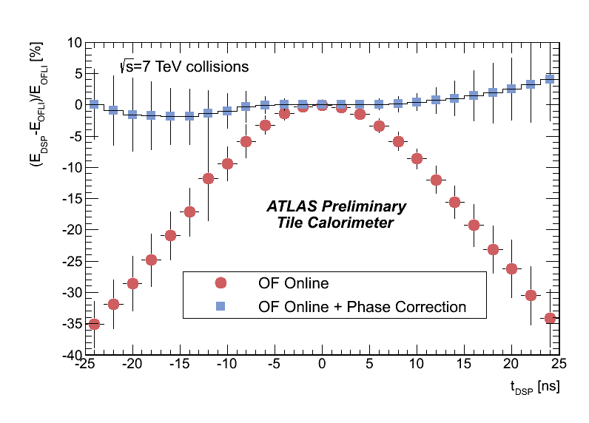
Energy reconstruction
Good agreement between data and simulation
Energy is calculated online for high level trigger
Good agreement between online and offline
Energy calculation depends on the phase of the signal, can be corrected online

Slide 26
Single hadrons
Correct description of E/p ratio for isolated hadrons

Slide 27
Jets
Jet transverse momentum resolution is under 20%

Slide 28
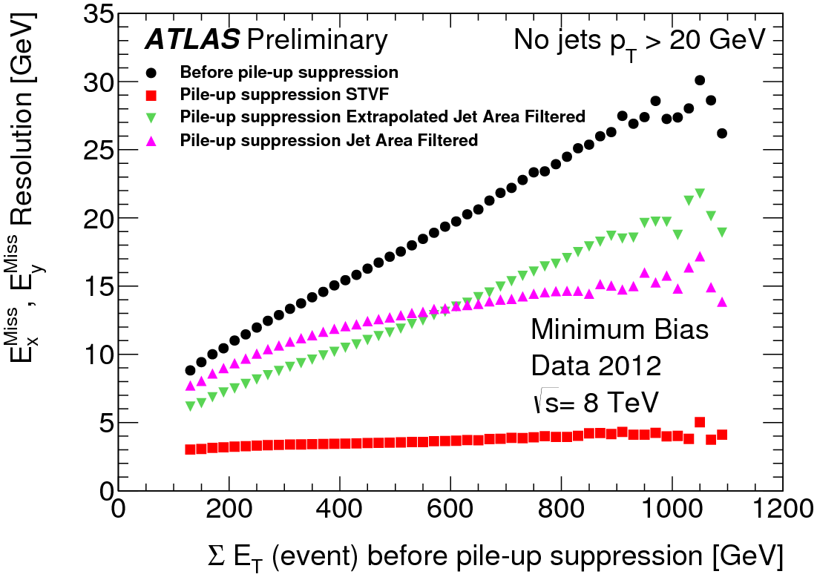
Missing E_{T}
Good resolution of missing E_{T} measurements
Robust pile-up suppression algorithms

Slide 29
Upgrade program
Advanced physics goals and LHC upgrade plans create new challenges for detectors
  LHC upgrade program aims at 5-10 fold luminosity increase → more radiation → better radiation tolerance required
  Ageing electronics → originally planned for 10 years of operation
  Higher event rates require more efficient trigger algorithms
A multi-phase upgrade program has been conceived: Phase-0, Phase-I and Phase-II
The major Tile Calorimeter mechanics and optics will stay, together with associated PMTs
Front-end and back-end electronics, calibration systems, will undergo major upgrades
  Complete redesign for font-end and back-end electronics
  New electronics drawer mechanics
  Fully digital trigger with higher selectivity and finer granularity
  Demonstrator project to discover and solve issues as early as possible

Slide 30
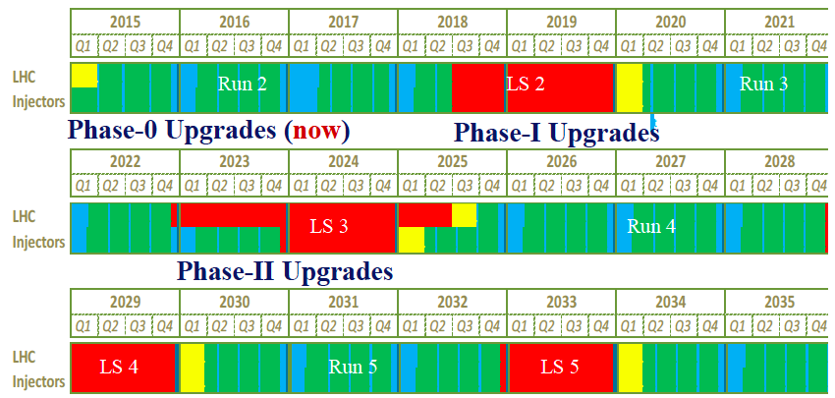
LHC and upgrade schedule

Slide 31
Ph0: Run-II improvements
Before Run-II all Tile Calorimeter front end electronics drawers were extracted to fix problematic channels
New, stable, low-noise power supplies were installed
Upgraded laser calibration system (Laser-II) is being constructed and will be installed
Cesium calibration system will be improved
The outer (D) layer muon trigger will be installed to reduce fake muon rate in a specific region

Slide 32
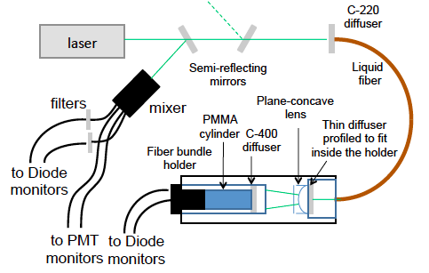
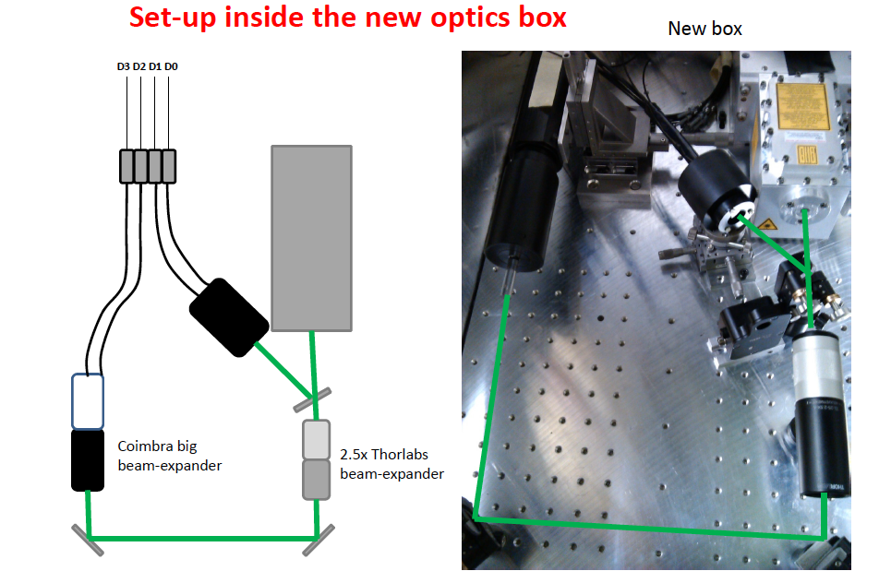
Ph0: Laser II
New laser system with improved stability and precision is required to follow the evolution of the PMT response during high luminosity running
Laser-II calibration system with new optics and electronics is being tested. Will be installed and ready for Run-II

Slide 33
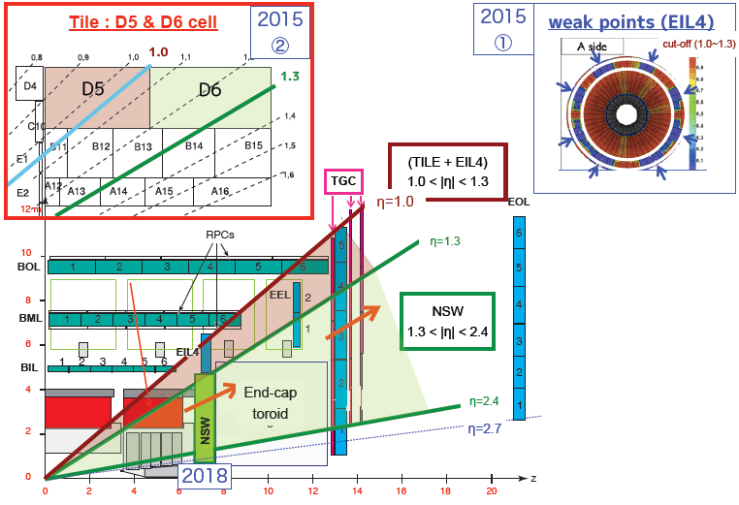
Ph1: D-layer muon trigger
L1 μ trigger in the End-cap region is polluted due to slow charged particles (protons)
Region 1.0<|η|<1.3 can be cleaned up by taking coincidence with end-cap TGC muon chambers and Tile cells D5 and D6
Tile muon trigger board (TMDB) is being developed for Run-II

Slide 34
Ph2: FE electronics upgrade
The HL-LHC upgrade will require more performance from detector electronics
The Tile Calorimeter will digitize shaped PMT signals and ship all samples off the detector for fast signal processing and digital triggering
Good opportunity to explore new technologies, including high-performance FPGAs, fibre optics, improve reliability
A demonstrator project will allow to test new ideas and technologies already in Run-II and demonstrate the feasibility of new design

Slide 35
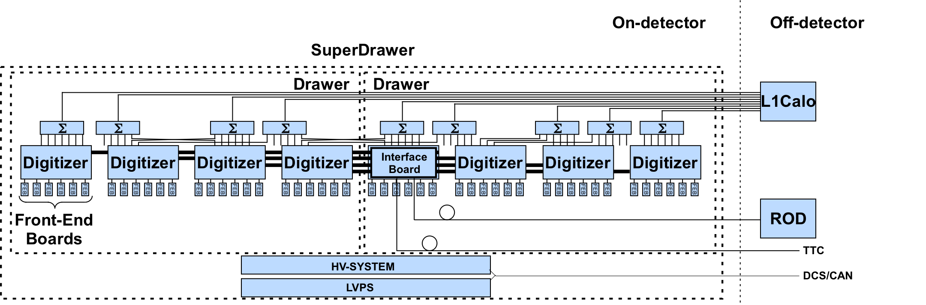
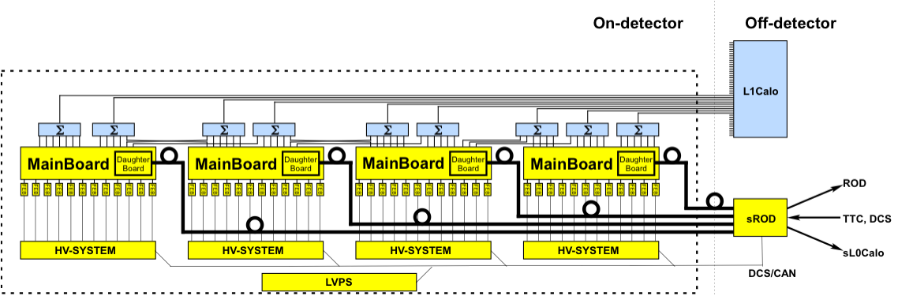
FEE architecture changes
OLD = 2 drawers
NEW = 4 mini-drawers

Slide 36
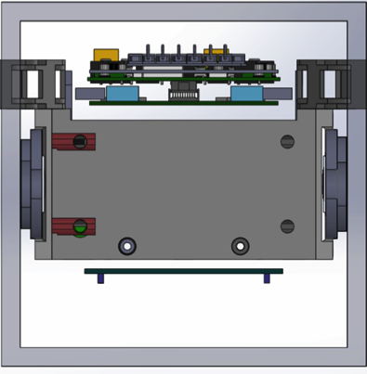
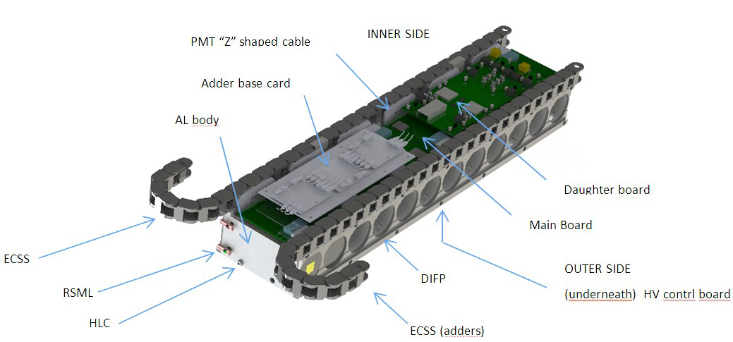
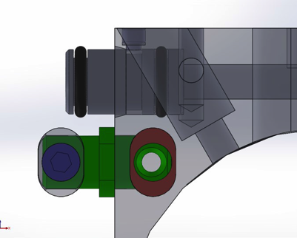
FEE new drawer mechanics
To improve the operation, maintainability and handling a new mini-drawer design was made to replace the old super-drawer one
New rigid inter-drawer connections and internal cooling
New internal flexible cable trays

Slide 37
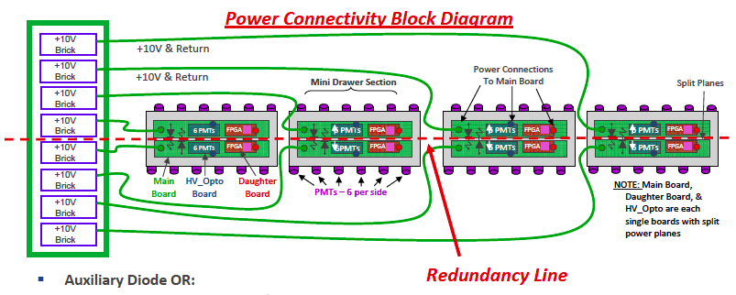
New power distribution
To improve the reliability and redundancy, the electronics in the new design are made as independent as possible to reduce the number of single point failures
Possibility to use dual power supply for redundancy

Slide 38
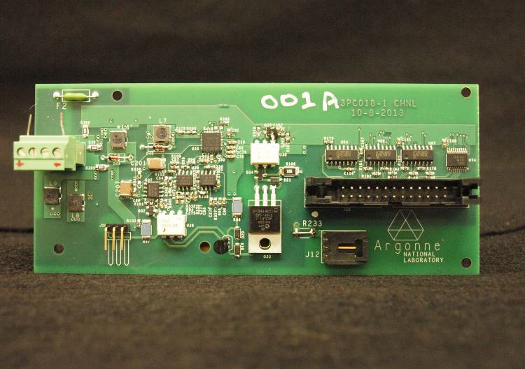
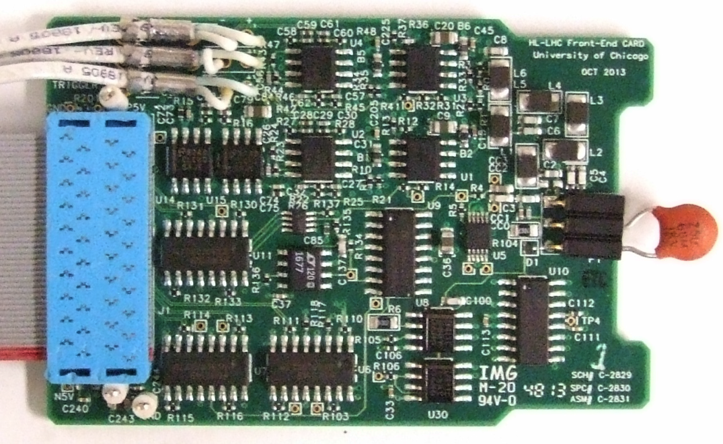
FEE upgrade options
3in1 front-end board
HV distribution prototype
Several design options are being followed for key components, up to three different technologies
  Example: front-end card – 3in1 or ASIC or QIE
  Example: HV system – on-detector/off-detector distribution
The best option will be chosen based on performance results from test beams and dedicated tests

Slide 39
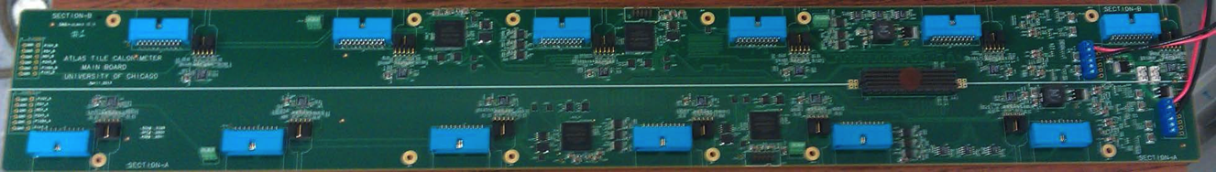
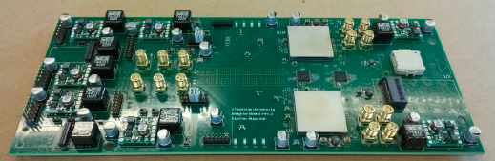
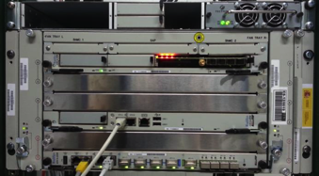
New readout electronics
The digitised samples will be sent outside the detector at full 40 MHz sampling speed
The digital trigger and data buffering will happen in the back-end electronics

Slide 40
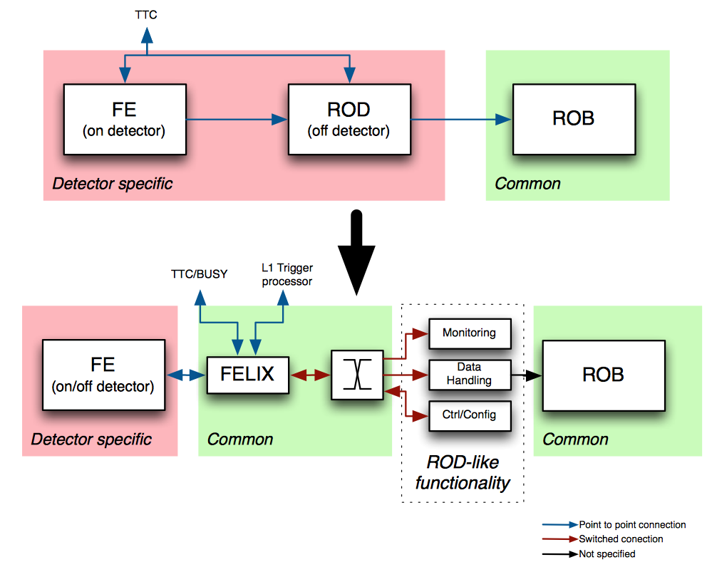
Proposed readout scheme
To reduce detector specific parts use COTS switching networks
Less P2P connections
DCS and monitoring information routed directly to information consumers

Slide 41
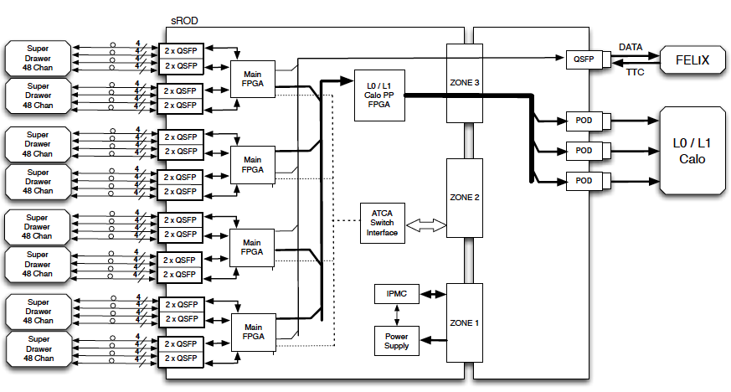
New BE electronics
ATCA Super-ROD (sROD) board
Processes data from 8 modules

Slide 42
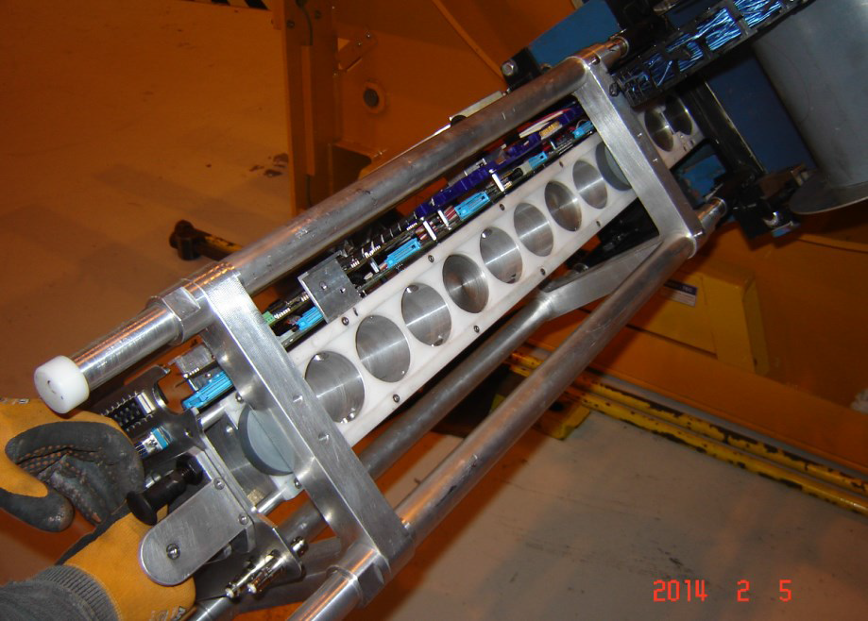
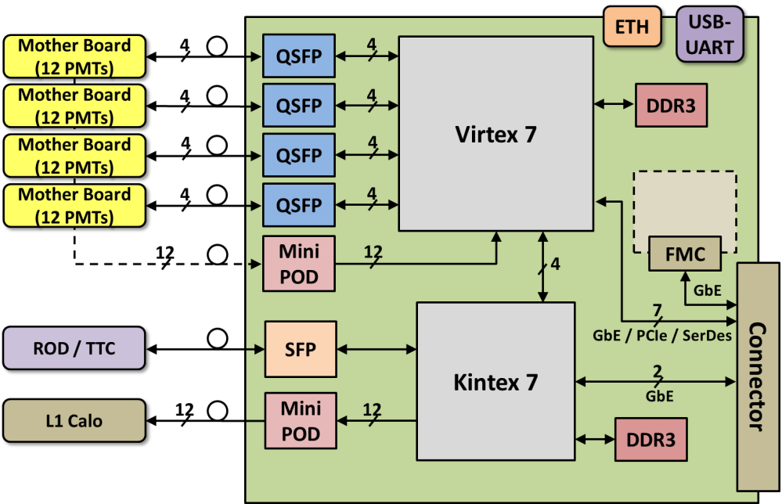
Demonstrator
Demonstrator drawer insertion tests
sROD demonstrator board design
In order to test and qualify new designs a “demonstrator” electronics drawer will be installed in the detector before Run-II
To be compatible with the previous design the demonstrator will provide analogue trigger and standard data stream
Board prototypes are being tested to be ready for insertion before the detector closure in August-2014
Expert integration weeks proved to be essential for the project

Slide 43
Summary
Tile hadron calorimeter is a key detector in measuring jet energy and missing E_{T} energy in ATLAS experiment
A full set of calibration systems ensures correct energy reconstruction in changing conditions
PMT gain down-drift is well monitored, calibration systems follow the calorimeter response behavior
Great Run-I performance with minimal data losses and high data quality
Detector maintenance and Run-II improvements are underway
Upgrade R&D projects for electronics replacement for HL-LHC programs are progressing, a demonstrator electronics drawer to be installed before Run-II

Slide 44
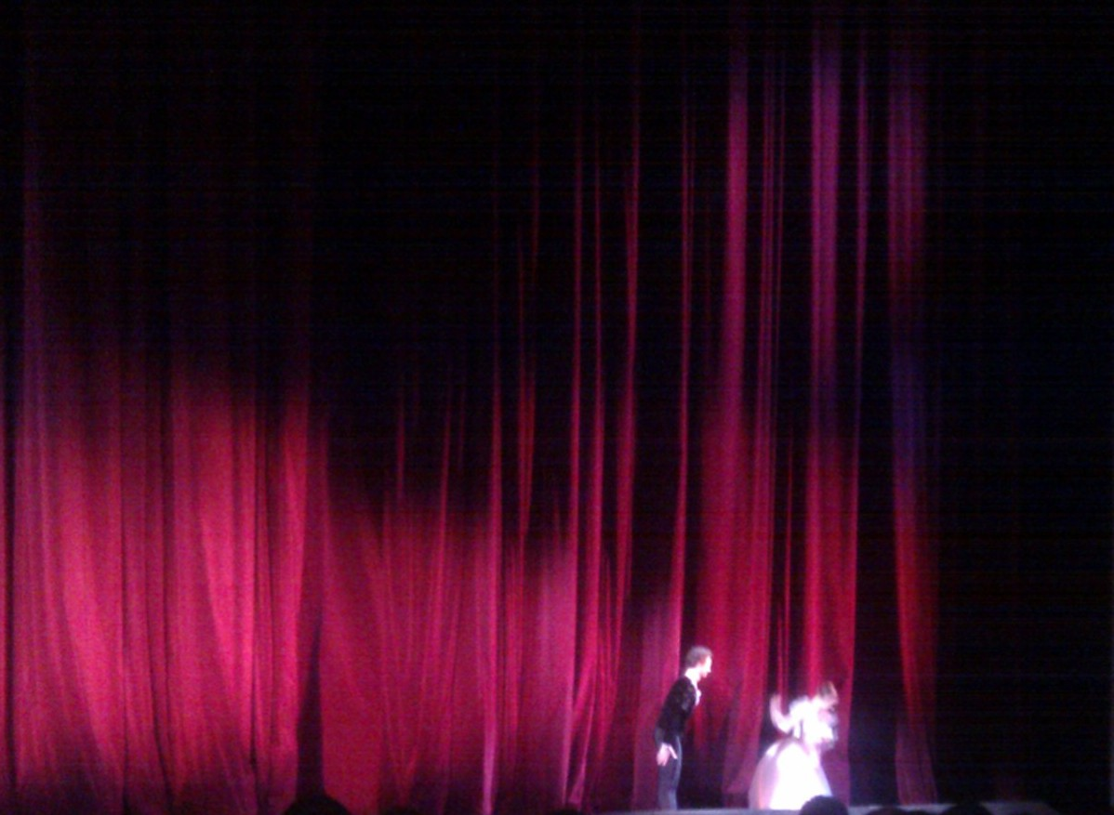
Thank you for your attention!

Slide 45
Backup slides

Slide 46
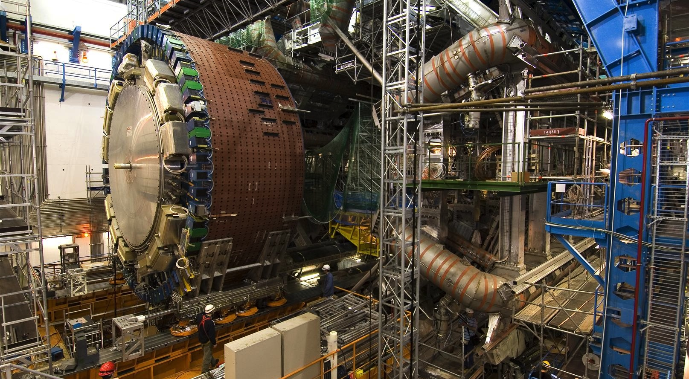
Calorimeter in the cavern
Extended Barrel calorimeters being moved to final position

Slide 47

Calorimeter in the cavern
Engineers working near Extended Barrel calorimeters

Slide 48





Front-end electronics drawer
Up to 45 PMT Blocks with HV bases
Up to 45 3-in1 cards (shaper-amplifier-integrator board)
4 motherboards
8 digitizer boards
one optical interface board
one TTC receiver mezzanine card
up to 10 analog summing cards
one integrator readout board
HV distribution boards
LV distribution and sense adapters

Slide 49

Tile upgrade timeline
Replace front end and back end electronics in phase 2 (except PMTs):
  New readout architecture
  Full data digitization at 40 MHz and transmission to off-detector system
  Cell digital information to the L1/L0 trigger
  Improve reliability (reduce connections, reinforce redundancy)
  Improve LVPS system (point of load regulators)
Install first demonstrator in Tile Cal Spring 2014
Final front end choice based on test-beam results (2014-2016)

Slide 50



FEE option: new 3in1
Fast signal processing
  7-pole LC shaper and bi-gain clamping amplifiers with gain ratio of 32
Slow signal processing
  6-gain integrator for Cs calibration and monitoring minimum bias current of proton-proton collisions
Charge injection calibration and controls
Retain analog trigger capability for Demonstrator

Slide 51



FEE option: QIE
QIE principle
Charge integrator
  4 clock cycles to acquire the data
Data Output : 10 bits encodes a 17-bit dynamic range
  6‐bit ADC value, 2 bits range (4 ranges), 2 bits CAPID
Version 10.5 under evaluation
  fully‐functional, including data drivers and TDC

Slide 52


FEE option: ASIC
Based on the FATALIC chip family + TACTIC ADC
  Current conveyor concept
IBM 130 nm technology. Shaping, 3 gain ranges (1, 8, 64)
First prototypes (FATALIC 1/2) tested
Version FATALIC 3 is being tested
Validation of the current conveyor concept
Digital integrator for the Cesium calibration
TACTIC: Includes 12-bit pipeline ADC@40 MHz
  Best resolution and speed
FATALIC
TACTIC

Slide 53

Mainboard
Mainboard digitises signals from FEBs with independent discrete ADCs
  Mainboard is split into two halves
  Each cell will be read-out by two PMTs, one on each side of the mainboard
  Samples are transferred serially to the daughterboard at 600 MHz
  Commands are sent in parallel to 2 control FPGAs on each side

Slide 54

Daughterboard
Daughterboard provides GBT communication with back-end electronics
  Implementing a redundant system on a single PCB + triple redundant FPGA programming
  Two Kintex 7 FPGAs and two QSFP Modulators at 40 Gb/s
  Firmware can be also uploaded through the optical link
  Two GBTx chips

Slide 55

Cs electronics upgrade
An upgrade of the Cesium control electronics and readout chain is needed
All good features and performance of the current system should be preserved and improved where possible
Integration of the Cs control data flow into the new drawer electronics (via GBT-CAN/SPI link)
First prototypes of upgraded boards have been tested
Special test-boards with perspective components for radiation hardness tests are being designed

