Slide 1
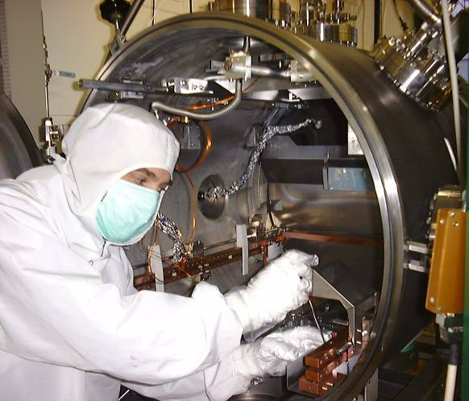
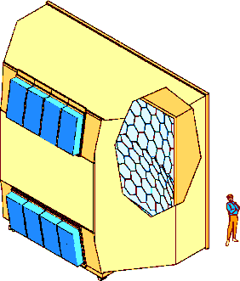
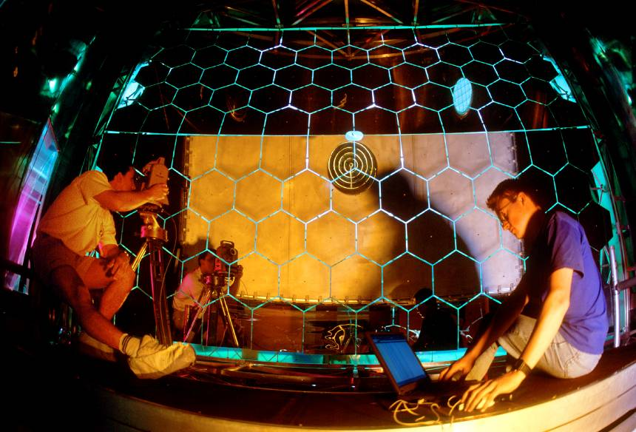
LONG TERM EXPERIENCE AND PERFORMANCE OF COMPASS RICH-1
Fulvio Tessarotto
( I.N.F.N. – Trieste )
For the COMPASS RICH Group
COMPASS RICH-1
Vessel, radiator gas and mirror system
MWPC’s with CsI photocathodes
The MAPMT based detectors
PID Performances of COMPASS RICH-1
The upgrade with MPGD-based PDs

Slide 2
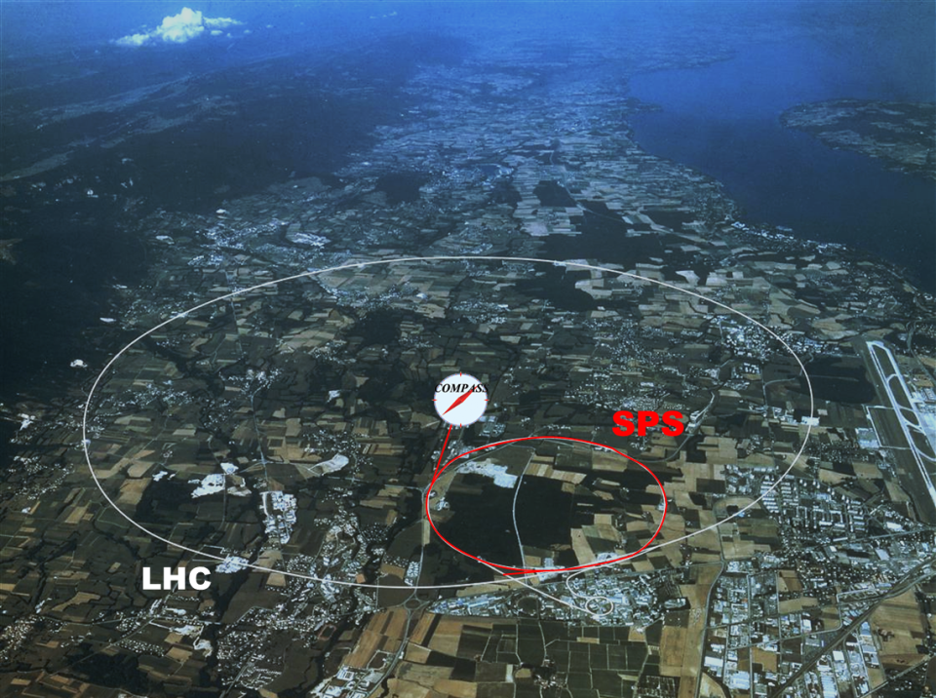













COMPASS II Collaboration
Дубна (LPP and LNP), Москва (INR, LPI, State University),Протвино
Bochum,
Bonn (ISKP
& PI),Erlangen,Freiburg,
Mainz,München TU
~ 250 physicists
from 24 Institutions
of 13 Countries
Warsawa (NCBJ),
Warsawa (TU)
Warsawa (U)
CERN
Praha (CU/CTU)
Liberec (TU)
Brno (ISI-ASCR)
USA (UIUC)
Yamagata
Saclay
Calcutta (Matriviani)
Lisboa/Aveiro
Torino (University,INFN),
Trieste (University,INFN)
Taipei (AS)
Tel Aviv
Experiments with muon beam:
  Spin structure, Gluon polarization
  Flavor decomposition
  Transversity
  Transverse Momentum-dependent PDF
  DVCS and HEMP
  Unpolarized SIDIS and TMDs
Experiments with hadron beams:
  Pion polarizability
  Diffractive and Central production
  Light meson spectroscopy
  Baryon spectroscopy
  Pion and Kaon polarizabilities
  Drell-Yan studies
COMPASS - I (2002 – 2011)
COMPASS - II (2012 – 2017) …

Slide 3
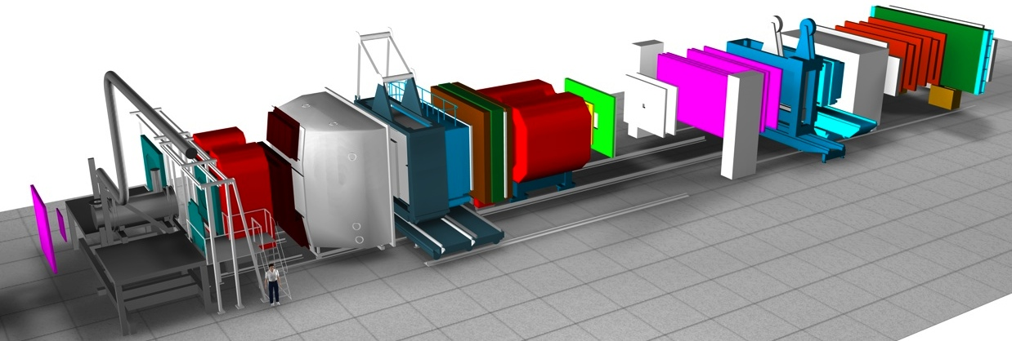
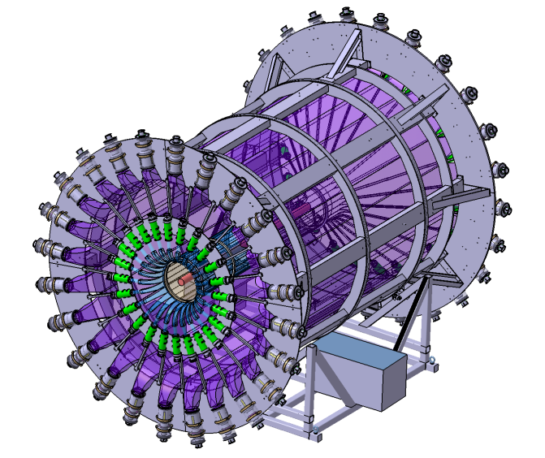
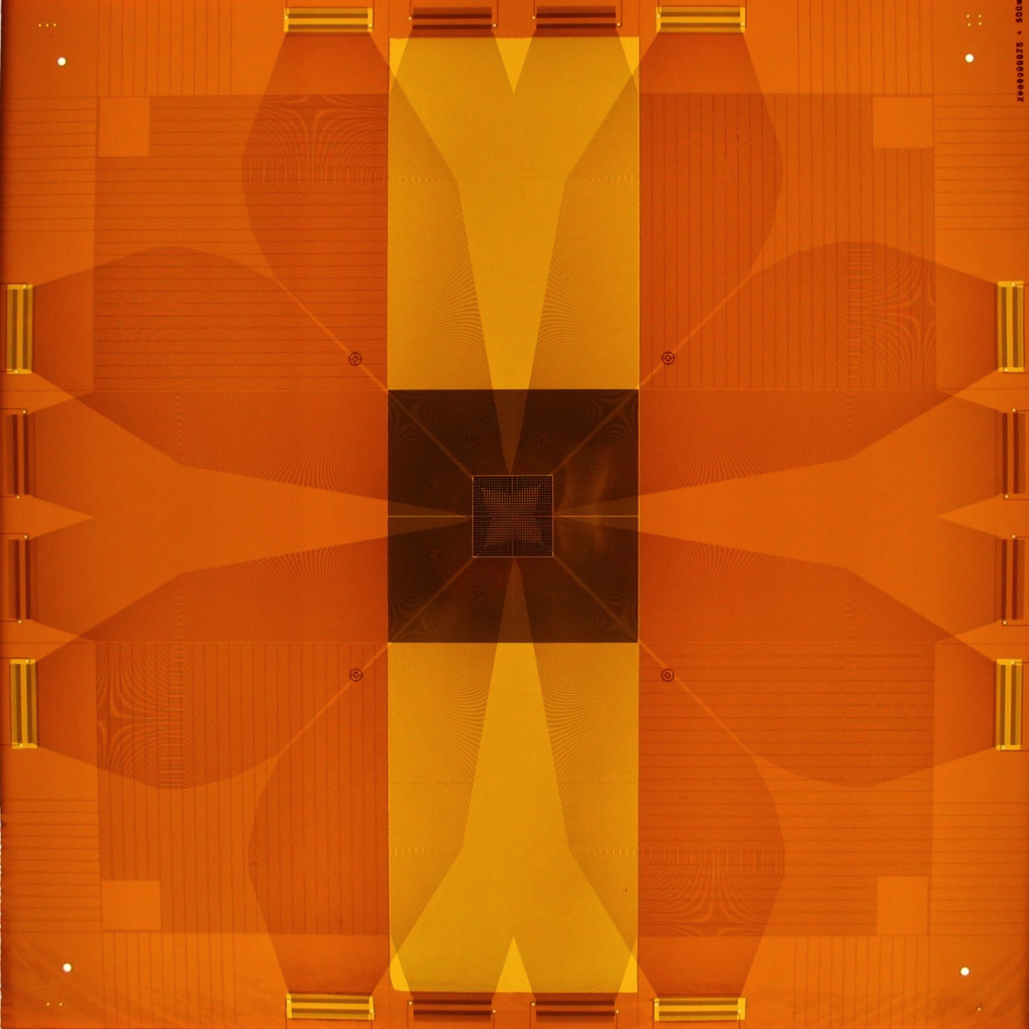
BEAM, TARGET AND SPECTROMETER
Polarized ( p , d) target
160 or 190 GeV/c µ⁺ (or µ⁻), 4 . 10⁸ µ/spill, P_{μ} ~ 80%
190 GeV/c p, π⁺, π⁻ , K⁺ ,K⁻ beams
Various targets used
first GEMs and Micromegas used in a HEP Experiment
Small
Angle
Spectrometer
DAQ: 40 kB, 30 kHz, O(PB)
Target
region
Large
Angle
Spectrometer
4 Tm
SM2
1 Tm
SM1
RICH-1
P. Abbon et al., Nucl. Instr. and Meth. A 567 (2006) 114
50m
new: pixel GEMs
Proton recoil detector
(not in scale)

Slide 4
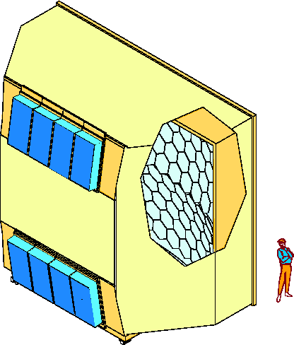
COMPASS RICH-1
is a large gaseous RICH
with two kind of photon detectors
providing:
3 m
6 m
Al vessel
hadron PID from 3 to 60 GeV/c
acceptance: H: 500 mrad V: 400 mrad
trigger rates: up to ~50 KHz
beam rates up to ~10⁸ Hz
material in the beam region: 1.2% Xo
material in the acceptance: 22% Xo
detector designed in 1996
in operation since 2002
upgraded in 2006
total investment: ~ 4 M €
a new upgrade is foreseen in 2016
MWPC’s + CsI
UV mirror
wall
5 m
PMT’s
radiator:
C₄F₁₀
radiator gas: C₄F₁₀
beam pipe

Slide 5
The principle and a typical event

Slide 6
The principle and a typical event

Slide 7
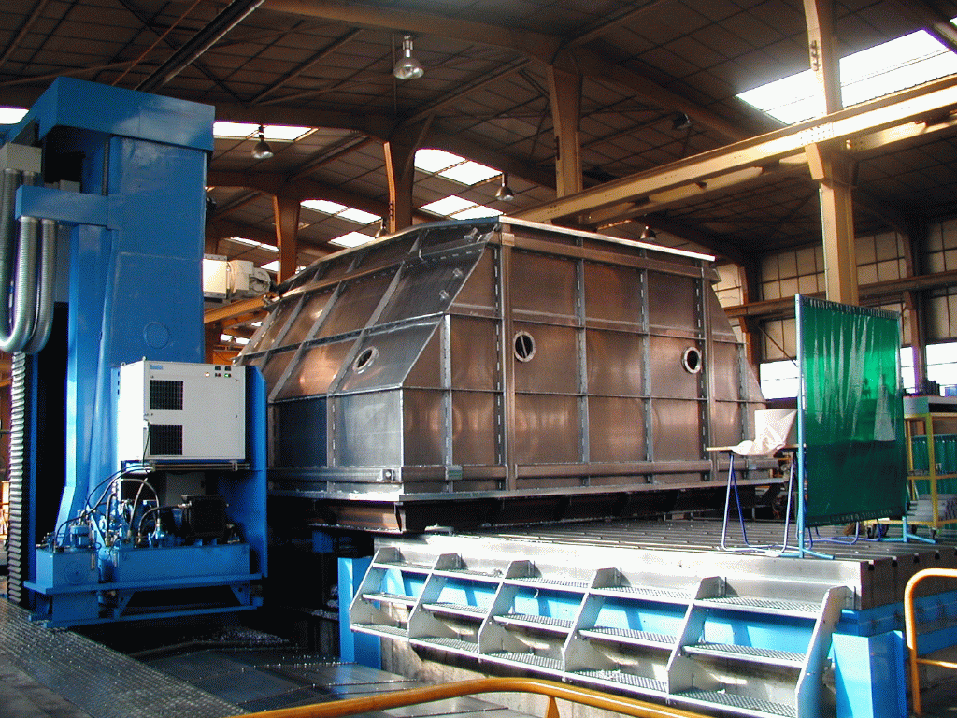
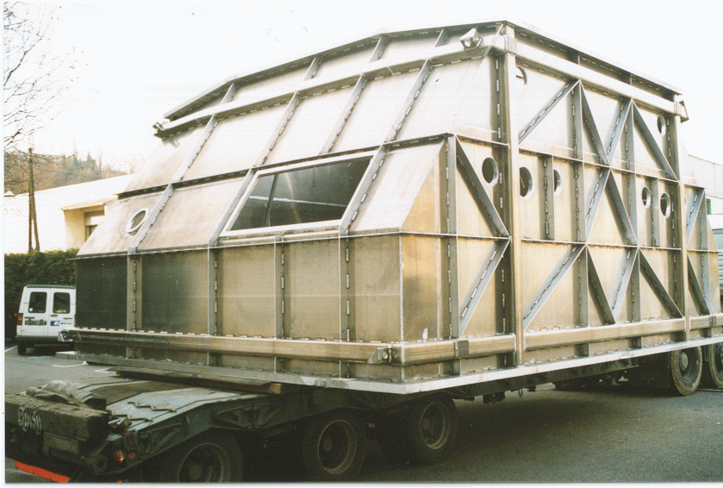
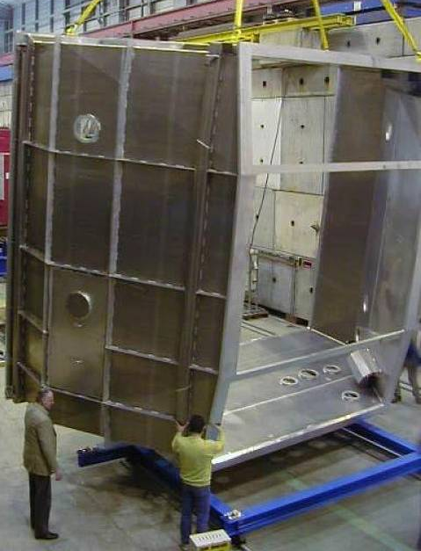
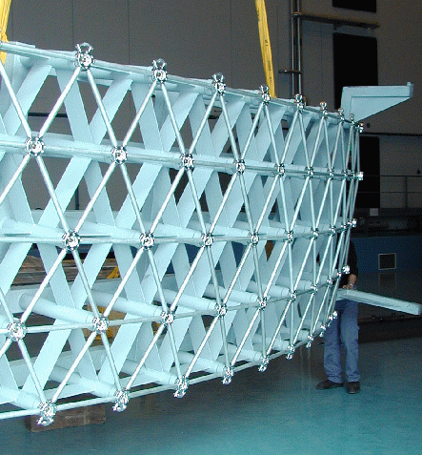
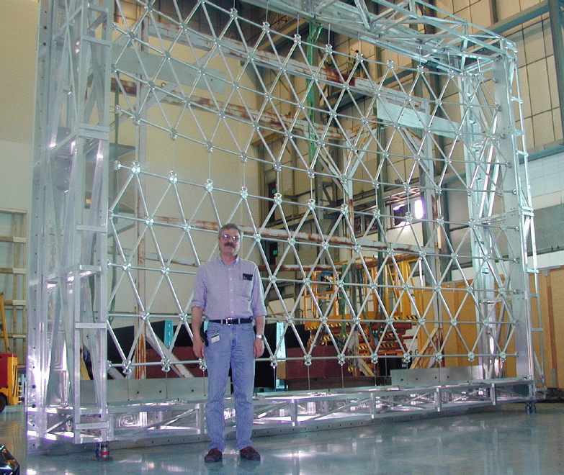
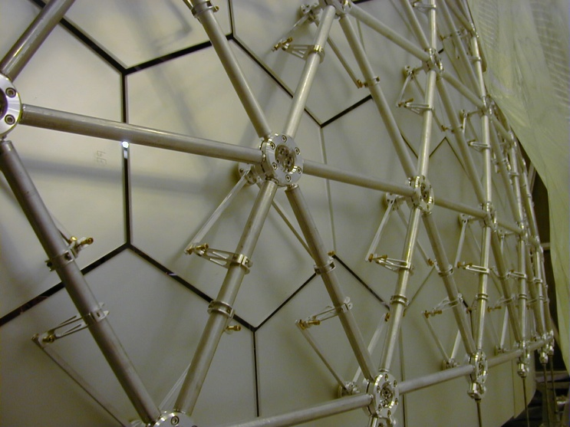
the vessel and the mirror support wall
Large and accurate mechanics
light front and rear windows
100 m of O-rings, 80 m³ C4F10

Slide 8
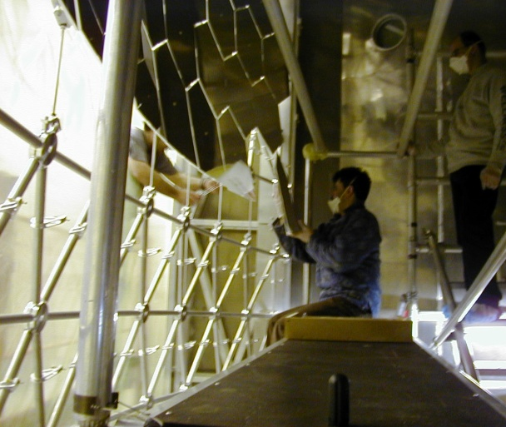
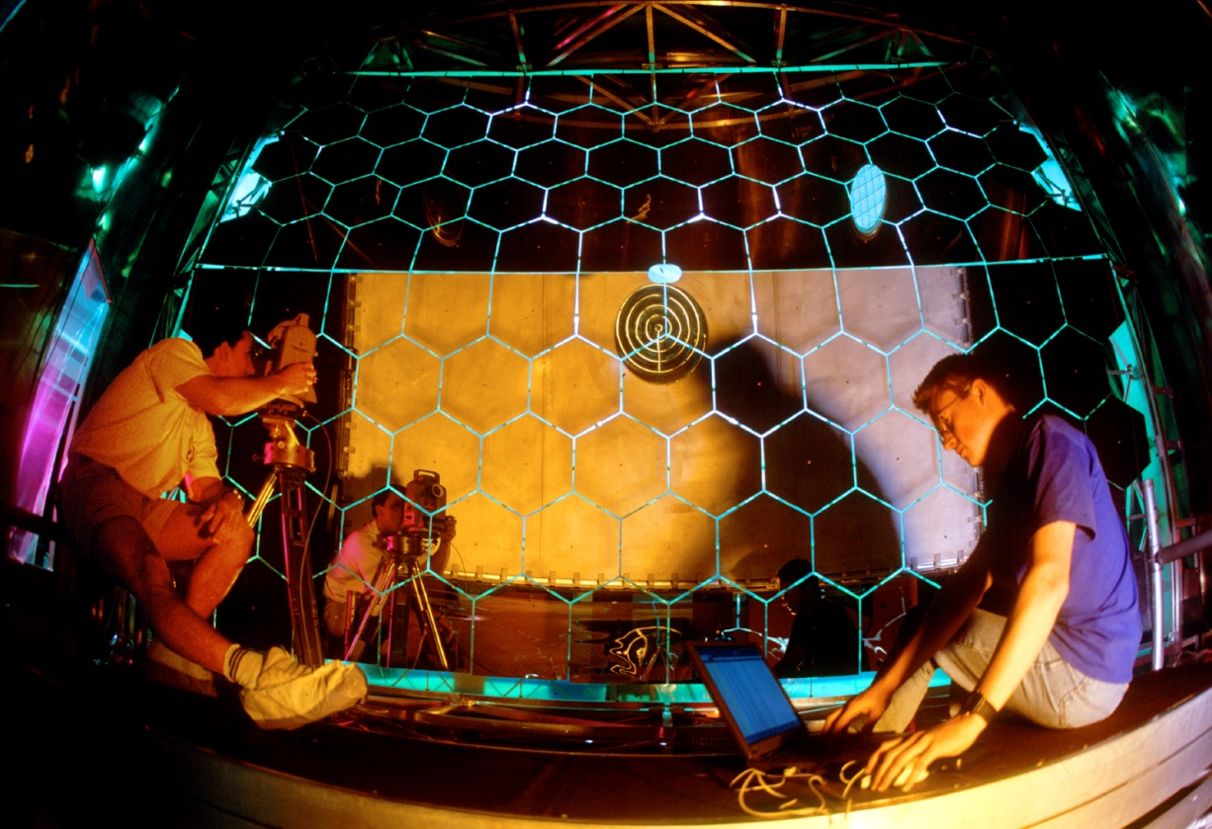
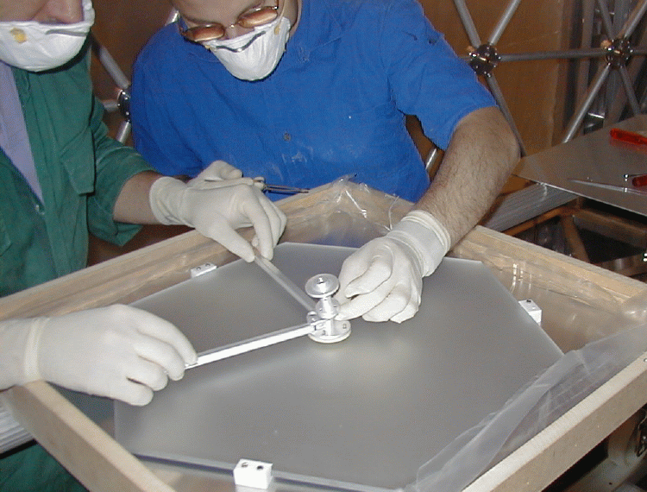
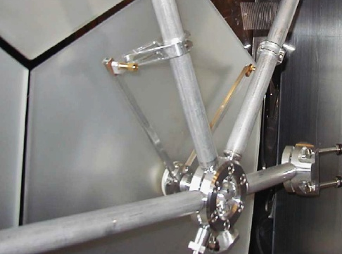
mirrors and alignment
21 m², 116 mirrors radius: 6.6 m
measurement of mirror alignment
via laser autocollimation
angular regulation screws

Slide 9
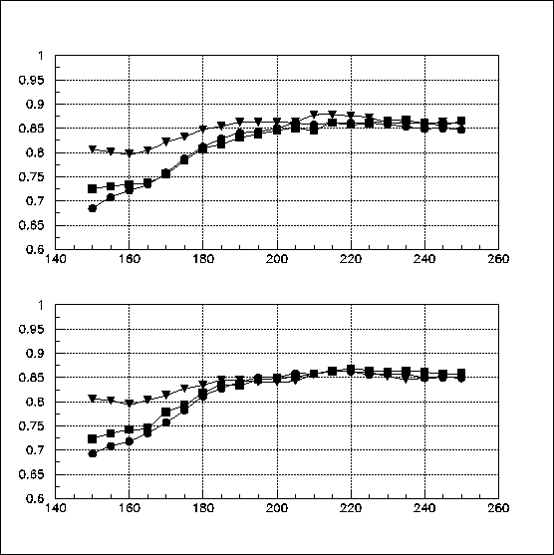
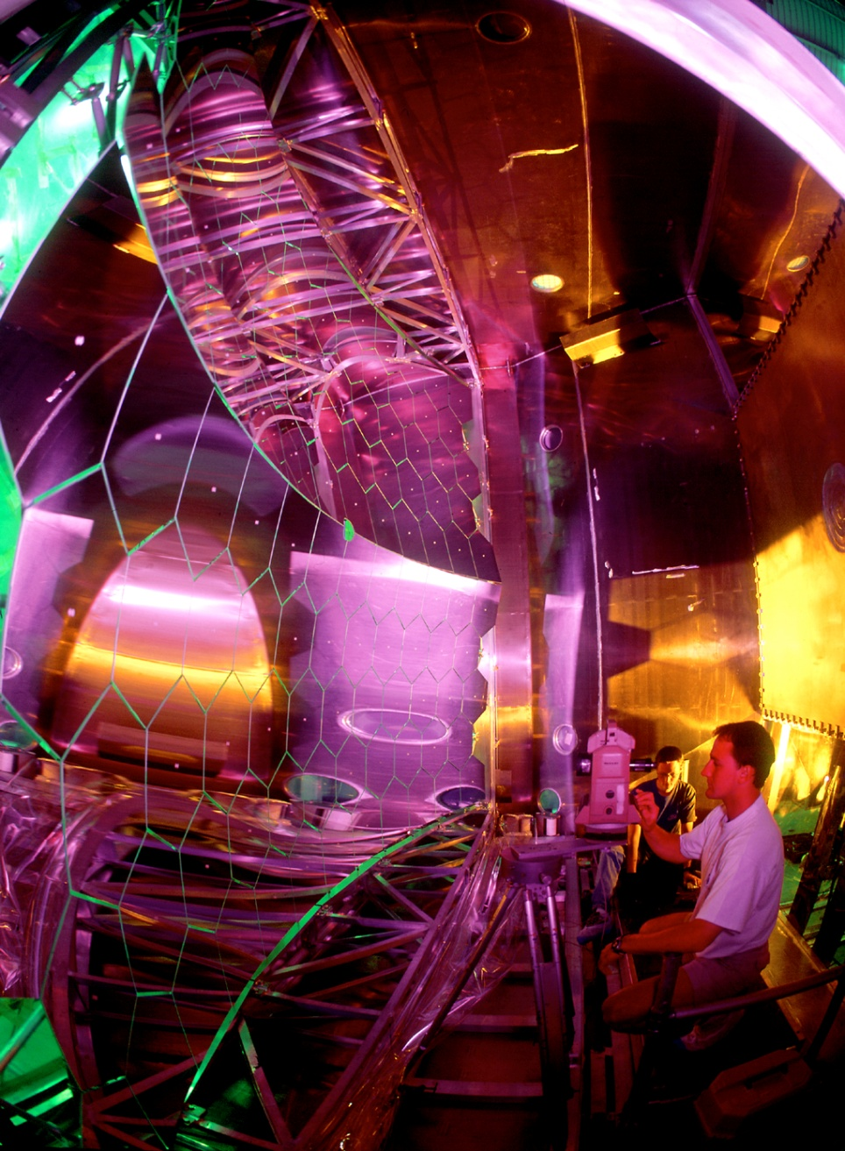
problems with mirrors
reflectance stability
reflectance
2000
(at coating)
2001
2002
λ(nm)
initial alignment accuracy: ~100 μrad
surveying accuracy: ~ 60 μrad
alignment instability: 1 mrad (first year)
alignment instability: ~ 100 μrad after 2002
alignment check → surveyors inside → opening the vessel: contamination, dust,
risky operations, work load, expenses.

Slide 10
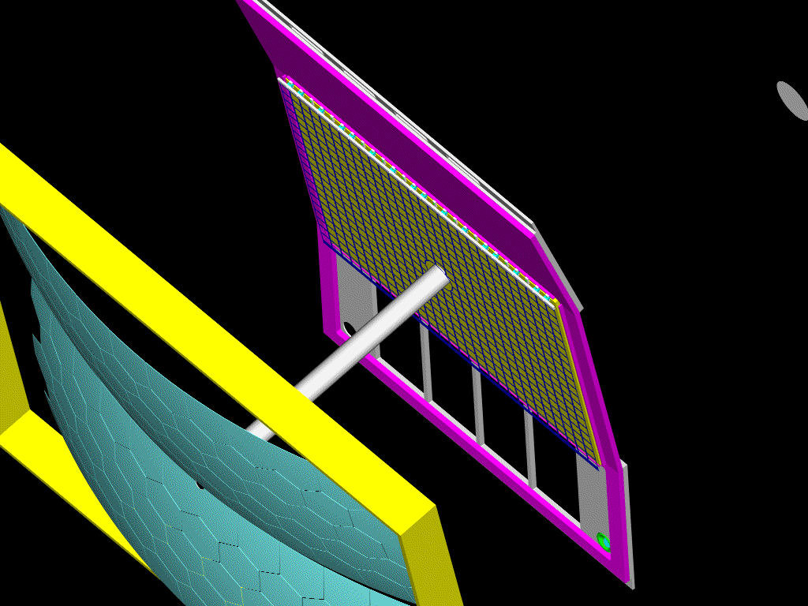
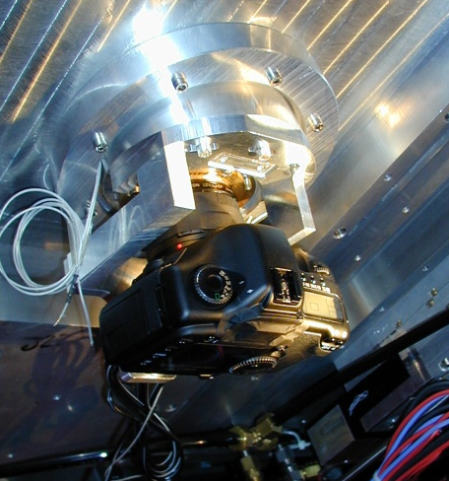
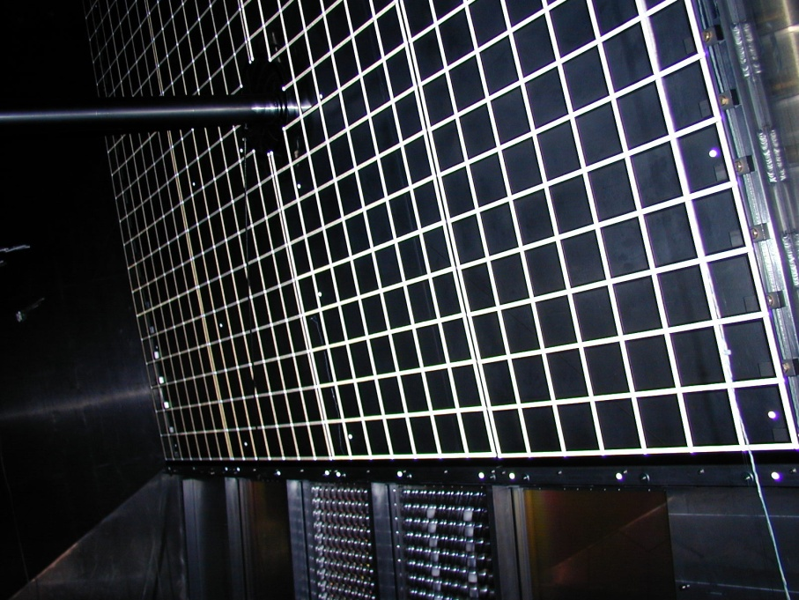
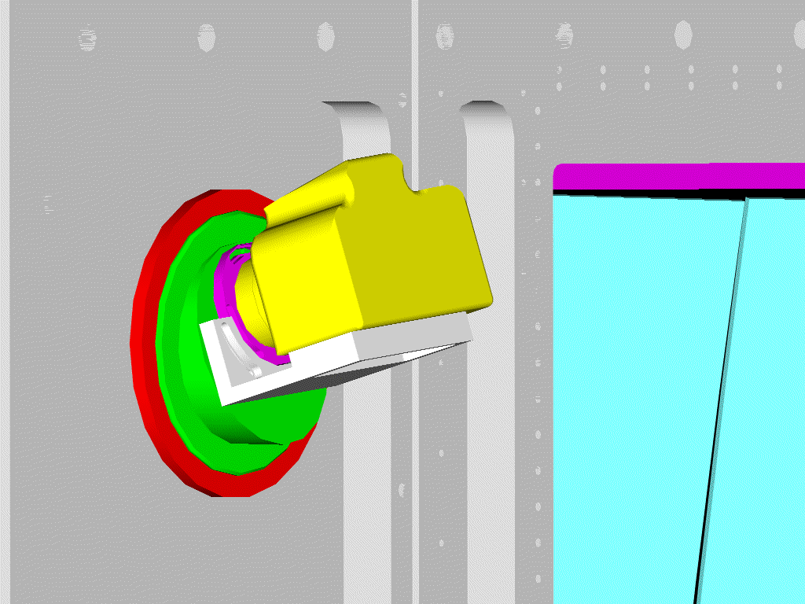
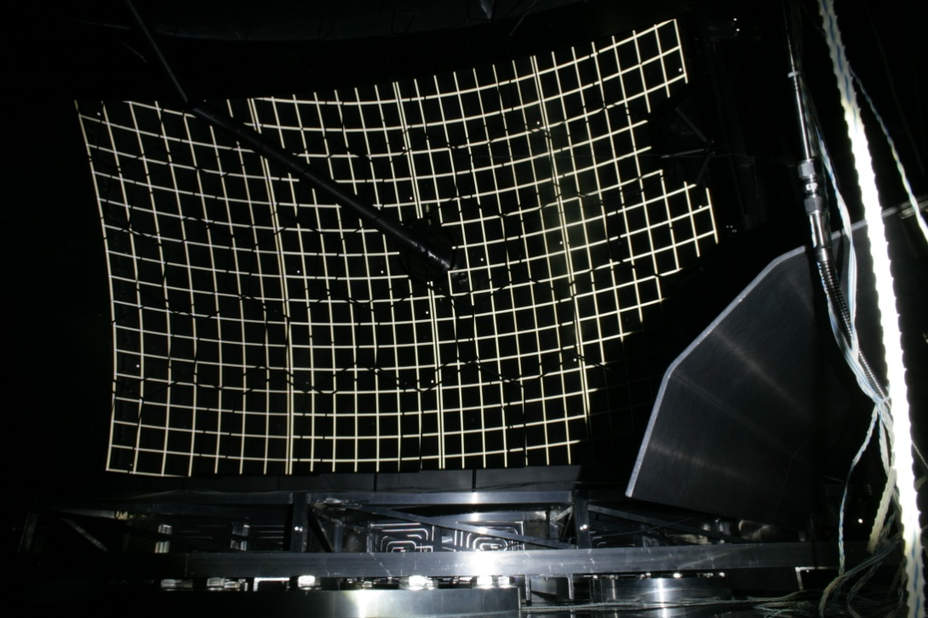
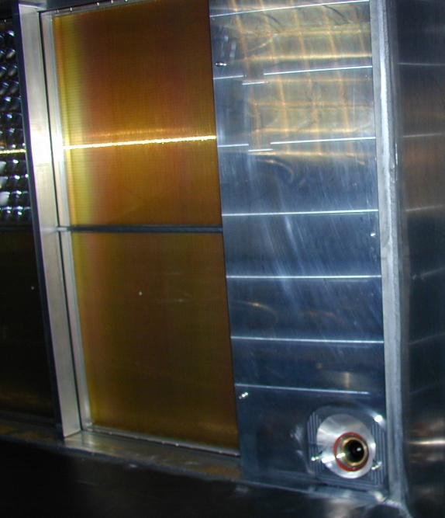
CLAM: mirror alignment monitoring
4 cameras
at corners
with LED’s
retroreflective grid
CLAM system in operation since 2007
accuracy: 30 μrad
photogrammetric calibration of cameras → measurement of absolute mirror tilt
“CLAM” picture for mirror monitoring

Slide 11
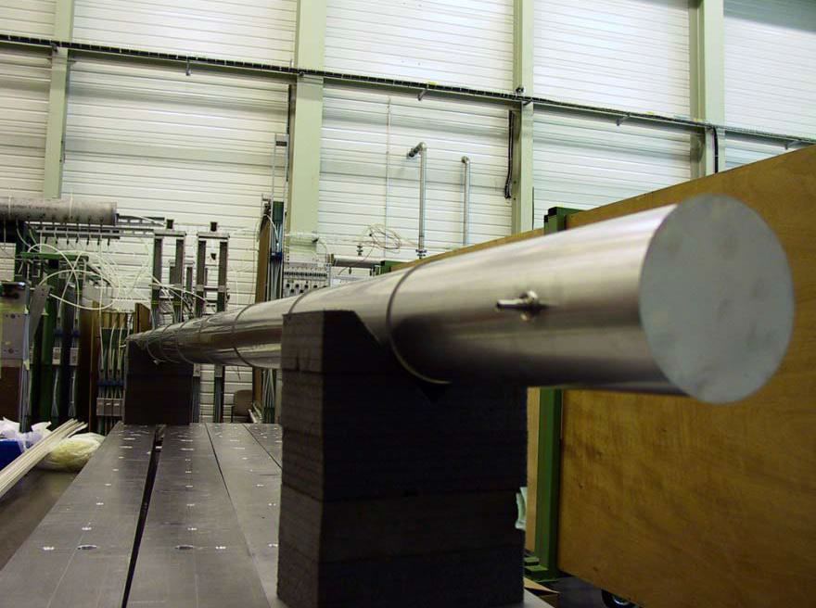
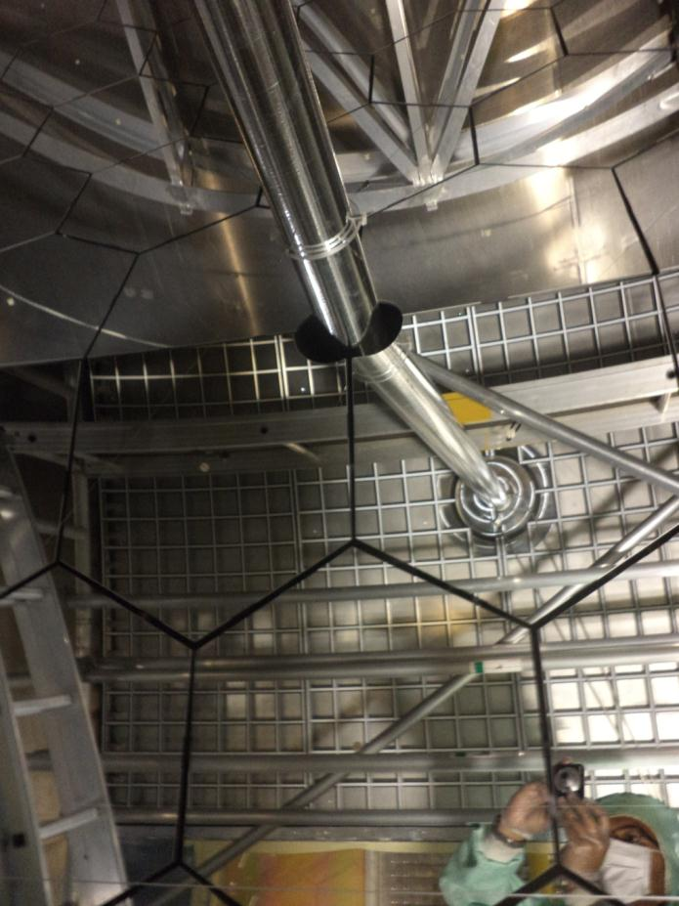
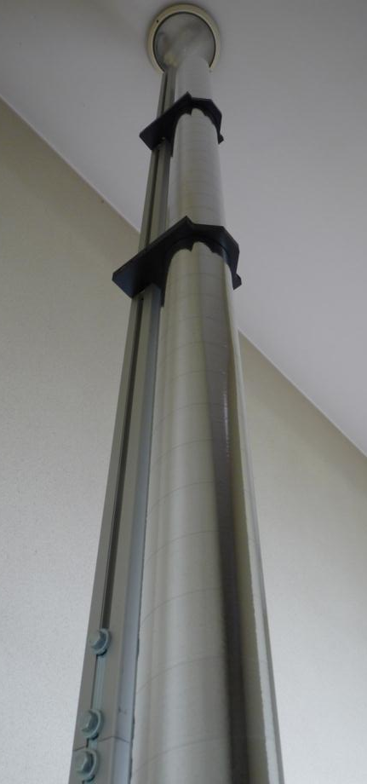
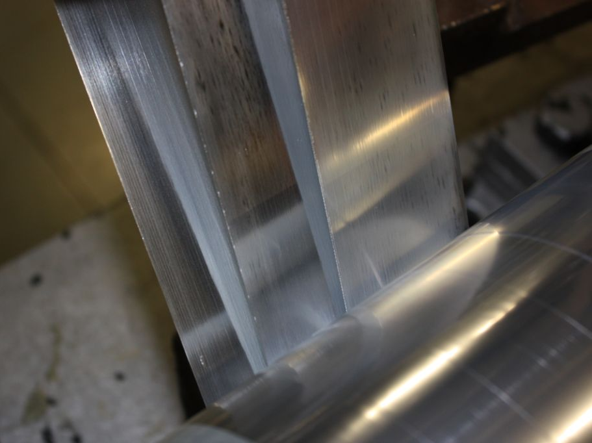
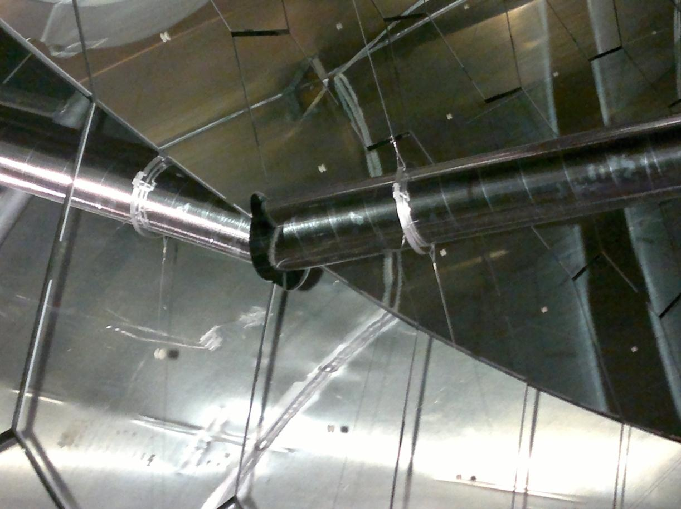
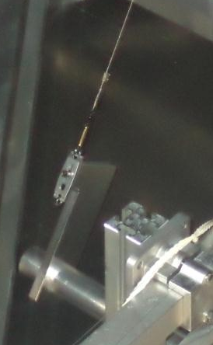
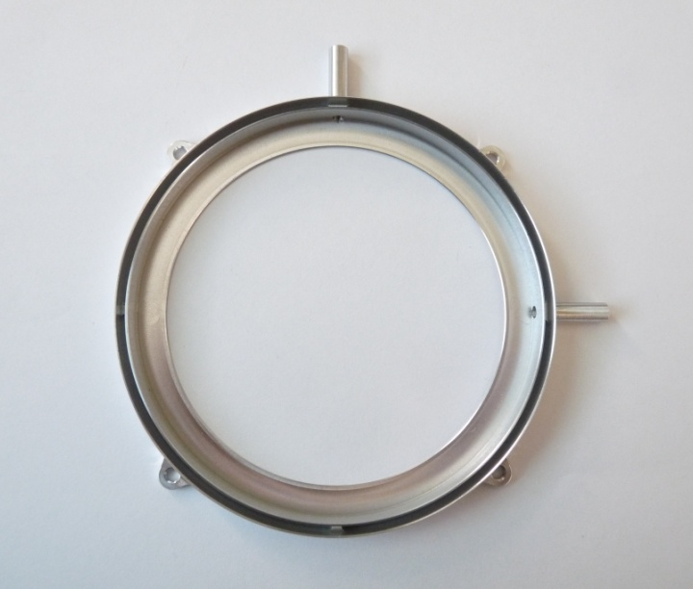
2012: a new light beam pipe
Old: 150 µm thick stainless steel pipe:
0.85 % X₀ for orthogonal crossing
New pipe: 0.044 X₀ for orthogonal crossing
Material: 4 x 25 μm thick Mylar + 200 nm Al coating (by Sheldahl)
winding by Lamina (6 µm glue)
1 microflange for suspension + gas connection + window holding
Suspension and tensioning system: 1 x 7 wires ss rope 30 μm diam.
1 microflange and 1
weight = 15 g

Slide 12
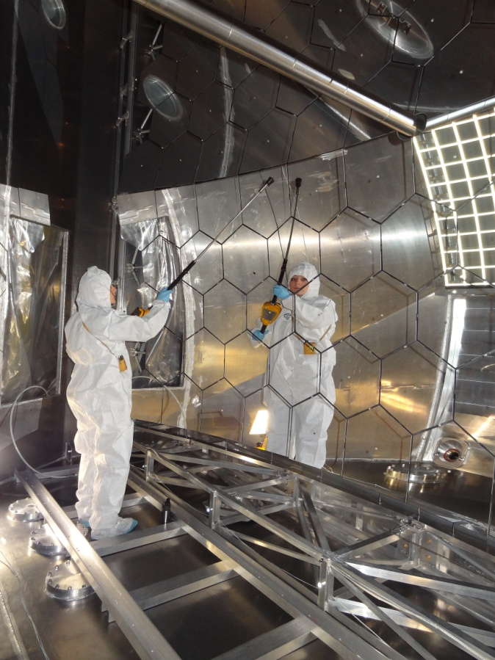
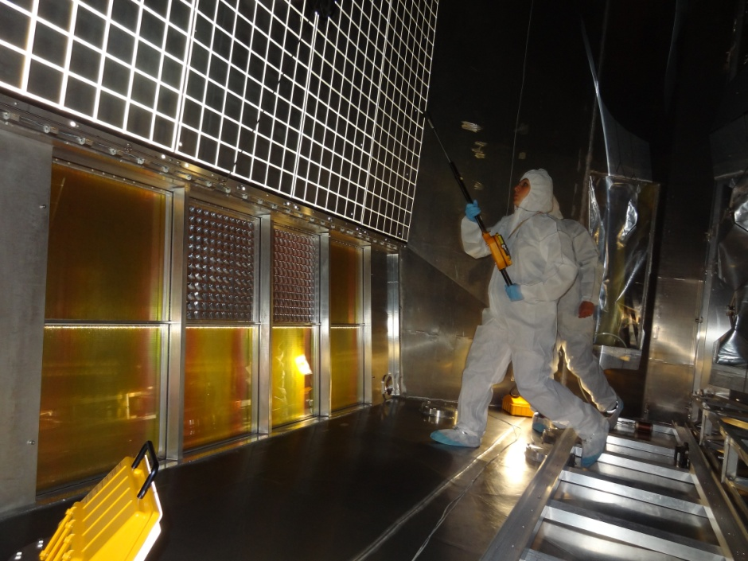
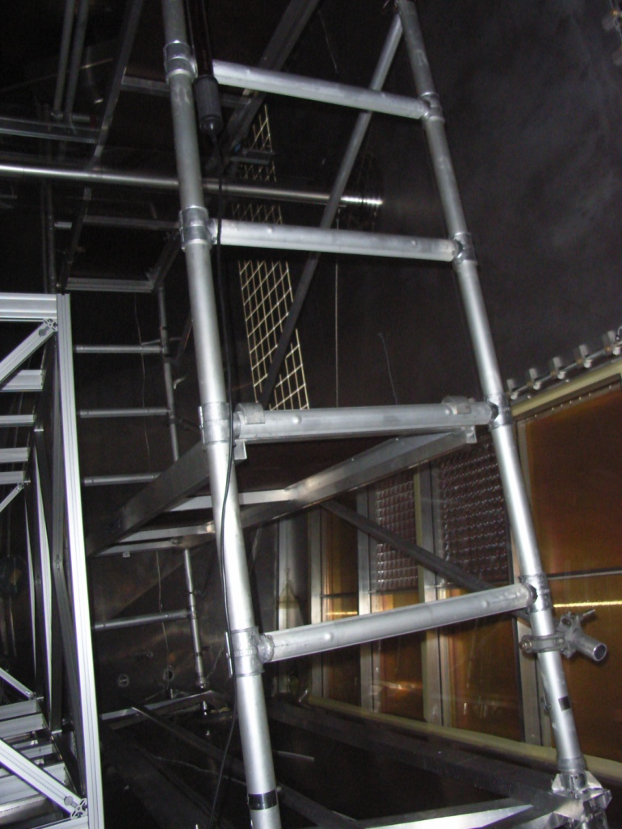
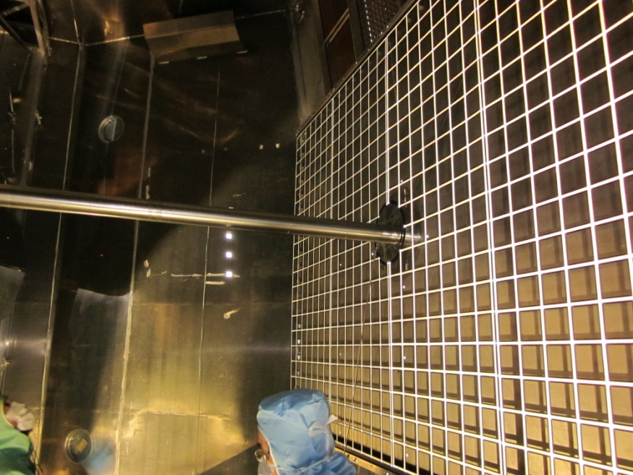
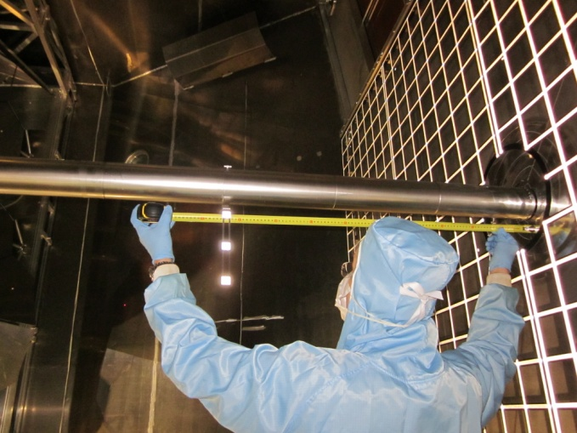
Safety issues for working inside the RICH
1) Radiation level: < 2 μSv/h
2) Scaffolding installation
3) Old pipe removal
4) Mirror alignment measurement
5) New pipe installation + alignment
6) Removal of scaffolding +cleaning

Slide 13
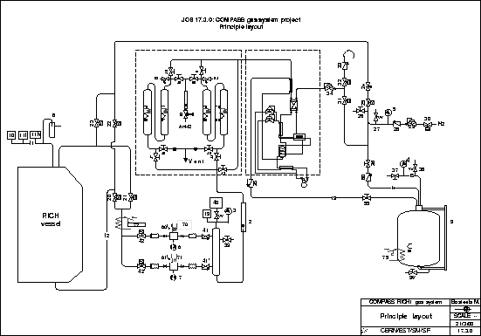
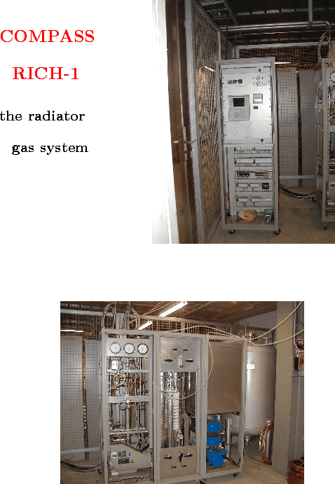
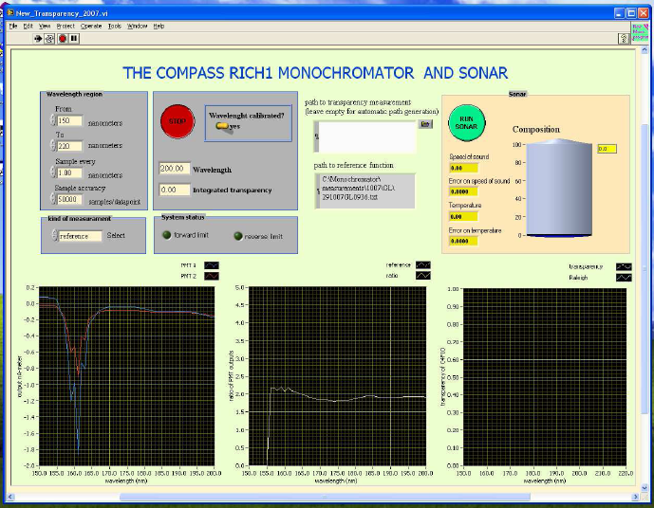
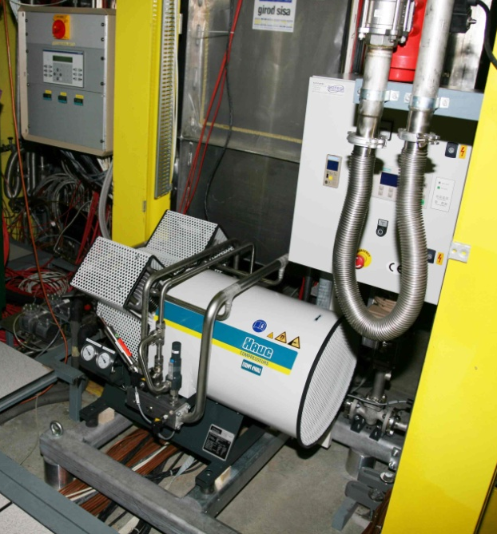
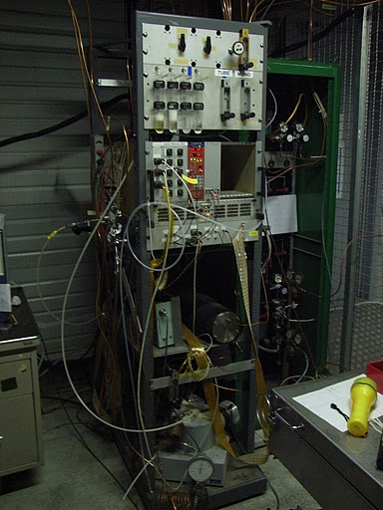
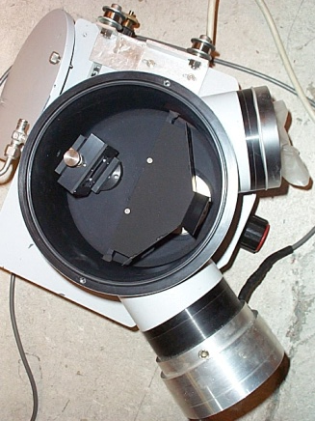
The radiator gas system
has excellent performance

Slide 14
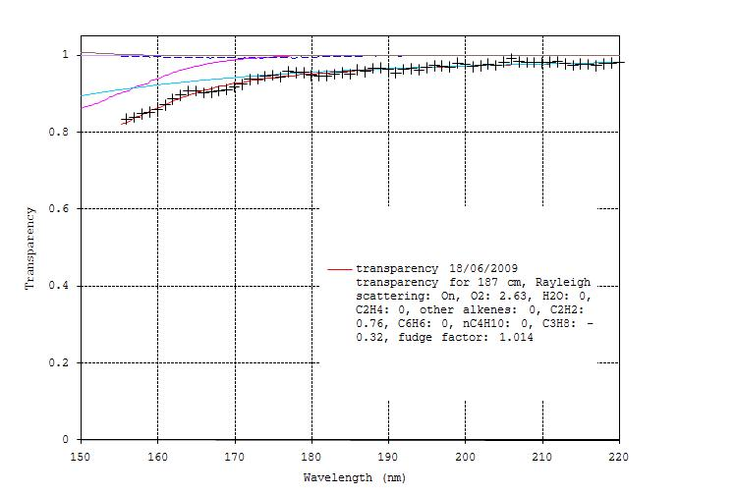
Typical RICH-1 C4F10 transparency
stable gas composition: 97.5% C4F10, 2.5% N2
on-line filters with separate functions:
  Cu catalyst, ~ 40⁰C for O₂
  5A molecular sieve, ~ 10⁰C for H₂O

Slide 15
Problems with the radiator gas
Buying C4F10 is non trivial (out of market for years)
It comes dirty (very dirty sometimes): pre-cleaning is a must
(dedicated system, unavoidable losses, expert manpower)
Inserting it into the vessel (and recovering it) is delicate,
losses ~ 2%, incomplete (97.5% maximum)
Critical circulation system with feedback to keep Δp < 0.1 mbar challenged by weather
C4F10 leaks out (50 l/day): refill is needed
It integrates contaminants: some can be accepted (N2, Ar), others need
continuous filtering out (O2, H2O) ; the filters have limited capacitance
(significant contaminations fill them quickly); regeneration takes several days
Monitoring the transparency is a must (dedicated system, expert
manpower, significant gas consumption for each measurement)
Thermal gradients problem: → fast circulation (20 m³/h) implemented in 2009
Accidents can become disasters; emergency intervention to be granted in short time:
EXPERT ON CALL 24 h/day, 7 days/week for 7 months/year: heavy load on experts

Slide 16
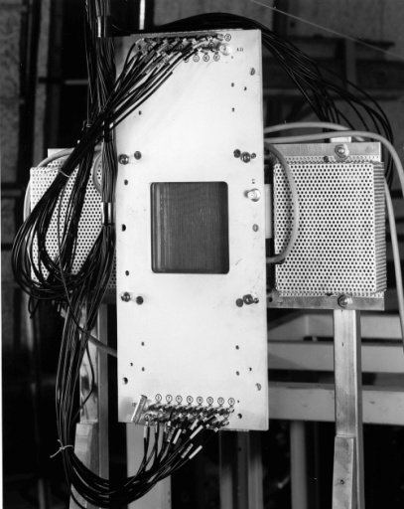
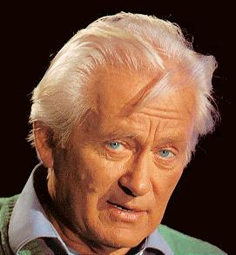
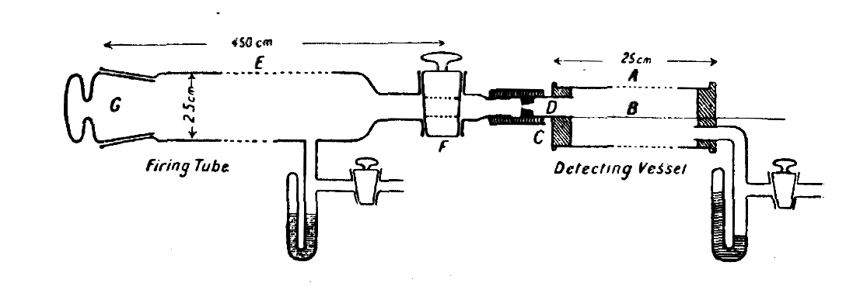
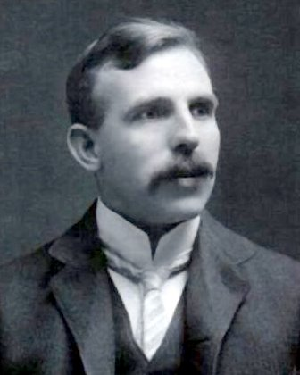
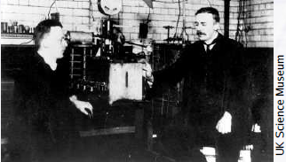


In the family of gaseous detectors, with a glorious tradition
1908: FIRST WIRE COUNTER
USED BY RUTHERFORD IN THE STUDY OF NATURAL RADIOACTIVITY
1968: MULTIWIRE PROPORTIONAL CHAMBER
E. Rutherford and H. Geiger , Proc. Royal Soc. A81 (1908) 141
Nobel Prize in Chemistry in 1908
1928: GEIGER COUNTER
SINGLE ELECTRON SENSITIVITY
Nobel Prize in 1992
G. Charpak, Proc. Int. Symp. Nuclear Electronics (Versailles 10-13 Sept 1968)
Fabio Sauli
Ernst Rutherford
Hans Geiger
Walther Bothe
Nobel Prize in 1954 for the “coincidence method”
H. Geiger and W. Müller, Phys. Zeits. 29 (1928) 839
George Charpak
Jean-Calude Santiard

Slide 17


Gaseous photon detectors use
PHOTOELECTRIC ABSORPTION :
gas photoionization photoelectric effect
gas volume: photosensor (TMAE or TEA) gas volume: CH₄
+ carrier (CH₄ or C₂H₆)
Albert Einstein
Cherenkov photon
Townsend
avalanche
Townsend
avalanche
photoelectron
E
Cherenkov
photon
thin layer (300 - 500 nm) of
CsI on the cathode pad plane
anode wires cathode pad plane
Tom Ypsilantis
the past and the present

Slide 18




RICH with gaseous PD’s
the first generation: photoconverting vapours
OMEGA
E605
SLD - CRID
DELPHI
CLEO III
TMAE(Tetrakis-Dimethylamine-Ethylene)
TEA (Tri-Ethyl-Amine)

Slide 19



Thanks to RD26
1992, F. Piuz et al. Development of large area advanced fast-RICH detector for particle identification at LHC operated with heavy ions
François Piuz
  TO ACHIEVE HIGH CsI QE:
  Substrate preparation:
  Cu clad PCB coated by Ni (7 µm) and Au(0.5 µm), surface cleaning in ultrasonic bath, outgassing at 60 ºC for 1 day
  Slow deposition of 300 nm CsI film:
  1 nm/s (by thermal evaporation or e⁻-gun) at a vacuum
  of ~ 10⁻⁷ mbar, monitoring of residual gas composition
  Thermal treatment:
  after deposition at 60 ºC for 8 h
  Careful Handling:
  measurement of PC response, encapsulation under dry Ar, mounting by glove-box.
The best quartz cuts here
Schematic structure of the COMPASS Photon Detector:
A. Di Mauro, NIM A 525 (2004) 173.

Slide 20






RICH with gaseous PD’s
the second generation: MWPC’s + CsI
ALICE-HMPID
TIC, NA44
JLAB-HALL A
A solid state photocathode exposed to a gaseous atmosphere in an effective PD: a success !
COMPASS
RICH-1
STAR
HADES

Slide 21




COMPASS: 8 MWPC’s with CsI
built in 1999 – 2000,
after prototypes tests
(RD26 development )

Slide 22





The CsI photocathodes

Slide 23

Good performance in low gain configuration
photons / ring (β ≈ 1, complete ring in acceptance) : 14
σ_{θ-ph} (β ≈ 1) : 1.2 mrad
σ_{ring} (β ≈ 1) : 0.6 mrad
2σ π - K separation @ 43 GeV/c
PID efficiency ~ 95% for θ _{Ch} > 30 mrad
except for the very forward region
After a long fight for increasing electrical stability at high m.i.p. rates and systematic studies at the CERN GIF we came to the same conclusion as Ypsilantis and Seguinot:
J. Seguinot et al., NIM A 371 (1996), 64:
CsI-MWPC with 0.5 mm gap to minimize ion collection time, fast front-end electronics (20 ns int. time):
stable operation is not possible at 10⁵ gain because of photon feedback, space charge and sparks

Slide 24




limits of MWPC’s with CsI in COMPASS
  MWPCs with CsI photocathodes in COMPASS:
  beam off: stable operation up to > 2300 V
  beam on: stable operation only up to ~2000 V
  (in spill→ ph. flux: 0 - 50 kHz/cm² , mip flux: ~1 kHz/cm²)
  Whenever a severe discharge happens, recovery takes ~1 day.
  Photocathode aging:
  - our information from accidental contamination
  - very detailed study by Alice team
cluster amplitude distribution:
effective gain ~ 10⁴
^{pe detection efficiency ~ 70%}

Slide 25


the central region before 2006
THE EXPERIMENTAL ENVIRONMENT
huge uncorrelated background related
to the memory of the MWPCs + read-out
overlap of
event images
μ beam
Accelerated ageing test
H. Hoedlmoser et al., NIM A 574 (2007) 28.
0.2 mC/cm²
1 mC/cm²

Slide 26





upgrade of RICH-1 with MAPMT’s in the central region (2006)
12 outer CsI cathodes: change electronics (use APV25-S1)
4 central CsI cathodes : remove and insert frames with MAPMTs and lense telescopes
photons
field lens
concentrator
Same mechanics as CsI photo-cathode frame
MAPMT

Slide 27
The difference
photons
field lens
MAPMT’s have:
  wide wavelength range
  time resolution < 1 nsec
  short detection system memory (MAPMT + read-out)
  adequate for high rate operation
  robustness
  high efficiency for single photon detection
concentrator
MAPMT
challenges:
    large ratio of the collection and photocathode
    areas with minimal image distortion
    → ratio = 7.3 ←→ critical LENS SYSTEM design
    UV range ←→ fused silica LENSES
    couple to a read-out system able to guarantee
    efficiency, high rate operation and to preserve
    time resolution
- C4F10 refractive index
- CsI sensitivity range
- MAPMT’s range

Slide 28




THE LENSES
ZEMAX optimization:
material:
fused silica, Corning 7980,
spherical s.
planar s.
Fused Silica
Borosilicate glass
Polymer lenses
aspherical s.
fraction of photons detected
0 0.5 1
200 400 600 λ(nm)
-if no reflection
with monolayer of MgF₂
w/o antireflective layer
concentrator
field lens
+8.4% photons
with MgF₂
complex and delicate
mechanical machining
aspheric
surface
Convolution of Cherenkov light and effective QE

Slide 29










Slide 30



MAPMT: HAMAMATSU R7600-03-M16
FE cards plugged
directly here
  16 anodes
  UV extended glass
home made voltage divider
Quantum efficiency (%)
recall:
effective QE including
window losses
(collection efficiency not included)
protects against
B ≤ 200 G
and guarantees
good alignment

Slide 31





Slide 32


MAPMT GAIN AT HIGH RATE
AND
mean signal amplitude versus rate/pixel
pulsed light source synchronous to trigger +
random background from lamp
CROSS-TALK RATE
measured for single photoelectron
cross-talk rate
10 fC threshold
cross-talk rate < 0.1 %
Working HV
operate with single photoelectron
rates up to 5MHz/pixel

Slide 33


Slide 34

The Upper Detector from inside

Slide 35

The central part of the lower detector

Slide 36









number of photons and resolutions
estimated photoelectron detection time resolution: ~320 ps

Slide 37
time resolution is useful for correctly assigning hits to rings

Slide 38



PID from the likelihood function

Slide 39

2004 data
M (GeV/c²)

Slide 40

Improved PID performances
2006 data
2004 data
M (GeV/c²)

Slide 41

Identification and misidentification probability

Slide 42
Purity of K samples

Slide 43

RICH PID information
in the Dº analysis
COMPASS 2006 Dº peak
without RICH information
with RICH information

Slide 44
Study of long term CsI QE variations
M. Alexeev et al, 2014 JINST 9 P01006
    Principle:
    Extract the mean number of detected photons per particle from the data collected during six years of COMPASS data taking
6 consecutive years of COMPASS data taking
up to 15 days of data taking per sample
identical cuts applied to the reconstructed particle trajectories (track quality)
MAPMTs
RATES IN THE EXTERNAL DETECTORS during SPS spills:
Photoelectrons < 10 Hz / cm²
MIPs < 10 Hz / cm²
→ Integrated charge over 6 years < 10 μC/cm²

Slide 45




Data selection, correction and fit
only identified π’s
only rings fully contained in a single cathode
count N_{ph} (detected photons) of each ring
(background cannot be disentangled at this stage)
1 mrad wide θ_{Ch} bins → N = < N_{ph} >
Cherenkov photons : Poisson distribution
→ detected photons : Poisson distribution
at least 1 detected photon
→measured N is biased, corrected
measured: μ’
μ solving numerically the equation
FIT THE DISTRIBUTION:
corrected
Frank and Tamm distribution
Background (flat distribution assumed)

Slide 46


Fit quality, consistency and stability
NDF = 18
χ² theoretical
distributions
and fits (>25 mrad)
2006 data
→estimated systematic error: 0.7 x σ_{stat}
use N(θ_{Ch} = 55.2 mrad)
for extrapolation
Fit results stable versus:
fit range variations
different ring selection:
at least 2, 3 photons

Slide 47


results
Frank and Tamm
background
N(θ_{Ch} = 55.2 mrad)
vs year
(statistical errors)
MEAN OVER 11 CATHODES
(statistical & systematic errors)
Too few photons:
not used in the following

Slide 48

CsI photocathodes can preserve QE over years
<N> vs year is compatible
with no CsI QE variation
max CsI QE variation
rate : 2.3 % / year
[1 “COMPASS year” :
~6 months of data taking]
For the 3 most critical cathodes:
max CsI QE variation rate : 5.2 % / year
Estimated systematic error of the measurement: 2 % /year
Errors enlarged to get 50% probability for the linear fit
<N> corrected for
lower HV (-20V)
The CsI QE decrease is modest

Slide 49
COMPASS II PID requirements
Exclusive meson production channels have low cross-section
Precision measurements require not just high efficiency but also very stable response
MWPC + CsI operate at low gain ➔ depend on p, T, threshold and background stability
but we need precise comparison of data with different background levels
Reduction of systematics from photon detectors ➔ larger gain and faster signals
PMTs not adequate because of large angular acceptance ➔ only small demagnification
factor of optical system allowed (large distortions); 5 m² of PMTs not affordable.
MPGD-based Photon Detectors are the best option
A dedicated R&D project to develop THGEM-based PDs started 6 years ago and
rececently achieved positive conclusions
The R&D status and progress will be presented by Stefano Levorato on Friday
We have decided to replace COMPASS RICH-1 MWPC’s with the new detectors

Slide 50
2016 COMPASS RICH-1 upgrade
3 m
Al vessel
6 m
MWPC’s + CsI
UV mirror
wall
5 m
PMTs
beam pipe
radiator:
C₄F₁₀
radiator gas: C₄F₁₀

Slide 51
2016 COMPASS RICH-1 upgrade
3 m
Foreseen for 2016-2017
Al vessel
6 m
MWPC’s + CsI
THGEMs + CsI
UV mirror
wall
5 m
PMTs
beam pipe
radiator:
C₄F₁₀
radiator gas: C₄F₁₀

Slide 52



New PD’s

Slide 53

The THGEM+Micromegas version

Slide 54

The THGEM+Micromegas version

Slide 55

The THGEM+Micromegas version

Slide 56

The THGEM+Micromegas version

Slide 57

The THGEM+Micromegas version

Slide 58

The THGEM+Micromegas version

Slide 59
spares

Slide 60

The keys of the success
A strong physics case
An outstanding project leader
A dedicated, highly motivated team
A constant support from the Institutes and the Experiment
The enthusiastic contribution from many colleagues:

Slide 61

To work safely inside our “confined space”
  COMPASS RICH is a CONFINED SPACE: authorized people
  only can enter .
  - authorization requires a formation course and a medical
  certification: for the first time CERN asked for the latter
  to be done by the institute.
  - a scaffolding had to be mounted inside the RICH
  (the old one does not conform to the new rules).
  We managed to provide:
  1) formation: general confined space course from CERN
  2) formation: specific course on risks inside COMPASS RICH
  3) definition and agreement on the medical protocol
  4) medical exams and production of medical certificates
  4) detailed definition of the activity and formalization of the specific procedures.
  5) opening of the RICH with Fire Brigades, GLIMOS, Supervisor, TSO, CERN confined space responsible, etc.
  6) authorization to enter by radiation protection personnel, formed, checked and authorized for entrance
  7) special formation course and authorization for us to mount a borrowed scaffolding
  (it can only be mounted by authorized personnel, but they were not authorized for confined space …)
  8) mounting of the scaffolding by ourselves
  6) formation and authorization to enter for the responsible of the scaffolding to check our mounting and
  authorize using it
  7) … 8) … 9) … 10) …
  EVERYBODY (CERN Medical Service, TIS, GLIMOS, …) have been extraordinarily collaborative…

Slide 62




Few months after the end of the run
wires
accidental exposure to air of one CsI cathode
accumulated charge:~ 1 mC/pad
highest photon flux region

Slide 63


CsI surface at microscope (x 1000)
normal
“white strip”
10 μm

Slide 64








SCHEDULE OF ASSEMBLING
Preliminary studies up to October 2004
Project design November 2004 – March 2005
Material procurement and constructions April 2005 - March 2006
Assembly April-May 2006
Ready for beam June 2006

Slide 65



When the detector was ready …
With the MAPMT’s and electronics

Slide 66

We moved out of the assembling area
It was May 18, 2006. A beautiful sunny day in Geneva.
At 11:45 the detector was ready for craning.
Suddenly a bang was heard.

Slide 67

In few seconds the protections were removed and that’s what was seen:

Slide 68

Immediate reaction
The repair started on the same day
Spares of all pieces, including the large quartz windows were available
The accident was carefully studied and understood in detail (20 mbar overpressure)
One month later, in time for the start of the run, the repaired detector was installed

Slide 69




OPTICS QUALITY CONTROL WITH THE HARTMANN METHOD
optical system
under test
image centroide
Theoretical
reference
for parallel light
He-Na laser
632 nm
Lens focus
2. the images
1. the principle
Detected
Image
(CCD camera)
tolerance
(= center points +/- 0.1 mm)
Hartmann plate
3. the analysis
576 TELESCOPES:
A) ~70% within 50 µm tolerance
B) ~20% within 100 µm tolerance
C) ~10% within 150 µm tolerances

Slide 70


MAPMT Quality Control
out of 620 MAPMTs
less than 10 MAPMTs not fully satisfactory, mainly due to the dark current requirement:
I dark < 2 nA/ch after ½ h in dark
Individual ADC
spectra for each
channel, voltage,
wavelenght
PROTOCOL – 2 h / MAPMT
Visual Inspection (Pixel grid o.k.)
Noise rates and dark current
Scope Image stored
Signal shape, uniformity, gain
  measuring ADC distribution @ several Voltages
Quantum efficiency
  measurement with blue LED and UV LED
measured @ 360 nm
gain vs HV for each
MAPMT anode

Slide 71


RICH PID information in Λ analysis
Λ → p π⁻
Λ → p π⁺
purity increased by 6, loss < 3%
purity increased by 7, loss < 3%
with without PID
with without PID
without with p identification

Slide 72


FIT CHECKS
Rings with al least
1 2 3 photons
Fit ranges:
25 – 45 mrad (25 – 40 mard)
20 – 40 mrad (20 – 35 mard)
15 – 35 mrad (15 – 30 mard)

Slide 73
COMPARING THE 6 DATA SETS
POTENTIAL SOURCES OF SYSTEMATIC EFFECTS
different beams (μ, h) and beam momentum
  different background and secondary multiplicities
  → signal and background contributions are separated in the analysis
HV fixed, -20V (over 2kV) in 2010, 2011: small effect ~ 2.3% N decrease
differences in parameters:
  T, P, electronics threshold
  → systematic effect estimated
procedure self-correcting for the
variation of the refractive index
(P, T, residual N₂ content)
  n-1 = (1422 - 1537) * 10⁻⁶
  gas transparency:
  → negligible variations
  (constant monitoring)

