Slide 1


Instrumentation for Colliding Beam Physics INSTR14
National Research Nuclear
University MEPhI
Institute for High Energy Physics
The coordinate-tracking setup based on
the drift chambers for ultrahigh-energy
cosmic ray investigations
E.A.Zadeba, N.V. Ampilogov, N.S. Barbashina, A.A. Borisov,
A.G. Bogdanov, D.V. Chernov, S.S. Khohlov, R.P. Kokoulin,
A.S. Kozhin, K.G. Kompaniets, V.V. Ovchinnikov, R.M.
Fakhrutdinov, A.A. Petrukhin, V.V. Shutenko, I.I.Yashin.
BINP, Novosibirsk, 2014

Slide 2
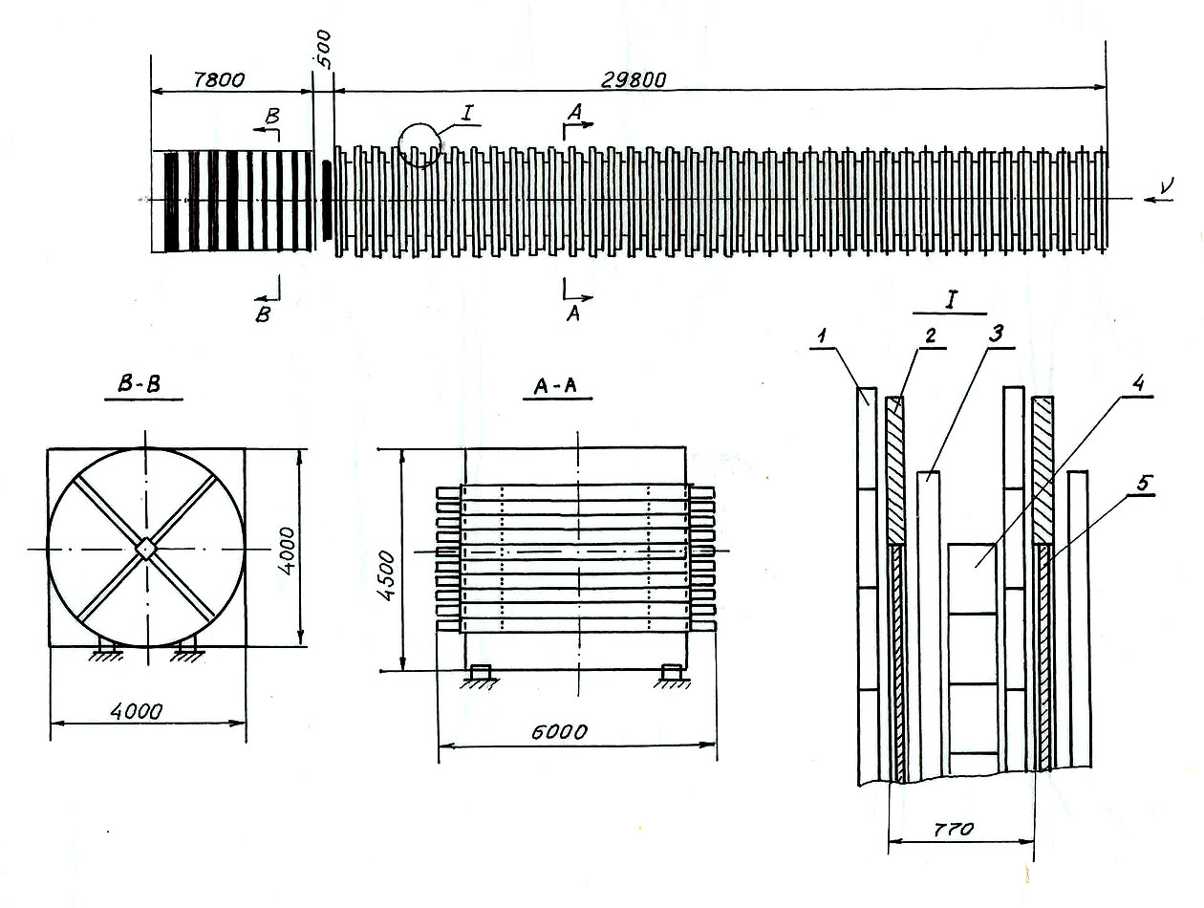
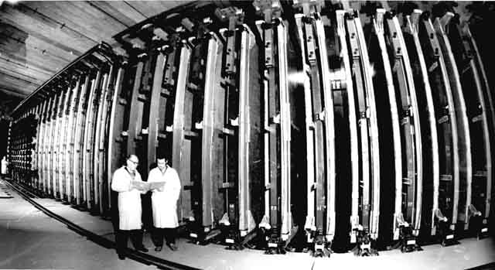
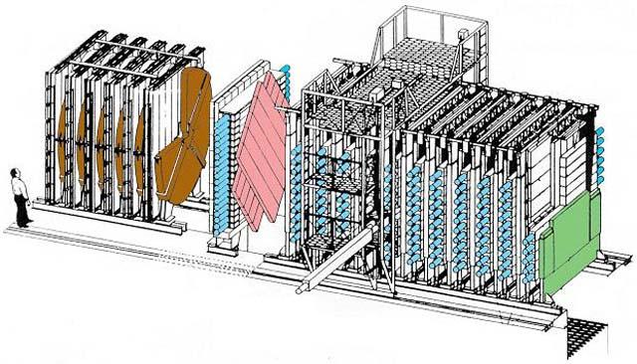
Neutrino experiment at accelerator U-70

Slide 3
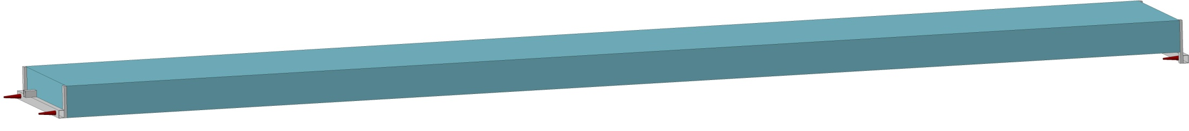
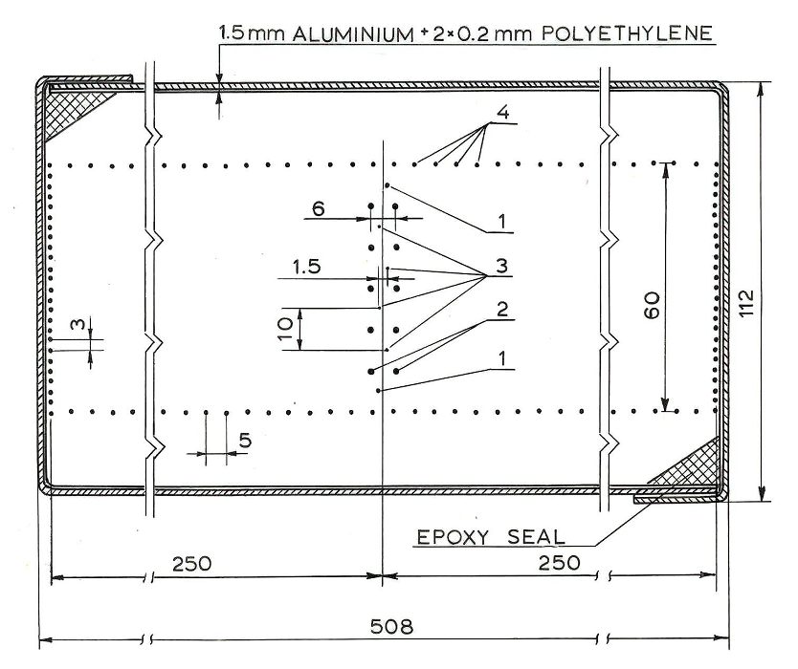
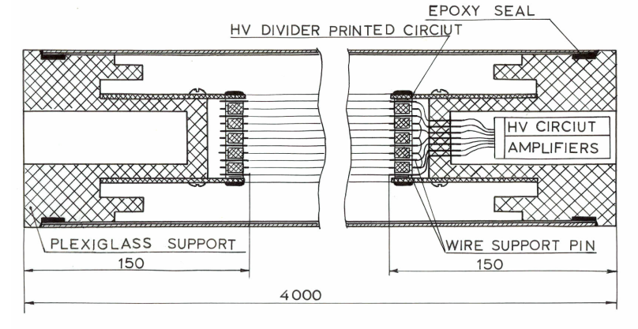
Drift chamber
Spatial resolution ~ 1 mm
Angle resolution ~ 30 mrad
Two track resolution ~ 5-6 mm
Gas mixture: 94% Ar + 6% CO2
Max drift time < 6 µs
Drift velocity – 0,04 mm/ns
Electric field – 450 V/cm

Slide 4
Structure of the chamber
Wire | Diameter, µm | Potential, kV
Signal | 64 | 2.2
Dummy | 200 | 2.2
Cathode | 200 | 0
Field forming | 200 | -12

Slide 5
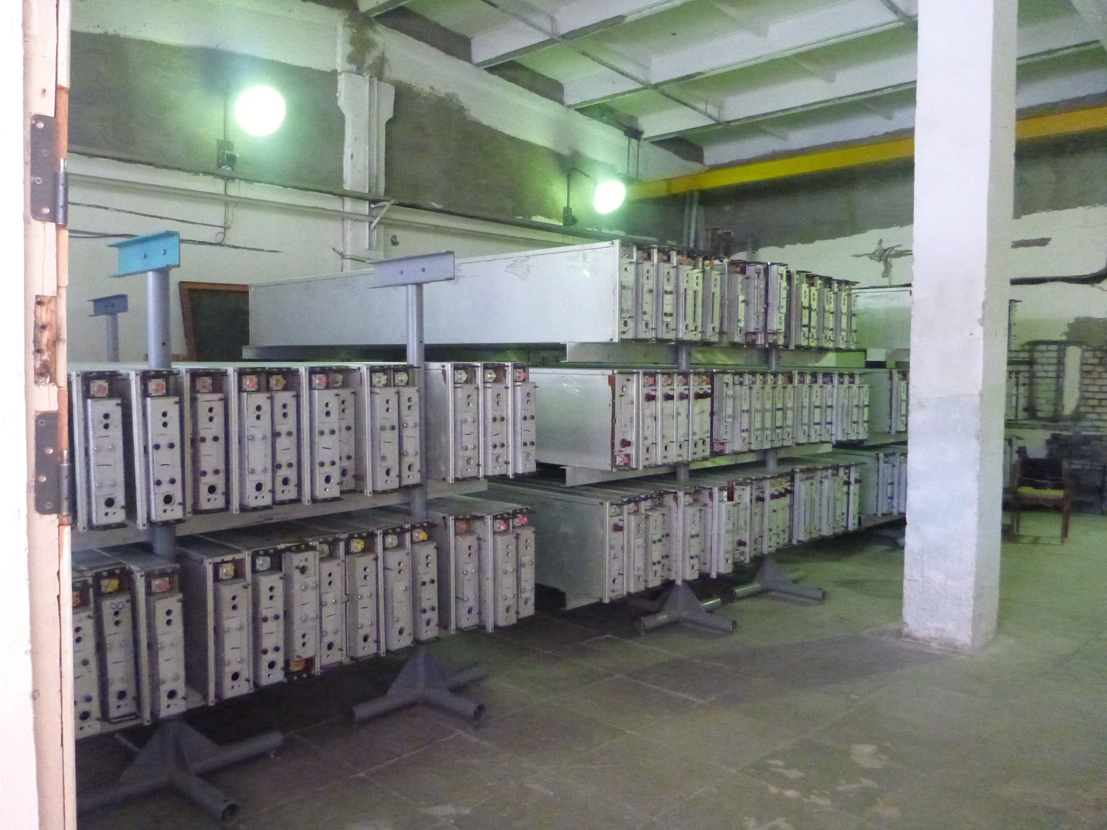
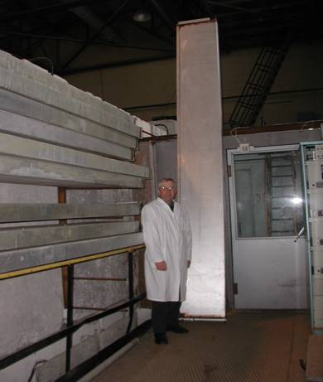
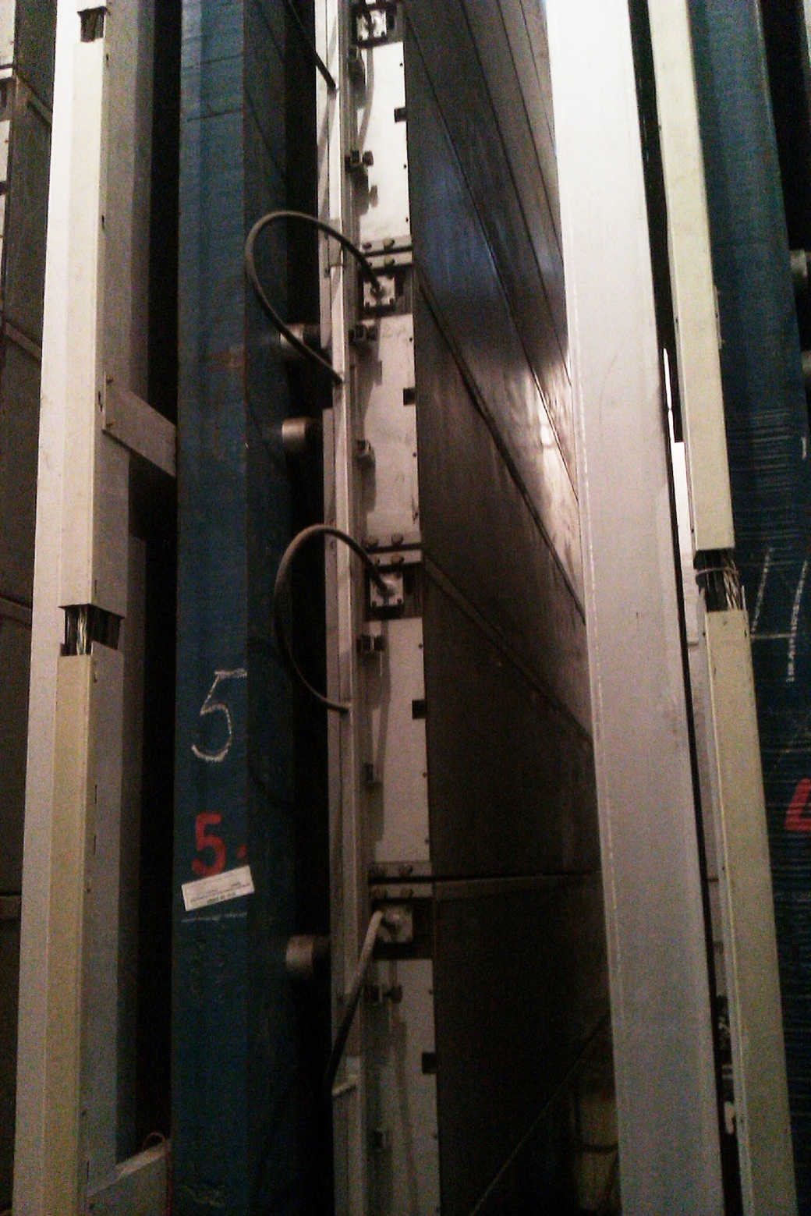
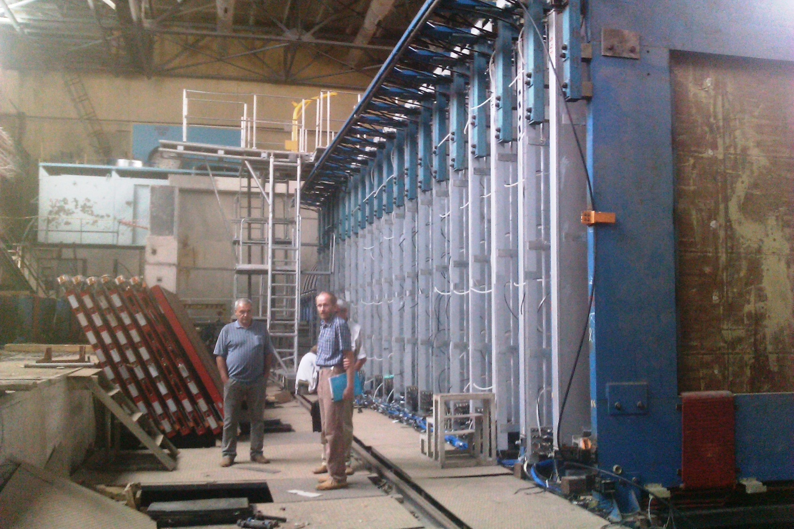

Slide 6
Cherenkov Water Detector
NEVOD
Water volume of 2000 m³
9×9×26 m
91 quasi-spherical module
546 photomultipliers

Slide 7
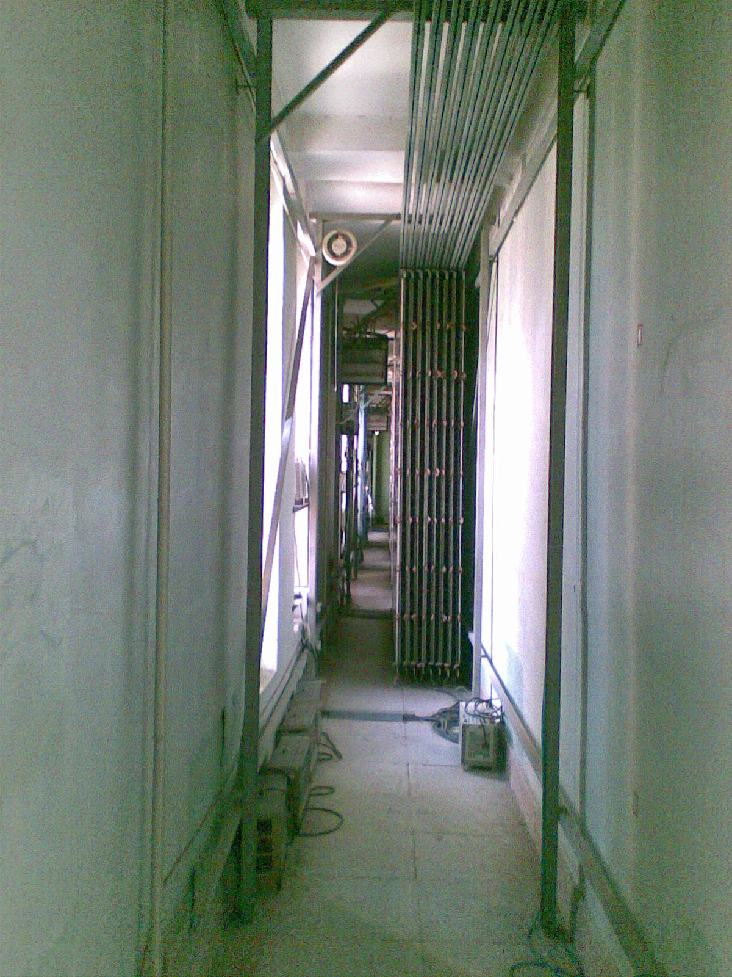
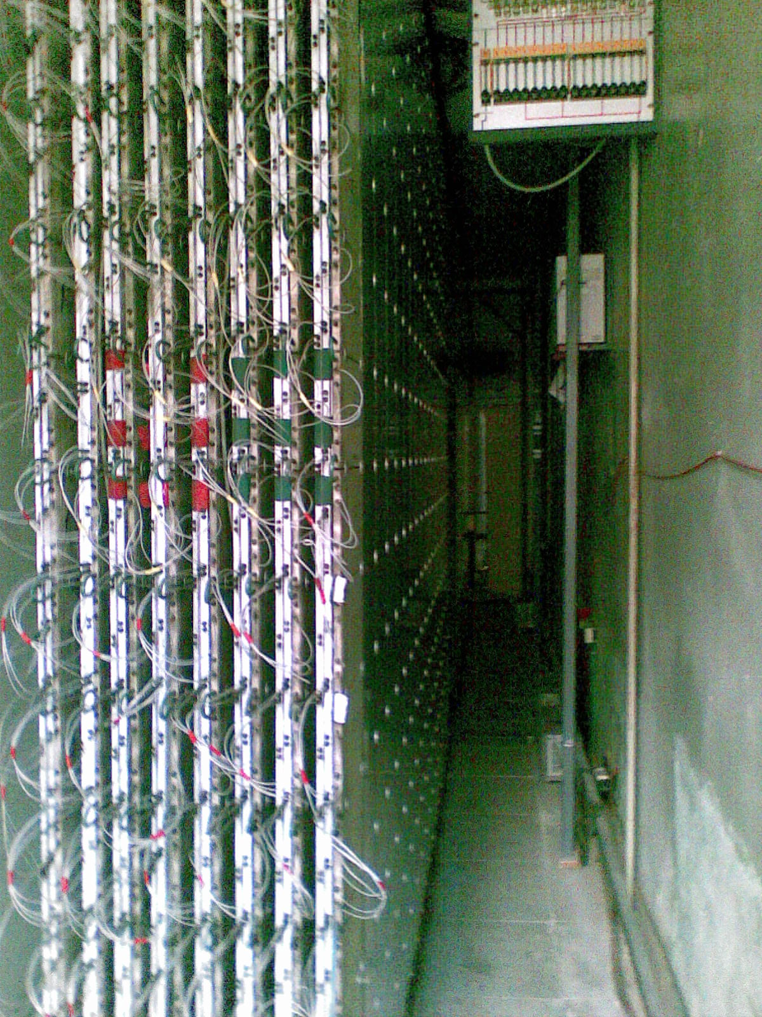
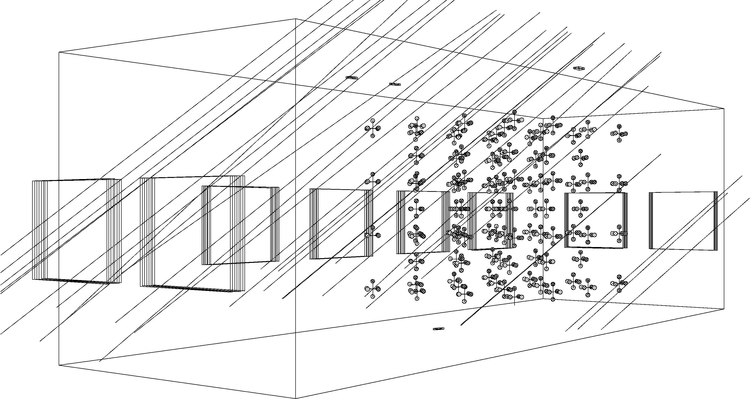

Slide 8
Experimental complex
NEVOD-DECOR
Total area of 4 super-modules of DÉCOR ~ 35 m²
This is less than 15% of side area of CWD
Spatial resolution ~ 0.8 cm
Angle resolution ~ 1°
Two track resolution ~ 3 cm

Slide 9
Experimental complex
NEVOD-DECOR
Total area of 4 super-modules of DÉCOR ~ 35 m²
This is less than 15% of side area of CWD
Spatial resolution ~ 0.8 cm
Angle resolution ~ 1°
Two track resolution ~ 3 cm

Slide 10
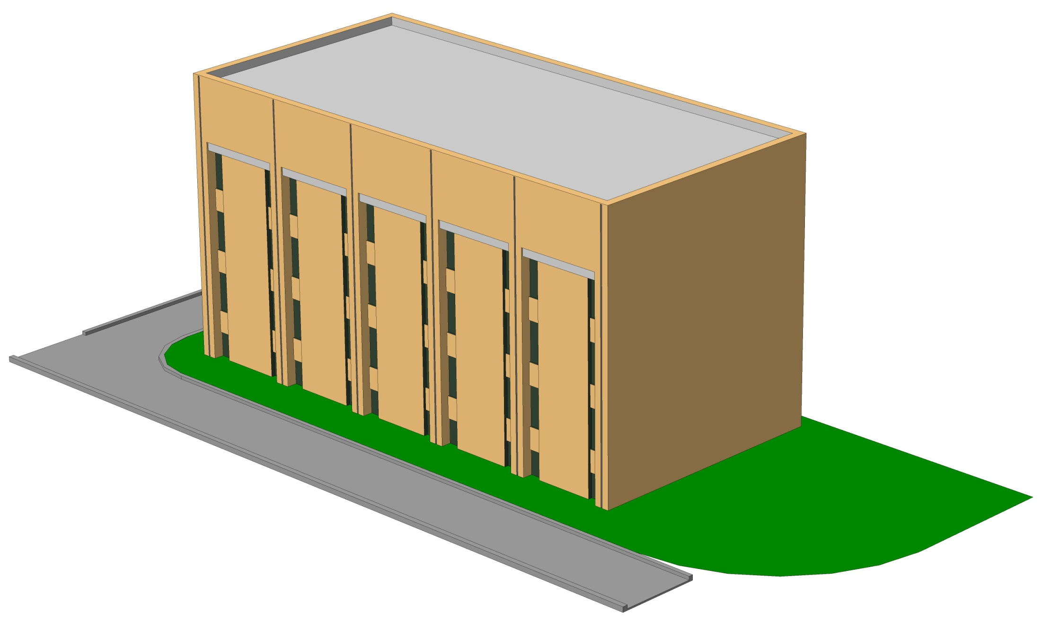
Project of coordinate detector

Slide 11
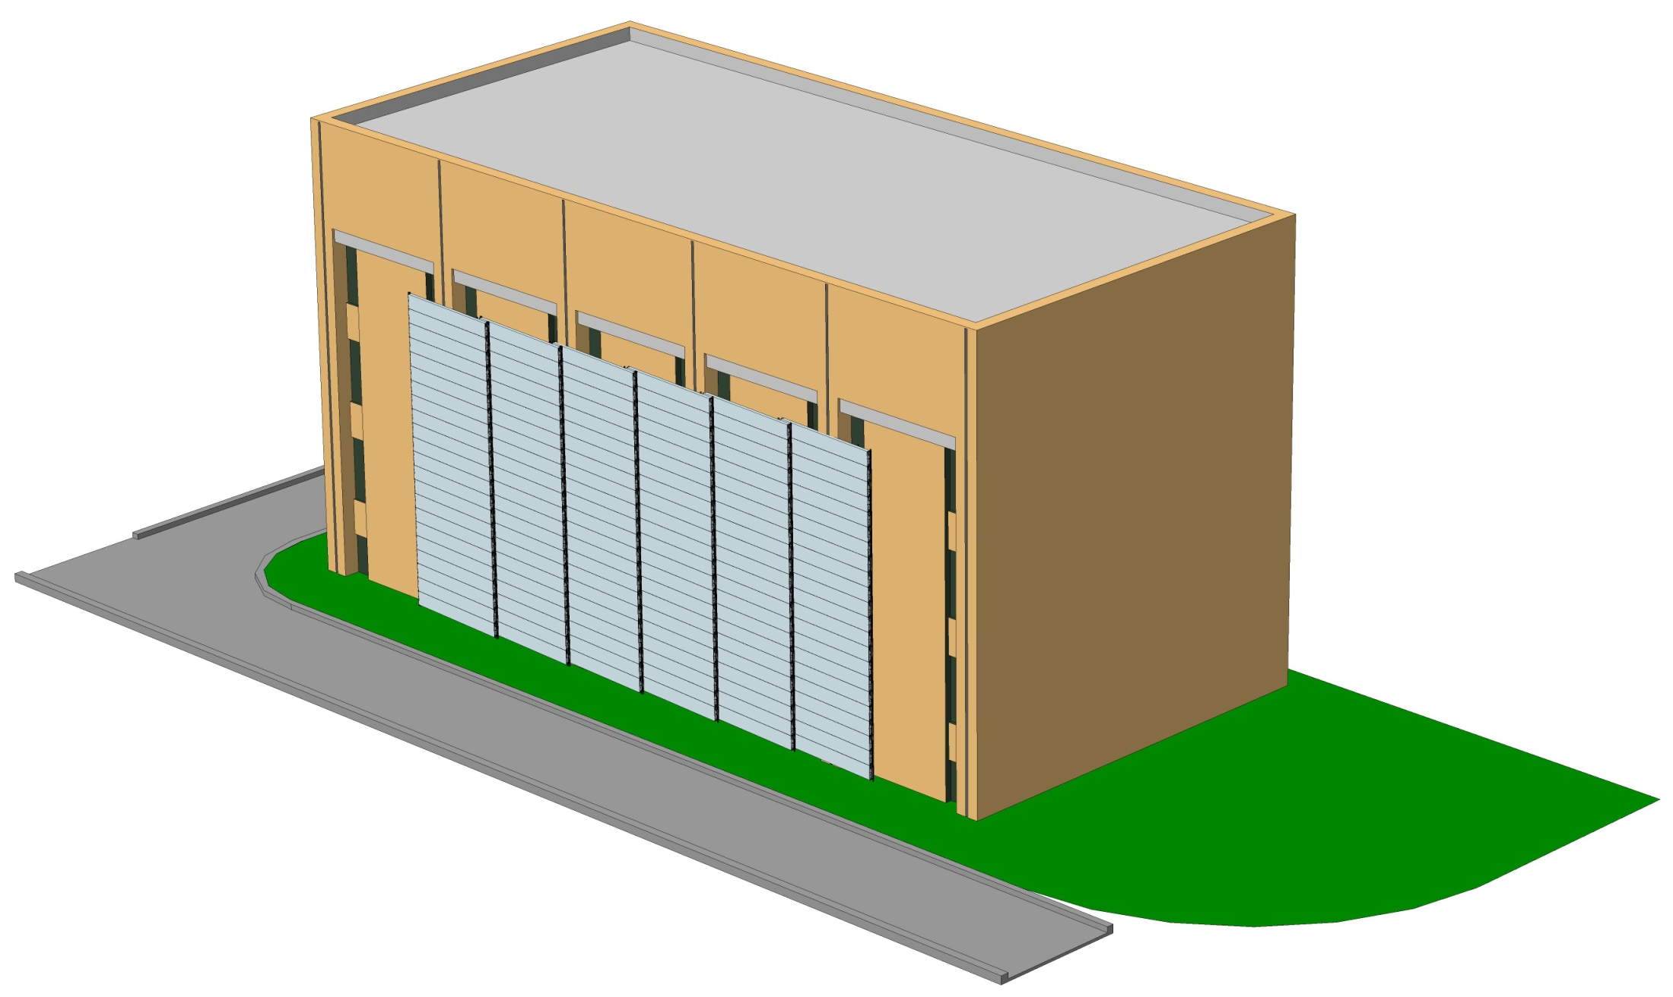
Project of coordinate detector

Slide 12
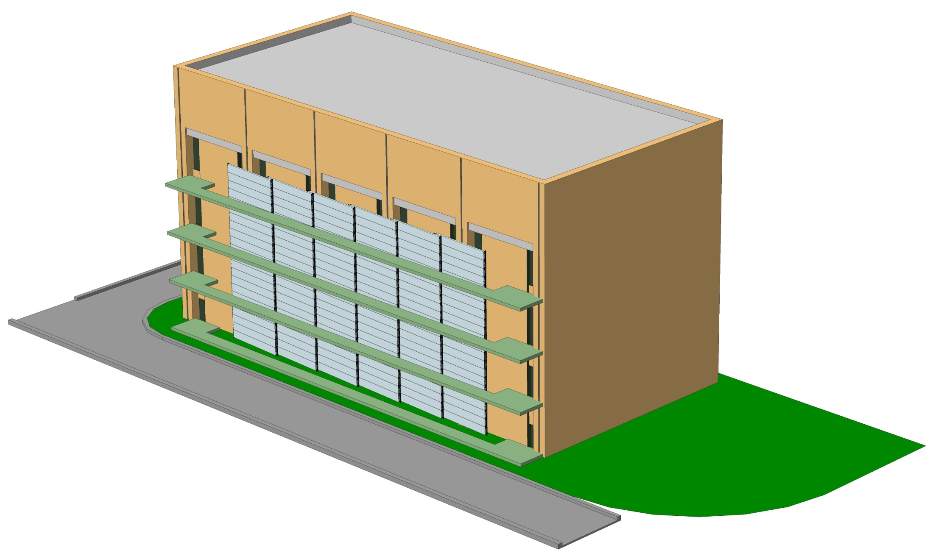
Project of coordinate detector

Slide 13
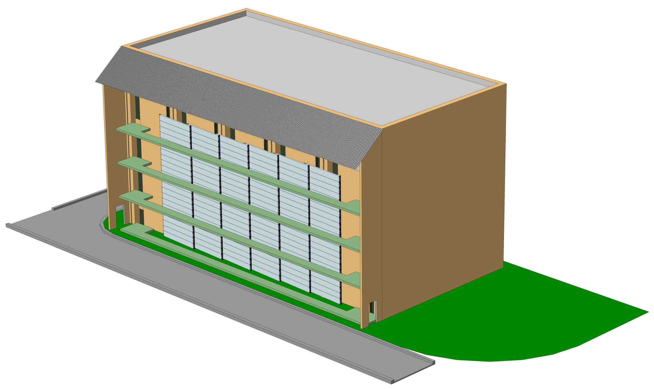
Project of coordinate detector

Slide 14
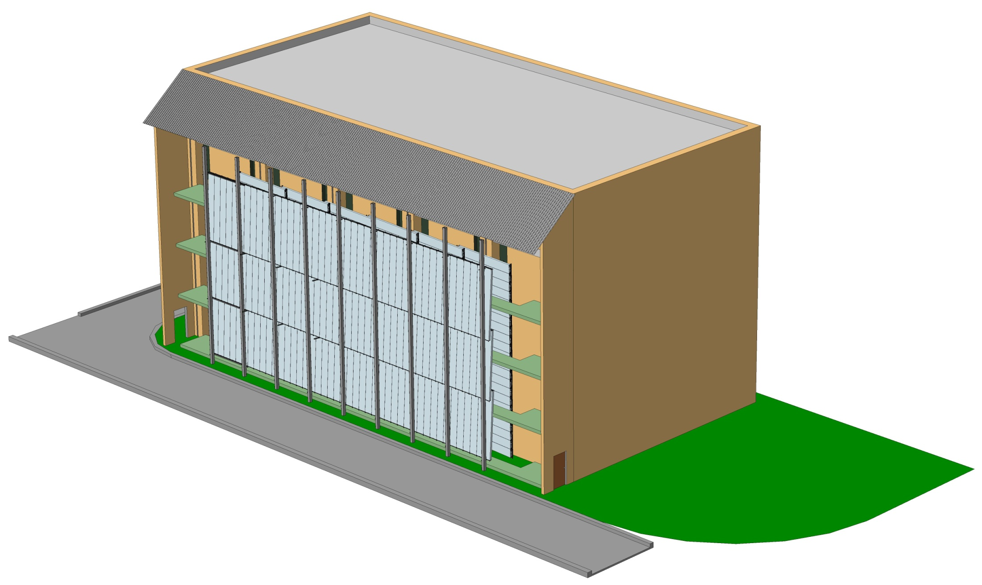
Project of coordinate detector

Slide 15
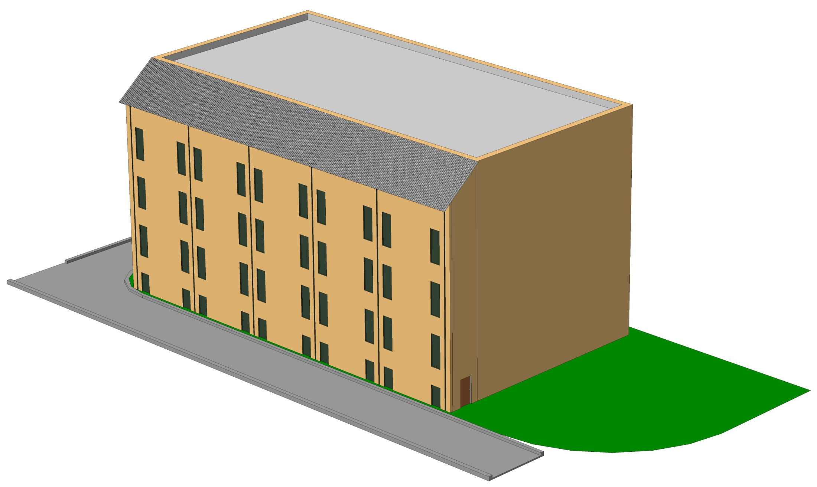
Project of coordinate detector
Consumption of gas is 10 liters of CO₂ and 150 of Ar per hour
Total sensitive area of detector (with 264 chambers) is about 270 m²

Slide 16
Stages of project development
Primary test for pressure leak and integrity of wires
  Study of the basic characteristics of the chamber with a coordinate-tracking detector URAGAN
Development of hodoscope-like test bench
  Working out the methods of reconstruction of tracks in several coordinate planes
  Serial testing of the drift chambers and other detectors
Development of the TREK prototype for a joint operation with Cherenkov water detector

Slide 17
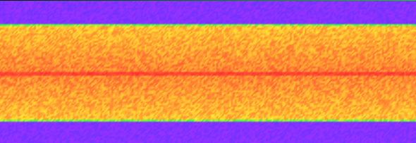
Test bench for drift chambers, based on coordinate-tracking detector URAGAN
Efficiency
The accuracy of reconstruction
Drift velocity
Development of reconstruction method

Slide 18
Hodoscope test bench for drift chambers

Slide 19
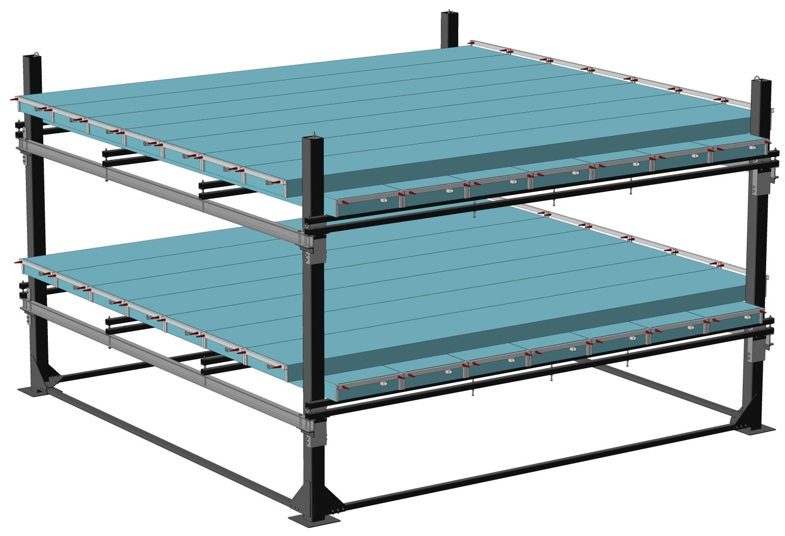
Hodoscope facility for drift chambers
7 chambers in X и Y planes
Area of X и Y-plane – 12,7 m²
Max zenith angle - 73°
Coordinate resolution ~ 1 mm

Slide 20
Prototype of TREK
Cluster area
– 16 m²
DECOR Short
– 17,5 m²

Slide 21
Summary
Project of large-scale coordinate-tracking setup is now under development
Drift chambers from neutrino experiment of U-70 were successfully removed
Most part of drift chambers passed primary test for leaks and wire integrity
The possibility of joint work of EC NEVOD cosmic ray detectors and IHEP drift chambers was proved

Slide 22
Thank you!

