Slide 1
Сотрудничество RD51 и События MPGD:
Пять Опыт лет и Будущие Планы
RD51 Collaboration and MPGD Developments:
Five Years Experience and Future Plans
Eraldo Oliveri (CERN PH-DT-DD)

Slide 2
Схема (outline)
More Interesting for people OUTSIDE the
MPGD (or Gaseous Detector) community
MPGD
More Interesting for people INSIDE the
MPGD (or Gaseous Detector) community
RD51

Slide 3
MPGD family ( a list of “curious” names and acronyms )
THGEM
MicroDot
MGWC (micro gap wire chamber)
MSGC (micro strip gas chamber)
MicroPin
MHSP (micro hole & strip plate)
Multi Step Avalanche Chamber
Micro-GEM
GEM
RE-GEM
GOSSIP
Glass GEM
MGC (micro gap chamber)
Bulk MicroMegas
COBRA
LEM
WELL
RETGEM
MicroBulk MicroMegas
μCAT
μPIC
THCOBRA
CAT (compteur a` trous)
GridPix
MicroMegas
Resistive WELL
Ingrid
Resistive MicroMegas
Resistive μCAT
MicroGroove
BulkMicroMegas
MWC (micro wire chamber)
Two basic rules:
1. Put something after “M” : MSGC, MGC, MGWC, MicroPin, MicroDot, MM…
2. Add Prefixes as many time as you want: GEM, REGEM, THGEM, RETGEM,…..

Slide 4
Let’s do a rude simplification: MPGD in two families
Micro Anode Structures
Single Wire Proportional Counter
Micro.. Strips/Gap/Dot/..
many research group involved following the MWPC success
Parallel Plate Chamber
Parallel Field Structures
Micromegas, GEM Family, …
Started later but with more stable operation nowadays

Slide 5
“Micro Anode” Amplification

Slide 6
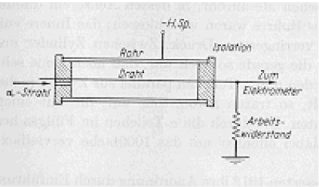
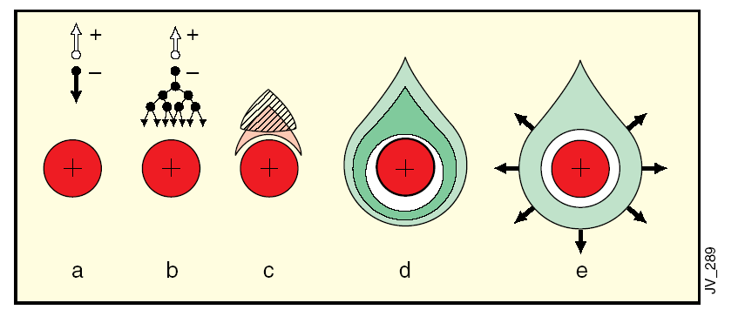
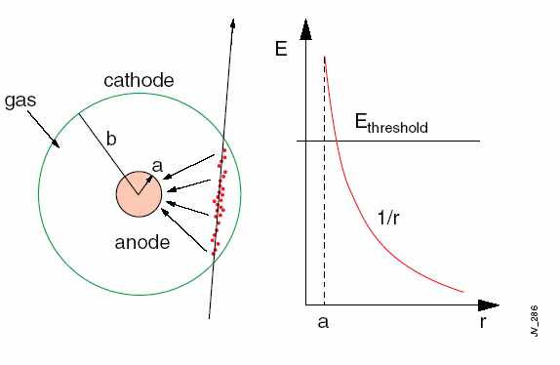
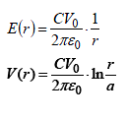
SWPC [Rutherford, E. and Geiger, H. (1908)]
Signal proportional to the original ionization
Need of large detection
areas with localization capability

Slide 7
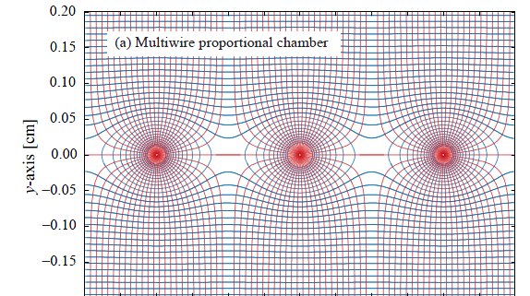
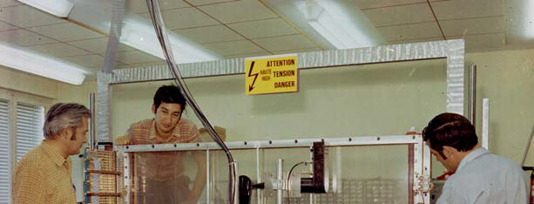
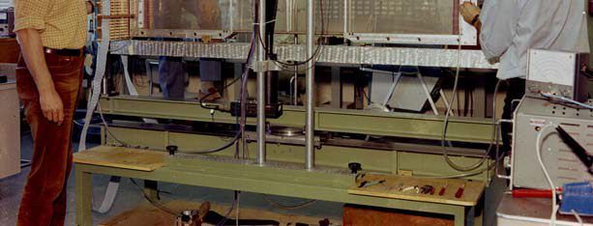
MWPC (Multi Wire Proportional Counter) [Charpak, G. et al. (1968)]
fast position-sensitive detectors (1968)
Continuously active,
Efficient at particle fluxes up to several MHz/cm2
Sub-mm position accuracy
Noble Prize in 1992

Slide 8
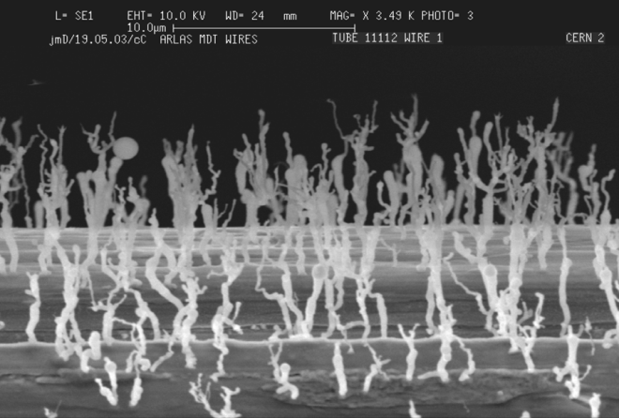
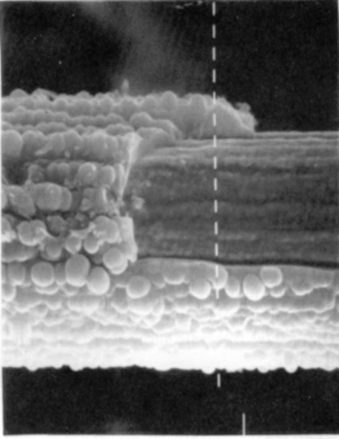
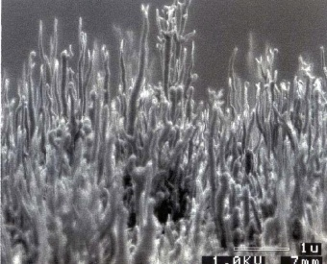
MWPC
Limited multi-track separation
mechanical instabilities due to electrostatic repulsion - critical length of about 25cm for 10mm wires and 1mm spacing]
Fast gain drop at high fluxes
field-distorting space charge accumulation due to the long time taken by the ions produced in the avalanches to clear the region of multiplication]
Aging
permanent damage of the structures after long-term exposure to radiation due to the formation of solid deposits on electrodes.
Anode Aging: drop of the gain, discharges
Cathode Aging: Malter effects

Slide 9
Faster Ions Evacuation Higher Spatial resolution the first Micro Pattern Gaseous Detector: MSGC (OED, 1988)
The basic idea: move down in size
(from now on…. material in between anode and cathode… with many consequences to take into account)

Slide 10
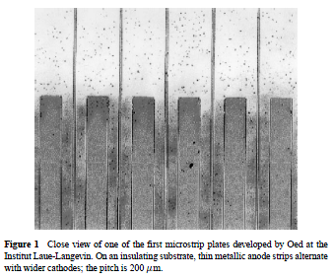
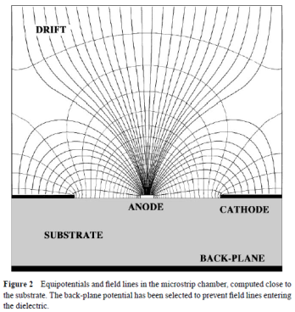
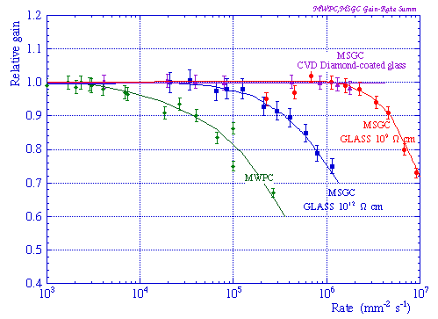
MSGC
MSGC (Oed A. Nucl. Instrum. Methods A263:351 (1988)) : excellent localization, high rate capability (reduced space charge buildup), good granularity
Observed instabilities:
time-dependent gain shifts (charge movement in the substrate, polarization and charge accumulation)
tendency to discharge
permanent deterioration (aging) during sustained irradiation
medium- and long-term stability determined by physical parameters used to manufacture and operate the detectors as : substrate material, metal of the strips, type and purity of the gas mixture

Slide 11
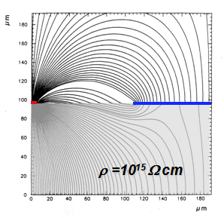
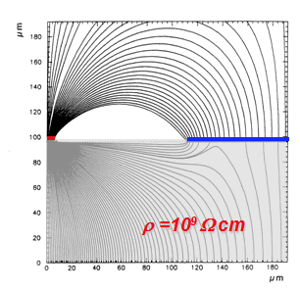
MSGC: Charging Up, polarization, charge movement
Playing with the material in between and around the anode and cathode
Studies of different substrate sand surface coatings to improve charge evacuation, field lines, eliminate polarization or internal charge movements
Substrate resistivity optimization to minimize the charge up

Slide 12
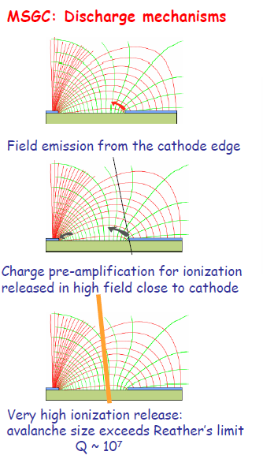
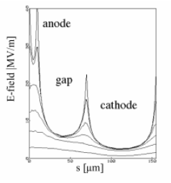
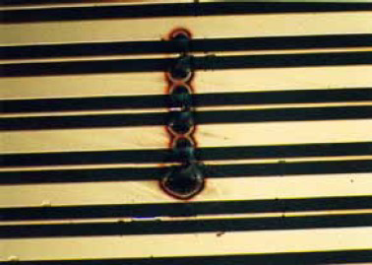
MSGC: Discharges

Slide 13
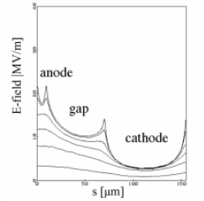
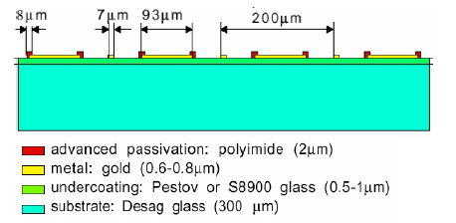
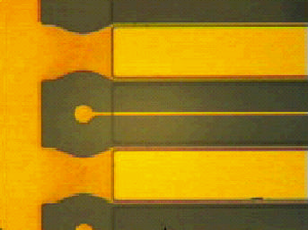
MSGC: Discharges
Standard MSGC
CVD Diamond Coated MSGC
Cathode Edge Passivation
[Bellazzini et al]

Slide 14
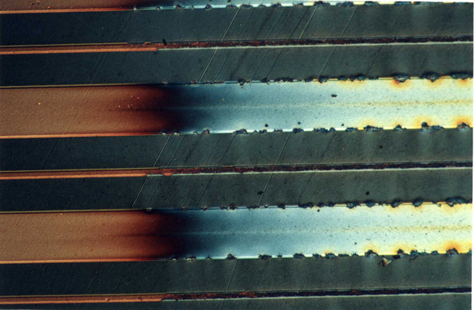
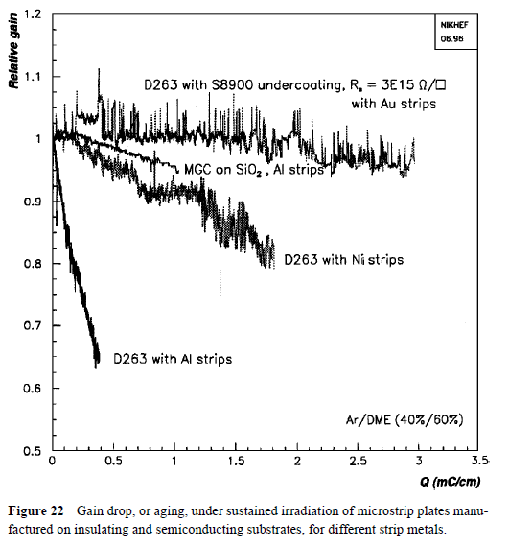
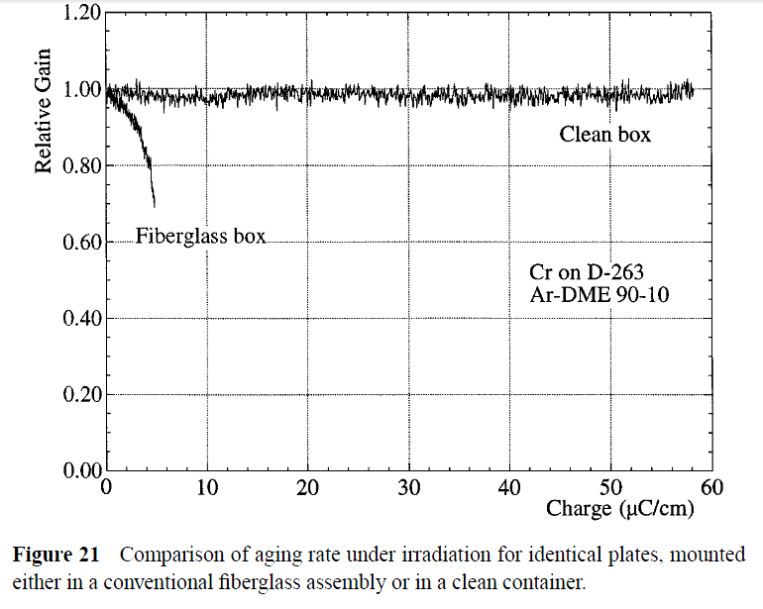
MSGC: Aging
van den Berg FD, et al. Nucl. Instrum.
Methods A392:94 (1997)
Bouclier R, et al. In Proc. MSGC Workshop,
Legnaro, p. 48 (1994)

Slide 15
Rapid Development of many different structures to improve the performances (rate and irradiation) and solve the problems of MSGC

Slide 16
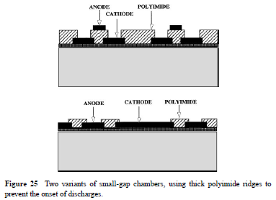
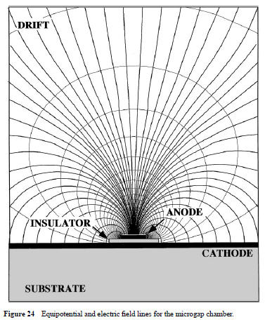
Micro Anodes
Micro Gap Chambers
Angelini F, et al. Nucl. Instrum. Methods A335:69 (1993)

Slide 17
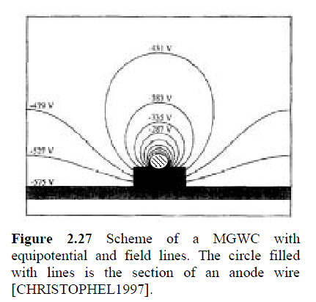
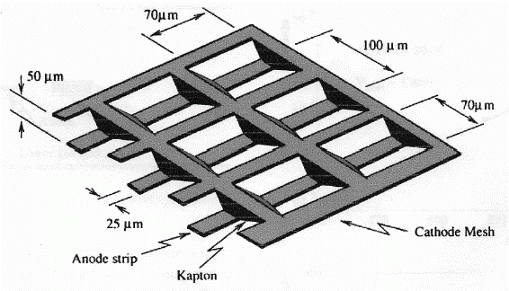
Micro Anodes
Micro Gap Wire Chamber
Micro Wire Chamber
E. Christophel et al, Nucl. Instr. and Meth, vol 398 (1997) 195
B. Adeva et al., Nucl. Instr. And Meth. A435 (1999) 402

Slide 18
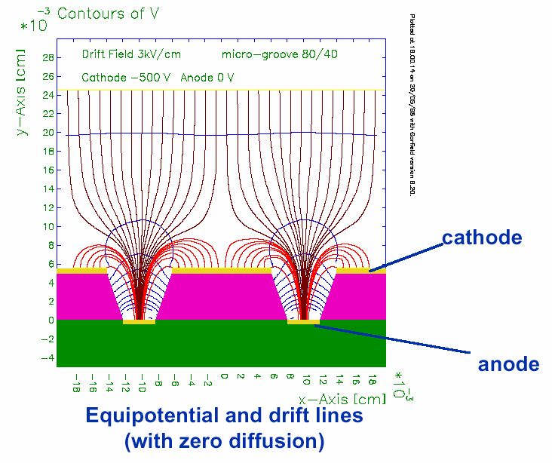
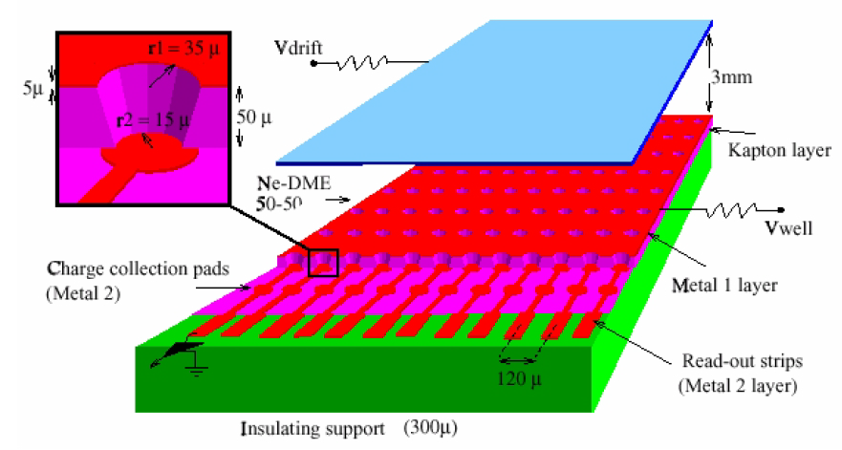
Micro Anodes
MicroGroove
MicroWELL
R. Bellazziniet al
Nucl. Instr. and Meth. A424(1999)444
R. Bellazziniet al
Nucl. Instr. and Meth. A423(1999)125

Slide 19
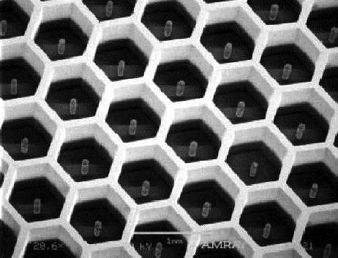
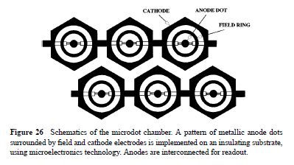
Micro Anodes
MicroPin
MicroDot
P. Rehak et al., IEEE Nucl. Sci. Symposium seattle 1999
μPIC
Biagi SF, Jones TJ. Nucl. Instrum. Methods A361:72 (1995)
Ochi et al NIMA471(2001)264

Slide 20
“Parallel Plate” Amplification
“…The successful development of multiwire and microstrip structures has somewhat
sidestepped the research on gas detectors that exploit the multiplication in uniform
fields. Parallel-plate multipliers not only are mechanically sturdier but also have
better energy resolution and higher rate capability.
However, experimental data and theoretical considerations indicate that the maximum proportional gain in parallel plate chambers is limited by the total amount of charge in the avalanche, around 10⁷–10⁸. Above this value, called the Raether limit, transition to a streamer occurs, followed by breakdown. This has been confirmed under a wide range of operating conditions and multiplying gaps (166–168).
The exponential dependence of gain on the gap has also discouraged the construction of large-area devices….”
From: F,Sauli, A. Sharma, MICROPATTERN GASEOUS DETECTORS , Annu. Rev. Nucl. Part. Sci. 1999. 49:341–88

Slide 21
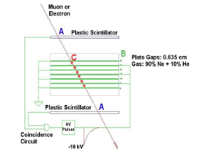
Parallel Plate with localization capabilities
Spark and streamer chambers
detectable breakdown along the ionization trails
modest rate capability
( ions evacuation)
Discrete electrode ( strips, wires ) gives localization capabilities

Slide 22
“Parallel Plate” Amplification (single stage devices… micromegas family)

Slide 23
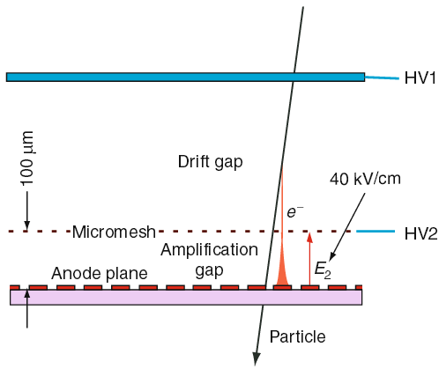
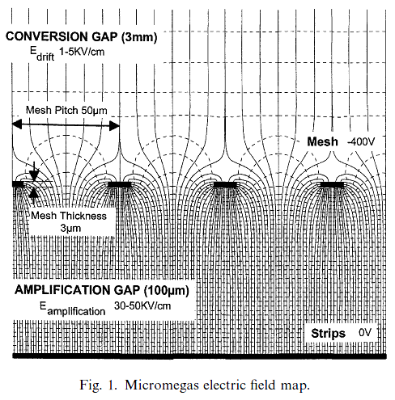
MicroMEGAS: Parallel Plate with Small GAP
MICRO Mesh Gaseous Structure
Two-stage parallel-plate avalanche chamber of small amplification gap
Rate capability and energy resolution of the parallel plate counter.
Y. Giomataris et al,
Nucl. Instr. and Meth. A376(1996)29
Small gap , high field: fast movement of positive ions that are mostly collected on the mesh (small space-charge accumulation) and very fast signals

Slide 24
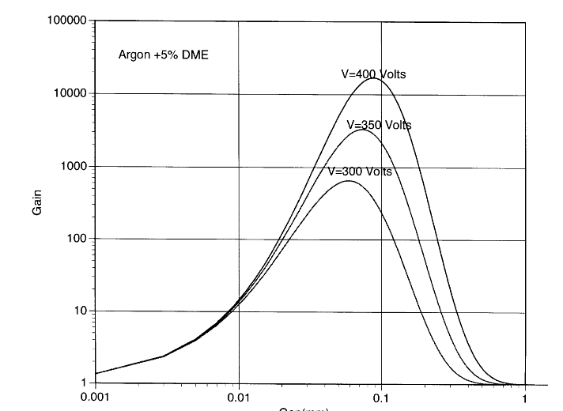
Micromegas
Narrow Gap Behaviour
“ Optimum gap provides stable operation and minimizes gain variation from pressure-temperature variations and fluctuations due to gap variations” Introduction to MPGD Y. Giomataris, CEA-Irfu-France
GAIN
small variations of the amplification gap compensated by an inverse variation of the amplification factor
Reduced dependence of gain on the gap thikness because of the saturating characteristics of the multiplication factor at very high field
i.e. good uniformity and stability of response over a large area.
GAP(mm)
Y. Giomataris, Nucl.Instr. and Meth. in Physi.Res. A 419 (1998) 239

Slide 25
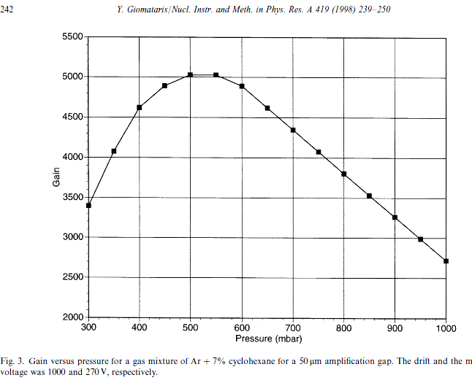
Micromegas

Slide 26
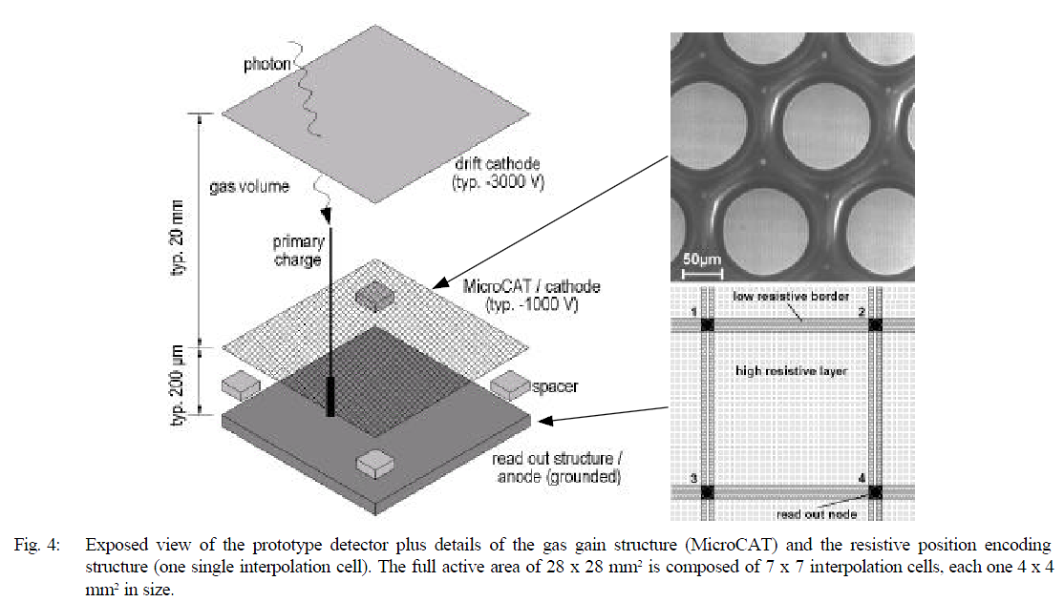
MicroCAT: structurally similar to micromegas but with round holes
Resistive layer (to improve space resolution)
A. Sarvestani et al., Nucl. Instr. And Meth. A410 (1998) 238
Cellular resistive readout using a resistive anode foil that is padded with conducting lines and forms a regular matrix of nodes, each connected to a charge-sensitive amplifier.

Slide 27
“Parallel Plate” Amplification and Transfer (multi stage devices… GEMs Family)

Slide 28
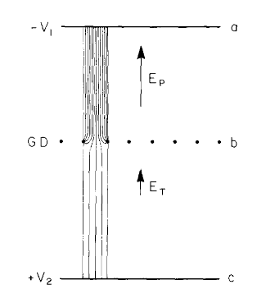
Multistep Avalanche Chamber (Charpak G, Sauli F. Phys. Lett. B78:523 (1978))
Made with a succession of metal meshes, the detector multiplied ionization electrons injected from a drift region into a high field. A fraction of the avalanche was then transferred through a lower field region into a second element of multiplication, a parallel plate or a wire chamber. Despite the loss of charge in the transfer from high to moderate fields, effective preamplification factors of several hundred were possible. Followed by a standard MWPC, the device permitted the high gains necessary to detect single photoelectrons.
PAT
[PreAmplification and Transfer]
To obtain larger gains with parallel-plate structures
“The multistep chamber was mechanically complex to implement and had only limited success, but demonstrated the great potential of subdividing the gain among several cascaded elements separated by low-field gaps”

Slide 29
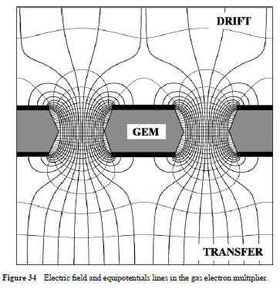
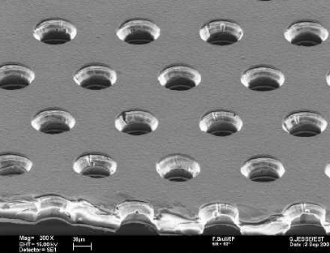
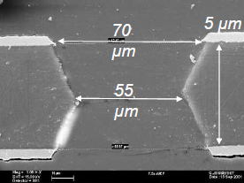
GEM (gas electron multiplier) introduced by Sauli in 1996, consists of a thin, metal-clad polymer foil chemically perforated by a high density of holes, typically 100/mm2
UNIQUE FEATURE
PREAMPLIFICATION AND TRANSFER OF CHARGE PRESERVING THE IONIZATION PATTERN
Sharing of the gain between two or more cascaded amplifiers, each operated at a voltage well below the discharge limit, appears to be a good solution to the problems common to all single-stage micro pattern detectors.

Slide 30
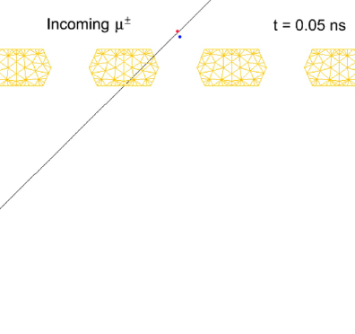
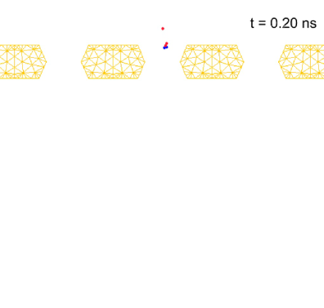
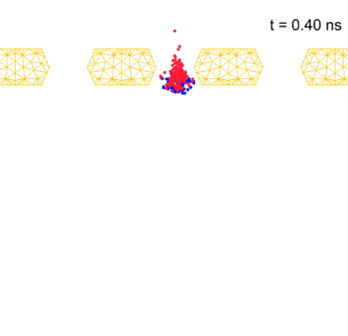
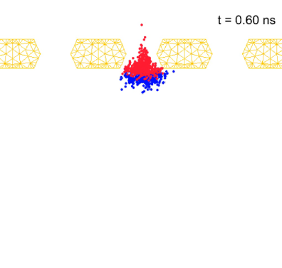
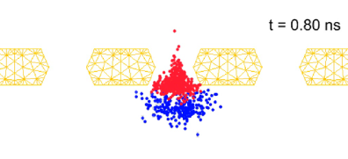
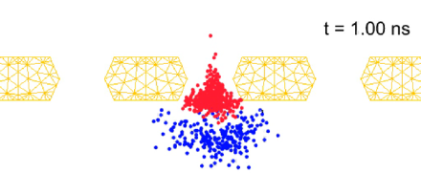
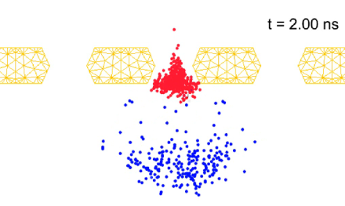
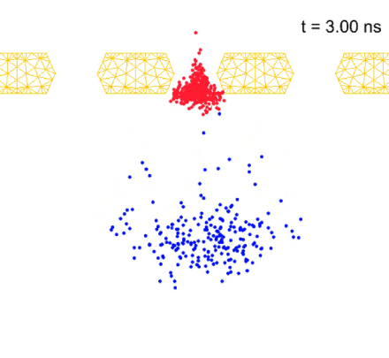
Avalanche Process in GEM: microscopic view
Time (0.2ns/step, From 0 to 0.8ns)
Avalanche
Time (1ns/step, From 1 to 5ns)
Electrons Drift and Diffusion
Time (400ns/step, From 10 to 1600ns)
Ions Drift and Diffusion
S. Dildick & R Veenhof (next speakers)

Slide 31
GEM

Slide 32
THickGEM
( R. Chechik, A. Breskin and C. Shalem,Thick GEM-like multipliers—a simple solution for large area UV-RICH detectors, to be published in NIMA - Similar approach to Peskov’s “optimized GEM”)
THGEM Peculiarity
Geometrical parameters scale respect with standard GEM
while
microscopic behavior of the electrons does not (in particular diffusion in the gas)
therefore
More effective electron collection and transport between cascaded elements
(hole diameter is larger than the electron’s diffusion range when approaching the hole)

Slide 33
Gas Micropattern Detectors for Tracking , L. Ropelewski CERN PH/DT2/ST

Slide 34
high resolution pixel readout
Ingrid ( & Timepix chip )
M. Cambell et al, NIMA540(2005)295
M. Chefdeville et al., NIMA556(2006)490
MM( & Medipix chip )
GEMPIx ( & TimePix) Murtas et al
Black, J. K. et al . (2003). Nucl. Instr. and Meth. A513, 639.
Bellazzini et al. (2004) Nucl. Instr. and Meth. A 535, 477.
P. Colas et al., NIMA535(2004)506
Bellazzini, R et al. (2007a) Nucl. Instr. and Meth. A 572, 160

Slide 35
Discharges in MPGDs
MPGD faster because of smaller gaps between anode and cathode but:
streamer -> fast discharges
Spontaneous breakdown, in absence of radiation, above a critical voltage
Rate-induced breakdown (presence of long-lived excited states produced in
the gas or, according to recent evidence, more likely on the electrode surface)
Heavily ionizing tracks
High rate behavior and discharge limits in micro-pattern detectors. A. Bressan et al, Nuclear Instruments and Methods in Physics Research A 424 (1999) 321
Two different approach followed against discharges:
Multi Stage Detectors
Resistive Electrodes

Slide 36
Multi Stage Devices
voltage dependence of Raether’s limit, larger for low operating potentials
DISCHARGE PROBABILITY ON EXPOSURE TO 5 MeV α (from internal 220Rn gas)
TEST AT PSI πM1 beam: No discharges in 12 hrs of operation at gain 10⁴ (4 years of operation in COMPASS!)
S. Bachmann et al, NIMA 470(2001)548
S. Bachmann et al, NIMA 479(2002)294
The low-field separation between multipliers is crucial, probably because it
suppresses photon- and ion-mediated feedback mechanisms; its fundamental role has been confirmed by observed failures of detectors that directly combine two elements in contact.

Slide 37
Multi Stage Devices
GEMs+mm
THGEM+mm
^{UV LED Source}
Kapton/Fused Silica Window
An aging study of MICROMEGAS+GEM S. Kane et al
Drift wires
THGEM+PIM+mm
THGEM
Micro Mesh
Anode
S. Levorato, Hybrid MPGD based photon Detector, R&D update, Rd51 Collaboration Meeting, CERN Feb-2014
http://indico.cern.ch/event/283108/session/7/contribution/11/material/slides/0.pptx
S. Duval et al., NIMA 695 (2012) 163

Slide 38
Resistive Electrodes (for single stage)
Micromegas Project for the ATLAS Small Wheel Upgrade (J. Wotschack et al.)
G. Iakovidis, arXiv:1310.0734v1 [physics.ins-det] 2 Oct 2013

Slide 39
Resistive layers (for single stage)
Resistive μPIC
A. Ochi2/7/2013 3rd International MPGD conference

Slide 40
Aging…
F. Sauli, RD51-NOTE-2012-007
GEM are less affected by the presence of deposits on electrodes. In accelerated aging tests, realized with continuous exposure to high rate soft X-rays, no degradation of performances has been observed up to an accumulated charge of several tens of mC/mm2 with argon-CO2 gas fillings (Guirl, L. et al. (2002)) (Altunbas, C. et al. (2003)).
Altunbas, C et al. (2002) Nucl.
Instr. and Meth. A490, 177 (COMPASS)

Slide 41
Aging…
F. Sauli, RD51-NOTE-2012-007
LHCb & CF4
Studies of etching effects on Triple-GEM detectors operated with CF4-based gas mixtures.
Exposures to high radiation levels have clearly shown damages to the structures at low gas flows (Alfonsi et al. (2005) IEEE Trans.Nucl. Sci. NS-52, 2872.).
M. Alfonsi et al, NPB PS 150 (2006) 159
Detector lifetime under irradiation mixture has been demonstrated to exceed the experimental requirements with proper Control of materials and gas flow (Alfonsi, M. et al. (2004) Nucl. Instr. and Meth. A518, 106)

Slide 42
Aging…
Resistive micromegas for the ATLAS Upgrade

Slide 43
Aging…
Less sensitive ≠ Insensitive
Usual control of the quality of the gas system is strongly suggested as the selection and test of all the material in contact with the gas volume and all the precaution used to be protected against aging (ref to single wire experience)

Slide 44
Rate Capabilities
Guirl, L. et al. (2002) Nucl. Instr. and Meth. A 478, 263.
Y. Giomataris, Nucl.Instr. and Meth. in Physi.Res. A 419 (1998) 239

Slide 45
Space Resolution
Ketzer, B. et al. (2004) Nucl. Instr. and Meth. A535, 314.
Y. Giomataris, Nucl.Instr. and Meth. in Physi.Res. A 419 (1998) 239
nb: not the best results obtained, just two example…

Slide 46
If you want to know more about the MPDG status…
State of Art of MPGD VERY WELL describe in the S. Dalla Torre Talk for the
RD51 Special Workshop "Detecting Neutrons with MPGDs" (October 14 - 15, 2013)
https://indico.cern.ch/conferenceDisplay.py?confId=265187

Slide 50
RD51

Slide 51
The MPGD Community
Collspotting.web.cern.ch/sites/collspotting.web.cern.ch/files/HTML/maps/index.html#mpgd_pub.csg
1987
1993
1998
2013
2003
2008

Slide 52
The RD51 Collaboration (from 2008.. Extended until 2018)
Development of Micro-Pattern Gas Detector Technologies
More than 400 people involved (>80 Institutes) from Africa, Asia, Europe, North and South America

Slide 53
RD51 Collaboration
The main objective of the R&D program is to advance technological development of Micro pattern Gas Detectors
“RD51 aims at facilitating the development of advanced gas avalanche detector technologies and associated electronic readout systems, for applications in basic and applied research”

Slide 54
Working Groups

Slide 55
RD51 Common Project

Slide 56
RD51 Common Project

Slide 57
Specialized Workshop
Micro-Pattern Gas Detectors (RD-51) Workshop, Nikhef, April 16-18, 2008
[http://www.nikhef.nl/pub/conferences/rd51]
NEXT
"Detecting Photons with MPGDs"
16,17 June 2014, CERN
https://indico.cern.ch/conferenceDisplay.py?confId=265187

Slide 58
Collaboration Meetings and Mini Week

Slide 59
Internal Notes: 2009[7], 2010[9],2011[17],2012[12],2013[8]

Slide 60
Schools and Trainings:
EDIT 2011: Excellence in Detectors and Instrumentation Technologies CERN, Geneva, Switzerland - 31 January - 10 February 2011
“GEM, GridPix and Micromegas Detectors”

Slide 61
CERN Facilities: GDD/RD51 Laboratory

Slide 62
CERN Facilities: Test beam @ SPS

Slide 63
CERN Facilities: GIF & GIF++

Slide 64
CERN Facilities: Access to all the CERN Services

Slide 65
If you want to know more the collaboration…
114th LHCC Meeting… I’ll briefly go through some of the slides
The RD51 Collaboration: Development of Micro-Pattern Gas Detector Technologies, L. Ropelewski, M. Titov, 114th LHCC Meeting, CERN, 12-13 June 2013

Slide 66
The RD51 Collaboration: Development of Micro-Pattern Gas Detector Technologies, L. Ropelewski, M. Titov, 114th LHCC Meeting, CERN, 12-13 June 2013

Slide 67
The RD51 Collaboration: Development of Micro-Pattern Gas Detector Technologies, L. Ropelewski, M. Titov, 114th LHCC Meeting, CERN, 12-13 June 2013

Slide 68
The RD51 Collaboration: Development of Micro-Pattern Gas Detector Technologies, L. Ropelewski, M. Titov, 114th LHCC Meeting, CERN, 12-13 June 2013

Slide 69
The RD51 Collaboration: Development of Micro-Pattern Gas Detector Technologies, L. Ropelewski, M. Titov, 114th LHCC Meeting, CERN, 12-13 June 2013

Slide 70
The RD51 Collaboration: Development of Micro-Pattern Gas Detector Technologies, L. Ropelewski, M. Titov, 114th LHCC Meeting, CERN, 12-13 June 2013

Slide 71
MPGD Quality Control and Assurance
The RD51 Collaboration: Development of Micro-Pattern Gas Detector Technologies, L. Ropelewski, M. Titov, 114th LHCC Meeting, CERN, 12-13 June 2013

Slide 72
Review of MPGD Simulation tools in the R. Veenhof Talk
Garfield & Co
The RD51 Collaboration: Development of Micro-Pattern Gas Detector Technologies, L. Ropelewski, M. Titov, 114th LHCC Meeting, CERN, 12-13 June 2013

Slide 73
DAQ fully developed in the rd51 framework (H. Muller et al)
The RD51 Collaboration: Development of Micro-Pattern Gas Detector Technologies, L. Ropelewski, M. Titov, 114th LHCC Meeting, CERN, 12-13 June 2013

Slide 74
Industry Advanced xTCA Version
Generic MPGD Electronics
(HV, ammeter, amplifier,..)
The RD51 Collaboration: Development of Micro-Pattern Gas Detector Technologies, L. Ropelewski, M. Titov, 114th LHCC Meeting, CERN, 12-13 June 2013

Slide 75
MPGD Workshop @ CERN (Rui de Oliveira)
The RD51 Collaboration: Development of Micro-Pattern Gas Detector Technologies, L. Ropelewski, M. Titov, 114th LHCC Meeting, CERN, 12-13 June 2013

Slide 76
MPGD Industrialization
The RD51 Collaboration: Development of Micro-Pattern Gas Detector Technologies, L. Ropelewski, M. Titov, 114th LHCC Meeting, CERN, 12-13 June 2013

Slide 77
The RD51 Collaboration: Development of Micro-Pattern Gas Detector Technologies, L. Ropelewski, M. Titov, 114th LHCC Meeting, CERN, 12-13 June 2013

Slide 78
Some References (MPGD & RD51)
F,Sauli, A. Sharma, MICROPATTERN GASEOUS DETECTORS , Annu. Rev. Nucl. Part. Sci. 1999. 49:341–88
L. Ropelewski, Gas Micropattern Detectors for Tracking
The RD51 Collaboration: Development of Micro-Pattern Gas Detector Technologies, L. Ropelewski, M. Titov, 114th LHCC Meeting, CERN, 12-13 June 2013
S. Dalla Torre, State of the Art of MPGD detection techniques, RD51 Special Workshop "Detecting Neutrons with MPGDs" (October 14 - 15, 2013)
M. Titov, New developments and future perspective for gaseous detector, 11th Vienna Conf on Instr. (2007)
F. Sauli, Gas electron multiplier (gem) detectors: principles of operation and applications, RD51-note-2012-007 revised 21.09.2012
Y. Giomataris, Development and prospects of the new gaseous detector Micromegas, Nuclear Instruments and Methods in Physics Research A 419 (1998) 239
R. Chechik, A. Breskin and C. Shalem,Thick GEM-like multipliers

Slide 79
MPGD(Hole Type)@BINP

Slide 80
MPGD(Hole Type)@BINP

Slide 81
backup

Slide 82
MHSP (Micro Hole & Strip Plate) & THCobra
Veloso et al, RSI, 71(2000) 2371
Maia etal., NIM A 504 (2003)364
Veloso etal, NIM A 524(2004)124
Breskin et al,to be published in NIM A

