Slide 1
The Mu2e Experiment at Fermilab
David Hitlin
Caltech
INSTR2014
February 25, 2014

Slide 2
Muon to electron conversion in the field of a nucleus
Initial state: muonic atom
Final state:
  a single mono-energetic electron.
    the energy depends on Z of target.
  recoiling nucleus is not observed
    the process is coherent: the nucleus stays intact.
  neutrino-less
Standard Model rate is 10⁻⁵⁴
There is an observable rate in many new physics scenarios.
Related decays: Charged Lepton Flavor Violation (CLFV):
e⁻

Slide 3
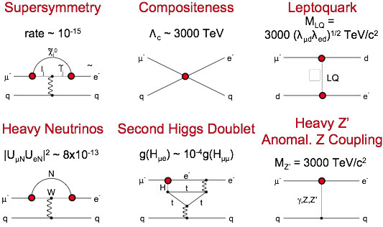
New Physics Scenarios
M. Raidal, et al., Flavour Physics of Leptons and Dipole Moments, Eur.Phys.J. C57, 13, 2008
Sensitive to mass scales up to O (10⁴ TeV)

Slide 4
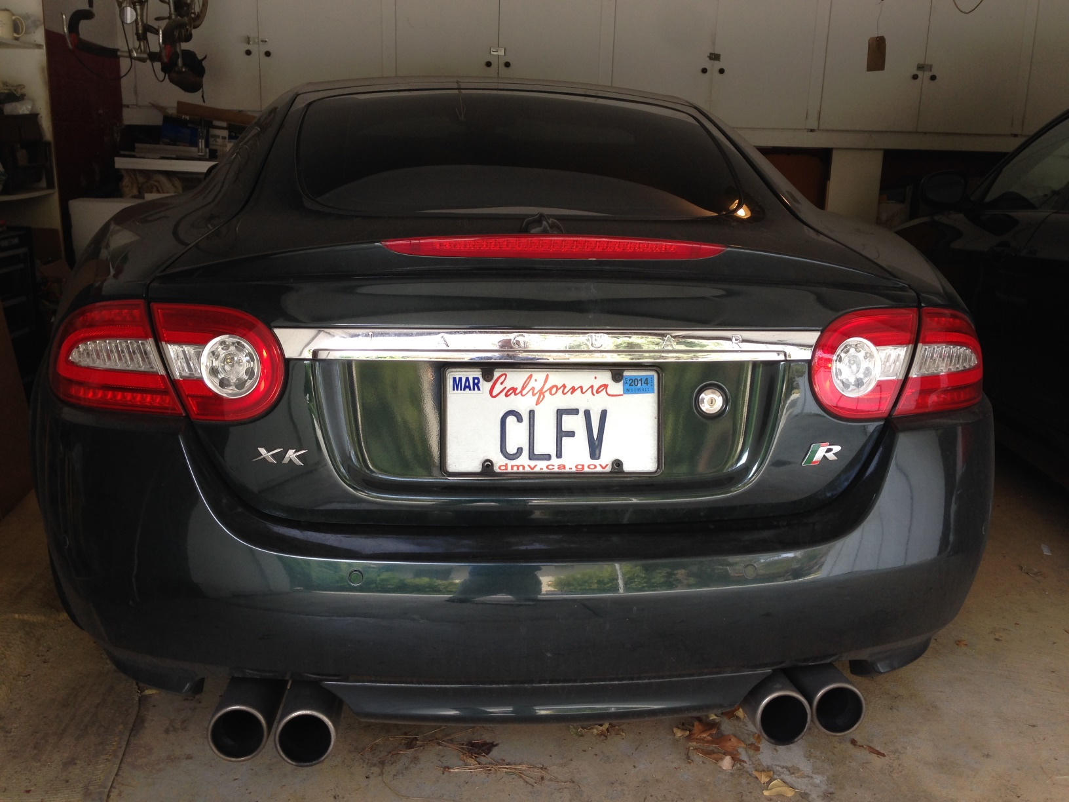
CLFV has actually been seen in California

Slide 5
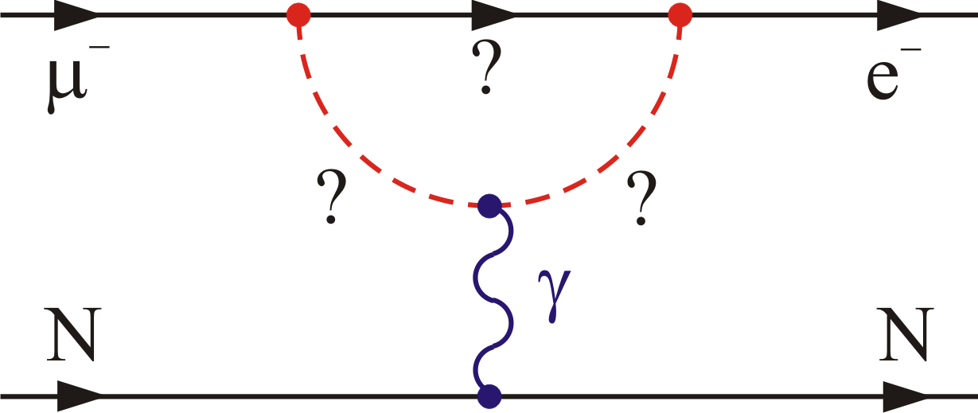
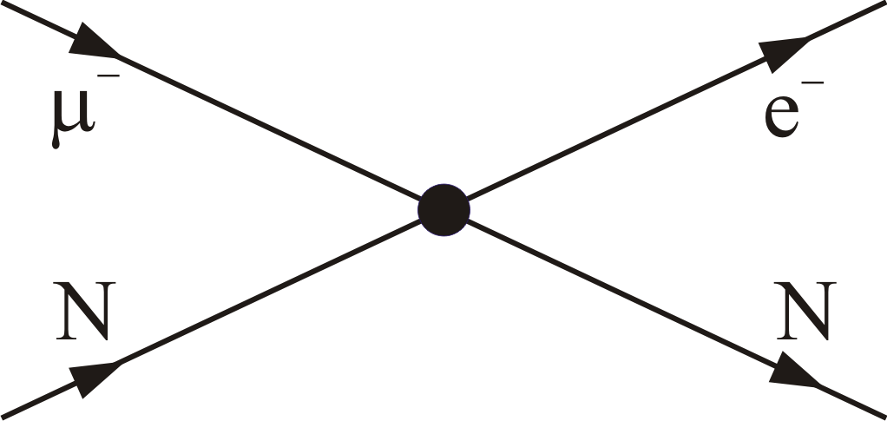
Two types of amplitudes contribute
Loops
Contact terms
μ→eγ
μ→eγ
μN→eN
μN→eN
μ→eee
μ→eee
Effective Lagrangian

Slide 6
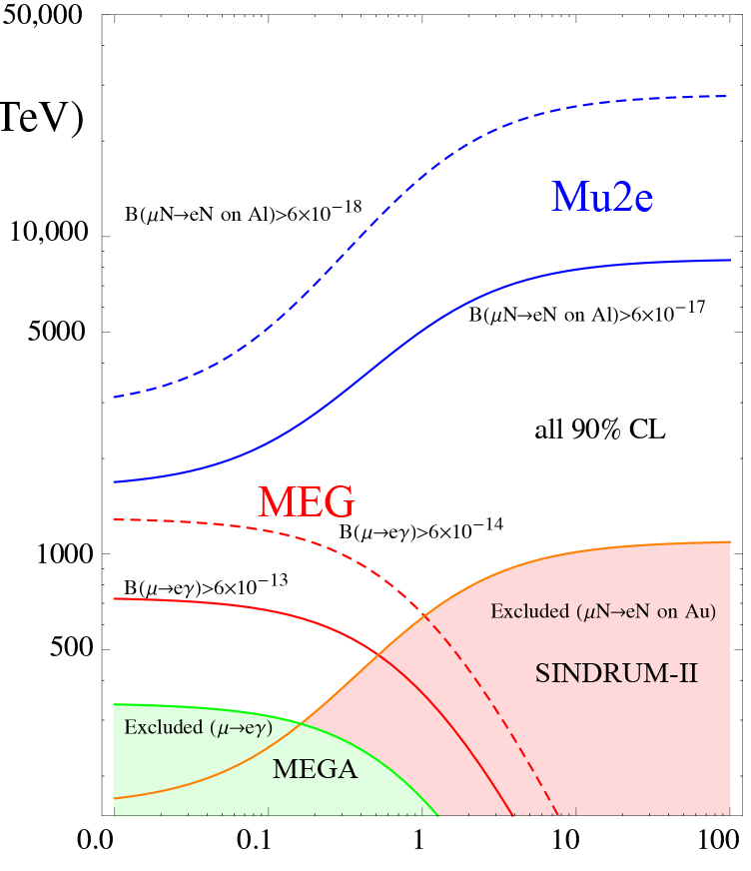
Sensitivity to high mass scales
Loops dominate
for κ << 1
A. DeGouvea
Contact terms
dominate for κ >> 1
Λ (TeV)
μ→eγ
μ→eγ
μN→eN
μN→eN
μ→eee
μ→eee
κ

Slide 7
Complementarity with the LHC
If new physics is seen at the LHC
  Need CLFV measurements (Mu2e and others) to discriminate among interpretations
If new physics is not seen at the LHC
  Mu2e has discovery reach to mass scales that are inaccessible to the the LHC

Slide 8
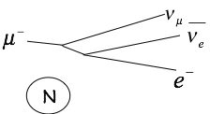
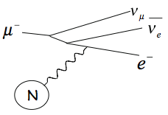
The dominant background: muon decay in orbit (DIOs)
free muon decay
DIO tail
m_{μ}
DIO
m_{μ} /2
m_{μ}
reconstructed momentum (MeV)

Slide 9
Resolution effects extend the DIO endpoint into the signal region
The tail of the DIOs falls as (E_{Endpoint} – E_{e})⁵
Separation of a few hundred keV for R_{μe} = 10⁻¹⁶
resolution effects
m_{μ}
m_{μ}
Czarnecki, Tormo, Marciano, Phys.Rev. D84, 013006, 2011)

Slide 10
Mu2e in one page
Make muonic Al.
Watch it decay:
  Decay-in-orbit (DIO): 40%
    Continuous E_{e} spectrum.
  Muon capture on nucleus: 60%
    Nuclear breakup: p, n, γ
  Neutrino-less μ to e conversion
    Mono-energetic E_{e} ≈ 105 MeV
    At endpoint of continuous spectrum.
Measure E_{e} spectrum.
Is there an excess at the endpoint?
Quantitatively understand backgrounds
Bohr radius ≈ 20 fm
Al nuclear radius ≈ 4 fm
Lifetime: 864 ns

Slide 11
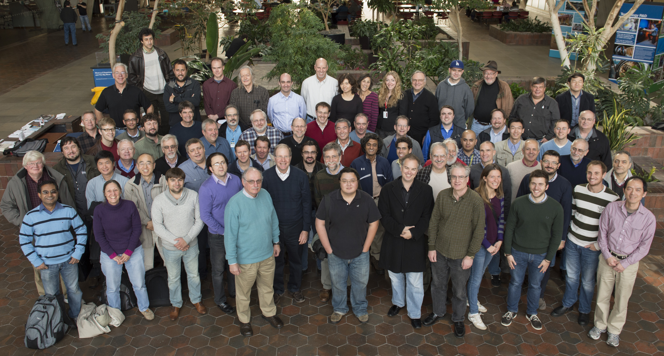
The Mu2e Collaboration
Boston University
Brookhaven National Laboratory
University of California, Berkeley and
Lawrence Berkeley National Laboratory
University of California, Irvine
California Institute of Technology
City University of New York
Duke University
Fermilab
University of Houston
University of Illinois, Urbana-Champaign
Lewis University
University of Massachusetts, Amherst
Muons, Inc.
Northern Illinois University
Northwestern University
Pacific Northwest National Laboratory
Purdue University
Rice University
University of Virginia
University of Washington, Seattle
Laboratori Nazionale di Frascati
INFN Genova
INFN Lecce and Università del Salento
Istituto G. Marconi Roma
INFN,, Pisa
Universita di Udine and INFN Trieste/Udine
JINR, Dubna
Institute for Nuclear Research, Moscow
About half of us: Nov 2013
  http://mu2e.fnal.gov
135 members from 28 institutions
Notes:
Replace with new photo and institution list

Slide 12
The measurement
Numerator:
  Do we see an excess at the E_{e} end point?
Denominator:
  All nuclear captures of muonic Al atoms
Design sensitivity for a 3 year run
  ≈ 2.5 ×10⁻¹⁷ single event sensitivity.
  < 6 ×10⁻¹⁷ limit at 90% C.L.
Factor of 10⁴ improvement over current limit (SINDRUM II)

Slide 13
Proton delivery
The two new muon experiments will reuse Tevatron-era infrastructure
Mu2e has worked with the new muon g-2 project to develop an
accelerator and beamline design that works well for both experiments
  Only one experiment can run at one time
Either experiment can run simultaneously with NOνA
With the envisioned longer term
Proton Improvement Project (PIP-II), 10x the beam intensity can be obtained

Slide 14
mu2e has three large superconducting solenoid systems
Production
Solenoid (PS)
Proton Beam
Detector Solenoid (DS)
2.0 T
2.5 T
4.6 T
1.0 T
Detector region:
uniform field 1T
Transport Solenoid (TS)
Graded B field for most of length

Slide 15
Backward travelling muon beam
production target
collimators
proton beam
to stopping
target and
detector
to dump
2.5 T
4.6 T
2.5 T
2.0 T
PS: magnetic mirror
TS: negative gradient and charge
selection at the central collimator

Slide 16
Stopping target and detectors
strawtube tracker
foil stopping targets
field gradient
BaF₂ calorimeter
incoming muon beam
< KE > = 7.6 MeV

Slide 17
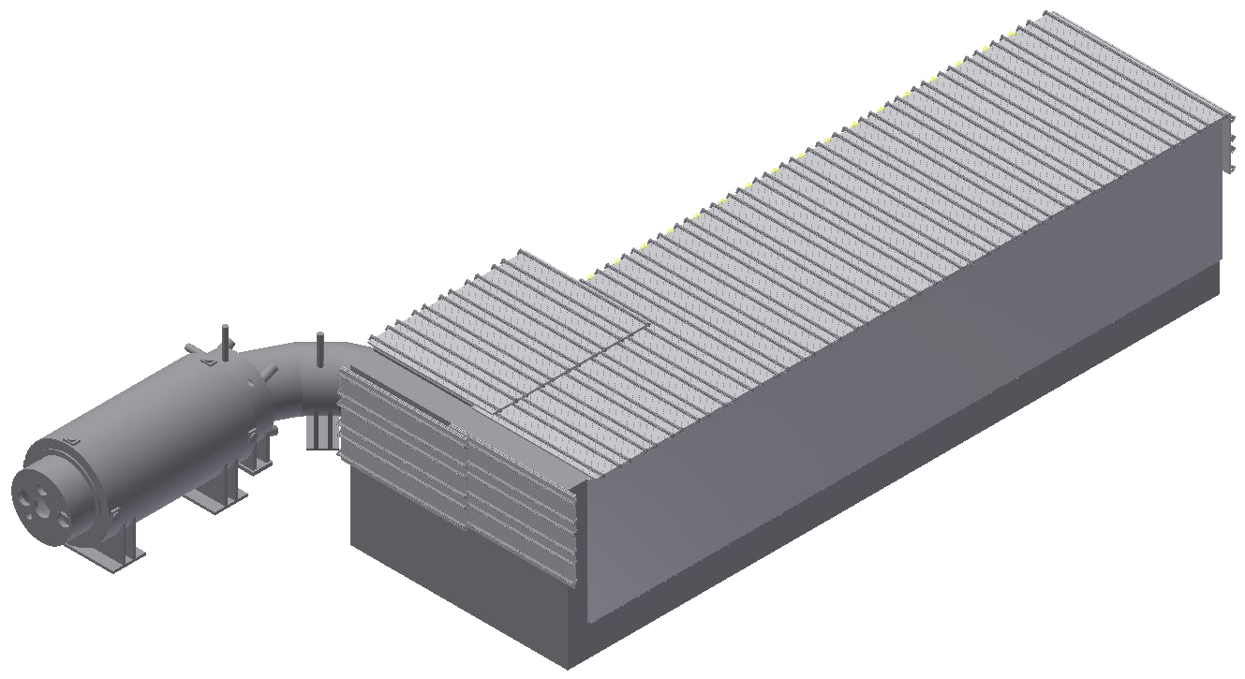
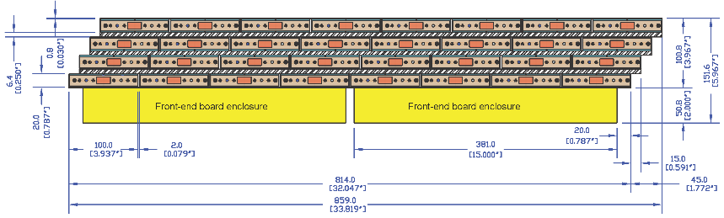
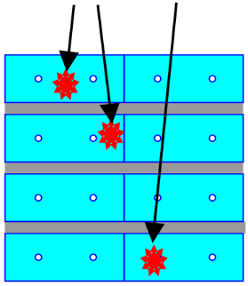
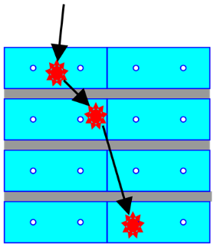
Detector solenoid is surrounded by a cosmic ray veto (CRV)
Four layers of extruded plastic scintillator
Fiber/SiPM readout (neutron damage is an issue)
Al and concrete shielding
CRV-D
CRV-L
CRV-T
CRV-R
CRV-U
Correlated hits are a concern

Slide 18
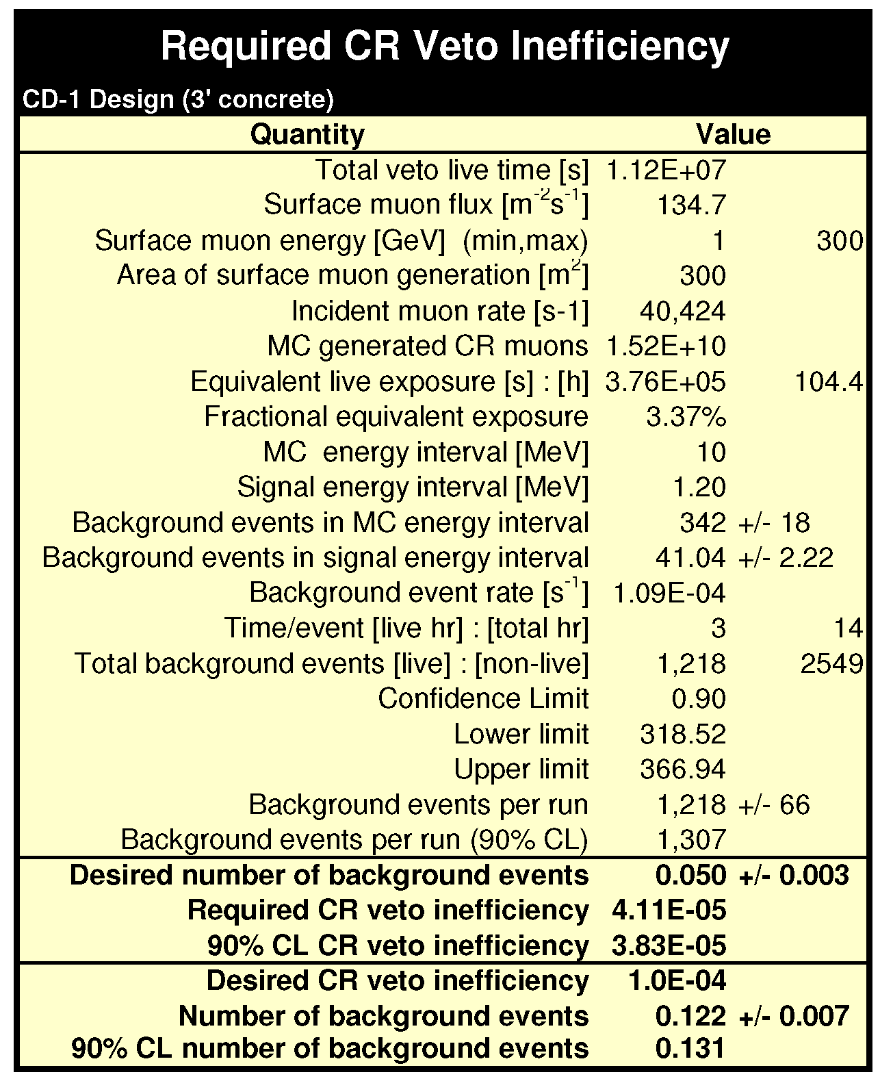
CRV inefficiency requirement

Slide 19
Stopping target
Pulse of low energy μ⁻ on thin Al foils
~50% are captured to form muonic Al
~0.0016 stopped μ⁻ per proton on production target
DIO and conversion electrons pop out of target foils
μ⁻
μ⁻
μ⁻
e⁻
Baseline
17 target foils
each 200 microns thick
5 cm spacing
radius:
  ≈10. cm upstream
  ≈6.5 cm downstream
Optimization is ongoing
μ⁻
μ⁻
μ⁻
μ⁻
μ⁻

Slide 20
One cycle of the muon beamline
Proton pulse arrival at production target
shapes are schematic, for clarity
selection window, defined at center plane of the tracker
μ are accompanied by e⁻, e⁺, π, anti-protons …
  these create prompt backgrounds
  strategy: wait for them to decay.
extinction = (# protons between bunches)/(protons per bunch)
  requirement: extinction < 10⁻¹⁰

Slide 21
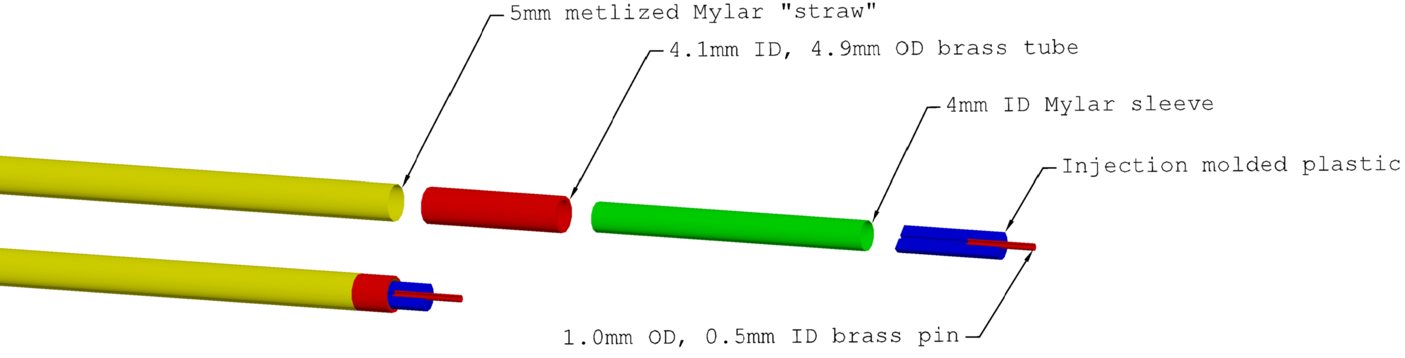
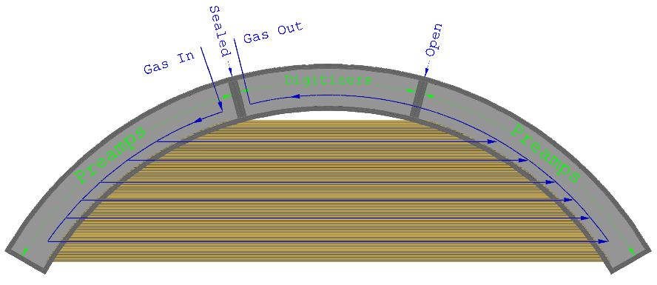
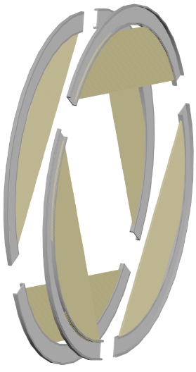

Tracker: strawtubes operating in vacuum
1
Straws: 5 mm OD; 15 μm metalized mylar wall.
Custom ASIC for time division: σ ≈ 5 mm at straw center
2
3
Plane: 6 self supporting panels
Panel: 2 layers, 48 straws each

Slide 22


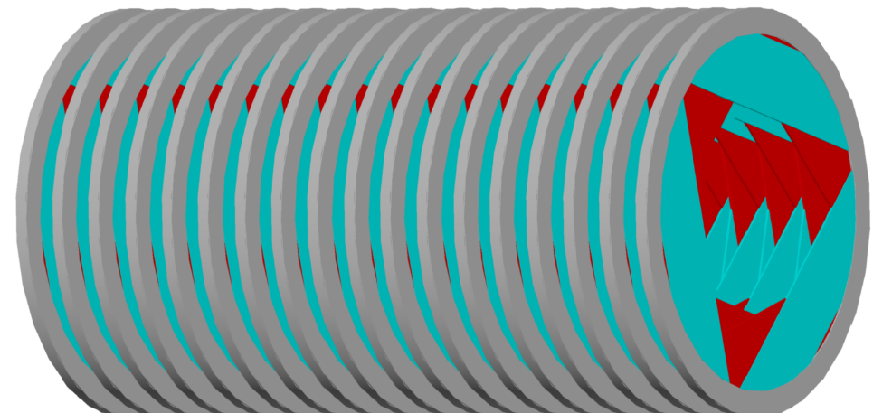
Tracker: strawtubes in vacuum
4
Station: 2 planes; relative rotation under study
5
Tracker: 22 stations (# and rotations still being optimized)

Slide 23
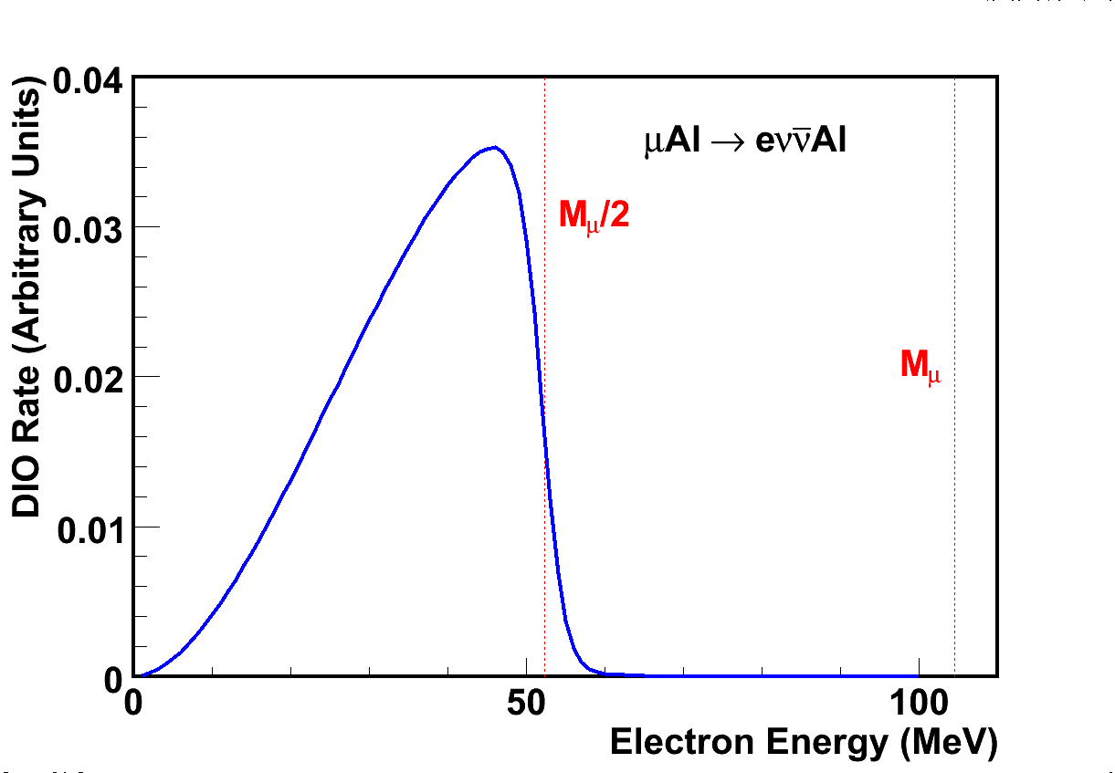
How do you measure 2.5×10⁻¹⁷ ?
reconstructable tracks
no hits in tracker
some hits tracker, tracks not reconstructable.
beam’s-eye view of the tracker

Slide 24
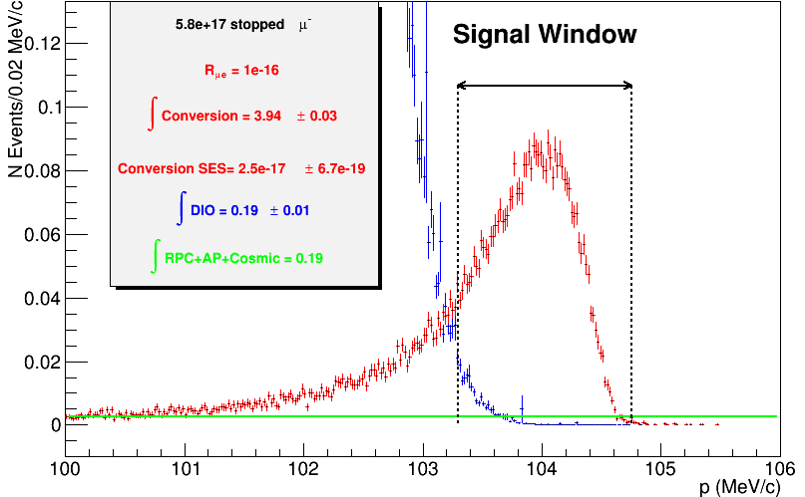
Signal sensitivity for a 3 Year Run
Stopped μ: 5. 8 × 10¹⁷
For R = 10⁻¹⁶
N_{μe} = 3.94 ± 0.03
N_{DIO} = 0.19 ± 0.01
N_{Other} = 0.19
SES = (2.5 ± 0.1) × 10⁻¹⁷
Errors are statistical only
Reconstructed e⁻ momentum

Slide 25
Scintillating crystal calorimeter
Two disk geometry
Hexagonal BaF₂ crystals; APD or SiPM readout
Provides precise timing, PID, background rejection, alternate track seed and possible calibration trigger.

Slide 26
Calorimeter crystal history
Initial choice PbWO4: small X₀, low light yield, low temperature operation,
temperature and rate dependence of light output
CDR choice LYSO: small X₀, high light yield, expensive (→very expensive)
TDR choice: BaF₂: larger X₀, lower light yield (in the UV), very fast
component at 220 nm, readout R&D required, cheaper,
See Friday
presentation

Slide 27
Backgrounds
Stopped muon-induced
  muon decay in orbit (DIO)
Out of time protons or long transit-time secondaries
  radiative pion capture; muon decay in flight
  pion decay in flight; beam electrons
  anti-protons
Secondaries from cosmic rays
Mitigation:
  excellent momentum resolution
  excellent extinction plus delayed measurement window
  thin window at center of TS to absorb anti-protons
  extreme care in shielding and veto

Slide 28
The “Ralf event”
In massive MC runs to optimize the
CRV, an event was found that evaded
the CRV, passed through the target
and the tracker, and stopped in
the calorimeter
The calorimeter, however, provides
substantial additional background
rejection, through μ/e PID, with a
combination of timing information and E/p

Slide 29
Backgrounds for a 3 Year Run
Source | Events | Comment
 | 0.20 ± 0.06
Anti-proton capture | 0.10 ± 0.06
Radiative π- capture* | 0.04 ± 0.02 | from protons during detection time
Beam electrons* | 0.001 ± 0.001
μ decay in flight* | 0.010 ± 0.005 | with e- scatter in target
Cosmic ray induced | 0.050 ± 0.013 | assumes 10-4 veto inefficiency
Total | 0.4 ± 0.1
All values preliminary; some are statistical error only.
* scales with extinction: values in table assume extinction = 10⁻¹⁰

Slide 30
Mu2e schedule
Solenoid design, construction and commissioning are the critical path
Today
Calendar Year
assemble and commission the detector:

Slide 31
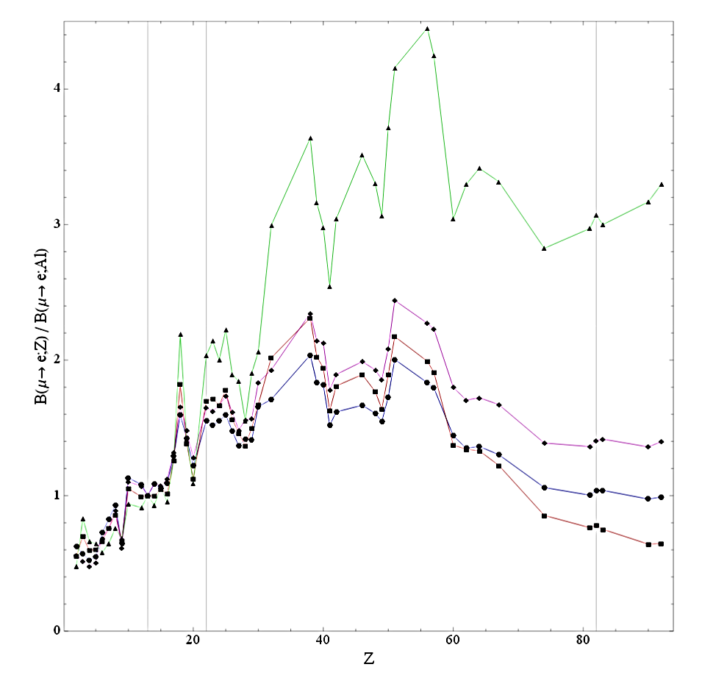
The mu2e experimental program has a branch point
If there is a signal:
  Study Z dependence: distinguish among
  BSM theories
  Options limited now that the programmable
  time structure of the proposed Project X
  beam is no longer anticipated
If there is no signal:
  Up to to 10× Mu2e physics reach, Rμe < a few × 10⁻¹⁸
  Can use the same detector, some modifications
Both programs can be done with the existing accelerator complex.
  Both could be done faster with more protons from PIP II

Slide 32
FNAL accelerator complex
Proton Improvement Plan (PIP)
  Improve beam power to meet NOνA requirements
  Essentially complete.
PIP-II design underway
  Project-X reimagined to match funding constraints
  1+ MW to LBNE at startup (2025)
  Flexible design to allow future realization of the full potential of the FNAL accelerator complex
    ~2 MW to LBNE
    10× the protons to Mu2e
    MW-class, high duty factor beams for rare process experiments

Slide 33
Summary and conclusions
mu2e will either discover μ to e conversion or set a greatly improved limit
  R_{μe} < 6 × 10⁻¹⁷ @ 90% CL.
  10⁴ improvement over previous best limit
  Mass scales to O(10⁴ TeV) are within reach
Schedule:
  Final review ~May 2014; expect approval ~July 2014
  Construction start fall 2014
  Installation and commissioning in 2019
  Solenoid system is the critical path
mu2e is a program:
  If there is a signal we will study the A,Z dependence of R_{μe} to elucidate the underlying BSM physics
  If there is no signal we will be able to improve the experimental sensitivity up to a factor of 10

Slide 35
For Further Information
Mu2e:
  Home page: http://mu2e.fnal.gov
  CDR: http://arxiv.org/abs/1211.7019
  DocDB: http://mu2e-docdb.fnal.gov/cgi-bin/DocumentDatabase
PIP-II
  Steve Holmes’ talk to P5 at BNL, Dec 16, 2013 https://indico.bnl.gov/getFile.py/access?contribId=11&sessionId=5&resId=0&materialId=slides&confId=680
  Conceptual Plan:http://projectx-docdb.fnal.gov/cgi-bin/ShowDocument?docid=1232

Slide 36
Not Covered in This Talk
Pipelined, deadtime-less trigger system
Cosmic ray veto system
Stopping target monitor
  Ge detector, behind muon beam dump
Details of proton delivery
AC dipole in transfer line; increase extinction
In-line extinction measurement devices
Extinction monitor near proton beam dump
Muon beam dump
Singles rates and radiation damage due to neutrons from production target, collimators and stopping target.

Slide 37
Fermilab Muon Program
Mu2e
Muon g-2
Muon Accelerator Program (MAP):
  MuCool – ionization cooling demonstration
  Other R&D towards a muon collider
NuStorm
  Proposal has Stage I approval from FNAL PAC
Preliminary studies for Project-X era:
  μ⁺➔ e⁺ γ
  μ⁺➔ e⁺ e⁻ e⁺
All envisage x10 or better over previous best experiments

Slide 38
Schematic of one cycle of the muon beamline
Proton pulse
Selection window, defined at center plane of the tracker
No real overlap between selection window and the second proton pulse!
  Proton times: when protons arrive at production target
  Selection window: measured tracks pass the mid-plane of the tracker

Slide 39
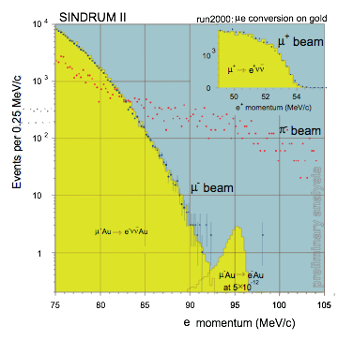
The previous best experiment
SINDRUM II
R_{μe} < 6.1×10⁻¹³ @90% CL
2 events in signal region
Au target: different E_{e} endpoint than Al.
HEP 2001 W. Bertl – SINDRUM II Collab
W. Bertl et al, Eur. Phys. J. C 47, 337-346 (2006)

Slide 40
SINDRUM II Ti Result
SINDRUM-II
Dominant background: beam π⁻
Radiative pion Capture (RPC), suppressed with prompt veto
Cosmic ray backgrounds were also important
R_{μe}(Ti) < 6.1X10⁻¹³
PANIC 96 (C96-05-22)
R_{μe}(Ti) < 4.3X10⁻¹²
Phys.Lett. B317 (1993)
R_{μe}(Au) < 7X10⁻¹³
Eur. Phys. J. , C47 (2006)

Slide 41
Why is mu2e more sensitive than SINDRUM II?
FNAL can deliver ≈10³ × proton intensity.
Higher μ collection efficiency.
SINDRUM II was background-limited.
  Radiative π capture.
  Bunched beam and excellent extinction reduce this.
  Thus mu2e can make use of the higher proton rate.

Slide 42
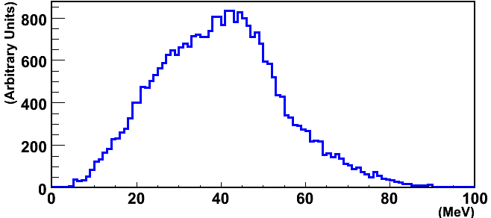
Muon Momentum
<p> ≈ 40 MeV
<Kinetic Energy> ≈7.6 MeV
Muon Momentum at First Target

Slide 43
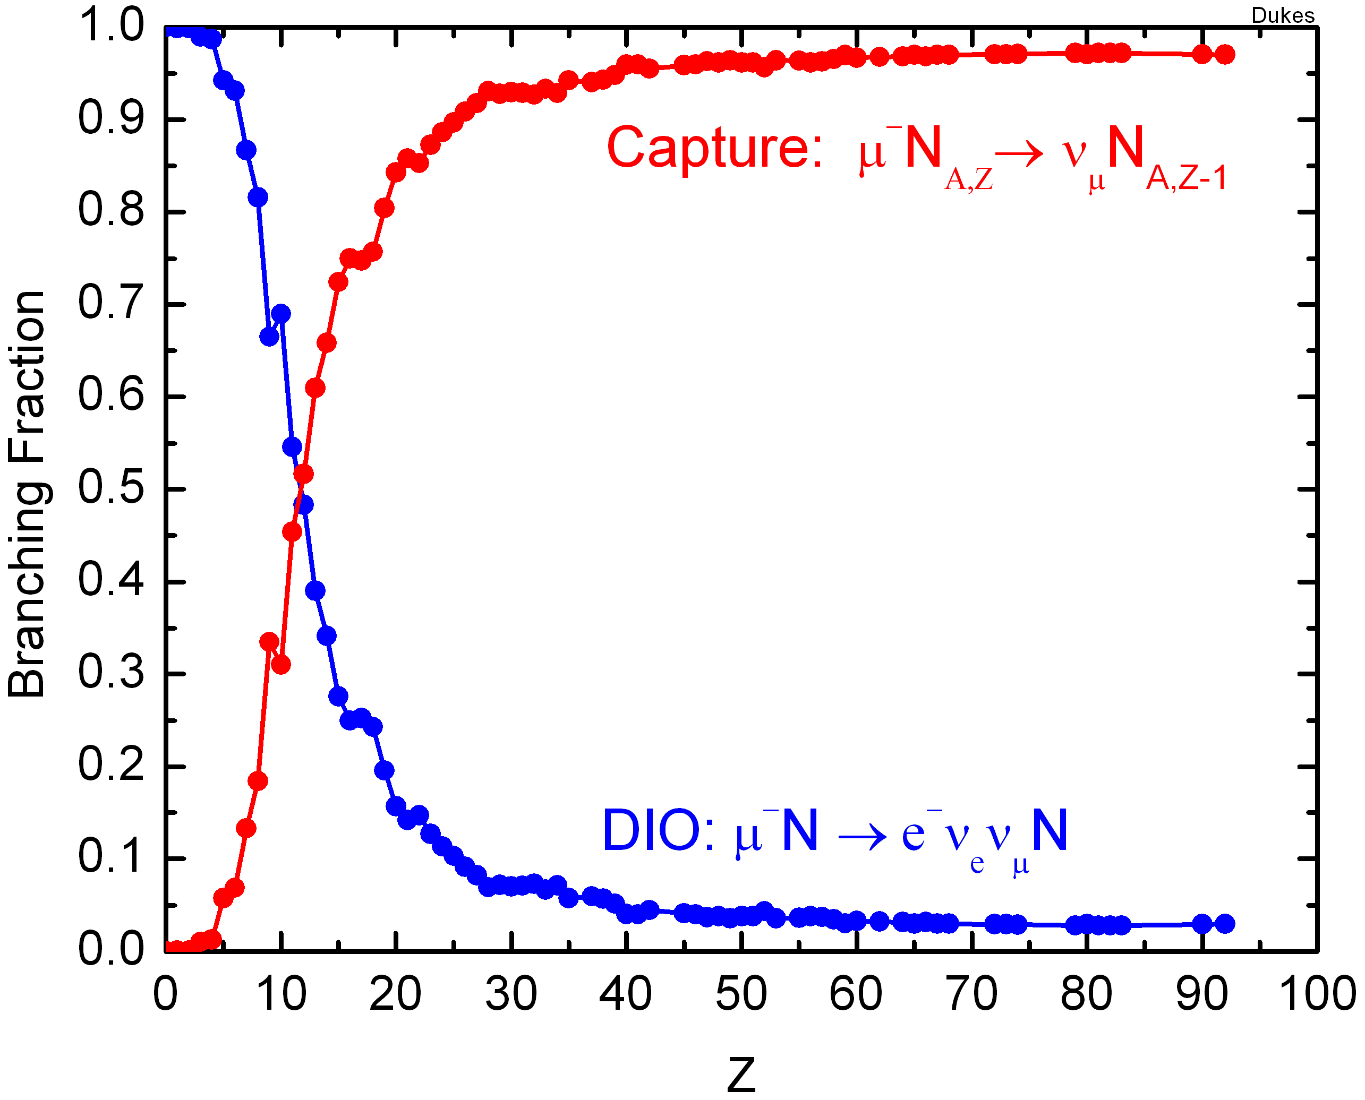
Capture and DIO vs Z
Al

Slide 44
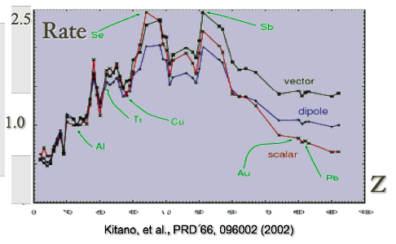
Conversion Rate, Normalized to Al

Slide 45
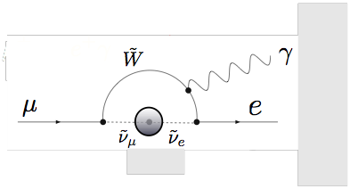
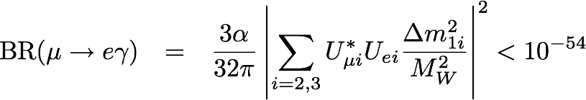
CLFV Rates in the Standard Model
With massive neutrinos, non-zero rate in SM.
Too small to observe.

Slide 46
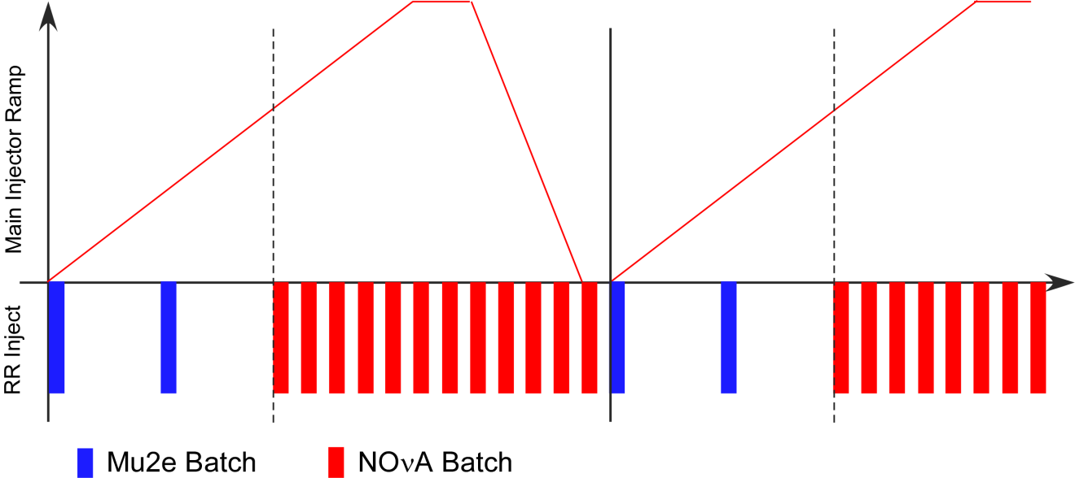
Proton Beam Macro Structure

Slide 47
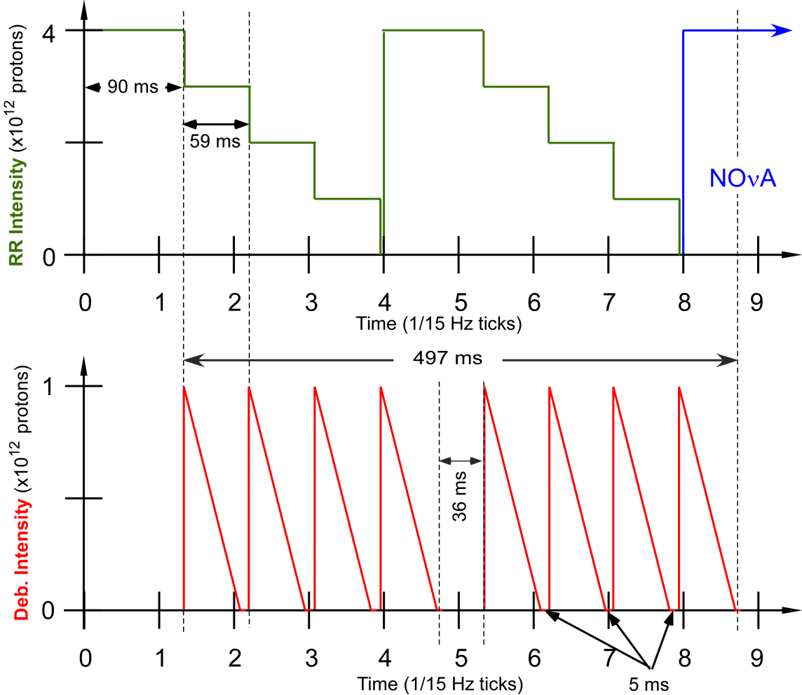
Proton Beam Micro Structure
Slow spill:
Bunch of 4 ×10⁷ protons every 1694 ns

Slide 48
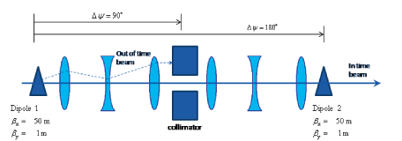
Required Extinction 10⁻¹⁰
Internal: 10⁻⁷ already demonstrated at AGS.
  Without using all of the tricks.
External: in transfer-line between ring and production target.
  AC dipole magnets and collimators.
Simulations predict aggregate 10⁻¹² is achievable
Extinction monitoring systems have been designed.

Slide 49
Project X
Accelerator Reference Design: physics.acc-ph:1306.5022
Physics Opportunities: hep-ex:1306.5009
Broader Impacts: physics.acc-ph:1306.5024

Slide 50
Mu2e in the Project-X Era
If we have a signal:
  Study Z dependence: distinguish among theories
  Enabled by the programmable time structure of the Project X beam: match pulse spacing to lifetime of the muonic atom!
If we have no signal:
  Up to to 100 × Mu2e physics reach, Rμe < 10⁻¹⁸ .
  First factor of ≈10 can use the same detector.

