Slide 1
The Update of the European Strategy for Particle Physics and first Steps for its Implementation
M. Krammer (chairman of ECFA)
HEPHY, Vienna, Austria
INSTR14, Novosibirsk, Russia
March 2014

Slide 2
The European Strategy
for Particle Physics 2006
First strategy approved by the CERN Council 14th July 2006
It contains 17 statements on scientific and organizational matters.
In 2006 the LHC was still under construction,
no hint for a Higgs at the Tevatron,
no prediction for the energy scale of interest for an ILC,
no country to proposing to host ILC,…
Obviously, completion of the LHC machine
was the highest priority !
Decision to update the strategy based on proposals
and observations from a dedicated scientific body
that Council shall establish for this purpose.

Slide 3
Time Line of the Update
The update process started in 2011 by setting up the European Strategy Group (ESG) and the Preparatory Group by Council
February 2012, Call for scientific input from the community
September 2012: Open Symposium (Kracow,PL)
December 2012: Scientific Briefing Book by the Preparatory Group based on the community input
(Open Symposium + written submissions)
http://europeanstrategygroup.web.cern.ch/europeanstrategygroup/Briefing_book.pdf (> 200 pages)
January 2013: Strategy Group drafting session (Erice, I)
Draft of European Strategy Update written and submitted
to Council
March 2013: Council agreed on final draft with minor wording
amendments
May 30 2013: The Council formally adopted the Strategy
Update in a special European Strategy Session of the Council in Brussels

Slide 4
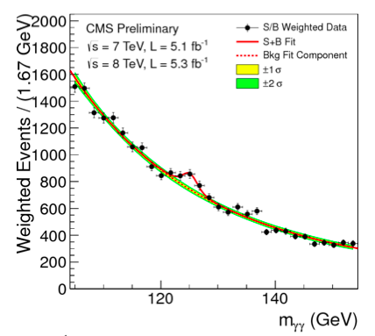
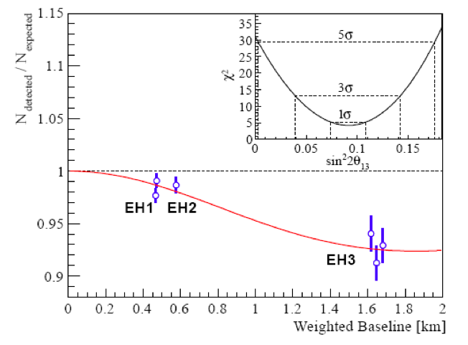
Scientific Input
~160 written contribution received from individuals, collaborations, national institutes, countries.
Large attendance during the open symposium (~500 participants)
A plethora of projects, facilities, new ideas were proposed and described.
Many triggered by the two discoveries in 2012 (just in time).
Higgs Boson at 125 GeV: Large θ₁₃ neutrino mixing angle:

Slide 5
A quick tour through the most discussed (fascinating) projects:

Slide 6
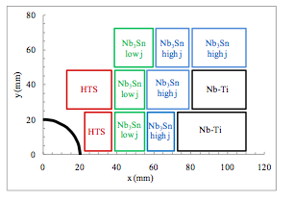
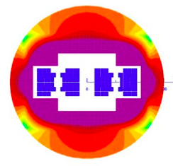
Proton-Proton Colliders
 | Years | E_{cm} TeV | Luminosity 10³⁴cm⁻²s⁻¹ | Int. Luminosity 300 fb⁻¹
Design LHC | 2014-21 | 14 | 1-2 | 300
HL-LHC | 2024-30 | 14 | 5 | 3000
HE-LHC | >2035 | 26-33* | 2 | 100-300/y
V-LHC** | >2035 | 42-100
* 16-20 T dipole field
** 80 km Tunnel
HE-LHC: LHC Energy Doubler
26 TeV c.m. ➔ 16 T magnets with classical low temperature superconducting magnets (Nb₃Sn)
33 TeV c.m ➔ 20 T using high temperature superconductors (YBCO-123, BSCCO-2212).
A possible 20 T design:
(CERN-ATS-2012-237)
Replace SPS by >1 TeV SC ring, etc…

Slide 7
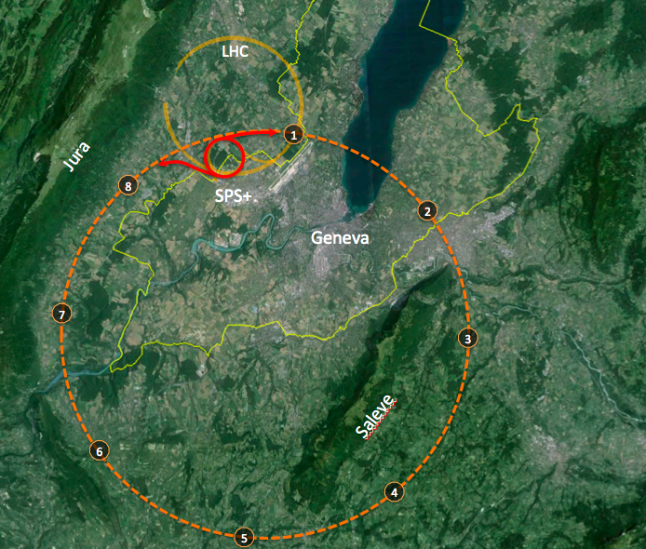
Proton-Proton Colliders
V-LHC: Very Large LHC
New 80 km tunnel (100 km), early stage of discussion, geological feasibility study:
In an 80 km tunnel:
42 TeV with 8.3 T
(present LHC dipoles technology)
80 TeV with 16 T
(high field based on Nb₃Sn)
100 TeV with 20 T
(very high field based on HTS)
If tunnel diameter is larger than
LEP/LHC (3.8 m) dipoles could be
larger and 20 T is no hard limit.
Injection energy > 3 TeV

Slide 8
Electron-Positron Colliders
 | Years | E_{cm} GeV | Luminosity 10³⁴cm⁻²s⁻¹ | Tunnel length km
ILC 250 | <2030 | 250 | 0.75
ILC 500 |  | 500 | 1.8 | ~30
ILC 1000 |  | 1000 |  | ~50
CLIC 500 | >2030 | 500 | 2.3(1.3) | ~13
CLIC 1400 |  | 1400(1500) | 3.2(3.7) | ~27
CLIC 3000 |  | 3000 | 5.9 | ~48
LEP3 | >2024 | 240 | 1 | LEP/LHC ring
TLEP | >2030 | 240 | 5 | 80 (ring)
TLEP |  | 350 | 0.65 | 80 (ring)

Slide 9
International Linear Collider
Two single beam linacs with superconducting RF cavities (31.5 MV/m)
Project at TDR level, key technologies in hand after extensive R&D, Industrial production of cavities established (e.g. XFEL – 5% of ILC),
For 500 GeV c.m. length of facility is ~ 30 km
Strong Japanese initiative to host ILC.
http://www.linearcollider.org/ILC/Publications/Technical-Design-Report

Slide 10
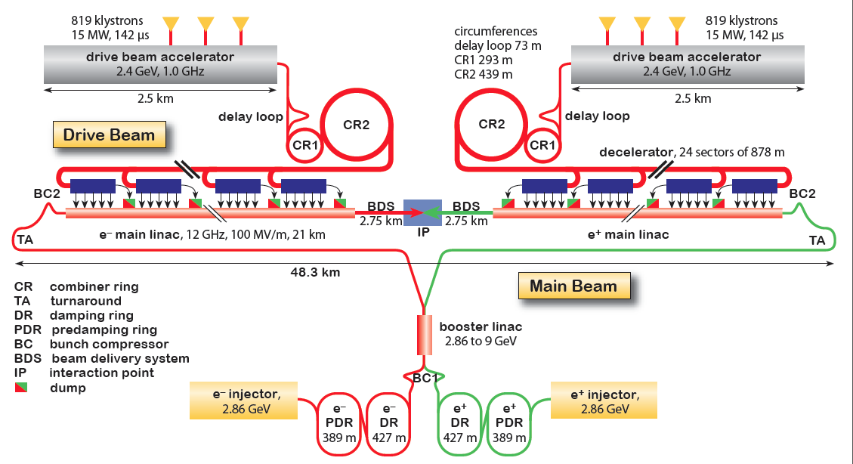
Compact Linear Collider
Two beam acceleration: low energy, high current drive beam powers RF cavities of main linac (cavities ~100 MV/m), energy up to 3 TeV c.m. in stages.
A Conceptual Design Report is published,
Prove of principle of two beam acceleration demonstrated!
(Proposal for a Clystron version for start up at low energy)
CERN-2012-003, arXiv:1202.5940, CERN-2012-005, arXiv:1209.2543

Slide 11
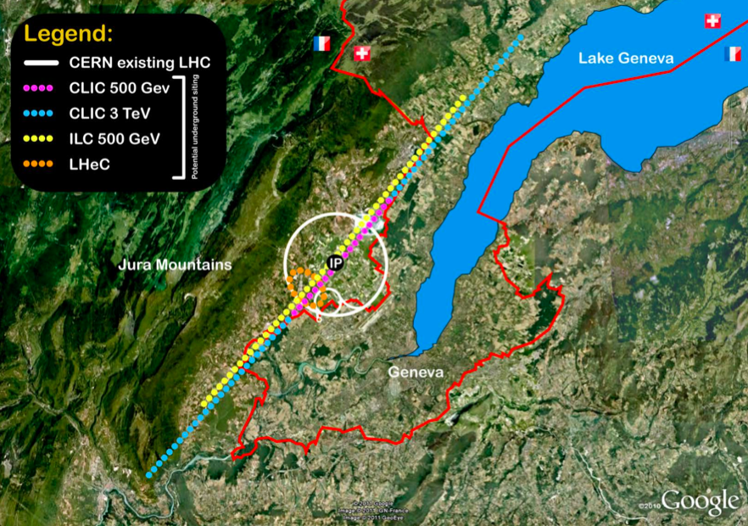
Compact Linear Collider

Slide 12
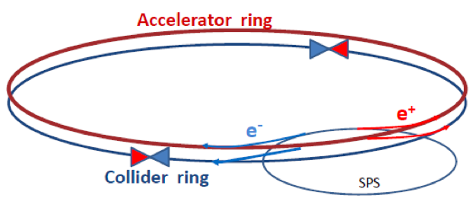
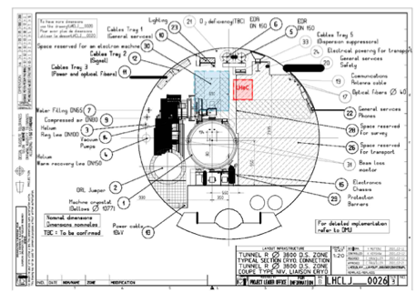
Circular e⁺e⁻ Colliders
Advantages: very high luminosity achievable, more than one IP, mature technology
Disadvantages: Beamstrahlung limits beam life time, limited energy reach – not upgradable
Two rings needed: first ring accelerates e⁺e⁻ to operating energy, injection every few
minutes into low emittance collider ring,
LEP3: 240 GeV c.m., proposal to install LEP3 before or just after HL-LHC and use ATLAS and CMS as detectors.
TLEP: Circular e⁺e⁻ collider in new 80 km tunnel, to be used later for pp collision (as with LEP, LHC), achievable energy 350 GeV (ttbar threshold).
More info at: http://tlep.web.cern.ch
Notes:
Figure 2.14: Typical precisions achievable at the ILC on model-independent Higgs boson cou-
Figure 3: An illustration of the typical precisions to which the relation between the Higgs couplings to the
couplings for mH = 120 GeV.

Slide 13
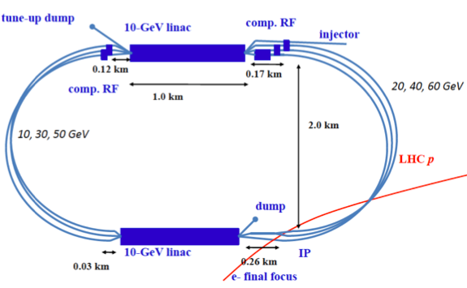
Electron-Proton Collider
LHeC: 10 GeV linear accelerator with energy recovery,
“Race track” configuration: 10 GeV x2 x3 = 60 GeV e⁻, e⁺
Q²_{max} ~ 1 TeV², additional eA option
Only practicable interaction point is IP2 (ALICE)
Very detailed CDR published: J. Phys. G: Nucl. Part. Phys. 39 (2012) 075001
Notes:
Figure 5.3: Relative uncertainty of the gluon distribution at Q2 = 1.9 GeV2, as resulting from an NLO QCD fit to HERA (I) alone (green, outer), HERA and BCDMS (crossed), HERA and LHC (light blue, crossed) and the LHeC added (blue, dark). logarithmic x scale, [ID175].

Slide 14
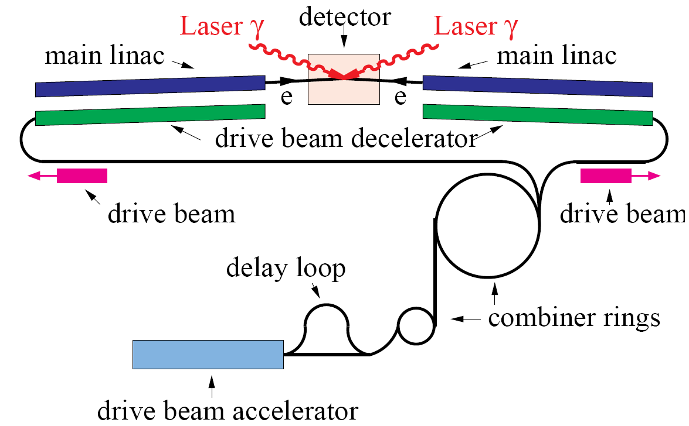
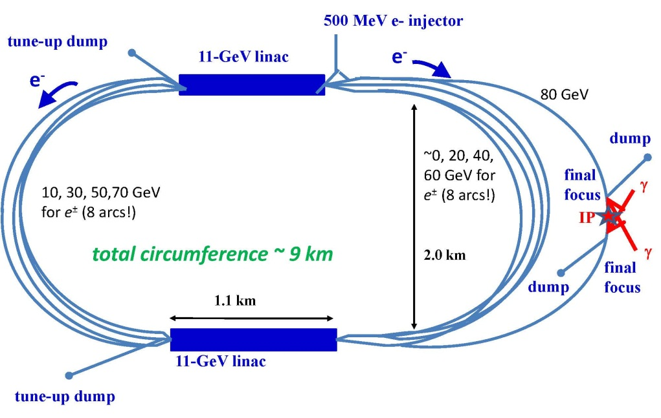
Photon-Photon Colliders
Photon-Photon collisions at √s = 125 GeV to produce Higgs (s-channel)
Advantages: lower beam energy (80 GeV), no positron source needed
High power laser back-scatter system (6 x 10²¹ Wm⁻²)
CLIC based:
SAPPHiRE:
Eur. Phys. J. C 28 (2003) 27

Slide 15
Muon Collider
Advantages of µ over e: smaller facility, very low synchrotron radiation, smaller energy spread, s-channel Higgs production ~m²
Muon collider as Higgs factory, precursor or follow-on of neutrino factory.

Slide 16
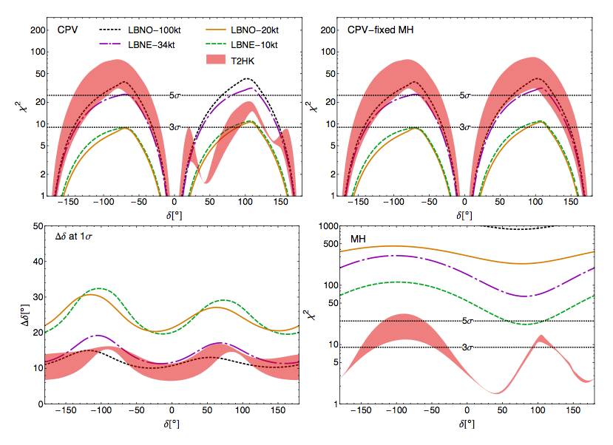
Neutrino Experiments
Long Baseline Neutrino Experiment with conventional beams
Discovery potential for CP violating,
Precision for δ measurement
and sensitivity to Mass Hierarchy:
Europe: LBNO
CERN ➔ Pyhäsalmi 2300 km
US: LBNE
FNAL ➔ Homestake 1300 km
Japan: T2HK
JPARC ➔ Hyper-K 295 km
If MH is known
Figure shows values for
LBNO, LBNE for 10y, T2HK for 5y
Experiments to address (answer?) the question of sterile Neutrinos:
νSTORM, ICARUS/NESSIE (possibly at CERN)
Notes:
Figure 4.9: Comparative performance of LBNE (with 34 and 10 kt and a 700 kW beam, 10 years data), LBNO (with 100 and 20 kt and a 800 kW beam, 10 years data) and T2HK (with 560 kt and a 1.66 MW beam, 5 years data) in terms of achievable discovery potential for CP violation (top panels), precision for a measurement in delta (bottom, left panel), and sensitivity to the mass hierarchy (bottom, right panel). The top right panel shows the improvement in the CP violation discovery potential when the MH is known while in the top left panel it is left free. Sim- ulation details as well as systematic uncertainties have been implemented according to Ref. [75]: correlations have been fully taken into account, and a near detector has also been considered for all experiments. The lines show the results assuming “default” systematics as defined in Table 2 in Ref. [75] have been considered; while the bands show the possible improvement when the values of the systematics are changed from the default to the optimistic values in the same table. Marginalization has been performed over the solar and atmospheric oscillation parameters including Gaussian priors around the central values, in agreement with present best fit values and uncertainties at 1σ. For the matter density, a Gaussian uncertainty of a 2% (for the default systematics) and a 1% (for the optimistic systematics) has also been considered. Normal mass hierarchy has been assumed. Finally, θ13 and δ are left completely free during marginalization. Figures courtesy of P. Coloma.

Slide 17
The Update of the European Strategy 2013
Excerpt from the Strategy Update
Official text highlighted, interpretations are my own, however trying to reflect the consensus.

Slide 18
Scientific Activities
After careful analysis of many possible large-scale scientific activities requiring significant resources, sizeable collaborations and sustained commitment, the following four activities have been identified as carrying the highest priority.
The strategy update must strike a balance between maintaining the diversity of the scientific program and setting priorities since the available resources are limited.
Only large scale projects are prioritized
Competitive small and medium size projects (national, regional) are important to keep the diversity of our field, since a breakthrough often emerges in unexpected areas
A priori these 4 activities are not prioritized, it is meant that all 4 should be pursued – there is a logical time line!

Slide 19
High-Priority Large-Scale Scientific Activities
LHC and HL-LHC:
c) ... Europe’s top priority should be the exploitation of the full potential of the LHC, including the high-luminosity upgrade of the machine and detectors with a view to collecting ten times more data than in the initial design, by around 2030. …
The strategy recommends to go for the full upgrade, i.e. 3ab⁻¹, without compromises!
The work and input from the experiments have made the case for HL-LHC and a target integrated luminosity of 3ab⁻¹.
This is a big “new” project. Huge work ahead, upgrade of LHC and upgrade of the detectors, funding to be secured, etc.
It is the next big challenge for particle physics world-wide ➔ contributions from other regions than Europe are crucial.

Slide 20
High-Priority Large-Scale Scientific Activities
LHC and HL-LHC:
c) ... Europe’s top priority should be the exploitation of the full potential of the LHC, including the high-luminosity upgrade of the machine and detectors with a view to collecting ten times more data than in the initial design, by around 2030. …
Program for the near future!
The strategy recommends to go for the full upgrade, i.e. 3ab⁻¹, without compromises!
The work and input from the experiments have made the case for HL-LHC and a target integrated luminosity of 3ab⁻¹.
This is a big “new” project. Huge work ahead, upgrade of LHC and upgrade of the detectors, funding to be secured, etc.
It is the next big challenge for particle physics world-wide ➔ contributions from other regions than Europe are crucial.

Slide 21
High-Priority Large-Scale Scientific Activities
Design studies and R&D for post-LHC projects:
d) … CERN should undertake design studies for accelerator projects in a global context, with emphasis on proton-proton and electron-positron high-energy frontier machines …
Europe has a vision for CERNs future as the laboratory at the forefront of particle physics. This statement sees the future in the energy frontier.
Possible machines are CLIC, HE-LHC, V-LHC, T-LEP (in connection with V-LHC)
More scientific input is needed before one can decide on a next large machine at CERN.
The strategy encourages accelerator R&D for proton-proton and electron-positron colliders, and consequently mentions explicitly high-field magnets and high-gradient accelerating structures.

Slide 22
High-Priority Large-Scale Scientific Activities
Design studies and R&D for post-LHC projects:
d) … CERN should undertake design studies for accelerator projects in a global context, with emphasis on proton-proton and electron-positron high-energy frontier machines …
Long time program !
Prepare now for >2035
Europe has a vision for CERNs future as the laboratory at the forefront of particle physics. This statement sees the future in the energy frontier.
Possible machines are CLIC, HE-LHC, V-LHC, T-LEP (in connection with V-LHC)
More scientific input is needed before one can decide on a next large machine at CERN.
The strategy encourages accelerator R&D for proton-proton and electron-positron colliders, and consequently mentions explicitly high-field magnets and high-gradient accelerating structures.

Slide 23
High-Priority Large-Scale Scientific Activities
International Linear Collider:
e) There is a strong scientific case for an electron-positron collider … European groups are eager to participate. Europe looks forward to a proposal from Japan to discuss a possible participation.
This is a strong statement in favor of the ILC and in particular of the Japanese initiative.
The strategy supports a machine with an initial energy of 250 GeV to perform Higgs studies and sees the energy upgradability of the ILC as major asset!
Many European groups are very interested in participating in the ILC project. Expect Japanese government to comes forward with a clear plan for hosting the ILC in Japan and an invitation for Europe to participate.

Slide 24
High-Priority Large-Scale Scientific Activities
International Linear Collider:
e) There is a strong scientific case for an electron-positron collider … European groups are eager to participate. Europe looks forward to a proposal from Japan to discuss a possible participation.
This is a strong statement in favor of the ILC and in particular of the Japanese initiative.
The strategy supports a machine with an initial energy of 250 GeV to perform Higgs studies and sees the Energy upgradability of the ILC as major asset!
Many European groups are very interested in participating in the ILC project. Expect Japanese government to comes forward with a clear plan for hosting the ILC in Japan and an invitation for Europe to participate.
Intermediate Program !

Slide 25
High-Priority Large-Scale Scientific Activities
Neutrino Programme:
f) … CERN should develop a neutrino programme to pave the way for a substantial European role in future long-baseline experiments. Europe should explore the possibility of major participation in leading long-baseline neutrino projects in the US and Japan.
It is important to reconstitute a neutrino physics activity at CERN, in order to provide technical expertise, support and focus for Europe to play a leading role in the forthcoming experiments – not necessarily hosted in Europe.
Note the emphasis on “long baseline”!

Slide 26
Other Scientific Activities
Statements g) to k) define other scientific activities which are essential for HEP, but do not need a prioritization. These are:
Theory
Small and mid-size experiments studying quark flavour physics, dipole moments, precision measurements at lower energies with neutrons, muons and antiprotons, etc.
Instrumentation, state-of-the-art infrastructure at CERN, large scale data-intensive computing
Non-accelerator experiments at the overlap with astroparticle physics.
Research at the boundary between particle and nuclear physics.

Slide 27
The implementation of the strategy update has already started:

Slide 28
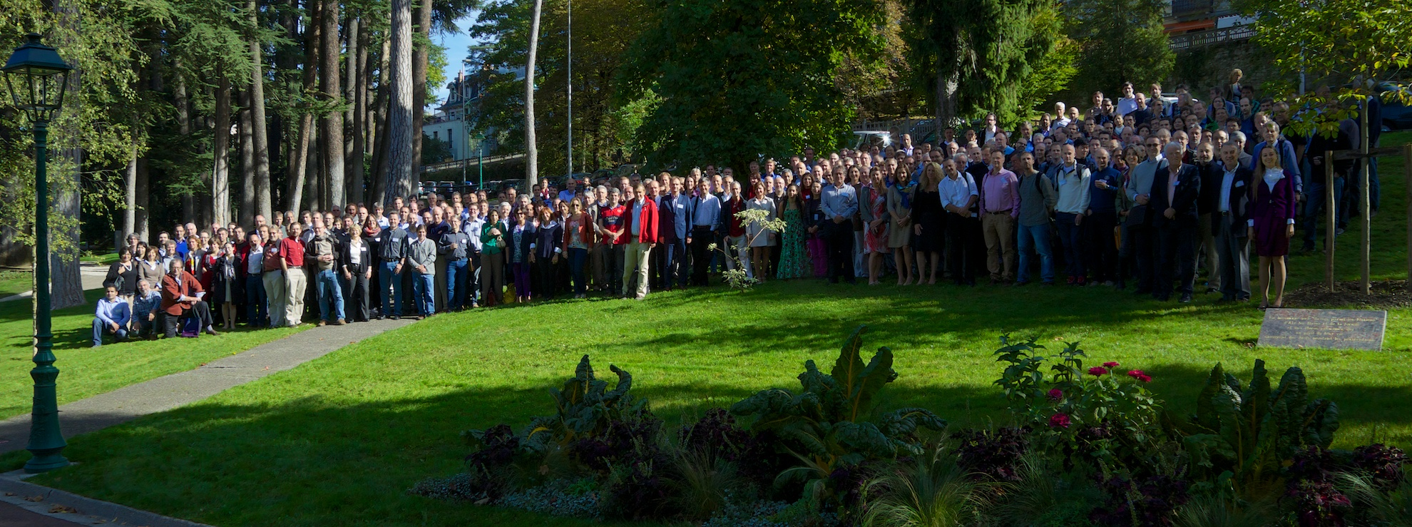
ECFA High Luminosity LHC Experiments Workshop: Physics and technology challenges
First meeting of the four LHC experiments, together with the accelerator and theory communities
1-3 October 2013, Aix-les-Bains, France
http://indico.cern.ch/conferenceDisplay.py?confId=252045
326 participants registered.

Slide 29
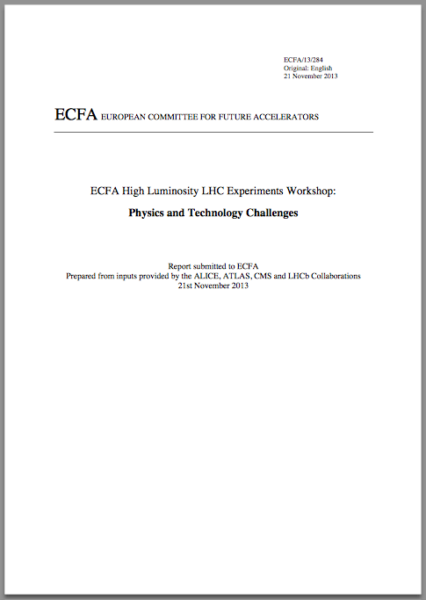
ECFA High Luminosity LHC Experiments Workshop: Physics and technology challenges
Work of Preparatory Groups in several areas before the workshop
Very positive interaction between the experiments
Several issues for common R&D identified
Interest to follow up this workshop with more dedicated
meetings between the experiments and theorists
A 2nd “Aix-Les-Bain” workshop in preparation
for October 2014
Workshop Summary Document:
ECFA/13/284
Available at:
http://cds.cern.ch/record/1631032/

Slide 30
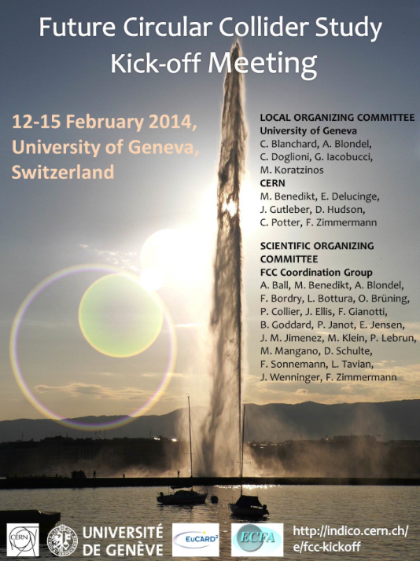
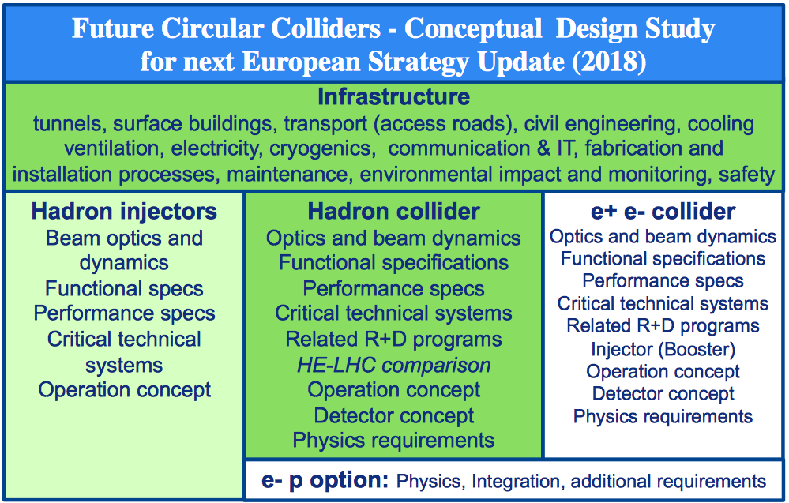
Study on Future Circular Colliders (FCC)
Launch of a new study under the auspices of ECFA, Kick-off meeting 12-15 February 2014, University of Geneva http://indico.cern.ch/event/282344/
330 registered participants

Slide 31
Summary
The Strategy Update is the result of a systematic and exhaustive discussion involving the whole particle physics community in Europe and elsewhere.
In all the discussions science was placed first!
Four high-priority large-scale activities identified.
High-Luminosity LHC
R&D for a future machine at CERN
Participation in the ILC in Japan
Support for European neutrino community
Europe has a clear vision and strategy for the future!
The program is challenging, but not unrealistic.
Europe supports the global effort in our field.
The implementation of the strategy has started!
The next update of the European strategy is foreseen in about 5 years.

Slide 32
Thank you for your attention!

