Slide 1
CMS Alignment and Calibration
Yuriy Pakhotin
on behalf of CMS Collaboration

Slide 2
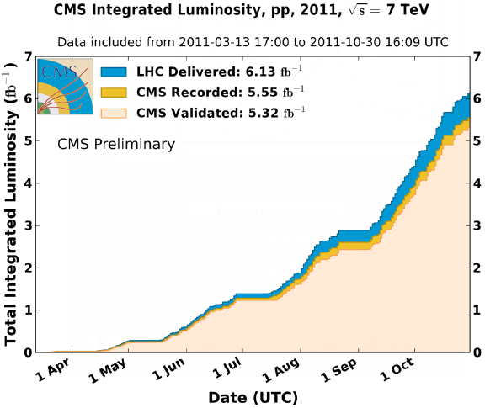
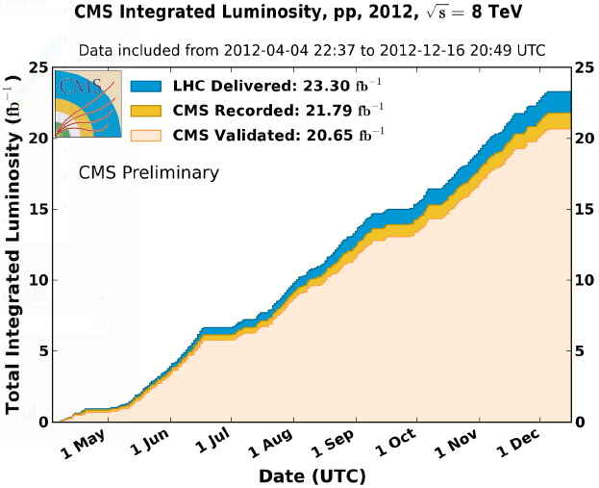
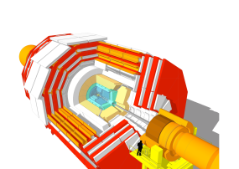
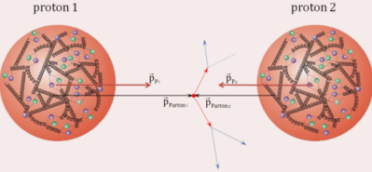
CMS Detector at LHC
(87%)
2012, $\sqrt{s}=8$ TeV
(88%)
2011, $\sqrt{s}=7$ TeV
LHC: proton-proton collider
*No results from Heavy-ions collisions in this talk

Slide 3
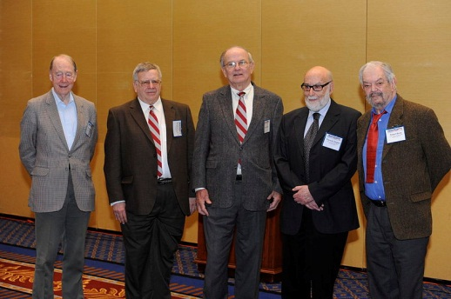
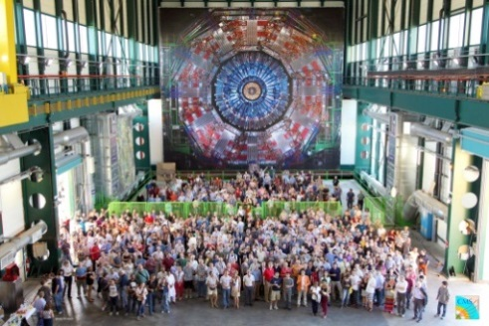
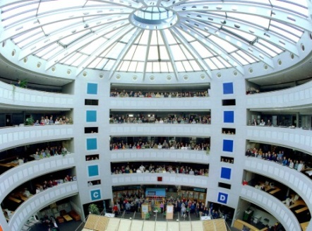
Higgs Boson: from original idea to observation
Higgs boson observation: July 4th, 2012
Reports from CMS and ATLAS on special event at CERN
http://indico.cern.ch/conferenceDisplay.py?confId=197461
It took almost 50 years to find Higgs
1964 $→2012$

Slide 4
Detector Calibration and Alignment
No discoveries possible without perfectly working detector
Smooth road to the discoveries essentially depends on calibration and alignment of the detector sub-systems internally and with respect to each other
In spotlight of this talk!
Sorry, not today

Slide 5
CMS Detector “Onion” Structure
Total weight: 12,500 t
Diameter: 15 m
Overall Length: 22 m
Magnetic field: 4 Tesla
2008 JINST 3 S08004
CMS is a complex detector:
Largest silicon tracker (~76M channels)
Homogeneous ECAL (76k crystalls)
Multilayers muon system (25k $m^{2}$)
Largest superconducting magnet (B=4 T)
Muon system:
momentum resolution: ${\left.\frac{δp_{T}}{p_{T}}\right|}_{25 GeV}\sim 1\%$
acceptance $\left|η\right|<2.4$
Calorimetry:
Hadron |η|<5.0, δE/E ~ 100% / √E + 5%
Electromagnetic |η|<3.0, δE/E ~ 2.8% / √E + 0.3%

Slide 6
Alignment and Calibration Strategy
Searches for new physics demand excellent knowledge of detector in terms of resolution
Near-detector calibration constants (pedestals, gains, etc.) are determined online
Rapidly changing detector conditions derived synchronously with data-taking and promptly used in first processing of data
derived within ~24-48 hours after data collection
important for fast physics analyses
Stable and improved conditions determined with state-of-the-art event-based alignment algorithms utilizing data sample accumulated over a longer range of time and used for data re-processing
usually derived within ~1 month after data collection
internal dependencies between alignment and calibration of different subsystems are accounted
Large data rate requires robust computing framework to handle alignment and calibration workflows utilizing special data formats to reduce bandwidth and disk space (AlCaReco)

Slide 7
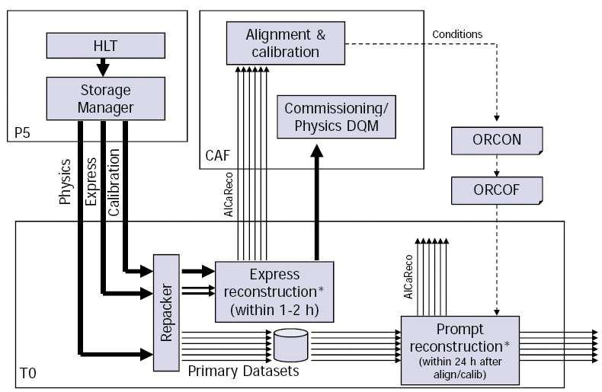
Alignment and Calibration Workflow
Two main alignment and calibration frames: prompt and offline
$$p^{+}→←p^{+}$$
Data-acquisition
Prompt Alignment and Calibration
Prompt Loop
Data Streams
Data
Re-reco
Data Flow
Offline Alignment and Calibration

Slide 8
Prompt Alignment and Calibration
Low latency workflows run immediately after the data-taking:
Beam-spot position: measured frequently (every Luminosity Section)
ECAL response corrections: frequently measured with laser pulses
Monitor conditions (update if necessary):
Tracker problematic channels: HV trips/noise
Calorimeter problematic channels: mask hot channels
Pixel alignment: monitor movements of large structures using tracks
Use delay between express and prompt reconstruction to include derived conditions in first data processing

Slide 9
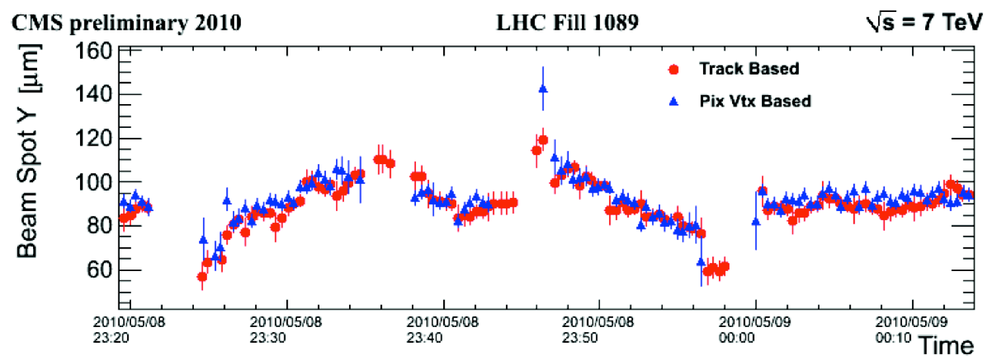
Calibrate Beam-spot Position
A value is measured every Luminosity Section (23 s)
use tracks from express stream
Position of the beam-spot in transverse plain ($x$, $y$) and slopes determined from fit using reconstructed minimum bias tracks
Beam width ($σ_{x}$ and $σ_{y}$), length ($σ_{z}$) and position ($z$) come from fit to primary vertices
The calibration strongly dependent on alignment of Pixel detector
Beam-spot is recomputed offline every time Pixel alignment is updated

Slide 10
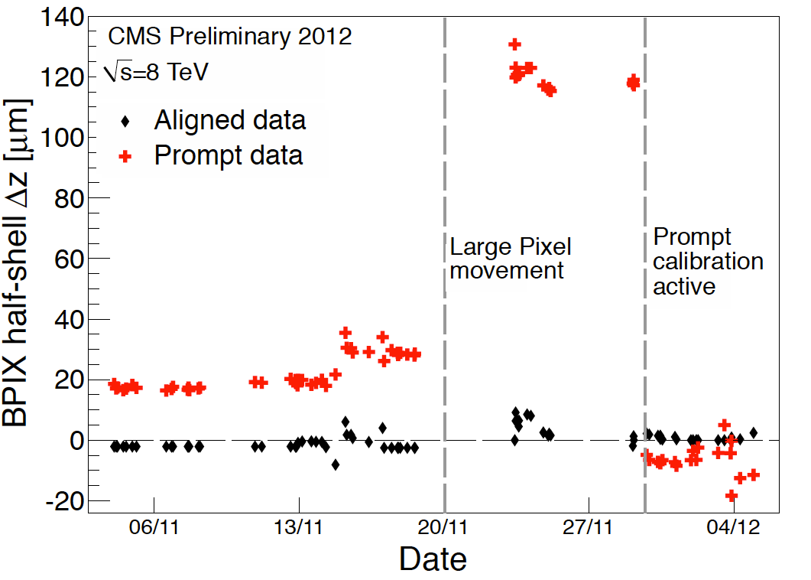
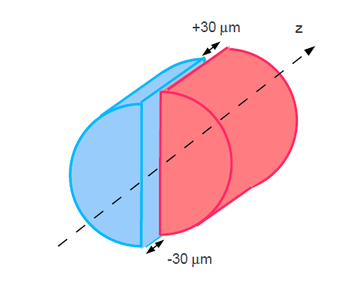
Monitor Movements of Pixel Large Structures
Cylindrically symmetrical Pixel detector is physically separated into two half barrels
Corrections for relative displacements along $z$ between the barrels are time-dependent
Monitor longitudinal separation (within mechanical tolerance) using unbiased track-to-vertex residuals
done for every run ($\sim 20k$ events) using express strem
Time dependence of pixel structure alignment accounts for separation as a function of time
b-tagging algorithms insensitive to remaining 10 $μ$m effect

Slide 11
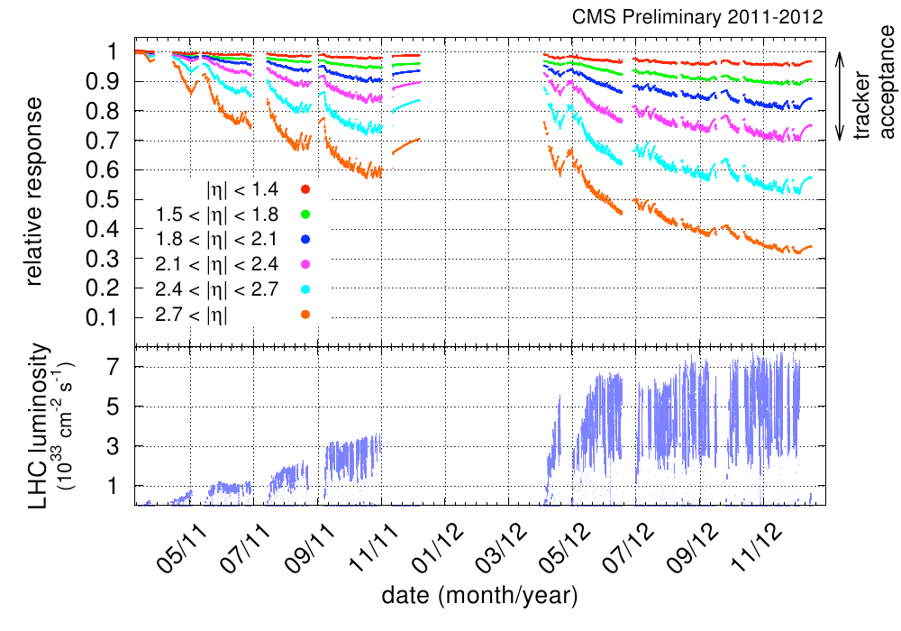
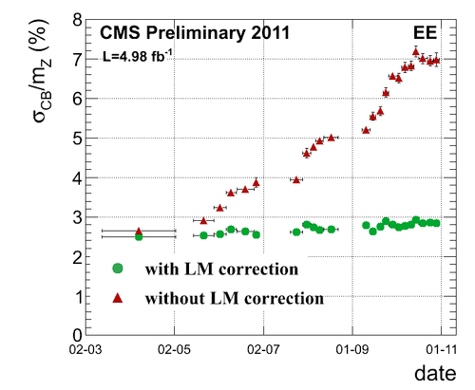
Monitoring the ECAL Response
ECAL $PbWO_{4}$ crystals temporary change transparency due to irradiation
less significant in barrel, more pronounced in endcaps (where photo-detectors get conditioned by strong irradiation)
Damage/recovery cycles monitored by laser pulses (447 nm, 100 Hz in LHC abort gaps) and photo-detectors measuring the response variation to the laser light
continuous monitoring, the whole ECAL measured in 40 min
use dedicated stream at trigger
Corrections derived within 48 h and applied to prompt reconstruction
Stable $Z→ee$ mass resolution

Slide 12
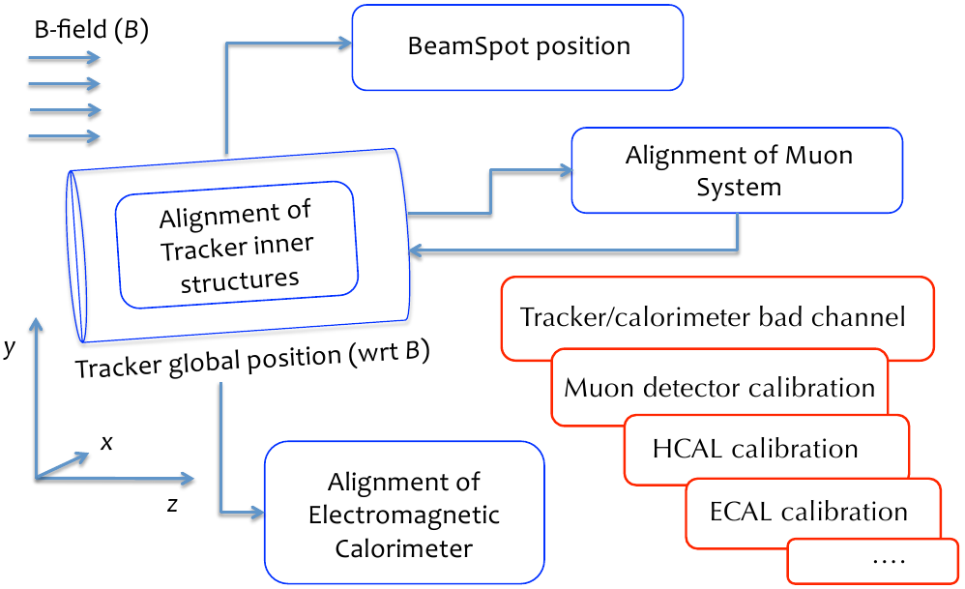
Offline Alignment and Calibration
All subsystems are aligned and calibrated offline

Slide 13
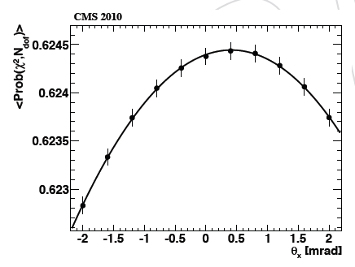
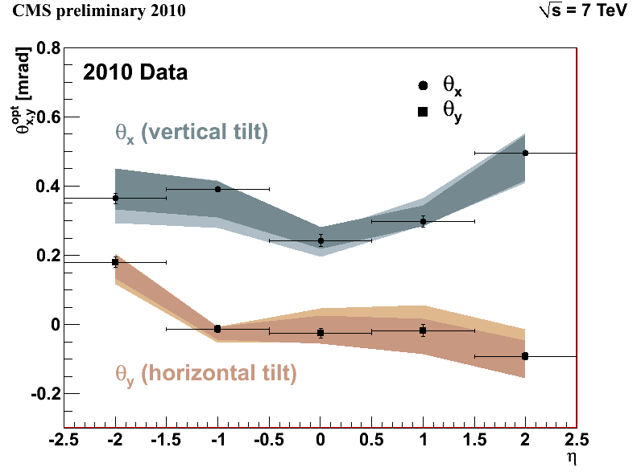
Tracker Orientation w.r.t. $\vec{B}$-field
Tilts of the Tracker relative to magnetic field (flux along global $z$) could result in biases of the reconstructed track parameters
need to be corrected
The global Tracker orientation is described by the angles $θ_{x}$ and $θ_{y}$ that correspond to rotation around global $x$ and $y$ axis of the CMS
Goodness of track fit scans for various tilt angles
$θ_{y}\sim 0$ mrad, $θ_{x}\sim 0.3$ mrad
Goodness of tracking fit

Slide 14
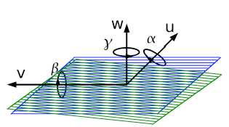
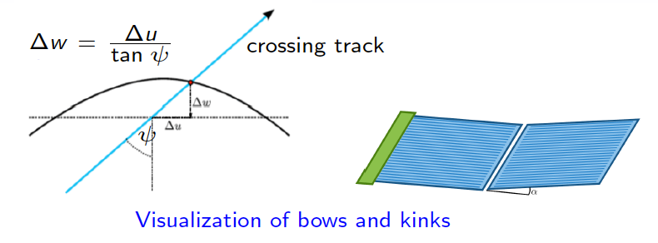
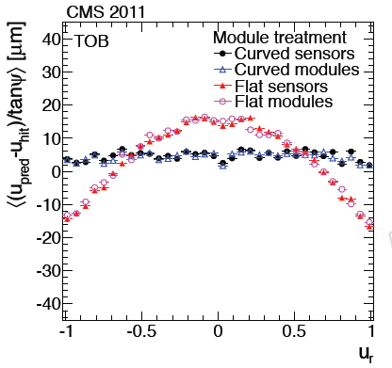
Tracker Alignment with Tracks
The track-based alignment with MillePedeII minimization algorithm expected to provide $<10 μ\text{m}$ precision
The CMS Tracker is a complex system:
24k sensors in total
$O(200k)$ free parameters per sensor (a sensor depends on other sensors)
5(6) rigid body + 3 bow parameters for each sensor
Example: the 2011 alignment campaign with 1 fb⁻¹ of reconstructed data
inputs: 15M loosely selected isolated muon tracks
3M low momentum tracks
3.6M cosmic ray tracks
375k muon track pairs from $Z$
Z-mass measurement as a constraint
Fitting sensor bows and kinks
Time dependent (9 intervals) rigid body
alignment for large pixel structures
Enormous computing task!
Precision estimated from the RMS of the Distribution of the Medians of the Residuals for each module
more robust against Multiple Scattering

Slide 15
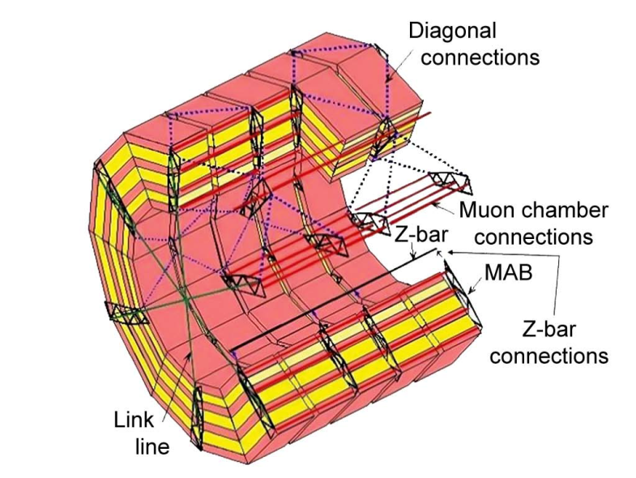
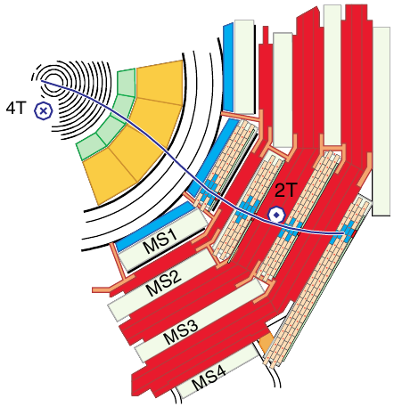
Muon System Alignment
Hardware based: measures positions of all chambers with respect to a floating network of rigid reference structures ($σ_{x}$ and $σ_{y}\sim 1$ mm)
provides physically bound constraints on track-based alignment
Track based: minimizing the residuals which are the differences between measured (with segments) and predicted (propagated from Tracker) position of the muon in the chamber ($σ_{Rφ}\sim 100−150 μ$m)
more details in poster session
Combination (and comparison) of the methods
muon from collision
$$z$$
$$x$$
“reference”
$$y$$
$$Δx_{L}$$
$$Δy_{L}$$
Muon track
from tracker
Muon segment
from hits
“target”

Slide 16
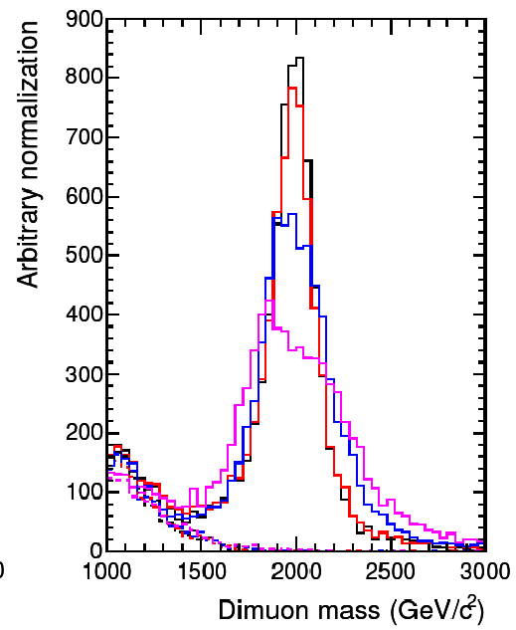
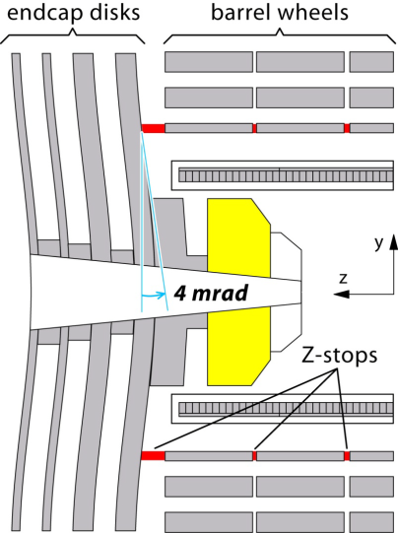
Why the Muon Alignment Important?
Beyond 200 GeV, the muon system can contribute significantly to overall momentum resolution due to large lever arm
Precise muon alignment becomes essential for searches with high $p_{T}$ muons (e.g., $Z′→μμ$)
Why the Muon System Misaligned?
Deformations due to gravity force (~10 mm)
Barrel shrinks & endcaps bend due to magnetic force (~10 mm)
Repositioning after detector open/close operations (~1 mm)
Imperfect positioning during installation (sub-mm)
Temperature effects (sub-mm)
$$0<η<0.2$$
$$Δp/p$$
Muon system only
Inner tracker only
Full system
$p$, GeV
$m_{Z^{′}}=2$ TeV

Slide 17
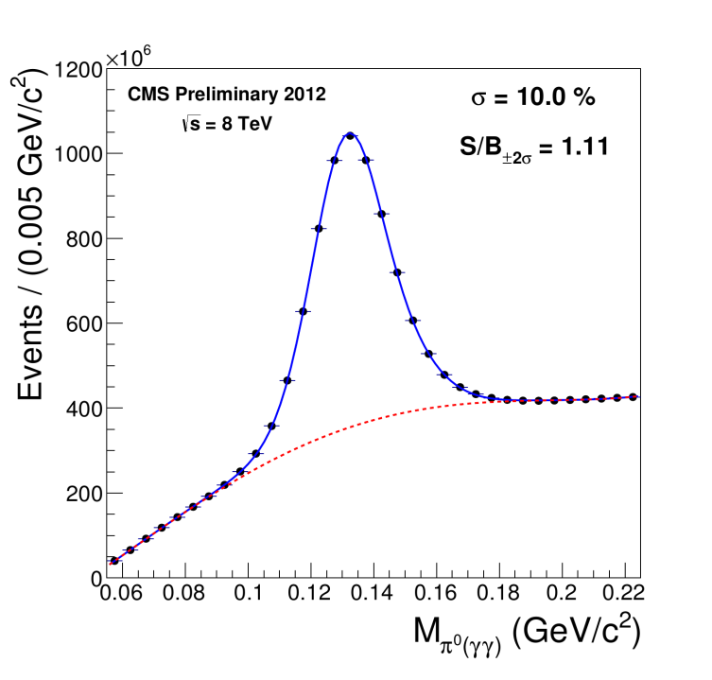
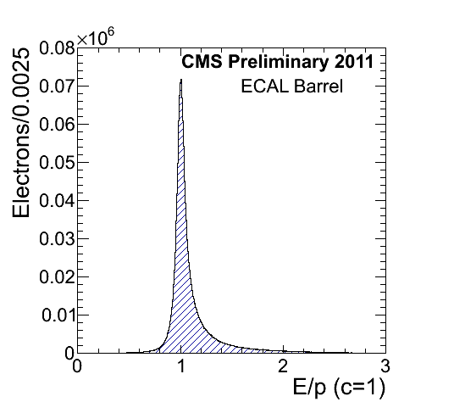
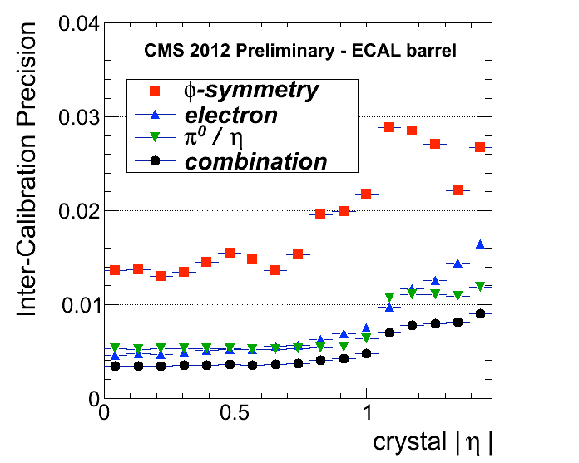
Offline ECAL Calibration
Inter-calibration of crystals located within the same $η$ ring:
$φ$-symmetry of the energy flow trough the ECAL crystal ($\sim 3$-$4$ days)
$π^{0}/η→γγ$ invariant mass peak ($\sim 1.5$ months)
$E_{ECAL}/p_{tracker}$: high energy electrons from $W→eν_{e}$ and $Z→ee$ decays (once in a year)
Key feature: dedicated streams at HLT with reduced event content
$\sim 1.5$ kHz of ZeroBias events for $φ$-symmetry and a total of $\sim 7$ kHz for $π^{0}/η$
Combination: weighted average of the 3 methods
The calibration determines energy scale and resolution

Slide 18
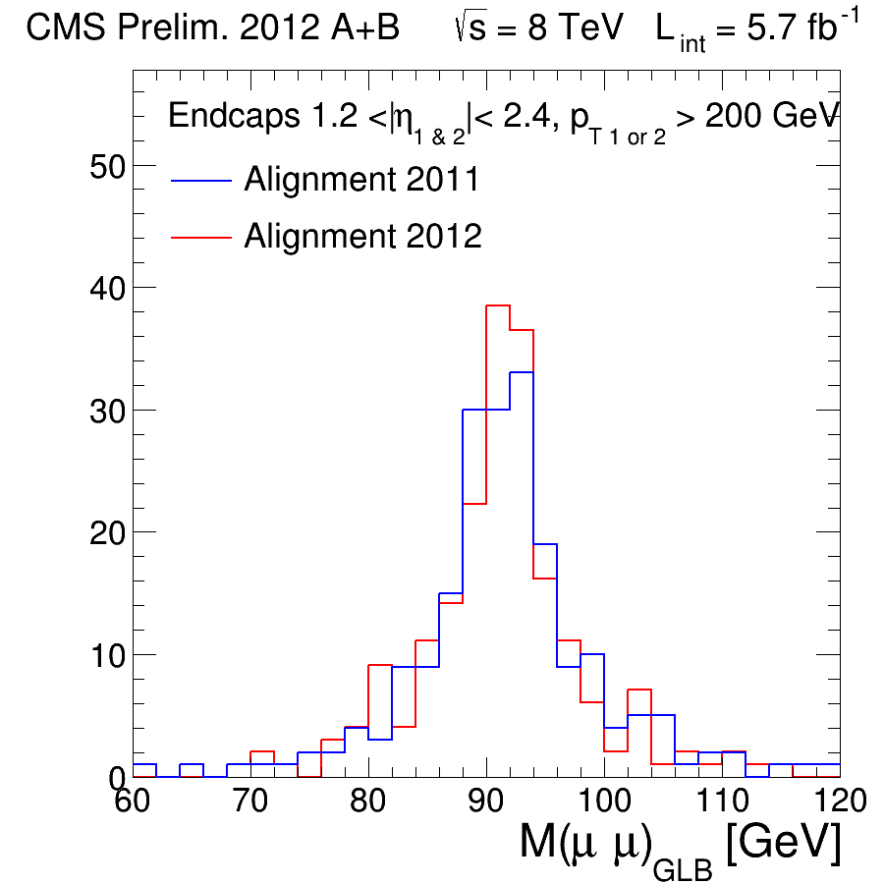
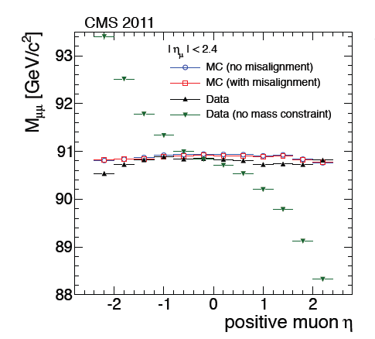
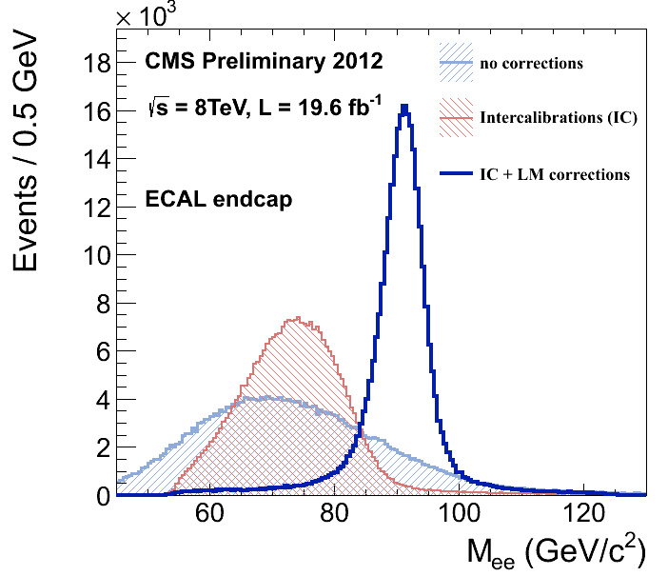
Validation
All offline alignment and calibration constants are thoroughly validated before injection for data reprocessing
“standard candle” process $Z→ee/μμ$ used by many system
Muon System
ECAL
Tracker
$$RMS=8.0 GeV$$
$$RMS=7.1 GeV$$

Slide 19
Alignment and Calibration Constants Storage
All constants stored in SQL Data Base for global access by data processing computing jobs from all over the World
All CMS Tiers must use the same conditions
Set of matching constants is identified via “tag”
complete and consistent as required for data processing
simple access for non-expert users (undergraduates and distinguished professors)
experts can customize used constants
Tags:
GR_P_V41
START53_V7A
MuAl_ver1
TkAl_v1
MuAl_ver2
*%#$@!
TkAl_v2
MuAl_ver3
ECAL_1
^&^&^&
Tracker
Alignment
Muon
Alignment
ECAL
Calibration
System XYZ
Alignment

Slide 20
Summary
The CMS alignment and calibration infrastructure proved to be efficient and effective for a fast analysis turn-around during data taking in 2011 and 2012
The prompt alignment and calibration mechanism:
Designed for low latency workflow run smoothly during Run1
Better quality of physics reconstructed objects already during very first processing of data
The offline calibration and alignment procedure:
Increasing time/space granularity of the calibrations and thus precision
Delivering to reconstruction the best knowledge of detector performance based on state-of-the-art algorithms
Account for inter-dependencies among the different systems and workflows
Calibration and alignment has been crucial step towards the successful physics program of CMS during 2010-- 2012
Revision of main workflow is under study
Goal is to keep the high standard
Looking forward to Run2 in 2015 and possible discoveries!

Slide 21
Back-up Slides

Slide 22
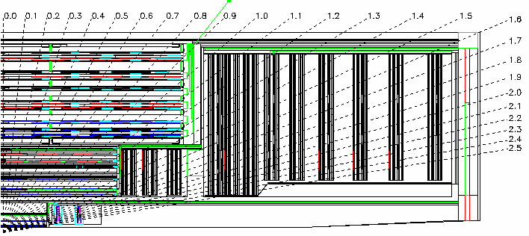
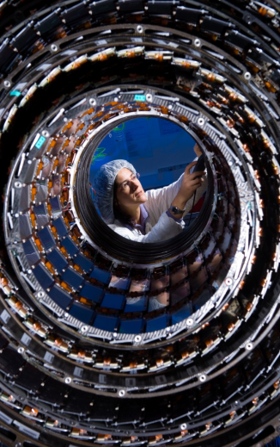
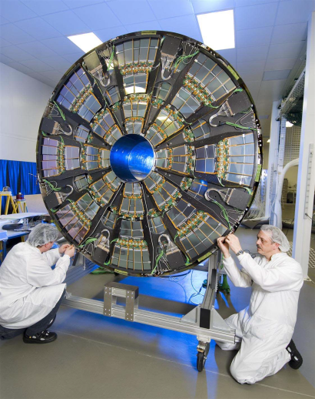
CMS Inner Tracker
Pixel detector: 66M channels
pixel size $100×150$ $μm^{2}$
3 barrel layers, $2×2$ endcap wheels
span to beam $4.7<R<10.2$ cm
Strip detector: 10M channels
10 layers and $>200 m^{2}$ of silicon
largest silicon tracker!
span to beam $20<R<116$ cm
Barrel
Endcap wheel

Slide 23
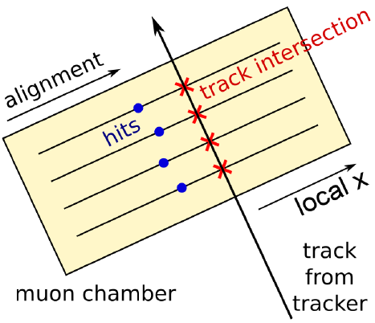
Residuals in Track-based Muon Alignment
Muon residual is difference between measured (with hits) and predicted (i.e. propagated from Tracker) position of the muon in the chamber
Residuals calculated in chamber’s local frame
hit (layers) based muon re-fit is used
local residual x = track local x – hit local x
scattering in iron → width of residual distribution
chamber misalignment → non-zero mean of distribution

