Slide 1
Time-Projection-Chamber for MPD NICA Project
Stepan Vereschagin
On behalf of the TPC team:
A.Averyanov, A.Bajajin, V.Chepurnov, S.Chernenko,
G.Cheremukhina, O.Fateev, A.Korotkova, F.Levchanovskiy,
J.Lukstins, S.Razin, A.Rybakov, S.Vereschagin, Yu.Zanevsky,
S.Zaporozhets, V.Zruyev
TPC/MPD Collaboration
Laboratory of High Energy Physics, JINR, Dubna
Novosibirsk, 2014

Slide 2
CONTENS
TPC design overview
Field cage and central cathode plane
TPC readout chamber (ROC)
Front-End electronics (FEE)
TPC laser calibration
Gas system
Cooling system
Conclusion

Slide 3
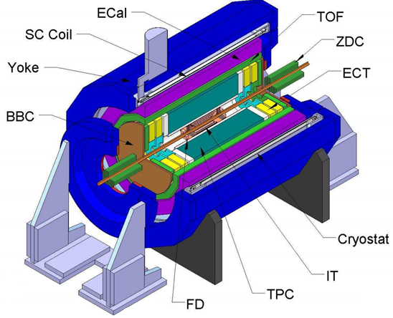
General view of the MultiPurpose Detector (MPD) NICA project
SC Coil - superconductor solenoid
IT - inner detector
ECT - straw-tube tracker
TPC - time-projection chamber
TOF - time-of-ﬂight stop counters
FD - The fast forward detectors
ZDC - zero degree calorimeter
BBC - beam-beam counter

Slide 4
TPC design overview
beam
12x2 Readout
chambers
E
beam
HV-electrode
Field cage
Physics requirements:
The overall acceptance on │‌η│~ 1.2
The momentum resolution ~ 3% in p_{t} interval from 0.1 to 1 GeV/c
Two-track resolution ~ 1 cm.
Charged particle multiplicity ~ 1000 in a central collisions
Hadron and lepton identification by dE/dx measurements with resolution better than 8%

Slide 5
Main parameters of the TPC
Length of the TPC | 340 cm
Outer radius of cylinder | 140 cm
Inner radius of cylinder | 27 cm
Length of the drift volume | 170cm (of each half)
Magnetic field strength | 0.5 Tesla
Drift gas | 90% Ar+10% CH₄
Temperature stability | 0.5°C
Gas amplification factor | ~ 10⁴
Number of readout chambers | 24 (12 per end plate)
Pad size | 5x12mm² and 5x18mm²
Number of pads | 95 232
Pad raw numbers | 53
Maximal trigger rate | ~5 kHz
dE/dx | better than 8%
∆p/p | ~ 3% in 0.1< p_{t}<1 GeV/c

Slide 6
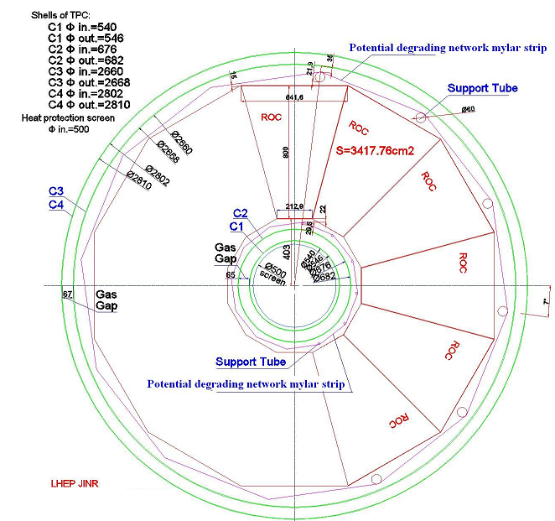
The front view of the TPC
Four cylinders (green circles: C1 - C4) are required to make the complete field-cage structure.
All four TPC cylinders are under construction in Russian Industry as monolithic Kevlar composite constructions. Kevlar thickness is 4 mm.
Such an approach allows one to minimize problems with gluing of field cage parts and fragments.
Moreover, we suppose to mount field cages, central electrode and end plates as independent precisely adjusted constructions which will be inserted between Kevlar сylinders and fixed together mechanically and with epoxy.

Slide 7
Construction of TPC cylinders
Material : Kevlar
Thickness: 4 mm
Length: 3.4 m
Diameter: 2.8 m
Deformation in operational position is less than 100 mkm

Slide 8
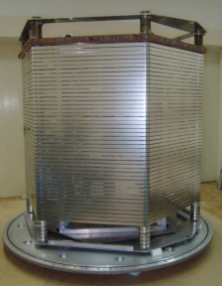
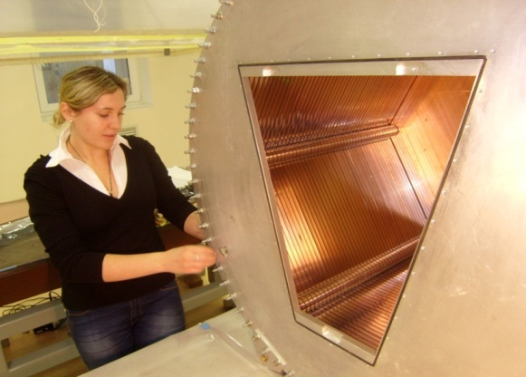
Field cage and central cathode plane
TPC prototype field cage
TPC prototype under constraction

Slide 9
Field cage
The non uniformity of the electric field inside the sensitive TPC volume has to be not more than 10⁻⁴ relative to nominal value (140V/cm P10 gas mixture)
The field distortions in the drift volume defined by mylar strip system a) precisely placed strips b) one strip is shifted by 50μm
The distortions are down to 10⁻⁴ at ~23mm from the strip surface inward drift space. The positioning precision of the strips into nominal place has to be not worst than 50μm.
✔Along the line parallel the strip surface(orange line)
✔Inward the drift space (violet line)
The dependence of the size of the worst region with the field distortion more than 10⁻⁴

Slide 10
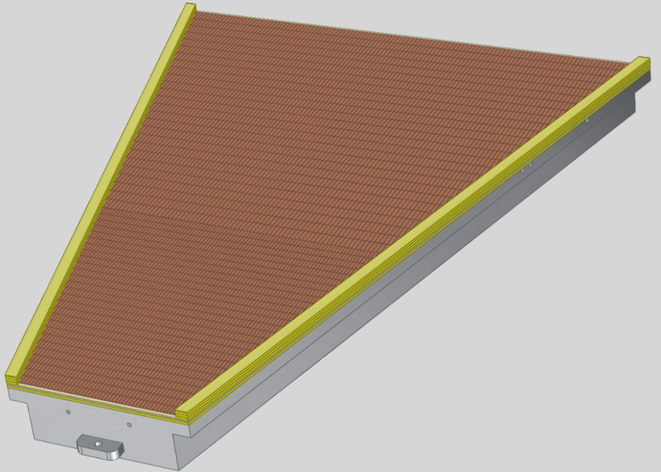
Readout chamber
Structure of readout chamber:
- three wire planes
- pad plane
- insulation plate
- trapezoidal aluminum frame
Pad structure
pad raw number 53
rectangle shape
- small pads 5×12 mm²
- large pads 5×18 mm²
Wires structure
- anode wire pitch 3 mm
- cathode wire pitch 1,5 mm
- gate wire pitch 1 mm
- wires gap 3 mm
Pad plane
Insulation plate
Al-body

Slide 11
TPC readout chamber: Al body
The aluminum frame provides the overall mechanical stability of the readout chamber. Its stability against deformation caused by wire stretching has to provide as minimal as possible overall deformation less than the expected wire sag caused by electrostatic forces.
The frame is reinforced by stiffening rib
The deformations do not exceed 27 mkm
at the total wire tension ~ 800 N and
over pressure inside TPC up to 5 mBar
Finite element calculation of the deformation of the readout chamber caused by the wire tension and over pressure inside TPC

Slide 12
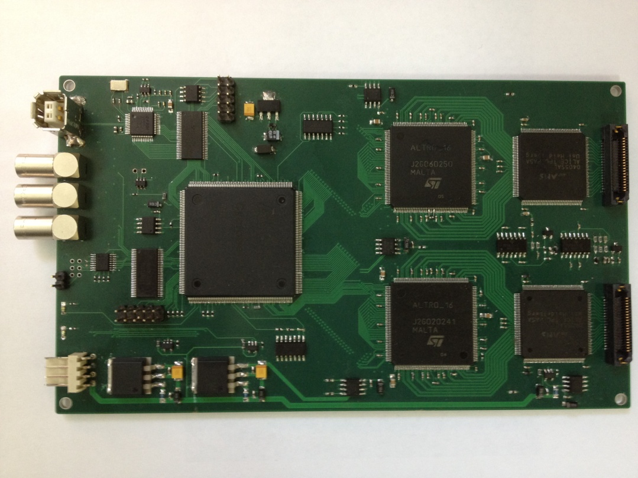
Front-End Electronics
Signal to noise ratio, S/N - 30
σ_{NOISE} < 1000e⁻ (С=10-20 pF)
Dynamic Range - 1000
Zero suppression
Buffer (4 / 8 events)
PASA
ALTRO
ALTERA
FPGA
PASA
ALTRO
Front-End Electronics prototype (USB2.0)
Microsemi
FPGA
3d-model of the new Front-End Electronics

Slide 13
Block diagram of FEE base

Slide 14
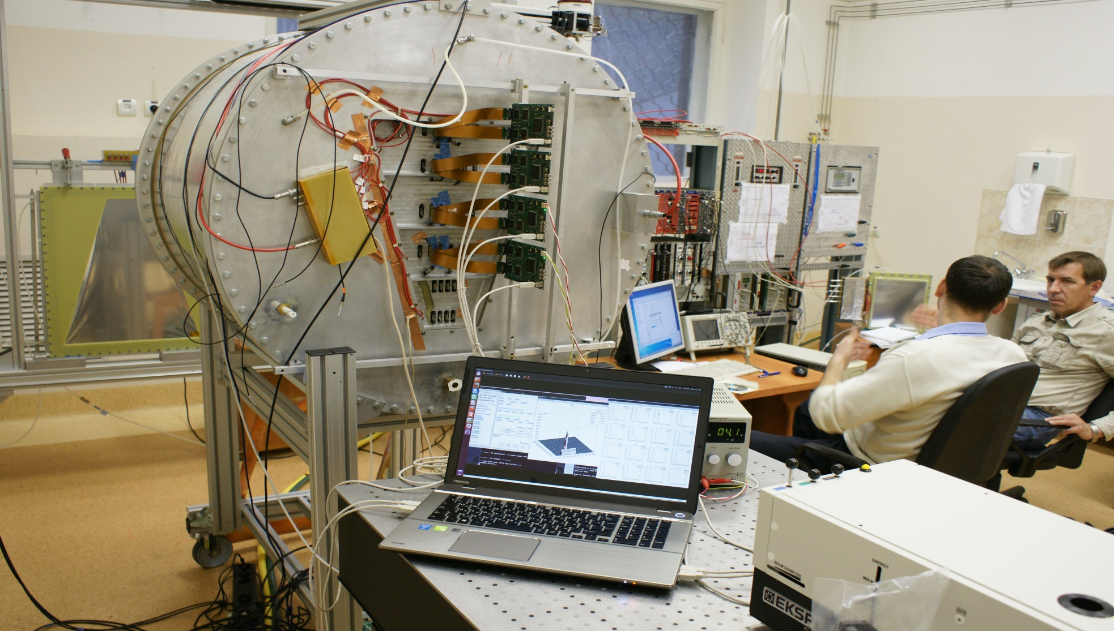
FEE Testing

Slide 15
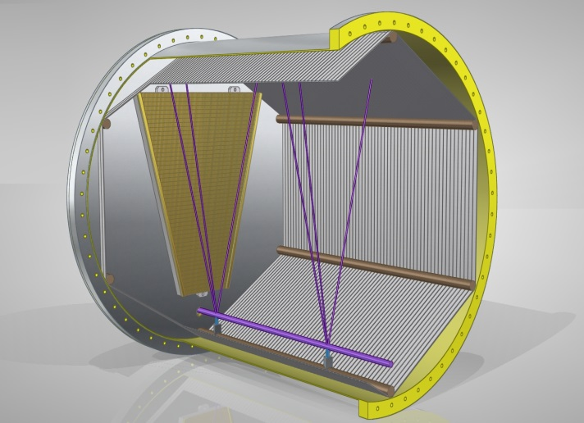
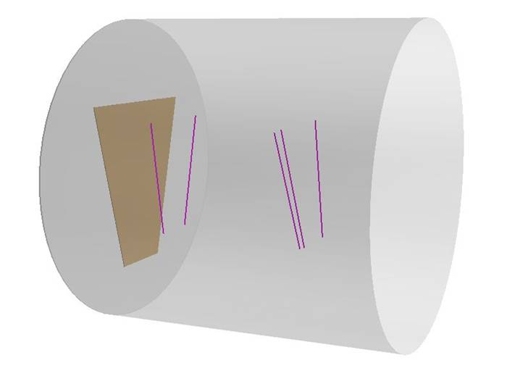
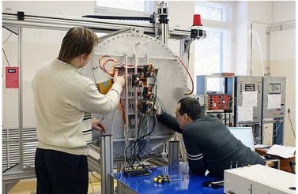
TPC testing
General view of the laser
beams inside TPC.
UV laser tracks reconstructed in Prototype 1.
Prototype 1 under preparing
to test with UV laser.

Slide 16
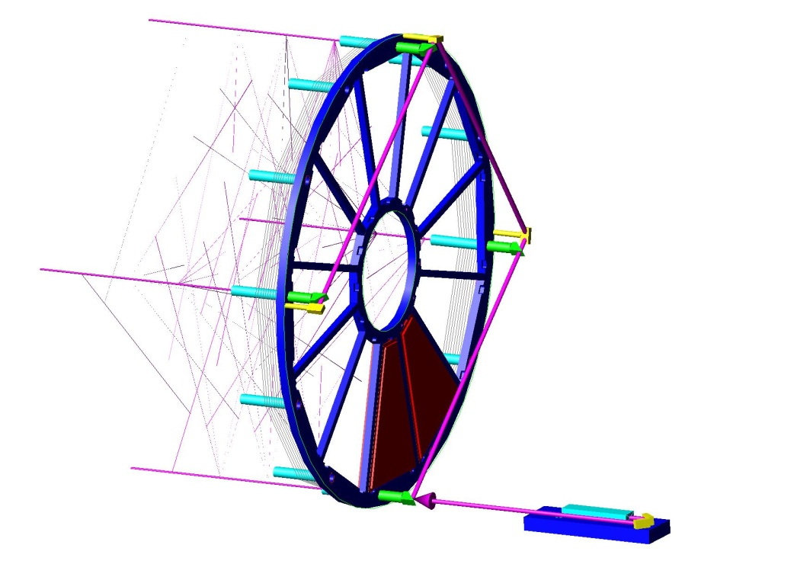
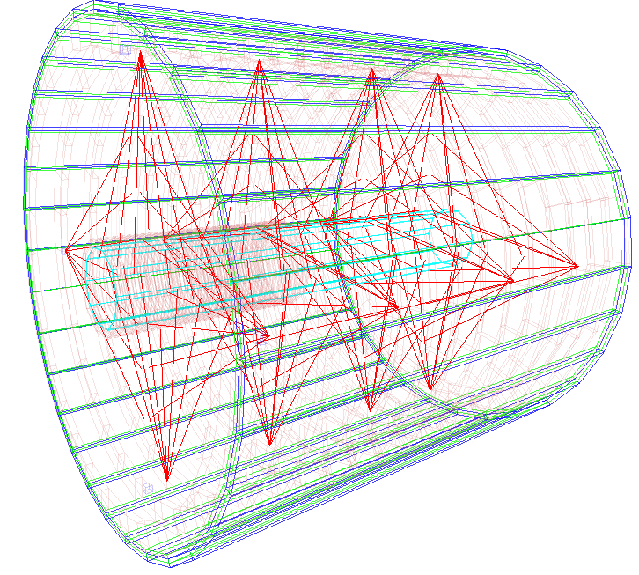
TPC Laser Calibration System
In order to minimize the error in the absolute position measurement by TPC, it is necessary to take into account both static and time-dependent distortions in the drift path of the ionization cloud. A calibration system that can reproduce fiducial tracks is needed to monitor the TPC performance. This calibration system will be based on the UV laser.
Semitransparent
mirror
Mirrors reflect
beam at 90⁰
There are 224 laser beams whole TPCin
Laser NL313-10
Scheme of high power laser beam splitting into 112 “tracks” of 1 mm diameter.

Slide 17
TPC gas system
Vent
Insulating gap
Ar
Requirements
90%Ar+10%CH₄
The drift volume is 18500 liters,
the insulating gaps – 4800 liters
Hermetically closed-loop gas circulation system
Dryer and purification in return line
Continuous monitoring of gas gain and drift velocity – gas chromatograph
Gas mixture temperature control - 0.5 K
Internal TPC pressure – 2 mbar
Recirculation flow - 3.8 m³ /h
CH
Insulating gas
4
Exhaust system
CO
Mixer
Gas supply
2
N
2
TPC
Absorber
Gas quality
monitor
Drift volume
Purifier
2
Compressor
CO
Buffer
Schematic view of the TPC gas system structure

Slide 18
TPC Cooling Scheme Preliminary estimation
Front End Cards cooling
Outer thermal screen
Resistor rods cooling
inner thermal screen
TPC gas volume, ∆T<0.5⁰C
Cover cooling
Bus bar cooling
FEE/ROC dissipation < 400 W
Resistor rods 2 x 8 W
Bus bar < 500 W

Slide 19
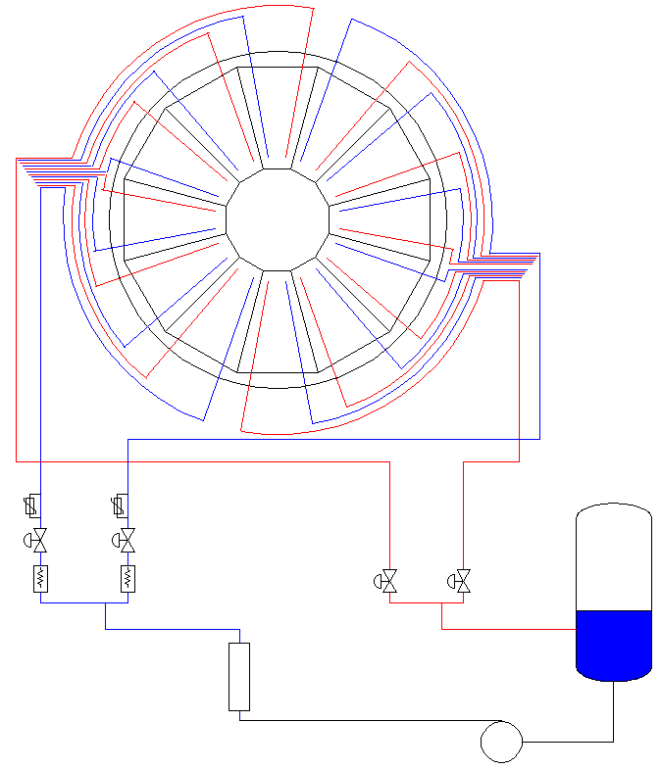
TPC cooling system
Flow rate:
• FEEC: 24 x 1m³/h
• ROC Covers: 24 x 0.2 m³/h
• Thermal screen: 24 x 0.5 m³/h
Total flow: 40 m³/h
Total heat to be removed: up to 10kW
Total Volume of water in the installation: 600L
Installed Electrical Power:
• Pump: 11kVA
• Heaters: 26kVA
Total Power: 37kVA
Number of Circuits:
• FEEC: 12+12
• ROC Covers: 2+2
• Therm screen: 12+6
• Resistor rods: 2+4
Total: 52
TPC
Temperature Sensors
Reservoir
Shut off valve
Heater
Heat Exchanger
at Exchanger
Circulator Pump
pressure in cooling loops is kept below atmospheric pressure

Slide 20
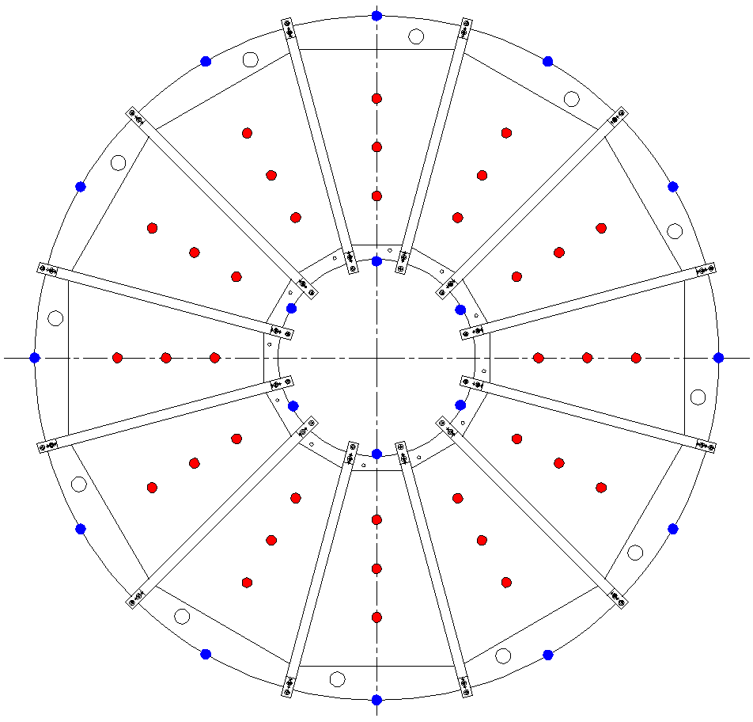
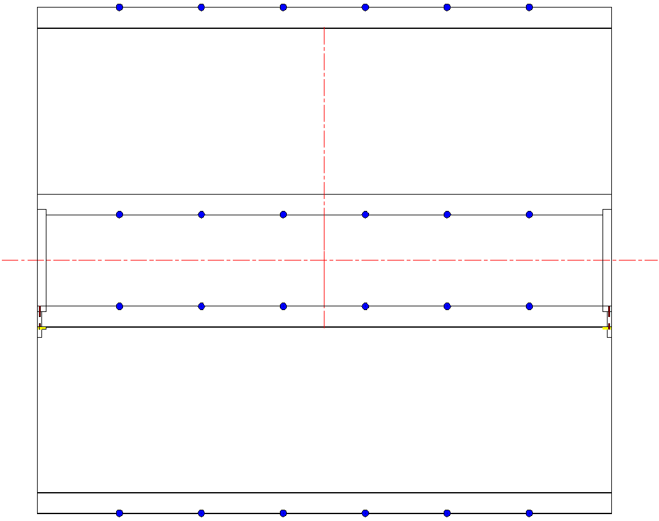
Temperature Monitoring
Sensors: blue – on the field cage, red on the chambers
Location | Outer Field cage | Inner Field cage | ROC modules
Number of the sensors | 72 | 36 | 72

Slide 21
Conclusion
Design of main parts of TPC are performed.
Three of fours TPC cylinders are constructed.
Technological Prototype TPC was designed, constructed and tested with laser beam and cosmic.
Readout Chamber (RoC) is designed and full size prototype is under construction.
The prototypes of FEE are constructed and tested.
Software is under developing.
Laser calibration system is designed.
Gas and Cooling systems are under designing.

Slide 22
Thank you for attention!
and welcome to collaboration.

Slide 23
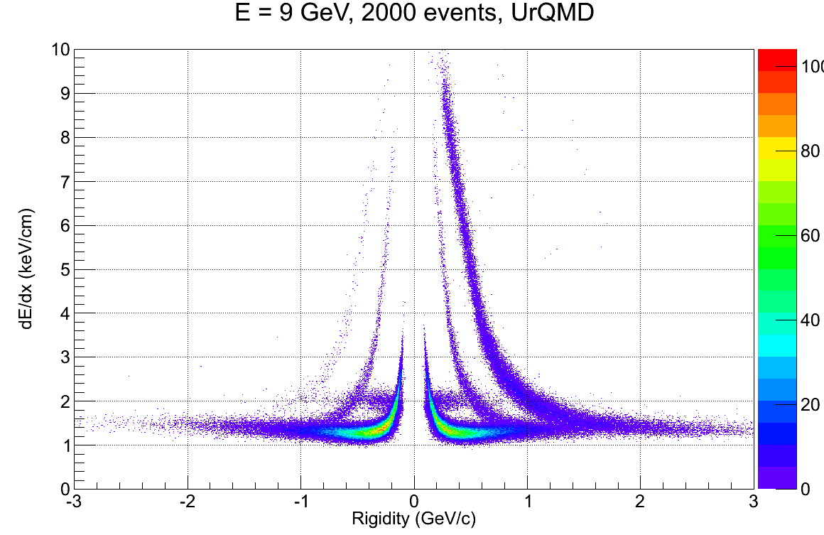
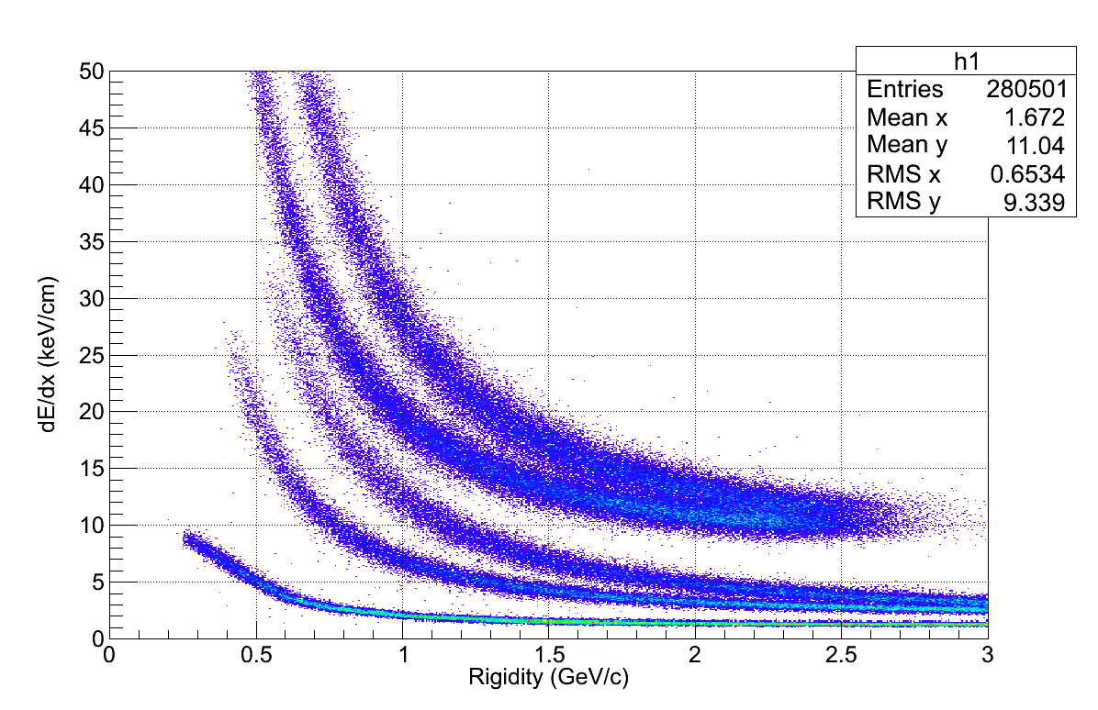
ENERGY LOSS
He3
He4
P
H3
K
D
π
P
e
TPC FEE input full scale amplifier ~ 200 fC
It is ~ 30-40 MIP energy loss
The energy loss distribution in the MPD TPC
PID: Ionization loss (dE/dx)
Separation:
e/h – 1.3..3 GeV/c
π/K – 0.1..0.6 GeV/c
K/p – 0.1..1.2 GeV/c
QGSM Au+Au central collision
9 GeV, b=1fm

Slide 24
Main parameters of the TPCs
Dimension | STAR TPC | ALICE TPC | MPD TPC
Length of the TPC | 420 cm | 500 cm | 400 cm
Outer Diameter of Vessel | 400 cm | 500 cm | 280 cm
Inner Diameter of Vessel | 100 cm | 170 cm | 54 cm
Cathode Potential | 28 kV | 100 kV | 28 kV
Drift Gas | Ar + CH₄ (90:10) | Ne + CO₂ + N₂ [85.7 : 9.5 : 4.8] | Ar + CH₄ (90:10)
Drift Velocity | 5.45 cm/µs | 2.65 cm/µs | 5.45 cm/µs
Number of Readout Sectors | 12×2 = 24 | 2×2×18 = 72 | 12×2 = 24
Number of Pads | 136 608 | 557 568 | 95 232
Pad Rows | 13 – inner subsector 32 – outer subsector | 32 – inner chamber 64 – outer chamber | 53
Pad Size | 2.85×11.5 mm² – inner subsector 6.2×19.5 mm² - outer subsector | 6×10 and 6×15 mm² | 5×12 mm² and 5×18 mm²
Magnetic Field | 0.25 T, 0.5 T | 0.5 T | 0.5 T
Electronics | ALTRO based | ALTRO based | ALTRO based
dE/dx resolution | 7.0% | 5.0% | 8.0%

Slide 25
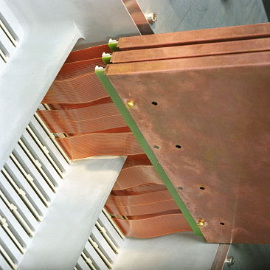
ALICE TPC FEE
FEC in Cu
sandwich
6 cables
per FEC
128 ch/FEC

