Slide 1


Study of focusing aerogels with test beams
A.Yu.Barnyakov, M.Yu.Barnyakov, V.S.Bobrovnikov, A.R.Buzykaev, V.V.Gulevich, P.V.Kasyanenko, S.A.Kononov, D.V.Korda, E.A.Kravchenko, V.N.Kudryavtsev, I.A.Kuyanov, A.P.Onuchin, I.V.Ovtin, N.A.Podgornov, V.G.Prisekin, L.I.Shekhtman, A.A.Talyshev
Budker Institute of Nuclear Physics, Novosibirsk, Russia
A.F.Danilyuk
Boreskov Institute of Catalysis, Novosibirsk, Russia
D.A.Finogeev, A.B.Kurepin, A.I.Reshetin, E.A.Usenko
Institute of Nuclear Research RAS, Moscow, Russia
C.Degenhardt, R.Dorscheid, T.Frach, O.Muelhens, R.Schulze, B.Zwaans
Philips Digital Photon Counting, Aachen, Germany
Sergey Kononov
Instrumentation for Colliding Beam Physics conference, INSTR14
February 27, 2014

Slide 2
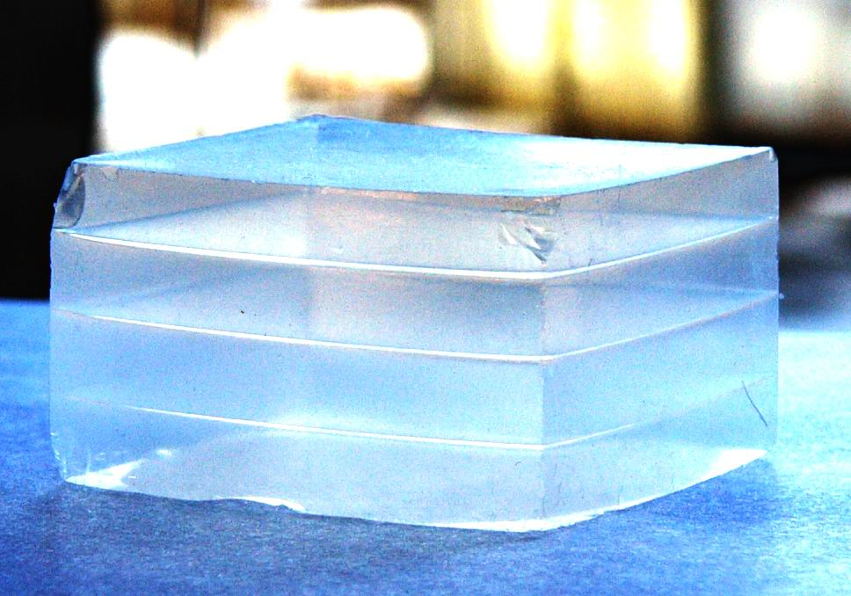
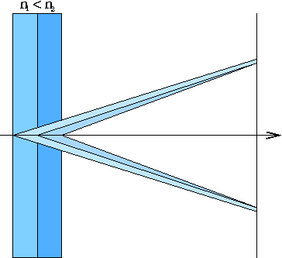
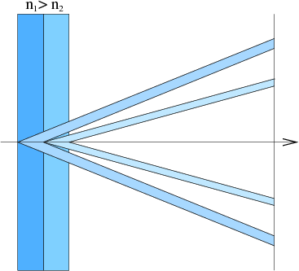
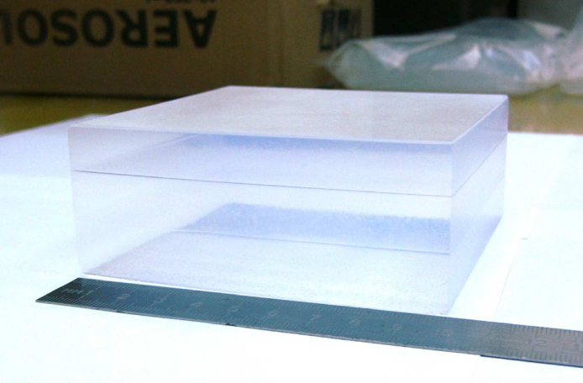
FARICH – Focusing Aerogel RICH
First sample of 4-layer aerogel by BIC
Single ring option
Multi-ring option
n=1.030 6.0mm
n=1.027 6.3mm
n=1.024 6.7mm
n=1.022 7.0mm
3-layer aerogel 115x115x41 mm³
Focusing aerogel improves proximity focusing design by reducing the contribution of radiator thickness into the Cherenkov angle resolution
Multi-layer monolith aerogels are produced by the Boreskov Institute of Catalysis in coop. with BINP since 2004.
In 2012 we succeeded in production of continuous density gradient aerogels.
T.Iijima et al., NIM A548 (2005) 383
A.Yu.Barnyakov et al., NIM A553 (2005) 70
Notes:
Идея ФАРИЧ появилась в 2004 г.
Точность измерения черенковского угла связана с точностью измерения скорости, а значит с качеством разделения частиц.

Slide 3
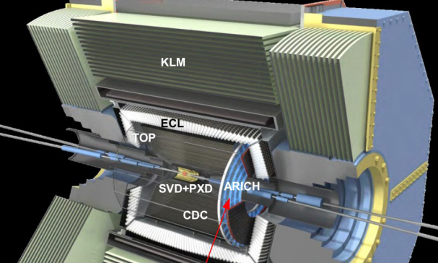
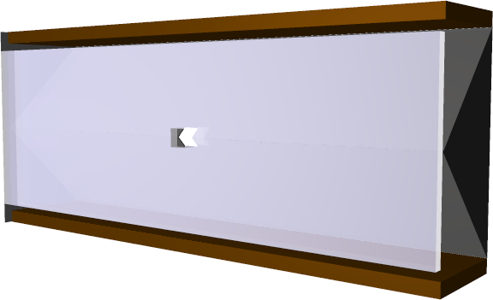
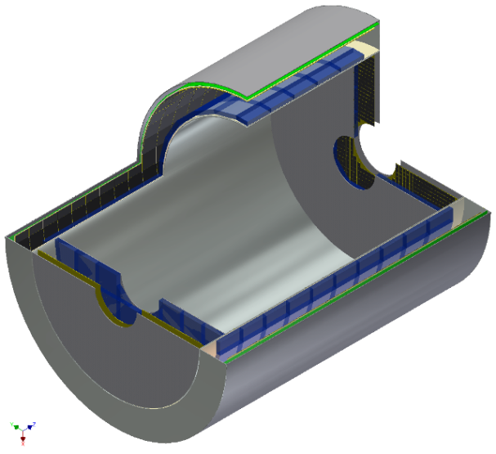
FARICH projects and proposals
Belle II ARICH (talk by Yosuke Yusa)
Particle ID: π/K up to 4 GeV/c
Forward end-cap: ~3m²
Two (separate) layers of aerogel: n₁= 1.045, n₂= 1.055
Photon detector: HAPD (Hamamatsu)
PANDA Forward RICH (BINP)
Particle ID: π/K/p up to 10 GeV/с
3m² detector area (MaPMTs or SiPMs)
FARICH PID system for Super c-τ factory (BINP)
Particle ID : μ/π up to 1.7 GeV/с
~21m² detector area (SiPM)
~10⁶ pixels with 4 mm pitch

Slide 4
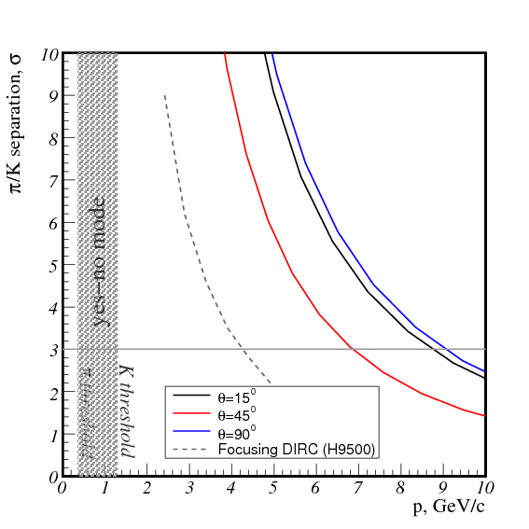
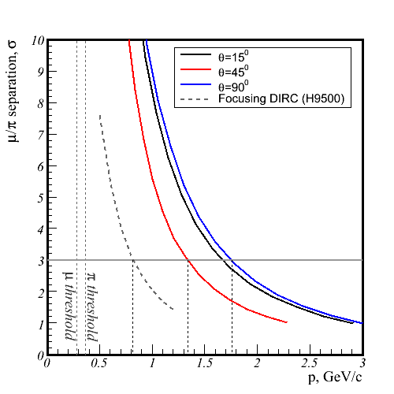
PID capability of
FARICH @ Super c-τ Factory
MC simulation: MPPC&4-layer aerogel
π/K
μ/π
μ momentum range for
τ → μγ at E_{cm}=4.2GeV
Such PID level is not achievable with other detectors like (F)DIRC
μ/π is needed for LFV search in τ→μγ.
Target sensitivity on Br(τ→μγ) ~10⁻⁹

Slide 5
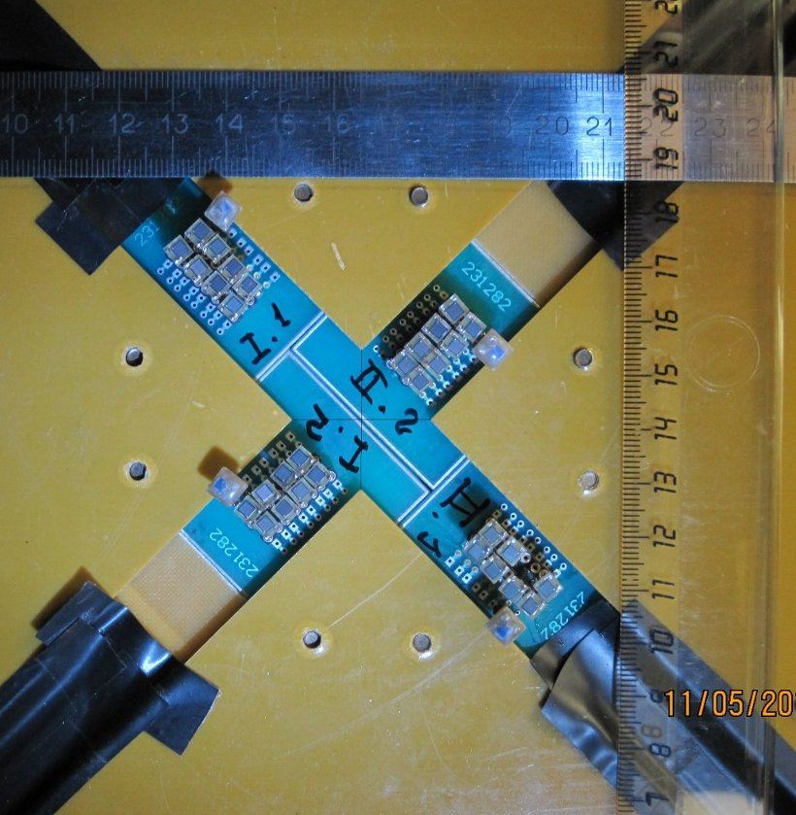
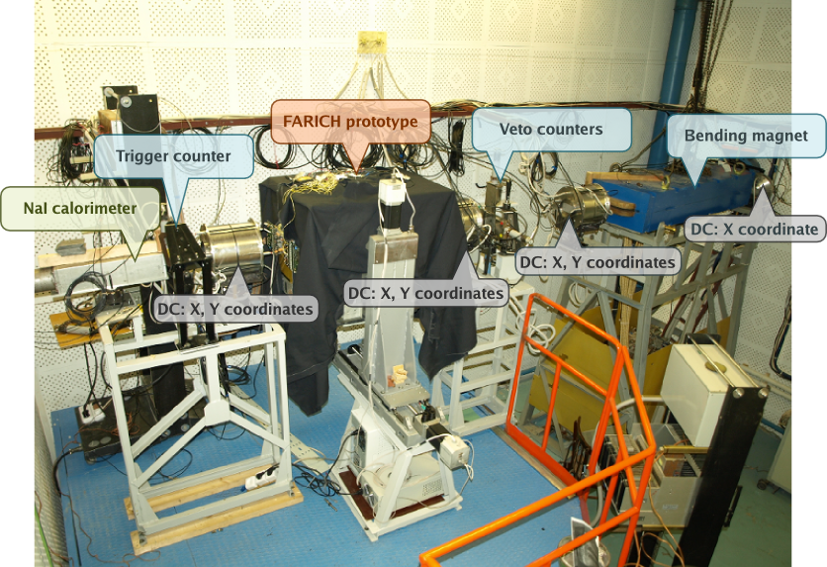
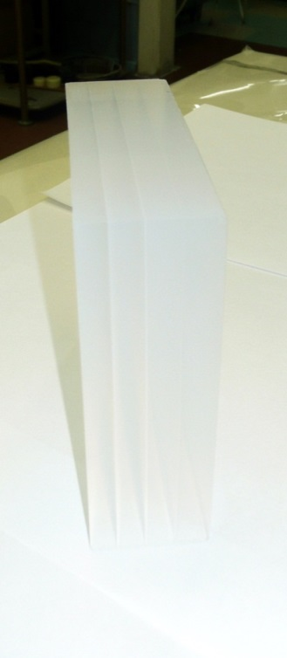
FARICH detector prototype with CPTA MRS APDs. BINP e⁻ test beam in 2011.
Poster by V. Bobrovnikov “Extracted electron and gamma beams in BINP“
32 CPTA MRS APDs with active pixel size 2.1x2.1mm²
4-layer aerogel focusing at 62 mm
n₁=1,050 t₁=6,2mm
n₂=1,041 t₂=7,0mm
n₃=1,035 t₃=7,7mm
n₄=1,030 t₄=9,7mm
Size: 100x100x31mm³
L_{sc}(400nm) = 43mm

Slide 6
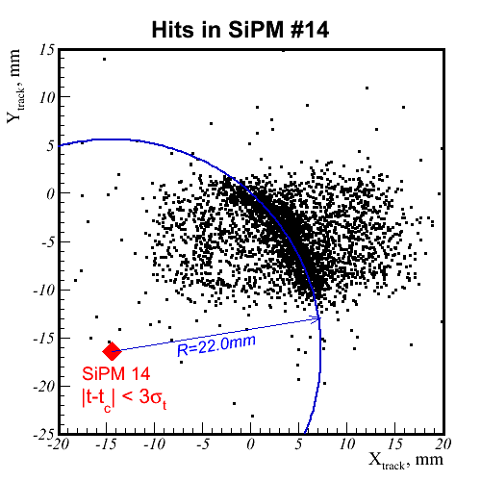
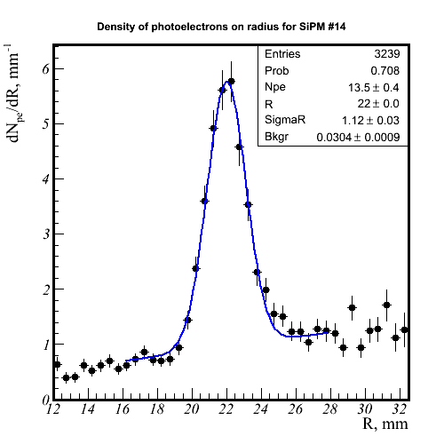
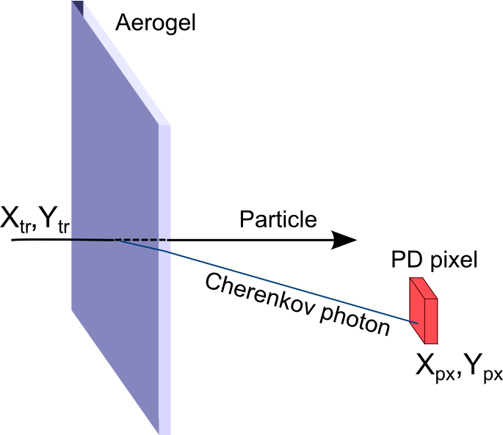
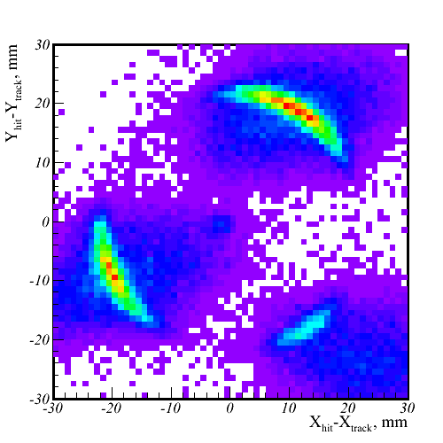
Single pixel approach for aerogel characterization
Given a tracking system and enough particle statistics, a single PD pixel is enough to build the distribution of Cherenkov photons on R_{ch} (θ_{ch}).
Sum of all pixels w.r.t. track position
Many pixels can be combined to improve accuracy and align the tracking system with the PD pixels

Slide 7
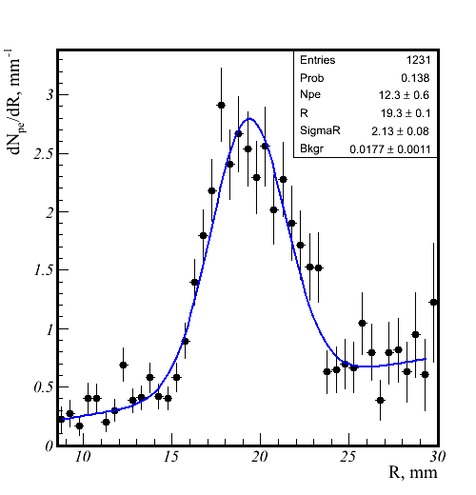
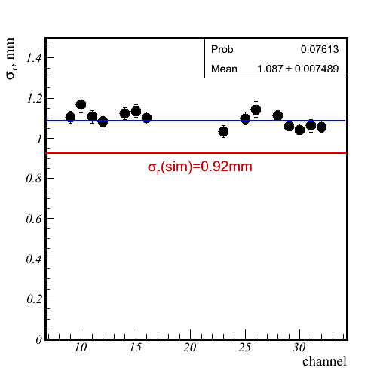
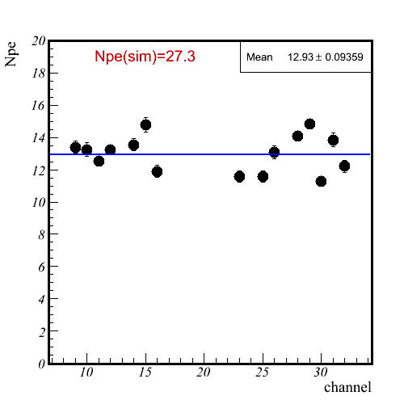
Beam test 2011 results
σ_{r} vs channel
σ_{r} =1.1 mm
σ_{r} =2.1 mm
N_{p.e.} vs channel
4-layer aerogel (t=3cm) vs single layer aerogel (t=2cm)
Focusing effect has been observed.
σ_{r}=1.1 mm – in rough agreement with MC simulation
‹N_{p.e.} › = 13 – 2 times less than expected

Slide 8
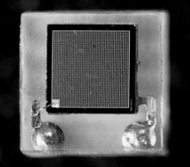
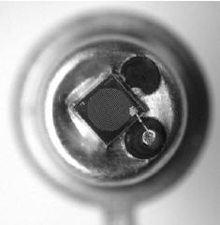
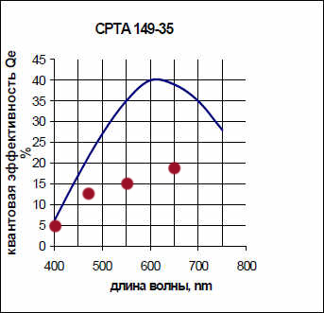
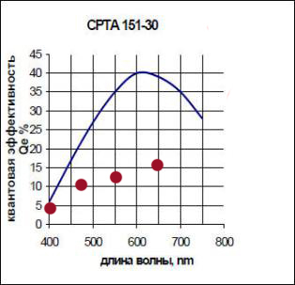
Absolute PDE measurements of
CPTA MRS APDs
CPTA data
Our measurements

Slide 9

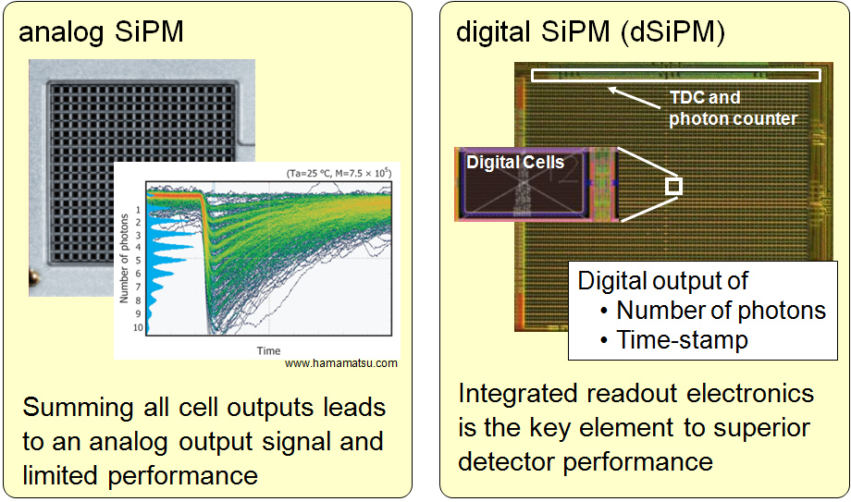
DPC: Front-end Digitization by Integration of SPAD & CMOS Electronics
Philips Digital Photon Counting (PDPC)
Digital Photon Counter (DPC)
T. Frach, G. Prescher, C. Degenhardt, B. Zwaans, IEEE NSS/MIC (2010) pp.1722-1727
C. Degenhardt, T. Frach, B. Zwaans, R. de Gruyter, IEEE NSS/MIC (2010) pp.1954-1956

Slide 10
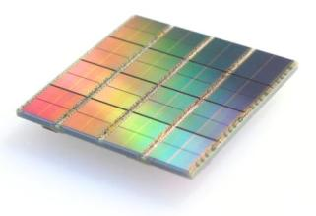
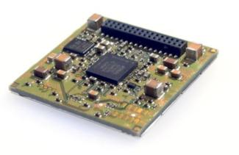
DPC tile – PCB with densely packed
4x4 sensors (8x8 pixels)
DPC3200-22-44 – 3200 cells/pixel
DPC6400-22-44 – 6396 cells/pixel
FPGA
Clock distribution
Data collection/concentration
TDC linearization
Saturation correction
Skew correction
Flash
FPGA firmware
Configuration
Inhibit memory maps
32.6 mm

Slide 11
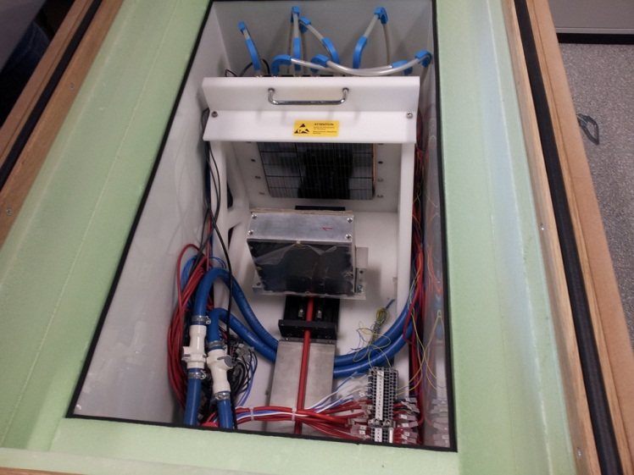
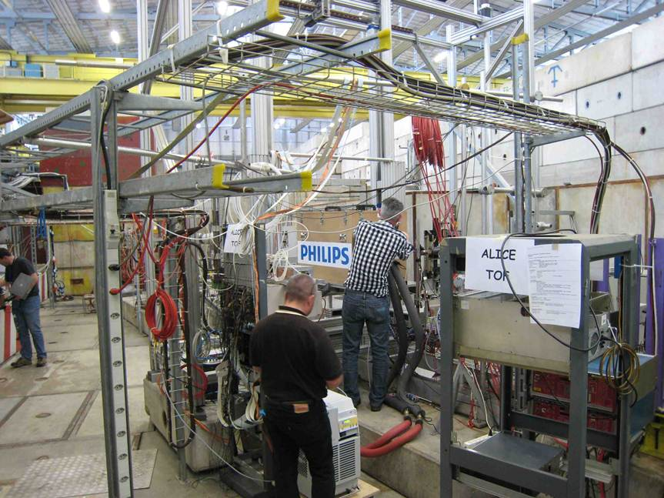
First test of DPC in RICH:
PDPC-FARICH prototype @ CERN PS T10, June 2012
Main objective:
  Proof of concept: full Cherenkov ring detection with a DPC array
Details:
Operation temperature is −40°C to suppress dark count rate
  Dead time is 720 ns.
  DCR(+25°C) ≈ 10 Mcps/sensor
  single photon detection is not feasible!
  DCR(-40°C) ≈ 100 kcps/sensor
  inefficiency is 7% .
2 stage cooling: LAUDA process thermostat + Peltiers.
Dry N₂ constant flow to avoid condensation.

Slide 12
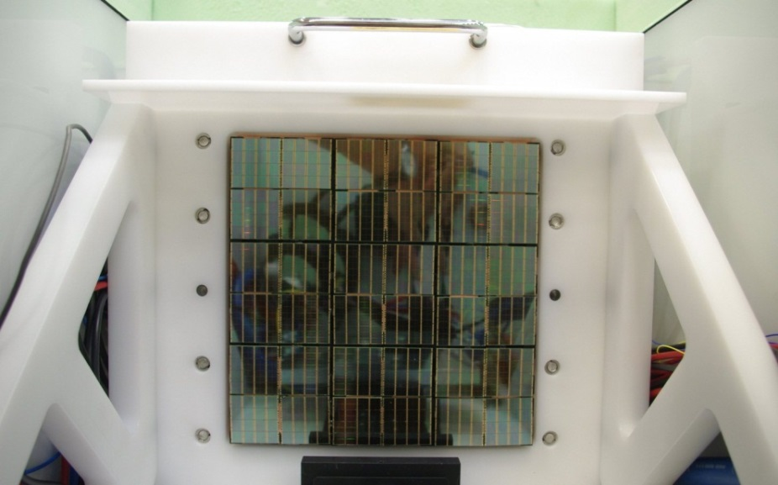
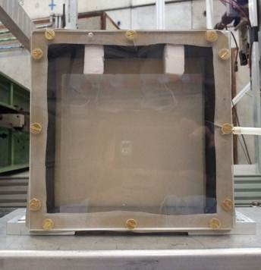
PDPC-FARICH setup
4-layer aerogel
n_{max} = 1.046
Thickness 37.5 mm
Focal distance 200 mm
Test conditions
Beam content: e⁺, μ⁺, π⁺, K⁺, p
Momentum: 1–6 GeV/c
Trigger: 2 sc counters 1.5x1.5 cm² in coincidence separated by 3 m
No external tracking, particle ID, precise timing of trigger
Square array 20x20 cm²
DPC3200-22 sensors,
3200 cells per pixel of 3.2x3.9 mm²
3x3 modules = 6x6 tiles
= 24x24 sensors = 48x48 pixels
576 timing channels
2304 amplitude channels (pixels)
3 levels of FPGA readout: tiles, modules, data collection board.

Slide 13
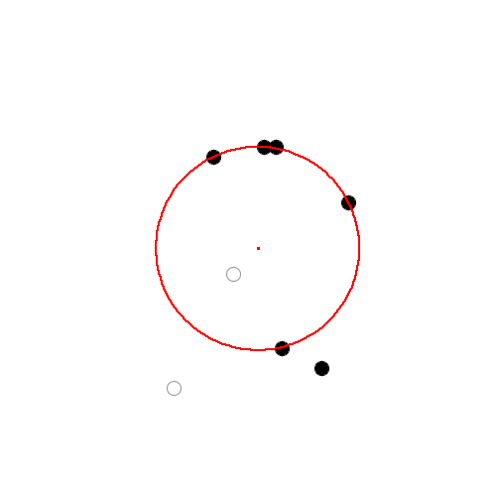
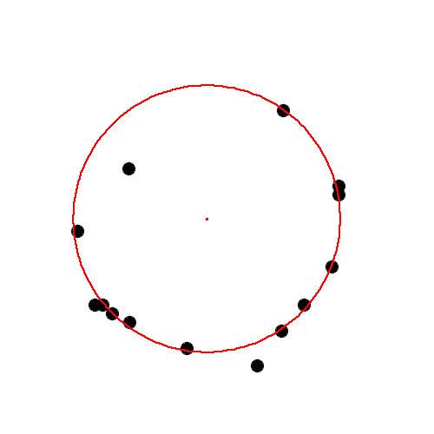
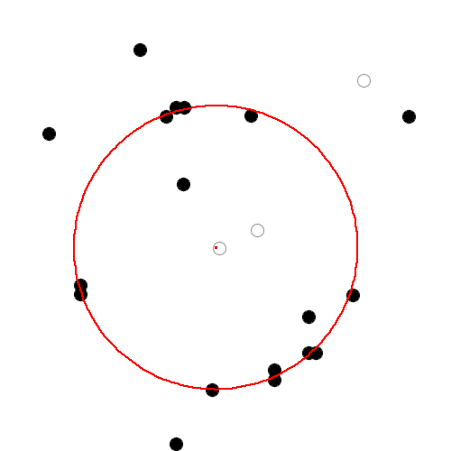
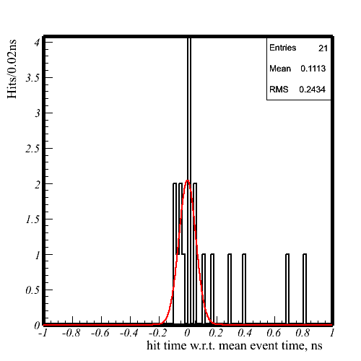
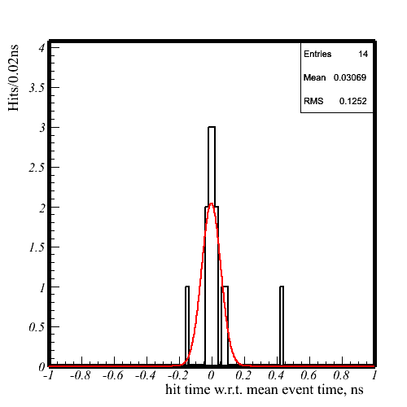
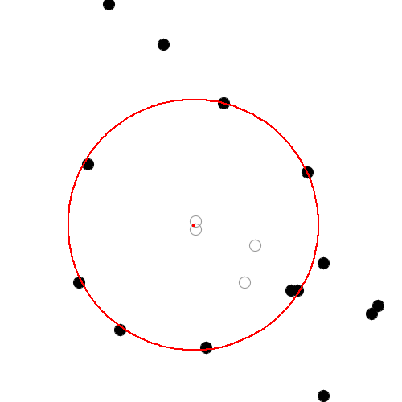
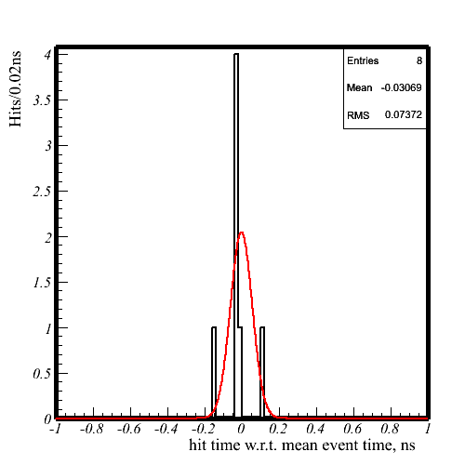
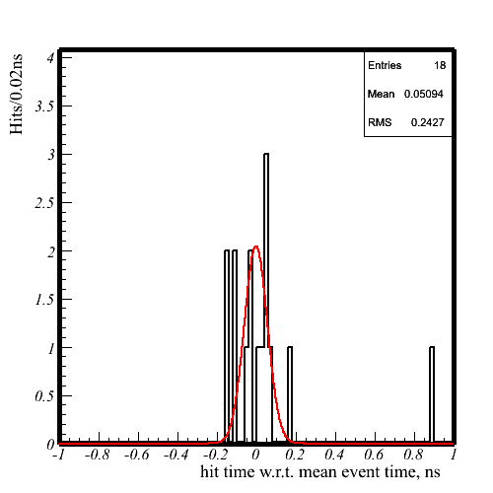
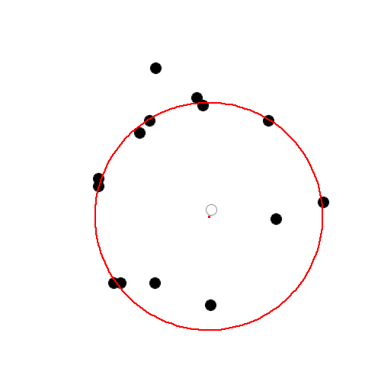
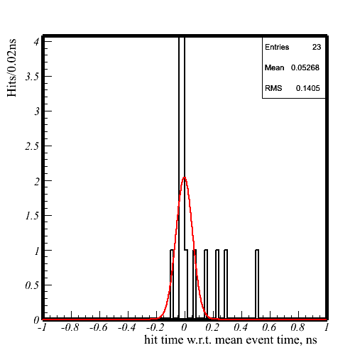
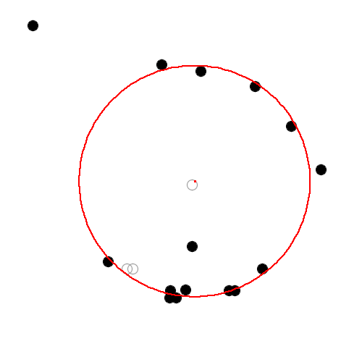
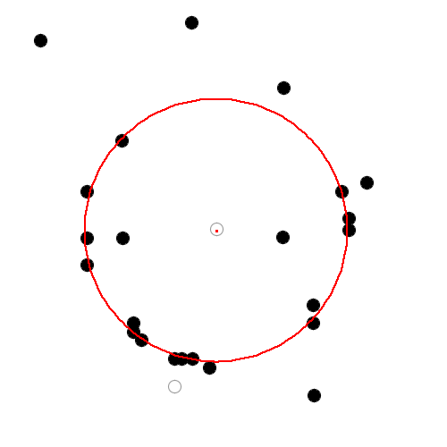
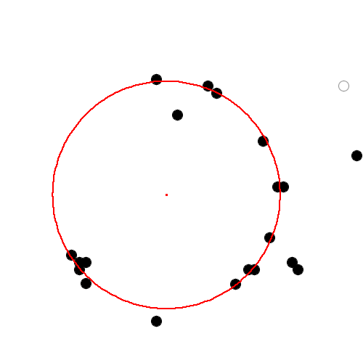
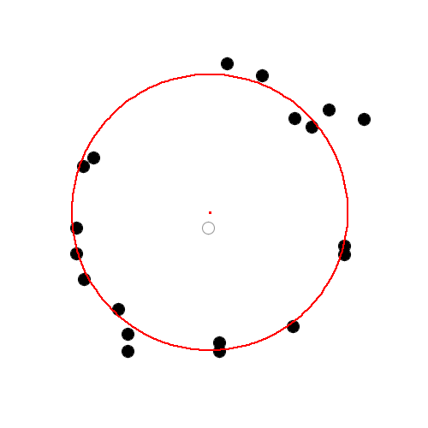
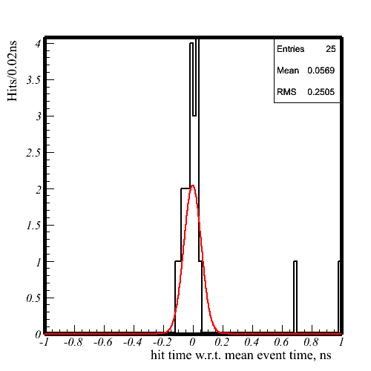
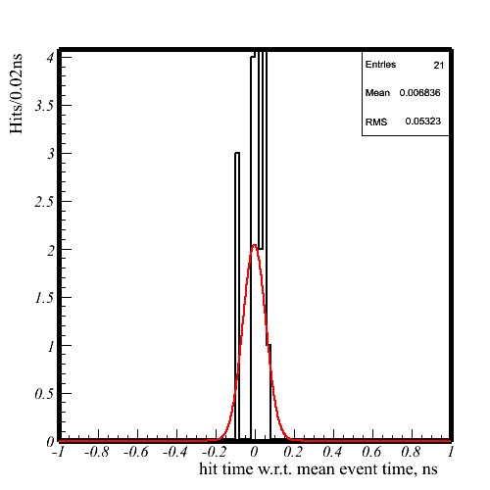
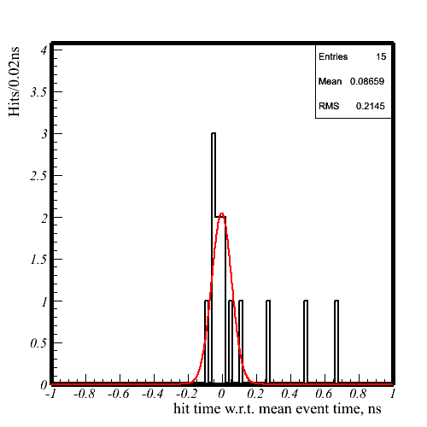
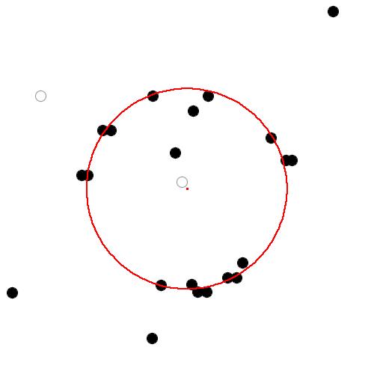
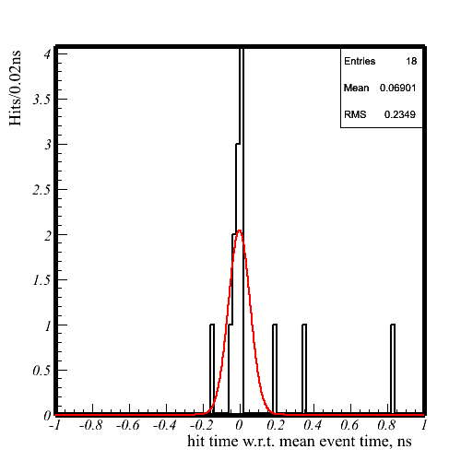
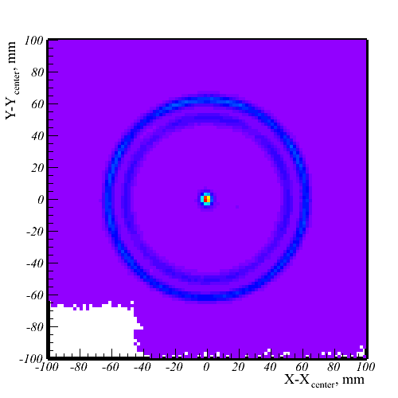

PDPC-FARICH: Ring fitting
Отбор срабатываний и подгонка кольца:
Отбрасывание центральных срабатываний
Отбор в 4 нс временном окне относительно среднего времени
≥3 срабатывания
Метод максимального правдоподобия с 4 параметрами: X₀, Y₀, R, t₀
P = 6 ГэВ/c
e, μ, π, K
p
Hit time w.r.t. fitted event time, ns

Slide 14


PDPC-FARICH: timing resolution and number of photoelectrons
Hit time w.r.t. fitted event time, ns
Number of hits
σ_{narrow} = 48ps
A record single photon resolution for SiPMs!
‹N_{p.e.} › = 12
(accounted for optical crosstalks)
1.7 times lower than expected

Slide 15




PDPC-FARICH: Particle ID evaluation
Ring distribution on radius
A.Yu. Barnyakov, et al., NIM A 732 (2013) 352
2.3 times higher than SuperB FDIRC
1.4 times higher than Belle II ARICH
2.6 times less than in initial MC simulation (with producer’s PDE)
π /K: 7.6σ @ 4 GeV/c
μ/π: 5.3σ @ 1 GeV/c

Slide 16

FARICH prototype #2 with CPTA MRS APDs diam 1.28 mm
60 CPTA 151, diam 1.28 mm,
noise 1-2 MHz/mm² at room
temperature

Slide 17



Upgraded PDPC-FARICH prototype at BINP
BINP e⁻ test beam in 2013

Slide 18


Beam test 2013 preliminary results
Only 17 of 36 DPC tiles were functioning due to an initial failure. Still more than enough for aerogel characterization.
Each DPC pixel was electronically masked to 1x1 mm² size (part of SPADs were disabled)
4 GEM strip chambers with 70 μm internal resolution were employed for tracking.
14 aerogel samples including ones with continuous density gradient were measured in several positions each. 7M events were acquired.
Data analysis is in progress.
“CERN” 4-layer aerogel

Slide 19


Absolute PDE measurement of DPC
Interference pattern due to chip protective SiN/SiO₂ coating
PIN-diode Hamamatsu S1336-8BQ
DPC
λ = 470 nm
PDE(470nm)=19±1%
vs
36% according to PDPC data
Measurement was done at T=−30°C. No temperature dependence was studied.

Slide 20


Continuous density gradient aerogel
To produce aerogel tiles with designed profile of gradient we modernized the method suggested by
[S.M. Jones “A method for producing gradient density aerogel”, J Sol-Gel Sci Technol. 44 (2007) 255]
We mix two pre-prepared mixtures with different content of TEOS from vessels A and B.
The mixture with designed concentration of TEOS seeps through the filter to the mould where gelation takes place.
The mould is positioned on the vertically moving table. The peristaltic pumps and moving table are controlled by a computer.

Slide 21
Continuous density gradient aerogel
To produce aerogel tiles with designed profile of gradient we modernized the method suggested by
[S.M. Jones “A method for producing gradient density aerogel”, J Sol-Gel Sci Technol. 44 (2007) 255]
We mix two pre-prepared mixtures with different content of TEOS fed by peristaltic pumps from vessels A and B.
The mixture with designed concentration of TEOS seeps through the filter to the mould where gelation takes place.
The mould is positioned on the vertically moving table. The peristaltic pumps and moving table are controlled by a computer.
Refractive index profile along thickness

Slide 22
Summary
Since 2011 we have done a series of beam tests with FARICH detector prototypes based on different SiPM technologies: CPTA MRS APD and Philips DPC.
Effect of focusing aerogel is clearly observed.
PS T10 at CERN we obtained π/K-separation 7.6σ at P=4 GeV/c, μ/π-separation 5.3σ at P=1 GeV/c
Number of photoelectrons is significantly lower than expected for all SiPMs.
Study of aerogels with the electron beam with fine position resolution is ongoing.

Slide 23






DPC hierarchy in PDPC-FARICH
3.20
7.15
Module
3.88
Tile
7.88
Pixel = 1 amplitude ch
6396 cells (DPC6400-22-44)
3200 cells (DPC3200-22-44)
Die = 1 timing ch
Pixel-in-module packing density ≈70%

Slide 24



DPC: Higher PDE than PMT is Possible
DPC6400-22-44
DPC3200-22-44
3.3V excess voltage, -20°C, randomly selected diodes
Measured one diode at a time, 50 cm slit
Parallel measurement with PIN photodiode
Transmission window not optimized yet → strong
decline towards dark blue/UV
no ARC → strong interference patterns

