Slide 1
Photon spectrum and polarization for high conversion coefficient in Compton backscattering process
A.P. Potylitsyn^{1,2}, A.M. Kolchuzhkin³,
M.N. Strikhanov², S.A. Strokov¹
1- National Research Tomsk Polytechnic University, Tomsk, Russia
2- National Research Nuclear University “MEPhI”, Moscow, Russia
3- Moscow state Technological University, Moscow, Russia

Slide 2
Compton scattering process description
In order to provide a large luminosity for γγ collider an intense laser pulse should be used.
In this case the nonlinear Compton backscattering process will be realized:
p₀+nk₀=p₁+k₁
where:
p_{0,1} (k_{0,1}) – momentum of initial and final particles,
n – number of “absorbed” laser photons (n=1,2,3,…).

Slide 3
The dimensionless laser strength parameter (nonlinearity parameter):
E₀ is the laser field,
ω₀ is the radiation frequency.
“Engineering formula”
λ₀ is the laser wevelength,
I₀ is the laser intensity (power per area unit).

Slide 4
Other feature – “high conversion coefficient (number of high-energy photons per one electron)”, V.I.Telnov, Problems in obtaining γγ and γe colliding beams at linear colliders, NIMA 294, 1990:
L_{eγ} – luminosity,
– cross-section,
N_{e} – electron population in a bunch.
For the simplest case (β-function →∝, Rayleigh length Z_{R}→∝ )
σ_{L(e)} – transverse sizes of laser (electron) bunches,
N_{L} – total number of photons in the laser pulse:
W – total energy, – energy of lasers’ photon

Slide 5
As a rule, σ_{e}<<σ_{L} . Then for
w₀ is the radius of the focused laser pulse,
Estimation of k in this case:
where l_{L} – effective length of the laser pulse, and n₀ is the laser photon concentration:
l_{c} – collision length ( l_{c}=1/(2n₀σ) )

Slide 6
Parameter a₀ can be written in the following manner:
As any quantum process, the scattering and emission of photons by an electron passing through a laser pulse is the discrete one.
It means that the value k is the mean number of emitted photons (k=0,1,2,…).
For correct description of the Compton backscattering process (CBS), we should consider the following kinds of stochasticity:
the random number of absorbed photons n,
the random number of collisions of the initial electron with laser photons k,
the stochastic spin-flip process in each collision.

Slide 7
Cross-section of the nonlinear CBS process for both polarized initial particles:
is the longitudinal polarization of the initial (scattered) electron
Pc is the circular polarization of
n is the number of “absorbed” photons.
In the ultra relativistic assumption, maximum value of y during interaction with n photons can be written as follows (see D.Ivanov et al. EPJC,2009)

Slide 8
where
f_{n}(z_{n}), g_{n}(z_{n}), h_{n}(z_{n}) are functions of the argument
and they can be derived through the Bessel function J_{n}:

Slide 9
For the notation
state 1
state 2
Cross-section without spin-flip can be described as
for
for

Slide 10
The cross-section for flip-spin process which is equal for 1-->2 and 2-->1 transitions can be written as
Cross-section for initial state with P_{c} and ζ_{0z}
After integration over y^{(n)} in the limits 0≤ y^{(n)} ≤ y^{(n)}_{max} , one can obtain partial cross-section of the nonlinear CBS process describing the process with “absorption” of n laser photons
And the total cross-section is defined by a sum of “partial” cross-sections:
The criterion for n_{max} choosing
Probability of absorption of n photons in each collision process is

Slide 11
Cross-section σ may be changed after each collision not only because of the radiation
energy losses but also because of the spin-flip process.
During the Compton scattering of laser photons with the circular polarization Pc by the longitudinally-polarized electrons, the cross-section and the circular polarization of the scattered photons is determined by the sign of the polarization of electrons. Probability to emit photons with right (left) polaization can be determined by
and circular polarization

Slide 12
Probability of obtaining polarization +1 (or -1) by the scattered electron
The resulting polarization

Slide 13
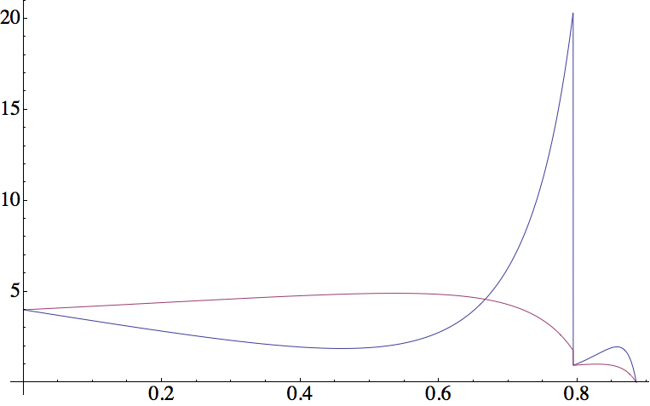
x₀ = 4.33
P_{c} = -1
a₀ = 0.5
y

Slide 14
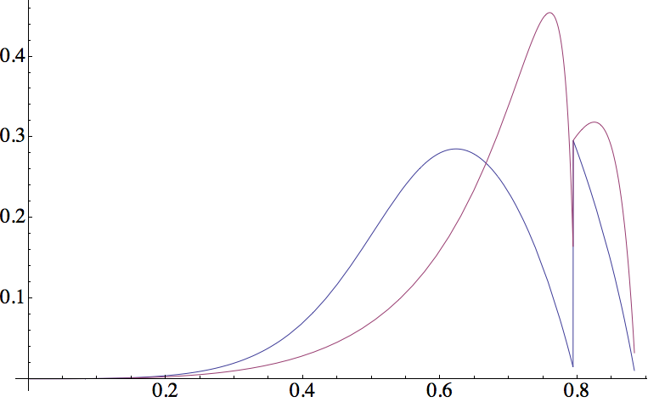
x₀ = 4.33
P_{c} = -1
a₀ = 0.5
y

Slide 15
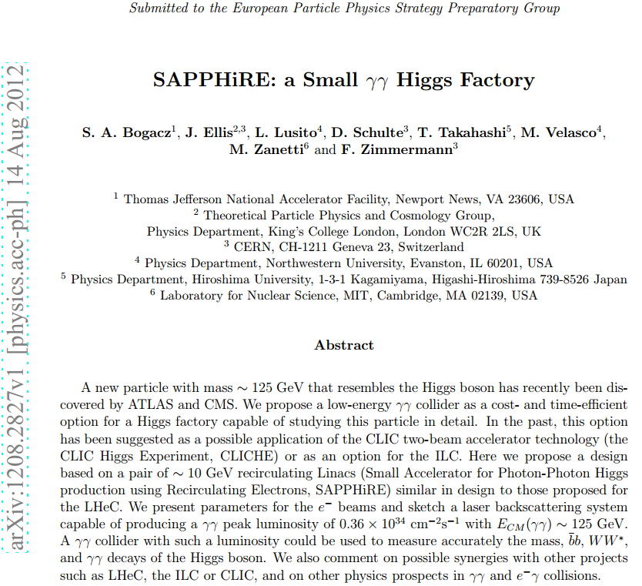

Slide 16
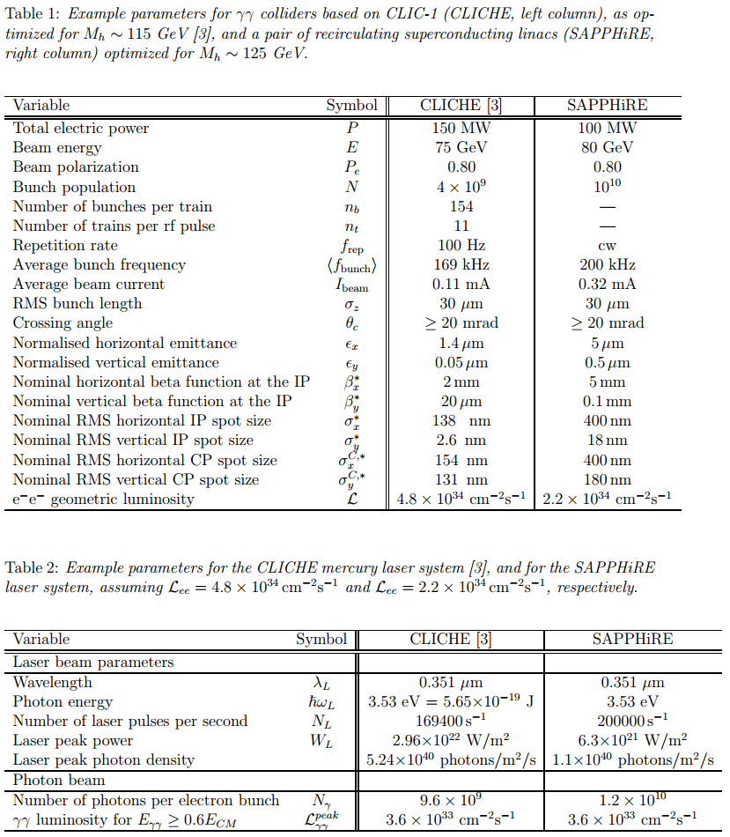

Slide 17
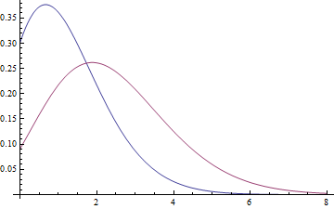
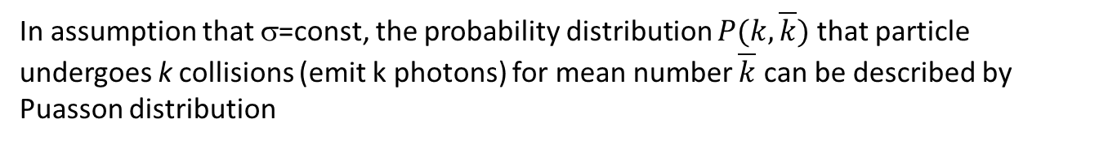
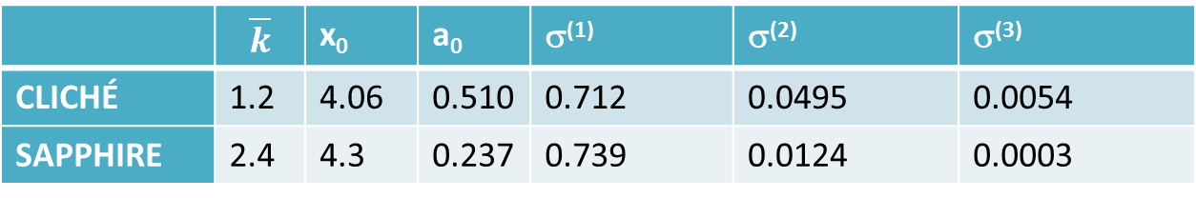
Cross-sections σ^{(n)} (n=1,2,3) for polazrized initial particles ζ_{0z}=+1, P_{c}=-1
 | $$\overline{k}$$ | x₀ | a₀ | σ⁽¹⁾ | σ⁽²⁾ | σ⁽³⁾
CLICHÉ | 1.2 | 4.06 | 0.510 | 0.712 | 0.0495 | 0.0054
SAPPHIRE | 2.4 | 4.3 | 0.237 | 0.739 | 0.0124 | 0.0003
In assumption that σ=const, the probability distribution $P(k,\overline{k})$ that particle undergoes k collisions (emit k photons) for mean number $\overline{k}$ can be described by Puasson distribution
Poisson distribution
P
0 1 2 3 4 5 6 7 8

Slide 18
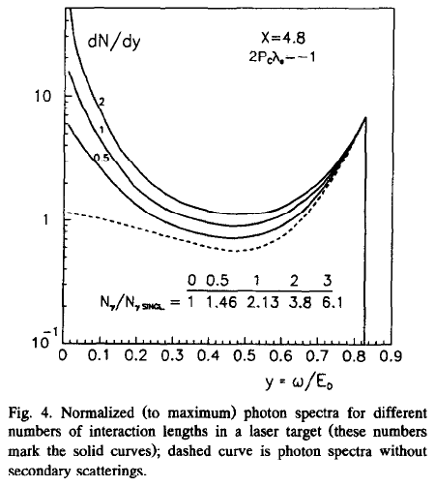
V. Telnov, Principles of photon colliders, Nucl. Instr. And Meth. In Phys. Res. A 355 (1995) 3-18.
“In a “thick” target each electron may undergo multiple Compton scatterings.”

Slide 19
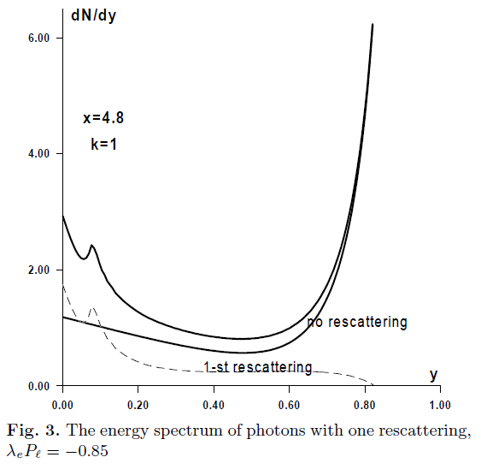
I.F. Ginzburg, G.L. Kotkin, Effective photon spectra for the photon colliders, Eur. Phys. J.. C 13, 295-300 (200)
“With the growth of the conversion coefficient the effect of rescattering of the electrons on the laser photons enhances and make this distribution dependent on the details of the design (mainly, in the low energy part).”
“Note also that the secondary photons on average are nonpolarized.”

Slide 20
In our algorithm we took into account the following steps:
Random generation of the absorbed photon number n;
Random generation of polarization state of electron after each collision;
Random generation of energy of the emitted photons after each collision;
Random generation of the length between consequent collisions for electron loosing energy for emitted photon;
Random generation of photon polarization;
Simulation was stopped when the sum of length between collisions will be larger than laser pulse length.

Slide 21
Spectra of scattered electrons
High conversion coefficient
Low conversion coefficient
Ne, 1/MeV
Ne, 1/MeV
Ee, MeV
Ee, MeV

Slide 22
Spectra of scattered quanta
High conversion coefficient
Low conversion coefficient
Nγ, 1/MeV
Nγ, 1/MeV
Eγ, MeV
Eγ, MeV

Slide 23
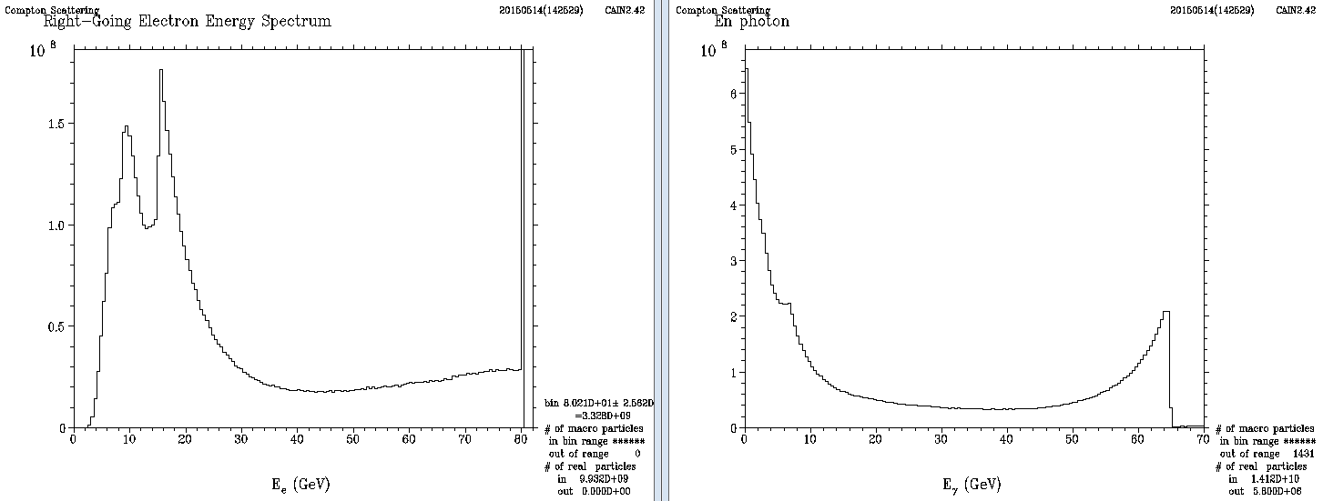
Simulation by CAIN code
Spectra of scattered electrons
Spectra of scattered quanta
Conversion coefficient

Slide 24
Spectra of scattered quanta -1,+1
Nγ, 1/MeV
Nγ, 1/MeV
Eγ, MeV
Eγ, MeV

Slide 25
Polarization of scattered electrons
Ee, MeV
Ee, MeV
High conversion coefficient
Low conversion coefficient
Polarization of scattered quanta
Eγ, MeV
Eγ, MeV
High conversion coefficient
Low conversion coefficient

Slide 26
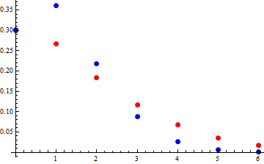
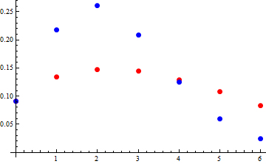
Distribution of the collision events
P
Poisson law
P
Poisson law
Simulation
Simulation
k
k
In this case , the distribution P_{eγ}(k) will be different from the Poisson distribution because:
in each collision, the electron can loose most of its initial energy (σ is changing),
after each collision, the polarization of scattered electron can be changed. Thus, this will also lead to cross-section transformation.

Slide 27
Conclusions
Stochasticity of the nonlinear CBS process is determined by such factors as random number of absorbed photons, random number of emitted photons, and the probability of spin-flip collisions.
Distribution of the number of emitted photons is distinguished from the Poisson law due to above mentioned factors.
For any conversion coefficient, there is the non-zeroth probability of the electron passage through the laser pulse without collisions.
In order to simulate γγ luminosity spectrum as well as γγ effective polarization, spin-flip process has to be taken into account.

Slide 28
Thank you!

