Slide 1
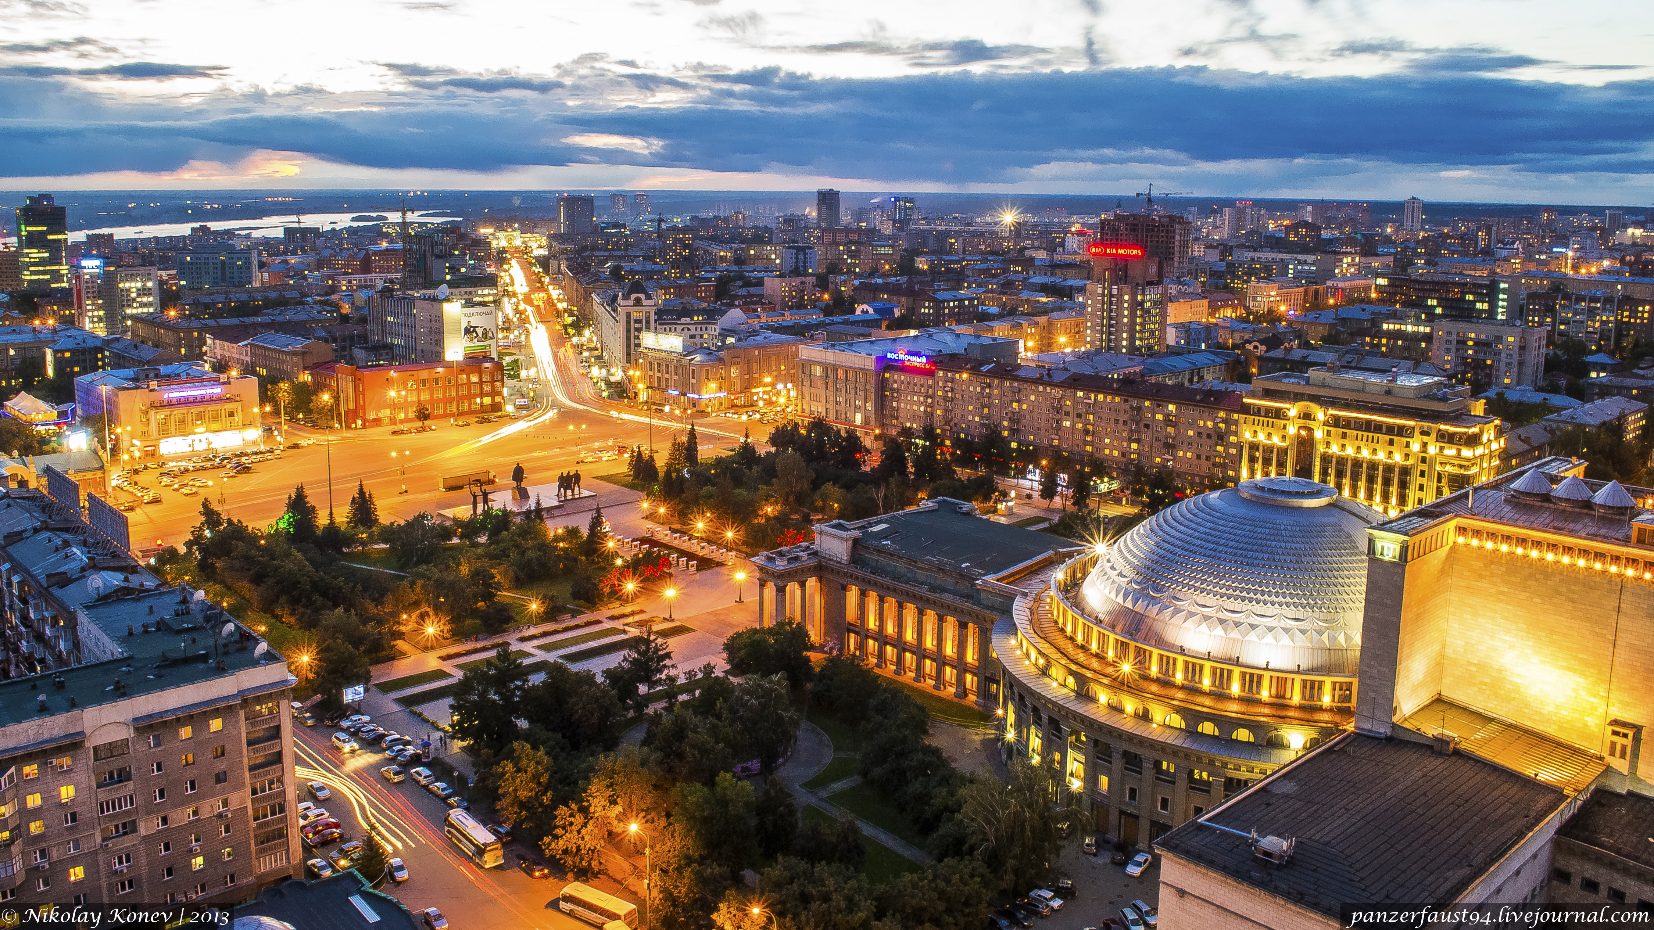


Highlights from the CMS Experiment
Alexei Safonov
Texas A&M University
for the CMS Collaboration
Photon-2015, Novosibirsk, Russia, June 2015

Slide 2
Outline
Run 1 Physics Results
  Higgs, Top, SUSY, Exotica
Re-commissioning for 13 TeV
  Upgrades for Run-2
  Preparations for data taking
Planning for the future
  CMS Upgrades for HL-LHC

Slide 3
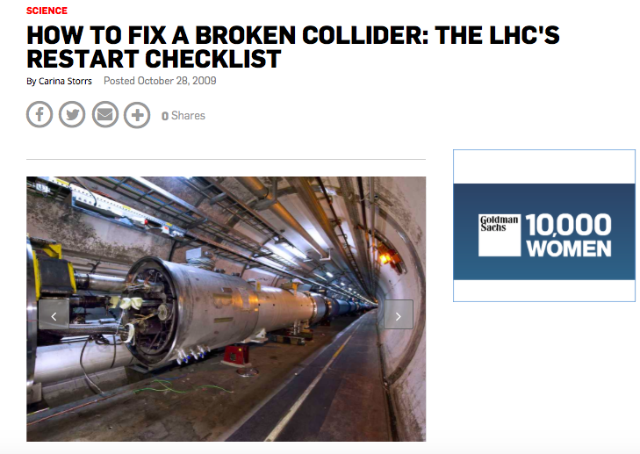
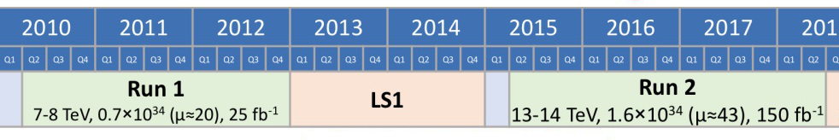
Brief History Recap
September of 2010 - December of 2012
About 5 ifb of data at 7 TeV followed by 20 ifb of data at 8 TeV
  Only 1% of ultimate dataset and half of the energy, yet a paramount impact on physics as we know it
After that first hiccup, LHC has been working marvelously
Run 1 has been a fascinating ride that re-wrote history

Slide 4
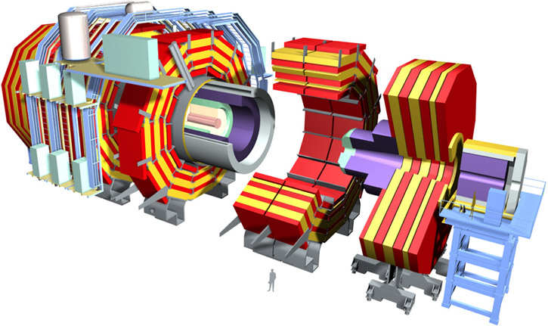
The CMS Detector
Key features:
  Excellent tracking
  Good EM calorimeter
Reconstruction based on Particle Flow

Slide 5
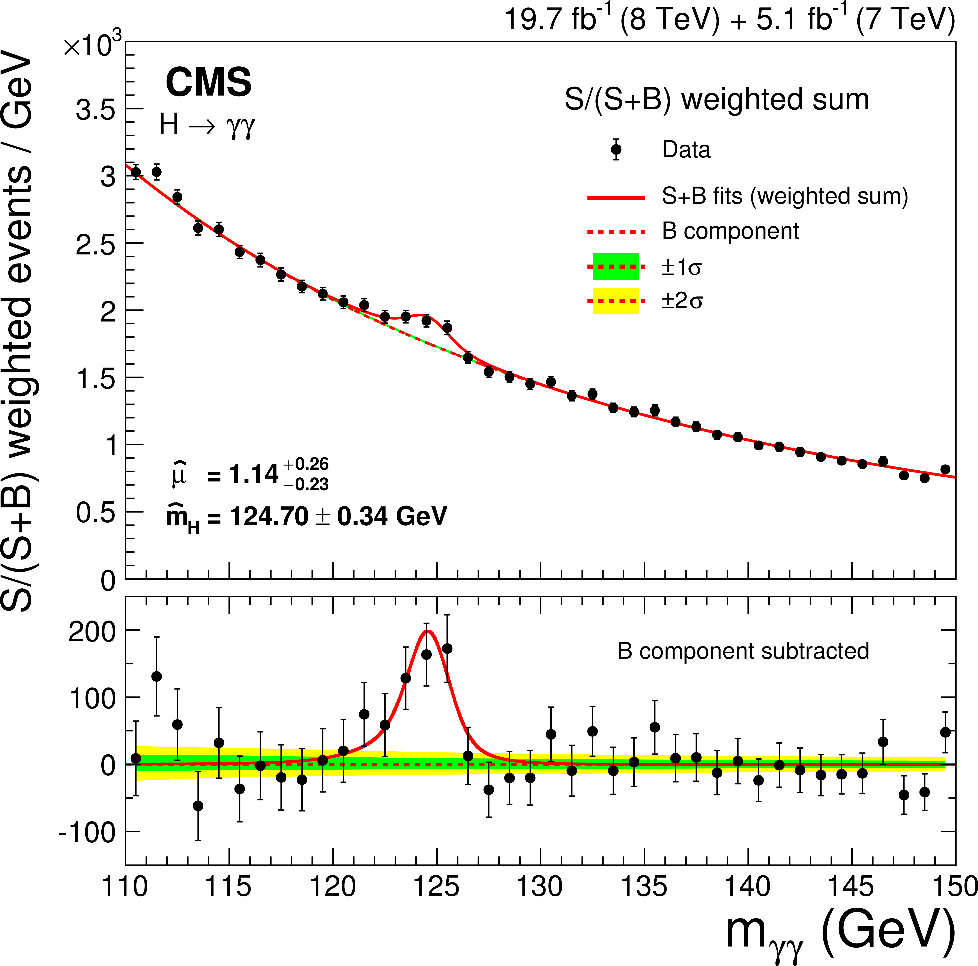
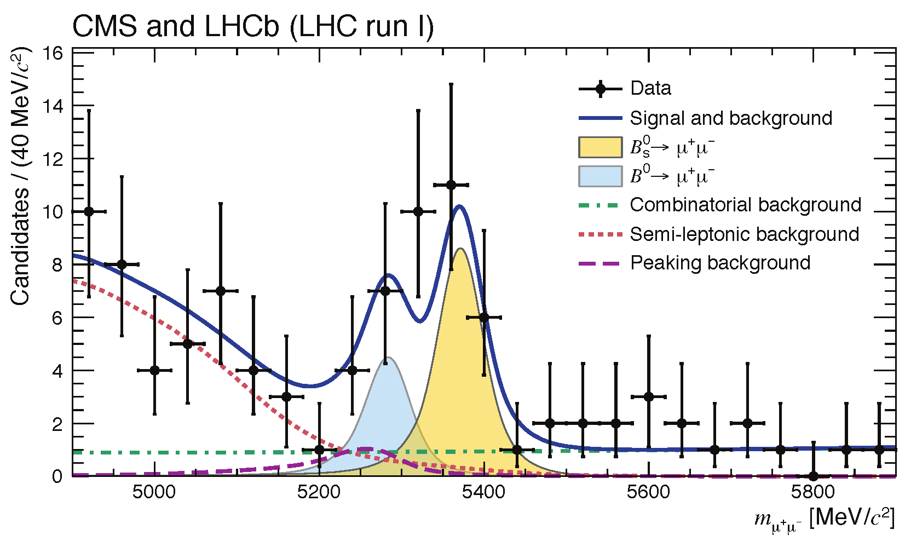
Run1: Making History
Higgs boson:
  Production, properties and decay channels
  Non-SM Higgs searches
  Also helped a couple of deserving gentlemen get their Nobel Prize
Top sector
  Mass and properties, production
New physics
  Conventional SUSY, as well as difficult (compressed, stealth etc.) scenarios
  Extra dimensions, new heavy bosons, hidden sectors etc.
Eur. Phys. J. C 74 (2014) 3076
Nature (2015) 14474

Slide 6
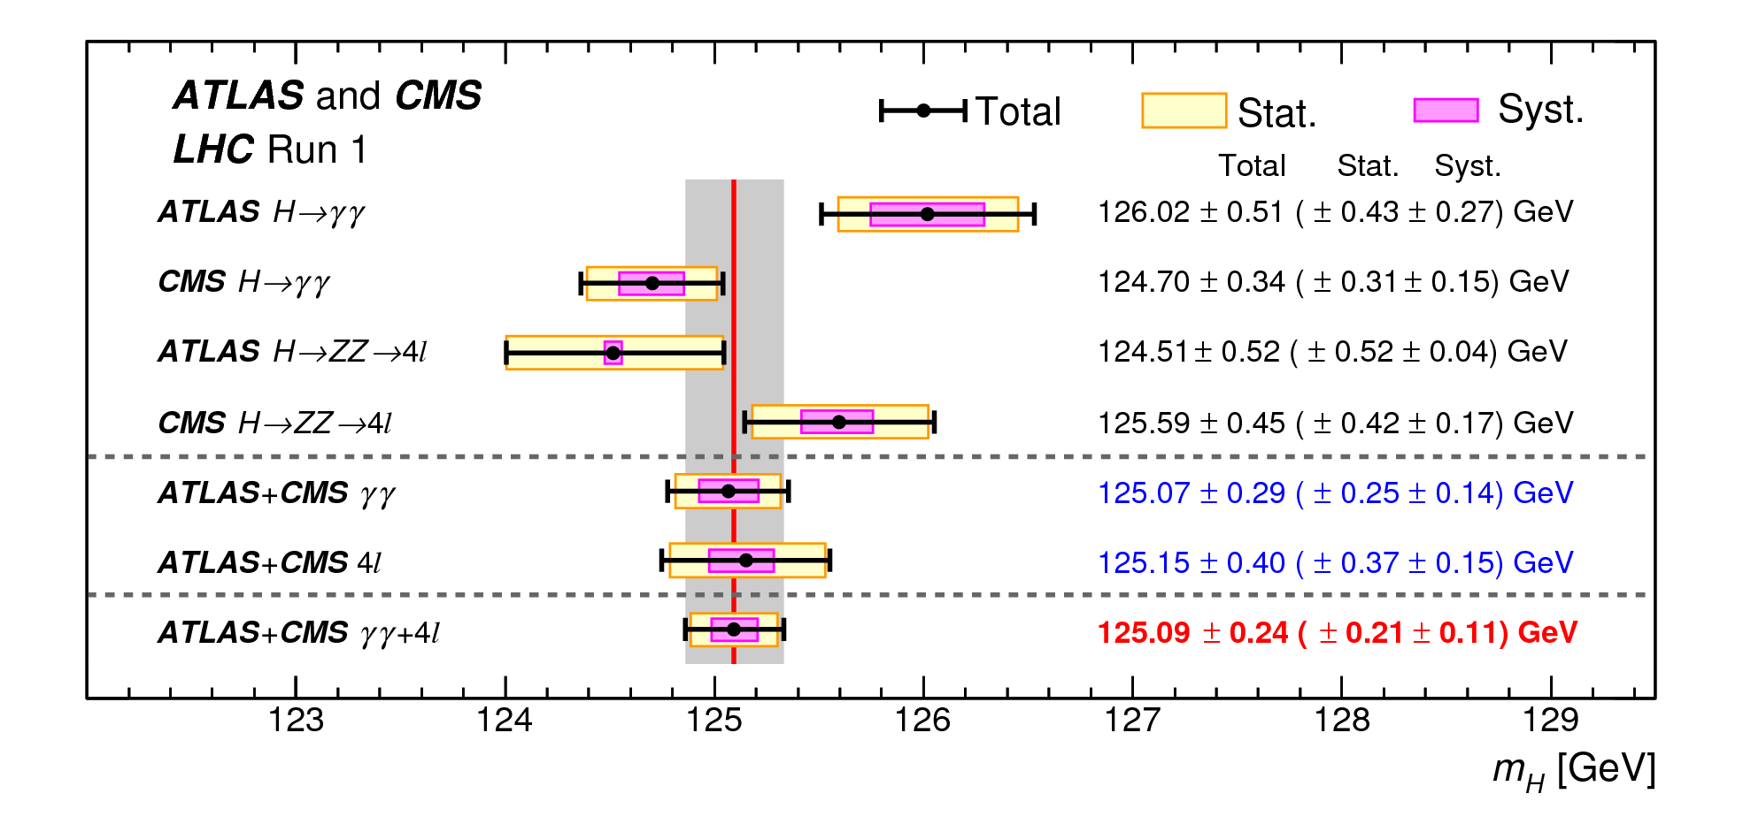
Higgs Mass
Phys. Rev. Lett. 114 (2015) 191803
The precision for Higgs mass is 0.2%
  5 years ago we didn’t know it even exists

Slide 7
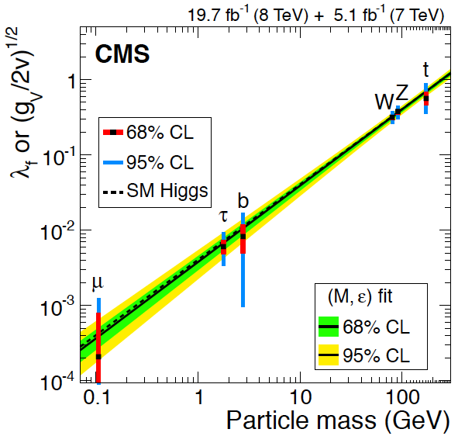
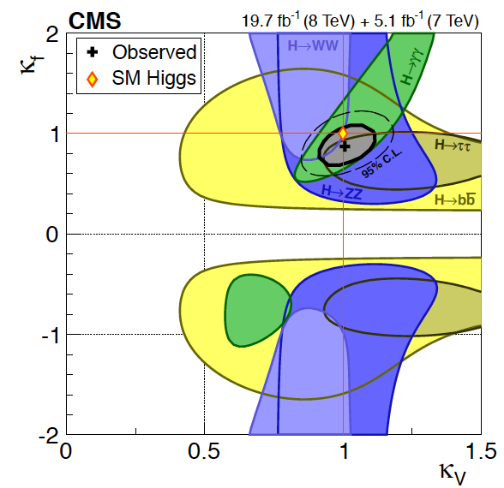
Higgs Properties
Mass: 125.02±0.27±0.15 GeV
5 measured decay couplings
Spin/Parity: 0+
CP: +1 favored, pure -1 excluded
Width: Γ_{meas}< 4 x Γ_{SM}
Limits on:
  LFV (H->τμ)
  FCNC (t->qH),
  Invisible decays
Eur. Phys. J. C (2015) 75:212

Slide 8
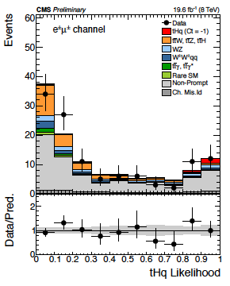
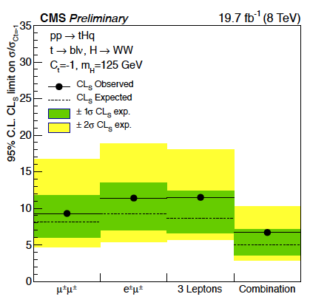



















Higgs to Top Coupling
Search for: same sign dileptons + top or 3 leptons + jets
$$q$$
$$q′$$
$$W$$
  Sensitive to multiple Higgs decay modes:
    WW, ZZ, ττ etc.
$$b$$
$$t$$
single-t production
$$q$$
$$q′$$
HIG-14-026
$$tHq$$
$$W$$
$$H$$
$$b$$
$$t$$
$$q$$
$$q′$$
$$tHq$$
$$W$$
$$H$$
$$b$$
$$t$$
Limit: σ(tHq) < 6.7 (5.0) x σ(tHq, C_{t}=-1)

Slide 9
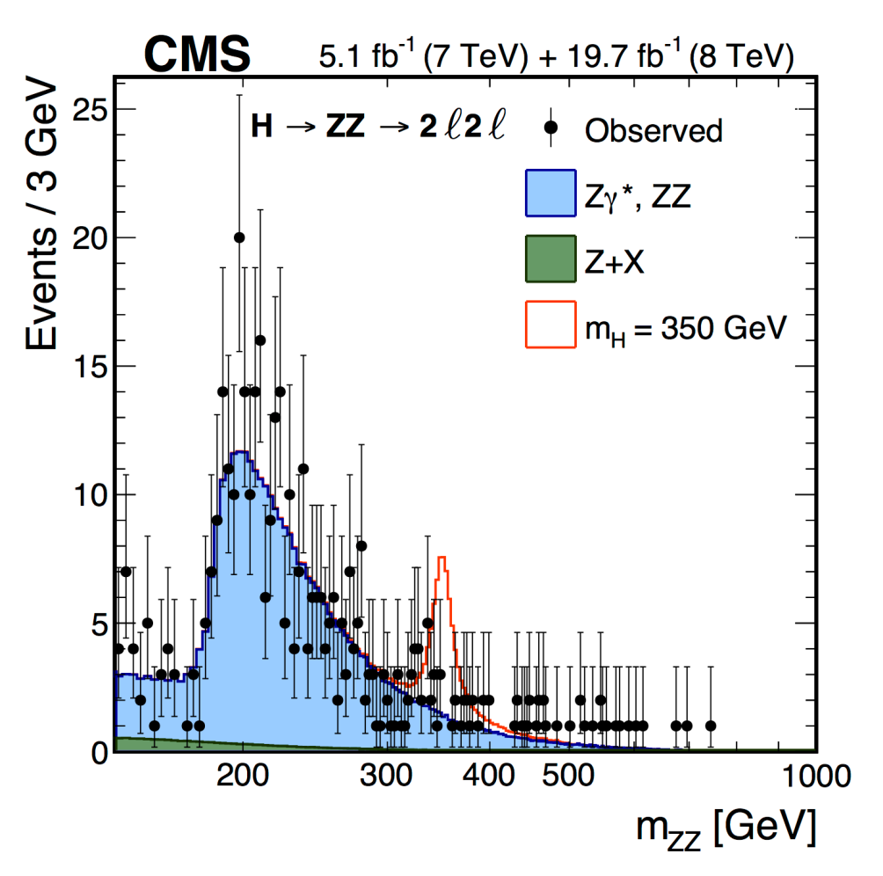
Heavy Higgs Searches
Many models predict more than one Higgs Boson:
  MSSM, NMSSM, 2HD models etc.
Searches in various channels
  No sign yet
Task for Run-2?
arXiv:1504.00936
arXiv:1504.00936v1

Slide 10
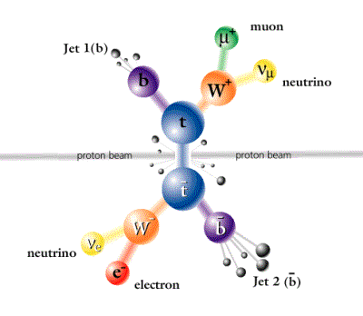
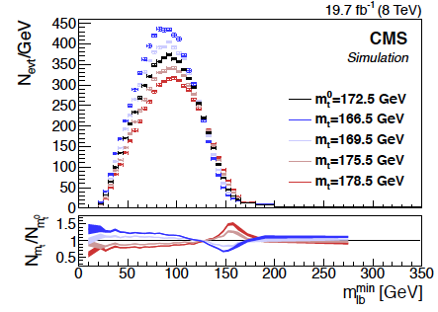


Top Mass
Top dilepton sample:
  Use shape and normalization of the m(lb) distribution
  Helps minimizing theoretical uncertainties in defining m_{t}
Only eμ events to suppress backgrounds:
  Watch the end-point:
CMS-PAS-TOP-14-014

Slide 11
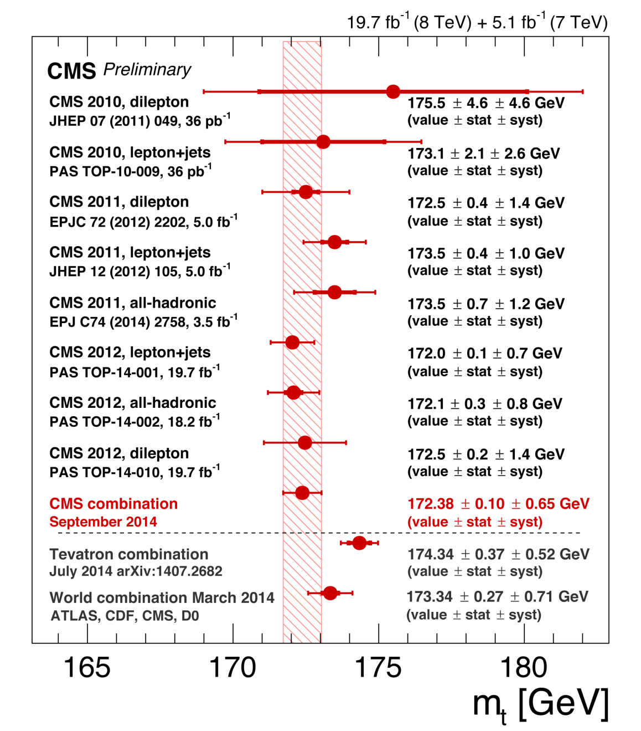
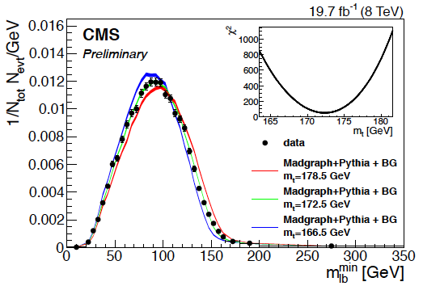
Top Mass
A new accurate measurement of top mass using top dilepton events:
m_{t}=172.3±0.3(stat)±1.3(syst) GeV

Slide 12
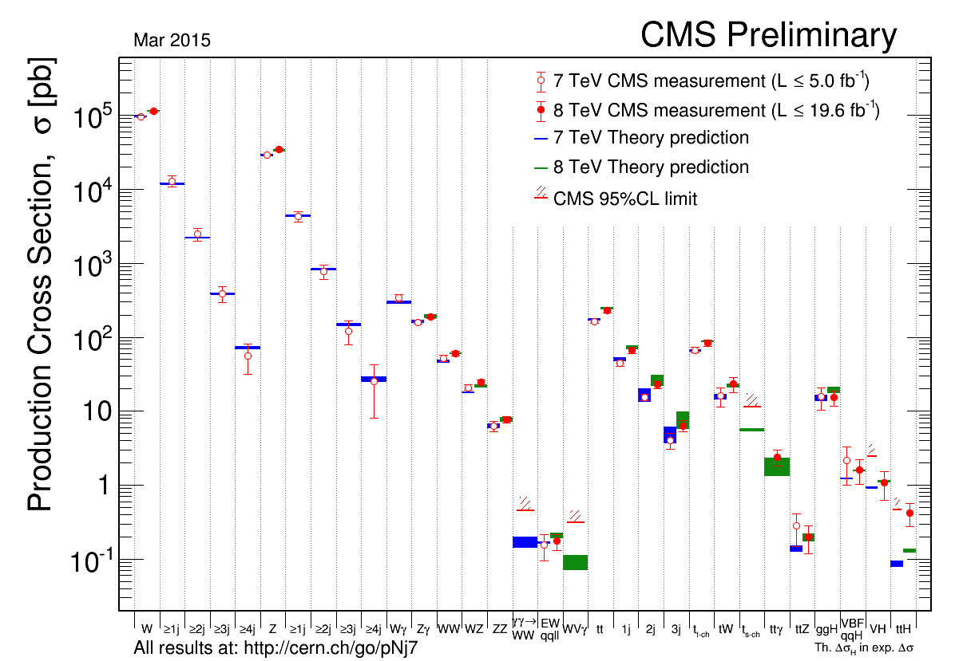
Electroweak Measurements
W Z di-boson tt single-t ttX Higgs

Slide 13
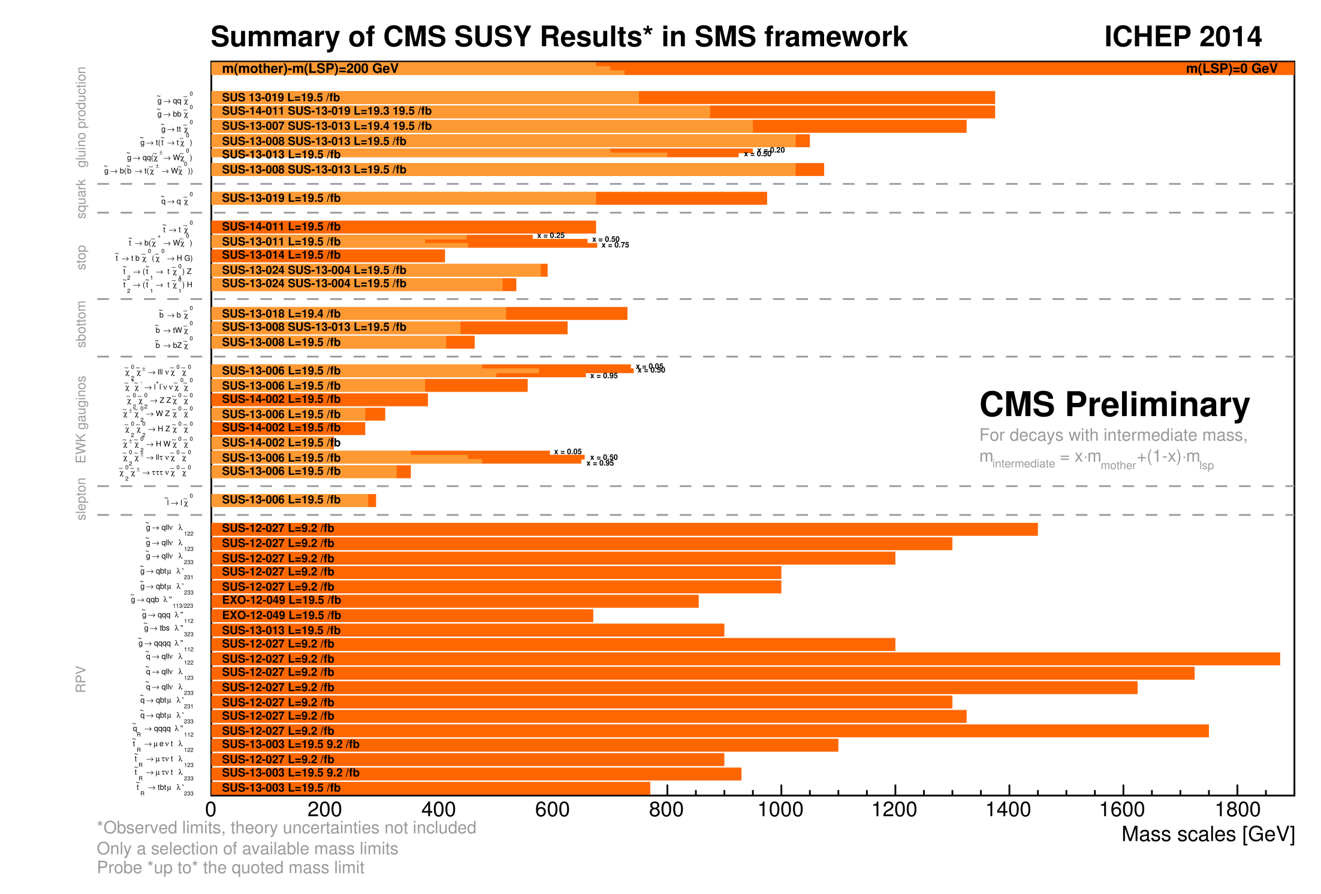
SUSY Searches
Summary of CMS SUSY Results in SMS framework and ICHEP 2014

Slide 14
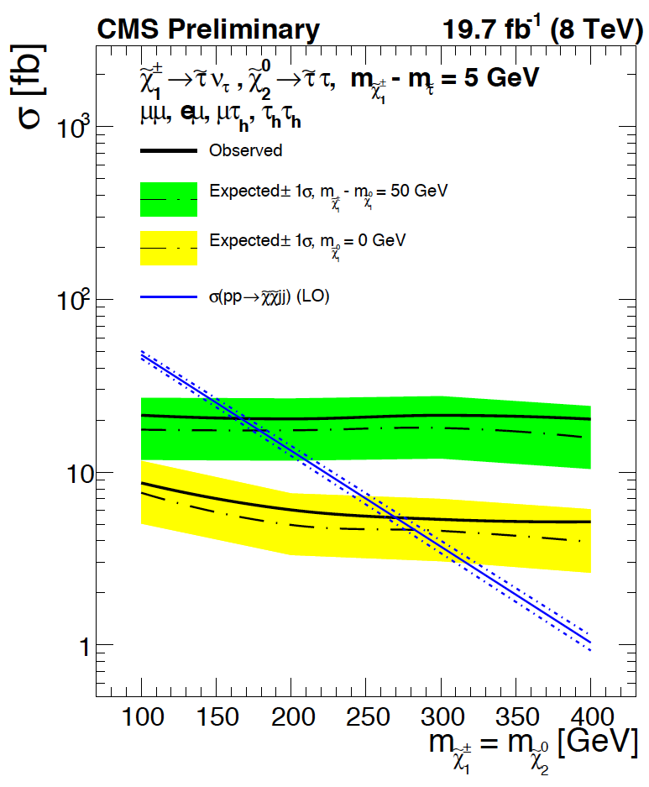
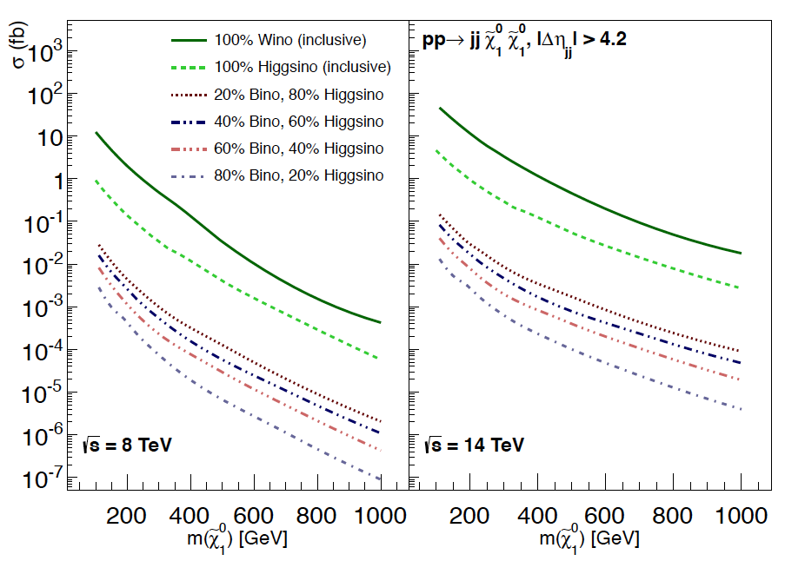
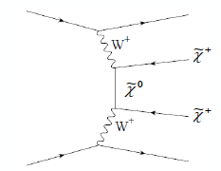
SUSY in VBF Channels
Similar to mono-X, a promising topology for extending reach for ewk-ino production
    Large increase in x-section for 13/14 TeV
  Could be the only way to get higgsino pair production
arXiv:1304.7779
SUS-14-005

Slide 15
Non-SUSY Searches

Slide 16
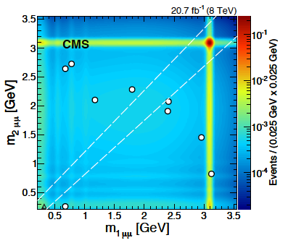
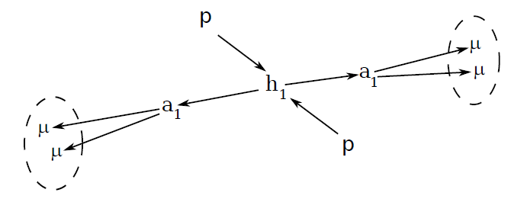
New Long-Lived Particles
Motivation: attempts to explain positron excesses, Higgs portal, NMSSM, electroweak baryogenesis
  Weak coupling to SM particles: hard to produce except through some sort of a higher energy “portal”
    Mass can range from MeVs to TeV
Selections:
  At least four muons with pT>8 GeV, one of them with pT>17
  Exactly two “dimuons” with compatible masses
    Analysis designed for easy re-casting in other contexts
arXiv:1506.00424

Slide 17
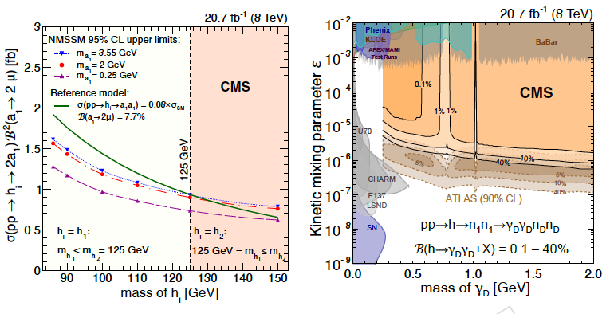
New Long Lived Particles
No excess, set model-independent limits on
  Anyone who can run Pythia can re-cast it for their favorite model
And model-dependent:
  In NMSSM, effectively a limit on non-SM BFs of SM-like Higgs and rate of extra Higgses
  An illustrative Dark SUSY model
    Note CMS/ATLAS complementarity
      ATLAS analysis looked at highly displaces tracks, CMS those produced within 5 cm of the beamline
arXiv:1506.00424

Slide 18
No New Discoveries from LHC Lately?
Well, we’ve been busy…
  Finishing analyses of the 2012 data
    Many results and publications, some still in queue
  Long Shutdown (LS) – 1: 2013-2015
    Upgrades of the CMS detector
      Muon detectors:
        New stations (CSC/RPC) to complete redundancy, new electronics for triggering
      Hadron Calorimeter readout
        Hybrid HPDs replaced with SiPMs
      New more narrow beamline
        More narrow in prep for new pixel detector in 2016
    Re-commissioning of the detector for Run-2
      Cosmic runs with ~full detector, integration, commissioning with beams (halo, splashes)

Slide 19
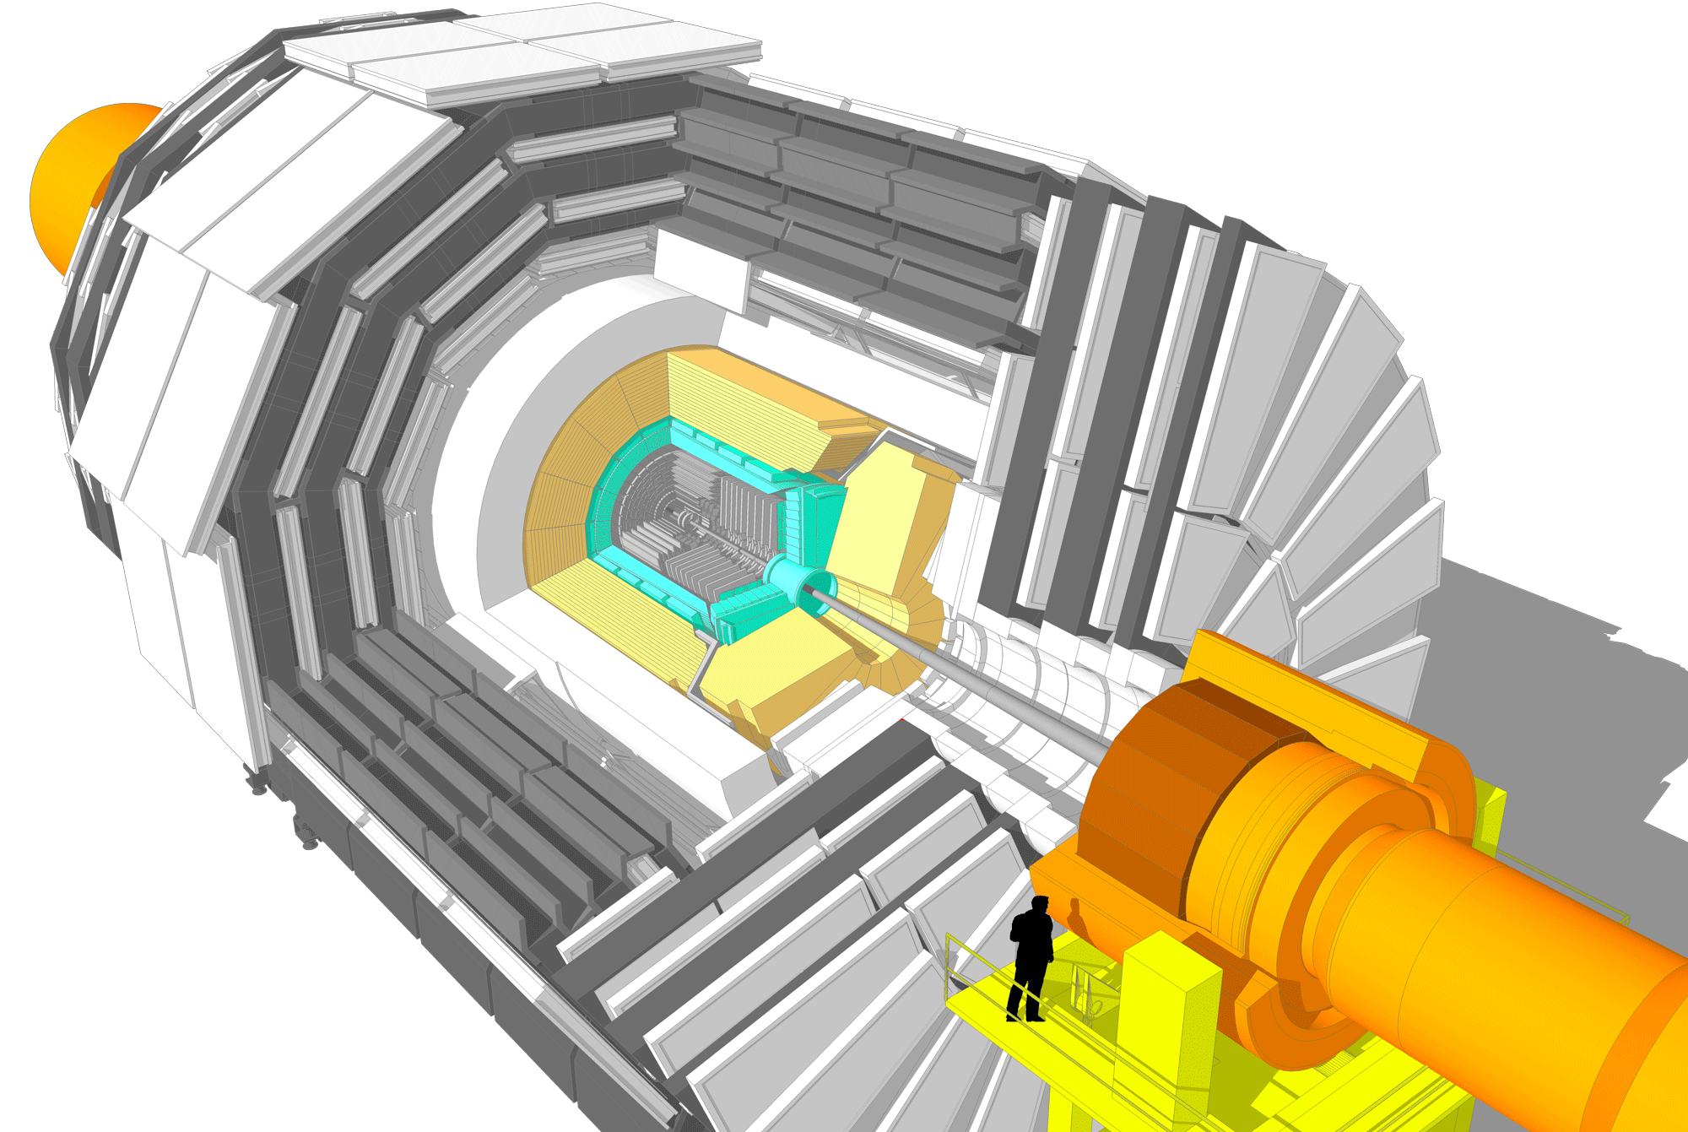
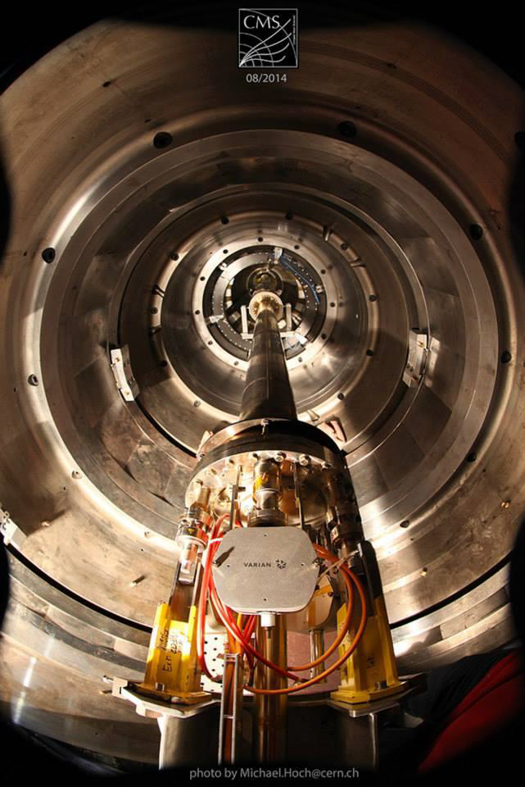
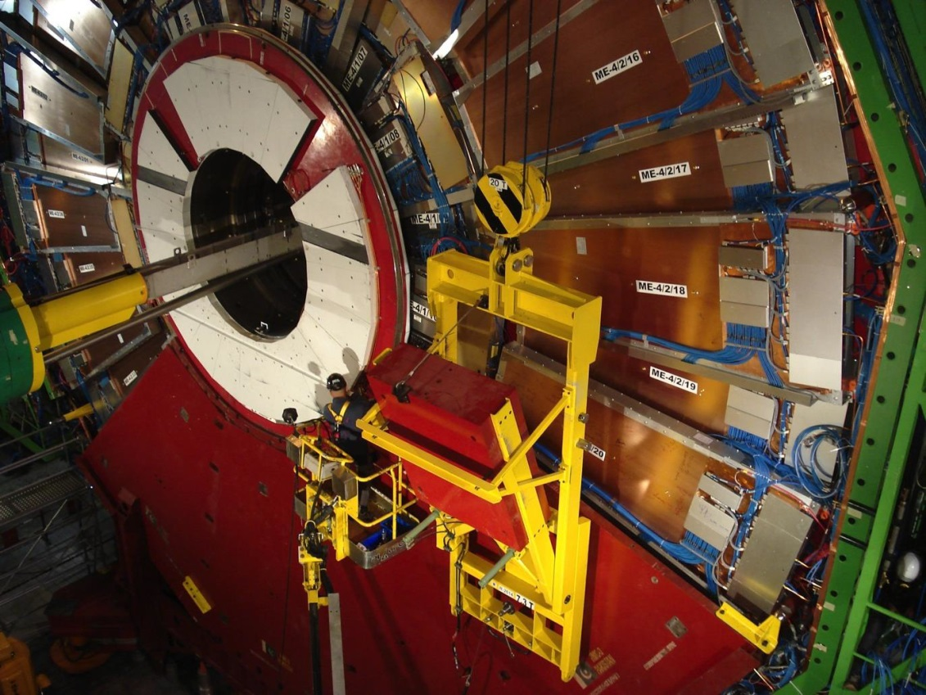
Detector Improvements for Run 2
Hadron Outer (SiPMs)
Muons
Completion of forward detector
- 4th layer in ME4/2 (CSC & RPC)
New Beam Pipe
Tracker -20°
BRIL: Beam Monitoring
19

Slide 20
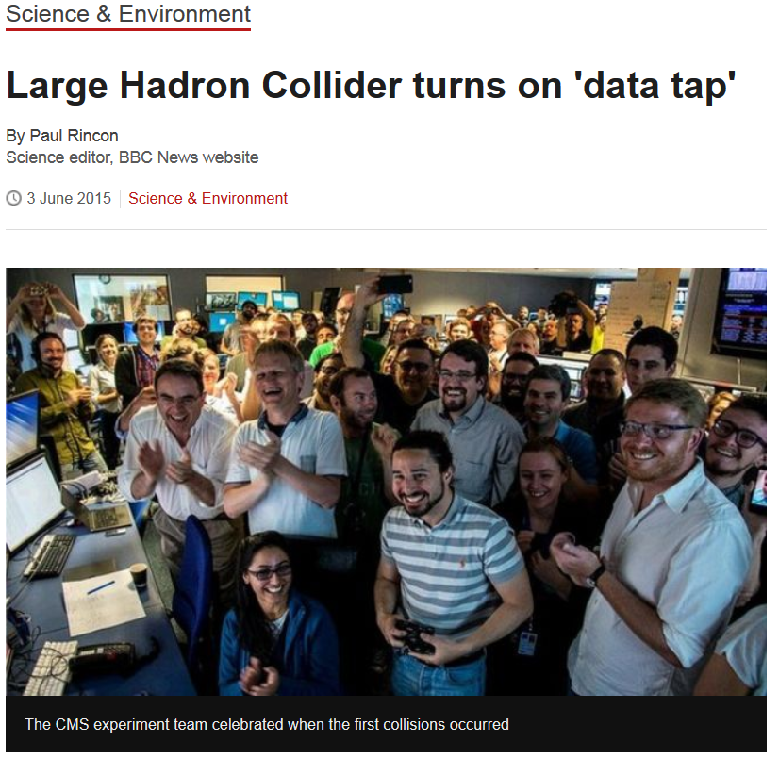
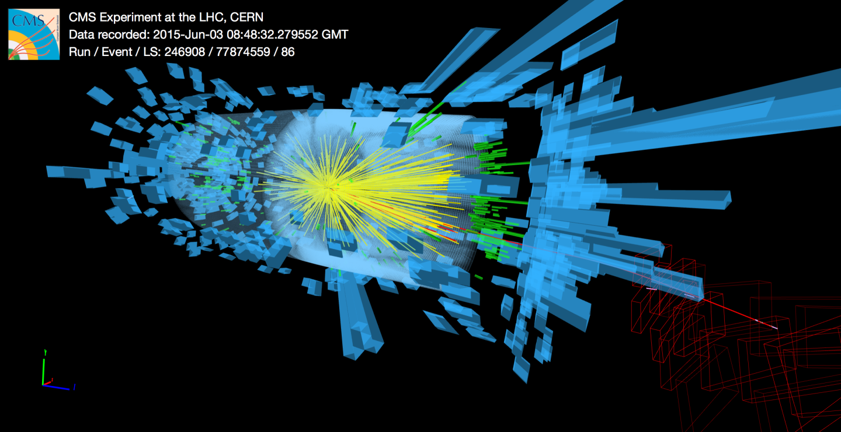
13 TeV Collisions
June 3: First collisions at the new center of mass energy
CMS Commissioning with 3x3 bunches (two colliding):
  Detector systems timing in
  Timing/bias scans/calibrations
  Trigger ramp-up

Slide 21
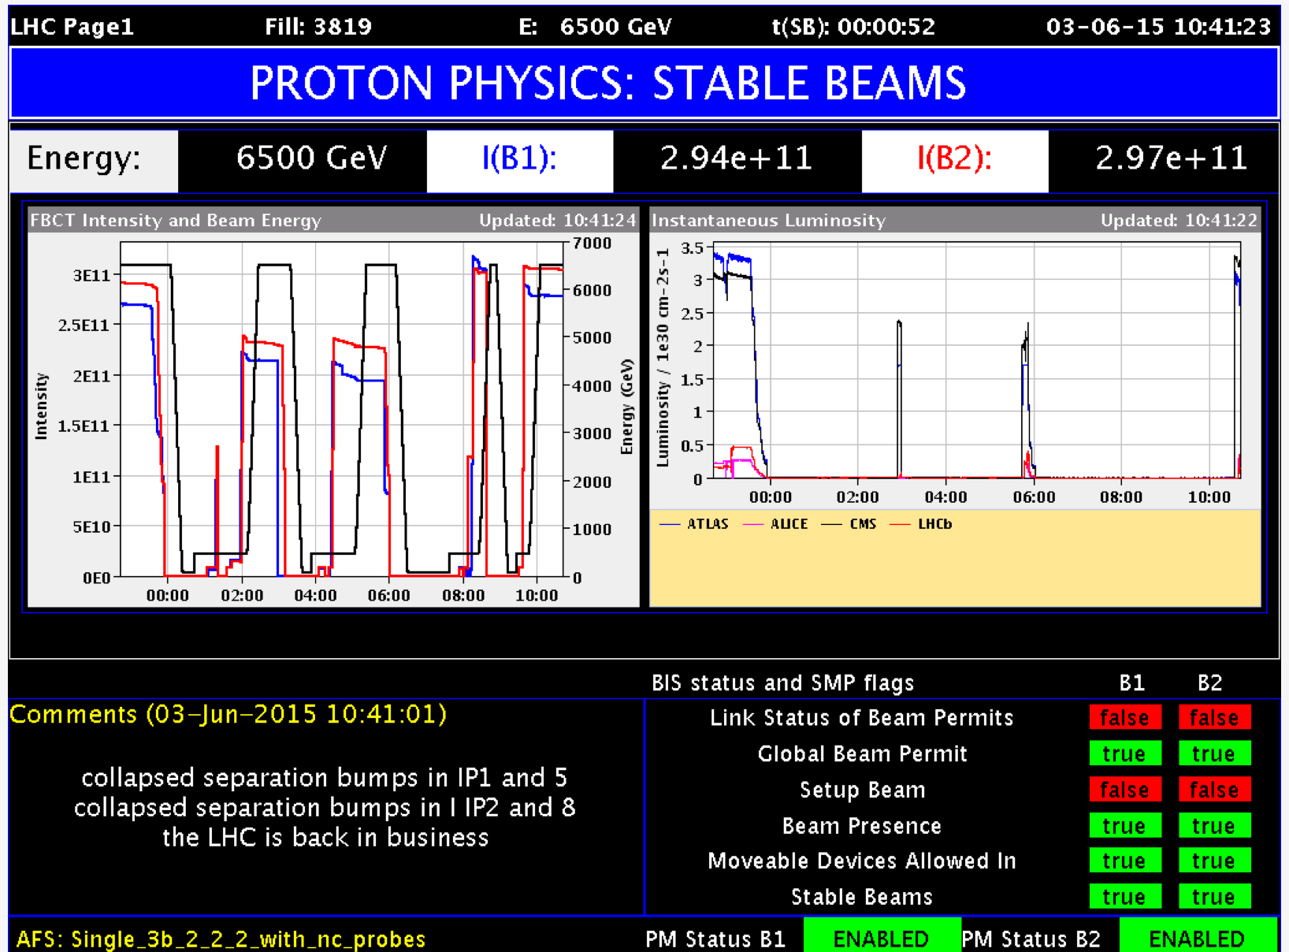
LHC Warming Up to 13 TeV
Continue commissioning with beams
  37 bunches, increase beam intensity
  48 bunches
June 15-19:
  Technical stop
June 20-28:
  Scrubbing for 50 ns operations
June 28:
  Ramp-up with 50 ns

Slide 22
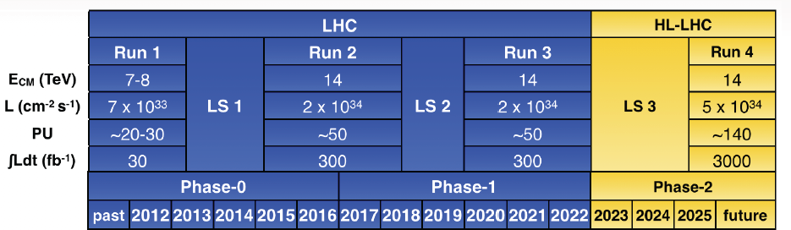
Looking into the Future
Most of the LHC dataset will be collected in the ultra high luminosity regime
  High pile-up (average is 140 interactions per bunch crossing, could be higher)
Essential that the detector is up to the challenge
  LS2 and LS3 are the time to get CMS in shape

Slide 23
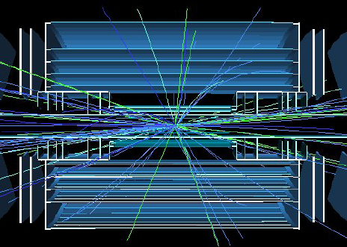
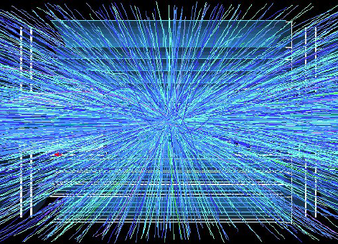
CMS Phase-2 Upgrade Planning
High pile-up is a challenge on many levels
  Energy deposit overlaps, resolution, combinatorics
  Increase in data volumes impacts processing power, speed and the ability to move data
Technical Proposal detailing proposed CMS upgrades to get public soon
  CMS-TDR-15-002, under the LHCC review now

Slide 24
HL-LHC Trigger Challenge
Triggering at high pile-up is arguably the greatest challenge
  Level-1 is the hardest
How can you distinguish 140 collisions from each other?
  Tracking: can “see” vertices
    Extremely large data volumes to shuffle at 40 MHz
  Calorimeter fine granularity & longitudinal profile: separate nearby particles
    Useful, but how can it help the trigger?
  Fast timing: measure time of flight
    140 vertices within 15 cm along z is very challenging for forward region, likely impossible in the central part

Slide 25
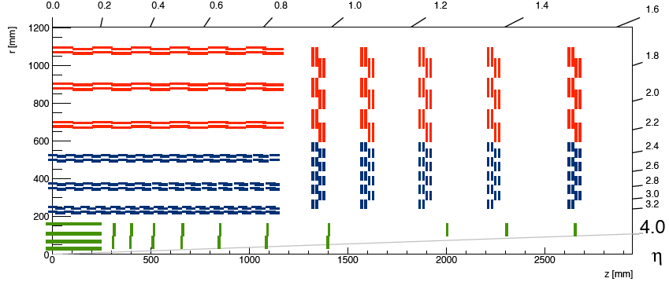
Phase-2 Trigger Capable Tracker
“Self-triggering” tracker:
  Double layers of silicon, look for coincidences
  About x10 reduction in data
    Impossible becomes challenging
Strip/Strip Modules
90 µm pitch/5 cm length
Inner Pixel
Covers up to η=4.0
Strip/Pixel Modules
100 µm pitch/2.5 cm length
100 µm x 1.5 mm “macropixels”

Slide 26
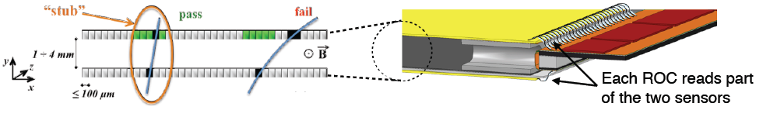
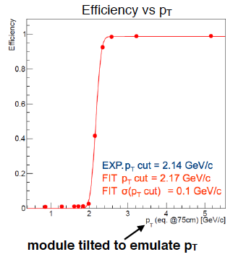
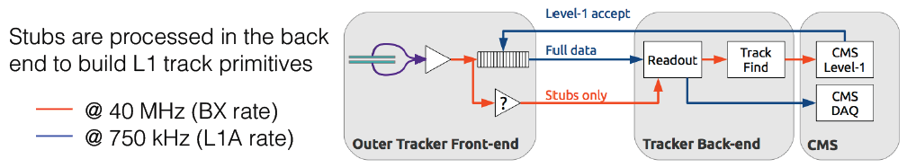
CMS Outer Tracker trigger
xxx

Slide 27
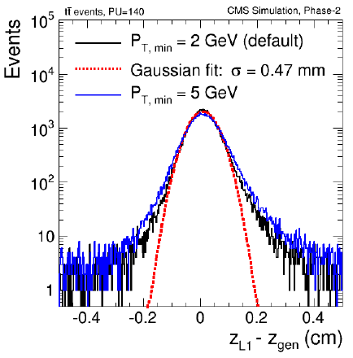
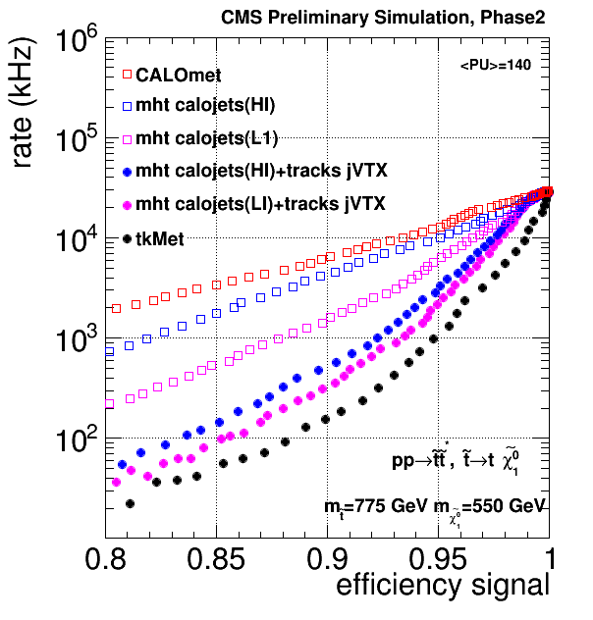
Phase-2 Track Trigger
A game changer:
  Reconstruct tracks and vertices online
  Associate jets, electrons, taus to vertices
And more:
  Missing energy back in play even at such high pile-up!

Slide 28
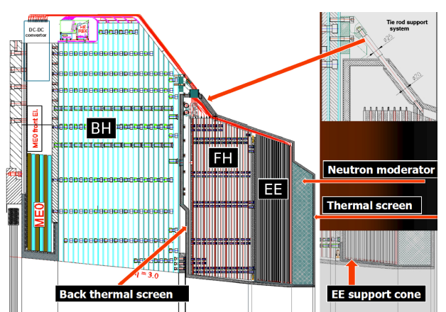
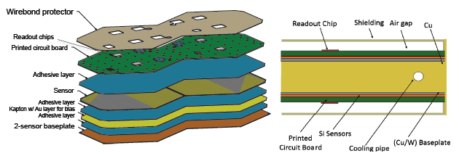
Forward Challenges
Forward region gets to see the harshest backgrounds
  Endcap calorimeter radiation damage – needs replacement
High granularity sampling calorimeter EE+FH:
  Silicon with tungsten/copper

Slide 29
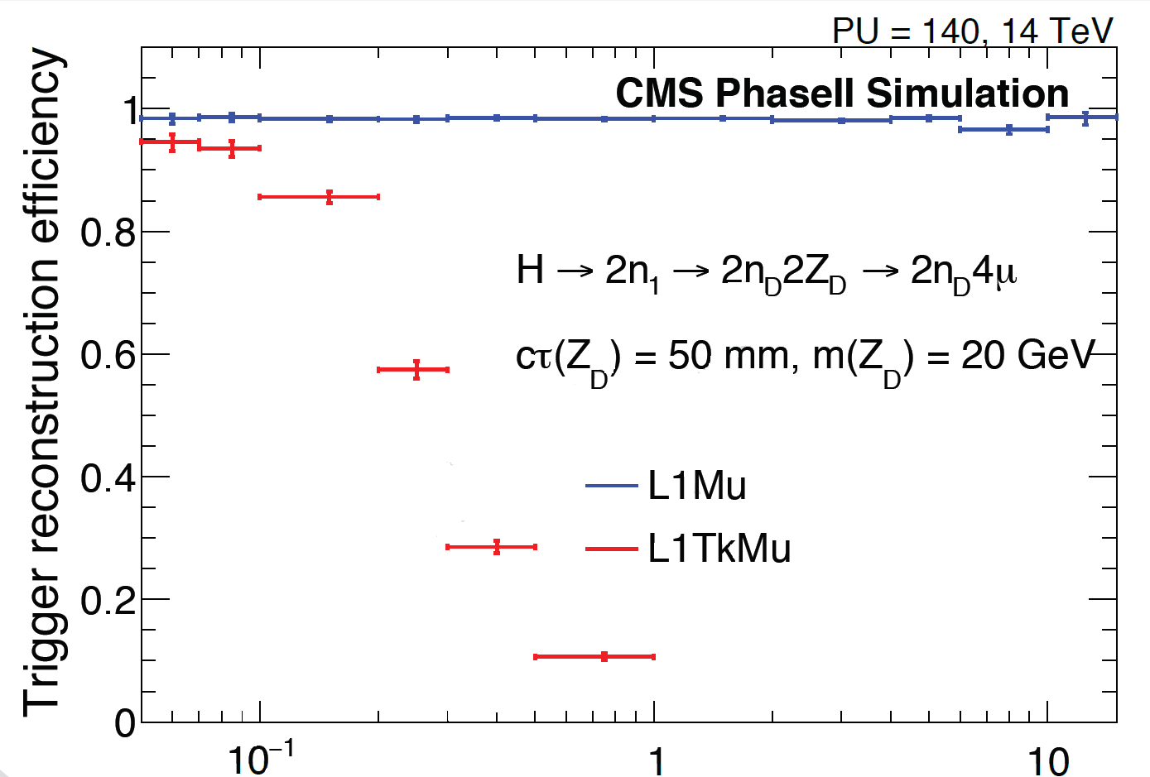
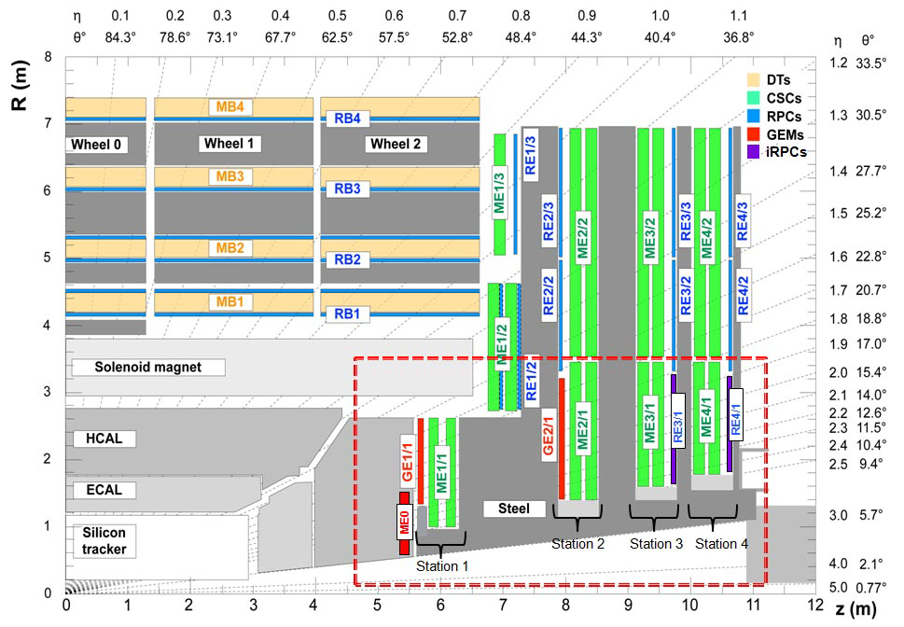
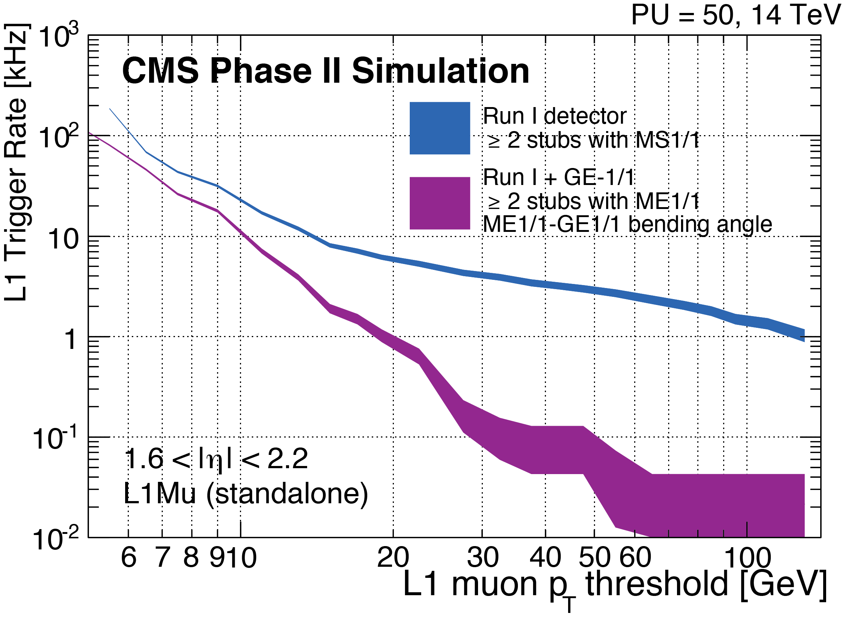
Ready for the Unexpected
Tracking trigger is a game changer, but it can’t do everything
  It won’t see displaced tracks from new long lived particles (Higgs portal, dark sector, new bosons, SUSY extensions, W’ etc.)
Improve standalone muon triggering
  Focus on forward region where most troubles come from

Slide 30
Summary
Past few years have been am incredible time for science
  Higgs discovery and everything we have learnt about it is rewriting textbooks
About to start the next stretch, which will bring us 7-10 times more data
  Nobody can’t tell if we are to find SUSY, extra dimensions or something else
    Independent of that, we got a lot of important work cut out for us measuring Higgs properties and searching for the unknown
Don’t go anywhere as the next few months can easily bring something major
  You don’t want to miss that!

Slide 31
Backup

Slide 32
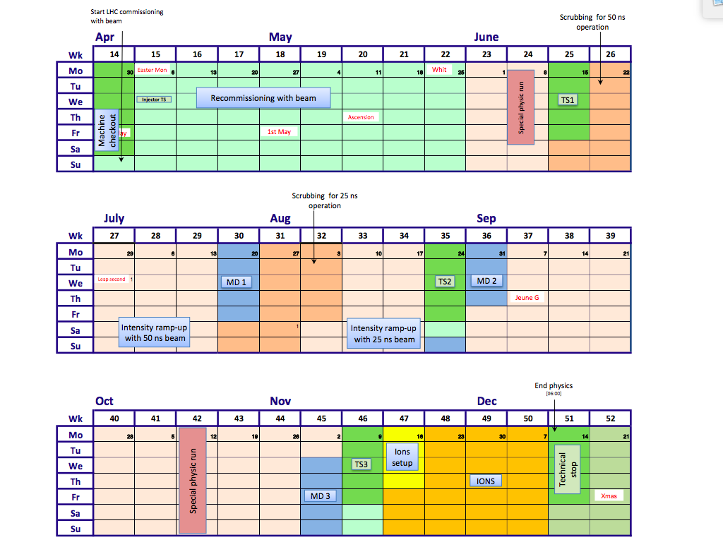
Machine Schedule for 2016
xxx

