Slide 1
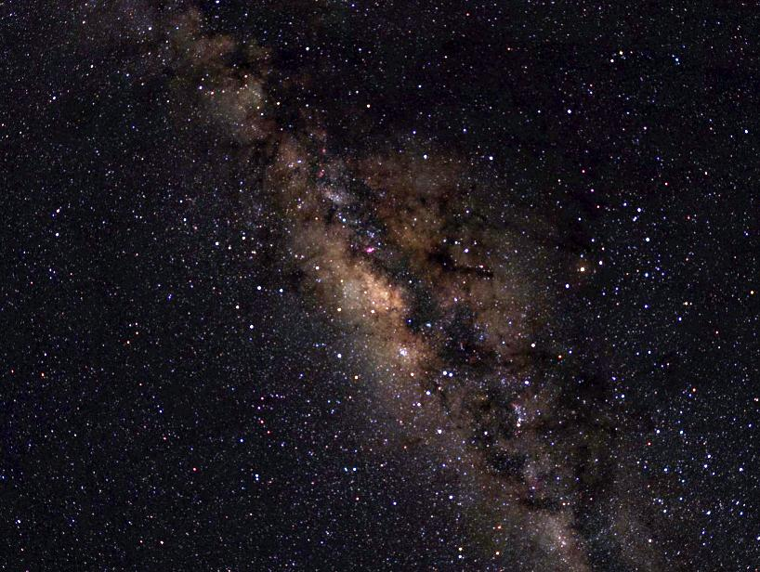
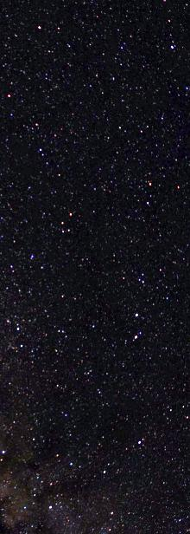

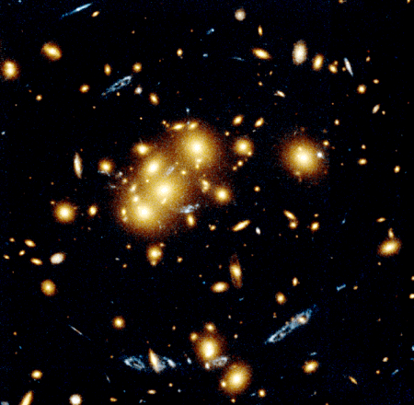
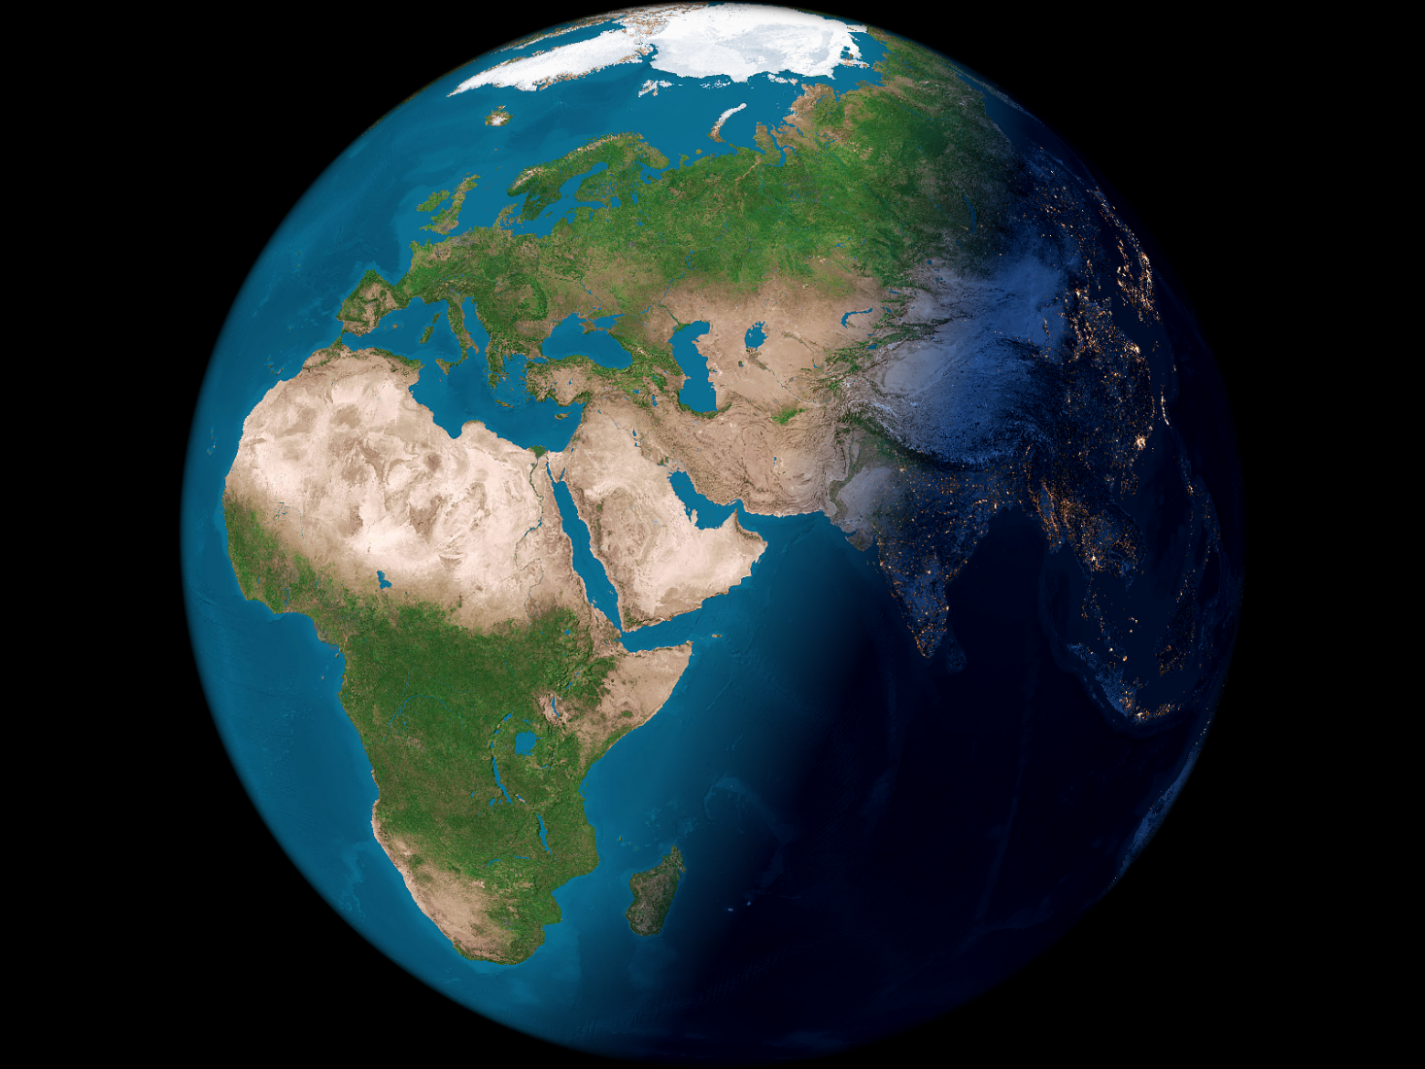
If it is not Dark it does not Matter
Photons as signature for dark matter and dark energy:
The Cast experiment at CERN
on behalf of the CAST collaboration at CERN:
Dieter HH Hoffmann,
Technische Universität Darmstadt
-
June 17th, 2014h @ Photno Science Conference, Novosibirsk, Russia

Slide 2
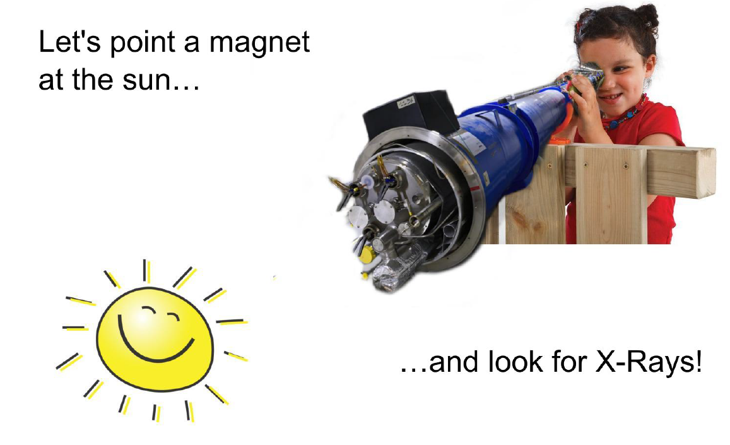
CERN Axion Solar Telescope
12 years of operation and continuous renewal aiming to search for dark matter and dark energy
Designed by Sebastian Baum Summer Student 2014
Notes:
The Cern Axion Solar Telescope (CAST) is the only astroparticle physics experiment at CERN. It is taking data the last 11 years searching for solar axions or other similar exotica from the dark sector, which dominates the Universe, and we do not know what they are made of. Axions emerged from a suggestion by Peccei & Quinn aiming to solve the “strong CP problem”, i.e., why the strong interactions do not violate CP as the weak interactions do. To put it differently, the expected CP violation would manifest itself, e.g., as an electric dipole moment of the neutron (nEDM) whose value should be at least some 10 orders of magnitude larger than the best current experimental upper limit. An axion field shortly after the Big Bang could be behind this mysterious fine-tuning in nature. After the discovery of the HIGGS particle at CERN, the strong CP problem is of fundamental importance for the Standard Model in physics. Therefore, searches for axions and EDMs of nuclear elements like neutron, proton, deuteron, etc., are theoretically well motivated with far reaching astrophysical-cosmological implications.

Slide 3
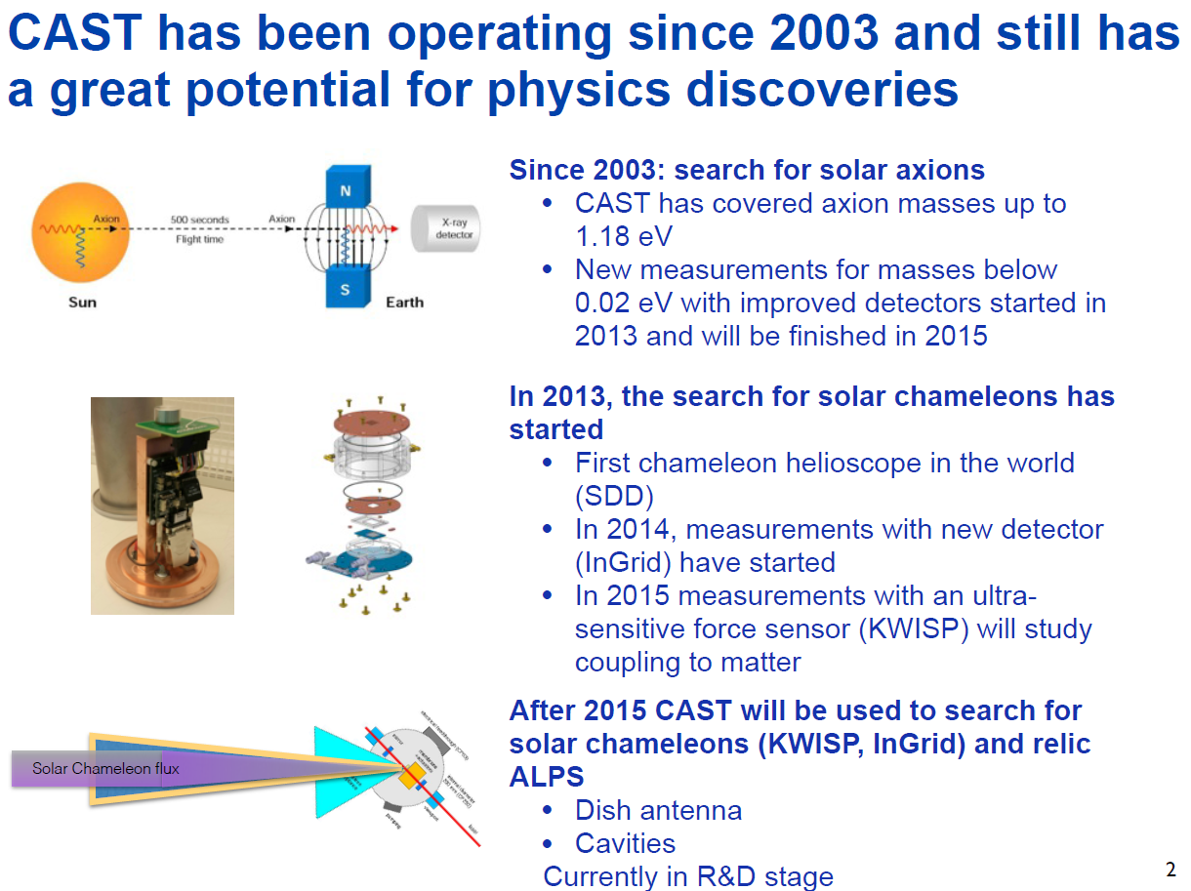
S. Neff @SPSC Oct. 2014

Slide 4
Dark Matter: AXIONs, …
Germany, Freiburg
Albert-Ludwigs-Universität Freiburg
Horst FISCHER, Juergen FRANZ , Fritz Hertbert HEINSIUS, Donghwa KANG, Kay KÖNIGSMANN
Germany, Frankfurt
Applied Physics
Vladimir ARSOV, Joachim JACOBY
Germany, Garching
Max-Planck-Gesellschaft (MPG), Max-Planck-Institut für Extraterrestrische Physik
Heinrich BRAUNINGER, Jakob ENGLHAUSER
Germany, München
Max-Planck-Institut für Physik, Werner-Heisenberg-Institut
Rainer KOTTHAUS, Markus KUSTER, Gerhard LUTZ, Georg RAFFELT
Germany, Darmstadt
Technische Universitat Darmstadt, Institut für Kernphysik
Theopisti DAFNI , Dieter HOFFMANN, Manfred MUTTERER, Thomas PAPAEVANGELOU, Hans RIEGE,
Yannis SEMERTZIDIS
Switzerland, Geneve
European Organization for Nuclear Research (CERN)
Klaus BARTH, Martyn DAVENPORT, Rui DE OLIVEIRA, Fabio FORMENTI, Michael HASINOFF1, Igor IRASTORZA, Alfredo PLACCI, Laura STEWART, Bruno VULLIERME, Louis WALCKIERS
Greece, Patras
AUniversity of Patras
Spyridon DEDOUSSIS, Christos ELEFTHERIADIS, Anastasios LIOLIOS, Argyrios NIKOLAIDIS, Ilias SAVVIDIS, Vlasios VASILEIOU, Konstantin ZIOUTAS
(8) Greece, Athens
National Center for Scientific Research "Demokritos" (NRCPS)
George FANOURAKIS, Theodoros GERALIS, Katerina ZACHARIADOU
(9) Italy, Pisa
Scuola Normale Superiore (SNS)
Luigi DiLella
(10) Russia, Moskva
Russian Academy of Sciences, Institute for Nuclear Research (INR)
Sergei GNINENKO, Nikolai GOLOUBEV
(11) Spain, Zaragoza
Universidad de Zaragoza, Facultad de Ciencias, Instituto de Física Nuclear y Altas Energías
Jose CARMONA, Susana CEBRIAN, Gloria LUZON, Angel MORALES, Julio MORALES, Alfonso ORTIZ DE SOLORZANO, Marisa SARSA, Jose VILLAR
(12) United States of America, Chicago, Il
University of Chicago, Enrico Fermi Institute
Juan COLLAR
(13) United State of America, Columbia, Sc
University of South Carolina, Department of Physics and Astronomy
Frank AVIGNONE, Richard CRESWICK, Horacio FARACH
(14) France, Gif-Sur-Yvette
Centre d'Etudes de Saclay (CEA-Saclay), DAPNIA
Alain DELBART, Ioanis GIOMATARIS, Samuel ANDRIAMONJE
(15) Croatia, Zagreb
Ruder Boskovic Institute
Milica KRCMAR, Ante LJUBICIC, B. LAKIC
(16) Korea, Daejon (KAIST)
Yannis Szemertzidis

Slide 5
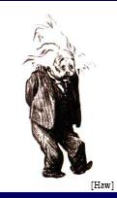
Programme
Motivation
Axion physics
CAST experiment
CCD Detector and X-ray Telescope
Data analysis - result
Conclusions
Outlook

Slide 6
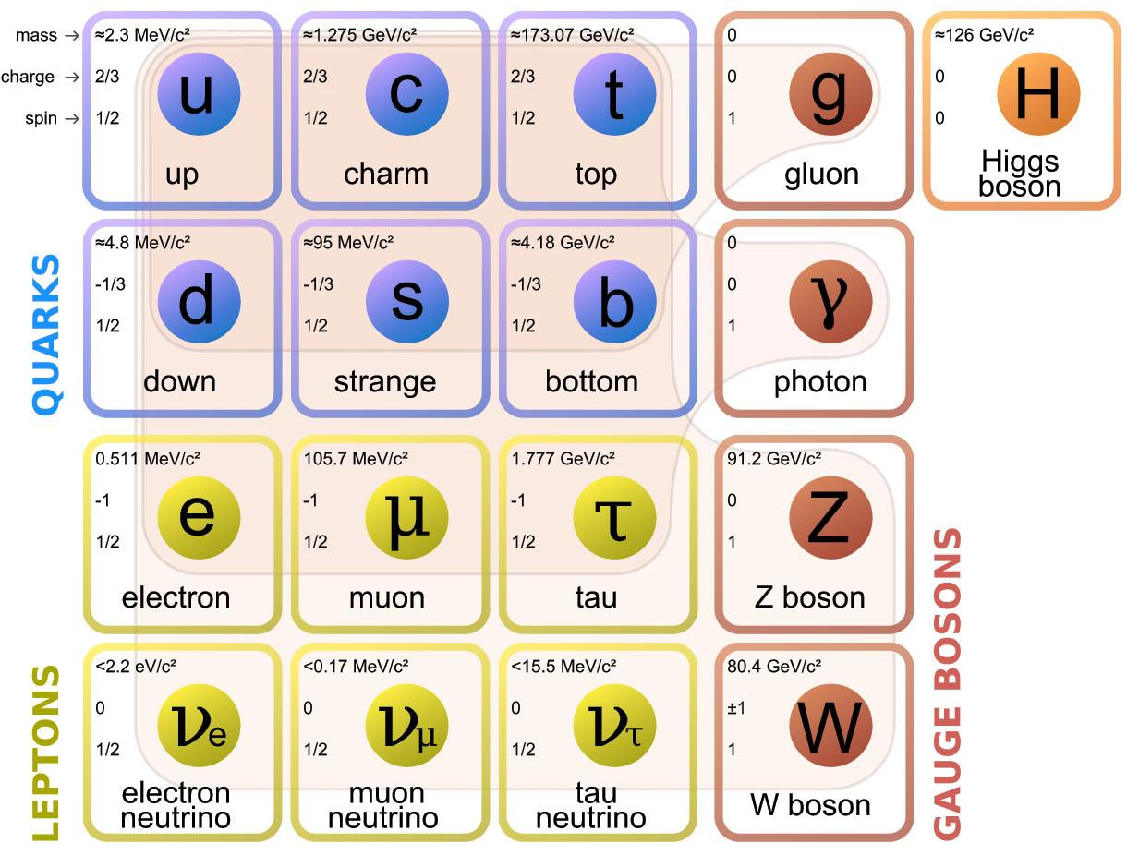
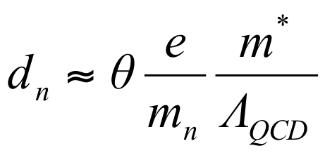
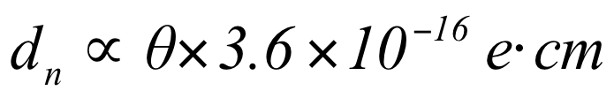
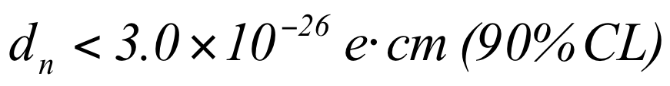
Motivation
Why Axions? (since 1977)
QCD theory predicts that CP symmetry is violated in strong interactions
Strong CP problem: no CP violation observed experimentally
CP violation ⇒ EDM of the neutron
The answer is Peccei-Quinn mechanism ⇒ Introduce the axion field a(x) interacting with the gluon field
Additional Peccei-Quinn U(1) global symmetry
Particle Data Group Fermilab

Slide 7
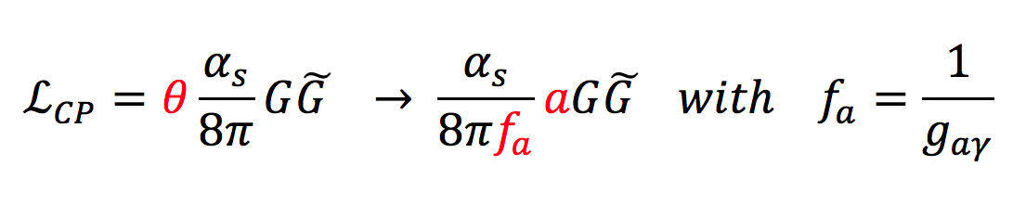
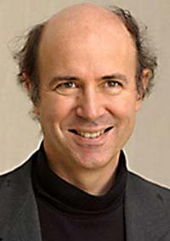
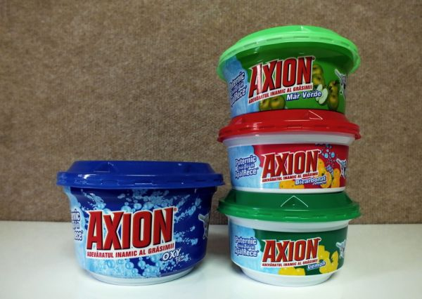
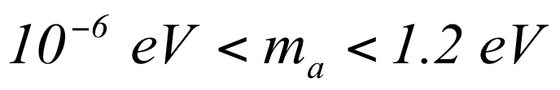
The Axion – properties
As a result a new neutral and very light particle is predicted, the Axion (Weinberg, Wilczeck)
Couples with two photons via Primakoff Effect in any model
Very weak interaction probability with matter
Spinless boson
Viable dark matter candidate (non baryonic)

Slide 8
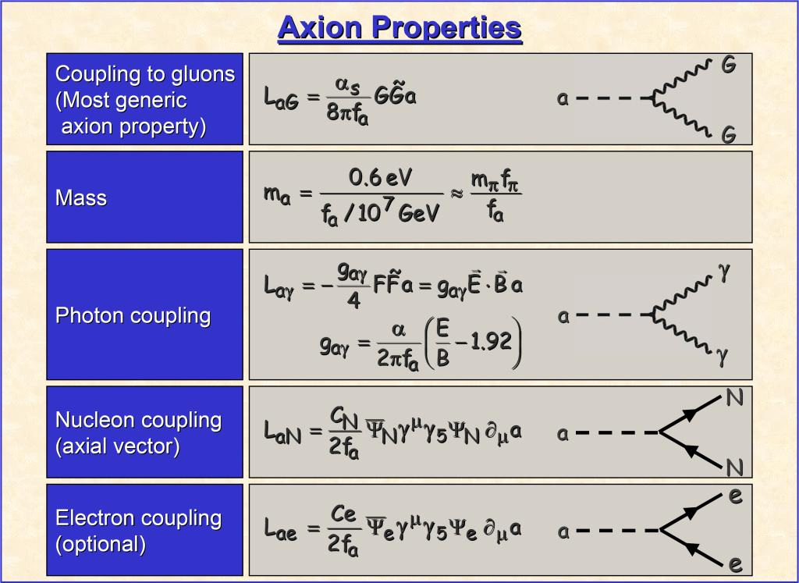
G. Raffelt

Slide 9
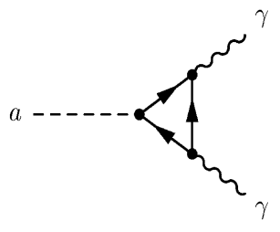
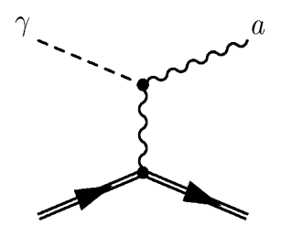
Axions
α
pseudoscalar
neutral
practically stable
phenomenology driven by the breaking scale f_{a} and the specific axion model
Couples to photon
L_{αγ} = g_{αγ} (E•B) a
Primakoff (1951) [π°→γγ]
PRIMAKOFF EFFECT
Any scalar or pseudoscalar particles:
axion-like particles

Slide 10
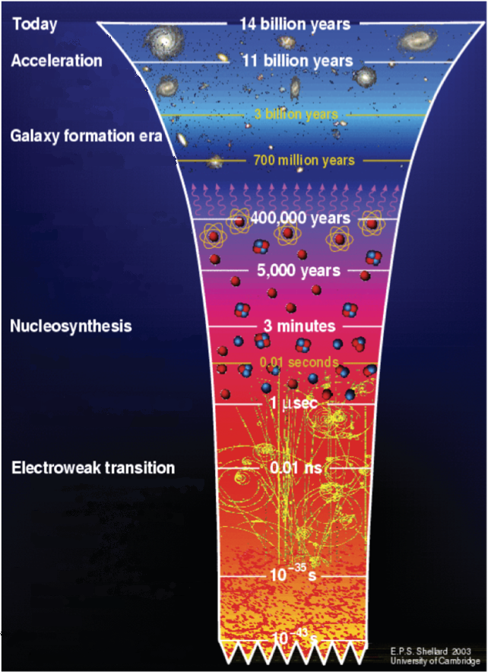
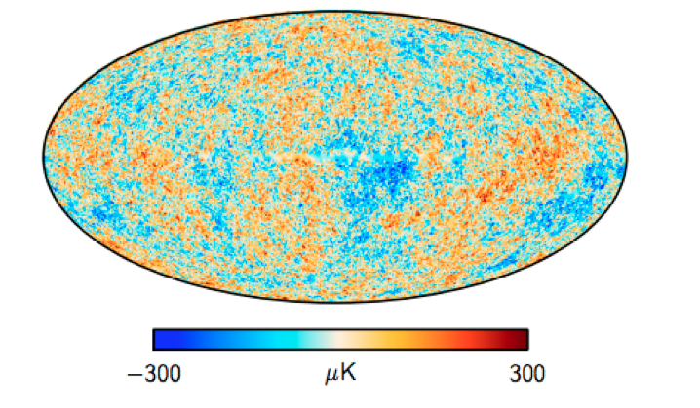
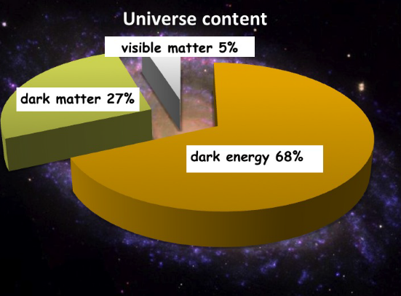

Relic Axions – early universe
←Redshift at Hubble expansion scale
68 km/s/Mps (Planck 2013)
←let there be light CMB (WMAP 30-857 GHz)
4% - Standard Model
← let there be Axions
E.P.S. Shellard 2003

Slide 11

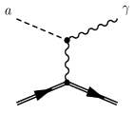
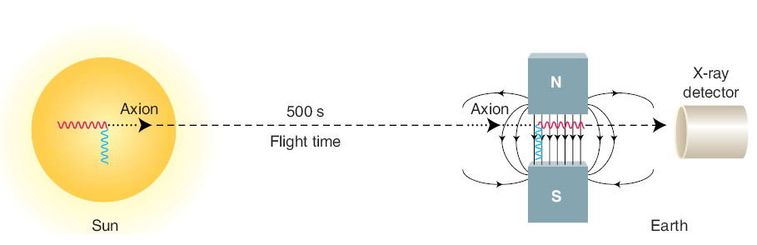
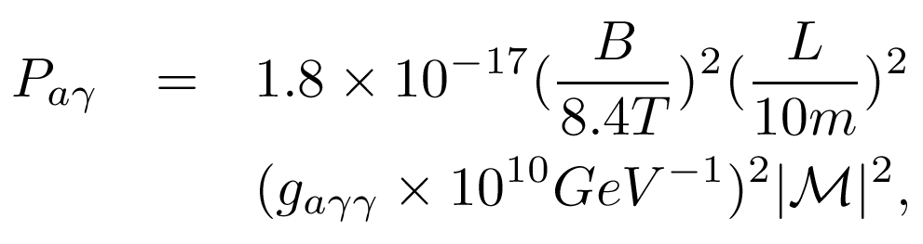
Dark Matter Detection (Axions)

Slide 12
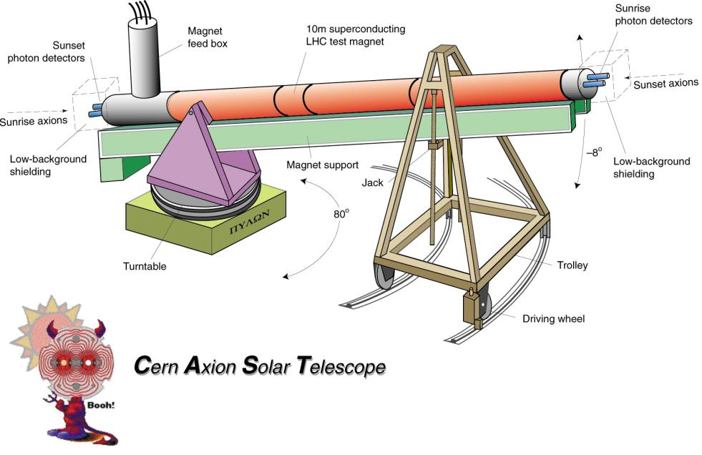
Cern Axion Solar Telescope
Sunset
Photon detectors
Sunrise
Photon detectors
Sunrise axions
Sunset axions
Decomissioned LHC test magnet
Rotating platform
3 X-ray detectors
X-ray Focusing Device

Slide 13
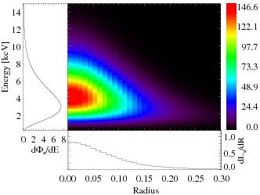
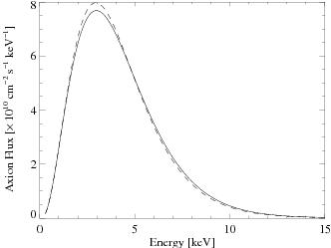
Expected Axion Signal
Most of the axions are emitted from the inner 20% of the Sun
Conversion probability is proportional to (BL)^2
Therefore a strong magnet ic field needs to be pointed to the sun
In CAST we expect 0.3 counts per h
our from axion-photon conversion
We need low background detectors
sensitive for energies from 0.3-12 keV

Slide 14
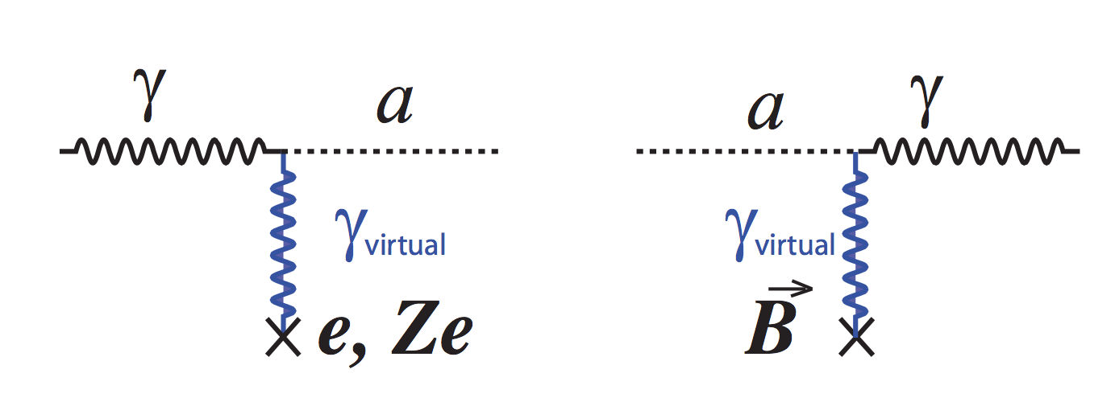
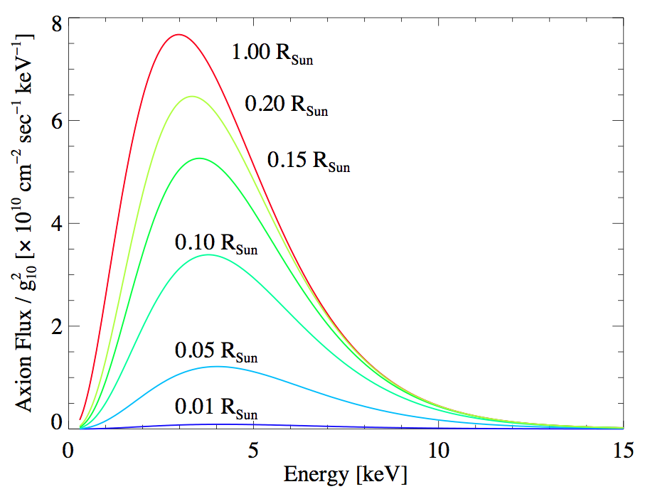
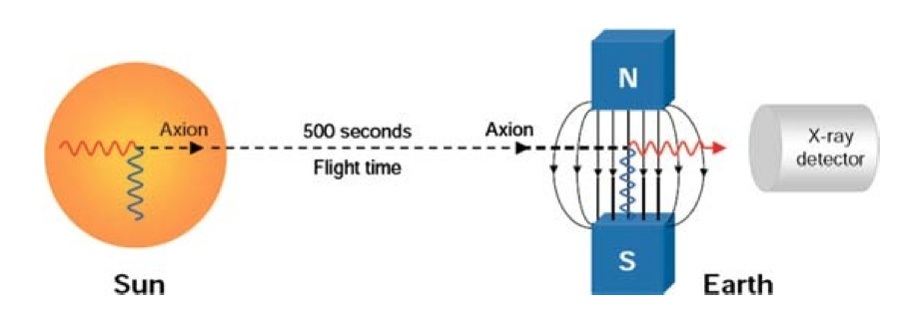
Solar axions – Primakoff effect
Mean energy = 4.2 keV
Axion Luminosity =1.9 x 10⁻³ L◉
Axion flux = 3.8x10¹¹ cm⁻² s ⁻¹
90% of the flux
Helioscope Principle

Slide 15
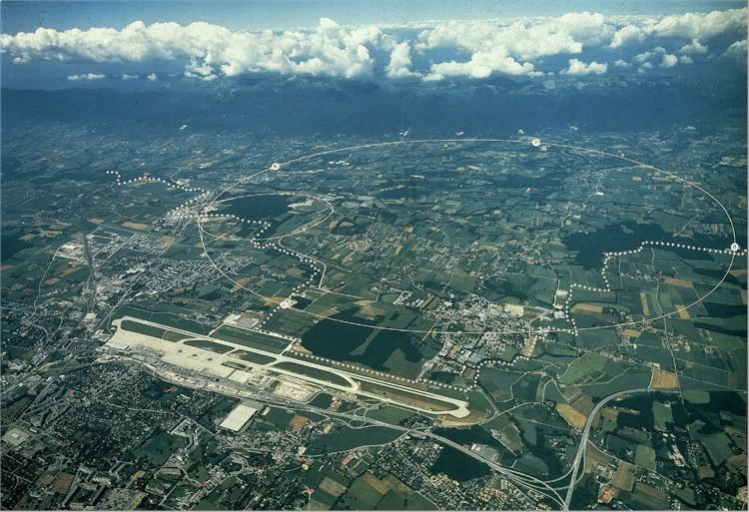
CERN und CAST (CERN Axion Solar Telescope)
CAST

Slide 16
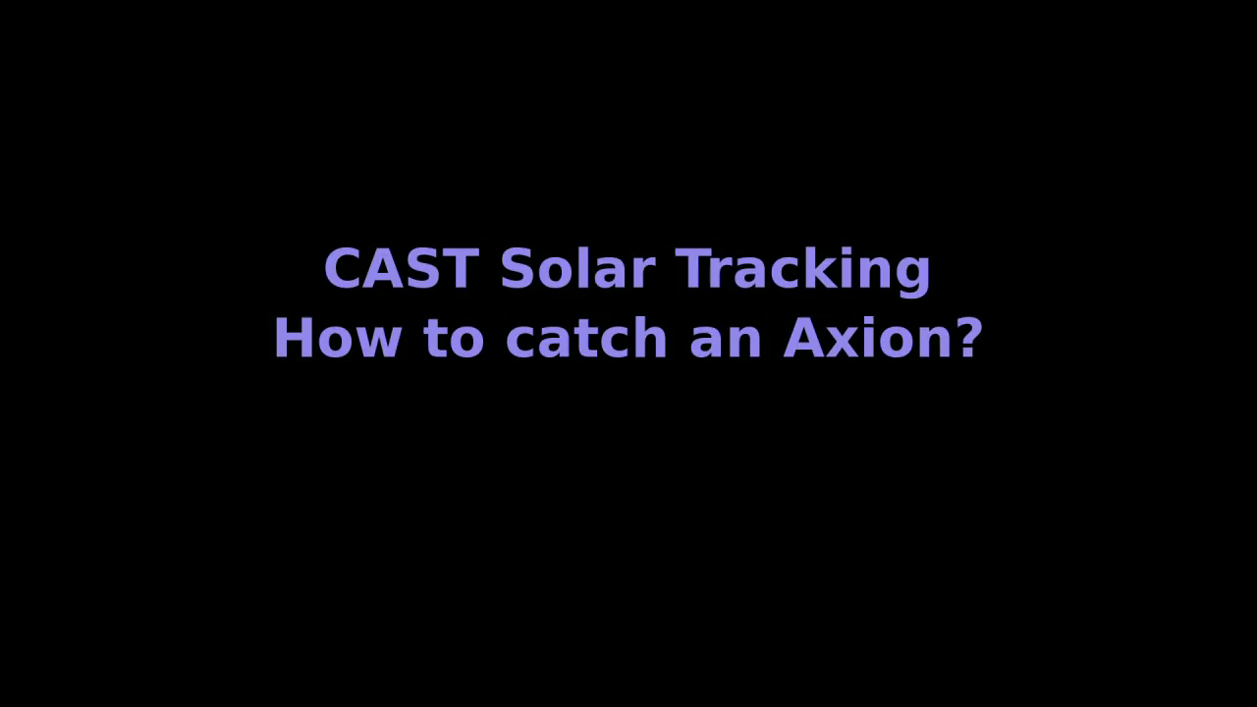
Sun tracking time-lapse / 3.5 Hours
90 minutes of solar tracking (16° zenith) and 21 hours of background per detector per day

Slide 17
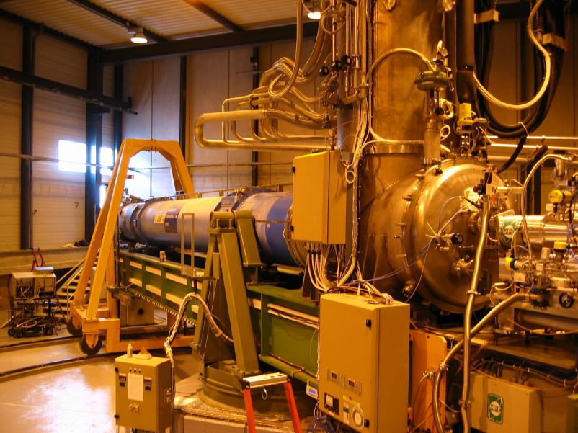
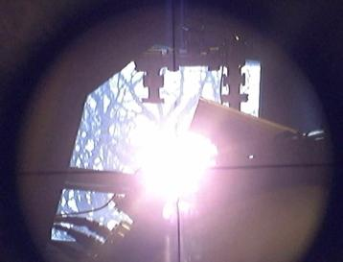
Magnet, platform, cryogenics
towards sunrise
Tracking System:
Calibrated and correlated to universal coordinates (GPS)
two times a year (September&March) the sun is within this window

Slide 18
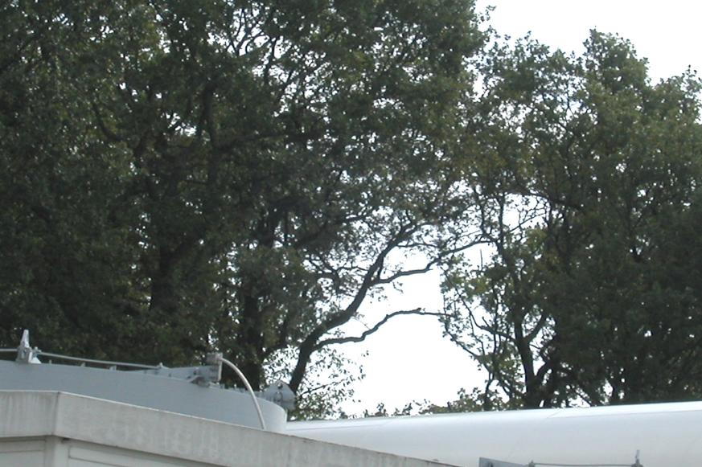
Really existing experimental problems

Slide 19
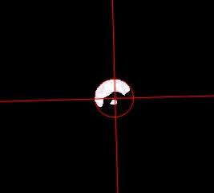
Tracking the Sun

Slide 20
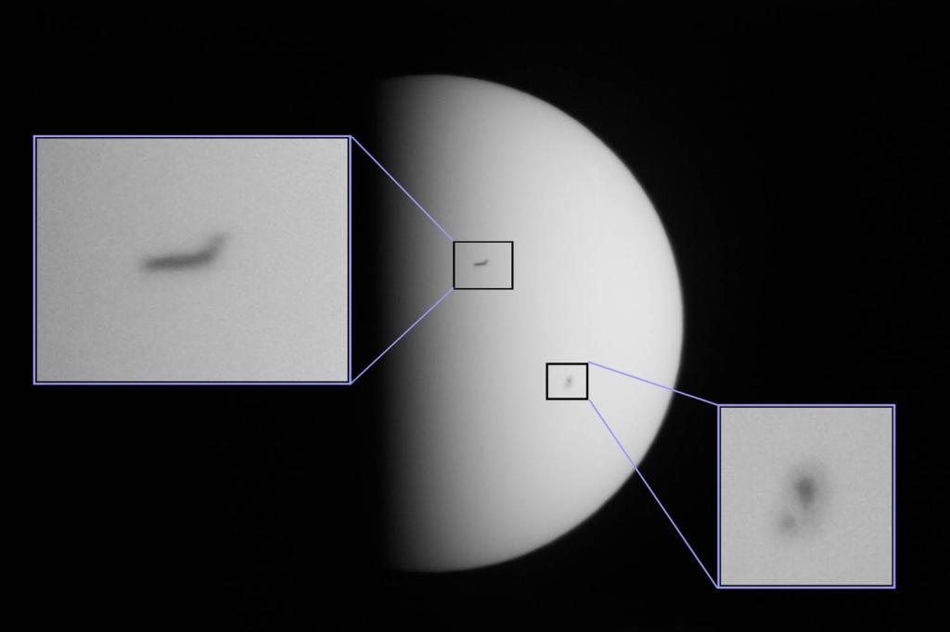

Slide 21
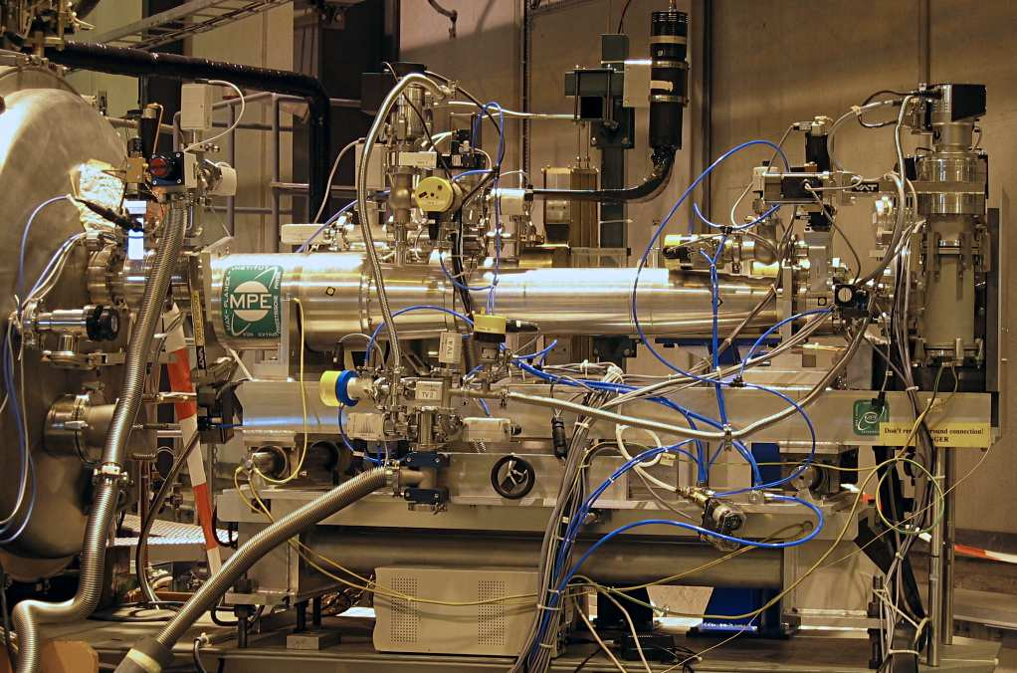
CCD-XRT Implementation at CAST

Slide 22
CCD-XRT Implementation at CAST
Magnet

Slide 23
CCD-XRT Implementation at CAST
XR-Telescope
Magnet

Slide 24
CCD-XRT Implementation at CAST
XR-Telescope
CCD
Magnet

Slide 25
CCD-XRT Implementation at CAST
XR-Telescope
CCD
Magnet

Slide 26
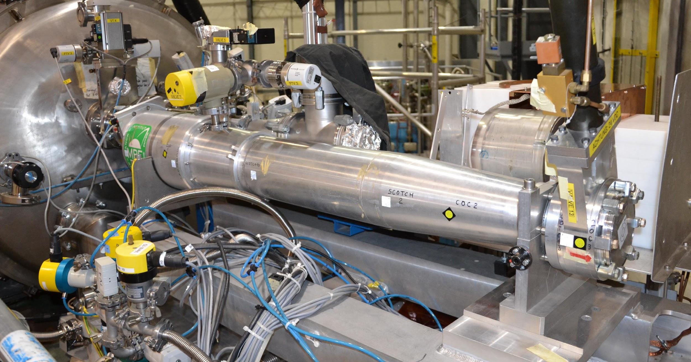
The X-ray Telescope Mirror System
Abrixas space mission spare telescope - 160 cm focal length

Slide 27
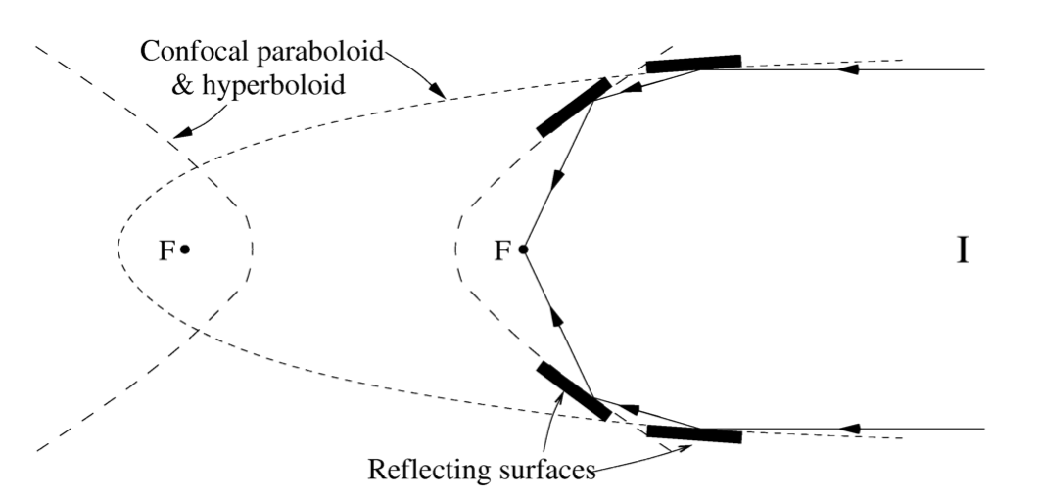
Wolter type 1, Grazing incidence optics

Slide 28
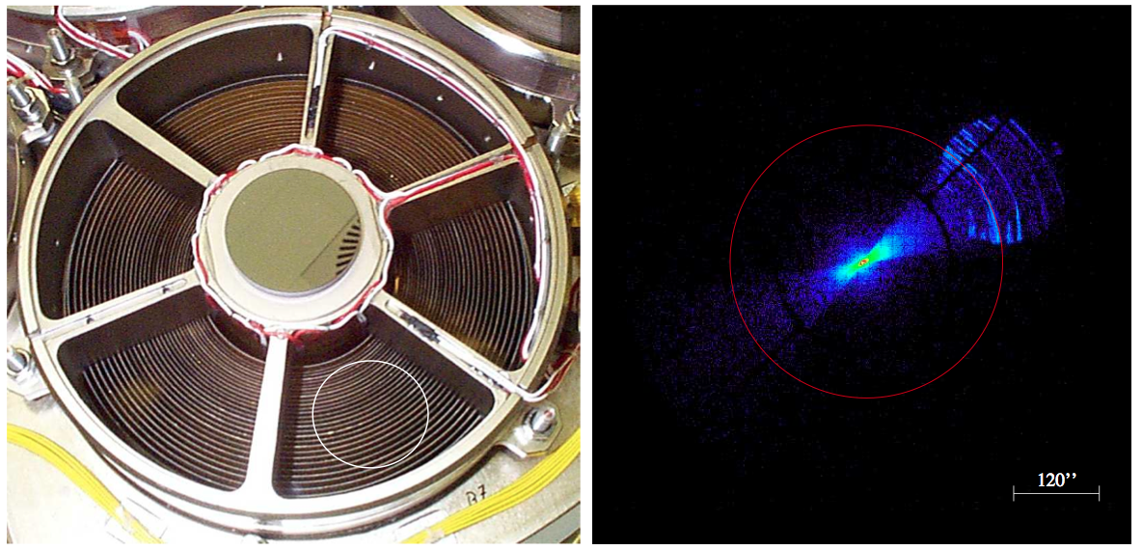
Abrixas space mission spare telescope - 160 cm focal length

Slide 29
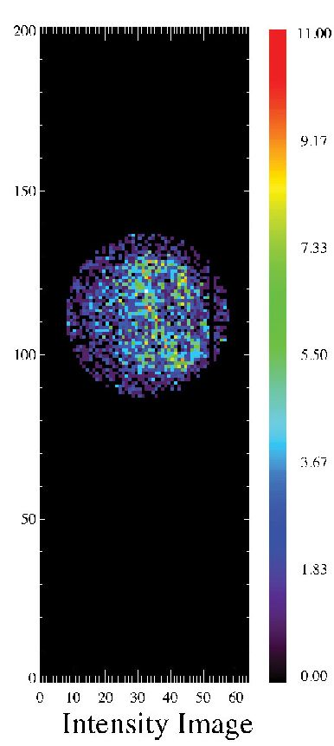
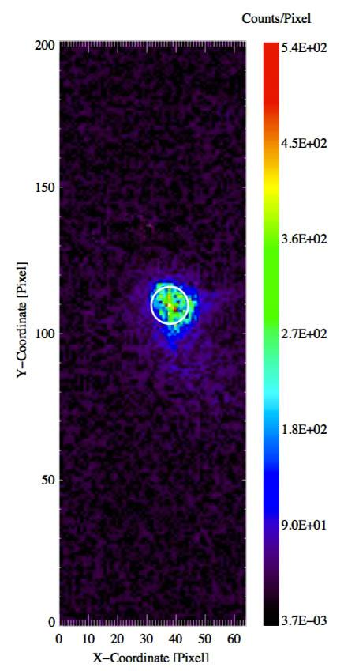
Finding the focal spot
14.5 cm²
≈ 154
9.4 mm²
Laser spot
(yearly)
X-ray finger source
(monthly)

Slide 30
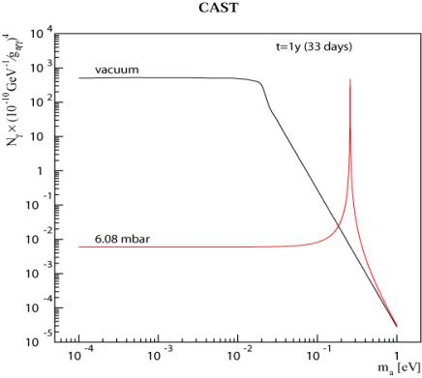


CAST phase II – principle of detection
Extending the coherence to higher axion masses...
Coherence condition (qL << 1) is recovered for a narrow mass range around m_{γ}
N_{e}: number of electrons/cm³
ρ: gas density (g/cm³)

Slide 31
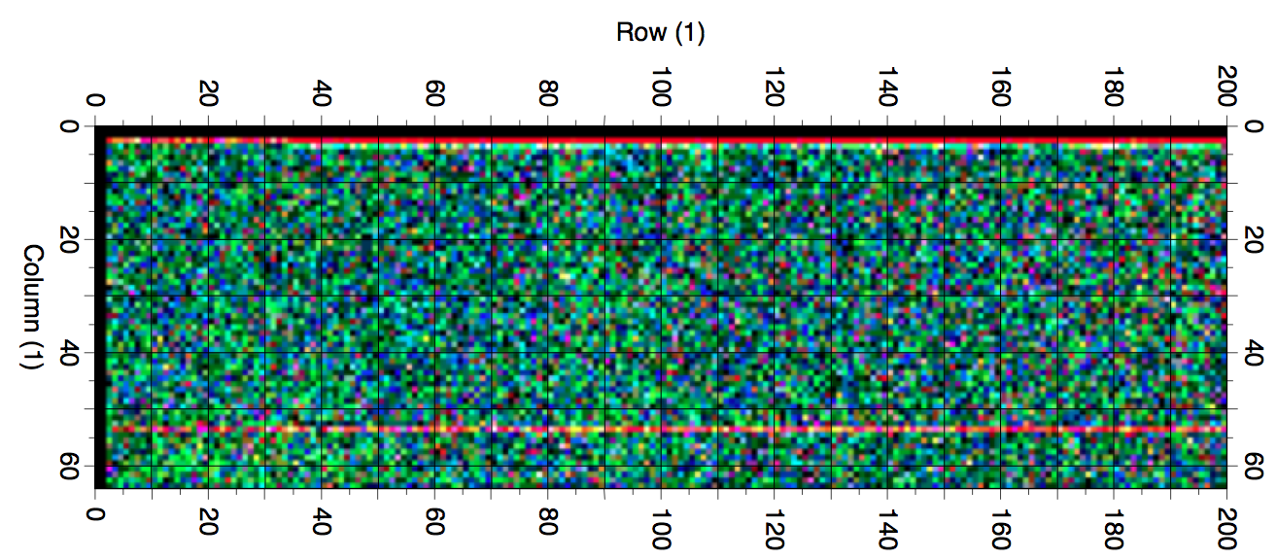
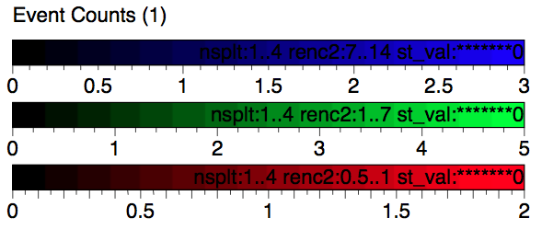
CCD data 2009 (2009–2011)
114 tracking runs out of 132 (86%);
167.5 hours of Axion sensitive exposure;
132.47 days of background;
0.185 counts per hour in the spot;
8.66±0.06×10⁻⁵cts cm⁻²s⁻¹keV⁻¹ - background.

Slide 32

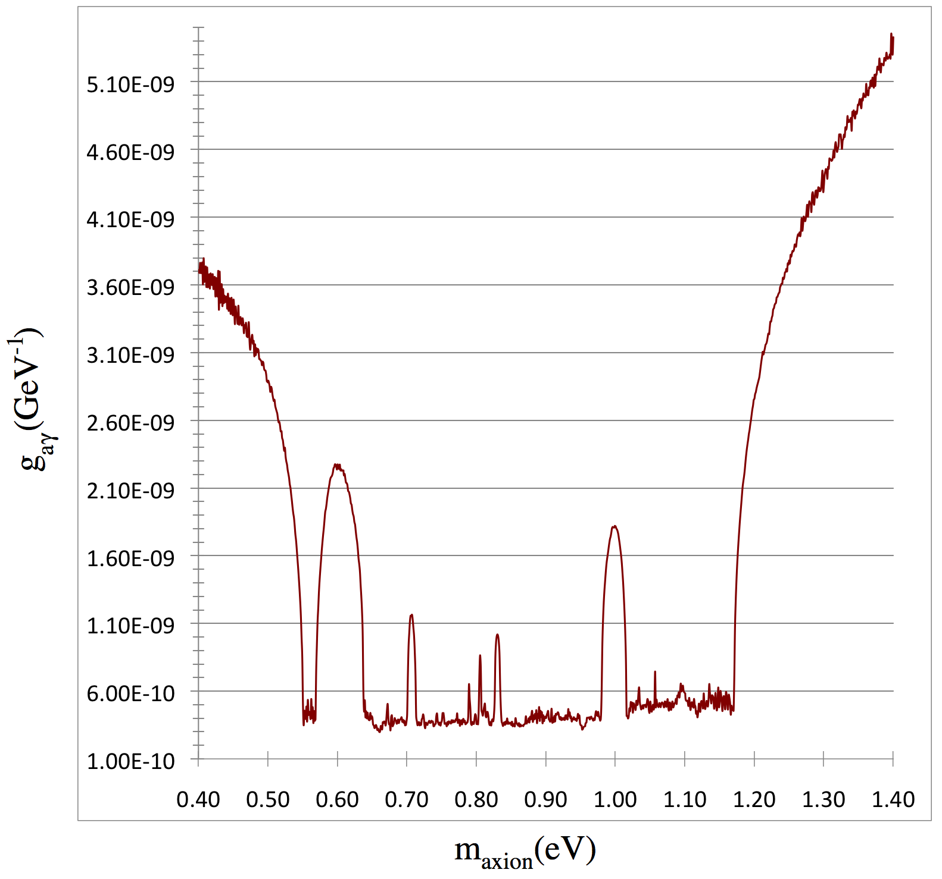
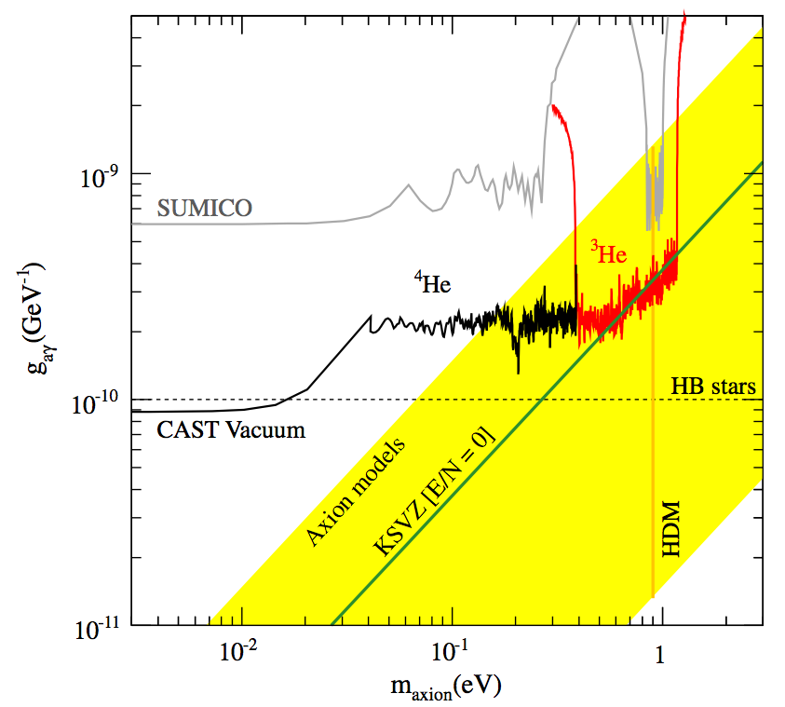
Result – no detection ➔ exclusion plot

Slide 33
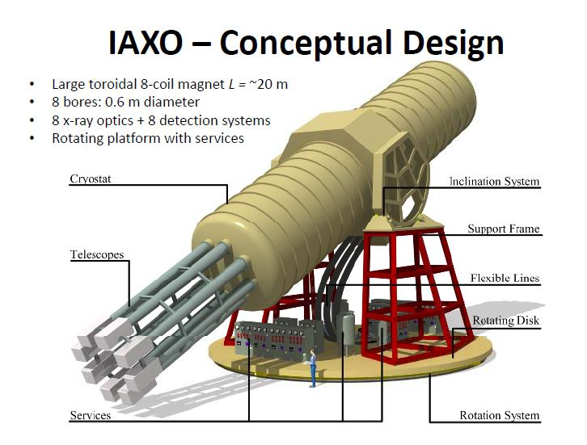
Thursday 12:25 : IAXO perspectives for Solar WISP searches : I.G. Irastorza

Slide 34
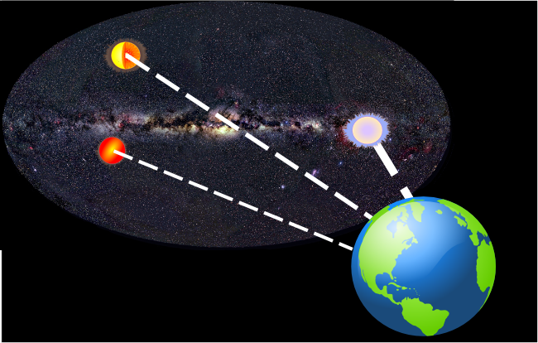
from catalogued data: Distance, type and position
→ calculated axion flux for known stars within CAST reach
Daniel Nowakowski
Notes:
Da Entfernung der Sterne nicht berechenbar, benutze experimentelle Beobachtungen für tabellierte Sterne, um den Axionen-Fluss von Sternen zu bestimmen.
Stellt man nun den Axionen-Fluss von den Sternen in der galaktischen Ebene dar, also man blickt in der Mitte auf das galaktische Zentrum und darum befinden sich ähnlich wie auf der Erde Längen- und Breitengrade, dann erkennt man farbkodiert den resultierenden Axionen-Fluss, also Axionen die auf der Erde eintreffen.

Slide 35

from catalogued data: Distance, type and position
→ calculated axion flux for known stars within CAST reach
Daniel Nowakowski
Notes:
Abdeckung der galaktischen Ebene des CAST-Experiments für das Jahr 2004. Weiß: Position des Magneten, (Grün: Im Gesichtsfeld des Teleskop registrierte Ereignisse)

Slide 36

Axion solution to mysteries:
Strong CP Problem
TeV Transparency
Solar Corona
11 Year Solar Cycle
Manuel Meyer, PATRAS Workshop 2011
Notes:
Friederike Januschek (DESY) on Monday

Slide 37

A. Einstein:
Lens-like Action of a Star by the Deviation of
light in the Gravitational Field. (Science 1936)
http://hubblesite.org/newscenter/archive/2000/07/image/c
Note to the editor:
Let me thank for your cooperation with the little publication which Mister Mandl squeezed out of me.
It is of little value, but it makes the guy happy

Slide 38



Hoffmann, Jacoby, Zioutas
$$v≈0.2c →effective amplification factor of {10}^{3}−{10}^{4}$$
$$tan\left(\frac{α}{2}\right)=\frac{GM}{Rv^{2}}$$
$$G=Grav. constant;R=distance from center of$$
$mass distr.$, M enclosed by R; v = velocity of particle

Slide 39




∼0.01c $≤v≤0.14$c Flux enhancement up to ${10}^{6}$.

Slide 40


Outlook
CAST is being upgraded:
New LLNL XRT optics
InGrid detector
Radiation pressure detector - Trieste
IAXO – International AXion Observatory
Signal-to-noise ratio 10⁵ better than CAST
In approval process by CERN
No Axion signal yet, but we are working on it!

