Slide 1
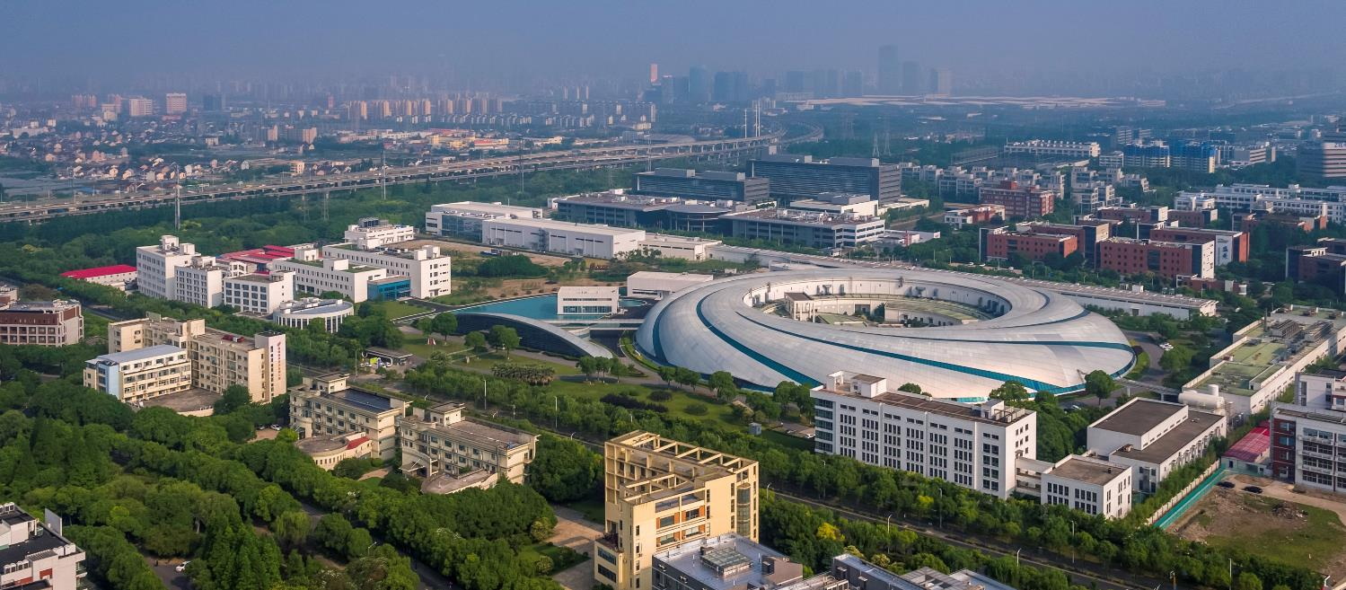
SSRF storage ring improvement in beam line phase II project
Bocheng Jiang on Behalf of the SSRF Accelerator Team
Jun 25-28 2018 Novosibirsk, Russia

Slide 2
Contents
Introduction of SSRF
Introduction of beam line Phase II project
Storage ring upgrades
  Lattice upgrade
  Cryogenic system
  3rd harmonic cavity
  Insertion devices

Slide 3
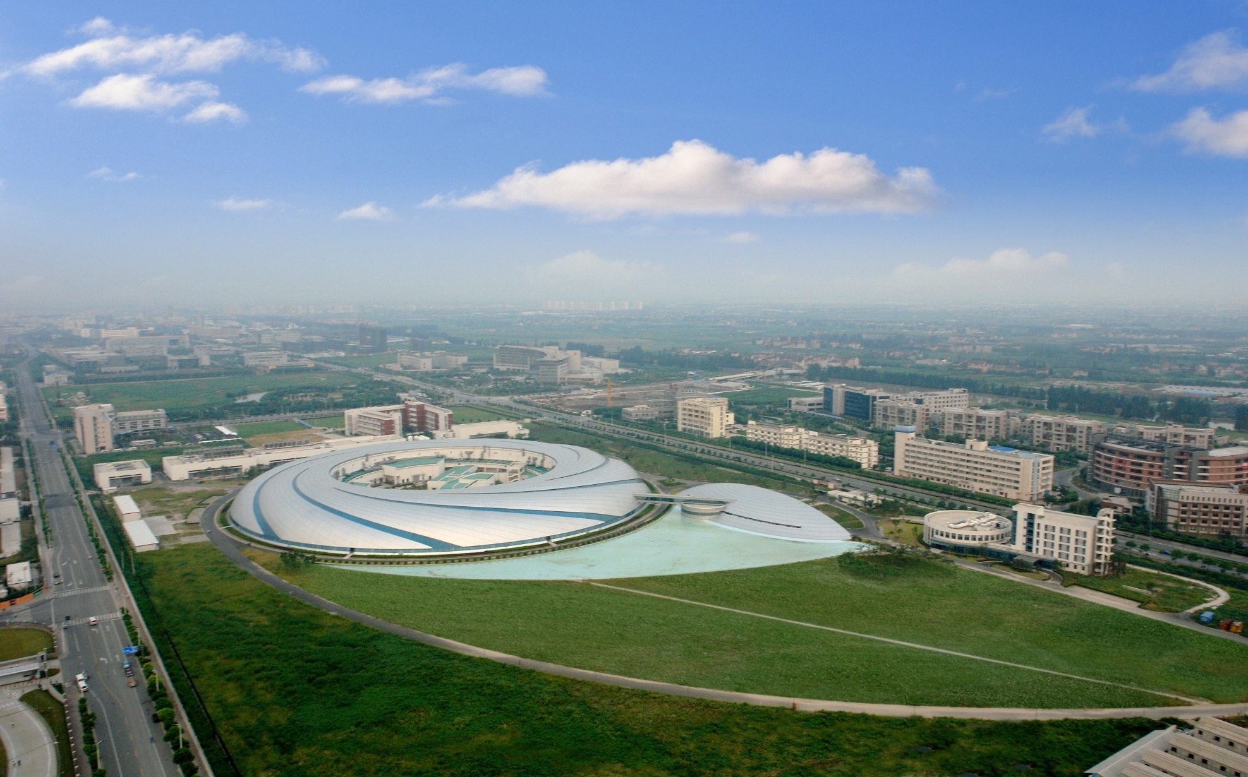
Introduction of SSRF
Shanghai Synchrotron Radiation Facility is
a 3rd generation light source in main land China. Located in Zhangjiang High tech-park, Pudong, Shanghai.
Based on a 3.5GeV electron storage ring with emittance 4 nm rad.

Slide 4
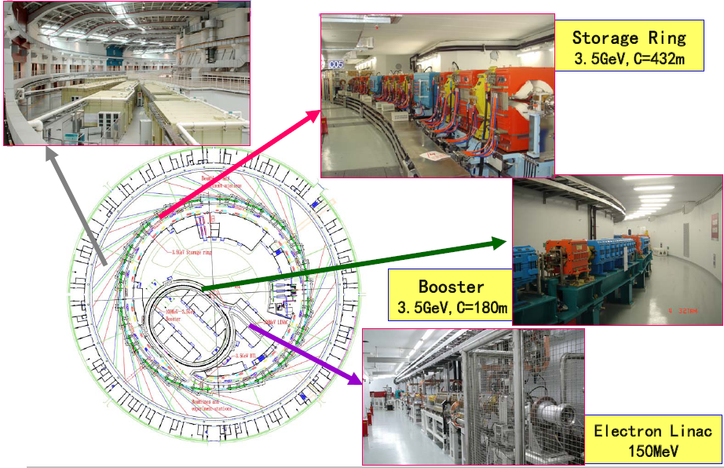
SSRF Complex
DBA lattice
7 beam lines on Phase I project
6 users’ beam lines

Slide 5
Introduction of SSRF
2004 ground breaking。（250Million USD）
2007 finished installation and commissioning started.
2009 open to users.
2012 Achieve op up operation (200mA->260mA).
2013 Fast orbit feedback, orbit stability sub micron.
2016 beam line phase II project started.

Slide 6
Operation status

Slide 7
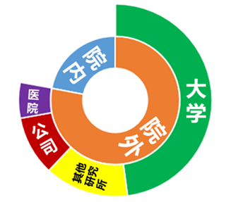
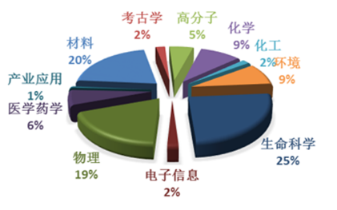
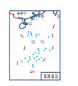
Introduction of SSRF
International：
singapore3
Australia2
S Korea17
Japan5
Sweden1
Denmark1
Canada2
U.S.5
Portugesa1
Tailand1
Russia1
France2
New Zealand1
Saudi Arabia1
German 1
黑龙江5
吉林6
新疆3
辽宁8
甘肃4
内蒙古3
⊙北京73
⊙天津10
河北3
青海3
宁夏
山西5
山东11
10多个研究领域
陕西7
河南4
江苏33
安徽11
⊙上海77
四川11
⊙重庆3
湖北13
浙江14
江西4
贵州2
湖南6
福建7
云南3
广东13
台湾2
广西3
澳门 ⊙
⊙香港5
海南3

Slide 8
Introduction of beam line Phase II project
16条光束线站
16 beamlines
Energy, environment, material, physics, chemistry, biology
Project contents
Storage ring upgrade
Lattice modification, 3rd harmonic cavity, Cryogenic system, Insertion devices.
Supplementary lab
Sample preparation lab for material, In situ environment lab, Chemistry & environment lab，biology & medical lab， Data center。
Beamline tech lab
Optical tech lab, Machinery & Vacuum lab, Electric &control lab, X-ray diagnostic lab
Buildings
Experimental hall、Supplementary lab building、Data center.
Total budget: ~250M USD,
From 2016~2022

Slide 9
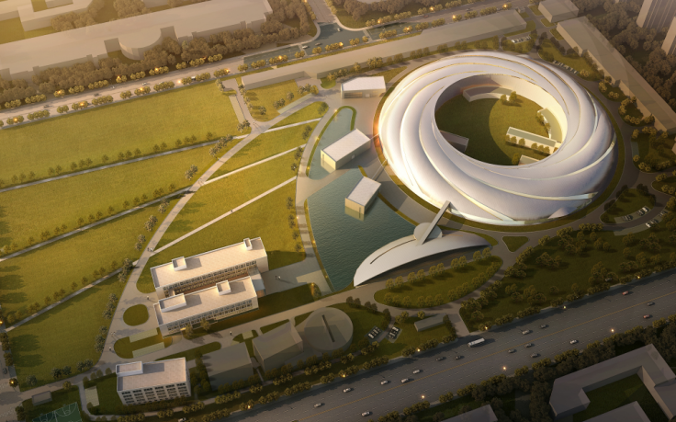
Introduction of beam line Phase II project
Experimental hall
Experimental hall
Supplementary lab
Experimental hall
Data center

Slide 10
Introduction of beam line Phase II project
Disciplines | Beamline | Science goals
Energy science | E-line | energy conversion and control
 | D-Line | Structure of non-equilibrium systems
 | Radioactive materials | Radioactive material
 | Hard X-Ray Spectroscopy | Catalysis
Environ. Science | Hard X-ray Nanoprobe | Nano technology, cell, environ. components
 | Medium-energy Spectroscopy | environmental pollutants
 | 3D Nano Imaging | nano imaging
Material Science | Magnetic Dichroism | magnetic and electronic properties
 | Laue microdiffraction | local microstructure and defects
 | Surface diffraction | microstructure of surfaces and interfaces
 | Laser Electron Gamma Source | nuclear astrophysics/structure
Life Science | P2 Protein Crystallography | Moderate-risk infectious viruses
 | Membrane Protein | Membrane protein
Industry Applications | Ultra Hard X-ray Applications | engineering materials and rocks
 | Time-resolved USAXS | self-assembly and fiber-spinning
 | Fast X-ray imaging | Fast process imaging

Slide 11
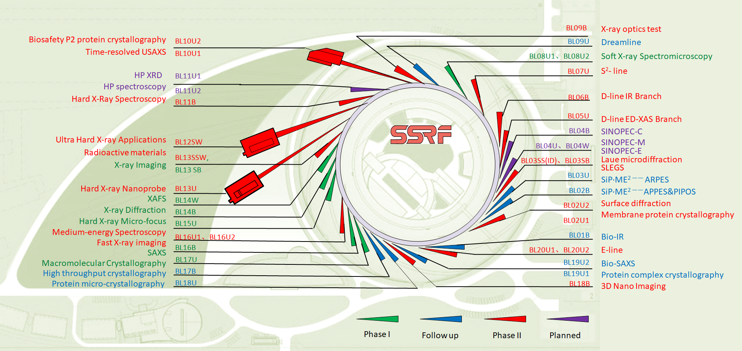
SSRF Beamlines layout

Slide 12
Introduction of beam line Phase II project
As a part of Phase II beamline project, accelerator get an upgrade plan to satisfy users’ requirement. The major principle is as follows:
Lattice adjustment to accommodate more insertion devices.
Provide various kinds of radiation sources. (SW, SuperB, EPU)
Provide more operation modes. (Such as hybrid filling mode)
Increase the reliability of the machine.
The major upgraded systems during Phase-II project:
Proposed upgrade system | Purpose
Super-Bend lattice | Provide more straight sections, Increase the flux of the hard X-ray
New Cryogenic system | An online spare of the primary cryogenic system, increase the machine reliability, Provide liquid helium to 3rd harmonic cavity
Third harmonic cavity | Increase the current threshold of single bunch, increase the beam lifetime.
New IDs | Satisfy the users’ requirements for new beam lines.

Slide 13
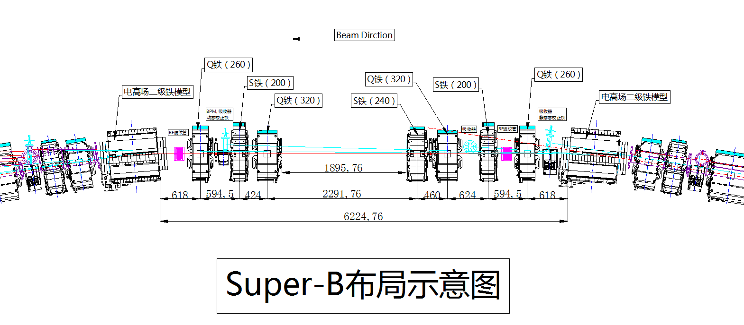
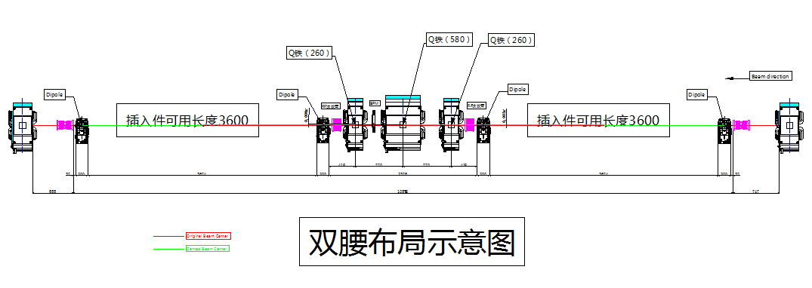
Storage ring upgrades
Lattice upgrade
C03, C13 replace 1.8m bend with 1m SuperBend
Creating 1.9m short straight section
Super Bend
ID11, ID16 long straight section add triplet create double mini beta function straight sections accommodate 2 IDs

Slide 14
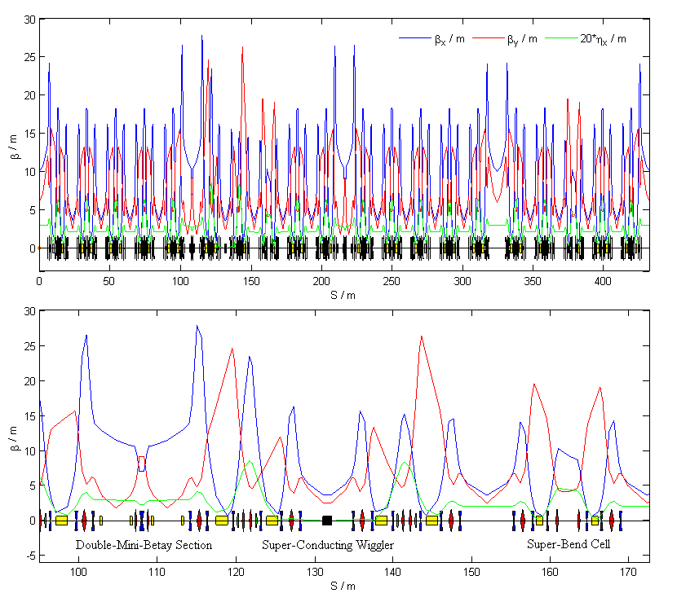
Storage ring upgrades
Lattice upgrade

Slide 15
Storage ring upgrades
Lattice upgrade
Parameter | Unit | Current | Upgrade
Energy | GeV | 3.5 | 3.5
C | m | 432 | 431.989
Tune |  | 22.22,11.29 | 22.222, 12.153
Emittance | nm rad | 3.9 | 4.22 (with SW)
Momentum compaction |  | 4.27e-4 | 4.2e-4
Energy spread |  | 9.8e-4 | 11.1e-4
Energy loss/turn | MeV | 1.44 | 1.7 (With SW）
Straight sections | m | 4×12, 16×6.5 | 4×12, 16×6.5, 2×1.9
Bunch length | mm | 3.8 | 4~8
Bend field | T | 1.27 | 1.27 2.29

Slide 16
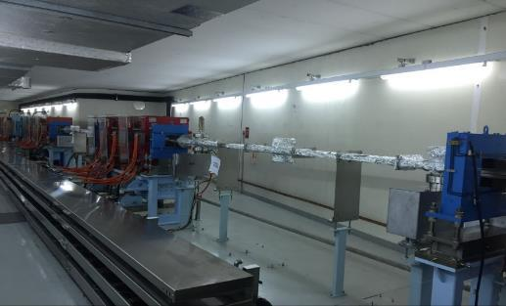
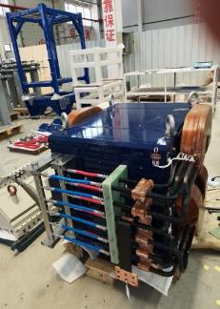
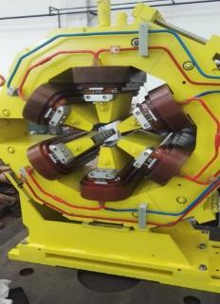
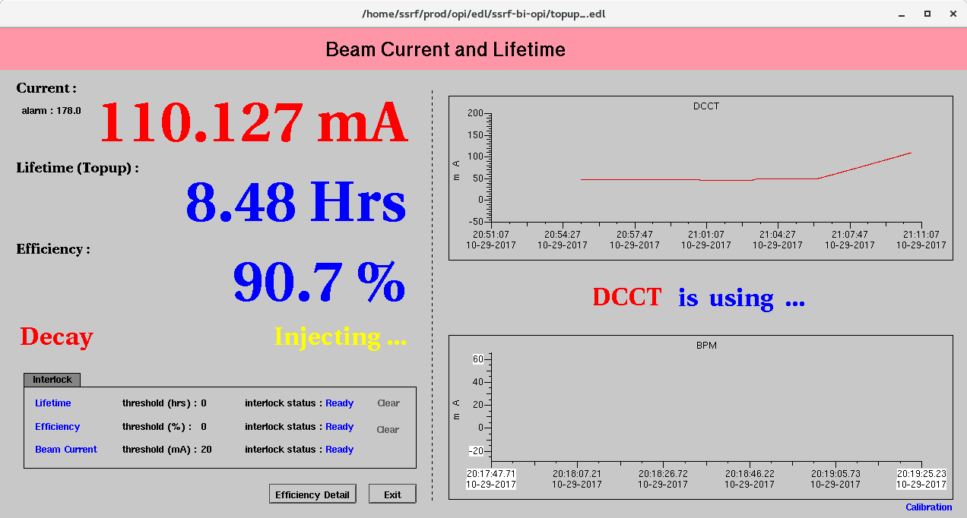
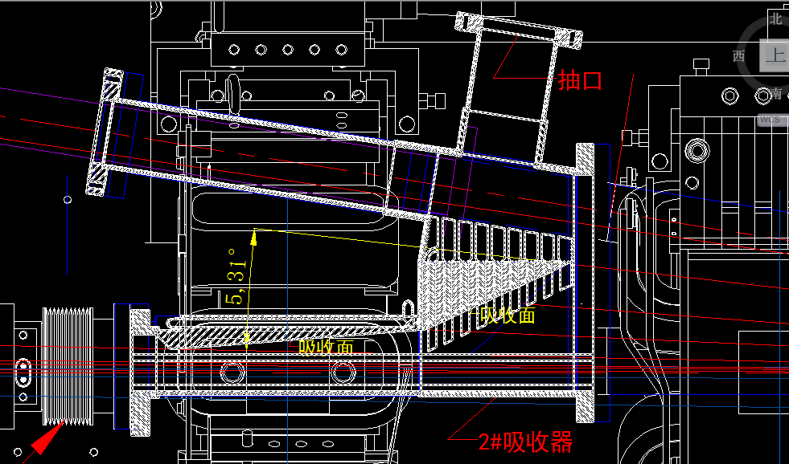
Storage ring upgrades
Lattice upgrade
Super Bends, combine sextupoles had been built
ID11，ID16 upgrade had been finished and beam commissioning successfully.
Vacuum system, Gird is in fabrication.

Slide 17
Storage ring upgrades
Cryogenic system
Refrigerator 650W/4.5K
60W@2K
LHe Dewar 2000L
Valve Boxes 4
Multi channel Transfer Line
Single channel Transfer Line
GHe Storage Tanks 2×100m³
MC
ORS
LP Tank
Buffer
Buffer
Buffer
LN
2
P
Compressor Station & Tank Farm
P
Atm
300K return
300K
N
2
phase
supply
Cold
separator
Box
Mul
ti
-
channel
4.5K return from
Transfer Line
80K return from
80K return from
4.5K return from
cavities
cavities
4.5K supply
80K supply
Atm
Atm
Atm
Atm
dewar
dewar
B
VB
VB
VB
V
HT
T
HT
T
HT
T
HT
T
L
L
L
L
S
P
T
P
T
P
T
P
T
P
T
L
Atm
SRF Cavity
-
T
SRF Cavity
-
A
SRF Cavity
-
B
SRF Cavity
-
C
O
Main Dewar
V
V
V
V
U
U
U
U
V
Operation mode:
1、Main cryo for 3 main RF cavity, Cryo-II for 3rd harmonic cavity @ 2K
2、Main Cryo or Cryo-II down, The other switched both for 3 main RF cavity & 3rd harmonic cavity @ 4K, with 3rd harmonic detuned.

Slide 18
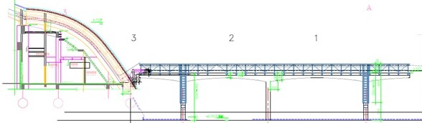
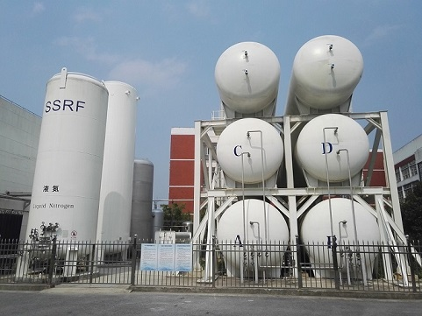
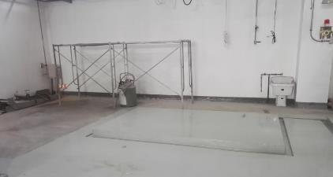
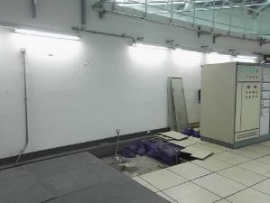
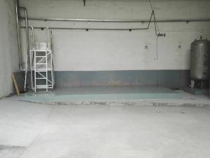
Storage ring upgrades
Cryogenic system
Current status
Transfer Line had been installed
2 LHE tank had been installed
Foundation for Refrigerator is ready

Slide 19
Storage ring upgrades
3rd harmonic cavity
Passive super conducting cavity
2 Cells
Working at 2K, 1.5GHz
Harmonic rf voltage 1.4~1.8MV

Slide 20
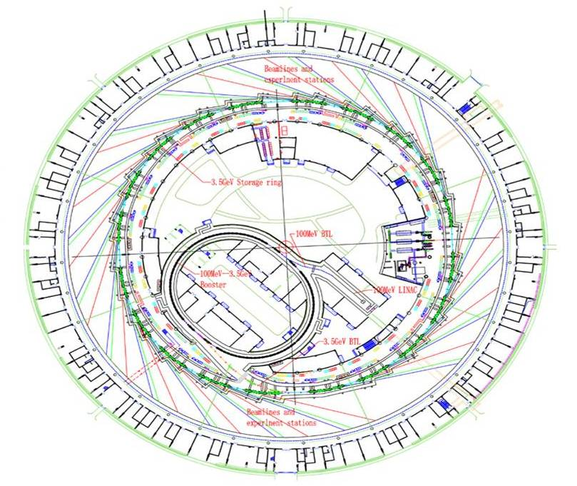
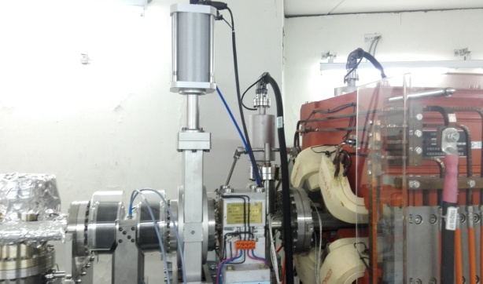
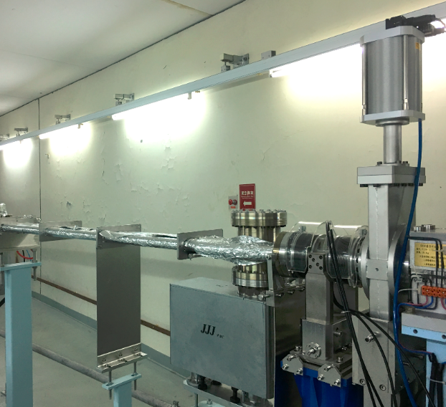
Storage ring upgrades
3rd harmonic cavity
3rd harmonic cavity installed at ID05， occupy half of the straight section
Near main Rf cavity and Cryogenic hall
C05
For 3rd hamonic
500MHZ Main RF cavity
3rd harmonic cavity

Slide 21
Storage ring upgrades
3rd harmonic cavity
ACB & 2K cold box
Main SRF modules & ValveBoxes
Harmonic
cryomodule
2K Multi-transfer line
Cryoplant
RF Hall
Test Cave

Slide 22
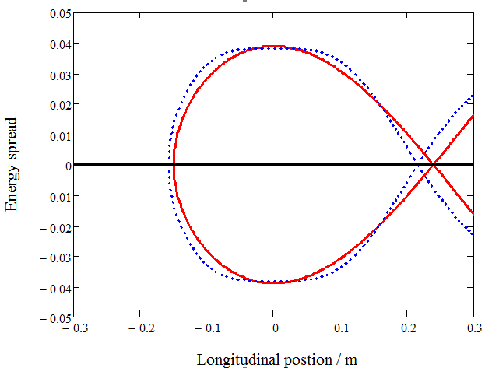
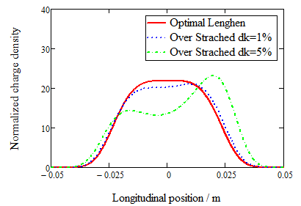
Storage ring upgrades
3rd harmonic cavity
Lengthening effect
Longitudinal acceptance
Detuning
Tracking for transient loading
Long bunch train
Short bunch trains
Hybrid filling pattern

Slide 23
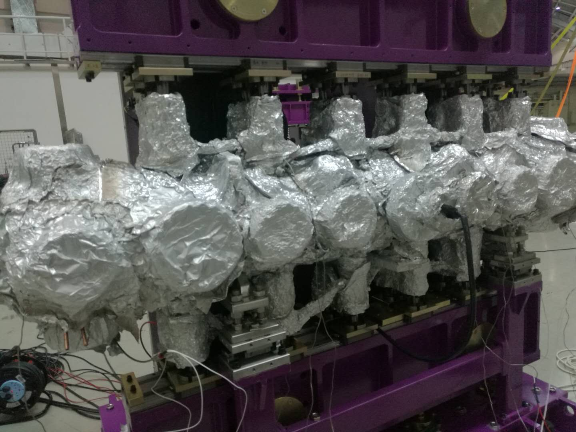
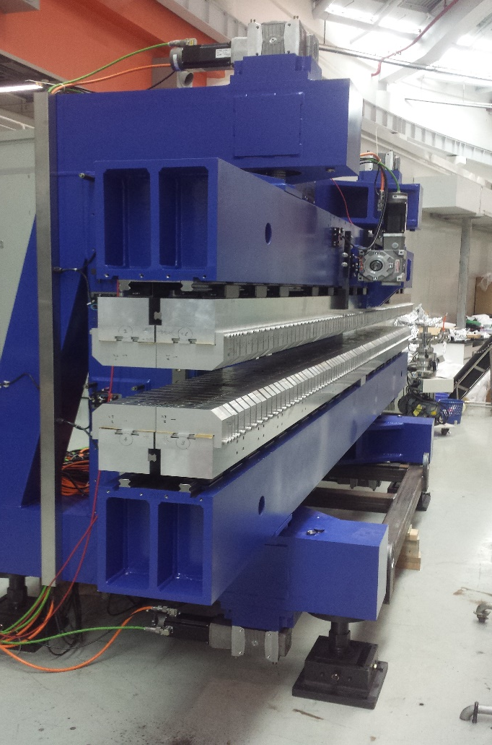
Storage ring upgrades
Insertion devices
In house built EPU ， IVU

Slide 24
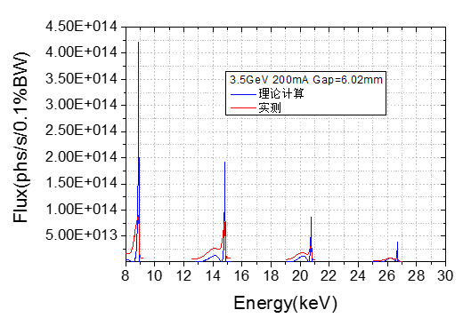
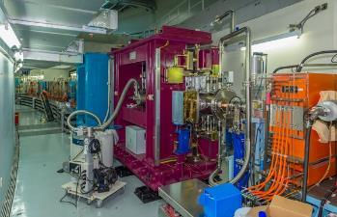
Storage ring upgrades
Insertion devices
CPMU
Beam test, 9th harmonic

Slide 25
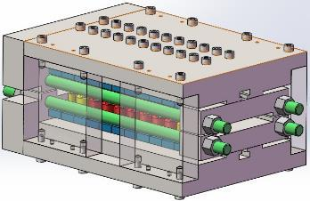
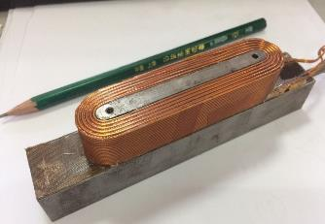
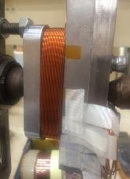
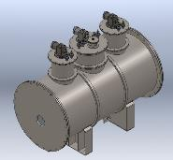
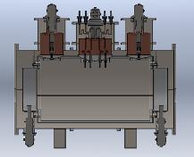
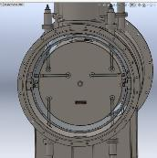
Super Conducting wigglers 4.2 Tesla, Periods 22.5, Period length 48mm
Storage ring upgrades
Insertion devices
Prototype
3D design
Superconducting wire coiling
Thermotat design

Slide 26
Scheduale
Building
2018.8
2018.12
竣工
完成穿墙线基建
Supplementary lab
设备安装
试运行
2019.6
2nd bath beam line installation
3rd batch beam line installation
Beam line
Finished commission
2018.12
2019.9
2020.9
2021.9
First batch installation
2019.6
2020.6
2nd batch beam line commissioning
2022年6月
Started2016年11月
First batch beam line commissioning
3rd batch beam line commissioning
Inspect
2022年11月
2018.12
Accelerator
Lattice upgrade
3rd harmonic cavity
2020.6

Slide 27
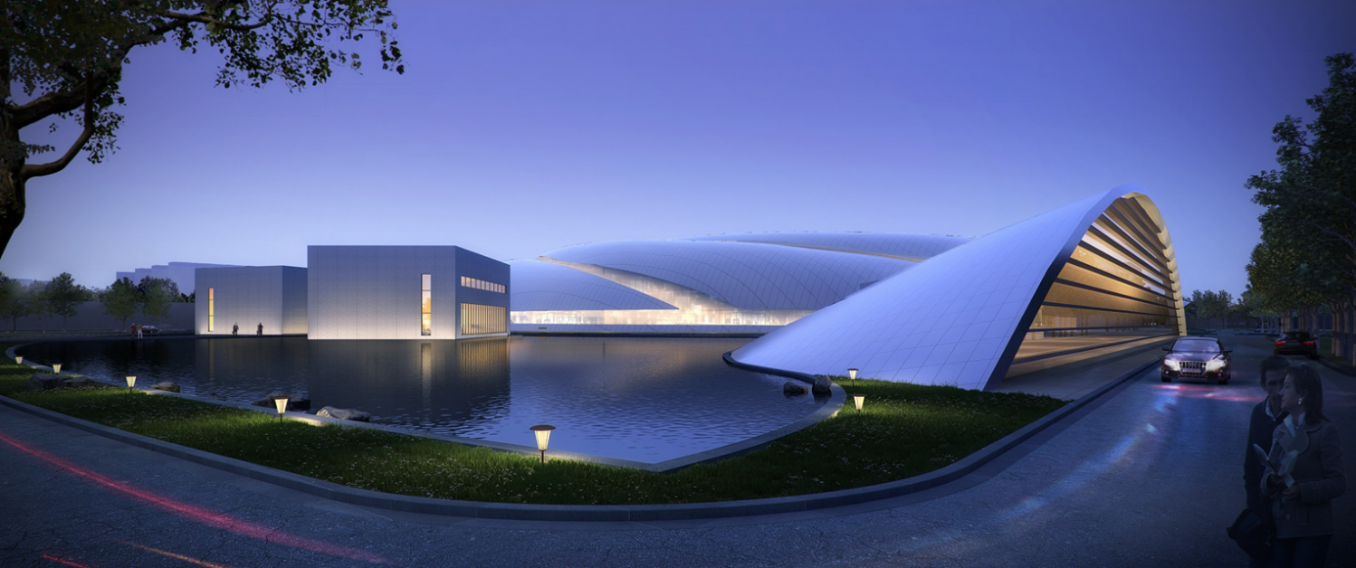
Thanks

