Slide 1
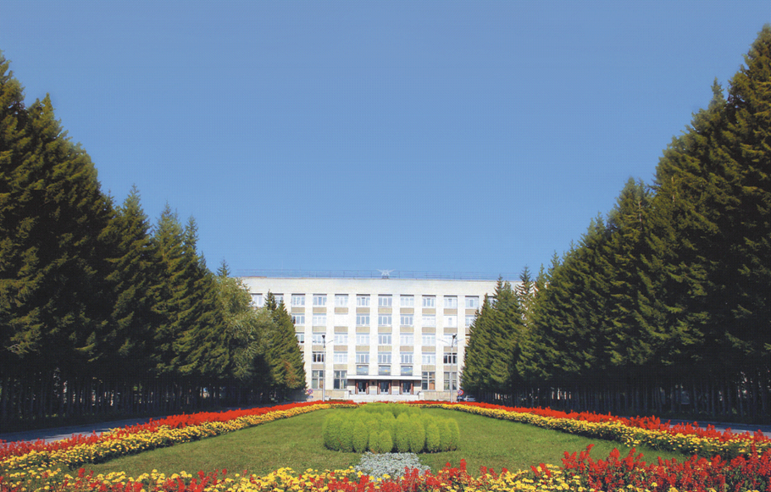

Super Charm-Tau Factory at Budker INP
Detector Concept
By Yuriy Tikhonov
Novosibirsk, May 26, 2018

Slide 2
Super Charm-Tau Factory at Budker INP
Detector Concept
Outline
Introduction
Considerations on the detector concept
Some options for subdetectors
Conclusion

Slide 3
Particle Physics at Budker INP
A few generations of the colliders and detector
World-wide recognized contributions to particle physics
Collider 2E, Gev Detectors Operation
VEP-1 (e⁻e⁻) 0.32 2 detectors 1965-67
VEPP-2 1.4 3 detectors 1967-72
VEPP-3 2.0 2 detectors 1972-
(booster and Nucl. Phys)
VEPP-4 11.0 OLYA, MD-1 1980-85
VEPP-2M 1.4 OLYA, ND, CMD 1974-2000
SND, CMD-2
VEPP-4M 11.0 KEDR 2000-
VEPP-2000 2.0 SND, CMD-3 2009
Tau-Charm ?
Notes:
3

Slide 4
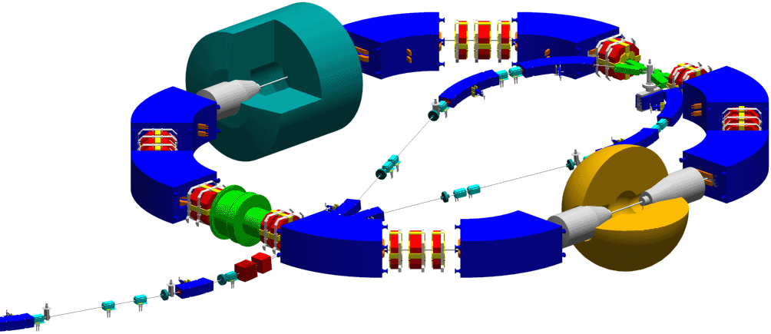

VEPP-2000 Collider
Status: in operation since 2009
Round beams, 2 x 1000 MeV
(1x1 bunch)
CMD-3
Cryogenic Magnetic Detector
injection
SND
Scintillator Neutral particles Detector
Present status: ξ=0.16!
Lmax =5x10³¹ cm⁻² c⁻¹ at 2E=1.0 GeV

Slide 5
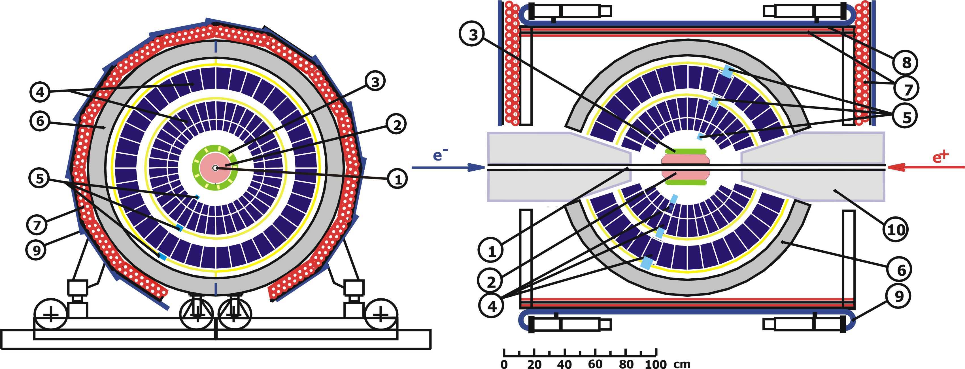
SND at VEPP-2000
1 – beam pipe, 2 – tracking system, 3 – aerogel, 4 – NaI(Tl) crystals, 5 – phototriodes, 6 – muon absorber, 7–9 – muon detector, 10 – focusing solenoid.
Advantages for VEPP-2000:
1- cherenkov counter, n=1.05, 1.13 –
e/πseparation E<450 MeV, π/K
separation E<1 GeV,
2 –drift chamber – better tracking

Slide 6

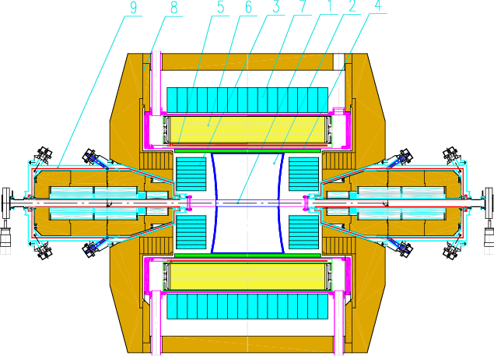
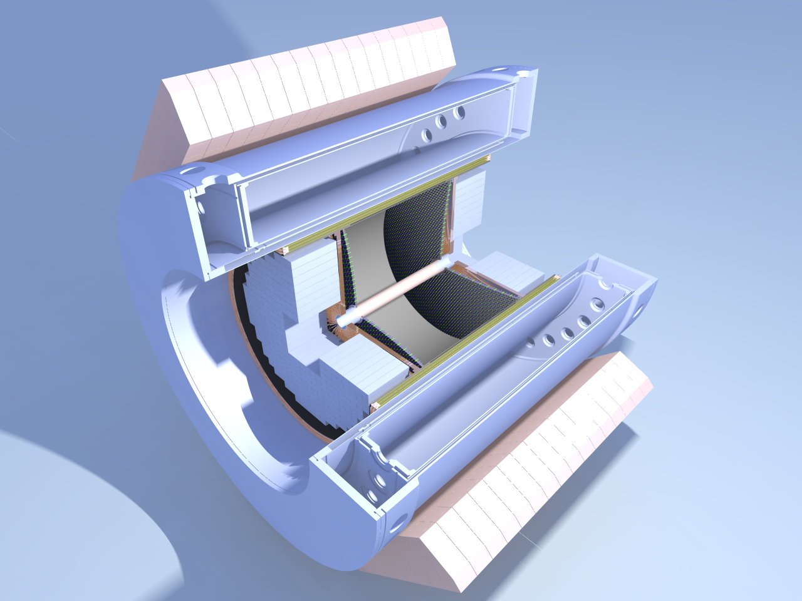
Cryogenic Magnetic Detector-3
(Collaboration: INFN, Italy)
1 – vacuum chamber
2 – drift chamber
3 – electromagnetic calorimeter BGO
4 – Z – chamber
5 – CMD SC solenoid
1М
6 – electromagnetic calorimeter LXe
7 – electromagnetic calorimeter CsI
8 – yoke
9 – VEPP-2000 solenoid

Slide 7
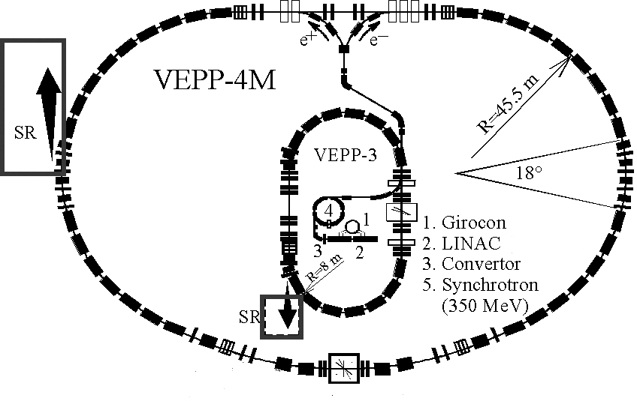
VEPP-4M Collider Complex
4.
2Е=2÷11 ГэВ
L=2х10**30 см-2с-1
L= 8х10**31 см-2с-1
ROKK-1M
Detector KEDR

Slide 8
Detector KEDR
(Collaboration: Milano, Bologna, Pavia Univ., BNL)
2004-2011 L= 21 пб-1 was collected: study of Ψ- mesons, D-mesons, τ-lepton,
R-measurements and etc.
2012-2013 –upgrade and reparation
2014-2017- next run

Slide 9
Budker INP collaborations in HEP
CERN: LHC, FCC, ATLAS , LHCb, CMS; AWAKE
KEK: KEKB, Belle -> Super-KEKB, Belle-2
J-PARC: COMET, g-2/EDM
SLAC: BaBar
PSI: MEG
FAIR: accelerator facility, PANDA, CBM
BNL/FNAL: g-2
IHEP (RPC): BES-III
JINR: NICA

Slide 10
General Requirements to Detector at SCTF
Exclusive reconstruction of the events with high efficiency is necessary
for analysis of all physics processes!

Slide 11
Classical detector concept for colliding beam experiments is suitable for SCTF

Slide 12
High luminosity machine with Crab Waist – very complicated and delicate final focus.
Some limitation for detector acceptance and impact on inner tracker.
Vertex detector is very important for optimization of the final focus and drift chamber.

Slide 13
A few options for each subdetectors can be considered and some of them
(but not all) will be presented at this workshop
Tracking (L.Schektman,A.DiCicco,R.Farnelli,G.Becivenni,D.Dedovich, D.Demetev,F.Grancangnolo,J.L.Ritman)
Particle identification systems (J.Schwiening,A. Hayrapetyan,A.Barnyakov,V.Babkin)
Electromagnetic calorimeter (B.Shwartz,D.Epifanov,V.Shebalin)
Magnet (E.Pyata,A.Bragin)
Muon system (V.Rusinov)
Beam background
Trigger & DAQ (A.Talyshev)
Computing (I.Logashenko)
Detector response simulation
Event generators
Beam energy and beam polarization measurements (V.Kaminsky)

Slide 14
Vertexing is not very important as it at B-factories.
It can simplify a design of main tracker- drift chamber.
%

Slide 20
pCsI looks as main options but LYSO (GsO) can be used at small angles

Slide 23
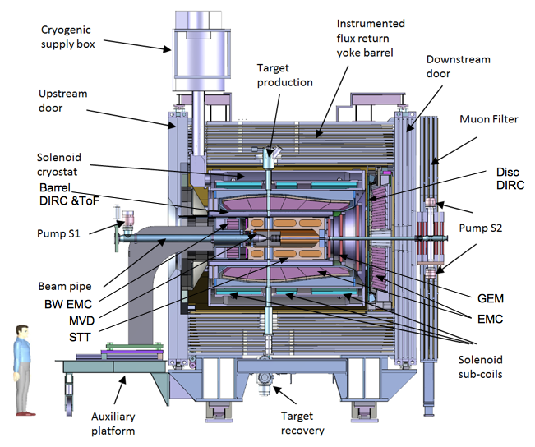
PANDA solenoid magnet as a prototype for SCTF detector
The PANDA solenoid is designed to provide a magnetic field of 2 T with a uniformity of ± 2% and radial magnetic field integral in the range 0 to 2 mm over the central tracking region. The magnet is characterized by a warm bore of 1.9 m diameter, a free length of 4 m and 22.4 MJ of stored energy.
Design: CERN+BINP. BINP is responsible for construction.

Slide 24
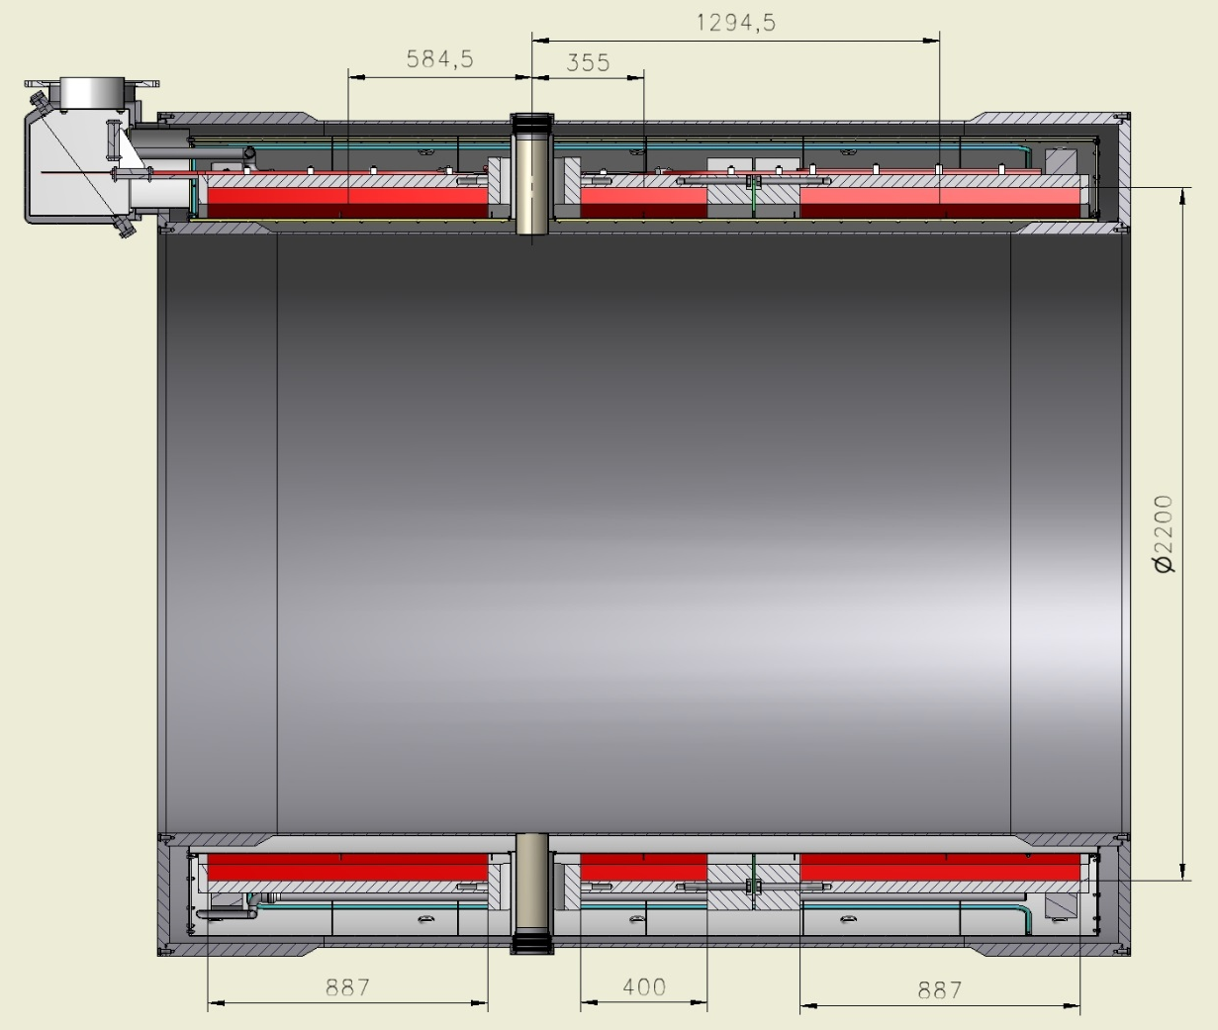
Panda SC solenoid (operation at 4.5 K).
Outer diameter of coils is 2200 mm, length: two coils - 887 mm, one – 400 mm.

Slide 25
Parameters of signals and FrontEnd electronics
Detector | Channel load | Duration of signals | Rate of digitization | Bit quantity of ADC (TDC) | Time measure precision
VD | 33 kHz | Rising edge 25 ns | from 20 MHz to 80 MHz | 10 -12 bit ADC | 1 ns
DC | 50 kHz | Rising edge 100-200 ns, Falling edge – 300 ns | 50 MHz (ordinary mode) 500-1000 MHz (claster mode) | 10 bit ADC | 1 ns
FARICH | 10 MHz | 5 – 10 ns | TDC | 6 bits (for 8 ns) TDC | 200 ps
Calorimeter | 15 kHz | 30 ns for clear CsI | 40 – 50 MHz | 18 bit ADC | 1 ns
Mu | 100 kHz | 30 – 200 ns | TDC | 11-12 bit TDC | 60 ps
Rates in J/ψ at luminosity 10³⁵ sm⁻²s⁻¹ :
events 260 kHz
Bhabha 90 kHz
cosmic 2 kHz
Backgound - several tens of kHz
The maximum readout rate up to 400 kHz
The event size 30 KB

Slide 26
The electronics block diagram
FrontEnd
Detector
Amplifiers
ADC / TDC
Pipeline 2-3 us
Optical transmitter
Read Out Processor
Event builder
Online computer
Controller
Trigger
L1
10Gb optical links

Slide 27
SCTF Computing is comparable with LHC experiments
Online
DAQ components
Output buffer
External users
BINP users
Super Charm-Tau Factory will require significant computing resources for data analysis, simulation and storage.
Estimated requirements:
1 Pflops
200-300 Pbytes
HLT
External gateway
Internal gateway
Event Builder
FLT
Buffer
Long-term storage
(tapes)
Detector
Offline
Disk storage
Virtualized computing center
Simulation, Reconstruction, Data analysis
Information system (DB)
Main raw
data flow
Internal data migration
Internal connections

Slide 30
Conclusion (1)
For realization of physics potential of the SCTF we have to built the detector with excellent performance- it is very interesting and difficult task
Most of subdetectors can be constructed on the base of existing detector technologies but we have to choice the optimal ones among many options (extensive R@D is needed)
But FARICH for PID is very challenging and probably we need to have more simple option for PID at the beginning

Slide 31
Conclusion (2)
A few generations of colliders and detectors successfully operated at Budker INP with world-wide recognized contributions to particle physics
VEPP-4M and VEPP-2000 with 3 detectors are in operation at present→
interesting physics in the coming years
3. 1 and 2 is good background for Super Tau-Charm Factory at BINP!
4. Budker INP successfully collaborates in many outstanding experiments in
other lab’s and we hope our colleagues will join to SCTF project

