Slide 1
Straw Tube systems at Jülich and
PANDA muon detectors at JINR
MAY 26th 2018 I Jim RItman
CREMLIN WP7 "Super c-tau factory workshop"
26-27 May 2018 at Budker INP

Slide 2
OUTLINE
PANDA Straw Tube Systems at Juelich
ASIC and FADC readout systems for both isochrone and dE/dx methods.
PANDA Muon Detector prototype at JINR
Summary

Slide 3
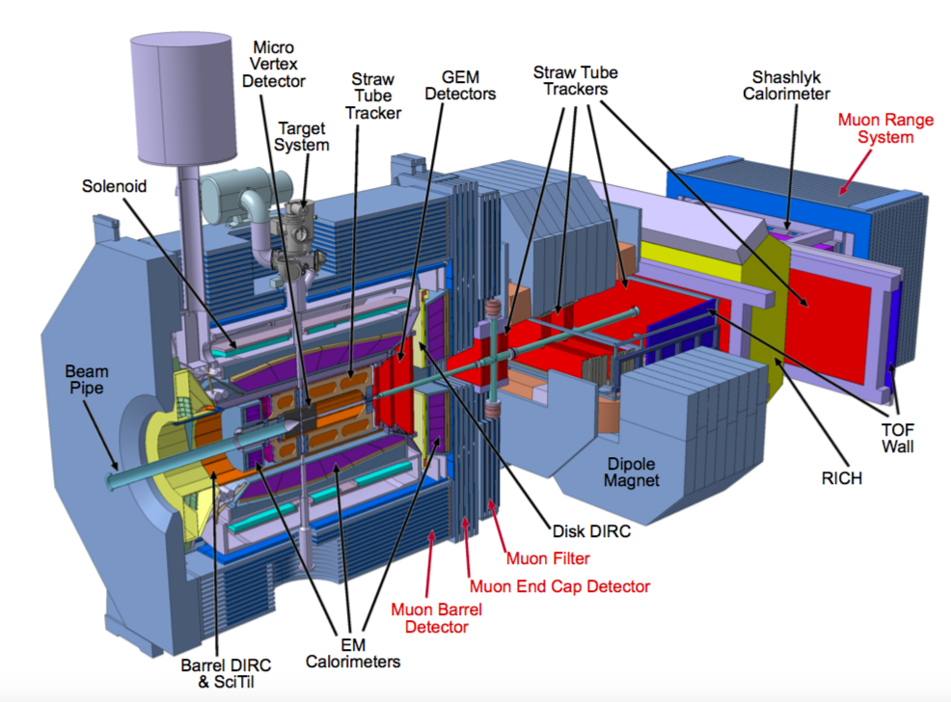
PANDA Detector
Notes:
General view of PANDA setup, Muon System is indicated in red. The experimental technique selected for Muon System is range system, which permits reliable registration of the muon sample (‘strait line’) as well as a rough estimate of hadronic energy (sampling hadron calorimetry). The sampling in the Barrel is 30 mm/Fe (for better performance/resolution at smaller energies typical for this region). The sampling in the forward direction (End Cap, Muon Filter and Forward Range System) is 60 mm/Fe (for better absorption of the products kinematically boosted in forward direction). The Fe layers are interleaved with layers of Mini-Drift Tubes (with 10 mm resolution for wires and perpendicular strips). The main numbers of the system are givem below in the summary Table:
MDTs Wires Strips % of resources needed
Barrel 2133 17064 49916 61.2
End Cap 618 4944 8911 14.9
Muon Filter 424 3392 6876 10.7
Forward Range System 576 4608 7128 13.2
Total 3751 30008 72831 100

Slide 4


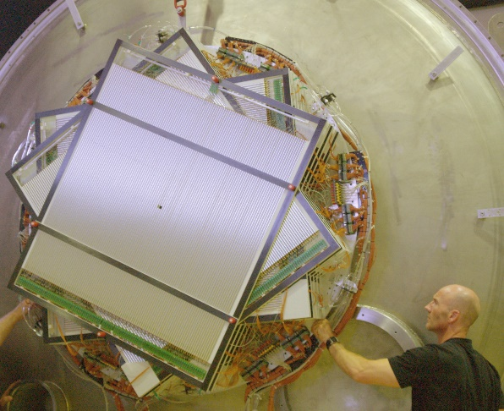
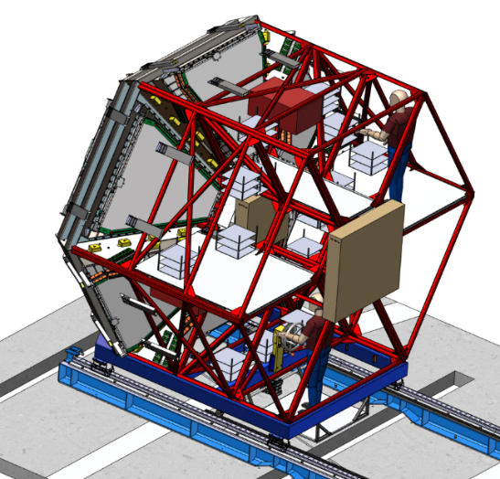
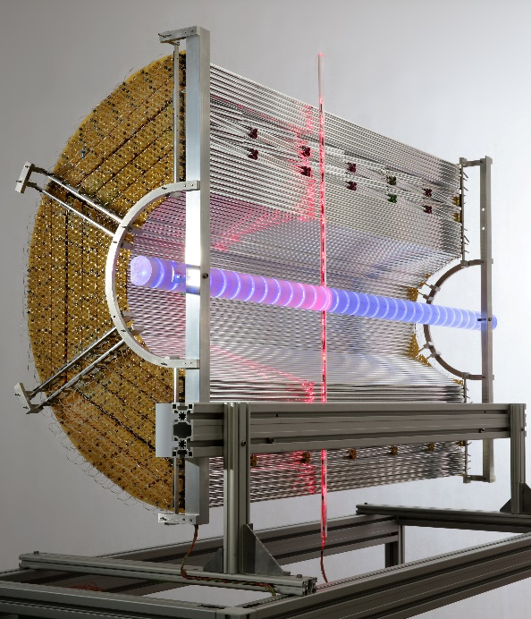










Straw Tube Projects at IKP
Vacuum Straw Tracker for COSY-TOF
experiment operation in 2009 - 2013
Straw Tracker Station for HADES upgrade
FAIR Phase 0 experiment from 2019 - 2022
PANDA - Central Straw Tube Tracker
installation planned for 2022/23
Partners: ZEA@FZJ, AGH/JU/IFJ Krakow, KVI Groningen, INPN Orsay
PANDA-STT group:
STS1
STS2

Slide 5

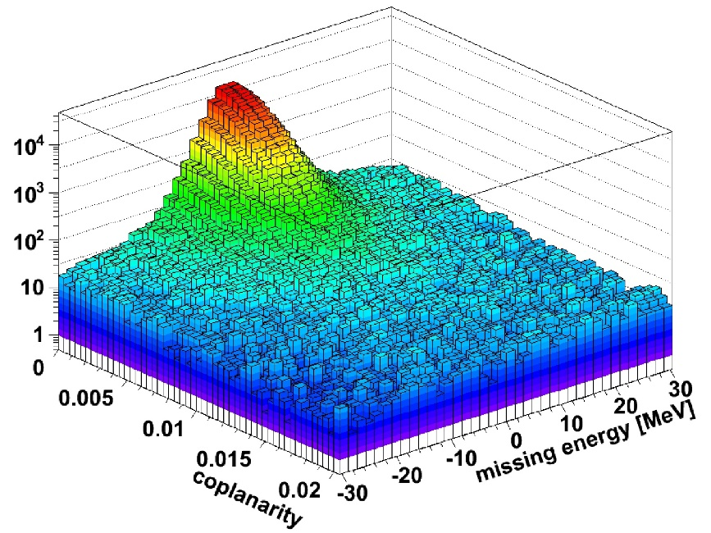
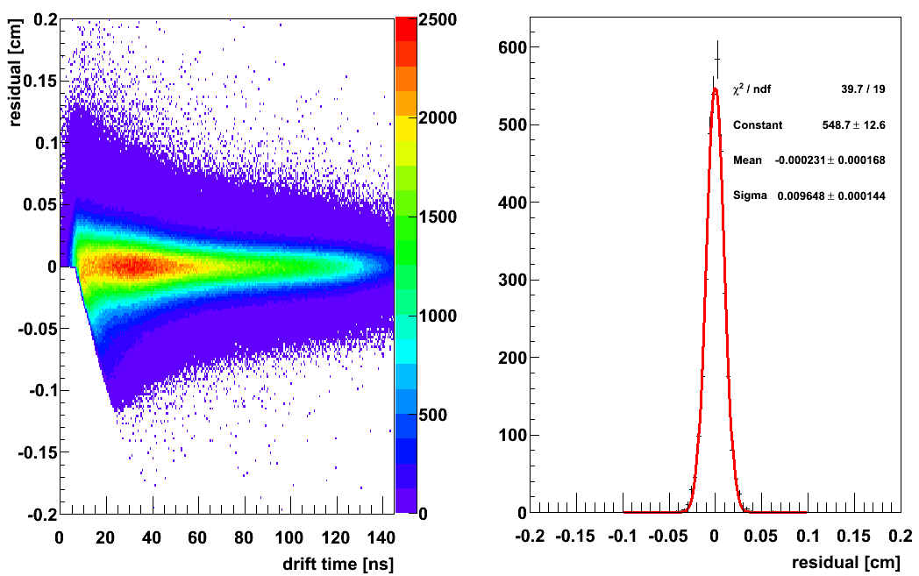
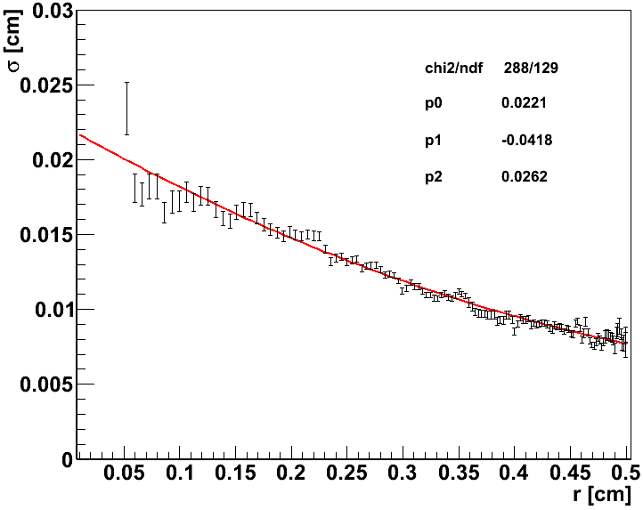

COSY-TOF Straw Tracker
Vacuum Straw Tracker in COSY-TOF experiment (2009-2013)
Upgrade for hyperon physics program (pol. p/d on p-target)
  2704 straw tubes, 13 double-layers (each rotated by 60°)
32 µm Al-Mylar film, 10 mm diameter, 1050 mm length
Self-supporting straw layers for minimal material budget
Straw leakage in surrounding vacuum on permeation level
Spatial resolution σ ~ 140 µm
pp elastic events in coplanarity vs
missing energy distribution
(Ph.D. thesis M. Roeder, 2011)
STT residual distributions
(Ph.D. thesis S. Jowzaee, 2014)
Coplanarity $C=\left|(\vec{p1}×\vec{p2} )∙ \vec{p}\text{beam}\right|$

Slide 6
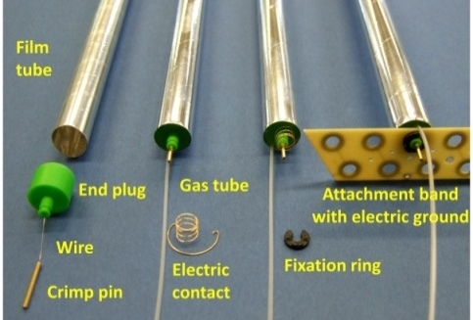
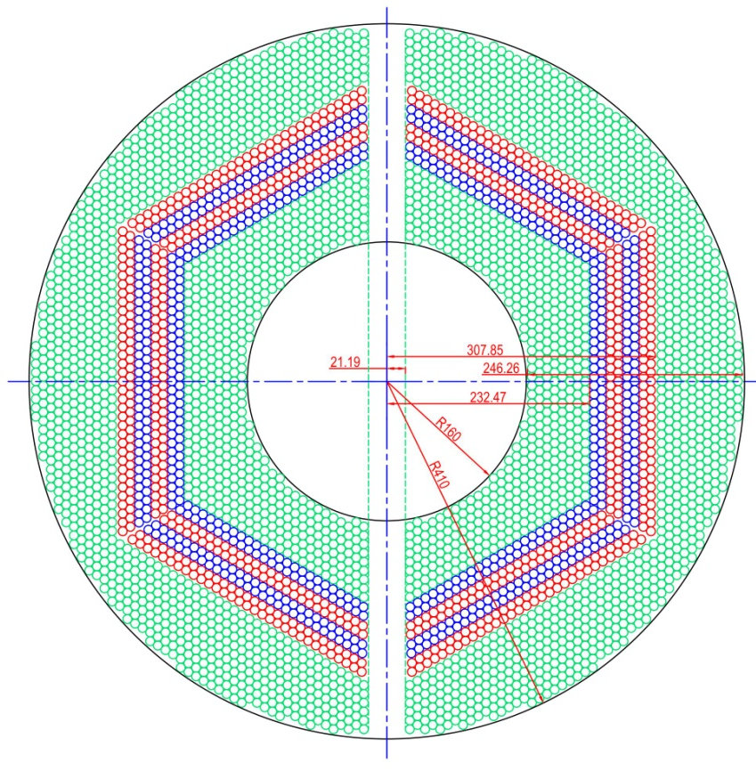
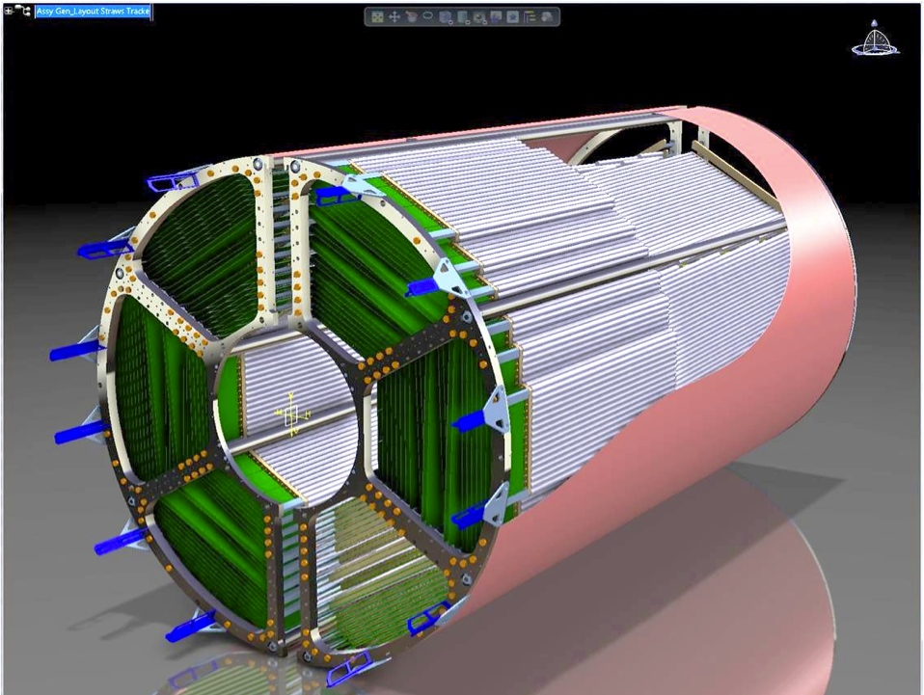
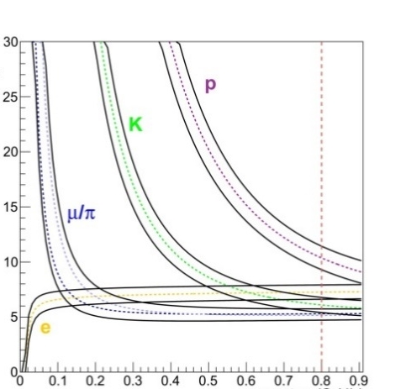
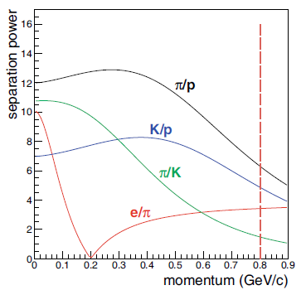

Central Straw Tracker
4224 straws in 19 axial (green) and 8 stereo (±3°) layers (blue/red)
  27 µm Al-Mylar film, 1400 mm length, 10 mm diameter
  Ar/CO₂ gas mixture at 2 bar pressure
X/X₀ = 1.25% by self-supporting quad-layers
Drift time readout & spatial resolution: σ_{xy} = 150 µm, σ_{z} = 2-3 mm
Charge readout for PID by dE/dx (p/K/π < 1 GeV/c)
Momentum resolution σ(p)/p ~ 1-2% (B @ 2T, STT+MVD)
Continuous data stream readout (~ 15 GB/s)
Input for real-time SW trigger (event ID)
Straw materials
Straw layout
1650 mm
$$S=\frac{\left\langle E_{1}\right\rangle −\left\langle E_{2}\right\rangle }{{(σ}_{1}+σ_{2})/2}$$
PID by dE/dx,
simulation for STT (from TDR, Eur.Phys.J. A49 (2013) 25)
dE/dx (arb. units)
Separation power
STT 3D – view
Momentum (GeV/c)
Momentum (GeV/c)

Slide 7
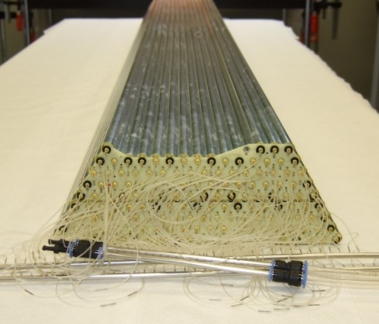
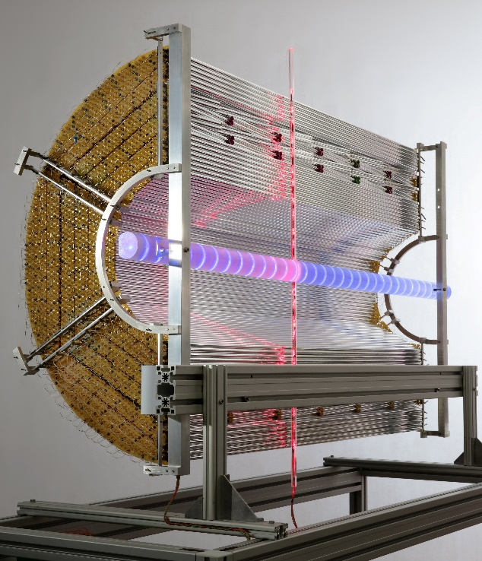

straw & module assembLy
Self-supporting straw technique: maintain wire tension by gas over-pressure (1 bar)
Straw series production and module assembly at IKP
QA of every single assembled straw: wire tension & gas leakage
Wire tension measurement by magnetic resonance method
Nominal wire stretching (0.5 N, m = 50 g) at straw assembly
Low calculated spread from f₁ measurements: m ~ 1.2 g (σ)
$$f_{1}=\frac{1}{2L}\sqrt{\frac{T}{m/L}}$$
(T: wire tension, m: mass, L: length)
Two inner quad-layer modules (axial) and STT prototype (half-barrel).
Increasing wire
diameter (2 km wire spool)
New wire
Straw production running number

Slide 8
PANDA-STT Specific readout
PID by dE/dx is non-standard application for straw detectors (PANDA environment)
Two concepts for charge readout: measure signal pulse area (sADC) or pulse width (TDC)
Readout decision planned for next months, pre-series system set up done, in-beam tests
Consequences for mec. layout & operation
TDC – system
    Charge information for PID by time-over-threshold (pulse width)
    Front-end ASIC cards, LVDS signals to “standard“ TDC (TRB3)
    Specific FE-layout: ASIC boards, cabling & cooling scheme
ADC-system
    Charge information by pulse shape integration (pulse area)
    Waveform sampling ADC, readout & processing by FPGA
    Non-standard scheme: “FEE-free“, all electronics backend

Slide 9
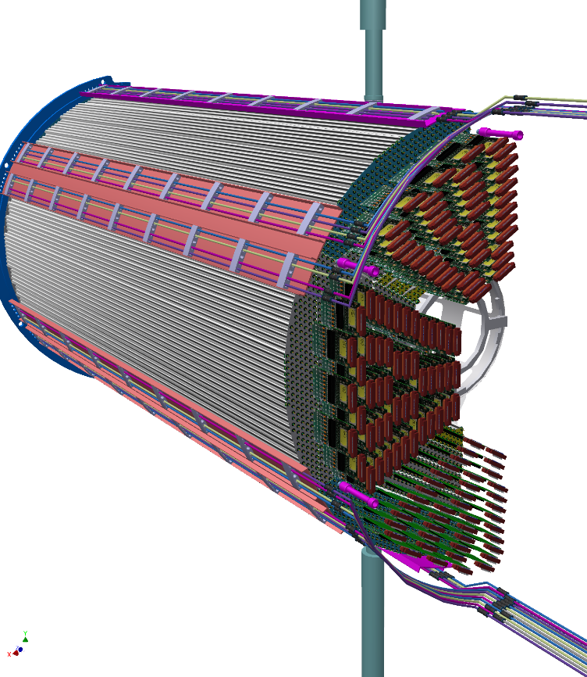
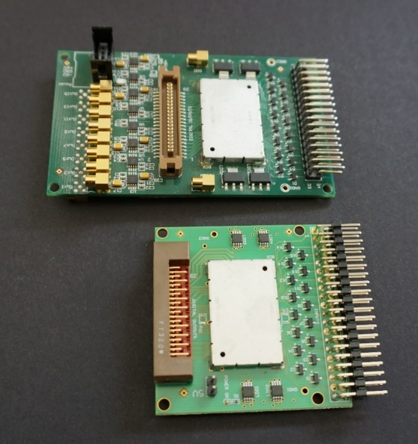
ASIC/TRB readout
STT-specific ASIC “PASTTRECv1“ (AGH & JU Krakow)
FEBv3 for STT developed (small size, low power)
TRB3 system with FPGA-ASIC control (SW)
Data concentrator stage in progress (commissioning HW)
PID capability demonstrated by in-beam tests
at COSY, dE/dx range: 5-50 keV/cm
Hardware setup
Burst Building Network
GbE
Slow Control
12x links
Slave TRB
Slave TRB
Slave TRB
Rack1
Slave TRB
SodaNet Source
SodaNet HUB
Slave TRB
11x links
Slave TRB
Slave TRB
132x FEE (2112 ch)
Slave TRB
Slave TRB
SodaNet HUB
SodaNet HUB
Slave TRB
SODANet TRB
Slave TRB 11
Slave TRB
SodaNet HUB
SodaNet HUB
Slave TRB
11x links
Slave TRB
Slave TRB
132x FEE (2112 ch)
Slave TRB
Slave TRB
SodaNet HUB
SodaNet HUB
Slave TRB
Slave TRB
Slave TRB
SODANet TRB
Slave TRB
12x links
Slave TRB 11
4x
48 channels
Rack2
Burst Building Network
FEBv1
FEBv3
55×55 mm²
STT FE-layout

Slide 10
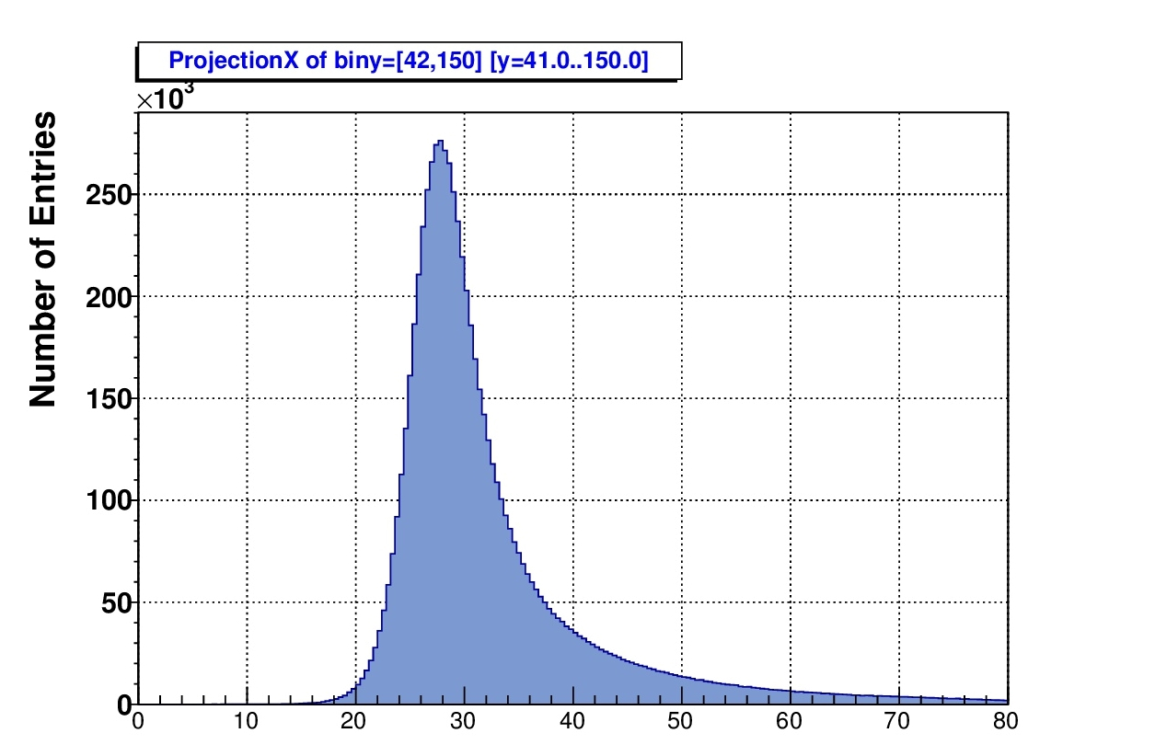
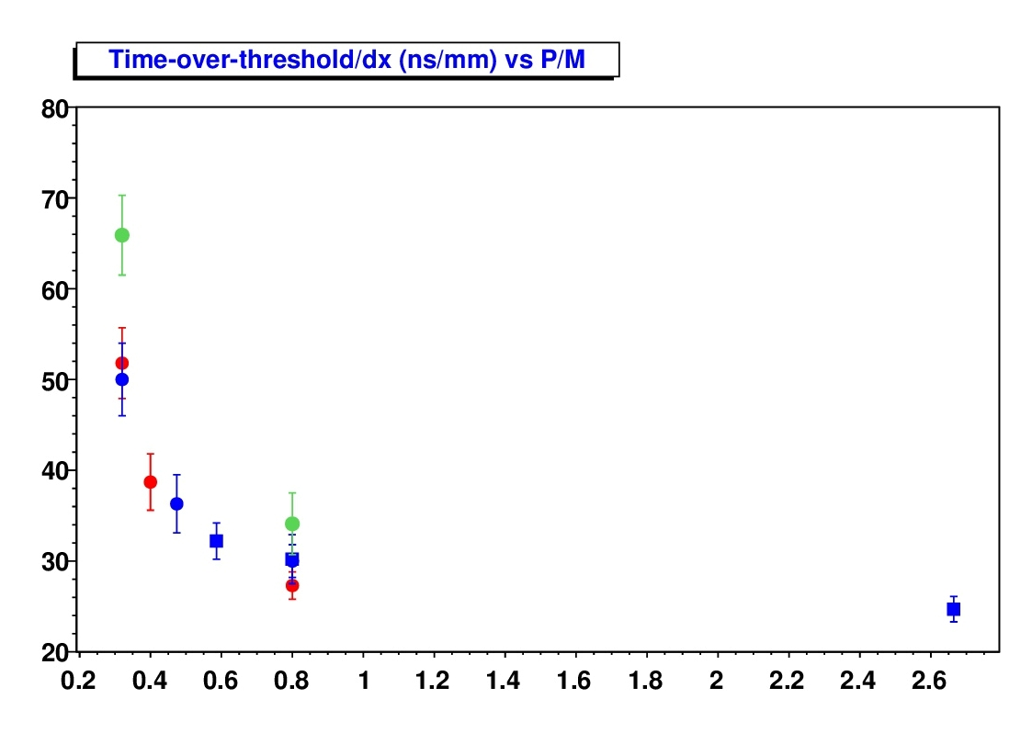
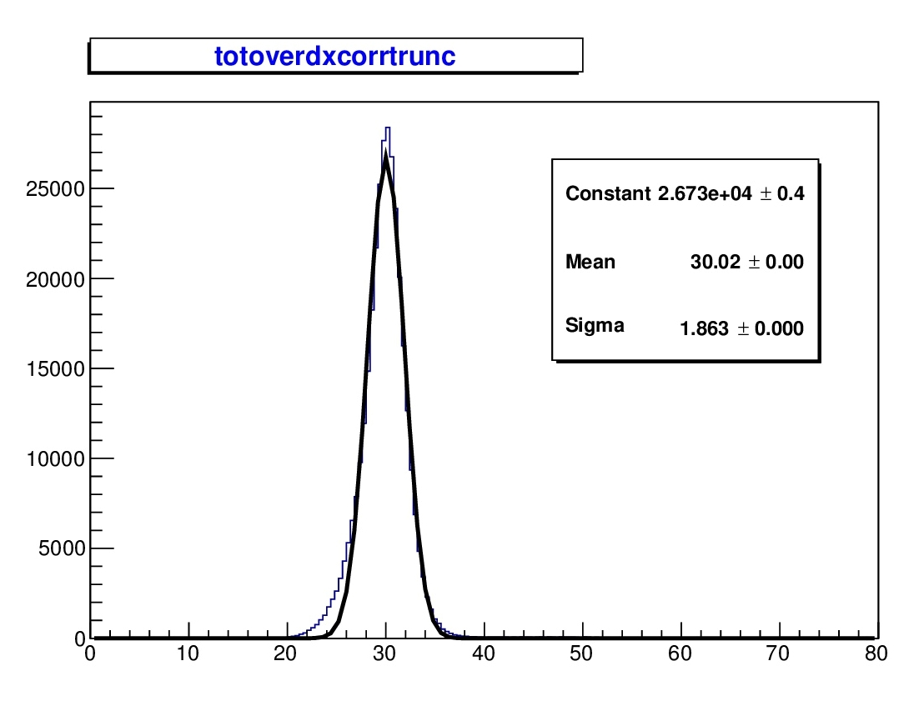
PID by Time-over-Threshold
In-beam tests at COSY in 2016/2018
dE/dx range ~ 5-50 keV/cm
ToT/dx distribution shows Landau-shape
Truncate highest ToT/dx hits per track
ΣToT/Σdx observable for PID
1.5 GeV/c
deuteron
ToT/dx (ns/mm)
Deuteron 2016, Ar/CO2(10%)
Deuteron 2018, Ar/CO2(20%)
Proton 2018, Ar/CO2(20%)
ΣToT / Σdx (ns/mm)
Proton 2018, Ar/CO2(20%),
diff. ASIC setting
Entries
1.5 GeV/c
deuteron
Σ ToT / Σ dx (ns/mm)
P / Mc

Slide 11
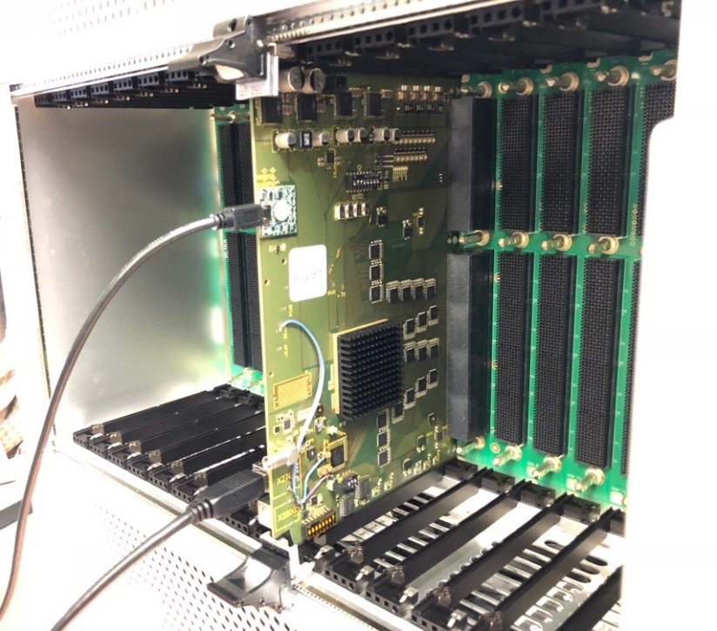
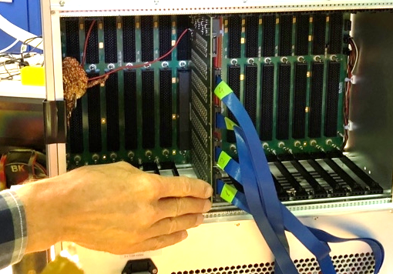
ADC-based readout
STT-specific, non-standard scheme: “frontend electronics-free“
  HV & signal on same coax line, straw access from backend (cut off option)
  FE-layout: no cooling, low mat. budget, less space required
RO board design by FZJ/ZEA-2, system scheme by PAN/IKP
    Op-amps, waveform sampling ADC (40× 4 ch @ 160 MSPS, 12 bit)
    WF-readout & signal processing by central FPGA (Xilinx Virtex7)
Data concentrator stage included (hit sorting)
160ch readout board, double-sided, with
2x20 ADC, 1x central FPGA (crate back side)
160ch amplifier board (crate front side)
HV board
Processing board
Add-on
board
Rear unit
Front unit
HV
decoupling
Commu-
nication
Straw
tubes
HV
supply
ribbon
cable
Op-amp
shaper
40 ADCs
+ FPGA
~8m coax
“FEE-free“ scheme of ADC-based readout.

Slide 12
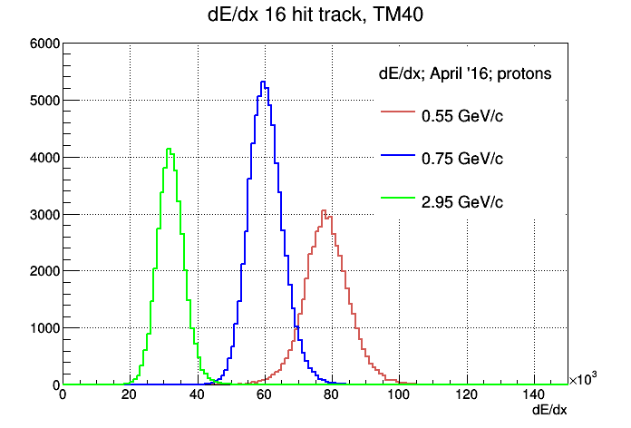
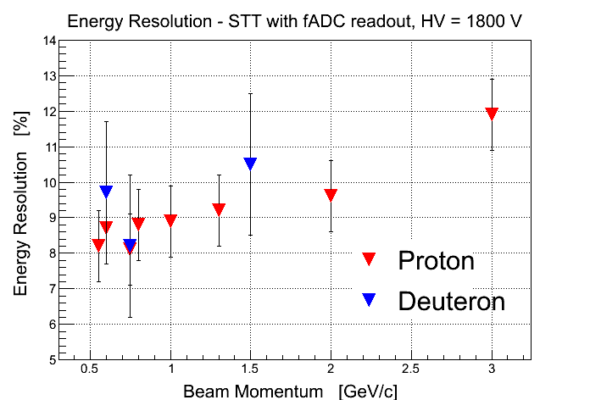
PID by ADC-Readout
Waveform sampling ADC and pulse shape analysis and readout by FPGA
In-beam test results for prototype readout system with sADC (240 MHz)
    ~ 9% resolution for dE/dx measurement
Pre-series system with sADC: 250 MHz & 8 bit or 160 MHz & 12 bit
Interleaving mode possible with max. sampling by 1 GHz (4ch → 1ch)
Krzysztof Pysz (IFJ Krakow)
Krzysztof Pysz (IFJ Krakow)
K. Pysz, IFJ Krakow
Entries
dE/dx (arb. units)

Slide 13
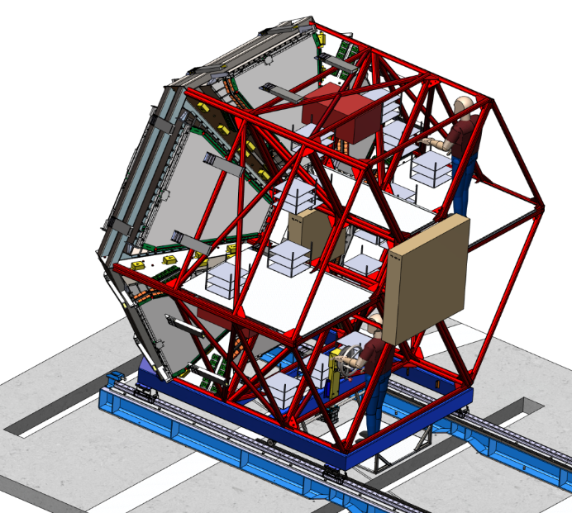
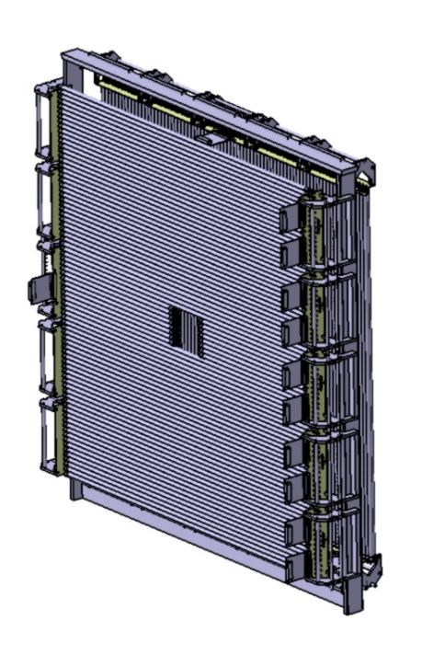
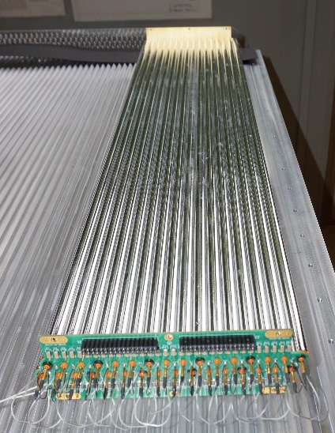
New Straw TUBE Stations for HADES
Test of PANDA detector system components in experimental setups before PANDA starts
Forward Straw Tracker Stations (STS) for HADES upgrade at SIS18
Experiment program of PANDA - interest: Dalitz and radiative hyperon decays
STS for (baryon) tracking θ < 6.5°, HADES measures di-leptons and mesons
HADES experiment proposal for FAIR Phase-0 approved (Sep-2017)
Experiment program for 2019-22 with pion and proton beam
Several campaigns: π+p, Ag+Ag, p+p and p+A
STS1 (Julich):
704 straws, 76.6 cm length, 4 double layers (0°, 90°)
STS2 (Krakow):
1024 straws, 125 cm length, 4 double layers (0°, 90°, ±45°)
Straw modules will be used later in PANDA-FT
ASIC/TRB3 readout system
STS1
STS2
HADES upgrade by two forward straw tracker stations (STS1/2)
STS1 station and one straw module (2×16 straws).

Slide 14
PANDA Detector
Notes:
General view of PANDA setup, Muon System is indicated in red. The experimental technique selected for Muon System is range system, which permits reliable registration of the muon sample (‘strait line’) as well as a rough estimate of hadronic energy (sampling hadron calorimetry). The sampling in the Barrel is 30 mm/Fe (for better performance/resolution at smaller energies typical for this region). The sampling in the forward direction (End Cap, Muon Filter and Forward Range System) is 60 mm/Fe (for better absorption of the products kinematically boosted in forward direction). The Fe layers are interleaved with layers of Mini-Drift Tubes (with 10 mm resolution for wires and perpendicular strips). The main numbers of the system are givem below in the summary Table:
MDTs Wires Strips % of resources needed
Barrel 2133 17064 49916 61.2
End Cap 618 4944 8911 14.9
Muon Filter 424 3392 6876 10.7
Forward Range System 576 4608 7128 13.2
Total 3751 30008 72831 100

Slide 15
Muon System as PID
PANDA Muon System based on range system technique is a good PID
system for muon-to-hadron separation
It works in full range of produced particles at PANDA (0,5 ~ 10 GeV/c)
Muons and hadrons above ~ 1 GeV/c resolved with ~ 100% efficiency
(i.e. near zero hadron contamination) by obviously different response pattern
Separation of muons vs pions (the main rival) below 1 GeV/c is less efficient
and requires test beam measurements for calibration
Important feature of range system is possibility to be used as coarse sampling
(30 mm to 60 mm of Fe in our case) hadron calorimeter – very important for neutron registration
Slide from Gena Alexeev, JINR

Slide 16
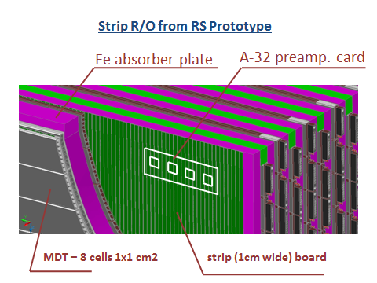
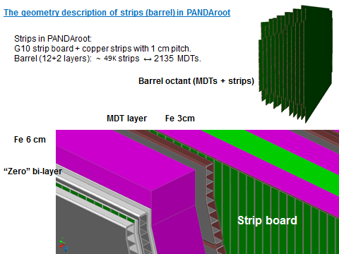
Structure of the Muon System
Barrel: Fe absorber – inner/outer plates 60 mm thick, all internal plates 30 mm thick; gaps for MDTs, strip boards and strip electronics – 35 mm
End Caps, Muon Filter, Muon Range System: all Fe absorber plates 60 mm, gaps 35 mm
Slide from Gena Alexeev, JINR
Notes:
Structure of the Muon System is shown on the (left) slide on example of the big Range System Prototype (10 ton) exposed to test beams at CERN. ‘Inner layer’ looks inside the detector. ‘Inner/outer’ layers in the Barrel have thickness 60 mm for mechanical rigidity as they are used for mounting of internal detectors and Barrel modules to each other. MDTs indicated in grey color, strip boards – in green, Fe absorber plates – in pink, and gaps for detectors and electronics – in light green. Position of the strip preamplifiers board (with 4 Ampl-8.3 chips, 8 channels each) is indicated in white. Right slide shows enlarged fragment (upper left corner) where structure of ‘zero’ bi-layer’ is shown. MDTs are generally made like “Iartocci tubes”: active detector – cathode cells with inner anode wires – is inserted into plastic sleeve for gas tightness and HV protection. In our case the cathode is formed by 8 cell modules (aluminum comb extrusion, 1x1 cm2 cell cross section, 3x0,6 mm ALU walls). Plastic sleeve – 1 mm thick ABS or Noryl. MDTs of bi-layer are shifted by 5 mm (to exclude the geometrical dead zones formed by the comb walls) and ‘look’ by its open cathode side to the strip board. This ‘zero’ bi-layer has practically 100% geometrical efficiency and provide 3 coordinates: U,V (strips) and Y(wires). The first examples of its performance are given in below in this report.

Slide 17
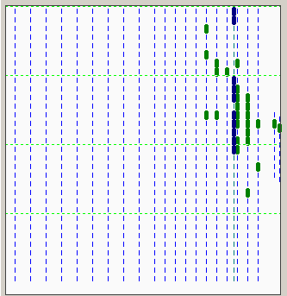
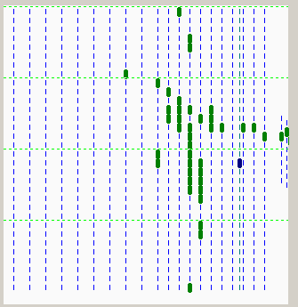
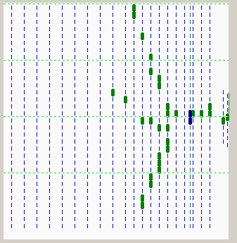
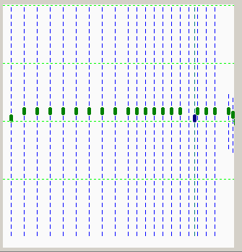
BEAM: e,µ,π,p
5 GeV/c, trigger: S1 (Ø 11,5 cm) & S2 (Ø 3,5 cm)
T9/PS/CERN test beam
32 cm
e
h
150 cm
h
µ
Slide from Gena Alexeev, JINR
Notes:
Examples of different response of the Muon (Range) System Prototype to different types of particles at medium (5 GeV/c) momentum. Data are taken at T9/PS/CERN test beam. Electron (e) has short shower, in real PANDA setup it will not be observed by the Muon System as it will be filtered out by the electromagnetic calorimeter. The hadrons (h) have longer and wider showers. The muon (μ) gives ‘straight line’ sample. So, pattern recognition in this case looks obvious.
Comments to the picture: (1) it is not to scale – vertical size is 32 cm (32 wires represented by vertical pink bars), horizontal size ~ 1,5 m; (2) hit wire is given in green; (3) particles enter the prototype from the right; (4) shorter distance between the wire planes (on the right side of prototype) represent the Barrel structure (3cm/Fe sampling), the rest has 6cm/Fe sampling (End Cap, Muon Filter, Forward Range System).

Slide 18
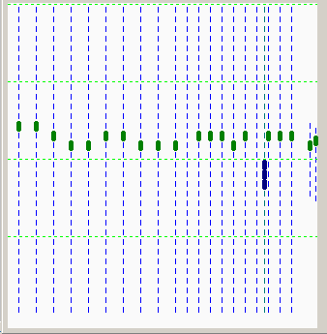
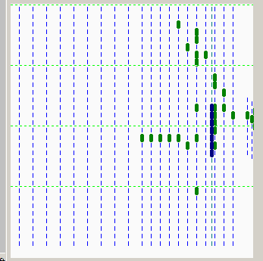
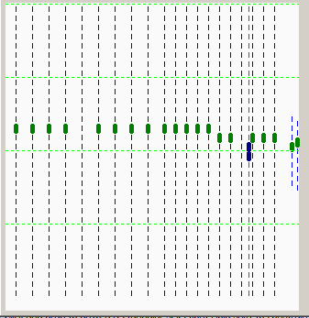
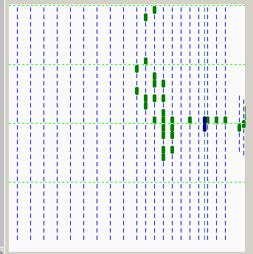
BEAM: e,µ,π,p
3 GeV/c, trigger: S1 (Ø 11,5 cm) & S2 (Ø 3,5 cm)
µ
h
µ
h
Slide from Gena Alexeev, JINR
Notes:
Nice picture demonstrating the visualization power of a digital calorimeter: one may see that hadron can start showering after passing quite a long way in Fe (the nuclear absorption length is ~ 17 cm).

Slide 19
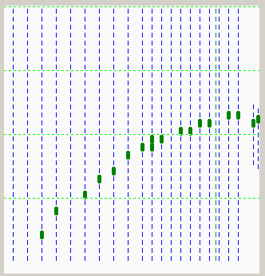
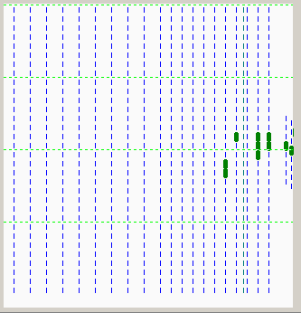
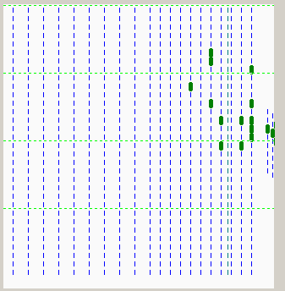
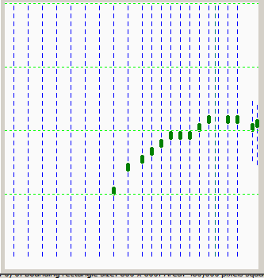
BEAM: e,µ,π,p
1 GeV/c, trigger: S1 (Ø 11,5 cm) & S2 (Ø 3,5 cm)
µ
e ?
Muon events selected due to unexpected shape.
e?
µ
Slide from Gena Alexeev, JINR
Notes:
Examples of very low energy responses. Muons are seen as ‘tracks’, and electrons give short shower. Symbol ‘e?’ means that that time we had no independent definition of the particles type by beam line diagnostics, and we judge on the type visually by estimating the depth of the shower penetration.

Slide 20
Test beam results (preliminary)
EPJ WoC, Volume 177 (2018) 04001
Run 605, autumn 2017
momentum = 0.5 GeV/c
Selection -> after layer #7:
22% - pion contamination and
93% - muon efficiency
FairBoxGenerator, PandaROOT
E = 0.5 GeV/c
Selection -> after layer #7:
27% - pion contamination and
99% - muon efficiency
Slide from Gena Alexeev, JINR
Notes:
As an illustration, Figs. show the normalized distributions of events containing muons (green line) and pions (black triangles) as a function of the last number of triggered (fired) layer in the prototype in data and MC, respectively. Distributions in data and MC have a similar shape, although they are a bit different in numerical terms. The experimental data permit us to make a preliminary rough estimate of the pion-to-muon separation at very low (~0.5 GeV/c) momentum.
So, the overlap of the pionic and muonic spectra after the layer # 7 of the Range System (to keep efficiency for muon registration ~90%) gives us ~20% of pion contamination. Whereas for the MC model we have contamination of pions 27% at 99% for muon detection efficiency. We assume now that the observed difference is caused by the secondary muons present in the beam due to pion-to-muon decay, and we plan to improve the result by discriminating them in further runs by direct measurement of incoming momenta at the final focus of the beam.

Slide 21
Summary
Low mass, self-supporting straw tube systems operated in vacuum for COSY-TOF
Large systems under construction for PANDA
  FAIR-Phase0 with HADES
  PANDA Straw Tube Tracker
Good position resolution (<150 μm) and dE/dx resolution (~9%)
Muon system for PANDA
Successful prototype development and tests by JINR

