Slide 1
Scintillator-based endcap KL and muon
detector for the BELLE II experiment has been made at ITEP!
V. Rusinov,
Institute for Theoretical and Experimental Physics
Workshop on the Project of
the Novosibirsk Super-tau-charm Factory
BNPI 26-27 May 2018

Slide 2

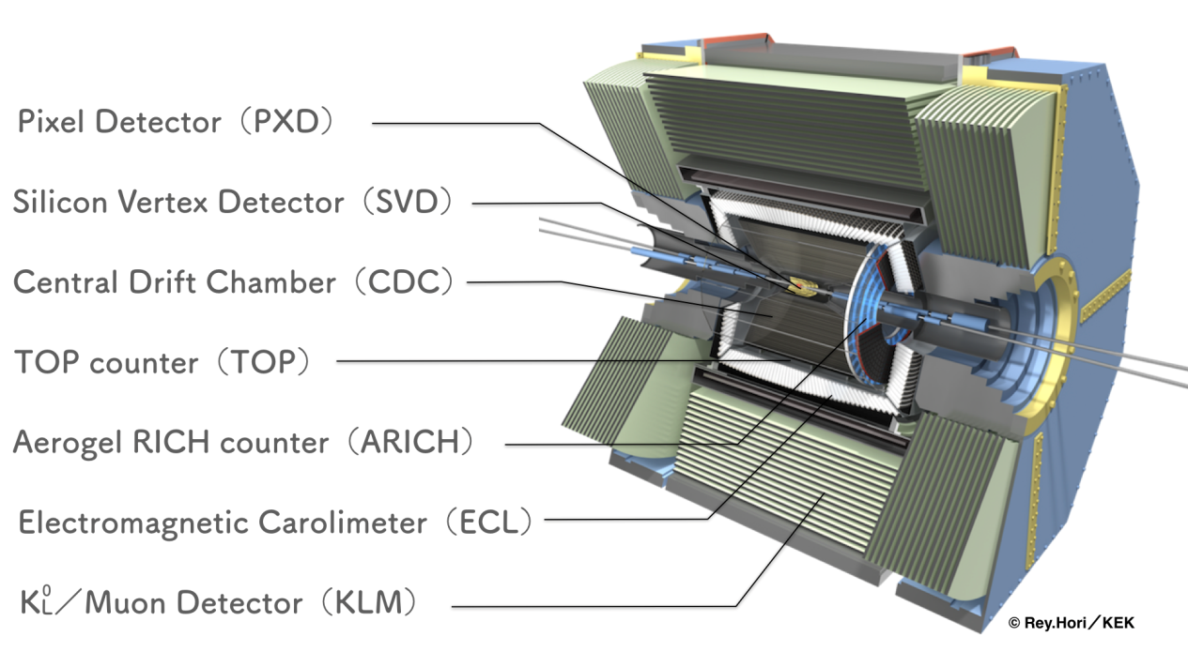
V. Rusinov, ITEP

Slide 3
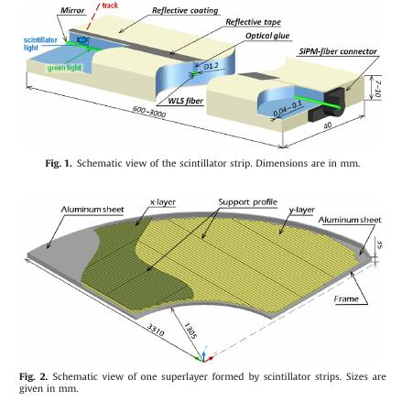
The base element and the goal
7mm
V. Rusinov, ITEP

Slide 4
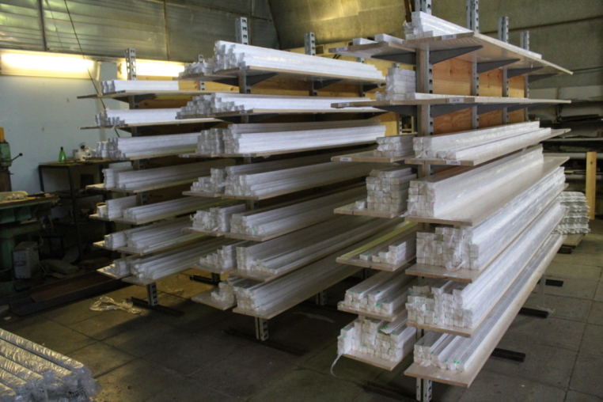
“ The base element of the new detector system is a scintillator strip
of polystyrene doped with scintillator die. “
“UNIPLAST” , Vladimir, more than 16000 strips
V. Rusinov, ITEP

Slide 5
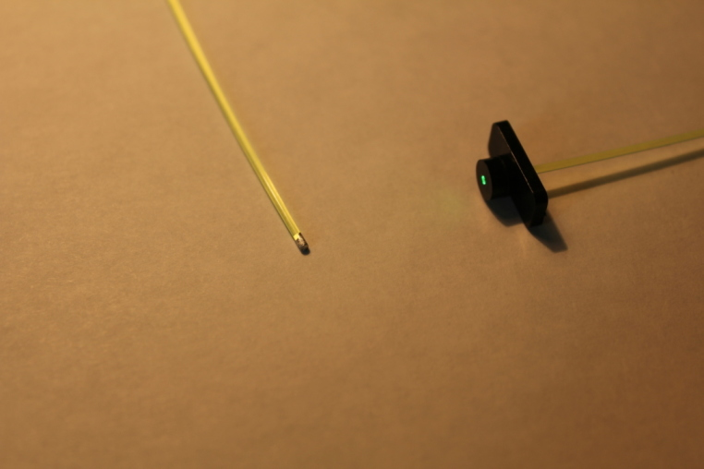
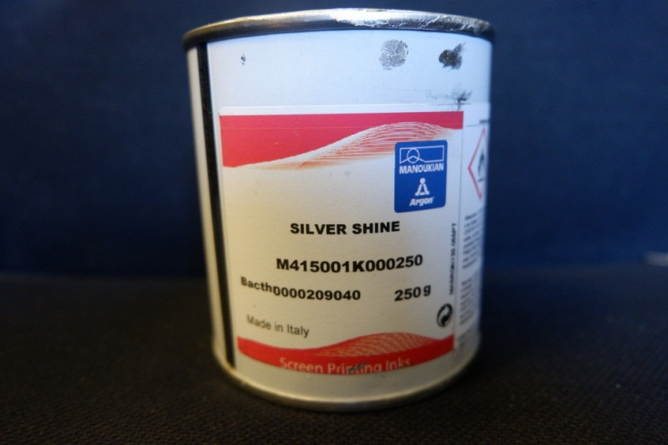
“Each WLS fiber is read-out from one side – the far end of the WLS
fiber is mirrored to increase the total light yield from the strip.”
Reflection of order 98% with respect
to black edge.
Silver paint stability for > 10 years.
V. Rusinov, ITEP

Slide 6
“ The effective transport of the scintillator light to the WLS fiber
is improved with the help of the optical glue, which has refractive index
similar to that of both the strip and the outer cover of the fiber.”
The similar gel effect we observe
for all types of scintillator strips and
tiles for all grooves geometry.
The optical gel Surel SL-1
from S-Peterburg
Stability and transparency
for > 10 years.
Tested for radiation ageing.
Tile 60 mm with a groove and WLS
V. Rusinov, ITEP

Slide 7
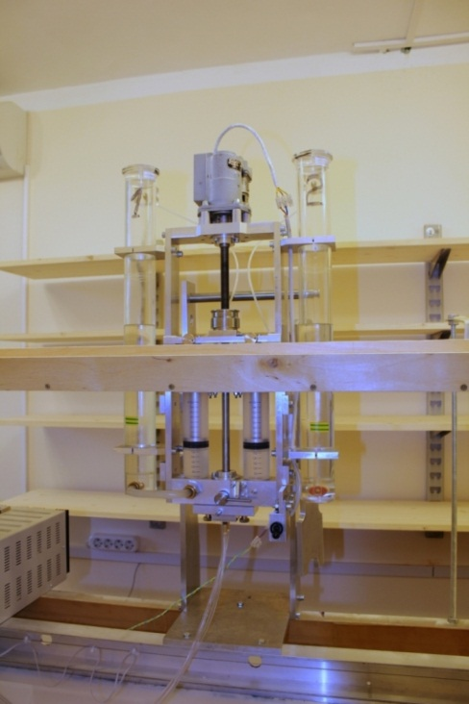
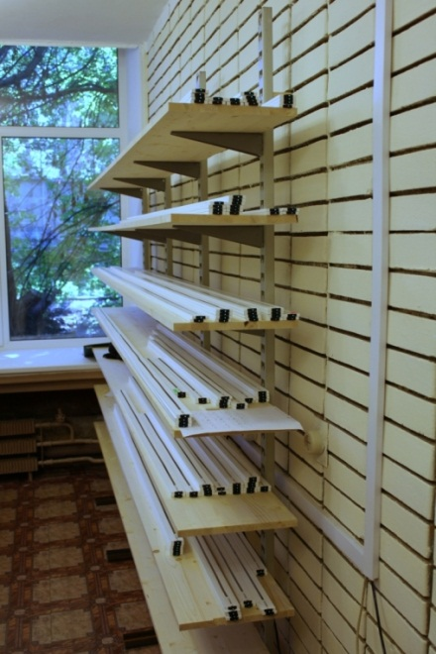
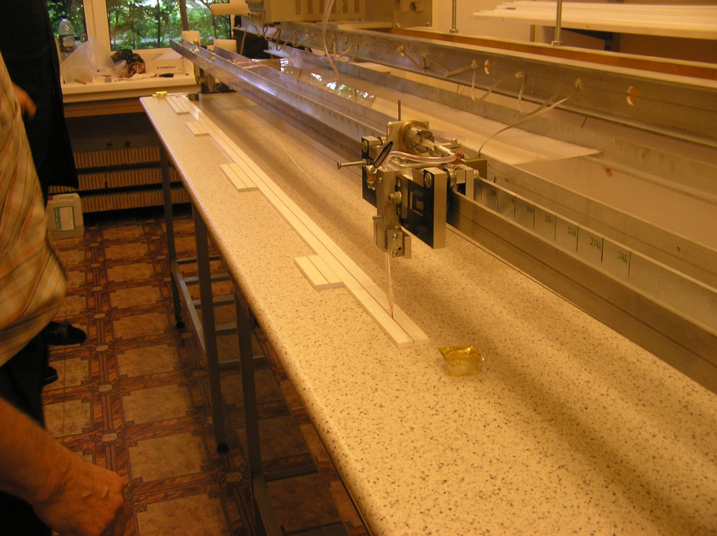
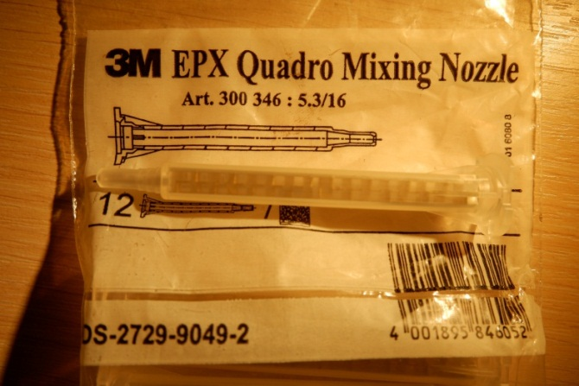
Special device for grooves filling
Uncomfortable dealing with gel:
2 components,
viscosity variations,
insoluble, difficult to clean.
V. Rusinov, ITEP

Slide 8
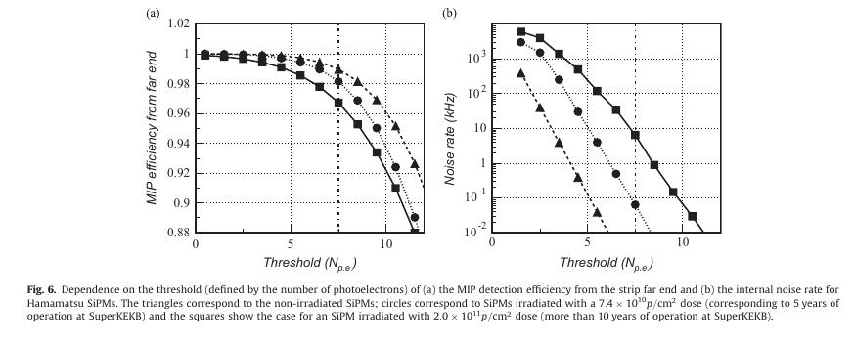
Why we tried to find effective mirror paint for WLS
and why we have used the optical gel?
Initial noise rate
Rate after irradiation
MIP efficiency required
The lower limit of
amplitude
Threshold choice
V. Rusinov, ITEP

Slide 9
“Individual strip are covered with a diffuse reflective coating;
each strip has a groove in the center to accommodate a WLS fiber”.
Strip coating with air bubbles, advantages and disadvantages
+
best reflection;
identical;
cheaply;
stable;
making by strip producer
-
variable thickness 0.05 -0.1 mm;
micro porous:
difficult to glue with smth,
gel penetrating
Optical cross-talk = 3+/-1%
V. Rusinov, ITEP

Slide 10
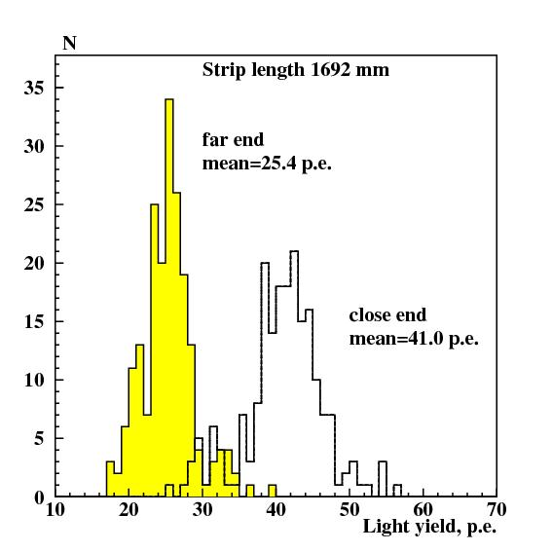
“ The strips have been tested with a cosmic stand.”
3 PAIRS OF TRIGGER COUNTERS
In total about 3% of strips was
rejected.
The main reasons were:
fiber or mirror damages
or mistakes in gel filling.
SiPM
Attenuation curve for 3 meter WLS
V. Rusinov, ITEP

Slide 11
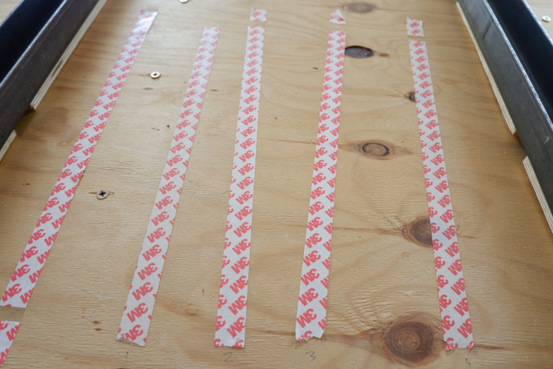
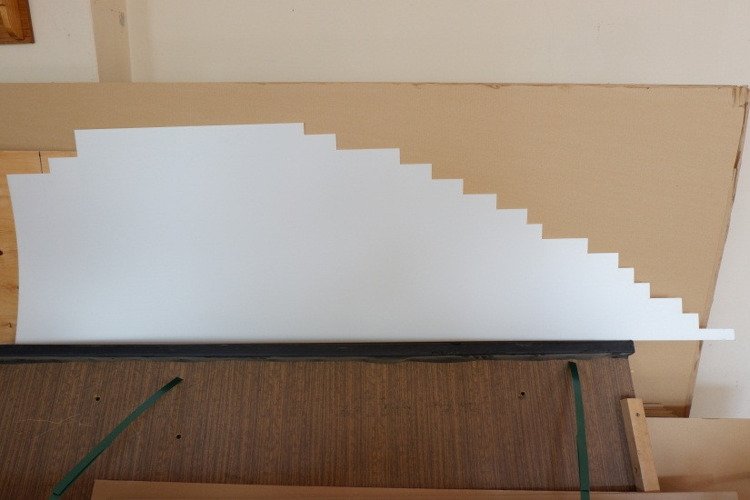
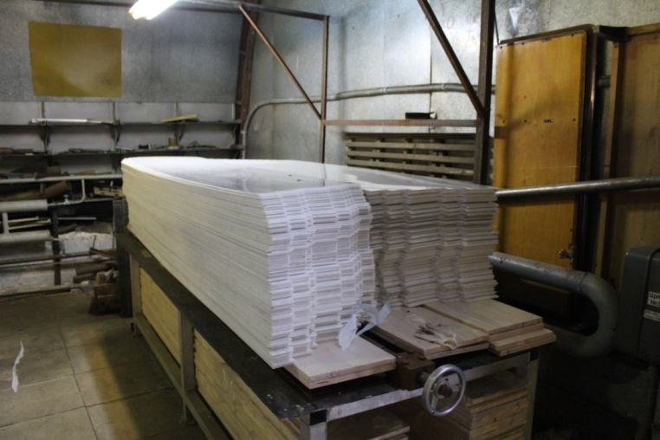
“Fifteen strips are glued to a common thin (1.5 mm)
polystyrene substrate from both sides...”
Due to gluing problems the 3M double
scotch has been used.
But: high pressure for few hours is needed,
the planes area are 1.5 – 2 sq.m.
V. Rusinov, ITEP

Slide 12
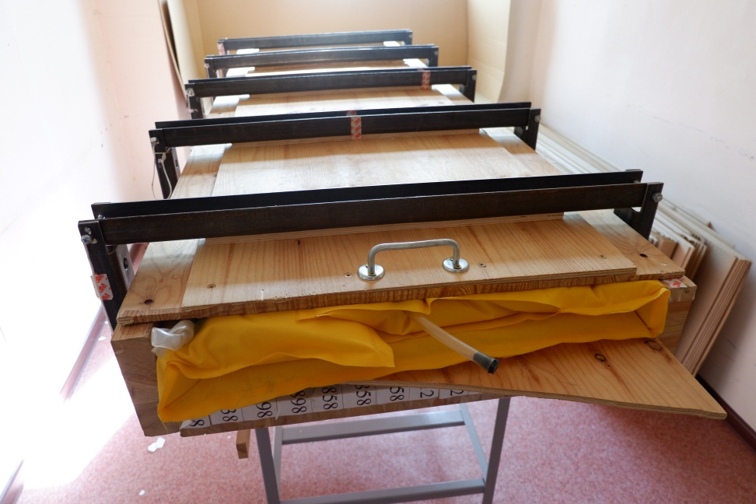
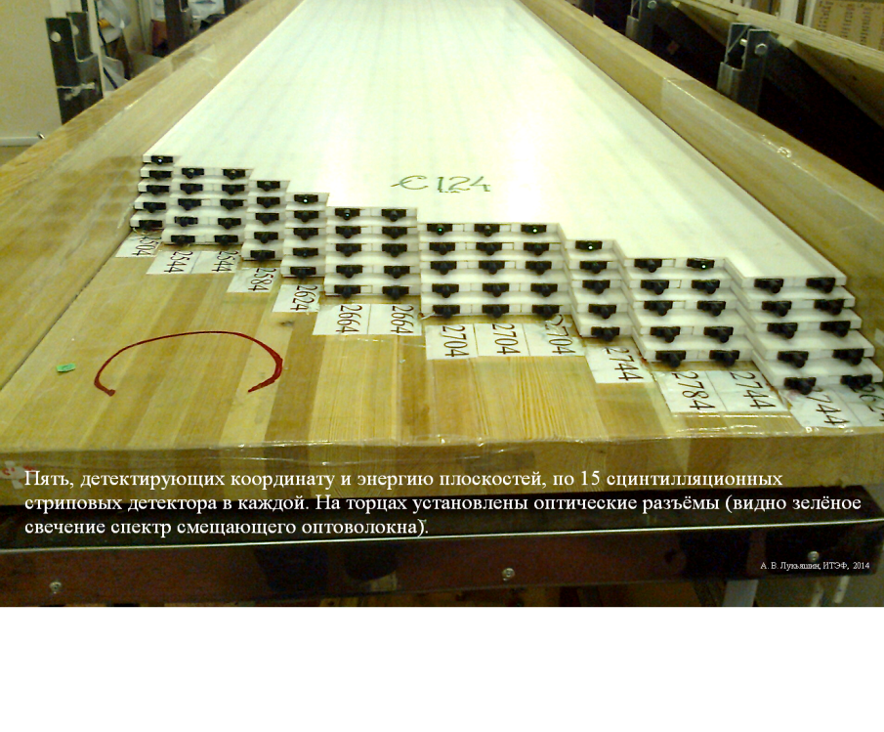
Solution of the gluing problem
5 types of wooden boxes with a very strong cover.
5 inflatable bags.
1 compressor.
1.2 bar = 1.5 – 2 tons of uniform loading.
V. Rusinov, ITEP

Slide 13
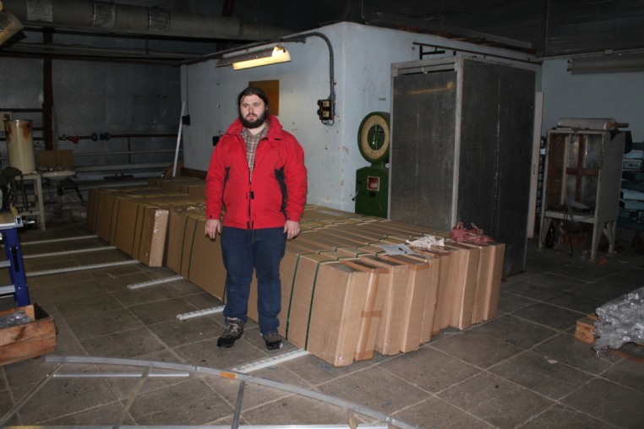
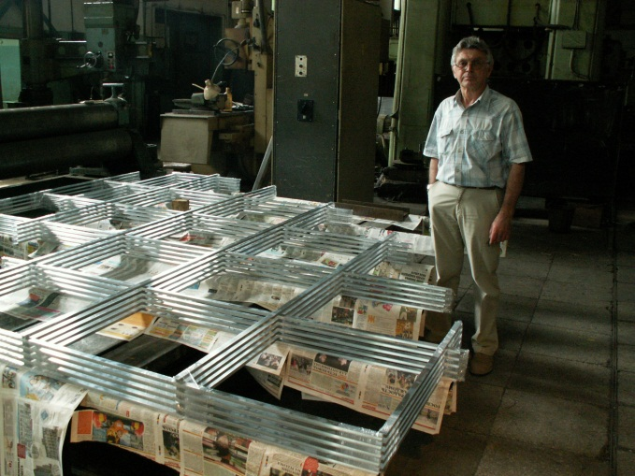
Few lessons from the job at ITEP
Polystyrene-based scintillator from Uniplast looks very good.
As well as theirs reflecting coating with mentioned remarks.
Scintillation light doesn’t go along the strip covered with diffuse
reflector; decrease of amplitude with a length is due to WLS attenuation.
4. Use of the optical gel Surel SL-1 leads to light increasing of the factor about 1.7,
and also leads to some mentioned problems.
Use of the silver paint for WLS edges looks like perfect solution with any problems.
6. The SiPMs used (S10362-13-050) have sharp dependence efficiency on
applied voltage; high accuracy with voltage stabilization required.
7. For gluing Al frames the anaerobic glue like ANACROL 101 looks as the good choice.
ITEP finish stage: ready for sending
V. Rusinov, ITEP

Slide 14
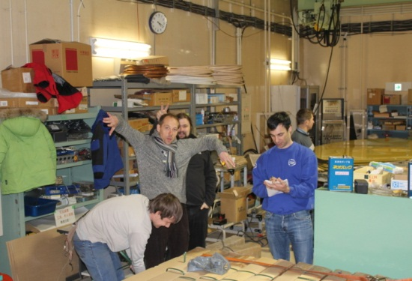
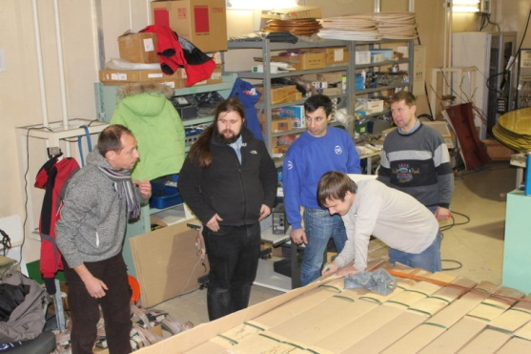
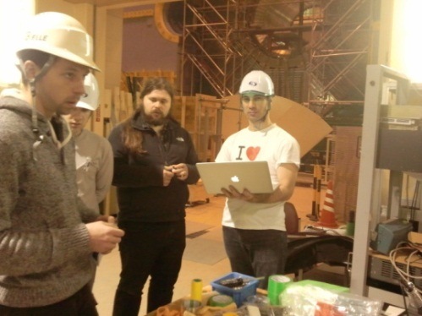
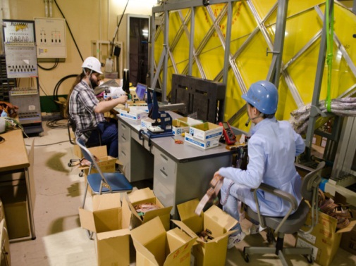
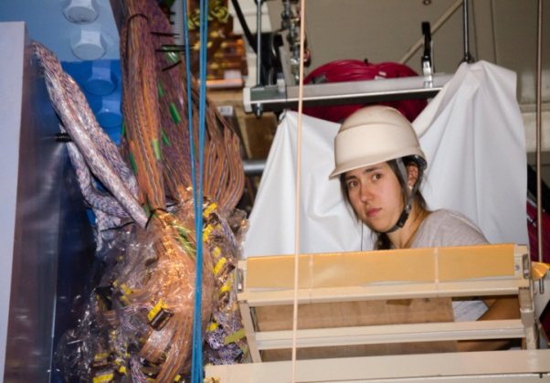
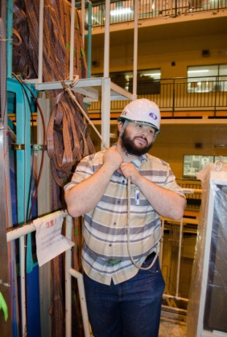
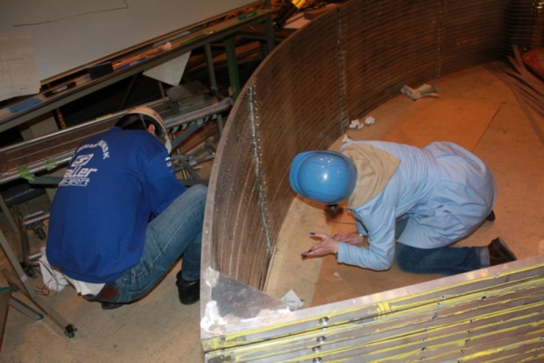
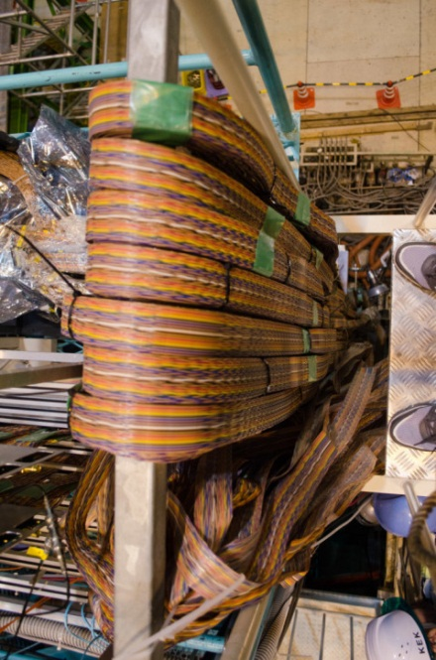
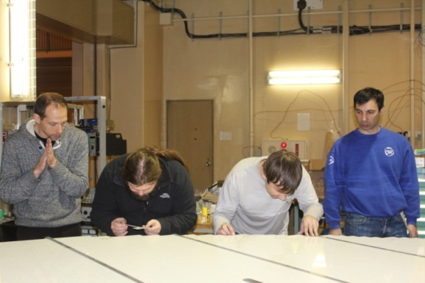
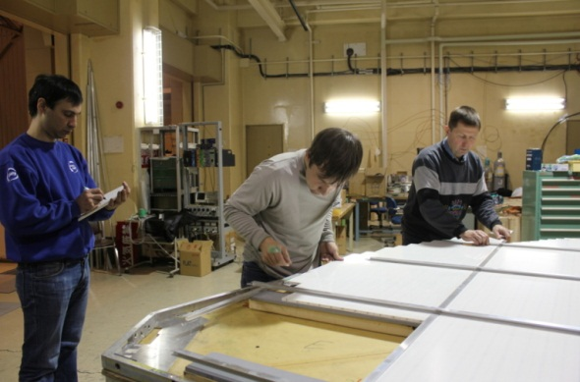
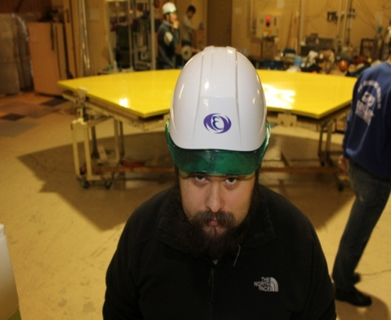
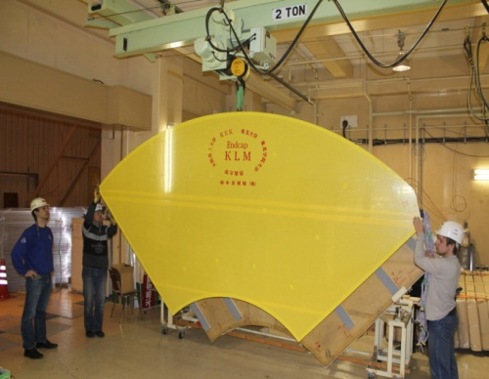
MULTIPLE ACTIVITIES AT KEK. 2014-2015
V. Rusinov, ITEP

Slide 15
Electrons and Positrons Collide for the first time in the SuperKEKB Accelerator
Press release 2018年04月26日
Press release April 26, 2018
Electrons and positrons accelerated and stored by the SuperKEKB
particle accelerator collided for the first time on 26 April 2018 0:38,
GMT+09:00 at KEK in Tsukuba, Japan. The Belle II detector, installed at
the collision point, recorded events from electron-positron annihilation
(matter-antimatter annihilation) of the beam particles, which produced other particles
likely including beauty quark and anti-beauty quark pairs as well as other
hadronic and Bhabha scattering events.
These are the first electron-positron collisions at the KEK particle physics
laboratory in 8 years; the previous KEKB particle collider ceased its operations in 2010
THANKS!
V. Rusinov, ITEP

