Slide 1
Isoscalar and isovector kaon form factors from $e^{+}e^{−}$ and $τ$ data

Slide 2
Introduction
Kaon electromagnetic form factors are the key objects in hadron physics describing electromagnetic interaction of kaons and providing important information about their internal structure.
An accurate knowledge of FFs at timelike momentum transfers is needed to calculate the hadronic loop contribution to the muon anomalous magnetic moment and to the running of the e.m. coupling
Our goal: to separate isoscalar and isovector kaon form factors
$$A_{γ^{∗}→K^{0}\overline{K^{0}}}=A_{γ^{∗}→K^{0}\overline{K^{0}}}^{I=0}+A_{γ^{∗}→K^{0}\overline{K^{0}}}^{I=1}$$
$$A_{γ^{∗}→K^{+}K^{−}}=A_{γ^{∗}→K^{+}K^{−}}^{I=0}+A_{γ^{∗}→K^{+}K^{−}}^{I=1}$$
$e^{+}e^{−}→K_{S}K_{L}$
DM1’81, OLYA’82, SND’01, CMD2’03, SND’06, CMD2’11, BABAR’14, CMD3’16
$e^{+}e^{−}→K^{+}K^{−}$
DM1’81, OLYA’82, DM2’88, SND’01, SND’07, CMD2’08, BABAR’13, SND’16, CMD3’18
$τ$ decay
CLEO’96, BABAR’18

Slide 3
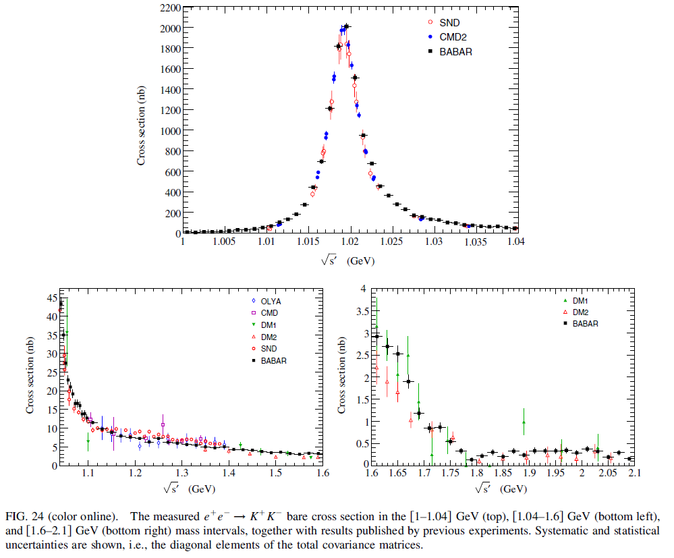
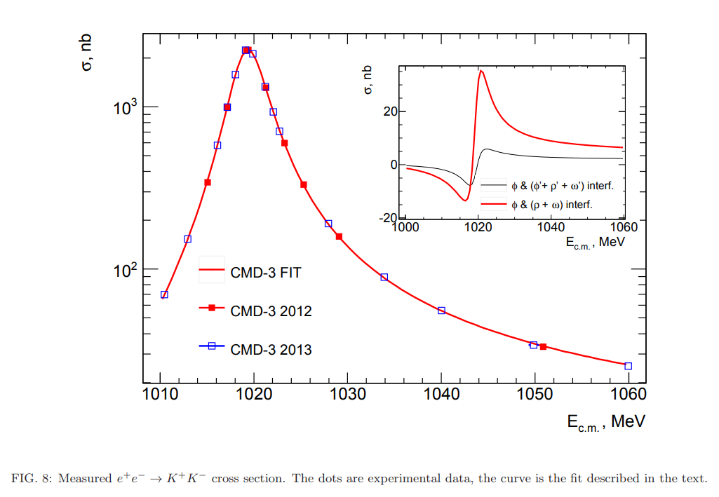
$e^{+}e^{−}→K^{+}K^{−}$: BABAR & CMD3
Phys. Rev. D 88, 032013 (2013)
Phys. Lett. B 779, 64 (2018)

Slide 4
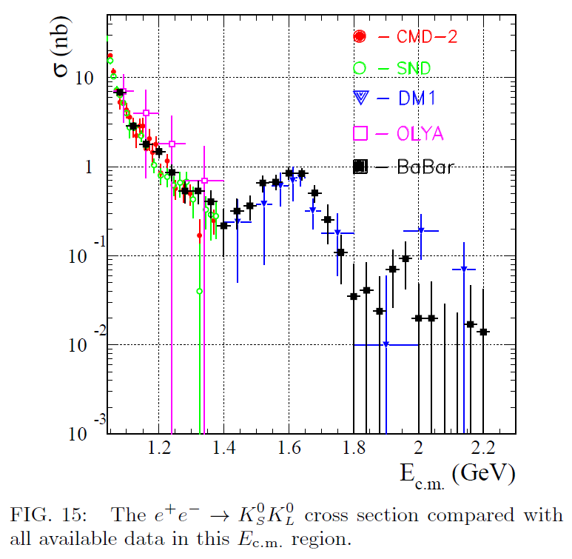
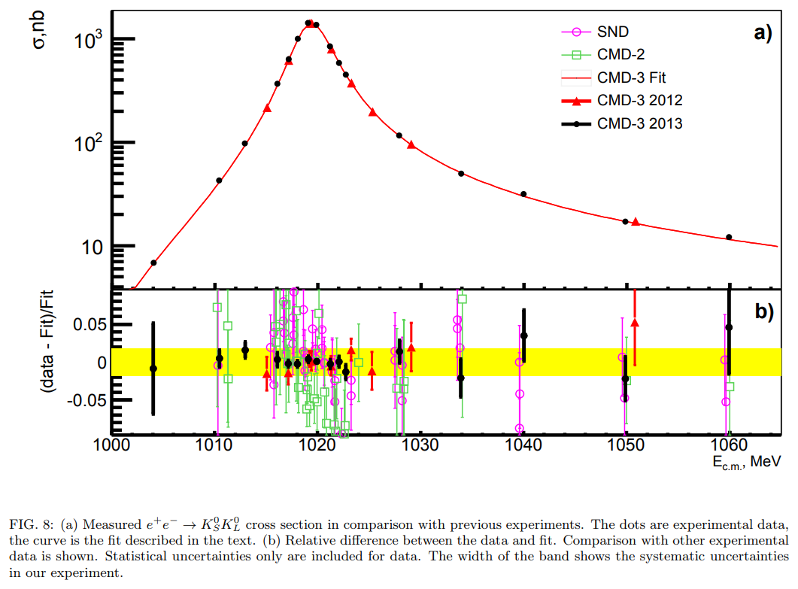
$e^{+}e^{−}→K_{S}K_{L}$: BABAR & CMD3
Phys. Rev. D 89, 092002 (2014)
Phys. Lett. B 760, 314 (2016)

Slide 5
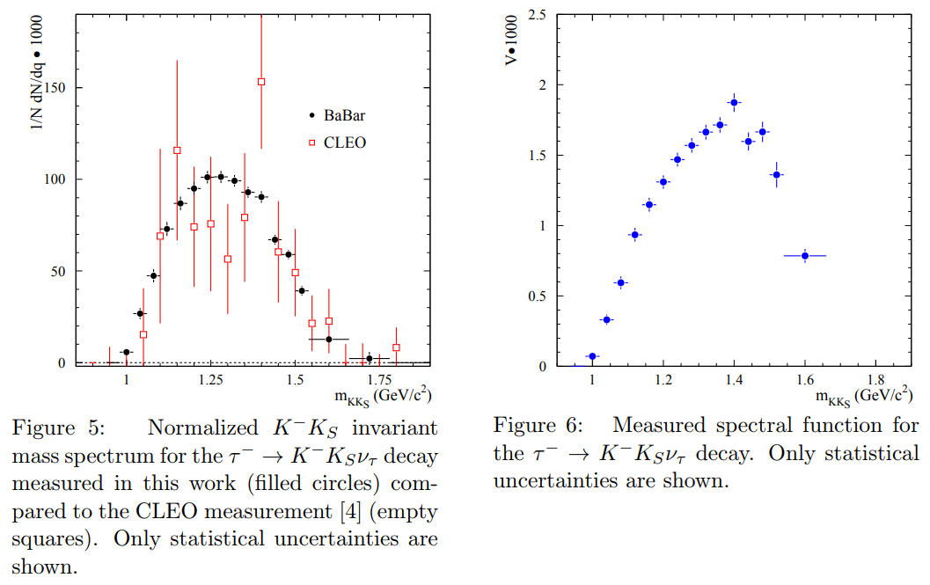
$τ^{−}→K^{−}K_{S}υ_{τ}$: BABAR
Phys. Rev. D 98, 032010 (2018)

Slide 6
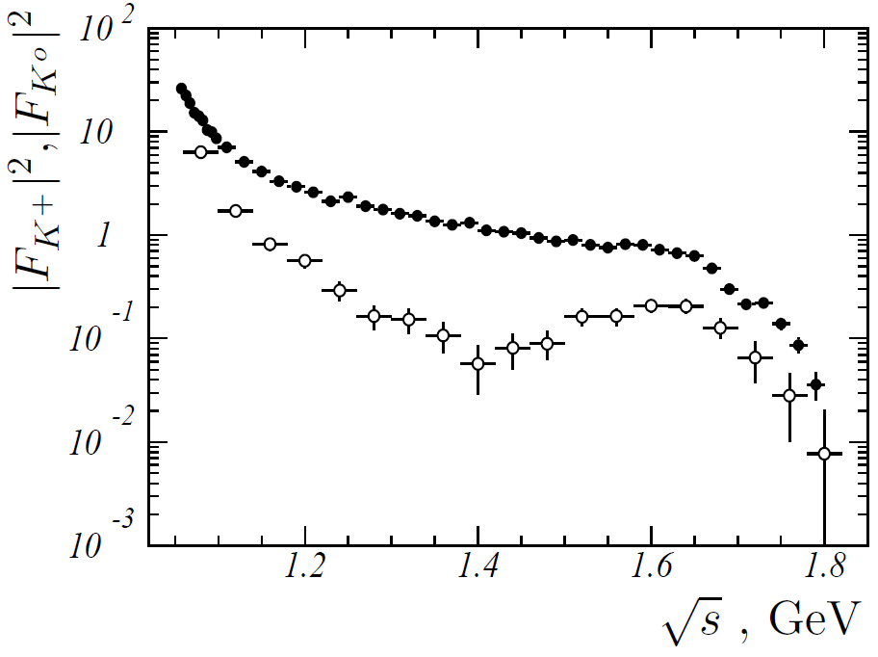
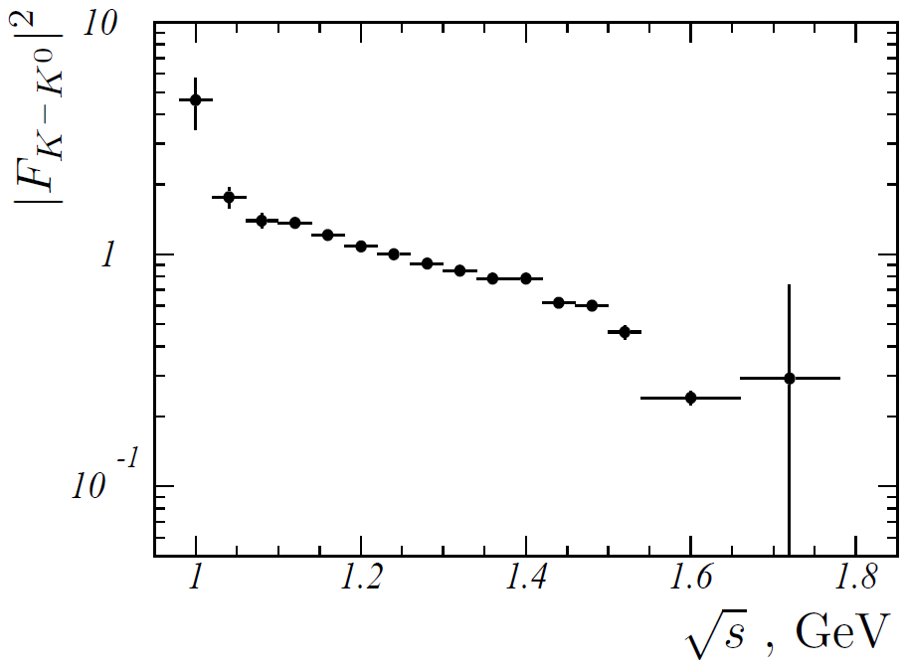
Form factors
Cross section of the $e^{+}e^{−}→K^{+}K^{−}$ process:
Cross section of the $e^{+}e^{−}→K_{S}K_{L}$ process:
Spectral function of the $τ^{−}→K^{−}K_{S}υ_{τ}$ decay:

Slide 7
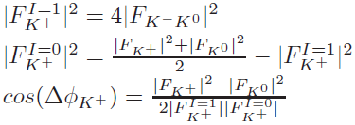
Approach I: calculations

Slide 8
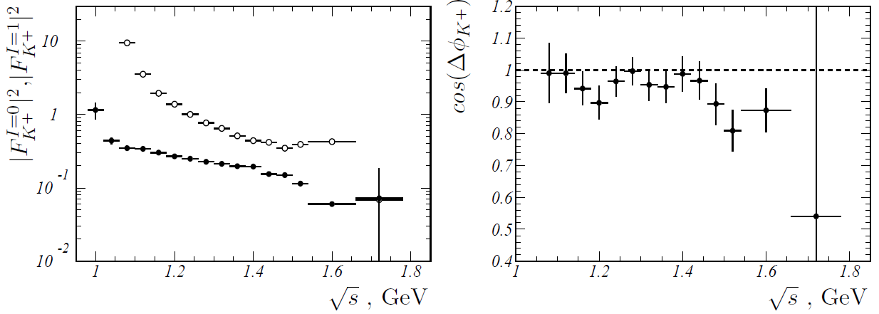
Form factors, relative phase
isoscalar
isovector
Both isoscalar and isovector form factors decrease monotonically in the range below 1.4 GeV.
Large contributions to the form factors comes from the tails of the ρ(770) in the isovector case, and ω(782) and φ(1020) in the isoscalar case.
The ω(782) and φ(1020) contribution is expected to interfere constructively, making the isoscalar form factor significantly larger than the isovector one.
The phase difference between the isovector and isoscalar form factors is the almost constant, close-to-zero in the energy range from 1.06 to 1.5 GeV.
Above 1.5 GeV, resonance structures related to the ρ(1700), ω(1650), and φ(1680) resonances are seen both in the energy dependences of the form-factor moduli and the phase difference.

Slide 9
Approach II : fit model
I=1
I=0

Slide 10
Resonances parameters
$$V$$ | $M_{V}$, MeV | $Γ_{V}$, MeV | $$Γ_{V}(s)$$
$$ρ≡ρ(770)$$ | $$775.26$$ | $$149.1$$ | $π^{+}π^{−}$, $ωπ^{0}$
$$ρ′≡ρ(1450)$$ | $$1465±25$$ | $$400±60$$ | $$ωπ^{0}$$
$$ρ′′≡ρ(1700)$$ | $$1720±20$$ | $$250±100$$ | $$ρππ$$
$$ρ′′′≡ρ(2150)$$ | $$2155±22$$ | $$350±64$$ | $$ρππ$$
$$ω≡ω(782)$$ | $$782.65$$ | $$8.49$$ | $π^{+}π^{−}π^{0}$, $π^{0}γ$, $π^{+}π^{−}$
$$ω^{′}≡ω(1420)$$ | $$1425±25$$ | $$215±35$$ | $$ρπ$$
$$ω′′≡ω(1650)$$ | $$1670±30$$ | $$315±35$$ | $$ωππ$$
$$ω′′′≡ω(2150)$$ | $$=M_{ρ(2150)}$$ | $$=Γ_{ρ(2150)}$$ | $$ωππ$$
$$φ≡φ(1020)$$ | free | free | $K^{+}K^{−}$, $K_{S}K_{L}$, $π^{+}π^{−}π^{0}$, $ηγ$
$$φ^{′}≡φ(1680)$$ | $$1680±20$$ | $$150±50$$ | $$KK^{∗}$$
$$φ′′≡φ(2170)$$ | $$2188±10$$ | $$83±12$$ | $$KK^{∗}$$
Free parameters (=12): $M_{φ}$, $Γ_{φ}$, $η_{φ}={g_{φK_{S}K_{L}}}/{g_{φK^{+}K^{−}}}$, $c_{V}$
$$c_{ω^{′′}}=c_{ρ^{′′}}$$
$$c_{ω^{′′′}}=c_{ρ^{′′′}}$$
$$Γ_{ρ→ωπ^{0}}\left(s\right)=\frac{g_{ρωπ}^{2}}{12}q_{ω}^{3}\left(s\right), g_{ρωπ}=15.9 {GeV}^{−1}$$

Slide 11
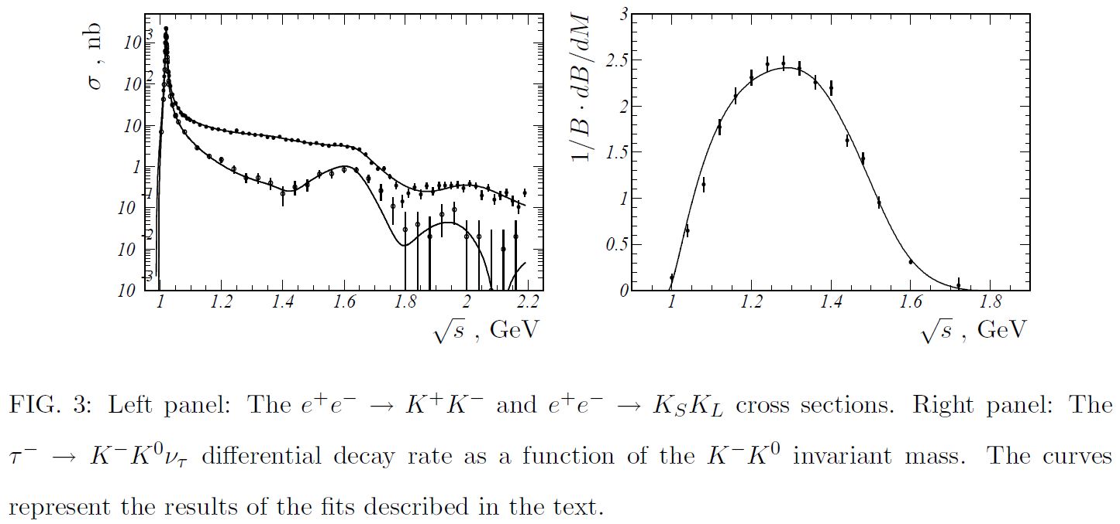
Fit results
arXiv:1902.02474

Slide 12
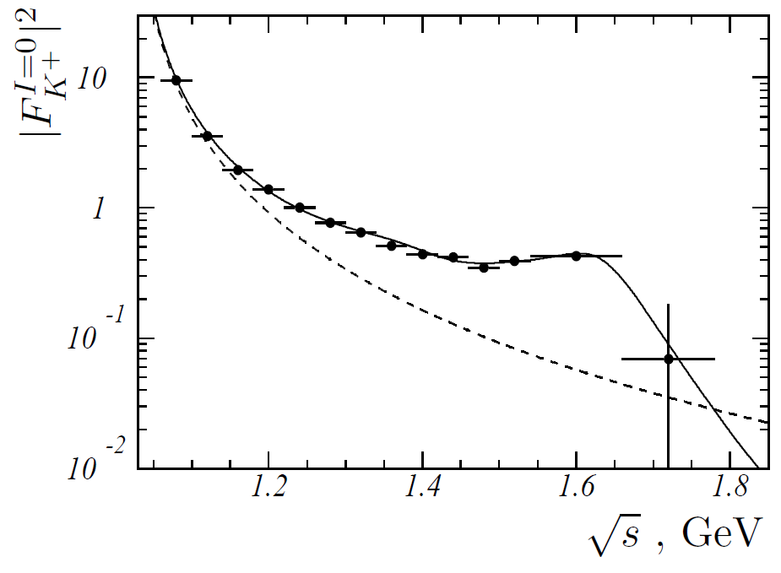
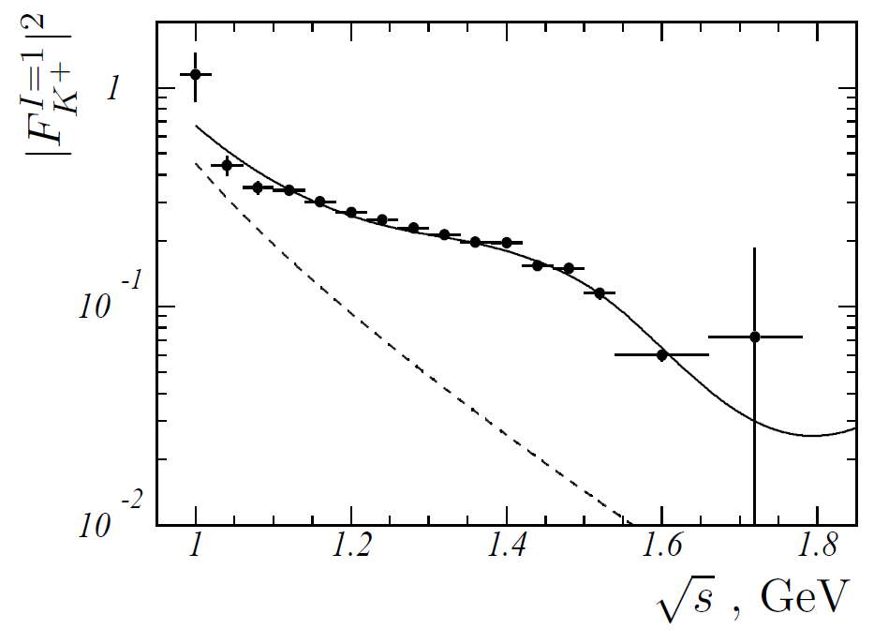
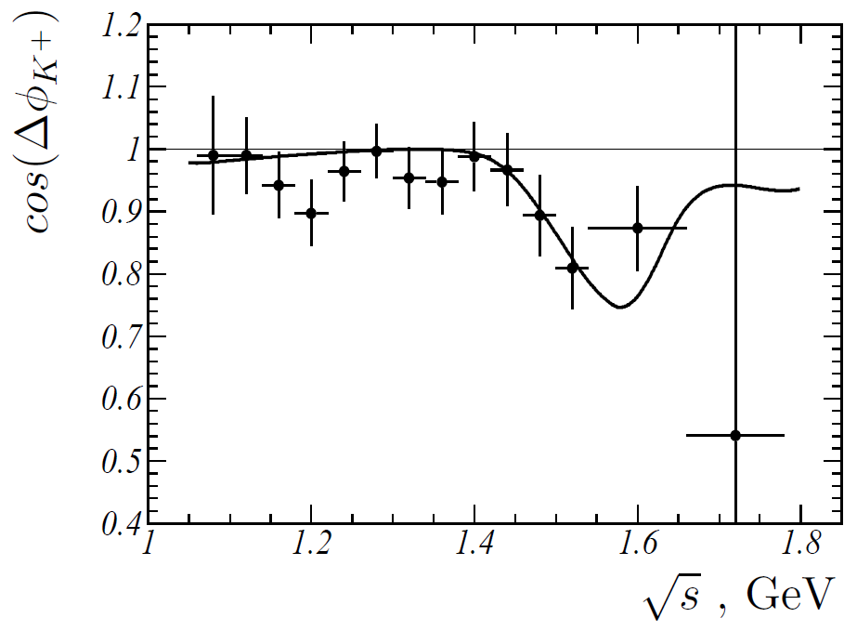
Comparison calculation and fit results
$$fit$$
$$fit$$
$$ω+φ$$
$$ρ$$

Slide 13
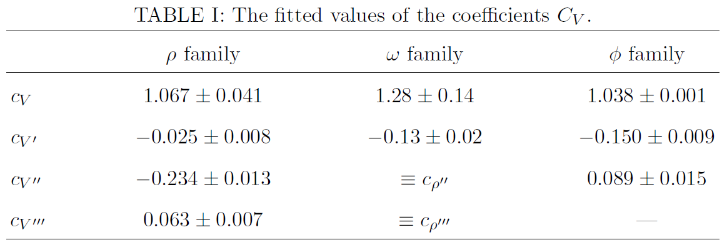
Results
The fitted value of the coefficient $η_{φ}$= 0.990±0.001 is found to be consistent with unity.
A large difference between $c_{V^{′}}$ for $ρ^{′}$ and $ω^{′}$, which are expected to have close values in the quark model. This difference is needed, in particular, to provide the almost constant value of the phase difference in the energy range 1.06–1.5 GeV.
We also perform a fit with an additional fit parameter $α_{CVC}$ describing a possible deviation from the CVC hypothesis. This parameter is used as a scale factor to the data of the differential decay rate. The fitted value of this parameter $α_{CVC}$ = 0.991 ± 0.020 shows that the CVC hypothesis for the $K\overline{K}$ system works with a few percent accuracy.

Slide 14
Conclusion
We have used recent precise measurements of the $e^{+}e^{−}→K\overline{K}$ cross sections and the $K^{−}K_{S}$ spectrum in the $τ^{−}→K^{−}K_{S}υ_{τ}$ decay to separate the isoscalar and isovector electromagnetic kaon form factors and determine the relative phase between them in a model independent way
The relative phase shows an unexpected energy dependence in the energy range from 1.06 to 1.5 GeV. It is almost constant and close to zero
We have simultaneously fitted to the $e^{+}e^{−}→K^{+}K^{−}$ and $e^{+}e^{−}→K_{S}K_{L}$ cross-section data and the hadronic mass spectrum in the $τ^{−}→K^{−}K_{S}υ_{τ}$ decay in the framework of the VMD model
The fit reproduces data reasonably well and shows that the CVC hypothesis for the $K\overline{K}$system works with a few percent accuracy
To explain the specific energy dependence of the relative phase between the isoscalar and isovector form factors the large difference between parameters $c_{ρ^{′}}$ and $c_{ω^{′}}$ is required, which contradicts to the quark model expectation $c_{ρ^{′}}$ = $c_{ω^{′}}$

Slide 15
Thank you!

