Slide 1

New Muonium Hyperfine Structure Measurement in J-PARC
K. Shimomura (KEK)
on behalf of the MuSEUM Collaboration
BINP, Novosibirsk

Slide 2
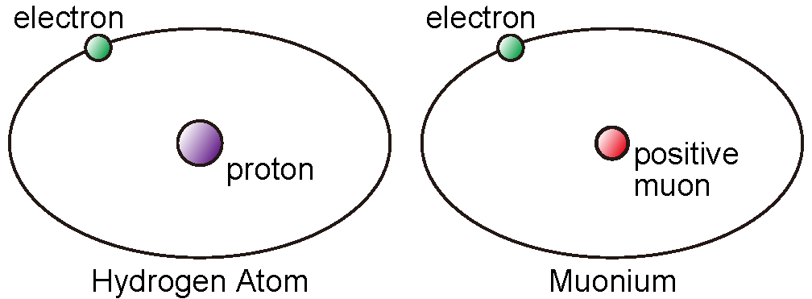
What is Muonium ?
Muon:
Elementary particle (lepton)
200 times heavier than an electron
Lifetime of 2.2 microseconds.
Muonium:
Bound state of a positive muon and an electron.
Hydrogen-like atom free from the finite size of the nucleon.
Most suitable for validation of bound state quantum electrodynamics (QED).
Theoretical and experimental precision of the hyperfine structure comparable.
Notes:
Hydrogen: limitation due to the internal structure of the proton
Positronium: limitation due to unknown non-logarithmic higher-order terms

Slide 3
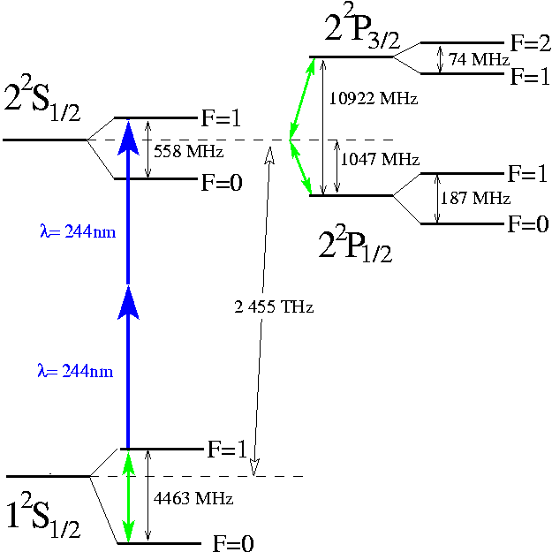

Mu Energy Diagram
From K. Jungmann
Fine Structure
explained by Dirac
Classical Lamb Shift
QED
Tomonaga, Shwinger,
Feynman
Not included QED weak hadronic correction

Slide 4
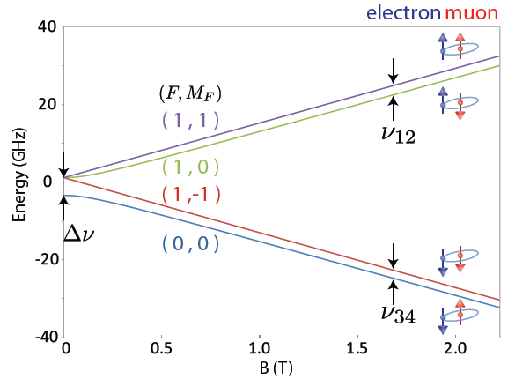
Muonium Hyperfine Structure
Δν_{HFS}: Mu Hyperfine Structure
Zeeman Splitting
Breit-Rabi diagram
e⁻
μ⁺
Δν_{HFS} ≈ 4463 MHz
e⁻
μ⁺
Pure lepton
= point particle
Magnetic Field (T)
ν₁₂+ν₃₄ = Δν_{HFS}
ν₁₂-ν₃₄ ∝ μ_{μ}/μ_{p} ∝ m_{μ}/m_{p}
Notes:
Microwave magnetic resonance technique

Slide 5
Most Precise Test of Bound State QED
Experiment:
LAMPF Experiment (1999)
ν_{HFS}(exp) 4463.302 765 (53) MHz [12 ppb]
µ_{µ}/µ_{p} = 3.18334524(37) [120ppb]
m_{µ}/m_{e} = 206.768277(24) [120ppb]
Theory:
ν_{HFS}(theory) 4463.302 868 (271) MHz [61 ppb]
ν_{HFS}(QED) 4463.302 720 (253) (98) (3) MHz
(m_{μ}/m_{e}) (QED) (α)
ν_{HFS}(weak) -65 Hz
ν_{HFS}(had. v.p.) 232 (1) Hz
ν_{HFS}(had. h.o.) 5 (2) Hz
By Nomura
QED calculation: Effort for 10 Hz accuracy in progress (by Eides et al.)
Progress: PRA 86 (2012) 024501, PRL 112 (2014) 173004, PRD 89 (2014) 014034
Notes:
had. v.p. : hadronic vacuum polarisation
had. h.o : hadronic higher-order correction
Alpha: Fine structure constant – precision of alpha
Theorists are confident that muonium HFS can be calculated to 10 Hz, if needed (Eides,...)
Experimental value from Liu et al.

Slide 6
Why Mu HFS measurement is so important?
g-2 E821(BNL) 0.5ppm 3.6σ deviation
• Measurement of the deviation of muon spin direction (ω_{s})
and muon momentum direction (ω_{c}) ω_{a}∝(g-2)/2=a_{μ}
• The ratio to the proton NMR frequency is important!
μ_{μ}/μ_{p} accuracy from direct measurement of 120 ppb.
θ
a_{μ} an independent precise muon mass measurement is required!
⇒
From g-2 storage ring
From Muonium HFS
W. Liu et al., Phys. Rev. Lett. 82 (1999) 711

Slide 7
Related on proton radius puzzle
Measurements of the proton radius:
By Randolf Pohl’ s slide
Muon atom spectroscopy
Electron scattering
0.8409 ±0.004
0.8770 ±0.0045
Proton Zemach radius can be obtained comparison of muonium HFS and hydrogen HFS*.
*SJ. Brodsy et al., PRL.. 94, 022001 (2005),
Notes:
The measured value of the proton rms charge radius from muonic hydrogen μ p is 10 times more accurate, but 4% smaller than the value from both hydrogen spectroscopy and elastic electron proton scattering.
There exists a 7.9σ discrepancy between electronic (ep atomic and ep scattering)
and muonic extractions of the proton radius.

Slide 8

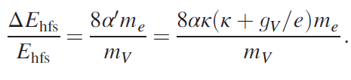
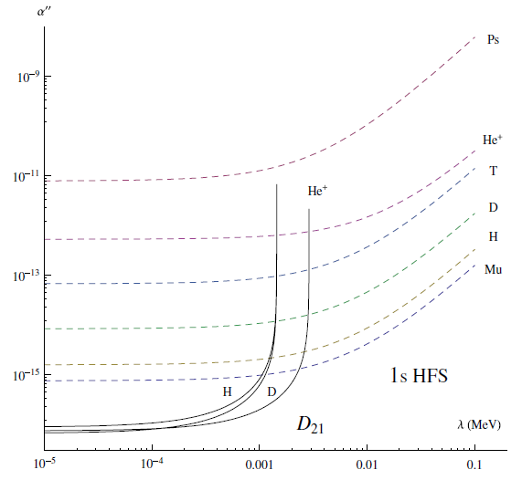
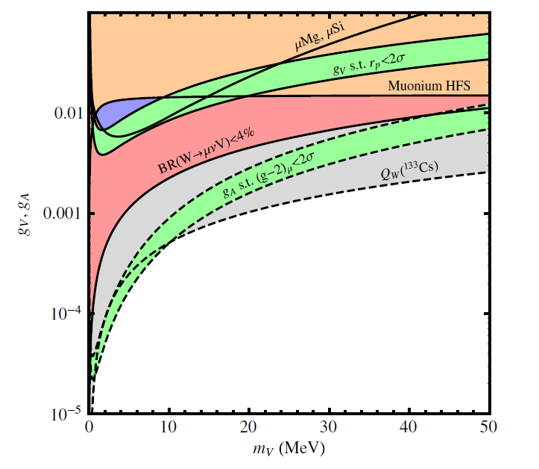
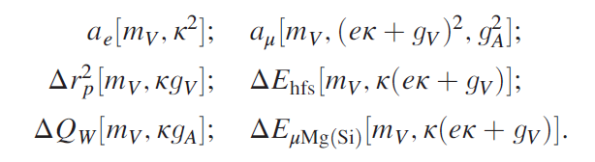
Exotic particle search
a pseudo vector boson
a massive vector boson
Fig. 2 on PRL 104, 220406 (2010)
Fig. 6 on PRD90, 073004(2014).
S. G. Karshenboim et al., PRL 104, 220406 (2010), PRD82, 113013(2010).
PRA 84, 064502(2011) , PRD90, 073004(2014).

Slide 9
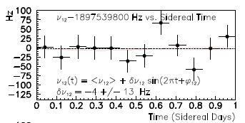
Test of CPT and Lorentz Invariance
CPT broken Theory ⇒ Lorentz symmetry is broken
O.W. Greenberg, PRL 89 (2002) 231602
R. Blihm, V.A. Kosteleky, C.D. Lane, PRL 84 (2000) 1098
V.W. Hughs et al., PRL 87(2002) 111804
CPT violation search
Ex: Muon difference g_{µ+}/ g_{µ–} 10⁻⁸
g_{μ}-2/MuHFS precise measurement
Lorentz symmetry violating term in STE Lagrangian b
Corresponding MuHFS Δν_{12/34}
These value might change in sidereal time (23h56m)
~
b₃^{μ}/π=-δΔν₁₂=δΔν₃₄
LAMPF Exp. Figure of Merit
Plank scale sensitivity
m_{μ}/M_{P}～10⁻²⁰
V.A. Kostelecky, A.J. Vargas, PRD 92 (2015) 056002
Notes:
MuHFS can contribute to a possible test of CPT and Lorentz violation incorporated in extensions to the standard model,
leading to potentially observable perturbative shifts in the ground state energy levels of muonium
[Old Ref. (top): O.W. Greenberg, Phys. Rev. Lett. 89 (2002) 231602]

Slide 10
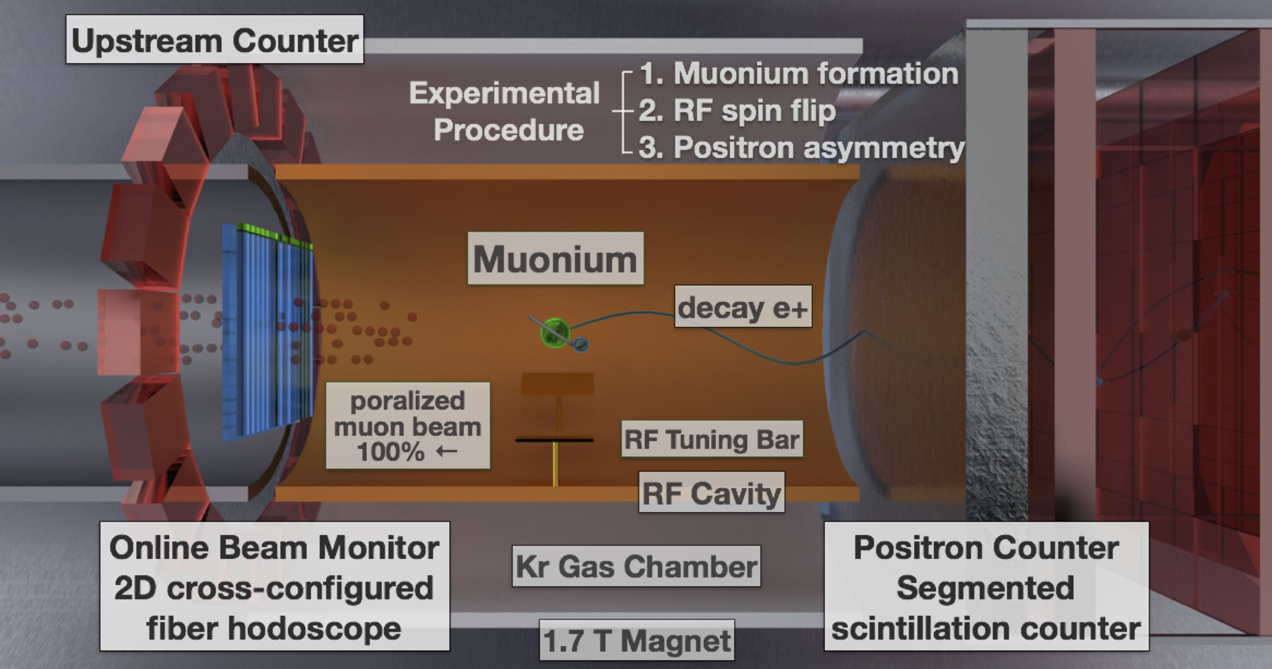
MuSEUM Experimental Layout

Slide 11
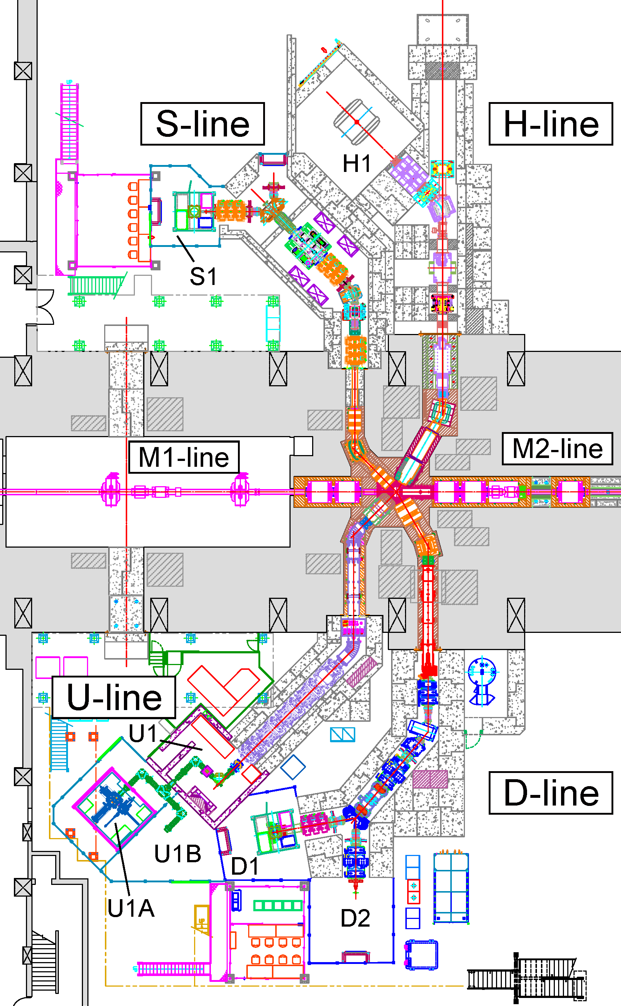
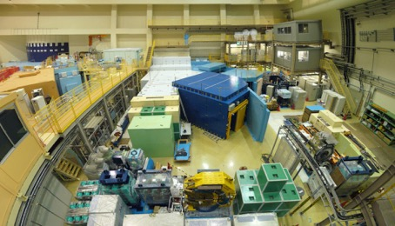
J-PARC Muon Science Facility (MUSE)
H1 Area
Phase 2 (g-2/EDM, TμS)
Under construction
H-Line: for particle and atomic physics large scale experiments, “precison frontier”.
Higher intensity tunable (4 – 50 MeV) µ⁺ & µ– beam.
(Exp.: MuSEUM, Deeme, g-2, …)
MuSEUM
DeeMe
H1 Area
MLF Experimental Hall No. 1 (2018)
Beamline in Operation
D-Line: Decay and Surface muon (µ⁺ & µ–)
Slow (50 keV) – fast (50 MeV) beam, general purpose.

Slide 12
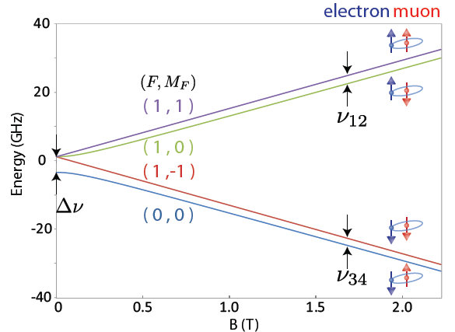
Zero field measurement at D Line
Important milestone for HF measurement-
Two additional components are required.
・Permalloy magnetic shield
・RF cavity for ZF

Slide 13
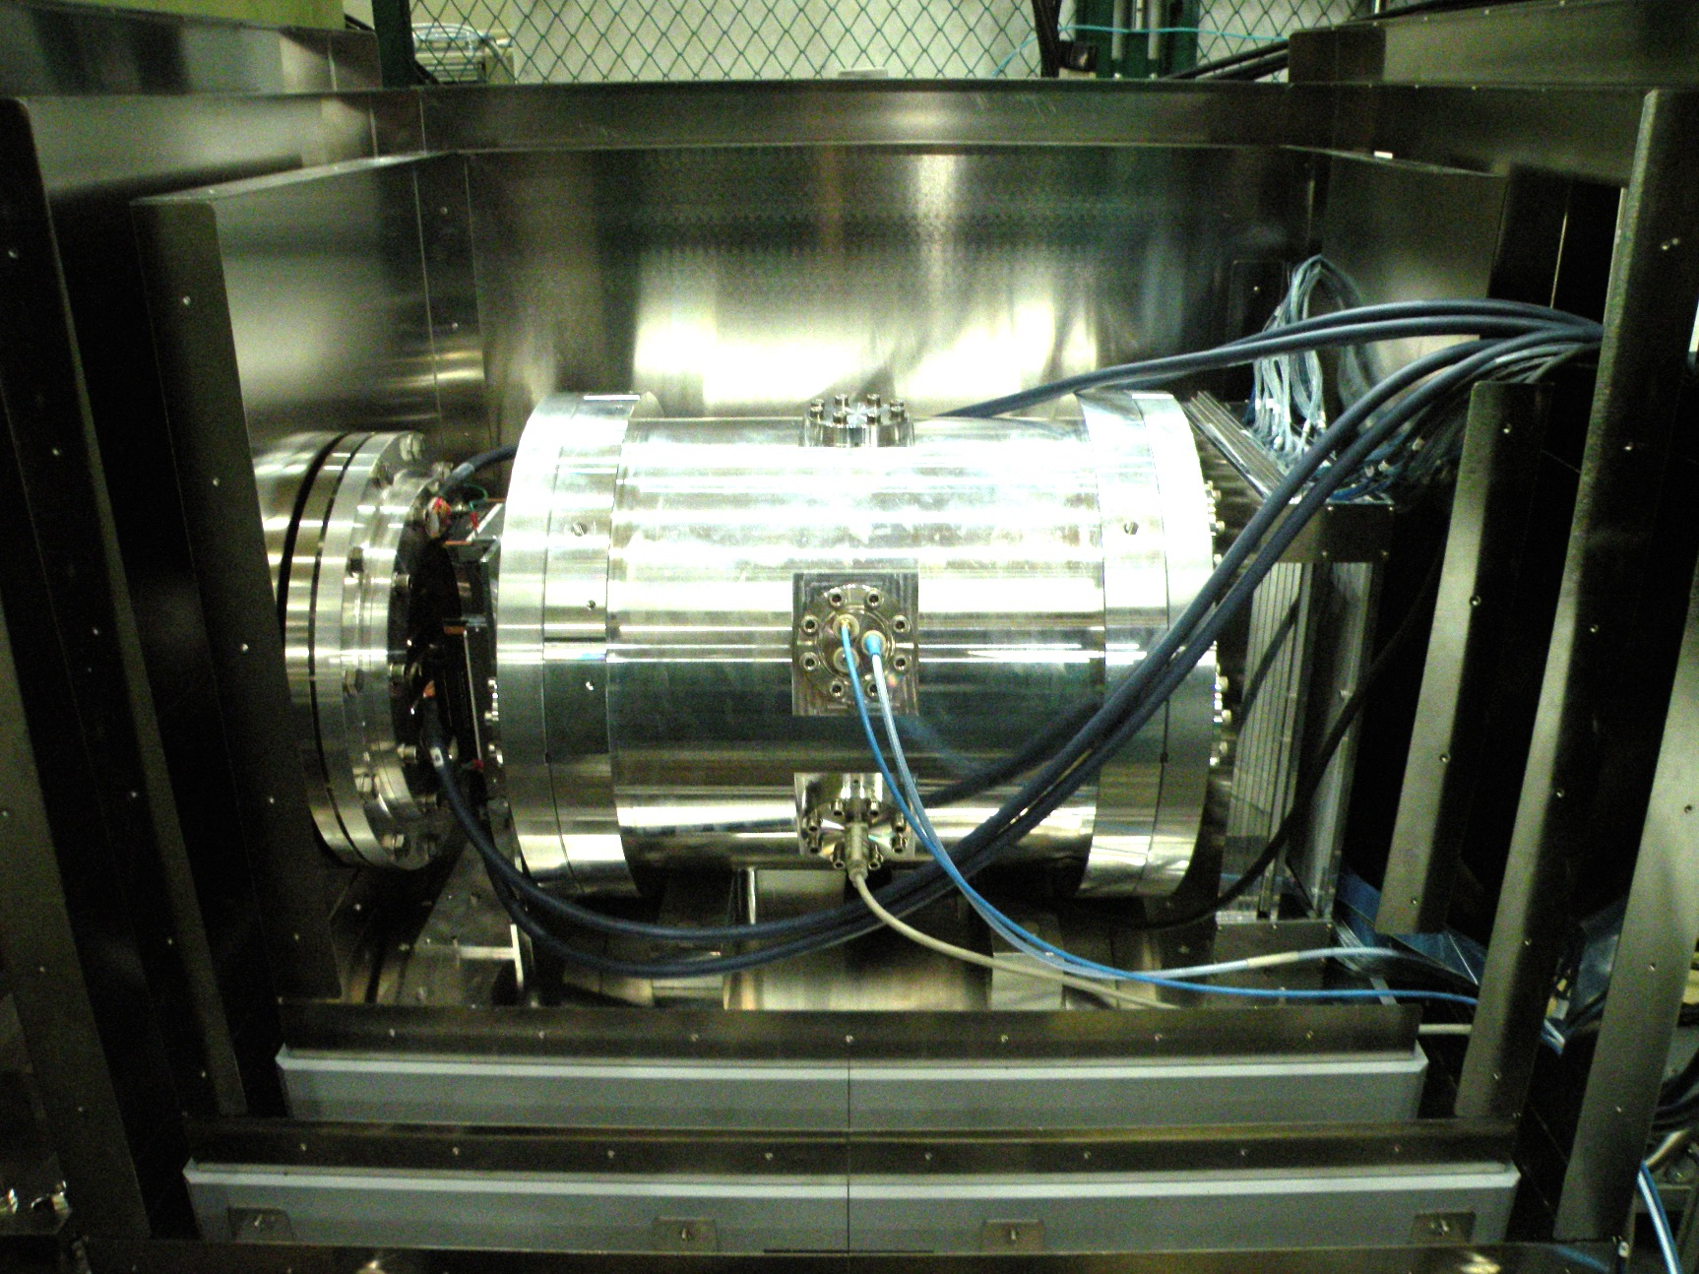
Resonance Measurement Setup
Positron Counter
w/Al Absorber
Fiber Beam Profile Monitor
Muon Beam
Kr Gas Chamber
(RF Cavity inside)
200 mm
Three layers of magnetic shield

Slide 14
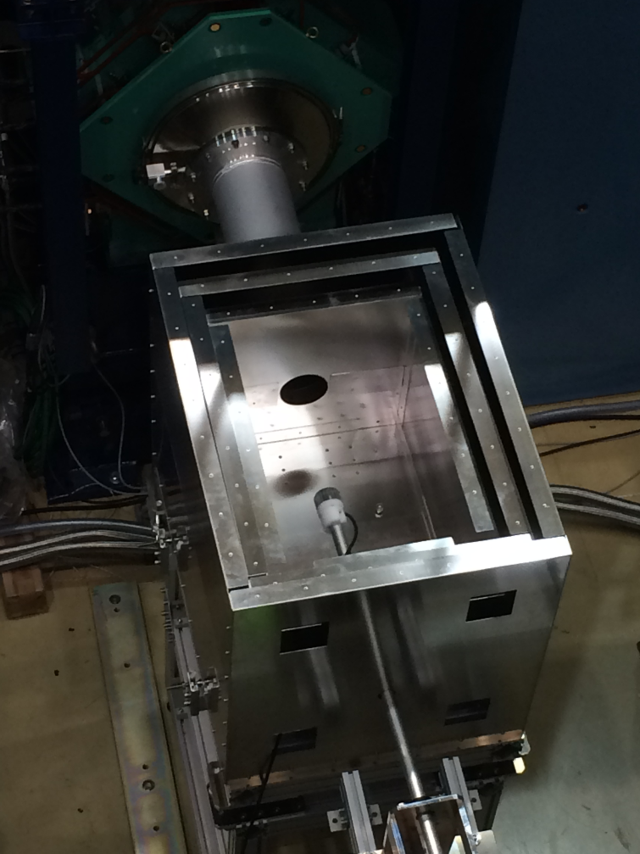
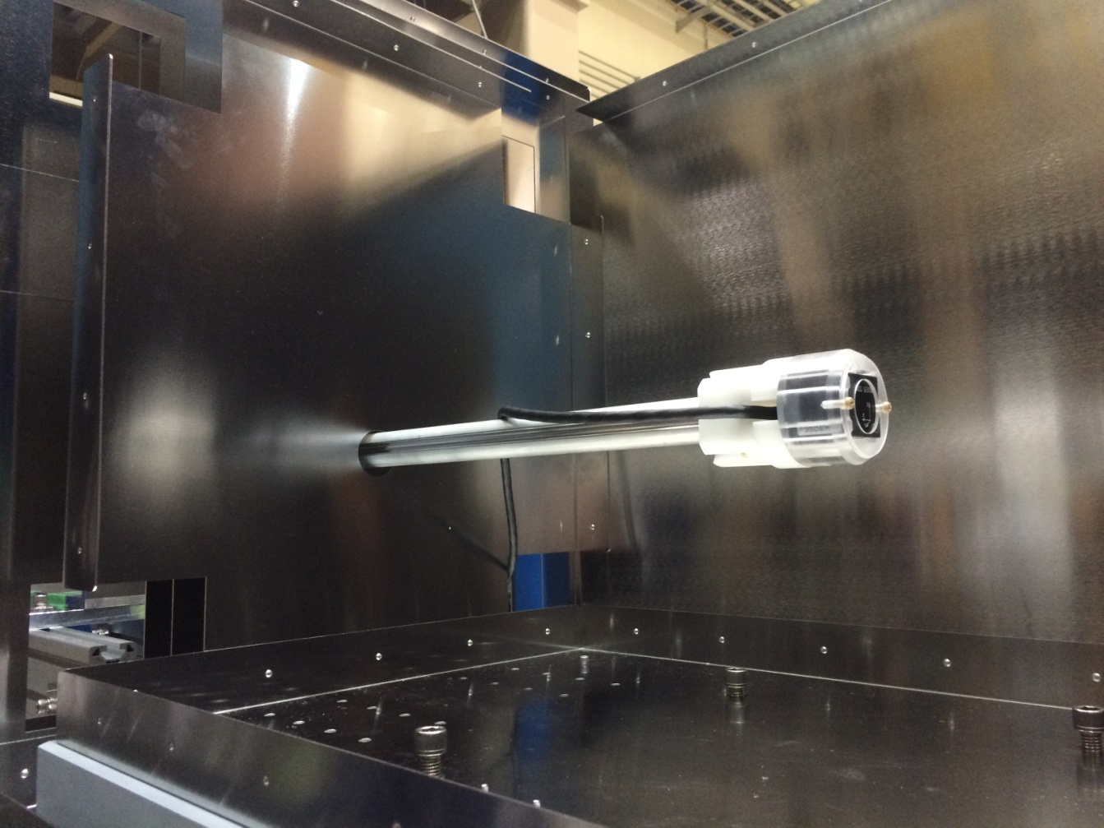
Magnetic Shield and Field Probe
Fluxgate magnetic probe
35 mm x 35 mm x 35 mm
700 mm
Assembled magnetic shield
without top boards
Magnetic field probe holder
and its moving system

Slide 15
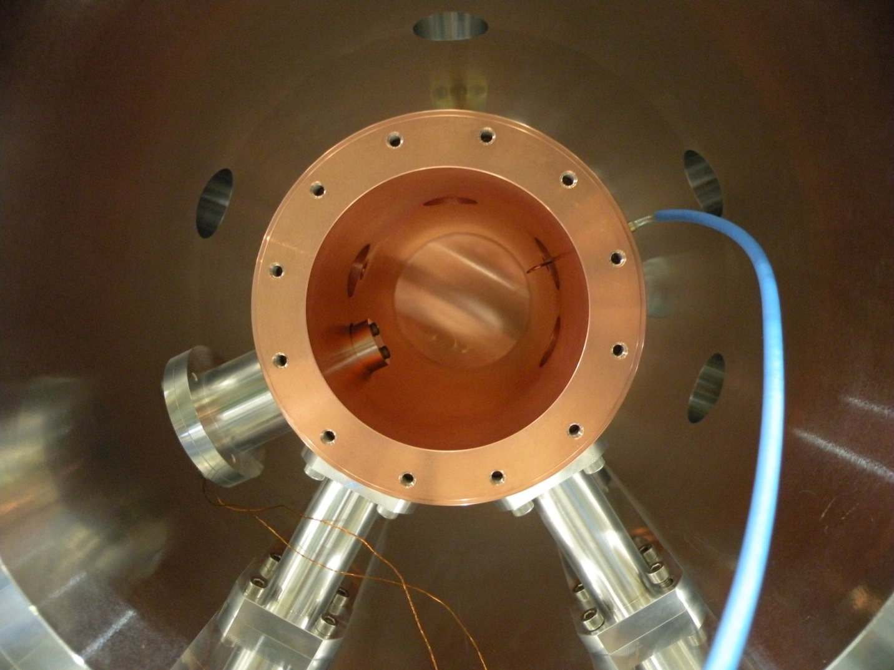
Inside of the Gas Chamber
Input antenna
Pickup antenna
81 mm
Tuning bar
Piezo positioner
Expected Q-value is 10000, microwave power is up to 3 W
TM110 mode at 4.463 GHz, +-1 MHz tuning by a piezo positioner

Slide 16
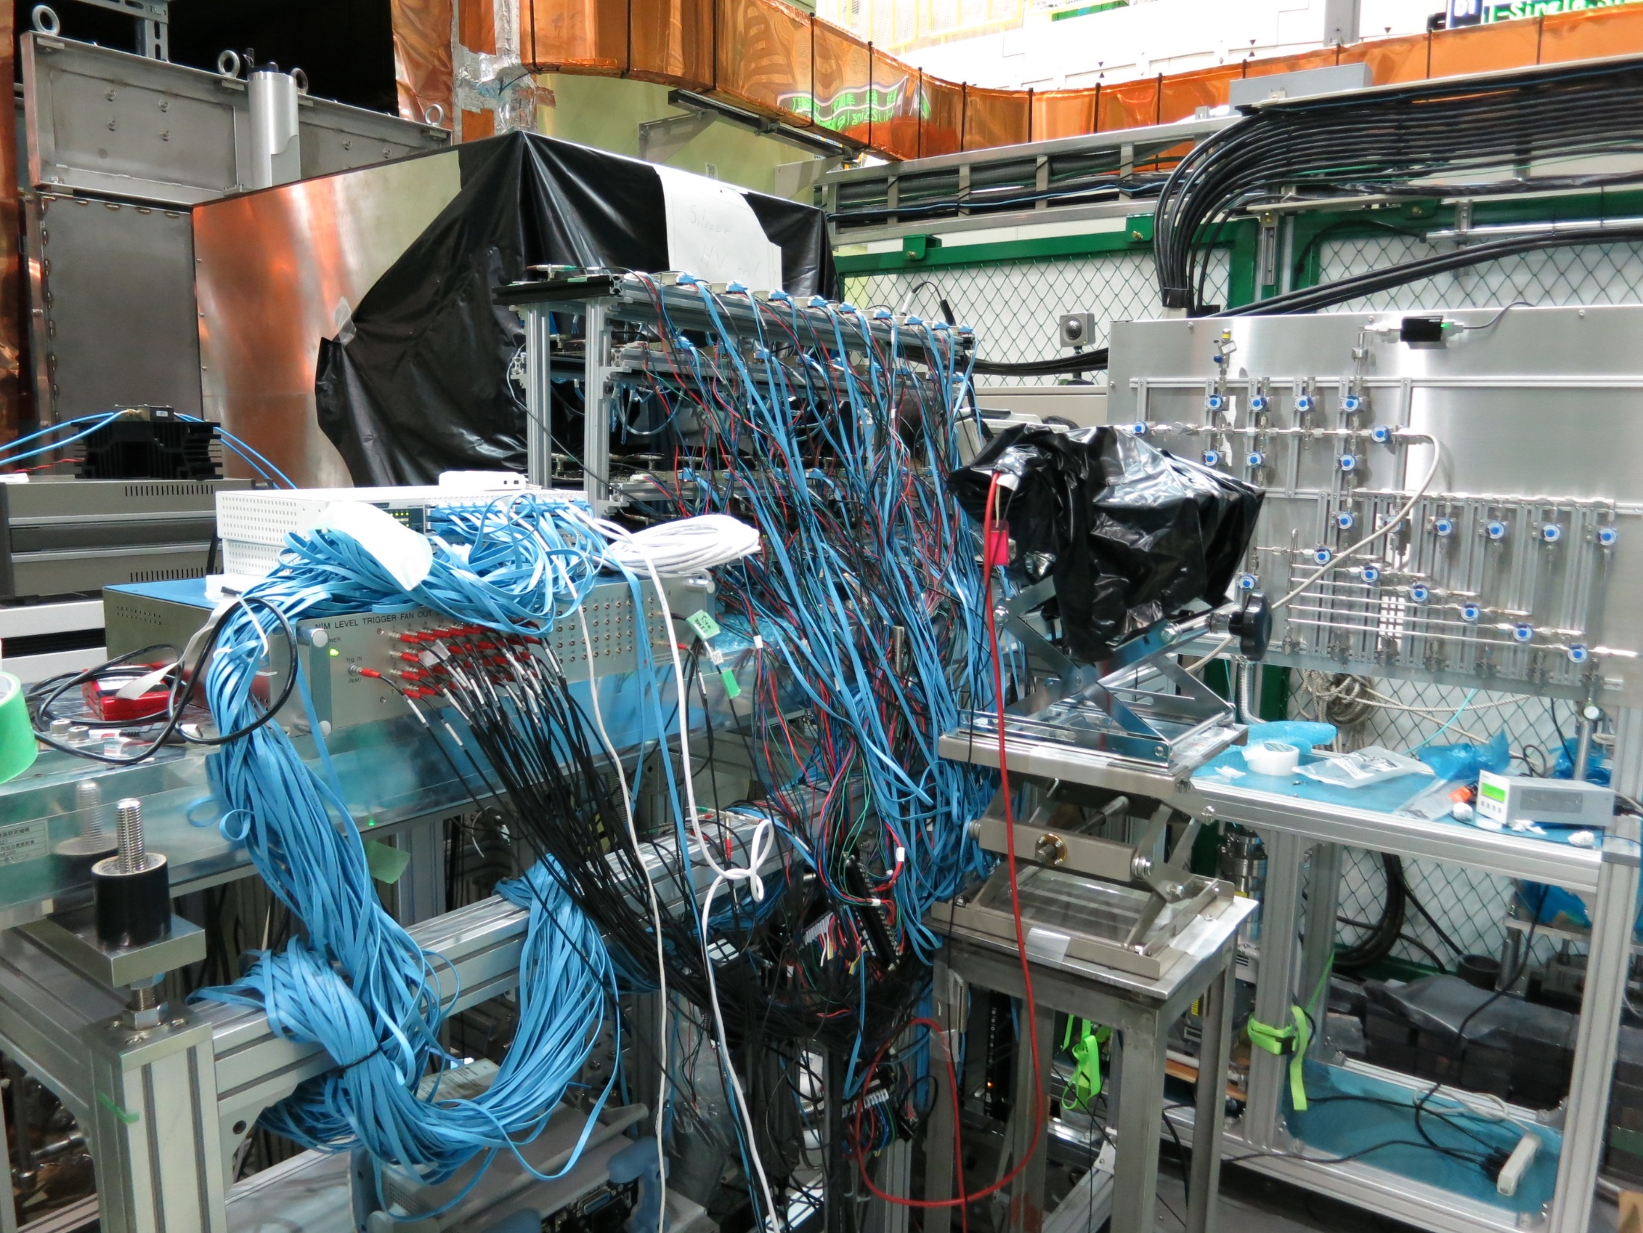

Slide 17
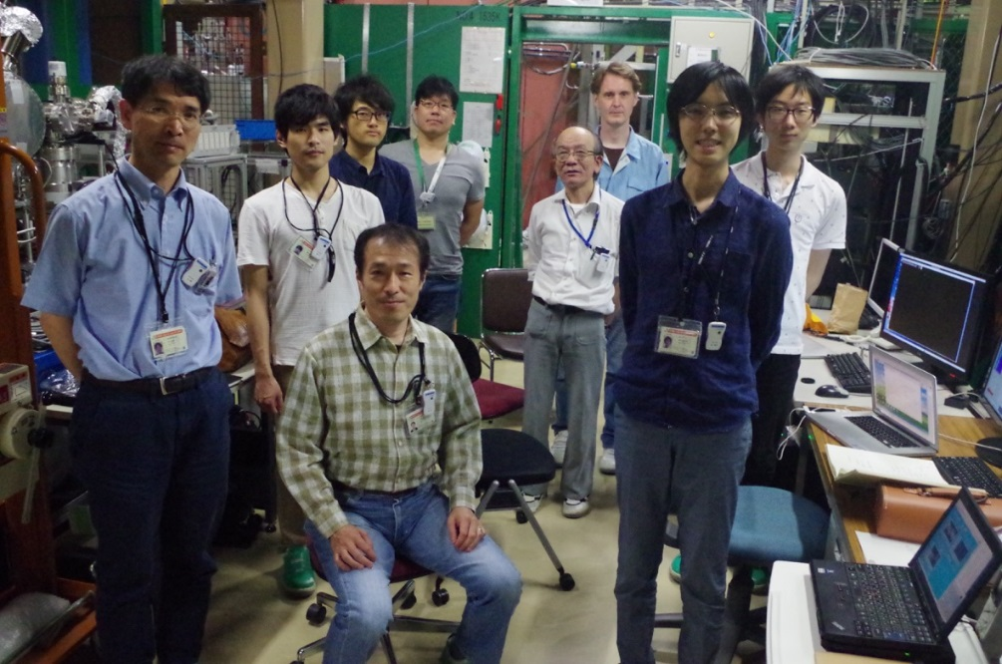
1st MuSEUM Zero Field Experiment
2016. June. 3(24h)
Beam profile measurement
2016. June. 12-14(60h)
Muonium Resonance Search
Results
Good zero field condition (~100nT) was obtained.
Beam profile was successfully measured.
Enough RF power and cavity Q value were obtained
All detectors were working properly.
After several trial, Muonium HFS resonances was obtained!

Slide 18
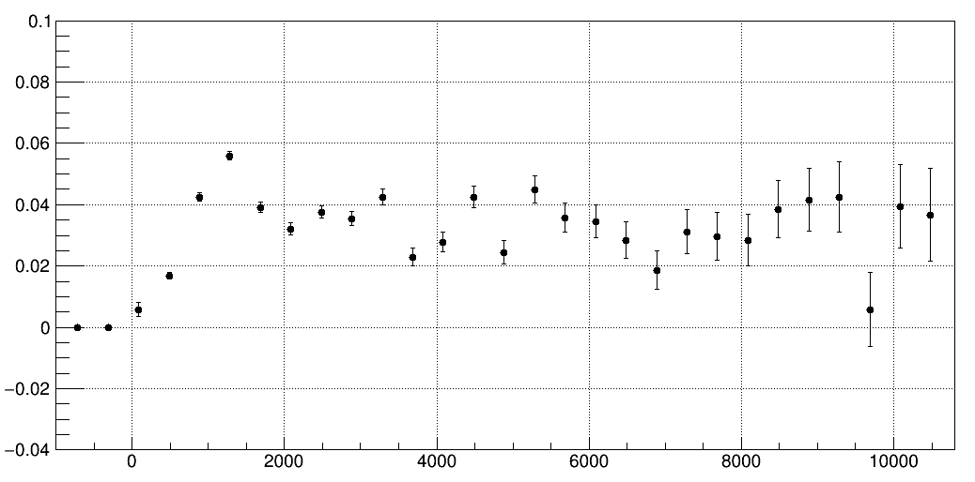
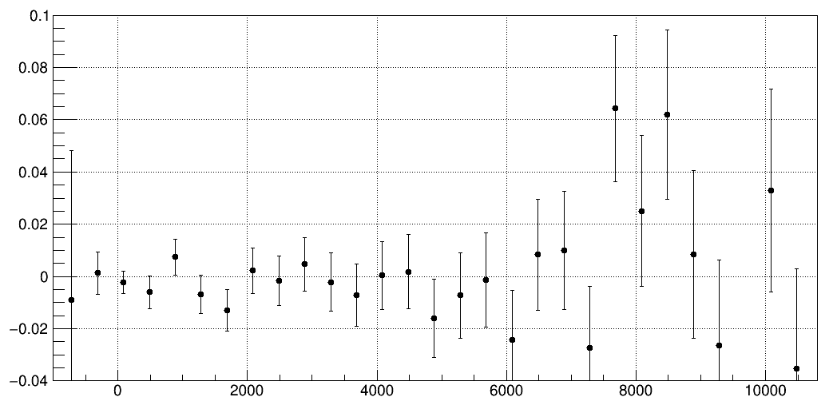
Time Dependent Spin Flip Signal
Kanda thesis
Near at Resonance
4463.1 MHz
RF frequency
1.0 Kr atm
27.4 MeV/c muon
Signal (a.u.)
time (ns)
Off-Resonance
RF frequency was far detuned
1.0 Kr atm
27.4 MeV/c muon
Signal (a.u.)
Signal = ON/OFF-1
time (ns)

Slide 19
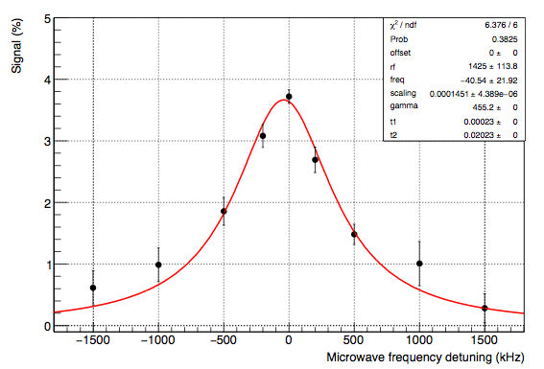
Resonance Lineshape
Kanda thesis
Spin flip signal (%)
Frequency detuning (kHz)
Muonium HFS resonance was observed
Fitted by Lorenzian and freq. center was 4463.1+-0.02 MHz
Expectation from precursor experiments is 4463.1 MHz

Slide 20
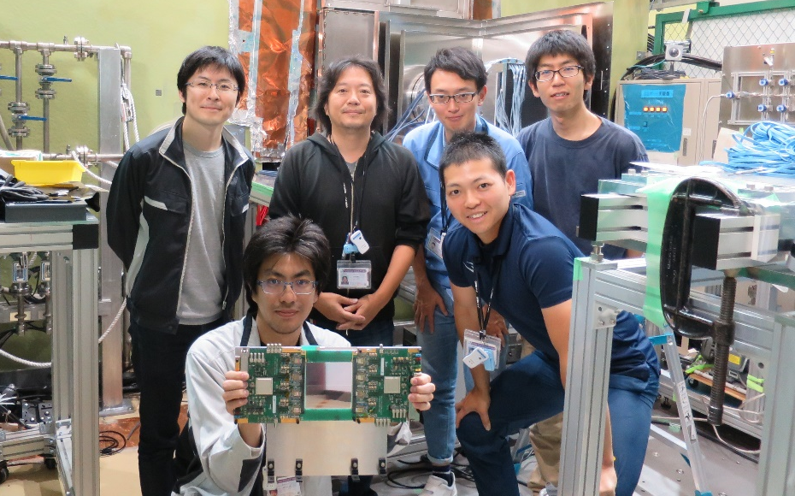
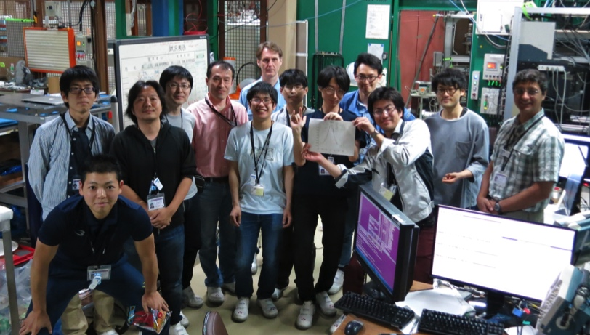
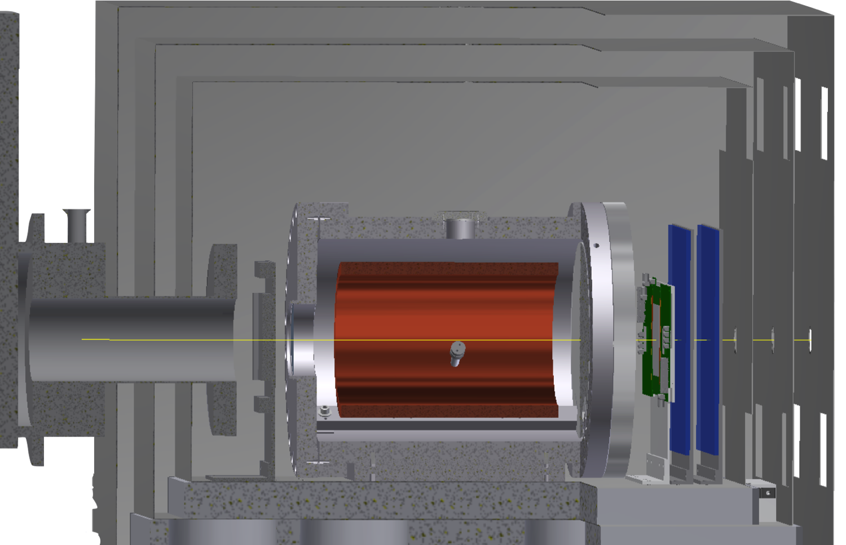
2nd MuSEUM Zero Field Experiment(2017)
Experimental Procedure
  Muonium formation in a Kr gas chamber
  Microwave spin flip
  Positron asymmetry
Magnetic shield
Sci. positron counter
Silicon detector
Kr gas chamber
Polarized muon beam
decay positron
RF cavity
(TM220)

Slide 21
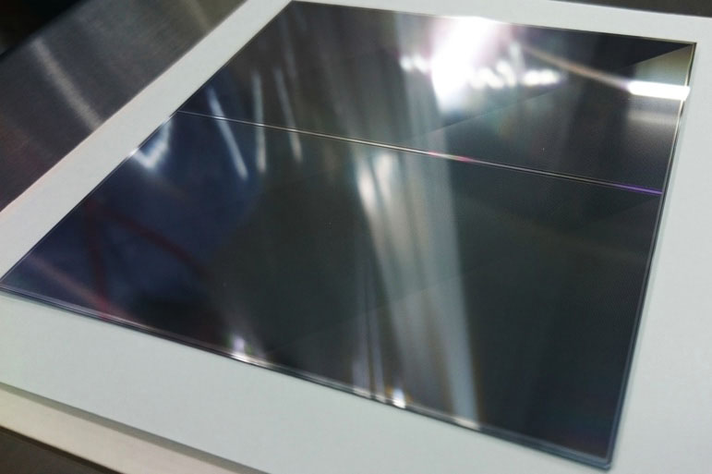
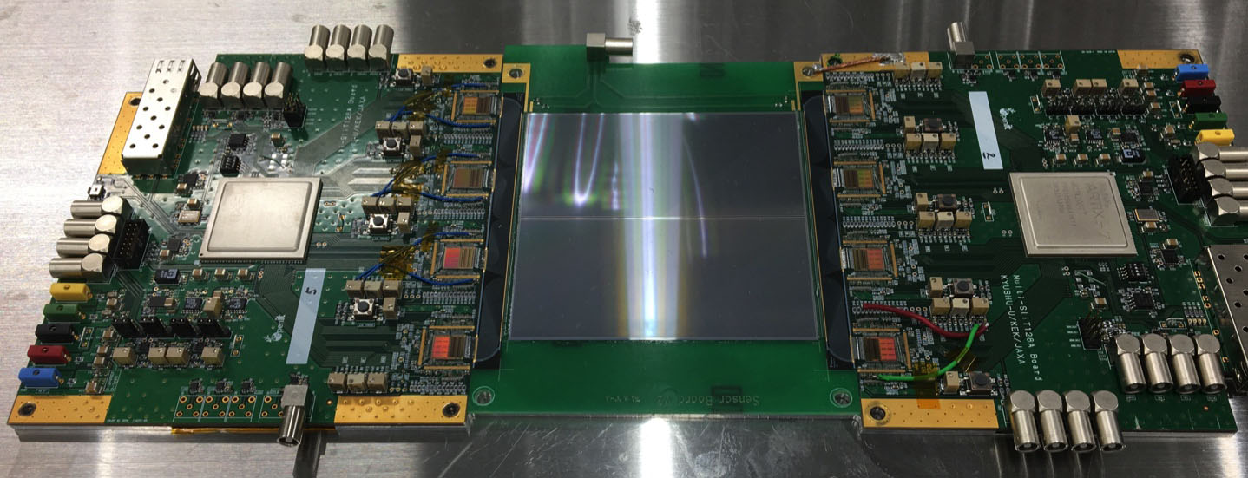
Positron Counter (2):
Silicon Strip Detector
Nishimura
Item | Specification
Sensor type | single-sided, p+ on n
Size | 98.77 mm × 98.77 mm
Active Area | 97.28 mm × 97.28 mm
Strip pitch | 0.19 mm
Strip length | 48.575 mm
No. of strips | 512 x 2 blocks
Thickness | 0.32 mm
98.77 mm
98.77 mm
Silicon strip detector
Readout chips (SliT128A, 128 ch/chip)
Developed for J-PARC g−2/EDM experiment
Highly-segmented
High-rate capability
S/N ~ 21

Slide 22
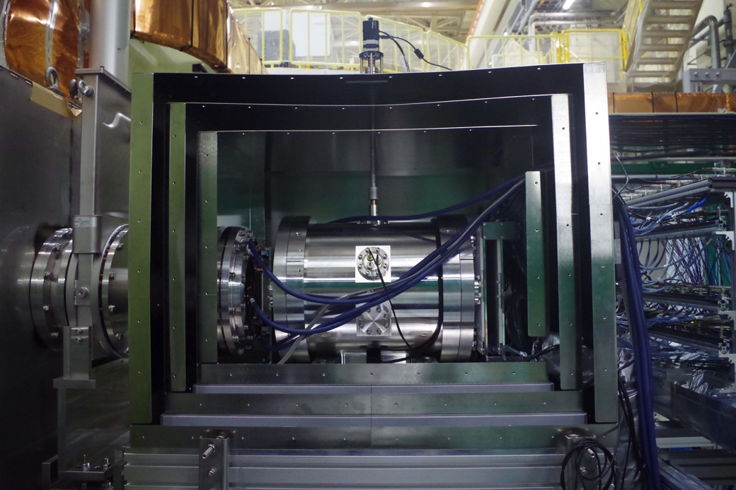
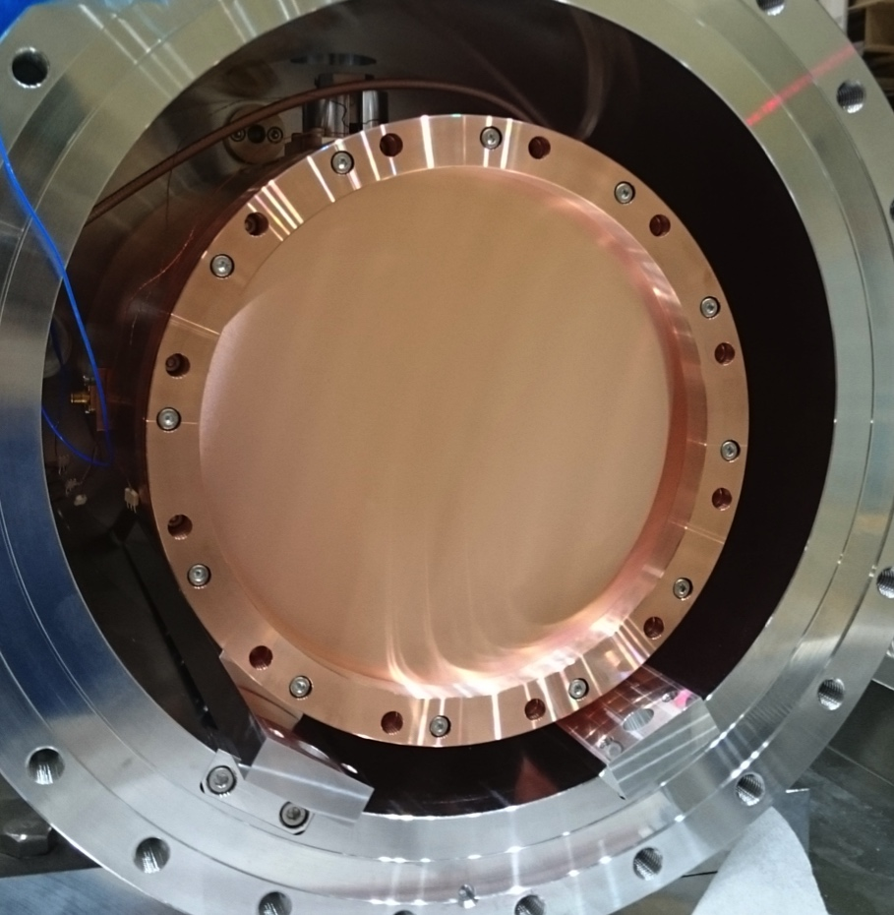
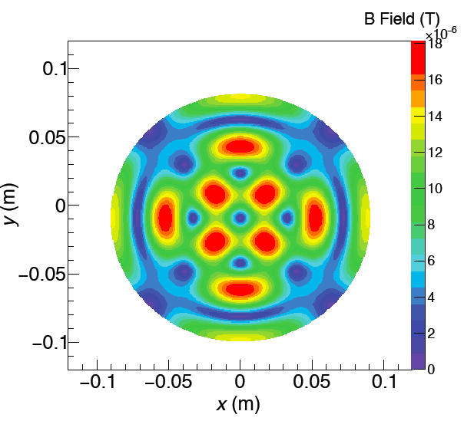
Zero Field Measurements at D-Line
Experimental Setup
New RF Cavity for Zero Field
Magnetic Shield
Online Beam
Profile Monitor
Positron
Counters
Readout
Electronics
180 mm
Muon Beam
RF Intensity
Kr Gas
Chamber
Residual Magnetic Field
Δν = 4.463 GHz
~ 80nT
TM220 mode
Larger cavity
More muon stop
Q-Value: 20,000 (calc.)
Upstream
Window
Downstream
Window

Slide 23
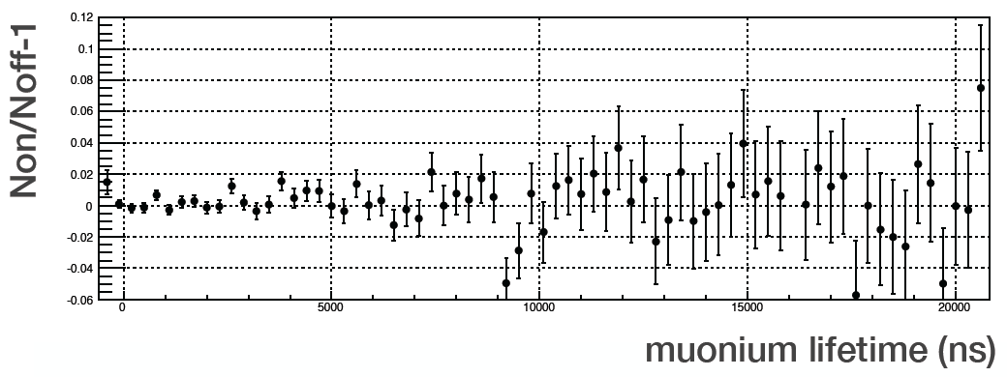
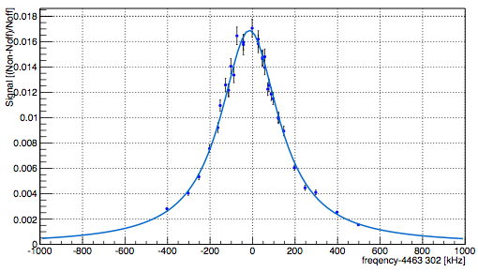
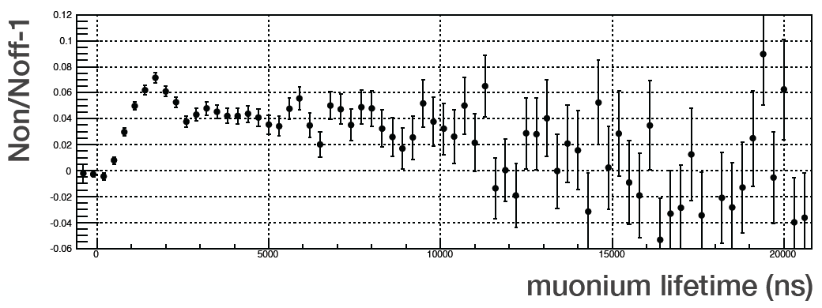
Results (1): Time Integral Method
Conventional
Method
– Scintillation Position Detector Data –
Off Resonance
Resonance Line Shape (2018 March)
Very Preliminary
On Resonance
Spin-flip Signal (%)
Detuning Frequency (kHz)
Time (ns)
Statistical uncertainty:
2016 Feb. ~ 20 kHz (5ppm)
2017 Feb. ~ 4 kHz (1ppm)
2017 June ~ 2 kHz (0.5ppm)
2018 March ~ 1kHz, measured at 0.4, 0.55, 0.7 atm.
2018 June ~ 1kHz, measured at 0.3 atm Kr gas pressure.
Previous ZF Experiment at LAMPF:
Δν_{HFS} = 4 463 302.2 ± 1.4 kHz (0.3 ppm)
New world record at ZF ???
Data analysis on going
Systematic uncertainty: Estimation in progress

Slide 24
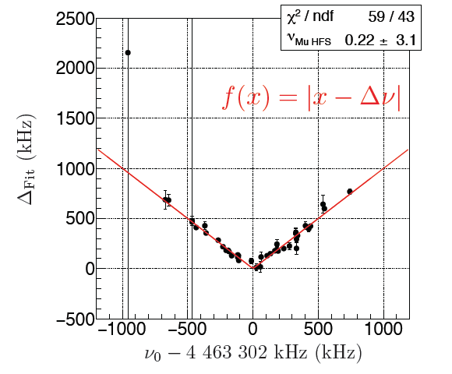
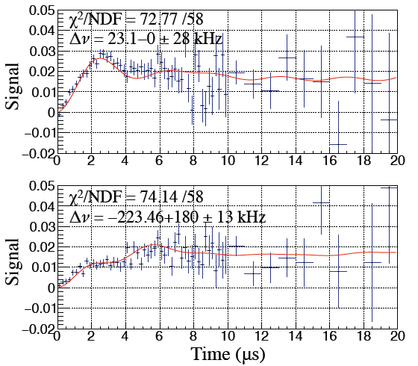
Results (2): Time Differential Method
– Silicon Strip Detector Data –
Nishimura thesis
Simulation:
Preliminary
0 ｋHz
Δν_{HFS} = 4 463 302.2 kHz
± 3.1 ± 0.2 kHz
100 ｋHz
Signal
200 ｋHz
Statistics:
less data (smaller detector area)
Systematics (main):
RF power drift (200 Hz)
gas pressure extrapolation (66 Hz) (only one pressure data !)
400 ｋHz
Time (μs)
Experiment (2017 June):
Possible advantages of this method:
Each detuning frequency data fitted individually.
Can determine Δν_{HFS} with only one frequency data.
Most sensitive detuning frequency is ~60 kHz.
Can improve statistical uncertainty by 3.2 times compared to the conventional method.
Can reduce systematics of RF power variation (free fitting parameter).
Need high-statistics data.
Notes:
Main systematics in these data: RF power drifft (200 Hz), gas pressure extrapolation (66 Hz) (only one pressure !)

Slide 25
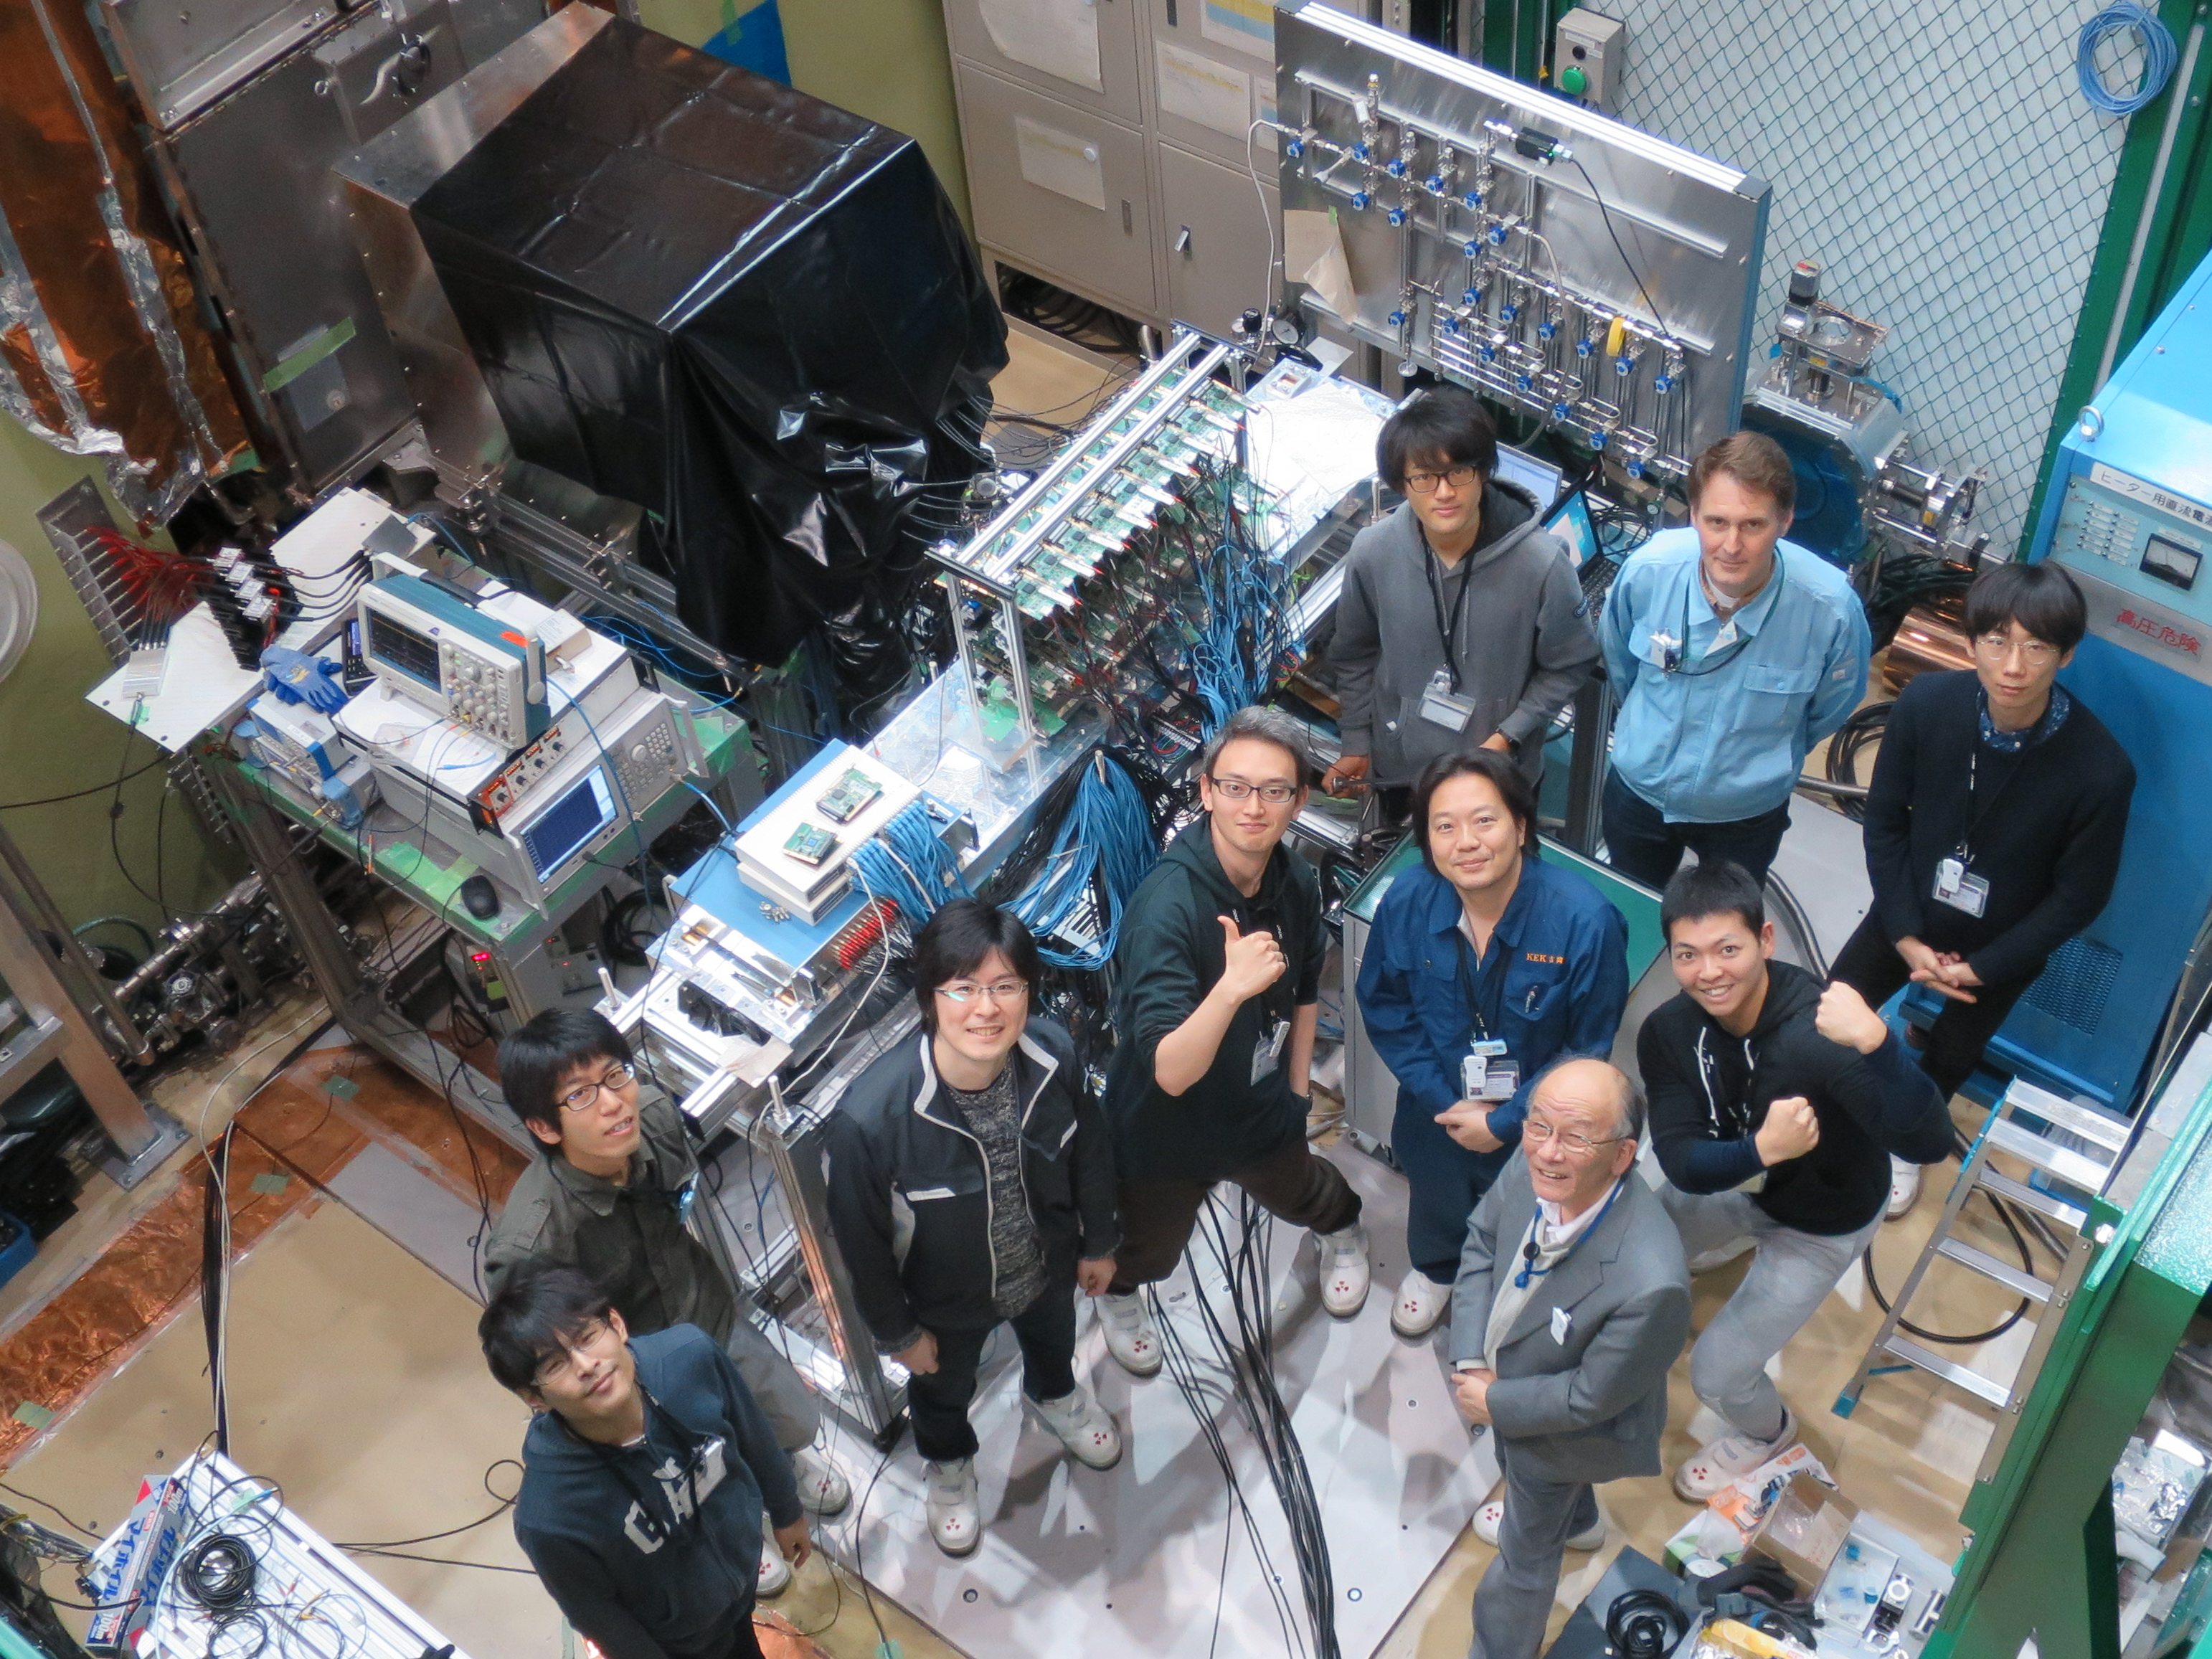
3rd MuSEUM Zero Field Experiment(2018)
2018 Mar 9th - 16th @ J-PARC D2-Line
Purpose : Measure the HFS value in vacuum by extrapolation
Measured with 0.4, 0.55 and 0.7 atm Kr gas pressure
HFS frequency
Pressure gauge precision
uncertainty by extrapolation
0.3
1.0
Kr Gas Pressure [atm]

Slide 26
3rd MuSEUM Zero Field Experiment(2018)
Ueno thesis
Kr gas pressure shift
  Resonance frequency is shifted due to collision of muonium & the Kr atom
  Gas pressure
  in the experiment in 2018
  0.3, 0.4, 1.0 atm
  Spin flip resonance signal was obtained for each gas pressure
0.4 atm
0.3 atm

Slide 27
3rd MuSEUM Zero Field Experiment(2018)
Ueno thesis
Kr gas pressure shift
  Resonance frequency is shifted due to collision of muonium & the Kr atom
  Gas pressure
  in the experiment in 2018
  0.3, 0.4,1.0 atm
  Spin flip resonance signal was obtained for each gas pressure
Recent analysis achieved 0.9kHz !
Preliminary

Slide 28
Systematic Uncertainty
Nishimura
Item | June 2017 | Prospects
Gas pressure fluctuation | 7 Hz | 7 Hz
Gas pressure extrapolation | 66 Hz | 7 Hz
Gas impurity | 0 Hz | 0 Hz
Static magnetic field | 0 Hz | 0 Hz
Microwave power drift （including muon beam profile） | 200 Hz | 1 Hz
Pileup event loss | 1 Hz | 1 Hz
Time Calibration | 1 Hz | 1 Hz
Total | 200 Hz | 10 Hz
  Systematic can be as small as the previous experiment

Slide 29
High field measurement at H Line
Two additional components are required.
・Permalloy magnetic shield
・RF cavity for ZF

Slide 30
Improvement of statistics
LAMPF Experiment
δ(Δν)
δ(μ_{μ}/μ_{p})
Statistics
10.9 ppb
Statistics
107 ppb
Kr Density/Pressure
4.4 ppb
Magnetic field
56 ppb
Systematics
Muon stopping
1.0 ppb
Muon stopping
13 ppb
RF power
0.96 ppb
Kr Density/Pressure
11 ppb
RF power
9.6 ppb
MuSEUM Improvements:
x200
J-PARC/MUSE: Pulsed 1x10⁸/s
H-Line total 2x10¹⁵
LAMPF: DC 10⁷/s
total 10¹³
Statistics:
Systematics:
magnetic field accuracy & uniformity
pressure dependence (longer cavity lower pressure)
muon stopping distribution measurement
RF power stability

Slide 31
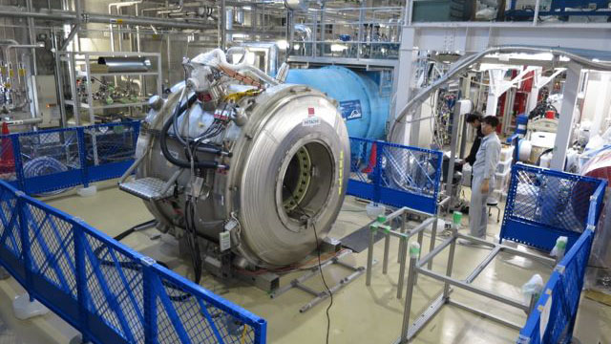
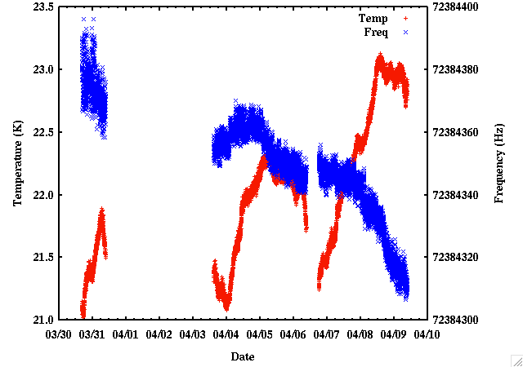
MRI Magnet for High-Field Experiment
Sasaki, Yamaguchi , T. Tanaka
Second-hand 2.9 T MRI magnet
CW-NMR Field Monitoring System
18 ppb→5.9 ppb (2017→2018)
Field Homogeneity (after shimming)
Long Term Stability
  Spheroid : r=100 mm, z=300 mm
1.4 ppm p-p→0.27 ppm p-p (2017→2018)
64 Hz / 9.7 days
0.003 ppm /h

Slide 32
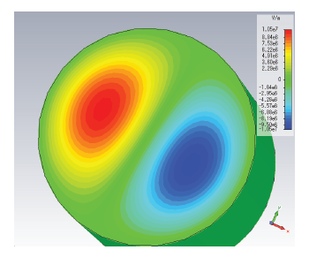
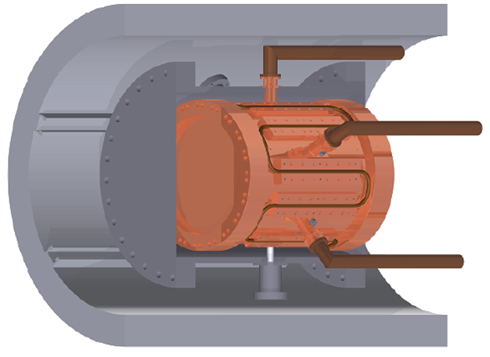
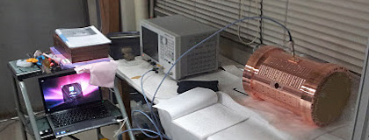
RF Cavity for High Field Experiment
K.S. Tanaka, Seo
MWS simulation
Tuning
Tuning
3D CAD
Test Cavity
Q Value
Modes | Q (measured) | Q (simulation)
TM110 | 11,300 | 29,700
TM210 | 8,050 | 28,900

Slide 33
Preliminary Systematic Error (HF)
 | Accuracy | ν₁₂ and ν₃₄ | δ(Δν_{HFS}) | δ(μ_{μ}/μ_{p})
Magnetic Field* | 30 ppb |  | 0.0 ppb | 15 ppb
RF power* | 0.2 % | 4 Hz | 0.8 ppb | 8 ppb
Kr gas temperature | 0.2 deg. | < 2 Hz | 0.4 ppb | 4 ppb
Kr gas pressure | 1 Pa | 1 Hz | 0.2 ppb | 0 ppb
H impurity | <50 ppm | 1 Hz | 0.5 ppb | 0 ppb
Quadratic dependence |  | 5 Hz | 1.0 ppb | 5 ppb
Muonium position (x,y) | 1 mm | 3 Hz | 0.6 ppb | 6 ppb
Muonium position (z) | 1 mm | < 1 Hz | 0.2 ppb | 2 ppb
Beamline | 10(e-4) | < 1 Hz | 0.2 ppb | 2 ppb
Detector pile-up | w/ absorber | 0.3 Hz | < 0.1 ppb | < 1 ppb
*should be re-estimated by latest progress and further MC simulation.
*should be re-estimated by latest progress of Time differential method.
Total systematic error of Δν_{HFS}~2 ppb, and μ_{μ}/μ_{p} ~ 20 ppb
Notes:
Our GOAL !!!

Slide 34
Plan for Next Five Years
FY2019 High Field Measurement at S line (1.7T)
50 days? More accuracy than LAMPF
FY2020 Zero Field Measurement H line
50 days？ Less than 12ppb uncertainty
FY2021 High Field Measurement at H line (1.7T)
50 days 50 times statics
FY2022 High Field Measurement at H line (1.13T)
50 days 50 times statics
（magic field, rectangular cavity）
FY2023 High Field Measurement at H line (3T)
50 days 50 times statics
（Better condition for μ_{μ} determination, rectangular cavity）

Slide 35
















MuSEUM Collaborators
(Muonium Spectroscopy Experiment Using Microwave)
KEK
M. Abe, Y. Fukao, Y. Ikedo, R. Kadono, N. Kawamura, A. Koda, T. Mibe, Y. Miyake,
K. Nagamine, S. Nishimura, T. Ogitsu, N. Saito, K. Sasaki, Y. Sato, K. Shimomura,
P. Strasser, A. Toyoda, K. Ueno, H. Yamaguchi, T. Yamazaki, A. Yamamoto, M. Yoshida
University of Tokyo
Y. Higashi, T. Higuchi, Y. Matsuda, T. Mizutani,
S. Seo, T. Tanaka, H. A. Torii, Y. Ueno, H. Yasuda
RIKEN
K. Ishida, M. Iwasaki,
O. Kamigaito, S. Kanda
Kyushu University
Nagoya University
K. Kawagoe, J. Tojo, T. Yoshioka, T. Suehara,
T. Yamanaka, M. Matama, T. Ito, Y. Tsutsumi
H. M. Shimizu,
M. Kitaguchi
S. Fukumura
Osaka University
ICU
Ibaraki University
M. Aoki, D. Tomono
K. Kubo
H. Iinuma
Univ. of Yamanashi
JAEA
Tohoku University
E. Torikai
T. U. Ito
K. S. Tanaka
U. of Massachusetts
Amherst
TRIUMF
Seoul National Univ.
K. M. Kojima
S. Choi
D. Kawall

Slide 36
Summary and Next Step
Zero-field measurements at existing beamline (D-Line) in progress for engineering run of the apparatus.
Muonium HFS resonance clearly observed !
Soon new world record at zero field ! (data analysis in progress)
Several Analysis Methods are in progress (Old Muonium, Time differential)
Time-Differential Method promising to improve statistics and reduce RF power fluctuation systematics.
Need improvement of the RF power stability (systematics) !!!
4 Doctor thesis 5 Master thesis
New Precise muonium HFS measurements at high magnetic field will be carried out in a few years (H-Line).
Present expected systematic error estimated as
HFS ~ 2 ppb (~8Hz)
Magnetic moment (μ_{μ}/μ_{p}) ~ 20 ppb
preliminary
Stay tuned !

Slide 37
Backup Slides

Slide 38
History of Mu HFS measurement
Magic Field
Spin Echo
Zero Field
World Record
Old Mu Method
High Field
World Record
K.S.Tanaka thesis

Slide 39
How to improve the accuracy of m_{µ}/m_{e}?
Comparison between theoretical and experimental value of Δν
＋higher order
where recoil term 800kHz (120ppm) and so on are included.
R∞＝10973731.568639(91)m⁻¹(0.09ppt)
（Ｃｓ atomic beam interferometory）
α⁻¹=137.03599958(52) (3.8ppb)
（from electron g-2）
m_{μ}/m_{e}=206.7682826(46) (22ppb), μ_{μ}/μ_{p}=3.183345396(94) (24ppb)
This value is used for the determination of g-2.

Slide 40
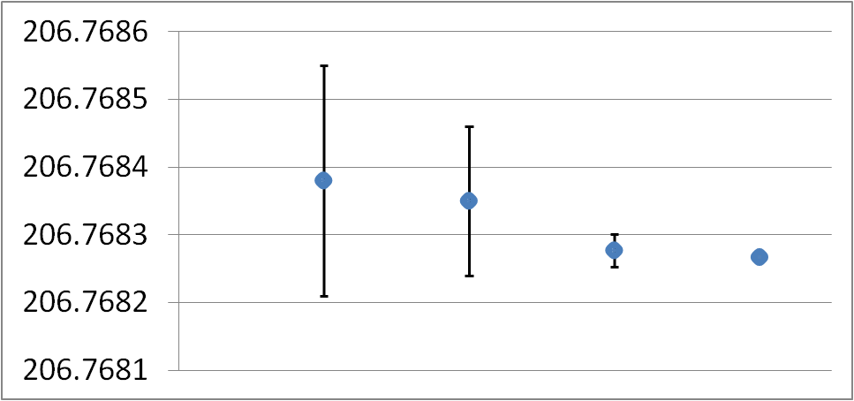
Determination of the Muon Mass
m_{μ}/m_{e}
μ_{μ}/μ_{p}, a_{μ}, μ_{p}/μ_{B}
206.768 282 6 (46)
[22 ppb]
μSR
in Br₂
MuHFS
Breit-Rabi
MuHFS
Δν(theory)
Mu 1S-2S
Muon mass (CODATA2016) determined by MuHFS (LAMPF 1999)

Slide 41
From K. Jungmann

Slide 42
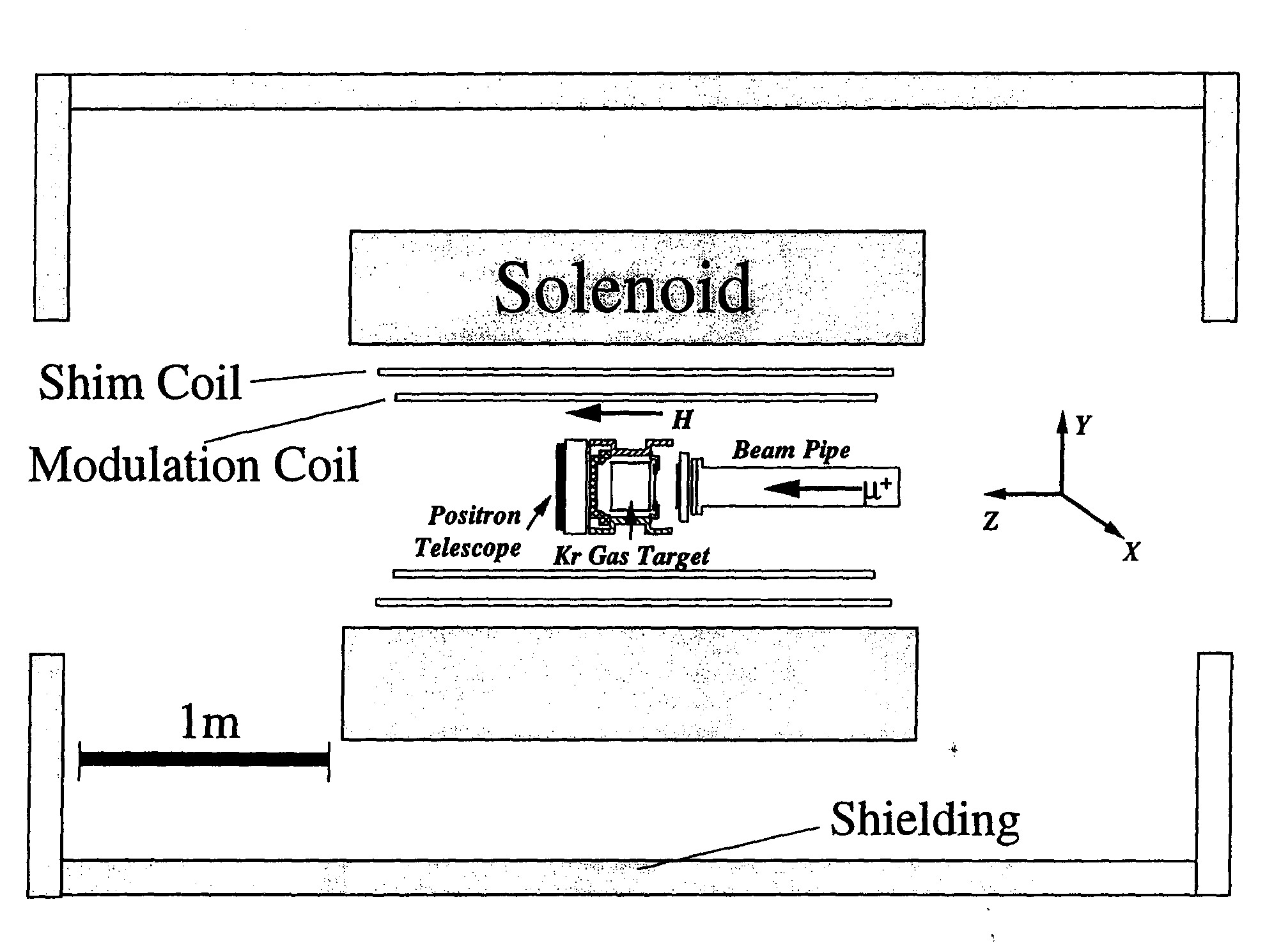
Los Alamos Experiment

Slide 43
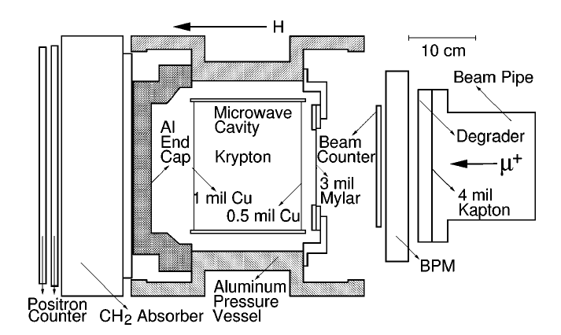
Los Alamos Experiment
W. Liu et al., Phys. Rev. Lett. 82, 711 (1999).

Slide 44
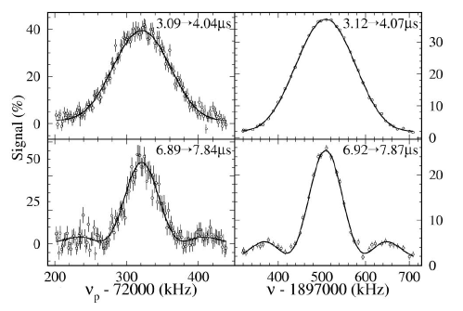

Old Muonium Method
Simulation
Measurement
Delay time gate shows
more sharp resonance !

Slide 45
Precision of the hyperfine structure (HFS, Δν):
Hydrogen-like atom | Experiment | Theory | (Δν_{theo} − Δν_{exp})/Δν_{exp}
Hydrogen | 0.2 ppt | 1.2 ppm | (-0.45 ± 1.2) ppm
Positronium | 3.3 ppm | 2.0 ppm | (15 ± 4) ppm
Muonium (Zero-Field) | 310 ppb | 61 ppb | (150 ± 320) ppb
Muonium (High-Field) | 12 ppb | 61 ppb | (23 ± 62) ppb

Slide 46
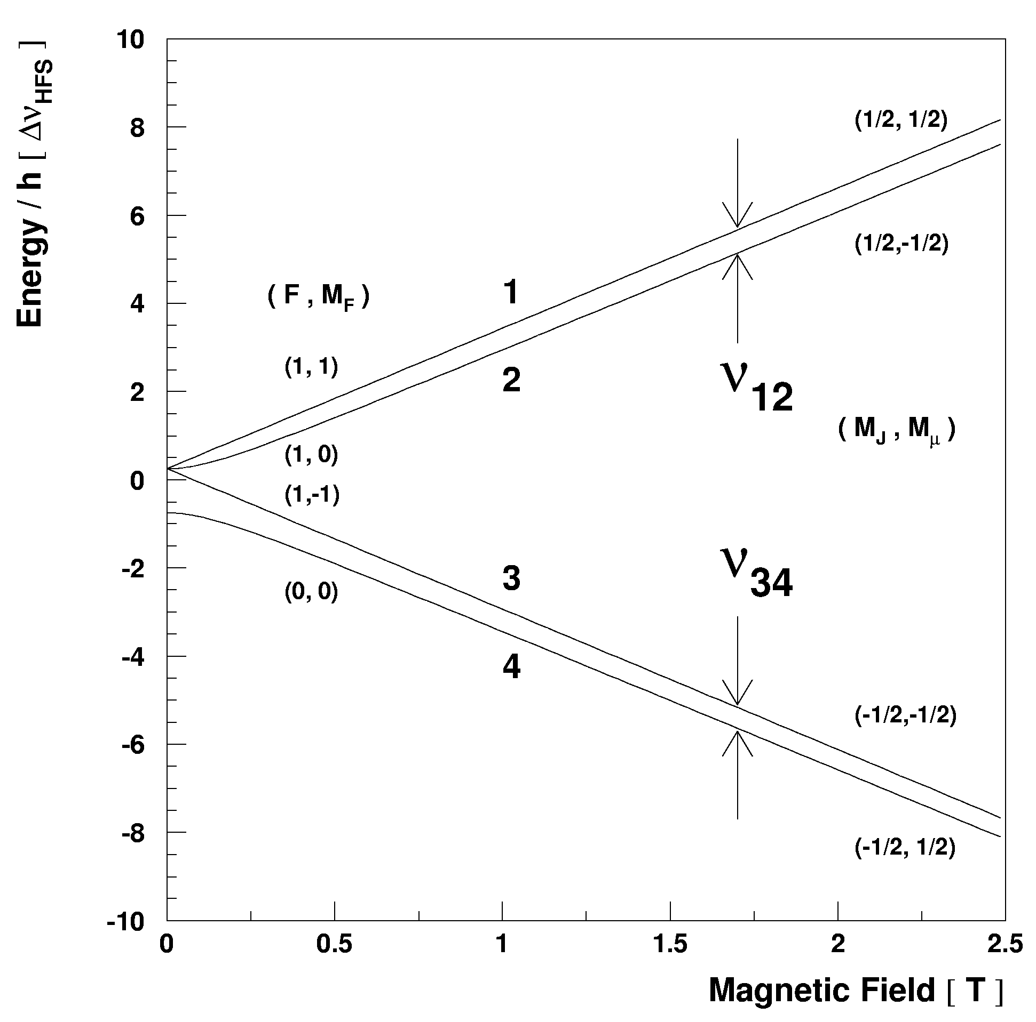
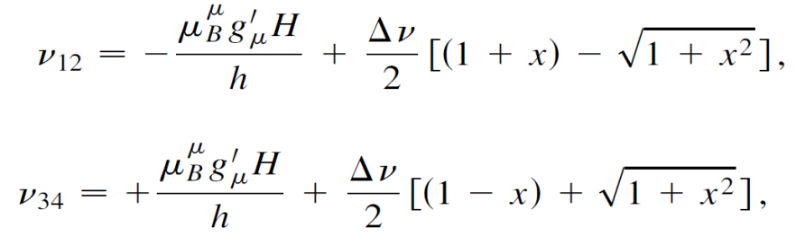
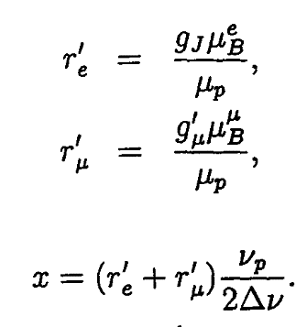
Breit Rabi Diagram
μ
e

Slide 47
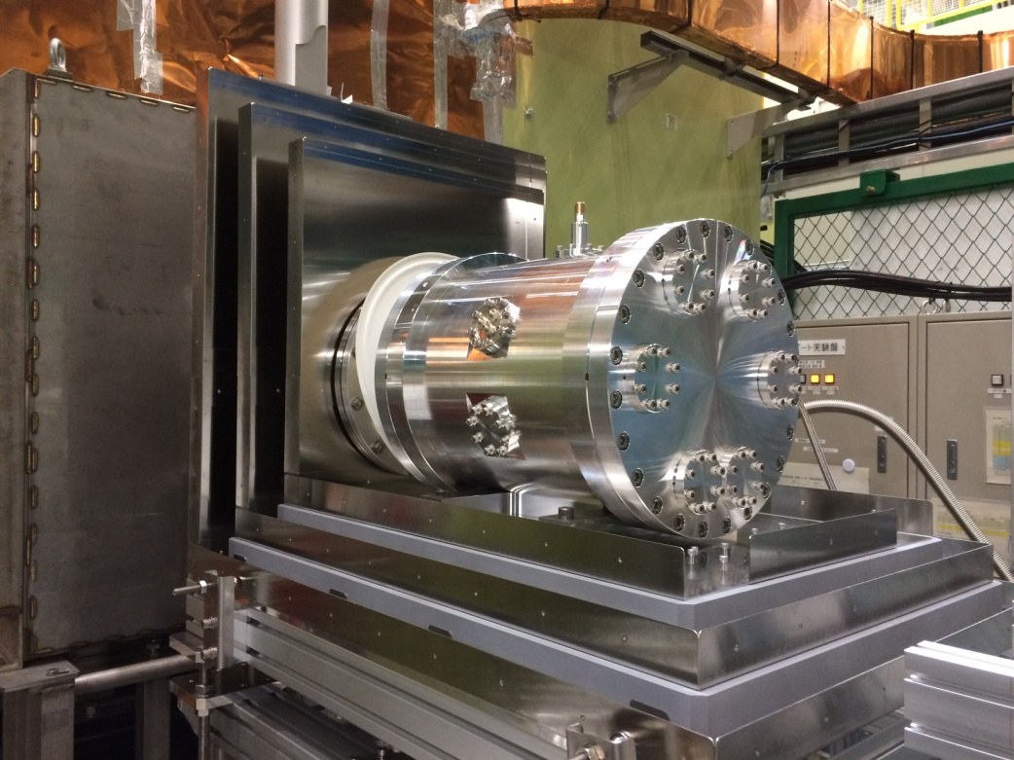
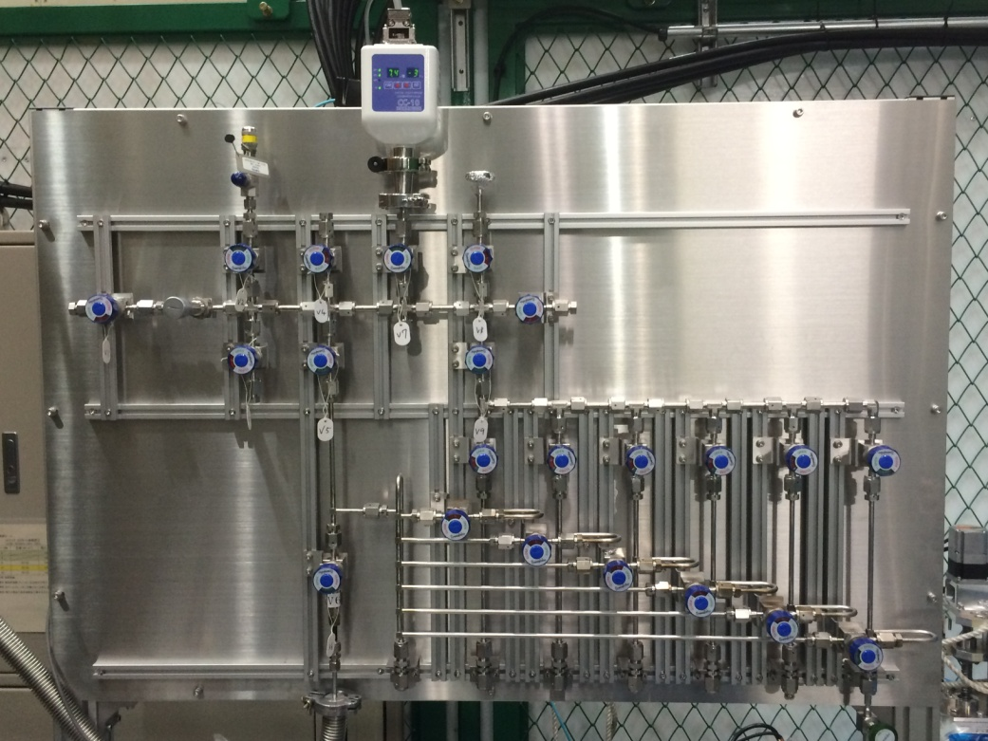
Gas Chamber and Gas Handling
425 mm length, 280 mm diameter, 100 μm Al beam window
Gas pressure is monitored by a capacitance gauge
Gas purity is measured by Q-Mass spectrometer

Slide 48
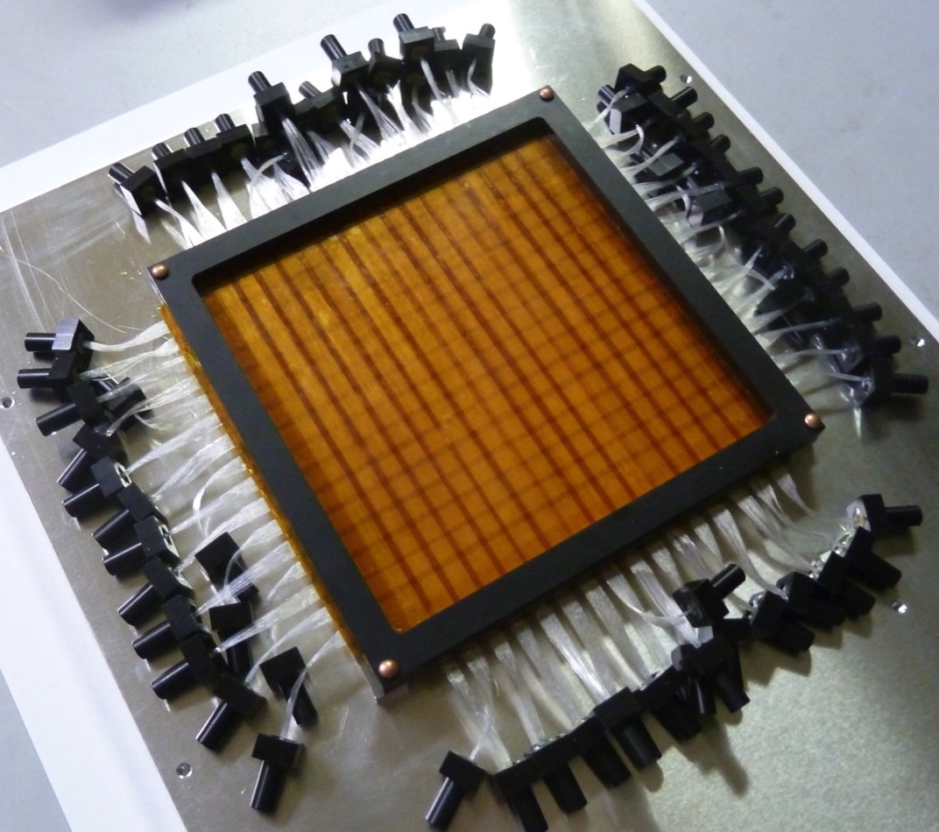



Muon Beam Profile Monitor
Kanda, Ueno, Toyoda
Two layers of 100-µm fiber hodoscope (2x16ch).
3 x 3mm² active area MPPC with 15-µm pixel pitch.
EASIROC readout
100 mm
σ=20.8±1.5 mm
Horizontal position (mm)
100 μm
σ=26.5±2.8 mm
Vertical position (mm)
Notes:
MPPC: multi pixel photon counter

Slide 49





Offline 3D Beam Profile Monitor
Ueno, Kanda, Toyoda, Ito
Muon beam width
Muon beam center
± 2 mm
± 2 mm
Actuator
Screw
Kr Gas
Chamber
CCD
Scintillator
Stage
Linear
Actuator

Slide 50




Positron Counter (1):
Scintillation Position
Detector
Kanda, Kojima
MPPC (Multi-Pixel Photon Counter)
1.3 mm x 1.3 mm active area
(Hamamatsu)
240 mm
10 mm
3 mm
576 ch/layer x 2 layers
Plastic scintillator + MPPC + Kaliope readout circuit
32ch MPPC input
FPGA
Ethernet
Trigger input
Segmented scintillation detector
Scintillation counter with SiPM readout
Unit cell: 10 mm × 10 mm × 3 mm^{t}
Area: 240 mm × 240 mm
24x24 segments x 2 layers = 1152 ch
High-rate capability required
Pileup loss at 3 MHz/ch ~ 2%
ASIC
PROM
+5V(A), +1.8V

Slide 51
3rd MuSEUM Zero Field Experiment
Nishimura
Kr gas pressure shift
  Resonance frequency is shifted due to collision of muonium & the Kr atom
  Gas pressure
  in the experiment in 2018
  | 0.3, 0.4, 0.7 atm
  Spin flip resonance signal was obtained for each gas pressure
Analysis is ongoing
Δ=100 kHz
0.7 atm
Preliminary
Time (μs)

Slide 52


RF Cavity & Gas Chamber
Gas Handling System
Pressure: 0.5 – 1.5 atm
Readout precision: several ppm
  (crystal gauge: 0.008% of full range)
Contamination: below 1ppm.
gas sampling before, during and after the experiment (several weeks).
Notes:
- pressure range 0.5 - 1.5 atm; measurement precision: several ppm (crystal pressure gauge: 0.008% of full range)
- contamination: under 1 ppm (oxygen depolarize muonium)
- gas sampling before, during and after the experiment (several weeks of experiment).

Slide 53

Systematic Error
Tanaka, Kanda, Ishida
Notes:
Scheme of simulation tool: Evaluation of uncertainty by resonance-line simulations

Slide 54
Mu Fraction

Slide 55
Old Muonium in ZF field

Slide 56
Time Integral Method
Signal of all positrons
  Δω / Detuning angular frequency
  |b| / Microwave magnetic
  field intensity
  λ / Spin relaxation rate
  γ / Muon decay rate
  P / Muon spin polarization
Resonance spectrum
Resonance spectrum｜Lorentzian function
  Peak of Lorentzian is equal to
  Mu HFS frequency
  Mu HFS is determined by multiple frequency data
  Width and height of spectrum
  is changed by microwave power

Slide 57
Time Differential Method
Time dependence of signal
Detuning frequency
dependence
Microwave power
dependence
Time spectrum｜
Summation of cos
  contains more information
    Mu HFS frequency
    Microwave power
    Spin relaxation time
  can determine Mu HFS
  by only one
  detuning frequency data
Notes:
変動に強いことを言う

Slide 58
Time Integral Signal
(Simulation)
Simulation setup
  Measurement point |
  10 points
  7.8×10¹⁰ muon/point
Fitting function for Time integral method
  Summation of Lorentzian function considering microwave power distribution
  felt by muonium
Simulation
Fitting

Slide 59
Time Differential Signal
（Simulation）
  Time differential signal | Same statistics as time integral method
  Time spectrum are changed by the detuning frequency
Fitting function
  Summation of cosine considering microwave power distribution felt by muonium
0 ｋHz
100 ｋHz
Signal
200 ｋHz
400 ｋHz
Time (μs)
Notes:
HFS transition frequency can be determined by only one microwave frequency

Slide 60
Time Differential Signal
(Simulation)
時間微分信号
  積分信号の各周波数点に相当する統計量
  測定周波数による
  時間スペクトルの
  変化を確認
Fitting関数
  マイクロ波強度分布を
  考慮したcos関数の
  重ね合わせ
Mu HFS is obtained by only one
detuning frequency data
Simulation
0 ｋHz
200 ｋHz
100 ｋHz
Signal
400 ｋHz
Time (μs)
Notes:
変動に強い

Slide 61
Multiple Time Differential Data
Mu HFS is determined by multiple results of time differential method
Simulation
Time Integral Method
｜0.41 kHz
Time Differential Method
｜0.34 kHz
15% improvement

Slide 62
More Efficient Measurement
Concentrating one frequency is the most efficient method
χ² | 88.0/95
Δ | 59.9±0.13 kHz
Time Integral Method
｜0.41 kHz
Time Differential Method
｜0.34 kHz
Time differential Method
(Concentrate on Δ=60 kHz)
｜0.13 kHz
The most sensitive
detuning frequency
3.2 times improvement compared
to the time integral method
Time (μs)

Slide 63
Analysis by the Time Differential Method (2017)
Time differential muon spin resonance signal was observed
  Detuning frequency dependence is similar to
  the simulation results
  Same fitting function as
  the simulation
  Mu HFS was obtained from
  each detuning frequency data

Slide 64
Mu HFS Measurement (2017)
Mu HFS was obtained from multiple data
  Obtained Δν_{Mu}
  It is consistent to the previous experiments
  4 463 302.2 ± 3.1 kHz
Previous experiment
ZF | 4 463 302.2(14) kHz
HF| 4 463 302.765(50)(17) kHz
Phys. Lett. B59 (1975) 397-400 ， Phys. Rev. Lett. 82 (1999) 711-714

