Slide 1
BINP electron-positron facilities
Dmitry Shwartz
on behalf of
IC, VEPP-4M, VEPP-2000 teams
Feb 25, 2019
PhiPsi’19

Slide 2
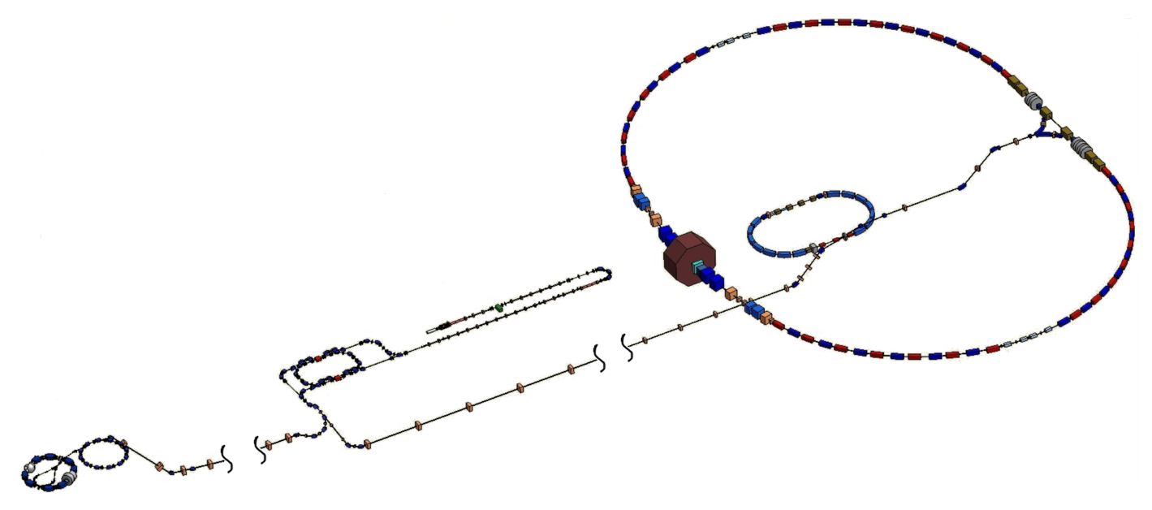
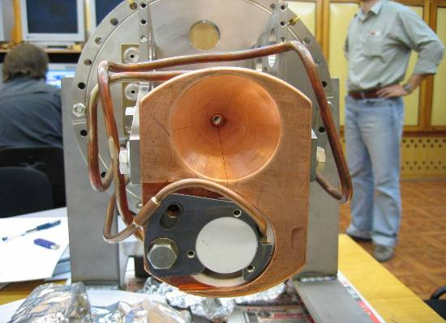
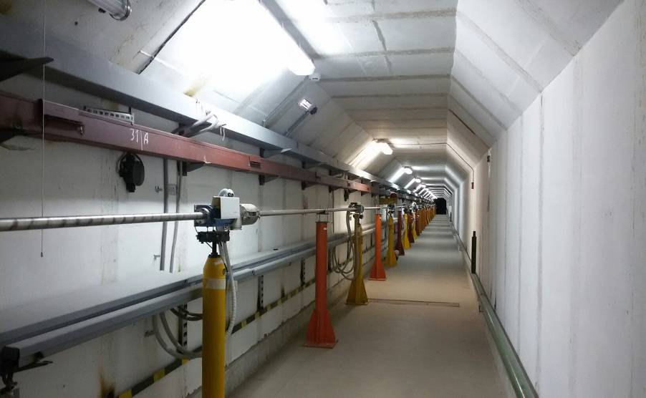
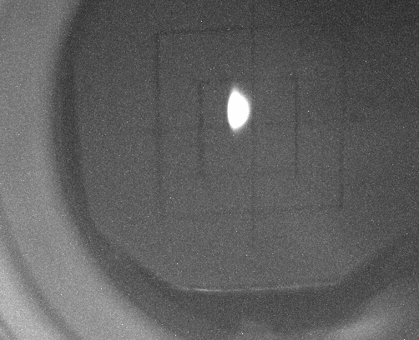
BINP accelerator complex layout
Tour over BINP facilities today @ 18:00
IC Parameters (2016)
Beam Energy: 395 MeV
Storage rate e⁻ @ 12.5 Hz: 4.0·10¹⁰/s (70 mA/s)
Storage rate e⁺ @ 12.5 Hz: 4.0·10⁹/s (7 mA/s)
VEPP-4M
VEPP-3
Conversion System
Linacs
Beamline to VEPP-2000
250 m
Damping
Ring
Beam @ VEPP-3
BEP
VEPP-2000
Injection Complex and beam transfer lines
Beamline to VEPP-4M
130 m

Slide 3
VEPP-4M complex
e⁺e– HEP at VEPP-4M with KEDR detector
SR at VEPP-3 (2 GeV)
SR at VEPP-4M (2÷4 GeV)
Nuclear physics at VEPP-3 with Deuteron facility
Test Beam Facility at VEPP-4M
Accelerator physics activity
Energy | 0.925 ÷ 4.75 (5.3)
Circumference | 366 |  |  |  | m
N of bunches | 2e⁺ × 2e– (16e–)
Harmonic number | 222
Betatron tunes, h/v | 8.54/7.57
Coupling | 0.05%
Bunch length | 5 |  |  |  | cm
Beam Energy | 1.5 | 1.9 | 4.7 | 5.2 | GeV
Emittance | 16 | 25 | 167 | 200 | nm·rad
Energy Spread | 2.5 | 3.0 | 7.8 | 8.5 | ·10⁻⁴
Bunch Current | 1.6 | 3.5 | 25 | 25 | mA
Luminosity | 0.9 | 3.3 | 44 | 25 | 10³⁰ cm⁻²·s⁻¹

Slide 4
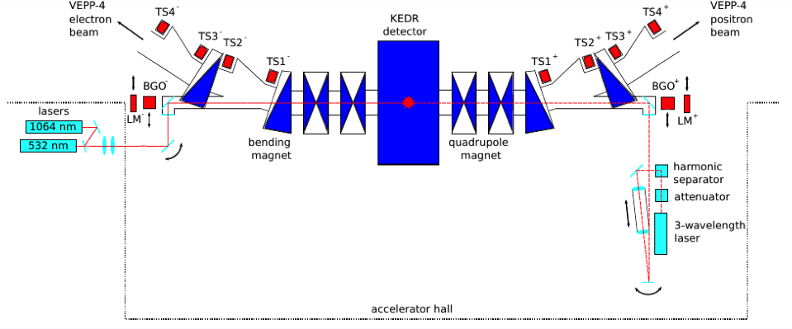
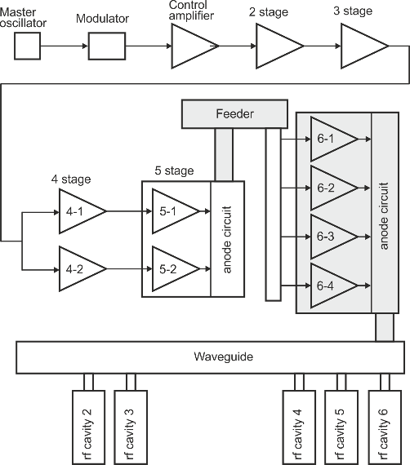
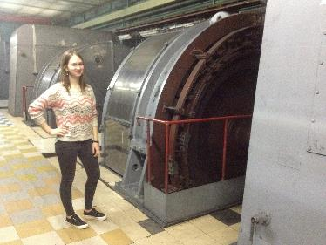
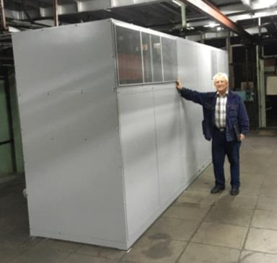
HEP @ VEPP-4M with KEDR
Universal magnetic detector KEDR
Electron-positron tagging system
Wide energy range 0.9÷6 GeV
Energy spread control
Precision beam energy calibration by resonance depolarization
First collider with beam energy monitoring by Compton backscattering
Dedicated talks by T.Kharlamova, K.Todyshev
2001-2017 low energy luminosity run 2x(0.9÷1.9) GeV
  J/ψ, ψ’ , ψ”, ψ(3770) meson masses
  τ lepton mass
  D⁰ mesons masses
  D± mesons masses
  Search for narrow resonances 1.85÷3.1 GeV
  R-scan 1.85÷3.1 GeV
  Ruds- and R- scan 3.12÷3.72 GeV
  J/ψ → γη_{c}
  ψ-mesons, η_{c}, … parameters
High energy luminosity run 2x(1.9÷Max energy) GeV
R scan 2x(2.3÷3.5) GeV (~ 10 bp⁻¹)
ϒ-mesons study (~ 50 pb⁻¹)
gamma-gamma physics (~ 200 pb⁻¹)
RF system Upgrade
Power Supplies upgrade
4 x GU-101A tetrode
2 MV → 4 MV
200 kW → 400 kW
100 mA @ 4.75 GeV
VEPP-3: ±15 kA ±40 V 600 kW
VEPP-4M: +7.5 kA +70 V 525 kW 4.75 → 5.2 (6.0) GeV

Slide 5
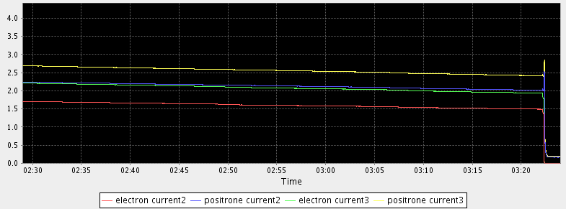
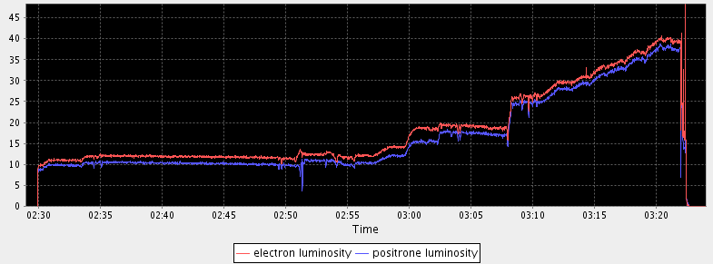
Run 2017/18 highlights
In 2017 hadron cross section measurement from 2.3 to 3.5 GeV in two runs was started
VEPP4-4M
SR runs
shutdown
KEDR runs
At present first run has been finished ~ 6 pb^{–1}
KEDR data
Bunches currents
Luminosity
First luminosity @ ϒ(1S)

Slide 6
Deuteron @ VEPP-3
Tensor-polarized deuteron photodisintegration at the VEPP-3 storage ring
The two-body deuteron photodisintegration is one of the most studied process in nuclear physics. Tensor analyzing power T20 reaction will be measured in an unexplored region of the photon energy up to 1.5 GeV.
and SR program
new (since 2017)
SR @ VEPP-3 – 1.2 or 2.0 GeV with 2 T shifter
SR @ VEPP-4M – 1.9 or 4.5 GeV with new 9-poles hybrid 2 T wiggler
VEPP-3
LIGA-technology and X-ray lithography.
Fast dynamic process.
Precise diffraction and anomalous scattering.
X-ray fluorescence analysis.
High pressure diffraction.
X-ray microscopy and micro-tomography.
Time resolved diffraction.
Time resolved luminescence.
Precise diffraction.
old
VEPP-4M
Metrology experiments.
Phase contrast microscopy, micro-tomography and hard X ray fluorescence.
Nanosecond spectroscopy of fast processes.
Material study under extremal conditions
Material study for thermonuclear applications

Slide 7
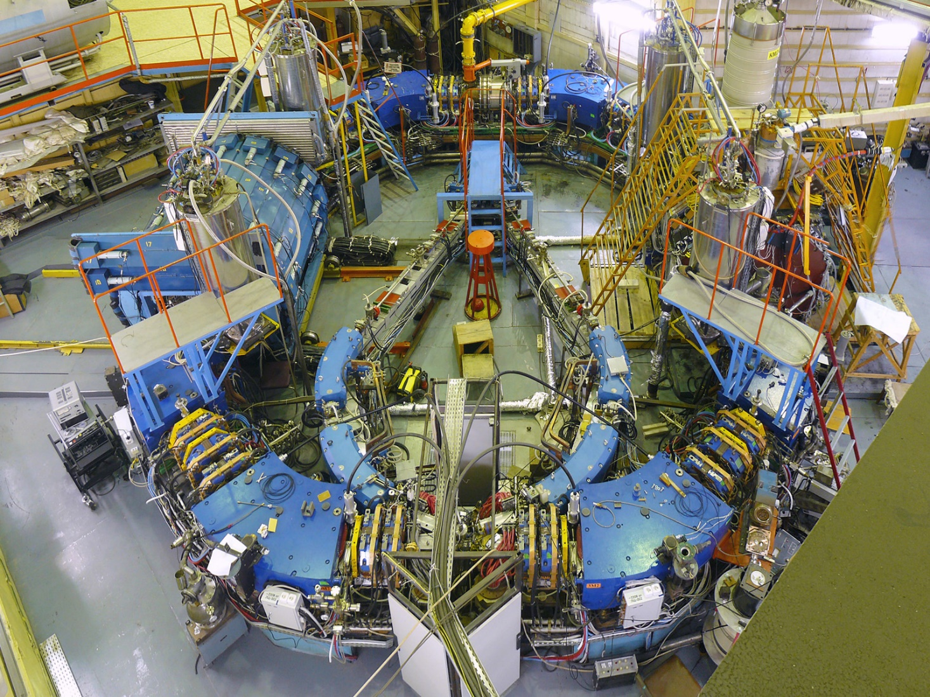
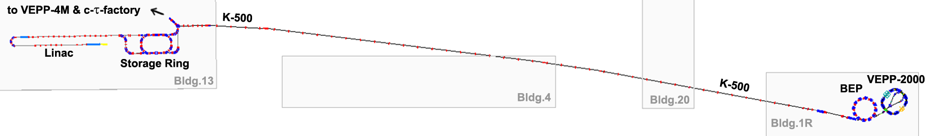
VEPP-2000 overview
Design parameters @ 1 GeV
Circumference | 24.388 m
Beam energy | 150 ÷ 1000 MeV
N of bunches | 1×1
N of particles | 1×10¹¹
Betatron tunes | 4.14 / 2.14
Beta* | 8.5 cm
BB parameter | 0.1
Luminosity | 1×10³² cm⁻²s⁻¹
SND
CMD-3
Round beams concept
Single-ring head-on collisions
13 T solenoids for FF
2.4 NC dipoles @ 1 GeV
CBS for energy control
Operating with IC#VEPP-5 since 2016

Slide 8
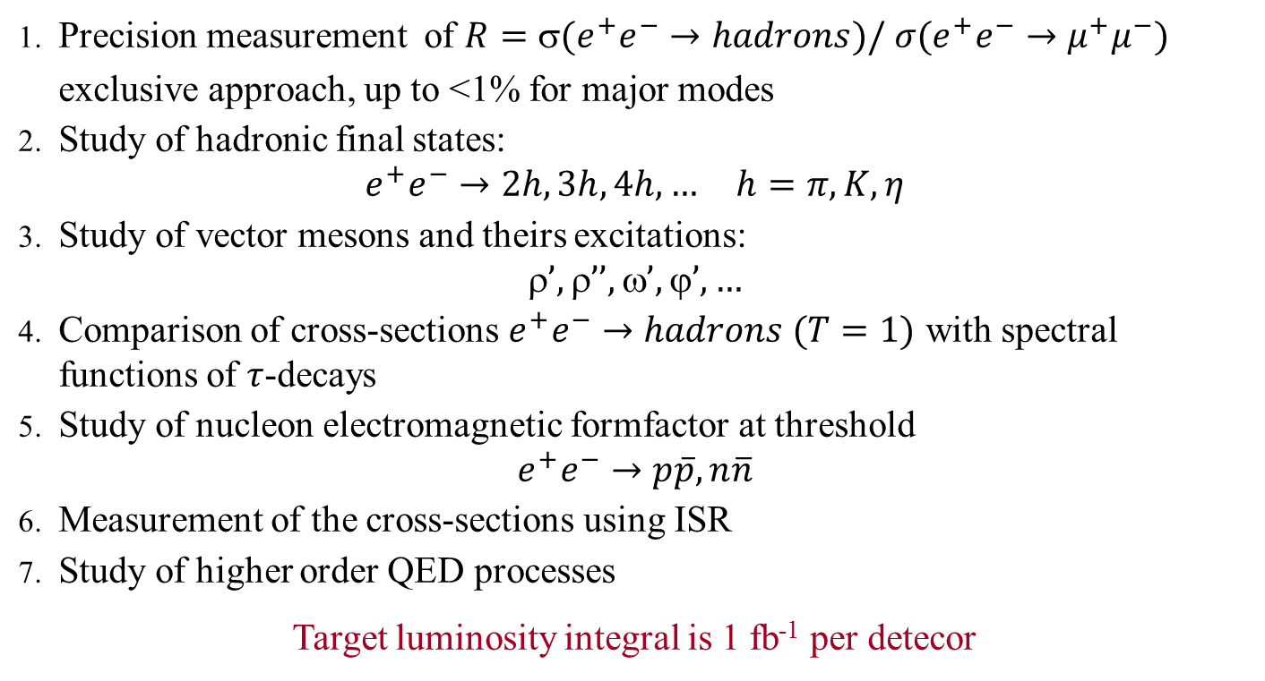
Experimental program
Dedicated talks by M.Achasov, F.Ignatov, E.Solodov
Precision measurement of $R=(e^{+}e^{−}→hadrons)/ σ(e^{+}e^{−}→μ^{+}μ^{−})$
    exclusive approach, up to <1% for major modes
Study of hadronic final states:
    $$e^{+}e^{−}→2h, 3h, 4h,… h=π,K,η$$
Study of vector mesons and theirs excitations:
  $$’, ’’, ’, ’,…$$
Comparison of cross-sections $e^{+}e^{−}→hadrons (T=1)$ with spectral functions of $τ$-decays
Study of nucleon electromagnetic formfactor at threshold
  $$e^{+}e^{−}→p\overline{p}, n\overline{n}$$
Measurement of the cross-sections using ISR
Study of higher order QED processes
Target luminosity integral is 1 fb⁻¹ per detecor

Slide 9
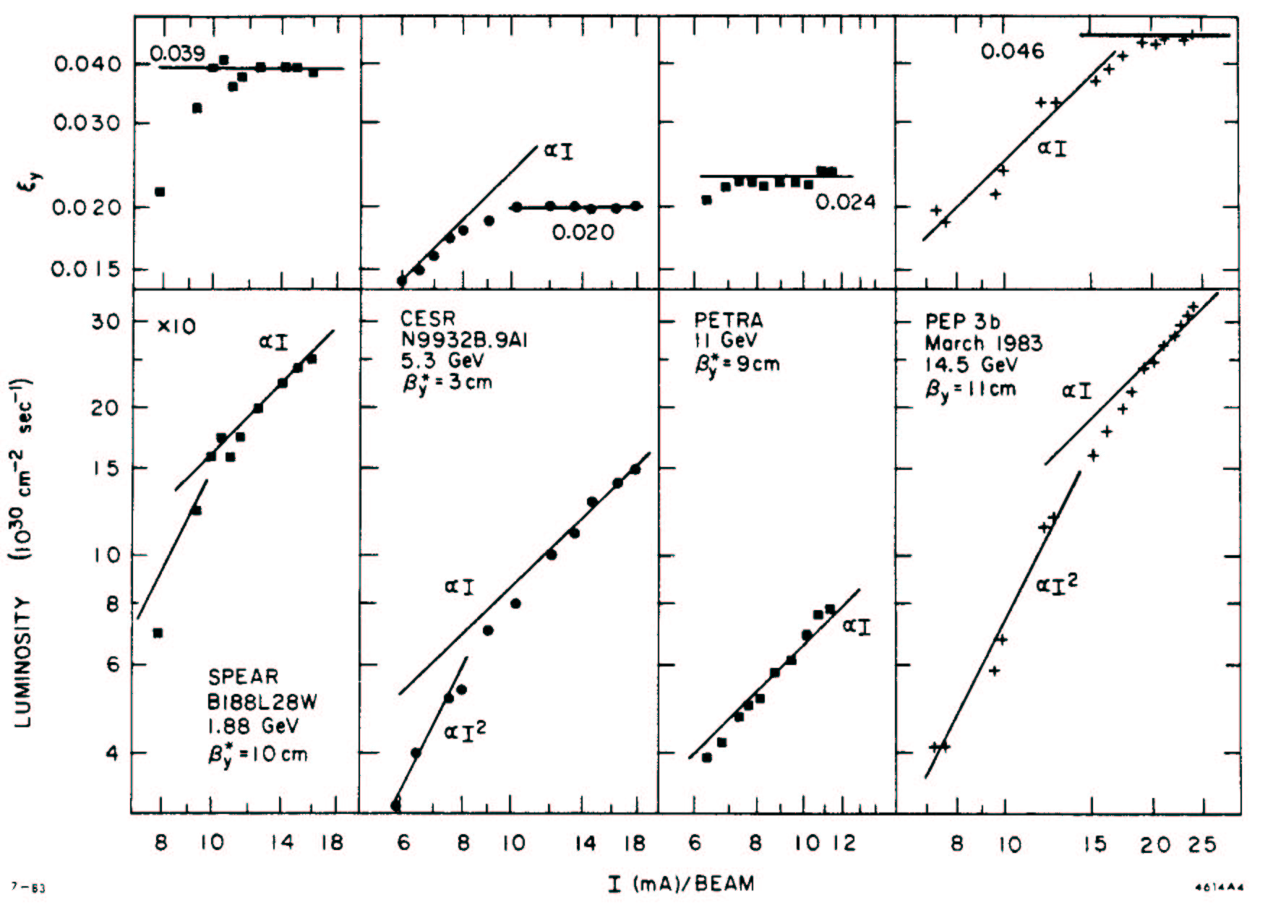
Beam-beam limit @ lepton colliders
Beam-beam parameter saturation,
emittance (and beam size) growth
Final limit:
emittance blowup,
lifetime reduction,
flip-flop effect
J.Seeman (1983)

Slide 10
The concept of Round Colliding Beams
Axial symmetry of counter beam force + X-Y symmetry of transfer matrix IP2IP
Additional integral of motion (angular momentum M_{z} = x′y - xy′)
Particle dynamics remains nonlinear, but becomes 1D
Lattice requirements:
Head-on collisions!
Small and equal β-functions at IP:
Equal beam emittances:
Equal fractional parts of betatron tunes:
Round beam
M_{x} = M_{y}
F.M. Izrailev, G.M. Tumaikin, I.B. Vasserman. Preprint INP 79-74, Novosibirsk,(1979).
L.M. Barkov, et. al, Proc. HEACC’89, Tsukuba, Japan, p.1385.
S. Krishnagopal, R. Siemann, Proc. PAC’89, Chicago, p.836.
V.V. Danilov et al., EPAC’96, Barcelona, p.1149.
S. Henderson, et al., Proc. PAC’99, New York, p.410.

Slide 11
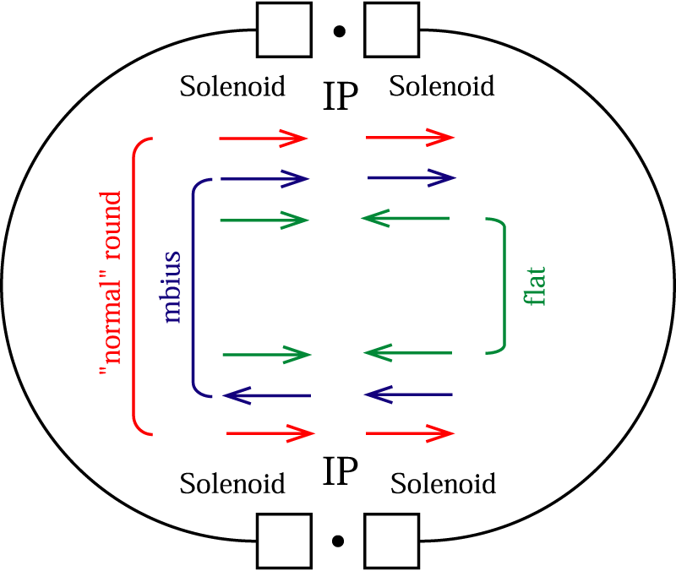
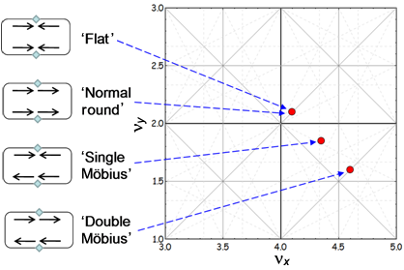
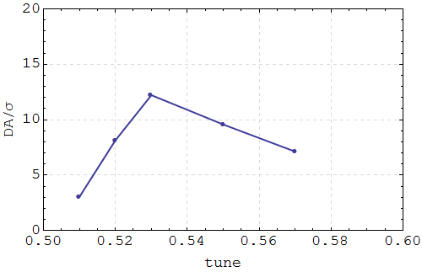
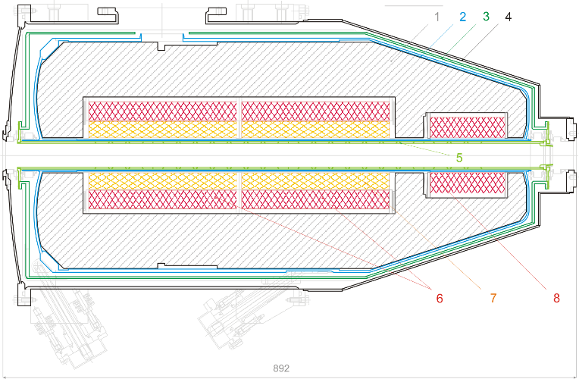
Round Beams Options @ VEPP-2000
Round beam due to coupling resonance?
The simplest practical solution!
Solenoid main coils
Both simulations and experimental tests showed insufficient dynamic aperture for regular work in circular modes options.
Below 600 MeV “short” FF solenoids are available.
Flat to Round/Mobius or Long to Short change needs polarity switch in solenoids, realignment and new orbit correction.

Slide 12
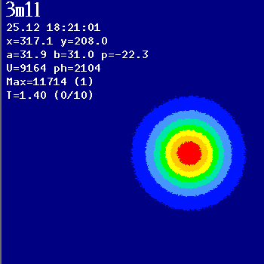
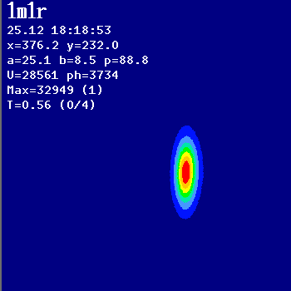
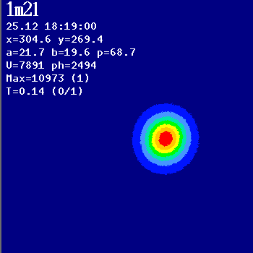
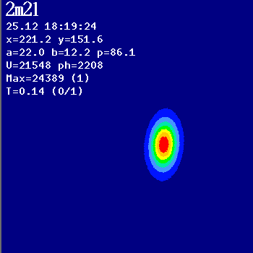
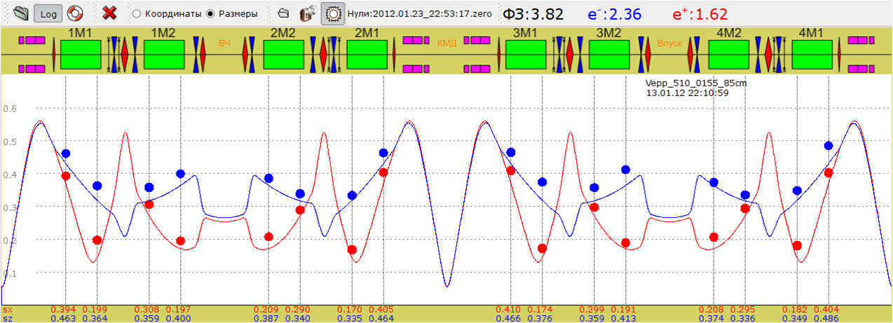
Beam size measurement via SR @ CCDs

Slide 13
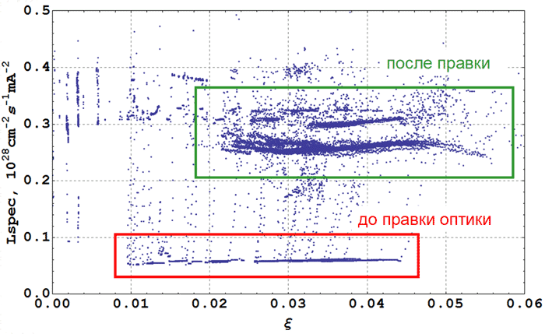
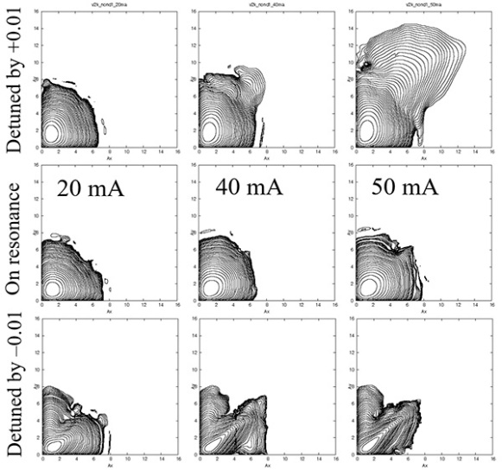
Machine tuning
Orbit correction & minimization of steerers currents using ORM techniques
Lattice correction via ORM SVD analysis (δβ < 5%)
Betatron coupling correction in arcs (δν_{min} ~ 0.001)
Working point fine tuning & small shift below coupling diagonal
Sextupoles fine tuning (chromaticity slightly undercompensated)
Specific luminosity & linear lattice correction
After correction
Before correction
Lifetrac by D.Shatilov, 2008

Slide 14
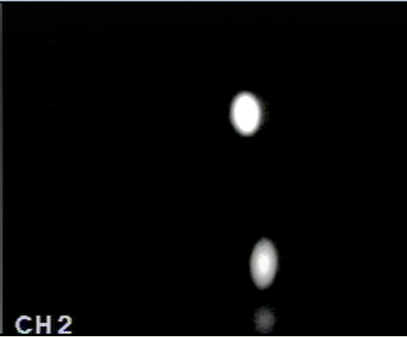
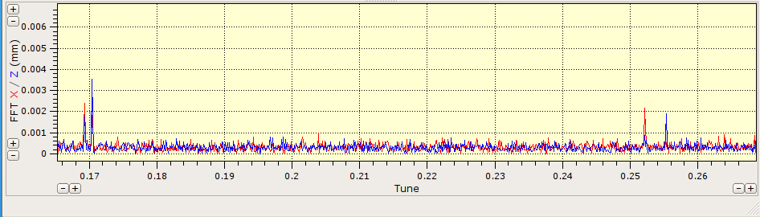
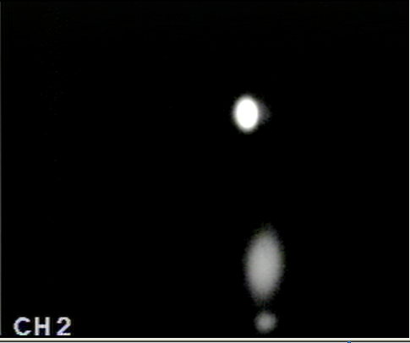
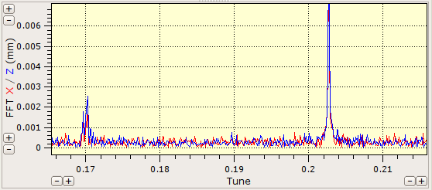
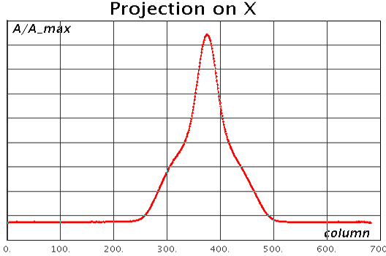
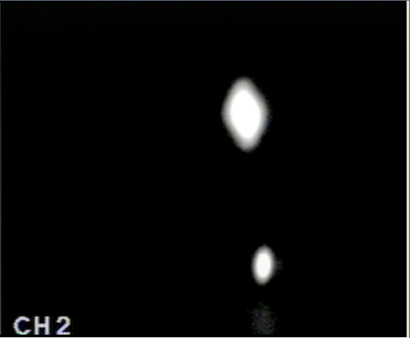
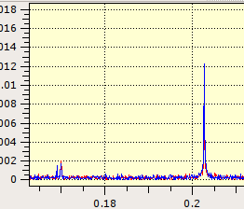
“Flip-flop” effect
TV
σ
π
e⁺
Pickup spectrum of the coherent oscillations
regular
e⁻
0.17
0.2
0.25
E = 240 MeV,
I_{beam} ~ 5×5 mA
blown-up e−
0.17
0.2
blown-up e+
Coherent beam-beam π-mode interaction with machine nonlinear resonances?
0.17
0.2

Slide 15
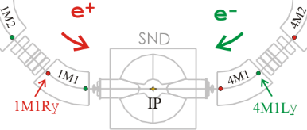
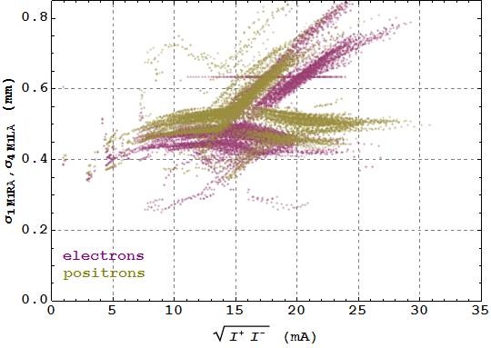
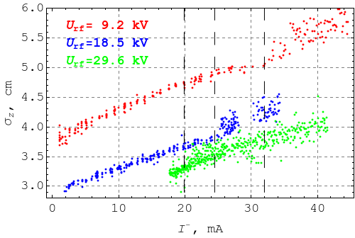
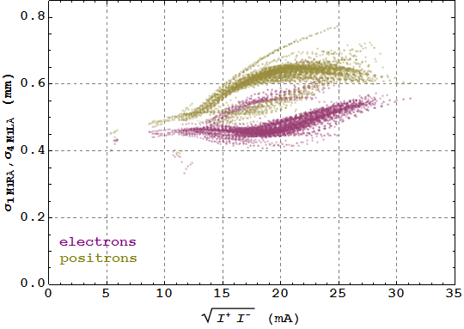
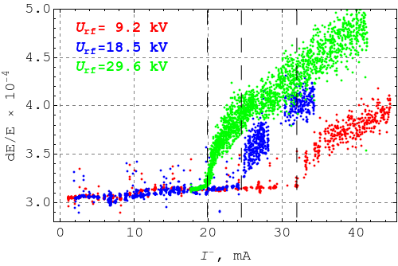
Flip-flop suppression with long bunch
Е= 392.5 МэВ
U_{RF}= 35 kV
Bunch lengthening & mw instability
Single bunch length measurement with phi-dissector as a function of single beam current for different RF voltage @ 478 MeV.
Energy spread dependence, restored from beam transverse profile measurements.
U_{RF}= 17 kV

Slide 16
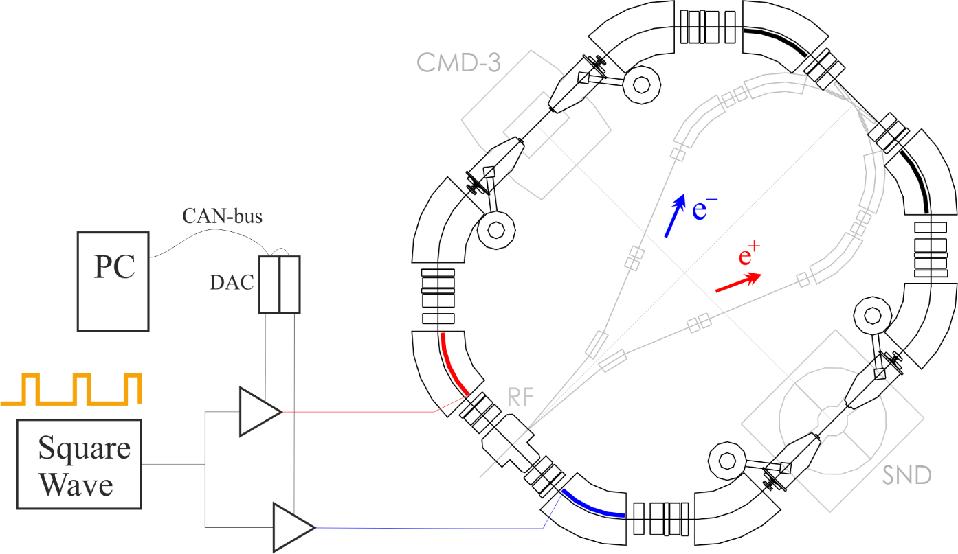
BeamShaker (Run 2017/18)
Idea (I.Koop): kicked bunch oscillations decoheres very fast in the presence of counter beam’s strongly nonlinear field. Weak and frequent kicks should effectively increase the emittance, similarly to quantum excitation by wiggler.
At low energies emittance growth is available up to aperture restriction. That allow with the same beam-beam parameter (particles density) increase the beam current and luminosity.
Typical values:
50-100 V, 300 ns, 50 μs
(T_{rev} = 81.4 ns)
Experimentally: permanent excitation of “strong” beam size prevent it from shrinkage to natural value during injection cycle of “weak” beam, or whatsoever. Very effective suppression of flip-flop meta-stable states.
In addition large emittance results in a lifetime enhancement.

Slide 17
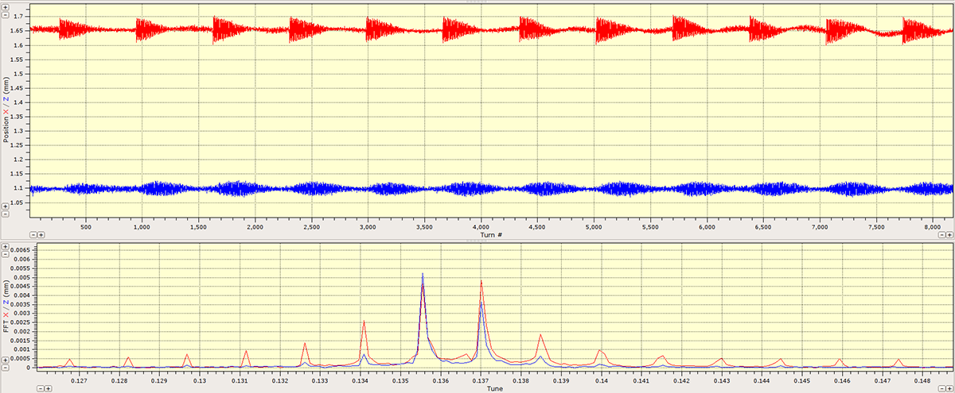
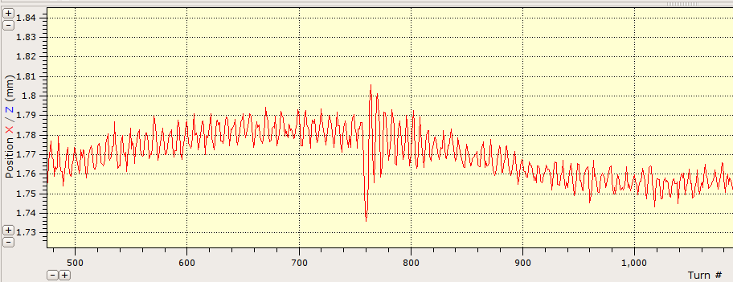
Shaking @ pickup
Pickup signal, without counter beam, 360 MeV
Periodically excited oscillations gives the line spectrum
Pickup signal, with strong counter beam, 274 MeV
@ 274 MeV:
σ_{x} = 250 μm @ pickup
τ_{damp} = 130 ms = 1.6×10⁶ turns
70 μm
100 turns

Slide 18
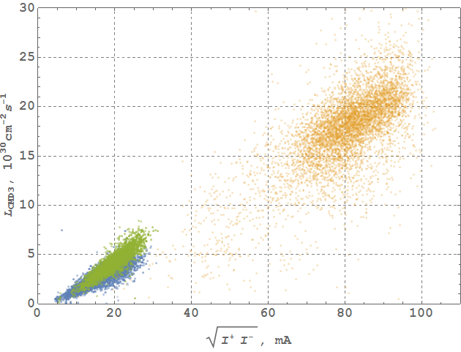
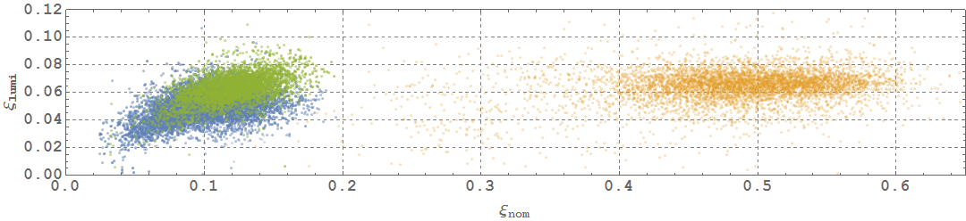
Luminosity and beam-beam parameter
392 MeV
2018
- normalized beam current
- “beam-beam parameter”
2013

Slide 19
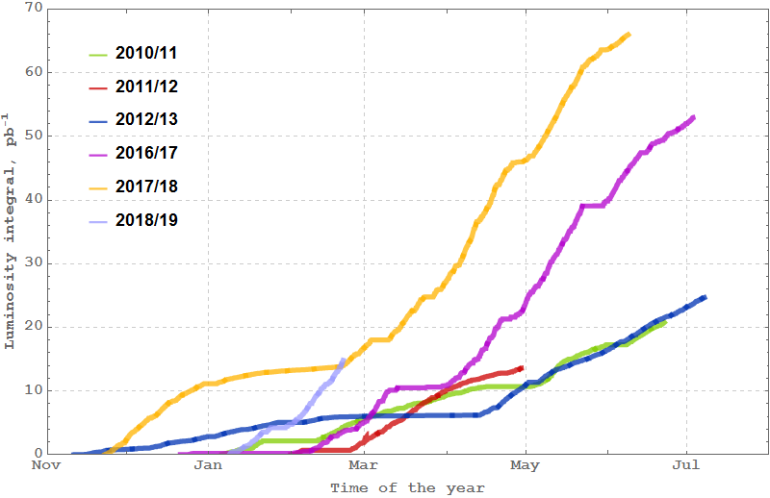
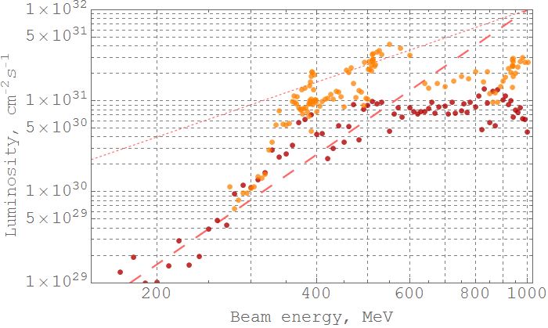
Data collection
Below 500 MeV
With new IC
Above 500 MeV
ongoing run
2017-2018 data
Variable β* scaling law
Highest luminosity achieved
L_{peak} = 5×10³¹ cm⁻²s⁻¹
@ 550 MeV
CMD-3 luminosity, averaged over 10% of best runs

Slide 20
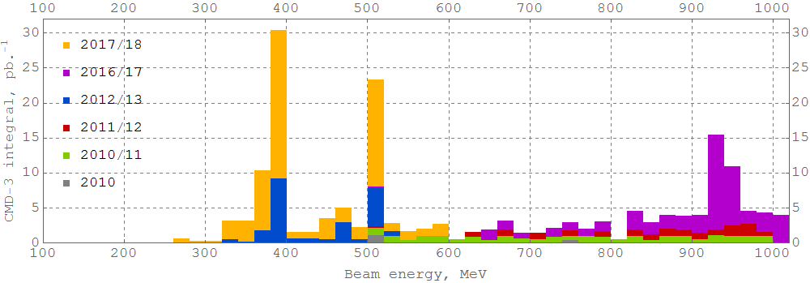
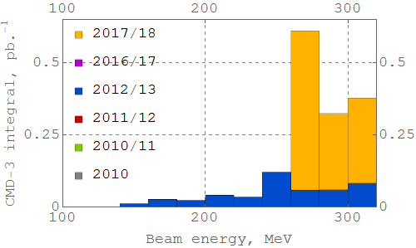
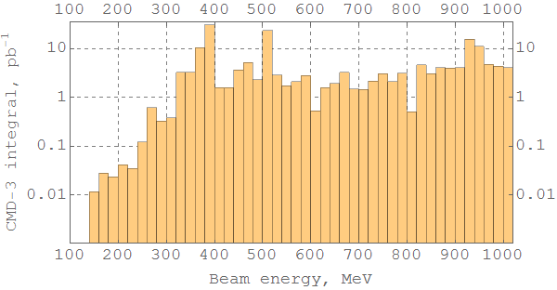
Total luminosity integral
η
ρ,ω
η̍
ϕ
NN
D^{*0}
Lowest energy ever obtained in e⁺e⁻ colliders

Slide 21
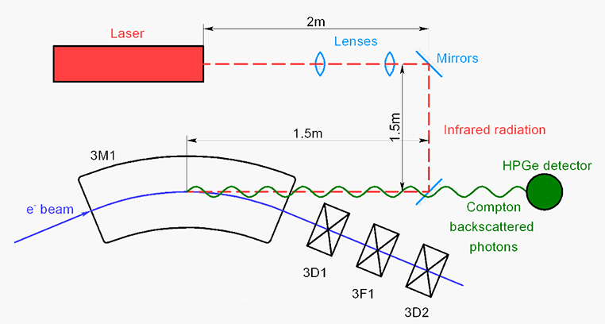
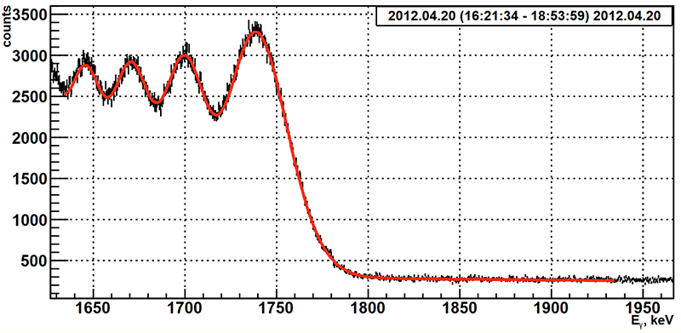
Beam energy measurements: CBS system
Backscattered photons spectrum edge:
E.V. Abakumova et al., PRL 110 2013 140402

Slide 22
Summary
New BINP injection complex routinely serves both colliders.
VEPP-4M has started the program at it’s high energy range with resonance depolarization system for precise energy control.
VEPP-2000 with new BINP injector and upgraded booster started data taking in all energy range of 200–1000 MeV with a luminosity increased in a factor of 2-5.
Round beams concept gives the luminosity enhancement @ VEPP‑2000.
Novel technique (“beamshaking”) for effective emittance control allow to suppress flip-flop effect and increase beams intensity at middle energies.
Ongoing run is devoted to energy range above 500 MeV with intent to achieve the target luminosity at 1 GeV.
Thank you for your attention

Slide 23
backup

Slide 24
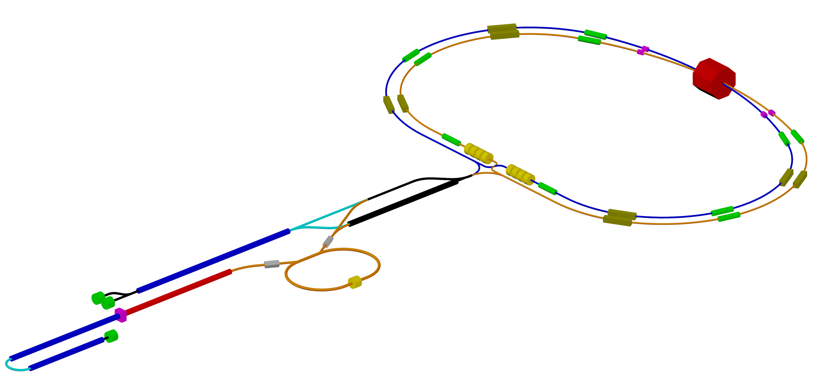
Super-CT Project
RF photogun: beam charge is 1 nC, laser length is 266 nm, laser energy is up to 3 mJ, laser pulse length is not more 10 ps, metallic cathode, beam energy is at least 5 MeV, beam energy spread for
total charge is not more 0.5%, rms beam length is about 1 mm (3 ps)
Accelerating structure: TW, constant impedance (geometry), length is 3 m, quasi-constant electric field distribution, energy gain is 22 MeV/m, beam energy per structure is 66 MeV
Klystron: peak power is 50 MW, repetition rate is 50 Hz, pulse length is up to 5 μs
RF module: 1 klystron, 2 accelerating strictures, electric field amplitude is 27 MV/m, gap between structures is 1 m
Thermionic gun: pulse length is up to 10 ns, peak current is about 8 A
Damping
Wiggler
Crab
Sext
IP
Damping
Wiggler
Crab
Sext
Siberian
Snake
e- 1.5 GeV Linac
AS – 24
Klystrons – 12
Length – 96 m
Drift channel for 1.5 GeV mode
RF System
Polarized e- Gun
1 GeV Linac
AS – 16
Klystrons – 8
Length – 72 m
Damping
Wiggler
Compressor
Damping
Wiggler
e- Photogun
1 nC, 3 ps
ΔE/E ~ 0.5 %
(total charge)
Debuncher
Damping Ring
e+ 1 – 1.5 GeV
e+ 1.5 GeV Linac
AS – 24
Klystrons – 12
Length – 96 m
Thermionic
Gun
Total number of accelerating structures: 104
Klystron number: 52
Total length of the linacs: ~440 m
e- 1 GeV + 1.5 Gev Linacs
AS – 16 + 24
Klystron – 8 + 12
Length – 72 m + 96 m

Slide 25

Coherent beam-beam spectrum
σ
π
ν_{σ} = 0.135, ν_{π} = 0.345
Δν = 0.21 → ξ = 0.17/IP
Here the Yokoya factor Y = 1, due to fast kick method of eigen modes excitation and due to short period analysis (studied @ VEPP-2M; simulated for VEPP-2000 by D.Shatilov)

