Slide 1
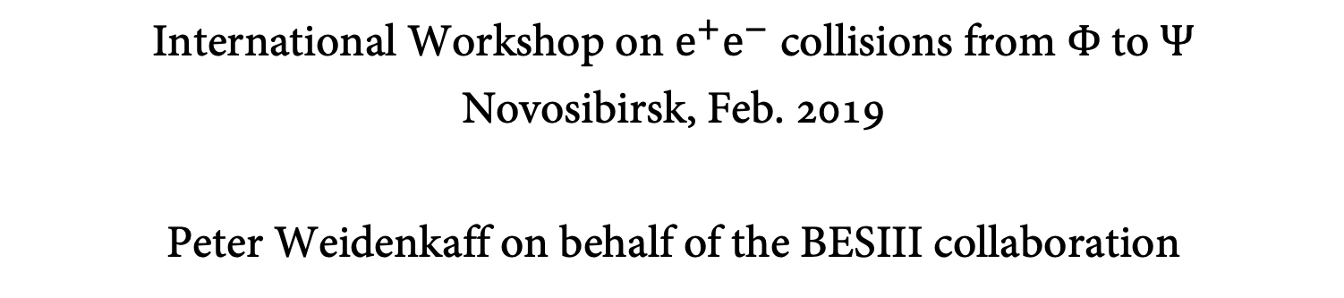
Open Charm Physics
International Workshop on $e^{+}e^{−}$ collisions from Φ to Ψ
Novosibirsk, Feb. 2019
Peter Weidenkaff on behalf of the BESIII collaboration
weidenka@uni-mainz.de

Slide 2
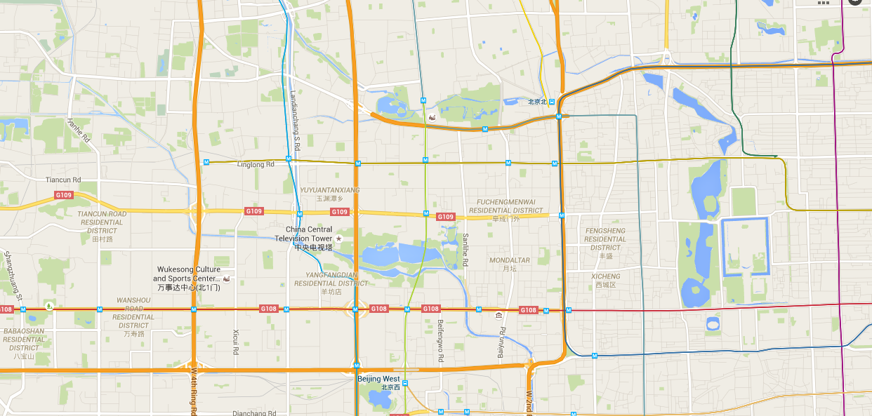


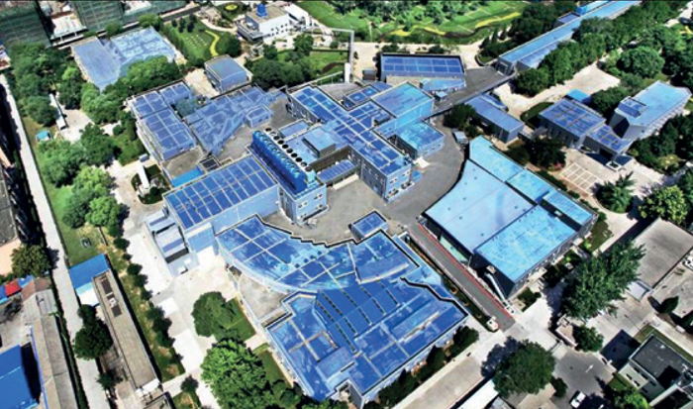







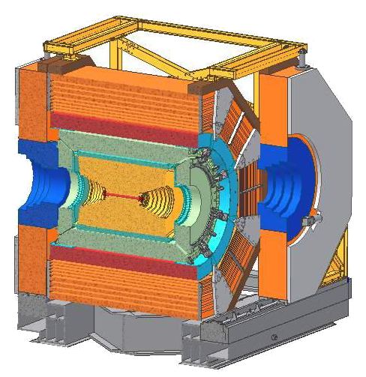





Storage ring
LINAC
BESIII
Construction phase 2004-2008
  Upgrade from BESII and BEPC
First physics data taking 2009
International collaboration
  ~450 authors
Dumplings

Slide 3

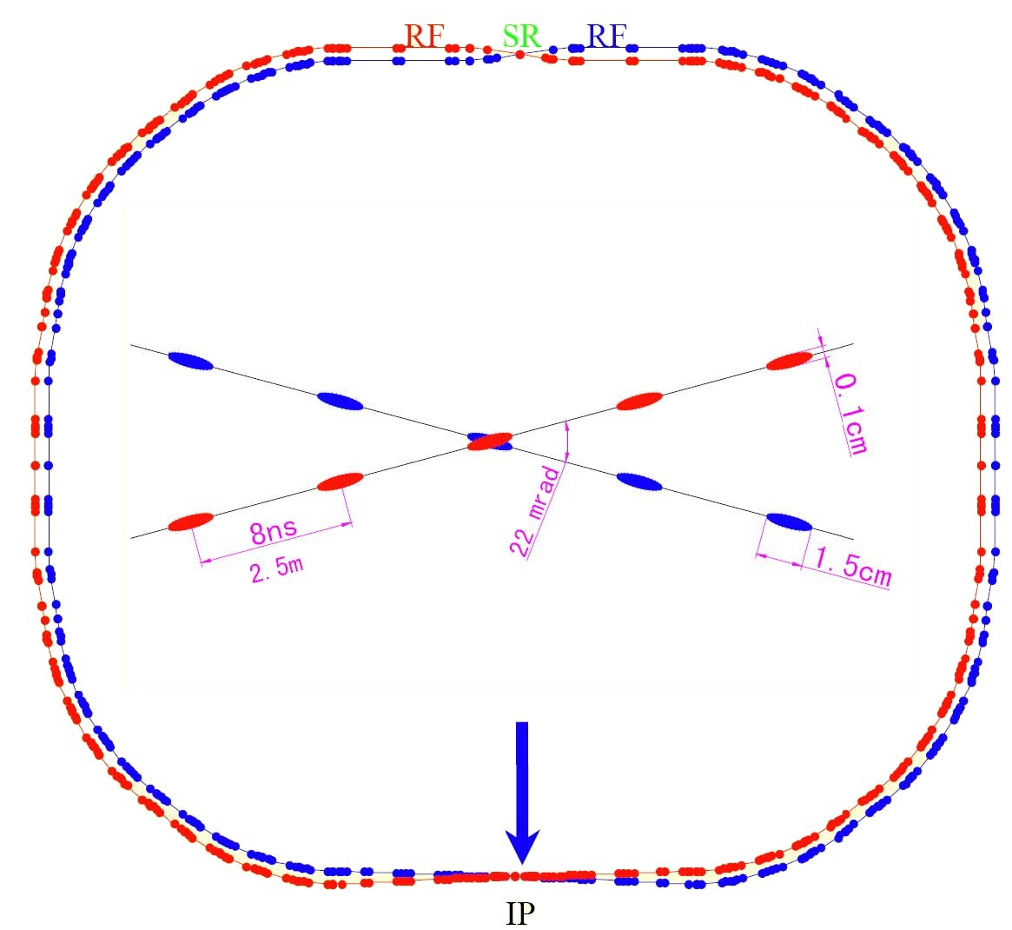
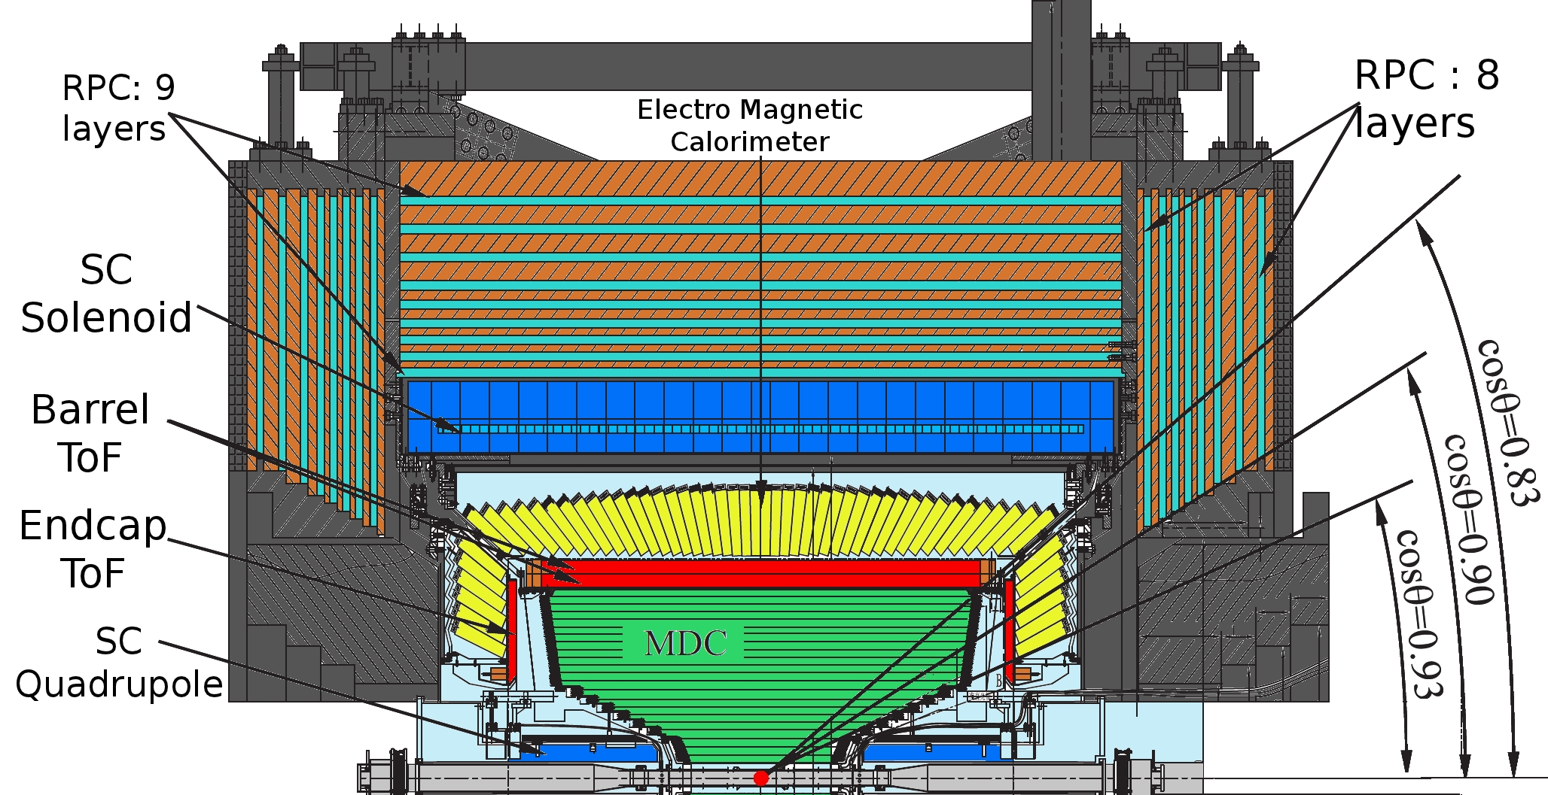





The Experiment
  Beijing-Electron-Positron Collider II
The detector
$e^{+}e^{−}$ collisions with
$\sqrt{s}=2.0 −4.6GeV$
Direct production of charmonia
Luminosity
93% coverage of the full solid angle
Main drift chamber
Time-of-flight system
Elmg. Calorimeter
Superconducting $1T$magnet
Muon system (RPC)
$$σ_{T}=80ps$$
$$ℒ={1×10}^{33}{cm}^{−2}s^{−1}$$
Zoom in IP:
e⁺
e⁻
Notes:
Several charm thresholds
$D^{0}{\overline{D}}^{0}, D^{+}D^{−}@ \sqrt{s}=3.773 GeV⟹2.932{fb}^{−1}$
$$D_{S}{\overline{D}}_{S} @ \sqrt{s}=4.009 GeV⟹0.482{fb}^{−1}$$
$$Λ_{c}{\overline{Λ}}_{c} @ \sqrt{s}=4.5995 GeV⟹0.5669{fb}^{−1}$$

Slide 4
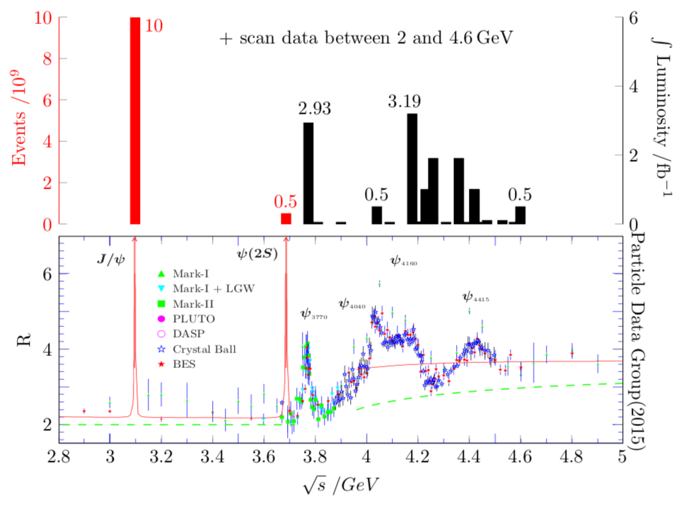
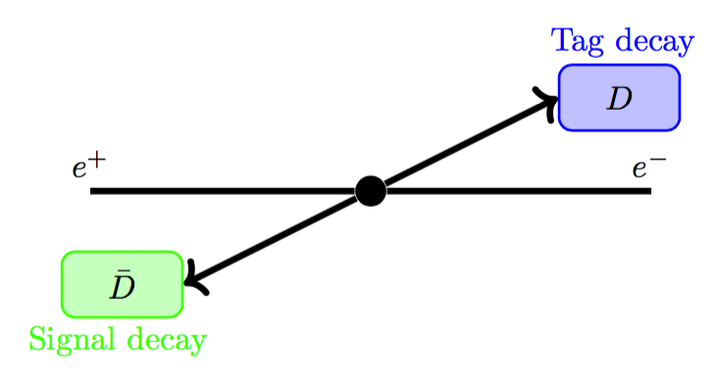




Charm production @ threshold
Large samples throughout the charmonium region
Conservation laws hold for the combined decay amplitude
  ‘Tag’ information of the signal decay
  $D^{0}$ flavour, CP
  Predict missing track
  Normalization
$$D\overline{D}$$
$$D_{S}^{∗}D_{S}$$
$$Λ_{c}{\overline{Λ}}_{c}$$
Notes:
Spend a bit more time on R
σ(e+e− → D0D0)= (3.66 ± 0.03 ± 0.06) nb -> 10M D0D0b
σ(e+e− →D+D−)= (2.91 ±0.03 ±0.05) nb -> 9M D+D-

Slide 5
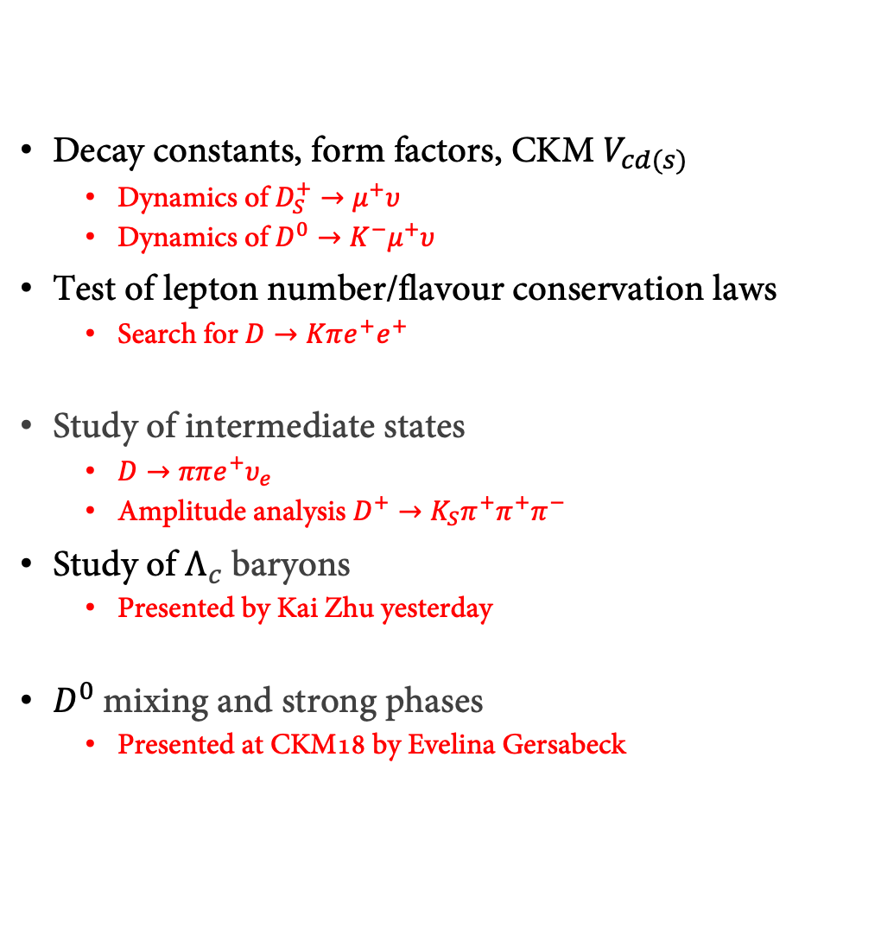
Charm physics @
Decay constants, form factors, CKM $V_{cd(s)}$
  Dynamics of $D_{S}^{+}→μ^{+}υ$
  Dynamics of $D^{0}→K^{−}μ^{+}υ$
Test of lepton number/flavour conservation laws
  Search for $D→Kπe^{+}e^{+}$
Study of intermediate states
  $D→ππe^{+}υ_{e}$
  Amplitude analysis $D^{+}→K_{S}π^{+}π^{+}π^{−}$
Study of $Λ_{c}$ baryons
  Presented by Kai Zhu yesterday
$D^{0}$mixing and strong phases
  Presented at CKM18 by Evelina Gersabeck

Slide 6
Decay constants, form factors, CKM $V_{cd(s)}$

Slide 7
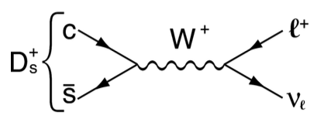
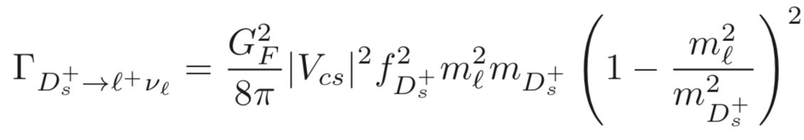
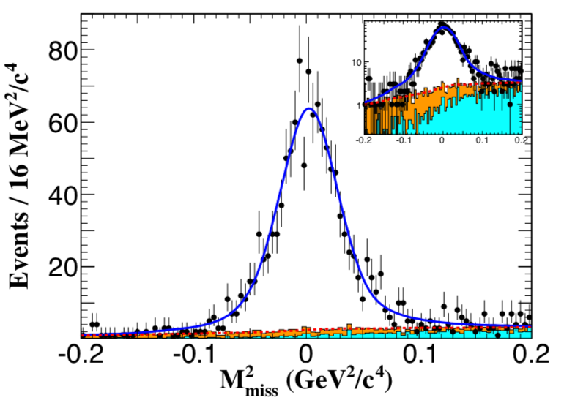
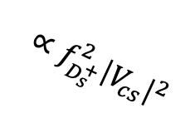





Dynamics of $D_{S}^{+}→μ^{+}υ$
$$∝f_{D_{s}^{+}}^{2}{\left|V_{cs}\right|}^{2}$$
3.19$fb^{−1}$ @ $\sqrt{s}=4.178GeV$ ($D_{S}^{∗}D_{S}$ threshold)
Decay rate
Extract $f_{D_{s}^{+}}^{2}∙{\left|V_{cs}\right|}^{2}$ from a measurement
of the decay rate
Analyse $D_{S}^{∗+}{→D}_{S}^{+}γ(π^{0})$
𝛾 wrongly associated
wrong tag or signal
14 tag modes:
$$K_{S}^{+}K^{−}$$
$$K^{+}K^{−}π^{−}$$
$$K_{S}^{+}K^{−}π^{0}$$
$$…$$
Single tags $N_{ST}^{tot}=388660±2592$
$$={\left(p_{cm}−p_{tag}−p_{γ(π^{0})}−p_{μ}\right)}^{2}$$
$$ℬ_{D_{S}^{+}→μ^{+}υ}=\left(5.49±0.16±0.15\right)×10^{−3}$$
(stat.)
(sys.)
Signal yield $N_{DT}=1135.9±33.1$
PRL122(2019)071802
Notes:
D_s -> tau nu is ongoing -> LFV test

Slide 8
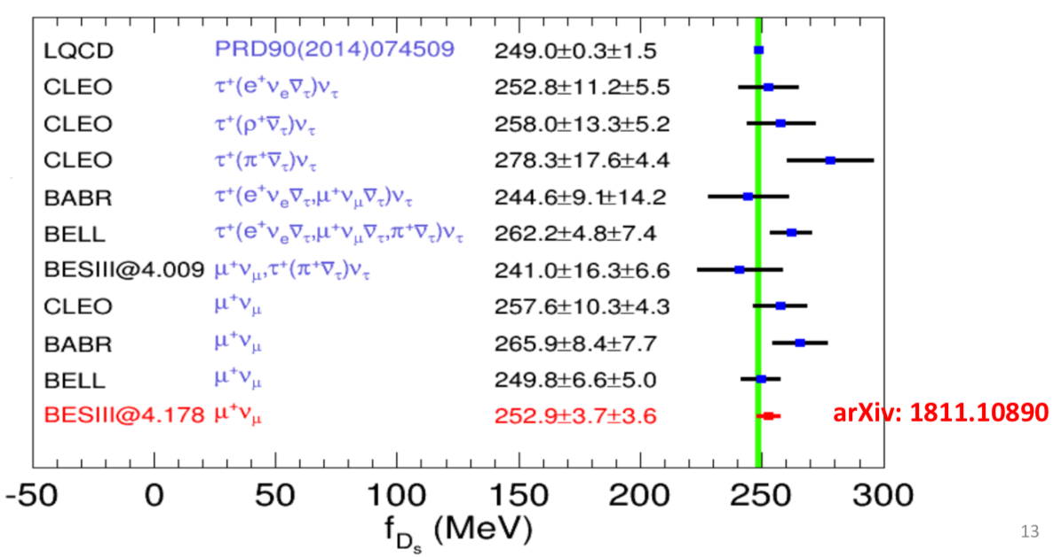

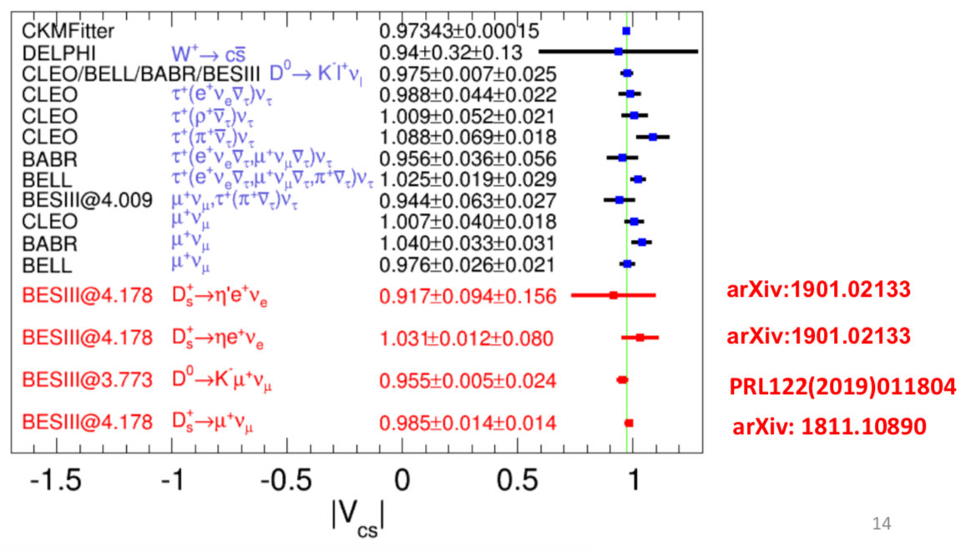
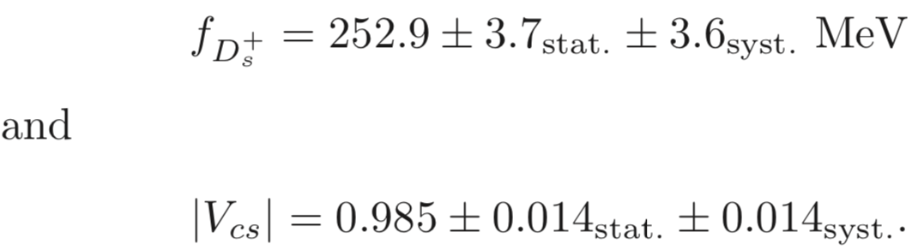
Dynamics of $D_{S}^{+}→μ^{+}υ$
Result:
External Input from
LQCD and PDG (2018)
Interfered results:
Phys.Rev.D98, 074512 (2018)
Phys.Rev.D91, 054507 (2015)
arXiv:1811.108090,to PRL
Notes:
Svjetlana Fajfer PhiPsi19: N
P at 3TeV scale -> 1% change in fD w.r.t LQCD

Slide 9
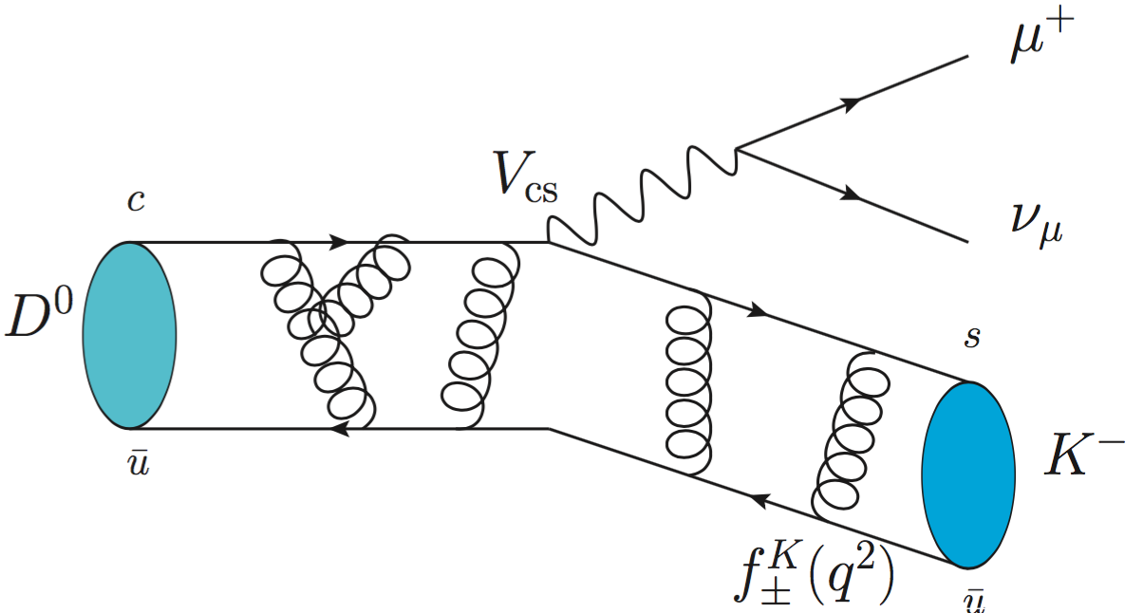
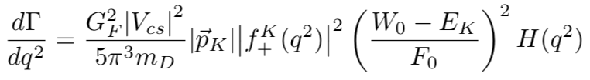
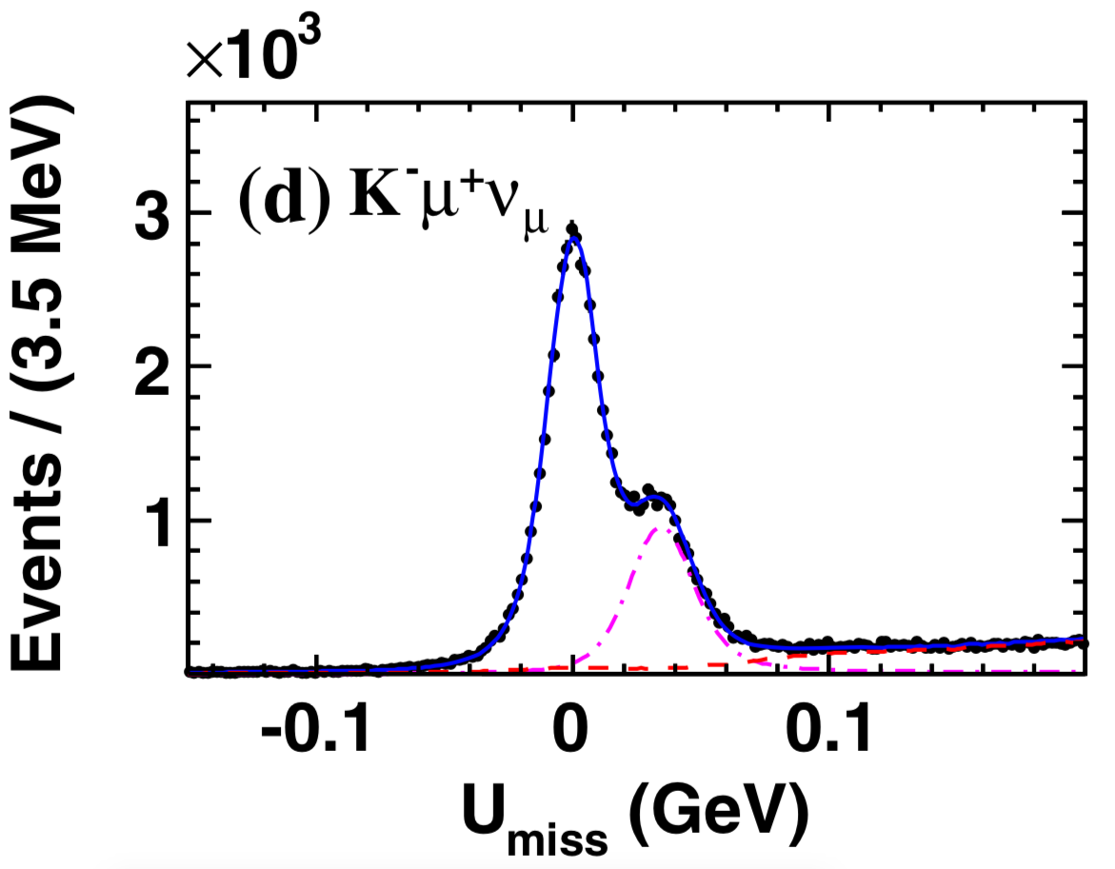






Dynamics of $D^{0}→K^{−}μ^{+}υ$
2.93$fb^{−1}$ @ $\sqrt{s}=3.77GeV$ ($D\overline{D}$ threshold)
Decay rate
Extract ${\left|f_{+}^{K}(q^{2})\right|}^{2}{\left|V_{cs}\right|}^{2}$ from a measurement
of the decay rate in bins of $q^{2}$
Branching fraction measurement
3 tag modes:
$$K^{+}π^{−}$$
$$K^{+}π^{−}π^{0}$$
$$K^{+}π^{−}π^{−}π^{+}$$
$$…$$
$$K^{−}π^{+}π^{0}$$
Single tags $N_{ST}^{tot}=2341408±$2056
significant improvement
w.r.t PDG
$$=E_{miss}−\left|{\vec{p}}_{miss}\right|$$
$$ℬ_{D^{0}→K^{−}μ^{+}υ}=\left(3.413±0.019±0.035\right)\%$$
D$ouble tags N_{DT}=447100±$259
(stat.)
(sys.)
PRL122(2019)011804

Slide 10
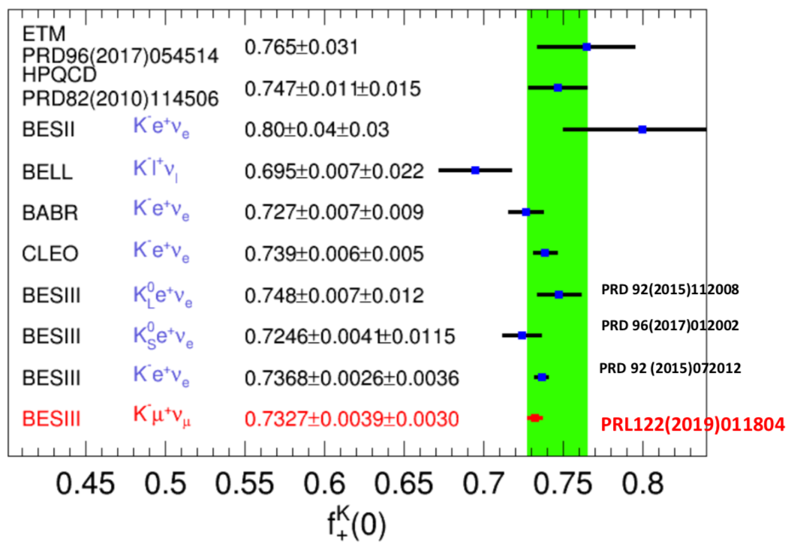
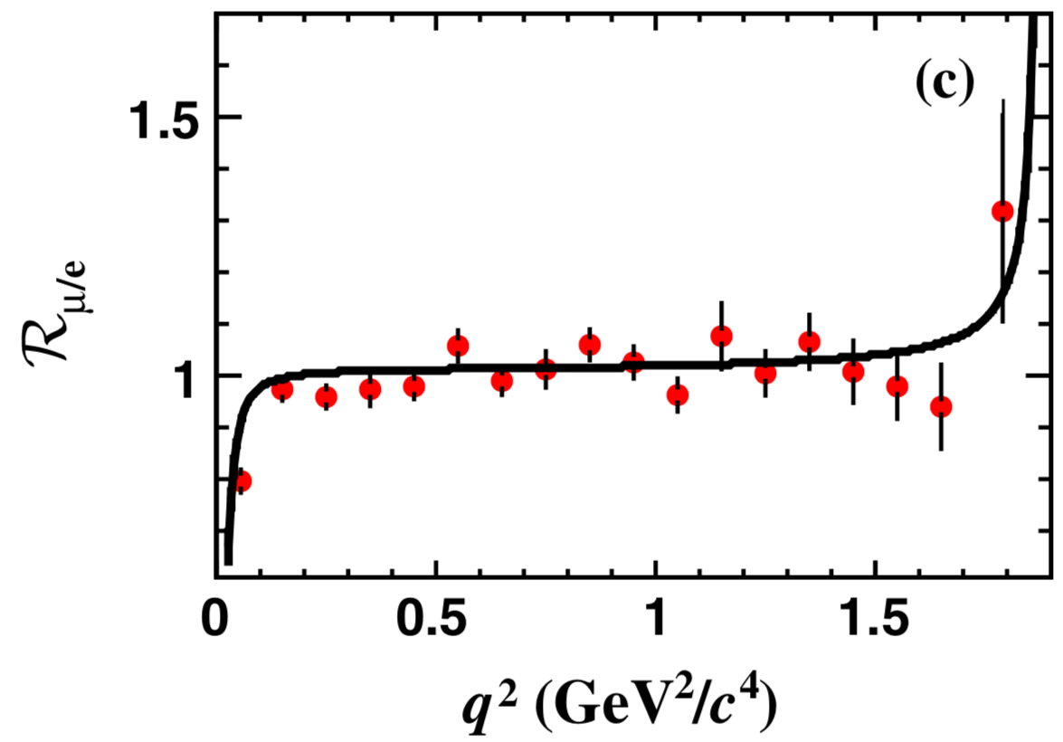

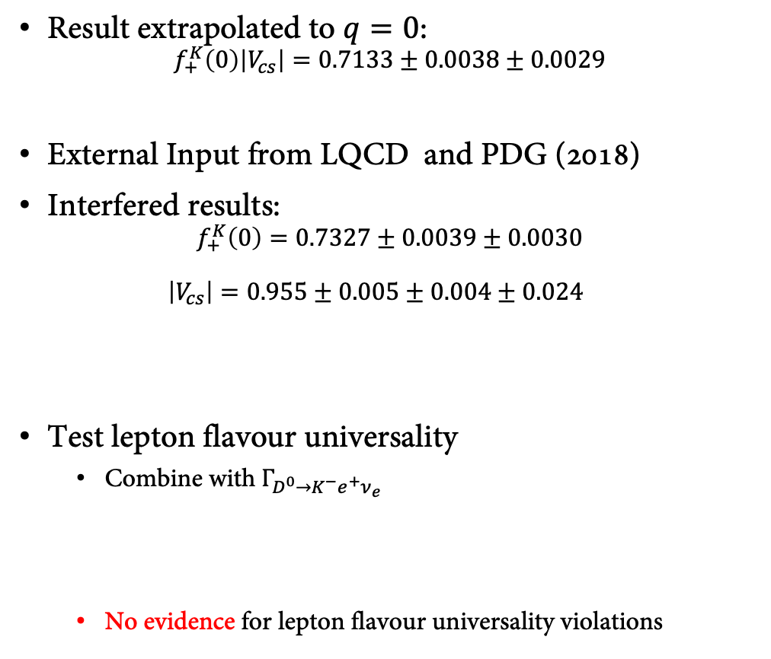
Dynamics of $D^{0}→K^{−}μ^{+}υ$
Result extrapolated to $q=0$:
$f_{+}^{K}\left(0\right)\left|V_{cs}\right|=0.7133±0.0038±0.0029$
External Input from LQCD and PDG (2018)
Interfered results:
$f_{+}^{K}\left(0\right)=0.7327±0.0039±0.0030$
$\left|V_{cs}\right|=0.955±0.005±0.004±0.024$
Test lepton flavour universality
  Combine with $Γ_{D^{0}→K^{−}e^{+}ν_{e}}$
  No evidence for lepton flavour universality violations
(stat.)
(sys.)
PRD82,114506(2010)
(stat.)
(sys.)
(stat.)
(sys.)
(LQCD)
Deviation < 2σ
PRL122(2019)011804
Notes:
Say: CKM matrix element

Slide 11
Test of lepton number/flavour conservation laws

Slide 12
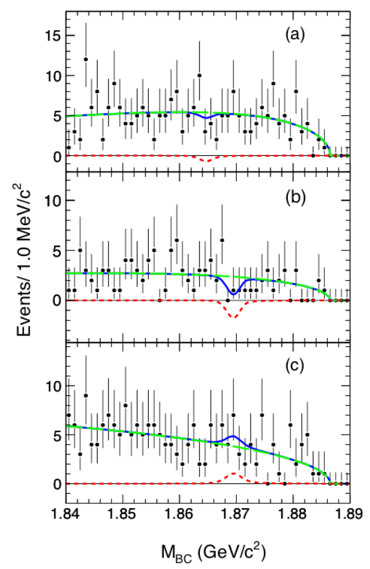
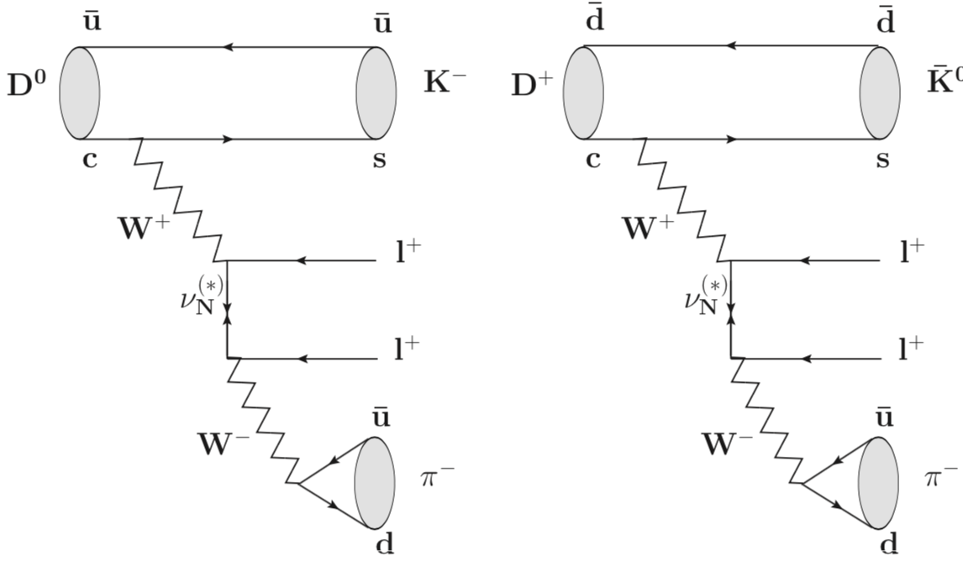
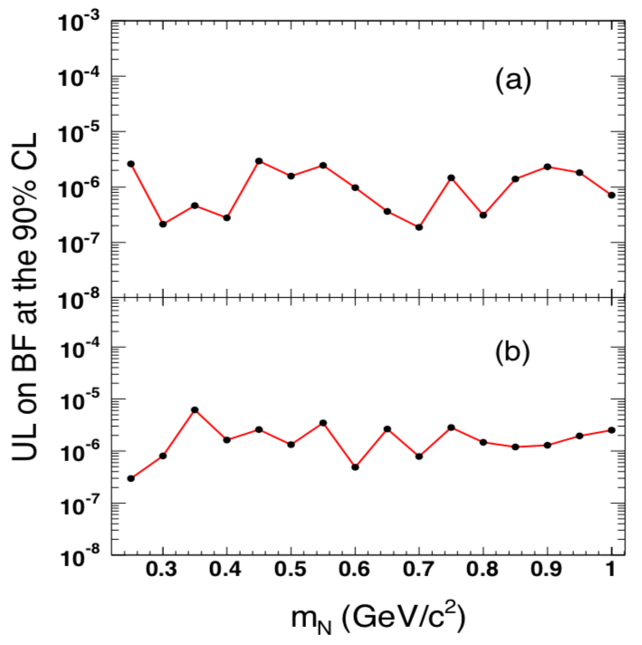
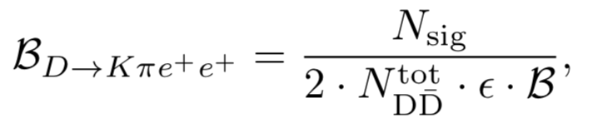





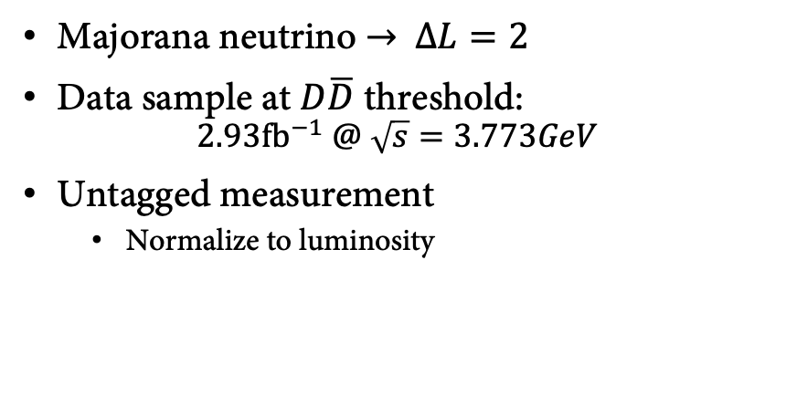

Search for $D→Kπe^{+}e^{+}$
$$D^{0}→K^{−}π^{−}e^{+}e^{+}$$
$$ℬ_{sig}^{UL}<2.7 ×{10}^{−6}$$
$$D^{+}→K_{S}^{0}π^{−}e^{+}e^{+}$$
Majorana neutrino
+ DCS diagrams
$$ℬ_{sig}^{UL}<3.3 ×{10}^{−6}$$
$$D^{+}→K^{−}π^{0}e^{+}e^{+}$$
$$ℬ_{sig}^{UL}<8.5 ×{10}^{−6}$$
Majorana neutrino → $∆L=2$
Data sample at $D\overline{D}$ threshold:
$2.93{fb}^{−1} @ \sqrt{s}=3.773GeV$
Untagged measurement
  Normalize to luminosity
Search for Majorana neutrino at different masses
arXiv:1902.02450,to PRD
Notes:
First result in this channel
Upper limits:
Efficiency from MC with phsp generator
Generator is largestest systematic
Search for Majorana neutrinos:
Generate model with varying neutrino mass
Cut on the invariant mass of the neutrino decay products
Convert in upper limits on the mixing matrix element

Slide 13
Study of intermediate states

Slide 14
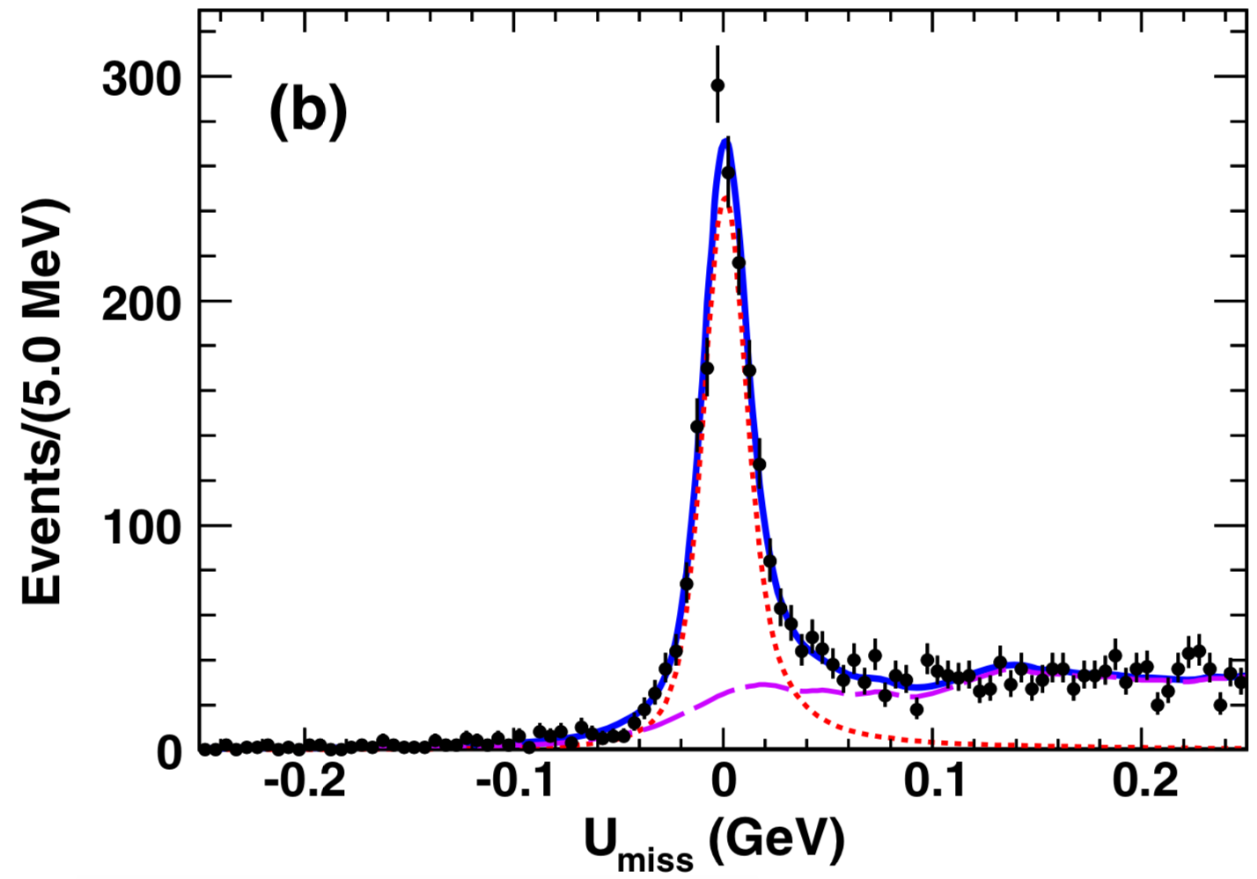
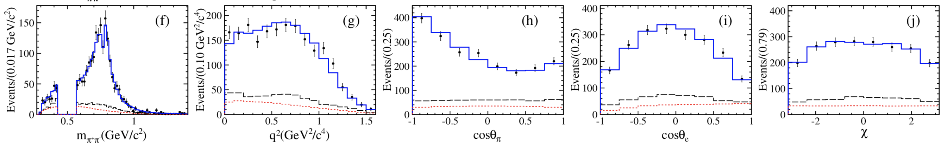


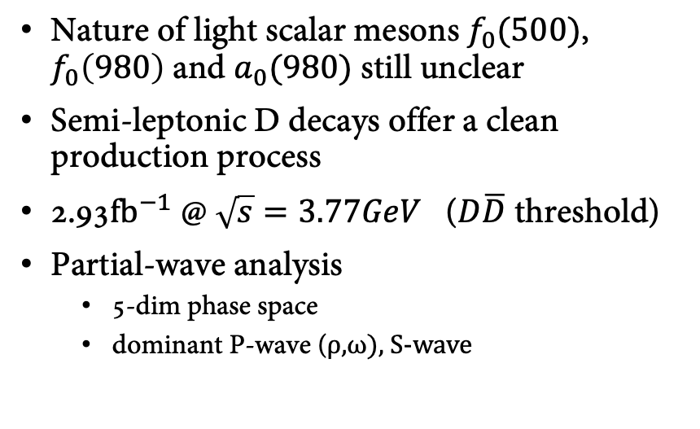

Resonant states in $D→ππe^{+}υ_{e}$
$$D^{+}→π^{+}π^{−}e^{+}υ_{e}$$
$$N_{DT}^{D^{+}}=1667±50$$
Nature of light scalar mesons $f_{0}(500)$, $f_{0}\left(980\right)$ and $a_{0}(980)$ still unclear
Semi-leptonic D decays offer a clean production process
2.93$fb^{−1}$ @ $\sqrt{s}=3.77GeV$ ($D\overline{D}$ threshold)
Partial-wave analysis
  5-dim phase space
  dominant P-wave (ρ,ω), S-wave
$D^{+}→π^{+}π^{−}e^{+}υ_{e}$
PRL122(2019)062001
Notes:
Peaking background from D->K e nu -> pi pi0 e nubackground
Background fraction is 20-30%
KS veto

Slide 15
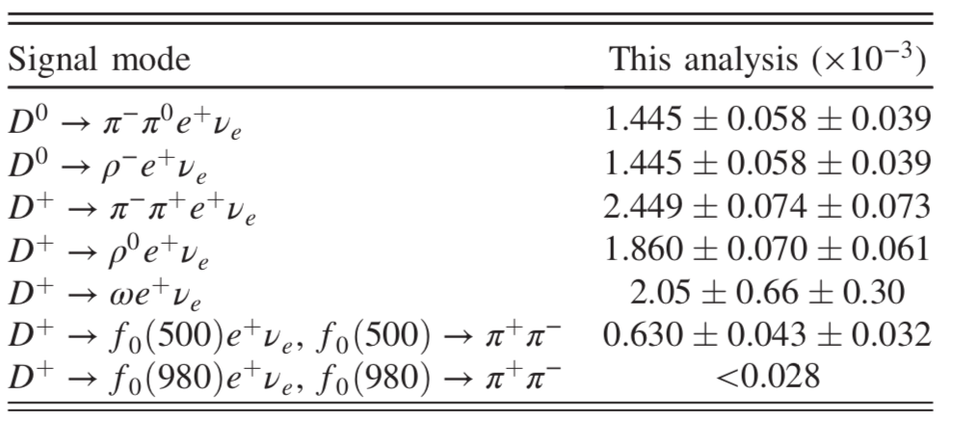
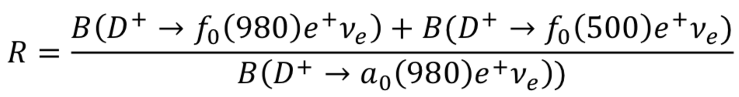
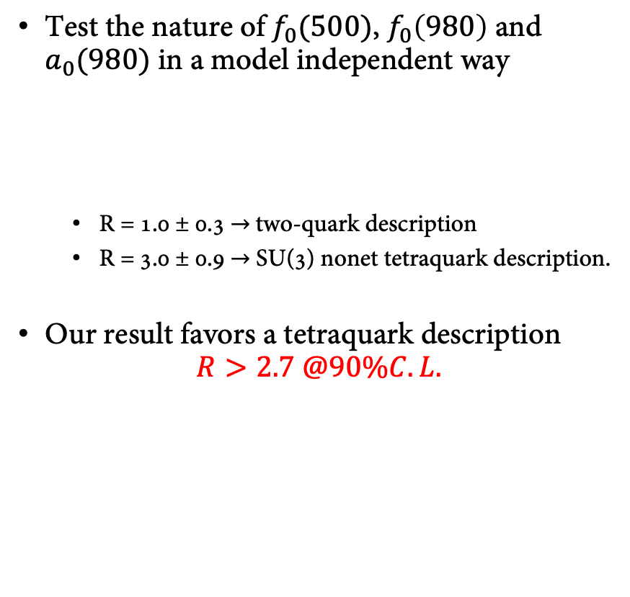

Resonant states in $D→ππe^{+}υ_{e}$
PRD82(2010)034016
Branching fractions from PWA
  Simultaneous fit of neutral and charged modes
  Upper limit on $f_{0}\left(980\right)$
  Significance of $f_{0}\left(500\right)>10σ$
Test the nature of $f_{0}(500)$, $f_{0}\left(980\right)$ and $a_{0}(980)$ in a model independent way
  R = 1.0 ± 0.3 → two-quark description
  R = 3.0 ± 0.9 → SU(3) nonet tetraquark description.
Our result favors a tetraquark description
$R>2.7 @90\%C.L.$
PRL122(2019)062001
Notes:
Largest source of systematics: f0(500) line shape
ToDo: understand theo prediction for R
Alexey Kiselev mentioned those decays in his talk on Wed.

Slide 16
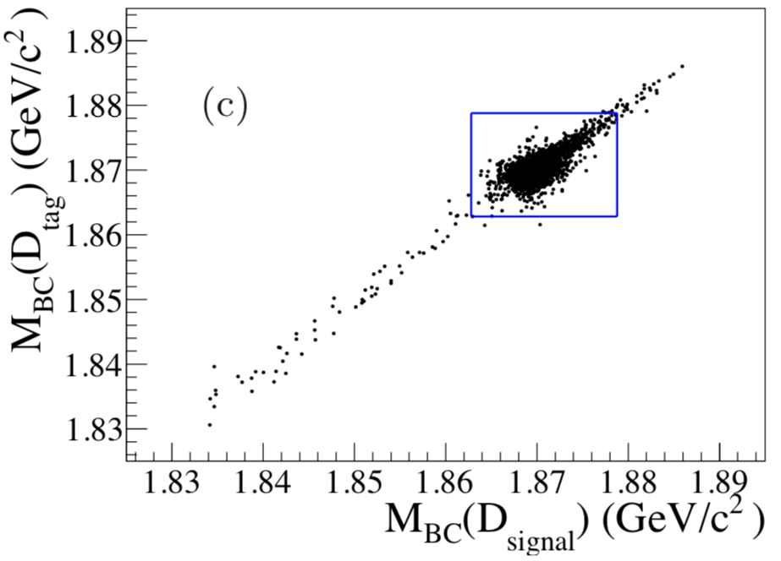


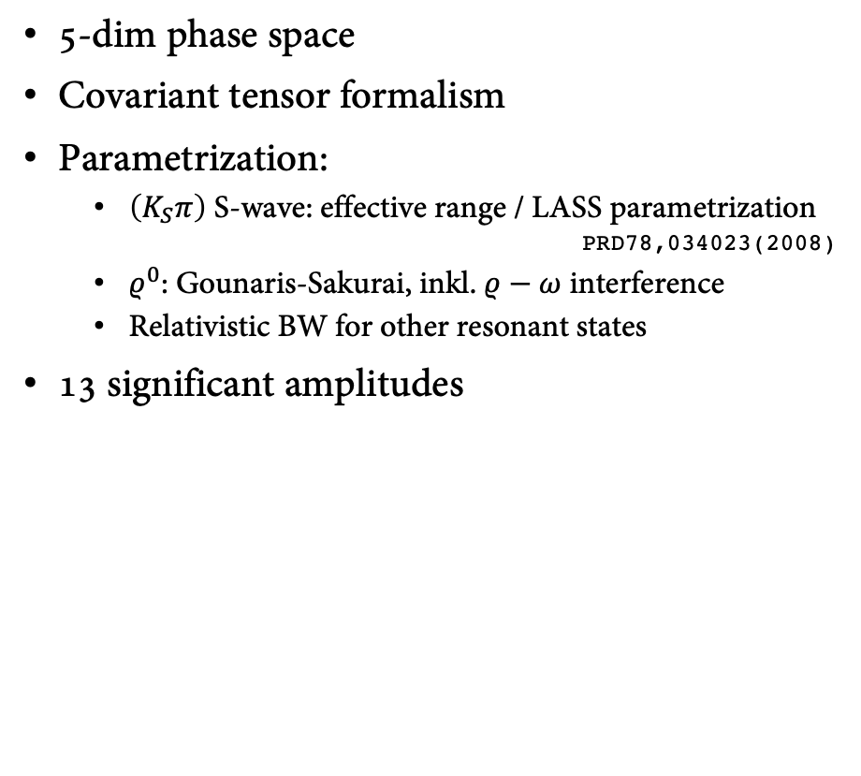

Amplitude analysis of $D^{+}→K_{S}π^{+}π^{+}π^{−}$
Study dynamics of strong interaction at low energy + final state interaction effects
Few results D$→AP$ decays
  $D^{+}→K_{S}π^{+}π^{+}π^{−}$ @ MARKIII
Compare to results of $D^{0}→K^{−}π^{+}π^{+}π^{−}$
5-dim phase space
Covariant tensor formalism
Parametrization:
  $\left(K_{S}π\right)$ S-wave: effective range / LASS parametrization
  PRD78,034023(2008)
  $ρ^{0}$: Gounaris-Sakurai, inkl. $ρ−ω$ interference
  Relativistic BW for other resonant states
13 significant amplitudes
PRD45(1992)2196
BESIII: PRD95(2017)072010
LHCb: EPJC78(2018)443
2.93$fb^{−1}$ @ $\sqrt{s}=3.77GeV$
$$N_{DT}=4559$$
purity 97.5%
arXiv:1902.05936,to PRD

Slide 17
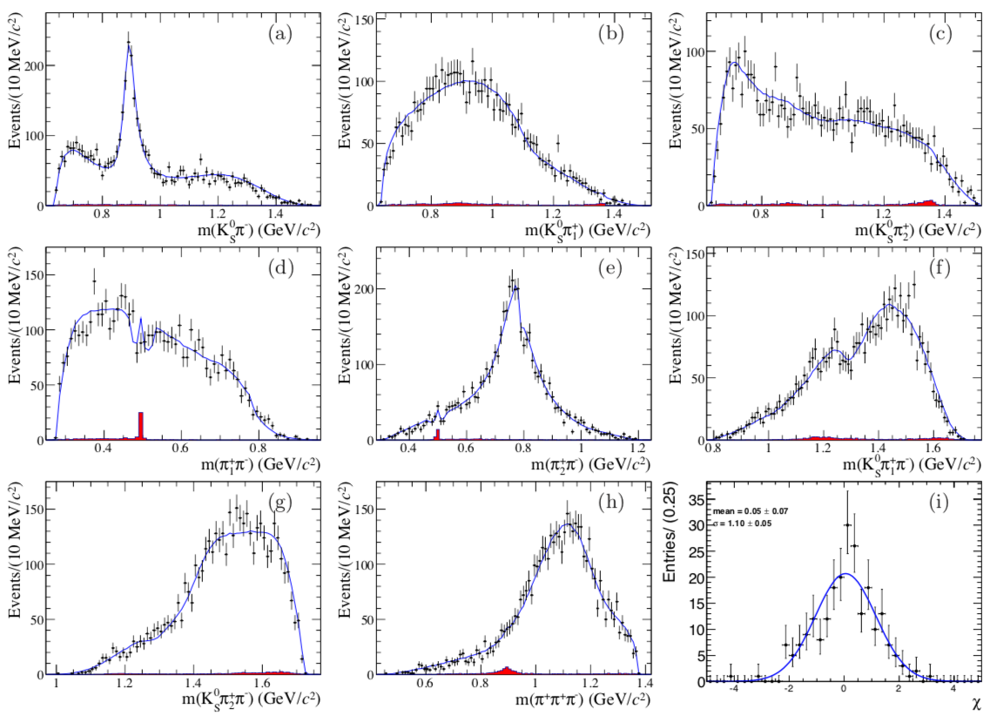
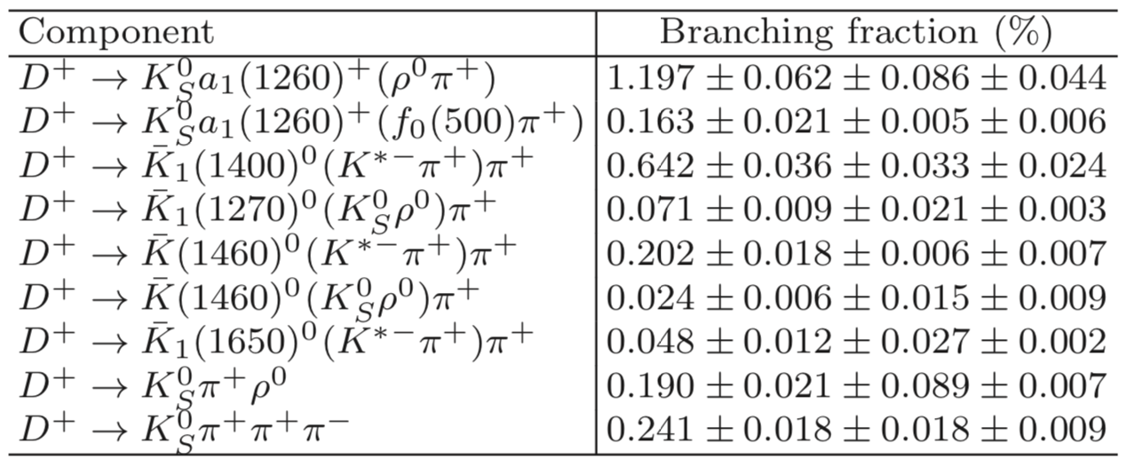
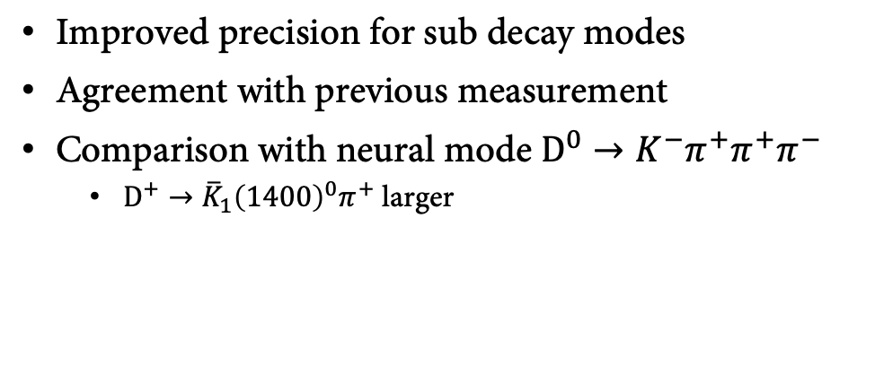
Amplitude analysis of $D^{+}→K_{S}π^{+}π^{+}π^{−}$
Improved precision for sub decay modes
Agreement with previous measurement
Comparison with neural mode $D^{0}→K^{−}π^{+}π^{+}π^{−}$
  $D^{+}→{\overline{K}}_{1}{\left(1400\right)}^{0}π^{+}$ larger
arXiv:1902.05936,to PRD

Slide 18
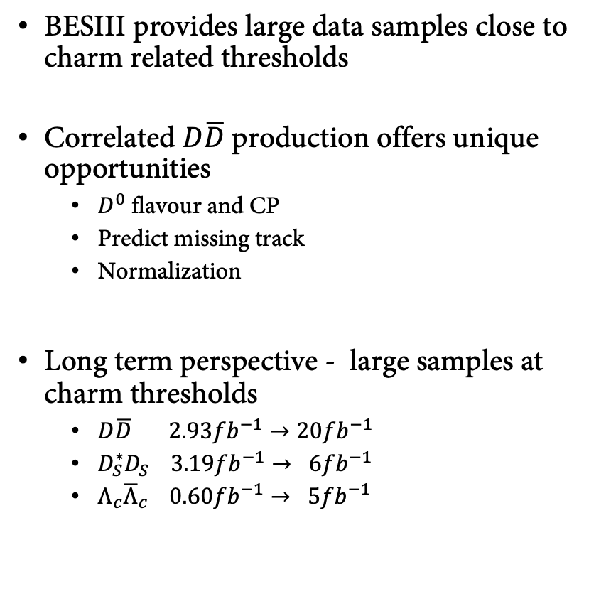
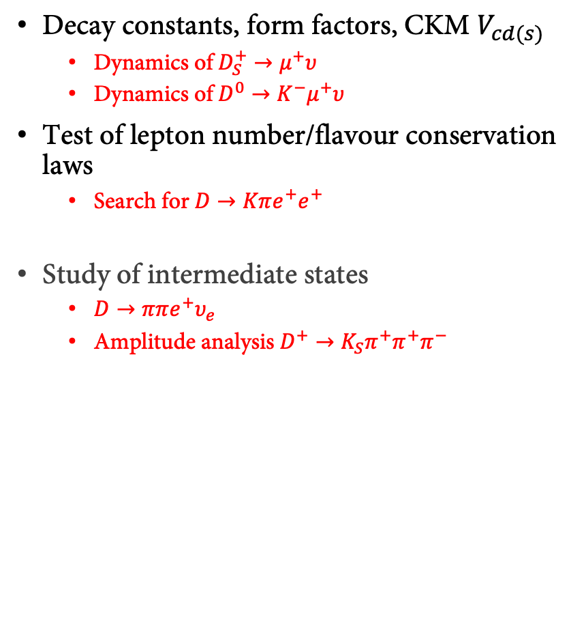
Summary
BESIII provides large data samples close to charm related thresholds
Correlated $D\overline{D}$production offers unique opportunities
  $D^{0}$ flavour and CP
  Predict missing track
  Normalization
Long term perspective - large samples at charm thresholds
  $D\overline{D} 2.93fb^{−1}→20fb^{−1}$
  $D_{S}^{∗}D_{S} 3.19fb^{−1}→ 6fb^{−1}$
  $Λ_{c}{\overline{Λ}}_{c} 0.60fb^{−1}→ 5fb^{−1}$
Decay constants, form factors, CKM $V_{cd(s)}$
  Dynamics of $D_{S}^{+}→μ^{+}υ$
  Dynamics of $D^{0}→K^{−}μ^{+}υ$
Test of lepton number/flavour conservation laws
  Search for $D→Kπe^{+}e^{+}$
Study of intermediate states
  $D→ππe^{+}υ_{e}$
  Amplitude analysis $D^{+}→K_{S}π^{+}π^{+}π^{−}$
Thank you for your attention!

