Slide 1
Departamento de Física Teórica and IPARCOS
Universidad Complutense de Madrid
Strange resonances from analyticity and dispersion relations
J. R. Peláez
In collaboration with
A. Rodas, J. Ruiz de Elvira
Phys.Rev. D93 (2016) no.7, 074025
Eur.Phys.J. C77 (2017) no.2, 91
Eur.Phys.J. C78 (2018) no.11, 897
and work in preparation
International Workshop on e+e- collisions from Phi to Psi 25th-February 1st-March, 2019

Slide 2
Motivation to study πK scattering with Dispersion Relations
π,K appear as final products of almost all hadronic strange processes:
B,D, decays, CP violation studies… many examples in this workshop
π,K are Goldstone Bosons of QCD → Test Chiral Symmetry Breaking
Main or relevant source for PDG parameters of:
K₀* (700), K₀*$(1430)\text{,} \text{K}\text{1}\text{∗}(892)$,$\text{K}\text{1}\text{∗}(1410)$,$\text{K}\text{2}\text{∗}(1410)$,$\text{K}\text{3}\text{∗}(1780)$
Extracted frequently with strong model dependences (Breit Wigners,….)
Analytic Methods reduce model independence
Dispersion Relations model independent
Particularly controversial:
κ/ K₀* (700) light scalar meson. “needs confirmation” @PDG.
Light scalar mesons longstanding candidates for non-ordinary mesons.
Needed to identify the lightest scalar nonet
Was $\text{K}\text{0}\text{∗}(800)$ until last 2018 PDG revision!
Partly triggered by our 2017 work

Slide 3
Overview of the K₀*(700) or “kappa” meson until 2018 @PDG
Omittted from the 2018PDG summary table since, “needs confirmation”
All descriptions of data respecting unitarity and chiral symmetry find a pole at M=650-770 MeV and Γ~550 MeV or larger.
Best determination comes from a SOLUTION of a Roy-Steiner dispersive formalism, consistent with UChPT Decotes Genon et al 2006
2017PDG $\text{K}\text{0}\text{∗}$(700) dominated by such a SOLUTION
M-i Γ/2=(682±29)-i(273±i12) MeV
New PDG2018:
(630-730)-i(260-340) MeV
name changed to $\text{K}\text{0}\text{∗}$(700)
But still “Needs Confirmation”
PDG may reconsider situation.. if additional independent dispersive DATA analysis.
We were encouraged by PDG members to do it.

Slide 4
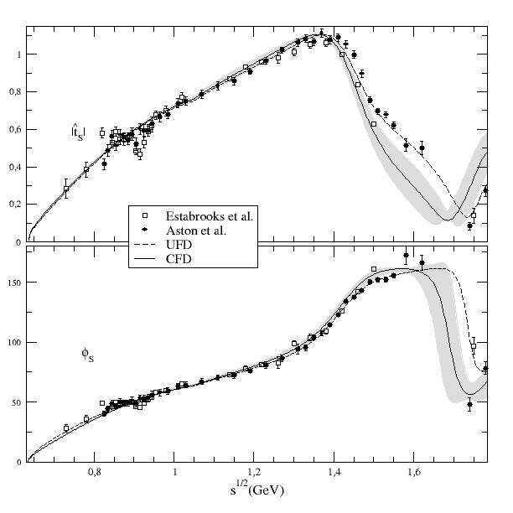
Data on πK scattering: S-channel
Most reliable sets:
Estabrooks et al. 78 (SLAC)
Aston et al.88 (SLAC-LASS)
I=1/2 and 3/2 combination
No clear “peak” or phase movement
of ${κ/K}_{0}^{∗}(700)$ resonance
Definitely NO BREIT-WIGNER shape
Mathematically correct to use POLES
Strong support for K₀*(700) from decays of heavier mesons, but rigorous
model-independent extractions absent. Often inadequate Breit-Wigner formalism
POLE extraction rigorous when using Dispersion Relations
or complex-analyticity properties

Slide 5
Why so much worries about low energy and CORRECT ANALYTIC STRUCTURE?
Analyticity is expressed in the s-variable, not in Sqrt(s)
Sqrt(s)$−plane$
(MeV²)
|s|=$m_{K}^{2}−m_{π}^{2}$
For partial waves and different masses, additional circular cut
$$Adler$$
zero
$$0$$
$${(m_{K}−m_{π} )}^{2}$$
$$πK$$
$$7002$$
$$8002$$
$$8902$$
$$ηK$$
$$K^{∗}(890)$$
$${κ/K}_{0}^{∗}(700)$$
Important for
the $κ{/K}_{0}^{∗}(700)$
Threshold behavior (chiral symmetry)
Subthreshold behavior (chiral symmetry →Adler zeros)
Other cuts (Left & circular)
Avoid spurious singularities
Less important for other resonances…

Slide 6
Our Dispersive/Analytic Approach for πK and strange resonances
Simple Unconstrained Fits to πK partial-wave Data (UFD).
Estimation of statistical and SYSTEMATIC errors
As πK checks: Small inconsistencies.
Forward Dispersion Relations:
Left cut easy to rewrite
Relate amplitudes, not partial waves
Not direct access to pole

Slide 7
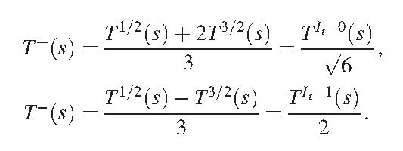
Forward dispersion relations for K π scattering.
Since interested in the resonance region, we use minimal number of subtractions
Defining the s↔u symmetric
and anti-symmetric amplitudes
at t=0
We need one subtraction for the symmetric amplitude
And none for the antisymmetric
where $Σ_{πK}=$ m_{π}²+m_{K}²

Slide 8
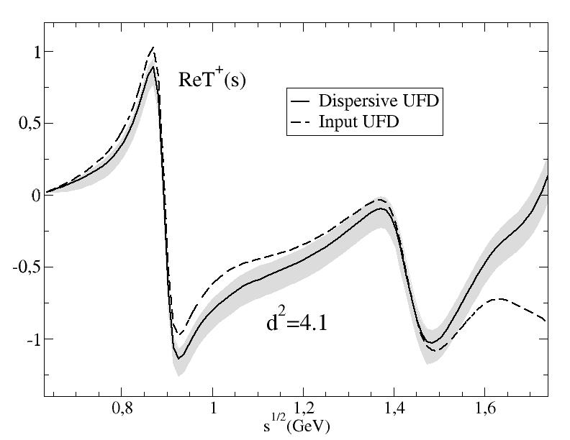
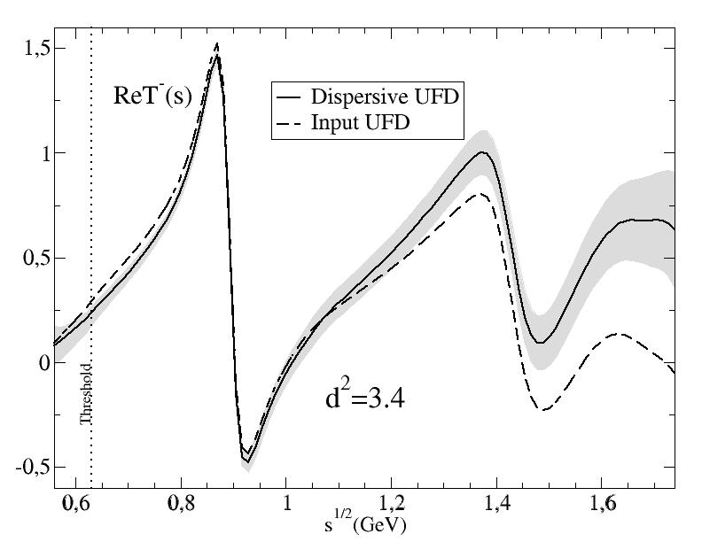
(not a solution of dispersión relations,
but a constrained fit)
A.Rodas & JRP, PRD93,074025 (2016)
Forward Dispersion Relation
analysis of
πK scattering DATA
up to 1.6 GeV
First observation:
Forward Dispersion relations
Not well satisfied by data
Particularly at high energies
So we use
Forward Dispersion Relations as CONSTRAINTS on fits

Slide 9
Our Dispersive/Analytic Approach for πK and strange resonances
Simple Unconstrained Fits to πK partial-wave Data (UFD).
Estimation of statistical and SYSTEMATIC errors
As πK checks: Small inconsistencies.
Forward Dispersion Relations:
Left cut easy to rewrite
Relate amplitudes, not partial waves
Not direct access to pole
As constraints:
πK consistent fits up to 1.6 GeV
JRP, A.Rodas,Phys.Rev. D93 (2016)

Slide 10
How well Forward Dispersion Relations are satisfied by unconstrained fits
Every 22 MeV calculate the difference between both sides of the DR /uncertainty
Define an averaged χ² over these points, that we call d²
d² close to 1 means that the relation is well satisfied
d²>> 1 means the data set is inconsistent with the relation.
This can be used to check DR
To obtain CONSTRAINED FITS TO DATA (CFD) we minimize:
2 FDR’s
Sum Rules
threshold
Parameters of the unconstrained data fits
W roughly counts the number
of effective degrees of freedom
(sometimes we add weight on certain energy regions)

Slide 11
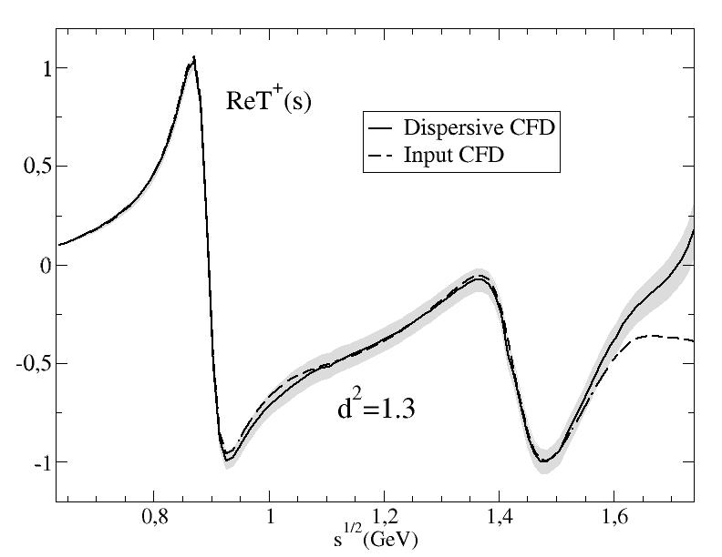
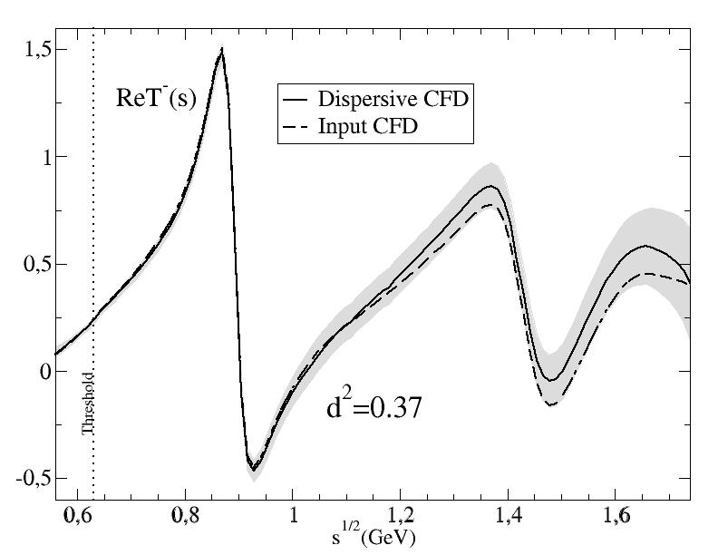
Consistency up to 1.6 GeV!!
Consistency up to 1.74 GeV!!

Slide 12
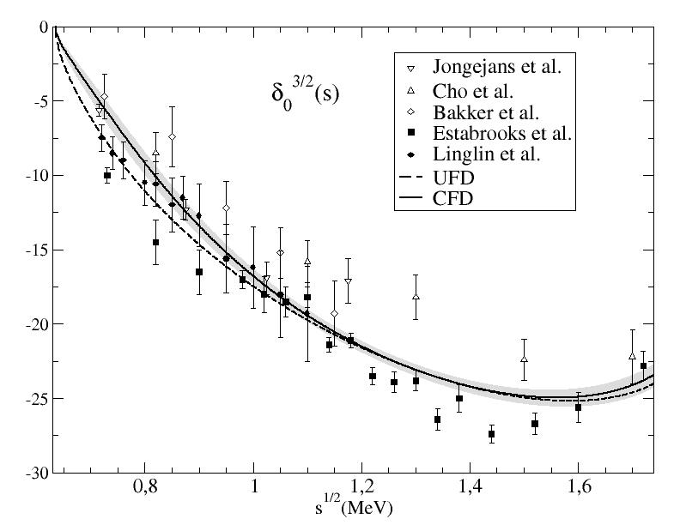
From Unconstrained (UFD) to Constrained Fits to data (CFD)
S-waves. The most interesting for the K₀* resonances
Largest changes from UFD to CFD
at higher energies

Slide 13
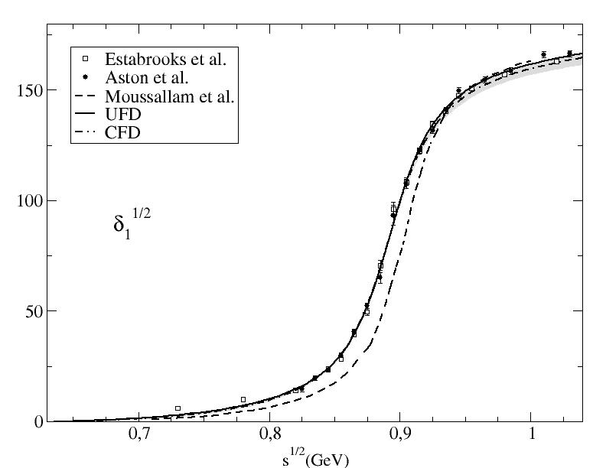
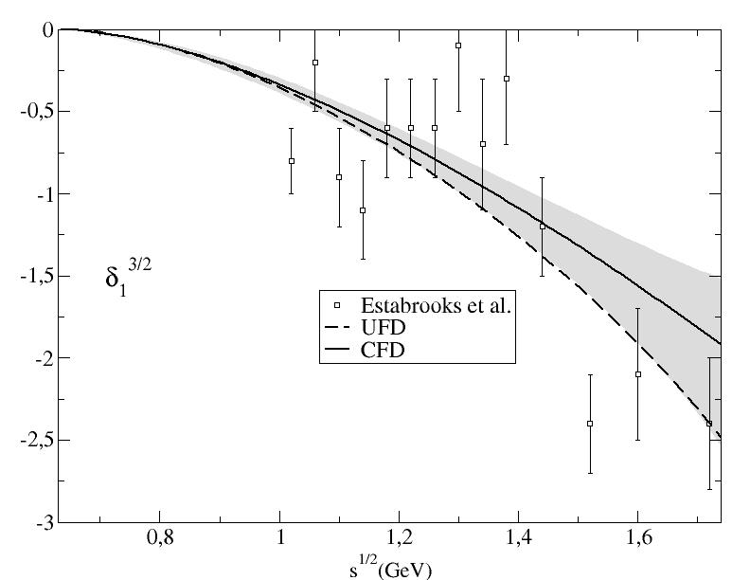
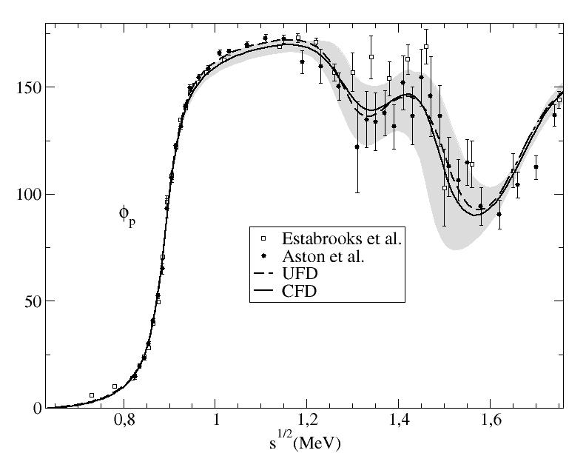
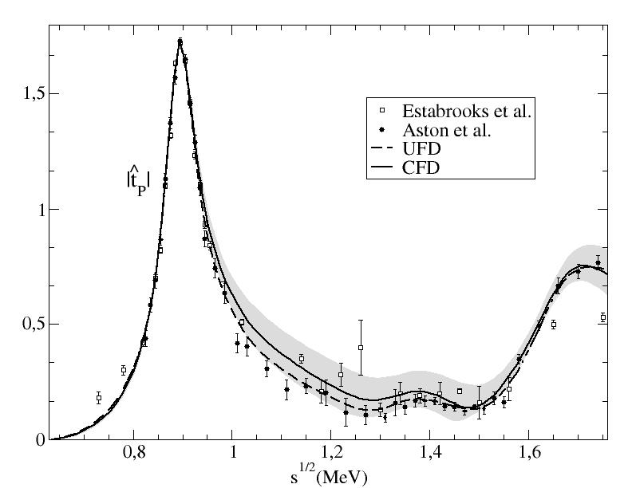
From Unconstrained (UFD) to Constrained Fits to data (CFD)
P-waves: Small changes
Our fits describe data well
SOLUTION from previous Roy-Steiner approach

Slide 14
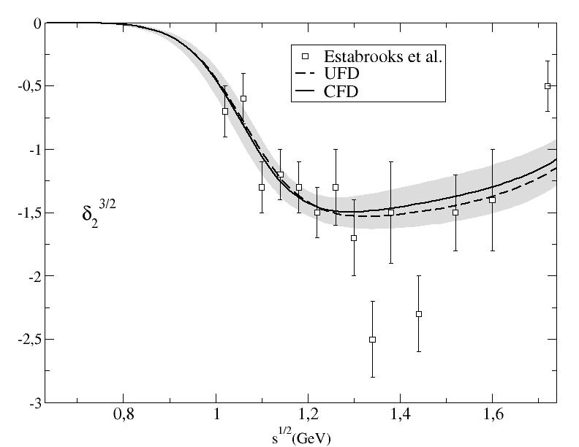
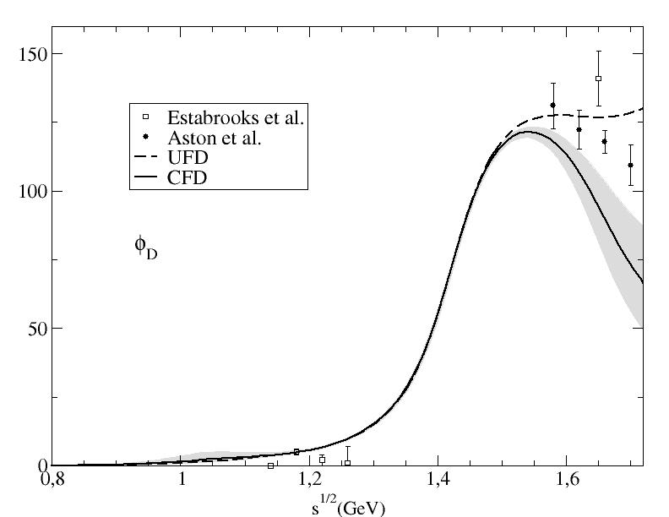
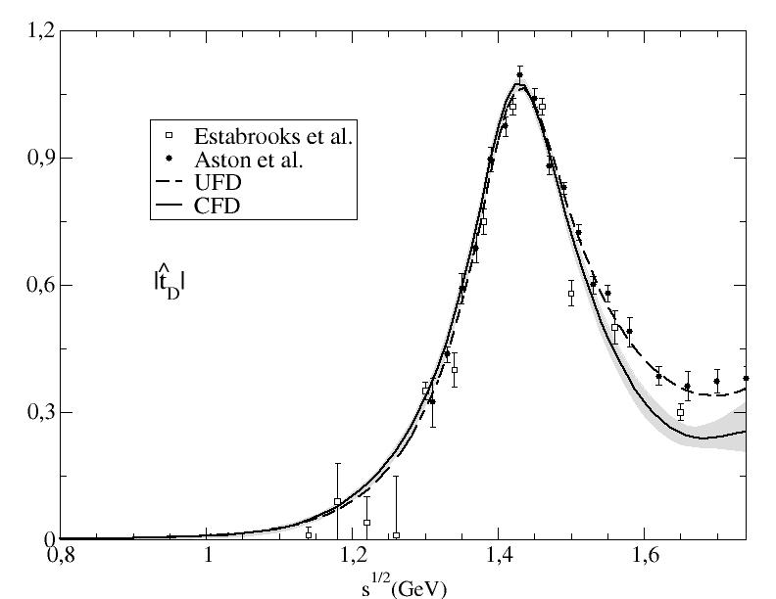
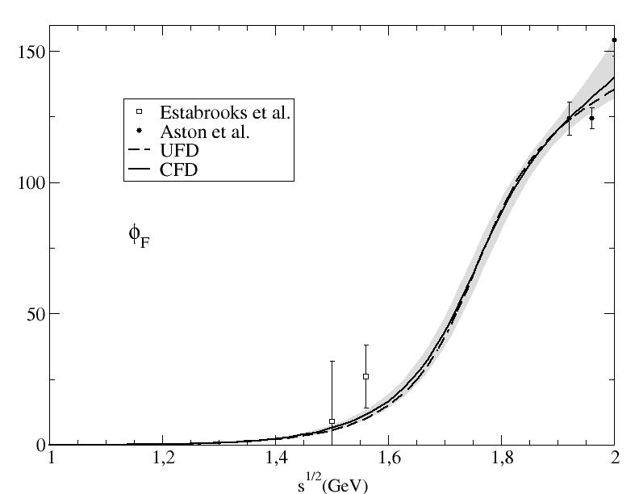
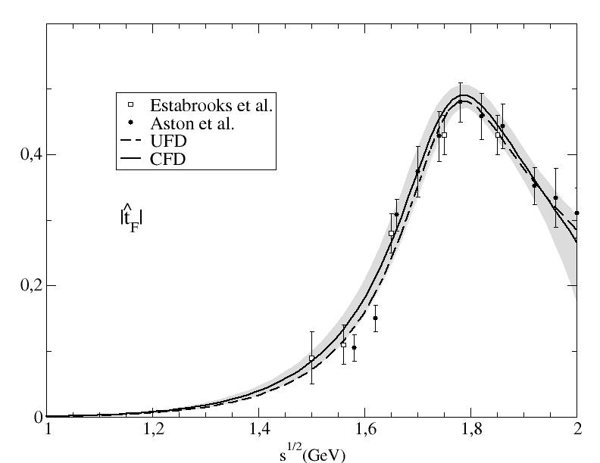
From Unconstrained (UFD) to Constrained Fits to data (CFD)
D-waves: Largest changes of all, but at very high energies
F-waves:
Imperceptible changes
Regge parameterizations allowed to vary: Only πK-ρ residue changes by 1.4 deviations

Slide 15
Our Dispersive/Analytic Approach for πK and strange resonances
Simple Unconstrained Fits to πK partial-wave Data (UFD).
Estimation of statistical and SYSTEMATIC errors
As πK checks: Small inconsistencies.
Forward Dispersion Relations:
Left cut easy to rewrite
Relate amplitudes, not partial waves
Not direct access to pole
As constraints:
πK consistent fits up to 1.6 GeV
JRP, A.Rodas,Phys.Rev. D93 (2016)
Analytic methods to extract poles: reduced model dependence on strange resonances
JRP, A. Rodas. J. Ruiz de Elvira, Eur.Phys.J. C77 (2017)

Slide 16
Strange resonance poles from CFD: Using Padé sequences JRP, A.Rodas & J. Ruiz de Elvira. Eur. Phys. J. C (2017)
Almost model independent: Does not assume any particular functional form
(but local determination)
Based on previous works by P.Masjuan, J.J. Sanz Cillero, I. Caprini, J.Ruiz de ELvira

Slide 17
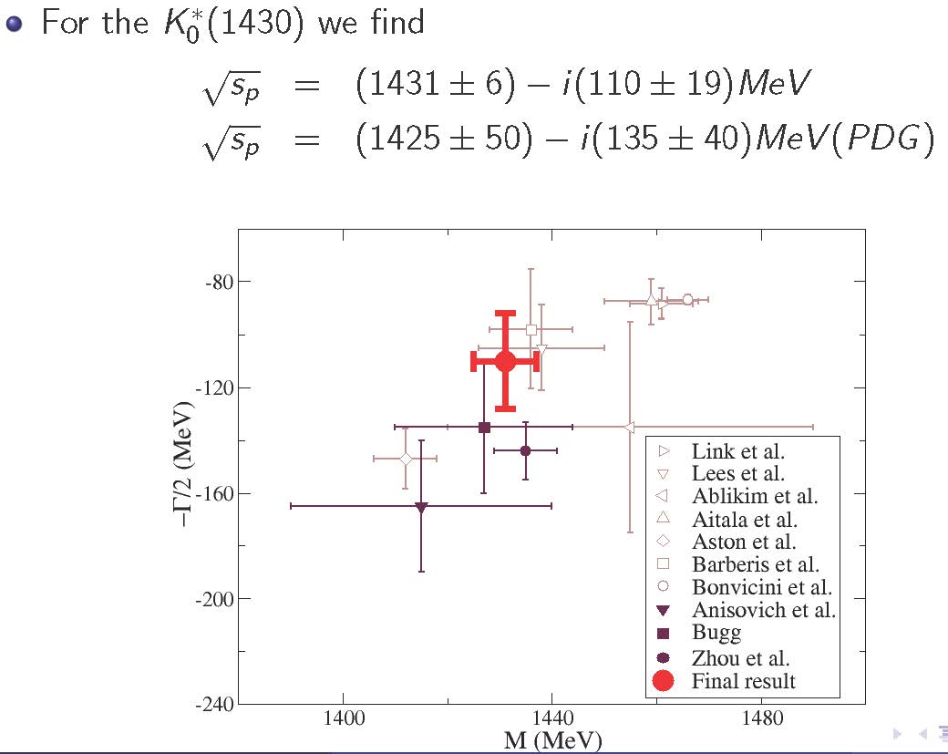
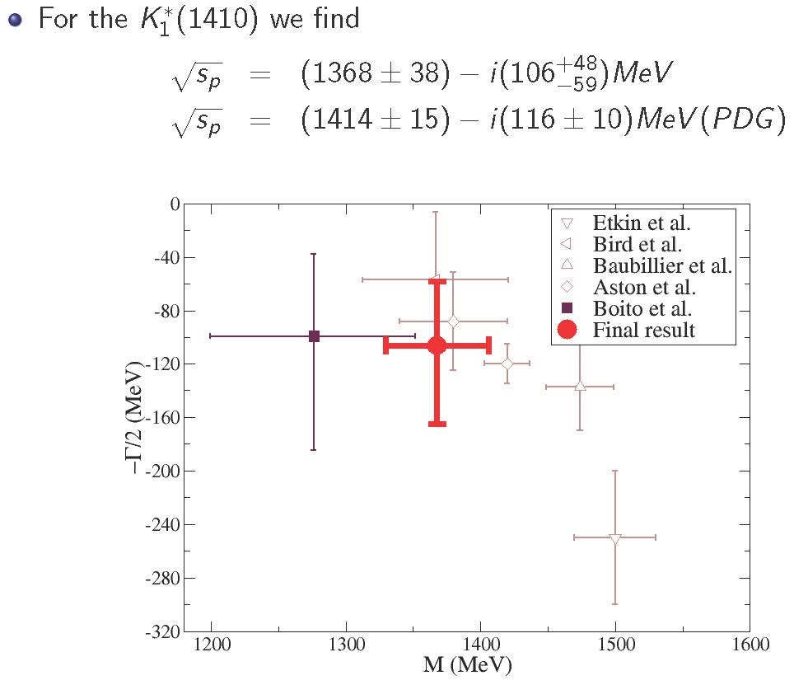
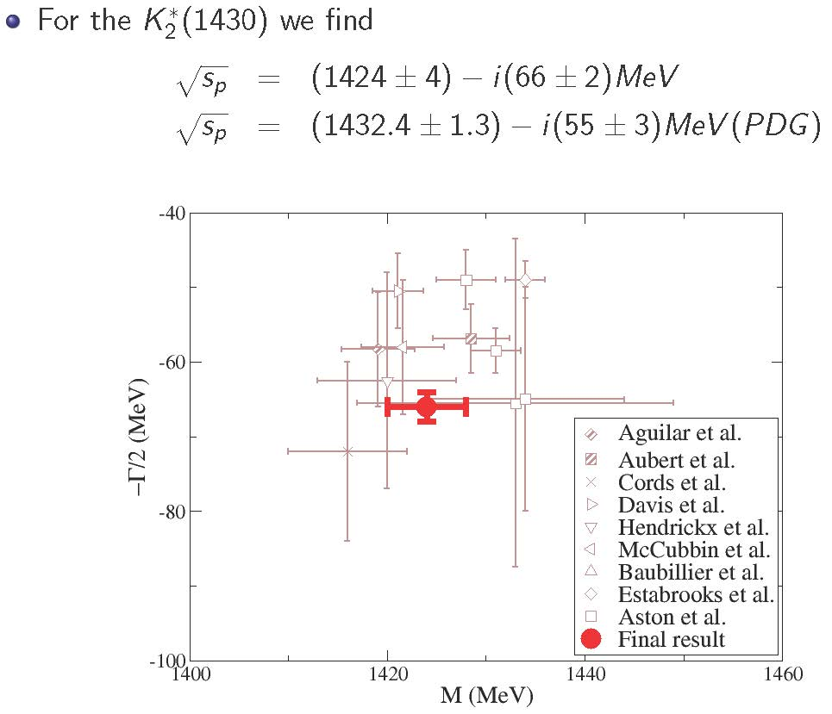
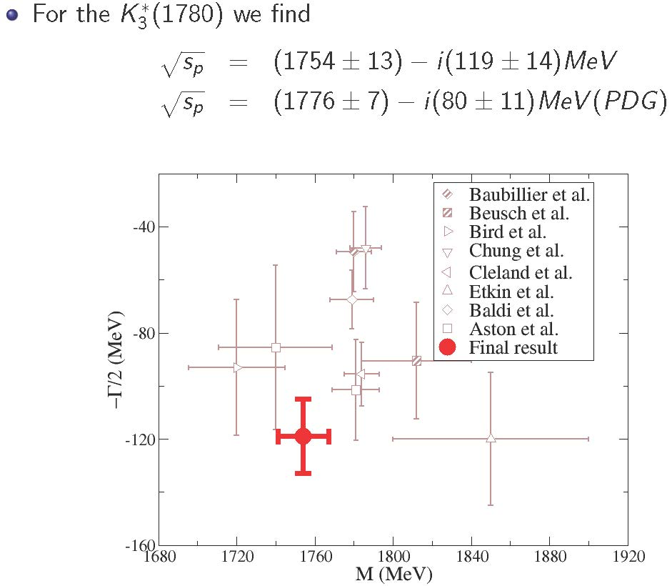
Strange resonance poles from CFD: Using Padé sequences JRP, A.Rodas & J. Ruiz de Elvira. Eur. Phys. J. C (2017)
The method can be used for inelastic resonances too. Provides resonance parameters WITHOUT ASSUMING SPECIFIC FUNCTIONAL FORM

Slide 18
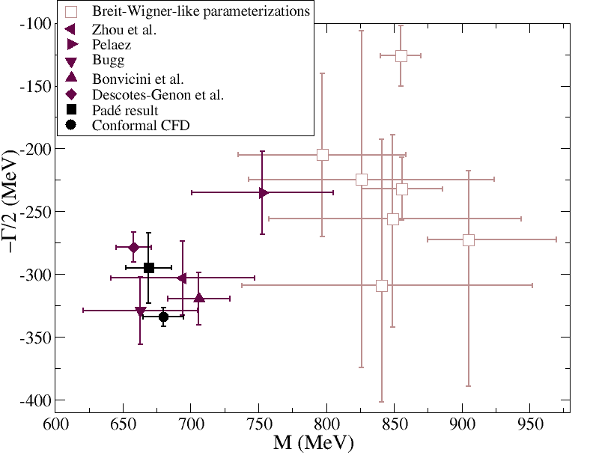
Kappa pole analytic determinations from constrained fits
1) Extracted from our conformal CFD parameterization A.Rodas & JRP, PRD93,074025 (2016)
Fantastic analyticity properties,
but not model independent
(680±15)-i(334±7.5) MeV
2) Using Padé Sequences…
JRP, A.Rodas & J. Ruiz de Elvira. Eur. Phys. J. C (2017) 77:91
(670±18)-i(295± 28) MeV
Compare to PDG2017:
(682±29)-i(273±12) MeV
New PDG2018:
(630-730)-i(260-340) MeV
And name changed
$\text{K}\text{0}\text{∗}$(700)
Still “Needs Confirmation”

Slide 19
Our Dispersive/Analytic Approach for πK and strange resonances
Simple Unconstrained Fits to πK partial-wave Data (UFD).
Estimation of statistical and SYSTEMATIC errors
As πK checks: Small inconsistencies.
Forward Dispersion Relations:
Left cut easy to rewrite
Relate amplitudes, not partial waves
Not direct access to pole
As constraints:
πK consistent fits up to 1.6 GeV
JRP, A.Rodas,Phys.Rev. D93 (2016)
Analytic methods to extract poles: reduced model dependence on strange resonances
JRP, A. Rodas. J. Ruiz de Elvira, Eur.Phys.J. C77 (2017)
As ππ→KK checks: Small inconsistencies.
Partial-wave πK Dispersion Relations
Need ππ→KK to rewrite left cut. Range optimized.
As constraints:
ππ→KK consistent fits up to 1.5 GeV
JRP, A.Rodas, Eur.Phys.J. C78 (2018)

Slide 20
ππ→KK HDR
g^{I}_{J} $=$π$\text{π}→KK$ partial waves. We study (I,J)=(0,0),(1,1),(0,2)
f^{I}_{J} $=K\text{π}→K\text{π} \text{partial} \text{waves}\text{. }\text{Taken} \text{from} \text{previous} \text{dispersive} \text{study}$
JRP, A. Rodas PRD 2016
$G_{J,J′}^{I}$(t,t’) =integral kernels, depend on a parameter
Lowest # of subtractions. Odd pw decouple from even pw.
Δ(t) depend on higher waves
or on Kπ→Kπ.
Integrals from
2π threshold !
Solve in descending J order
We have used models for higher waves, but give very small contributions

Slide 21
ππ→KK HDR
For unphysical region below KK threshold, we used Omnés function
This is the form of our HDR: Roy-Steiner+Omnés formalism
We can now check how well these HDR are satisfied

Slide 22
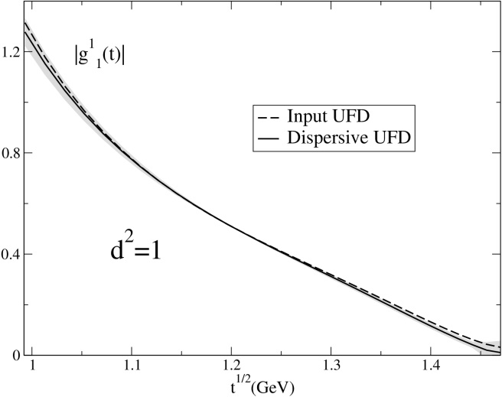
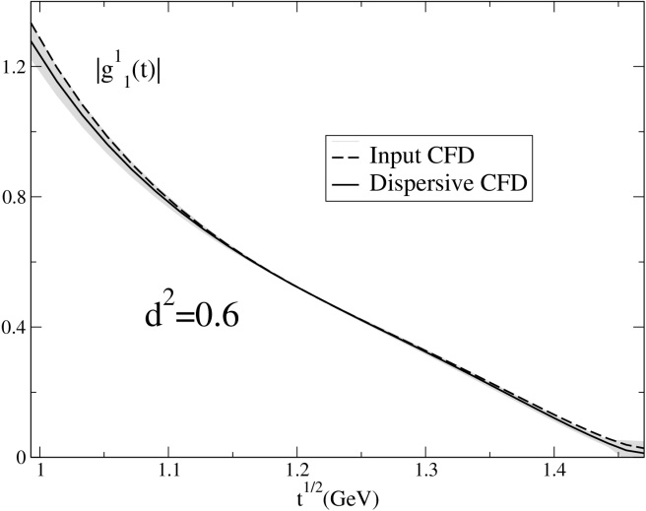
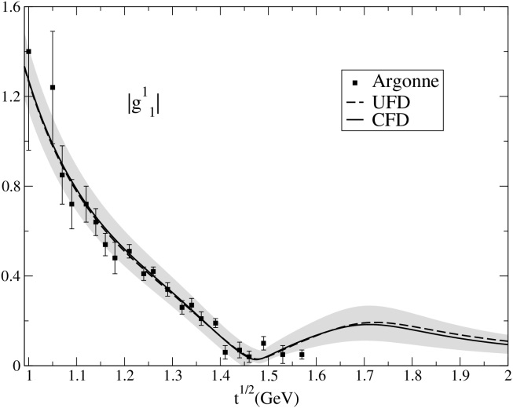
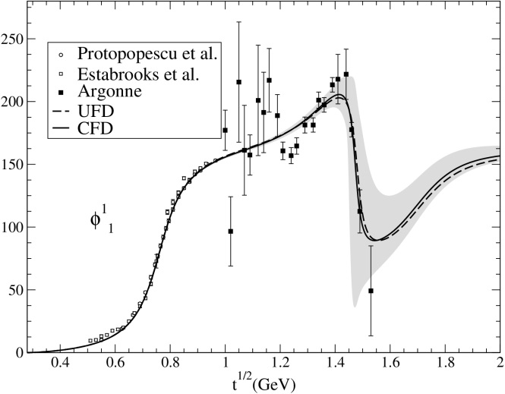
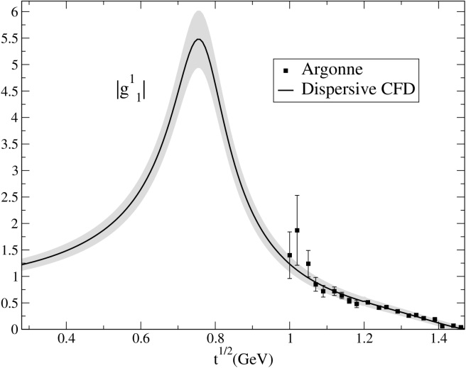
ππ→KK Hiperbolic Dispersion Relations
I=1,J=1, UFD vs.CFD
JRP, A.Rodas, Eur.Phys.J. C78 (2018)
UFD already good
CFD even better
Requires almost imperceptible change from UFD to CFD

Slide 23
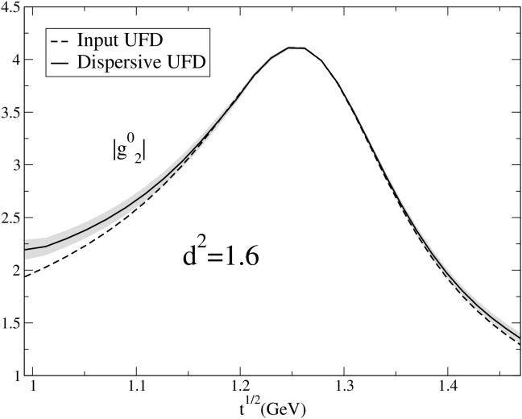
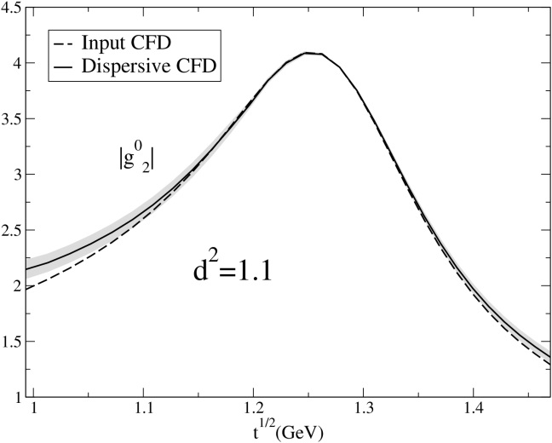
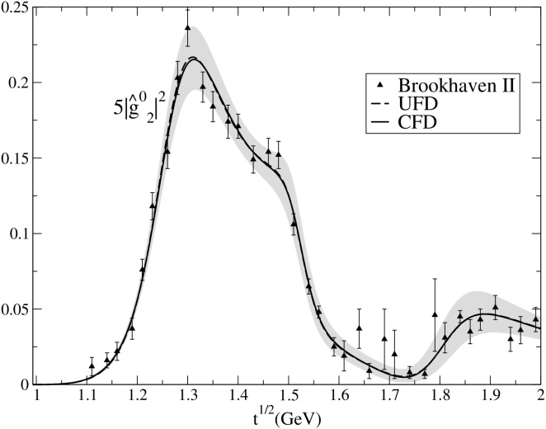
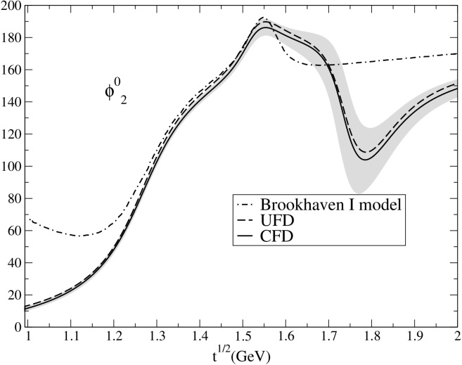
ππ→KK Hiperbolic Dispersion Relations
I=2,J=2, UFD vs. CFD
JRP, A.Rodas, Eur.Phys.J. C78 (2018)
UFD room
for improvement
CFD better
But still tension at threshold
Very small change from UFD to CFD. Only significant at threshold and high energies
Other parameterizations (BW…), worse.

Slide 24
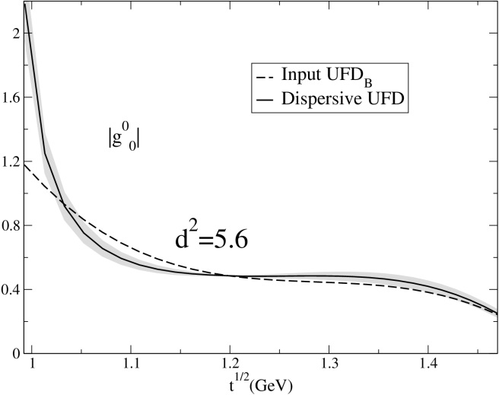
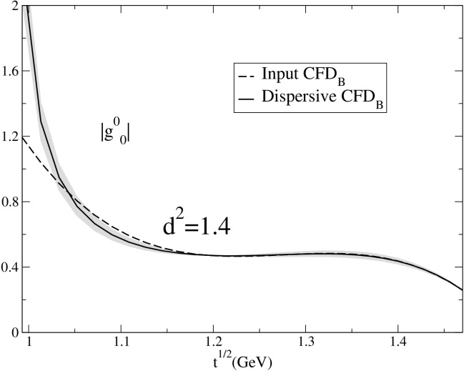
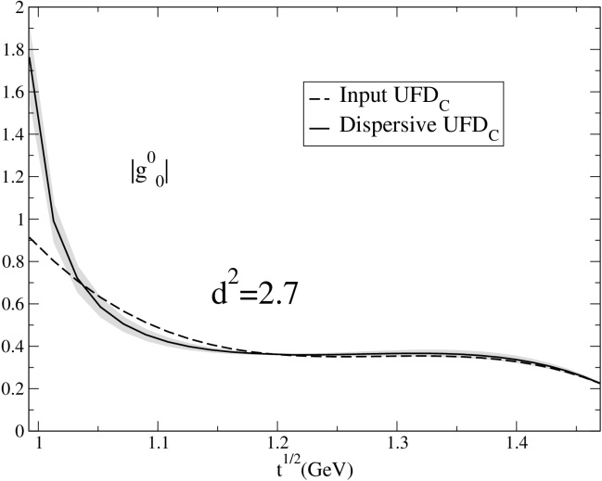
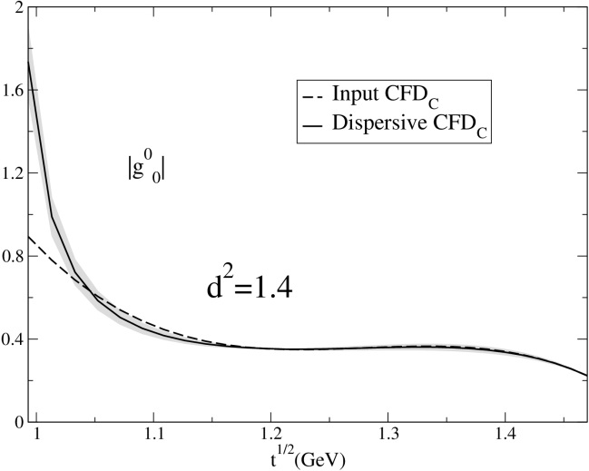
ππ→KK Hiperbolic Dispersion Relations
I=0,J=0, UFD vs. CFD
JRP, A.Rodas, Eur.Phys.J. C78 (2018)
Two possible sets of data
We use I=0,J=2 CFD as input.
Remarkable improvement from UFD to CFD, except at threshold.
Both data sets equally acceptable now.

Slide 25
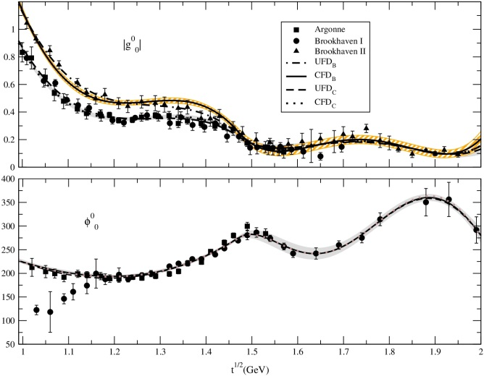
ππ→KK Hiperbolic Dispersion Relations
I=0,J=0, CFD
JRP, A.Rodas, Eur.Phys.J. C78 (2018)
Some 2-σ level differences between UFD_{B} and CFD_{B} between 1.05 and 1.45 GeV
CFD_{C} consistent within 1-σ band of UFD_{C}
2-σ differences between
UFD_{B} and CFD_{B} phase
1-σ differences between
UFD and CFD phase

Slide 26
Our Dispersive/Analytic Approach for πK and strange resonances
Simple Unconstrained Fits to πK partial-wave Data (UFD).
Estimation of statistical and SYSTEMATIC errors
As πK checks: Small inconsistencies.
Forward Dispersion Relations:
Left cut easy to rewrite
Relate amplitudes, not partial waves
Not direct access to pole
As constraints:
πK consistent fits up to 1.6 GeV
JRP, A.Rodas,Phys.Rev. D93 (2016)
Analytic methods to extract poles: reduced model dependence on strange resonances
JRP, A. Rodas. J. Ruiz de Elvira, Eur.Phys.J. C77 (2017)
As ππ→KK checks: Small inconsistencies.
Partial-wave πK Dispersion Relations
Need ππ→KK to rewrite left cut. Range optimized.
As constraints:
ππ→KK consistent fits up to 1.5 GeV
From fixed-t DR:
ππ→KK influence small.
κ/$\text{K}\text{0}\text{∗}$(700) out of reach
JRP, A.Rodas, Eur.Phys.J. C78 (2018)
As πK Checks: Large inconsistencies.
From Hyperbolic DR:
ππ→KK influence important.
ALL DR TOGETHER as Constraints:
πK consistent fits up to 1.1 GeV
JRP, A.Rodas, in progress. PRELIMINARY results shown here

Slide 27
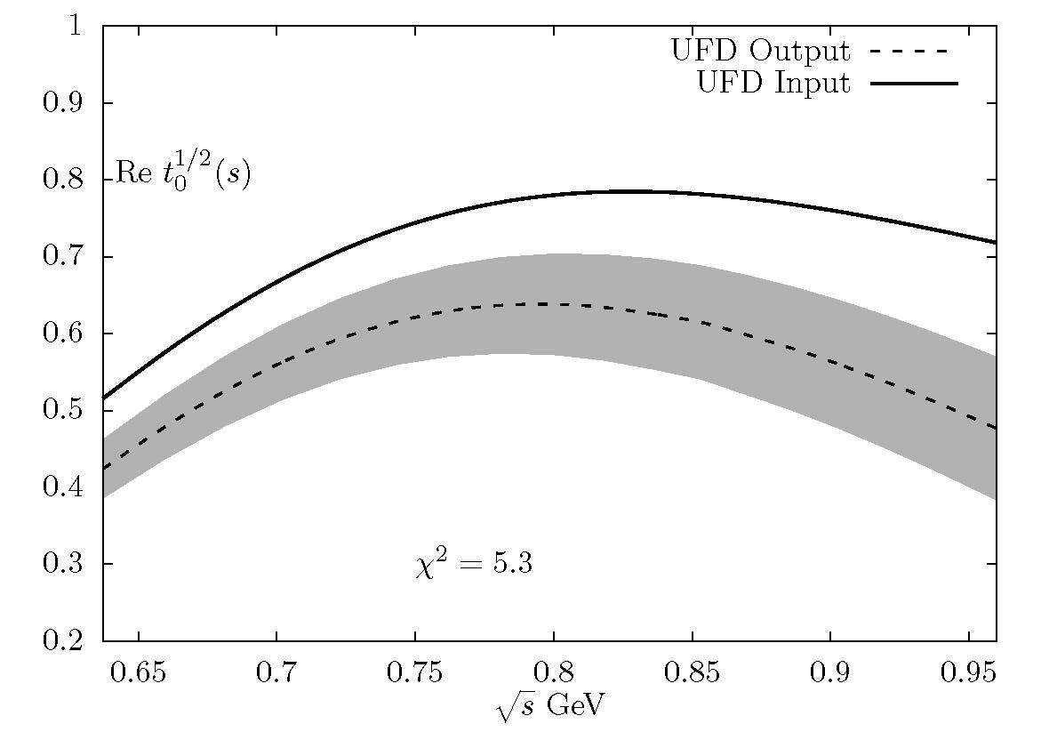
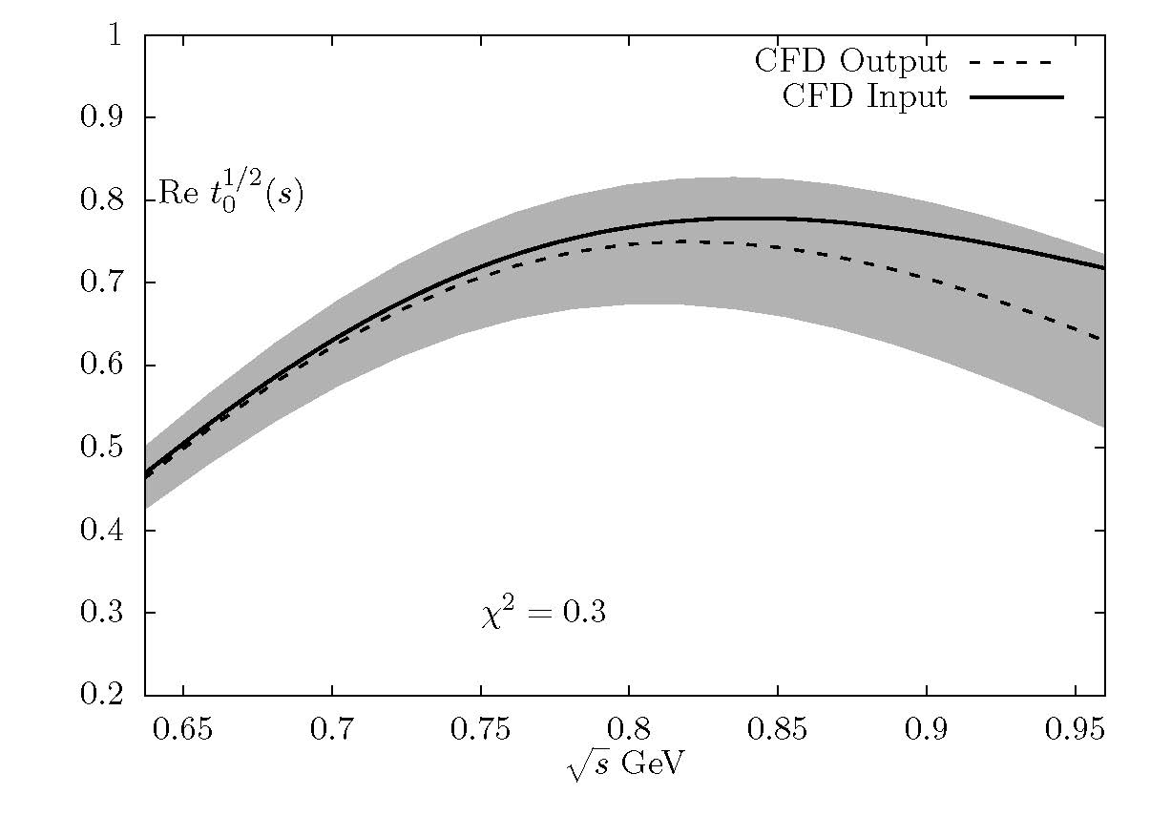
πK Hiperbolic Dispersion Relations I=1/2, J=0
Preliminary!!
LARGE inconsistencies of unconstrained fits with the minimal number of subtractions
(shown here)
Fairly consistent with one more subtraction for F⁻
Consistent within uncertainties
if we use the DR as constraints

Slide 28
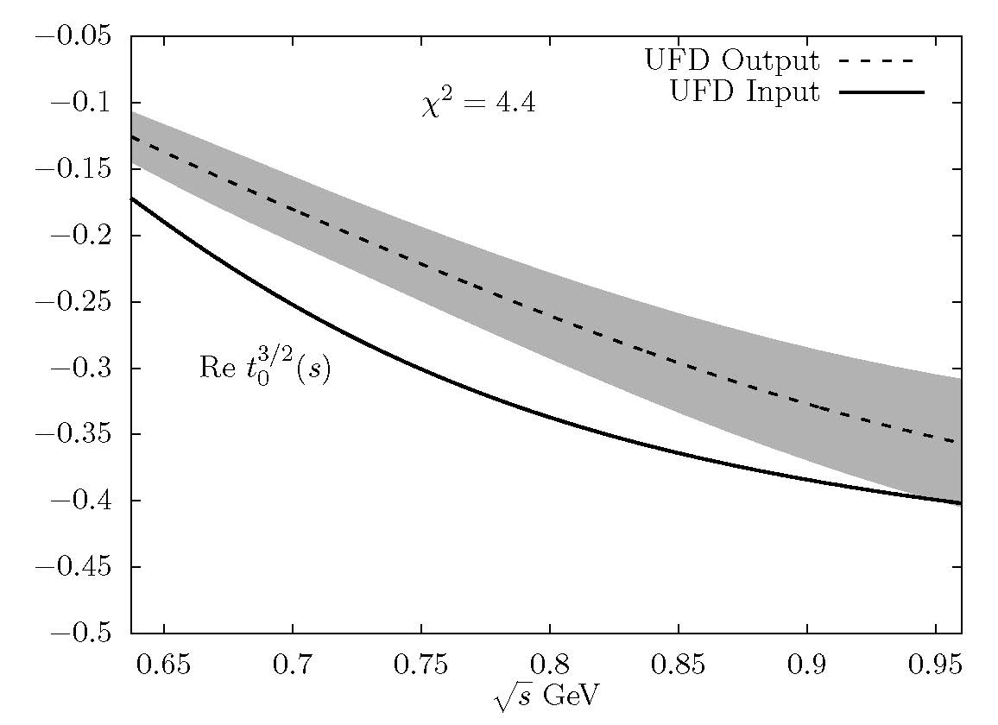
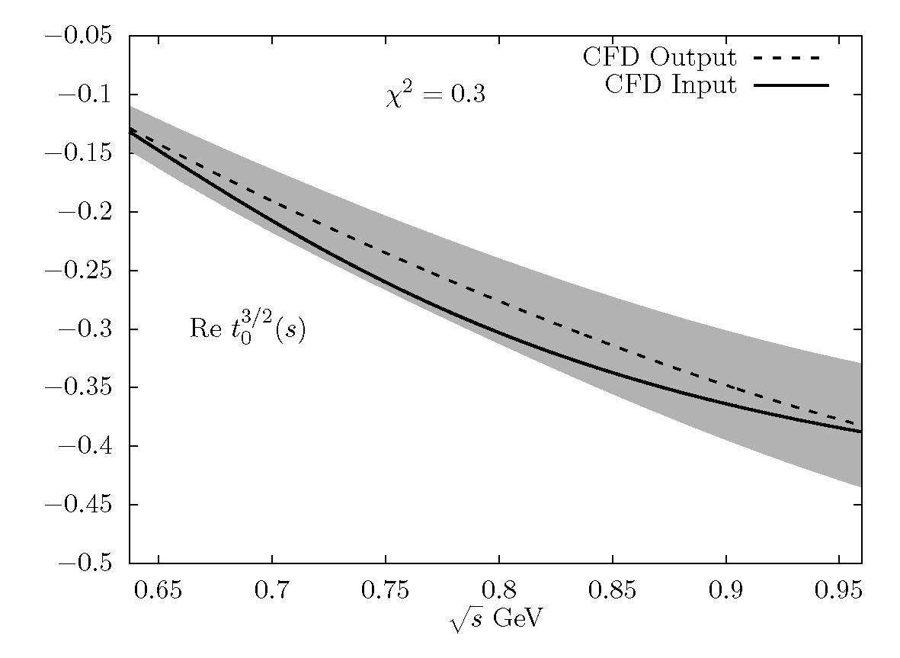
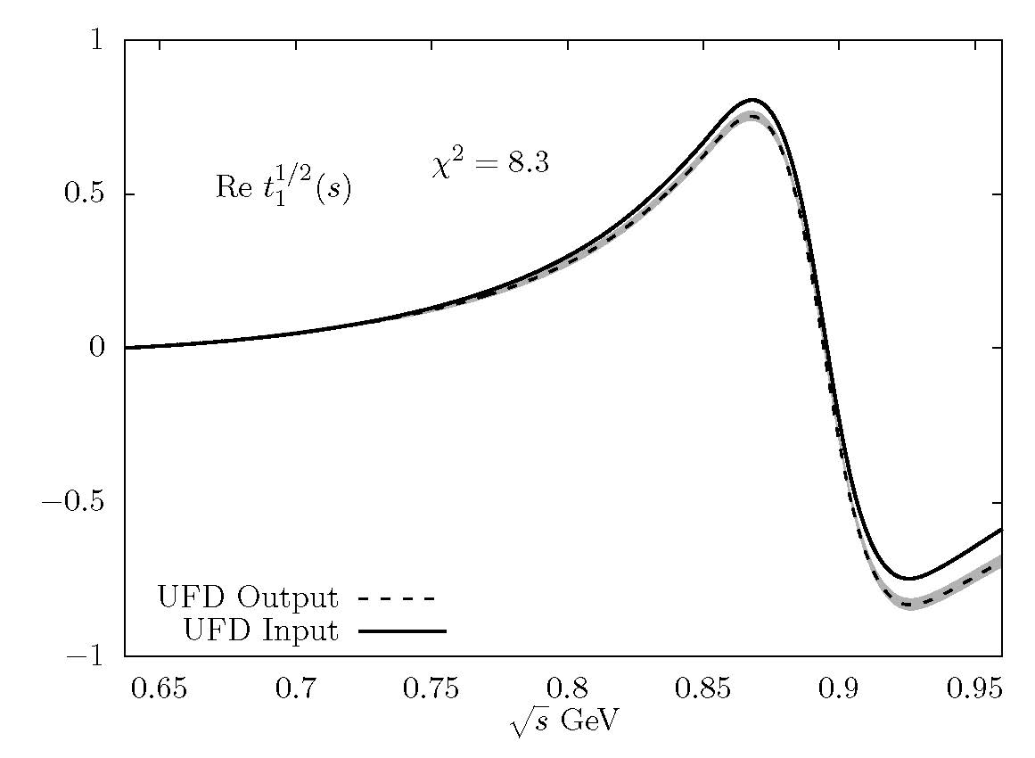
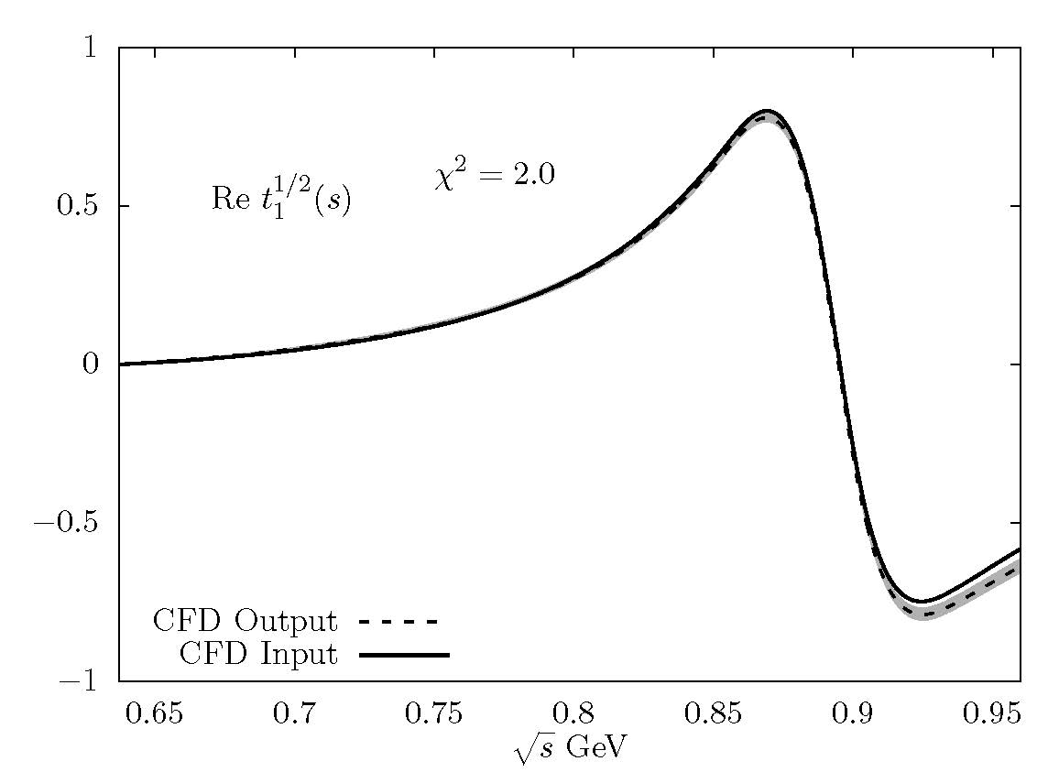
πK Hiperbolic Dispersion Relations I=3/2, J=0 and I=1/2, J=0
Preliminary!!
SIZABLE inconsistencies of unconstrained fits with the minimal number
of subtractions (shown here). Fairly consistent with one more subtraction for F⁻
Made consistent within uncertainties when we use the DR as constraints

Slide 29
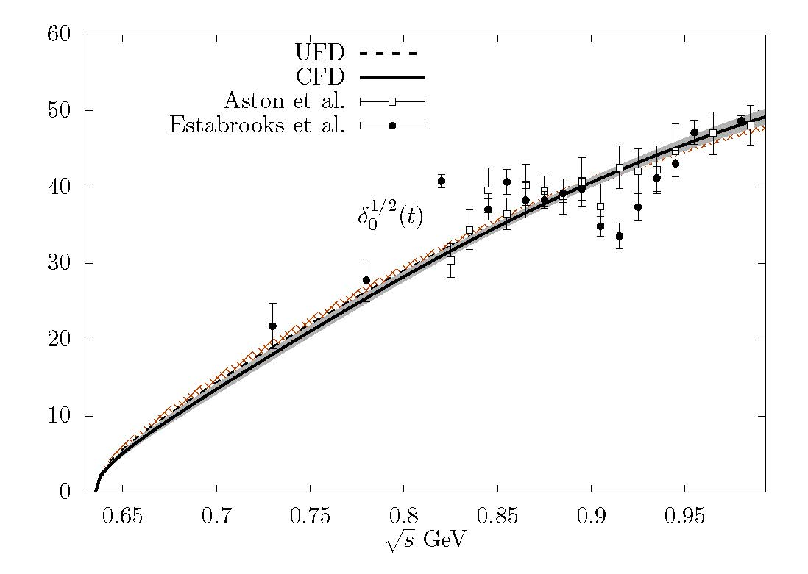
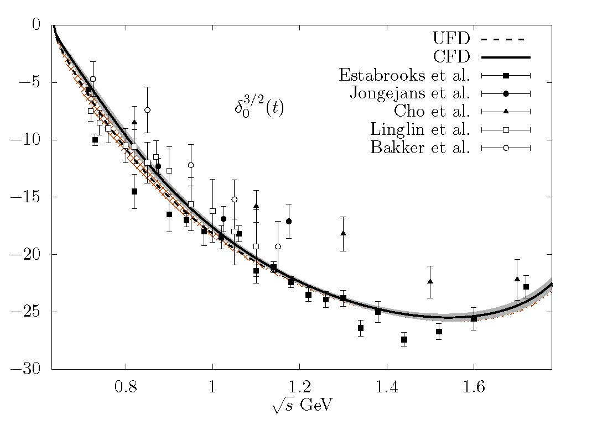
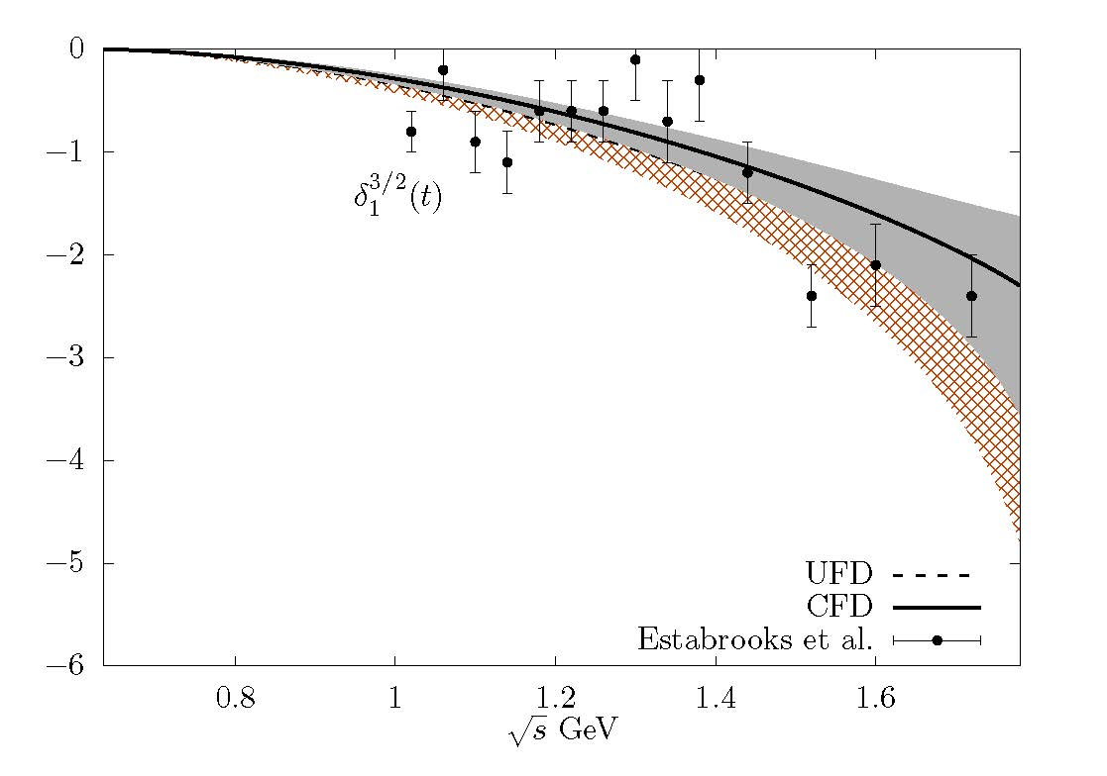
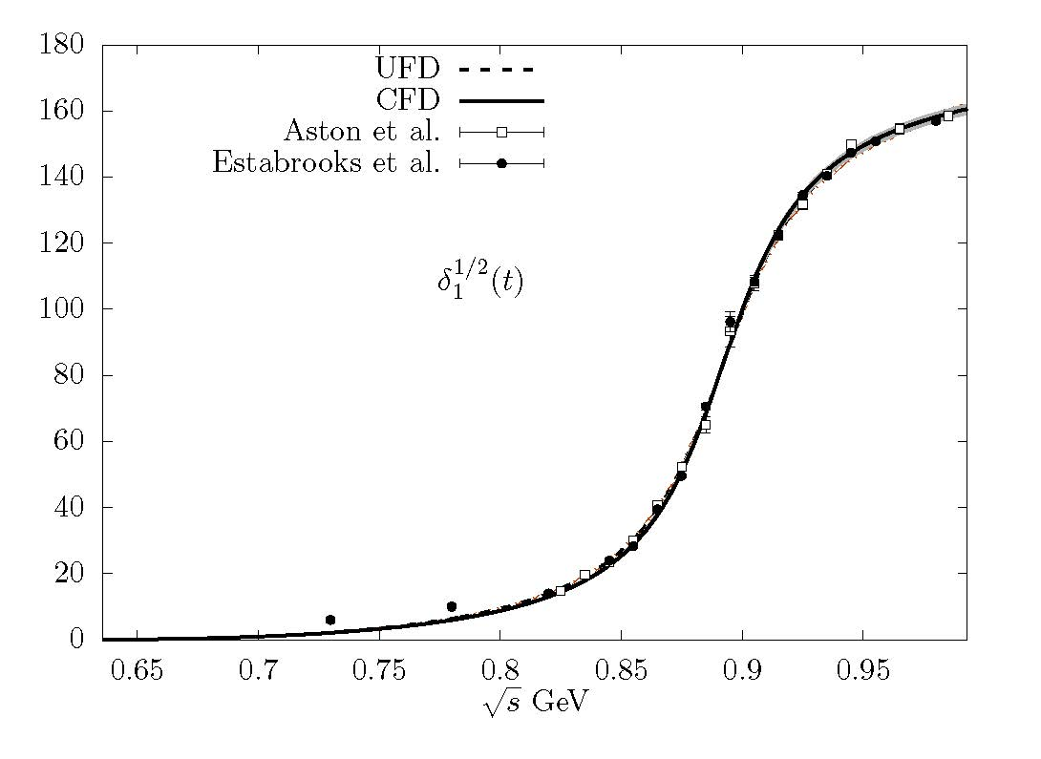
πK CFD vs. UFD
Preliminary!!
Constrained parameterizations suffer minor changes but still describe
πK data fairly well. Here we compare the unconstrained fits (UFD) versus the constrained ones (CFD)
The “unphysical” rho peak in ππ→KK grows by 10% from UFD to CFD

Slide 30
Our Dispersive/Analytic Approach for πK and strange resonances
Simple Unconstrained Fits to πK partial-wave Data (UFD).
Estimation of statistical and SYSTEMATIC errors
As πK checks: Small inconsistencies.
Forward Dispersion Relations:
Left cut easy to rewrite
Relate amplitudes, not partial waves
Not direct access to pole
As constraints:
πK consistent fits up to 1.6 GeV
JRP, A.Rodas,Phys.Rev. D93 (2016)
Analytic methods to extract poles: reduced model dependence on strange resonances
JRP, A. Rodas. J. Ruiz de Elvira, Eur.Phys.J. C77 (2017)
As ππ→KK checks: Small inconsistencies.
Partial-wave πK Dispersion Relations
Need ππ→KK to rewrite left cut. Range optimized.
As constraints:
ππ→KK consistent fits up to 1.5 GeV
From fixed-t DR:
ππ→KK influence small.
κ/$\text{K}\text{0}\text{∗}$(700) out of reach
JRP, A.Rodas, Eur.Phys.J. C78 (2018)
As πK Checks: Large inconsistencies.
From Hyperbolic DR:
ππ→KK influence important.
ALL DR TOGETHER as Constraints:
πK consistent fits up to 1.1 GeV
Rigorous κ/$\text{K}\text{0}\text{∗}$(700) pole
JRP, A.Rodas, in progress.
PRELIMINARY results
shown here

Slide 31
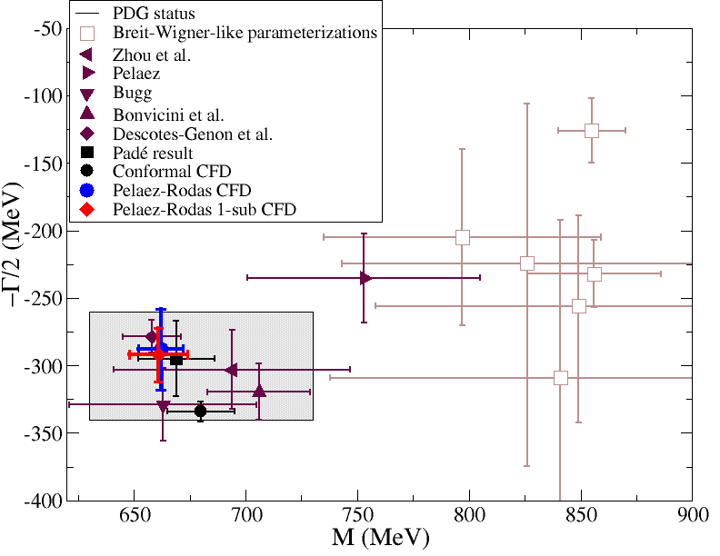
Dispersive pole analysis from constrained fit to data JRP, A. Rodas, in preparation
Preliminary!!
Recall Roy-Steiner SOLUTION from Paris group
Decotes-Genon-Moussallam 2006
(658±13)-i(278.5±12) MeV
Now we have:
Constrained FIT TO DATA (not solution but fit)
Improved P-wave (consistent with data)
Realistic ππ→KK uncertainties (none before)
Improved Pomeron
Constrained ππ→KK input with DR
FDR up to 1.6 GeV
Fixed-t Roy-Steiner Eqs.
Hyperbolic Roy Steiner Eqs.
both in real axis (not before)
and complex plane
Both one and no-subtraction
for F- HDR (only the subtracted one before)
No sub: (662± 9)-i(288±31) MeV
1 sub: (661±13)-i(293±20) MeV

Slide 32
Summary
The πK and π π →KK data do not satisfy well basic dispersive constraints
Using dispersion relations as constraints we provide simple and consistent data parameterizations.
Simple analytic methods of complex analysis can then reduce the model dependence in resonance parameter determinations.
We are implementing partial-wave dispersion relations whose applicability range reaches the kappa pole. Our preliminary results confirm previous studies. We believe this resonance should be considered “well-established”, completing the nonet of lightest scalars.

Slide 33
Dispersive pole analysis from constrained fit to data JRP, A. Rodas, in preparation
Preliminary!!
When using the constrained fit to data both poles come out nicely compatible
No sub: (662± 9)-i(288±31) MeV
1 sub: (661±13)-i(293±20) MeV
Compatible with Paris group
Decotes-Genon-Moussallam 2006
(658±13)-i(278.5±12) MeV

Slide 34
Kappa pole from CFD
1) Extracted from our conformal CFD parameterization A.Rodas & JRP, PRD93,074025 (2016)
Fantastic analyticity properties,
but not model independent
(680±15)-i(334±7.5) MeV

Slide 35
Strange resonance poles from CFD: Using Padé sequences JRP, A.Rodas & J. Ruiz de Elvira. Eur. Phys. J. C (2017)
Almost model independent: Does not assume any particular functional form
(but local determination) CAN BE USED FOR INELASTIC RESONANCES TOO
Based on previous works by P.Masjuan, J.J. Sanz Cillero, I. Caprini, J.Ruiz de ELvira

Slide 36
Why use dispersion relations?
CAUSALITY:
Amplitudes T(s,t) are ANALYTIC in
complex s plane but for cuts for thresholds.
Crossing implies left cut from u-channel threshold
Cauchy Theorem determines T(s,t) at ANY s,
from an INTEGRAL on the contour
If T->0 fast enough at high s, curved part vanishes
Otherwise, determined up to
a polynomial (subtractions)
Left cut usually a problem
Good for:
1) Calculating T(s,t) where there is not data
2) Constraining data analysis
3) ONLY MODEL INDEPENDENT extrapolation to complex s-plane
without extra assumptions

Slide 37
Kappa pole from CFD
1) Extracted from our conformal CFD parameterization A.Rodas & JRP, PRD93,074025 (2016)
Fantastic analyticity properties,
but not model independent
(680±15)-i(334±7.5) MeV
2) Using Padé Sequences…
JRP, A. Rodas & J. Ruiz de Elvira. Eur. Phys. J. C (2017) 77:91
(670±18)-i(295± 28) MeV
Compare to PDG2017:
(682±29)-i(273±12) MeV

Slide 38
The resonance is NO LONGER the κ nor the $\text{K}\text{0}\text{∗(}\text{8}\text{00}\text{)}$
But Still “Needs
Confirmation” !
Best analysis so far:
Roy-Steiner
dispersion relations
Plenty of room
for improvement
on parameters
Our
Pade sequences

Slide 39
Our Dispersive/Analytic Approach for πK and strange resonances
Simple Unconstrained Fits to πK partial-wave Data (UFD).
Estimation of statistical and SYSTEMATIC errors
As πK checks: Small inconsistencies.
Forward Dispersion Relations:
Left cut easy to rewrite
Relate amplitudes, not partial waves
Not direct access to pole
As constraints:
πK consistent fits up to 1.6 GeV
JRP, A.Rodas,Phys.Rev. D93 (2016)
Analytic methods to extract poles: reduced model dependence on strange resonances
JRP, A. Rodas. J. Ruiz de Elvira, Eur.Phys.J. C77 (2017)
As ππ→KK checks: Small inconsistencies.
Partial-wave πK Dispersion Relations
Need ππ→KK to rewrite left cut. Range optimized.
As constraints:
ππ→KK consistent fits up to 1.5 GeV
From fixed-t DR:
ππ→KK influence small.
κ/$\text{K}\text{0}\text{∗}$(700) out of reach
JRP, A.Rodas, Eur.Phys.J. C78 (2018)
As πK Checks: Large inconsistencies.
JRP, A.Rodas, in progress.
PRELIMINARY results
shown here
From Hyperbolic DR:
ππ→KK influence important.
ALL DR TOGETHER as Constraints:
πK consistent fits up to 1.1 GeV
Rigorous κ/$\text{K}\text{0}\text{∗}$(700) pole

Slide 40
Our Dispersive/Analytic Approach for πK and strange resonances
Simple Unconstrained Fits to πK partial-wave Data (UFD).
Estimation of statistical and SYSTEMATIC errors
As πK checks: Small inconsistencies.
Forward Dispersion Relations:
Left cut easy to rewrite
Relate amplitudes, not partial waves
Not direct access to pole
As constraints:
πK consistent fits up to 1.6 GeV
JRP, A.Rodas,Phys.Rev. D93 (2016)
Analytic methods to extract poles: reduced model dependence on strange resonances
JRP, A. Rodas. J. Ruiz de Elvira, Eur.Phys.J. C77 (2017)
As ππ→KK checks: Small inconsistencies.
Partial-wave πK Dispersion Relations
Need ππ→KK to rewrite left cut. Range optimized.
As constraints:
ππ→KK consistent fits up to 1.5 GeV
From fixed-t DR:
ππ→KK influence small.
κ/$\text{K}\text{0}\text{∗}$(700) out of reach
JRP, A.Rodas, Eur.Phys.J. C78 (2018)
As πK Checks: Large inconsistencies.
JRP, A.Rodas, in progress.
PRELIMINARY results
shown here
From Hyperbolic DR:
ππ→KK influence important.
ALL DR TOGETHER as Constraints:
πK consistent fits up to 1.1 GeV
Rigorous κ/$\text{K}\text{0}\text{∗}$(700) pole

Slide 41
Our Dispersive/Analytic Approach for πK and strange resonances
Simple Unconstrained Fits to πK partial-wave Data (UFD).
Estimation of statistical and SYSTEMATIC errors
As πK checks: Small inconsistencies.
Forward Dispersion Relations:
Left cut easy to rewrite
Relate amplitudes, not partial waves
Not direct access to pole
As constraints:
πK consistent fits up to 1.6 GeV
JRP, A.Rodas,Phys.Rev. D93 (2016)
Analytic methods to extract poles: reduced model dependence on strange resonances
JRP, A. Rodas. J. Ruiz de Elvira, Eur.Phys.J. C77 (2017)
As ππ→KK checks: Small inconsistencies.
Partial-wave πK Dispersion Relations
Need ππ→KK to rewrite left cut. Range optimized.
As constraints:
ππ→KK consistent fits up to 1.5 GeV
From fixed-t DR:
ππ→KK influence small.
κ/$\text{K}\text{0}\text{∗}$(700) out of reach
JRP, A.Rodas, Eur.Phys.J. C78 (2018)
As πK Checks: Large inconsistencies.
JRP, A.Rodas, in progress.
PRELIMINARY results
shown here
From Hyperbolic DR:
ππ→KK influence important.
ALL DR TOGETHER as Constraints:
πK consistent fits up to 1.1 GeV
Rigorous κ/$\text{K}\text{0}\text{∗}$(700) pole

