Slide 1
The Collector Ring at FAIR
Dmitriy Berkaev
IWAPT 2015, BINP, Novosibirsk

Slide 2

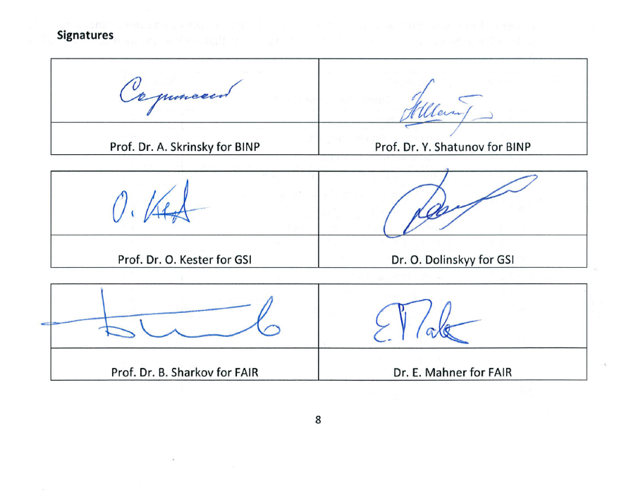
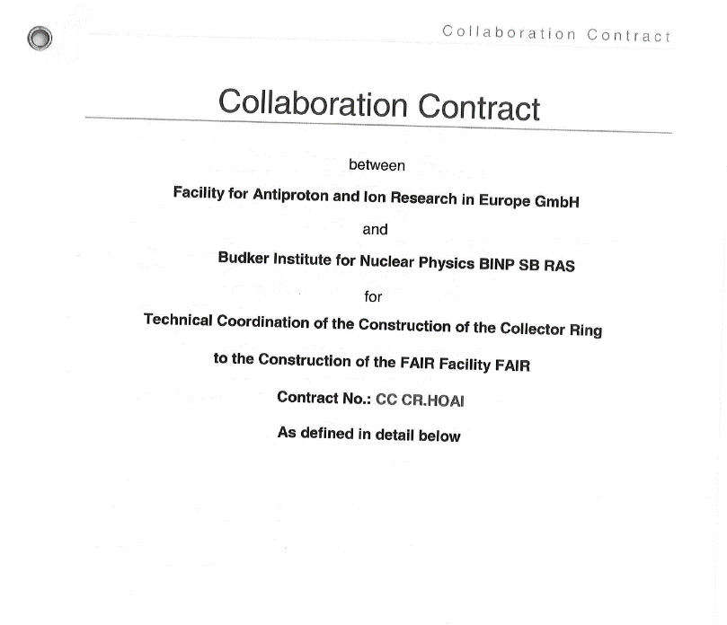
CR Responsibility
MoU between FAIR, GSI and BINP (Oct 2013)
Addendum to MoU (Nov 2013)
Collaboration Contract CC CR.HOAI (Aug 2014)
BINP is responsible for the “general design and corresponding specifications of the CR system” (Article 4.1 of Collaboration Contract)

Slide 3
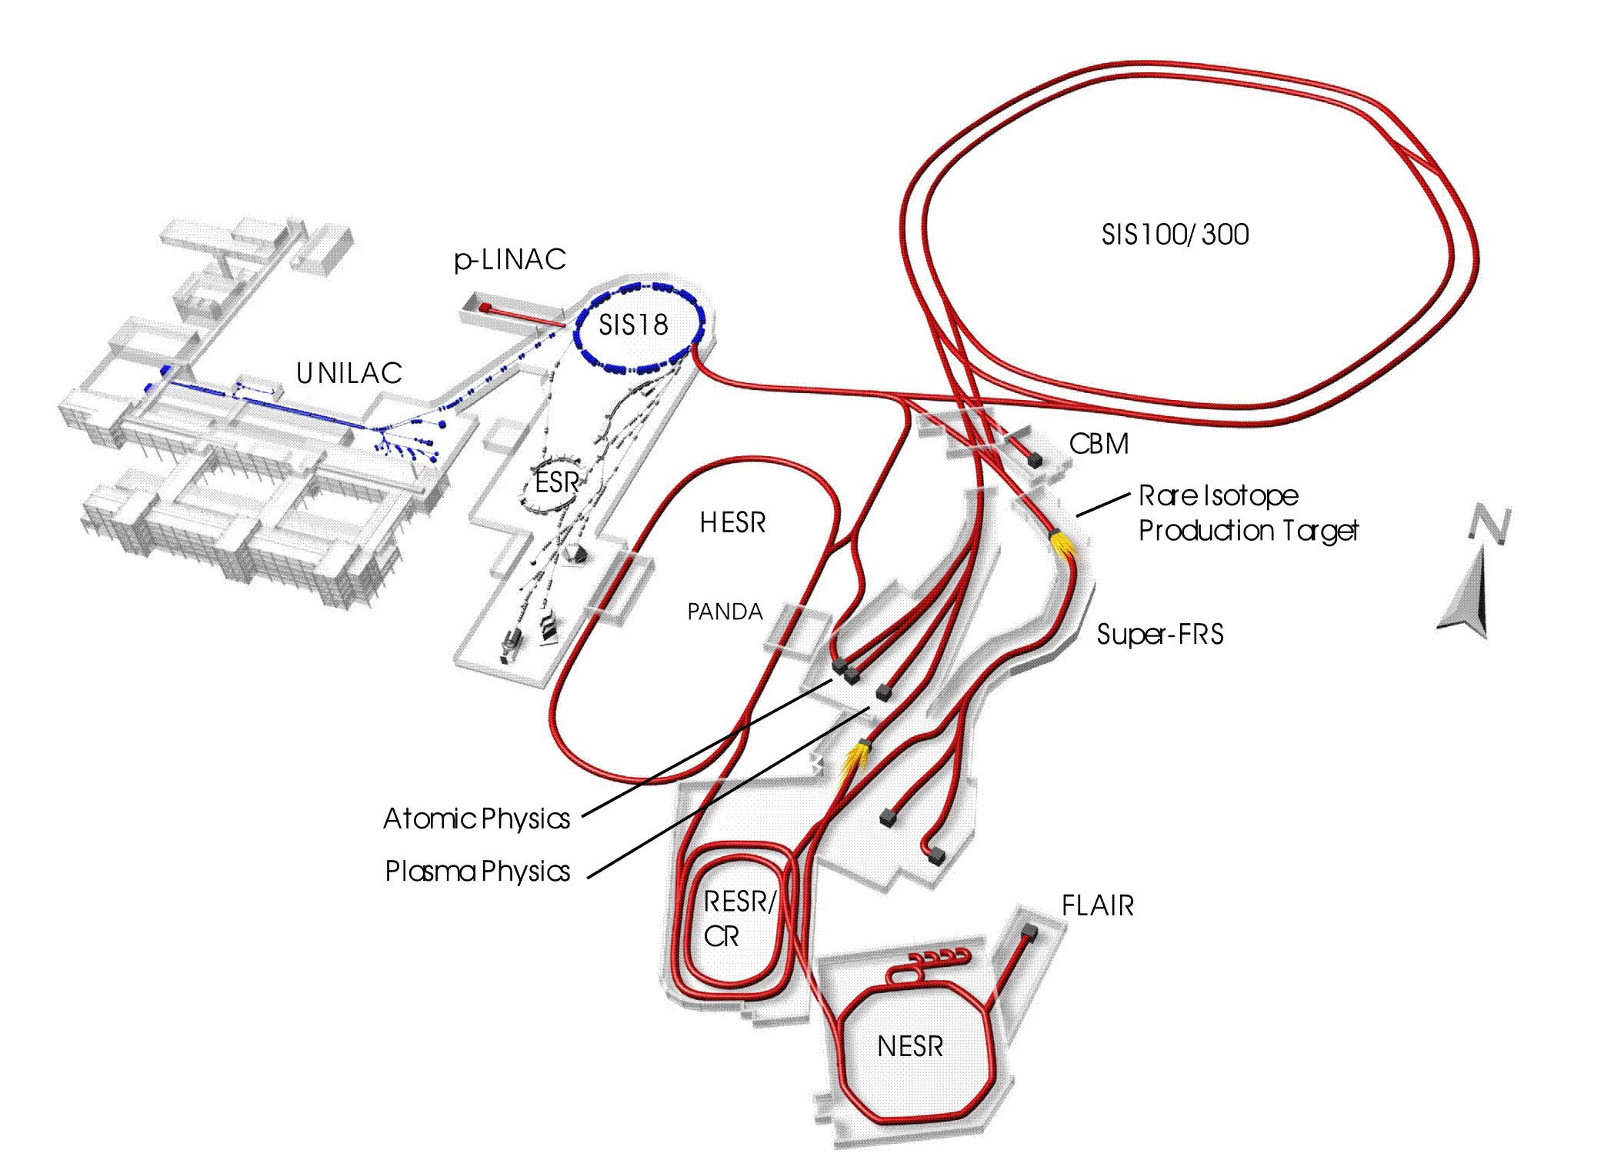
FAIR layout of accelerators
pbar-target/separator
Collector Ring

Slide 4
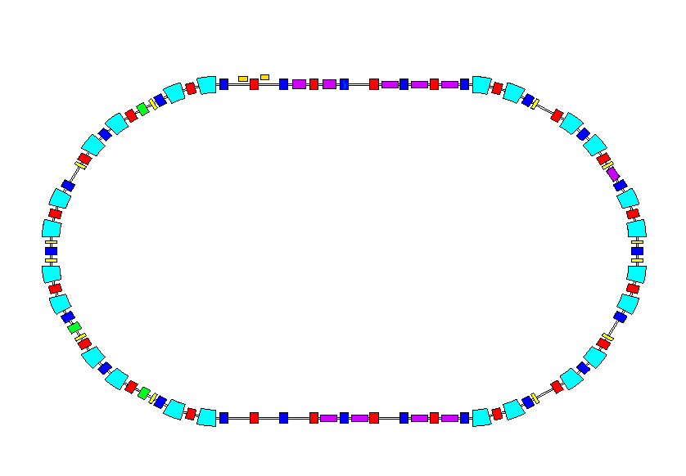
Tasks of the CR*
1. Cooling of secondary beams of radioactive ion beam (RIB)
ε⊥=200 mm mrad
Δp/p=3 %
CR
ε ⊥ ≤ 0.5 mm mrad
Δp/p ≤ 0.05 %
Injection RI beams from the Super-FRS E=740 MeV/u
extraction RI beams to the HESR
~ 1.5 sec
2. Cooling of antiproton beams (P_bar)
CR
ε ⊥ ≤ 5 mm mrad
Δp/p ≤ 0.1 %
Injection from antiproton separator E=3 GeV
ε⊥ =240 mm mrad
Δp/p=6 %
extraction Pbar to the HESR
~ 10 sec
3. Mass spectrometer of radioactive ions RI (TOF)**
CR
Injection RI beams from the Super-FRS E=400 – 800 MeV/u
ε ⊥ =100 mm mrad
Δp/p=1 %
Δf
~ few turns
* Beam Dynamics for CR to be presented in the Dr. D. Schwartz talk (17.11.2015)
** To be presented in the Dr. S. Litvinov talk (17.11.2015)

Slide 5
Present layout of the CR
Injection from
P_bar target or SFRS
Injection Kicker
magnets
Stochastic cooling
Kickers
 | Antiprotons | Ions
Perimeter, П | 221.451 m
Rigidity, Bρ | 13 T⋅m
Number of particles, N | 10⁸ | 10⁹
Kinetic energy, K | 3 GeV | 740 MeV/u
Velocity, v | 0.971c | 0.830c
Relativistic factor , γ | 4.20 | 1.79
Betatron tunes, ν_{x}, ν_{y} | 4.39, 3.42 | 3.40, 3.44
Revolution frequency, ω₀ | 1.35 MHz | 1.16 MHz
RF harmonic, q | 1
Stochastic cooling
Pick-Up
RF – cavities
ToF System
Extraction
to HESR

Slide 6
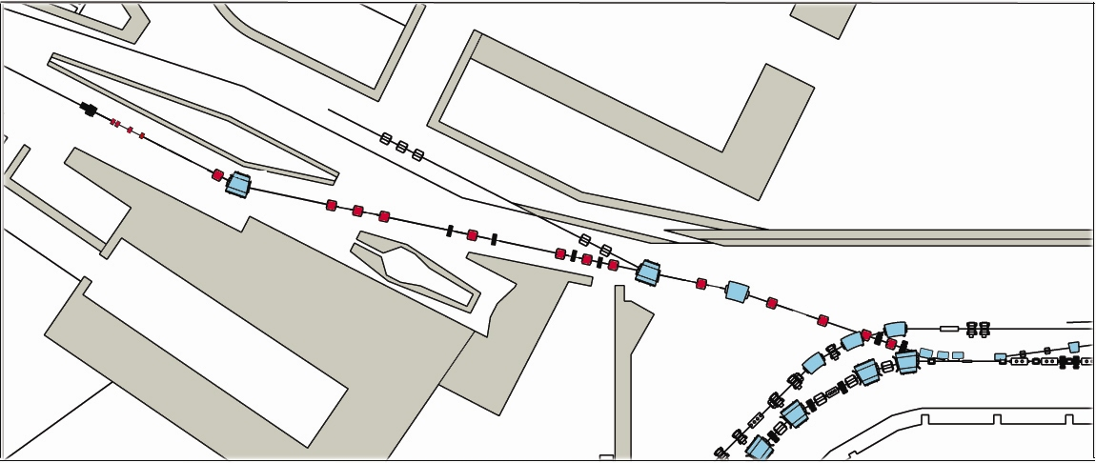
TCR1 Line
29 GeV protons from SIS100
740 MeV/u RIBs
From the SFRS
target station
3 GeV antiprotons
Pbar TL
BINP responsibility
TCR1
CR

Slide 7
CR System Responsibility. Part 2
PSP | Name | Resp. | Resp. Persons
2.5.1 | System design | BINP | Dr. I. Koop(MPL), Dr. D. Berkaev
2.5.2 | Magnets | BINP | Dr. A. Starostenko
2.5.3 | Power Converters | BINP | D. Senkov
2.5.4 | RF System* | GSI | Dr. U. Laier
2.5.5 | Inj/Ext System | BINP | Dr. P. Shatunov, A. Kasaev
2.5.6 | Beam Diagnostics** | BINP/GSI | Yu. Rogovsky / Dr. M. Schwikert
2.5.7 | Vacuum | BINP | Dr. A. Krasnov, Dr, V. Anashin
2.5.10 | SC Cooling* | GSI | Dr. C. Dimopolou
 | Common Systems | GSI | Dr. Thorsten Ziglasch
* To be presented in the Dr. A. Dolinskii Talk (17.11.2015)
** To be presented in the Yu. Rogovsky Talk (17.11.2015)

Slide 8
CR Improvements
Optimization of the CR layout. In order to reduce the beam sizes in the Quadrupoles, Sextupoles and Dipoles approximately by 20% as compared to the initial variants of antiproton and ion optics the positions of Quadrupoles and Sextupoles in the CR arcs have been changed. This reduction was absolutely required due to the fixed parameters (apertures) of the RF cavities (PSP 2.5.4, responsibility of GSI) and Stochastic Cooling subsystem (PSP 2.5.10, responsibility of GSI). The result of layout optimizations is more reliable beam optics for all CR operation modes.
Optimization of the Quadrupole Magnets. We have come to the conclusion that to provide the required free space for other magnetic elements and beam instrumentation it is expedient to increase the number of types of the Quadrupole Magnets with a wide aperture from one to three. All these wide Quadrupole Magnets have the same production technology, very similar electric properties and properties of their Power Converters. More compact and less weighted SWQs are cheaper to manufacture.
Increased number of CR Narrow Quadrupole Magnets. Additional decrease in expenses is reached by means of replacement (everywhere where it is possible in CR) of weak, wide and more expensive Quadrupole Magnets with the Narrow type Quadrupole magnets. Thus, all required CR parameters are provided. Besides the advantages of the new beam optics, this replacement gives a reduction of the total CR magnet system cost. The total number of CR Quadrupole magnets is the same: 40 pcs.
Simplification of the steering magnets design. The presented new layout of CR allowed moving vertical orbit Steering Magnets from the Sextupole Magnets to the increased drift spaces due to the shortened Quadrupole magnets nearby the initial places. Additionally to the significant simplification of the design of the Steering Magnets, the changes provide a reduction of their aperture and power of their PoCos approximately by a factor of two.
Pickups have been moved from Wide Quadrupole Magnets to the closest straight section. Such the approaches led to simplify significantly the design of the both Quadrupole and Sextupole Magnets, their vacuum chambers and the design of the vertical Steering Magnets and pickups.
All the improvements, performed in the close connection with the GSI experts, are aimed to the best performance of the CR and will provide more stable and long-term CR operation.
The increase of antiproton and rare ion beam currents up to 25% can be expected.

Slide 9
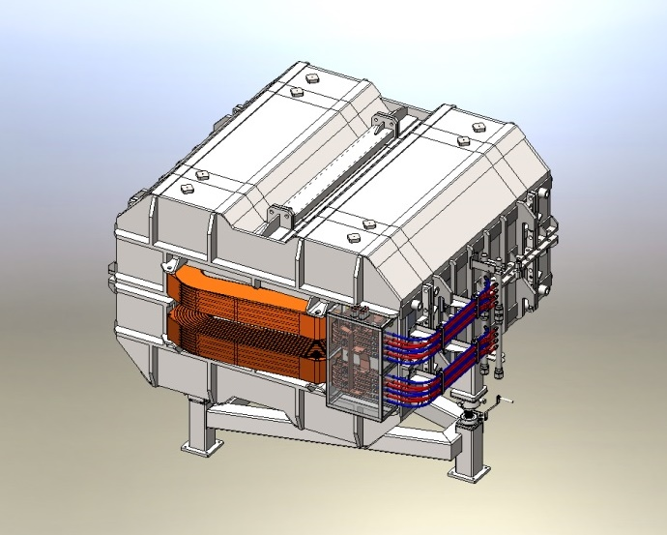
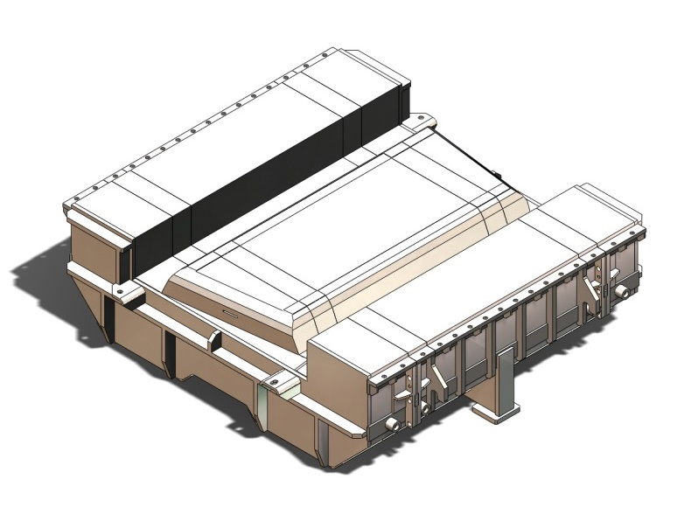
CR magnets: dipole (PSP 2.5.2.1)
For convenience of assembling and shipment each half of the yoke is separated into three parts: 3.8 t, 17.6 t and 3.8 t, which are assembled with bolting
Magnet type | H – type
Geometry | Straight yoke, sector pole
Edge focusing | No
Coils | Race Track
Iron | M1200-100A
Lamination thickness | 1 mm
Number | 24+2

Slide 10
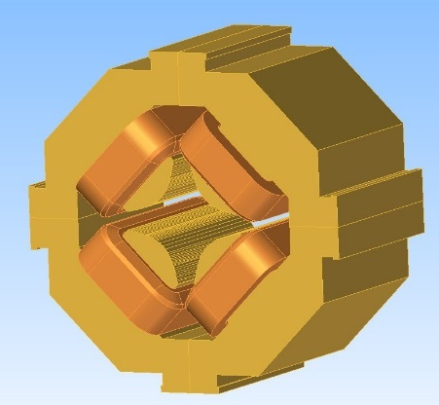
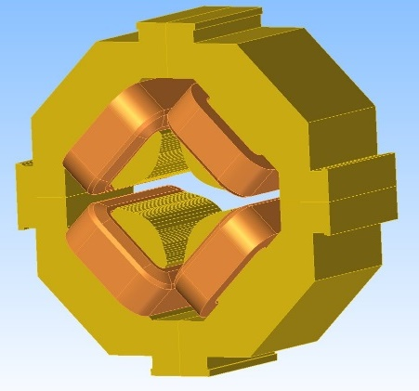
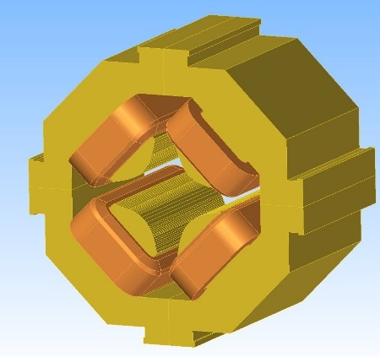
CR magnets: Wide Quadrupole
  WQ type. 14 Quadrupole magnets in the arcs have an inscribed radius of 160 mm with an effective length of 1000 mm, G_{max} = 4.7 T/m;
  SWQ type (Short Wide Quads). The rest 12 arc Quadrupole magnets have the same inscribed radius of 160 mm, but effective length is reduced to 700 mm, G_{max} = 4.7 T/m. It can be done due to a smaller integral of quadrupole field required and the remained drift space can be used for other CR items (see 4) ;
  EWQ type (Extra Wide Quads). 3 Quadrupole magnets right after the injection point should have additional aperture to avoid injected beam losses. An inscribed radius of 185 mm at an effective length of 1000 mm, G_{max} = 3.5 T/m.
All these types of wide Quadrupole Magnets have the same production technology, very similar electric properties and properties of their PS.

Slide 11
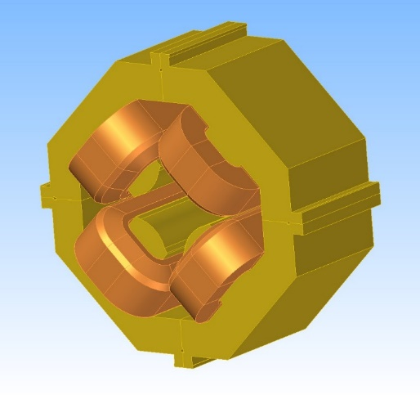
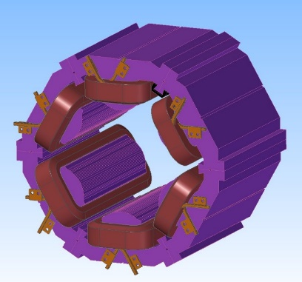
CR magnets:
Narrow Quads & Sextupoles
Increased number of CR Narrow Quadrupole Magnets
(11 instead of 4 in TDR) replaces weak but Wide
(and more expensive) Quadrupole Magnets at all the places of CR where it is possible while maintaining all required CR parameters.
The main advantages of the reviewed CR Sextupole magnets:
Vertical corrector is moved from this magnet. As a consequence the aperture of the Sextupole Magnet (inscribed radius) is reduced down to 201 mm (210 in TDR). Thus, the PS requirements are reduced too: 500A, 17.3 V (580 A and 34.2 V in TDR).
Accurate magnetic and mechanical calculations have shown the necessity of the “return” yoke thickness increasing. Otherwise this magnet will not have enough mechanical strength (hardness). Nevertheless, total weight of the magnet is also reduced down to 1.2 t (1.4 in TDR).

Slide 12
Power Converters
Dipoles
Current: 1400 A
Voltade: 300 V
Quads (three types)
Current: 1500 A
Voltade: 200, 100, 50 V
Sextupoles
Current: 500 A, Voltade: 100 V
Steerers (three types)
Current: 20 A (max), Voltade: 100 V

Slide 13
CR Vacuum⁺
1
2
1000 L/s pump ports
13x2 per arc
3
4
All chambers potentially bake-able
5
About 100p DN500 flange connections,
200 flanges in arcs
300m sealing length !
6
BINP decision:
The only TIG welded flanges guarantee 100p DN500 fail-safe connections
7
⁺Dr. A. Krasnov, Dr. V. Anashin, A. Semenov

Slide 14
Geometrical requirements for orbital TIG welding
BINP have the offer for automatic orbital TIG welding machine…
…and automatic cutting machine as well.
These items will be the part of the CR vacuum equipment.

Slide 15
CR Vacuum
Dipole
1. Decreasing number of flange connections
2. Universalization of pumping system
3. Placement of pumping ports far from Schottky resonators in all the sectors
4. The solution gives space for additional devices

Slide 16
Overview
The CR is a special ring that is designed for fast cooling of RIBs and antiprotons
Stochastic cooling is an essential task of the CR
The optical layout of the ring is chosen to meet the requirements for most efficient stochastic cooling (incl. eta-ramping procedure)
The flexibility in setting the transition energy γ_{tr} to an optimal value is extremely important
One should remember that one needs to install enough diagnostic instruments, COD corrector magnets, high order non-linear correctors

