Slide 1



Beam Diagnostics
Overview for CR
Yury Rogovsky
BINP, Novosibirsk
International Workshop on Antiproton Physics
and Technology at FAIR
17.11.2015
1

Slide 2
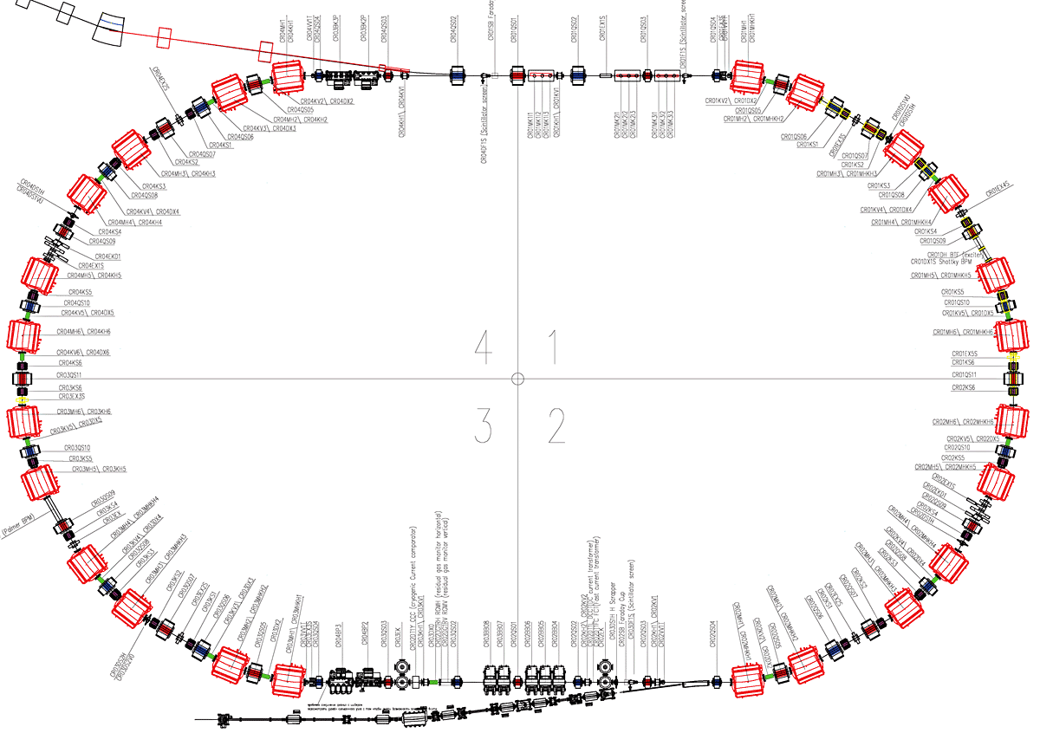
Collector Ring layout
Changes in lattice was
done to fit with
requirements
 | Antiprotons | Ions
Perimeter, П | 221.451 m
Rigidity, Bρ | 13 T⋅m
Number of particles, N | 10⁸ | 10⁹
Kinetic energy, K | 3 GeV | 740 MeV/u
Velocity, v | 0.971c | 0.830c
Relativistic factor , γ | 4.20 | 1.79
Betatron tunes, ν_{x}, ν_{y} | 4.39, 3.42 | 3.40, 3.44
Revolution frequency, ω₀ | 1.35 MHz | 1.16 MHz
RF harmonic, q | 1
CR lattice is kind
of two fold symmetric, but it is not.
2

Slide 3
Beam Diagnostics available for CR
Project | PSP | Descr | Numb | Types
CR | 2.5.6 | Beam Diagnostics
CR | 2.5.6.1 | Current Measurement
CR | 2.5.6.1.1 | DC Transformer | 1 | 1
CR | 2.5.6.1.3 | Cryogenic Current Comparator | 1 | 1
CR | 2.5.6.2 | Beam Position Monitors
CR | 2.5.6.2.1 | BPM Warm Sections | 18 | 2
CR | 2.5.6.3 | Tune and longitudinal Diagnostics
CR | 2.5.6.3.1 | Tune BTF Exciter | 1 | 1
CR | 2.5.6.3.2 | Schottky Pick Up | 1 | 1
CR | 2.5.6.3.4 | Fast Current Transformer | 1 | 1
CR | 2.5.6.4 | Residual Gas Profile Monitor
CR | 2.5.6.4.1 | Residual Gas Profile Monitor | 2 | 1
CR | 2.5.6.5 | Beam Loss System
CR | 2.5.6.5.1 | Beam Loss Monitor | distributed
CR | 2.5.6.6 | First Turn Diagnostics
CR | 2.5.6.6.1 | Scintillation Screen | 5 | 2
CR | 2.5.6.6.2 | SEM-Grid | removed | -
CR | 2.5.6.6.3 | Beam Stopper | 1
CR | 2.5.6.7 | Scraper
CR | 2.5.6.7.1 | Horizontal Scraper | 5 x 2 | 2
CR | 2.5.6.7.2 | Vertical Scraper | 5 x 2 | 2
CR |  | Experimental devices | 2-4 (?) | 4
3

Slide 4
Beam Diagnostics layout @ Collector Ring
Scint. Screen
BPM
BPM
BPM
BPM
BPM
BPM
Scint. Screen
Scrapper
Scrapper
BTF, BB Schtottky
BPM
BPM
Scint. Screen
Scint. Screen
BPM
BPM
Scrapper
DCCTFCT
Scrapper
CCC, RGM
Scint. Screen
BPM
BPM
4
BPM
BPM
Scrapper
BPM
BPM

Slide 5
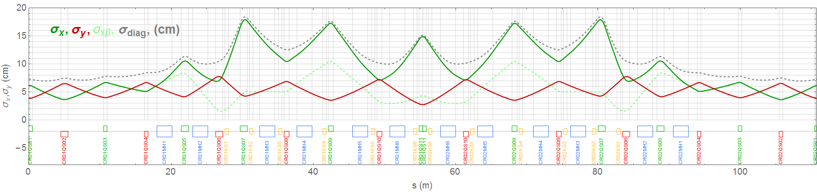
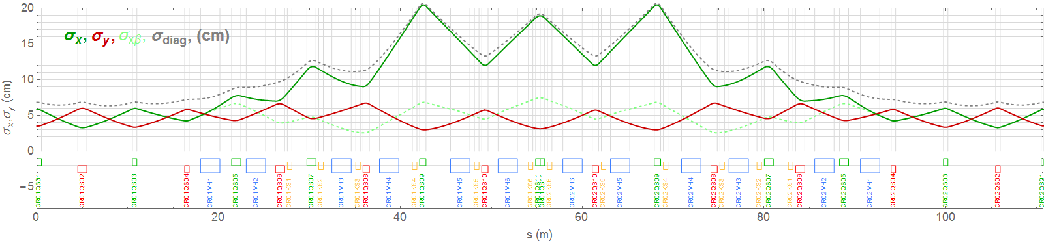
BD layout @ CR lattice functions
(1)
(2)
(2)
(2)
(3)
(4)
(2)
(1)
(2)
(3)
(2)
(1)
(2)
(6)
(2)
(2)
(3)
(5)
Beam Sizes: pbar @ top; rib @ bottom;
(1) – Screen; (2) – BPM; (3) – Scrapper; (4) – BTF & BB Schottky; (5) – DCCT & FCT; (6) – RGM;
5

Slide 6
BD @ CR commissioning
Assuming single injection and we have
to guarantee that beam goes at least one turn
Task of Beam diagnostics :
to detect the “presence” of the beam
to diagnose at which location the beam is lost
 | Low intensity (ions) | High intensity (pions) | Measured quantity
BPM | - | + | intensity, deviation
Schot. reson. | + | + | intensity
BLM | + | + | losses
Screens | + | - | intensity, transv. profile
SEM | - | + | intensity, transv. profile
Beam stopper | + | - | intensity
Scraper |  |  | losses (together with BLM)
FCT | - | + | intensity, long. profile
10^8 antiprotons: 20 uA average current
10^9 ions: 16 mA average current
Intensity ranges:
low intensity (< 1 mA)
intermediate intensity
high intensity (>1 mA)
For antiprotons a low intensity is expected,
but because it will be “supported” by pions
the beam can be considered as high intensity.
What will be the first beam in the CR?
Screens, BLM can be optimized
for both pbar and ions?
6

Slide 7
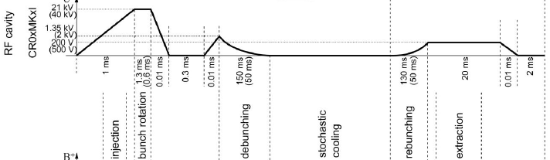
BD @ CR stable operation
 | Bunch rotation | Debunching | Cooling | Rebunching | Extraction | Measured quantity
BPM | + | + | - | + | + | Closed orbit
FCT | + | + | - | + | + | Bunch long. profile
DCT, CCC | + | + | + | + | + | DC current
RGM | - | - | + | - | - | Transv. profile
Schottky resonator | - | - | + | - | - | Momentum distr.
1/Bunching factor
(1/duty cycle)
15
3
1
15
7

Slide 8
BD @ CR stable operation
 | Plateau 1 | Plateau 2 | Plateau 3 | Application
Exciter + Scrapers + BLM + DCT /CCC | + | + | - | Apperture and acceptance studies, Halo detection
Exciter + BPM / Reson. | - | - | + | Chromaticity, Tunes
FCT | + | + | + | RF test
BPM | + | + | + | Closed orbit
plateau 1
(also without RF)
plateau 2
plateau 3
1/Bunching factor
(1/duty cycle)
15
3
1
15
8

Slide 9
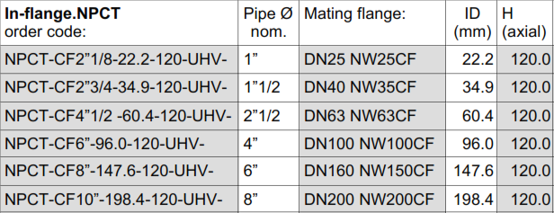
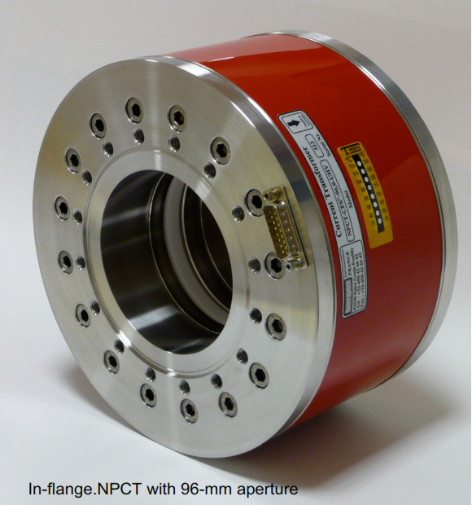

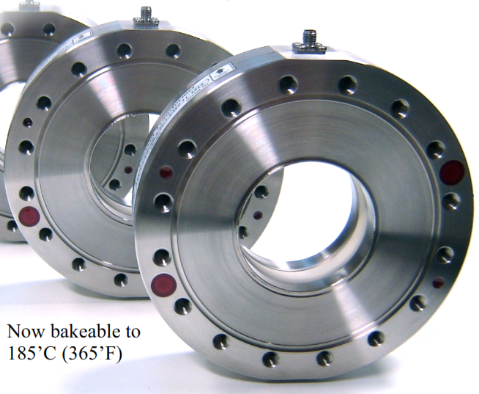
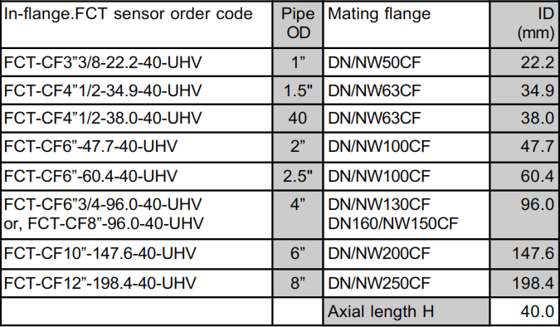
DCCT and FCT (commercially available)
9

Slide 10
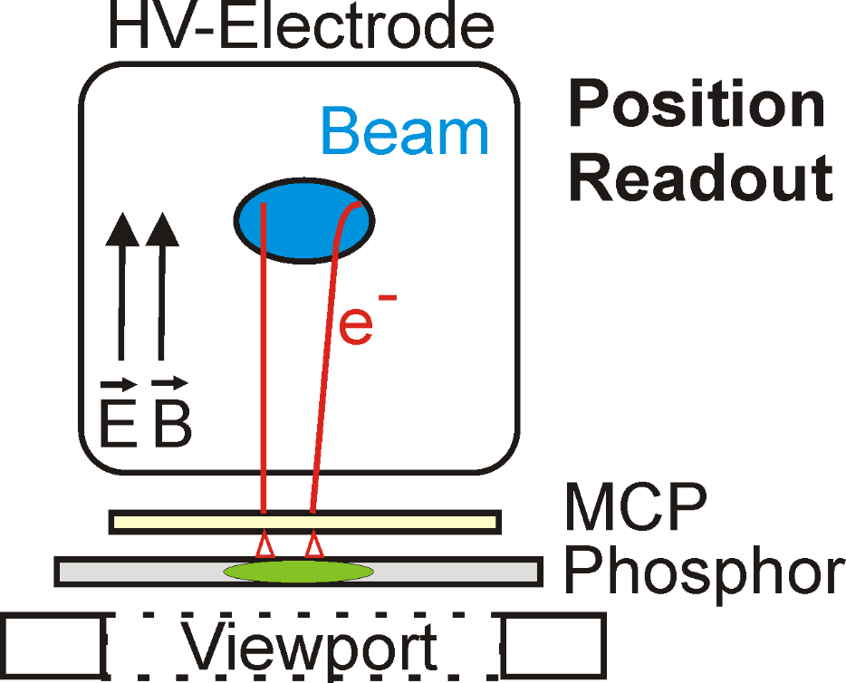
Ionization Profile Monitor aka RGM
IPM principle
Profile measured for 1000 ions
For P = 10⁻⁹ mbar, T = 300 K, n = 2.7∙10⁷ cm⁻³.
For Ϭion = 10⁻¹⁸ cm², N = 10⁸ and detector length L = 5 cm ion frequency is 1.5∙10⁴ Hz.
10

Slide 11
Variants for IPM detector
1. After MCP electrons move to phosphor screen. Picture from screen is red by CCD camera.
2. After MCP electrons move to resistive plate. Position of electron cloud is measured by difference in charge in two ends of the plate.
The advantage of this approach is a total elimination of the transformation of particle flux to light, which, due to the reflections can lead to spurious peaks in the measured profile.
11

Slide 12
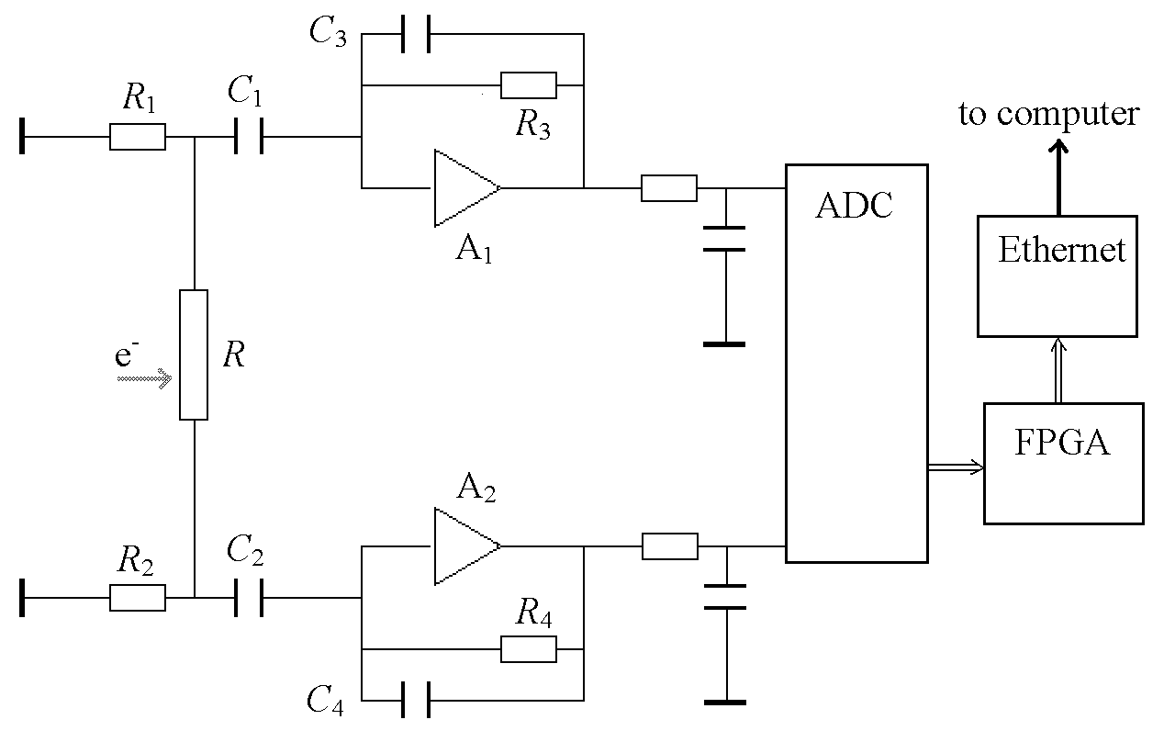
Electronics for resistive plates variant
Structure of readout electronics for resistive plate detector
Current measured from both sides of the plate (simulation)
12

Slide 13
IPM construction
IPM with phosphor screen
13

Slide 14

Fluorescent screen aka Scintillator screen
Beam
Pneumatic actuator
Screen is parked
Light to lens and CCD camera
Screen is moved by pneumatic actuator as a “semaphore”. The screens have two different apertures (∅ 200 mm and 400 mm) and the same design.
14

Slide 15
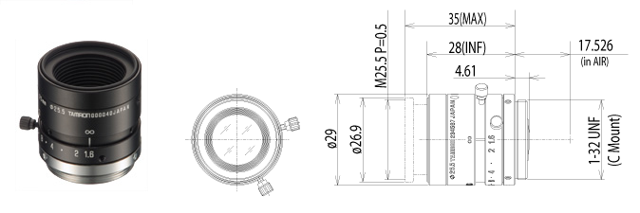
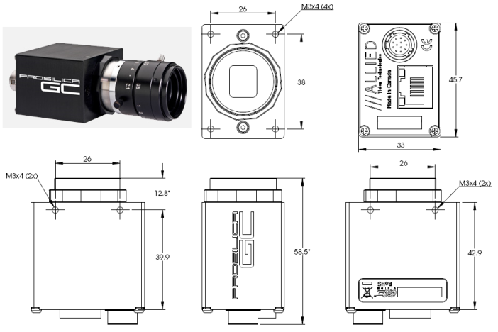
Fluorescent screen & equipment
Objective lens Tamron M118FM25
Beam
Imager Size | 1/1.8
Mount Type | 1200 N
Focal Length | 800 N
Aperture Range | 100 mm
Angle of View (hor×ver) | 16.6°×12.5°
TV Distortion | less than 0.2%
Focusing Range | 0.1 m – ∞
Operation | Manual with lock
Filter Size | M25.5 P=0.5 mm
Back Focus(in air) | 12.92 mm
Weight | 39 g
Operating Temperature | –10°C – +60°C
Resolution | 1280 × 960
Max frame rate at full resolution | 32 fps
Type | CCD Progressive
Interface | IEEE 802.3 1000baseT
A/D | 12 bit
Output | 8/12 bit
Sensor Size | Type 1/3
Sensor | Sony ICX445
Cell size | 3.75 µm
On-board FIFO | 16 MB
Body Dimensions (L×W×H in mm) | 33×46×59 including connect., w/o tripod and lens
Light to lens and CCD camera
15

Slide 16
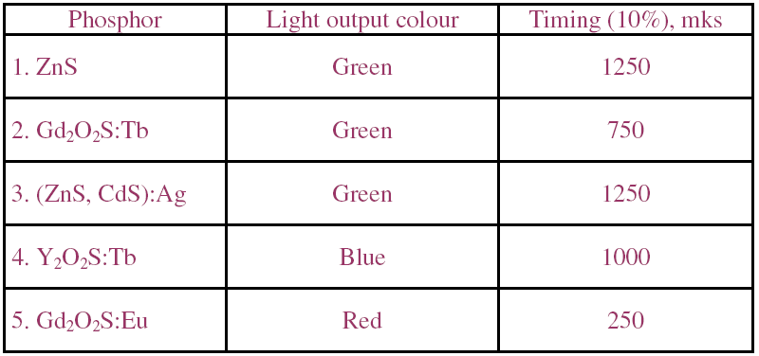
Fluorescent screen & phosphors coating
Light yield for phosphors, measured with 350 MeV electrons @ VEPP4M
16

Slide 17
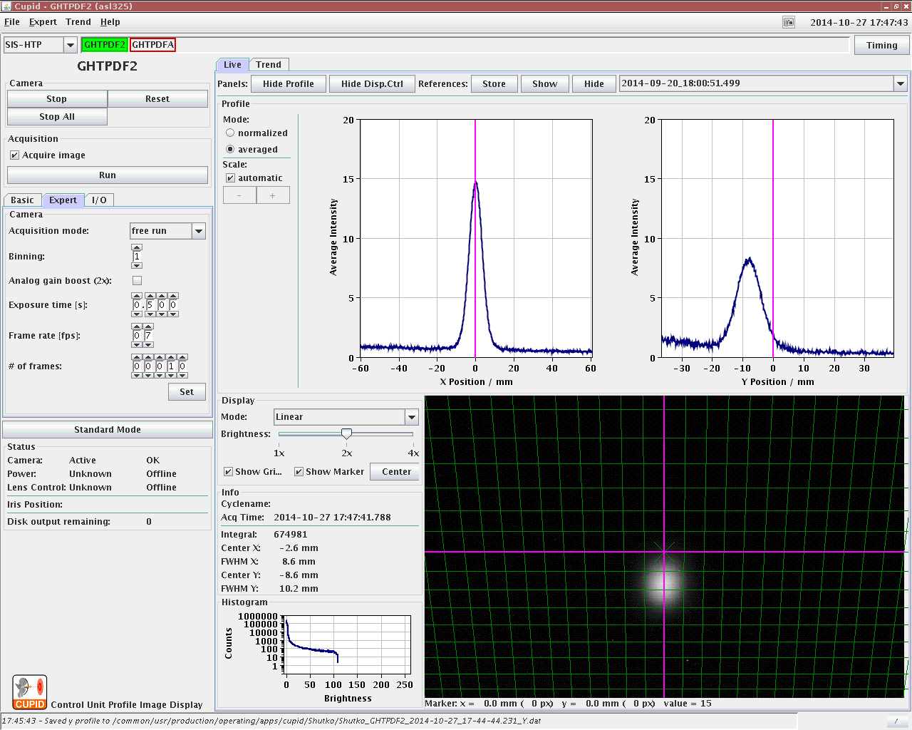
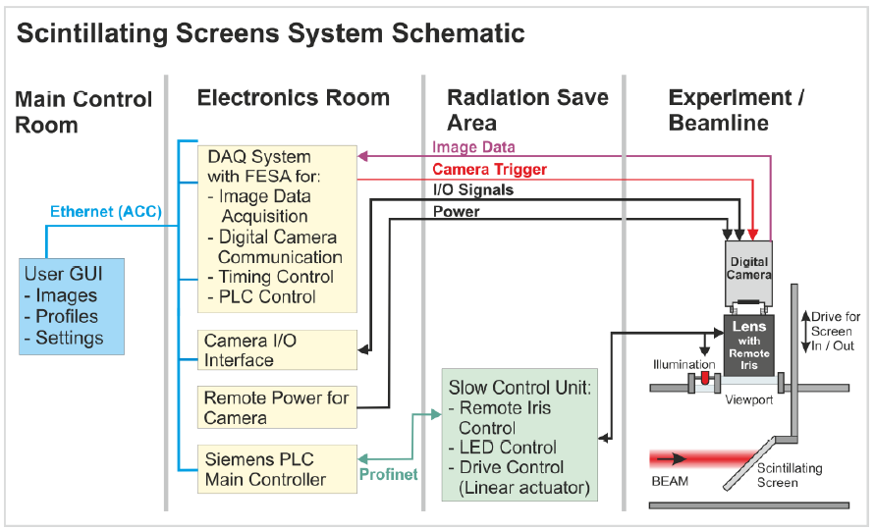
Fluorescent screen & DAQ, UI
Comissioning this year, during beam time at GSI
CPUID – Control Unit for Profile and Image DATA
GUI screenshot during one of the measurements
17
courtesy: O. Chorniy, LOBI/GSI

Slide 18
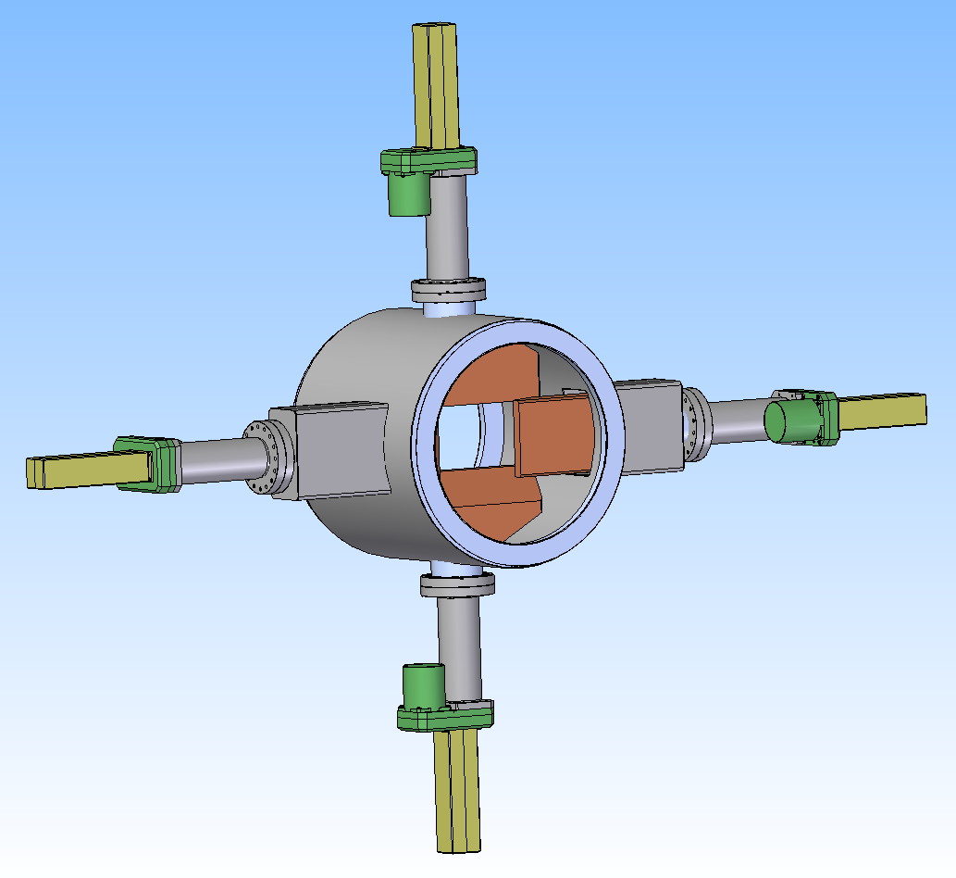
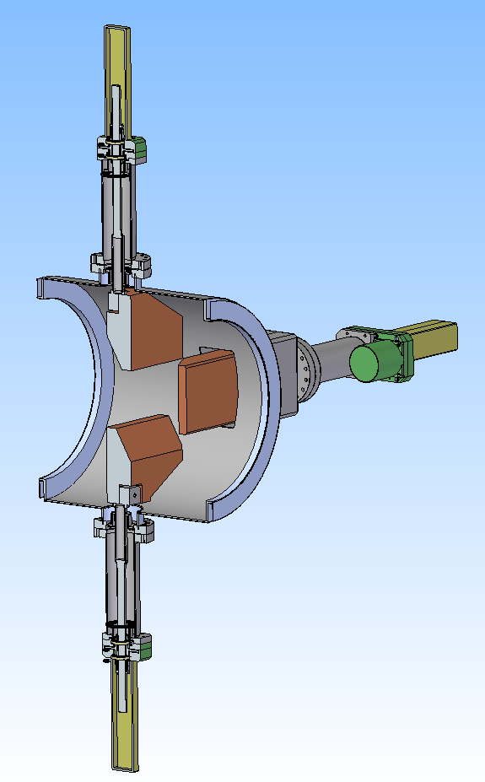
Beam Scrapper
The scrappers, as well as screens, have a same design for two different apertures. Each scrapper has 4 blades. The twosome blades restrict the beam aperture at X and Y directions.
18

Slide 19
BPM geometry
Linear cut type BPM is advantageous for beams that are transversally large and have a complex charge distribution
Available space between elements in CR (about 630 mm) leaves up to 250 mm length for BPM electrodes for X/Z direction
Horizontal an vertical plates in series
The aperture of the BPM plates is close to the aperture of the nearby quadrupole chamber
BPM plates are mounted into special casing which helps to form all needed parameters and prevent from mechanical displacement
BPM is located at round chamber with 450 mm diameter
19

Slide 20
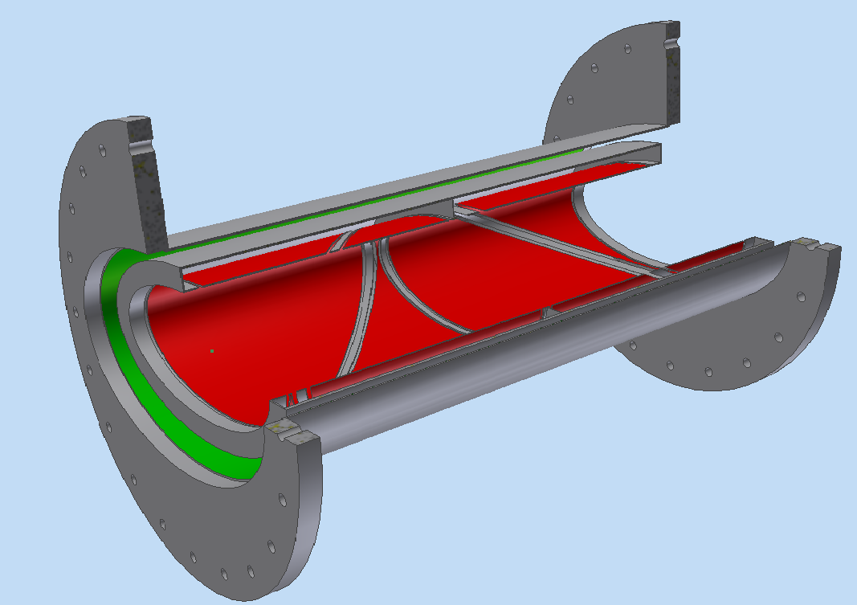
BPM model (draft)
20

Slide 21
Simulations
All simulations was done using HFSS code
Pbar beam was simulated as 2 mm diameter wire
Electrodes were defined as S-parameter ports with impedance equal (or close) to 50 Ohm
The map between electrode signals and wire positions and displacement sensitivity was calculated using S-parameter in frequency domain
Frequency range up to 100 MHz and more
The simulations was done for almost full aperture of BPM
The geometrical design of all BPMs was optimized
21

Slide 22
Optimization criteria
Using well known linear formula
where
dx – electrical center offset,
Kx – BPM scale constant
dS/Sum(S) – difference over sum ratio (or electrical beam position)
x – real beam position
Displacement sensitivity maximization
Linearity of position determination
Offset of electrical center minimization
Capacity and coupling minimization
22

Slide 23
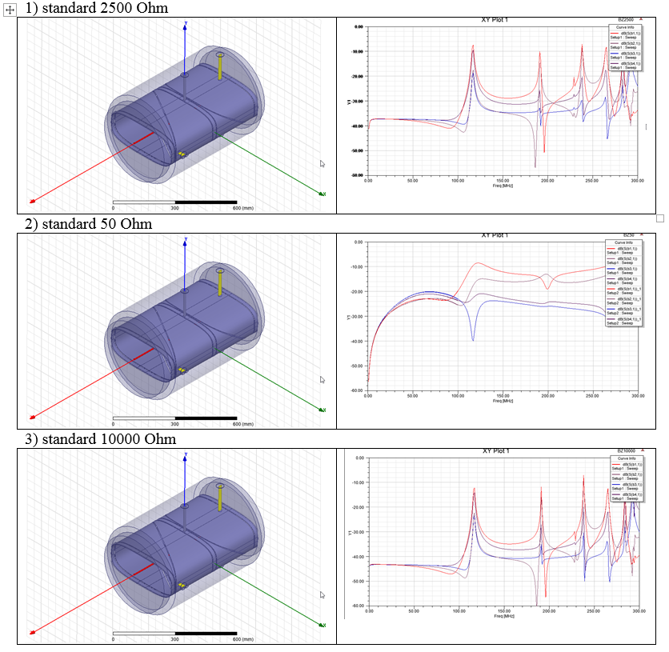
Optimizations (batch 1)
23

Slide 24
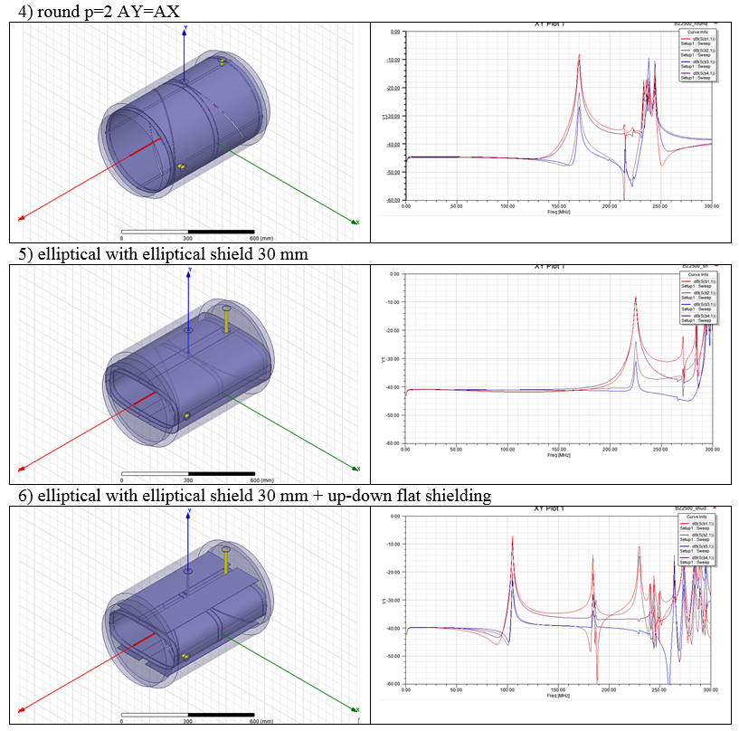
Optimizations (batch 2)
24

Slide 25
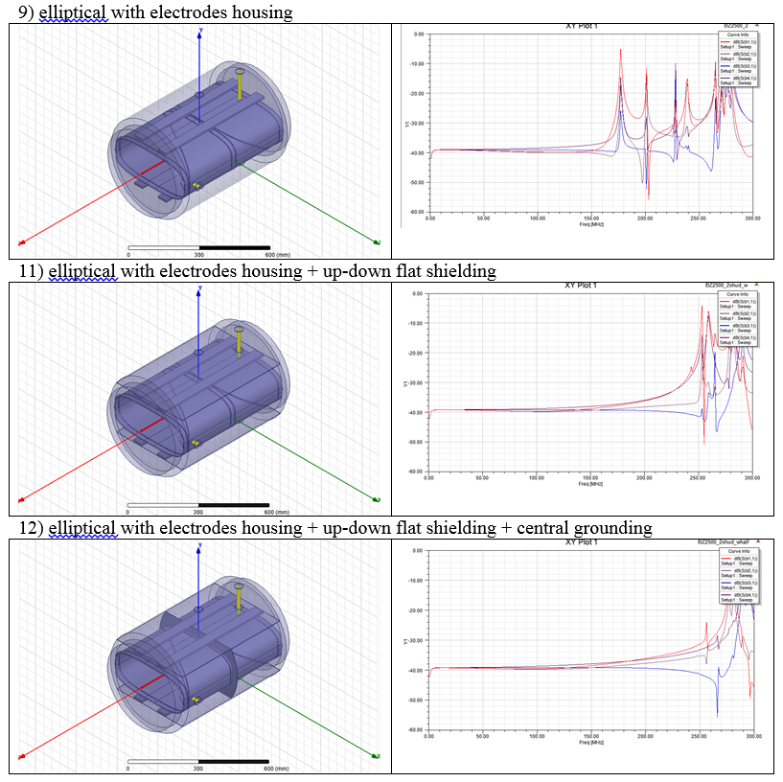
Optimizations (batch 4)
25

Slide 26
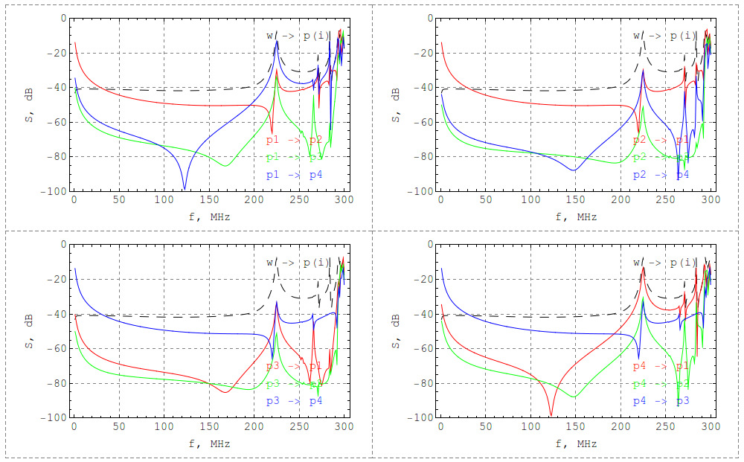
Variant 5: Transfer functions
C = 60-65 pF, a=210, b=90
26

Slide 27
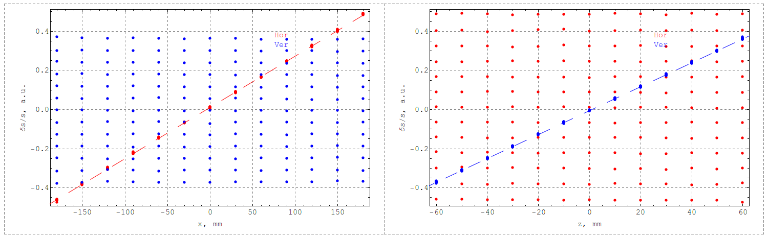
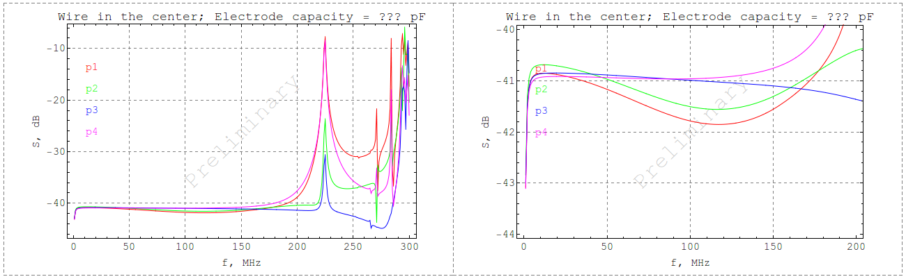
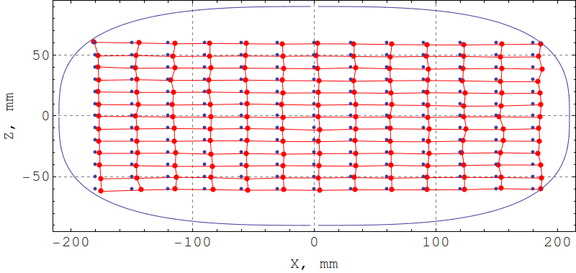
Variant 5: Analysis
27
Kx = +381.6 dx = -4.1 mm, residual = 1.5%, Kz = +163.2 dz = 0.9 mm, residual = 3%

Slide 28
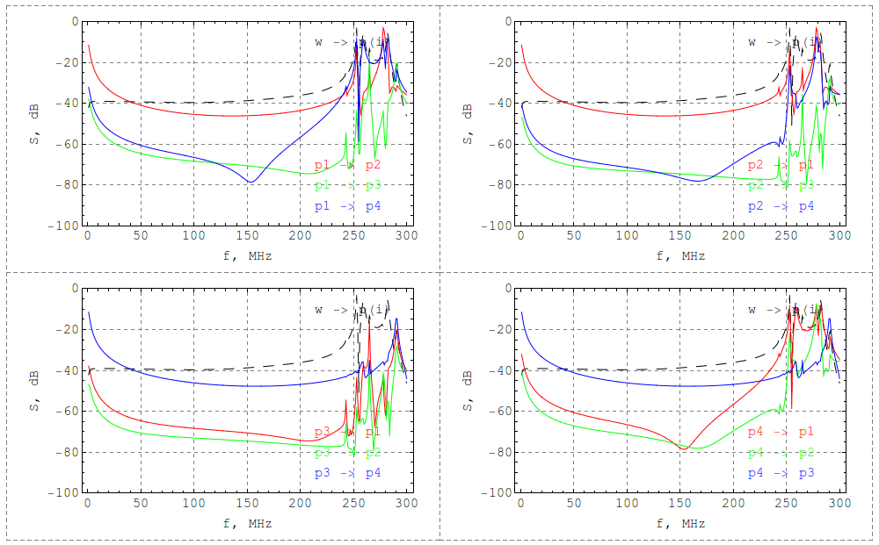
Variant 11: Transfer functions
C = 60-65 pF, a=210, b=90
28

Slide 29
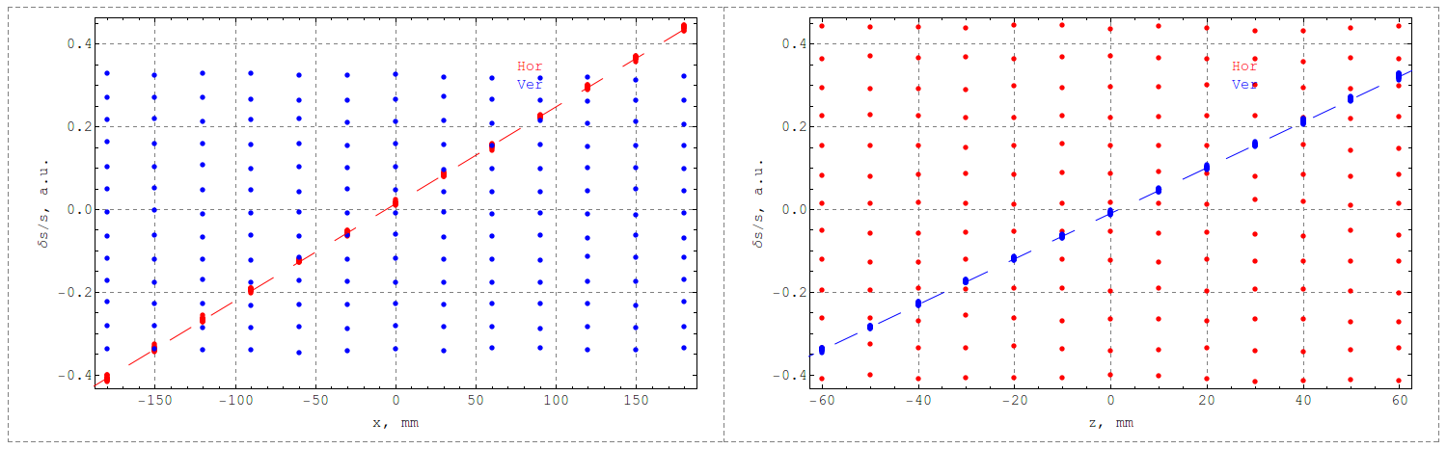
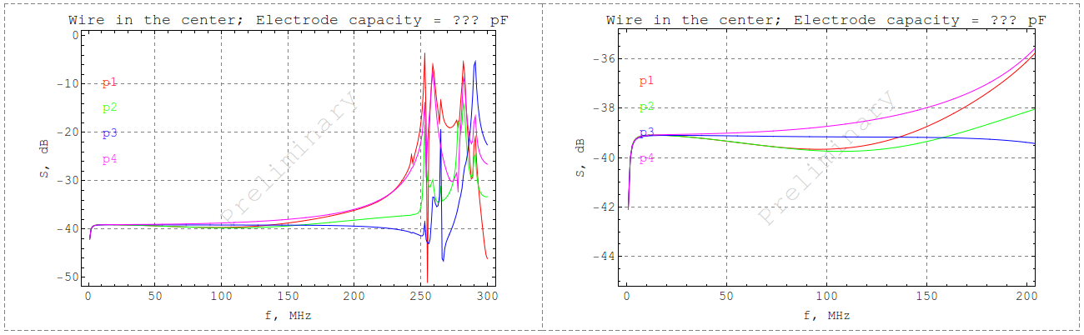
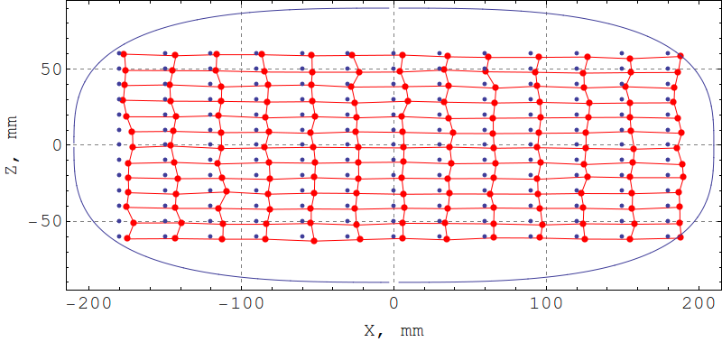
Variant 11: Analysis
29
Kx = +427.6 dx = -6.1 mm, residual = 1.2%, Kz = +181.2 dz = 1.7 mm, residual = 1.3%

Slide 30
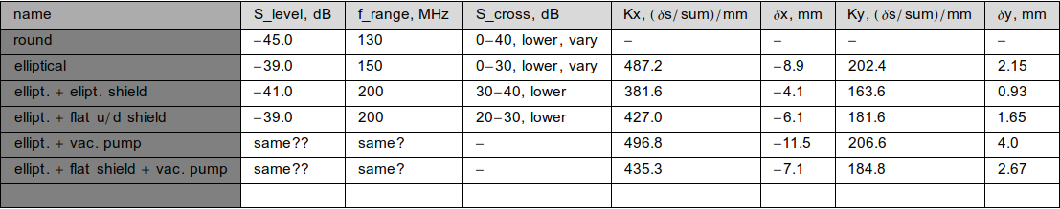
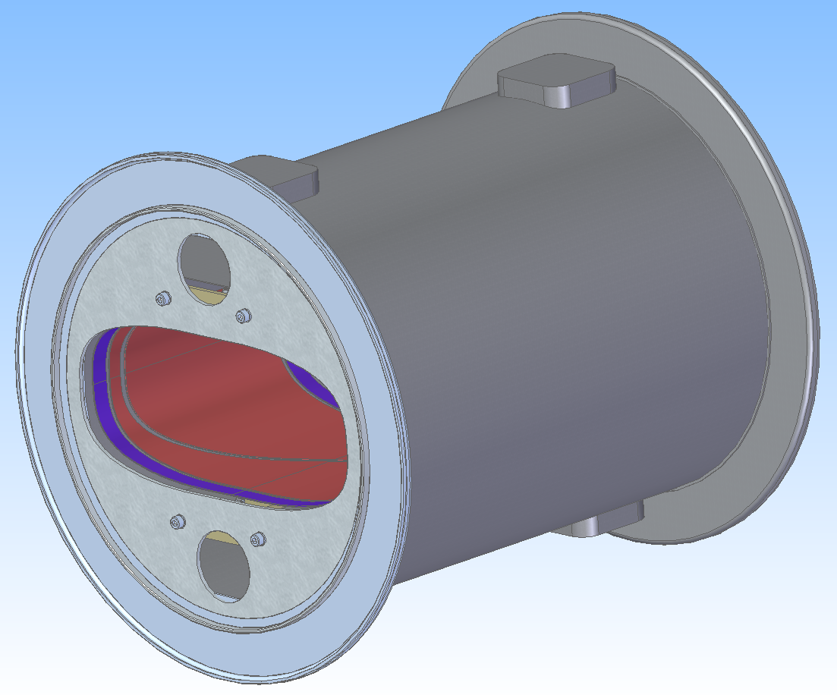
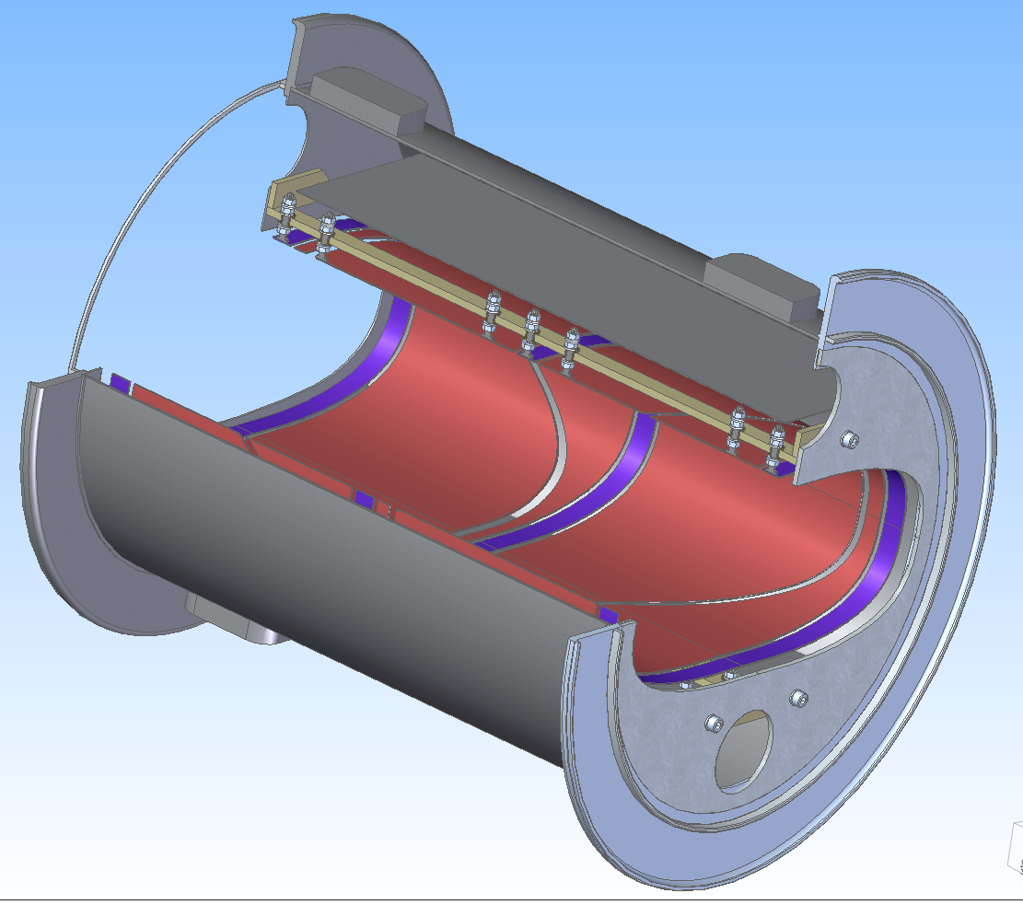
Optimization summary & BPM model
30

Slide 31
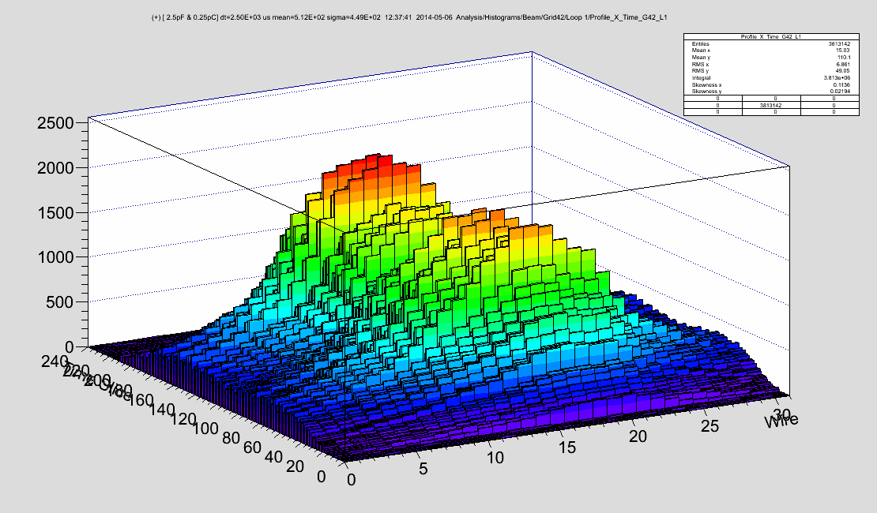
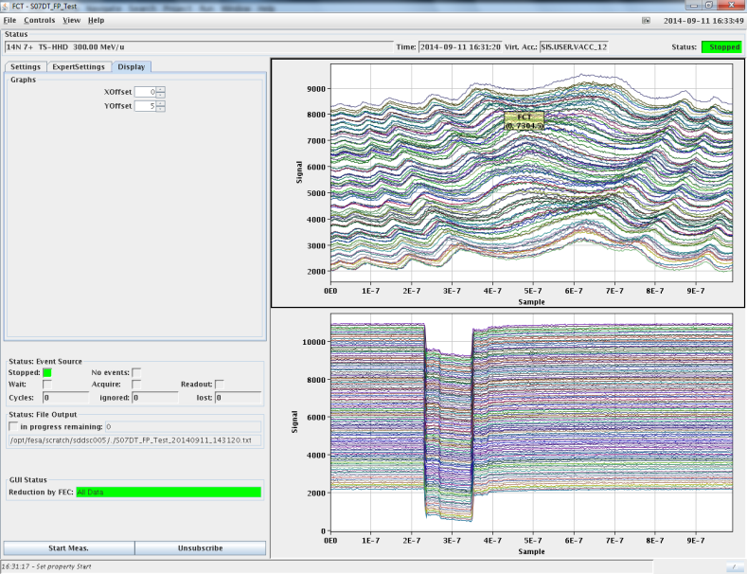
BD UI @ Control room (GSI => FAIR)
SCREENS
SEM
BPM and TUNE
BLM, DCT
FCT
31
courtesy: O. Chorniy, LOBI/GSI

Slide 32
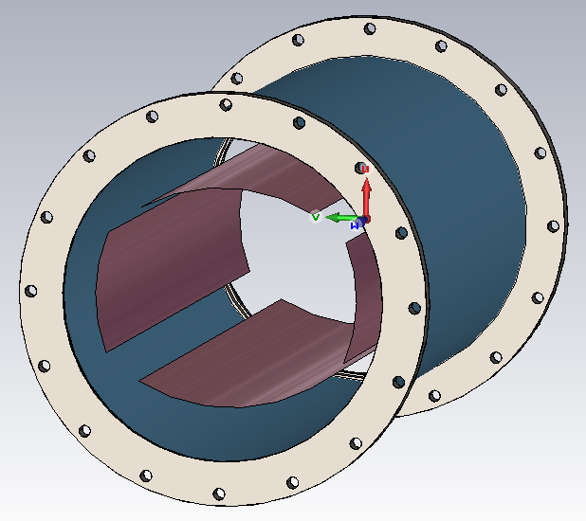
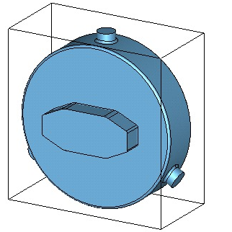
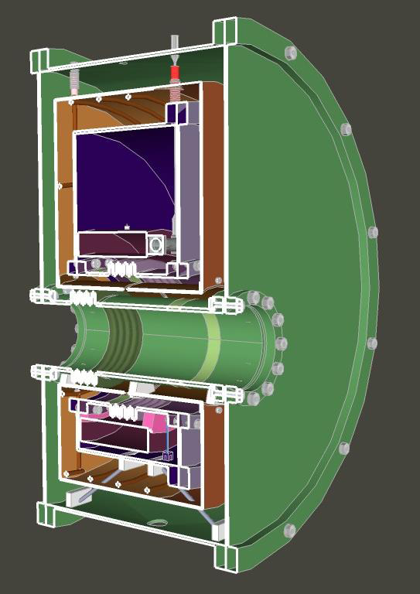
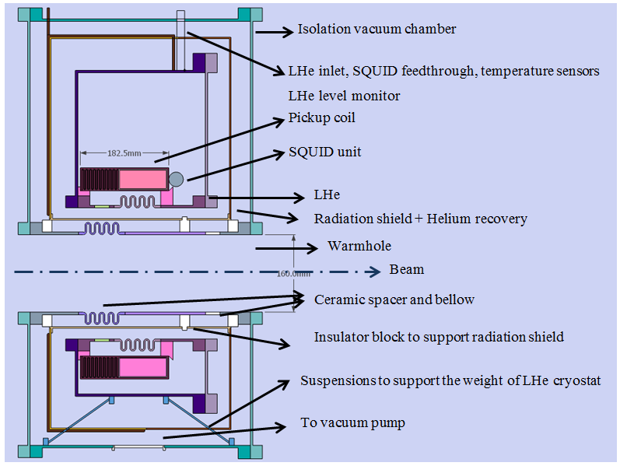
Schottky, CCC @ BD (GSI part)
The Schottky measurements concept
is split in two parts:
Broadband system for Schottky measurements of ions
Resonator based system for Schottky measurements of pbars
Broadband system
Resonator for longitudinal
Schottky meas.(S. Sanjari)
Two dimensional schematic of the intended Cryostat and the vacuum chamberdesign
Example of CCC design @ GSI
32
courtesy: O. Chorniy, LOBI/GSI

Slide 33
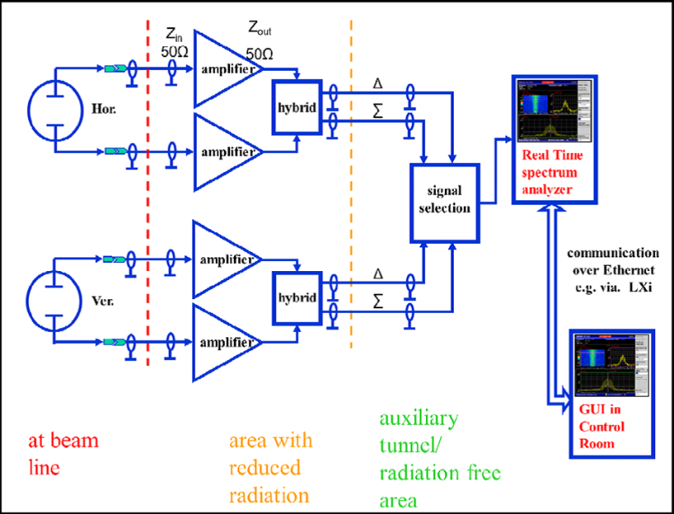
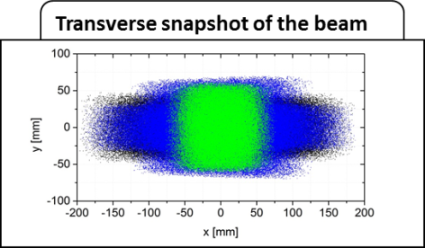
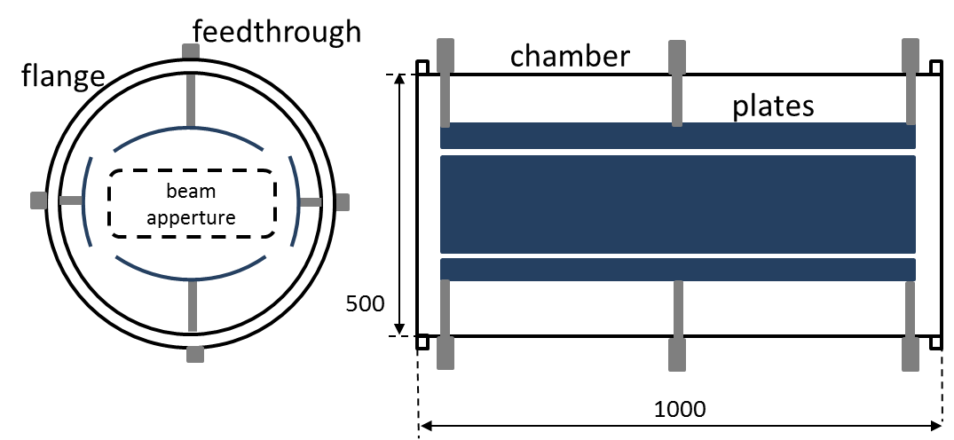
Schottky system
Schematic circuit diagram of the signal chain
Pickup design
Transfer impedance calculations
Required measurement time
for one spectrum
Threshold intensities for ions
courtesy: O. Chorniy, LOBI/GSI

Slide 34
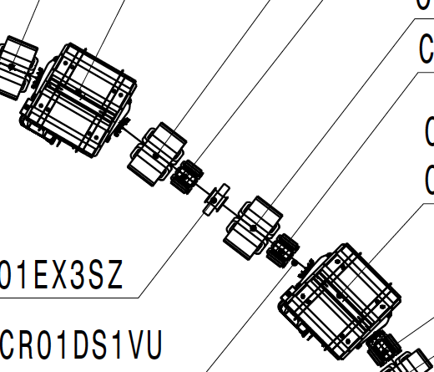

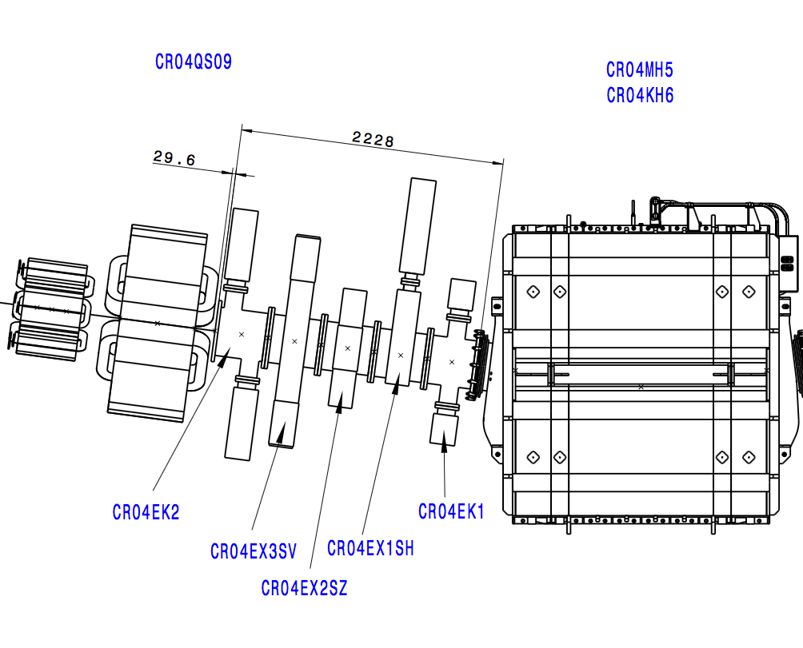
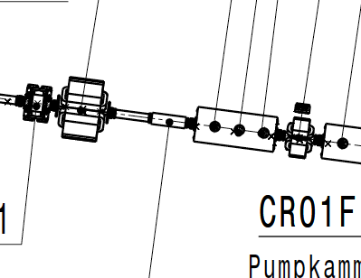
Schottky detector types
  10x longitudinal “Arc Section Resonators”
  2 x longitudinal “Straight section variable Q”
  2x horizontal
  2x vertical
  1x longitudinal “tubular non-resonant”
Additionally
  2x calibration scraper
courtesy: S. Sanjari, ILIMA/GSI
Shahab Sanjari, 2015-05-21, Новосибирск.
Drawing: I. Schurig

Slide 35
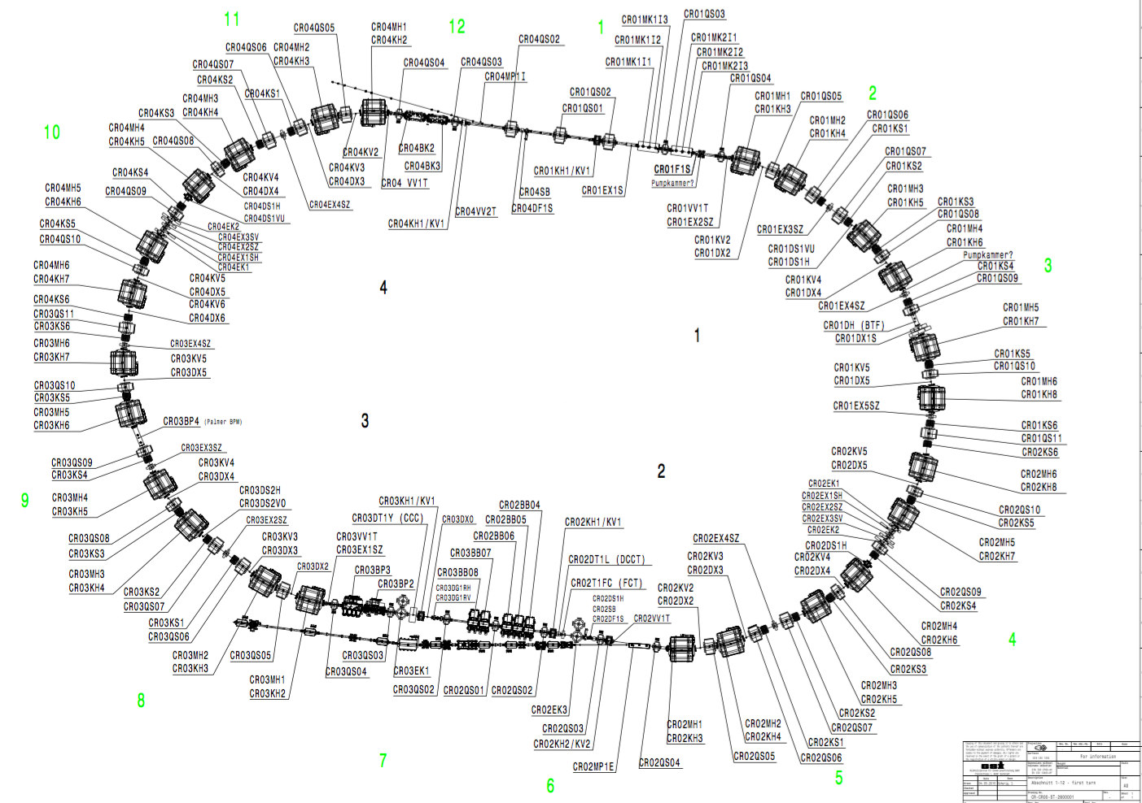
Latest arrangements:
Reduced from 15 to 13 places
Horizontal,
Vertical,
Scrapers
(and Pocket detectors)
Longitudinal
Straight section
Variable Q
Longitudinal
tubular
non-resonant
Longitudinal
Arc section
high Q
Drawing: I. Schurig

Slide 36
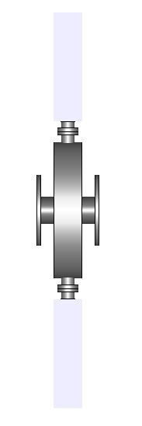
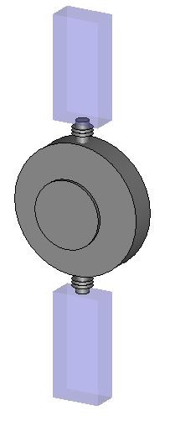
Arc section resonators
Pilot design for arc sections
  No ceramic gap
  Stainless steel no coating
  radius 35 cm, depth 10 cm
Initial simulations
Mode | Freq. [MHz] | Qu | R/Q [ohm]
1 | 344 | 33787 | 82
2 | 477 | 41034 | ~ 0
Space models (dummy) provided
  Fixed sizes
  Detailed design ~ 2017 - 2018
Shahab Sanjari, 2015-05-21, Новосибирск.

Slide 37
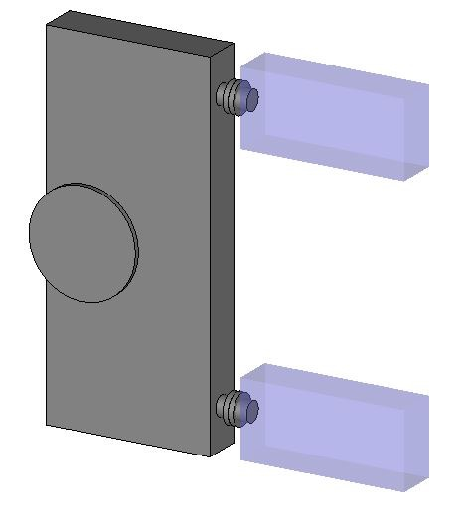
Horizontally senstive detectors
Source: Phys. Scr. Special Issue 2014
All previous designs based on Dipole mode
Our approach:
  Based on elliptical geometry
  Place of high dispersion
  Use of arc section chamber
Diameters:
40 x 120 cm
pipe: 17 cm
Depth: 10
Advantages over Dipole resonators
  Cope with large Beam pipe apertures
  Information the strong monopole mode
Mode | Freq. [MHz] | Qu | R/Q [ohm]
1 | 422 | 23381 | pos. dep.
2 | 509 | 25580 | ~ 0
Shahab Sanjari, 2015-05-21, Новосибирск.

Slide 38
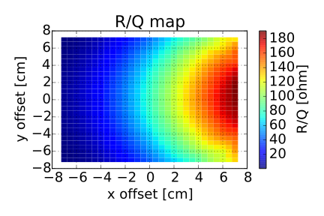
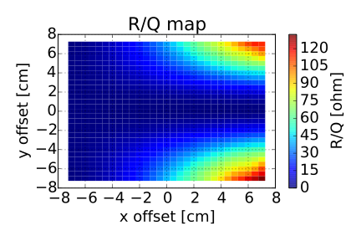






Present Design Approach
Source: Phys. Scr. Special Issue 2014
Impedance
  Circular vs Elliptical
Circular
Elliptical
Shahab Sanjari, 2015-05-21, Новосибирск.

Slide 39



Motors
Bellow on Quad Chamber
CosyLAB Controller
CF200 Valve
CF200 Diagonal Schottky
Shahab Sanjari, 2015-11-17, Новосибирск.

Slide 40
Conclusion
Beam diagnostic layout for CR is clear and fixed
Beam diagnostic give us possibilities to measure various beam parameters during different stages of operations
Many beam diagnostic elements are close to final design, but we have a number of topics to be done
We work together with GSI, FAIR colleagues on the different parts of BD and keep close connections
40

Slide 41









Beam Diagnostic team @ BINP + GSI
Yu. Rogovsky, E. Bekhtenev
O. Meshkov, V. Parkhomchuk
M. Bryzgunov, M. Fedotov
I. Koop (phys)
A. Sukhanov, L. Schegolev (techn)
S. Sanjari, O. Chorniy, and colleagues from GSI LOBI group
41

Slide 42

Thank you for your attention!
Yu. Rogovsky on behalf of BD BINP/GSI team 17.11.2015
42

