Slide 1


The high performance PANDA detector
International Workshop on Antiproton Physics and Technology at FAIR
Julian Rieke, JLU Giessen
on behalf of the PANDA Collaboration

Slide 2
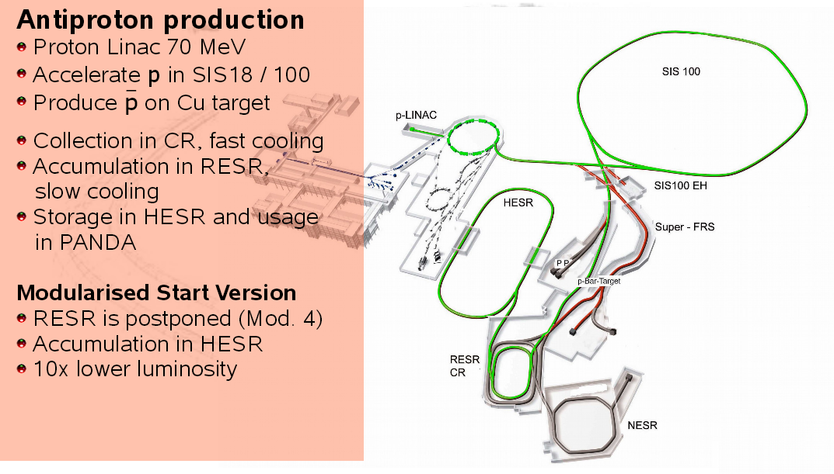
Antiprotons

Slide 3
Antiprotons

Slide 4
Antiprotons

Slide 5
Antiprotons

Slide 6
Antiprotons

Slide 7
Antiprotons

Slide 8
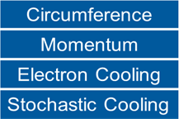
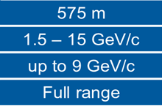
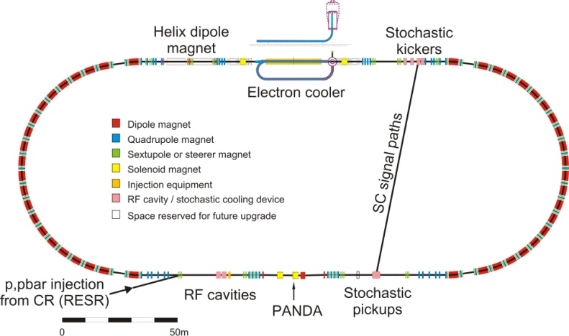
High Energy Storage Ring
Mode | High luminosity (HL) | High resolution (HR)
∆p/p | ~10⁻⁴ | ~4x10⁻⁵
L(cm⁻²s⁻¹) | 2x10³² | 2x10³¹
Stored p̄ | 10¹¹ | 10¹⁰

Slide 9
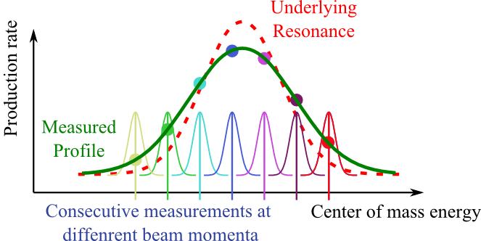
High Energy Storage Ring
Mode | High luminosity (HL) | High resolution (HR)
∆p/p | ~10⁻⁴ | ~4x10⁻⁵
L(cm⁻²s⁻¹) | 2x10³² | 2x10³¹
Stored p̄ | 10¹¹ | 10¹⁰
e⁺ e⁻ | p p̄
Low hadronic background | High hadronic background
Direct production restricted to 1⁻ ⁻ states | Direct production of various states
Production experiments

Slide 10
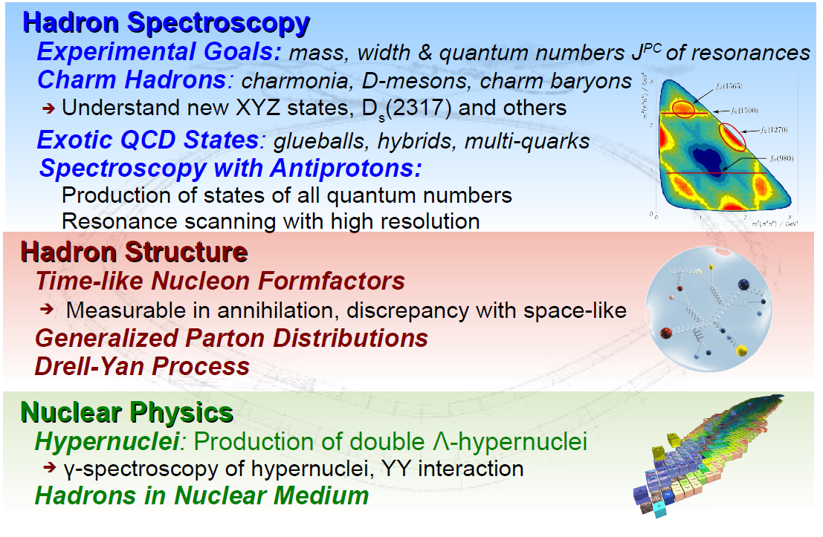
PANDA Physics Goals
More info on the PANDA physics
in talk of Paola Gianotti

Slide 11
PANDA Physics Goals
More info on the PANDA physics
in talk of Paola Gianotti

Slide 12
PANDA Physics Goals
More info on the PANDA physics
in talk of Paola Gianotti

Slide 13
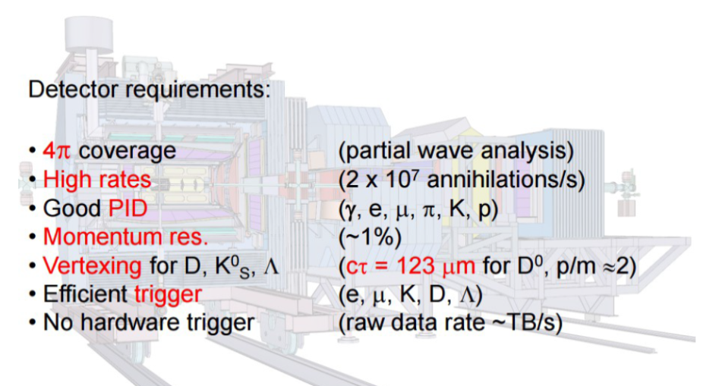
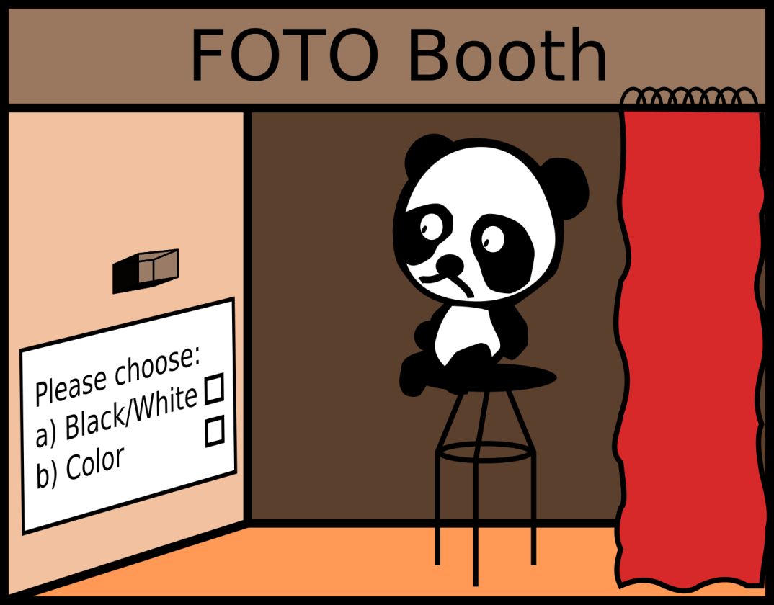
PANDA Detector
PANDA has many options!! ☺

Slide 14
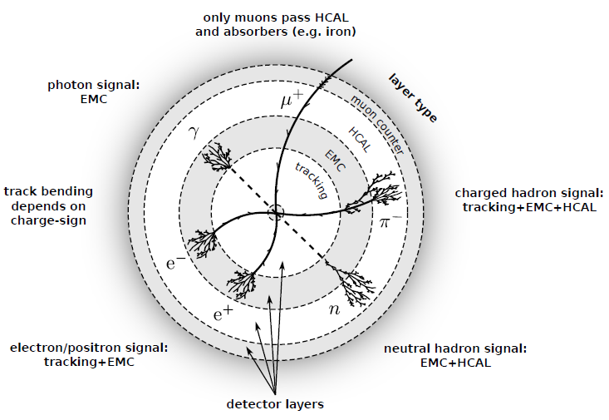
PANDA Detector
Typical detector techniques
O. Merle

Slide 15
PANDA Detector
Typical detector techniques
PANDA does not have a dedicated HCAL.
But the muon ID can measure hadron energies
with a moderate error.
O. Merle

Slide 16
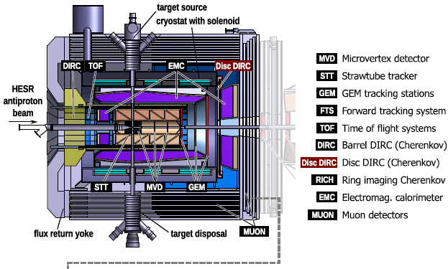

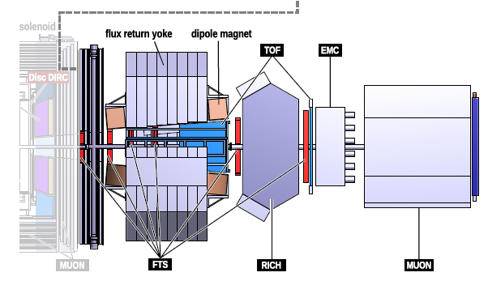
PANDA Detector
O. Merle
O. Merle

Slide 17
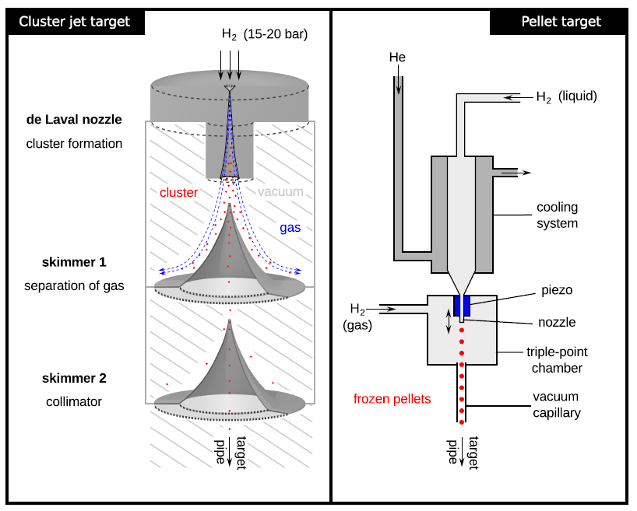
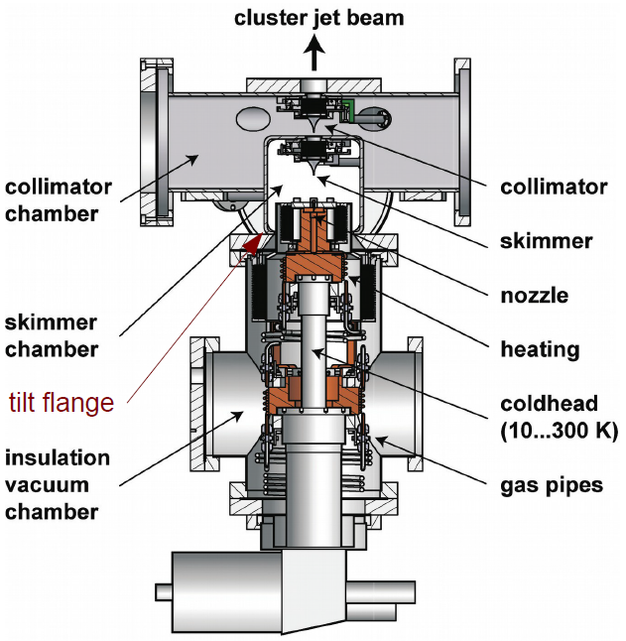
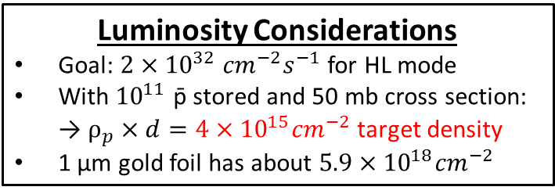
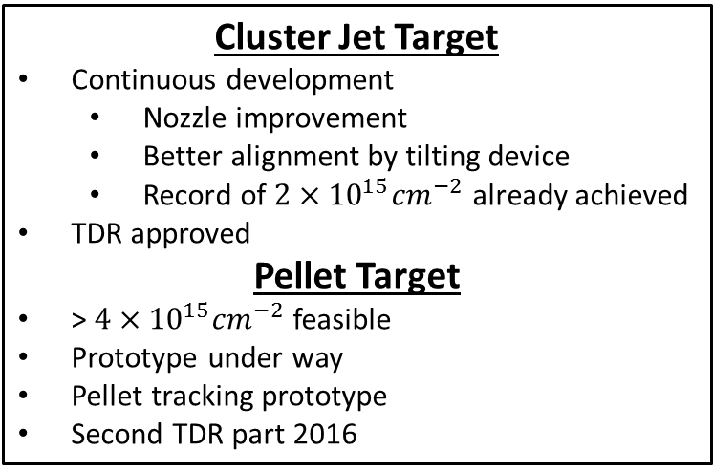
PANDA Targets
Luminosity Considerations
Goal: $2×{10}^{32} {cm}^{−2}s^{−1}$ for HL mode
With ${10}^{11}$ p̄ stored and 50 mb cross section:
→ $ρ_{p}×d=4×{10}^{15}{cm}^{−2}$ target density
1 µm gold foil has about $5.9×{10}^{18}{cm}^{−2}$
Cluster Jet Target
Continuous development
  Nozzle improvement
  Better alignment by tilting device
  Record of $2×{10}^{15}{cm}^{−2}$ already achieved
TDR approved
Pellet Target
> $4×{10}^{15}{cm}^{−2}$ feasible
Prototype under way
Pellet tracking prototype
Second TDR part 2016
O. Merle
Notes:
Luminosity considerations???

Slide 18
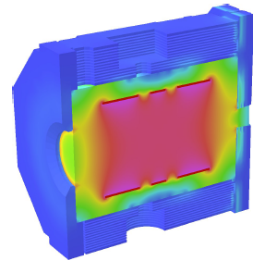
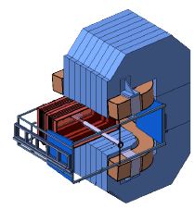
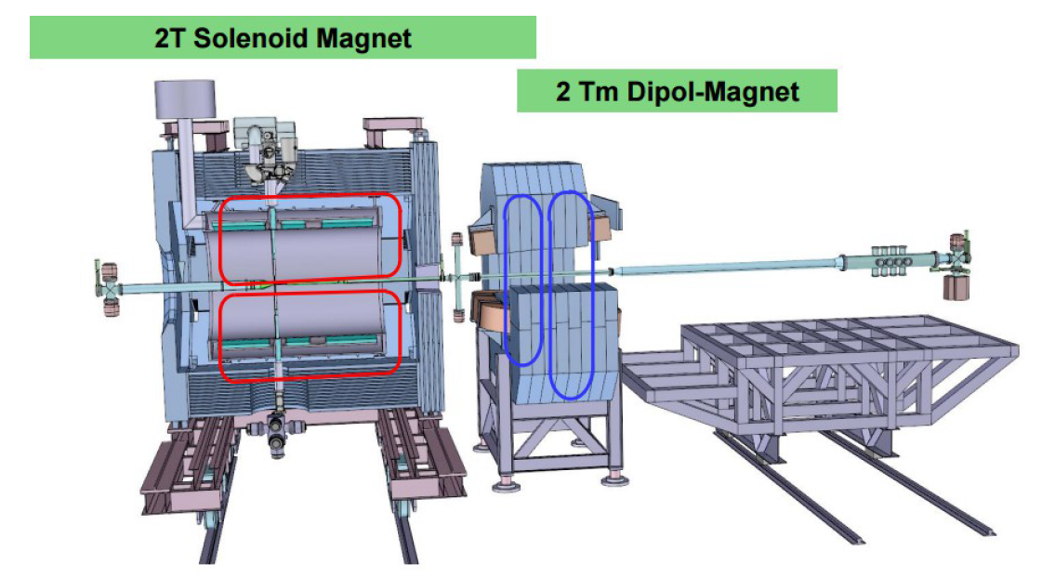
Magnets
Solenoid Magnet
Super conducting coil
2 T central field
Segmented coil allows
target entry/exit
Iron yoke instrumented with muon detection
Provides doors for installation and maintenance
Status:
  Cooperation with CERN for cold mass
  Conductor optimized, close to tender
  Yoke design complete
Dipole Magnet
Normal conducting racetrack design
Dipole also bends the beam
Segmented yoke for ramping
Notes:
Cold mass?
Segmented yoke for ramping?

Slide 19
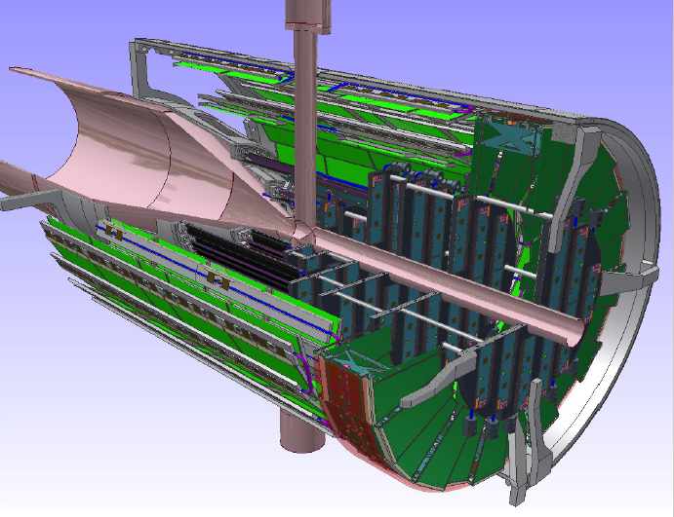
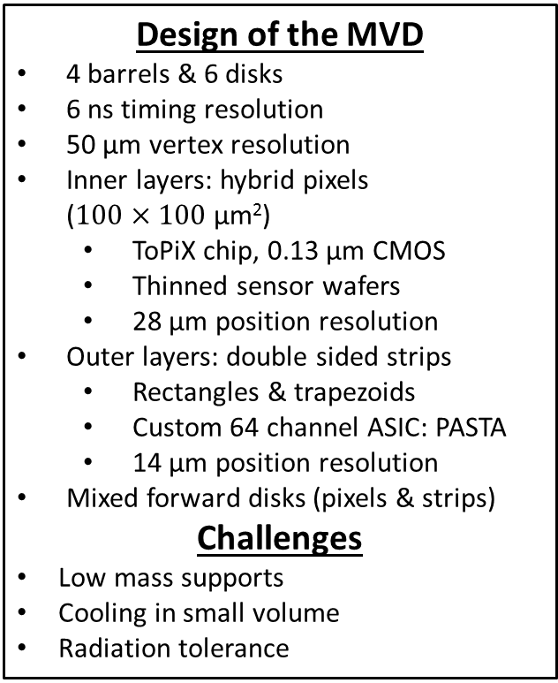
Micro Vertex Detector
Design of the MVD
4 barrels & 6 disks
6 ns timing resolution
50 µm vertex resolution
Inner layers: hybrid pixels
($100×100$ µm²)
  ToPiX chip, 0.13 µm CMOS
  Thinned sensor wafers
  28 µm position resolution
Outer layers: double sided strips
  Rectangles & trapezoids
  Custom 64 channel ASIC: PASTA
  14 µm position resolution
Mixed forward disks (pixels & strips)
Challenges
Low mass supports
Cooling in small volume
Radiation tolerance
ToPiX V4 tested
PASTA ASIC prototype in 2015
Detailed service planning

Slide 20
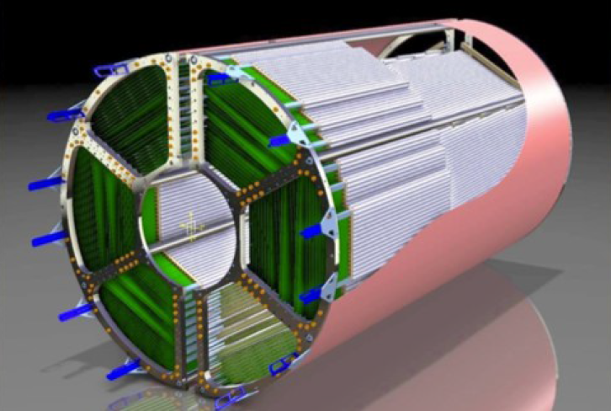
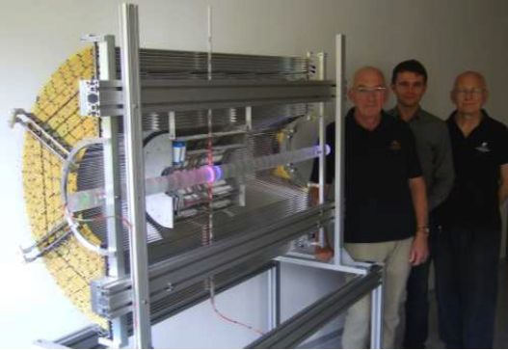
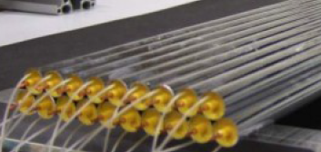
Strawtube Tracker
Detector Concept
4600 straws in 21 - 27 layers
8 layers are skewed at 3°
Ionizing radiation creates electron-ion-pairs
Central counting wires register incoming electron avalanches
Tubes are made of 27 µm Al-mylar, Ø = 1cm
R_{in} = 150 mm, R_{out} = 420 mm, l = 1500 mm
Self-supporting straw double layers at about 1 bar overpressure filled with Ar/CO₂
Readout with ASIC + TDC or FADC
Spatial resolution of about 150µm/3mm
Material Budget
Max 26 layers
0.05% X/X₀ per layer
Total 1.3% X/X₀
Project Status
Prototype construction & beam tests
Aging tests: up to 1.2 C/cm²
Straw series production started

Slide 21
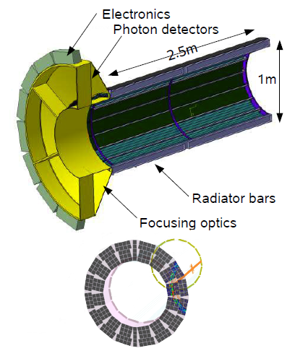
Barrel DIRC
Baseline design:
DIRC: Detection of Internally Reflected Cherenkov light pioneered by BaBar
Cherenkov detector with SiO₂ radiator
Detected patterns give ß of particles
Optimization and challenges
Focusing by lenses/mirrors
More compact design
Magnetic field → MCP PMTs
Fast readout to suppress background
Plates as more economic radiator
Project status
Baseline design verified
Qualification of final design in 2015

Slide 22
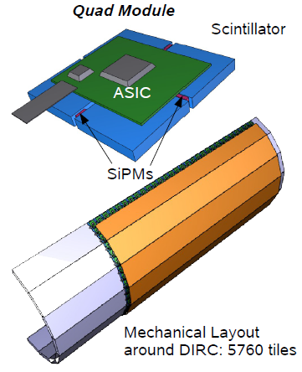
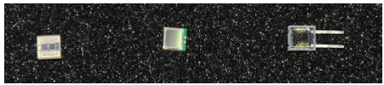
Scintillator Tile Hodoscope
Detector for ToF and event timing:
Scintillator tiles 3 x 3 x 0.5 cm³
  BC 404, BC 408 or BC 420
  Space points with precision timing
  Lowest possible material budget
Photon readout with 2 SiPMs (3x3 mm²)
  High PDE, time resolution, rate capability
  Work in B-fields, small, robust, low bias
  High intrinsic noise
  Temperature dependence
Goal for time resolution: 100 ps
ASIC for SiPM readout

Slide 23
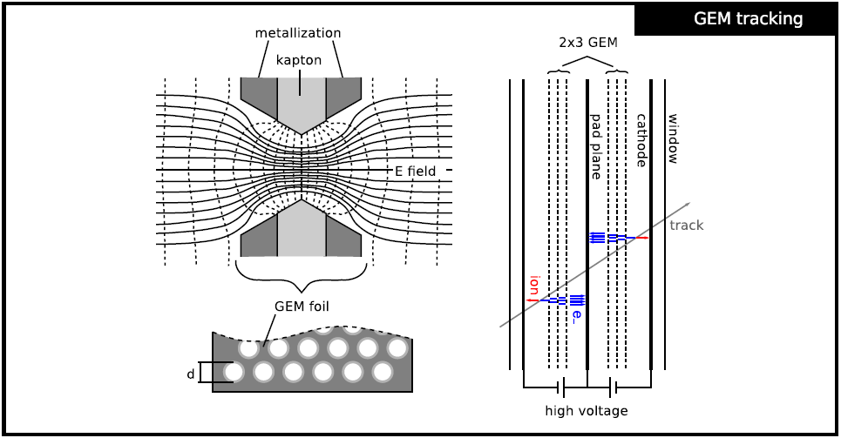
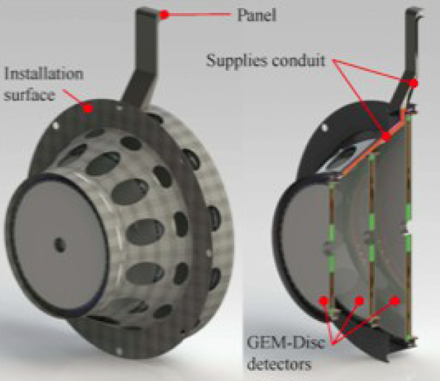
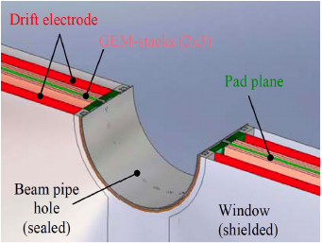
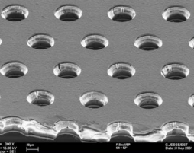
Forward GEM Tracker
Forward tracking inside the solenoid:
3 stations with 4 projections each
→ Radial, concentric x, y
Large area GEM foils from CERN (50 µm Kapton, 2-5 µm copper coating)
ADC readout for cluster centroids
→ approx. 35000 channels total
Challenging task to minimize material budget

Slide 24
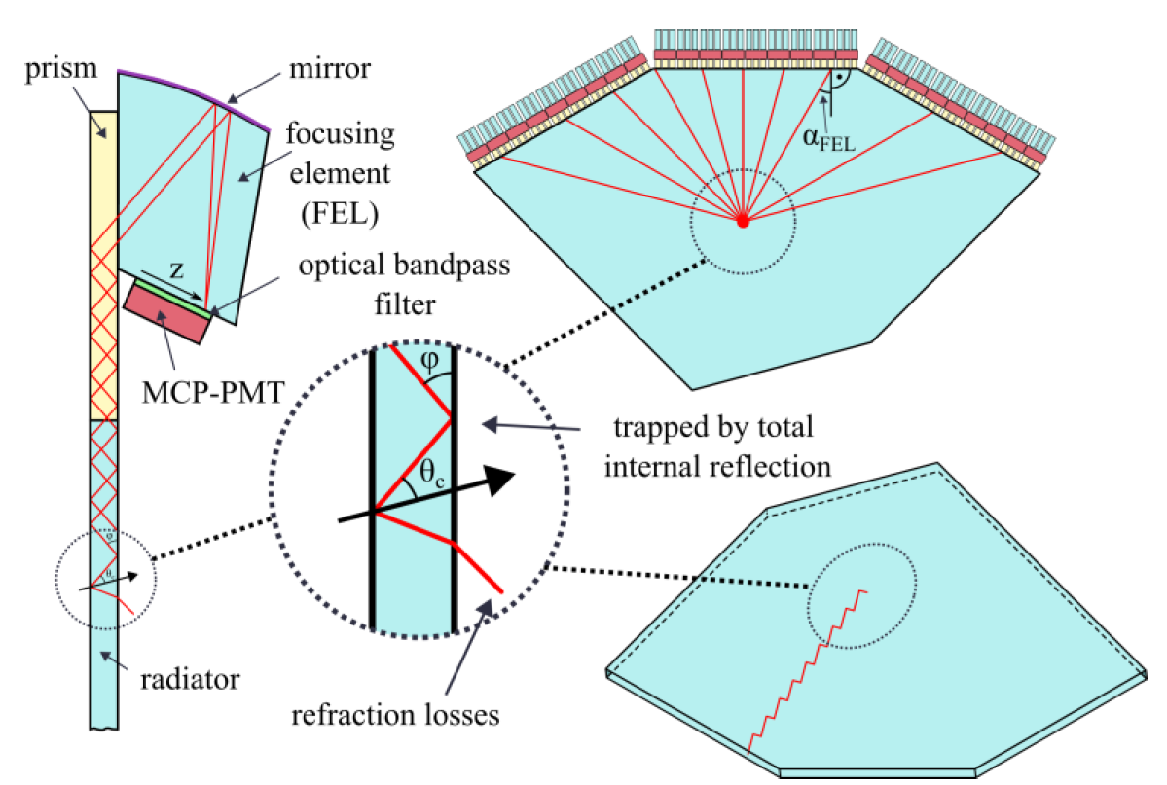
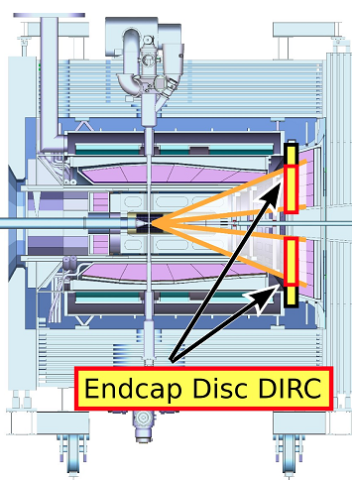
Disc DIRC
Novel concept for forward PID:
based on DIRC Principle
Disc shaped fused silica radiator
Readout of Cherenkov photons at the disc rim
Project status:
Advanced design
Review with external experts
Promising late testbeam results
Next: full quarter prototype
Detector consist of 4 independent
quadrants

Slide 25
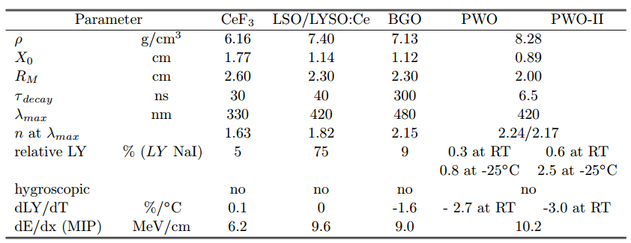
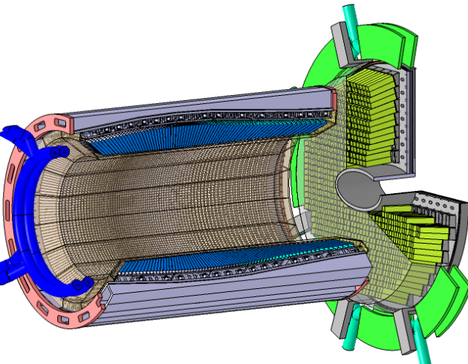
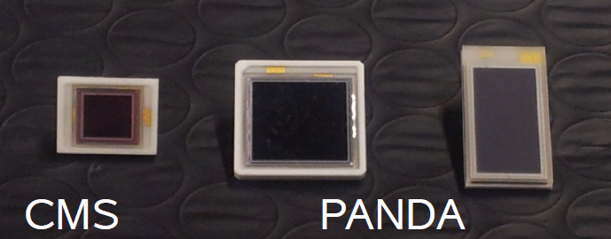
Electromagnetic Calorimetry
PWO Crystals
PWO is dense and fast
Challenges
  Low γ threshold
    Improved PWO II
    Operation at -25°C
  Temperature stability of 0.1°C needed
  Radiation tolerance
  Low noise electronics
Forward Endcap
4000 PWO crystals
High occupancy in center
LA APD and VPTT
Barrel Calorimeter
11000 PWO crystals
LAAPD readout 2x1cm²
σ(E)/E~1.5%/√E + const
Large Area APDs
5x5 mm²
10x10mm²
7x14 mm²
Backward Endcap for hermeticity (not shown)
530 PWO crystals

Slide 26
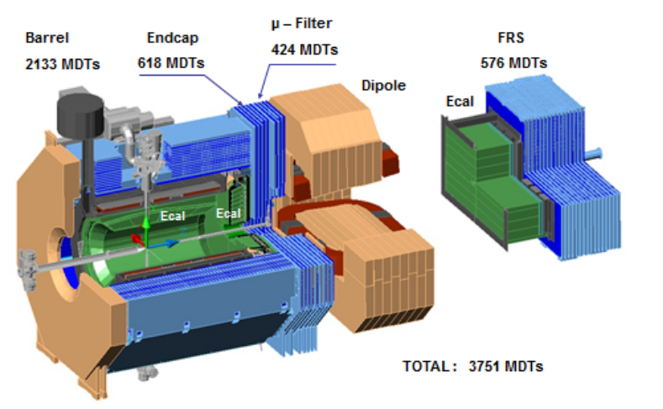
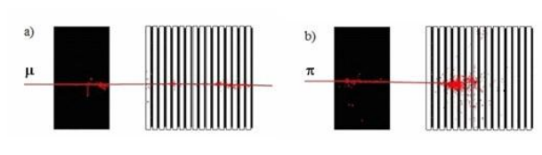
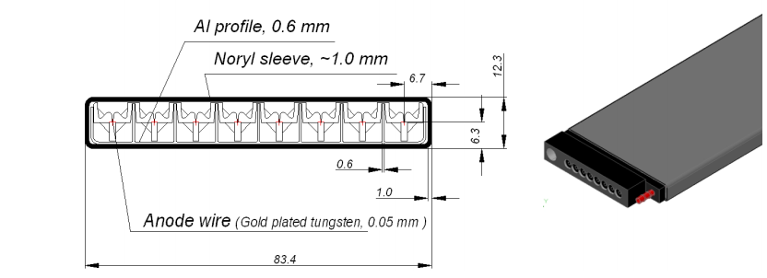
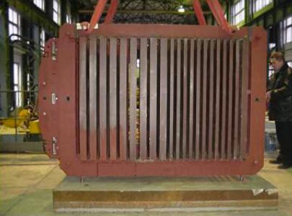
Muon Detector System
Challenge
Muons have low momenta, high π-BG
→ Multi-layer range system
System layout
Barrel: 12+2 layers in yoke
Endcap: 5+2 layers
Muon Filter: 4 layers
Fw Range System: 16+2 layers
Detectors: Drift tubes with wire & cathode strip readout
System status
TDR approved Sep 2014
Range system tests at CERN
µ-Filter
424 MDTs
Barrel
2133 MDTs
Endcap
618 MDTs
FRS
576 MDTs
Total
3751 MDTs
µ
π

Slide 27
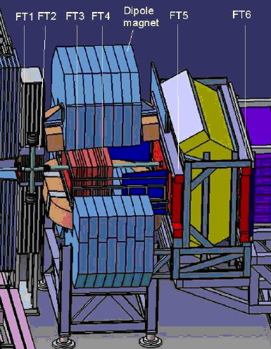

Forward Tracking
Tracking in Forward Spectrometer:
3 stations with 2 chambers each
  FT1&2: between solenoid and dipole
  FT3&4: in the dipole gap
  FT5&6: largest chambers behind dipole
Straw tubes arranged in double layers
  27 µm thin mylar tubes, 1 cm Ø
  Stability by 1 bar overpressure
3 projections per chamber (0°, ± 5°)
Modular setup of straws

Slide 28
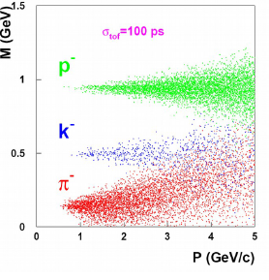
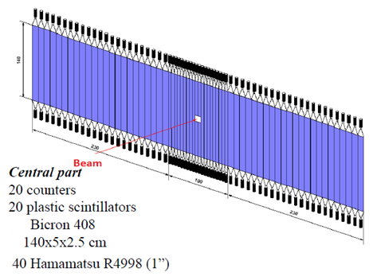
Forward Time of Flight
Forward Spectrometer PID:
Time-of-Flight essential
No start detector
Relative timing to Barrel-TOF
Detector layout:
Scintillator wall at z = 7.5m made of 140 cm long slabs
Bicron 408 scintillator
PMT readout on both ends
10 cm slabs on the sides, 5 cm slabs in the center
TDC readout
Additionally: Side wall inside dipole for low momentum tracks
Side parts:
2 x 23 counters (same as central part)
46 plastic scintillators (same as central part)
40 PMTs (same as central part)
Goal: Time-of-flight with
σ(t) better that 100 ps

Slide 29
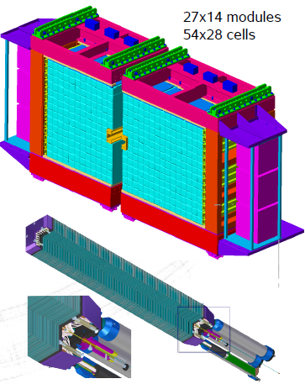
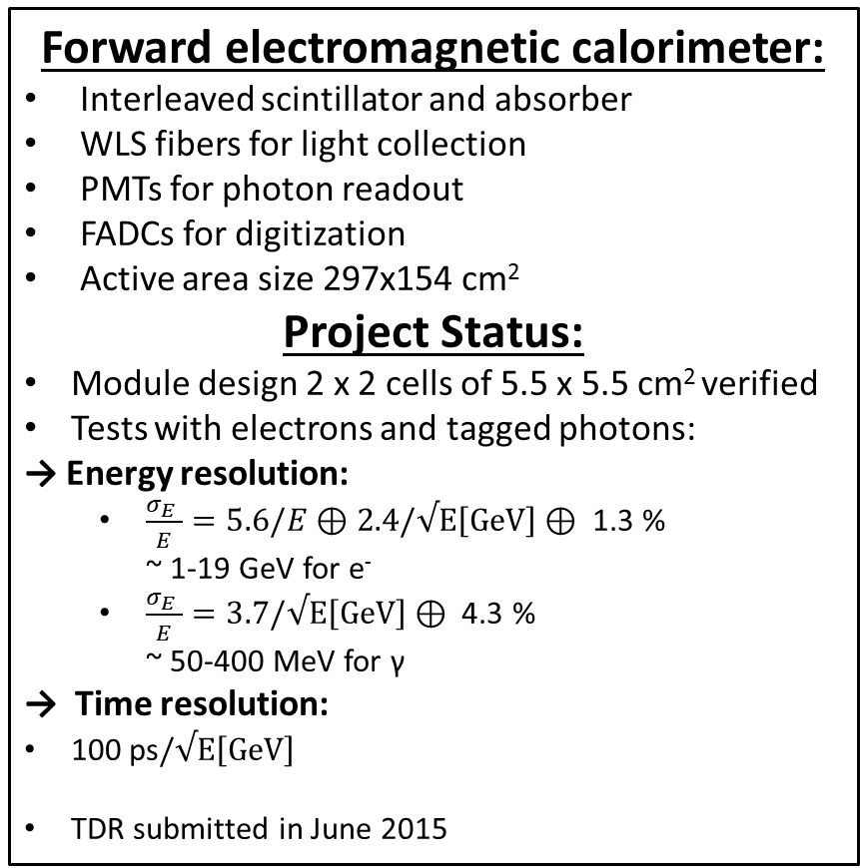
Forward Shashlik Calorimeter
Forward electromagnetic calorimeter:
Interleaved scintillator and absorber
WLS fibers for light collection
PMTs for photon readout
FADCs for digitization
Active area size 297x154 cm²
Project Status:
Module design 2 x 2 cells of 5.5 x 5.5 cm² verified
Tests with electrons and tagged photons:
→ Energy resolution:
  $\frac{σ_{E }}{E}=5.6/E⊕2.4/√E\left[GeV\right]⊕\text{ 1.3 \%}$
  ~ 1-19 GeV for e⁻
  $\frac{σ_{E }}{E}=3.7/√E\left[GeV\right]⊕ \text{4}\text{.3 \%}$
  ~ 50-400 MeV for γ
→ Time resolution:
100 ps$/√E\left[GeV\right]$
TDR submitted in June 2015

Slide 30
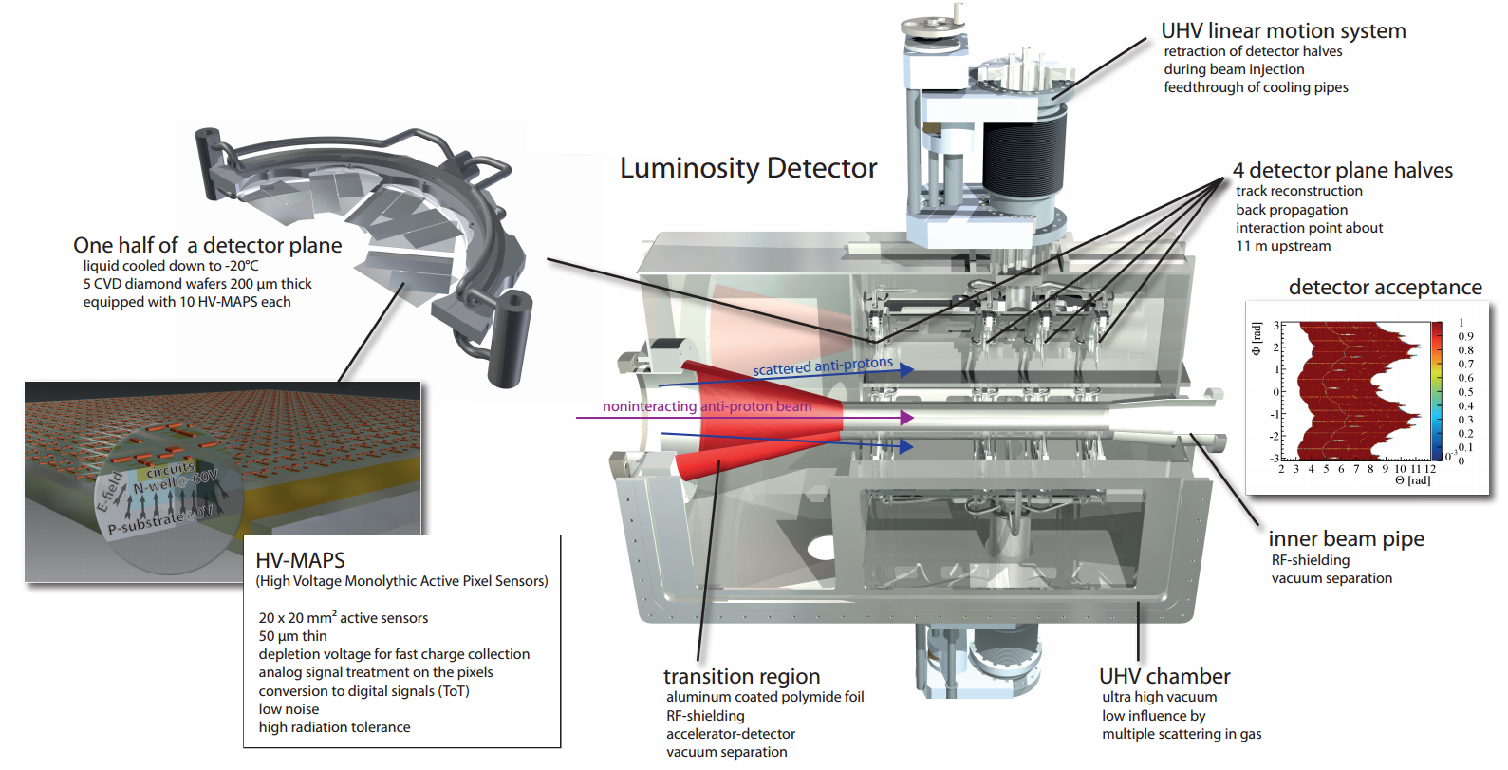
Luminosity Detector
Detector layout
Roman pot system at z = 11 m
Silicon pixel detector:
  4 layers of HV MAPS (50 µm thick)
  Pixels 80x80 µm²
CVD diamond supports (200 µm thick)
Retractable half planes in secondary vacuum

Slide 31
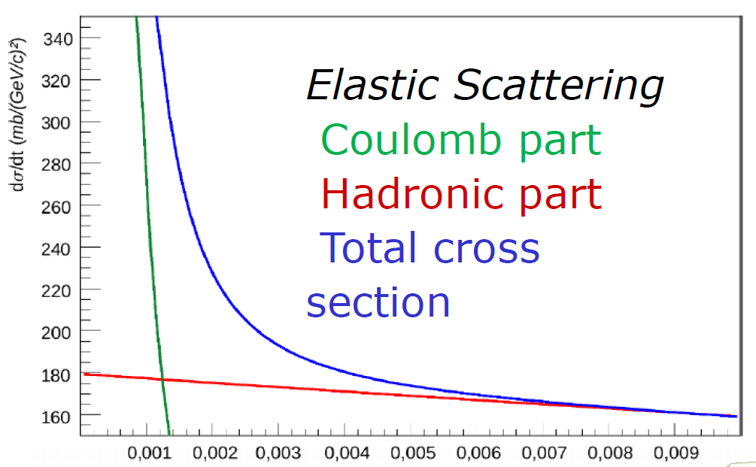
Luminosity Detector
t[GeV/c²]
HV MAPS:
Development at the University of Heidelberg for the Mu2e experiment
Active pixel sensor in HV CMOS
Digital processing on chip
Testbeam results: S/N ~ 20,
Efficiency ~ 99,5 %
Project Status:
Cooling system prototype tested
Mechanical vessel and vacuum system prototype tested
CVD diamond supports available
TDR in final stage

Slide 32
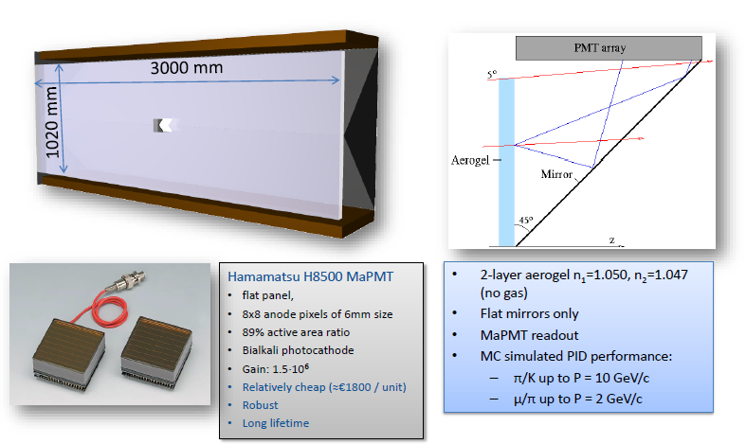
Forward RICH

Slide 33
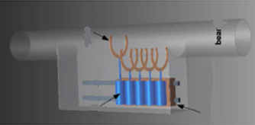
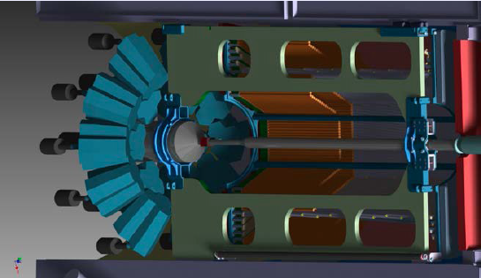
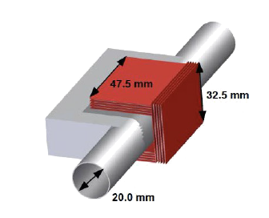
Hypernuclear Setup
Principle:
Produce hypernuclei from captured Ξ
Modified Setup:
Primary retractable wire/foil target
Secondary active target to capture Ξ and track
products with Si strips
HP Ge detector for γ-spectroscopy
Priamary target:
Diamond wire
Piezo motored wire holder
wire target
beampipe
Piezo
motors
sliding carriage
on rails
Active secondary target:
Silicon microstrips
Absorbers

Slide 34

PANDA Data Acquisition
Self-triggered readout:
Components:
  Time distribution system
  Intelligent frontends
  Powerful compute nodes
  High speed network
Data flow:
  Data reduction
  Local feature extraction
  Data burst building
  Event selection
  Data logging after online reconstruction
→ Programmable Physics Machine

Slide 35
Summary
Present status of PANDA:
Preparation for construction MoU
Many new subsystems are heading towards finalization
Present status of PANDA:
Most TDRs complete by end of 2016
Start construction in 2014 for some systems
Preassembly at Jülich
Ready for mounting at FAIR in 2018/19
PANDA & FAIR start in hadron physics from 2020+:
Versatile physics machine with full detection capabilities
PANDA will shed light on many of today‘s QCD puzzles
Beyond PANDA further plans for spin physics at FAIR exist

