Slide 1
FLAIR: The Physics Case
The Facility for Low-Energy Antiproton and Ion Research
HITRAP
Wolfgang Quint
GSI Darmstadt and Univ. Heidelberg
Conference FAIR-2015, Novosibirsk, 16 November 2015, Wolfgang Quint

Slide 2
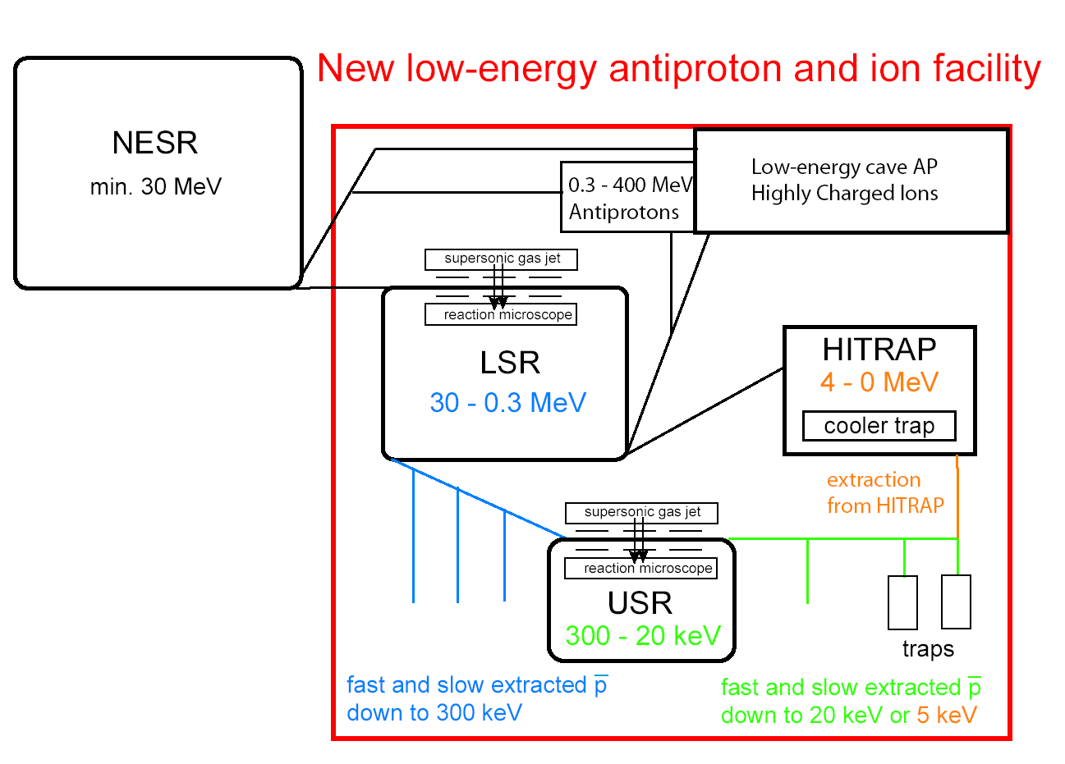
FLAIR - Facility for Low-Energy Antiproton and Ion Research
NESR
  Pbars and ions
  30 – 400 MeV
LSR
  Magnetic ring
  Min. 300 keV
  (former CRYRING)
USR
  Electrostatic ring
  Min. 20 keV
HITRAP
  Pbars and ions
  Stopped & extracted @ 5 keV
FLAIR
energy range: 400 MeV – 1 meV
Conference FAIR-2015, Novosibirsk, 16 November 2015, Wolfgang Quint

Slide 3
Cryring (Stockholm) for LSR (Low-Energy Storage Ring) at FLAIR
Beam delivery for HITRAP, USR, experiments
• Fitting energy range, electron cooling
• Fast ramping, internal target
• CRYRING has been contributed by Sweden as in-kind
contribution to FAIR
Conference FAIR-2015, Novosibirsk, 16 November 2015, Wolfgang Quint

Slide 4
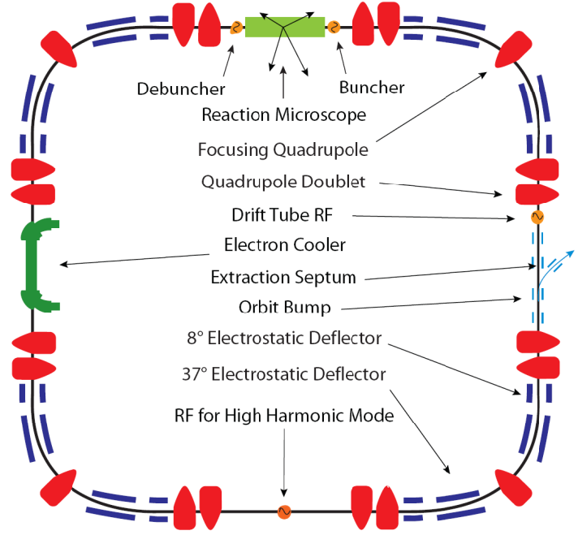
USR – Ultra-Low Energy Storage Ring
E_{min} / E_{max} | 20 / 300 keV
Dimensions | 8 m x 8 m
Voltages | < ± 20 kV
Number of pbars at 20 keV | 1·10⁷
C. Welsch et al.
GSI/Cockcroft Institute Liverpool
Conference FAIR-2015, Novosibirsk, 16 November 2015, Wolfgang Quint

Slide 5
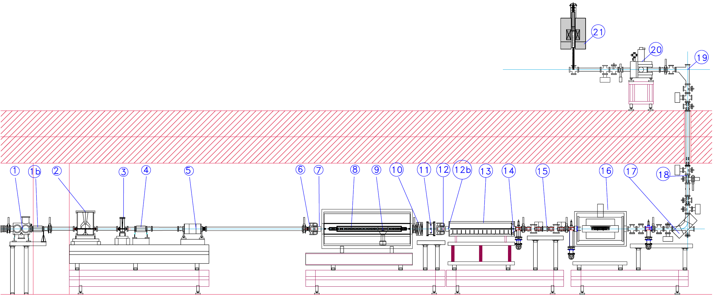
The HITRAP Facility
HITRAP will deliver 5 keV antiprotons
to low-energy experiments
Precision trap
Other experimental setups,
second floor
Double-drift-buncher
IH-structure
RFQ
cooler trap
HCI from NESR,
antiprotons from LSR
To exp. areas
ground floor
4 MeV/u → 0.5 MeV/u → 6 keV/u
Conference FAIR-2015, Novosibirsk, 16 November 2015, Wolfgang Quint

Slide 6
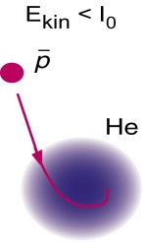
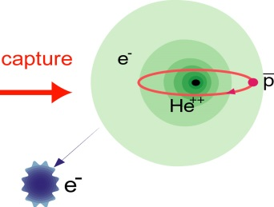
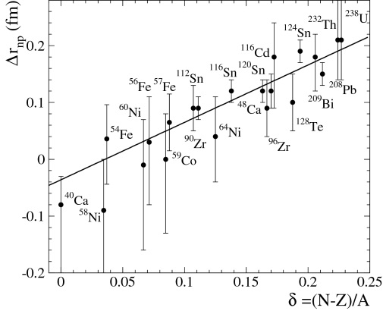
FLAIR: Research Topics with Low-Energy Antiprotons
EXPERIMENTS WITH ANTIPROTONS
AT EXTREMELY LOW ENERGIES
fundamental interactions
- CPT (antihydrogen, HFS, magnetic moment)
- gravitation of antimatter
atomic collision studies
- ionization
- energy loss
- matter-antimatter collisions
antiprotonic atoms
- formation
- strong interaction and surface effects
ATHENA Nature 419 (2002) 456
M. Hori et al., PRL 92 (2003) 123401
A. Trzcinska, J. Jastrzebski et al.PRL 87 (2001) 082501
Conference FAIR-2015, Novosibirsk, 16 November 2015, Wolfgang Quint

Slide 7
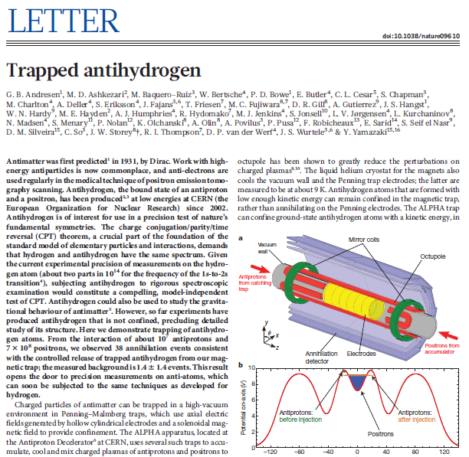
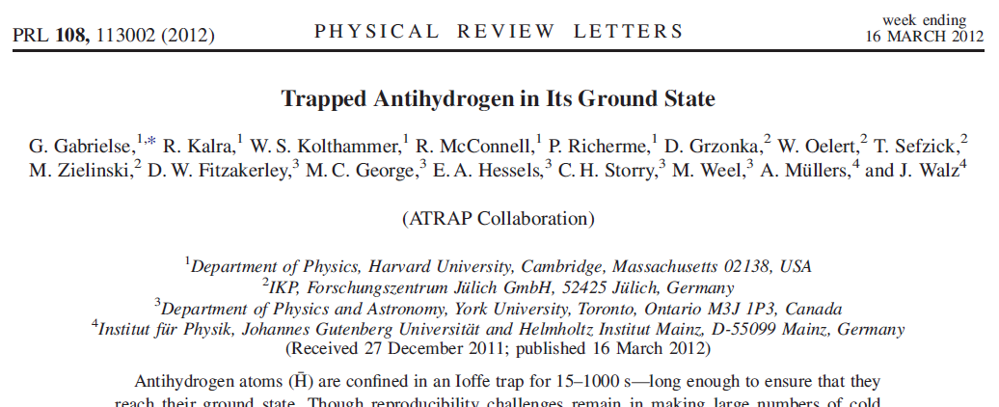
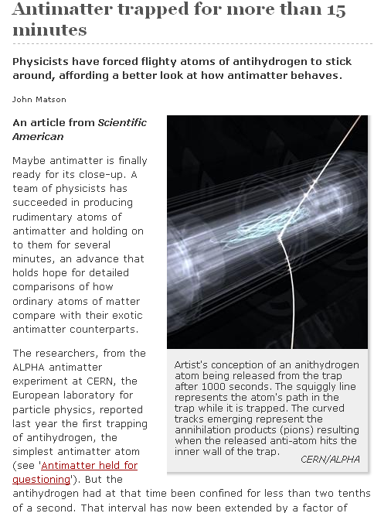
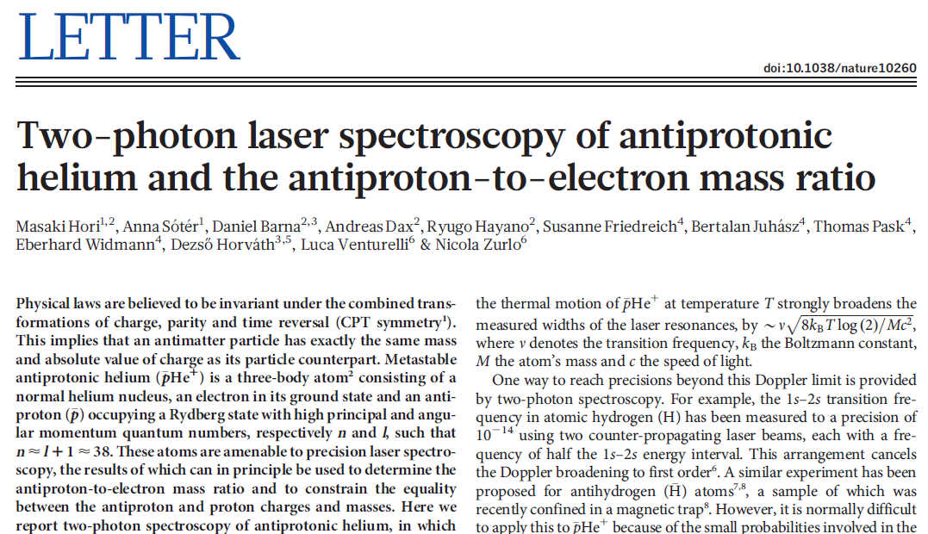
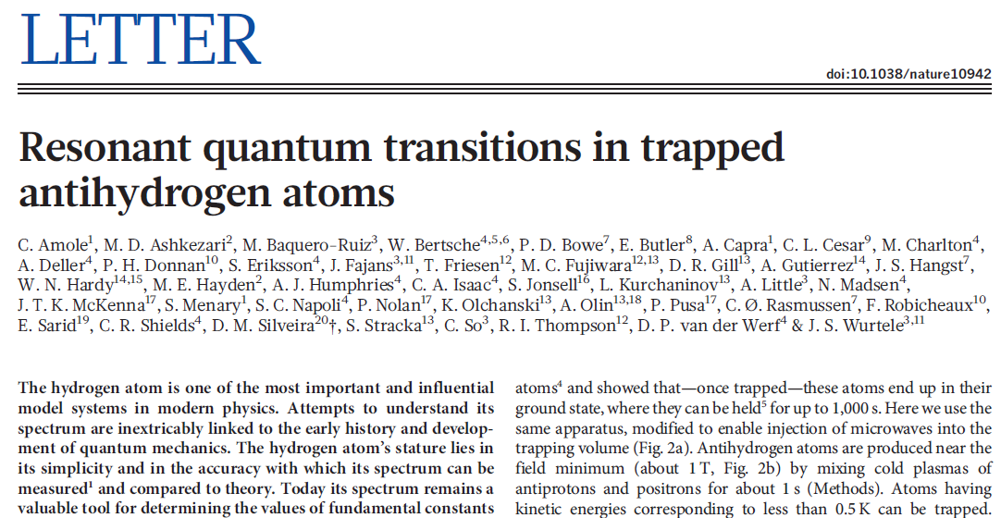
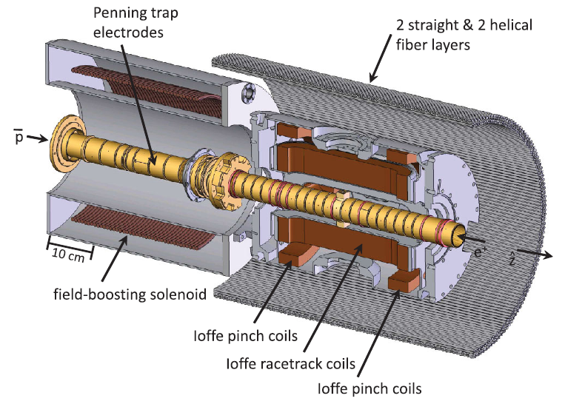
News on Antihydrogen and Antiprotonic Helium
Conference FAIR-2015, Novosibirsk, 16 November 2015, Wolfgang Quint

Slide 8
My Personal View of the History of Antiproton Physics
1875: Föppl, Idea of neg. masses, Bavarian Acad. of Sciences, Munich
1897: Sir Arthur Schuster dreams of antigold (electricity ↔ gravitation)
1931: P.A.M. Dirac predicts the existence of antimatter
1950ies: Discovery of the antiproton at the Bevalac
1970ies: H. Dehmelt proposes ion trap in collider ring to store antiprotons
1980ies: Antiproton-proton collisions reveal the existence of W±, Z⁰
1980ies: G. Gabrielse proposes to produce and store cold antihydrogen atoms in a trap and starts developing all related trapping techniques at LEAR / CERN
1990ies: AD / CERN starts operation
2002: Trapped antihydrogen atoms at AD / CERN by two collaborations
2010s: Start of ELENA at CERN and of FLAIR at FAIR ☺
Conference FAIR-2015, Novosibirsk, 16 November 2015, Wolfgang Quint

Slide 9
CPT Invariance
Physicists have been wrong before…
  - P violation---Wolfgang Pauli:¹
  "I do not believe that the Lord is a weak left-hander, and I am
  ready to bet a very high sum that the experiments will give
  symmetric results.”
  - CP violation---L. Landau:²
  “If CP is violated, I will hang myself.”
¹Pauli in a letter to Victor Weisskopf, quoted in the Ambidextrous Universe, by Martin Gardner.
² Oral history, as related by Dima Budker.
Conference FAIR-2015, Novosibirsk, 16 November 2015, Wolfgang Quint
Notes:
9
Experts on CPT say look at Gravity…experts on Gravity say look at CPT….
Feynman made a $50 bet similar to Pauli
Are we really cleverer than Pauli, Landau and Feynman?

Slide 10

Overview: CPT-Tests
BASE: Baryon Antibaryon Symmetry Experiment
Spokesperson: Stefan Ulmer
Red: Recent tests
Purple: Past tests
Green: Planned
ALICE
Nature Physics
(10.1038/nphys3432)
S. Ulmer et al., Nature 524 196 (2015)
CERN
AD
planned by
ASACUSA / ALPHA / ATRAP
Conference FAIR-2015, Novosibirsk, 16 November 2015, Wolfgang Quint

Slide 11
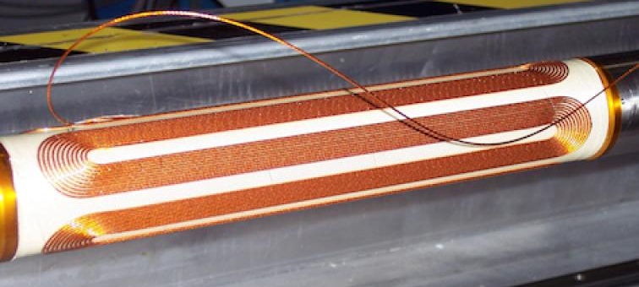
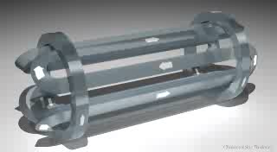
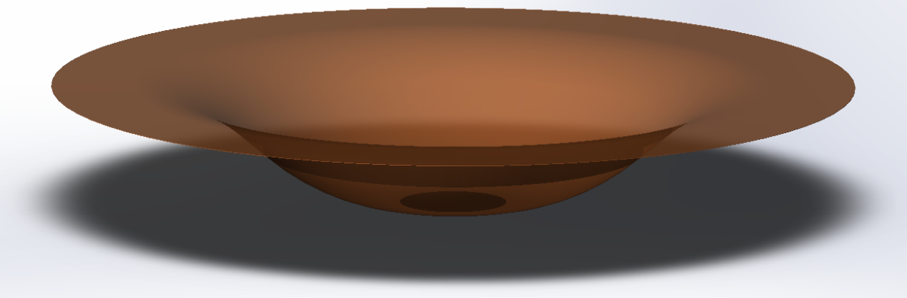
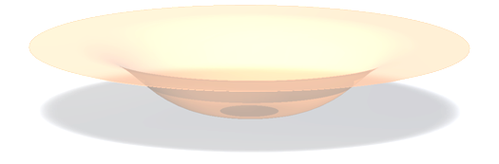
ALPHA Collaboration: Antihydrogen Trap
Octupole is a state-of-the art superconducting magnet.
Produces a maximum field of ~1.54 T.
This results in a well depth of ~0.54 K.
The anti-atoms cannot be quickly cooled…they have to be born, via three body recombination, in the well
e⁺
p
e⁺
H
e⁺
Courtesy of ALPHA-Collaboration
Conference FAIR-2015, Novosibirsk, 16 November 2015, Wolfgang Quint
Notes:
11
Kelvin is used as an energy unit.
Well is very shallow.

Slide 12
ALPHA Collaboration: Antihydrogen Trap
Octupole is a state-of-the art superconducting magnet.
Produces a maximum field of ~1.54 T.
This results in a well depth of ~0.54 K.
The anti-atoms cannot be quickly cooled…they have to be born, via three body recombination, in the well
e⁺
p
e⁺
H
e⁺
Courtesy of ALPHA-Collaboration
Conference FAIR-2015, Novosibirsk, 16 November 2015, Wolfgang Quint
Notes:
12
Kelvin is used as an energy unit.
Well is very shallow.

Slide 13
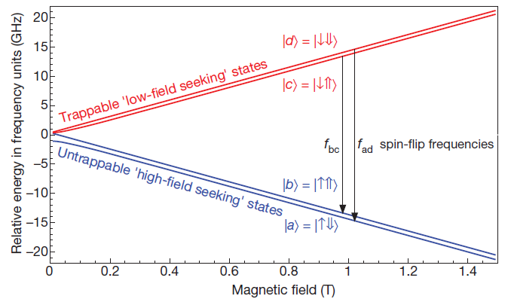
Microwave Spin Flip: Breit-Rabi Diagram
Ref.: ALPHA, Resonant quantum transition in trapped antihydrogen atoms, Nature 483, 439 (2012).
Conference FAIR-2015, Novosibirsk, 16 November 2015, Wolfgang Quint
Notes:
13
PSR-> Positron spin flip measurements.

Slide 14
Microwave Spin Flip: Appearance Measurements
Ref.: ALPHA, Resonant quantum transition in trapped antihydrogen atoms, Nature 483, 439 (2012).
Conference FAIR-2015, Novosibirsk, 16 November 2015, Wolfgang Quint
Notes:
14
Microwave measurements will measure the hyperfine constant.
PSR-> Positron spin flip measurements.

Slide 15
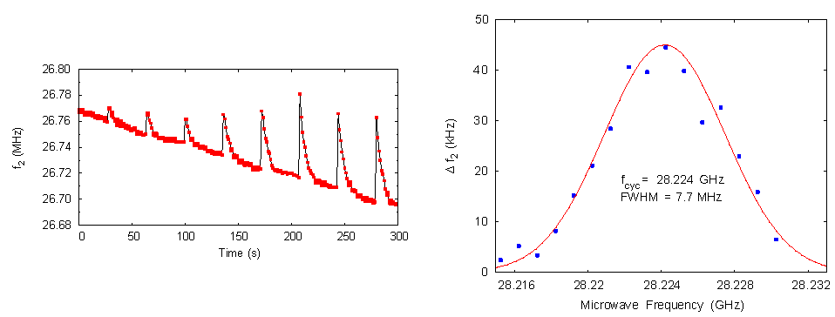
Antihydrogen Spin Flip Measurement
ALPHA, Resonant quantum transition in trapped antihydrogen atoms, Nature 483, 439 (2012).
Conference FAIR-2015, Novosibirsk, 16 November 2015, Wolfgang Quint
Notes:
15
Microwave measurements will measure the hyperfine constant.
PSR-> Positron spin flip measurements.

Slide 16
FLAIR: Hyperfine Structure of Antihydrogen
Conference FAIR-2015, Novosibirsk, 16 November 2015, Wolfgang Quint

Slide 17
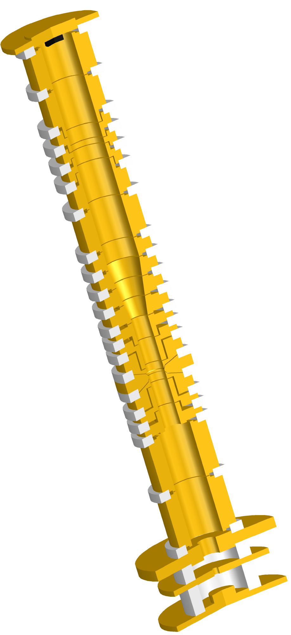
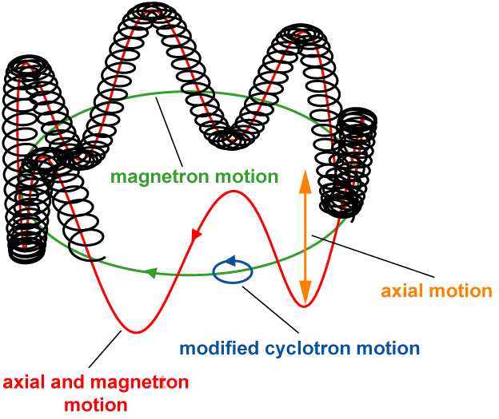
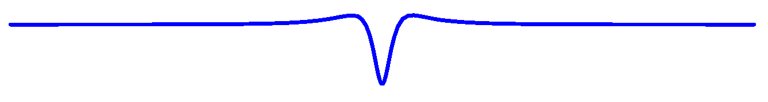
Determination of the Proton g-Factor
Cyclotron frequency
Larmor frequency
analysis trap
precision trap
Conference FAIR-2015, Novosibirsk, 16 November 2015, Wolfgang Quint

Slide 18
Nuclear Periphery with Antiprotonic Atoms
Conference FAIR-2015, Novosibirsk, 16 November 2015, Wolfgang Quint

Slide 19
Antiprotons and Radioactive Ions in Traps for Nuclear Structure Studies
Conference FAIR-2015, Novosibirsk, 16 November 2015, Wolfgang Quint

Slide 20
Meson Physics at FLAIR:
Production of Mesons with Strangeness -2
Conference FAIR-2015, Novosibirsk, 16 November 2015, Wolfgang Quint

Slide 21
FLAIR - Facility for Low-Energy Antiproton and Ion Research
HITRAP
We need a transfer line
from the Collector Ring
to the ESR.
Conference FAIR-2015, Novosibirsk, 16 November 2015, Wolfgang Quint

Slide 22
Conclusions:
If we will have a transfer line from the
Collector Ring to the ESR, then
the ESR can take over a part of the tasks
of the NESR,
CRYRING is the LSR of FLAIR,
HITRAP can decelerate antiprotons, and
the USR can be attached to CRYRING.
= nearly the full FLAIR facility
(except for the neighbourhood
to rare isotopes)
HITRAP
Conference FAIR-2015, Novosibirsk, 16 November 2015, Wolfgang Quint

