Slide 1
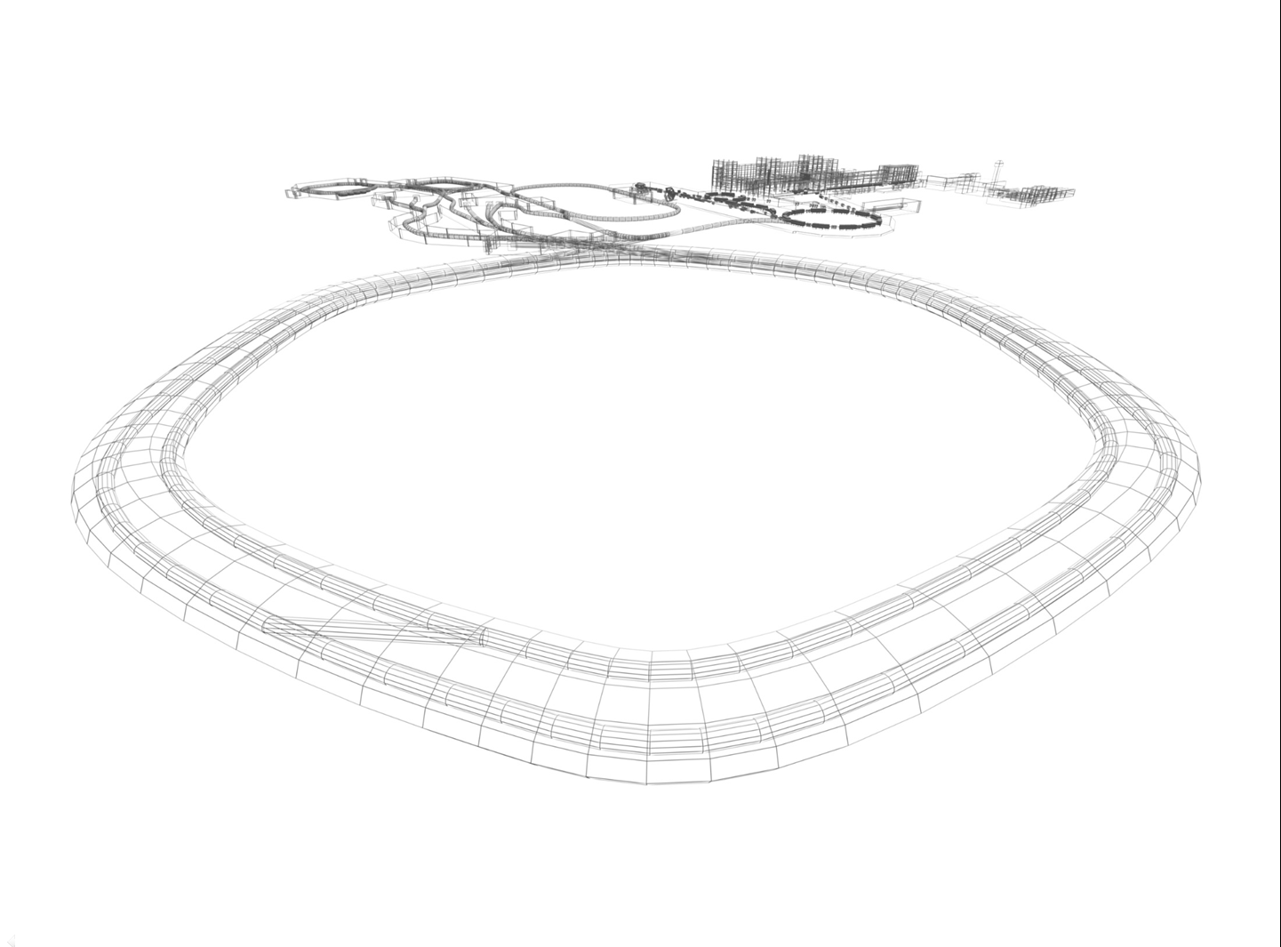


The power supply for magnetic elements at CR
International Workshop on Antiproton Physics and Technology at FAIR
16.11 - 19.11.2015
D.Senkov
IWAPT 2015, BINP, Novosibirsk

Slide 2
CR magnet system
International Workshop on Antiproton Physics and Technology at FAIR
16.11 - 19.11.2015
24
DIPOLES
1 POWER
CONV
DC magnets/ correctors
40 QUADRUPOLES
15 POWER
CONV
24 SEXTUPOLES
6 POWER
CONV
CR Magnet System
47
CORRECTORS
47 STEERER
PC
Injection/ Extraction
magnets
2 KICKER
MAGNETS
KICKER
PSs
INJECTION
SEPTUM
INJ SEPTUM PS
EXTRACTION
SEPTUM
EXT SEPTUM PS

Slide 3
CR magnet system
International Workshop on Antiproton Physics and Technology at FAIR
16.11 - 19.11.2015
24
DIPOLES
1 POWER
CONV
DC magnets/ correctors
40 QUADRUPOLES
15 POWER
CONV
24 SEXTUPOLES
6 POWER
CONV
CR Magnet System
47
CORRECTORS
47 STEERER
PC
Injection/ Extraction
magnets
2 KICKER
MAGNETS
KICKER
PSs
INJECTION
SEPTUM
INJ SEPTUM PS
EXTRACTION
SEPTUM
EXT SEPTUM PS

Slide 4
CR MAGNETS TYPES
International Workshop on Antiproton Physics and Technology at FAIR
16.11 - 19.11.2015
TYPE | SUB | Qty | Imax A | Lm mHn | Rm mOm | Vm V | Field Quality
DIPOLES | - | 24 | 1400 | 449 | 73.6 | 124 | 10ppm
QUADRUPOLES | EWQ | 3 | 1400 | 49.8 | 26.31 | 40 | 100ppm
 | WQ | 14 | 1400 | 59 | 26.31 | 40 | 100ppm
 | SWQ | 12 | 1400 | 44 | 21.67 | 34 | 100ppm
 | NQ | 11 | 1250 | 11 | 13.1 | 18 | 100ppm
SEXTUPOLES | - | 24 | 500 | 5.9 | 34.5 | 17.3 | 0.05%
CORRECTORS | MHKH | 24 | 10 | 1230 | 5160 | 52 | 0.5%
 | KH/KV | 5x2 | 12 | 100 | 6420 | 77 | 0.5%
 | KV | 13 | 20 | 250 | 4340 | 87 | 0.5%

Slide 5
CR MAGNETS
International Workshop on Antiproton Physics and Technology at FAIR
16.11 - 19.11.2015

Slide 6
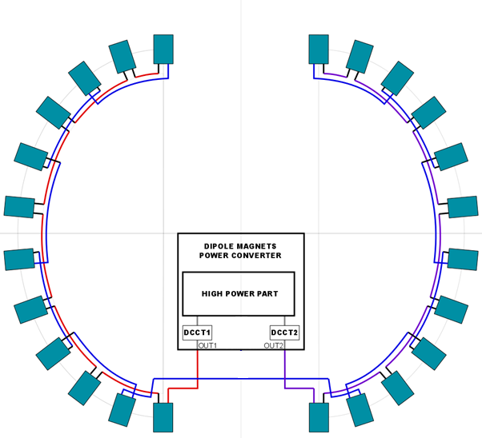
DIPOLE MAGNETS CONNECTION
International Workshop on Antiproton Physics and Technology at FAIR
16.11 - 19.11.2015
24 CONNECTED IN SERIES
DIPOLE MAGNETS
VOLTAGE – 2988V
CURRENT– 1400A
DIPOLE MAGNETS
POWER CONVERTER
3000V
1400A
OUT1
OUT2

Slide 7
International Workshop on Antiproton Physics and Technology at FAIR
16.11 - 19.11.2015
CR DIPOLE MAGNETS POWER CONVERTER
PARAMETER | VALUE
IOUT MAX | 1400 A
VOUTMAX | 3000 V
ΔIOUT/IOUT (500Hz-1.2MHz) | 1ppm
ΔIOUT/IOUT (f<500Hz) | 10ppm
LONG TERM STABILITY (8 hour) | 10ppm
CONTROL | GSI CONTROL UNIT
DCCT | GSI CONTROL UNIT
MAINS | 20 kV

Slide 8
DIPOLE MAGNETS POWER CONVERTER DIAGRAMM
International Workshop on Antiproton Physics and Technology at FAIR
16.11 - 19.11.2015
20kV
MAINS
20kV
SWITCH
GEAR
2x2MVA
20kV->1200V TRANSFORMERS
RECTIFIER
RIPPLES
SUPPRES
DCCT
POLARITY
SELECT
24
DIPOLE
MAGNETS
1.4kA
3kV
RECTIFIER

Slide 9
DIPOLE MAGNETS POWER CONVERTER CONTROL
International Workshop on Antiproton Physics and Technology at FAIR
16.11 - 19.11.2015
ADAPTIVE
CONTROL
UNIT
(GSI)
IOUT SET
POWER CONVERTER
UNIT
1.5kA
DCCT
(GSI)
DAC
FEEDBACK
READBACK
VOUT
V DCLINK
ADC
I DCLINK
T HEATSINK
CONTROL
DOUT
STATUS
DIN
CURRENT MEASURE
DCCT CONTROL

Slide 10
International Workshop on Antiproton Physics and Technology at FAIR
16.11 - 19.11.2015
Converter parameters table
Maximum current, I_{max} | 1500A
Nominal current, I_{N} | 1400A
Range of load current, I_{min}…I_{max} | -1500A…1500A
Rise time from 0 to I_{max} | 30sec
Fall time from I_{max} to 0 | 30sec
Maximum output voltage V_{max} | 3000V
ΔIout/ I_{N} (F<500Hz) | ± 5ppm p-p
ΔIout/ I_{N} (F>500Hz) | ± 1ppm p-p
Long Term Stability | 10 ppm r.m.s.
Operating mode | DC operation, Ramping operation
Control | ACU
DCCT | ACU controlled DCCT
Cooling | Distill Water
Cooling water max pressure | 15 bar
Cooling water input temperature | 25°C
Cooling water outlet temperature | 55°C
Load connection cable crossection | 750mm²
Maximum length of load cable | 200m
Mains | AC 20kV

Slide 11
International Workshop on Antiproton Physics and Technology at FAIR
16.11 - 19.11.2015
QUADRUPOLE MAGNETS POWER CONVERTERS TYPES
QUAD TYPE | Magnets in series | G kGs/cm | Inom kA | Vm tot V | Vcable V | Vtotal V | Ptotal kW
EWQ | 1 | 0.3 | 1.18 | 33 | 11 | 44 | 52
EWQ | 2 | 0.3 | 1.18 | 66 | 11 | 77 | 91
WQ | 4 | 0.32 | 1.00 | 114 | 10 | 124 | 124
WQ | 4 | 0.32 | 1.00 | 114 | 10 | 124 | 124
WQ | 4 | 0.41 | 1.28 | 144 | 13 | 157 | 201
WQ | 2 | 0.35 | 1.10 | 62 | 11 | 73 | 80
SWQ | 4 | 0.36 | 1.13 | 106 | 11 | 117 | 132
SWQ | 4 | 0.33 | 1.04 | 98 | 10 | 108 | 112
SWQ | 4 | 0.38 | 1.20 | 112 | 12 | 124 | 149
NQ | 2 | 0.43 | 0.83 | 24 | 8 | 32 | 27
NQ | 2 | 0.52 | 1.00 | 28 | 10 | 38 | 38
NQ | 2 | 0.52 | 1.00 | 28 | 10 | 38 | 38
NQ | 2 | 0.43 | 0.83 | 24 | 8 | 32 | 27
NQ | 2 | 0.58 | 1.12 | 32 | 11 | 43 | 48
NQ | 1 | 0.57 | 1.10 | 16 | 11 | 27 | 30

Slide 12
International Workshop on Antiproton Physics and Technology at FAIR
16.11 - 19.11.2015
QUADRUPOLE MAGNETS POWER CONVERTERS CONNECTION

Slide 13
International Workshop on Antiproton Physics and Technology at FAIR
16.11 - 19.11.2015
QUAD MAGNETS POWER CONVERTERS PARAMETERS
PARAMETER | VALUE TYPE1 | VALUE TYPE2 | VALUE TYPE3
IOUT MAX | 1500 A
VOUTMAX | 200 V | 100 V | 50 V
ΔIOUT/IOUT | ±50ppm p-p
LONG TERM STABILITY | 100ppm r.m.s.
CONTROL | GSI CONTROL UNIT
DCCT | GSI CONTROL UNIT
MAX POWER | 300kW | 150kW | 75kW
MAINS | AC 400 V 50Hz TN-S

Slide 14
International Workshop on Antiproton Physics and Technology at FAIR
16.11 - 19.11.2015
QUADRUPOLE MAGNETS POWER CONVERTER STRUCTURE

Slide 15
QUAD POWER CONVERTER CONTROL DIAGRAMM
International Workshop on Antiproton Physics and Technology at FAIR
16.11 - 19.11.2015
ADAPTIVE
CONTROL
UNIT
(GSI)
IOUT SET
POWER CONVERTER
UNIT
1.5kA
DCCT
(GSI)
DAC
FEEDBACK
FB READBACK
VOUT
LOCAL CURRENT SENSOR
V DCLINK
ADC
I DCLINK
T HEATSINK
CONTROL
DOUT
STATUS
DIN
IOUT MEASURE
DCCT CONTROL

Slide 16
QUAD POWER CONVERTER RACK LAYOUT
International Workshop on Antiproton Physics and Technology at FAIR
16.11 - 19.11.2015
CONTROL SYSTEM
CONVERTER
RACK
CONTROL
RACK
250A CHANNEL
CONTROL UNIT
250A CHANNEL
STEP-DOWN
TRANSFORMER
250A CHANNEL
DCCT
250A CHANNEL
250A CHANNEL
250A CHANNEL
MAINS 400VAC
I OUT

Slide 17

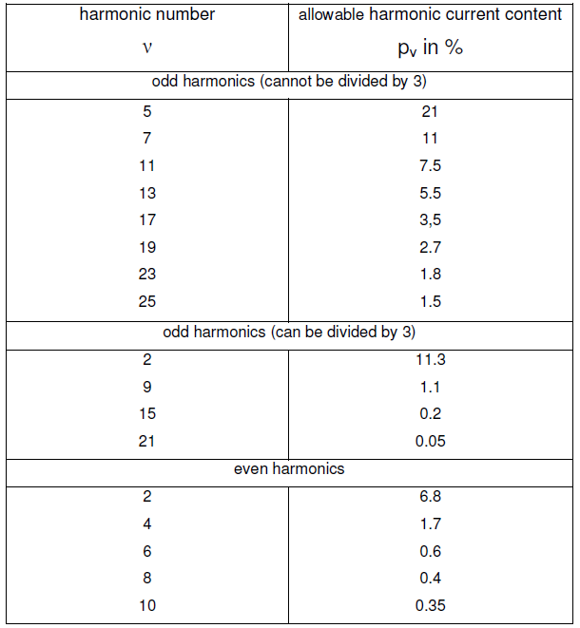
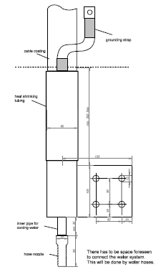
International Workshop on Antiproton Physics and Technology at FAIR
16.11 - 19.11.2015
QUAD POWER CONVERTERS CONNECTIONS
Connection to electrical power : TN-S
Connection to load:
Water cooled cables with 750mm² cross-section
To magnet
Cable connection to converter
converter

Slide 18
International Workshop on Antiproton Physics and Technology at FAIR
16.11 - 19.11.2015
Power converter type | QPC Type1 | QPC Type2 | QPC Type3
Maximum current, I_{max} | 1500A
Nominal current, I_{N} | 1350A | 1100A | 1200A
Range of load current, I_{min}…I_{max} | -1500A…1500A
Rise time from 0 to I_{max} | 5sec
Fall time from I_{max} to 0 | 5sec
Maximum output voltage V_{max} | 200V | 100V | 50V
ΔIout/ I_{N} | ±50 ppm p-p
Long Term Stability | 100 ppm r.m.s.
Operating mode | DC operation, Ramping operation
Control | ACU²
DCCT | One Built-In, One ACU controlled DCCT
Maximum Channel Power | 300kW | 150kW | 75kW
Mains | AC 400V 50Hz TN-S
Cooling | Distill Water
Cooling water maximal flow | 16L/min
Cooling water max pressure | 15 bar
Cooling water input temperature | 25°C
Max allowed outlet temperature | 55°C
Load connection cable crossection | 750mm²
Maximum length of load cable | 200m
Number of cabinets for converter | 3 | 2+1/2 | 2+1/4
Max cabinet dim W x D, m; H=2.1m | 1.2x0.8 | 1.2x0.8 | 1.2x0.8

Slide 19
International Workshop on Antiproton Physics and Technology at FAIR
16.11 - 19.11.2015
SEXTUPOLE MAGNETS POWER CONVERTERS CONNECTION

Slide 20
International Workshop on Antiproton Physics and Technology at FAIR
16.11 - 19.11.2015
SEXTUPOLE MAGNETS POWER CONVERTERS PARAMETERS
PARAMETER | VALUE
IOUT MAX | 500 A
VOUTMAX | 100 V
ΔIOUT/IOUT | ±100ppm p-p
LONG TERM STABILITY | 500ppm r.m.s.
CONTROL | GSI CONTROL UNIT
DCCT | BUILT-IN
MAX POWER | 50kW
MAINS | AC 400 V 50Hz TN-S

Slide 21
International Workshop on Antiproton Physics and Technology at FAIR
16.11 - 19.11.2015
SEXTUPOLE POWER CONVERTER STUCTURE

Slide 22
SEXTUPOLE POWER CONVERTER CONTROL DIAGRAMM
International Workshop on Antiproton Physics and Technology at FAIR
16.11 - 19.11.2015
ADAPTIVE
CONTROL
UNIT
(GSI)
IOUT SET
POWER CONVERTER
UNIT
DAC
FEEDBACK
FB READBACK
VOUT
V DCLINK
ADC
I DCLINK
T HEATSINK
CONTROL
DOUT
STATUS
DIN
IOUT MEASURE
DCCT ADC

Slide 23
^{[1]} Components will be delivered to the contractor by the FAIR.
^{[2]} Refer Sec.5.5
International Workshop on Antiproton Physics and Technology at FAIR
16.11 - 19.11.2015
Power converter type | SPC (Sextupole Power Converter)
Maximum current, I_{max} | 500A
Nominal current, I_{N} | 500A
Range of load current, I_{min}…I_{max} | -500A…500A
Rise time from 0 to I_{max} | 10sec
Fall time from I_{max} to 0 | 10sec
Maximum output voltage V_{max} | 100V
ΔIout/ I_{N} | ±100 ppm p-p
Long Term Stability | 500 ppm r.m.s.
Operating mode | DC operation, Ramping operation
Control | ACU
DCCT | One Built-In, One ACU controlled DCCT¹
Maximum Channel Power | 50kW
Mains | AC 400V 50Hz TN-S
Cooling | Distill Water
Cooling water maximal flow | 16L/min
Cooling water max pressure | 15 bar
Cooling water input temperature | 25°C ± 2°C
Max allowed outlet temperature | 55°C
Load connection cables cross section | 300mm² (2 coaxial power cables 150mm² in parallel)
Maximum length of load cable | 200m
Number of cabinets per converter | 1
Max cabinet dim W x D, m; H=2.2m | 1.2x0.8

Slide 24
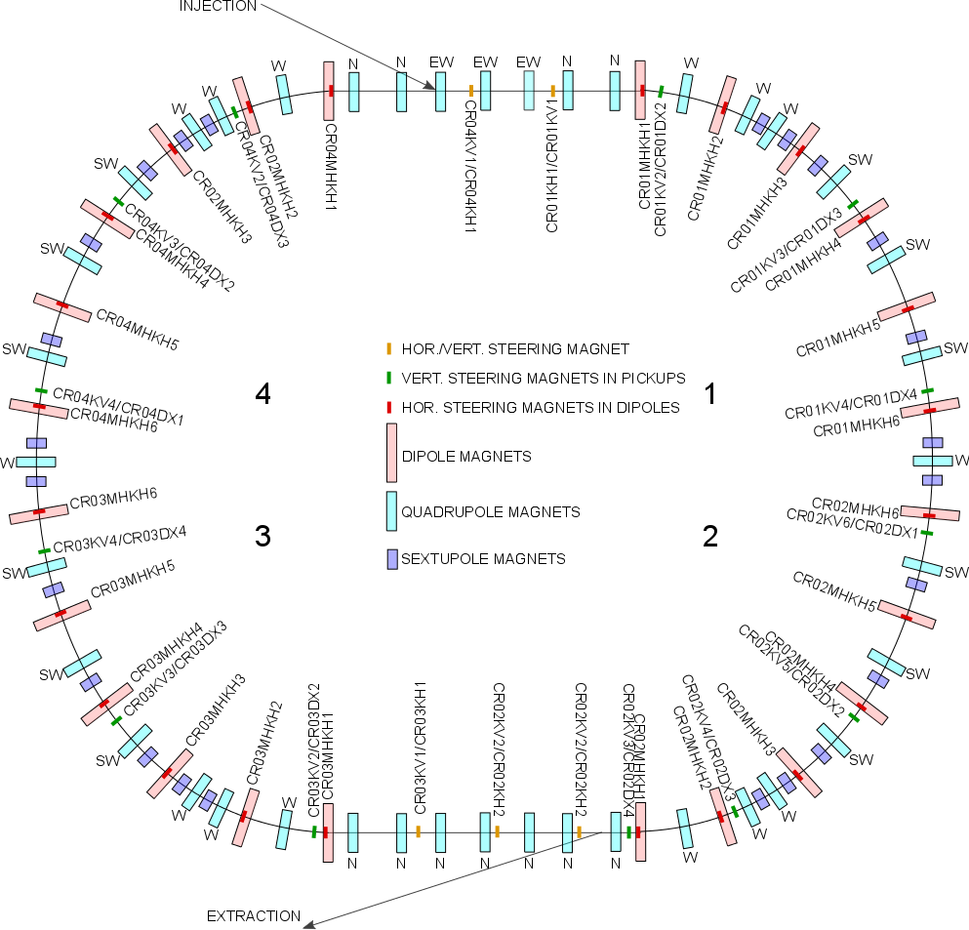
International Workshop on Antiproton Physics and Technology at FAIR
16.11 - 19.11.2015
STEERING MAGNETS LAYOUT

Slide 25
International Workshop on Antiproton Physics and Technology at FAIR
16.11 - 19.11.2015
STEERER POWER CONVERTERS PARAMETERS
PARAMETER | CR.KH/KV.GN | CR.KV.GN | CR.MHKH.GN
IOUT MAX | 12 A | 20 A | 6 A
VOUTMAX | 100 V | 100 V | 50 V
ΔIOUT/IOUT ( F < 100Hz) | 0.5%p-p
ΔIOUT/IOUT ( F > 100Hz) | 0.1% p-p
LONG TERM STABILITY | 0.5% r.m.s.
CONTROL | GSI CONTROL UNIT
DCCT | BUILT-IN
MAINS | AC 400 V 50Hz TN-S

Slide 26
International Workshop on Antiproton Physics and Technology at FAIR
16.11 - 19.11.2015
STEERER POWER CONVERTER CONTROL DIAGRAMM
ADAPTIVE
CONTROL
UNIT
(GSI)
IOUT SET
POWER CONVERTER
DAC
IOUT MEASURE
VOUT
ADC
CONTROL
DOUT
STATUS
DIN

Slide 27
^{[1]} Components will be delivered to the contractor by the FAIR.
^{[2]} Refer Sec.5.5
^{[3]} Refer Sec 5.6
International Workshop on Antiproton Physics and Technology at FAIR
16.11 - 19.11.2015
POWER CONVERTER TYPE | CR.KH/KV.GN | CR.KV.GN | CR.MHKH.GN
Maximum current, I_{max} | 12A | 20A | 6A
Nominal current, I_{N} | 12A | 20A | 6A
Range of load current, I_{min}…I_{max} | -12A…12A | -20A…20A | -6A…6A
Rise time from 0 to I_{max} | 5sec | 5sec | 5sec
Fall time from I_{max} to 0 | 5sec | 5sec | 5sec
Maximum output voltage V_{max} | 100V | 100V | 50V
ΔIout/ I_{N} (F<100Hz) | 0.5% p-p | 0.5% p-p | 0.5% p-p
ΔIout/ I_{N} (F>100Hz) | 0.1% p-p | 0.1% p-p | 0.1% p-p
Long Term Stability | 0.5% r.m.s. | 0.5% r.m.s. | 0.5% r.m.s.
Operating mode | DC operation, Ramping operation | DC operation, Ramping operation | DC operation, Ramping operation
Resistance of magnet | 6.42Ohm | 4.34Ohm | 5.16Ohm
Low field inductance of magnet | 100mHn | 250mHn | 1230mH
Control | ACU
DCCT | Built-In
Cooling | Air
Load connection cables cross section | 16 mm² | 16 mm² | 16 mm²
Maximum length of load cable | 100m | 100m | 100m
Number of power converters | 10 | 13 | 24
Max number of converters in one cabinet | 6 | 7 | 12
Max cabinet dim W x D, m; H=2.2m | 1.2x0.8 | 1.2x0.8 | 1.2x0.8

Slide 28
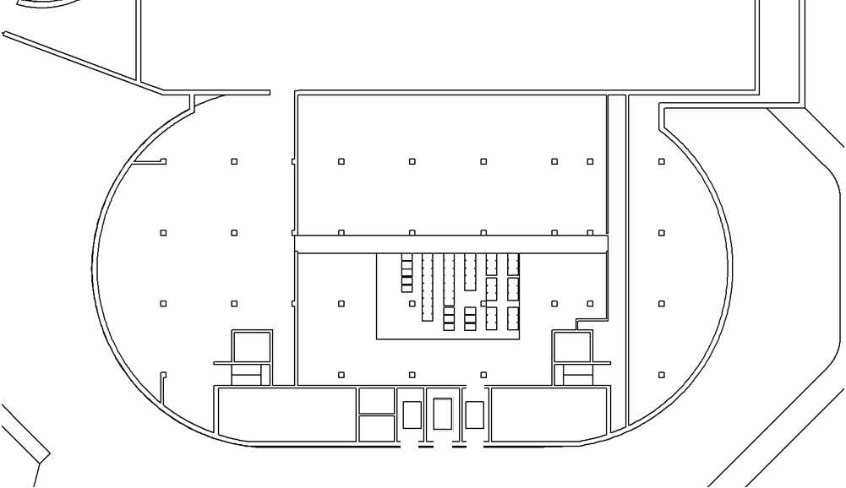
International Workshop on Antiproton Physics and Technology at FAIR
16.11 - 19.11.2015
CR POWER CONVERTERS
PLANNED ARRANGEMENT
E20 LEVEL
Quadrupole PC
Stereers PC
Sextupole PC
Dipole PC

Slide 29
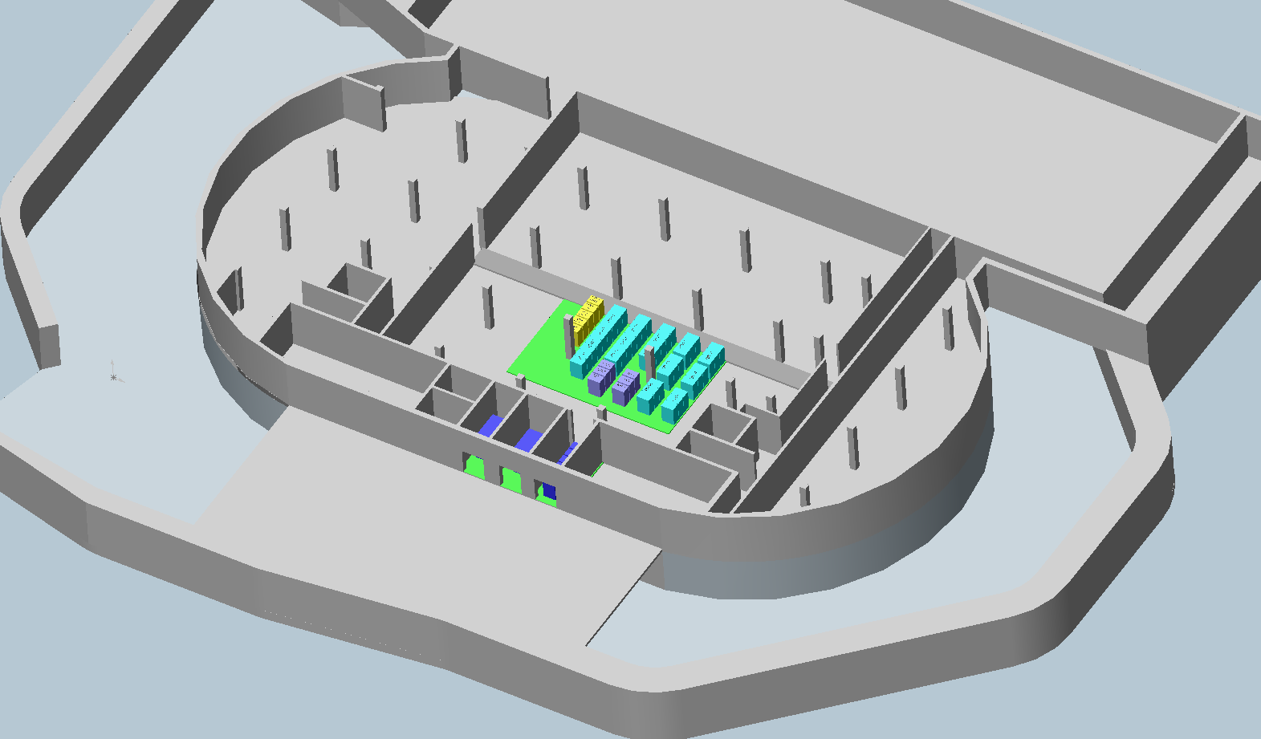
International Workshop on Antiproton Physics and Technology at FAIR
16.11 - 19.11.2015
CR POWER CONVERTERS PLANNED ARRANGEMENT

Slide 30
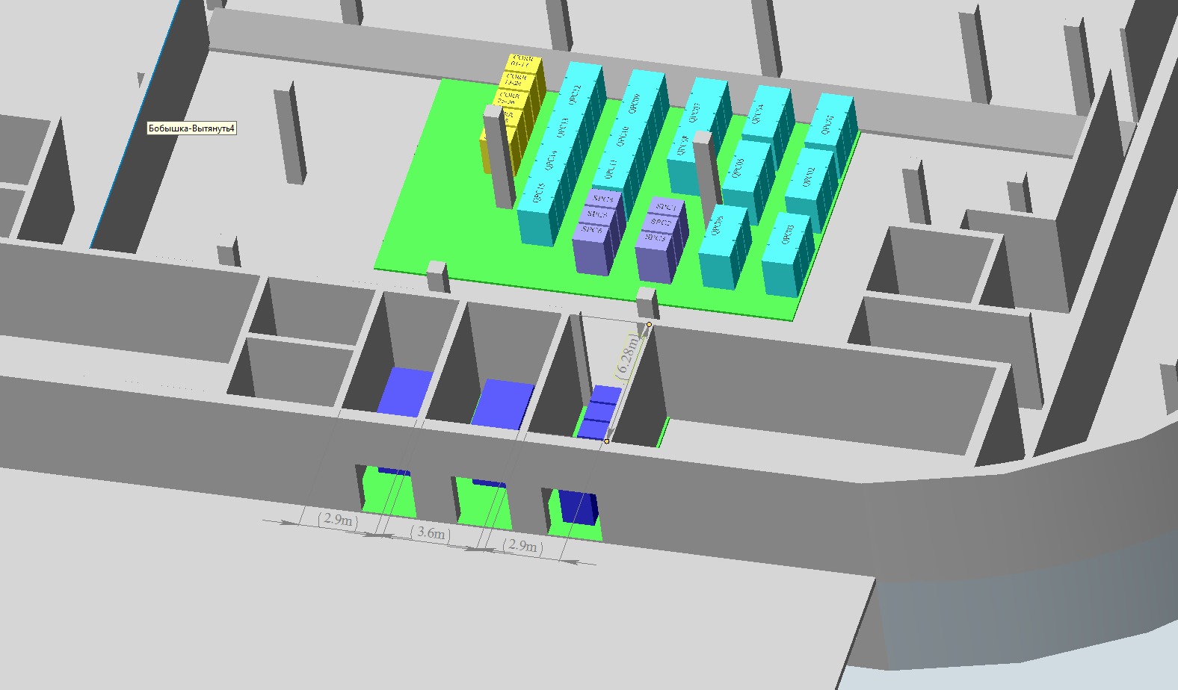
International Workshop on Antiproton Physics and Technology at FAIR
16.11 - 19.11.2015

Slide 31
Thank you for your attention
International Workshop on Antiproton Physics and Technology at FAIR
16.11 - 19.11.2015

