Slide 1



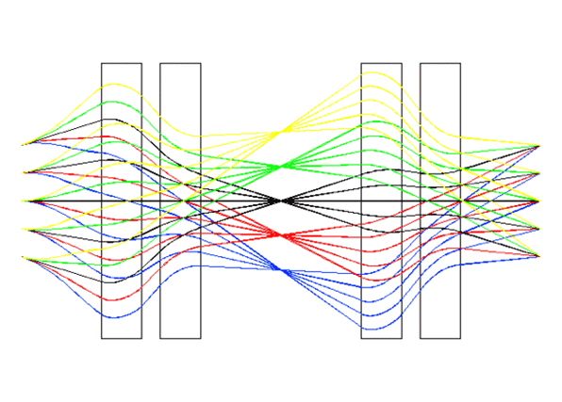
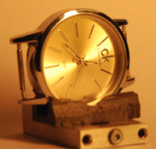
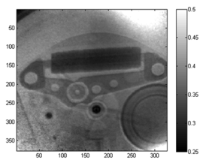
THE METHOD OF CALCULATION AND OPTIMIZATION
OF THE ION-OPTICAL SCHEME OF THE PROTON
MICROSCOPE
ITEP
Аnton Bogdanov
Institute for Theoretical and Experimental Physics (ITEP),
Moscow, Russia
FAIR, Novosibirsk 2015

Slide 2
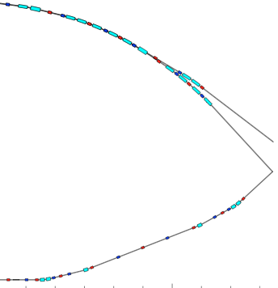
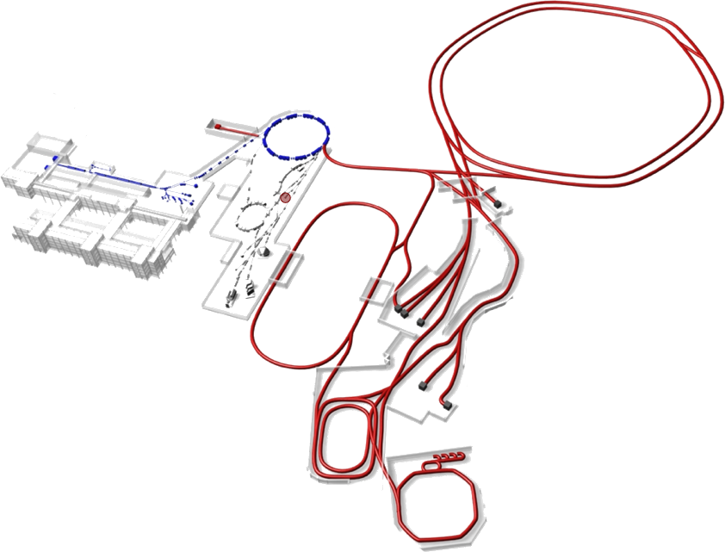
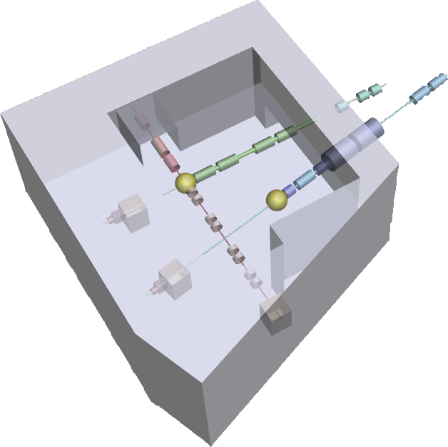
PRIOR – density diagnostic tool for high energy density in matter experiments of HEDgeHOB collaboration:
Challenging requirements
for density measurements in dynamic experiments:
up to ~20 g/cm2 (Fe, Pb, Au, etc)
≤10 μm spatial resolution
10 ns time resolution (multi-frame)
sub-percent density resolution
SIS-100
SIS-18
from SIS-100
Tasks for PRIOR :
FAIR proton radiography system will be designed, constructed and commissioned in full-scale dynamic experiments with 10 GeV proton beam from SIS–100
prior to FAIR, a worldwide unique radiographic facility will become operational at GSI providing a capability for unparalleled high-precision experiments in plasma physics, high energy density (HED) physics, biophysics, and materials research
PRIOR
Notes:
Novel high-energy proton microscope called PRIOR (Proton Microscope for FAIR)[1] will be the key diagnostic instrument for HED research program of HEDgeHOB collaboration at FAIR. (HIHEX and LAPLAS experiments).

Slide 3
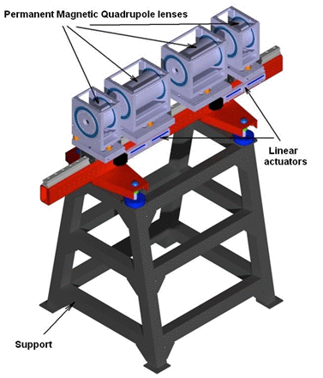
PRIOR (Proton microscope for FAIR)
Main parameters:
proton energy: up to 4.5 GeV (at GSI), up to 10 GeV (at FAIR) ;
areal density of target: up to 100 g/cm²;
areal density reconstruction: sub-percent level;
spatial resolution: less than 10 μm;
temporal resolution: 10 ns;
multi-framing capability: up to 4 frames per
dynamic event (at GSI), 16 frames at FAIR ;
field of view: 10 – 15 mm;
length of setup ~ 25 m
proton beam intensity: 5*10¹⁰ (at GSI),
2.5*10¹³ (at FAIR)
chromatic length: ~3 m
Notes:
In the first half of 2013 was implemented assembly of the basic elements the PRIOR setup . PMQ lens were set (via adjusting stends) on single rail, which in turn is mounted on support bar attached to the support. Assembled proton microscope mounted on the axis of the proton beam at HHT (GSI) experimental area.

Slide 4
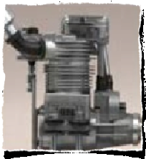
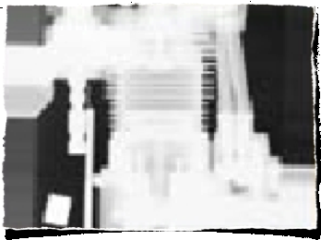
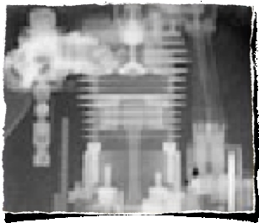
Advantages of proton radiography
Protons VS X-rays
Higher spatial resolution for dense objects (up to 10 um)
Higher penetrating possibility, up to 300 g/cm²
Protons VS Neutrons
Possibility of multiframe registration of fast processes
High density resolution and dynamic range
Photo
100 keV
X-rays
Advantages of GeV protons:
Minimized spatial scattering in object
Reduction of chromatic aberrations
Minimized blurring in detector
800 MeV
protons
Notes:
method of studying the internal structure of objects with a beam of protons

Slide 5
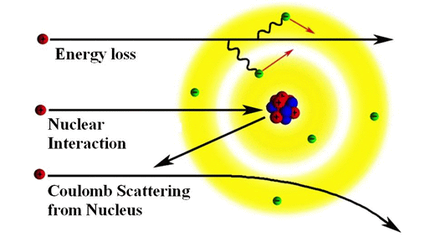
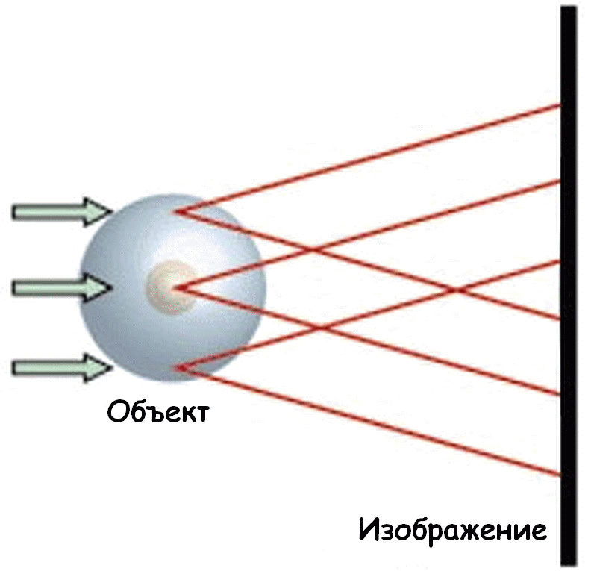
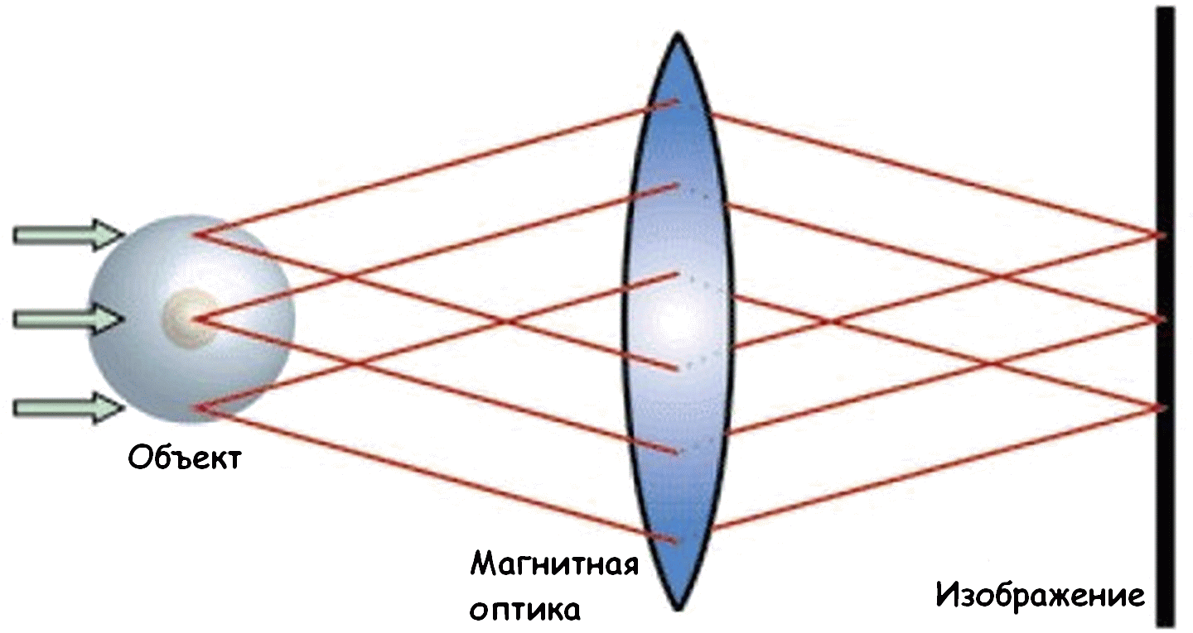
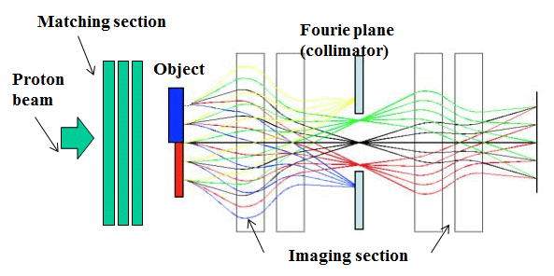
History
Interaction of proton with matter
Image at the detector is blurred due to MCS (1968)
Magnetic imaging lens preserves the image
in high resolution (LANSCE 1997)
Transmission = information about density distribution
Notes:
Existing proton radiography facilities in U.S. and in Russian clearly showed advantage of the proton radiography compared with conventional X-ray methods, under study of dense objects, especially in dynamic experiments. The best spatial resolution of the method for proton radiography was obtained at facilities with increasing image of the objects, constructed according to the scheme of the proton microscope. Quadrupole lenses based on permanents magnets (PMQ) with high gradient magnetic field and small geometric dimensions are used to create such facilities.

Slide 6
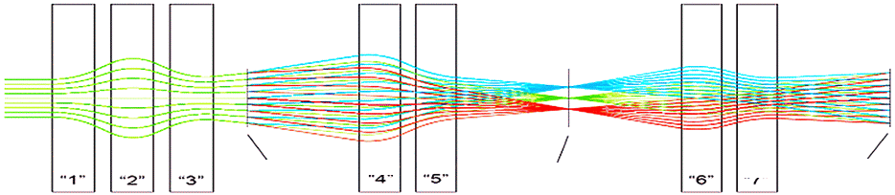
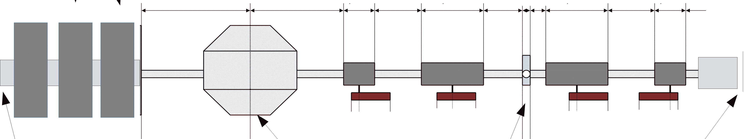
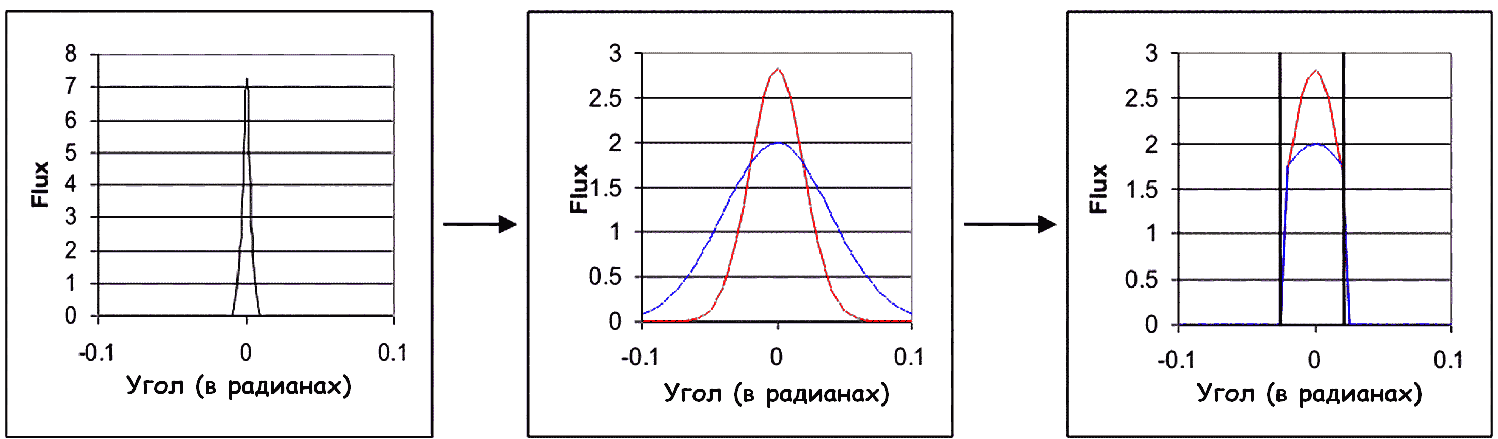
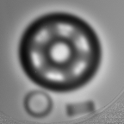
Principal scheme of setup
object
collimator
image
Initial beam
After object
After collimator
Measured transmission give information about “linear thickness” of object

Slide 7
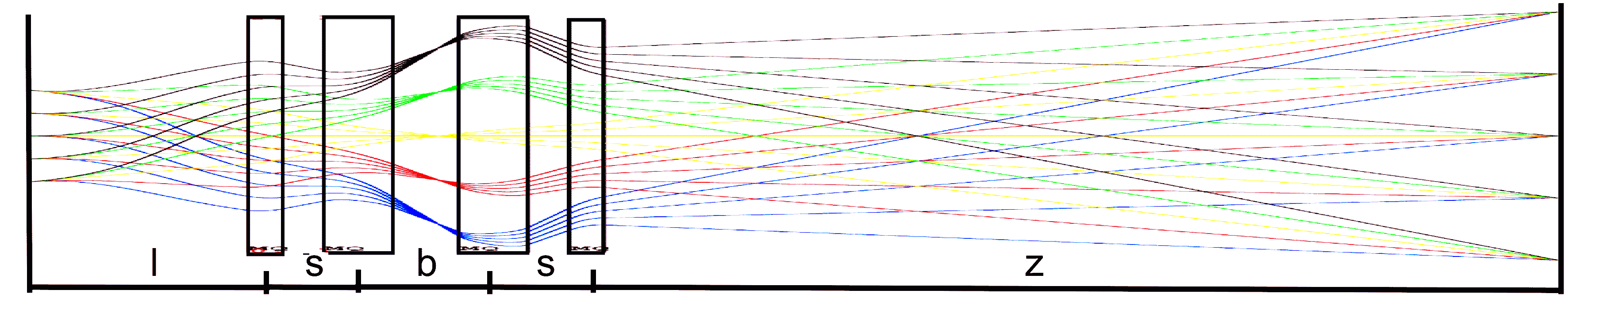
Transport matrix formalism
k – coefficient of proportionality of focus distances of inner and outer PMQ lenses. For microscope it equal 2.0;
f - focal length for PMQ lens.
m – magnification
Solve relatively: k,l,s,m. Stay constant

Slide 8
Transport matrix formalism
Distances between PMQ lenses
focal length for PMQ lens

Slide 9
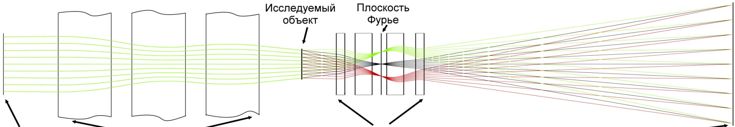
Construction of optical scheme in Cosy infinity
On registration plane
Condition of image forming
Condition of matching of setup
Chromatic length of system
Magnification
x_{o}, φ - position and angle on object;
x_{fp} - position of particle in Fourier plane;
x_{i} - position on image plane;
δ- Δp/p – the momentum change;
M - transport matrix of second order;

Slide 10
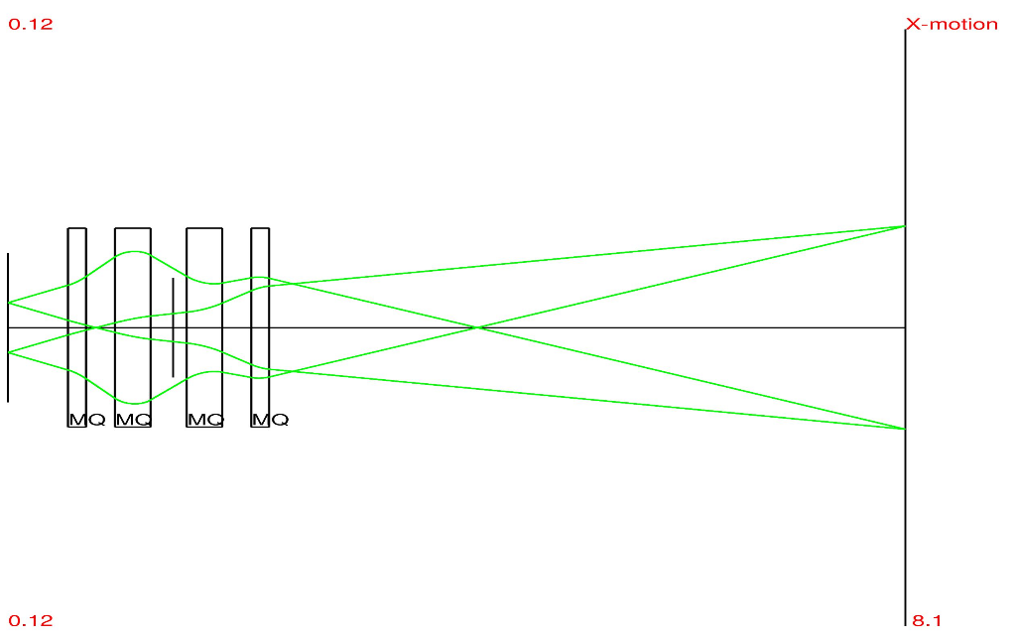
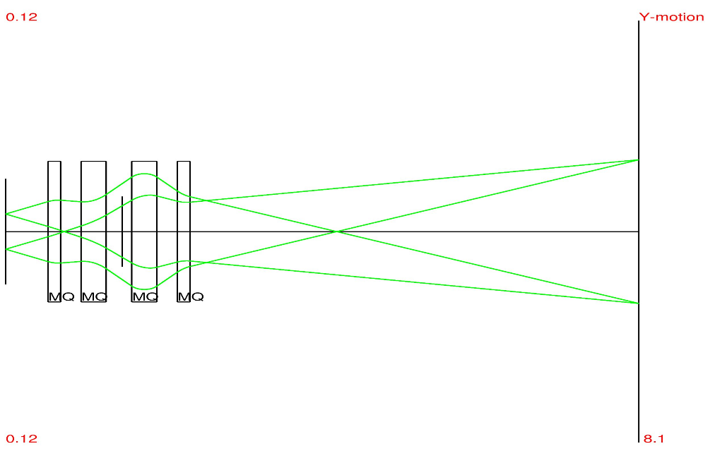
Step 1
Imaging system
(PMQ)
Set coefficients of magnification in X plane and Y plane is equals one to other : М11= М33.
“point to point” focusing
М12=0, М34=0

Slide 11
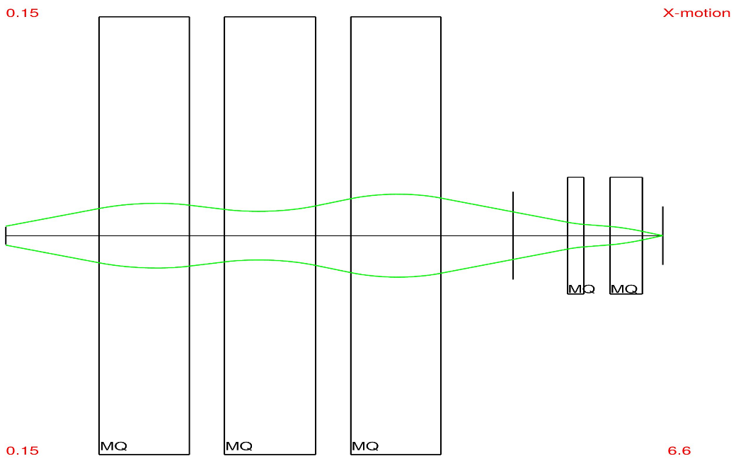
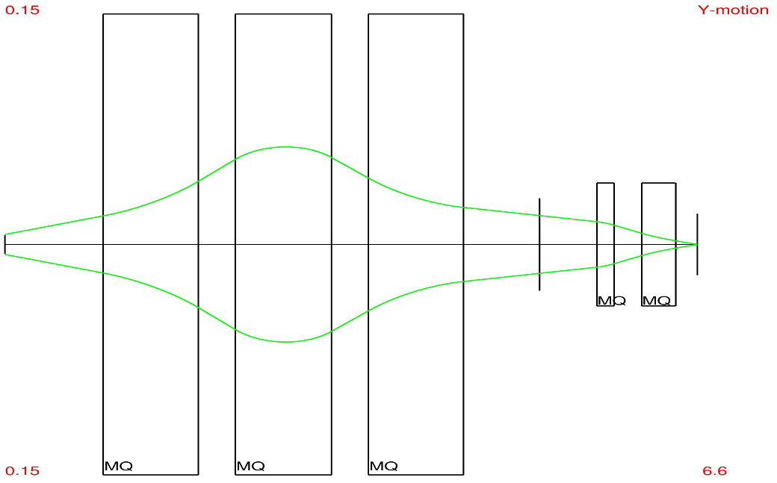
Step 2
Matching system (electromagnets)
Aim– optimal sizes of the beam in object plane, and correlation of angle and distance from particle to the beam axis.
Method – point to point focusing between 1-st plane and collimator plane (М12=0, М34=0)
Finding of better field of view.

Slide 12
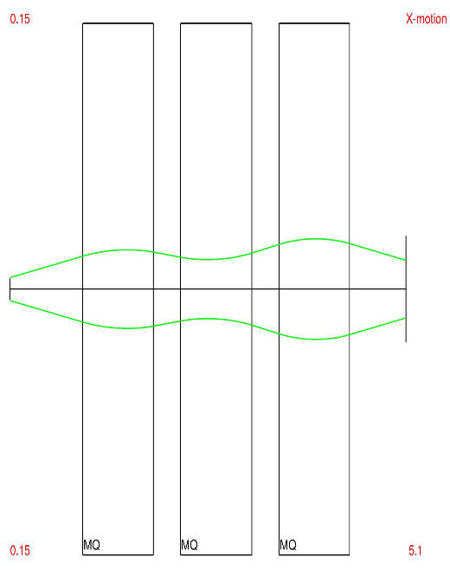
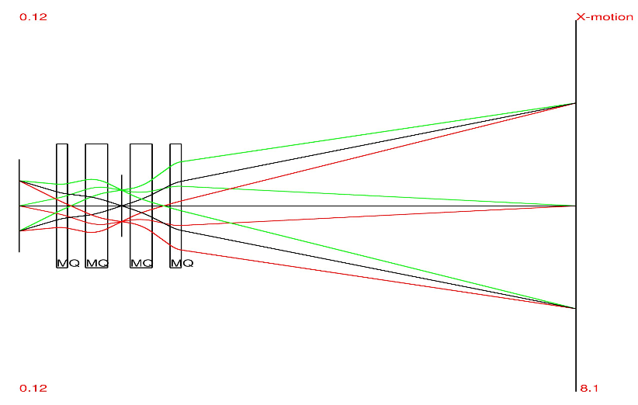
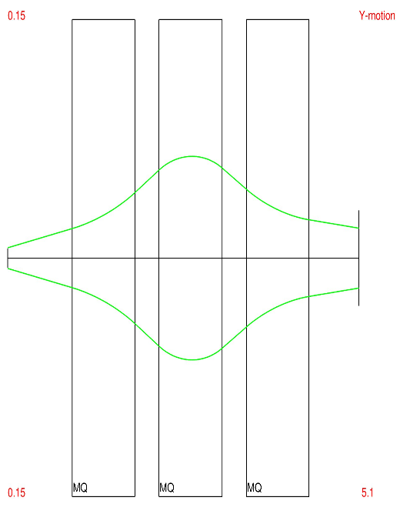
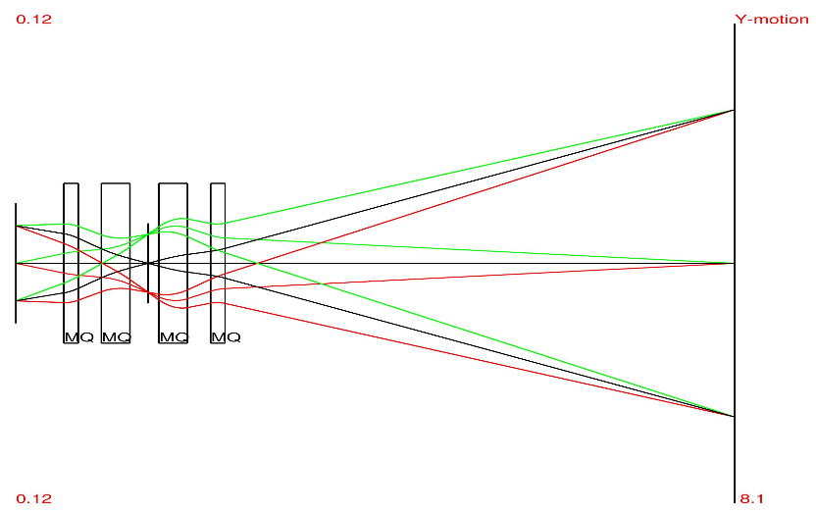
Step 3
Proton microscope
Magnification ~ - 4
Main aims:
Optimization of matching system (forming of Fourier plane)
Optimization of “rotation quadruplet” (reduction of chromatic aberrations in image plane)
Adding of multiply coulomb scattering in object

Slide 13
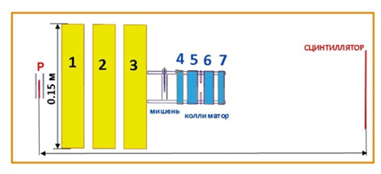
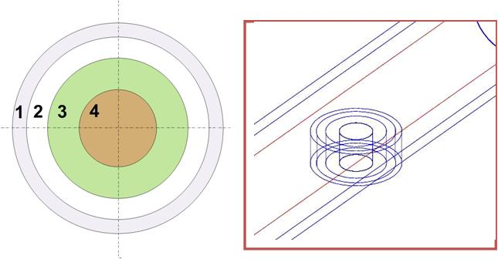
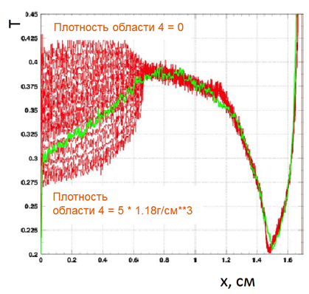
Step 4
Verification of the scheme
by Monte-Carlo simulation.
(GEANT code)
Steel
Vacuum
PMMA
Various density PMMA
Transmission curves:
18 static passages & 1 dynamic
Made by Demidov V.S.

Slide 14
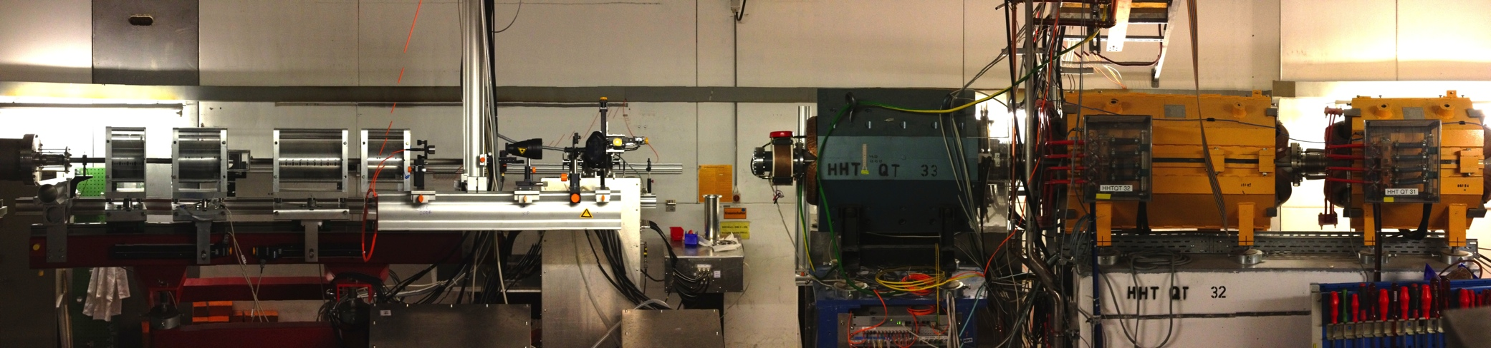
Prototype of PRIOR at HHT experimental area at GSI
Magnifying/imaging section
Matching section
proton beam direction

Slide 15
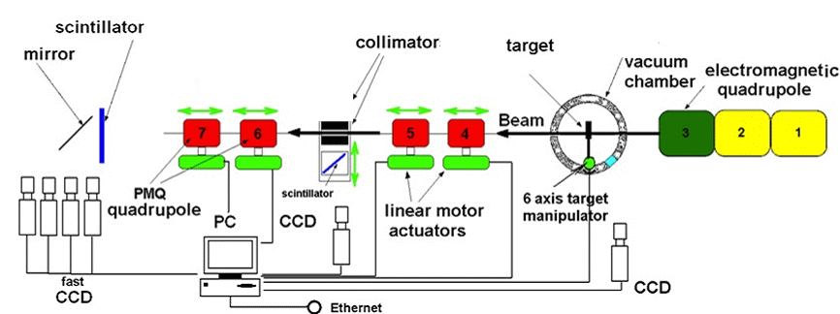
Prototype of PRIOR at HHT experimental area at GSI
Matching section
proton beam direction
Magnifying/imaging section
Notes:
A prototype of PRIOR, was developed at SIS-18 accelerator at GSI (Darmstadt, Germany). PRIOR setup is designed for measurement, with high spatial resolution, of density distribution of static and dynamic objects by using a proton beam with energy up to 4.5 GeV. The aim of this work is to development, assembling and commissioning of the prototype of PRIOR at HHT experimental area of GSI. The magnetic system of the PRIOR beam-line consists of two sections. The first, matching section, contains electromagnetic-quadruple lenses and provides formation of a proton beam for the objects imaging task (beam size, angular distribution). The second section is a magnification section (K ~4) that consists of four Permanent Magnet Quadruples (PMQ) lenses. Tungsten collimators, installed at central plane of magnification section, provides regulation of contrast of the proton-radiographic images. Investigated object installed between first and second section.

Slide 16
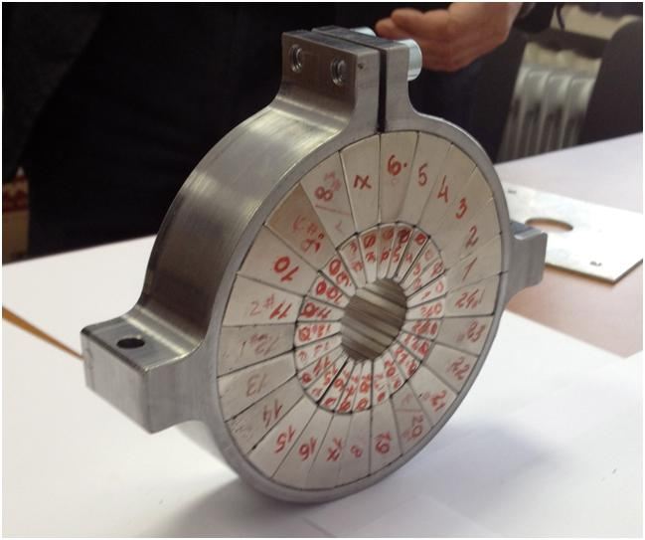
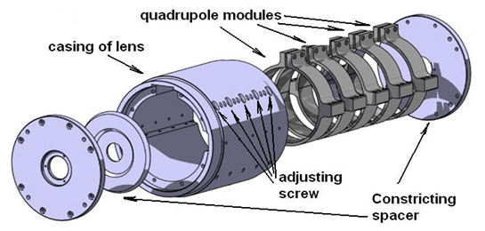
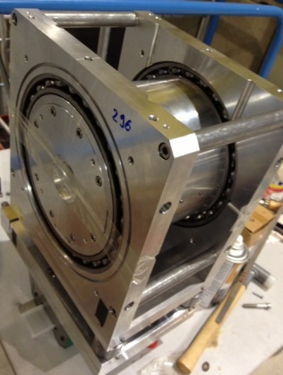
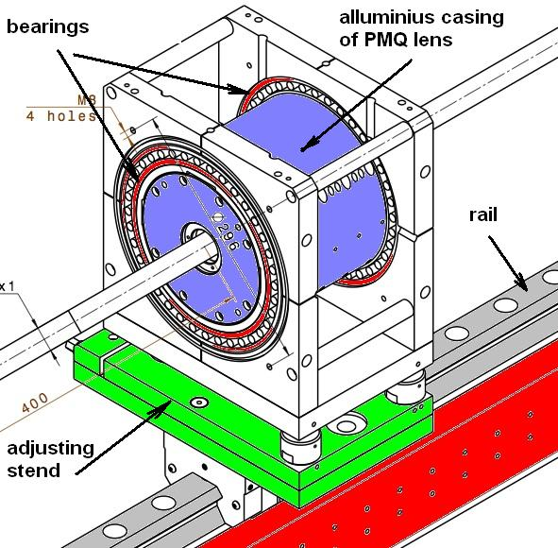
Permanent magnet quadrupole lenses (PMQ)
One quadrupole module
in metal case
Main parameters of PMQ lenses:
PMQ quantity: 4
Pole tip field: 1.83 T
Field gradient: 122 T/m
Nonlinearity: <0.9%
Two layer structure with trapezoidal sectors
Magnetic element material: NdFeB
Aperture diameter: 30 mm ;Outer diam. 210 mm
PMQ Length: 180mm (144 mm) (4 modules+1 dummy)
360mm (288 mm) (8 modules +2 dummy)
Possibility to use same lenses at FAIR (10 GeV proton beam)
with addition modules
Notes:
Each PMQ lens consists of set of quadrupole magnetic modules, thickness of each module is 36 mm, aperture is 30 mm. Each module is two-layered structure consisting of separate trapezoidal sectors (magnetic elements) mounted in the metal casing (yoke). The modules are pulled together by a special stand, before installing to PMQ lens. Casings of PMQ lens are made of aluminum with holes and adjusting screws to adjust the position of the quadrupole modules. Aluminum casing of lens is mounted in bearings (allowing to rotate the lens assembly relative to the axis of the proton beam) associated with the adjusting stand. Length of bodies of two short PMQ lenses - 180 mm, long lenses - 360 mm. Basic parameters of PMQ lenses are shown. Effective length of short lenses (for the version of PRIOR setup capable for operating at GSI with the proton beam energy of 4.5 GeV) is 144 mm, long lenses - 288 mm. Quadrupole modules are installed in the casing of lens clamped by two alluminium spacers on both sides of the lens. Short PMQ lenses consist of four quadrupole modules, long lenses consist of eigth modules. Casings of PMQ lenses equipped with adjustable screws that allows adjust the position of modules at horizontal and vertical planes with the ability to change the angle of the module. Adjusting positions of the modules is very important to align the median planes of PMQ lens and set the position of the magnetic axis of each module on the mechanical axis of rotation and the axis of the proton beam.

Slide 17
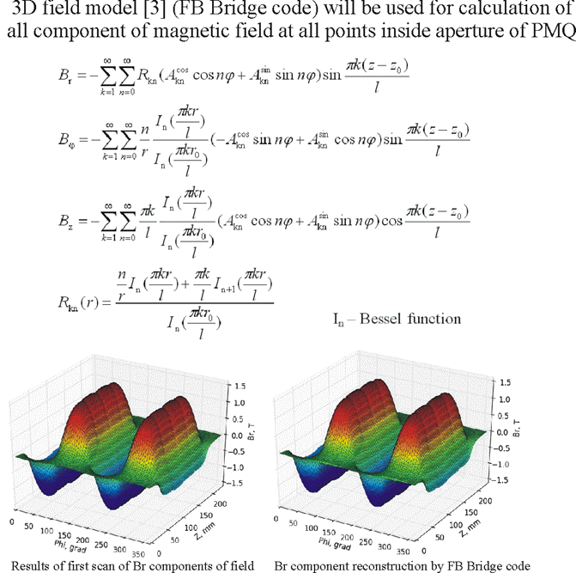
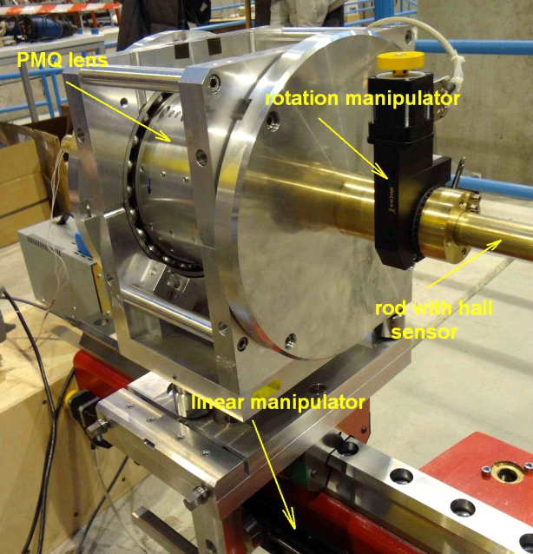
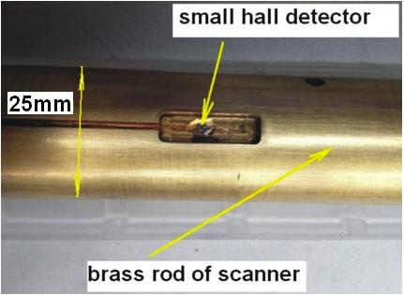
3D magnetic field reconstruction
Scanner for radial component of magnetic field of PMQ
Notes:
To calculate all components of magnetic field of PMQ lens was used analytic techniques, which was developed in ITEP [2].
According to this method, the magnetic field is measured in a relatively small number of points located on a closed surface within the working area of ​​the lens (radius near the cylindrical surface of the lens aperture) and measured only one component of magnetic field on the surface - radial field component. From a practical point of view that data enough to calculate the field at any point inside the surface. Using expressions (10), (11), (12) can calculate the value of any component of the magnetic field at each point in the working area of ​​the lens (inside radius of the radial component of the field measurement) with coordinates r, φ, Z.
To use above described technique in the programming language Python program was developed program filed_reconstruction.py. With this program, analysis of the results of scanning of short lens of PMQ was performed.

Slide 18
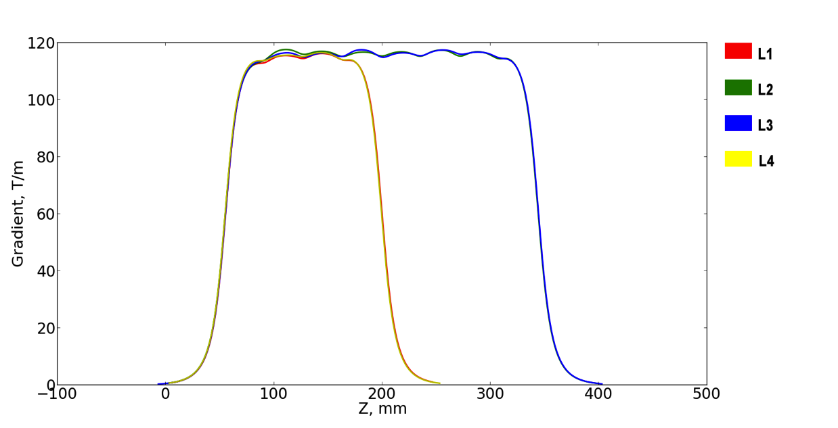
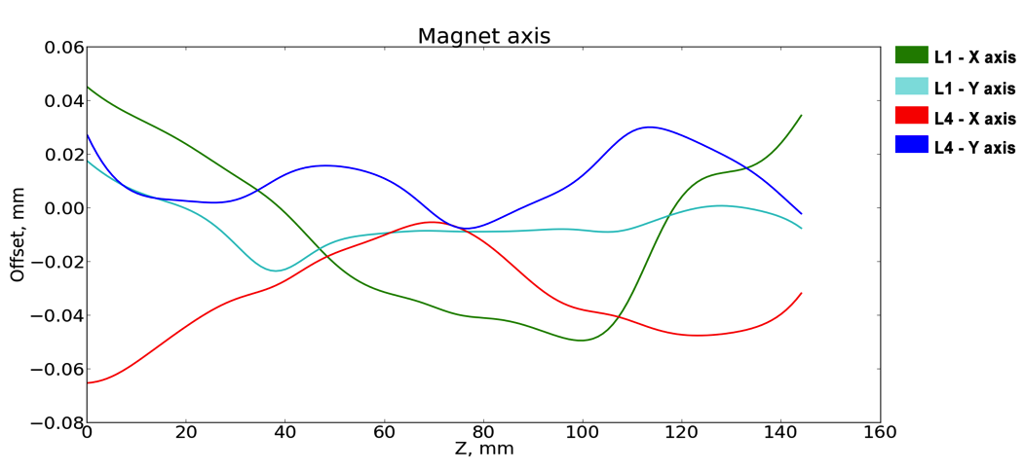
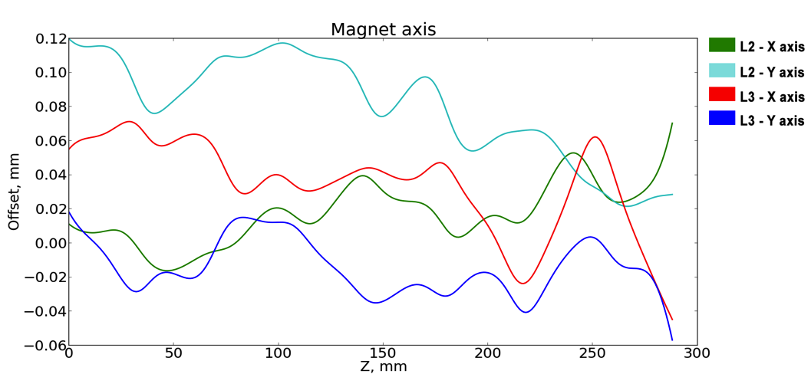
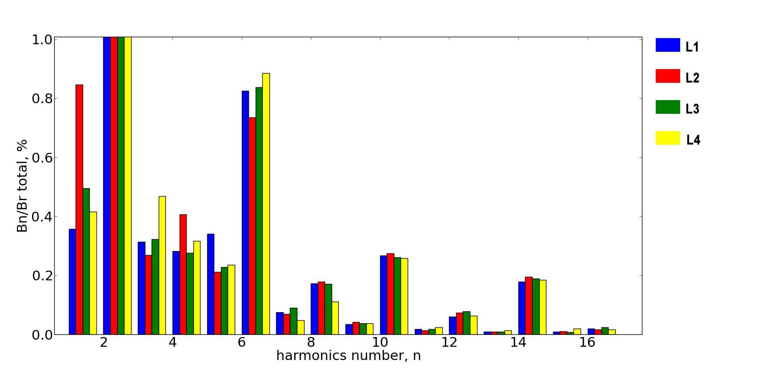
Measured parameters of magnetic field of PMQ
Field gradient.
Integral of gradient: L1 = 16.96 Т, L2 = 33.90 Т,
L3 = 33.88 Т, L4 = 17.01 Т
Accuracy of magnetic axis position : ±30 μm
Nonlinearity of magnetic field: less then 1 %
High order harmonics.
Notes:
Each PMQ lens consists of set of quadrupole magnetic modules, thickness of each module is 36 mm, aperture is 30 mm. Each module is two-layered structure consisting of separate trapezoidal sectors (magnetic elements) mounted in the metal casing (yoke). The modules are pulled together by a special stand, before installing to PMQ lens. Casings of PMQ lens are made of aluminum with holes and adjusting screws to adjust the position of the quadrupole modules. Aluminum casing of lens is mounted in bearings (allowing to rotate the lens assembly relative to the axis of the proton beam) associated with the adjusting stand. Length of bodies of two short PMQ lenses - 180 mm, long lenses - 360 mm. Basic parameters of PMQ lenses are shown. Effective length of short lenses (for the version of PRIOR setup capable for operating at GSI with the proton beam energy of 4.5 GeV) is 144 mm, long lenses - 288 mm. Quadrupole modules are installed in the casing of lens clamped by two alluminium spacers on both sides of the lens. Short PMQ lenses consist of four quadrupole modules, long lenses consist of eigth modules. Casings of PMQ lenses equipped with adjustable screws that allows adjust the position of modules at horizontal and vertical planes with the ability to change the angle of the module. Adjusting positions of the modules is very important to align the median planes of PMQ lens and set the position of the magnetic axis of each module on the mechanical axis of rotation and the axis of the proton beam.

Slide 19
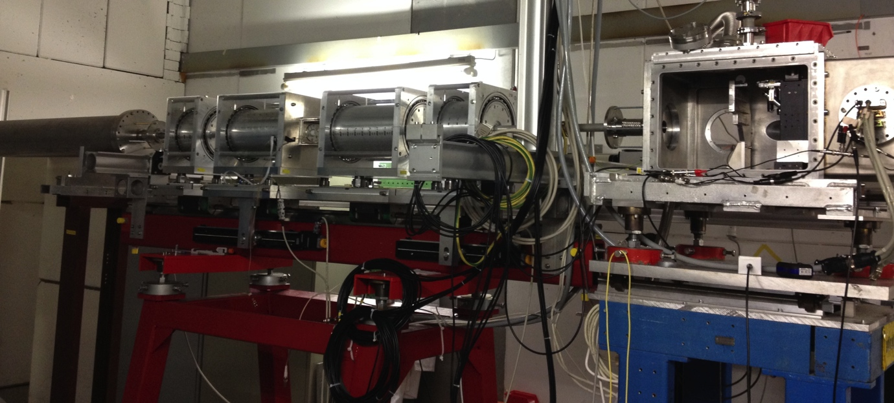
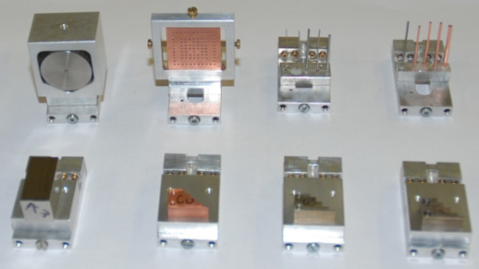
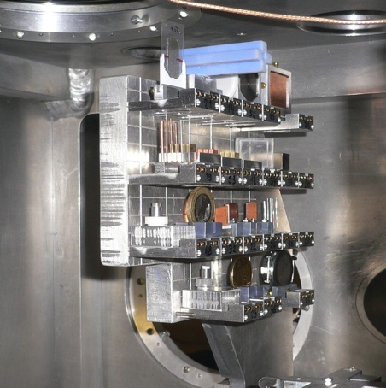
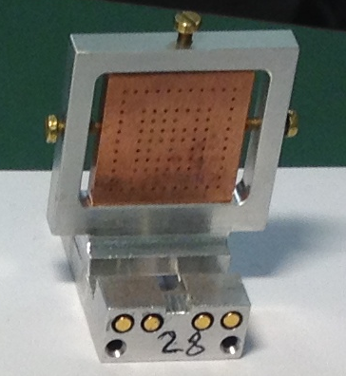
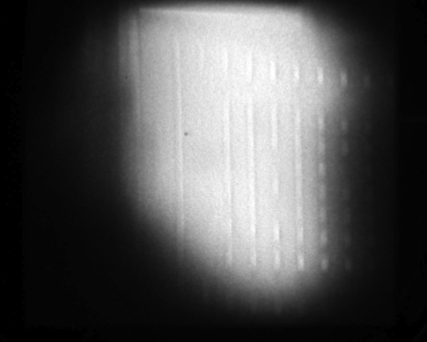
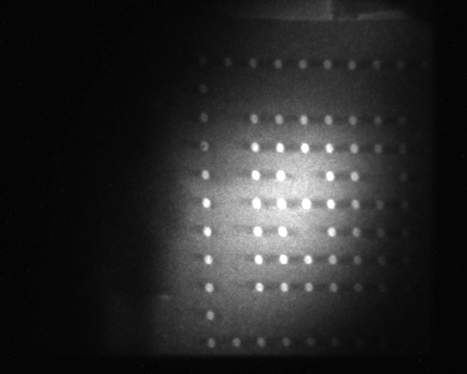

Static commissioning of PRIOR
(April 2014, GSI, SIS-18, proton beam energy 3.6 GeV)
Static targets
Proton beam parameters
Energy: 3.6 GeV
Intensity: <5*10⁹ protons
Target 5 mm Cu 4.5 GeV 3.6 GeV tuned
Notes:
Each PMQ lens consists of set of quadrupole magnetic modules, thickness of each module is 36 mm, aperture is 30 mm. Each module is two-layered structure consisting of separate trapezoidal sectors (magnetic elements) mounted in the metal casing (yoke). The modules are pulled together by a special stand, before installing to PMQ lens. Casings of PMQ lens are made of aluminum with holes and adjusting screws to adjust the position of the quadrupole modules. Aluminum casing of lens is mounted in bearings (allowing to rotate the lens assembly relative to the axis of the proton beam) associated with the adjusting stand. Length of bodies of two short PMQ lenses - 180 mm, long lenses - 360 mm. Basic parameters of PMQ lenses are shown. Effective length of short lenses (for the version of PRIOR setup capable for operating at GSI with the proton beam energy of 4.5 GeV) is 144 mm, long lenses - 288 mm. Quadrupole modules are installed in the casing of lens clamped by two alluminium spacers on both sides of the lens. Short PMQ lenses consist of four quadrupole modules, long lenses consist of eigth modules. Casings of PMQ lenses equipped with adjustable screws that allows adjust the position of modules at horizontal and vertical planes with the ability to change the angle of the module. Adjusting positions of the modules is very important to align the median planes of PMQ lens and set the position of the magnetic axis of each module on the mechanical axis of rotation and the axis of the proton beam.

Slide 20







Static commissioning of PRIOR
(April 2014, GSI, SIS-18, proton beam energy 3.6 GeV)
Quartz watch
Ta wire 0.8 mm at vacuum
Thickness of Ta steps (0.56 mm, 2.06 mm, 4.07 mm and 6.05 mm)
Best spatial resolution of 30 μm was obtained with target - tungsten rolled edge with a radius of 500 mm

Slide 21


Dynamic commissioning of PRIOR
(underwater electrical wire explosion target)
Pulse power generator:
50 kV, 10 µF, 150 nH
250 kA,
2.5 µs (rise time)
12.5 kJ stored
Wire: 0.1-1 mm diam.,
4-5 cm long
(Ta, Cu, W ..)
T ~ few eV
ε ~ up to 50 kJ/g
Advantages of the Underwater Electrical Wire Explosion:
Shunting of the discharge is prevented due to:
High breakdown voltage of the water medium (>300 kV/cm).
High pressure of the adjacent water layer (>10 kBar) increases breakdown voltage.
Increase in the temperature of the wire plasma is achieved by:
High resistance of the water to compression limits the wire expansion and leads to the increase in the current density.
Substantial decrease in the energy loss to the shunting channel and to radiation (water “bath” effect)
Yakov Krasik, Technion (Haifa, Israel)

Slide 22





Dynamic commissioning of PRIOR
Main goal: measure density distribution of internal structure of expanding Ta wire
Water filled target
chamber
Electrical signals

Slide 23







Dynamic commissioning of PRIOR
(August 2014, GSI, SIS-18, proton beam energy 3.65 GeV)
Ta wire: diameter - 0.8 mm, length - 50 mm
HV pulse: voltage 35 kV
amp. of current: 200 кА (2.5 ms - rise time)
Energy deposition: ~10 kJ/g
Current density is about 40 MA/cm²
~2 eV
Streak camera image (5 us/frame)
Shadowgraphy (DicamPro)
Static Dynamic(2.5 us)
Dynamic Static
Notes:
Each PMQ lens consists of set of quadrupole magnetic modules, thickness of each module is 36 mm, aperture is 30 mm. Each module is two-layered structure consisting of separate trapezoidal sectors (magnetic elements) mounted in the metal casing (yoke). The modules are pulled together by a special stand, before installing to PMQ lens. Casings of PMQ lens are made of aluminum with holes and adjusting screws to adjust the position of the quadrupole modules. Aluminum casing of lens is mounted in bearings (allowing to rotate the lens assembly relative to the axis of the proton beam) associated with the adjusting stand. Length of bodies of two short PMQ lenses - 180 mm, long lenses - 360 mm. Basic parameters of PMQ lenses are shown. Effective length of short lenses (for the version of PRIOR setup capable for operating at GSI with the proton beam energy of 4.5 GeV) is 144 mm, long lenses - 288 mm. Quadrupole modules are installed in the casing of lens clamped by two alluminium spacers on both sides of the lens. Short PMQ lenses consist of four quadrupole modules, long lenses consist of eigth modules. Casings of PMQ lenses equipped with adjustable screws that allows adjust the position of modules at horizontal and vertical planes with the ability to change the angle of the module. Adjusting positions of the modules is very important to align the median planes of PMQ lens and set the position of the magnetic axis of each module on the mechanical axis of rotation and the axis of the proton beam.

Slide 24



Plans
PRIOR at FAIR:
x500 beam intensity
x2 proton energy
SC or PMQ imager options
probably the first HEDgeHOB experiment at FAIR
Radiation damage of magnetic material – NdFeB:
Remagnetization of PMQ ?
Notes:
Each PMQ lens consists of set of quadrupole magnetic modules, thickness of each module is 36 mm, aperture is 30 mm. Each module is two-layered structure consisting of separate trapezoidal sectors (magnetic elements) mounted in the metal casing (yoke). The modules are pulled together by a special stand, before installing to PMQ lens. Casings of PMQ lens are made of aluminum with holes and adjusting screws to adjust the position of the quadrupole modules. Aluminum casing of lens is mounted in bearings (allowing to rotate the lens assembly relative to the axis of the proton beam) associated with the adjusting stand. Length of bodies of two short PMQ lenses - 180 mm, long lenses - 360 mm. Basic parameters of PMQ lenses are shown. Effective length of short lenses (for the version of PRIOR setup capable for operating at GSI with the proton beam energy of 4.5 GeV) is 144 mm, long lenses - 288 mm. Quadrupole modules are installed in the casing of lens clamped by two alluminium spacers on both sides of the lens. Short PMQ lenses consist of four quadrupole modules, long lenses consist of eigth modules. Casings of PMQ lenses equipped with adjustable screws that allows adjust the position of modules at horizontal and vertical planes with the ability to change the angle of the module. Adjusting positions of the modules is very important to align the median planes of PMQ lens and set the position of the magnetic axis of each module on the mechanical axis of rotation and the axis of the proton beam.

Slide 25
Conclusion:
COSY
The method based on principals of the matrix formalism was developed for matching and optimization the ion-optical scheme. Method allows to find the optimal parameters of the ion-optical scheme for wide range of input data.
What we're working now
Development of new Monte-Carlo code on Geant4.
Combine 3D field reconstruction & Cosy calculations.
Implementation field reconstruction in Geant model.
PRIOR at FAIR
New EM Quadrupols?
Remagnitization?? (questionable way)

Slide 26







Proton microscopy for high energy density in matter physics, material sciences and beyond
Dynamic fracture and surface ejecta formation in metal under shock loading
Static Dynamic
materials in extremes (EOS, dynamic phase transitions, hydrodynamics of HED flows, instabilities, material strength and damage, ...)
new materials synthesis and process-aware manufacturing
biophysics, medical applications industrial applications
Phase transition of molecular nitrogen
(IPCP, ITEP)
Biologically samples
Static Dynamic
Tomography reconstruction of inner structure of static objects (ITEP)
Non ideal plasma of shock compressed noble gas (Xe)
Static Dynamic

Slide 27





Prototype of PRIOR at HHT experimental area at GSI
Image
registration system
PCO DicamPro +
PCO DiMax
Static targets
in vacuum
Dynamic target (Underwater electrical wire explosion)
W collimator (2 mrad, )
Notes:
The registration system for static experiments consists of CsI scintillator and plastic scintillator (Bicron BC-412) for dynamic one with two types of intensified CCD cameras. In the first experiments with static objects with 3.6 Gev proton, was demonstrated a spatial resolution of 30 μm. Dynamic commissioning was performed with target based on underwater electrical wires explosion with electrical pulse with current amplitude of ~200 kA and time duration of ~5 μm.

Slide 28



Experiment PaNTERA – ProtoN ThErapy and Radiography
(image-guided stereotactic particle radiosurgery IGSpRS)
Advantages with high energy protons and proton radiography:
Online imaging and low lateral scattering allow reduction of margins, treatment of moving targets and dose escalation
Lateral scattering for high energy protons

Slide 29

Transmission – information about areal density of target

Slide 30






Results of previous experiments
Мишень из ПММА
плотность - 1,19 г/см³
толщина 8 мм.
Диаметр отверстий 2 мм.
Глубина отверстий:
минимальная - 0,5 мм
максимальная - 8,0 мм
Демонстрируется разрешение объектов различающихся по плотности на 6 %
Мишени из ПММА и их изображения
Мишени из ПММА и их изображения
Плотность:
парафина - 0,91 г/см³
рыбки ~ 1,00 г/см³,
Разрешение
по плотности ~ 10%
Рыбка Данио-рерио в парафиновой плитке, и её протонное радиографическое изображение

Slide 31
Формализм транспортных матриц
Заданная структура состоит только из квадрупольных линз и промежутков между ними.
Используем приближение тонких линз.
Связь координат пучка после прохождения оптической системы, с исходными матричным уравнением
Где матрица оптической системы
Общее условие формирования изображения в данной точке
В данном случае М₁₁ есть увеличение системы
Для квадрупольной линзы
матрица М имеет вид
f – фокусное расстояние линзы
Для промежутка
матрица М имеет вид
d – длина трансляции
Вся система представляется одной матрицей
где М_{i} – матрица i-го оптического элемента считая по ходу пучка

Slide 32

Matching magnetic optic system – reduction of aberrations
magnification
δ= Δp/p
Russian quadruplet
Magnification (proton microscope) leads to
increase of spatial resolution

Slide 33


Коррекция хроматических аберраций
Согласование системы магнитной оптики
Система без увеличения
(Идентичные дублеты)
L
В плоскости регистрации
M
M
Главный фактор ухудшения разрешения
В плоскости Фурье (коллиматора)
x_{o},x_{o}’ - позиция и угол на объекте
x_{fp} - позиция в Фурье плоскости
x_{i} - позиция и угол на изображении
- Δp/p
M - Транспортная матрица дублета
L - Транспортная матрица первого
порядка
T - Транспортная матрица второго
порядка
T ₁₂₃ ,T₃₄₆ - хроматические длины системы магнитной оптики установки

Slide 34







Хроматические аберрации магнитной системы, в случае правильного согласования протонного пучка, определяются для двух плоскостей и установки как:
Где и нормализованные хроматические длины системы магнитной оптики установки
и получаются из системы уравнений, как сложная комбинация геометрических размеров и характеристик радиографической установки

Slide 35
Definition of BEAM for mathematical formulation of ion-optics
Описание пучка
(x, a, y, b, l, dp/p)
(1, 2, 3, 4, 5, 6 )
COSY Infinity:
(x, a, y, b, l, δ_{K}, δ_{m}, δ_{z})
Needed for complex ion-optical systems including several
charge states
different masses
velocities (e.g. Wien Filter)
higher order corrections
δ_{K} = dK/K = rel. energy
δ_{m} = dm/m = rel. energy
δ_{z} = dq/q = rel. charge change
a = p_{x}/p₀
b = p_{y}/p₀
All parameters are relative
to “central ray” properties

Slide 36

Обработка изображений

