Slide 1







Status of the Forward RICH for PANDA
Sergey Kononov
Budker Institute of Nuclear Physics SB RAS
Novosibirsk State University
FRRC - SSC RF ITEP of NRC “Kurchatov Institute”
November 18, 2015
MINISTRY OF EDUCATION AND SCIENCE OF THE RUSSIAN FEDERATION
Work is funded by

Slide 2

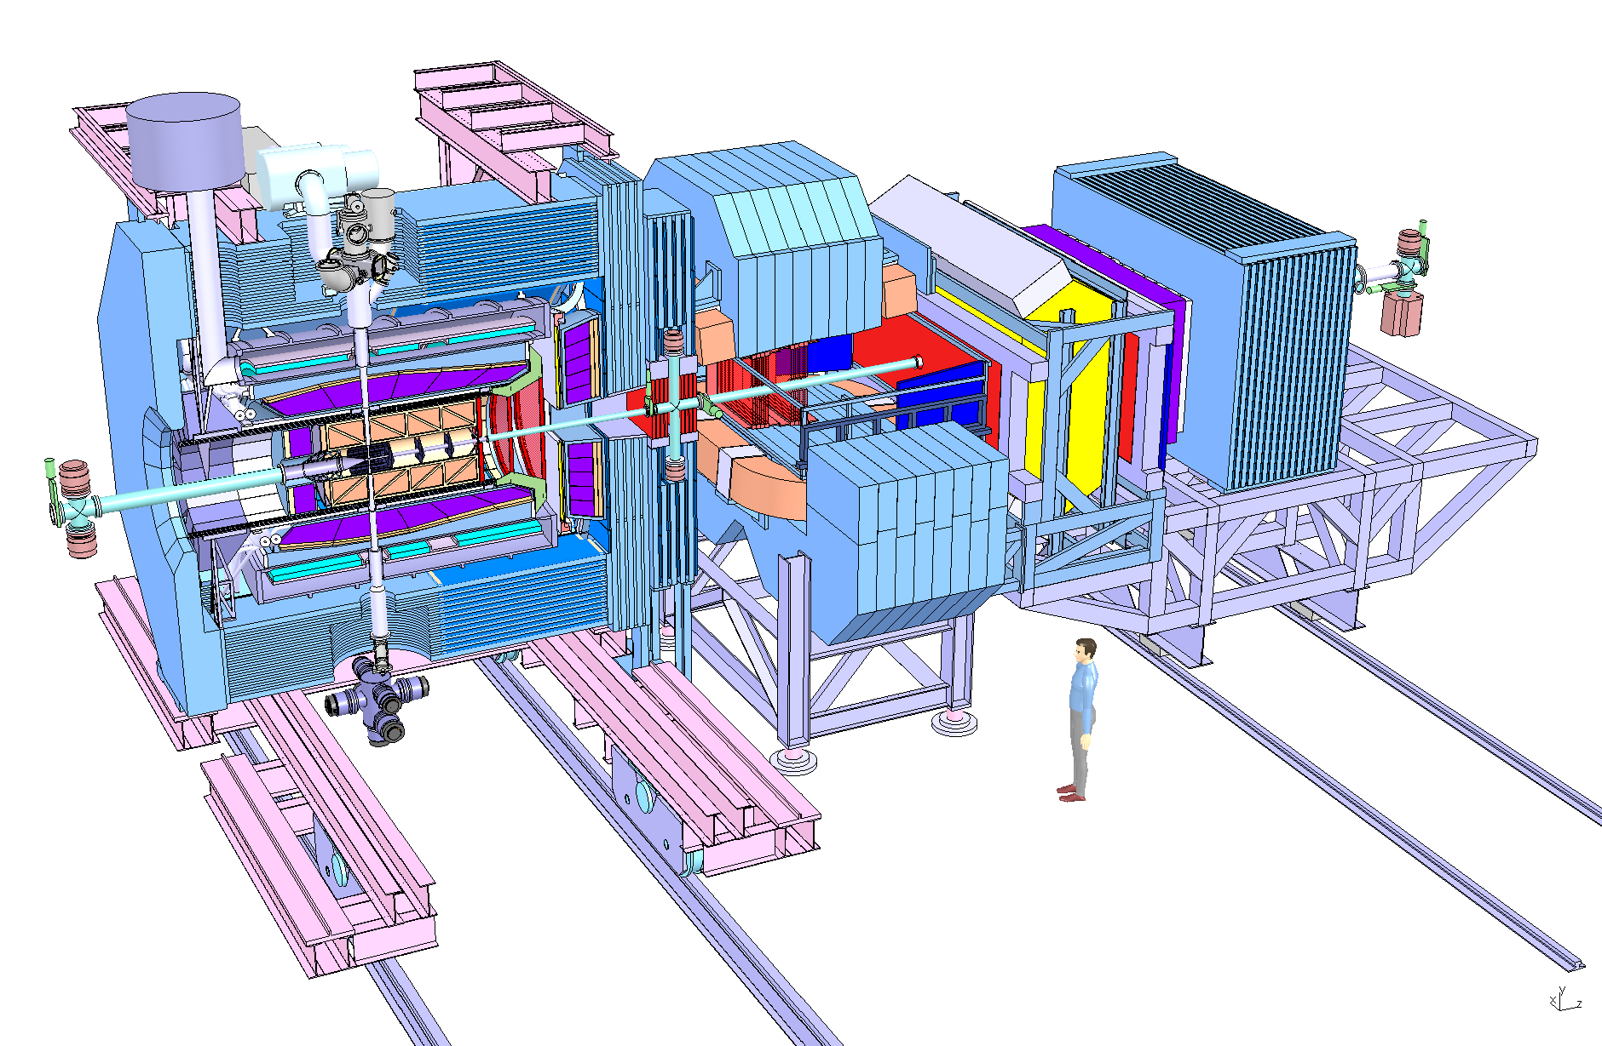
PANDA detector
PID
Barrel DIRC
Disc DIRC
Forward RICH

Slide 3
Requirements to Forward RICH
PID in the Forward Spectrometer
|θx| < 10°, |θy| < 5°
1 m space along the beam
approximately 3 x 1 m transverse active size
Working momentum range for 3σ separation
  π /K: 3÷10 GeV/c
  μ/π: 0.5÷2 GeV/c possible
Physics cases application: processes with high charged hadrons multiplicity in the final states for high beam momenta

Slide 4
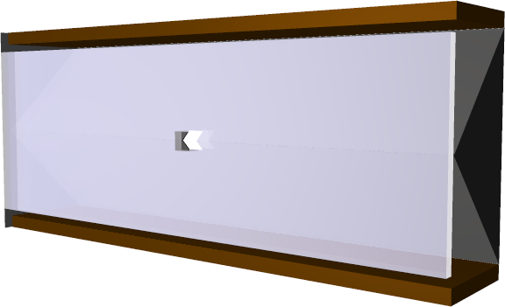
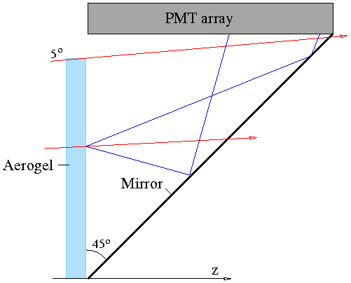
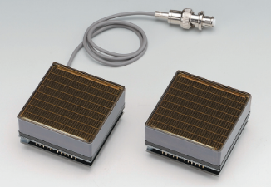
Conceptual design
Baseline PD option
Hamamatsu H12700 MaPMT
flat panel,
8x8 anode pixels of 6mm size
87% active area ratio
Bialkali photocathode
Gain: 1.5∙10⁶
Good single p.e. amp. resolution
Relatively cheap (≈€1700 / unit)
Robust
Long lifetime
Focusing aerogel radiator (non-homegenious)
No gaseous radiator
Flat mirrors
MaPMT readout (other options possible)

Slide 5
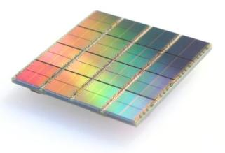
Readout options
MaPMT
H12700
FEE
PADIWA
TDC
TRB
Baseline option
H12700B price: 1700 € per tube (~1400 tubes in total)
DPC
Tile FPGA
Module
FPGA
Data concentrator FPGA
option
DPC price: 3500 € per module (~800 modules in total)
Needs liquid cooling.

Slide 6
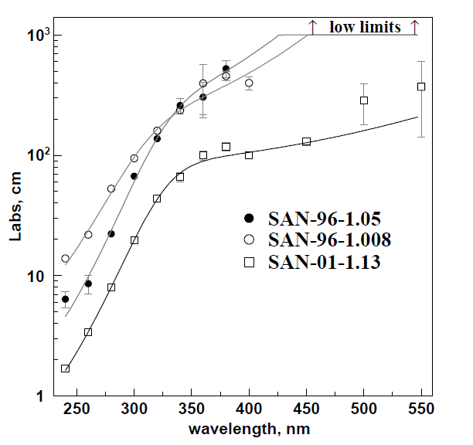
Production of aerogel in Novosibirsk
Started in 1986 by the Boreskov Institute of Catalysis SB RAS in cooperation with the Budker Institute of Nuclear Physics SB RAS
Hydrophilic (absorbs moisture)
Refraction indices 1.006 – 1.08 (1.08-1.13 produced by sintering)
Block dimensions up to 200x200x50 mm³ (for n=1.03)
Remarkable optical quality has been achieved:
L_{abs} (400nm) = 5 – 7 m
L_{sc} (400nm) = 4 – 6 cm
(Clarity = 0.0043 – 0.0064 μm⁴/cm)
Used in the experiments:
  KEDR/VEPP-4M: n=1.05 (1000 l)
  SND/VEPP-2000: n=1.13 (5 l) + n=1.05 (5 l)
  LHCb RICH: n=1.03 (20 l)
  AMS-02/ISS RICH: n=1.05 (60 l)
  DIRAC-II/CERN PS: n=1.015 (26 l) + n=1.008 (13 l)
Absorption length

Slide 7
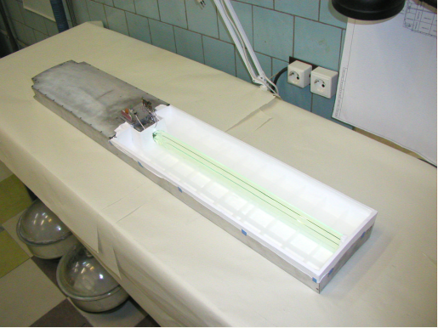
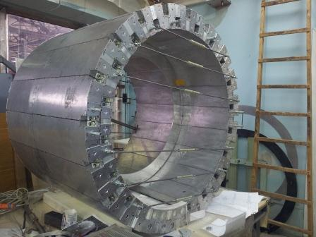

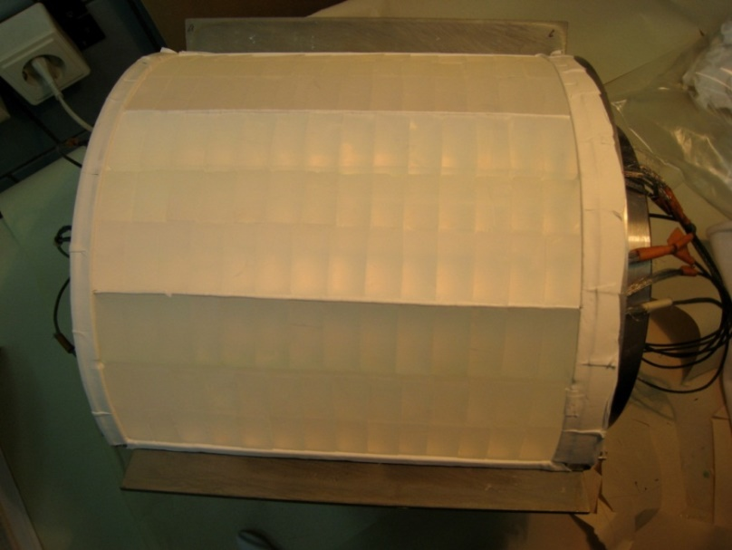
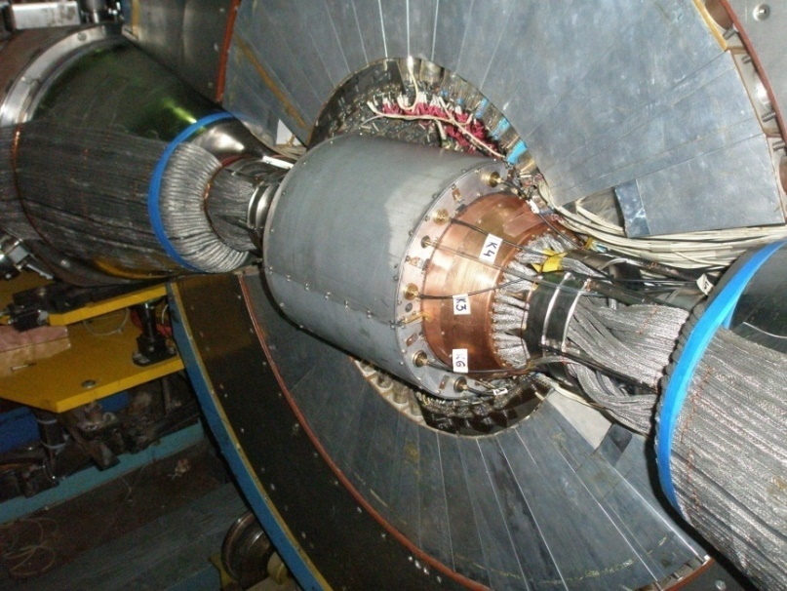
KEDR ASHIPH counters: 1000 liters of aerogel
SND ASHIPH counters: n=1.13 (n=1.05)

Slide 8
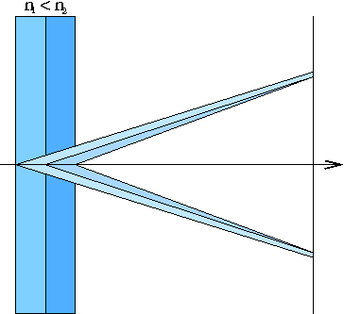
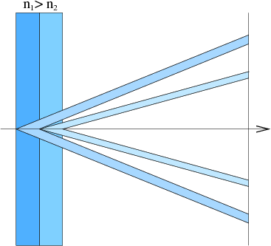
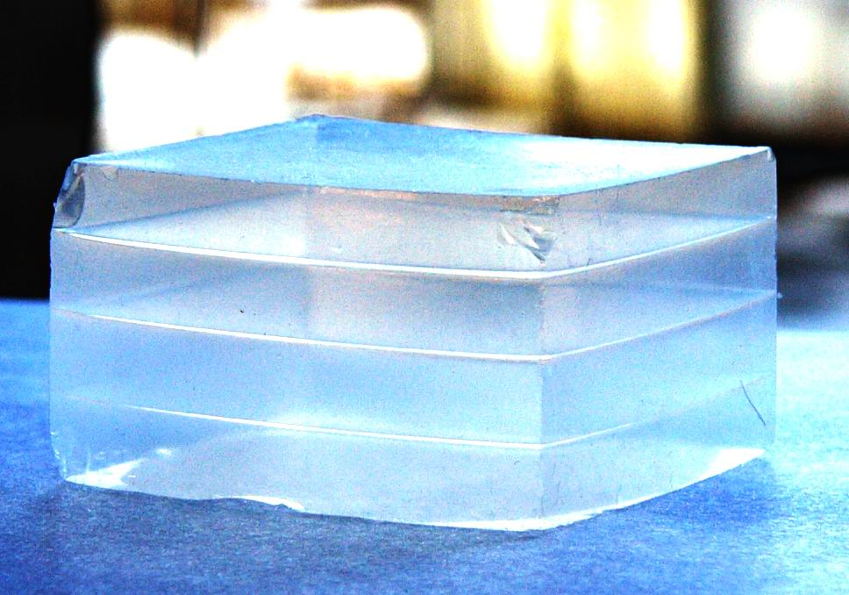
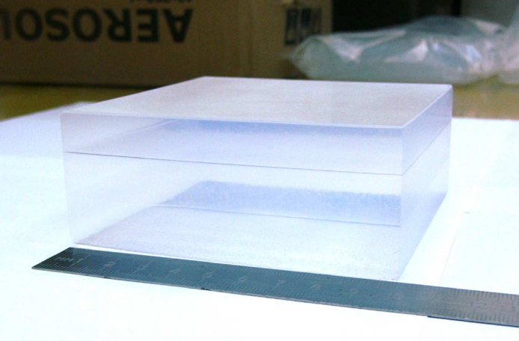
FARICH – Focusing Aerogel RICH
Single ring option
Multi-ring option
First sample of 4-layer aerogel by BIC
n=1.030 6.0mm
n=1.027 6.3mm
n=1.024 6.7mm
n=1.022 7.0mm
Focusing aerogel improves proximity focusing design by reducing the contribution of radiator thickness into the Cherenkov angle resolution
3-layer aerogel 115x115x41 mm³
Multi-layer monolith aerogels are produced by the Boreskov Institute of Catalysis in coop. with BINP since 2004.
In 2012 we succeeded in production of continuous density gradient aerogels.
T.Iijima et al., NIM A548 (2005) 383
A.Yu.Barnyakov et al., NIM A553 (2005) 70
Notes:
Идея ФАРИЧ появилась в 2004 г.
Точность измерения черенковского угла связана с точностью измерения скорости, а значит с качеством разделения частиц.

Slide 9
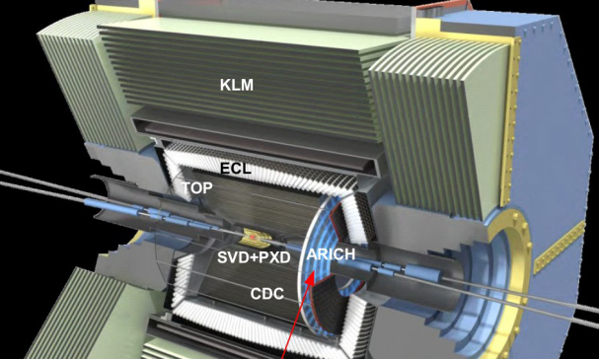
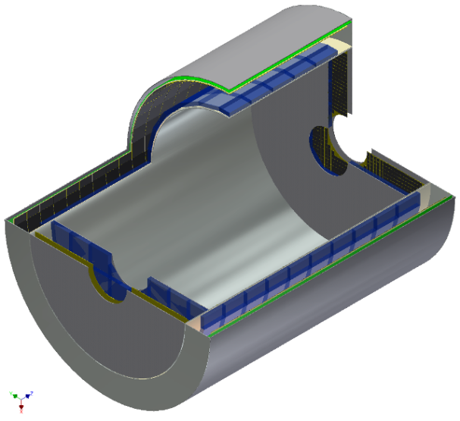
FARICH projects and proposals
Belle II ARICH (Belle coll.)
Particle ID: π/K up to 4 GeV/c
Forward end-cap: ~3m²
Two (separate) layers of aerogel: n₁= 1.045, n₂= 1.055
Photon detector: HAPD (Hamamatsu)
PANDA Forward RICH (BINP&BIC)
Particle ID: π/K/p up to 10 GeV/с
3m² detector area (MaPMTs or SiPMs)
FARICH PID system for Super c-τ factory (BINP&BIC)
Particle ID : μ/π up to 1.7 GeV/с
~21m² detector area (SiPM)
~10⁶ pixels with 4 mm pitch

Slide 10
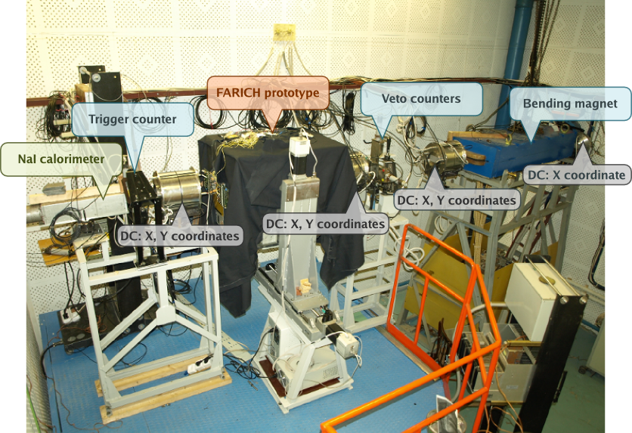
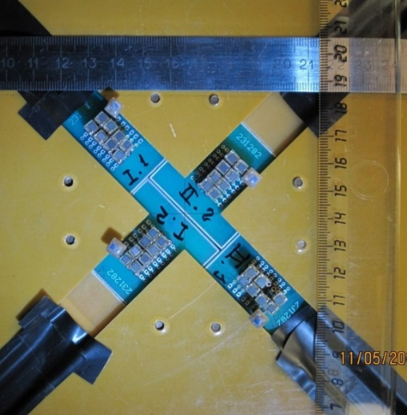
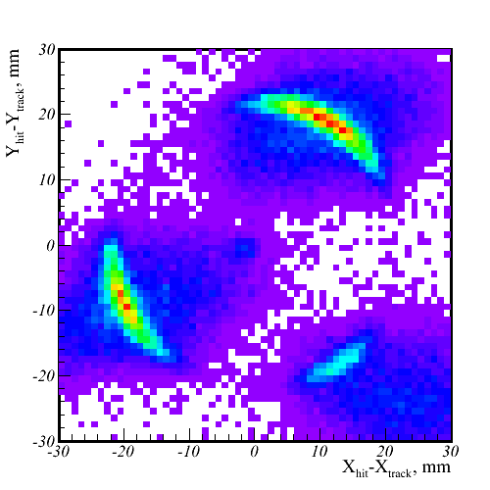
Electron and gamma beam test facility at BINP
Parameters of the e⁻ beam
E [MeV] | 100÷3000
σ_{E}/E [%] | 1.8%@1GeV
Rate [s⁻¹] | 50

Slide 11

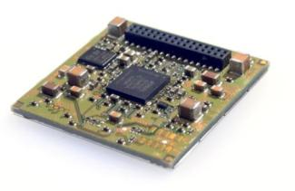
DPC is an Integrated “Intelligent” Sensor by Philips Digital Photon Counting
DPC3200-22-44 – 3200 cells/pixel
DPC6400-22-44 – 6396 cells/pixel
FPGA
Clock distribution
Data collection/concentration
TDC linearization
Saturation correction
Skew correction
Flash
FPGA firmware
Configuration
Inhibit memory maps
32.6 mm

Slide 12



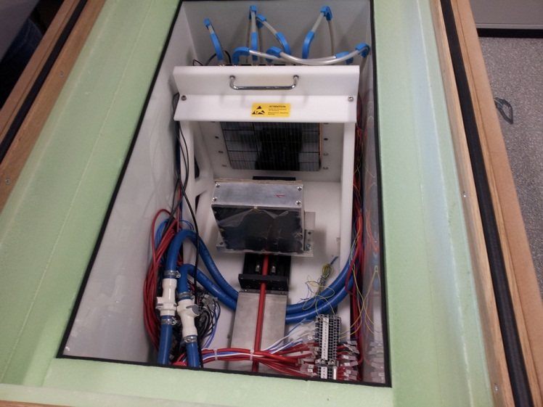
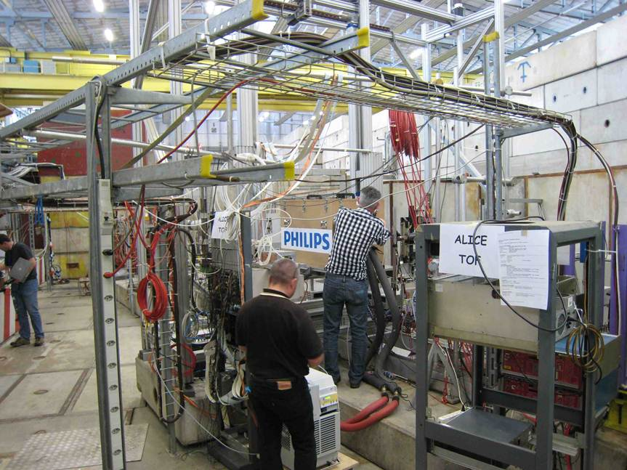
First test of DPC in RICH:
PDPC-FARICH prototype @ CERN PS T10, June 2012
Main objective:
  Proof of concept: full Cherenkov ring detection with a DPC array
Details:
Operation temperature is −40°C to suppress dark count rate
  Dead time is 720 ns.
  DCR(+25°C) ≈ 10 Mcps/sensor
  single photon detection is not feasible!
  DCR(-40°C) ≈ 100 kcps/sensor
  inefficiency is 7% .
2 stage cooling: LAUDA process thermostat + Peltiers.
Dry N₂ constant flow to avoid condensation.

Slide 13
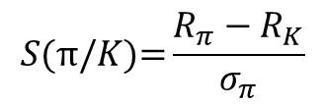
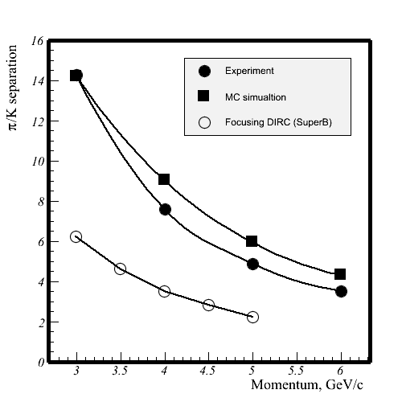
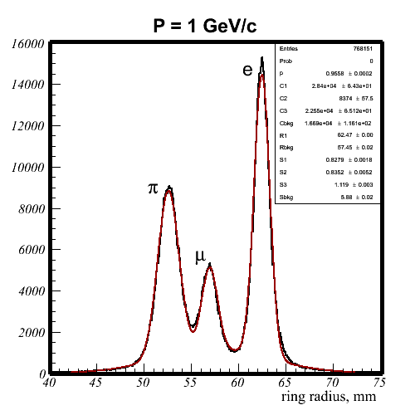
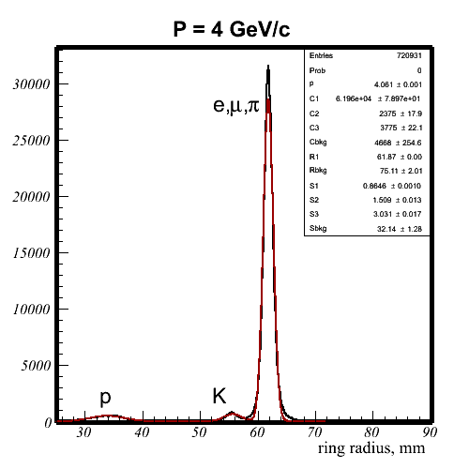
PDPC-FARICH: Particle ID evaluation
Ring distribution on radius
A.Yu. Barnyakov, et al., NIM A 732 (2013) 352
π /K: 7.6σ @ 4 GeV/c
μ/π: 5.3σ @ 1 GeV/c
2.3 times higher than SuperB FDIRC
1.4 times higher than Belle II ARICH
2.6 times less than in initial MC simulation
Aerogel to be optimized
DPC PDE lower than expected

Slide 14
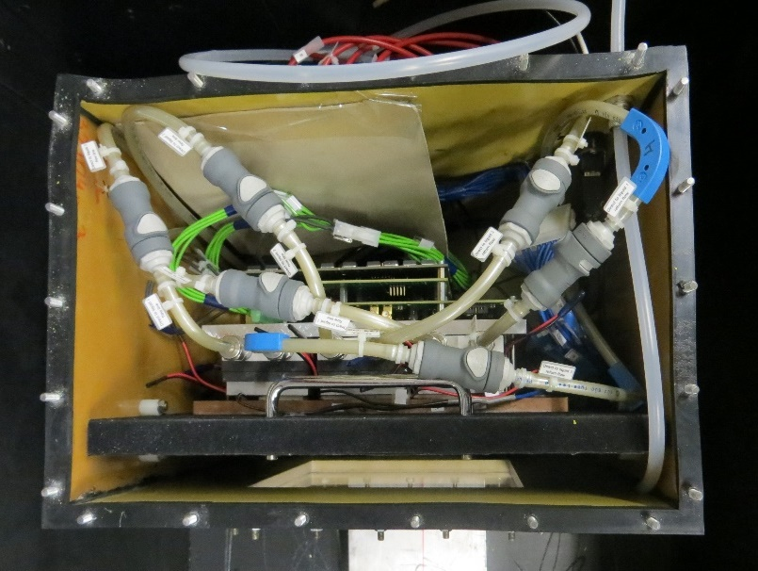
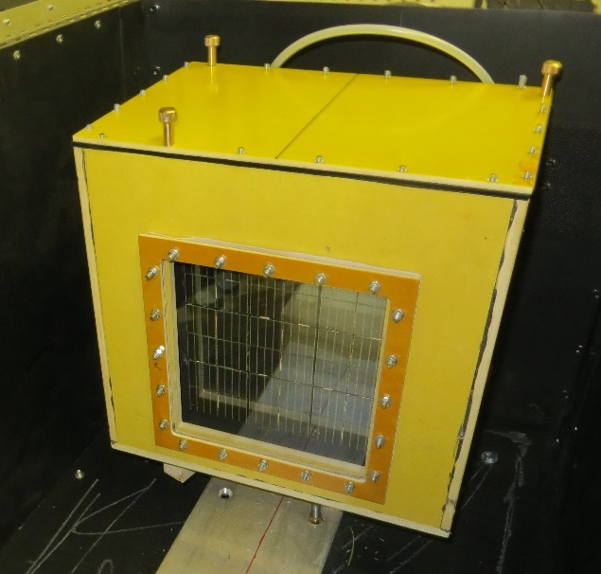
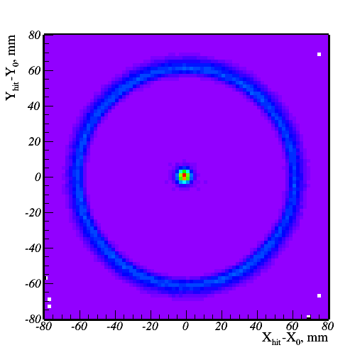
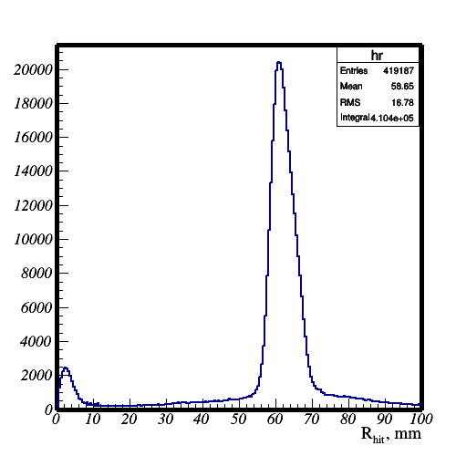
Upgrade of PDPC-FARICH prototype
Cold box for DPC photon detector. Aerogel is placed outside at room temperature and can be easily exchanged
Extend aerogel-PD distance to ~500 mm
Dark envelop box with moving stage for aerogel and mirror (under construction)
Test of upgraded DPC detector with e⁻ beam in March 2015
PMMA window

Slide 15
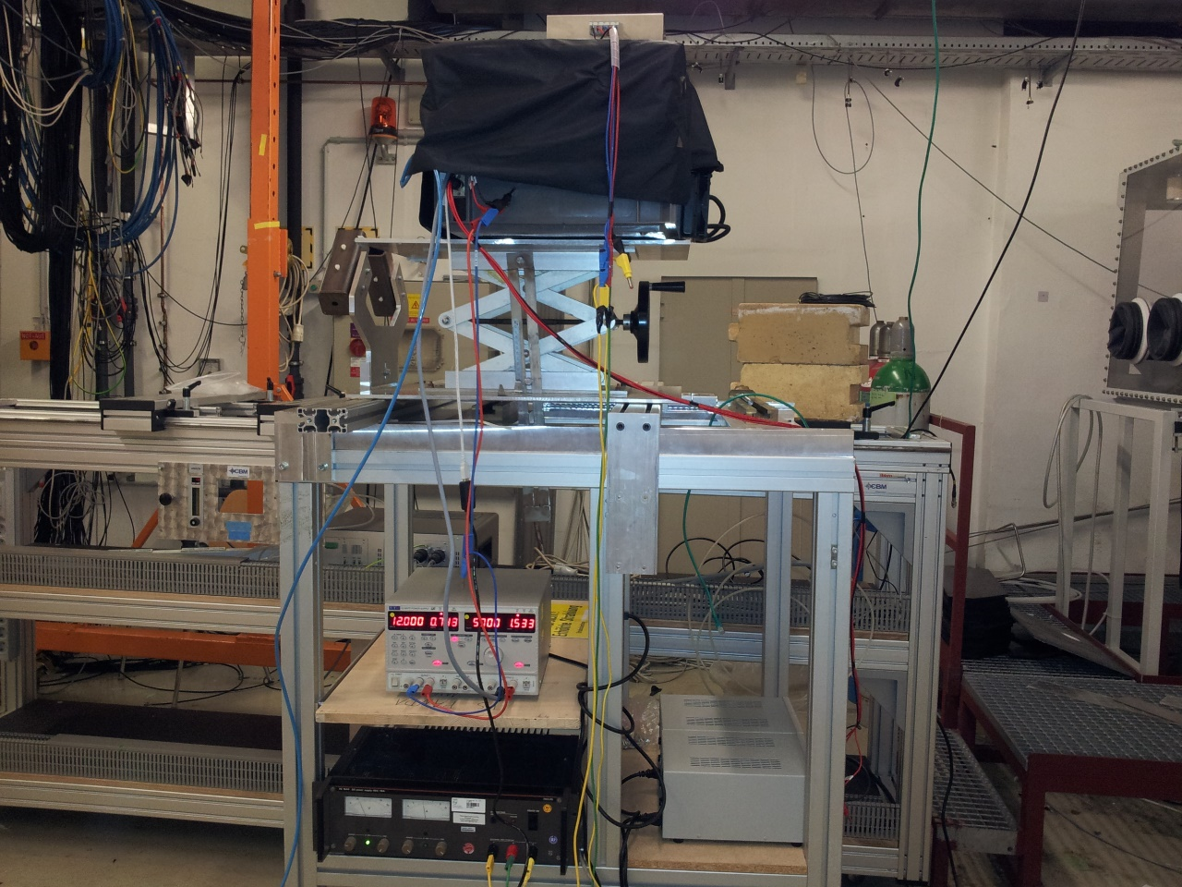
Proton irradiation of DPC at COSY
August 1-4, 2014
Cold box with
2 DPC-3200-22-44 tiles
Protons with P=800 MeV/c (T=295 MeV)
Maximum fluence ~4·10¹¹ p/cm² accumulated in 9 steps
Tiles irradiated at −18°C
DCR scan of cells was done in beam stops
Total dose is measured by ionization chamber provided by COSY team
Beam profile was determined by data
p beam
M.Yu. Barnyakov et al., http://dx.doi.org/10.1016/j.nima.2015.10.098

Slide 16
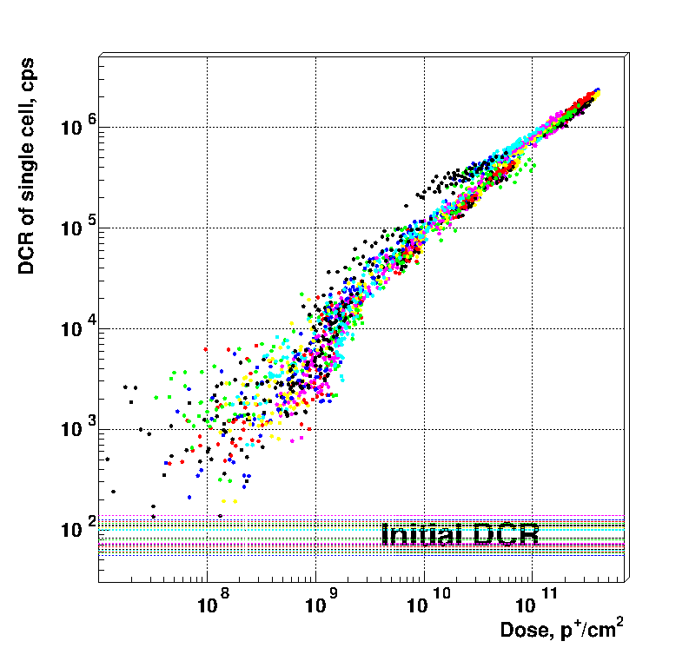
Dark count rate vs fluence
Single cell DCR averaged over one subpixel (32x25 cells).
Different colors for different dies.
Proton fluence
4x10¹¹ p/cm⁻²
NIEL-equivalent neutron fluence 3x10¹¹ n_{1MeV}/cm⁻²

Slide 17
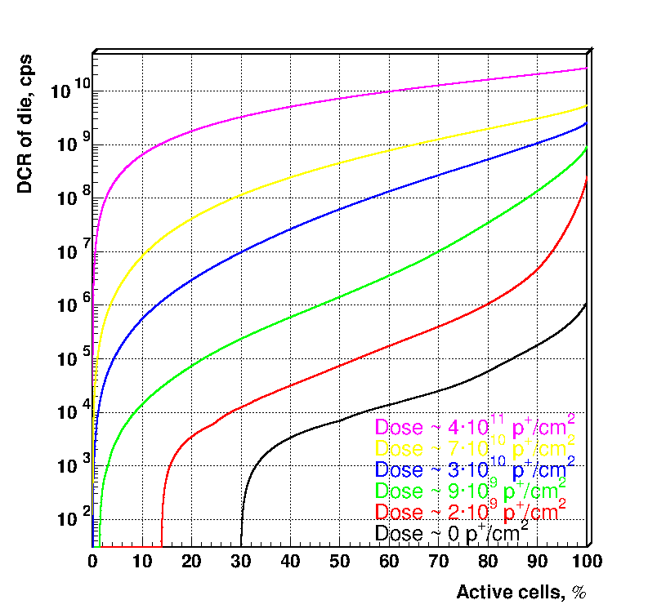
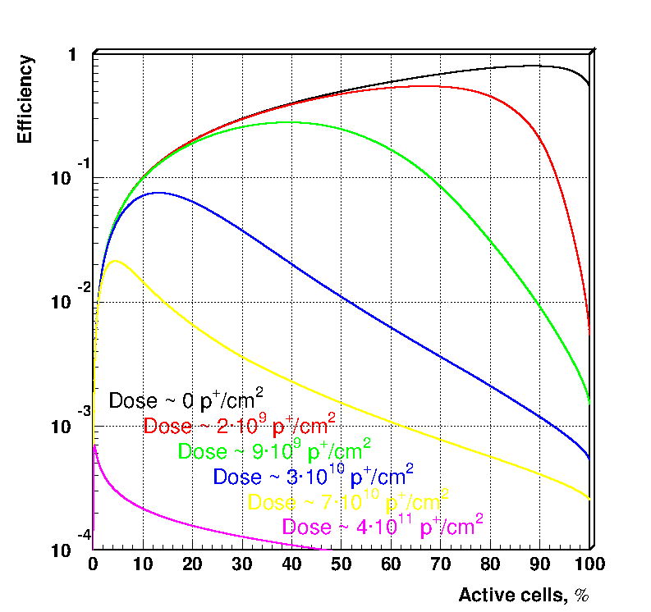
Leveraging DPC cell inhibit function to keep up efficiency
DCR of a die as a function of active cells
fraction for different proton fluences.
Relative photon detection efficiency as a function of active cell fraction taking into account dead time.
Optimal efficiency is a tradeoff between the fraction of active cells and DCR-induced dead time. The dead time for the current chip design is 720 ns.

Slide 18
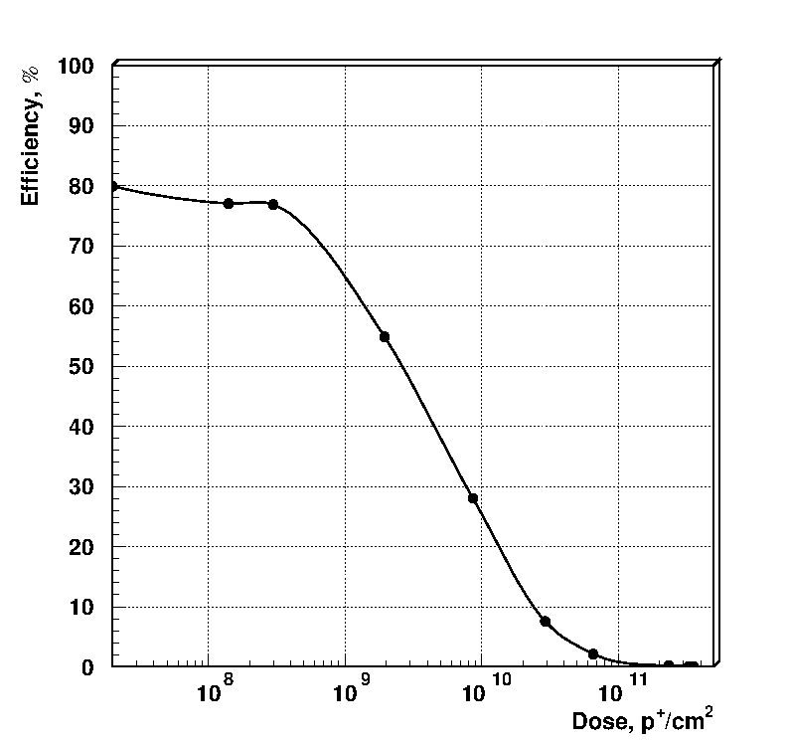
DPC PDE vs proton fluence
2 times drop
4∙10⁹ n_{1MeV}/cm²

Slide 19
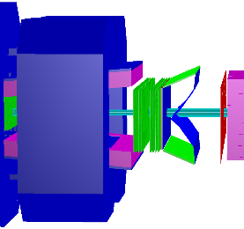
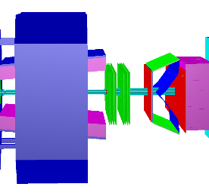
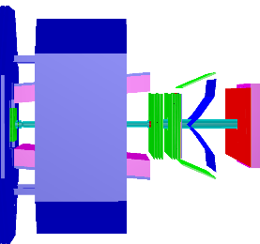
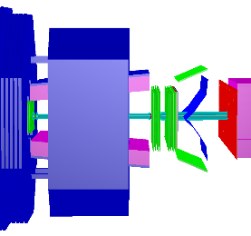
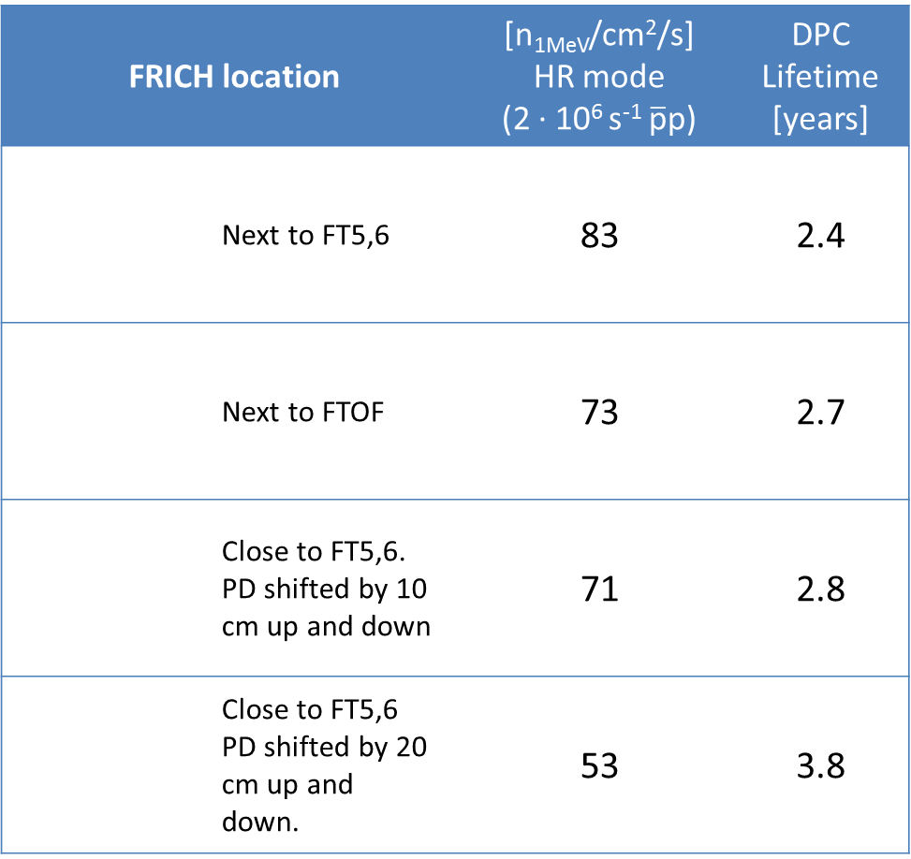
Expected rad. backgr. @ PANDA
FRICH location |  | [n_{1MeV}/cm²/s] HR mode (2 ∙ 10⁶ s⁻¹ $\overline{\text{p}}\text{p}$) | DPC Lifetime[years]
 | Next to FT5,6 | 83 | 2.4
 | Next to FTOF | 73 | 2.7
 | Close to FT5,6. PD shifted by 10 cm up and down | 71 | 2.8
 | Close to FT5,6 PD shifted by 20 cm up and down. | 53 | 3.8
Radiation background simulation in PandaRoot:
DPM generator
10 GeV/c beam momentum
Geant4 for secondary sim.
4 geometry options considered
Almost all particles considered and scaled by NIEL to 1MeV neutron fluence
Simplified detector description w/o frames, support, etc.
Neutron shielding may be considered
Highest flux comes from neutrons

Slide 20
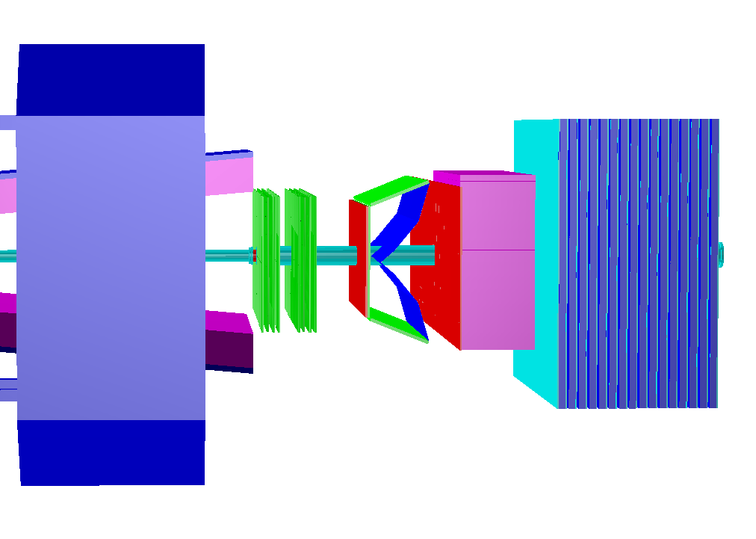
Forward RICH in PANDAroot
Dipole magnet
π/K-separation | up to ~10 GeV/c
Radiator | Focusing layered aerogel
Refractive indices | ~1.05
Radiator thickness | 4 cm
Placement | after FT5&6
Vertical angle | ±5°
Horizontal angle | ±10°
TOF
HCAL
FT5
FT6
FRICH
ECAL

Slide 21
Simulated effects
Simulation
  Geometry description
    RICH position
    Aerogel (size, number of layers, refraction index)
    Mirror geometry (round, flat)
  Materials properties for Cherenkov photons
Digitization
  Pixelization
  Quantum efficiency of photodetector
  Photon detector noise
  Dead time of photodetector
  Photodetector time resolution
  Crosstalks (TO DO)
Reconstruction (simple mode)
  Hit preselection
  Fit θ(φ) dependence
PID (TO DO)
  Probability calculation
  PID selector implementation

Slide 22
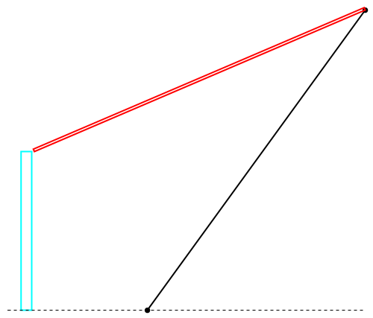
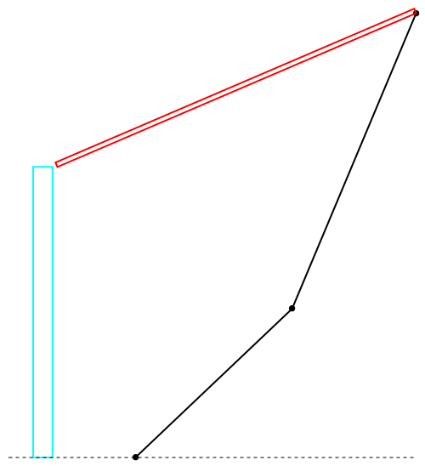
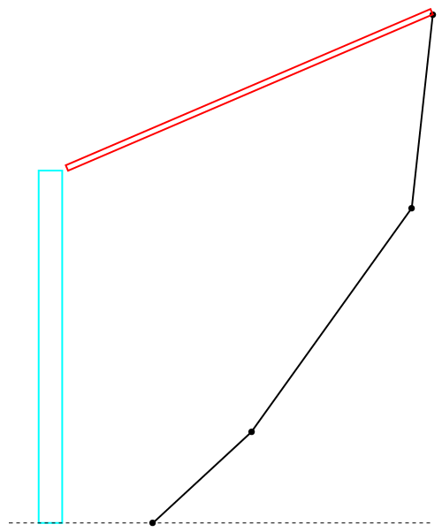
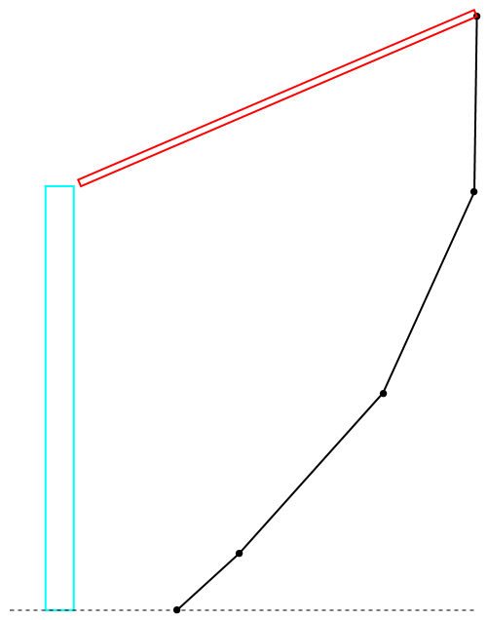
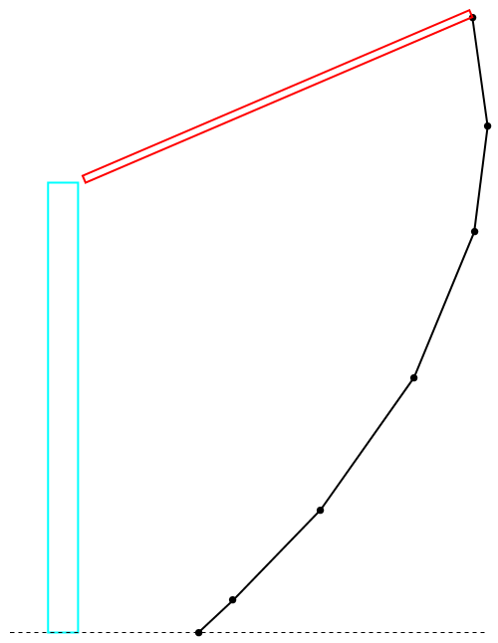
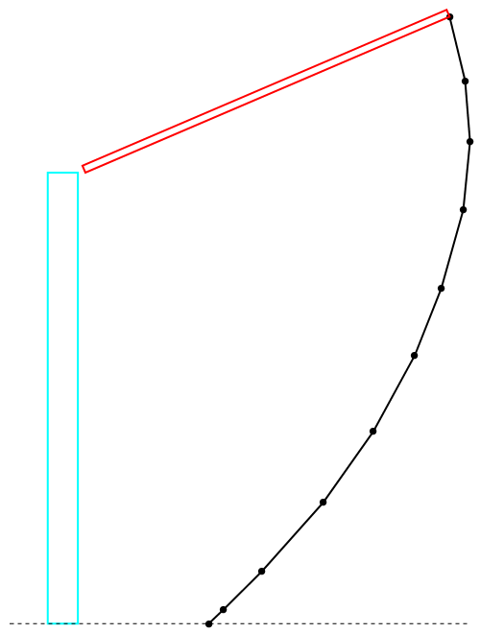
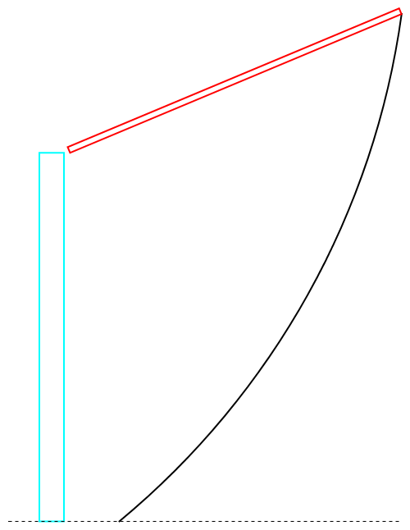
Optimizing mirror configuration
1 segment
2 segments
3 segments
PD width
4 segments
6 segments
10 segments
Round
Acceptance for Cherenkov photons is maximized, photon detector area is minimized. Mirror is curved in 1D.

Slide 23
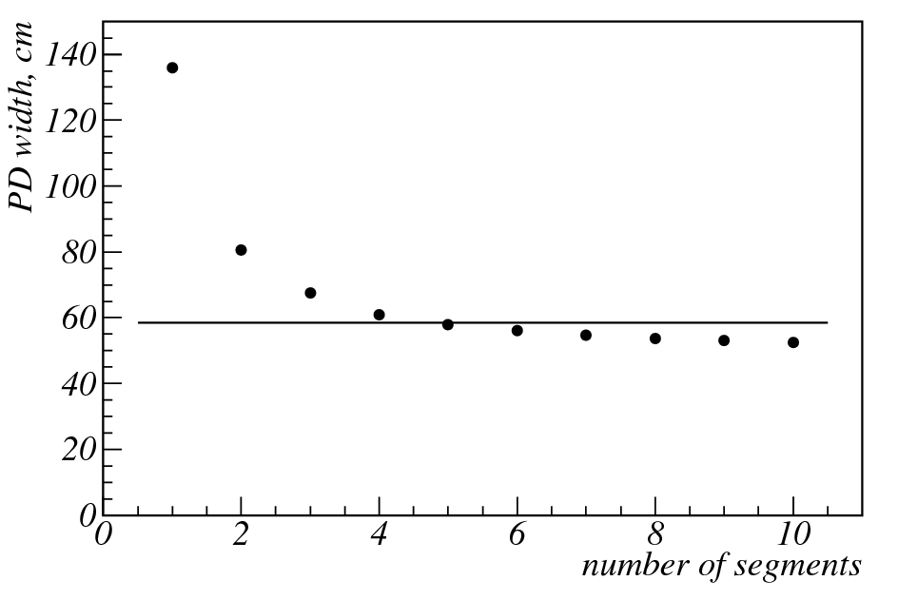
Optimal photon detector width
Parameter | 3 segments | Round
PD width, cm | 67.5 | 58.5
Mirror focusing | no | yes
Aerogel focusing | yes | no
Combinatorial background | yes | no
Cherenkov image shape on PD surface | broken elliptical | complicated
Number of parts | 3 | 1
Cylindrical mirror

Slide 24
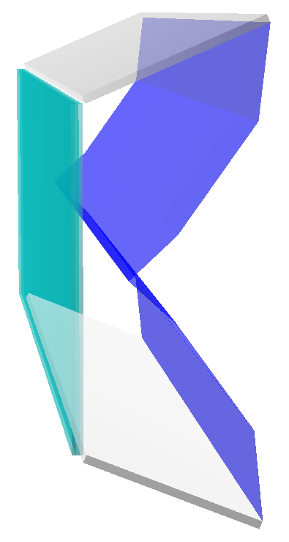


Multi-layer aerogel optimization
Two layers
Three layers
1.05 − δn
1.05 − δn
1.05 + δn
1.05
1.05 + δn

Slide 25


Multi-layer aerogel: optimal refractive index spread
Two layers
Three layers
n = 1.05
δn_{opt} = 1.03·10⁻³
δn_{min} = 0.76·10⁻³
δn_{max} = 1.36·10⁻³
n = 1.05
δn_{opt} = 1.23 ·10⁻³
δn_{min} = 0.96 ·10⁻³
δn_{max} = 1.47·10⁻³
Configuration with three segments mirror and three layer aerogel is used further on

Slide 26




Events simulation and reconstruction
Possible reconstruction methods:
2D pattern recognition on photon detector surface
track hits to the origin and reconstruct Cherenkov angles (θ_{c}, φ_{c})
Y, cm
Y, cm
θ_{C}, rad
Y, cm
X, cm
X, cm
θ_{C} = acos(1/n)
X, cm
φ_{C}, rad

Slide 27



Reconstructing Cherenkov photon direction angles
θ_{c} = f( φ_{c}; β, n, α )
φ_{c} − azimuthal angle
β − velocity of the charge particle
n − refraction index of the aerogel
α − polar angle of the charge particle
Event data fit
μ
p = 10 GeV/c
β = 0.99994
β_{FIT} = 0.99912
θ_{c}, rad
φ_{c}, rad

Slide 28





π/K-separation: first result
2 GeV/c
4 GeV/c
6 GeV/c
π
K
π
K
π
K
8 GeV/c
10 GeV/c
K
π
K
π

Slide 29
Conclusion
Forward RICH R&D is in a good shape
Two readout options (MaPMT, DPC) are considered
DPC radiation hardness study has been carried out
Full PandaRoot simulation of FRICH is under development. First results on PID performance of FRICH are obtained.
Plans for 2015-2016
DPC characterization
MaPMT H12700 characterization with PADIWA&TRB3 FEE
Mirror optical measurements
Submit FRICH full sim. to PandaRoot
Mechanical design
Prototype beam tests

Slide 30
Backup slides

Slide 31


Use cases of PANDA Forward RICH
2010
Covered solid angle: |θx| < 10°, |θy| < 5°
Identification of high momentum (>3GeV/c) kaons in presence of a large pionic background
Separation of other charged particles: μ/π, e/π, K/p
Distribution of pions and kaons
Example: hybrid ${\tilde{η}}_{c1}$($c\overline{c}g$) search at 15 GeV/c
$$p\overline{p}→{\tilde{η}}_{c1}η→D^{0}{\overline{D}}^{∗0}η+c.c.→2K 2π 6γ$$
Fast MC simulation shows:
46% of events are reconstructed only due to the RICH. That means 86% statistics gain due to the RICH.
In spite of the small covered solid angle production processes at high beam momentum with a large multiplicity are likely to give particles in the Forward RICH.

Slide 32




SiPM detectors and electronics
32 CPTA MRS APDs
pixel size 2.1x2.1mm²
60 CPTA MRS APDs
pixel diam. 1.28 mm
CAEN V1190B multihit TDC board
+
+
Custom 16ch
amplifier-disc. boards
ALICE TOF
NINO-based board

Slide 33



Single pixel approach for aerogel characterization
Sum of all pixels w.r.t. track position
Given a tracking system and enough particle statistics, a single PD pixel is enough to build the distribution of Cherenkov photons on R_{ch} (θ_{ch}).
Many pixels can be combined to improve accuracy and align the tracking system with the PD pixels

Slide 34



Beam test 2011 results
σ_{r} vs channel
σ_{r} =1.1 mm
σ_{r} =2.1 mm
N_{p.e.} vs channel
4-layer aerogel (t=3cm) vs single layer aerogel (t=2cm)
Focusing effect has been observed.
σ_{r}=1.1 mm – in rough agreement with MC simulation
‹N_{p.e.} › = 13 – 2 times less than expected

Slide 35


PDPC-FARICH setup
4-layer aerogel
n_{max} = 1.046
Thickness 37.5 mm
Focal distance 200 mm
Square DPC array 20x20 cm²
DPC3200-22 sensors
3200 cells per pixel of 3.2x3.9 mm²
3x3 modules = 6x6 tiles
= 24x24 sensors = 48x48 pixels
576 timing channels
2304 amplitude channels (pixels)
3 levels of FPGA readout: tiles, modules, data collection board.
Test conditions
Beam content: e⁺, μ⁺, π⁺, K⁺, p
Momentum: 1–6 GeV/c
Trigger: 2 sc counters 1.5x1.5 cm² in coincidence separated by 3 m
No external tracking, particle ID, precise timing of trigger

Slide 36


PDPC-FARICH: timing resolution and number of photoelectrons
Hit time w.r.t. fitted event time, ns
Number of hits
σ_{narrow} = 48ps
for single photons
‹N_{p.e.} › = 12
(accounted for optical crosstalks)
1.7 times lower than expected

