Slide 1
Status of the
FAIR Antiproton Target
K. Knie

Slide 2
FAIR / CERN / FNAL pbar Sources
 | FAIR | CERN (AC+AA) | FNAL
E(p), E(pbar) | 29 GeV, 3 GeV | 25 GeV, 2.7 GeV | 120 GeV, 8 GeV
acceptance | 240 π mm mrad | 200 π mm mrad | ≈ 30 π mm mrad
protons / pulse | 2 × 10¹³ | 1 - 2 × 10¹³ | ≥ 5 × 10¹²
pulse length | single bunch (50 ns) | 5 bunches in 400 ns | single bunch 1.6 µs
cycle time | 10 s | 4.8 s | 1.5 s

Slide 3
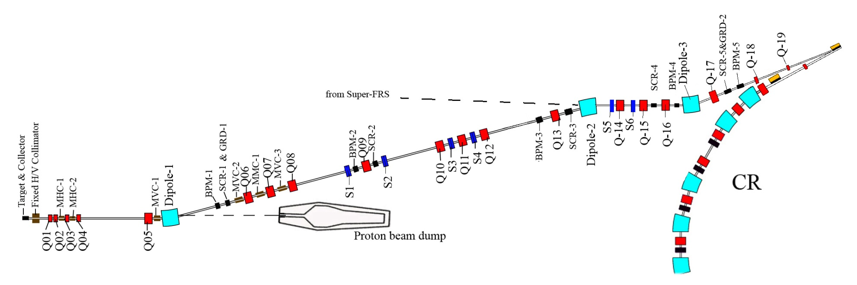
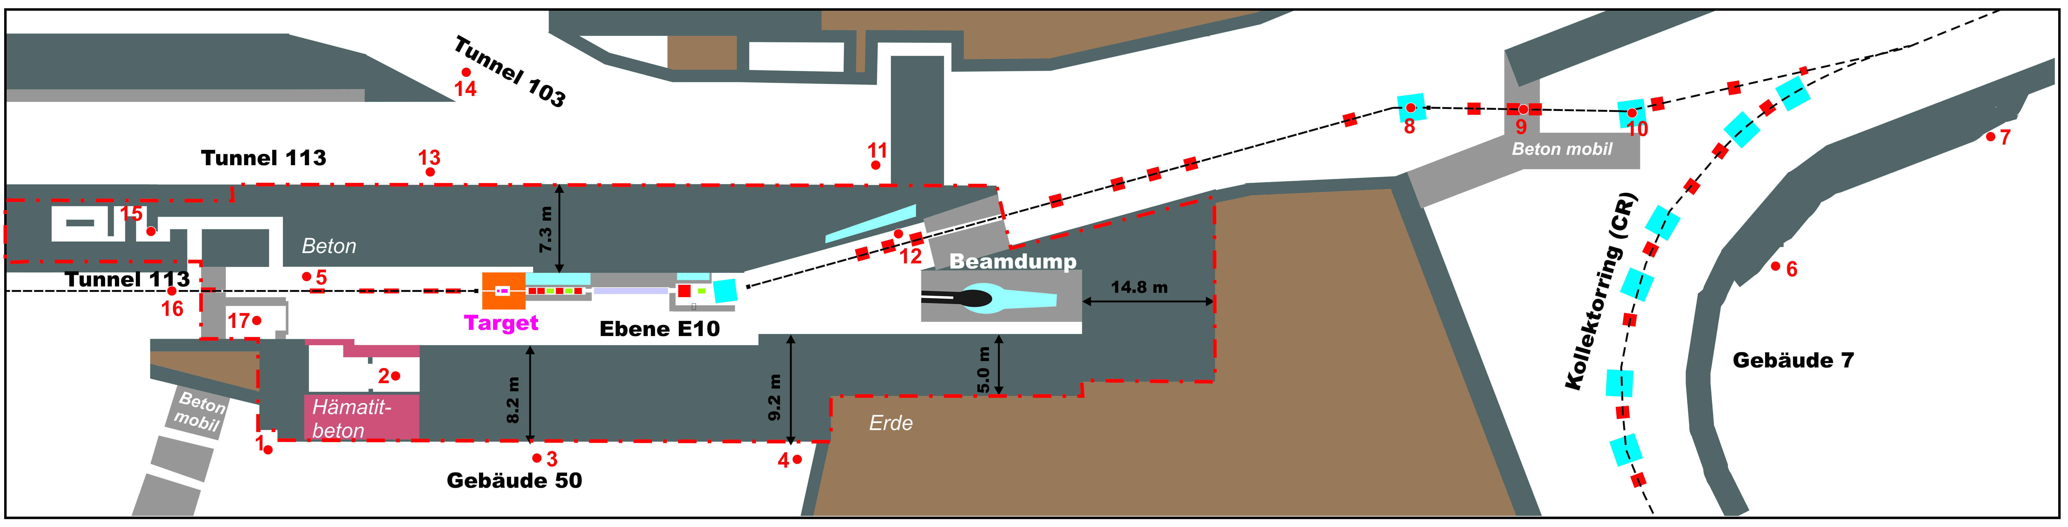
pbar target / separator
29 GeV p
pbar separator
240 π mm mrad
p = 3.82 GeV/c
Δp/p = ±3%
target &
collector

Slide 4
Main Components

Slide 5
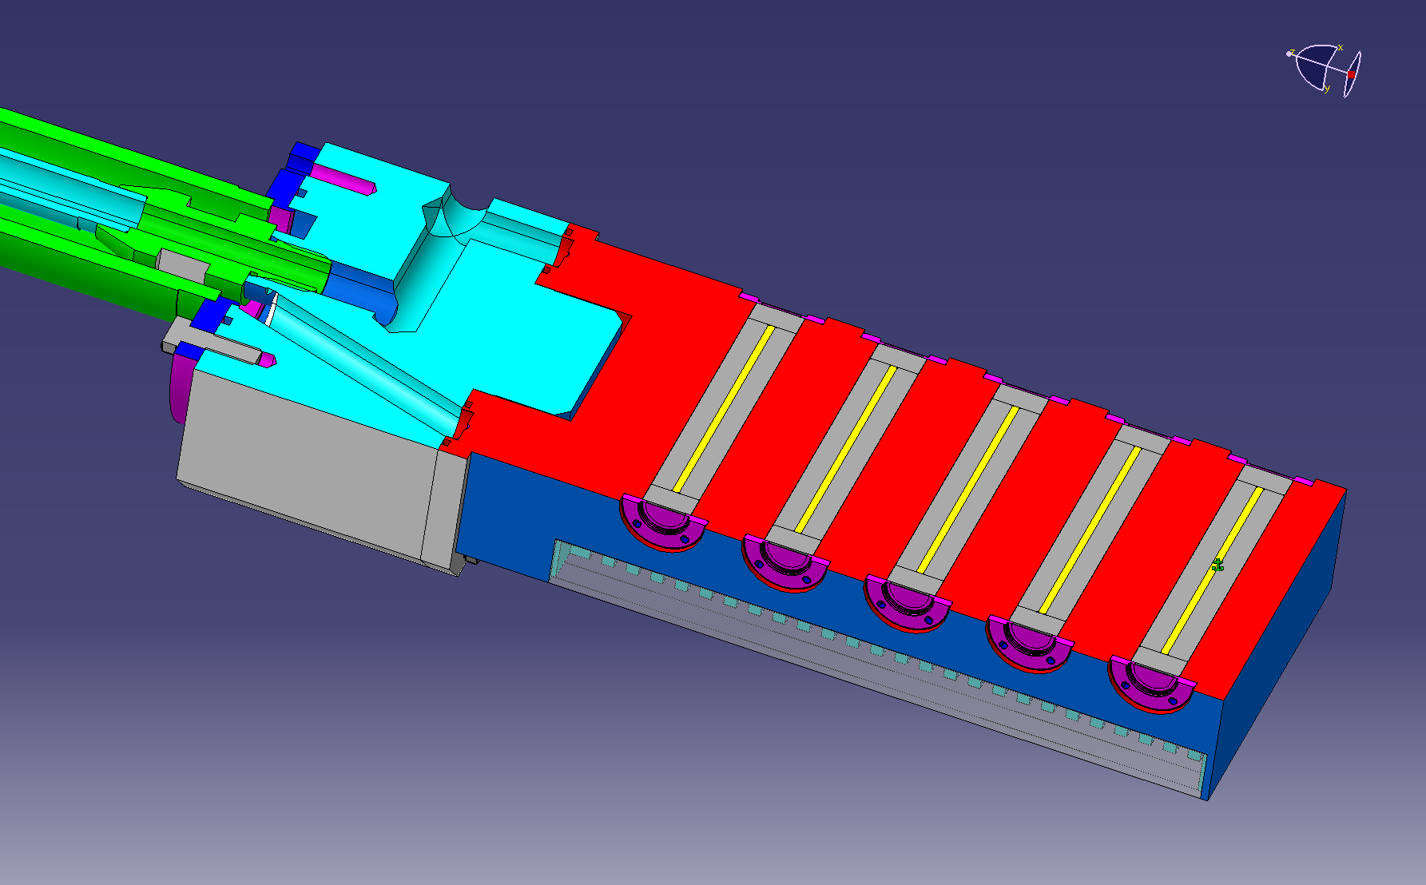
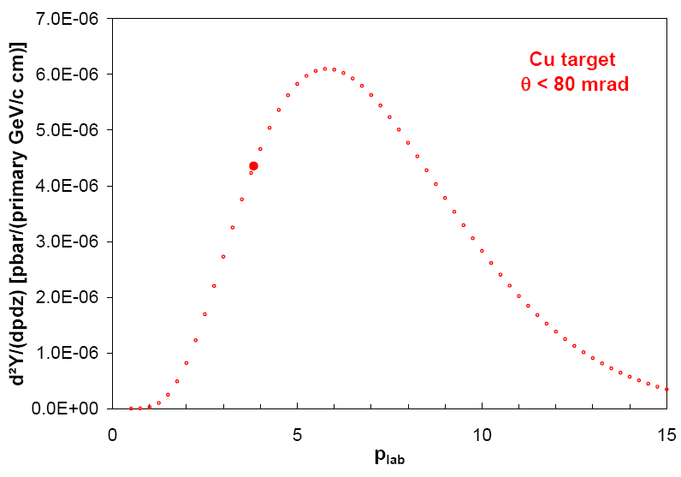
Target
air-cooled AL block
graphite
E_{p} = 29 GeV
y / cm
Ni rod, 110 mm, d = 3 mm
z / cm
seprator acceptance:
p_{pbar} = 3.82 GeV/c ± 3%
magnetic horn with 400 kA:
θ ≤ 80 mrad
From ~ 2.5 × 10⁻⁴ pbar / (p cm target) ~ 5 × 10⁻⁶ (or 2 %) are "collectable"
R.P. Duperray et al., Phys. Rev. D 68, 094017 (2003)

Slide 6
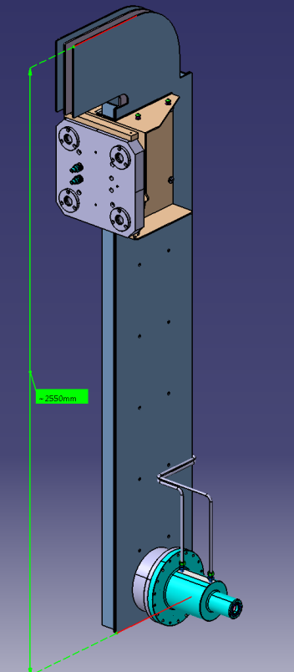
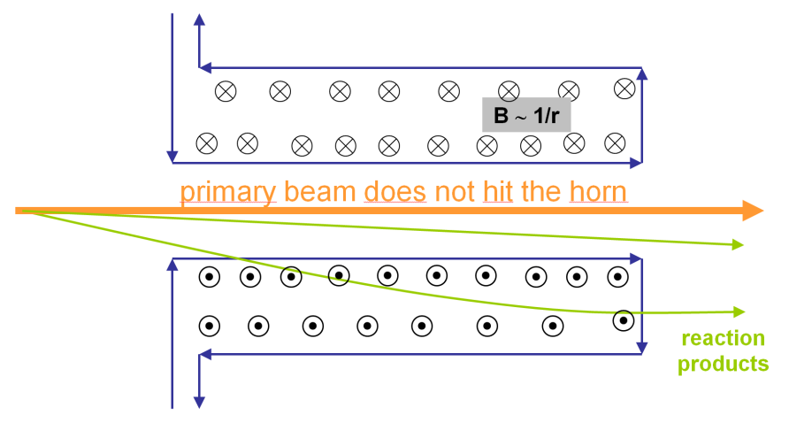
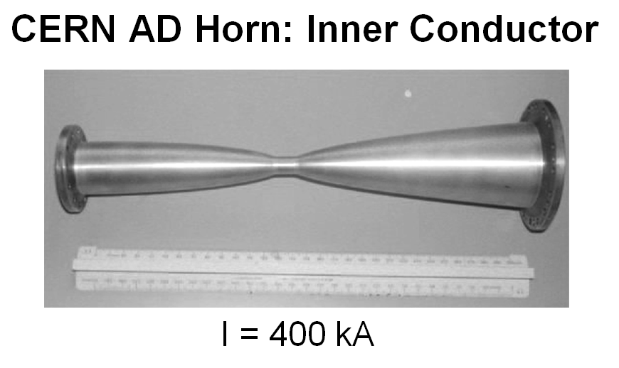
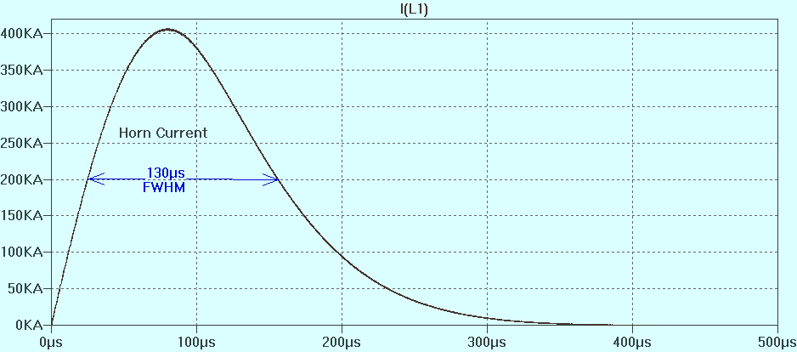
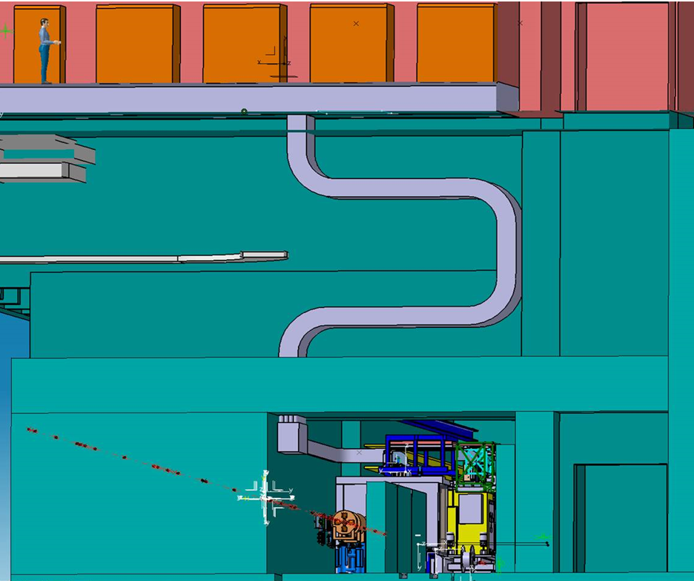
Magnetic horn
power pulser room
LTspice Simulation:
Pulsed Horn Current
duct with 60 cables
soil shielding
stripline

Slide 7
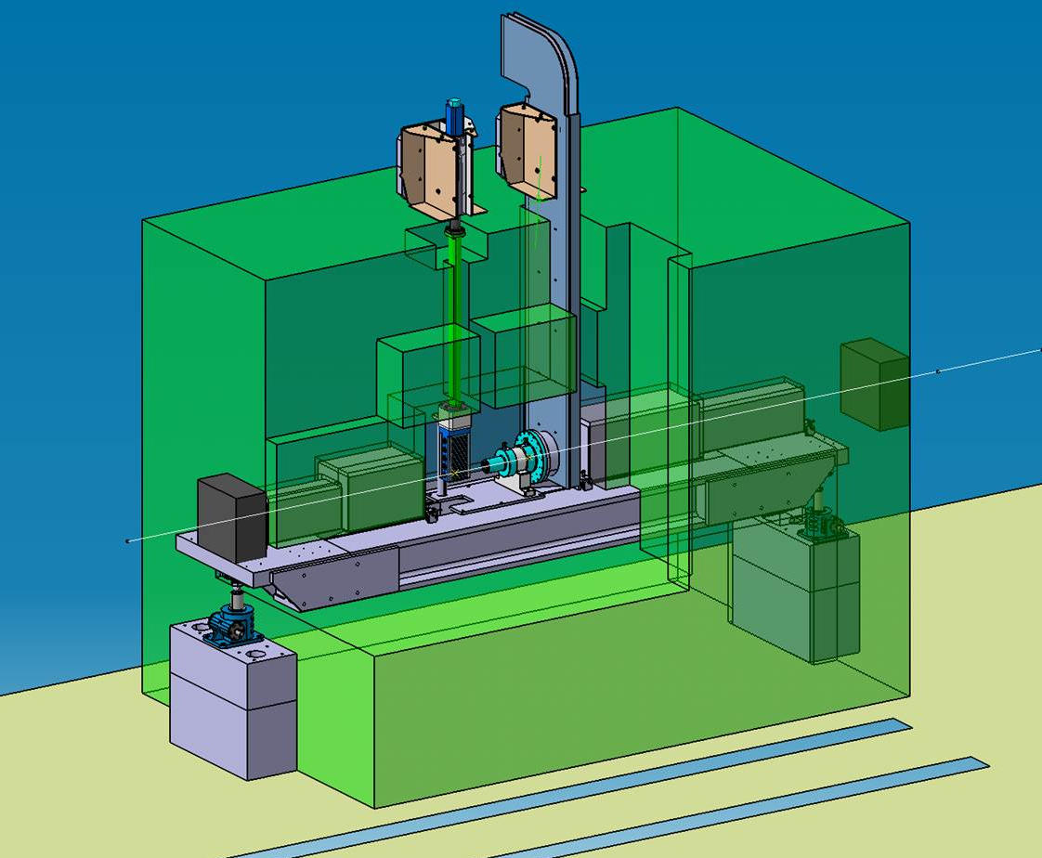
pbar target station

Slide 8
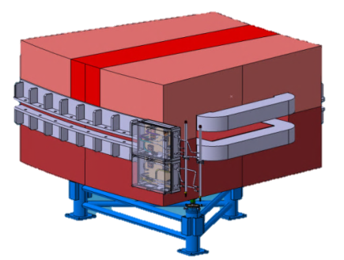
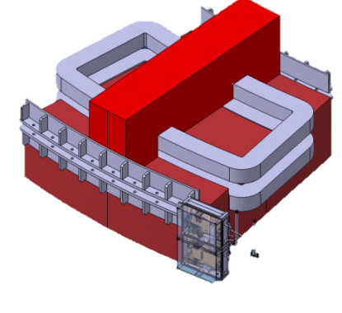
Magnets in pbar separator
CR type magnets
(simplified chambers possible)
Special dipole
radiation hard coil (100 MGy)
upper part of yoke divided in pieces < 10 t (needed for exchange of the coil)
high radiation, no vacuum
CR-type yokes, rad. hard coils with polyimide insulation
Q1-Q2 and Q3-Q4 will be combined to one longer magnet, respectively

Slide 9
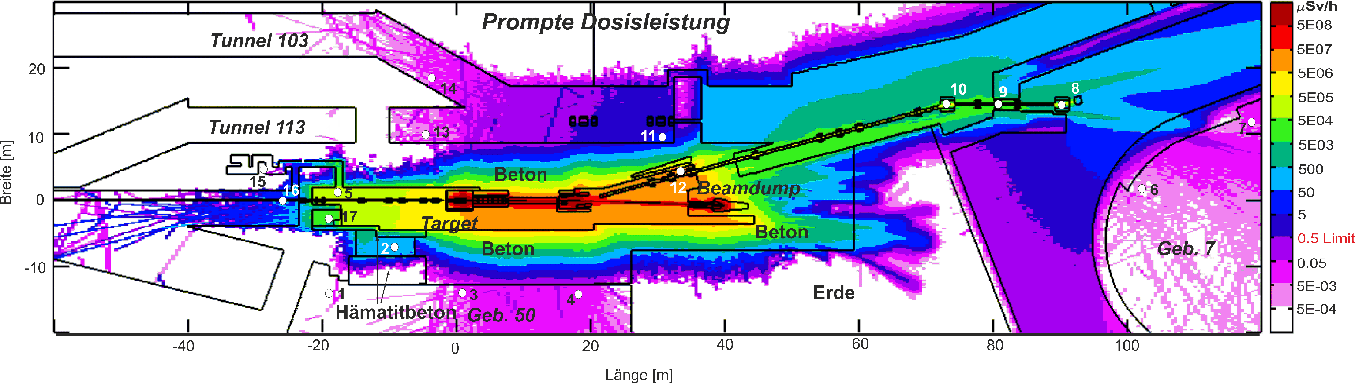
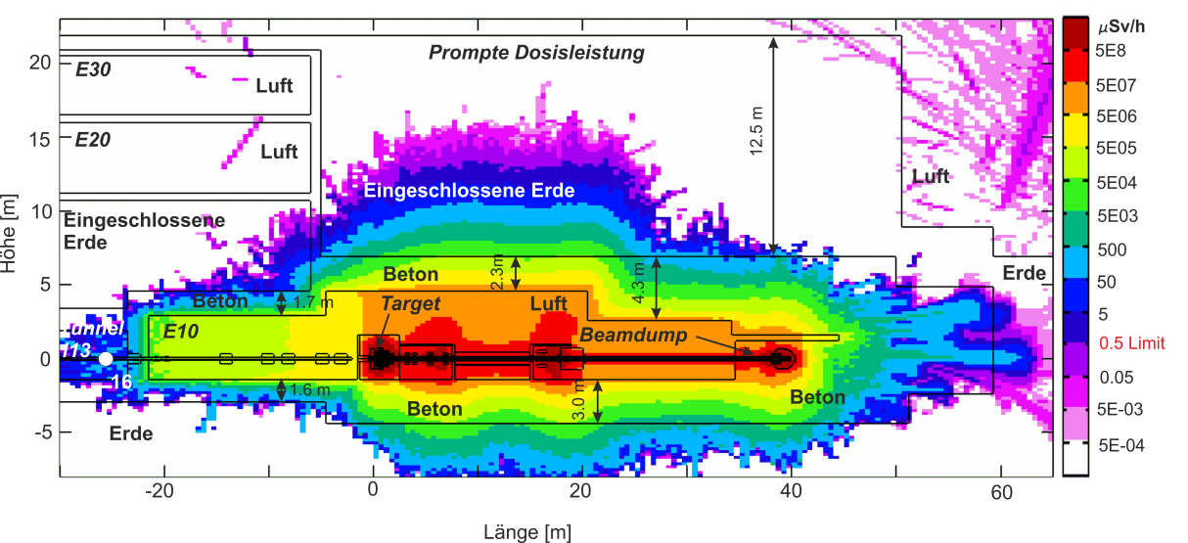
Dose rates during operation (FLUKA):
Construction permit 
horizontal cut
vertical cut

Slide 10
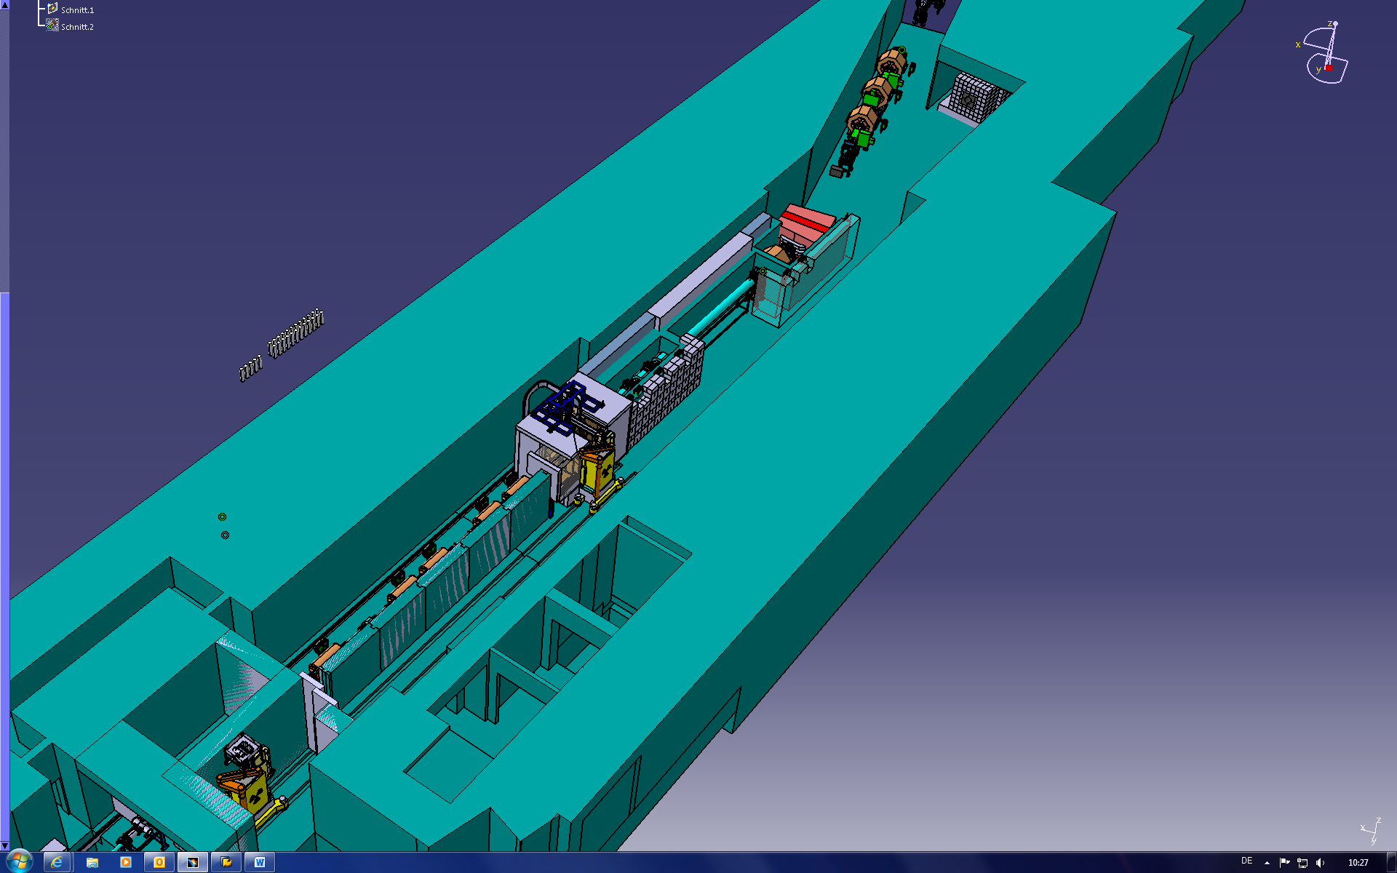
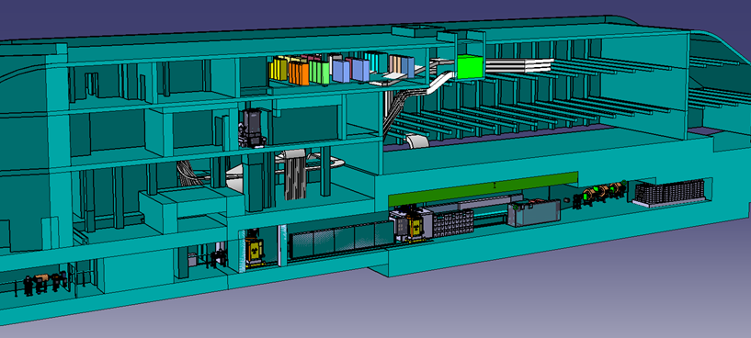
pbar building
dump
target
7 m concrete walls

Slide 11
Residual dose rates / handling:
Operation permit:
(in work, positive responses from authorities for target exchange/disposal concept obtained)

Slide 12
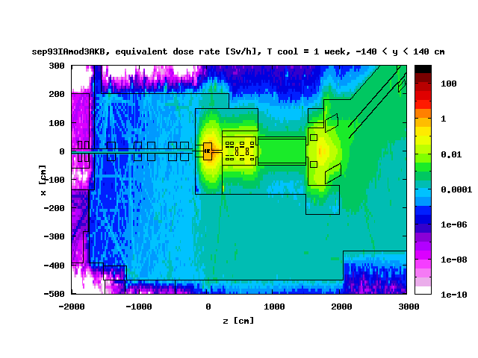
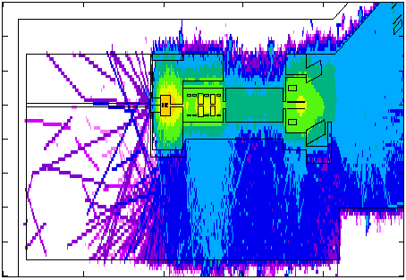
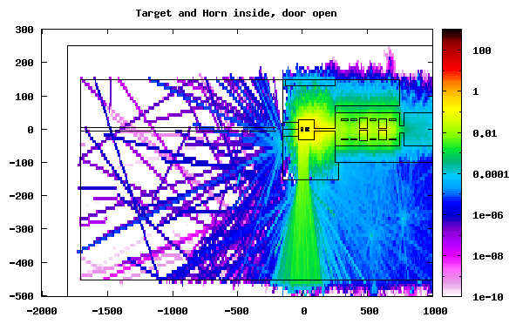
Residual dose rate around target station
BEAM
concrete
iron
concrete
Handling Area
air

Slide 13
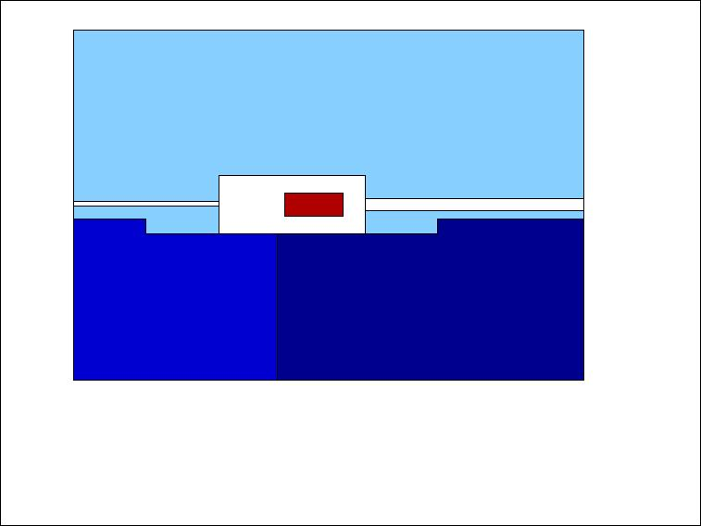
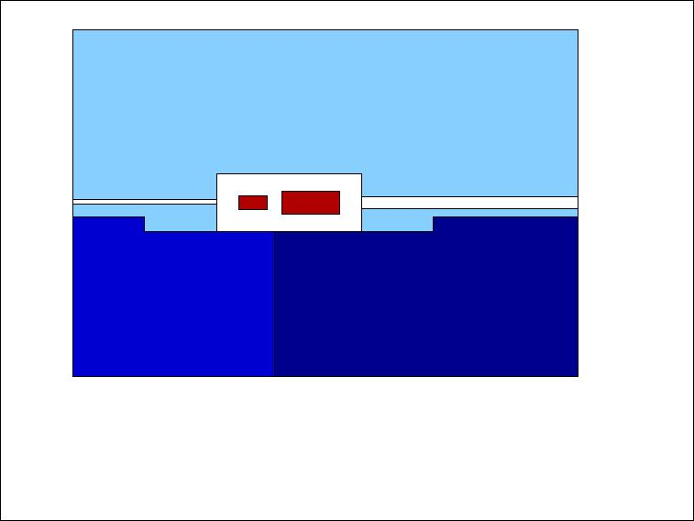
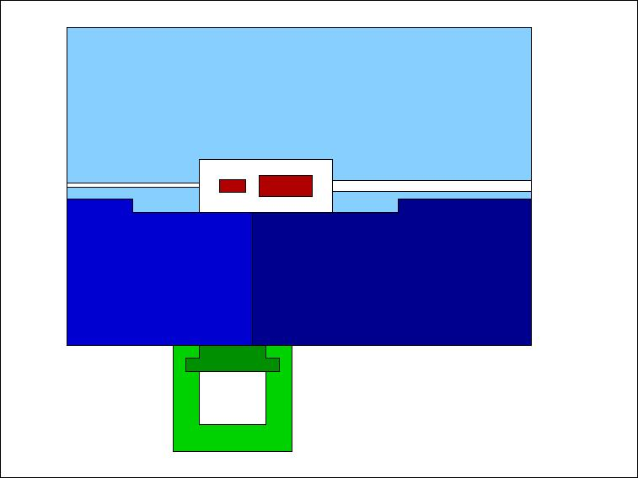
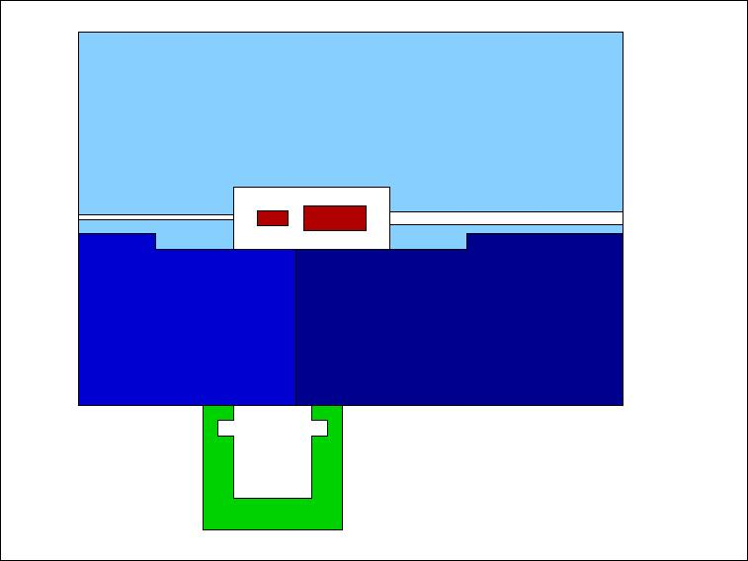
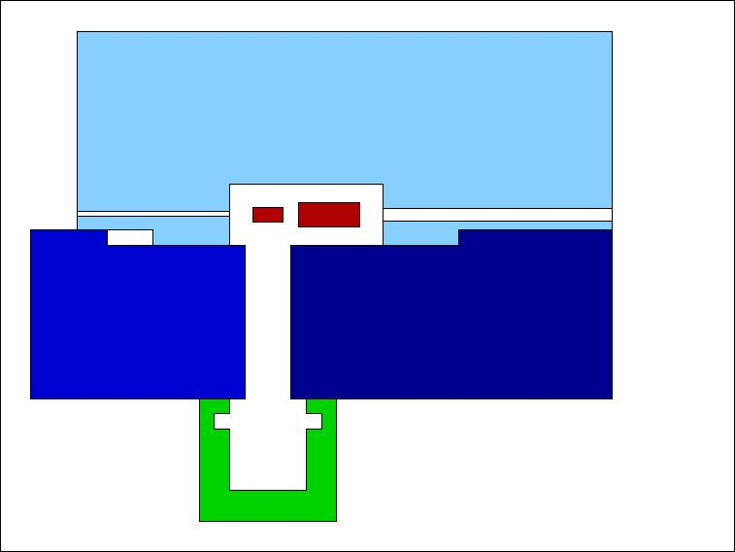
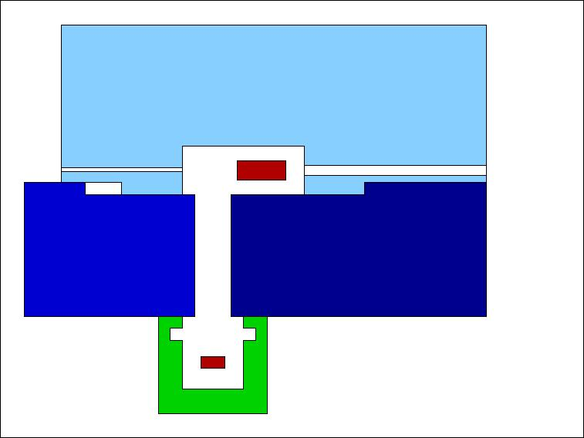

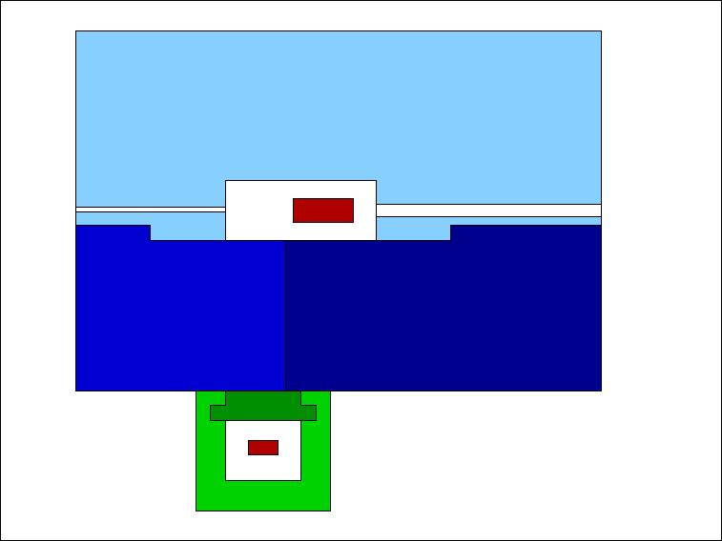
Transport concept in building 6c
Top view, beam from left to right. Inner part of target station is always shielded

Slide 14
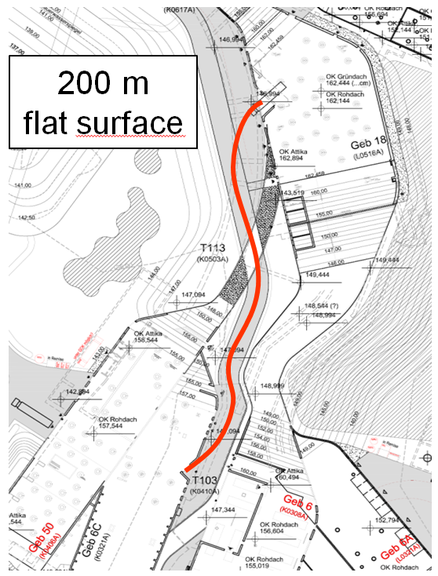
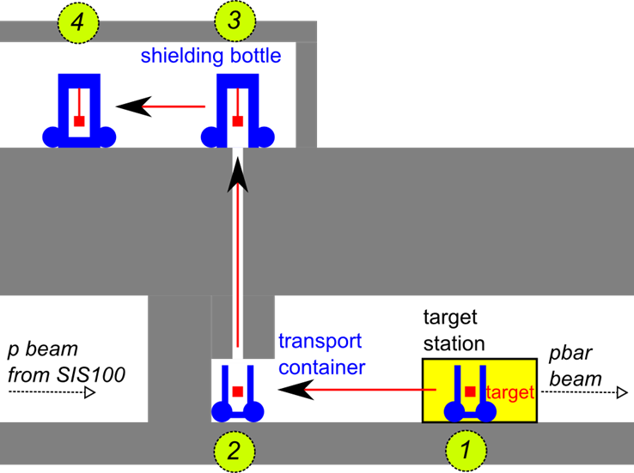
Transport concept in building 6c
Transport container moves to the shaft (1-2).
Crane of carrying frame of the shielding flask lifts up the component (3).
Concept accepted in construction permit

Slide 15
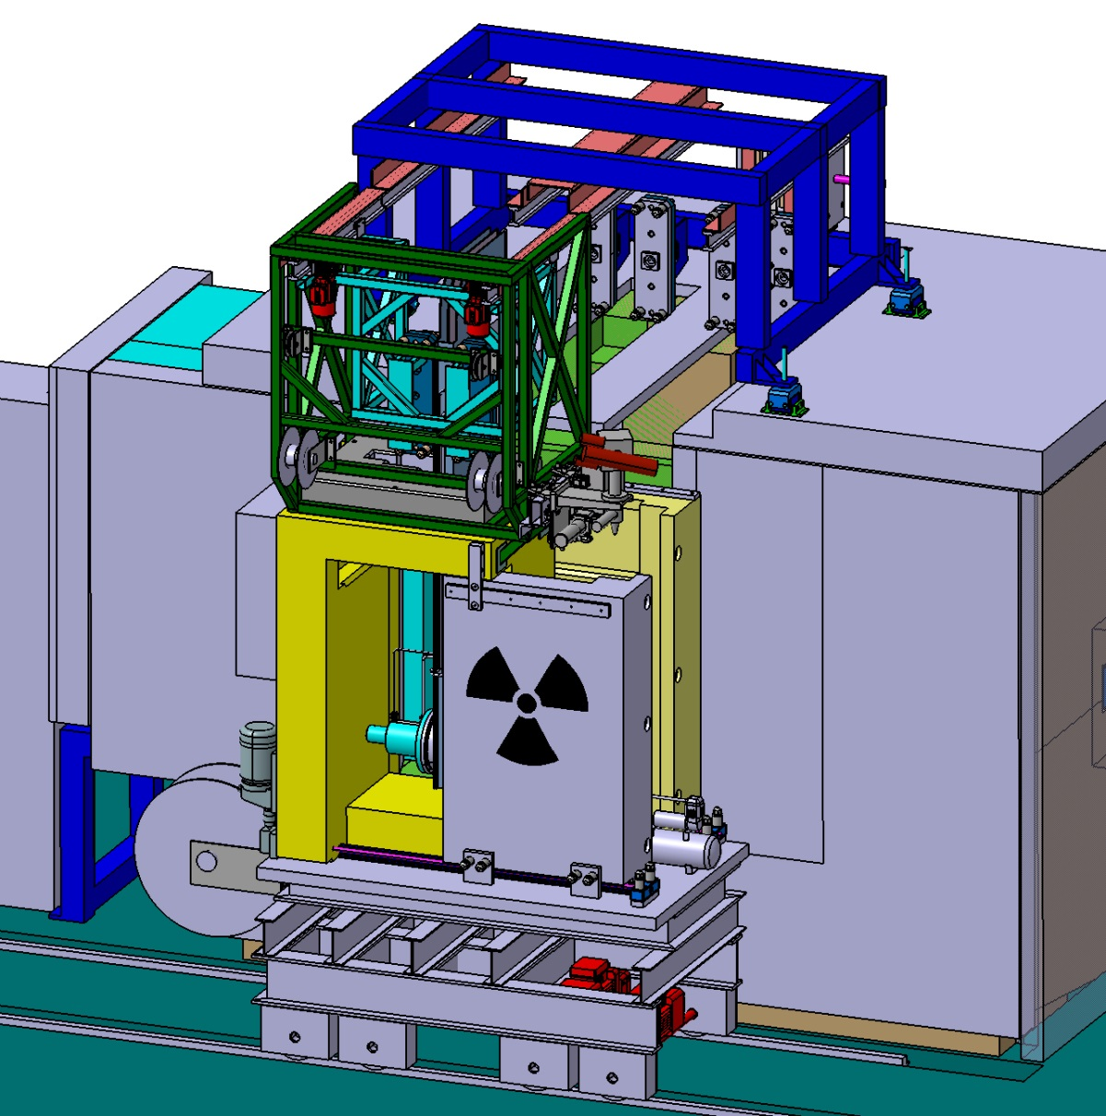
Transport concept in building 6c
Rail system
Detailed study from Kraftanlagen Heidelberg
Presented already to authorities:
Very positive response obtained
Coupling
system
Trolley
Inner door
Front door (for
intervention only)

Slide 16
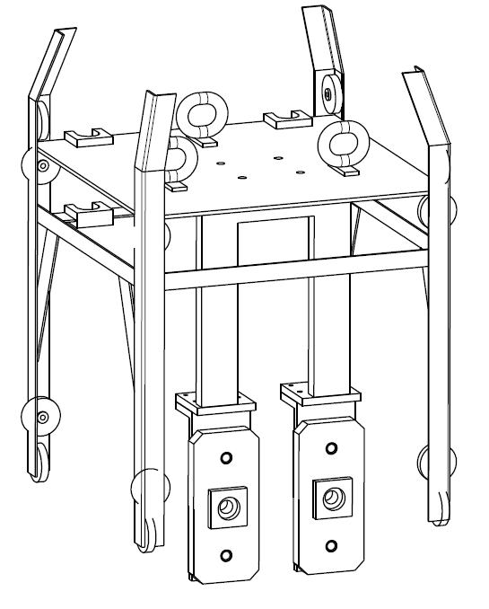
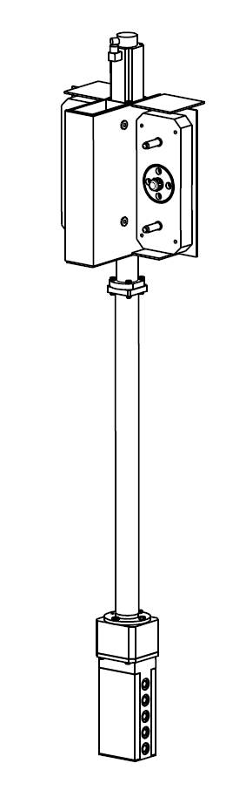
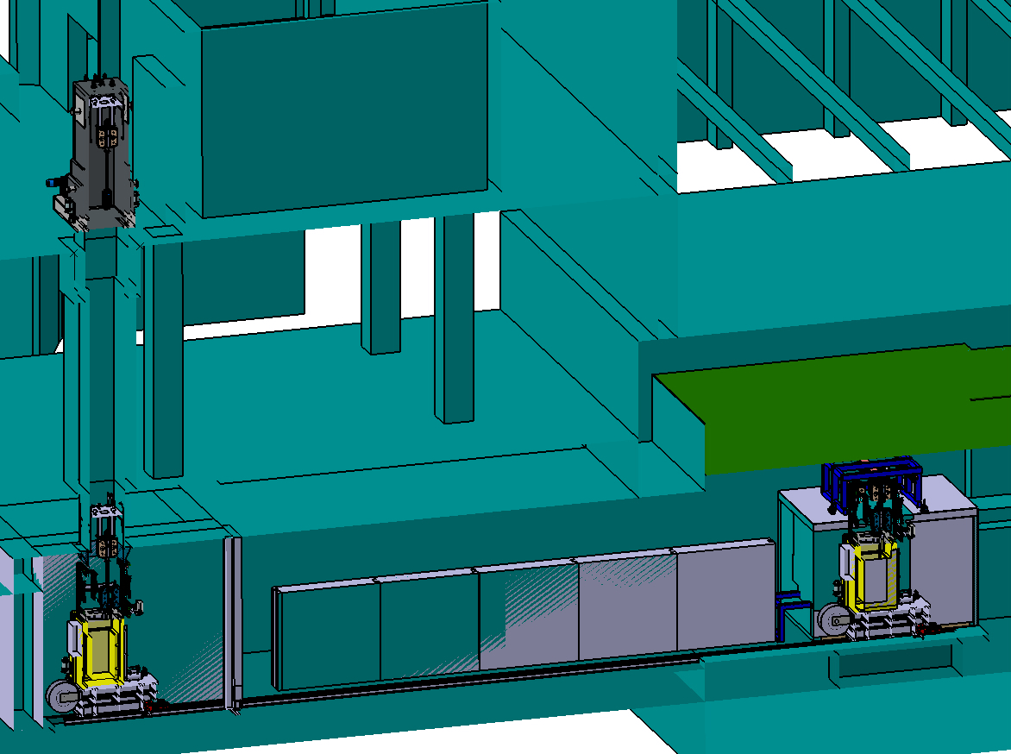
Transport concept in building 6c
3
1
2

Slide 17
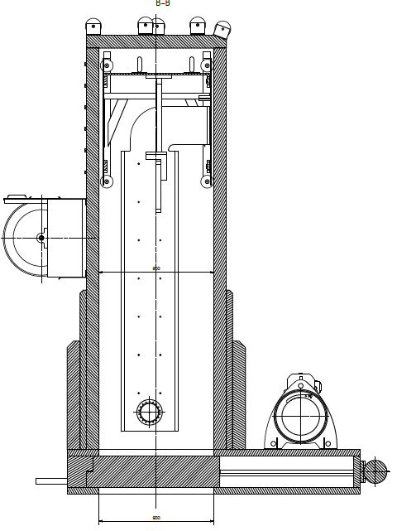
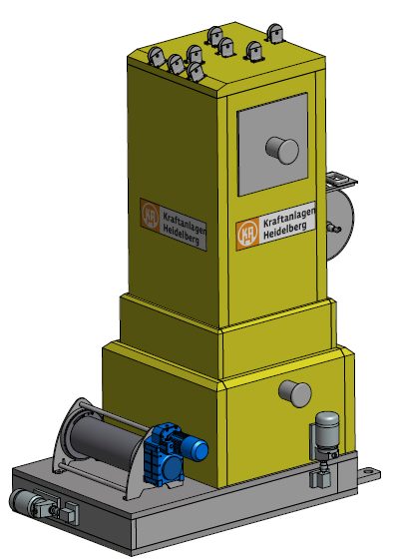
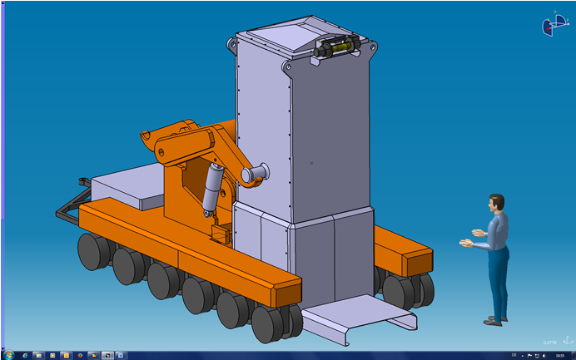
pbar shielding flask: technical design
weight: 25 tons

Slide 18
Conversion rates

Slide 19
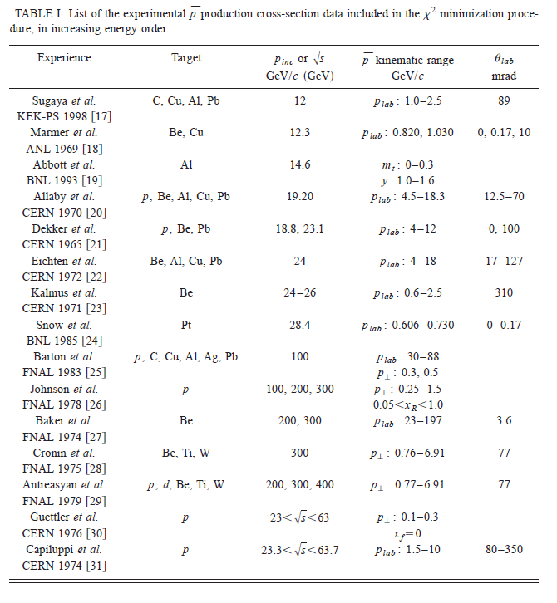
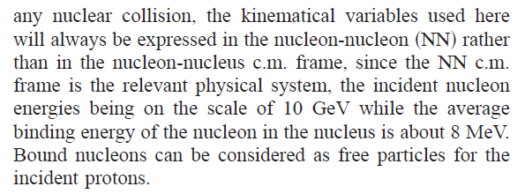
Production Cross Section
Semiempirical formula:
R.P. Duperray et al., Phys. Rev. D 68, 094017 (2003)
Fit of experimental data available in 2003.
Monte Carlo Codes used in addition:
FLUKA, MARS

Slide 20
Production Cross Section
p = 3.82 GeV / c, E = 3 GeV, Bρ = 13 Tm

Slide 21
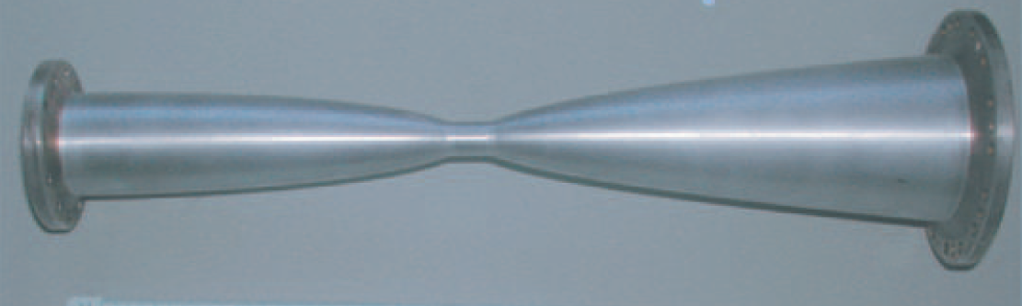
Collectible pbars
Emax SIS 100
y / cm
E_{p} = 29 GeV
magnetic horn
CR max. 13 Tm
z / cm
acceptance separator/CR
p_{pbar} = 3.82 GeV/c ± 3%
0 < p_{pbar} < 80 mrad
From ~ 2.5 × 10⁻⁴ pbar / (p cm target) ~ 5 × 10⁻⁶ (or 2 %) are "collectible"

Slide 22
Collectible pbars

Slide 23
Collectible pbars: Self Absorption
p
pbar
Cu: σ_{pbar} = 0.8 b

Slide 24
Collectible pbars: MARS/FLUKA
p
pbar
Cu: σ_{pbar} = 0.8 b

Slide 25
Collectible pbars: MARS
p
pbar
Cu: σ_{pbar} = 0.8 b

Slide 26
Collectible pbars: Graphite Surrounding
p
pbar
Cu: σ_{pbar} = 8.8 b
C: σ_{pbar} = 0.42 b

Slide 27
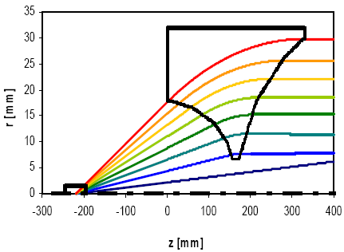
pbar Yield:
Collection efficiency of the magnetic horn
pbars in the ellipse
yield =
primary protons

Slide 28
pbar Yield: Cu vs Ir (8.92 vs 22.65 g/cm³)

Slide 29
pbar Yield: Comparison to CERN Data
To injection orbit of collector ring:
pbar/p = 2×10⁻⁵ × 0.85 × 0.7 = 1.2×10⁻⁵
scattering losses in air / aluminum losses in separator / during injection
Exp. data from CERN (Baird 1998) to injection orbit:
pbar/p = 0.45×10⁻⁵ × 1.5 = 0.7×10⁻⁵
correction for different energies and emmitances

Slide 30
Summary
For 1 antiproton in the CR
10⁵ primary protons on the target are needed.
I do not see room for significant improvements.
All optimization steps* I can imagine are in the order of <20 %.
* including a Li-lens instead of a horn

