Slide 1



Towards anions laser cooling
International Workshop on Antiproton Physics and Technology at FAIR - Nov 2015
* Giovanni Cerchiari (e-mail: giovanni@mpi-hd.mpg.de)
Elena Jordan
Alban Kellerbauer
Max-Planck-Insitut für Kernphysik (Saupfercheckweg 1, 69117 Heidelberg, Germany)

Slide 2
Outline
Motivations
Negative ions and laser cooling
Experimental technique
Result and cooling scheme

Slide 3

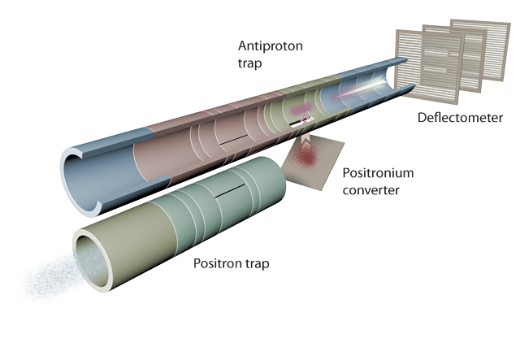
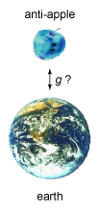
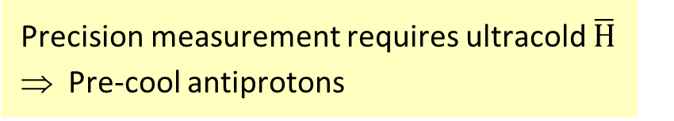
AEGIS antimatter gravity experiment
Main goal: Measurement of g with 1% precision on antihydrogen
  Production of a bunched cold beam of antihydrogen (100 mK)
  Measurement of vertical beam deflection (10 μm drop over 1 m)
Precision measurement requires ultracold $\overline{H}$
⇒ Pre-cool antiprotons

Slide 4
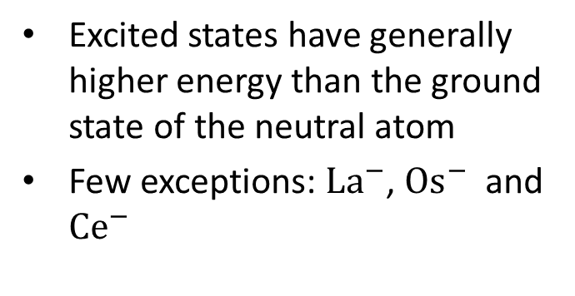
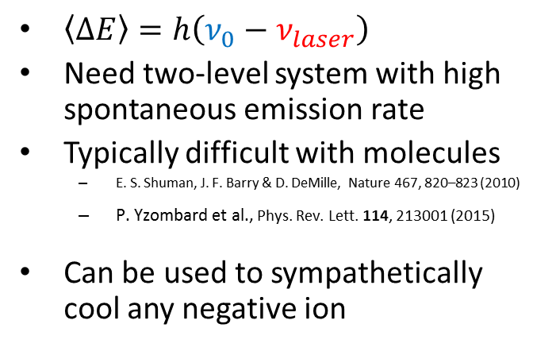
Doppler laser cooling
Negative atomic ions
Negative atomic ions
Spontaneous emission
Negative ion
Neutral atom
Energy
Detuned laser radiation
Excited
Ground
atom
Ground
$\left\langle ΔE\right\rangle =h\left(ν_{0}−ν_{laser}\right)$
Need two-level system with high spontaneous emission rate
Typically difficult with molecules
  E. S. Shuman, J. F. Barry & D. DeMille, Nature 467, 820–823 (2010)
  P. Yzombard et al., Phys. Rev. Lett. 114, 213001 (2015)
Can be used to sympathetically cool any negative ion
Excited states have generally higher energy than the ground state of the neutral atom
Few exceptions: ${La}^{−}$, ${Os}^{−}$ and ${Ce}^{−}$

Slide 5
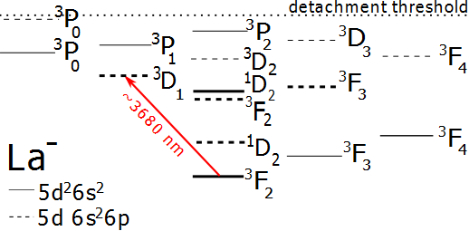
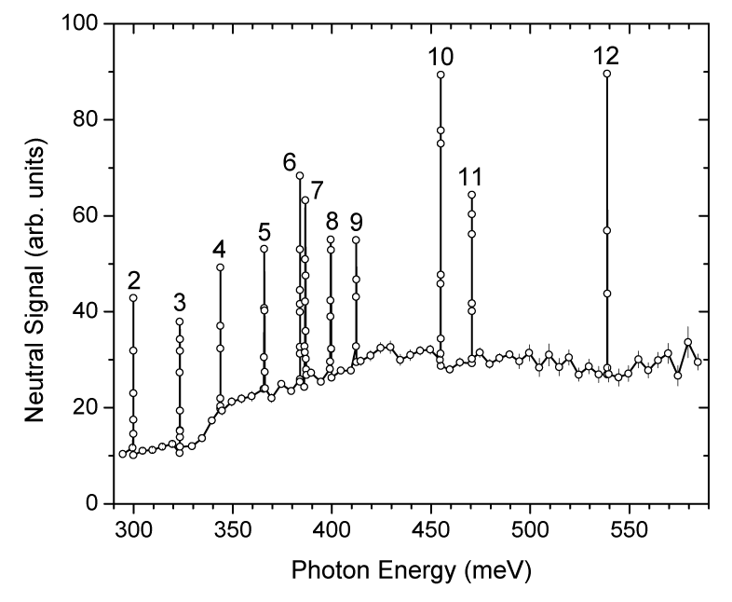
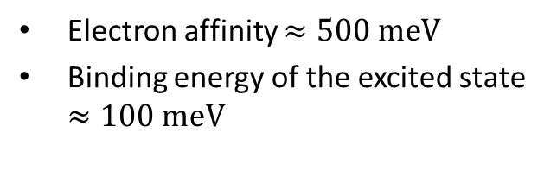
Bound–bound transitions in La⁻
Electron affinity $≈500 meV$
Binding energy of the excited state $≈100 meV$
[S.M. O’Malley and D.R. Beck,
Phys.Rev. A 81,032503 (2010)]
all peaks unambiguously assigned
laser cooling transition identified:
preliminary
Peak 8
Energy E = 399.42(3) meV
Wavelength λ = 3104.4(2) nm
[C. W. Walter & N. D. Gibson, private communication (2014)]
20
Notes:
Energy about 60 meV higher than calculated. Binding energy for excited state of Os- is

Slide 6
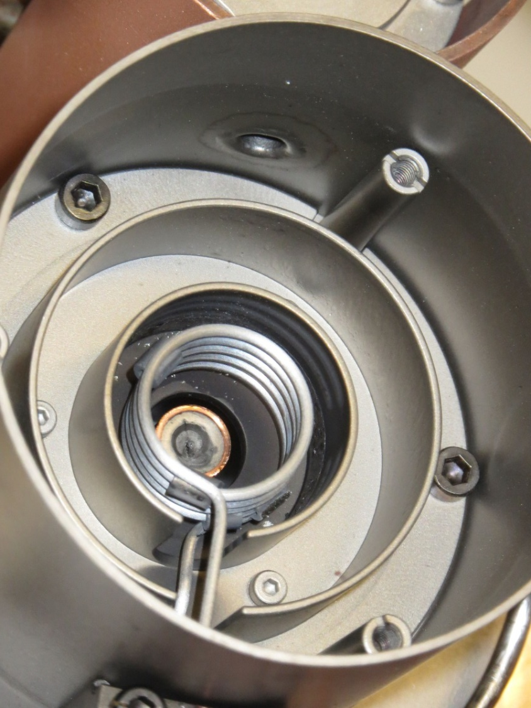
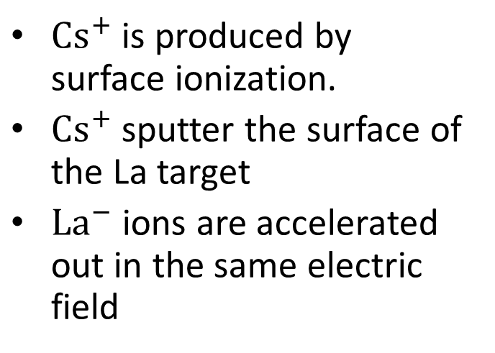


Ion Source
$$U_{s}$$
Cs
Cs
Cs
La target
La
Cs
Cs
$$U_{e}$$
$Cs^{+}$ is produced by surface ionization.
$Cs^{+}$ sputter the surface of the La target
$La^{−}$ ions are accelerated out in the same electric field
[R. Middleton, A Negative-Ion Cookbook, PA 19104 October 1989 (Revised February 1990)]

Slide 7
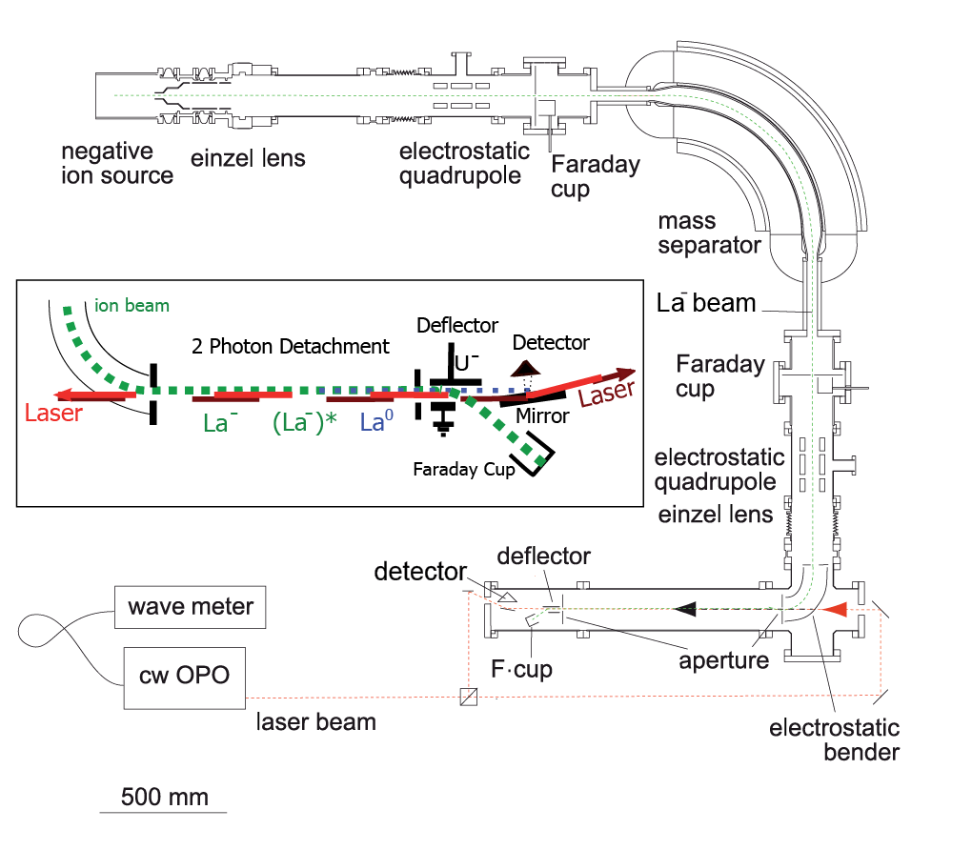
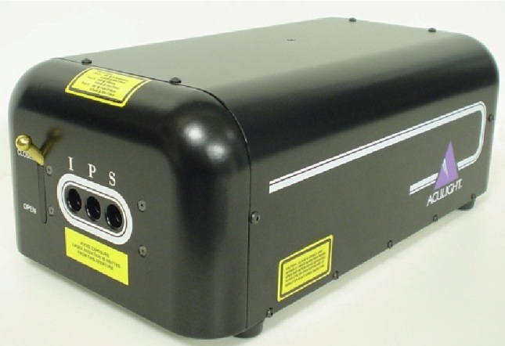
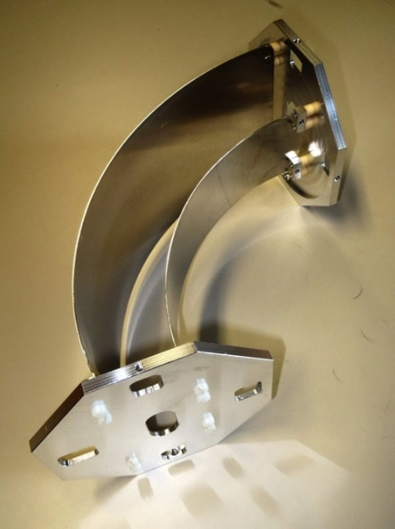
Apparatus
Overall schematic:
Production of anion beam
Mass separation
Spectroscopy

Slide 8
Spectroscopy technique
Ion beam
Electrostatic deflector
Laser
E
Neutrals
MCP
Anions
Faraday-Cup
Continuous anions current and laser beam
Collinear interaction between ions and laser beams
Detachment of excited state
Measurement of neutral particles flux
Energy
Non resonant transition
Low cross section
Electron affinity
Excited
Resonant transition
High cross section
Ground

Slide 9
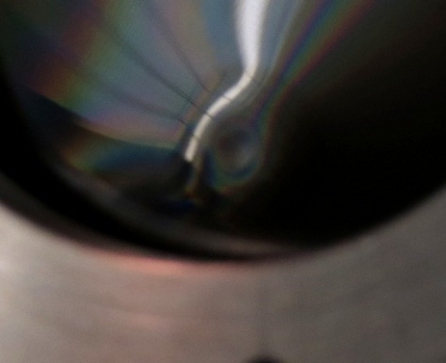
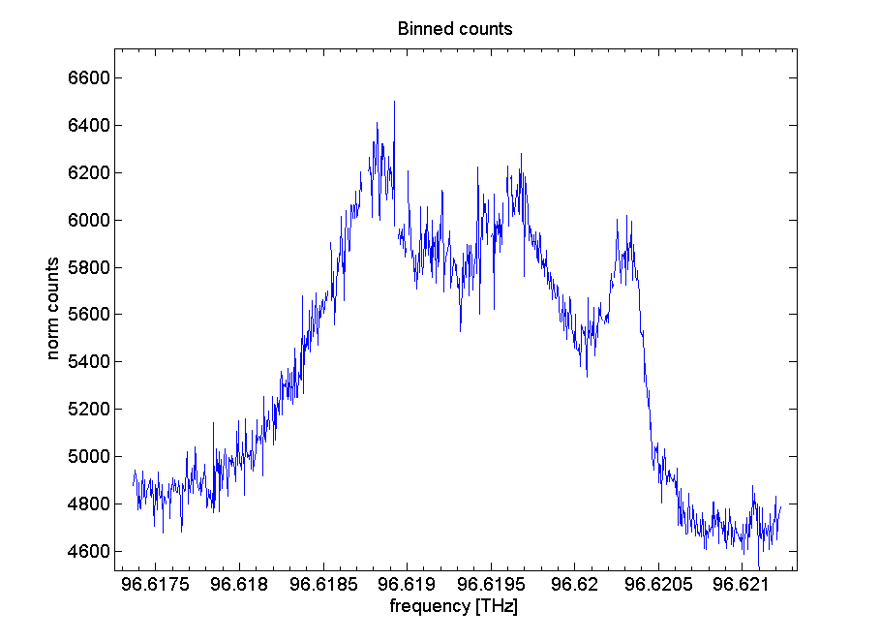
Spectroscopy technique
Ion beam
Electrostatic deflector
Laser
E
Neutrals
MCP
Anions
Faraday-Cup
Continuous anions current and laser beam
Collinear interaction between ions and laser beams
Detachment of excited states
Measurement of neutral particles flux
Energy
Non resonant transition
Low cross section
Electron affinity
Excited
Resonant transition
High cross section
Ground

Slide 10
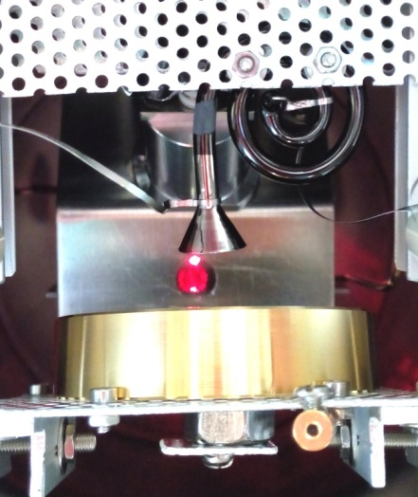

Spectroscopy technique
Channeltron
Ion beam
Electrostatic deflector
$$e^{−}$$
Laser
E
Neutrals
Anions
Faraday-Cup
Neutrals produce secondary electrons on a gold mirror
Secondary electrons are collected and counted
The mirror allows for a second laser
Ions in motion perceive to different Doppler shifts
Energy
Non resonant transition
Low cross section
Electron affinity
Excited
Resonant transition
High cross section
Ground

Slide 11
Spectroscopy technique
Channeltron
Laser
Ion beam
Electrostatic deflector
$$e^{−}$$
Laser
E
Neutrals
Anions
Faraday-Cup
Neutrals produce secondary electrons on a gold mirror
Secondary electrons are collected and counted
The mirror can reflect a second laser on the beam
Ions in motion perceive to different Doppler shifts
Energy
Non resonant transition
Low cross section
Electron affinity
Excited
Resonant transition
High cross section
Ground

Slide 12
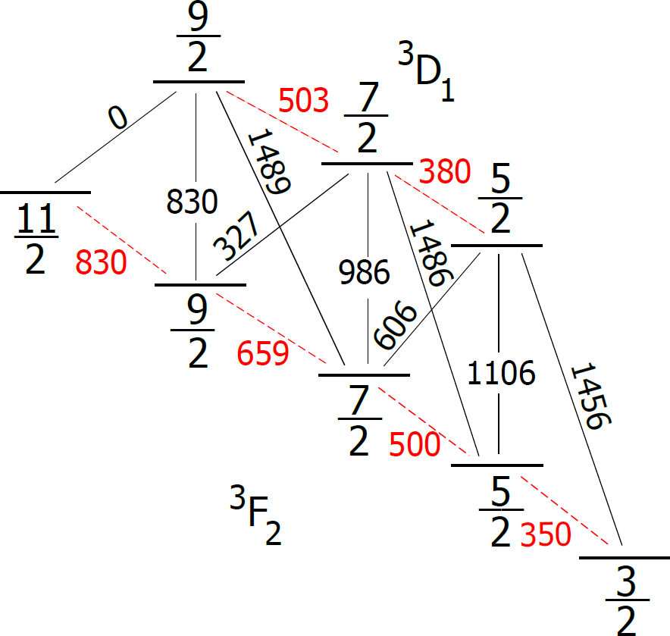
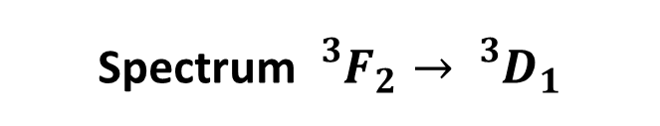
La⁻ spectroscopy
Spectrum ${}_{}^{3}{F_{2}}→$ ${}_{}^{3}{D_{1}}$
E = 5 keV
[E. Jordan et al.,PRL 115 (2015) 113001]
21
12

Slide 13
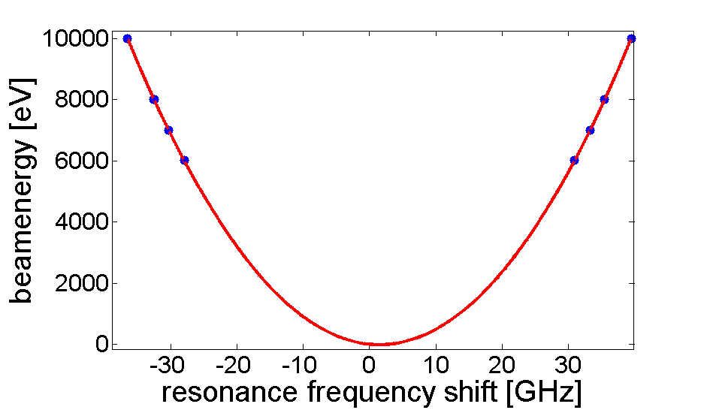
La⁻ spectroscopy
Spectrum ${}_{}^{3}{F_{2}}→$ ${}_{}^{3}{D_{1}}$
E = 5 keV
2 measurements for every acceleration energy
Frequency at rest extracted from Doppler shifts
21
13

Slide 14



La⁻ spectroscopy
Hyperfine spectrum
$${}_{}^{3}{D_{1}}$$
7/2
9/2
5/2
E = 10 keV
$${}_{}^{3}{F_{2}}$$
9/2
11/2
5/2
7/2
3/2
Hyperfine splitting: $F=I+J$
where C, D are functions of quantum numbers I, J, F
A_{g} = 146.8(3) MHz B_{g} = 36(9) MHz
A_{e} = 110.6(7) MHz B_{e} = 5(1) MHz
21
14

Slide 15


La⁻ cooling
Hyperfine spectrum
$${}_{}^{3}{D_{1}}$$
7/2
9/2
5/2
E = 10 keV
$${}_{}^{3}{F_{2}}$$
9/2
11/2
5/2
7/2
3/2
7/2
9/2
$${}_{}^{3}{D_{1}}$$
5/2
9/2
11/2
$${}_{}^{3}{F_{2}}$$
5/2
7/2
3/2
15
21

Slide 16
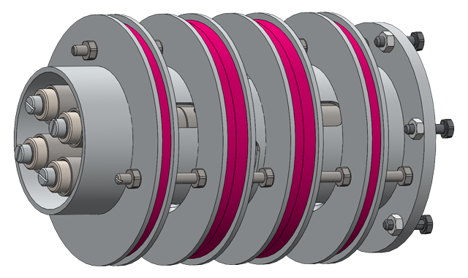
Outlook
La⁻ seems to be excellent laser cooling candidate
Next steps:
  Paul trap to trap and laser-cool La⁻
  under construction
  Development of sideband generation
  for existing laser system
  Measurement of resonant cross-section
12
Notes:
∆ν = −830 MHz, +660 MHz

Slide 17
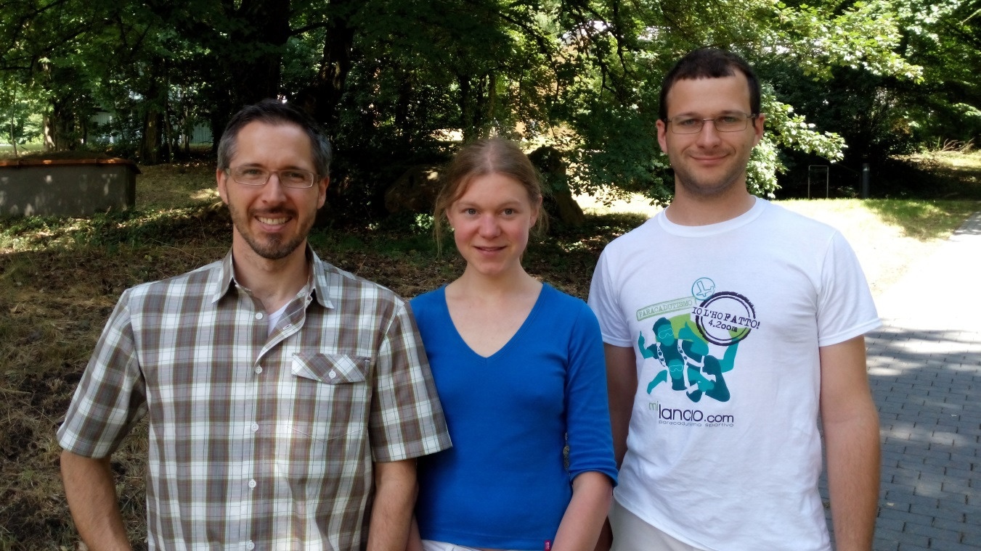

Thanks

