Slide 1
Computing at PANDA
The PandaRoot Framework
| Tobias Stockmanns

Slide 2
FAIRROOT

Slide 3
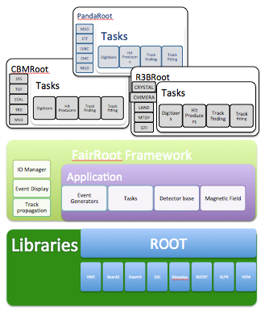
FairRoot

Slide 4
FairRoot → ALFA
AliRoot6 (O²)
CbmRoot
R3BRoot
SofiaRoot
MPDRoot
ShipRoot
PandaRoot
AsyEosRoot
FopiRoot
EICRoot
ALFA
FairRoot
????
DDS
Building configuraion
Testing
Fair MQ
MC Application
Module
Detector
Magnetic Field
Event
Generator
Runtime DB
Libraries and Tools
Protocol Buffers
BOOST
ROOT
ZeroMQ
CMake
Geant4
Genat4_VMC
Geant3
VGM
…

Slide 5
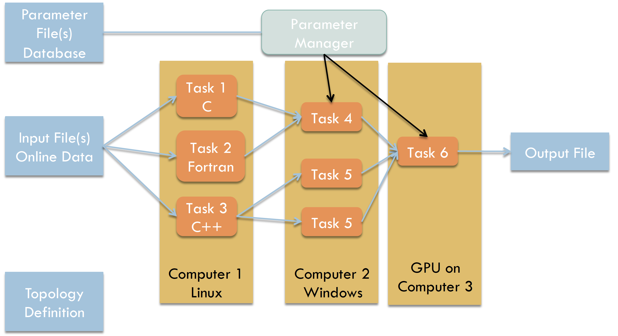
FairMQ
Message Queue

Slide 6
Pandaroot

Slide 7
Simulation Stages
Event
Generation
Propagation
Digitization
Local Reconstruction
Global Reconstruction
Event
Building
Analysis

Slide 8
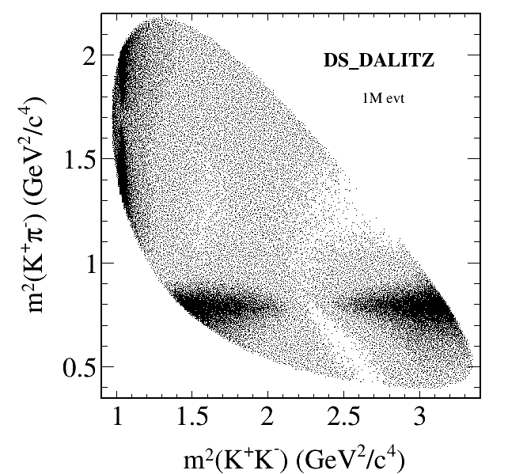
Event Generation
Many different event generators available
  EvtGen:
    Simulation of dedicated physics
    channels
    Can be extended by individual decay
    models
  Dual-Parton-Model (DPM):
    Background generator for anti-proton – proton interactions
  UrQMD:
    Background generator for anti-proton – nucleus interactions
  FTF generator:
    New development of a combined background generator by Vladimir Uzhinsky and Aida Galoyan
  Box generator:
    Particle gun

Slide 9
Particle Propagator
Usage of Virtual Monte Carlo allows seamless change of propagation engine
Available:
  Geant3
  Geant4
  (Fluka)
Same geometry description in propagation and reconstruction of events by using the same geometry engine from root

Slide 10
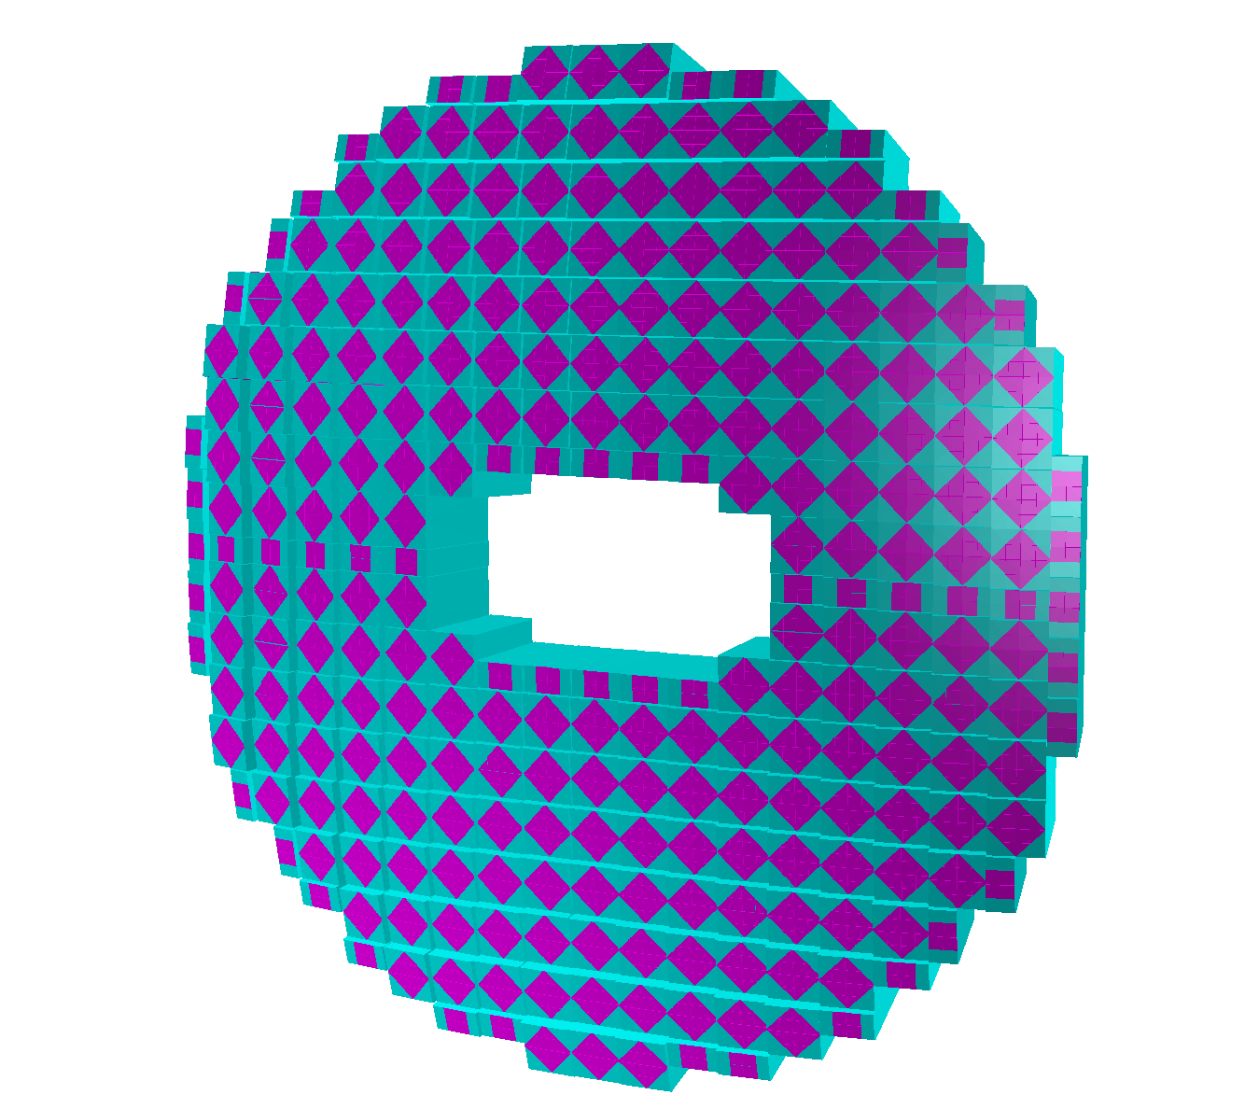
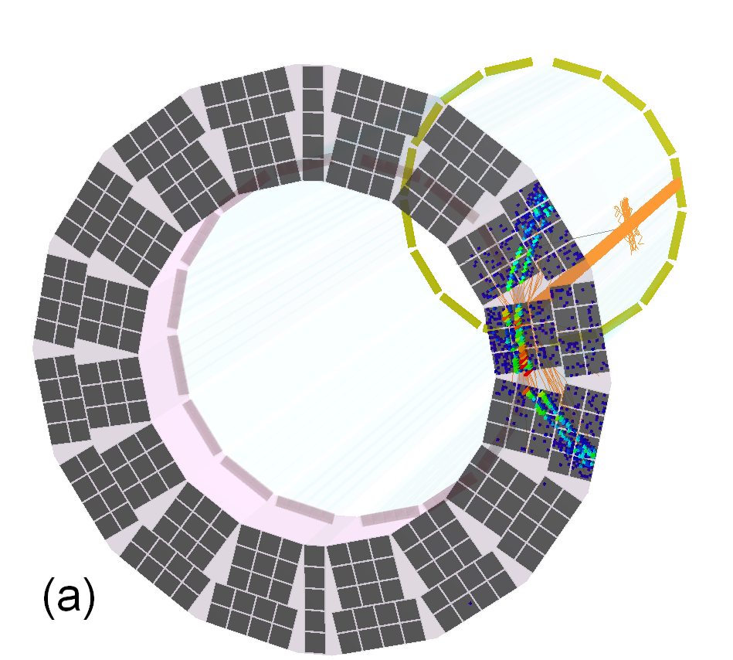
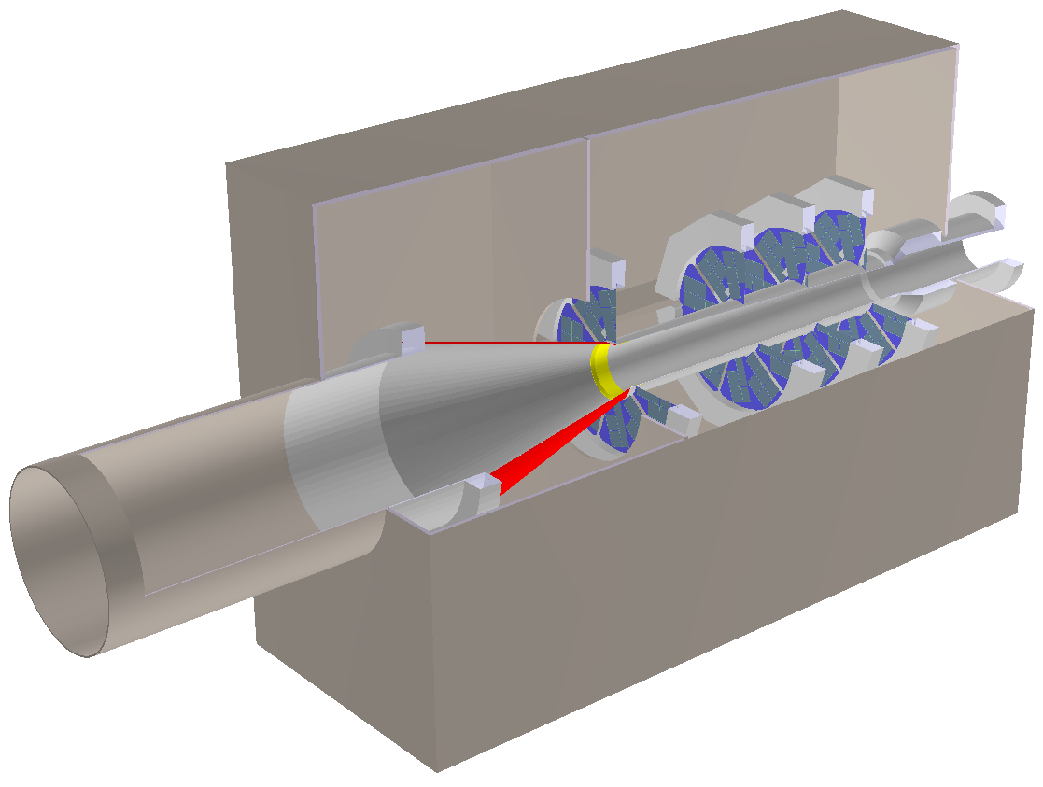
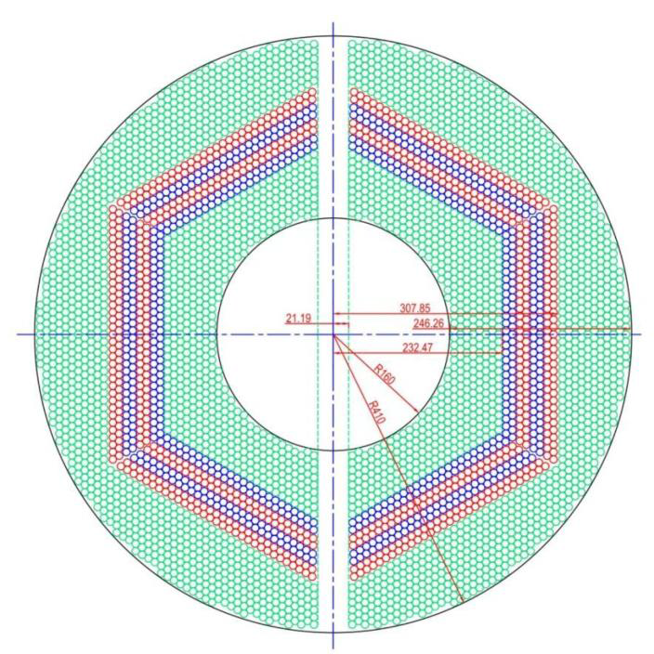
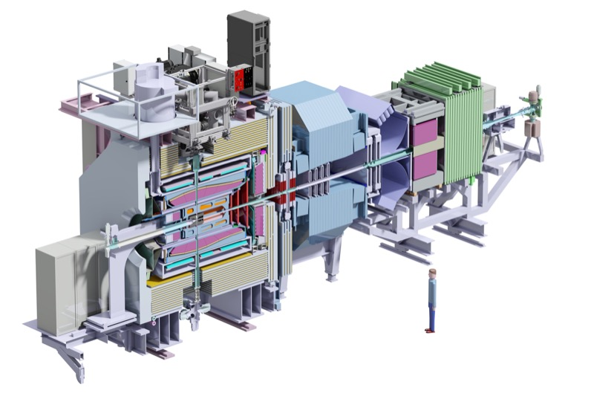
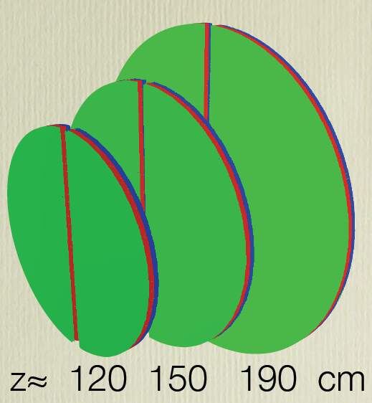
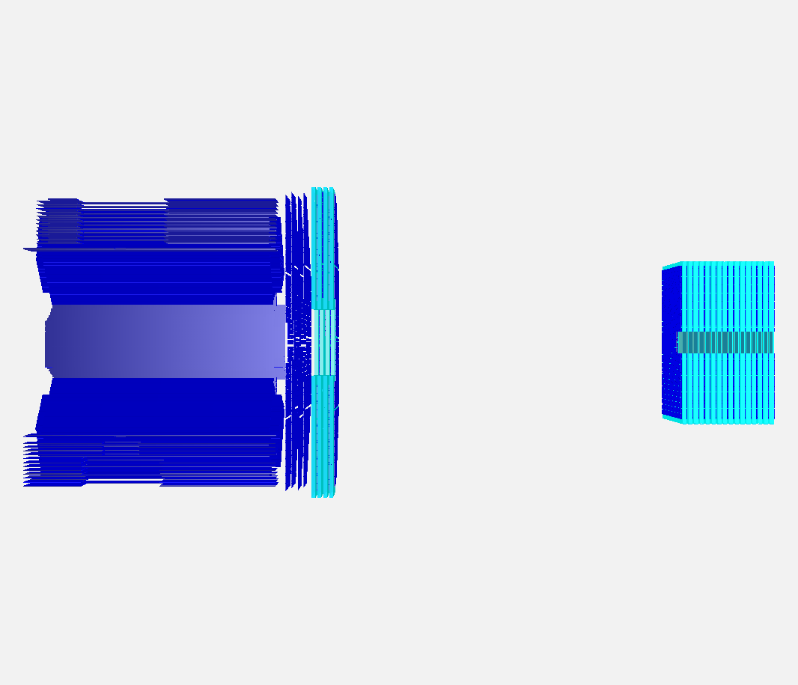
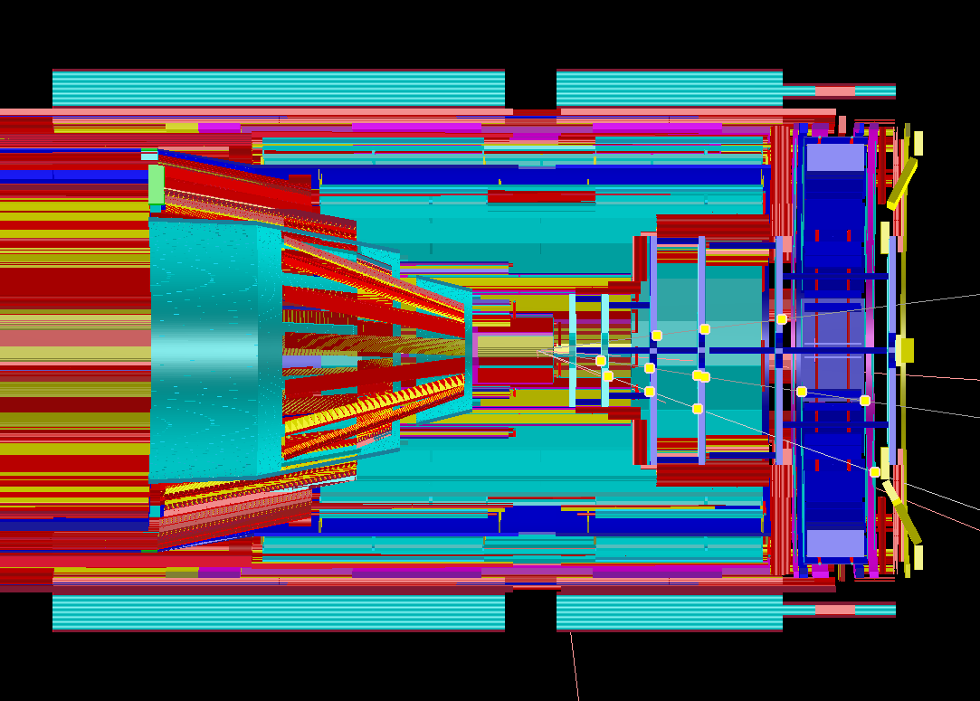
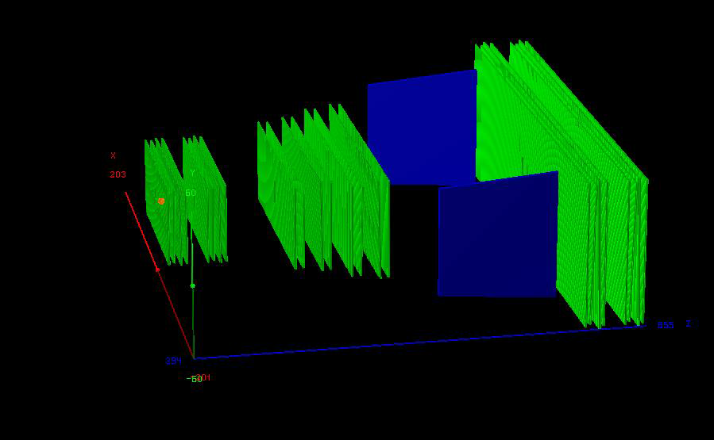
Geometry description

Slide 11
Geometry description
All detectors in simulation
Strongly varying level of detail, e.g.
  MVD: All materials including support structures, cooling, active and passive electronic
  EMC: only crystals

Slide 12
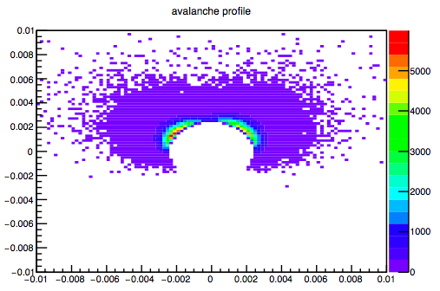
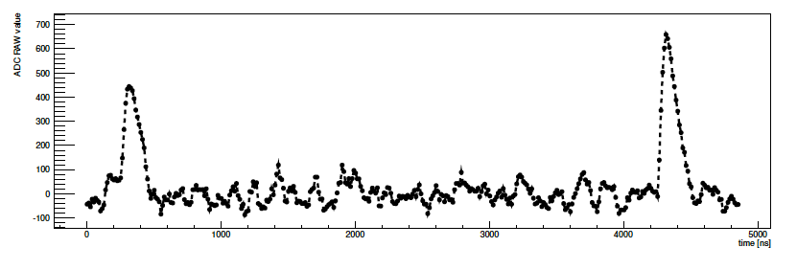
Digitization
Avalanche Simulation
in MDT
Translates ideal detector data into realistic data stream
  3D space points into channel number
  Deposited energy into ADC values
  Adding noise and inefficiencies
  Charge sharing between neighboring detector elements
  Dead times and electronics properties
Data should look like as coming from the final experiment
Simulated EMC waveform

Slide 13
Reconstruction - I
Local reconstruction for each sub-detector
  Translation from detector data into physical parameters (from channel number to space point, ADC to energy)
  Calibration
  Cluster formation
  Reconstruction algorithms
  Various different algorithms implemented for each sub-detectors
  Compared with test beam data
  PandaRoot used to reconstruct test beam data

Slide 14
Reconstruction - II
Global reconstruction
  Combining different sub-detectors
  Tracking
  PID
  Event building

Slide 15
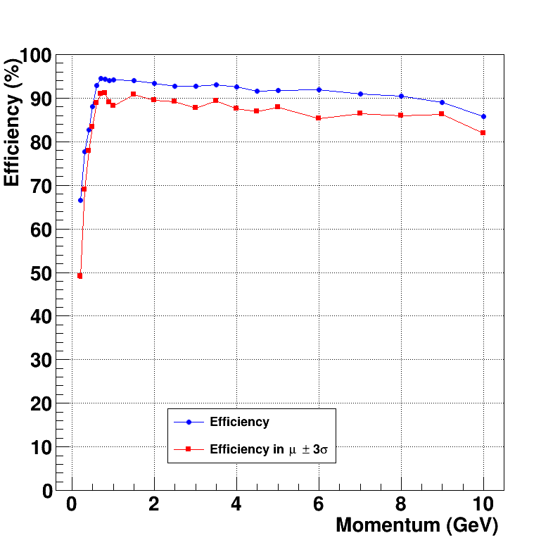
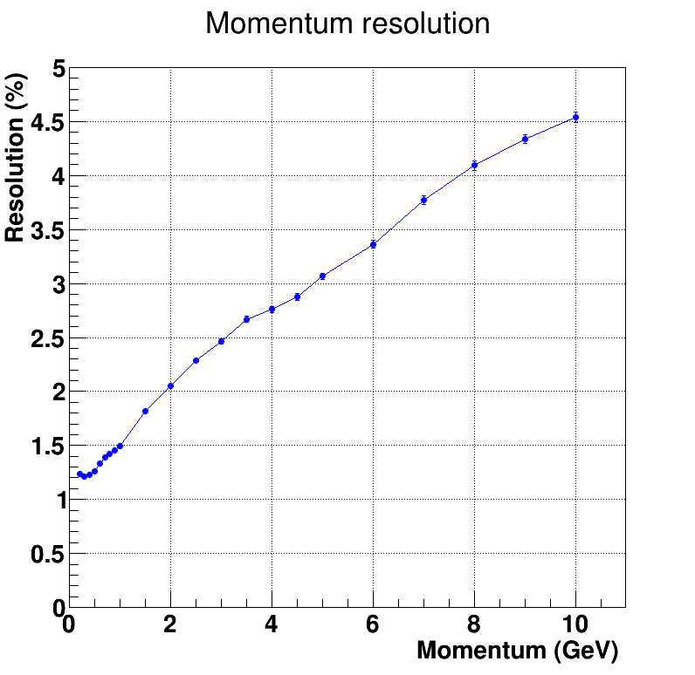
Tracking - offline
Track finding and fitting working in Central and Forward Spectrometer
Kalman filter used as second stage developed by TUM (GenFit 1 + 2)
Efficiency above 90 % (for beam above 3 GeV/c)
Momentum resolution between 1% and 5% depending on momentum
For p(pbar) < 3 GeV/c
B = 1T
p resolution doubles
low p efficiency increases

Slide 16
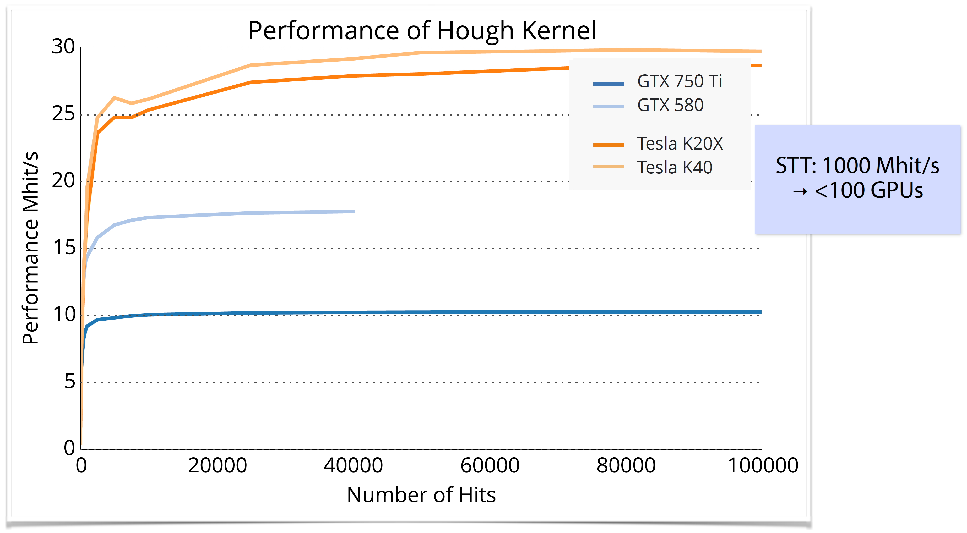
Tracking - online
Find and fit tracks with the production speed at Panda
(10 - 20 MHz in high luminosity mode)
Alternative hardware:
  FPGA:
    Helix tracking algorithm
  GPGPU:
    Cellular automaton
    Hough transformation
    Triplet finder
    Riemann transformation
    Direct switch in PandaRoot between CPU and GPU

Slide 17
Particle Identification
Many different detectors contribute to PID:
MVD: dE/dx
STT: dE/dx
EMC: E/p, shower shape
DIRC: Cherenkov angle
DISC: Cherenkov angle
SciTil: Time-of-Flight
MDT: # layers, # hits, track Chi2
FTOF: Time-of-Flight
FSC: E/p, shower shape
RICH: Cherenkov angle

Slide 18
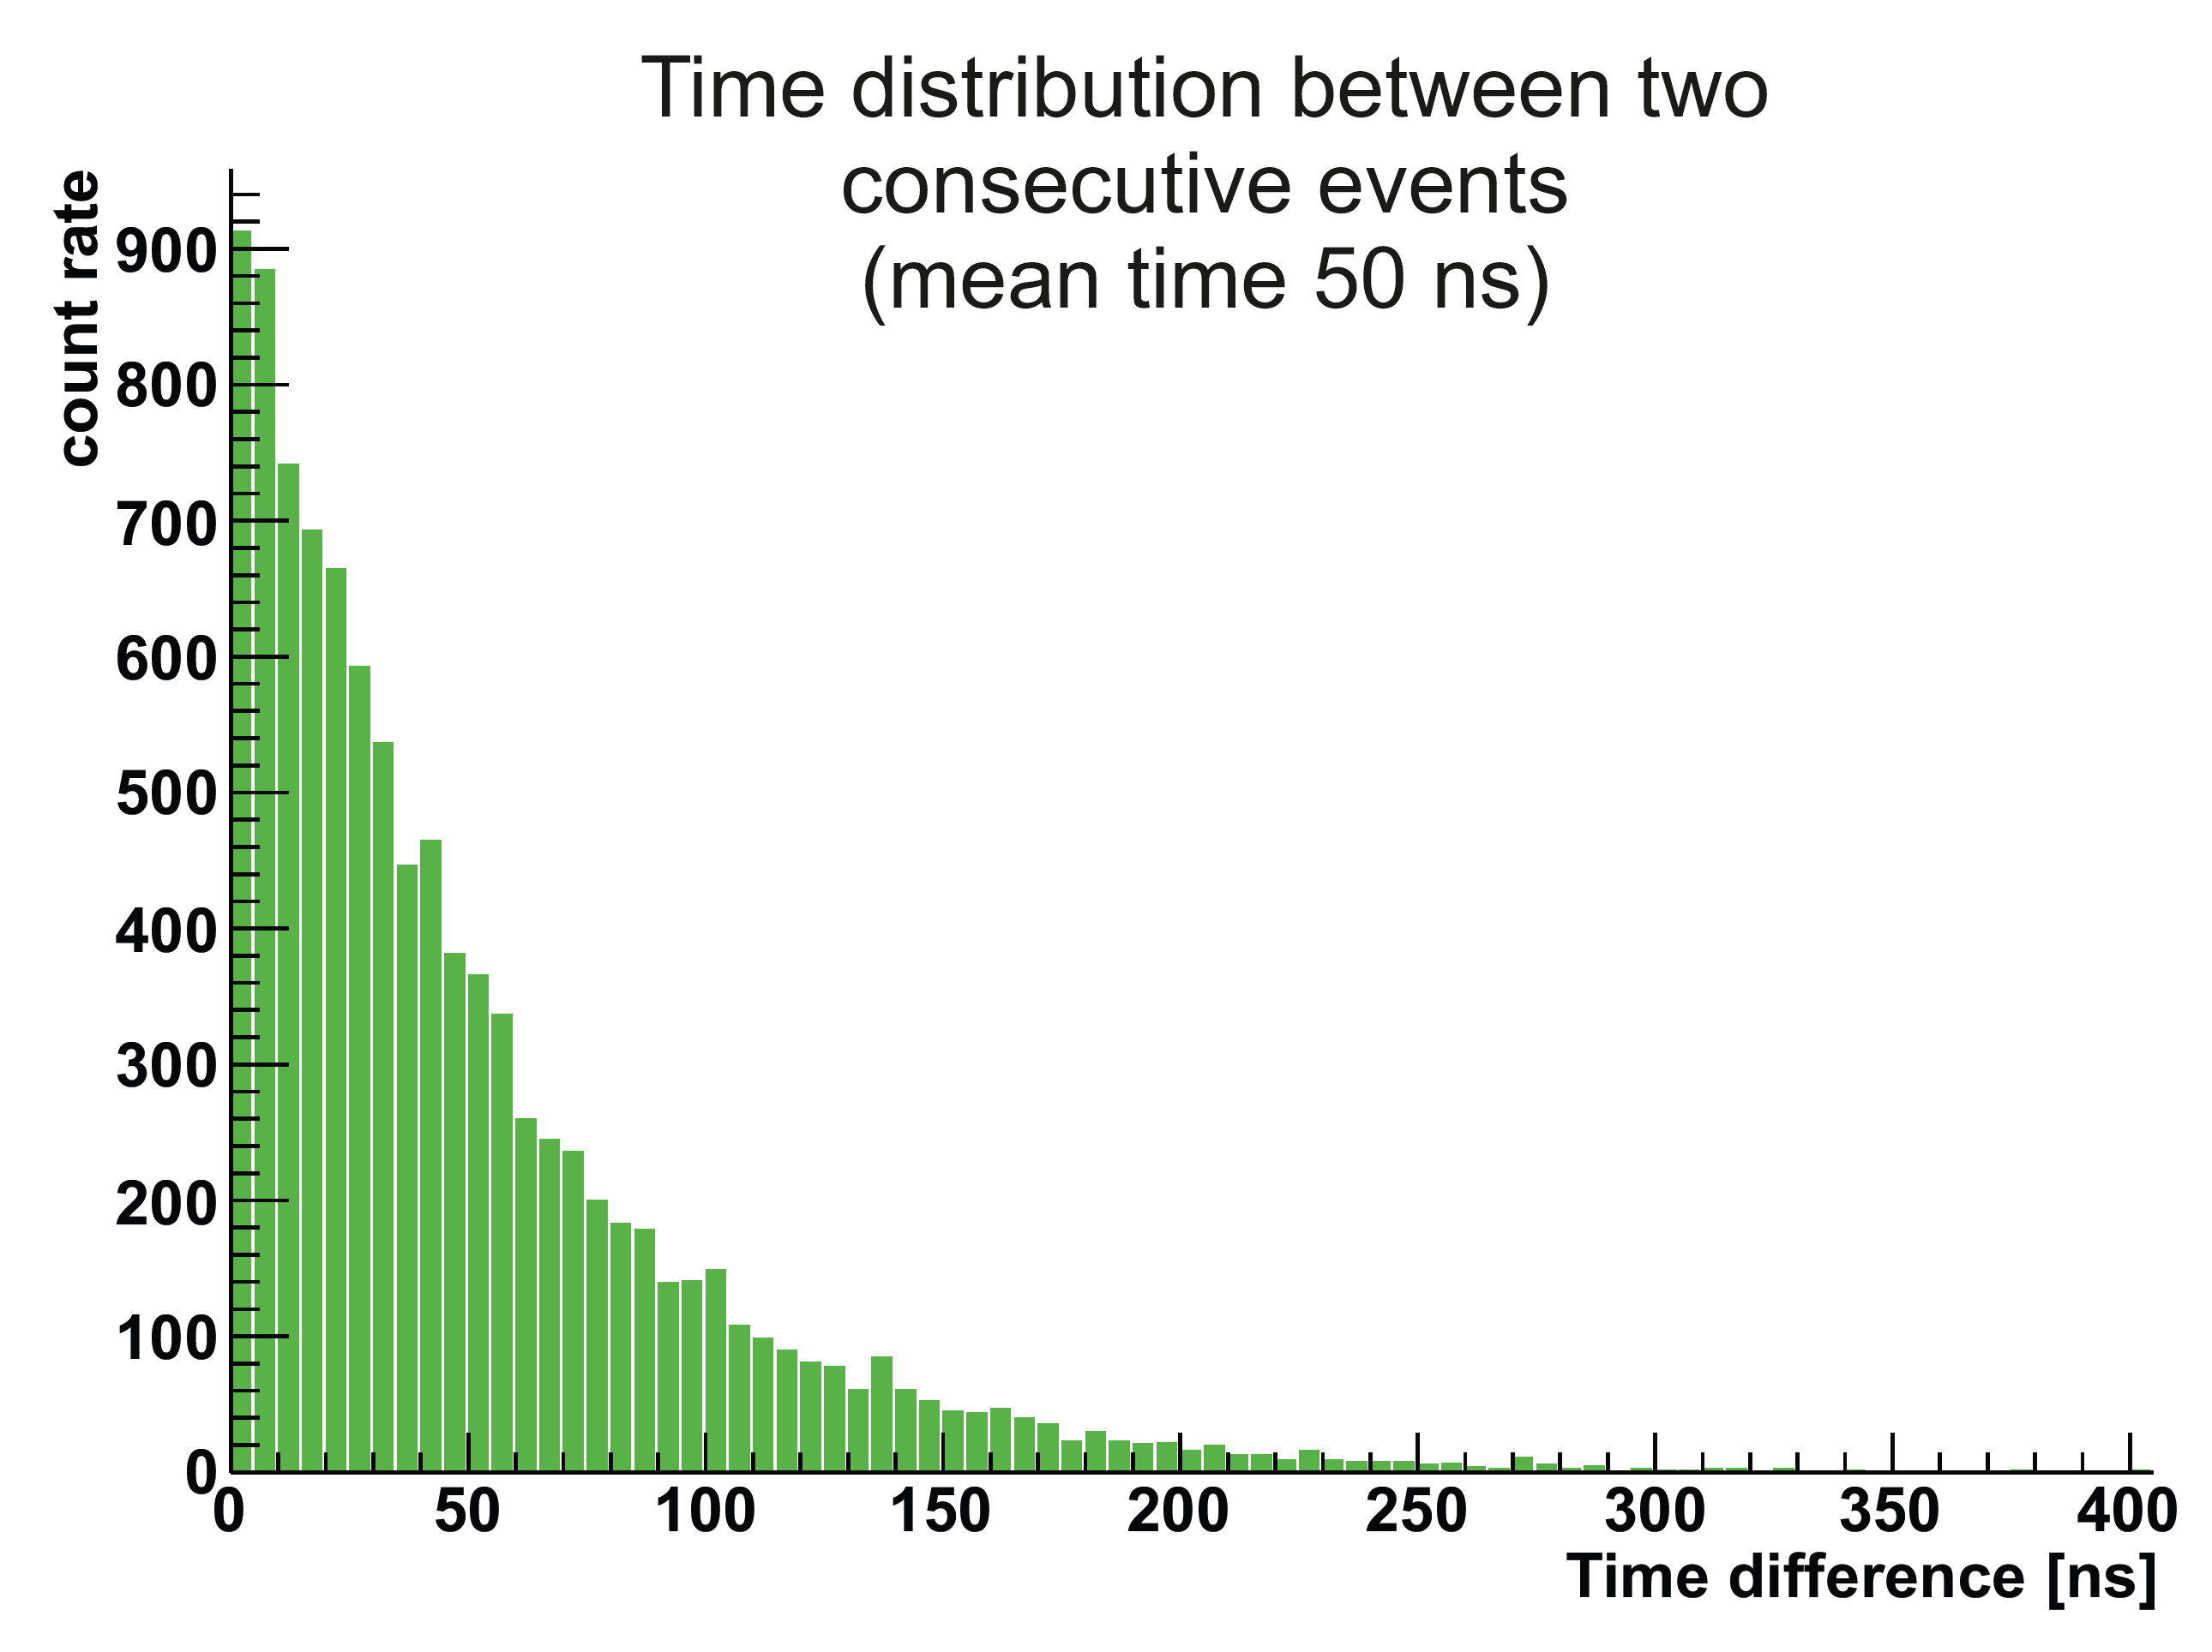
Time-based simulation
Signal and background-events very similar ➔ no hardware trigger possible
Quasi continuous beam with maximum interaction rate of 20 MHz ➔ Poisson distribution
Raw data rate of 200 GByte/s
Reduction of 1000 needed for permanent storage O(PByte/year) ➔ Online Event Filte

Slide 19
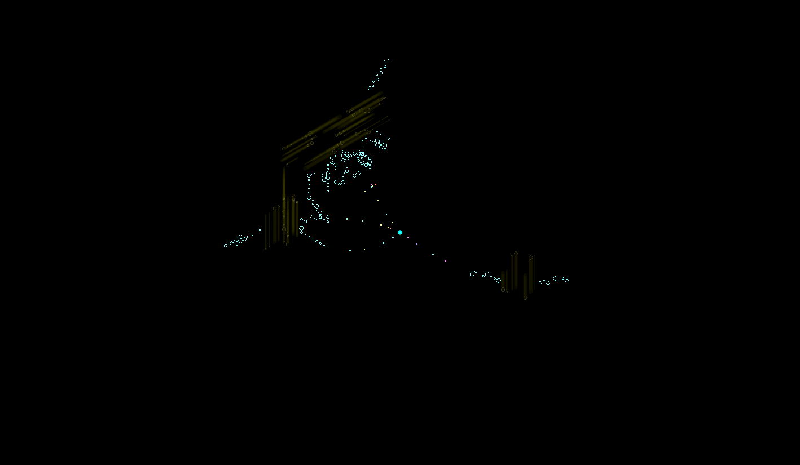
Time-Based Simulation
Single Event

Slide 20
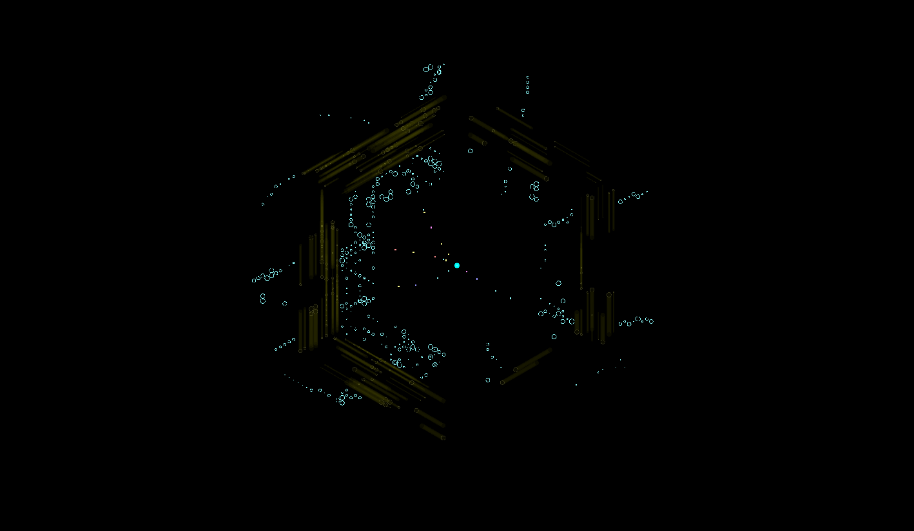
Time-Based Simulation
20 MHz overlap

Slide 21
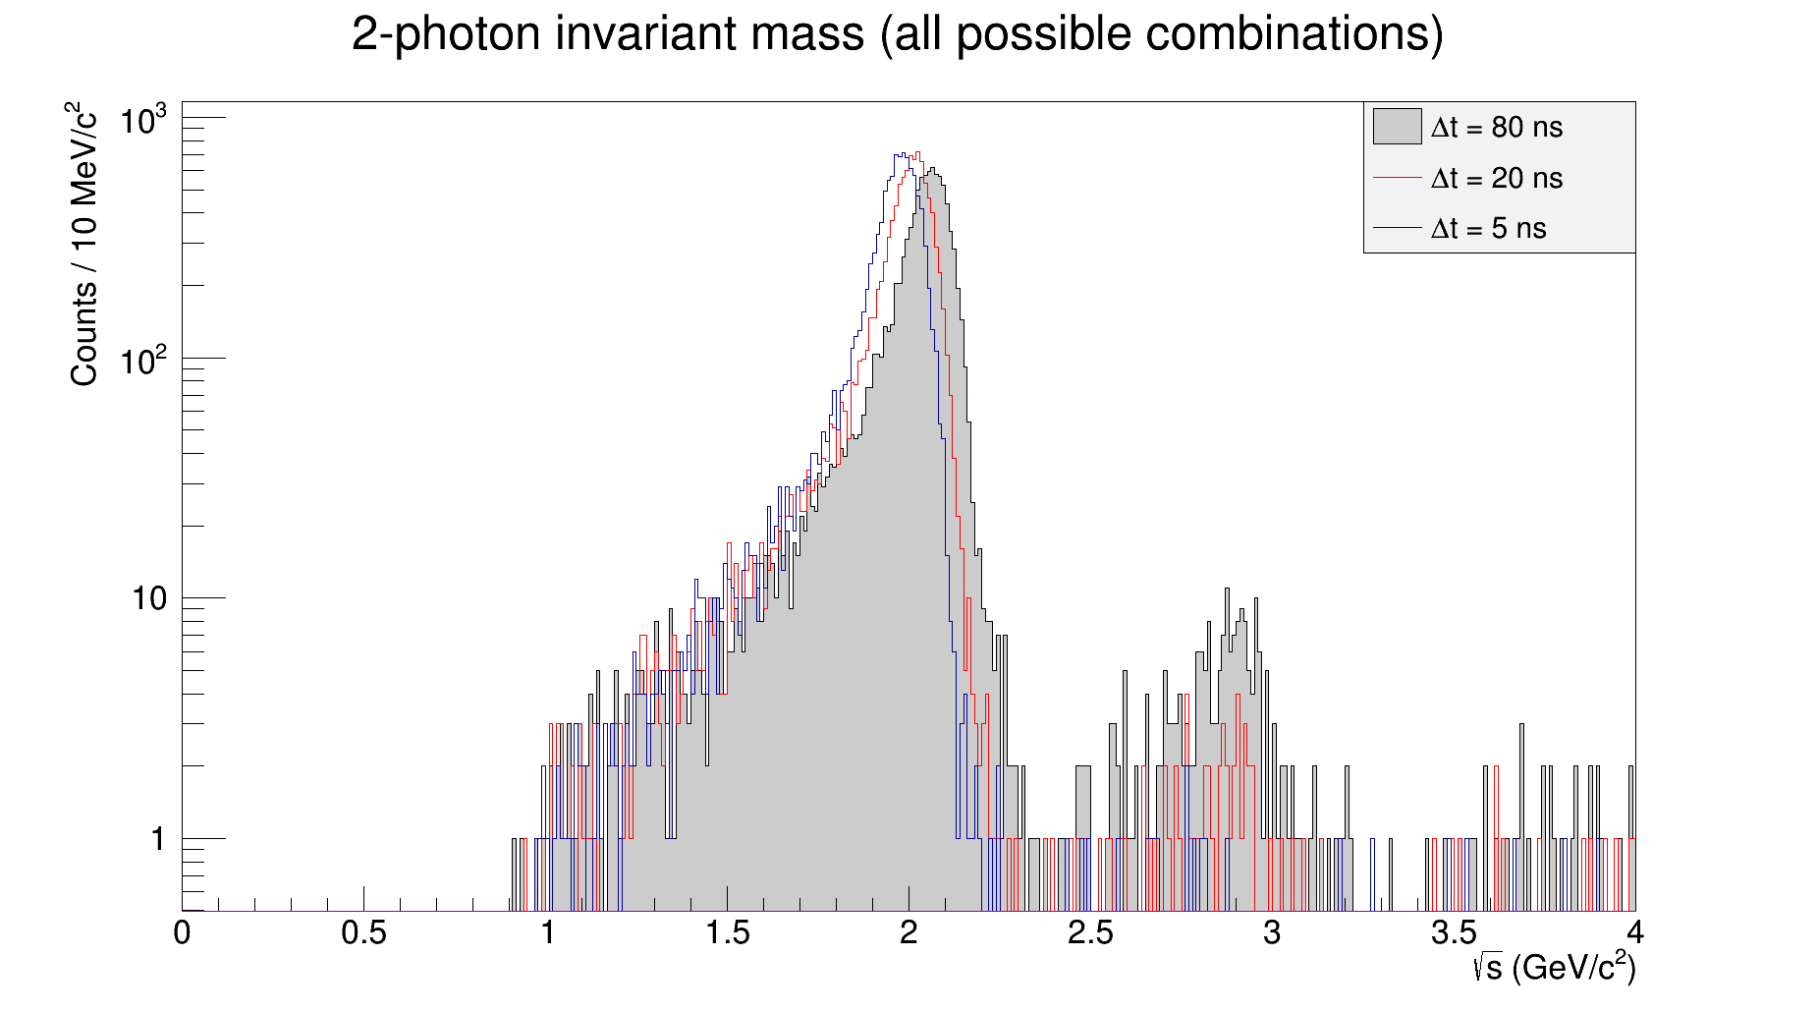
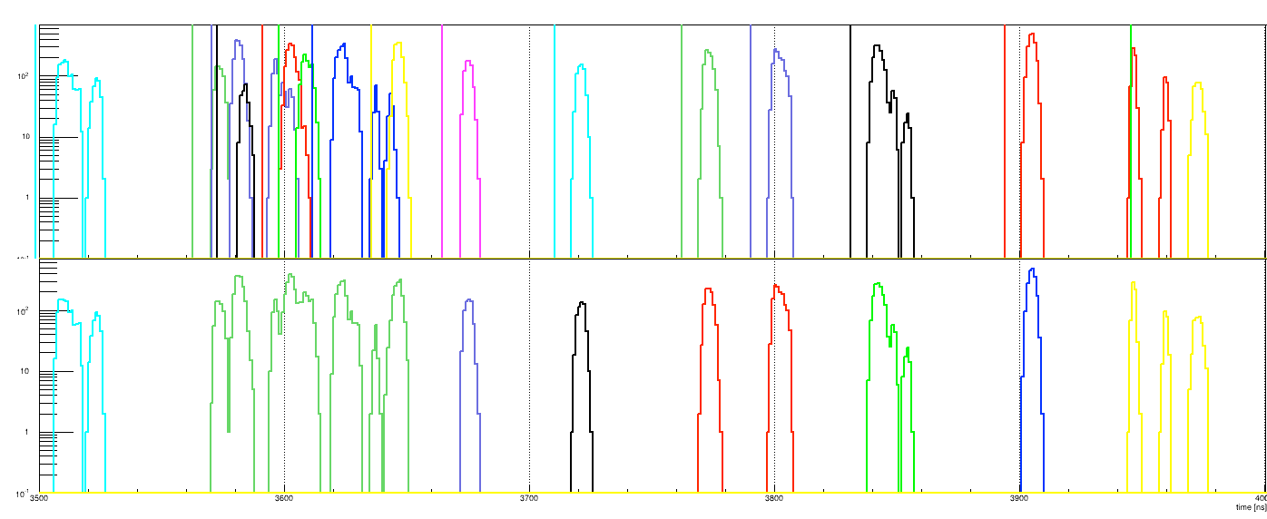
Time-Based Reconstruction
MVD
STT
Event 1
Event 2
Event 3
Activities on the central tracker MVD + STT + GEM + EMC
EMC

Slide 22
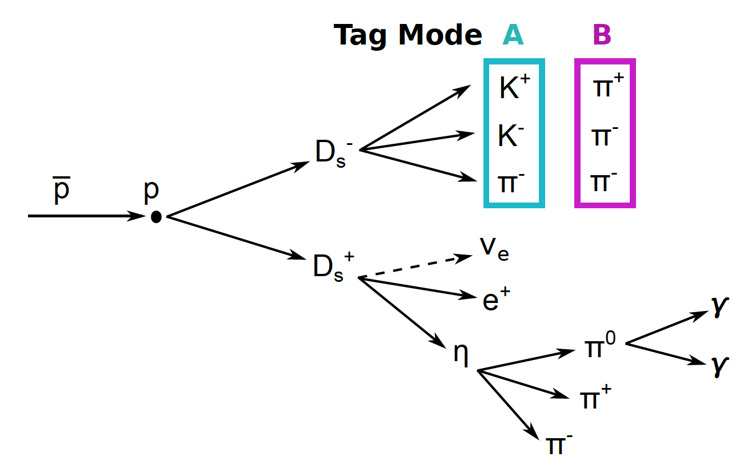
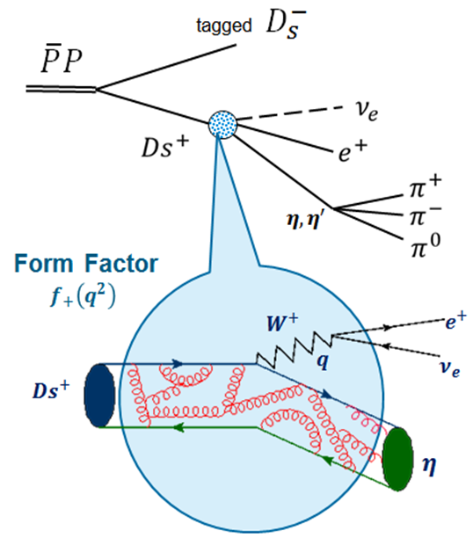
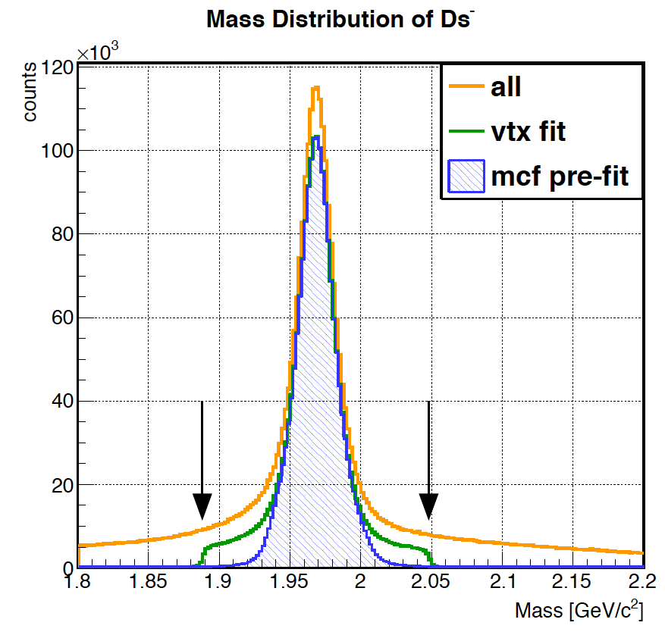
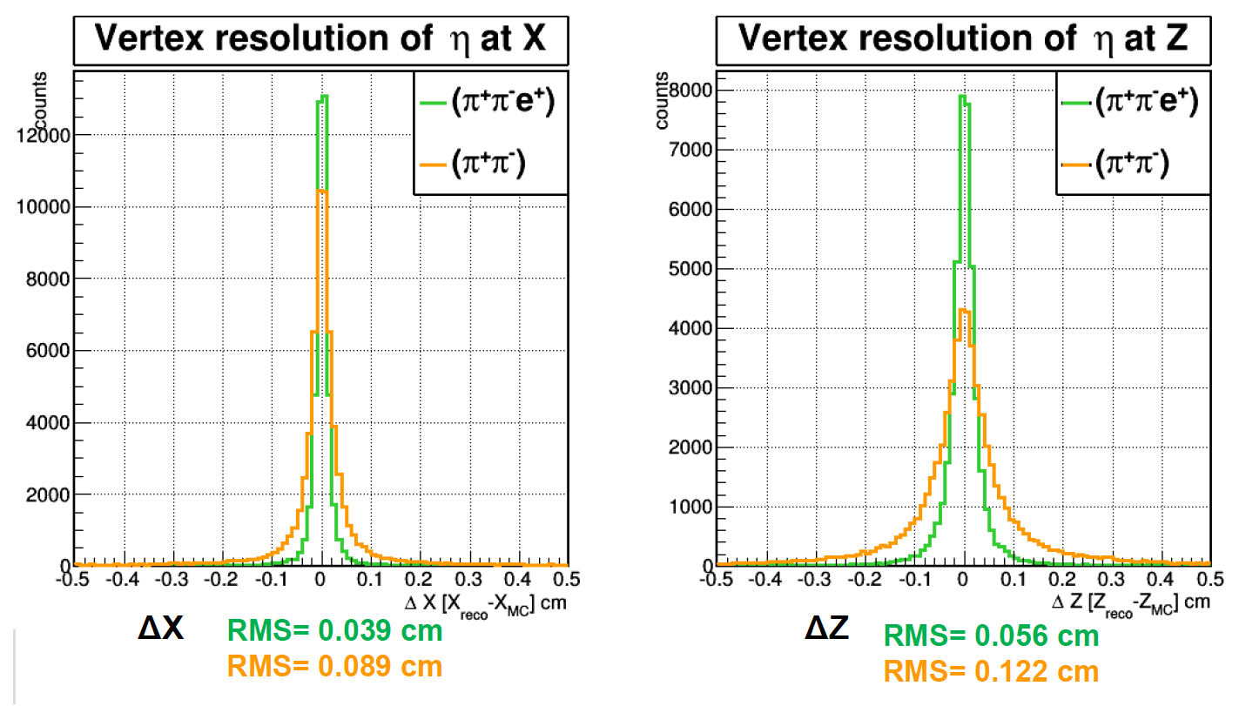
Analysis example
Rho package
  Combine hits
  Fit with constraints
  Apply cuts

Slide 23
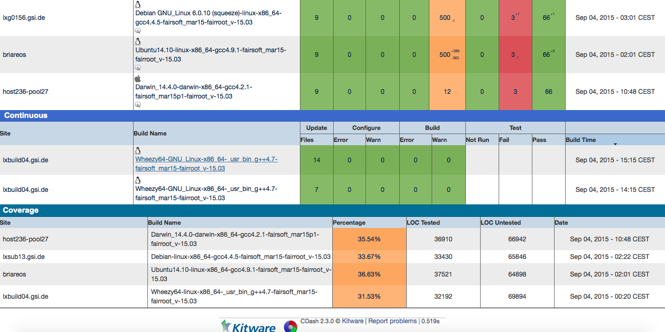
Code Coverage
Automatic code coverage checks each night in Dashboard

Slide 24
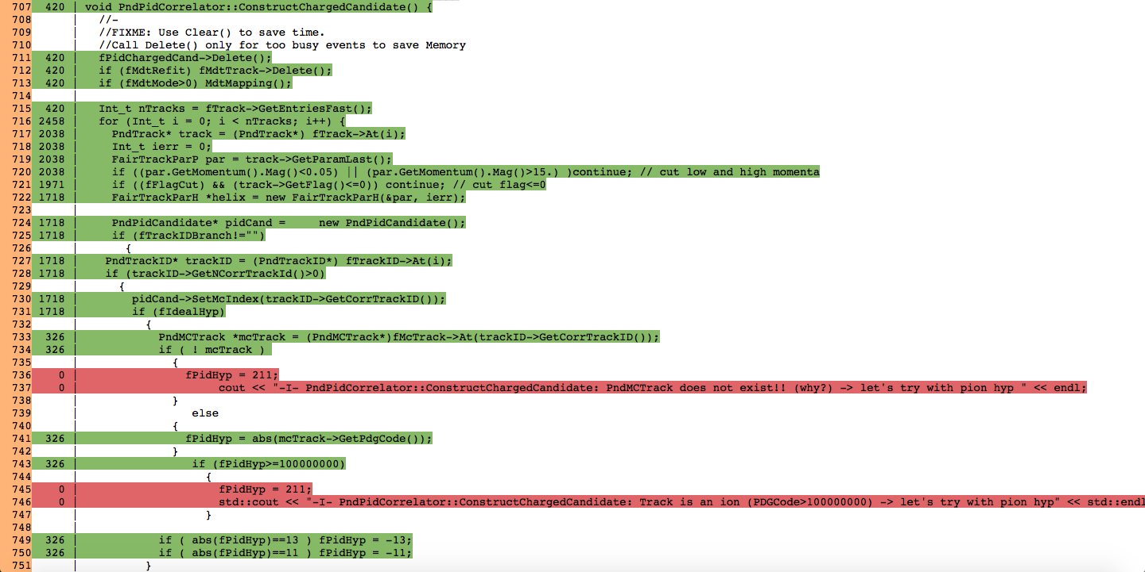
Code Coverage
Example: PndPidCorrelator.cxx
Red lines are not processed since the ideal option is not set

Slide 25
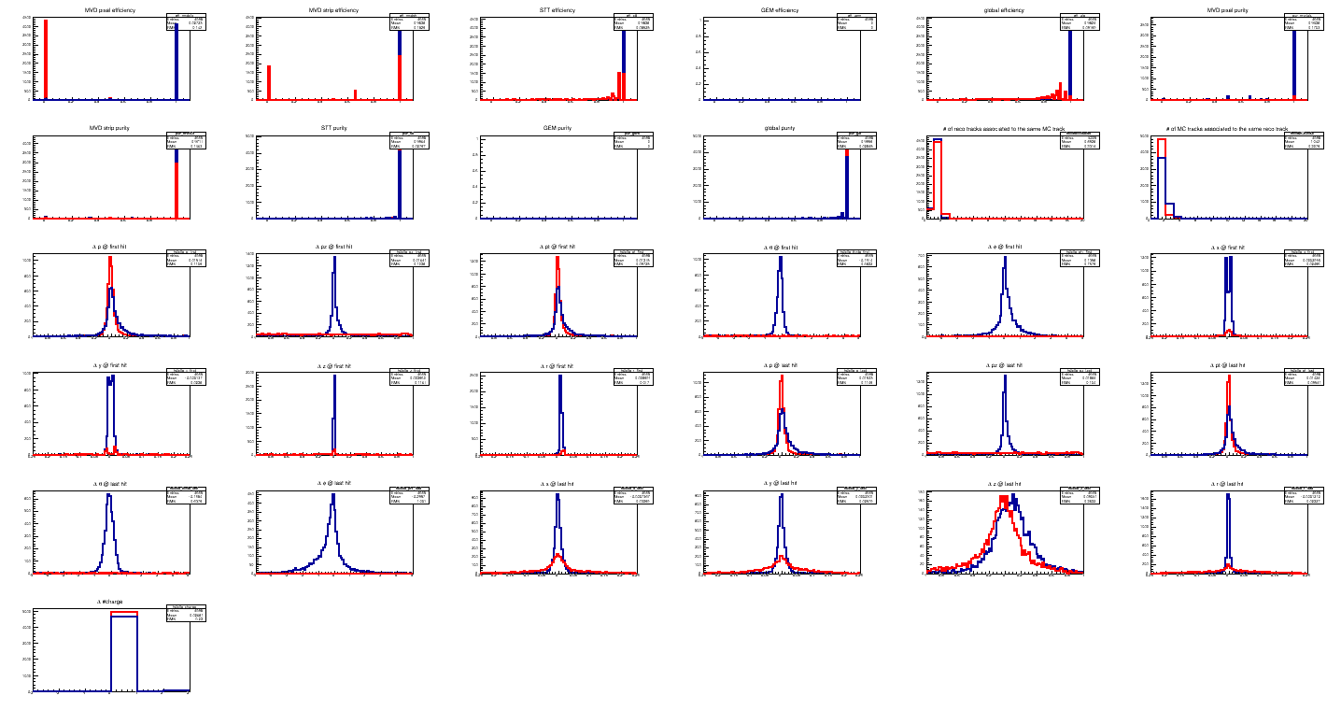
Quality Assurance
Check of different tracking parameters in standardized way
Comparison to old code, or between different tracking algorithms
Standard Tracking
CA Tracking (preliminary)
Lia + Tobias

Slide 26
General computing

Slide 27
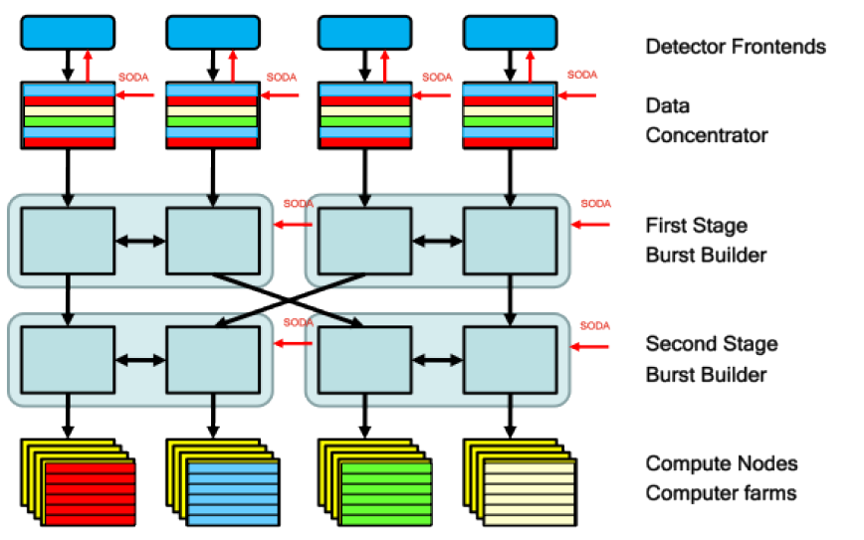
Online Data Taking
DETECTORS
Max Interaction rate
20MHz
80GB/s ‐ 300GB/s
1/1000 reduction factor
80MB/s ‐ 300MB/s
MASS STORAGE

Slide 28
Design of Distributed Computing
Tier 0
  Prompt reconstruction
  Permanent storage of ALL data
  Calibration
  Reprocessing
  Simulation ?
Tier 1
  Reprocessing
  Calibration ?
  Simulation
  Permanent storage of part of the data
  Analysis ?
Tier 2
  Analysis
  Taking data from close Tier 1
  Small simulation jobs

Slide 29
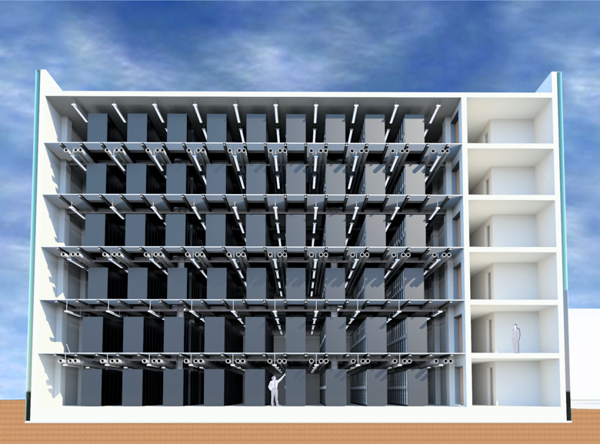
FAIR Tier-0: Green Cube
Reducing power consumption,
CO₂ emissions
6 floors (starting with 2)
128 racks each floor (8 rows with 16 racks)
Each rack can provide:
  Data: 0.6 PB
  Cores: 1800
Construction work started in fall 2014
Building finished summer 2015
Tests and migration
Starting normal operations end of 2015
Successfull prototype: “Prometheus” (mini-cube)

Slide 30
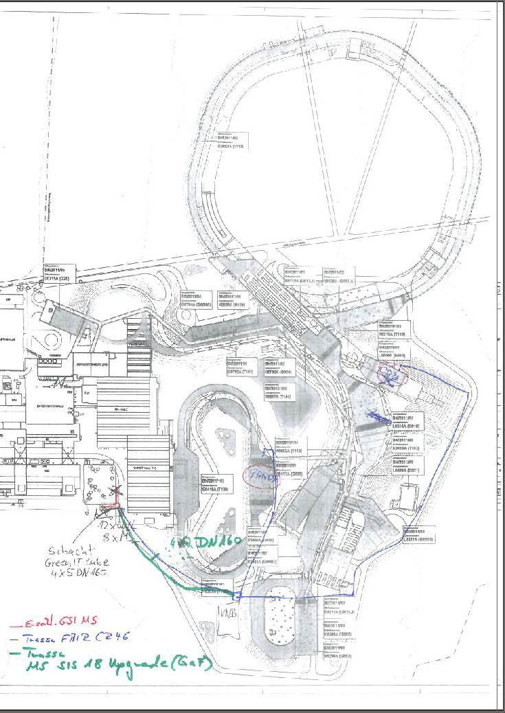
Connection to Green Cube
3500 optical fibers for CBM
500 optical fibers for PANDA
4 empty tubes
(10Gb/s fiber)
PANDA→ 2 X 310 GB/s
GreenCube
Panda
Maximum data rate from Panda data concentrators:
300 GB/s

Slide 31
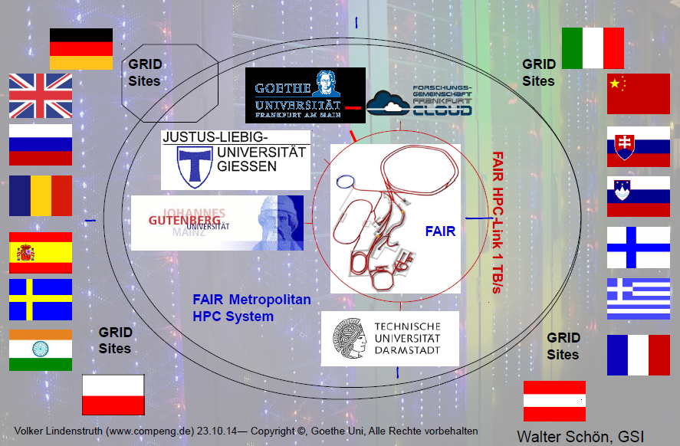
Central Computing
Central Production at Tier0 (GreenCube@FAIR)
Fast link (1TB/s) connection to the “Metropolitan HPC System”
Metropolitan HPC System:
Frankfurt SuperComputing
Mainz HIMster
Darmstadt
Additional Computing Power to Tier0 on-demand

Slide 32
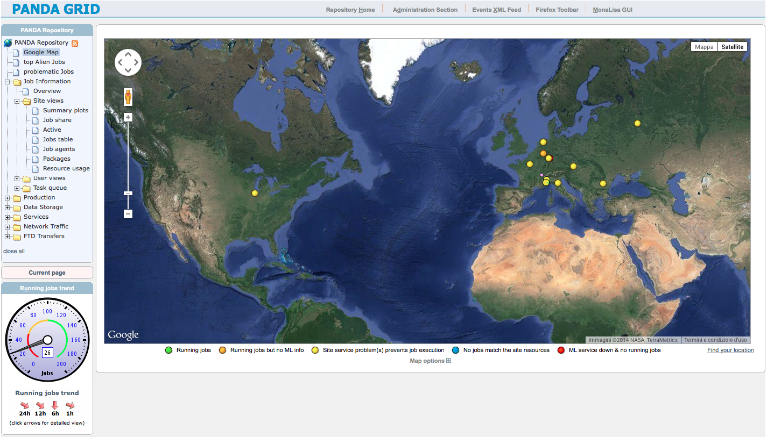
Data Production System
PandaGrid
Around 1200 cores
>100 TB disk space
Prometheus farm @ GSI (will be replaced by Chronos)
10k cores for all the GSI/FAIR experiments (max queue 2000)
100 TB disk space
New FAIR-Russia Research Center @ ITEP (Moscow)
10000 cores
1PB disk space
Large potential
Probable
Tier1 Center

Slide 33
First tests at ITEP

Slide 34
Summary
Root and FairRoot are the basis for PandaRoot
Transition to Message Queues allows very flexible online data taking system
Different event generators and particle propagators available to simulate the physics channels and background of interest for PANDA
All detectors implemented in PandaRoot with varying level of detail
Time based simulation implemented to simulate the difficult event building and –selecting process at Panda
New FAIR Russia Research Center offers large computing power for MC studies and maybe also as a Tier-1 center

Slide 36
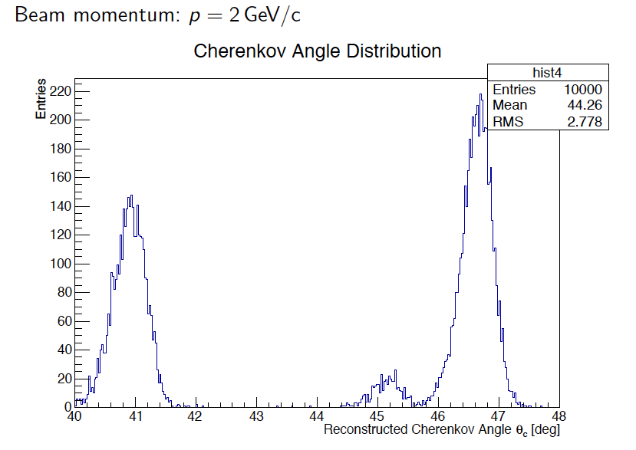
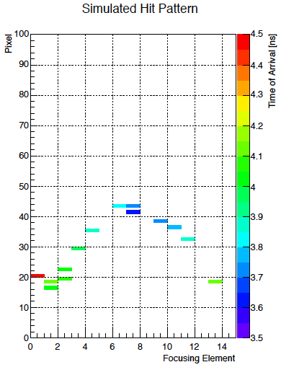
Endcap DIRC (DISC)
Reminder:
detailed code used for TDR
but not in the repository and with old PandaRoot
the author left the collaboration
Reconstruction and PID working with “old“ PandaRoot version
Algorithms tested with planed prototype
Next step: inserting code into trunk (December 2015?)
Mustafa Schmidt

Slide 37
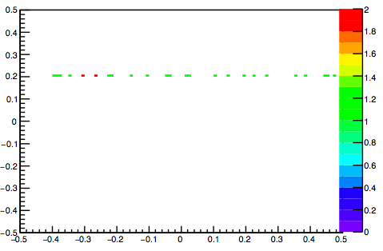
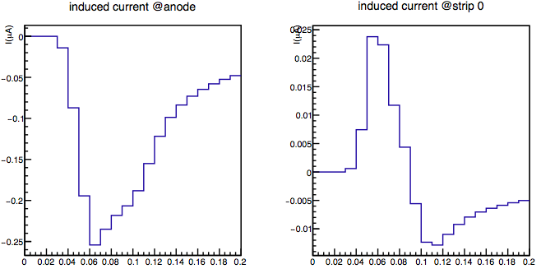
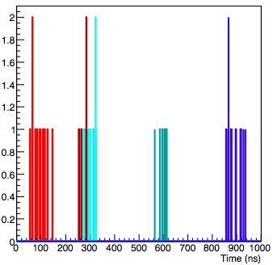
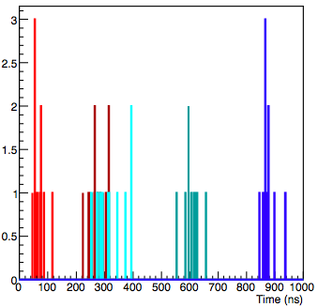
New MDT Digitization
New detailed geometry in the reconstruction
Realistic digitization with Garfield simulations
Time based simulations
Time based reconstruction ongoing
Not yet in the trunk (December 2015?)
Jifeng Hu

Slide 38
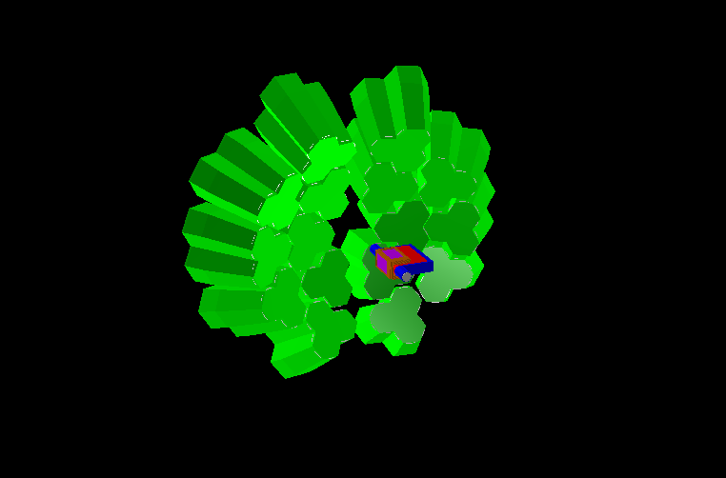
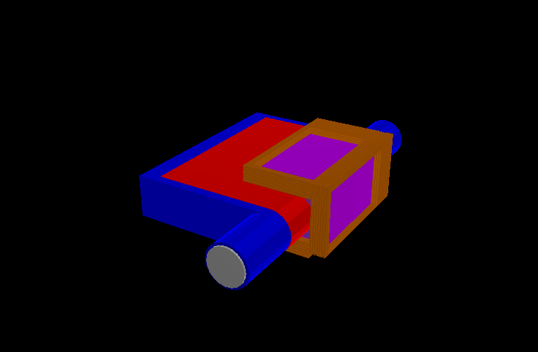
Hypernuclei Setup (HYP)
Geometry
    Germanium Detector + Target System
    No support structure, cabling, passives, etc…
    Optimization on the way
Digitization
    Ideal hit production
    Realistic digitization missing
    Time based simulation is absent
Reconstruction
Ideal pattern recognition + genfit and geane
Realistic pattern recognition missing
Time based reconstruction missing

Slide 39
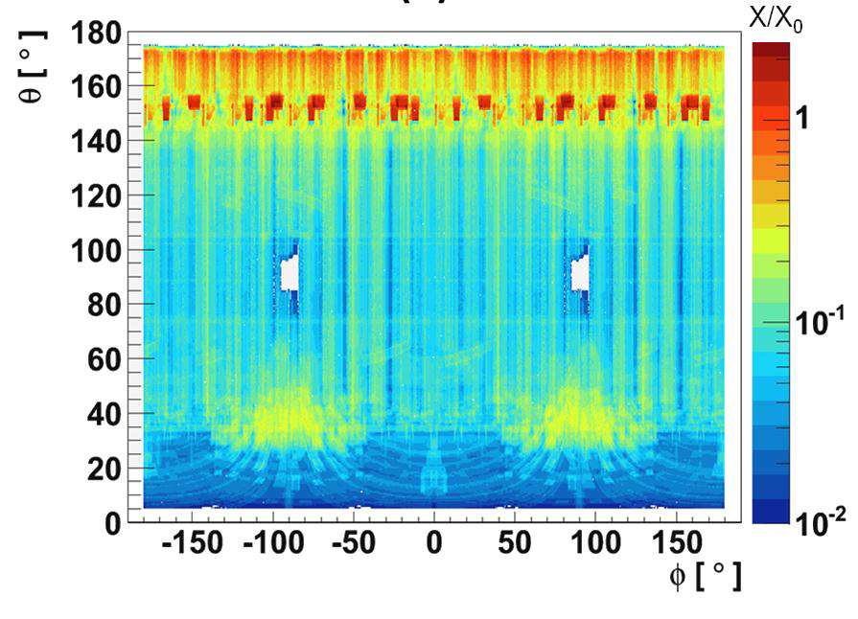
Micro Vertex Detector
Geometry
Most realistic geometry description including support, cooling, cables
Digitization
Digitization with realistic noise and threshold
parameters including noisy hit production
Time based simulation implemented
Reconstruction
Several cluster and reconstruction algorithms implemented and tested with test beam data
Time based reconstruction implemented
Test beam data analyzed with PandaRoot
dE/dx PID included in the analysis

Slide 40
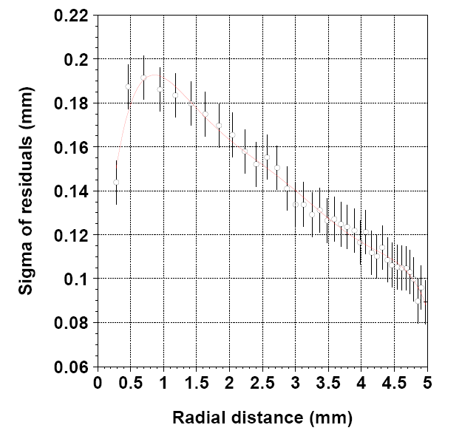
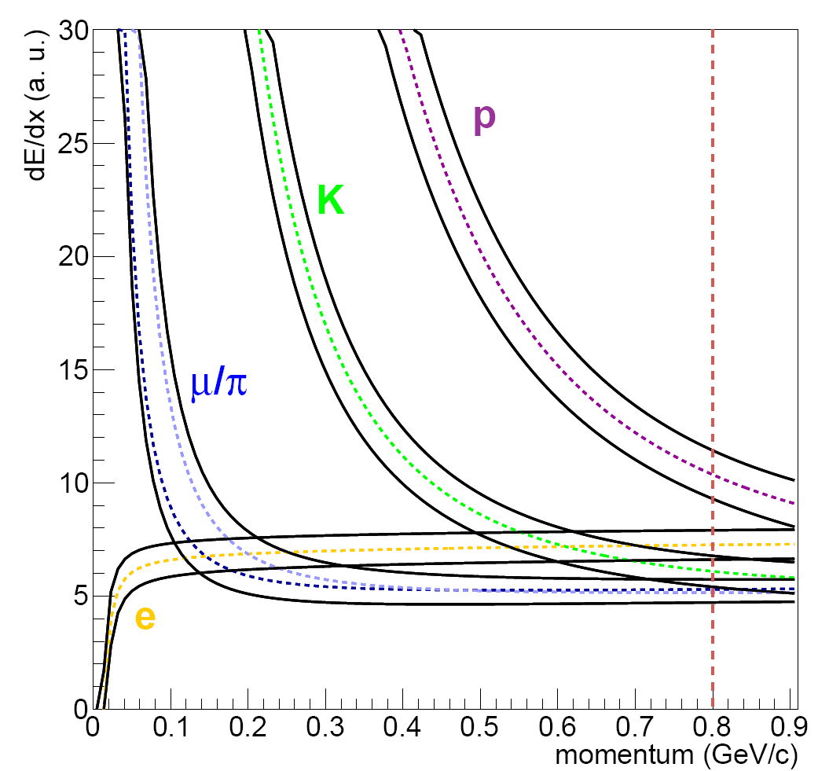
Straw Tube Tracker (STT)
Geometry
mylar + Ar/CO2(90/10%) + wire
inner & outer supports
Digitization
fast and full simulations
waiting for final electronics
Reconstruction
track reconstruction (finding & fitting)
dE/dx for PID
reconstruction with/without t0

Slide 41
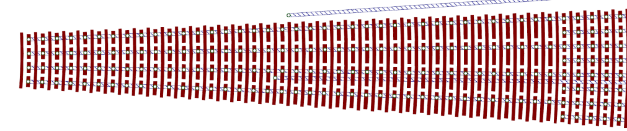
Gas Electron Multiplied (GEM)
Geometry
3 GEM disks
  Sensor#1 (fType=3: radial & circular)
  Sensor#2 (fType=2: cartesian ver & hori.)
Digitization
Realistic digitization algorithm
  Hit efficiency > 85% (up to 14 GeV/c)
Time based simulation
Reconstruction
Event based standalone GEM reconstruction
Time based standalone GEM reconstruction
padplane design
GEM Disc | Disc#1 | Disc#2 | Disc#3
In_R [mm] | 45 | 45 | 45
r-strips at In_R | 707 | 707 | 707
Out_R [mm] | 379 | 464 | 644
Out_R/In_R | 8.42 | 10.31 | 14.31
Ch factor | 8 | 8 | 8
r-strips at Out_R | 5656 | 5656 | 5656

Slide 42
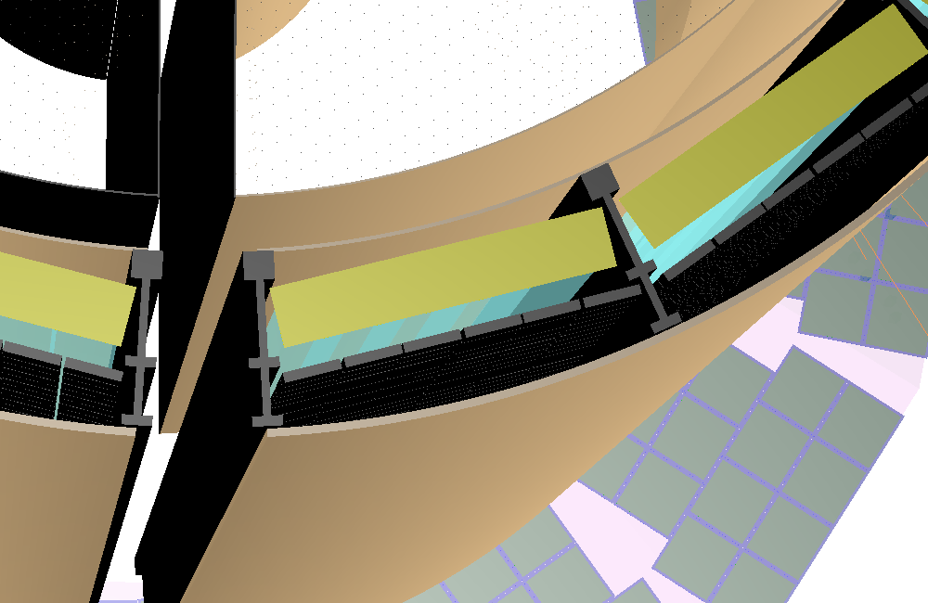
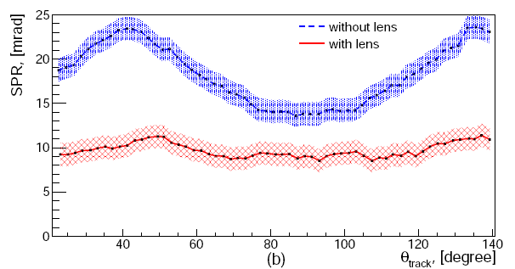
Barrel DIRC (DIRC)
Geometry
  up-to-dated
  includes support structure
Digitization
  Fast digitization (Cherenkov angle smearing)
  Charge sharing, dark counts, collective efficiency, quantum efficiency
  Single photon time resolution
  Time based simulation
Reconstruction
  Bayesian algorithm (digitization)
  Correlation with charged tracks (fast digi)
  Look-up-Table (LUT) method

Slide 43
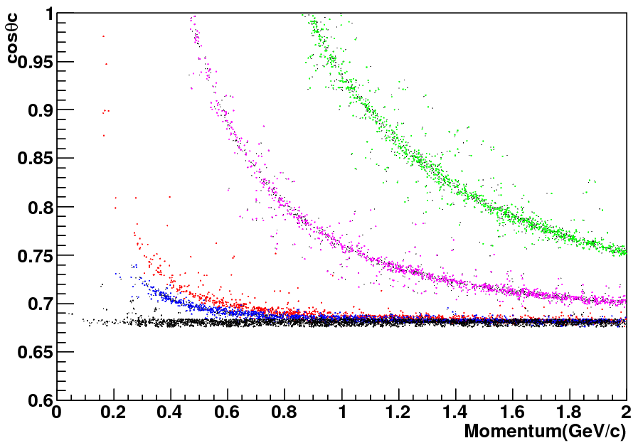
Endcap DIRC (DISC)
Geometry
4 radiator discs with irregular hexagonal shape (108 focusing elements and readout modules per disc with MCP-PMTs)
Focusing optics with cylindrical mirror
Digitization
Fast digitization (in PR)
Realistic digitization algorithm (not in PR)
Time based simulation (not in PR)
Reconstruction
Dummy hit correlated to tracks
and bayes PID (in PR)
Time based reconstruction and
pattern recognition implemented (not in PR)
DISC DIRC
P>20%
k
p
π
μ
e

Slide 44
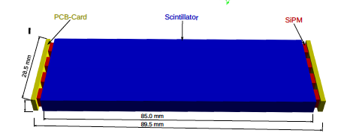

Scintillation Tiles (SciTil)
Geometry
A simple. detector geometry based on the Scintillator Tile Hodoscope detector proposal
  Scintillator tiles, SiPMs, readout cards
  Material: Polypropylene up-to-dated
Digitization
Position corresponding to tile center
Time is smeared by ~ 100ps
Realistic time based simulation
Reconstruction
Hit correlation with
charged tracks
SciTil info used by
the central tracking
Missing PID algorithms

Slide 45

Electromagnetic Calorimeter (EMC)
Geometry
All crystalls implemented
Some passive materials
Digitization
Realistic digitization implemented
Time based simulation implemented
Implementation of realistic electronics
Reconstruction
Clustering, bump splitting, energy corrections, etc…
Correlation to charged tracks

Slide 46
Muon Detector Tracker (MDT)
Geometry
Detailed geometry implemented (tubes, strips)
Digitization
Realistic digitization with Garfield simulation
Time-based simulation
Reconstruction
Pattern recognition with detailed geometry
Correlation to charged tracks
Hard Cuts muon identification
Not in SVN yet

Slide 47

Forward Tracking System (FTS)
Geometry
implemented and working
3 stations: 2 before the dipole magnet, 2 inside the dipole magnet and 2 after
4 double layers for each station
For each double layer 2 planes
5°skew angle (2°& 3°double layer) – can be modified
Square beam pipe hole
Digitization
a-la-STT
Reconstruction
Ideal track finder working
Realistic track finder

Slide 48

Forward ToF (FTOF)
Geometry
FTOF geometry and materials implemented
DTOF geometry implemented
Digitization
Simple algorithm: a charged particle with energy deposition in a plastic scintillator ΔE>0 is assumed detected
Tof with gaus smearing 80ps
Reconstruction
FTOF correlated to forward tracks
DTOF
DTOF
SciTil
FTOF

Slide 49

Forward Shashlik Calorimeter (FSC)
Geometry
    Complete structure of modules with fibers and wrapping
Digitization
    Full chain is implemented
Reconstruction
Clusterization and bump splitting working
Correlation to forward tracks implemented
PID algorithms missing

Slide 50


Forward RICH
Geometry
    RICH position
    Aerogel and Mirror geometry
    Material properties for Cherenkov photons
Digitization
    Pixelation
    QE, noise, deadtime
    Time resolution
Reconstruction
Hit preselection
Fit θ(φ) dependence
PID algorithms missing
Not in SVN yet
θ_{C}, rad
θ_{C} = acos(1/n)
φ_{C}, rad

Slide 51
Luminosity Detector (LMD)
Geometry
    Detailed description including glue, cables, support structure
Digitization
    Charge distribution & pixel mapping
    Identical base classes for LMD and MVD
Reconstruction
Many different algorithms for tracking tested
Alignment procedures

