Slide 1
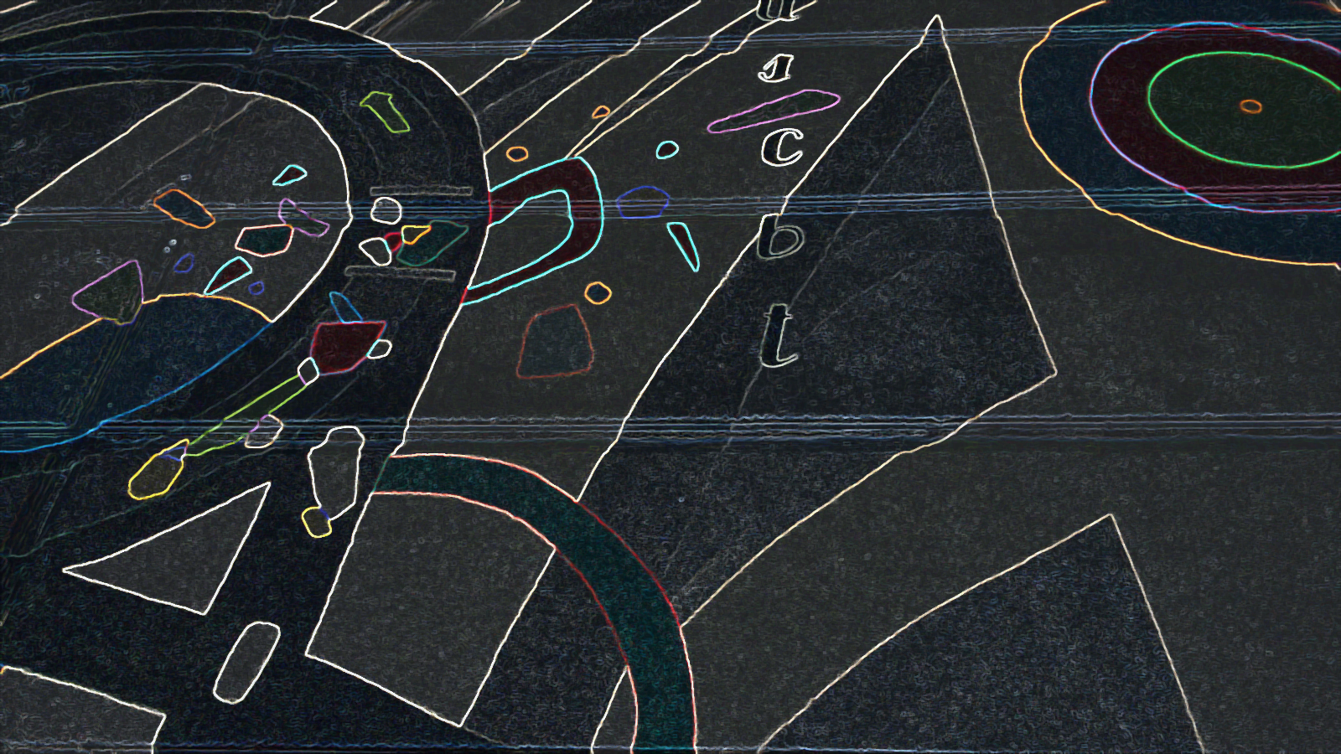
Instrumentation for Colliding Beam Physics, Novosibirsk, 2020
ATLAS Forward Proton Time-of-Flight Detector LHC Run2 performance and experiences
Tomáš Sýkora
Institute of Particle and Nuclear Physics
Faculty of Mathematics and Physics
Charles University
on behalf of the ATLAS collaboration

Slide 2
abstract
The performance of the ATLAS Forward Proton Time-of-Flight (ToF) Cherenkov detector is shown using the ATLAS collaboration data collected in the 2017 running period of the LHC Run2. The detailed analysis of the results, including detector efficiency and time resolution of the ToF is performed. The detector construction and its expected performance based on beam tests results are briefly summarized at the beginning of the first part of the talk. Operational experiences, problems caused due to attempts to operate Micro-Channel Plate PhotoMulTipliers (MCP-PMTs) in the vacuum and leading to the change of the detector construction, the request for R2D2 like construction of a new, future, MCP-PMT due to the observed gain drop for high rates and its non-recoverability are described. Also, other tested hardware changes are presented – the effect of the replacement of non-monolithic by monolithic crystal bars, the change of the MCP-PMT back-end electronics based on simulation to reduce signal cross talk resulting in further detector time resolution improvement. The second part of the talk is devoted to the achieved time resolutions, 20 ± 4 ps and 26 ± 5 ps, of two installed ToF detectors. Despite of their very low efficiencies (below 10%) in major parts of the analyzed data, this represents a superb time resolution for detectors operating a few millimeters from the LHC beams and making them, from the time resolution point of view, the best ToF detector among those operated by the different LHC experiments in the forward regions during the LHC Run2. At the end the possibility of reconstruction of z-coordinate of the ATLAS interaction region using the ToF detectors is shown.

Slide 3
outline
ATLAS-AFP Collaboration: Technical Design Report for the ATLAS Forward Proton Detector, CERN-LHCC-2015-009; ATLAS-TDR-024-2015
LANGE, J. et al., Beam tests of an integrated prototype of the ATLAS Forward Proton detector, JINST 11 (2016), no. 09, P09005
NOZKA, L. et al., Design of Cherenkov bars for the optical part of the time-of-flight detector in Geant4, Optics Express, 2014, vol 22(23), pp 28984-28996
NOZKA, L. et al. Construction of the optical part of a time-of-light detector prototype for the AFP detector, Optics Express, 2016, vol 24(24), pp 27951- 27960
CHYTKA, L. et al., Timing resolution studies ofthe optical part of the AFP Time-of-flight detector, Opt. Express. 2018, vol. 26, no. 7, pp. 8028–8039
CHYTKA, L. et al., Time resolution of the SiPM-NUV3S, NIM A, Volume 935, 11 August 2019
ČERNÝ, K., The ATLAS Forward Proton Time-of-Flight Detector System, International Workshop on Vertex Detectors 2019, Croatia
MELIKYAN, Y. at al., Load capacity and recovery behaviour of ALD-coated MCP-PMTs, NIM A, Volume 949, 1 January 2020, 162854
KOMÁREK, T. at al., Timing resolution and rate capability of Photonis miniPlanacon XPM85212/A1-S MCP-PMT, submitted to NIM A
AFP – physics and ToF subdetector
AFP ToF design in 2017
AFP ToF – expected performance
AFP ToF – operational experience in 2017
MCP-PMT in vacuum
crosstalk
high rates
AFP ToF – new design
Out-of-Vacuum solution
LQBars
trigger module (x)
pulser (x)
AFP ToF – results
timing
z-vertex reconstruction

Slide 4
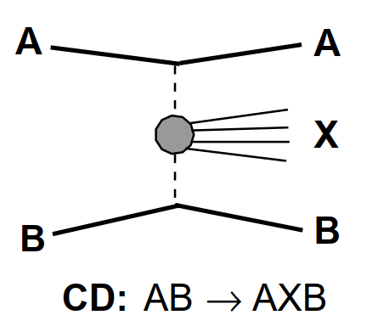
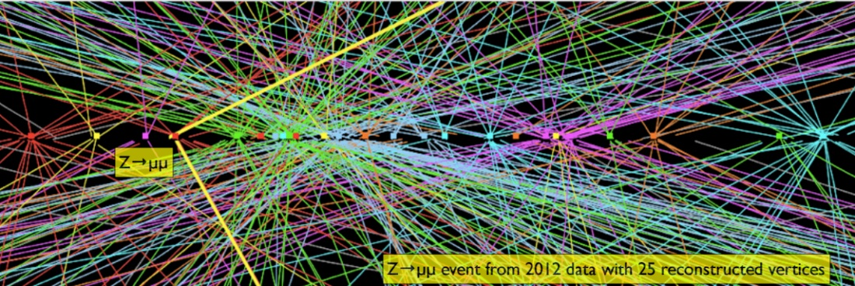
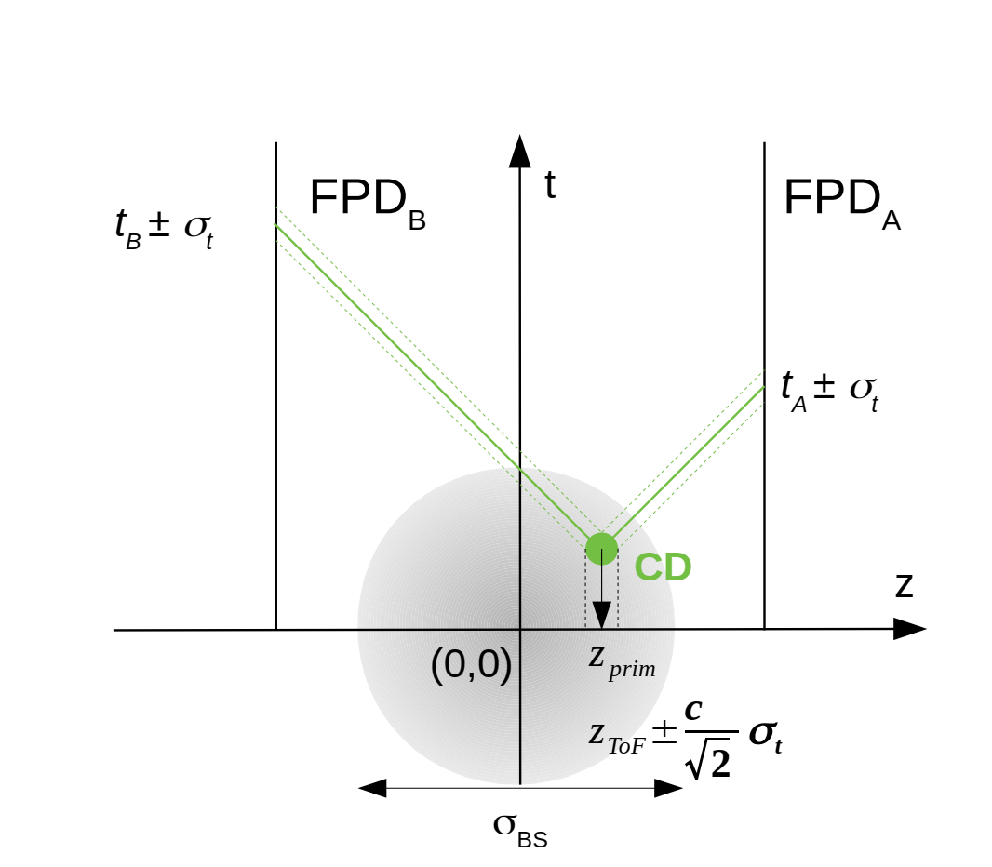
AFP – physics and ToF subdetector
ATLAS
AFP 217
AFP 205
beamline
AFP 205
AFP 217
beamline
p
p
ToF main goal – pileup suppression; possibility for a dedicated trigger
a combination of AFP ToF information with e.g. HGTD…

Slide 5
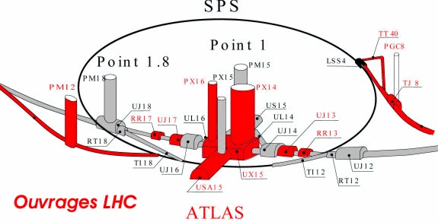
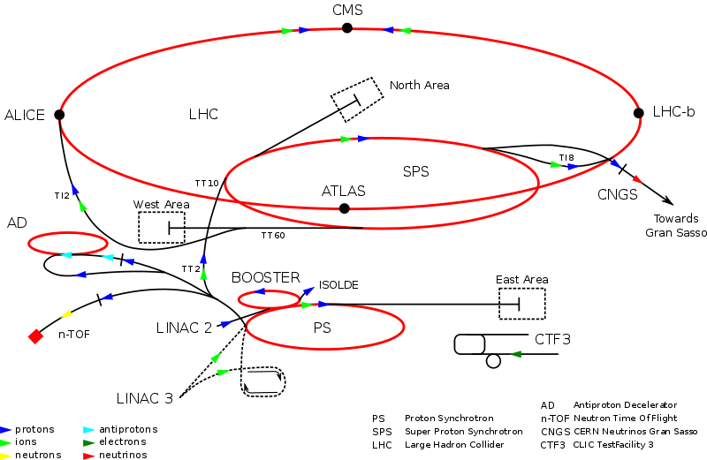
AFP – location
ATLAS
AFP stations
left-right (IP)
one side
AFP near
Patch Panel 211 m
AFP far
XRP-NEAR
205 m
XRP-FAR 217 m
205m
217m

Slide 6
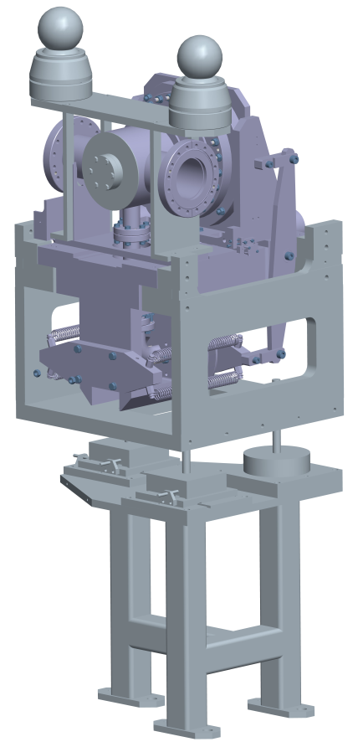
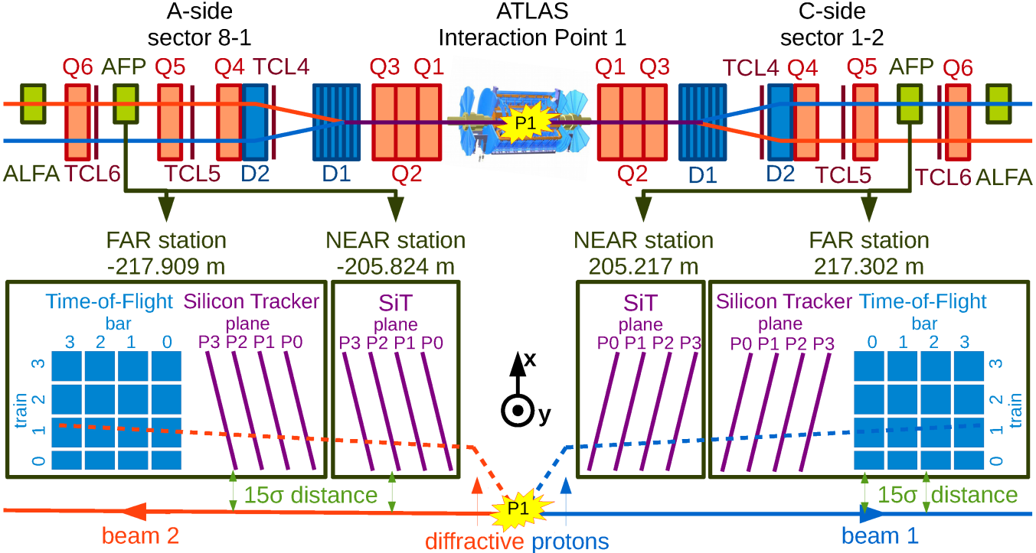
AFP – design
p
SiT Trig/IO HitOR-LTB
2/4 Planes
SiT Trig/IO HitOR-LTB
2/4 Planes
PMT
CFD
HPTDC
FPGA ToF Trigger
2/4 bars/train
Opto-Board
RF Switch
RG59 coax
fiber
280 m
AirCore coax
320 m
AFP station with passing proton p
RCE-HSIO
CTP

Slide 7
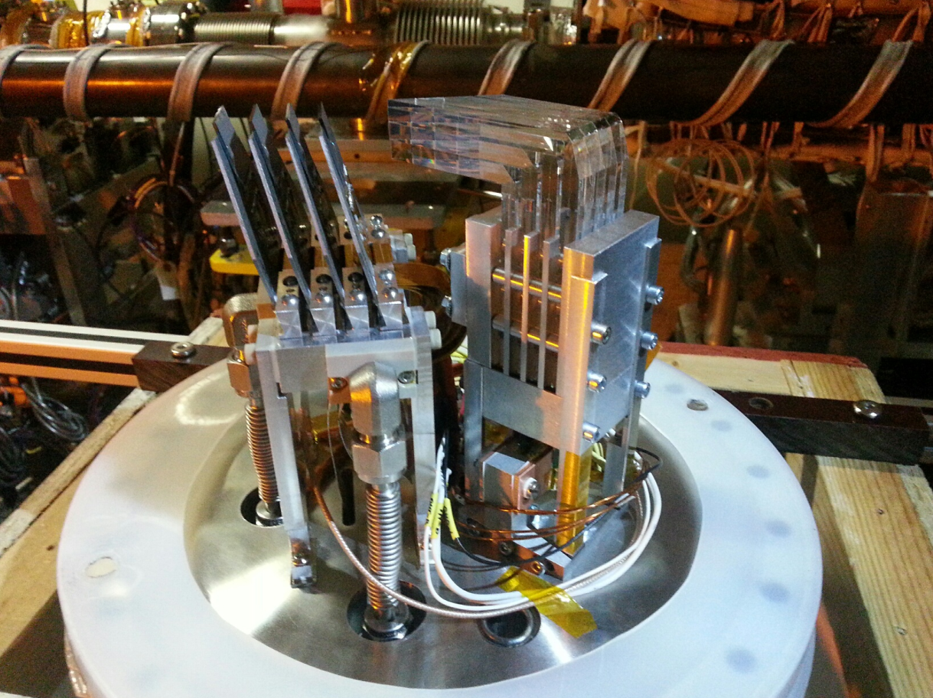
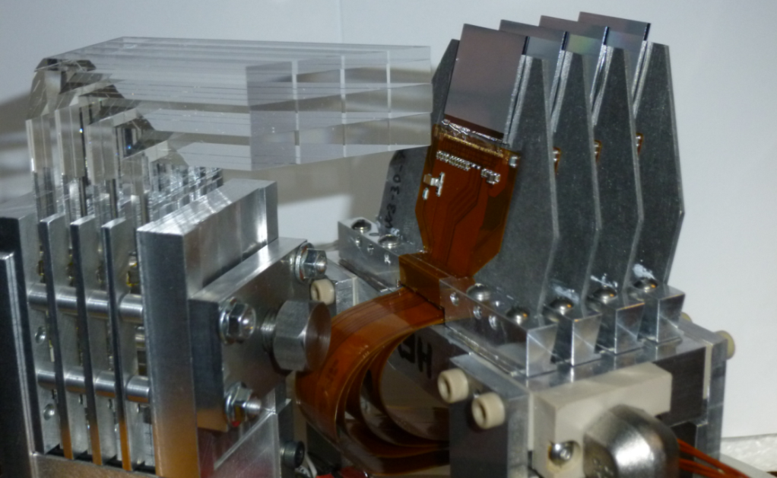
AFP ToF design in 2017
SiT
LQbars
ToF
SiT: 3D Pixels
50μm(x)×250μm(y)
σ_{x}≃7 μm/track
ToF: Cerenkov 4 Trains × 4 Bars
σ_{t}≃30 ps/Bar
MCP-PMT
not possible with current design
resolution 10 ps or better for higher pileup 30 ps for 1-st phase
acceptance over full range of tracker
near 100% efficiency
segmentation for multi-proton timing
high rate capability, ~ 5 MHz/segment
L1 trigger capability
radiation hardness
MCP-PMT high rates capabilities

Slide 8
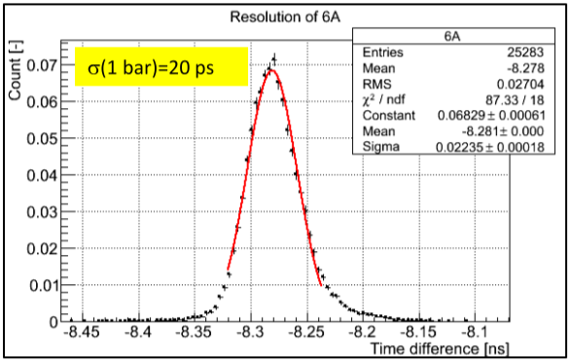
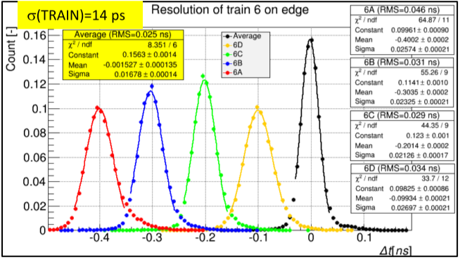
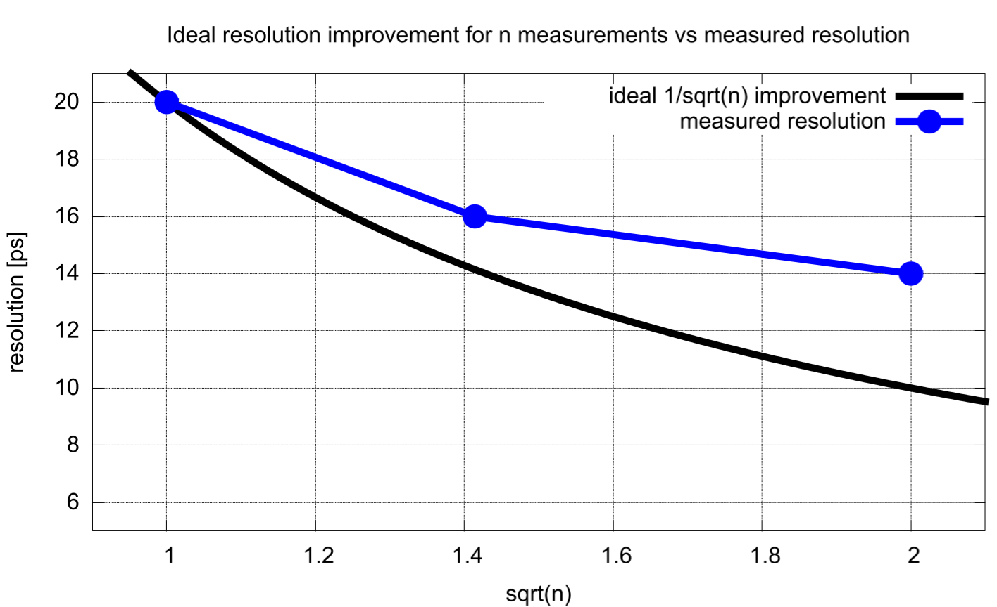
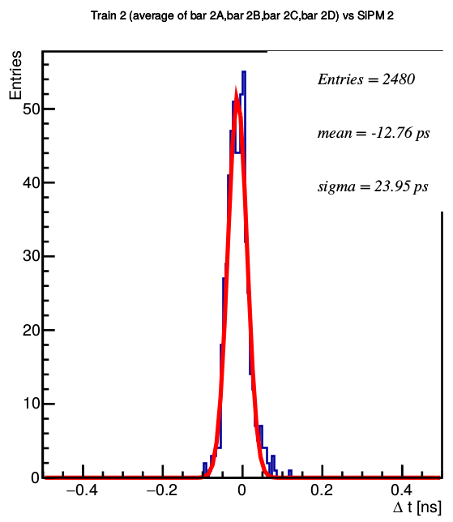
ToF performance as measured in beam tests
π (SPS, 40/120 GeV)
bars
PMT
PA-a + PA-b
PA-c
CFD
TDC
scope
RCE
oscilloscope
measurements
HPTDC included (RCE), trigger included
the hunt for $\sqrt{N}$
final resolution after trigger subtraction – 20.6 ps

Slide 9
ToF components
contributions to time resolution
MCP-PMT < 10 ps (low rates, see below)
PAa (first layer of preamps)
PAb (second layer) 3-4 ps
CFD (constant fraction discriminator) 5 ps
HPTDC (high performance TDC) 15-17 (-25; can be corrected) ps
picoTDC < 6 ps
reference clock (synchronization) 6 ps (conservative)
time resolution limited by
bar design
MCP-PMT rate capability

Slide 10
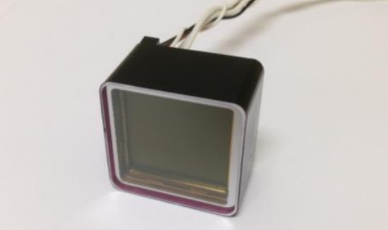
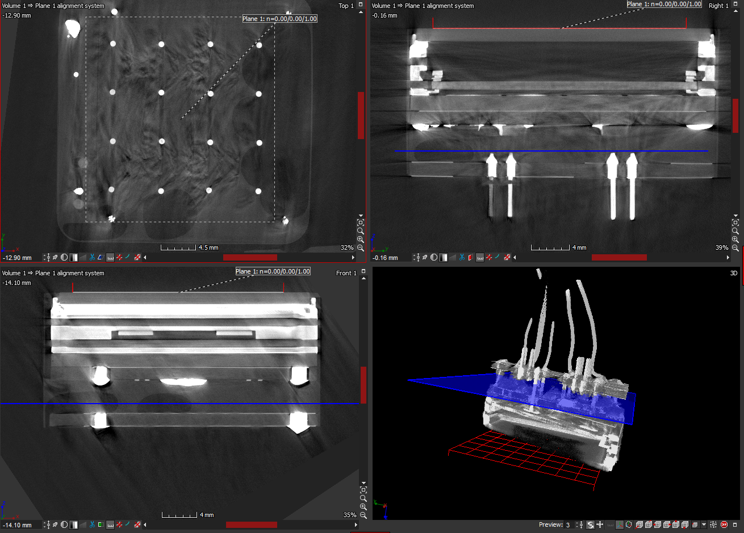
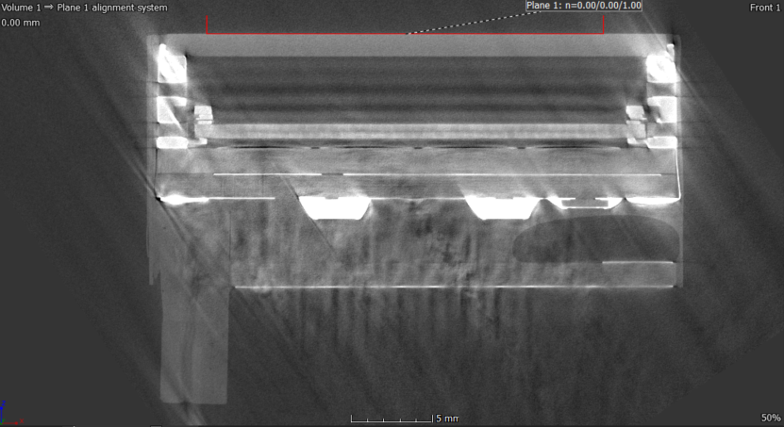
MCP-PMT – operability in vacuum
AFP ToF baseline
repeated failures during HV tests in vacuum
change of the detector design

Slide 11
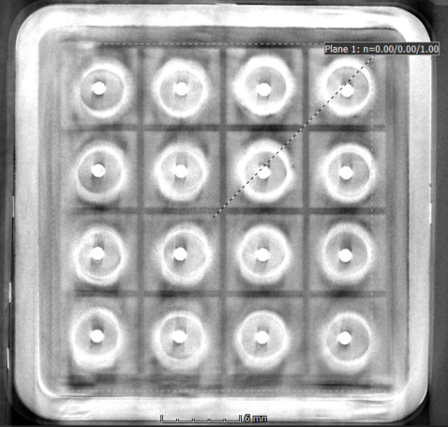
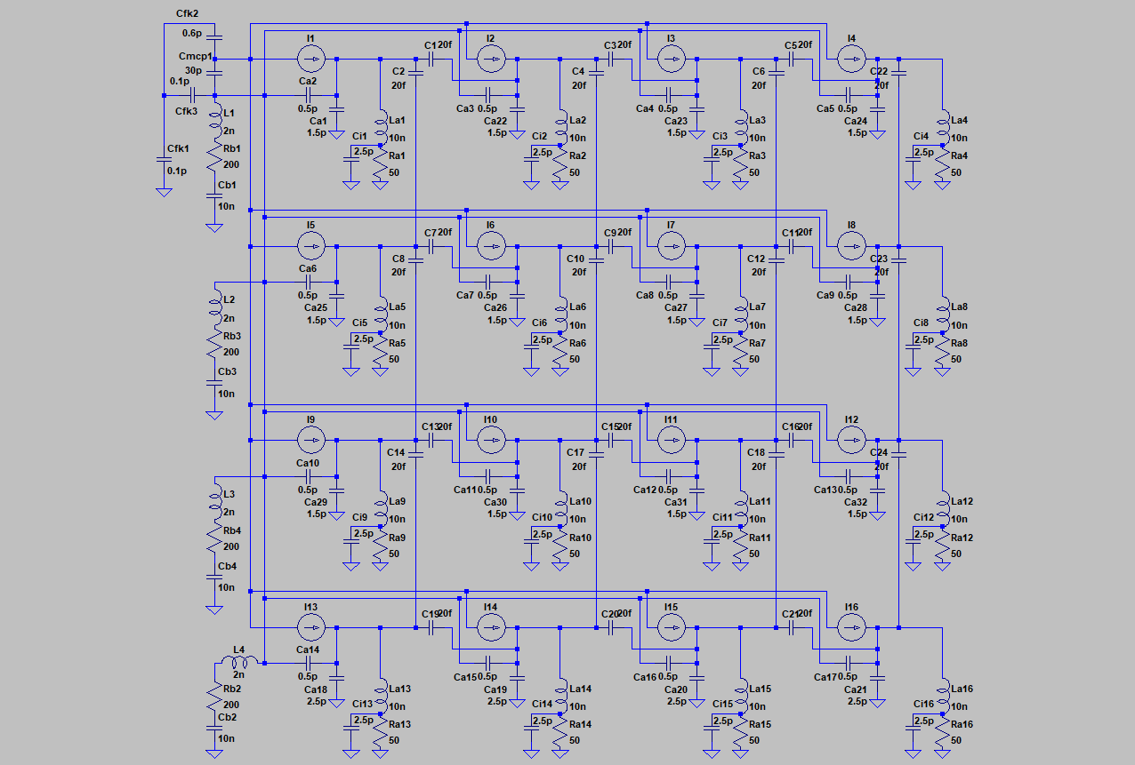
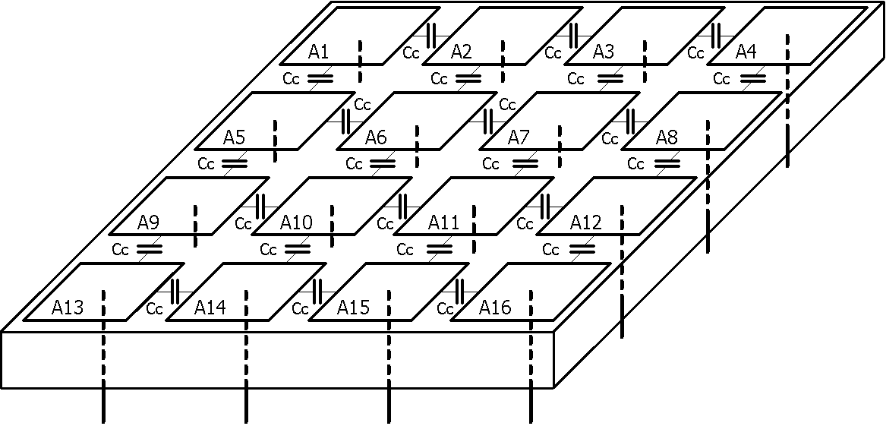
MCP-PMT – crosstalk ($\sqrt{N}$)
observed crosstalk, depending on the model (e.g. reduced anode gap): 20-40 %
motivated (also) by ALICE – change of back-end electronics design
modelling and simulations
anode pad
ceramic base
anode wire

Slide 12
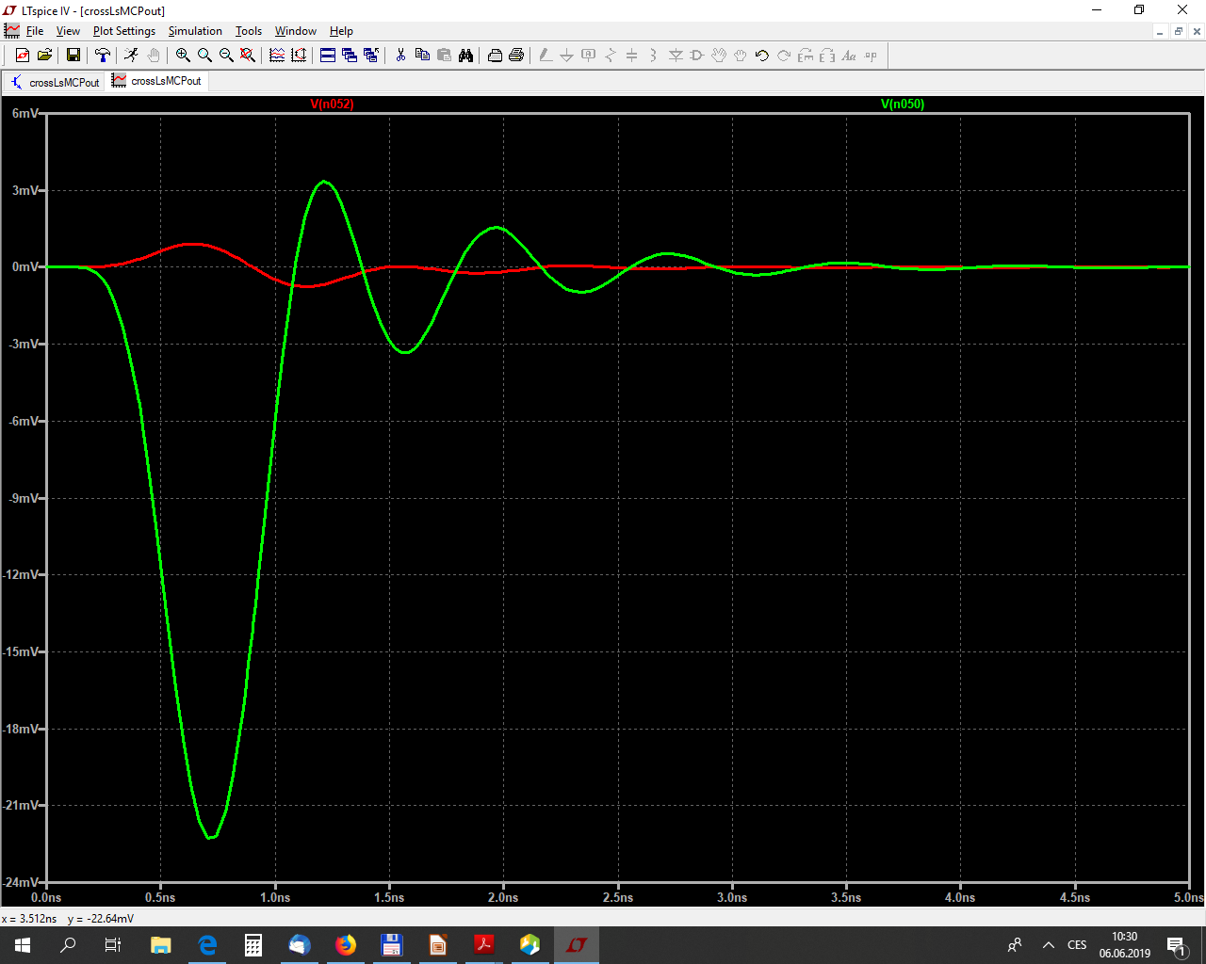
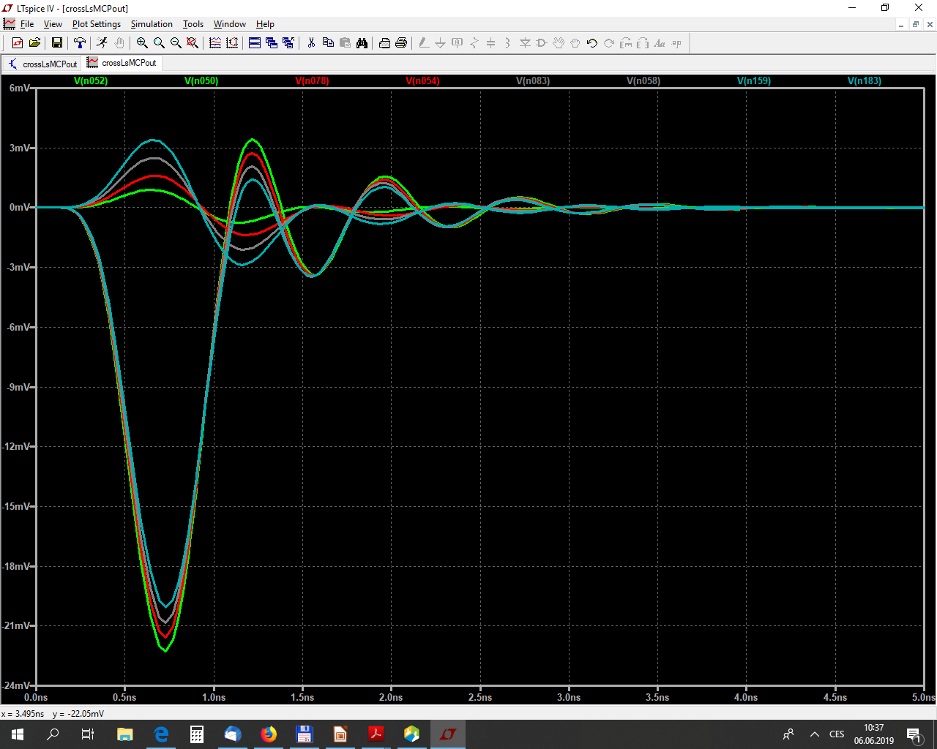
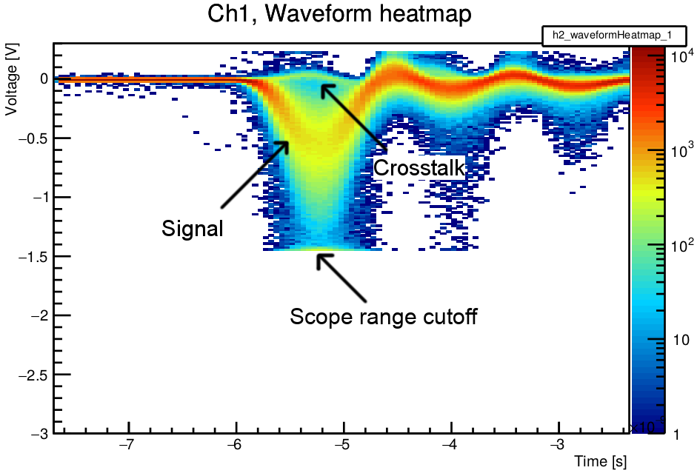
MCP-PMT – crosstalk modelling
signal and crosstalk – signal in 1-4 channels
signal and crosstalk – active 1 channel MCP-PMT
good agreement of simulation with measurement
new design, crosstalk: < 13 % for reduced anode gap

Slide 13
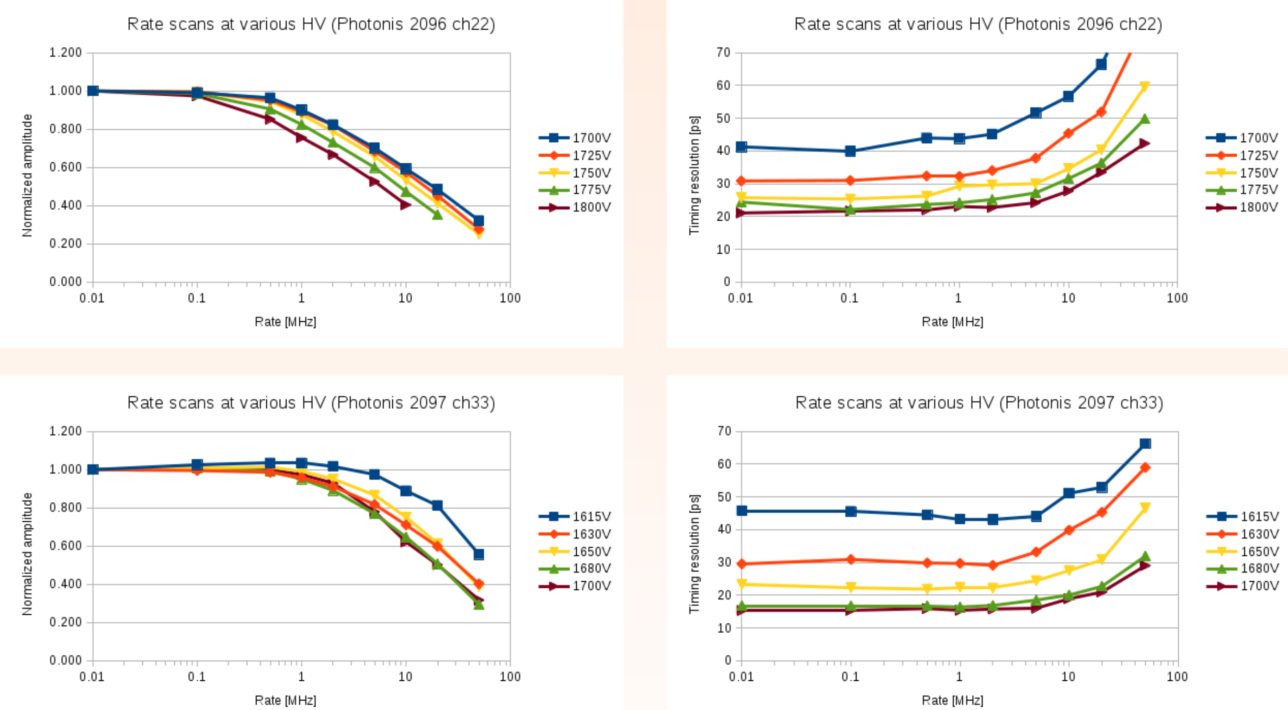
MCP-PMT and high rates, Photonis, XPM85212

Slide 14
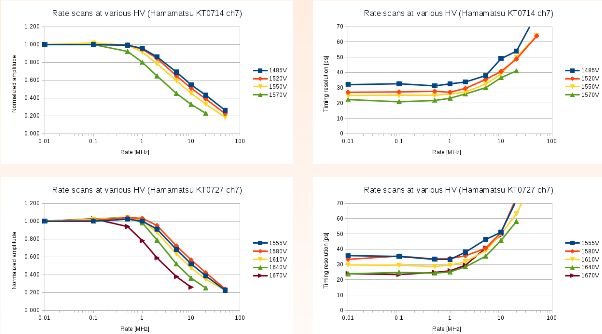
MCP-PMT and high rates, Hamamatsu, R10754-07-M16

Slide 15
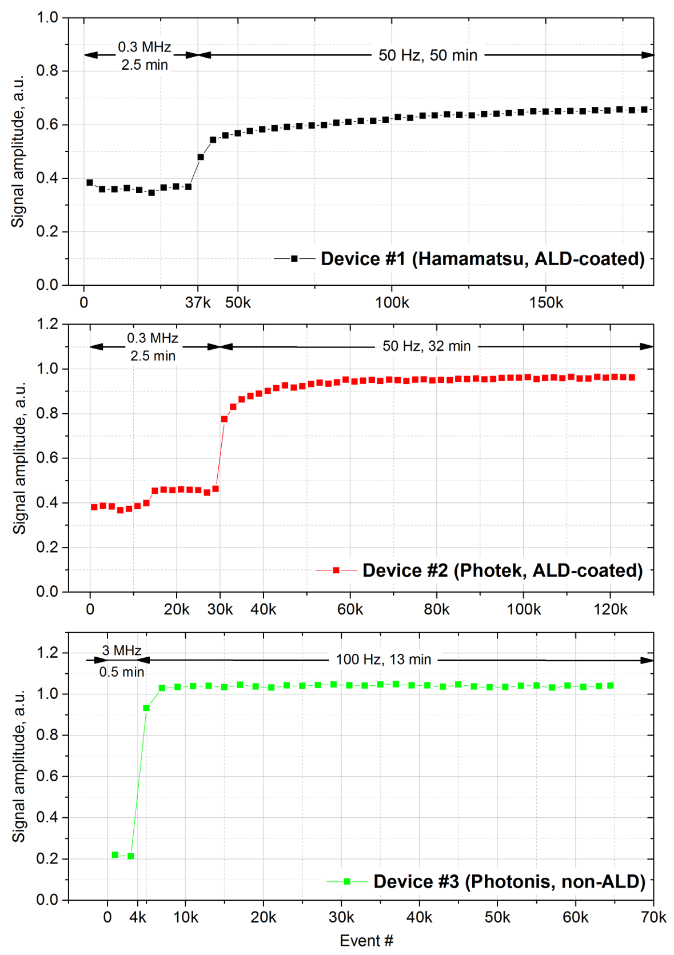
MCP-PMT and high rates recovery
Device # | 1 | 2 | 3
MCP-PMT type | R10754-07-M16 | PMT253 | XP85002/FIT-Q
Manufacturer | Hamamatsu | Photek | Photonis
ALD-coating of the MCPs | yes | yes | no
Resistance of the MCP stack | 40 MΩ? | 15.5 MΩ | 14 MΩ
Total bias voltage | 1600 V | 3000 V | 1285 V
Voltage across the MCP stack |  | 1704 V | 1018 V
Sensitive area of an individual readout channel | 5.3x5.3 mm² | 6.6x6.6 mm² | 26.5x26.5 mm²
Serial number | KT0714 | A1171005 | 9002140
Gain variation with the increase of the average anode current of each device caused by a proportional increase in the illumination rate.

Slide 16
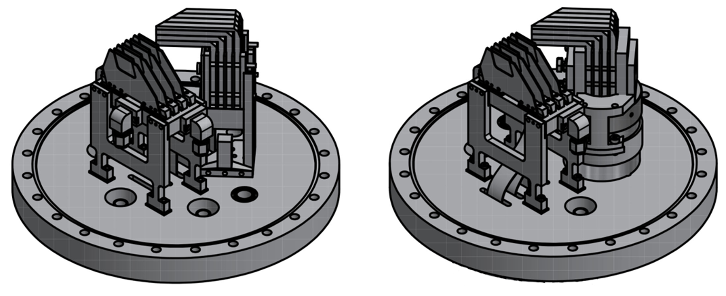
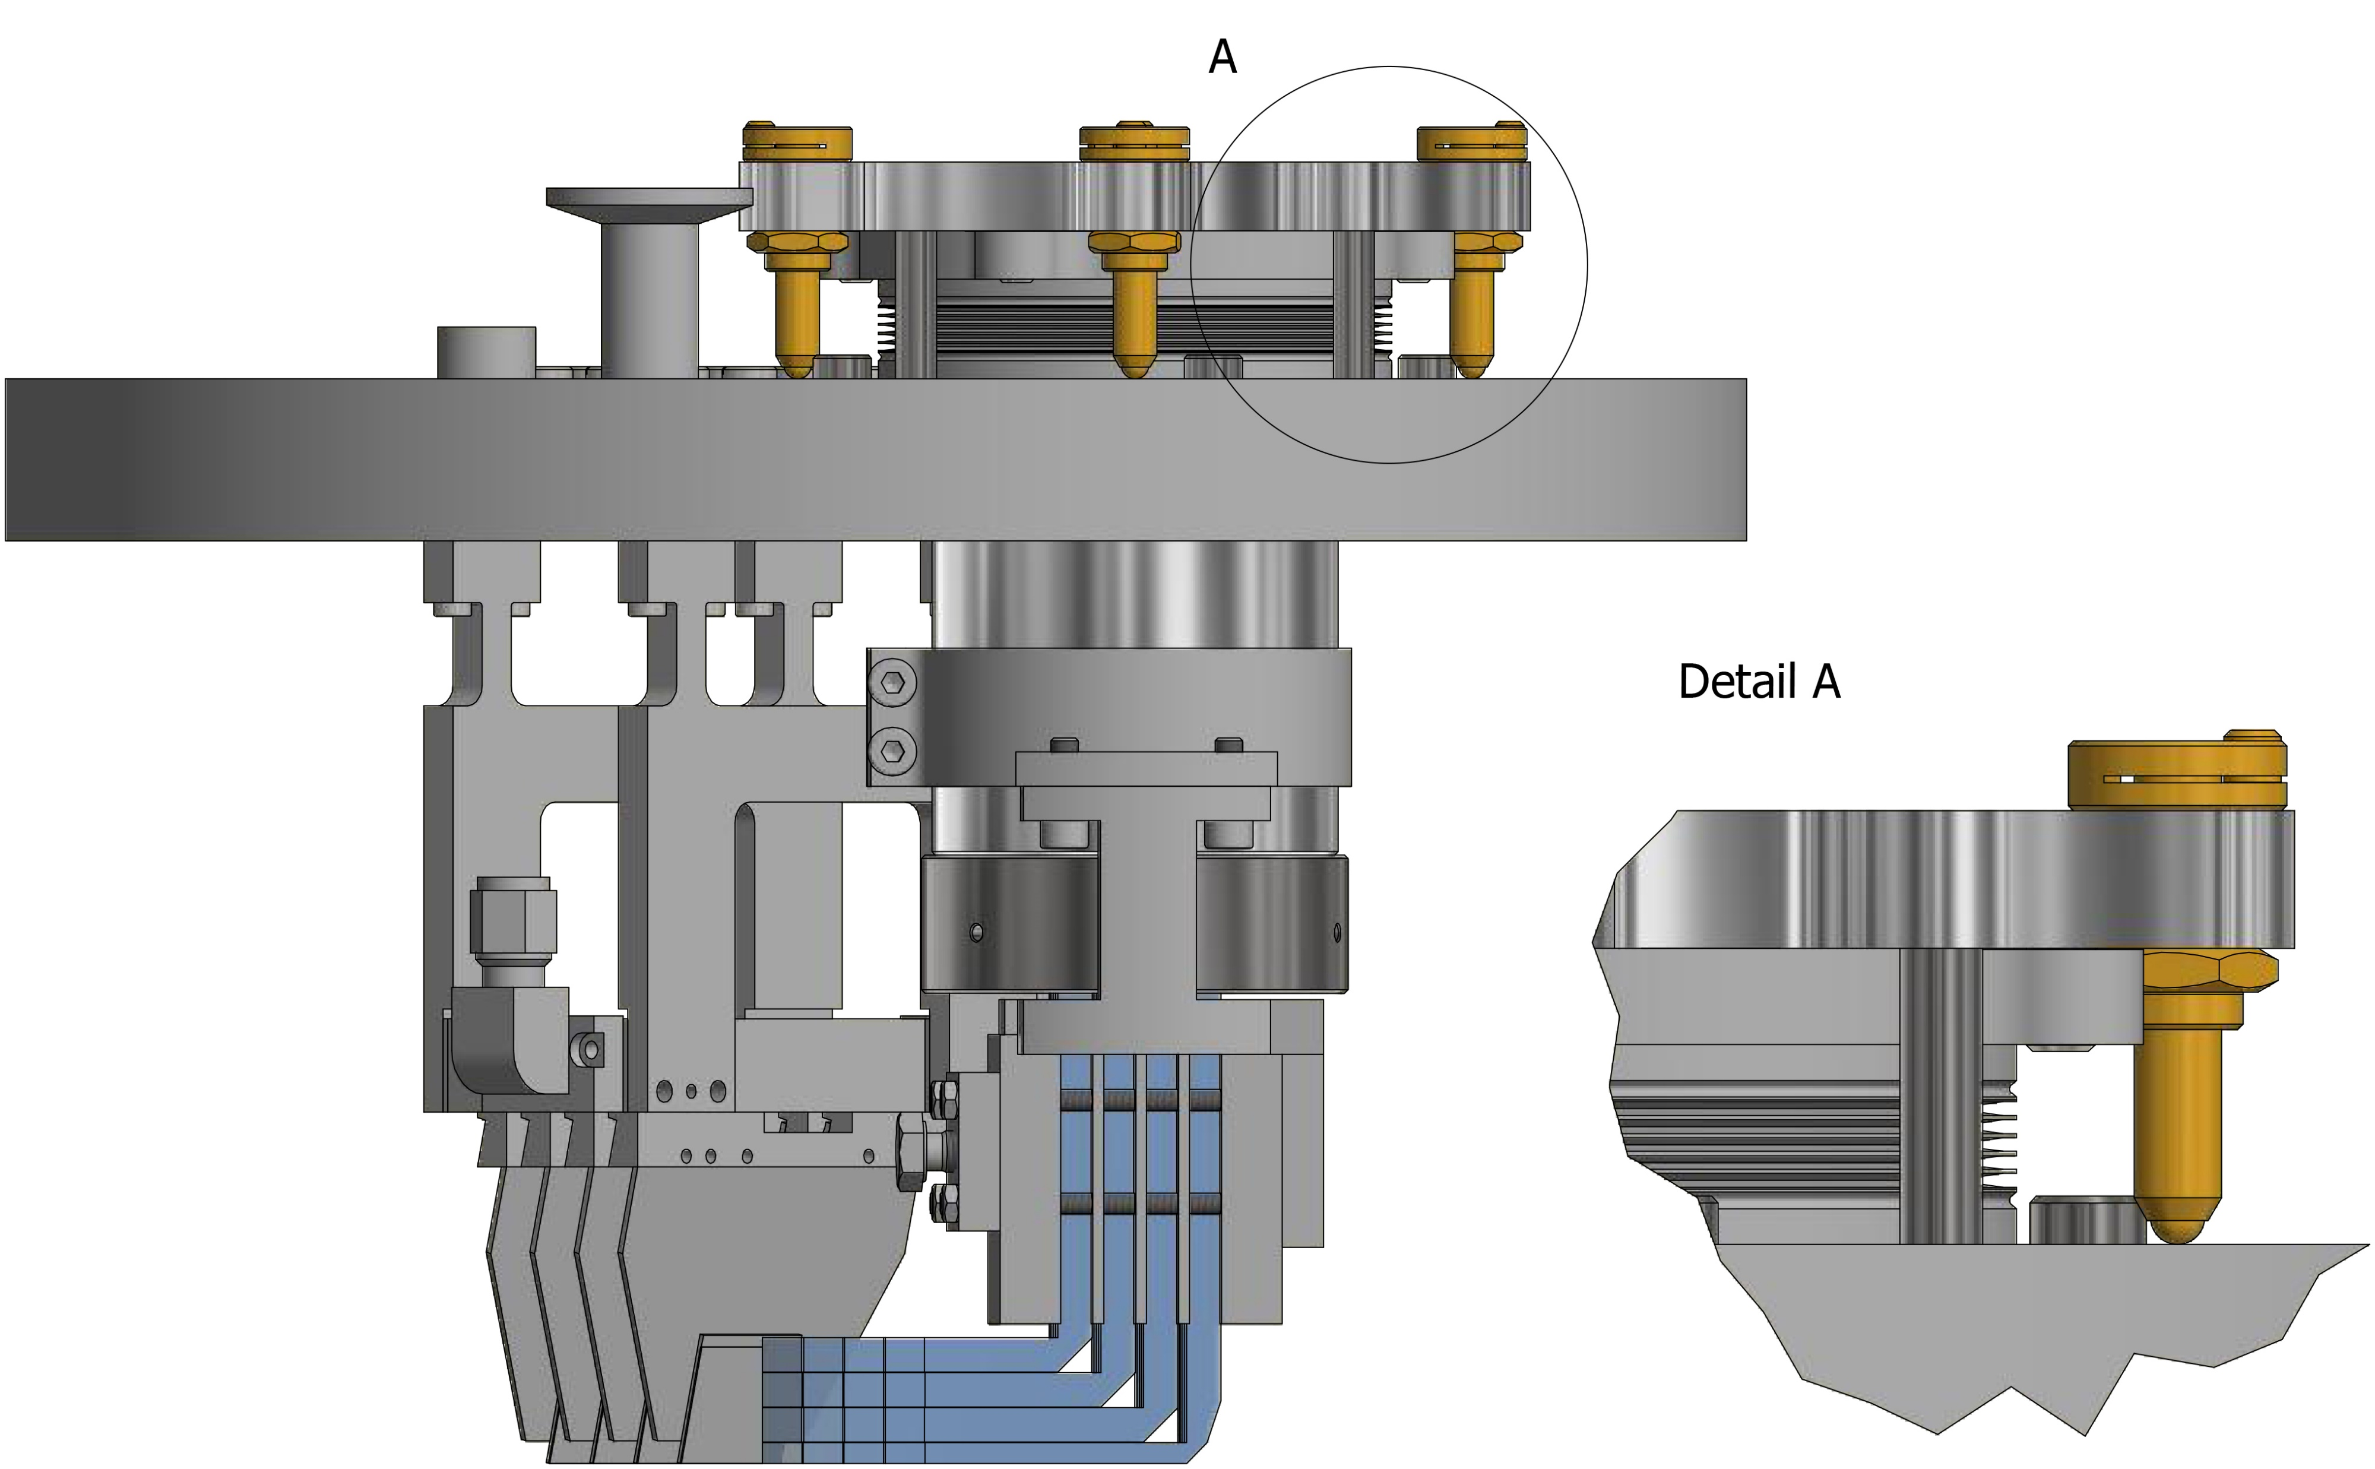
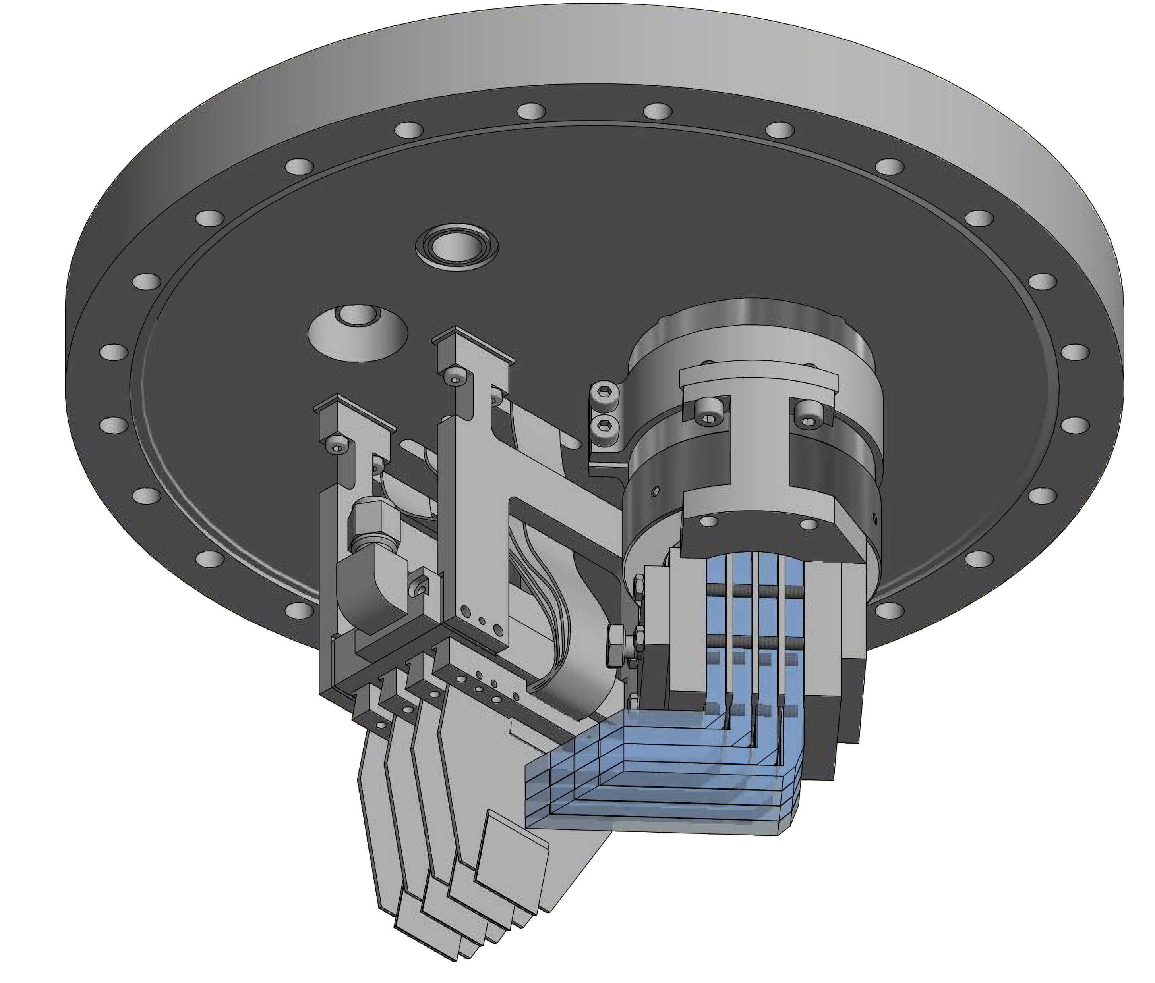
detector new design

Slide 17
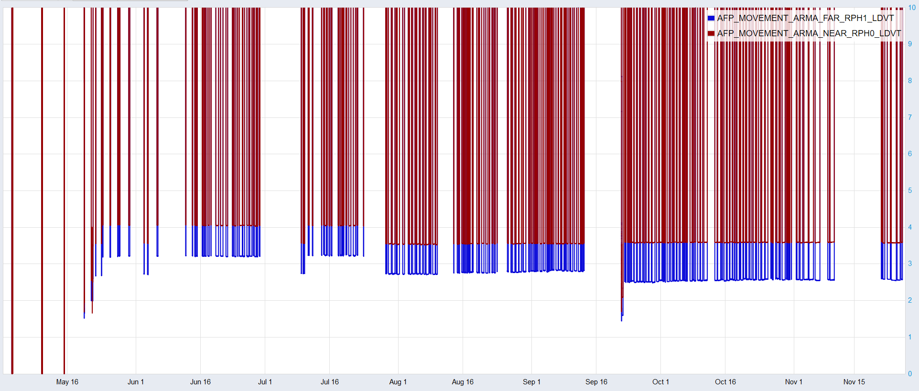
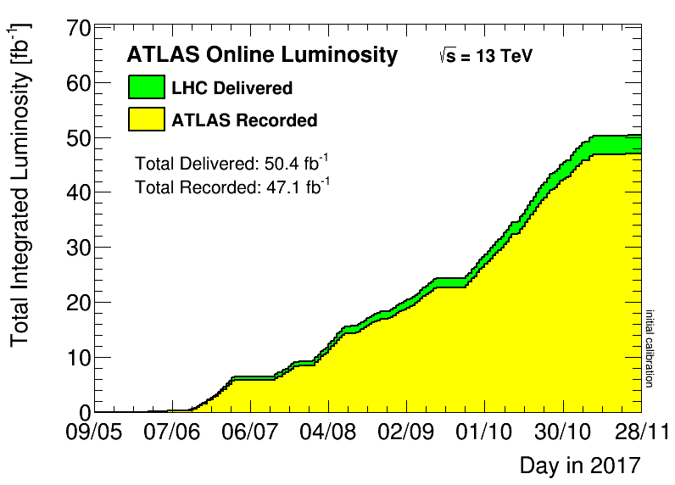
AFP insertions 2017
[fb^{–1}]
50
40
30
20
10
0
Total Delivered to ATLAS: 50.4 fb^{–1}
Total Recorded by ATLAS: 47.1 fb^{–1}
Total AFP in Combined DAQ: 29.6 fb^{–1}
ATLAS delivered/received ntegrated Luminosity
MD1-TS1 30.06-09.07
MD2 24-27.07
MD3-TS2 13-22.09
Xe run 12.10
SpecRun-MD4 11-30.11
Insertion: 12σ + 0.8 mm
Insertion: 12σ + 0.3 mm
Insertion: 11.5σ + 0.3 mm

Slide 18
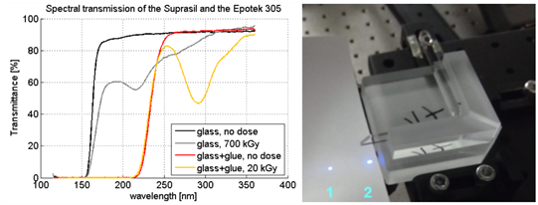
LQBars – glued vs monolithic solution
glued bars
– advantages
simpler and cheaper production – less groundwork (preparation phase, auxiliary elements), better machining (grinding, polishing)
excellent polishing quality up to 1 interference ring (peak-to-valey = 320 nm) on all surfaces
– disadvantages
glue – wavelength cut (235 nm) [?], additional tilt between arms, less radiation hard than used glass, fragility (small joint area, for bars with 2 mm radiator excessively small 2x5 mm²)
700 kGy ~ 100 fb⁻¹ at 5 mm from beam
20 kGy ~ 100 fb⁻¹ at 5 cm from beam

Slide 19
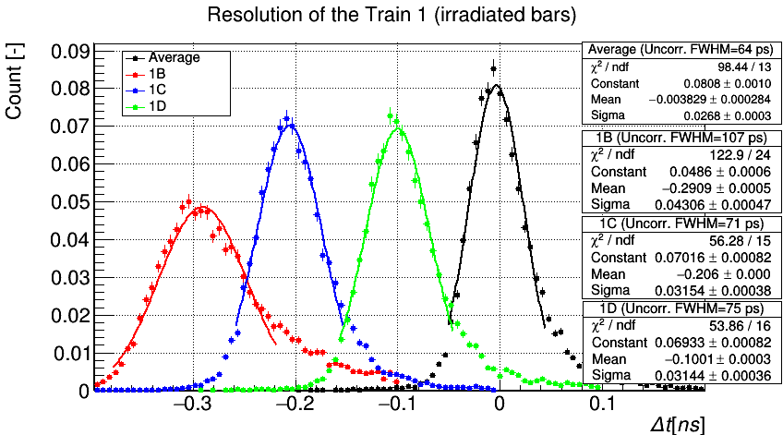
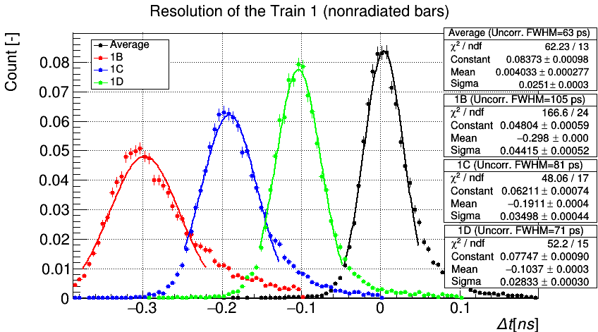
LQBars – irradiated vs non irradiated, timing
bars irradiated by ~ 50.4 fb^{–1}
bars measured during the AFP beam test in DESY 2019
no significant difference

Slide 20
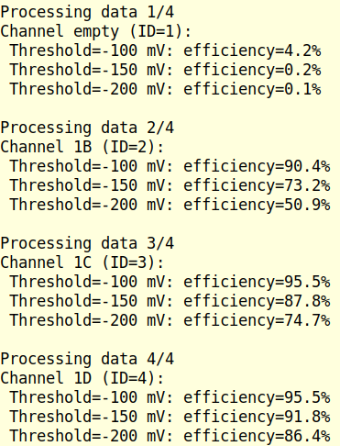
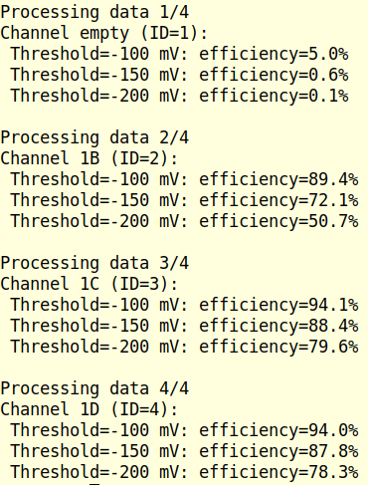
irradiated vs non-irradiated – efficiencies
non-irradiated bars
irradiated bars
1B
1B
1C
1C
1D
1D
no significant difference

Slide 21
LQBars – glued vs monolithic - timing
monolithic bars give worse resolution!

Slide 22
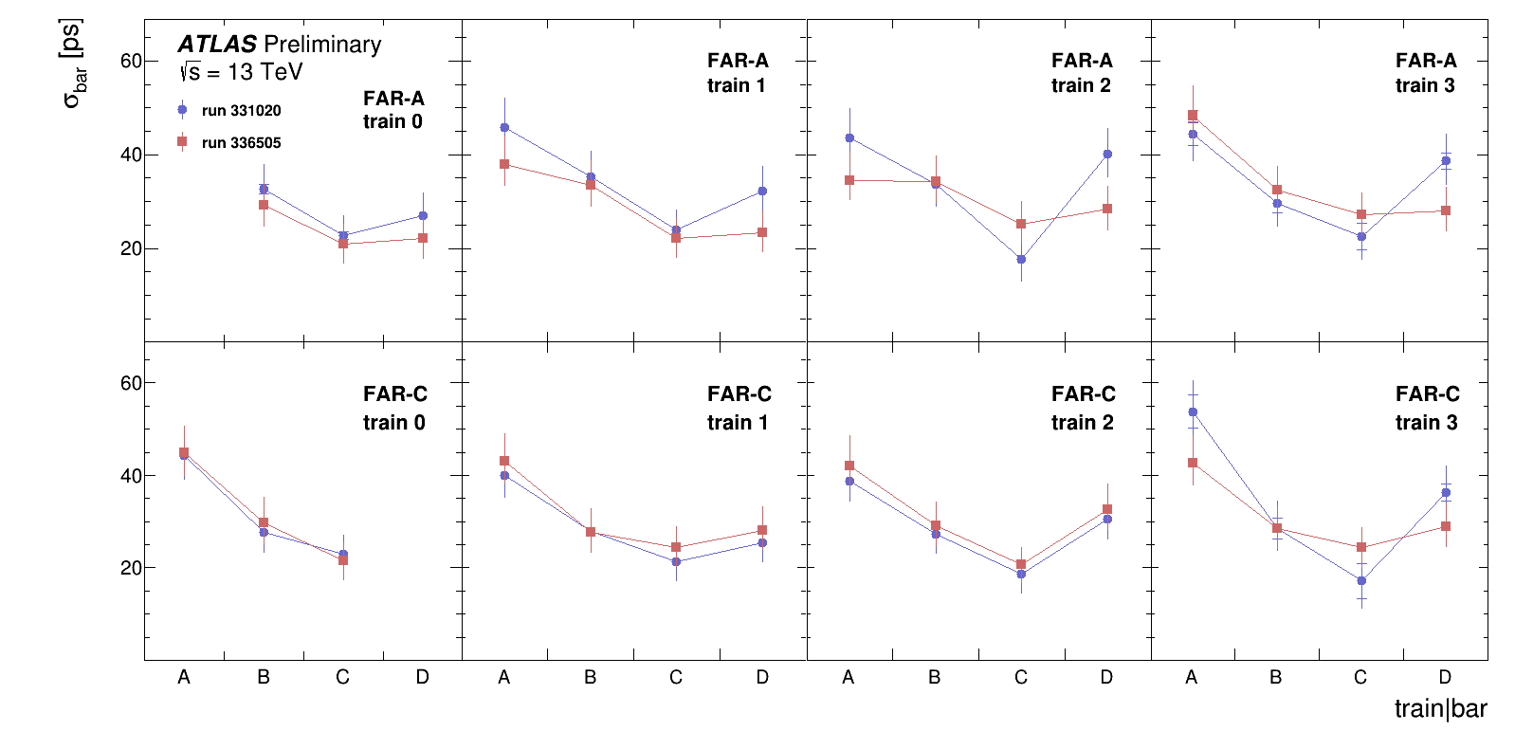
ToF in 2017 – timing
resolution of each bar within train and station, fully consistent with beam tests; no effect of synchronization clock

Slide 23
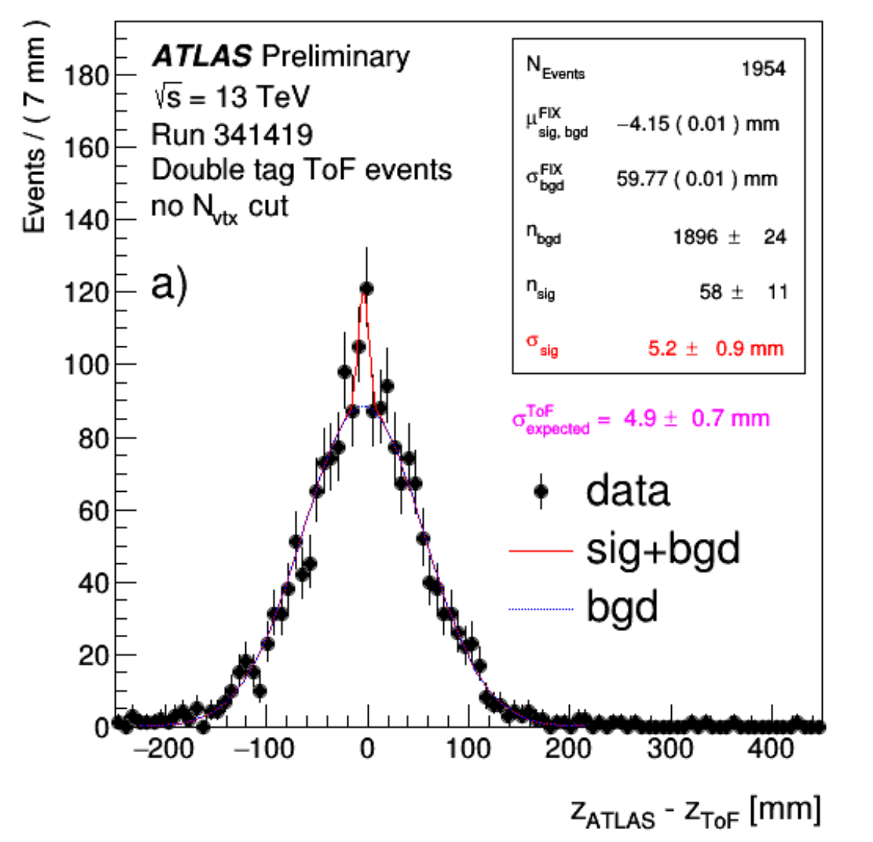
ToF in 2017 – z-vertex reconstruction
z_{ATLAS} - z_{ToF} distribution: obtained by random mixing of times measured by the AFP To detector in either station and the z_{ATLAS} values which do not originate in the same collision event.
the expected resolution of the ToF detector, σ^{ToF}_{expected} is obtained from the known single-channel resolutions convoluted with the actual channel-hit-patterns observed in the data in the 'no N_vtx cut' scenario
the shape of the distribution (narrow peak) provides a hint of presence of the (central diffraction) signal pp → pXp

Slide 24
summary
AFP ToF detector was installed and took data in 2017
achieved timing performance was very good, despite of detector very low efficiency (which affected timing), in agreement with beam tests results
due to repeated failures of MCP-PMTs in vacuum, the detector was not installed in 2018
new design of detector ready
MCP-PMT out of vacuum, tested in 2019
new back-end electronics to suppress cross-talk, tested in 2020
new sets of monolithic, glue-less, bars in production
simplified signal and powering paths, will be tested in April 2020 beam test
prototype of picoTDC tested in 2019, further tests planned in 2020
new trigger module partially tested 2019; testing is ongoing, will be finalized during April’s beam test
detector will be installed for the LHC Run3 during summer 2020
open question – new type (R2D2) of MCP-PMTs [Arradiance + Photonis], answer within ~ 3 month from now
analysis of the 2017 data shown the good agreement with beam tests results and confirmed ToF detector potential to achieve resolution 15 ps in the LHC Run3 running

Slide 25
backup slides

