Slide 1
Simulations of physics background in Super c-tau factory detector
L.Shekhtman
Budker INP, Novosibirsk State University

Slide 2

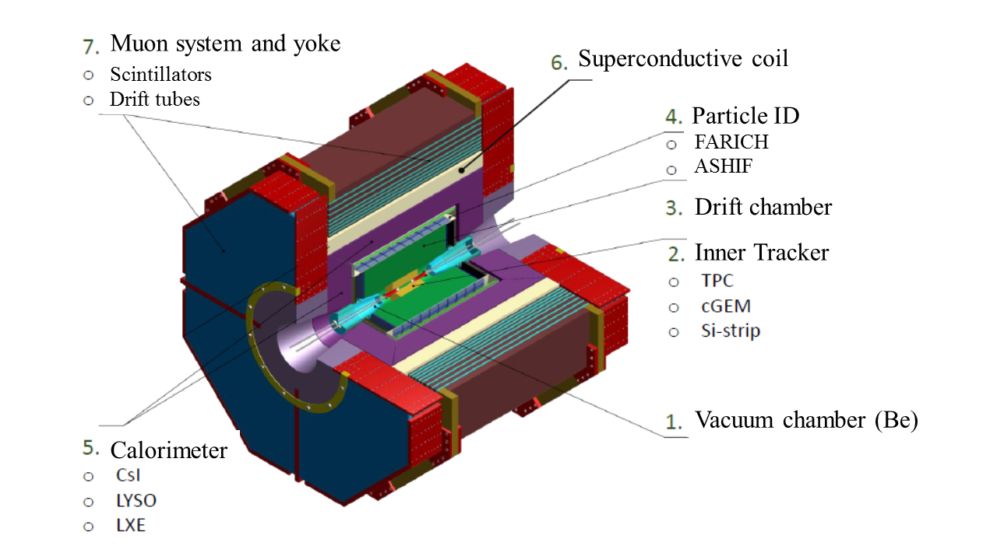
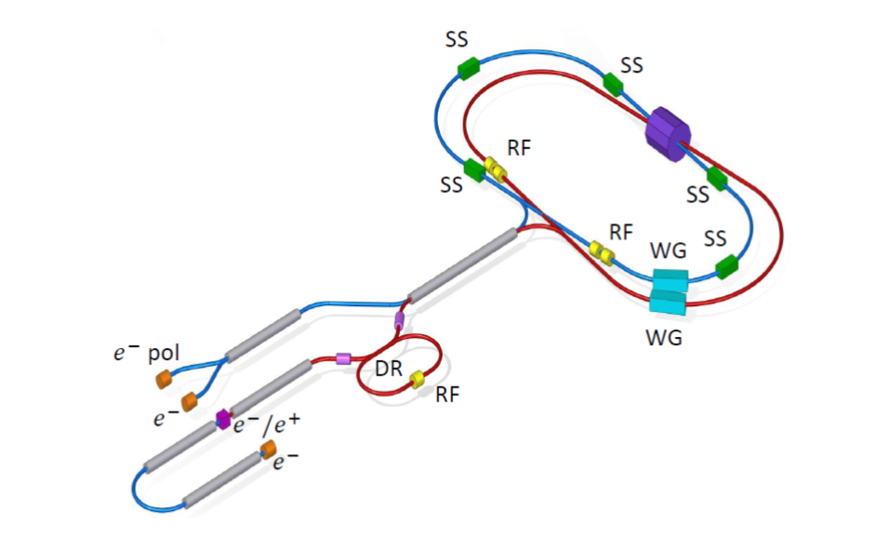
Novosibirsk Super Charm-Tau Factory
Main specifications:
2E = 3 ÷ 6 GeV
Crab waist collision
Peak luminosity 10³⁵ cm⁻²s⁻¹
Longitudinal polarization of electron beam

Slide 3
Main luminosity background sources:
Two-photon processes e⁺e⁻ → γ∗γ∗→e⁺e⁻e⁺e⁻ (E_{e+e-}>2MeV) - 2.9mb (at 3 GeV per beam), DIAG36
Radiative Bha-Bha e⁺e⁻ →e⁺e⁻γ(nγ) (θ>5mrad), Eγ>1MeV) - 1.2mb (at 3 GeV per beam), BHWIDE
Average number of particles with θ>5mrad – ~1.9 per event (primary electrons and positrons in two-photon processes were removed from the source)
With 10³⁵ cm⁻²s⁻¹ - ~4x10⁸ background events per second
If frequency of bunch crossings is 2x10⁸ - ~2 events per crossing, ~4 background particles with θ>5mrad

Slide 4
General conditions of the simulation:
Magnetic field was calculated by A.Bragin for “standard” coil, 1.5T in central part (as in old simulation)
In order to turn the source particles in accordance with the crossed VP, they were transferred to the system with β_{x}≈-0.03.
Simulation of background particles fluxes is performed with FLUKA package with FLAIR interface (http://www.fluka.org)
Particles transport threshold is set to 0.1 MeV for all particles except of electrons-positrons and photons: 10 MeV in concrete walls (electrons and photons), 1 MeV (0.1MeV for photons) in other regions, production threshold in the walls is 10 MeV (electrons and photons).

Slide 5
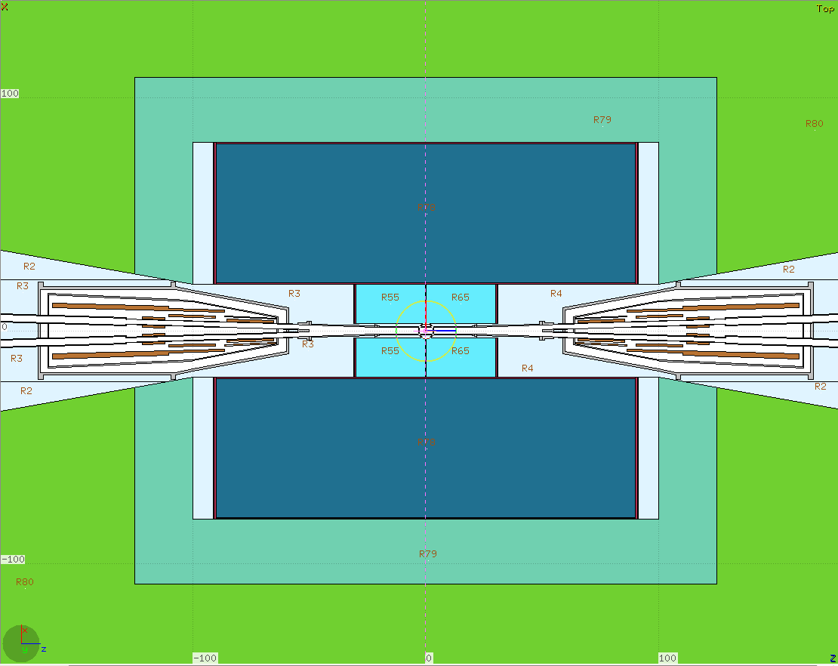
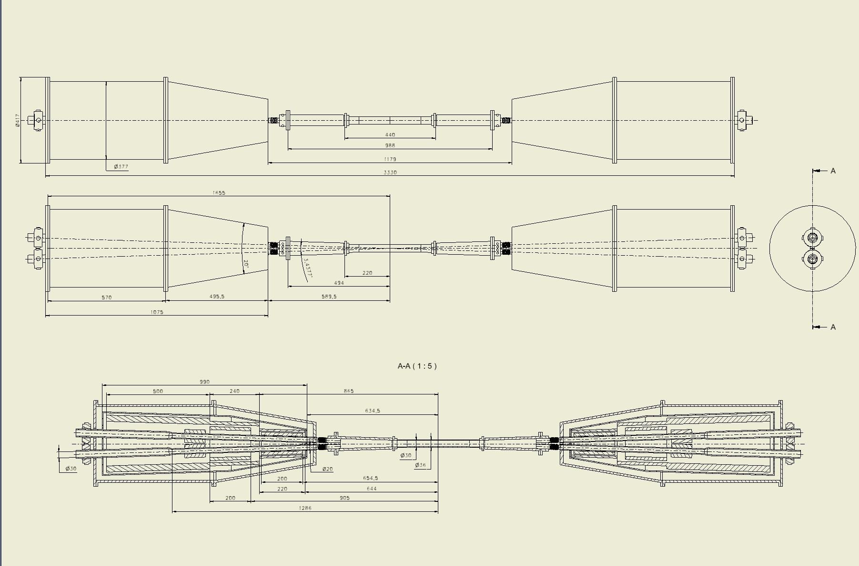
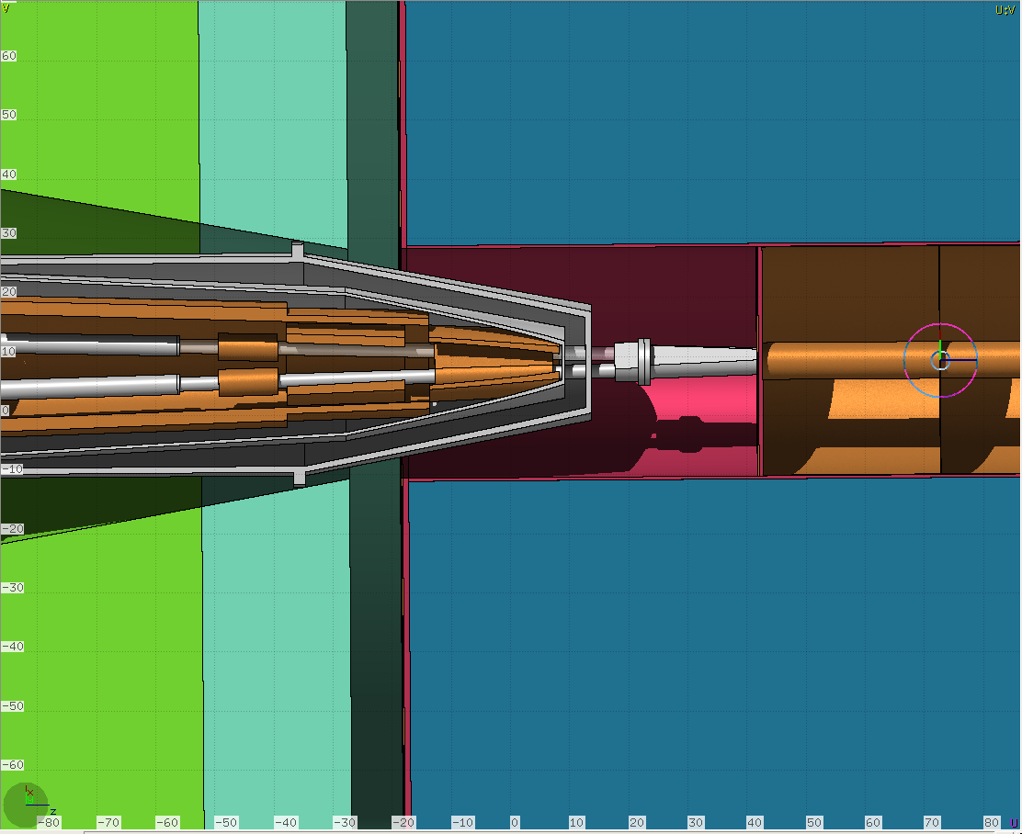
Crossed vacuum pipe
Tilted view with cut
Z-X cross-section

Slide 6
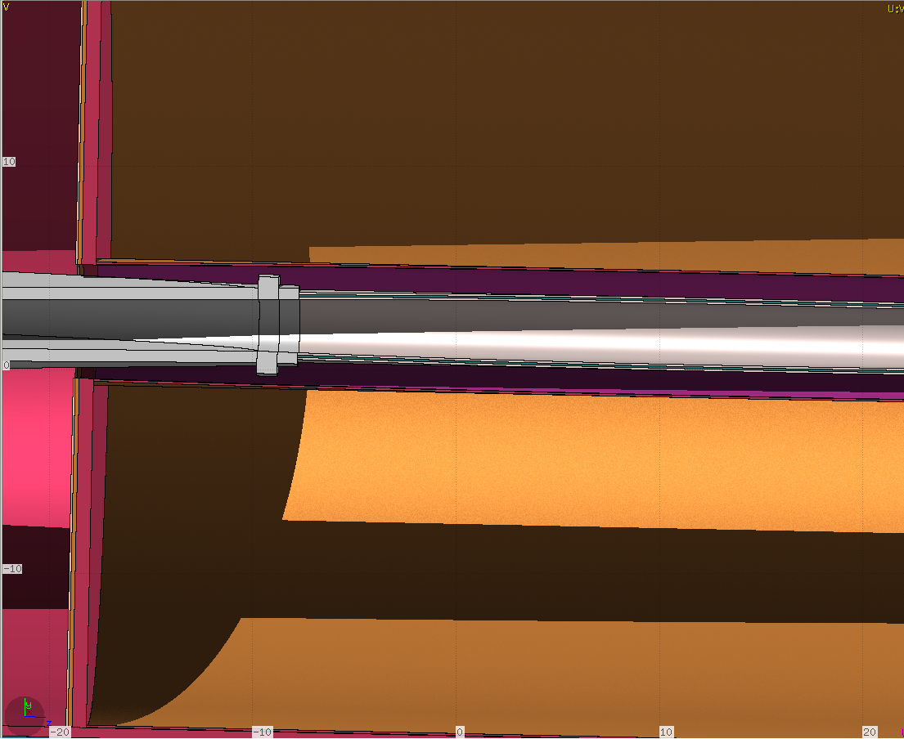
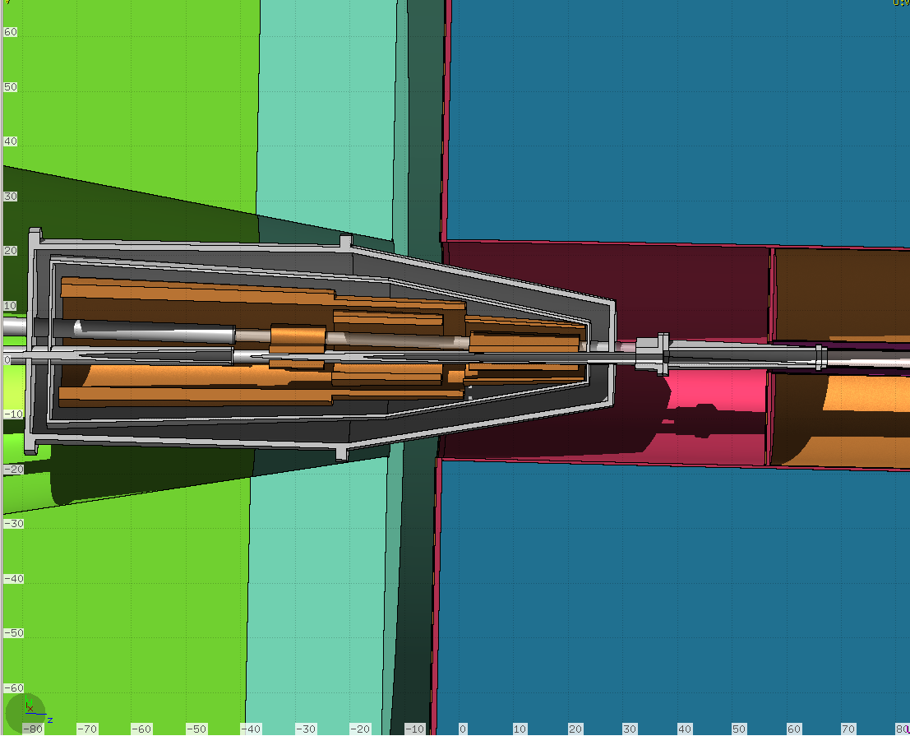
Crossed vacuum pipe
Expanded view of the interaction region of VP
Final focus

Slide 7
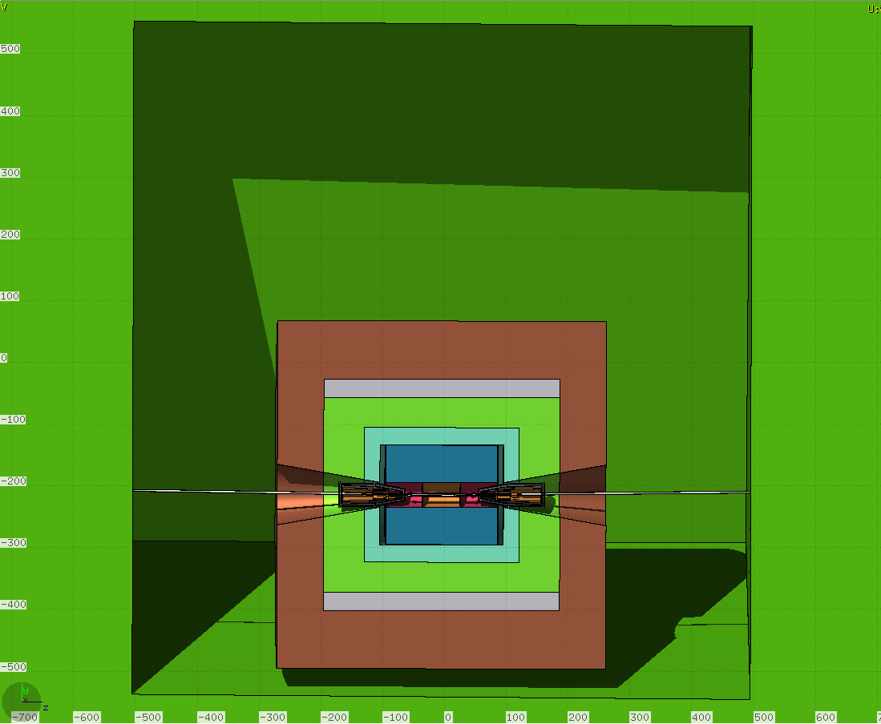
General view of the model

Slide 8
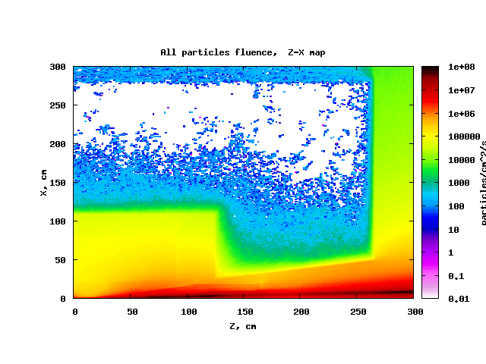
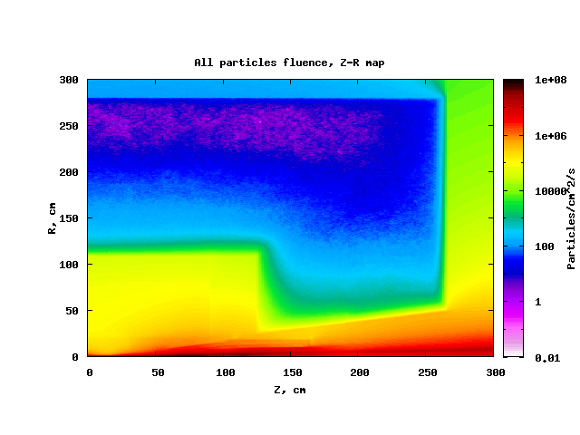
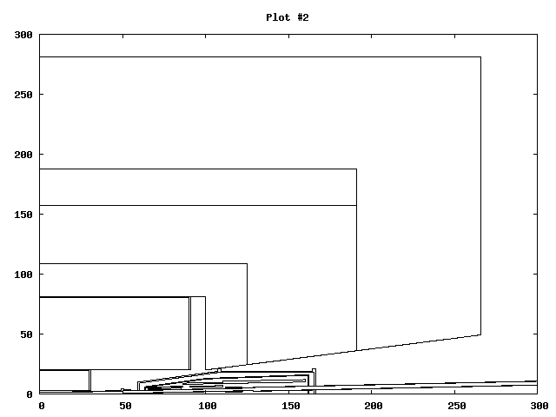
Comparison of “all particles” Z-X (-5cm <Y<5cm) and Z-R maps (2π>φ>0)
Maps of all particles fluence in units of track length per cubic cm per second
Statistics – 2x10⁶ source particles (10 runs, 200000 source particles each)

Slide 9
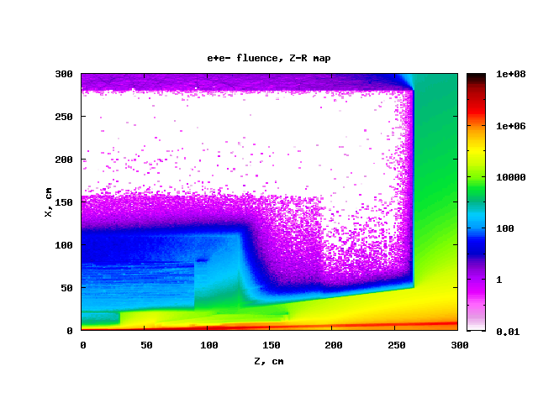
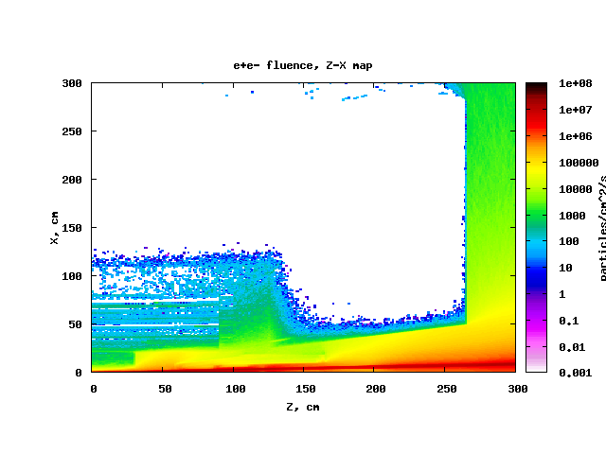
Comparison of Z-X map and Z-R map of e+e- fluence

Slide 10
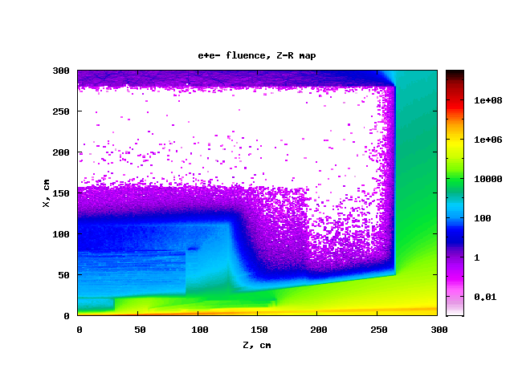
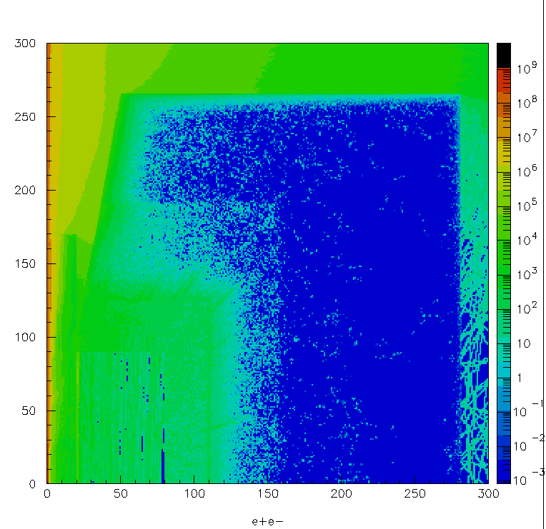
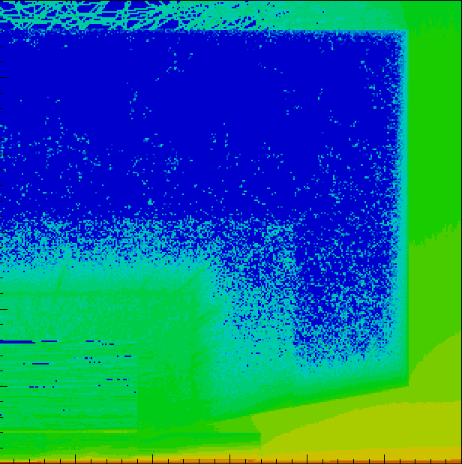
e+e- fluence (Z-R map), comparison of new and old simulations
Electrons & positrons (TPC)
1/cm²s
R, cm
Z, cm
2x10⁶ source particles
2x10⁵ source particles

Slide 11
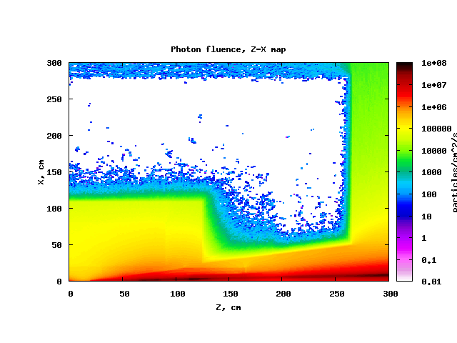
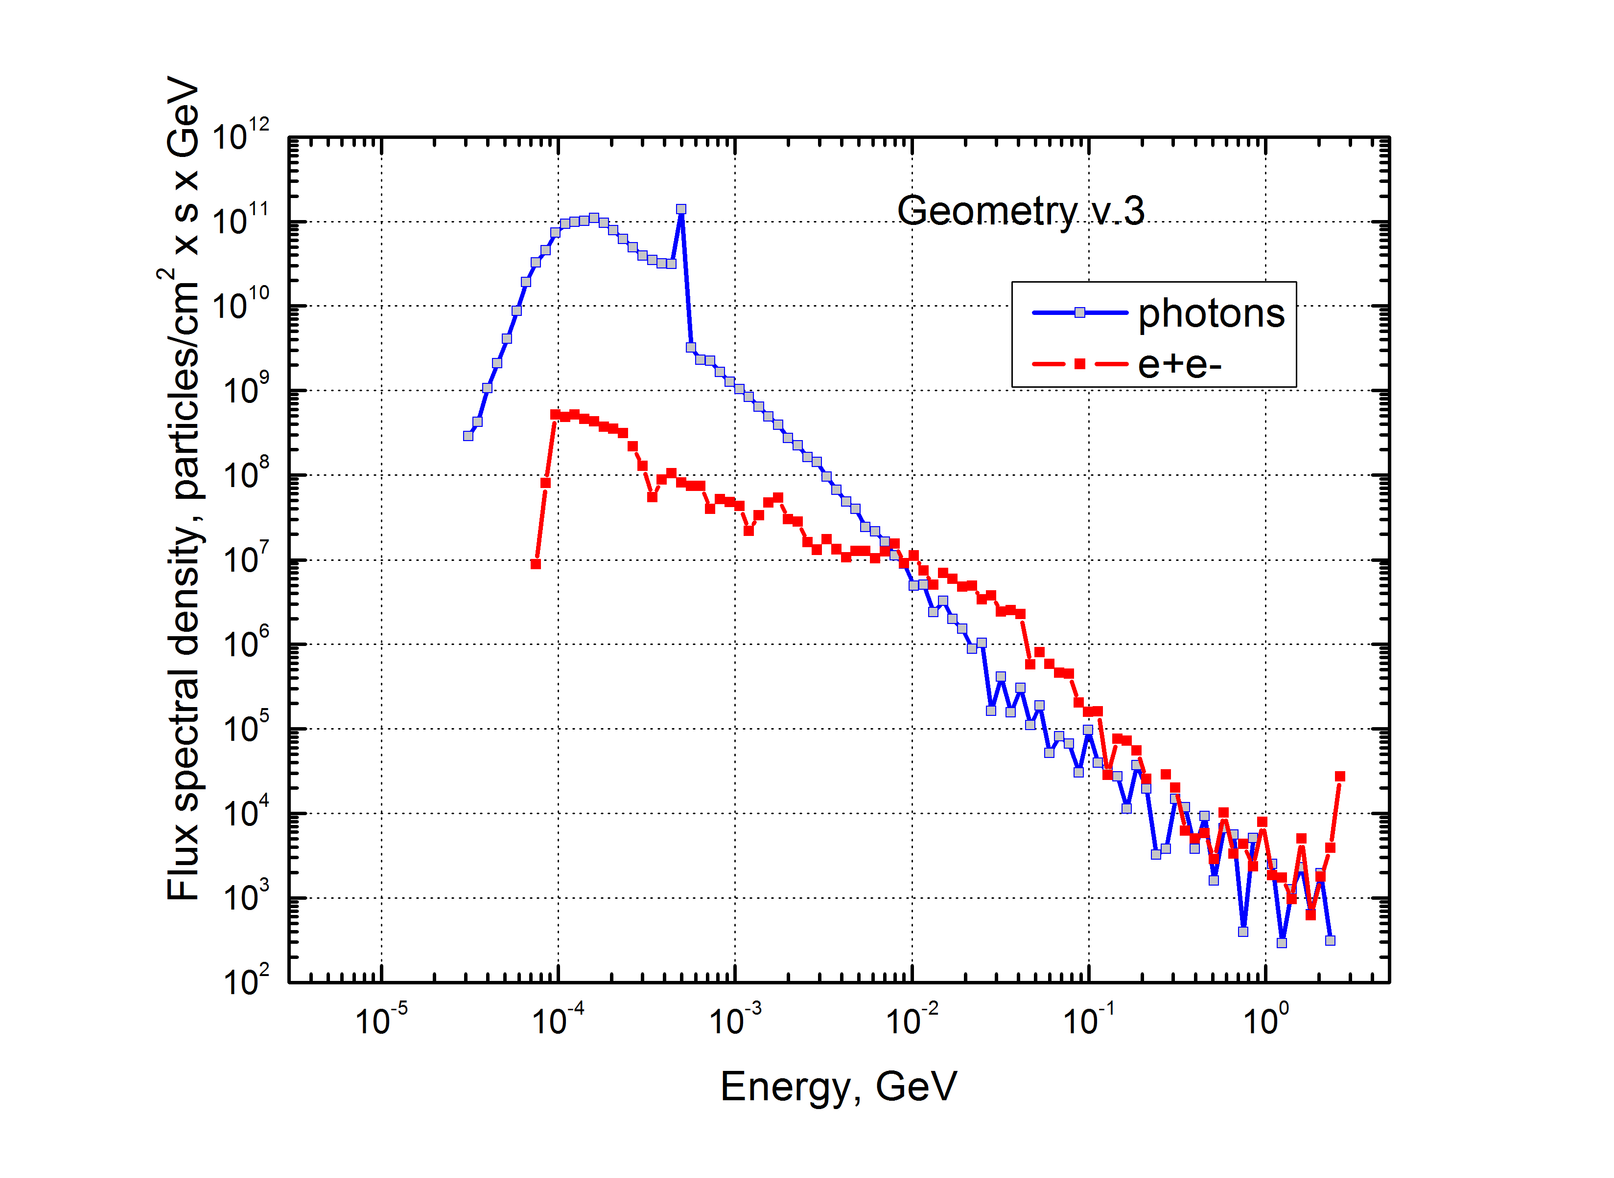
Z-X map of photon fluence
Spectra in Inner Tracker volume

Slide 12
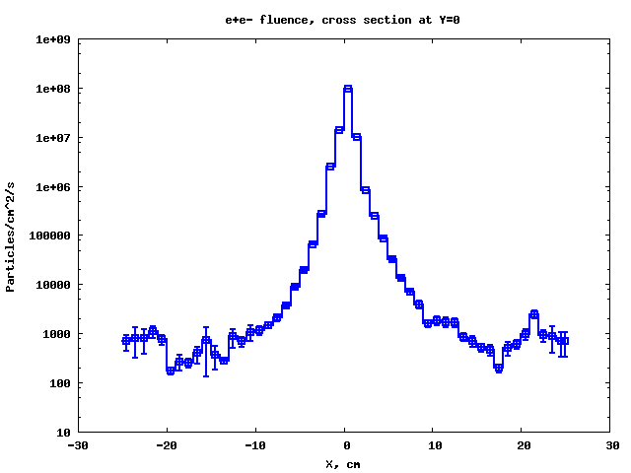
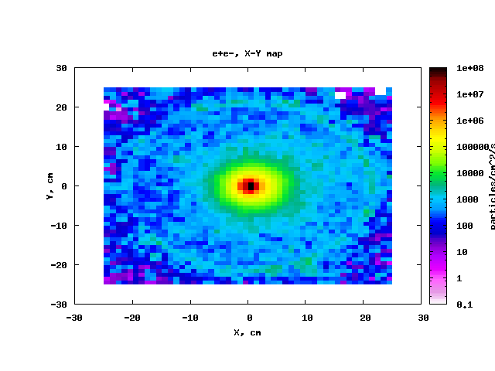
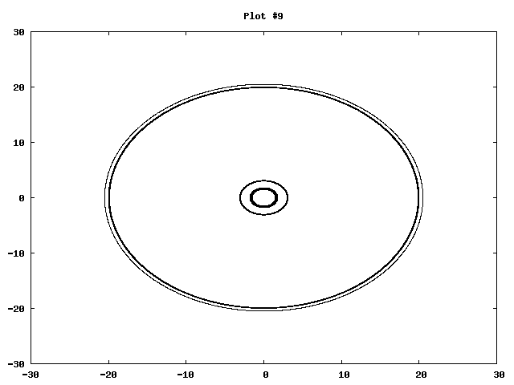
Electrons and positrons in the region of IT

Slide 13
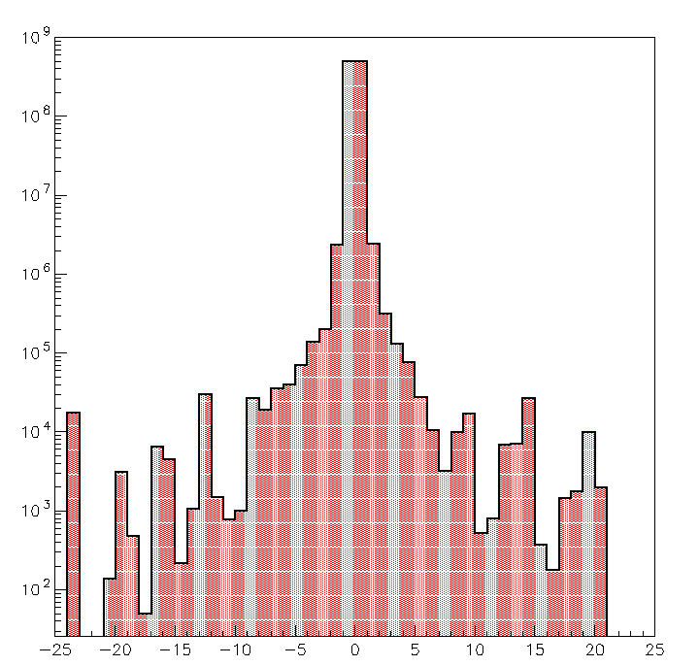
Comparison of new and old simulations
New simulation
Old simulation

Slide 14
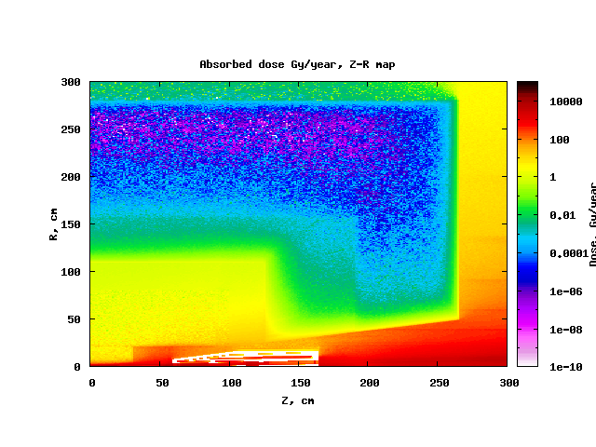
Absorbed dose in Gy/year

Slide 15
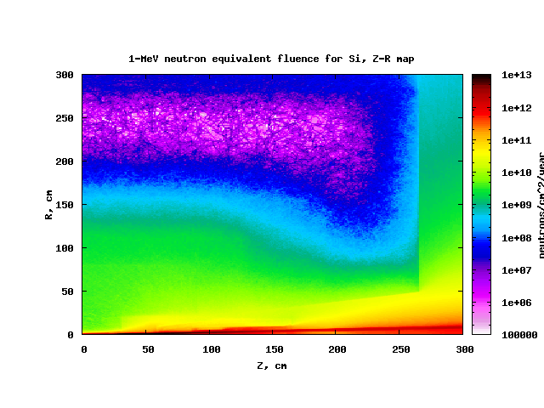
1-MeV neutron equivalent fluence for Si in n/cm²year

Slide 16
Conclusions
Crossed geometry of VP and final focus assembly according to the available
drawing are realized in FLUKA
Results of simulations with new geometry are very similar to old ones
Charge particles rate in the region of Inner Tracker 10⁵ – 10³ cm⁻²s⁻¹. This result is used for further studies of the TPC option (ion space charge impact)
1 MeV n-equivalent fluence for Si is below 10¹¹ n/cm²y
Absorbed dose is below 100 Gy/y (rad-tolerant electronics needed)

Slide 17
Backup slides

Slide 18
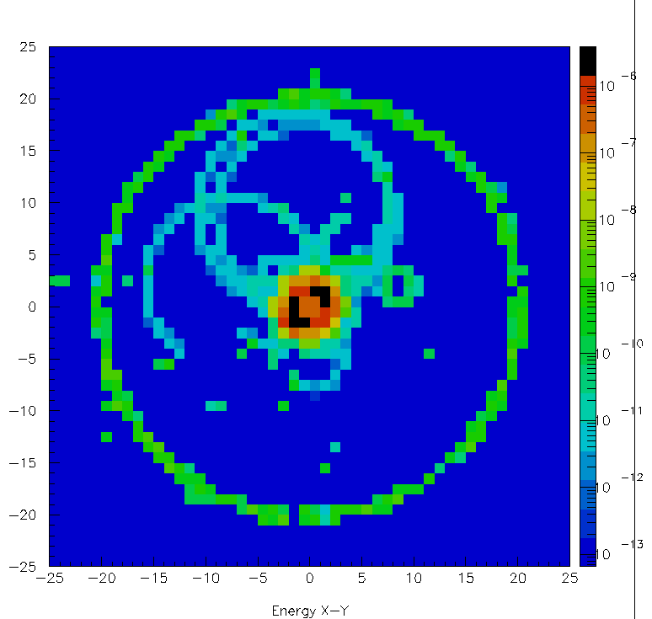
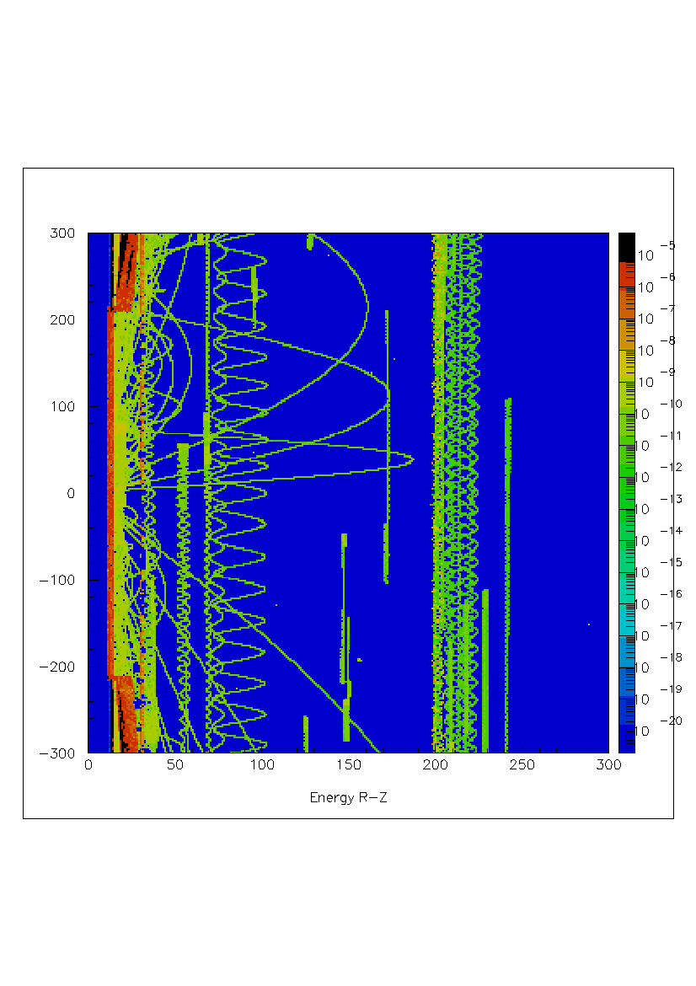
Energy deposition in TPC after 2000 bunch crossings
R, mm
Z, mm

Slide 19
Cross sections dependances

