Slide 1
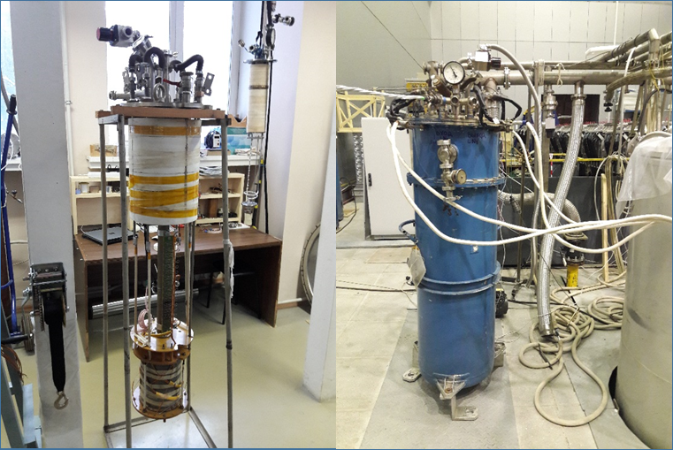
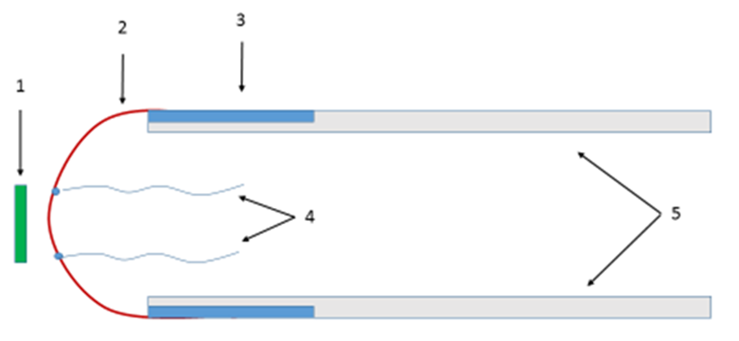
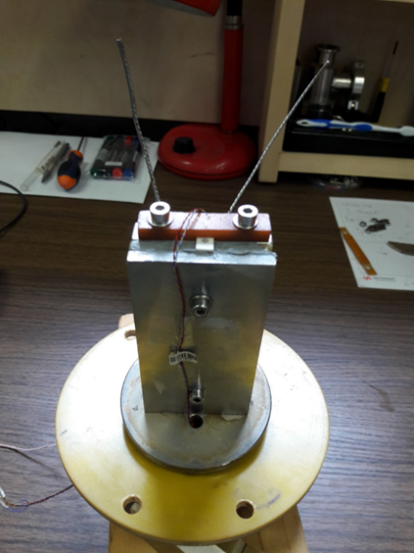
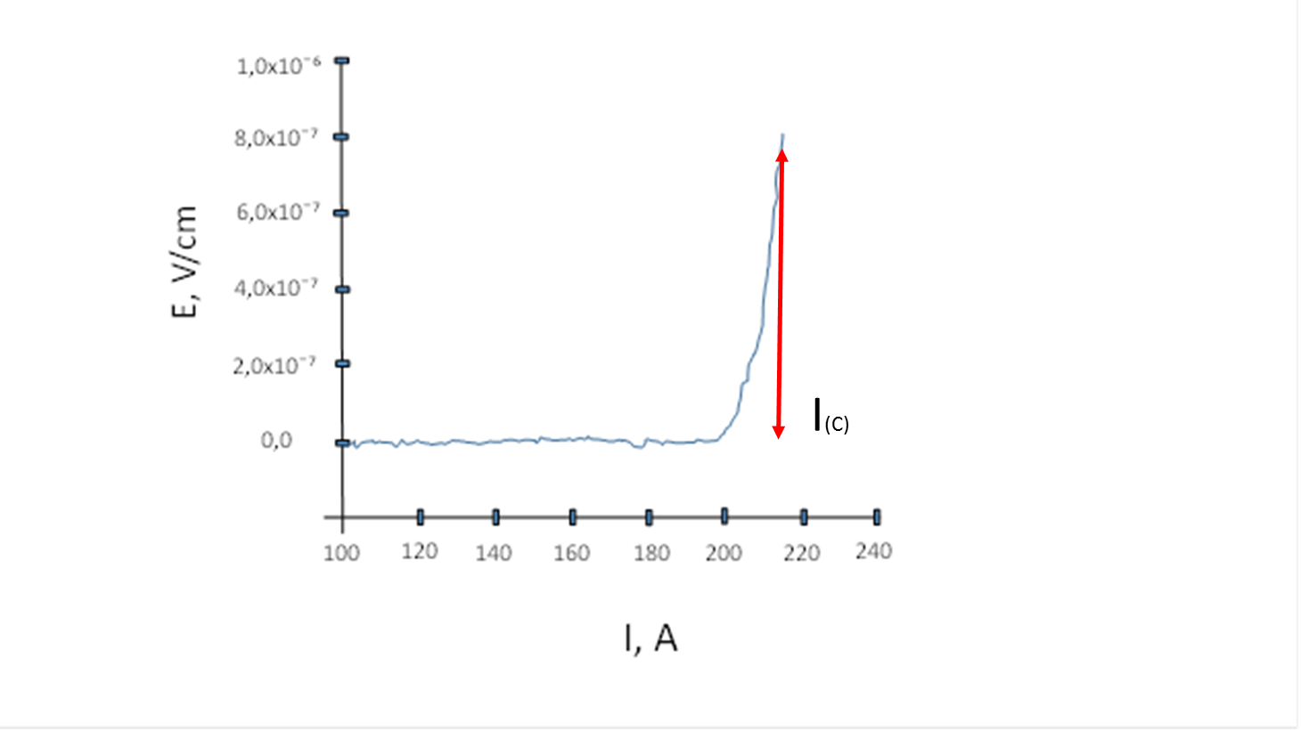
Measuring Installation for Determining Current-Voltage Characteristics at Liquid Helium Temperature
When designing superconducting magnets and other objects of cryogenic engineering, a special role gave to characteristics of said manufacturers of superconducting wires. In this connection, it was decided in BINP to create a measuring unit designed to determine the actual critical current values in superconductors coming to market from domestic and foreign composite wire manufacturers based on Nb-Ti alloy. At present, federal laws "On technical regulation" and "On standardization" have the status of "voluntary application" [1], so domestic enterprises, including foreign ones, supplying various materials to the market, do not have obligations and opportunities to carry out weekend control on a huge number of existing properties, and also in the range of cryogenic temperatures.
Measuring plant are made on the base of cryostat КГ-60/300-1 in internal cavity of which, in liquid helium medium, solenoid is located, and in its central part insert-holder with sample is located. Power supply of solenoid and tested sample, by current leads located in the upper cover of cryostat, are performed by power supplies of Danfysik - system 8800 company with the help of PC and control program developed in BINP. The appearance of the cryostat and solenoid is shown in Figure 1.
FIGURE 1. Solenoid and cryostat КГ-60/300-1
In order to test the plant for determination of current–voltage characteristics (CVC) in superconductors at helium temperatures, test measurements were carried out according to the method MVI 400-423/8-2018 developed by JSC VNIINM [2]. Measurements were made on composite wire samples based on the Nb-Ti alloy, 0,08 m long and 0,5 and 0,85 mm diameters cut from the wires of standard batches, with CVC being indicated by the manufacturers of these superconductors. Each sample was soldered to a 4 x 2 mm copper mandrel with indium-tin low temperature solder (Figure 2). Mandrel with sample is mounted to cryostat current leads. In the center of the measured wire, potential wires were soldered at a distance of 1 cm between each other, which are connected to a universal precision meter В7-99. The whole measurement process recorded by using the software supplied with the precision meter.
FIGURE 2. A sample of the wire on the mandrel: 1 - Hall sensor (Sensor Model: HGCT-3020, Mean Loaded Sensitivity: 0,773 mV/kG), 2 - composite wire based on Nb-Ti alloy, 3 - the place of soldering the studied wire to the mandrel, 4 - potential wires, 5 - mandrel for connecting to the current leads of the cryostat.
All process grooves filled with high-temperature silicone sealant-gasket. After final assembly of the insert-holder, a Hall sensor is installed in its central part for magnetic field measurement, manufactured by Lake Shore Cryotronics Inc. (Sensor Model: HGCT-3020, Mean Loaded Sensitivity: 0, 773 mV/kG) immediately adjacent to the measuring superconductor (Figure 3). Before testing all measuring instruments of this installation should be calibrated.
FIGURE 3. Insert holder
After all organizational operations are carried out when liquid helium is poured into the cryostat, monitoring the gas level in the cryostat and its temperature 4, 2 ± 1K (temperature sensors DT-670 Silicon Diodes, Lake Shore Cryotronics Inc.), as well as the temperature of the current leads. Then we raise the magnetic field in the solenoid to the level of 7 T according to the Hall sensor readings (54,11 ± 0,01 mV), as a reference point of the superconductor specified by the manufacturer.
CVC recording in samples is carried out at increase of current intensity with speed up to 0,1 A/s up to appearance of value of electric field strength E equal to 0,8 – 1,0 µV/cm [3]. As critical current (Ic), current values corresponding to electric field in sample 0,8 – 1,0 µV/cm are taken as inclination of log E - log I diagram in specified range of electric fields. The result of measuring the critical current in the conductor depending on the induction of the magnetic field is shown on the CVC graph of the sample with a diameter of 0,5 mm at 7 T in Figure 4.
FIGURE 4. CVC of a wire sample in a field of 6.94 T
He calculated value of the critical current specified by the manufacturer of the measured superconducting wires at the 7 T shall be 200 A and 372 A. The value we have obtained is 212 A and 382 A, which is less than 10% [4] and this corresponds to the limit of the permissible basic absolute error of the meter В7-99 which is ± (1, 5·10⁻³ + 4, 5·10⁻⁵ | U |) mV (U - measured voltage, mV). As can be seen, the operability of the measuring unit for determining the actual critical current values is confirmed, and obtaining a more accurate measurement result will allow modern precision digital measuring equipment, with the permissible basic absolute error of ± 0,0025%+ 0,02 nV.
REFERENCES
Fisherman N.I., Cherepanov V.J., Scheinin E.M., Yamshanov V.A. “Legal status of national standards of measurement unity”Standards and quality. - 2015. - № 12. Page 44 – 47.
MVI 400-423/8-2018 ”Method of measuring critical current and determining curvature indices of current-voltage characteristic of superconducting wires based on alloy Nb-Ti” JSC VNIINM -2018.
N.V. Bykovsky, V.S. Vysotsky, A.A. Nosov, S.S. Fetisov “Installation for research of temperature dependence of critical current of superconductors based on MgB₂” Cables and Wires. - 2016 - № 5. Page 20 – 25.
Sotnikov D. V. “Study of current-carrying properties of promising high-temperature superconducting materials for electrical devices” JSC "All-Russian Research and Design and Technological Institute of Cable Industry" - 2016.
A.F. Brodnikov¹, N.А. Vihareva²
¹Budker Institute of Nuclear Physics,
Novosibirsk, Russia, e-mail: A.F.Brodnikov@inp.nsk.su
²Siberian State University of Geosystems and Technologies,
Novosibirsk, Russia, e-mail: milana-maria@mail.ru

