Slide 1
Calculation of thermal loads of x-ray mirror optics of a synchrotron radiation source SKIF
Institute of Solid State Chemistry and Mechanochemistry of the Siberian Branch of the RAS, 18, Kutateladze str., Novosibirsk, Russia, 630128
1
B. Tolochko, N. Razumov.

Slide 2
Abstract
2
The work is devoted to the problem of the occurrence of large thermal loads on x-ray optics when it is irradiated with a 69 kW synchrotron radiation beam from a superconducting wiggler installed on a SKIF synchrotron radiation source.
The task of this work was:
calculation of the thermal load on X-ray mirror optics when it is irradiated with a synchrotron radiation beam with a power of about 69 kW, which leads to a temperature gradient and, accordingly, to mechanical thermal stresses, which lead to geometric distortions of X-ray mirrors;
choosing the geometry of the cooling system;
choosing a refrigerant for the cooling system;
optimization of the exposure time of x-ray mirror optics of the experimental station "Fast processes";
conducting test (calibration) experiments to study the heating of elements of X-ray mirror optics on beams of synchrotron radiation from the wiggler of the VEPP-4 accelerator.

Slide 3
Method of simulating
3
In the calculation of the beam characteristics, such as power, divergence, and spatial distribution, emission spectrum, the SPECTRA program was used.
To calculate the passage of synchrotron radiation through the material of filters and mirrors, as well as to calculate the reflected spectrum from the mirror at the angle of total external reflection, the XOP 2.3 program was used.
Using the data obtained, the distribution of the thermal power of the beam in the near-surface layer of the mirror was simulated.
Using the obtained distribution and the ANSYS Workbench program, the local heating of the X-ray mirror under various modeling conditions was calculated, which made it possible to construct a map of the temperature distribution over the mirror surface.
A control experiment was carried out to measure the surface temperature of a mirror when irradiated with a SI beam from a VEPP-4 wiggler. This made it possible to verify the calculations performed by the ANSYS Workbench codes.

Slide 4
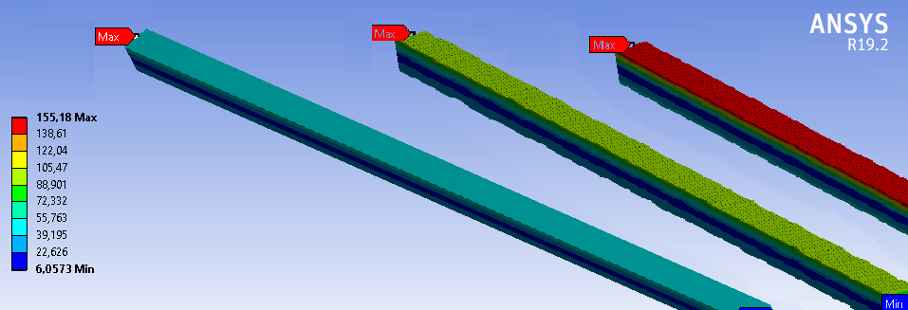
results
4
In the case of VEPP-4M, the mirror was cooled convectively by air. For the SKIF wiggler, computer simulation of radiation heating of a mirror was calculated for various cases, both of the cooling geometry and of various refrigerants, including liquid nitrogen.
VEPP-4M
1 sec
5 sec
8 sec
10 sec
SKIF mirror when cooled by water.
2 sec
5 sec
10 sec

Slide 5
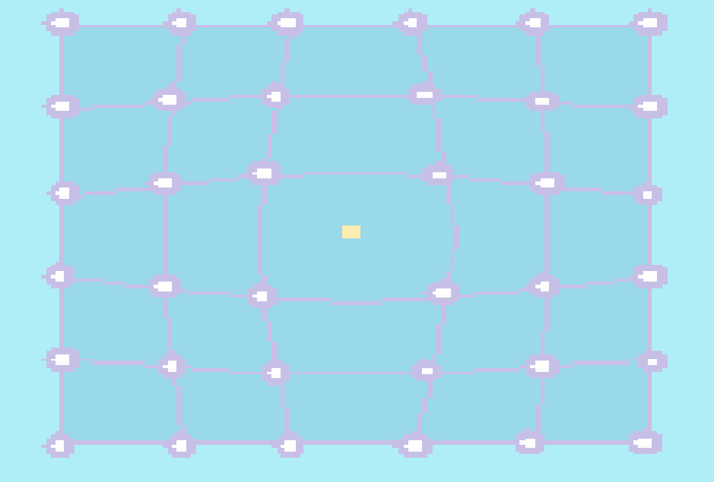
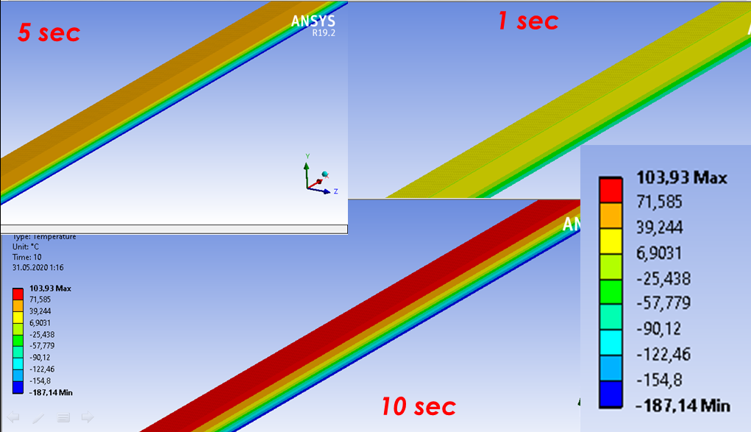
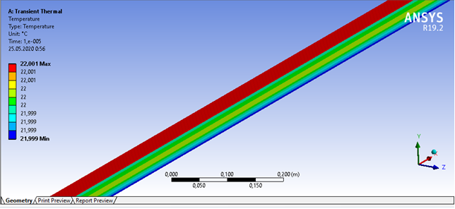
5
SKIF mirror when cooled by liquid nitrogen.
The SKIF mirror is cooled by liquid nitrogen for 10 microseconds

Slide 6
Conclusion
6
The thermal load on the VEPP-4M mirror is calculated;
Experiment with the dimension of the heating mirror at the VEPP-4M is held;
Based on these data, conclusions are made about the reliability of simulating the heating of the mirror on the SKIF.
The conclusion is made about the applicability of x-ray focusing mirrors on the channels of SR output from a wiggler with a field of 4 T for the station “Fast processes".

