Slide 1
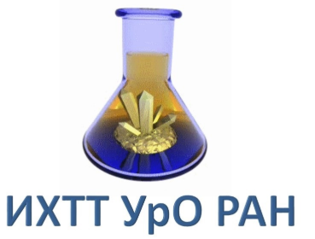
Application of synchrotron radiation to study the surface atomic structure of 2D materials
1
2
3
Speaker: ¹I.A.Arkhandeev
Co-authors: ²I.I.Ogorodnikov, ¹ T.V.Kuznetsova, ²M.V.Kuznetsov, ³L.V.Yashina

Slide 2
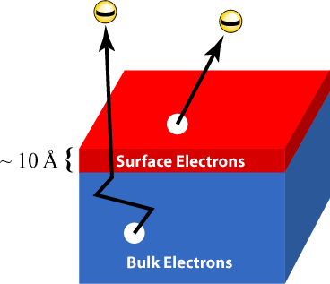
What does the surface mean?
2
Application of Synchrotron Radiation to Study the Surface Atomic Structure of 2D Materials
The characteristic size of the surface depth is only a few atomic layers (~nm). In addition, there are structures where the surface is important in terms of definition: thin (10 nm – 1 µm) and ultra-thin (1-10 nm) films, multilayer structures and others.

Slide 3
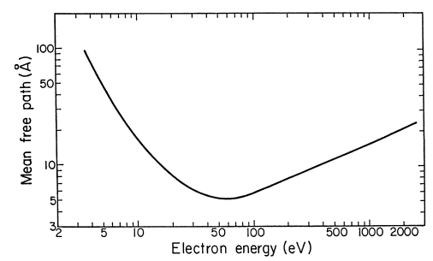
The depth of analysis
3
Application of Synchrotron Radiation to Study the Surface Atomic Structure of 2D Materials
The inelastic mean free path (IMFP) of a photoelectron is a criterion that determines the depth of analytical information selection. For most materials in the range of kinetic energies $E_{0}$= 200-1500 eV, i.e. in the operating energy range for XPD, the values of $λ_{e}$ are proportional to $\sqrt{E_{0}}$. The sensitivity of the surface is rigidly related to the IMFP, which has a pronounced minimum: $λ=\frac{A}{E_{0}^{2}}+B\sqrt{E_{0}}$.

Slide 4
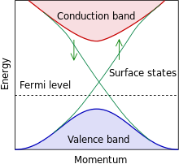
Topological insulators
4
Application of Synchrotron Radiation to Study the Surface Atomic Structure of 2D Materials
Insulating bulk but metallic surface due to strong spin-orbit interaction and time reversal symmetry.
Unique surface state that make surface conducting, with linear dispersion forming a Dirac Cone with a crossing point at the Fermi level.
Helical spin structure with the spin of the electron perpendicular to its momentum.
Electrons in this surface state are protected against scattering.
Very promising for spintronics or quantum computing applications (memory devices, spin field-effect transistors, etc).

Slide 5
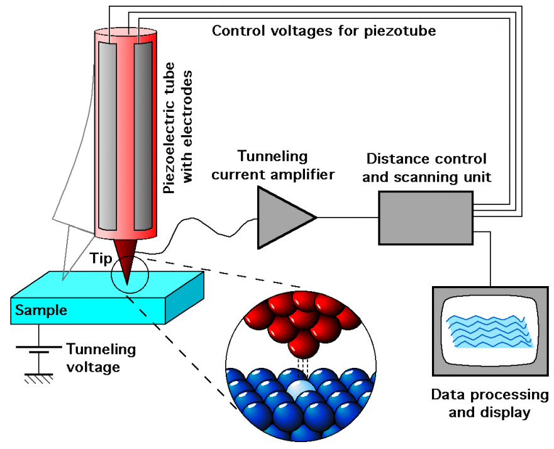
Surface research methods: STM & AFM
5
Application of Synchrotron Radiation to Study the Surface Atomic Structure of 2D Materials
When referring to the surface and its research methods, we often refer to scanning tunneling microscopy (STM) and atomic force microscopy (AFM). These methods have incomparable advantages, since they reproduce the highest-level image. However,
as mentioned earlier, it is necessary to explore the underlying levels, which is not available to these methods.
*Figure taken from conductscience.com/scanning-tunneling-microscope/

Slide 6
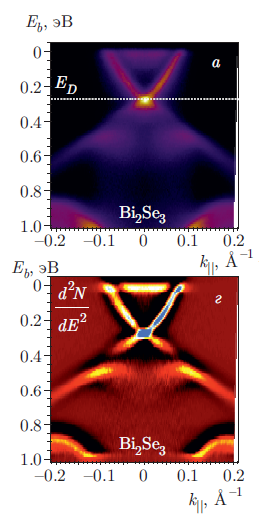
Surface research methods
6
Application of Synchrotron Radiation to Study the Surface Atomic Structure of 2D Materials
There are also a lot of surface research methods currently available:
Absorption methods: NEXAFS/XANES/EXAFS.
Electron spectroscopies methods: XPS, UPS, Auger.
Angle-resolved photoemission spectroscopy
*Figure taken from DOI: 10.7868/S0044451018040120

Slide 7
X-Ray photoelectron diffraction
7
Application of Synchrotron Radiation to Study the Surface Atomic Structure of 2D Materials
XPD is a powerful method that has long been trusted. Let's briefly recall the modes in which x-ray diffraction can be performed.
Angle scanning XPD – the full diffraction pattern is captured at a certain energy. This can also be done on a laboratory electron spectrometer, but the diffraction pattern obtained in this way usually has a longer experiment time, because the photon intensity is much higher in synchrotron centers.
Energy scanning XPD. Using this method, diffraction is available when the energy changes, i.e. on a synchrotron centers such as Bessy II. This type of experiment cannot be performed in a laboratory.
Angle scanning XPD with various energies. This method of performing diffraction is the most informative, since it combines both types of scanning. This is especially useful when performing diffraction in different energy ranges: low energy-medium energy – high energy.

Slide 8
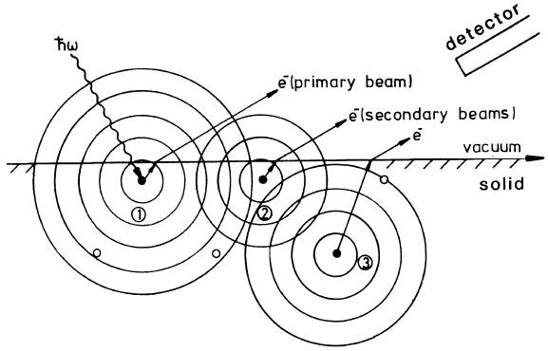
Key features of XPD
8
Application of Synchrotron Radiation to Study the Surface Atomic Structure of 2D Materials
Chemical sensitivity to surface conditions;
Sensitivity to the local atomic structure;
XPD method analysis depth more than 10 layers (~20 Å);
The accuracy of the determination of interatomic distances is better than 0,05 Å;
the possibility of an experiment in the laboratory (only angle-scanned XPD)
*Figure taken from Stefan Hüfner. Photoelectron Spectroscopy: Principles and Application

Slide 9
XPD pattern as a prerequisite for photoelectron holography
9
Application of Synchrotron Radiation to Study the Surface Atomic Structure of 2D Materials
The results of x-ray photoelectron diffraction is a diffraction pattern.
«The phenomenon we know as photoelectron diffraction can be interpreted as photoelectron holography. A two-dimensional photoelectron diffraction pattern is a hologram which can be reconstructed to create an "image" of the three-dimensional crystal structure of a solid surface.»*
To perform reconstruction it’s necessary to use holographic algorithms. At first, specialists used the Fourier transform. But currently there are more advanced algorithms.
*J.J.Barton. Photoelectron holography. Phys.Rev.Lett. 61,1356.

Slide 10
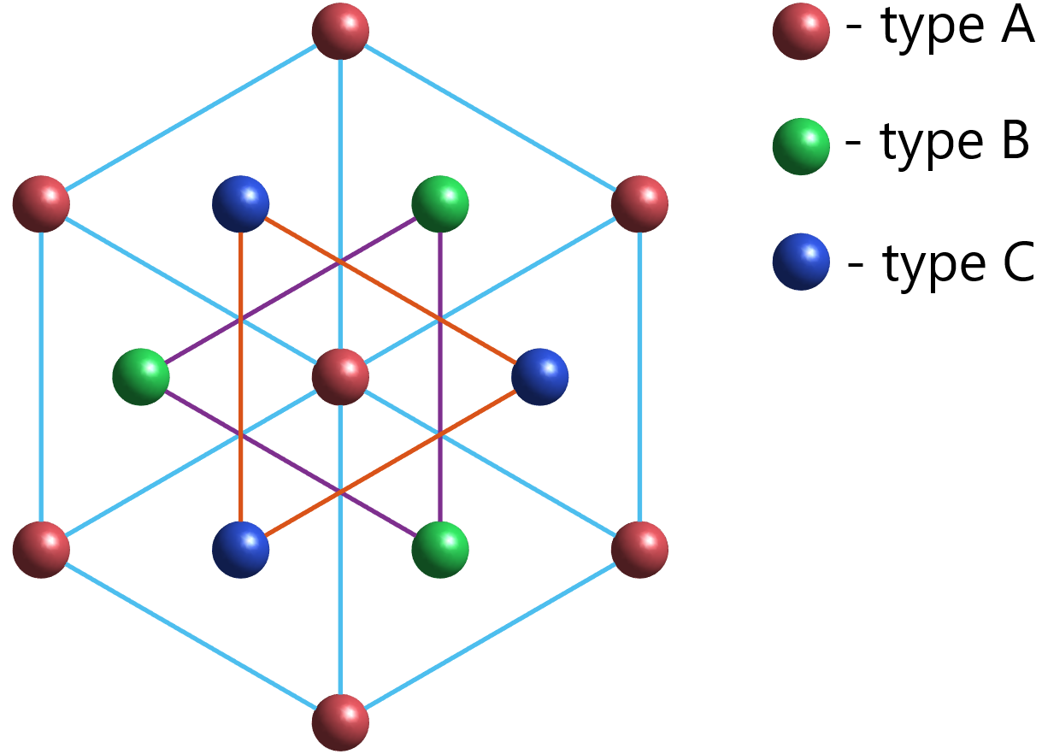
Bismuth Chalcogenides: Bi₂X₃ (X = Se, Te)
10
Application of Synchrotron Radiation to Study the Surface Atomic Structure of 2D Materials
One quintuple layer (QL): X – Bi – X – Bi – X. Quintuple layers slabs are linked by weak van der Waals forces.

Slide 11
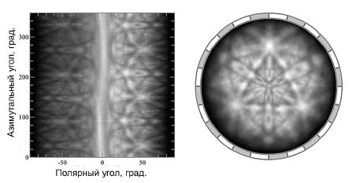
Step I: Experimental diffraction patterns
11
Application of Synchrotron Radiation to Study the Surface Atomic Structure of 2D Materials
The experiments were performed at the Bessie II synchrotron center (Germany) using a toroidal electron analyzer. The result of XPD is a diffraction pattern for which the azimuthal angle is graded vertically and the azimuthal angle is graded horizontally. For convenience, the scan is converted to a stereographic representation. This gives certain advantages: determination of the symmetry of the diffraction pattern and the angles of the main scattering maxima.

Slide 12
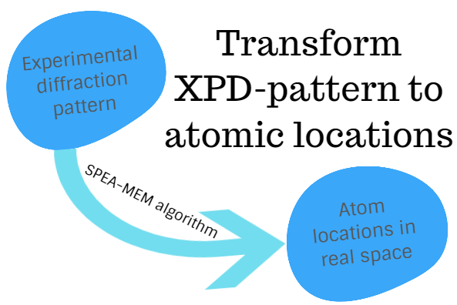
Step II: from experiment to holography by SPEA-MEM algorithm
12
Application of Synchrotron Radiation to Study the Surface Atomic Structure of 2D Materials
Using an experimental diffraction pattern, we can transform XPD-pattern to the atomic structure. Certain holographic algorithms are used for this purpose. Currently, we can safely distinguish SPEA-MEM algorithm proposed by the Matsushita group* and continuously developing to this day. Here, the experimental diffraction pattern is taken as a hologram, and
the reconstruction of the environment is the solution of the inverse problem.
*F. Matsui, T. Matsushita and H.Daimon. Holographic Reconstruction of Photoelectron Diffraction and Its Circular Dichroism for Local Structure Probing. Journal of the Physical Society of Japan 87 (2018) 061004.

Slide 13
Step III: result of photoelectron holography
13
Application of Synchrotron Radiation to Study the Surface Atomic Structure of 2D Materials

Slide 14
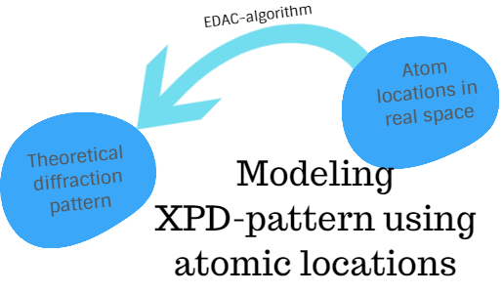
Step IV: verifying results by modeling theoretical patterns. EDAC-algorithm
14
Application of Synchrotron Radiation to Study the Surface Atomic Structure of 2D Materials
As a result of photoelectron holography, a set of atom locations is obtained. After that, the obtained data must be verified by performing a simulation of the theoretical diffraction pattern. To do this we can use the EDAC* algorithm. EDAC is one of the reliable programs that
allows to do this. To do this, it’s necessary to build an atomic cluster with certain calculation parameters set.
*García de Abajo, Van Hove, and Fadley, Phys. Rev. B 63, 75404 (2001)

Slide 15
Result of modeling diffraction patterns
15
Application of Synchrotron Radiation to Study the Surface Atomic Structure of 2D Materials

Slide 16
Step V: R-factor analyses.
16
Application of Synchrotron Radiation to Study the Surface Atomic Structure of 2D Materials
Comparison of experimental and theoretical XPD patterns is based on the so-called R-factor of divergence. The lower this parameter, the better the theory and experiment agree and, consequently, the model cluster most accurately describes the studied surface.

Slide 17
Conclusion
17
Application of Synchrotron Radiation to Study the Surface Atomic Structure of 2D Materials
Structural study of the surface is well achieved by the combined use of x-ray photoelectron diffraction and holography methods.
Obtaining diffraction patterns is most effective in a synchrotron center because of the radiation characteristics (the possibility of varying energies, high radiation intensity, different types of polarizations, etc.).
Thus, synchrotron radiation can help effectively study the atomic structure of the surface.

Slide 18
Acknowledgements
18
Application of Synchrotron Radiation to Study the Surface Atomic Structure of 2D Materials
The reported study was funded by RFBR, project number 19-29-12061 and was carried out within the state assignment of Ministry of Science and Higher Education of the Russian Federation (theme “Spin” No. АААА-А18-118020290104-2).

