Slide 1
ECL DAQ status
Vladimir ZHULANOV, Budker INP
06.09.2016

Slide 2
Outline
Electronics status
ECL data format
ShaperDSP access & initialization

Slide 3
ECL electronics
52 X
ECLCollector
FTSW
ShaperDSP
TTD
ShaperDSP
ShaperDSP
belle2link
COPPER
HSLB
HSLB
12 ShaperDSPb
Modules
TTRX
Electronics for all 52 crates has been installed and connected to DAQ
PreAmps only for barrel part are connected
Stable DAQ operation with random TR=30 kHz. And continuous stable work during >20 hours

Slide 4
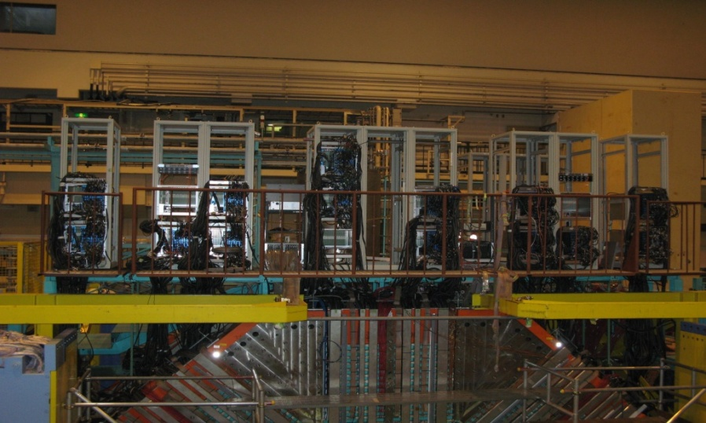
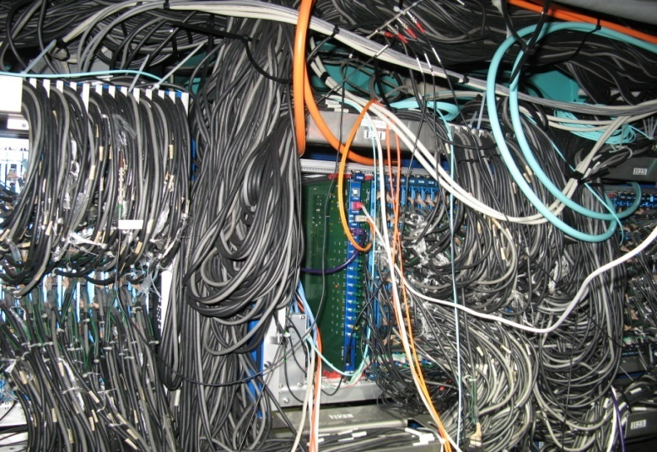

Slide 5
ECL Data format – overall structure
EclCollector header
Overall packet structure
31 | 30 | 29 | 28 | 27 | 26 | 25 | 24 | 23 | 22 | 21 | 20 | 19 | 18 | 17 | 16 | 15 | 14 | 13 | 12 | 11 | 10 | 9 | 8 | 7 | 6 | 5 | 4 | 3 | 2 | 1 | 0
reserved |  |  |  |  |  |  |  |  |  |  |  |  |  |  |  |  |  |  |  | SHAPER_DSP_DATA_MASK
EclCollector header
ShaperDSP#1 data
ShaperDSP#2 data
ShaperDSP#3 data
…
ShaperDSP#12 data
ADC_DATA_ENCODED flag
b12=1: ADC data encoded
b12=0: ADC data in raw format
SHAPER_DSP_DATA_MASK
b11=1: ShaperDSP#12 data presented
b11=0: ShaperDSP#12 data omitted
b10=1: ShaperDSP#11 data presented
b10=0: ShaperDSP#11 data omitted
…
b0=1: ShaperDSP#1 data presented
b0=0: ShaperDSP#1 data omitted
ShaperDSP data presented
only for those ShapersDSPs
marked in corresponding
position here
ShaperDSP data format see in the next slide

Slide 6
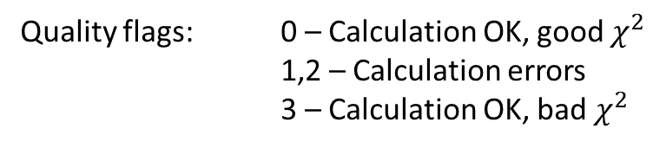
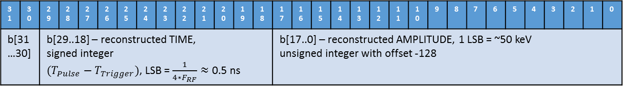
ECL Data format – ShaperDSP data
ShaperDSP data
 | b31…b24 | b23…b16 | b15…b8 | b7…b0
0 | PCK_ID (debug reasons) | 0x10 (magic number) | b[15..0] – PCKT_LEN ShaperDSP packet length
1 | b[28…24] – ADC_NUM Channels # with raw ADC data presented = weight (number of ‘1’s) of the ADC_MASK | b[22…16] – SAMPLES_NUM | b[12…8] – DSP_NUM Channels # with DSP data presented = weight (number of ‘1’s) of the DSP_MASK | b[7…0] – TRG_PHASE Trigger phase within ADC conversion period. Δt = 4 ns
2 | b[31..16] – DSP_MASK Reconstructed (DSP) data present only for those channels marked in this mask |  | b[15..0] – TRG_TAG Trigger TAG
3 | reserved |  | b[31..16] – ADC_MASK ADC data present only for those channels marked in this mask
4 … | DSP data: DSP_NUM words
… | ADC data: ADC_NUM x SAMPLES_NUM if encoding not enabled, much less otherwise
DSP data for 1 channel:
31 | 30 | 29 | 28 | 27 | 26 | 25 | 24 | 23 | 22 | 21 | 20 | 19 | 18 | 17 | 16 | 15 | 14 | 13 | 12 | 11 | 10 | 9 | 8 | 7 | 6 | 5 | 4 | 3 | 2 | 1 | 0
b[31…30] |  | b[29..18] – reconstructed TIME, signed integer $(T_{Pulse}−T_{Trigger})$, LSB = $\frac{1}{{4∗F}_{RF}}≈$ 0.5 ns |  |  |  |  |  |  |  |  |  |  |  | b[17..0] – reconstructed AMPLITUDE, 1 LSB = ~50 keV unsigned integer with offset -128
Quality flags: 0 – Calculation OK, good $χ^{2}$
1,2 – Calculation errors
3 – Calculation OK, bad $χ^{2}$

Slide 7
ECL Data format – ShaperDSP data – raw format
b[31…18] | b[17…0]
reserved | Ch#1, Sample #0
reserved | Ch#1, Sample #1
reserved | …
reserved | Ch#1, Sample #N
reserved | Ch#2, Sample #0
reserved | Ch#2, Sample #1
reserved | …
Ch#1
SAMPLES_NUM
samples
ADC_NUM x SAMPLES_NUM
samples
Very ineffective way of encoding!
14 bits of 32 are not used
Usually ADC values are within narrow region around baseline
ADC data encoding see next slide

Slide 8
max = 2750
word# | contents
0 | b[31…23] 7 | b[22…18] WIDTH 9 |  | b[17…0] BASELINE 2245
1 | ... |  | b[17…9] 27 |  | b[8…0] 22
… | …
diff = 505
min = 2245
Sample #0 = 2252 = 2245 + 7
Sample #1 = 2267 = 2245 + 22
Sample #2 = 2272 = 2245 + 27
…
9 bits enough to encode any offset
relative to the common base line.
Even less bits for smaller pulses!
BASELIND, WIDTH and OFFSETS
are encoded in common bitstream

Slide 9
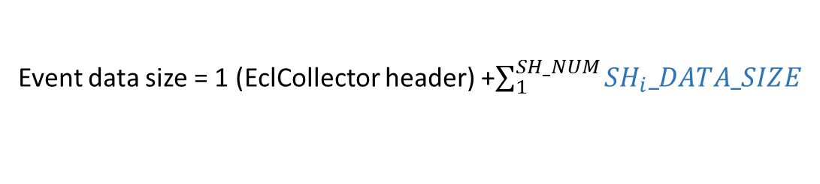
Event data size estimations
Event data size = 1 (EclCollector header) +$\sum_{1}^{SH_NUM}{SH_{i}_DATA_SIZE}$
$SH_{i}_DATA_SIZE$ = 4 (ShaperDSP header) + DSP_NUM + ADC_NUM * SAMPLES_NUM
1 word for every hit channel
16 words * occupancy (<30%)
496 words = 16 channels * 31 samples (no encoding)
For regular runs
appended only to
1/100 events or less
140 words ~= 16 channels * 8.7 words (av. # of words with encoding)
Thus, for occupancy 30% and 1/100 ratio of events with raw ADC data we have average event size:
S = 1 + 12 * (4 + 16*0.3 + 140 * 1/100) = 1 + 12 * (4+4.8+1.4) ~= 123 words. MIN/MAX = 49/3841 words
49 out of 123 words are headers!!!
We should think on how much of this we can strip and where (on EclCollector?/ on Copper?)
Looking at the headers I see that this number (49) can be reduced to 14,
so the average Event size can be reduced to 88 words.

Slide 10
Access to ShaperDSPs
Original design
EclCollector FPGA
In the very first version (no belle2link) we
used Ethernet interface with low level access:
no packet decoding on Collector side
IN
BUF # 1
Custom
ETH
I/F
ShaperDSP #1
Ethernet
OUT
BUF # 1
IN
BUF # 2
ShaperDSP #2
OUT
BUF # 2
…
IN
BUF # 12
ShaperDSP #12
OUT
BUF # 12

Slide 11
Intermediate design
EclCollector FPGA
In the intermediate version
the data merger was implemented
decoding packets from Shapers moved from remote PC to embedded CPU
Drawback:
No read from shapers while Event data merger is active ➔ no Shapers monitoring during RUN
IN
BUF # 1
Embedded
CPU
ShaperDSP #1
Ethernet
OUT
BUF # 1
IN
BUF # 2
ShaperDSP #2
OUT
BUF # 2
Event data merger
…
Belle2link
IN
BUF # 12
ShaperDSP #12
OUT
BUF # 12

Slide 12
Advanced (current) design
EclCollector FPGA
In the current version
Packets for Read ShaperDSP registers/memories is implemented in Merger’s logic
Full access to ShaperDSP internals during RUNs
IN
BUF # 1
Embedded
CPU
ShaperDSP #1
Ethernet
OUT
BUF # 1
IN
BUF # 2
Decoded data
ShaperDSP #2
OUT
BUF # 2
Event data merger
+
all packets decoder
…
Belle2link
IN
BUF # 12
ShaperDSP #12
OUT
BUF # 12

Slide 13
ECL initialization using only b2link
Operation recently done only with Ethernet interface can be done now with b2link
Download ShaperDSP firmware
Download ShaperDSP coeficients
reghs -a fee32 0x00B0 0xA7000000 # set Flash-memory address
reghs -a fee32 0x00B2 0xFFF # set active ShaperDSP mask
reghs -a fee32 0x00B8 1 # init downloading ShaperDSP firmware
set er_code = 1 # wait completion of operation
while( $er_code != 00000000 )
set er_code = `reghs -a fee32 0x00B8 | awk '{split($0,array," "); print array[3]}'`
end
set er_code = `reghs -a fee32 0x00B9 | awk '{split($0,array," "); print array[3]}'`
echo $er_code # print operation status: 00000000 - OK
reghs -a fee32 0x00B0 0xAA000000 # set Flash-memory address
reghs -a fee32 0x00B2 0x002 # set active ShaperDSP mask
reghs -a fee32 0x00B8 2 # init downloading ShaperDSP coeficients
set er_code = 1 # wait completion of operation
while( $er_code != 00000000 )
set er_code = `reghs -$SLOT fee32 0x00B8 | awk '{split($0,array," "); print array[3]}'`
end
set er_code = `reghs -$SLOT fee32 0x00B9 | awk '{split($0,array," "); print array[3]}'`
echo $er_code # print operation status: 00000000 - OK
Write ShaperDSP registers
set REG_NUM = 0303 # set ShaperDSP register number
set REG_WDATA = 0BB8 # set ShaperDSP register date to be written
reghs -a fee32 0x00B0 0x${REG_NUM}${REG_WDATA}
reghs -a fee32 0x00B2 0x${SH_MASK} # set active ShaperDSP mask
reghs -a fee32 0x00B8 0x4 # init write ShaperDSP register
set er_code = 1 # wait completion of operation
while( $er_code != 00000000 )
set er_code = `reghs -$SLOT fee32 0x00B8 | awk '{split($0,array," "); print array[3]}'`
end
set er_code = `reghs -$SLOT fee32 0x00B9 | awk '{split($0,array," "); print array[3]}'`
echo $er_code # print operation status: 00000000 - OK

Slide 14
Conclusion
ECL DAQ works smoothly with all 52 EclCollectors connected but in process of continuous improvements
Initialization and verification modules in CBASF TBD
Strip excessive header information

Slide 15
Thank you

Slide 16
Calibration 0.7 ns instability
Time shift of the calibration pulse after EclCollector reset
192 channels served by 1 EclCollector
= single calibration pulse generator

Slide 17
FPGA
DATA CLOCK
DAC has 4 sample pipeline and smart logic
to provide the continuous conversion with
no strict requirements for input data interface.
After reset this logic falls to unpredicted state
unpredicted extra test pulse delay of 0.7 ns
Disabling the logic for auto data-capture
solved the instability problem
DAC
DATA
Test
pulse
CONV
phase between “data clock”
and “CONV” signals can drift
up to 1 DAC conversion period
jitter-free clock

Slide 18
No time shift after Update

Slide 19
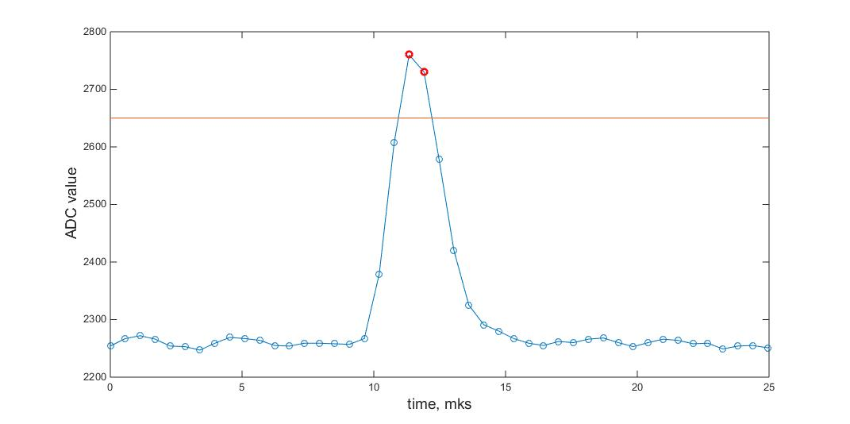
HIT threshold – original design
Original HIT threshold:
If average of two samples at peak is less than set threshold then the processing of this channel is skipped
➔ Process only channels with hits
Drawback : due to baseline drift we had to set this threshold too low
➔ effectively no threshold

Slide 20
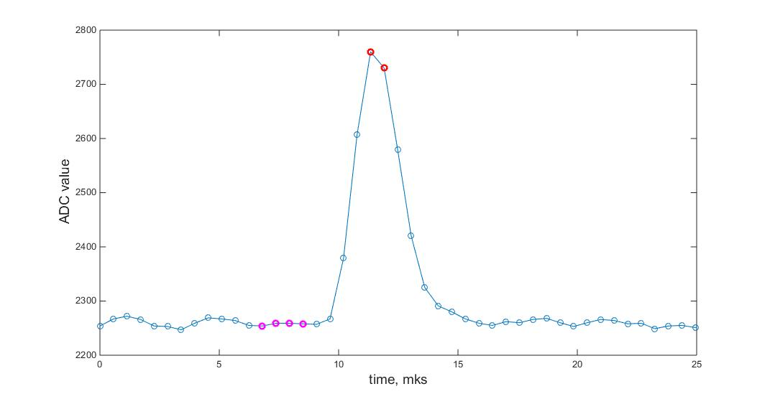
HIT threshold – differential design
Differential HIT threshold:
average of two samples and peak
and average of 4 samples at baseline
are compared to the set threshold
➔ Immune to baseline drifts
Diff threshold

Slide 21
Minor updates
b2tt part in EclCollector updated to v0.48
No spurious LINK state for not connected Shaper interfaces
ShaperDSP coefficients verification
Access to ShaperDSP internals through belle2link ➔ All initialization (except uploading data to flash-memory) can be performed
using only belle2link

