Slide 1
Novel Electron Beam Based Test Facility for Observation of Dynamics of Tungsten Erosion under Intense ELM-like Heat Loads
L.N. Vyacheslavov^{a,b}, A.S. Arakcheev^{a,b,c}, A.V. Burdakov^{a,c}, I.V. Kandaurovª, A.A. Kasatov^{a,b}, V.V. Kurkuchekov^{a,b}, K.I. Meklerª, V.A. Popov^{a,b}, A.A. Shoshin^{a,b}, D.I. Skovorodin^{a,b}, Yu.A. Trunev^{a,b}, A.A. Vasilyev^{a,b}
^{a.}Budker Institute of Nuclear Physic SB RAS, Novosibirsk, 630090, Russia
^{b.}Novosibirsk State University, Novosibirsk, 630090, Russia
^{c.}Novosibirsk State Technical University, Novosibirsk, 630092, Russia
11th International Conference on Open Magnetic Systems for Plasma Confinement
11 Aug

Slide 2
Motivation
The most serious damages of plasma facing material in reactor-grade fusion devices are expected during transient events
In the ITER divertor heat load increases 2-3 orders of magnitude and reaches energy density Q_{h}=5-80 MJm⁻², power density q_{h}=5-25 GWm⁻² over the heating time τ_{h}=0.3–3 ms for type I ELMs and major disruption. These heat loads correspond to maximal heat flux parameter values F_{HF}=600-2000 MJ m⁻² s^{-0.5} [1, 2]
Even with development of procedures for transients mitigation some number of unmitigated transient event cannot be excluded
Modern tokamaks cannot reproduce ITER-grade transient heat loads while specially developed linear devices for transient simulation like QSPAs and lasers also have limitation like excessive pressure on melted material, strong vapor shielding and strong background light
[1] R.A. Pitts et al., J. Nucl. Mater. 438 (2013) S48
[2] M. Shimada et al., J. Nucl. Mater. 438 (2013) S996

Slide 3
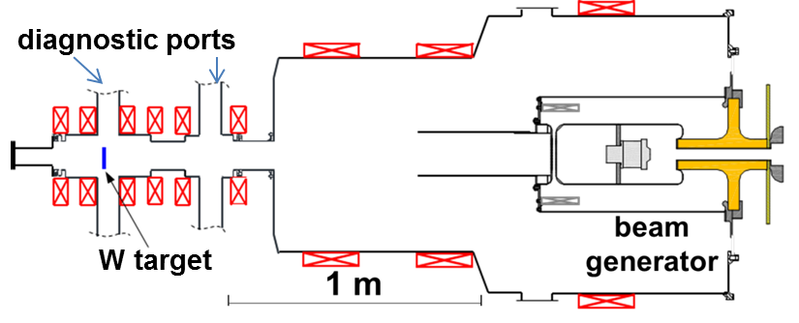
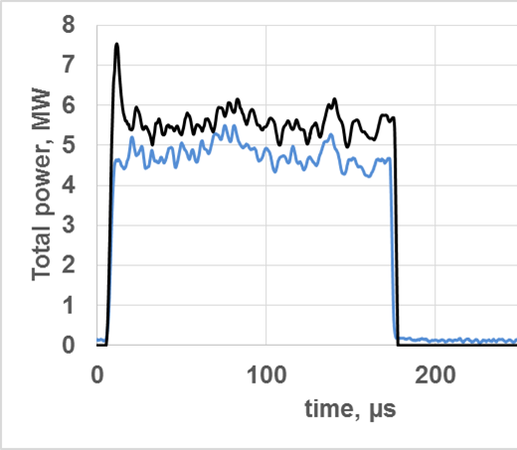
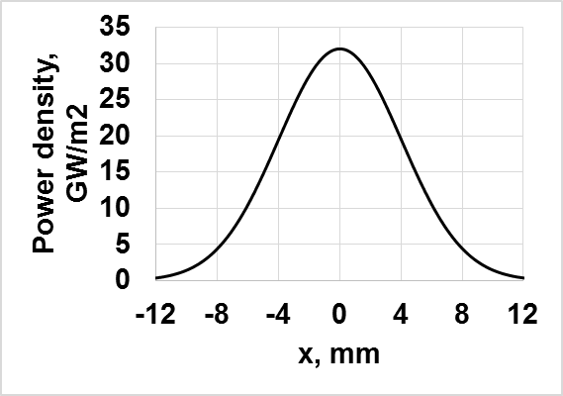
Advantages of long-pulse electron beam use for simulation of transient heat loads
Geometry of experiments
Electron beam power dynamics
X-ray from the target
Profile of absorbed heat power density
Better suits to ITER divertor condition due to absence of high plasma pressure typical for plasma gun simulators of transient heat
Much higher limit for maximal heat load by shielding effect of the ablation plume (vapor shielding)
Relative weak background light permits in-situ observation of tungsten surface modification

Slide 4
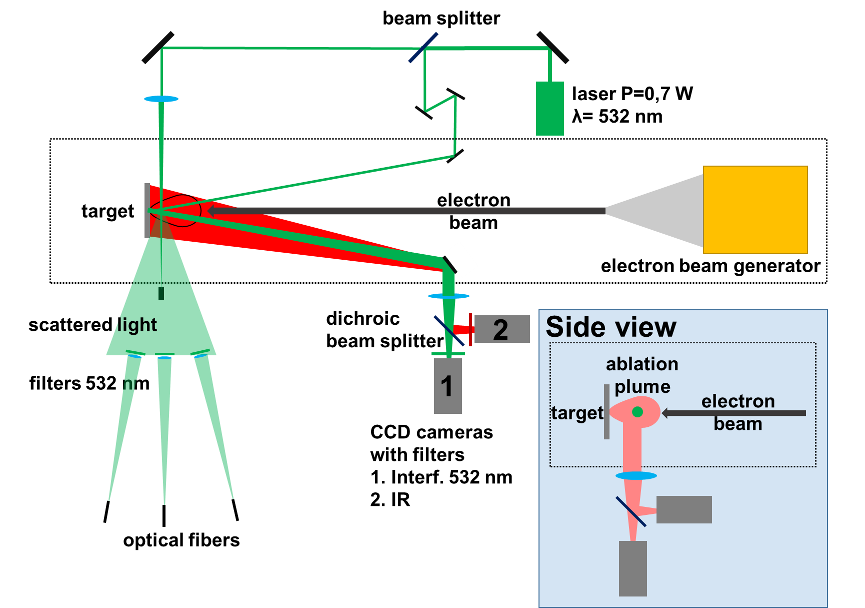
Diagnostics setup
Top view
CCD
CCD or spectrometer

Slide 5
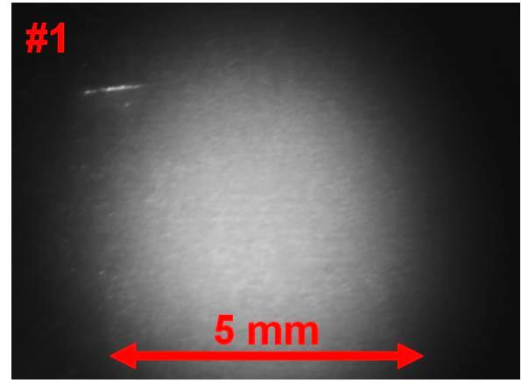
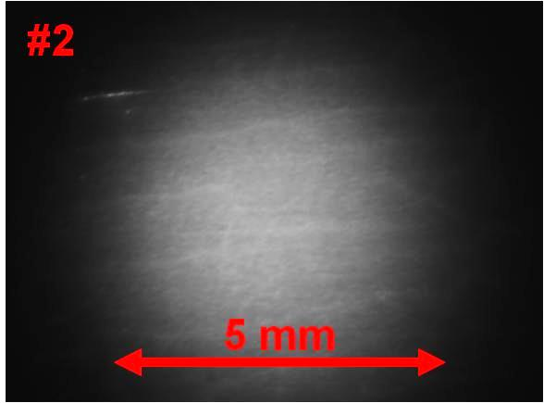
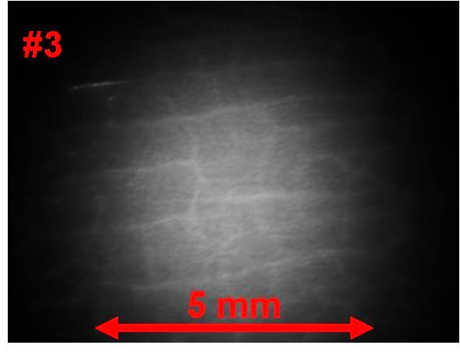
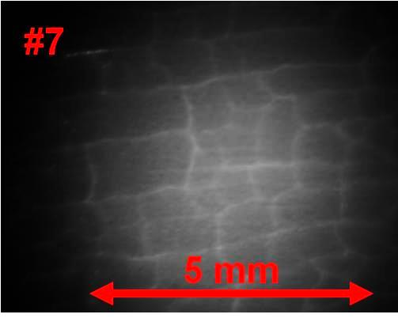
CCD cameras in the near infrared detect non-uniform heating of tungsten surface due to cracks creation from the first heating pulses
The target surface of rolled tungsten was imaged in NIR range during heating with average heat load 0.5 MJ/m² near the melting threshold. Slight crack network formed after the first pulse. With subsequent exposures this net became denser and radiation non-uniformities became more distinguishable.

Slide 6
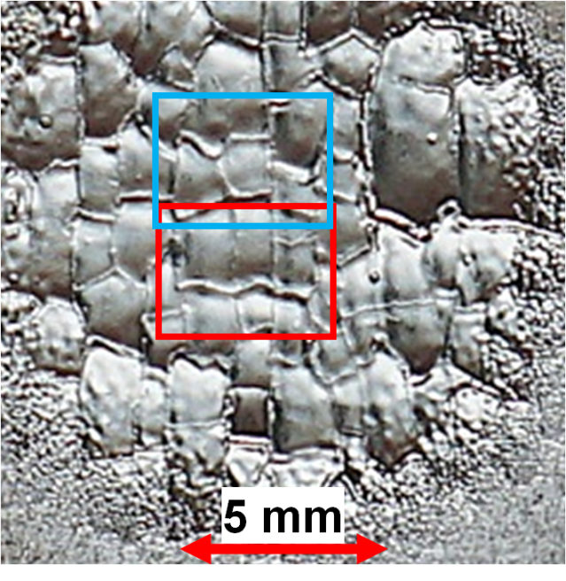
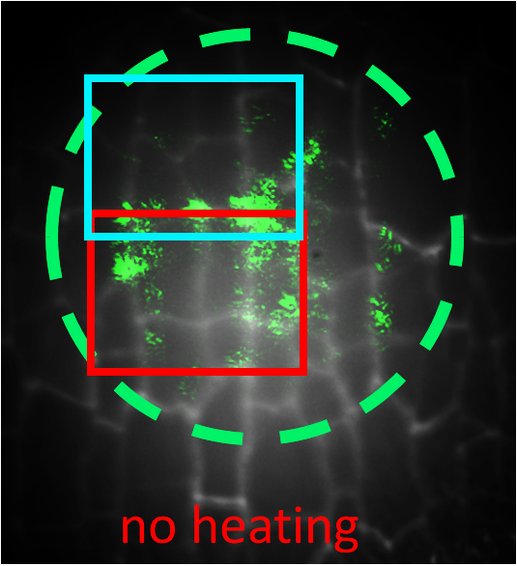
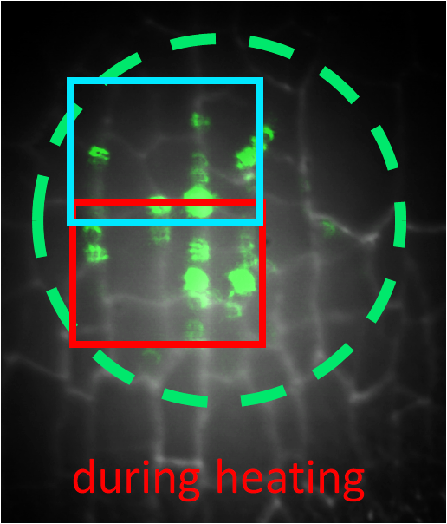
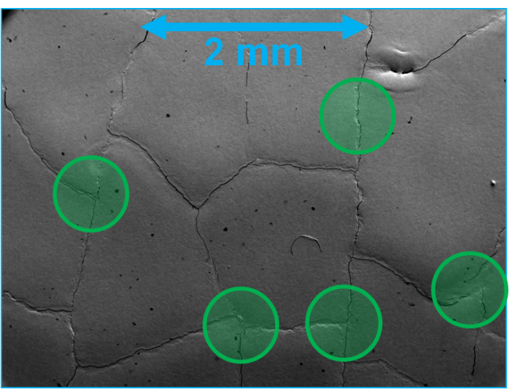
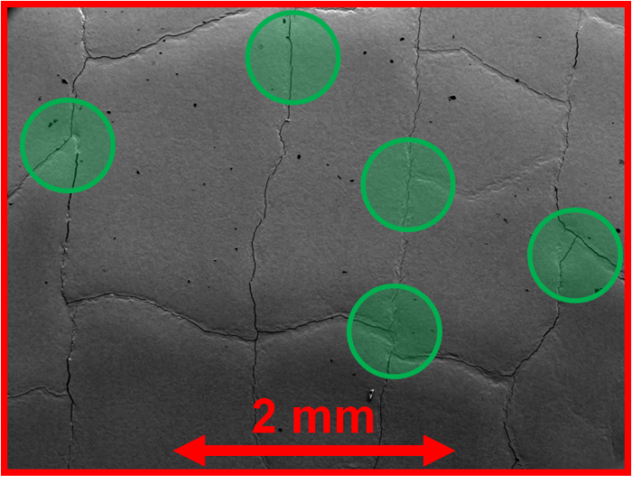
Target surface imaging with laser light illumination
Photo of the target surface after extraction from vacuum chamber
Tungsten surface images with green laser light illumination with and without heating overlaid on thermal radiation images
Tungsten plate was exposed 72 times with average heat load about 0.55 MJ/m² and
F ~60 MJ/m²/s^{0.5}.
SEM images of the areas with increased laser light reflections shown with green circles

Slide 7
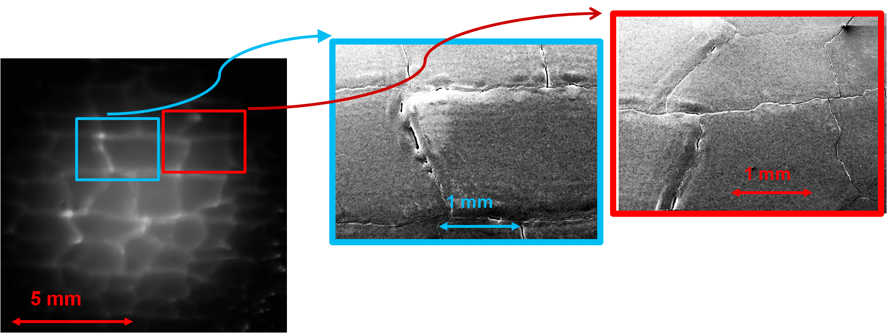
The occurrence of cracks parallel to the surface
IR image of the target surface during heating process (F≈80 MJ/m²/s^{0.5}. )
SEM images of the hot areas after electron beam exposure
Parallel cracks creation shown on transverse microsections of the target after 24 exposures with average heat load about 1 MJ/m² and
F ~70 MJ/m²/s^{0.5}

Slide 8
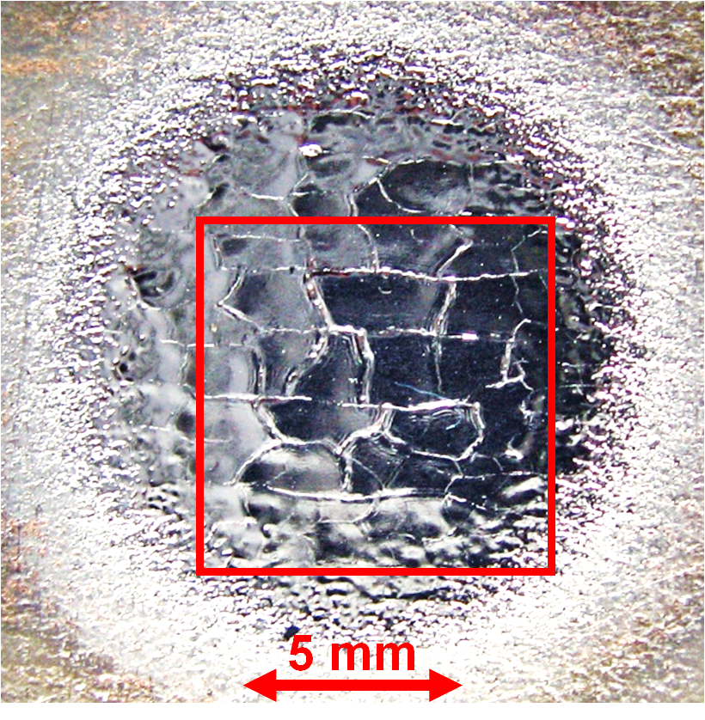
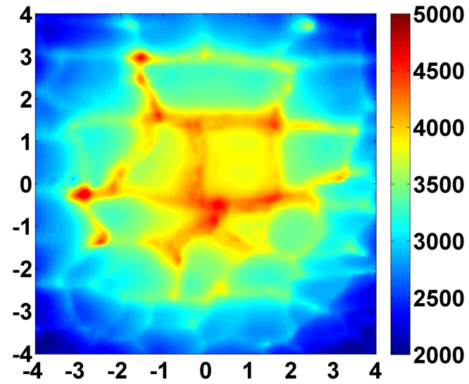
Areas with parallel cracks have higher temperature
Photo of the target surface after extraction from vacuum chamber
Surface temperature distribution 20 μs after heating termination
F≈60 MJ/m²/s^{0.5}

Slide 9
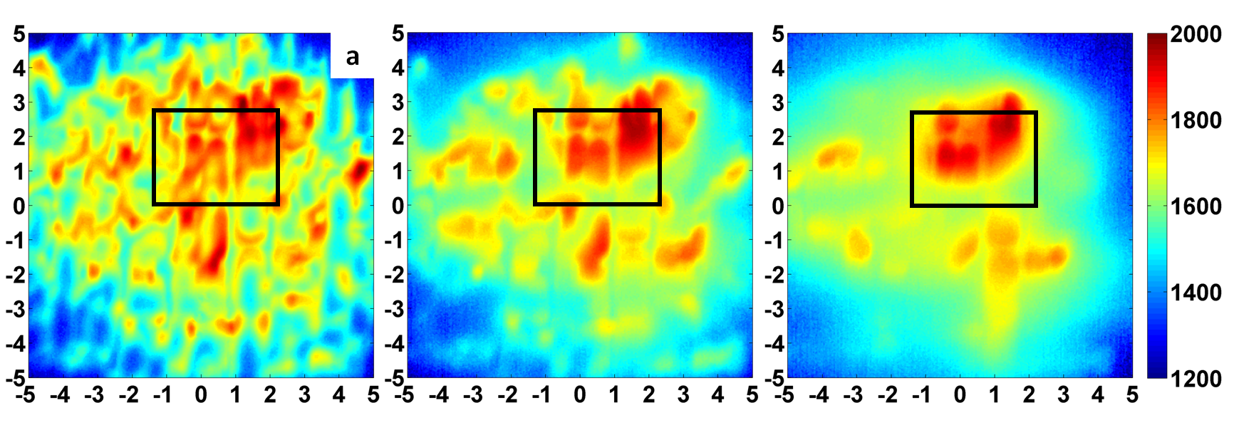
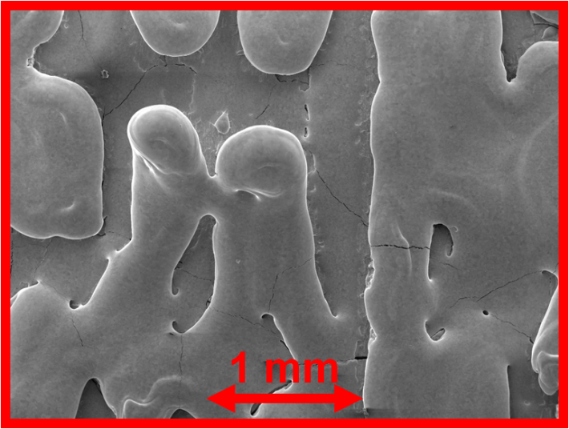
Parallel cracks develop to detached material portions and cool down much more slowly than less damaged surrounding areas
Surface temperature profiles at different delays after heating termination
same target and same spatial and color scales
0.35ms
1.85 ms
7.85 ms
SEM image of detached parts of the top surface layer after exposure
Target was exposed under heat loads about 0.8 MJ/m² with F~90 MJ/m²/s^{0.5} for more than 100 pulses which was above melting threshold.

Slide 10
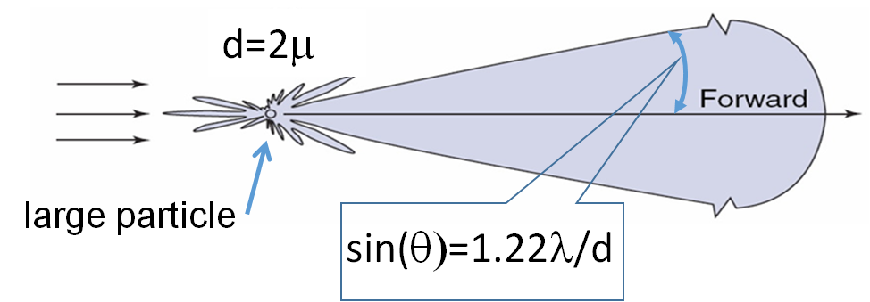
Geometry of small angle scattering near the target surface
Fraunhofer diffraction from an opaque spherical particle
side view
top view
ablation plume
scattered light
scattered light
5-7 mm
laser beam
25x25 mm
tungsten target

Slide 11
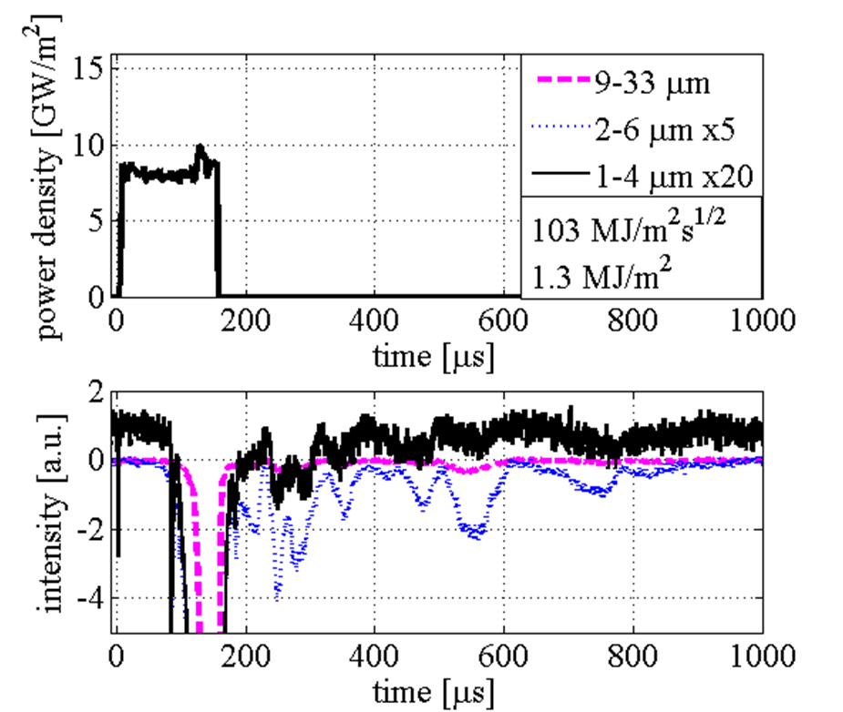
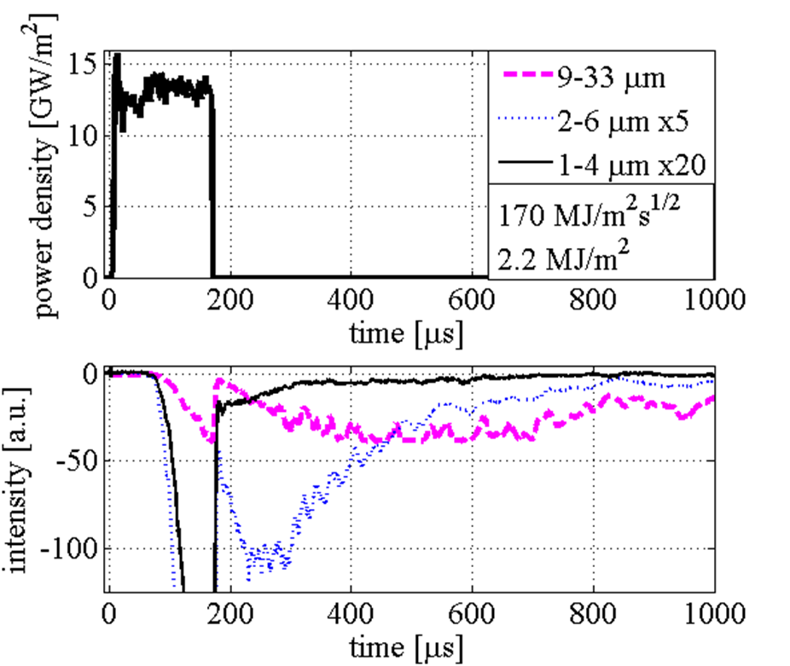
Small angle scattering of continuous laser light permits observation of dynamics of particle flow from the tungsten surface
Scattering signal waveforms
Medium heat flux (F=100MJ/m²s^{0.5})
High heat flux (F=170MJ/m²s^{0.5})
x20
x5
x5

Slide 12
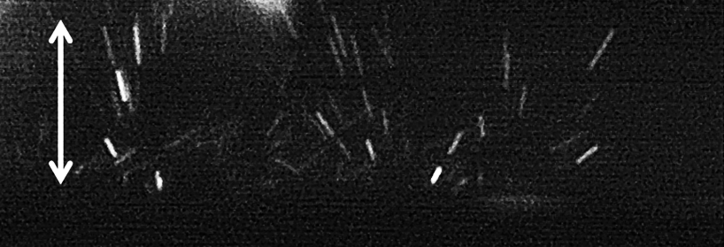
Ejection of tungsten particles greatly increases with the heat flux
CCD images of particles ejection with exposition of 10µs 40-50 µs after the heat termination
1mm
F =120 MJ/m²/s^{0.5}
1mm
F =210 MJ/m²/s^{0.5}
target surface
Energy of light scattered on tungsten particles vs intensity of heat load

Slide 13
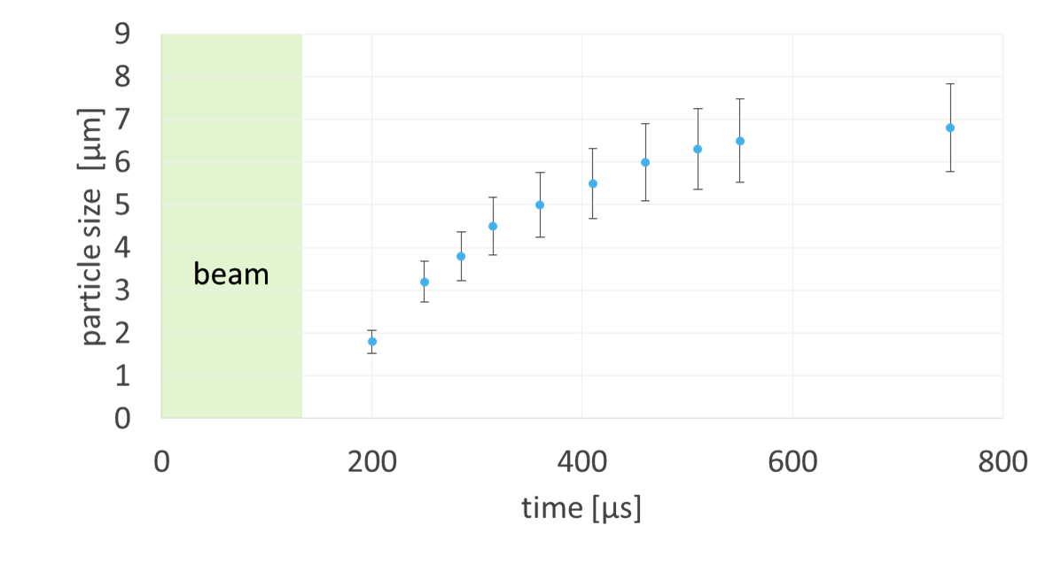
Particles size increases vs time according to laser light scattering data
In assumption that each moment laser beam is crossed by particles of similar size

Slide 14
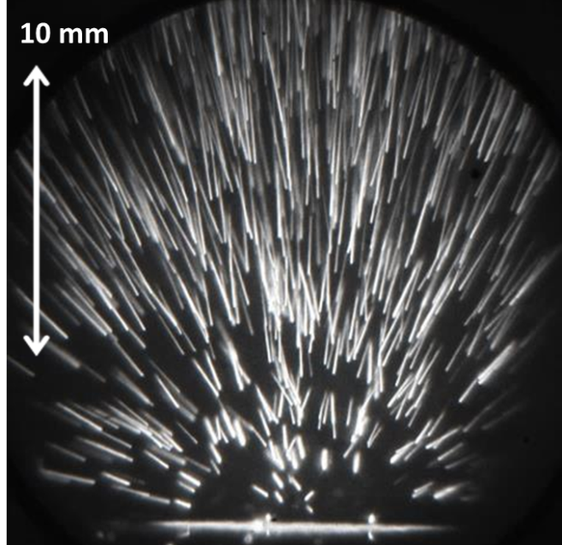
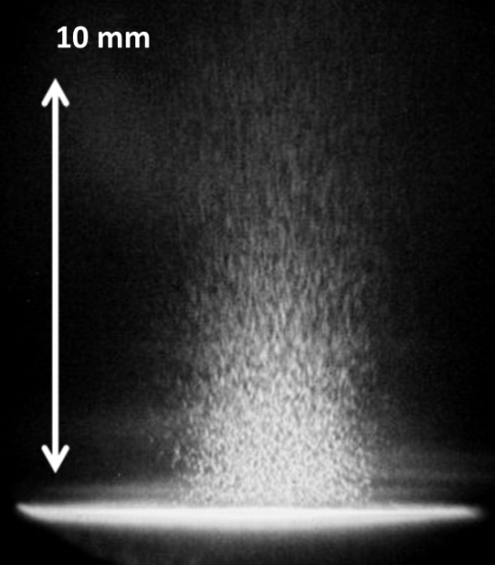
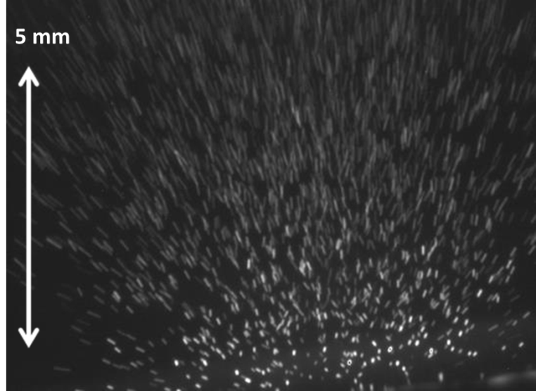
Fast imaging of droplet ejection from the tungsten surface
T_{exp} = [170, 172] µs,
T_{beam} = 125 µs
19 GW/m²,
2.3 MJ/m²,
210 MJ/m²s^{0.5}
T_{exp} = [500, 520] µs, T_{beam} = 131 µs
22 GW/m²,
3.2 MJ/m²,
260 MJ/m²s^{0.5}
T_{exp} = [1500, 1800] µs, T_{beam} = 124 µs
19 GW/m²,
2.3 MJ/m²,
210 MJ/m²s^{0.5}

Slide 15
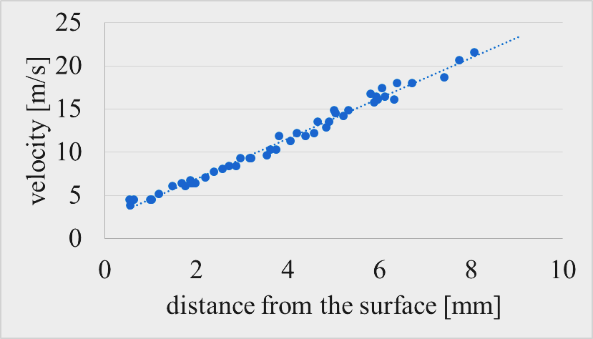
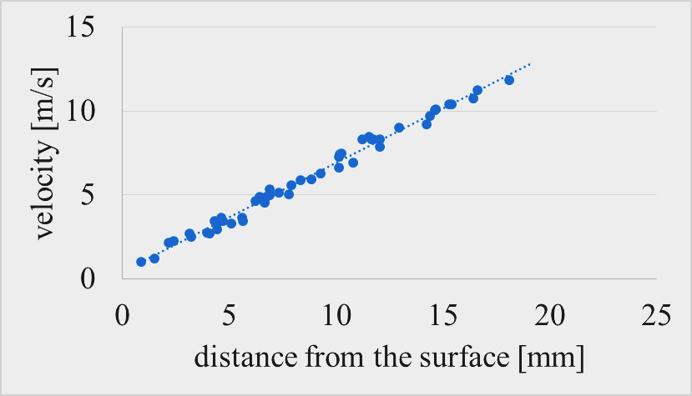
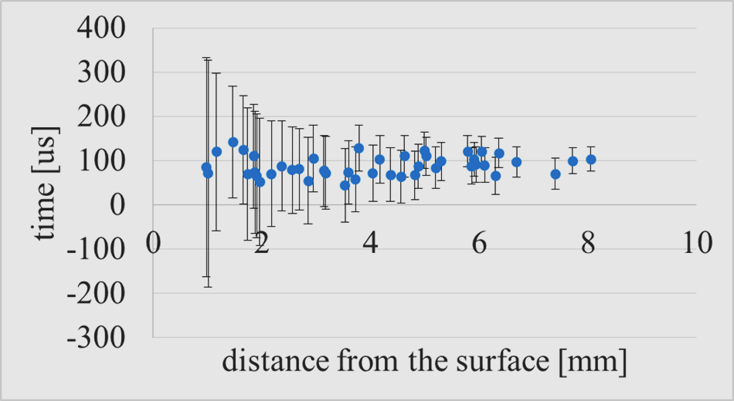
Velocities of particles follow a sort of Hubble law
0.37 ms after heat end
1.7 ms after heat end
Start time vs particle distance from the surface

Slide 16
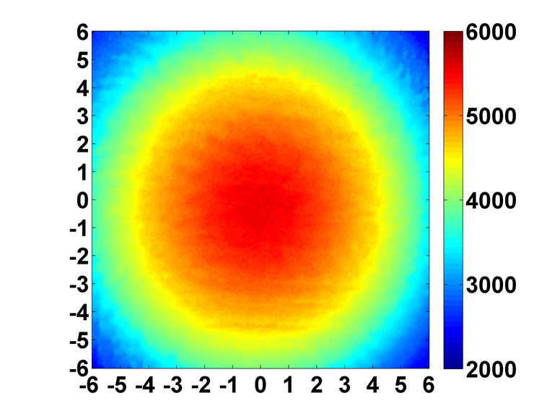
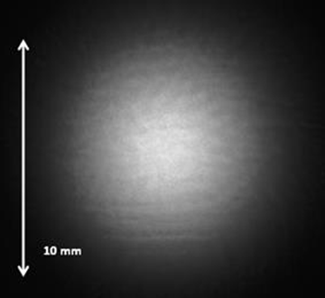
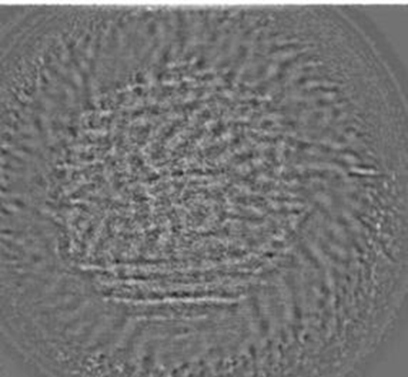
Imaging of melt to search the mechanism of particles ejection
IR image of the target
IR image high-pass filtered
Temperature profile
T_{exp} = [115, 125] µs, T_{beam} = 125 µs, 19 GW/m², 2.3 MJ/m², F=210 MJ/m²s^{0.5}

Slide 17
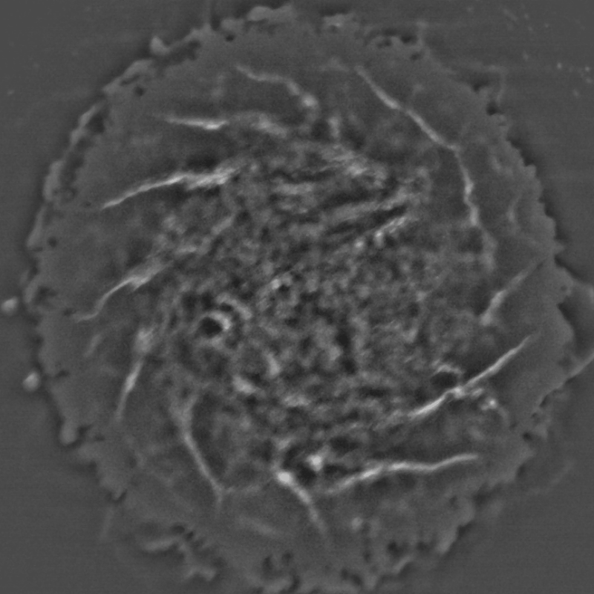
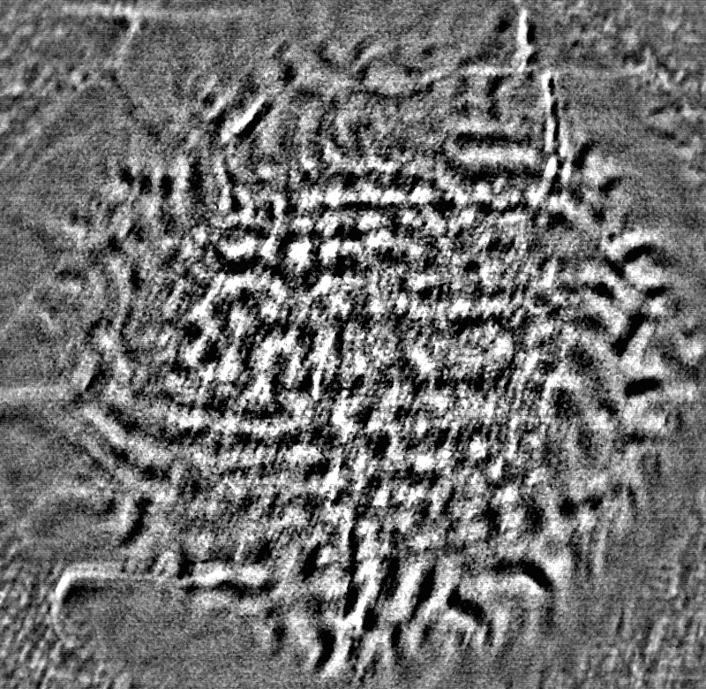
Tungsten melt layer dynamics recorded with fast CCD cameras
JxB rotation evident from the successive pulses, frame exposition 30µs
dynamics of molten layer solidification obtained in a single heat pulse, frames separation 10µs
T_{beam} = 200 µs, 19 GW/m²,
3.4 MJ/m², F=250 MJ/m²s^{0.5}

Slide 18
summary
Intense long-pulse electron beam has advantage in experimental simulation of ITER scale transient heat loads
Fast imaging in the near infrared range reveals dynamics of tungsten surface modification during the transient heat load
Continuous wave laser light reflection from the tungsten surface detects melting in hot spot near the crack edges
Small angle scattering of continuous laser light is effective in observation of dynamics of tungsten particles emission at elevated heat load FHF>170 MJ/m²s^{0.5}

Slide 19
Thank you for attention!

