Slide 1
Logistics
Andrey Shoshin

Slide 2
Week’s Plan
 | Tue 21 | Wed 22 | Thu 23 | Fri 24
Bus from Golden Valley | 8:45 | 8:45 | 8:45 | 8:45
Ru progress | 9:00-16:00
ITPA #30 |  | 9:00-17:00 | 9:00-18:00 | 9:00-18:00
PICT #4 |  |  | 9:00-12:00 14:30-17:30
Side meetings |  | 10:25-12:25 14:00-16:30
Bus to BINP from Academpark | 16:00
Bus to Theatre from Academpark |  | 17:00
Bus to Hotel | 20:15 | ~22:00 | ~22:00 | 18:00
https://indico.inp.nsk.su/event/6/

Slide 3
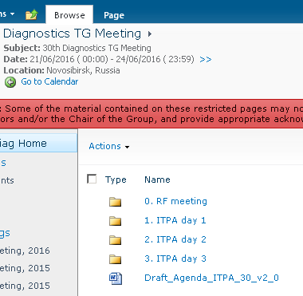
Uploads
•For those who can (need IDM account and expert or member)
•Upload to: https://portal.iter.org/departments/POP/ITPA/Diag/DIAG/default.aspx?InstanceID=33
•If not please mail to ?

Slide 4
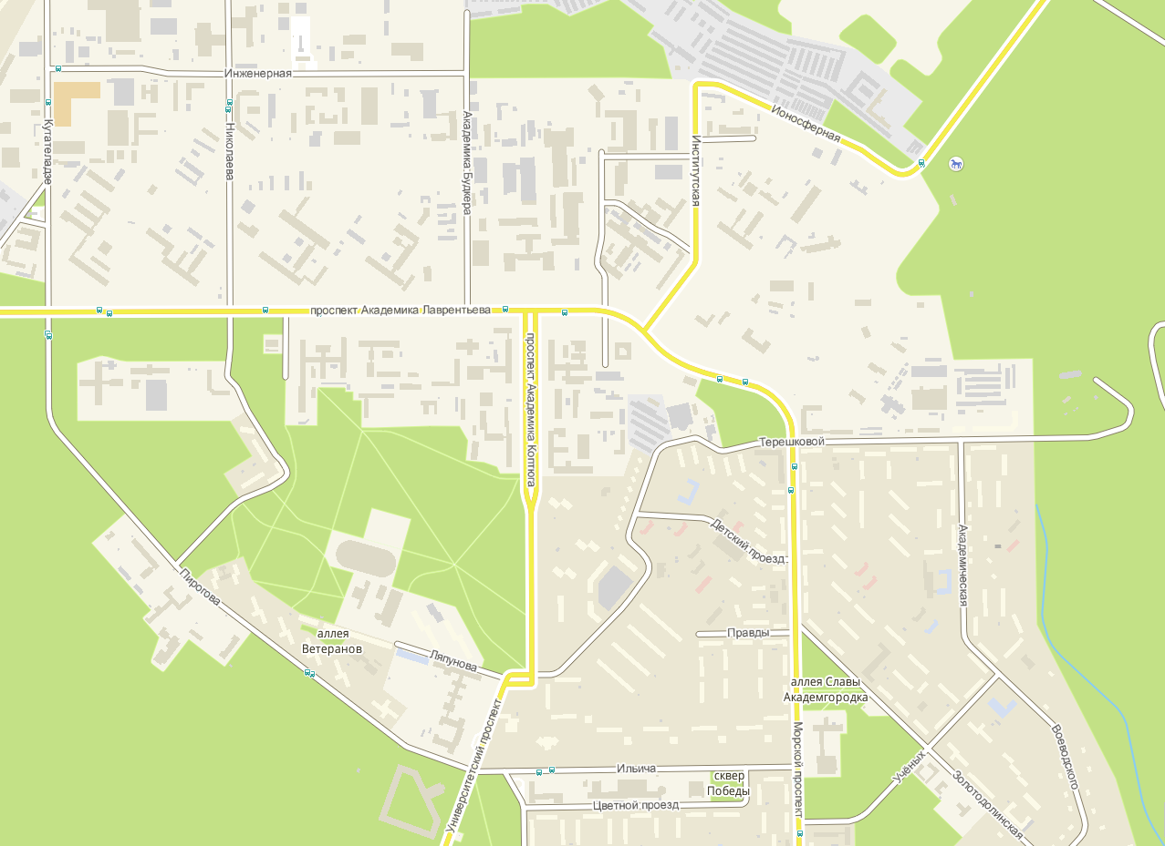
Way from the Golden Valley hotel to the meeting (Academpark) (2,8 km)
Academpark Tower
BINP
Hospital
Supermarket
Novosibirsk State University
Hotel Golden Valley

Slide 5
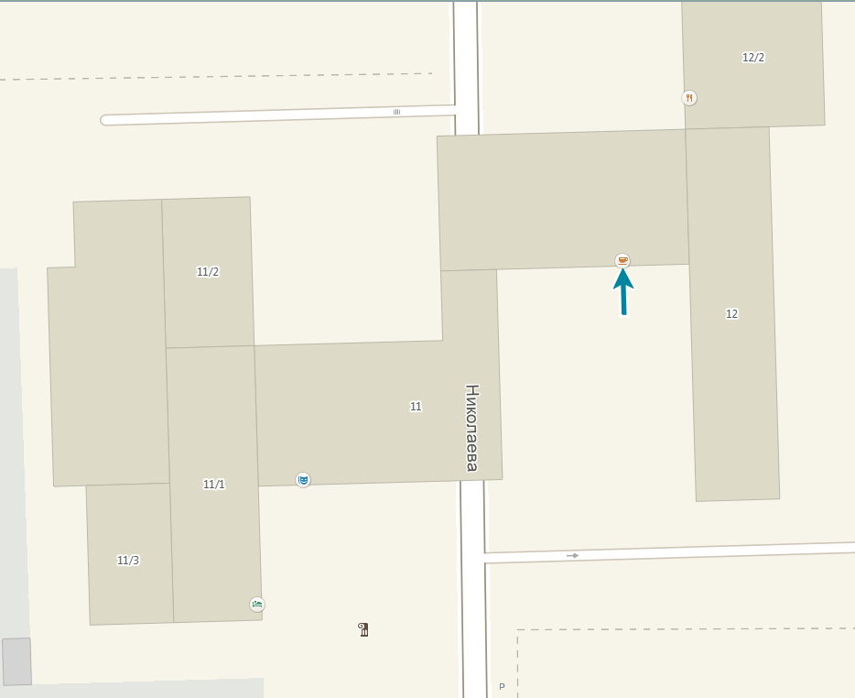
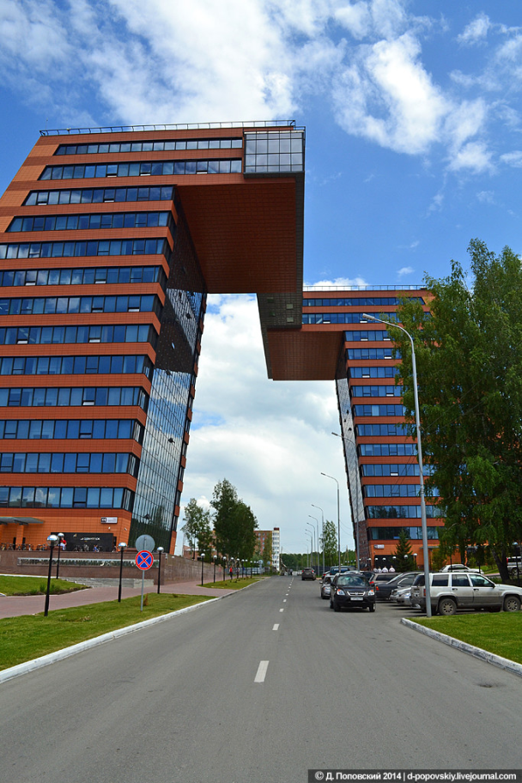
In Academpark tower
Canteen
2nd floor
Hall 4
3rd floor
Hall 3
stairs to the 3rd floor
Entrance

Slide 6
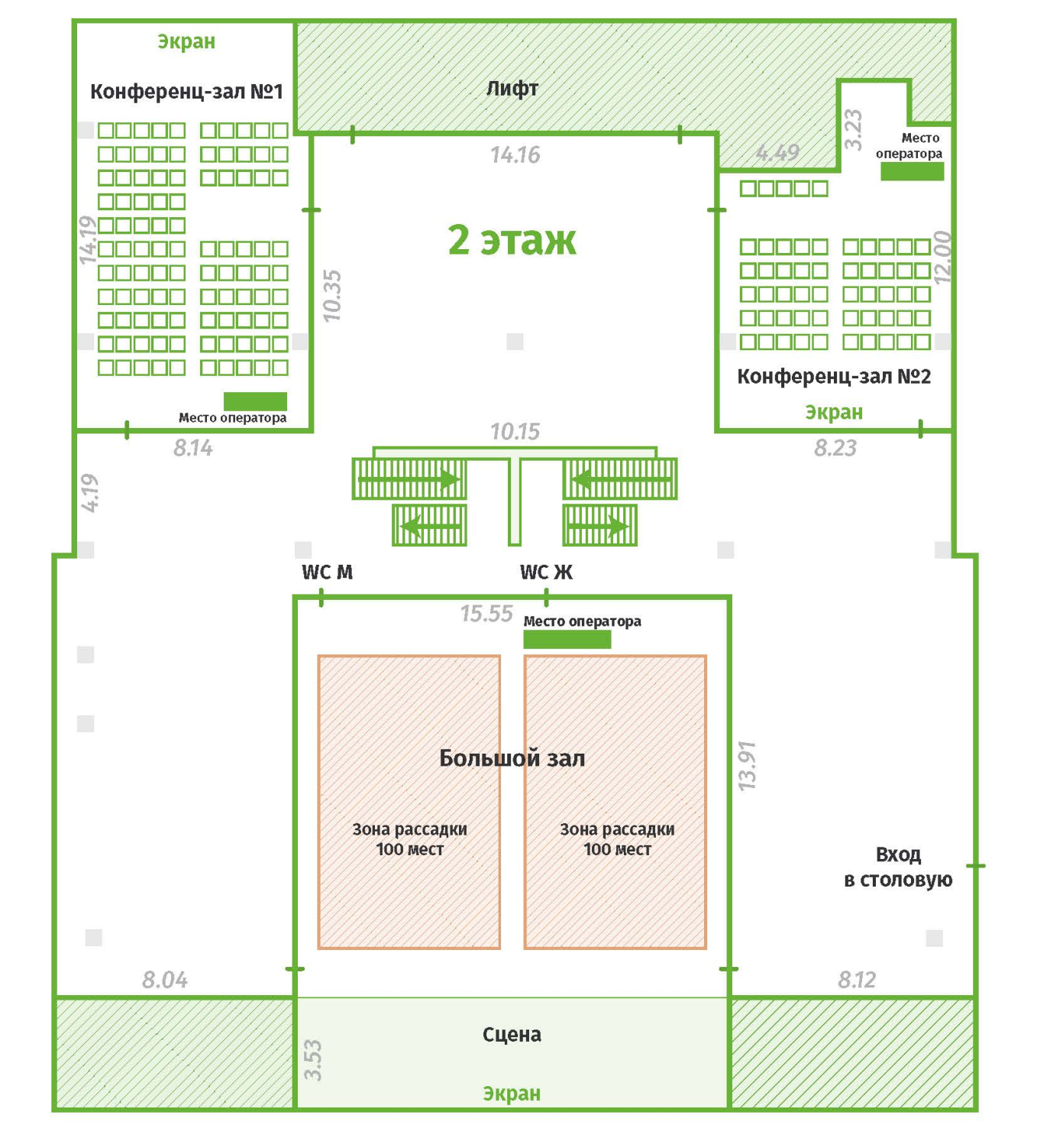
Academpark 2nd floor (Meetings are held on the 3rd floor): WC and Canteen
Canteen

