Slide 1
Trigger systems of the LHC experiments
Present systems and upgrade plans
Manfred Jeitler
Institute of High Energy Physics of the
Austrian Academy of Sciences

Slide 2
rates of processes at LHC

Slide 3
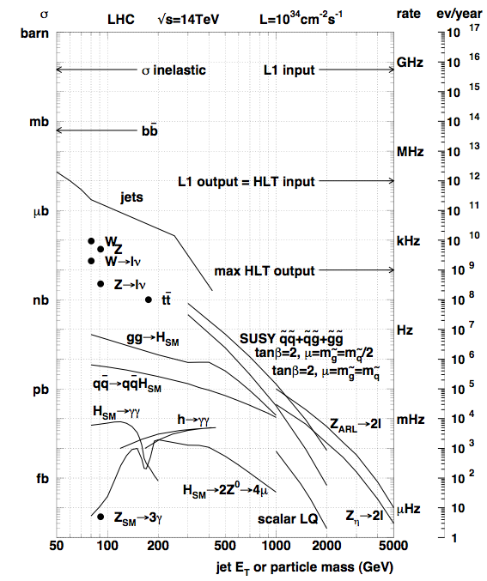
rates of processes at LHC

Slide 4
data selection challenges at hadron colliders
high background rates
  intrinsic problem of hadron colliders
interesting events make up tiny fraction
cutting hard on transverse momentum → signal loss
sophisticated rate reduction methods needed

Slide 5
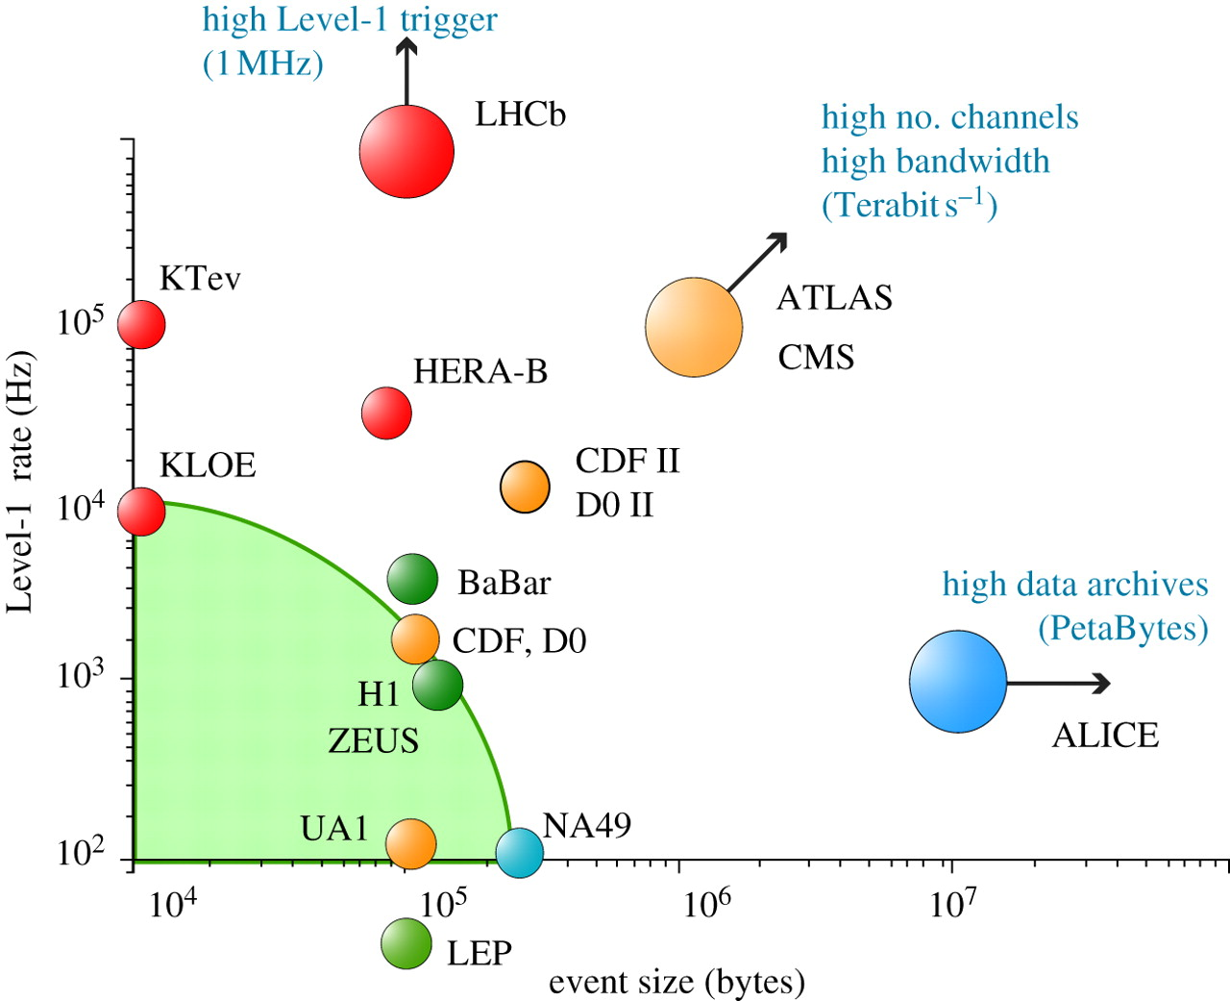
Trigger rates and data sizes

Slide 6
Differences between LHC experiments
ATLAS and CMS: investigate particles at energy frontier
  high data rates and large event sizes
LHCb: precision studies of b-physics processes
  very high statistics needed
  moderate event size
ALICE: heavy-ion collisions and studies of quark-gluon plasma
  collision rate much lower than for proton-proton collisions
  very high multiplicities → very big event sizes

Slide 7
Hardware trigger: the idea
read out some parts of detector at full bunch-crossing rate
  possibly at reduced granularity
these data allow a first guess if event is interesting
if yes: “Level-1 Accept” → read out everything and take a closer look
  in “High-Level Trigger” computer farm
constraint: data must still be available in on-detector memory (“pipeline”) → “latency”
read
write

Slide 8
Why a hardware trigger?
Ideal: read out everything
  read out detector data for every “bunch crossing”: every 25 ns, so read out at 40 MHz
  reconstruct events using all detector data in computers
  discard data without interest before writing to tape

Slide 9
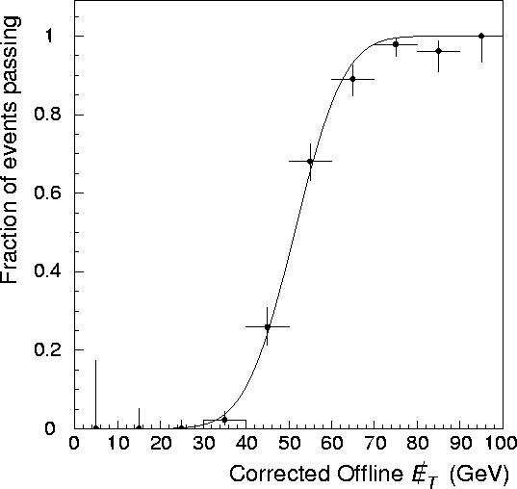
Why a hardware trigger?
Ideal: read out everything
  read out detector data for every “bunch crossing”: every 25 ns, so read out at 40 MHz
  reconstruct events using all detector data in computers
  discard data without interest before writing to tape
turn-on curve
hardware trigger based on reduced information has
worse momentum resolution
worse particle identification
  electrons / photons
  electrons / jets
Notes:
86 pileup (high-pileup test run)

Slide 10
Why a hardware trigger?
Ideal: read out everything
  read out detector data for every “bunch crossing”: every 25 ns, so read out at 40 MHz
  reconstruct events using all detector data in computers
  discard data without interest before writing to tape
pileup
about 50 - 60
in 2017
140 – 200 at High-Lumi LHC
need full resolution to resolve vertices!
Notes:
86 pileup (high-pileup test run)

Slide 11
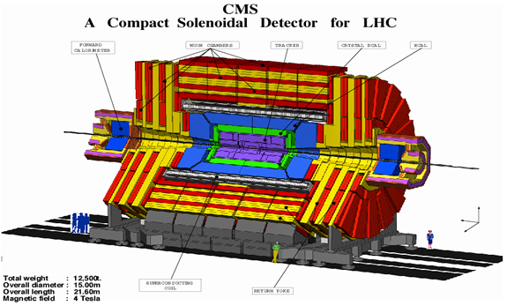
Why a hardware trigger?
Ideal: read out everything
  read out detector data for every “bunch crossing”: every 25 ns, so read out at 40 MHz
  reconstruct events using all detector data in computers
  discard data without interest before writing to tape
Why not work without hardware trigger?
  need very big computer farms (money problem)
  but also:
  have to get all data out from detector
  have to supply detector with much power
  not only money problem but resolution degradation due to amount of material in detector (“copper tracker”)

Slide 12
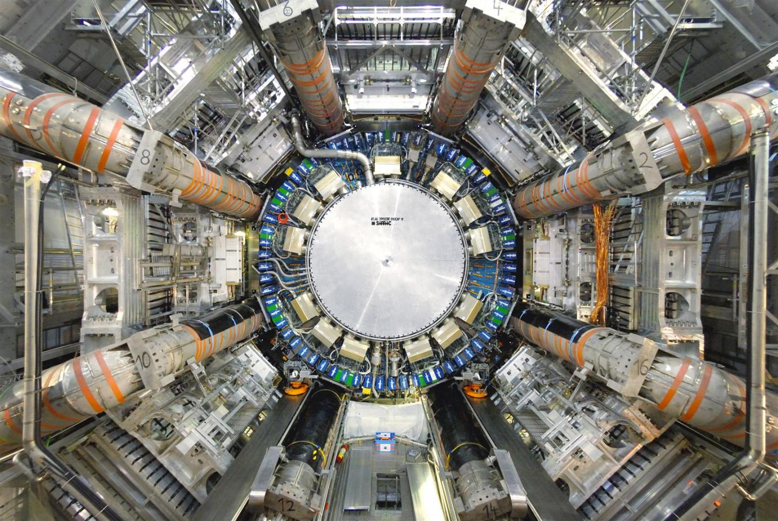
ATLAS and CMS
similar approach in both experiments:
both use data from muon systems and calorimeters
  in reduced resolution
both read out tracker only in case of “Level-1 Accept”
similar latency (2.5 - 4 μs)
minor differences:
ATLAS uses different muon detectors for trigger (RPCs and TGCs) and precision data (Monitored Drift Tubes and CSCs)
  Resistive Plate Chambers, Thin Gap Chambers, Cathode Strip Chambers
CMS uses same muon detectors for both trigger and data
at “Level-1 Accept”, ATLAS reads out “Regions of Interest” while CMS reads out full detector

Slide 13
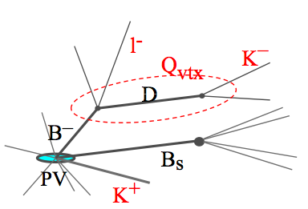
LHCb
specialized for studying b-physics
forward detector only
  differently from the “4 π” geometry of ATLAS, CMS and ALICE
  → smaller detector and smaller data volume
needs very good vertex resolution for resolving b-decays
events with pileup hard to disentangle → luminosity and pileup reduced by LHC
  by defocussing beams
since LHC startup: hardware trigger rate 1 MHz

Slide 14
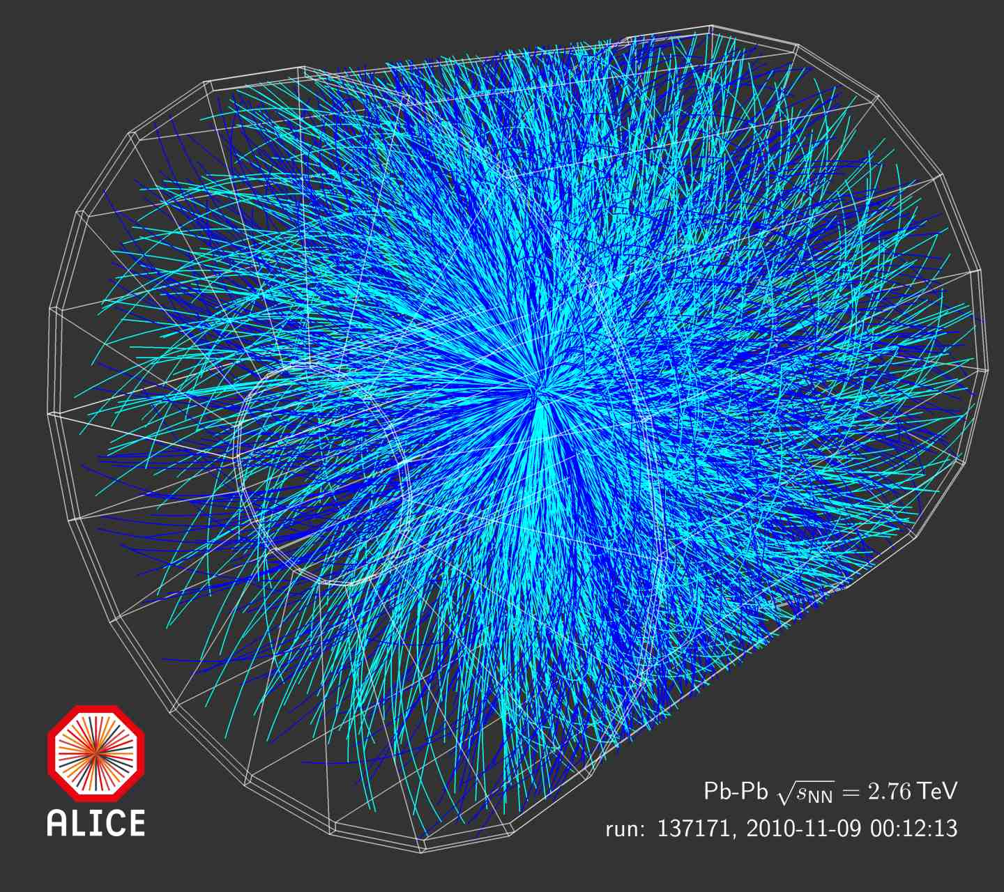
ALICE
specialized to observe heavy-ion collisions
  take proton-proton data also for reference
luminosity in heavy-ion collisions much lower than for protons
  10²⁷ cm⁻² s⁻¹ rather than 10³⁴ cm⁻² s⁻¹
enormous complexity of events
  tens of thousands of tracks per event
core detector: TPC
  Time Projection Chamber
  slow readout → events overlapping in time hard to analyze
  → “past-future protection”
multi-layer trigger
  hardware Level-0, Level-1, Level-2
  High-Level Trigger computer farm
Notes:
ALICE has real deadtime (no buffering / no ring buffer)

Slide 15
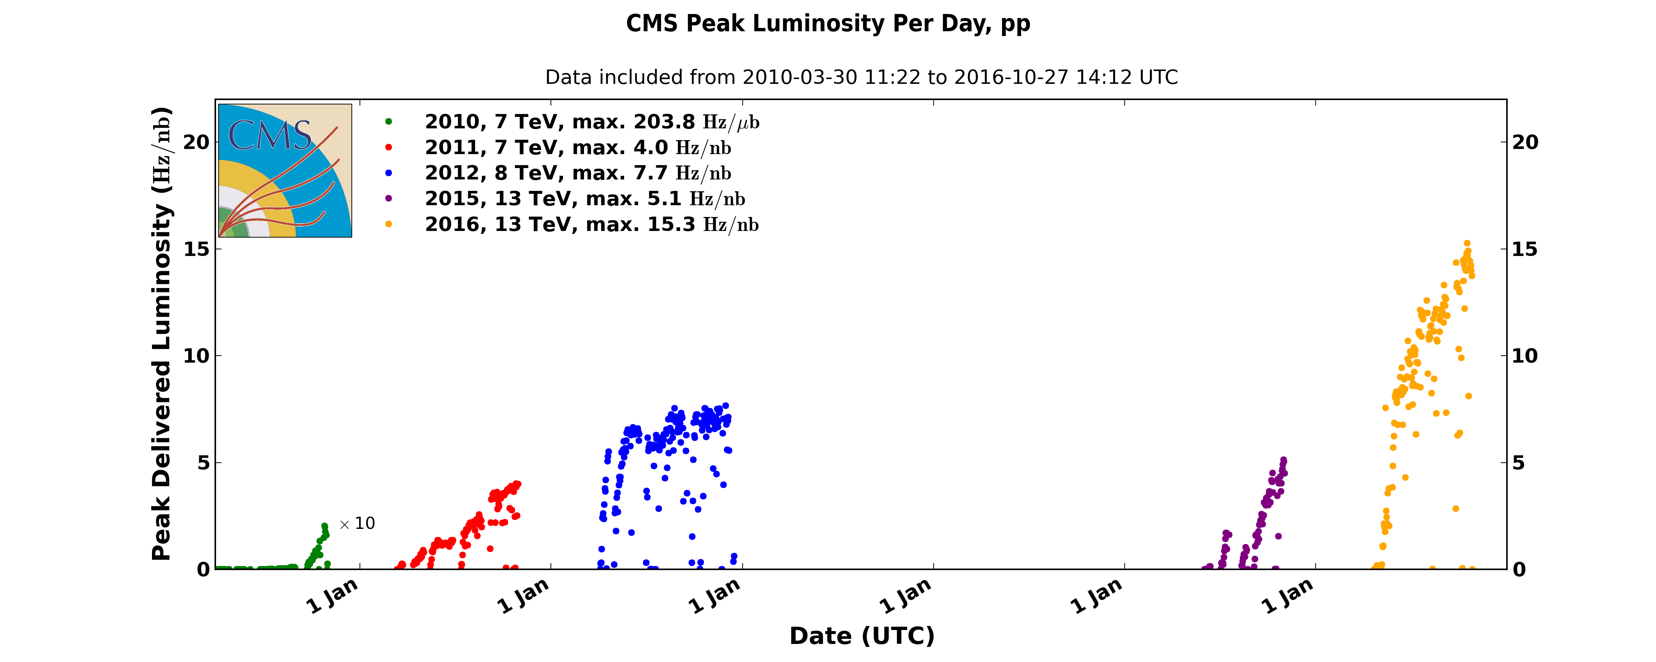
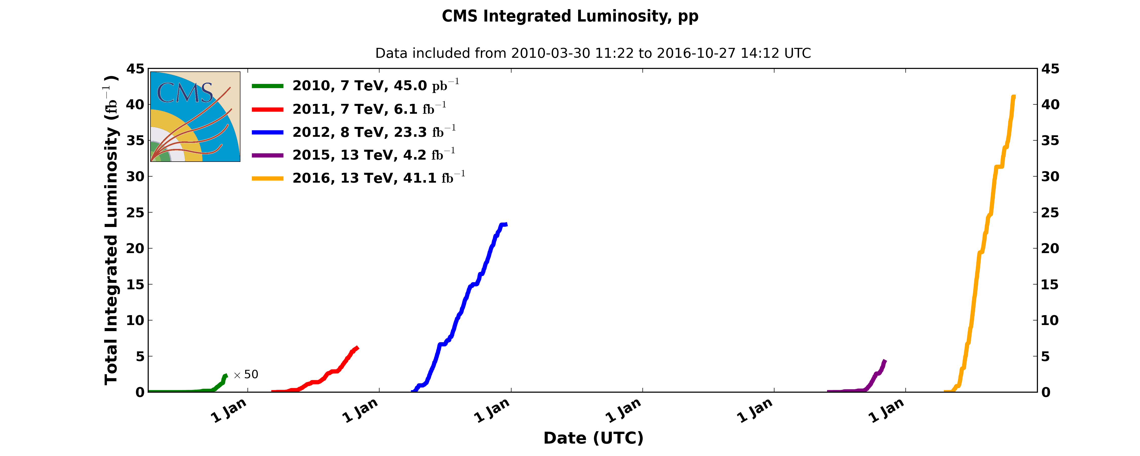
LHC luminosity build-up
2016
nominal instantaneous luminosity
2012
2011
2015
2010
LS 1

Slide 16
LHC is evolving
“Run 1” at lower than design energy
  8 TeV instead of 14 TeV collision energy
now almost at design energy
  13 TeV collision energy
luminosity has been steadily going up
  now exceeding design goal of 10³⁴ cm⁻² s⁻¹
design goal for High-Luminosity LHC:
  luminosity: 5 to 7.5 10³⁴ cm⁻² s⁻¹
  pileup: 140 to 200
to make use of improved accelerator performance, detectors also have to evolve

Slide 17
LHC upgrade schedule
“Runs” interrupted by “Long Shutdowns” (“LS”)

Slide 18
ATLAS and CMS current upgrades
electronics gets quickly obsolescent
  hard to maintain, difficult to purchase old components for repairs
getting more functionality into bigger chips allows to increase performance, reduce size and improve reliability
  fewer points of failure
during LS1, ATLAS and CMS started switching from VME-based to TCA-based electronics
  ATCA for ATLAS, μTCA for CMS
replacing galvanic connections by optical fibers → higher data rates, better reliability, smaller form factors
  but does not come for free: (de)serialization needs extra latency!
  so far, have to fit into 2.5 - 4 μs latency budget!

Slide 19
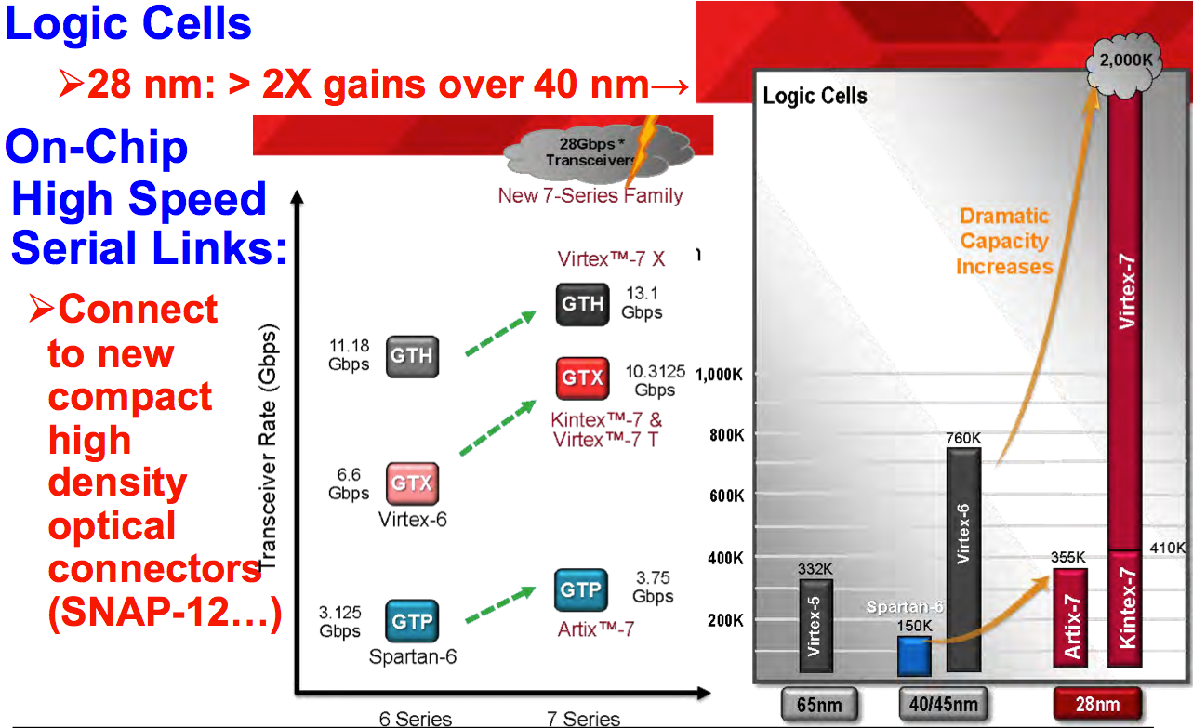
Progress in FPGAs

Slide 20
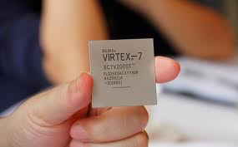
Progress in FPGAs
Notes:
Virtex-7 FPGA from Xilinx would be the ‘winner’ with 6.8 billion transistors.

Slide 21
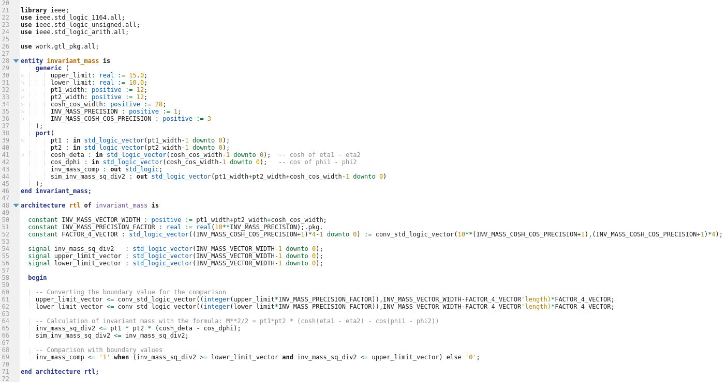
FPGA trigger code example
example: calculation
of invariant mass of two objects

Slide 22
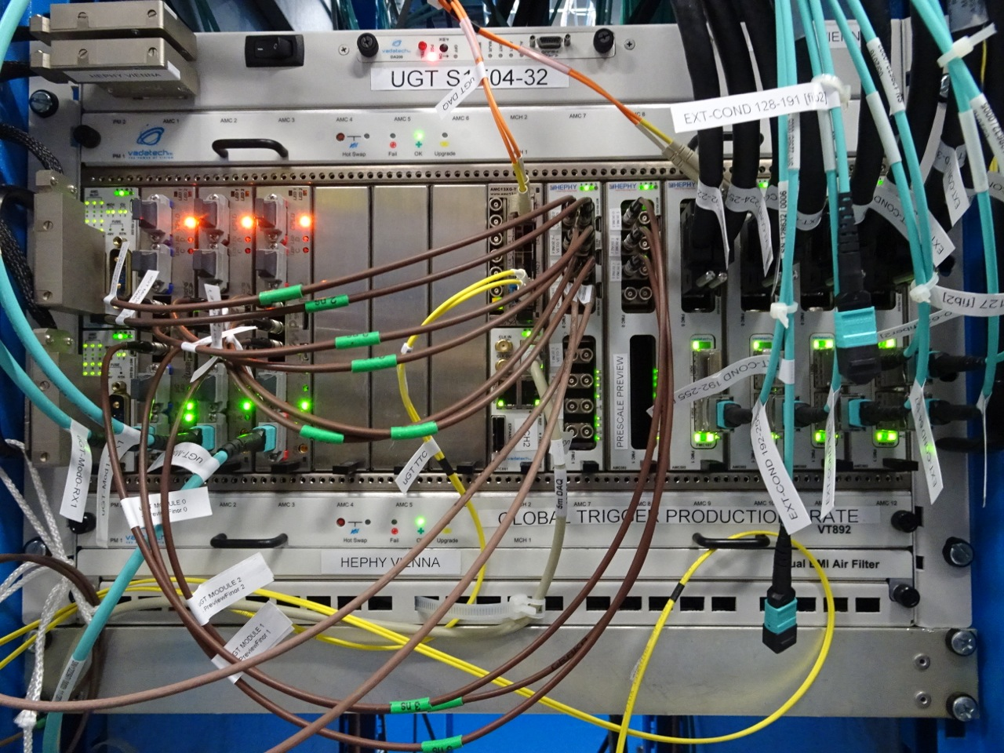
The Global Trigger of CMS
(μTCA crate)
LHC Run 2

Slide 23
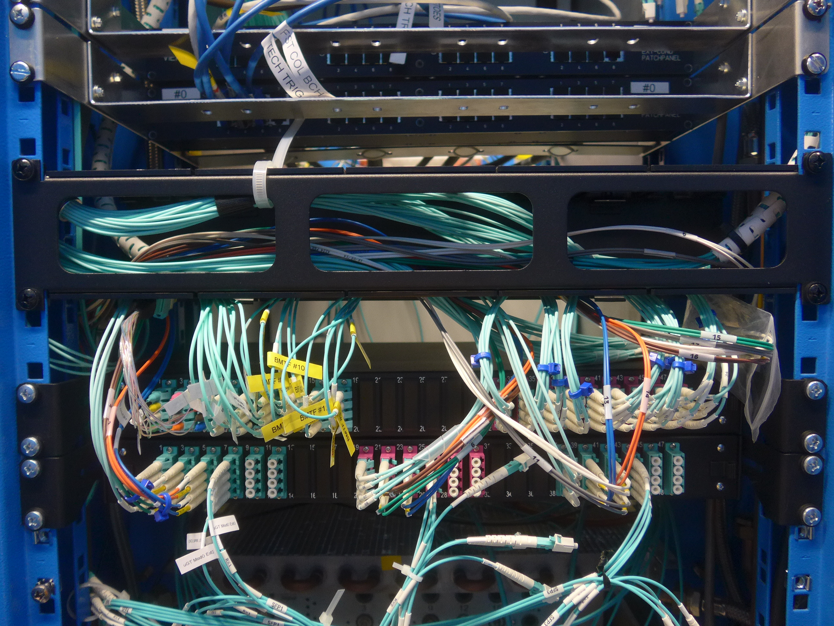
Optical fibers replace galvanic connections
LHC Run 2

Slide 24
ATLAS and CMS future upgrades (LS3)
very important step will be inclusion of silicon trackers into Level-1 trigger during “Long Shutdown 3”
will select tracks with transverse momentum above a few GeV at local level
  look for low bending (close azimuth in adjacent strip modules)
“stub”
y
z
x

Slide 25
Why will ATLAS and CMS need a tracker trigger?
better identify charged leptons (e, μ, τ)
improve the p_{T} determination of muon candidates
  p_{T} threshold of a few GeV
determine the isolation of leptons and photons with respect to the neighboring tracks
determine the “vertex” of charged leptons and jet objects
  position resolution along beam of about 1 mm
determine an event primary vertex and the transverse missing energy carried by Level-1 Tracks that come from this vertex
Notes:
^{from CMS TDR, page 190 (244)}
^{CMS pT threshold: 2 GeV}
at 14 GeV: 30 charged particles in eta<2.4 but only 2.7% have pT>2 GeV; PU=140: ~115 tracks > 2 GeV → 1 track > 2 GeV per minbias event (i.e. #tracks = PU)

Slide 26
ATLAS and CMS future upgrades (LS3)
latency will increase from 2.5-4 μs to 10-30 μs
  required by including tracker into hardware trigger
  ATLAS: 30 CMS: 12.5
hardware trigger rate will be about 1 MHz
  ten times higher than present
  ATLAS: above 1 MHz (“Level-0”) and possibly “Level-1” stage with output of 400 kHz
  CMS: 750 kHz
also: use full calorimeter granularity in hardware trigger
ATLAS will also significantly improve its muon trigger
  “Monitored Drift Tubes” (MDT, precision muon chambers) will be included in trigger
  for CMS, all muon detectors have been in trigger since LHC startup

Slide 27
LHCb upgrade
High-Level Trigger upgrade during LS1
  Level-1 data can be stored for up to one week
  final calibration accessible for High-Level trigger
  no reprocessing needed
  make optimum use of LHC inter-fill periods
Hardware trigger to be removed during LS2
  send full data rate at almost 40 MHz to computer farm buffer
  store until final calibration available and High-Level Trigger analysis can be run
  only then discard events without interest
why is this possible for LHCb and not for ATLAS and CMS?
  smaller detector and smaller event size
  no compact 4π geometry, easier access from side
Notes:
when LHC runs too well, HLT buffer becomes bottleneck

Slide 28
ALICE upgrade
Heavy-Ion collision rates will increase
need large amount of proton-proton data
adapt various subdetectors for higher rates
main detector (Time Projection Chamber) gets new readout (GEMs instead of MWPCs)
  continuous readout of Pb-Pb collision data at 50 kHz
  based on minimum-bias trigger (provided by Fast Interaction Trigger detector (FIT))
introduce readout buffers for many subdetectors

Slide 29
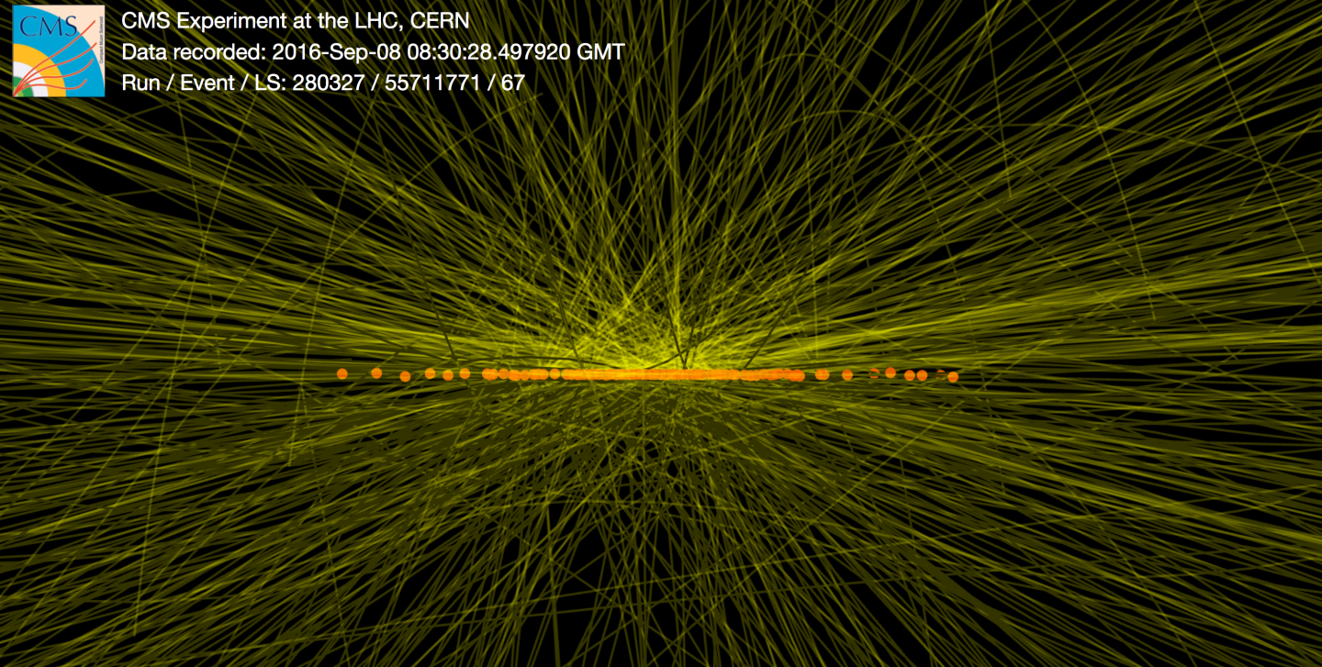
Summary
Trigger systems are vital ingredients to make use of the enormous data rates at modern hadron colliders
Upgrades of hardware, firmware and software continue over the lifetime of each experiment
In most cases, hardware event selection will still be needed for some time to come

Slide 30
References
Letter of Intent for the Phase-II Upgrade of the ATLAS Experiment
  https://cds.cern.ch/record/1502664
ATLAS Phase-II Upgrade Scoping Document
  https://cds.cern.ch/record/2055248/files/LHCC-G-166.pdf
Technical Proposal for the Phase-II Upgrade of the CMS Detector
  https://cds.cern.ch/record/2020886/files/LHCC-P-008
CMS Phase II Upgrade Scope Document
  https://cds.cern.ch/record/2055167
LHCb Trigger and Online Upgrade Technical Design Report
  https://cds.cern.ch/record/1701361/files/LHCB-TDR-016.pdf
ALICE Upgrade of the Readout & Trigger System TDR
  https://cds.cern.ch/record/1603472/files/ALICE-TDR-015.pdf

Slide 31
BACKUP

Slide 32
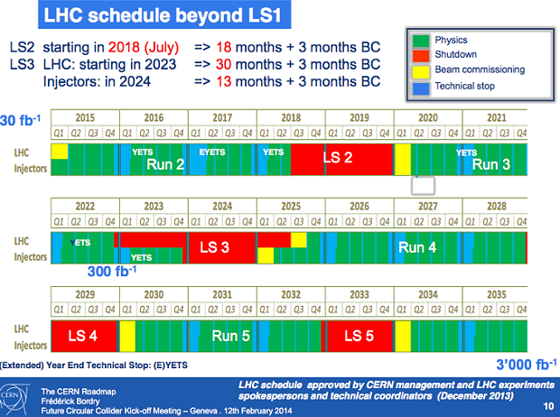
LHC upgrade schedule

Slide 33
The Compact MUON Solenoid

Slide 34
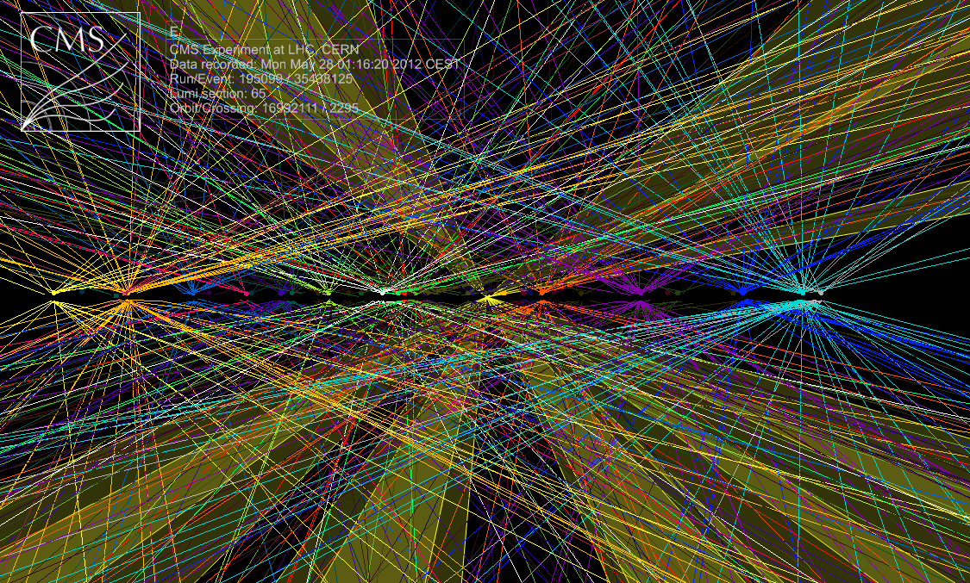
pile-up of events

Slide 35
L1 Trigger Layout in LHC Run 1
Calorimeter Trigger
Muon Trigger
DAQ
|η|<3
0<|η|<5
|η|<1.6
0.9<|η|<2.4
|η|<1.2
ECAL
Trigger Primitives
HCAL/HF
Trigger Primitives
RPC hits
CSC hits
DT hits
Link system
Segment finder
Segment finder
Regional
Calorimeter
Trigger
Pattern Comparator
Track finder
Track finder
40 MHz pipeline
4+4 μ
4 μ
4 μ
Global
Calorimeter
Trigger
Global Muon Trigger
e, J, E_{T}, H_{T}, E_{T}^{miss}
4 μ
Global Trigger
L1A
Status
CMS
experiment
TTC system
TTS system
32 partitions
Detector Frontend

Slide 36
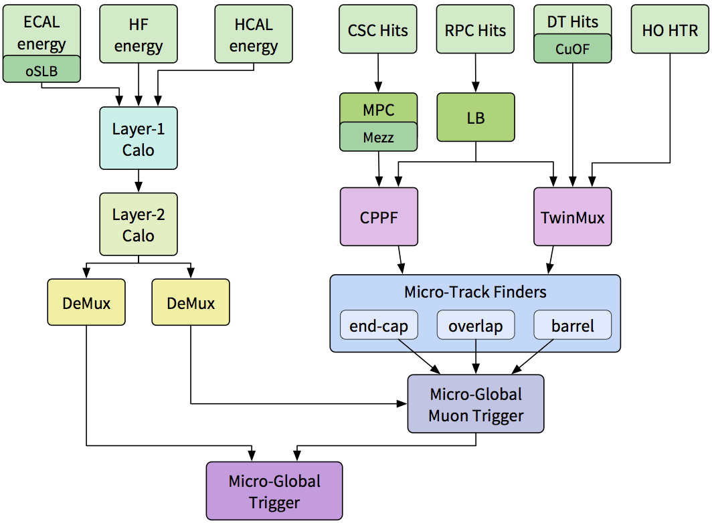
L1 Trigger Layout in LHC Run 2
BMTF
uGMT
uGT
systems built by
HEPHY Vienna
Notes:
neues Bild, mit Twinmux!

Slide 37
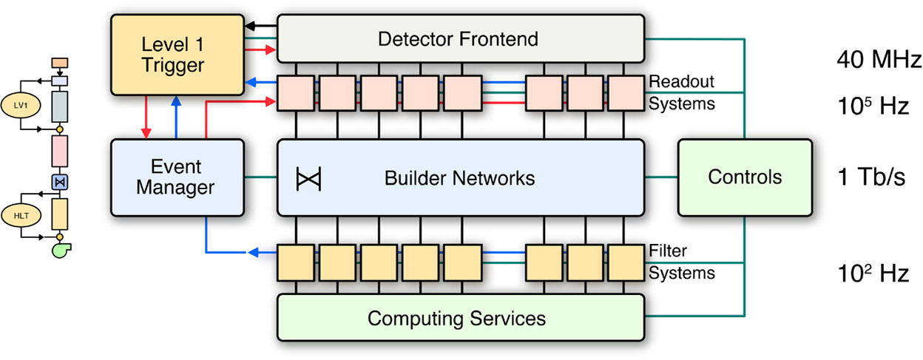
CMS Trigger & DAQ Systems
HLT
10²..10³ Hz

Slide 38

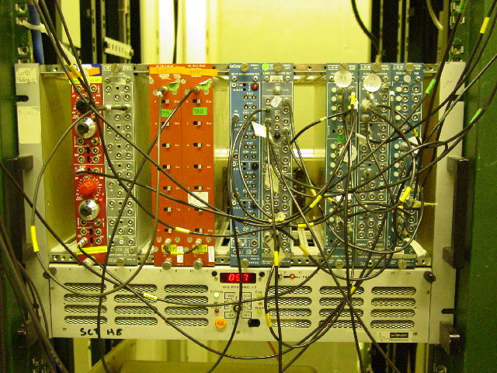

detectors yielding electrical output signals allow to select events to be recorded by electronic devices
  thresholds (discriminators)
  logical combinations (AND, OR, NOT)
  delays
  available in commercial “modules”
  connections by cables (“LEMO” cables)
pre-LHC

Slide 39
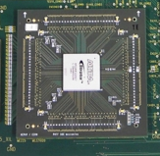
because of the enormous amounts of data at major modern experiments electronic processing by such individual modules is impractical
  too big
  too expensive
  too error-prone
  too long signal propagation times
⇒ use custom-made highly integrated electronic components (“chips”)
stay flexible by using Field-Programmable Gate Arrays (FPGAs)
400 x
⇒ 1x
~ 10 logical operations / module ⇒ ~ 40000 logical operations in one chip
LHC Run 1

Slide 40
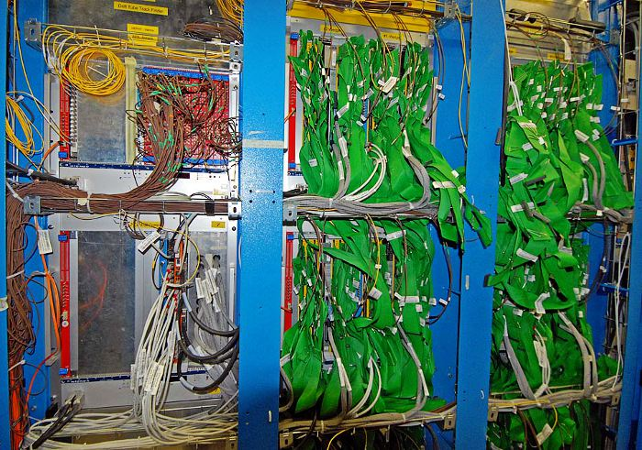
LHC Run 1 (<=2012): many parallel galvanic connections
Example:
Drift Tube
Track Finder
(part of
muon trigger)
LHC Run 1

Slide 41
How do we trigger ?
at a rate of 40 MHz impossible to read out all detector data
preliminary decision based on part of the event data only
be quick!
  in case of positive trigger decision all detector data must still be available
  data are stored temporarily in a “pipeline” in the detector electronics
    “short term memory” of the detector
    “ring buffer”
    in hardware, can only afford a few μs (presently, 4 μs)
read
write

Slide 42
L1 Trigger Layout in LHC Run 2
Calori-
meter
Muons
Notes:
neues Bild, mit Twinmux!

Slide 43
L1 Trigger Layout in LHC Run 2
BMTF
uGMT
uGT
systems built by
HEPHY Vienna
Notes:
neues Bild, mit Twinmux!

Slide 44
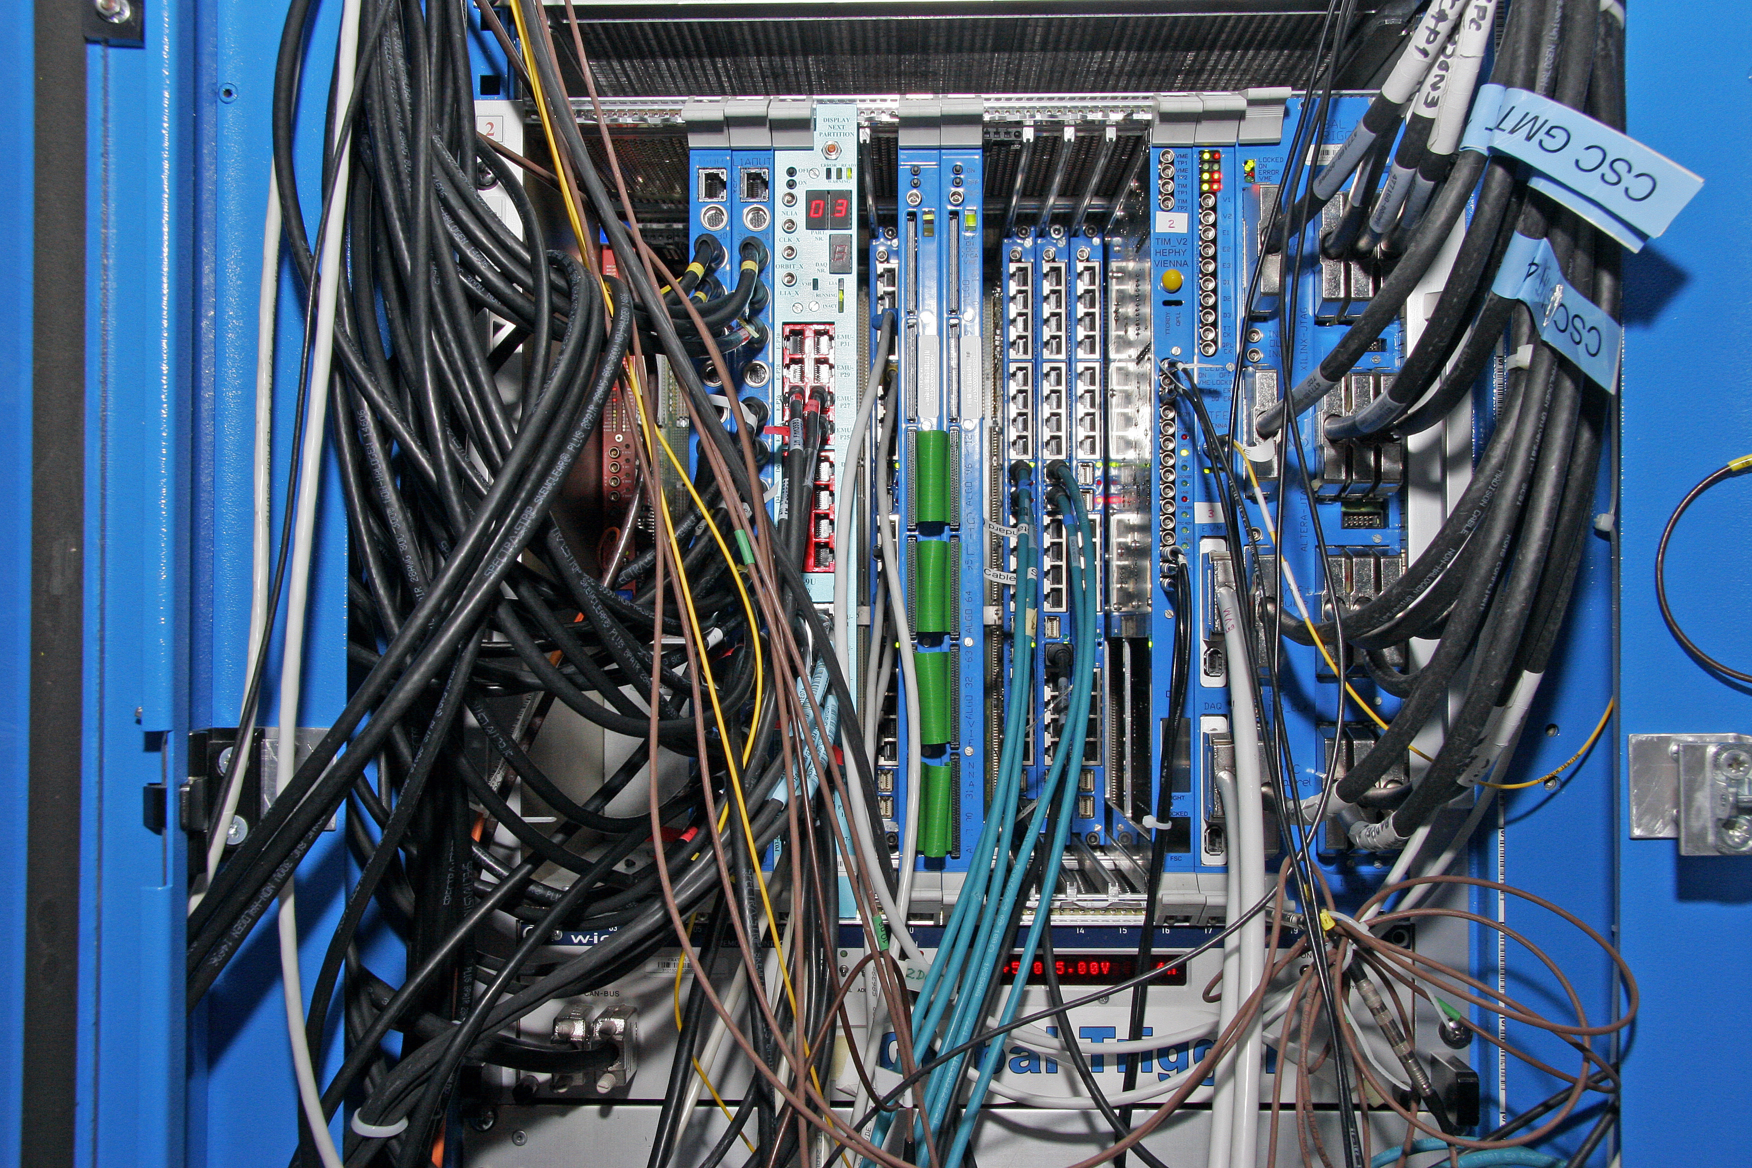
LHC Run 1 (<=2012): many different custom-built electronics modules (VME)
Example:
Global Trigger (left)
and
Global Muon Trigger (right)
LHC Run 1

Slide 45
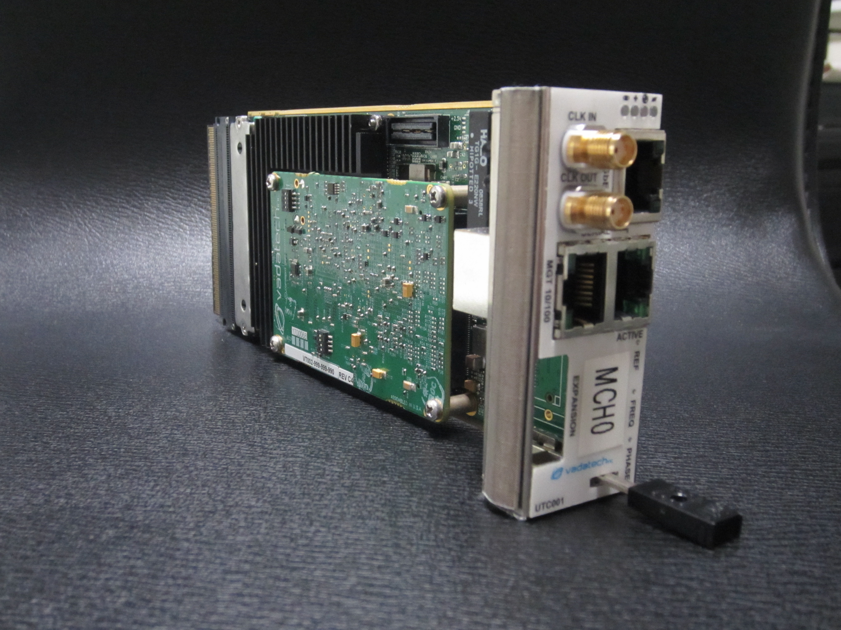
Commercial μTCA module
MCH (MicroTCA Carrier Hub)

Slide 46
When do we trigger ?
„bunch” structure of the LHC collider
  „bunches” of particles
  40 MHz
    a bunch arrives every 25 ns
    bunches are spaced at 7.5 meters from each other
    bunch spacing of 125 ns for heavy-ion operation
at present luminosity of the LHC collider (>10³⁴ cm⁻² s⁻¹) we have about 30 proton-proton interactions for each collision of two bunches
  only a small fraction of these “bunch crossings” contains at least one collision event which is potentially interesting for searching for “new physics”
  in this case all information for this bunch crossing is recorded for subsequent data analysis and background suppression
  luminosity quoted for ATLAS and CMS
    reduced luminosity for LHCb (b-physics experiment)
    heavy-ion luminosity much smaller

Slide 47
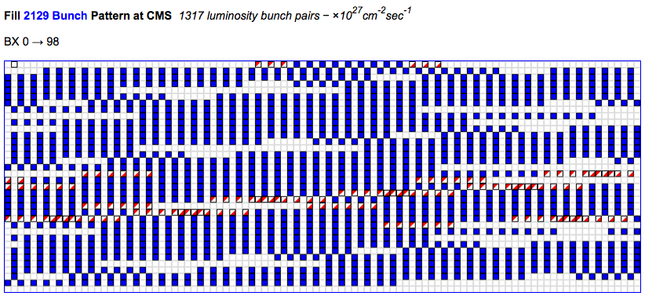
LHC bunch-filling scheme
LHC orbit with 3564 “bunch crossings”
(colliding bunches in CMS: blue; single bunches in CMS: red/white):

Slide 48
⇒ multi-level trigger
first stage takes preliminary decision based on part of the data
  rate is already strongly reduced at this stage
  ~1 GHz of events (= 40 MHz bunch crossings) → ~100 kHz
  only for these bunch crossings are all the detector data read out of the pipelines
  still it would not be possible (with reasonable effort and cost) to write all these data to tape for subsequent analysis and permanent storage
the second stage can use all detector data and perform a “complete analysis” of events
  further reduction of rate: ~100 kHz → ~ 1 kHz
  only the events thus selected (twice filtered) are permanently recorded

Slide 49
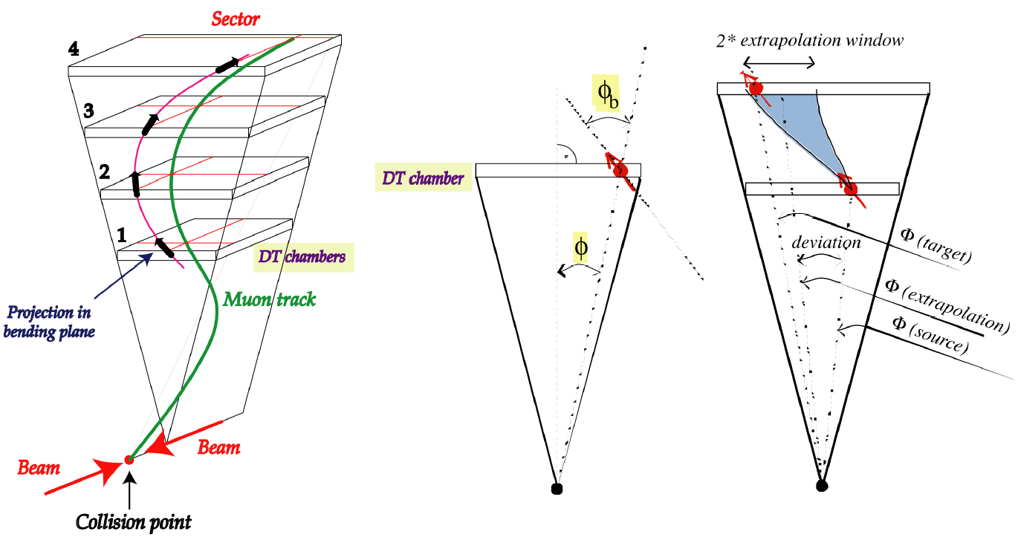
how to find muon tracks ?
(CMS: solenoidal field)

Slide 50
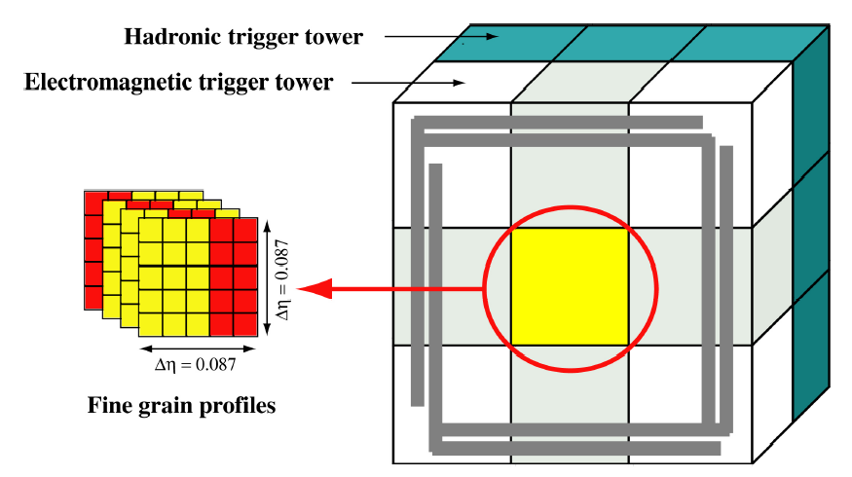
calorimeter trigger

Slide 51
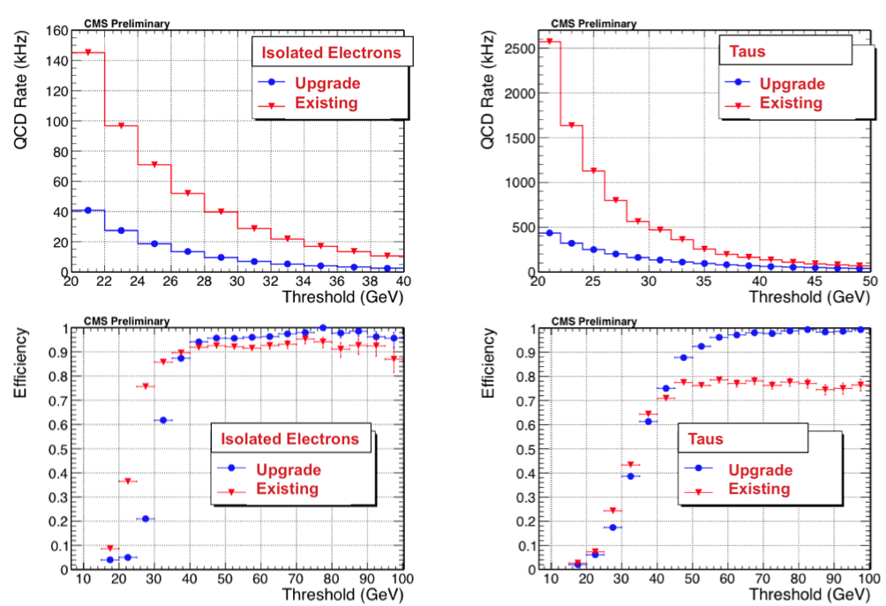
Rates and efficiencies of current and upgraded calorimeter trigger

Slide 52
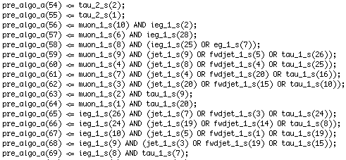
How does the trigger actually select events ?
the first trigger stage has to process a limited amount of data within a very short time
  relatively simple algorithms
  special electronic components
    ASICs (Application Specific Integrated Circuits)
    FPGAs (Field Programmable Gate Arrays)
  something in between “hardware” and “software”: “firmware”
    written in programming language (“VHDL”) and compiled
    fast (uses always same number of clock cycles)
    can be modified at any time when using FPGAs
the second stage (“High-Level Trigger”) has to use complex algorithms
  not time-critical any more (all detector data have already been retrieved)
  uses a “computer farm” (large number of PCs)
  programmed in high-level language (C++)

Slide 53
How does the trigger actually select events ?
the first trigger stage has to process a limited amount of data within a very short time
  relatively simple algorithms
  special electronic components
    ASICs (Application Specific Integrated Circuits)
    FPGAs (Field Programmable Gate Arrays)
  something in between “hardware” and “software”: “firmware”
    written in programming language (“VHDL”) and compiled
    fast (uses always same number of clock cycles)
    can be modified at any time when using FPGAs
the second stage (“High-Level Trigger”) has to use complex algorithms
  not time-critical any more (all detector data have already been retrieved)
  uses a “computer farm” (large number of PCs)
  programmed in high-level language (C++)

Slide 54
Level-1 Trigger latency
presently ~ 4 μs
  ~ 160 clock cycles
  limited by tracker pipeline length
will be increased only during tracker upgrade
  Long Shutdown 3: phase-2 upgrade
  ~2023
phase-1 trigger upgrade will have to fit into same latency budget
  challenge because of optical links
    parallel-serial conversion (SerDes) needs time
  we have some reserve

Slide 55
CMS trigger upgrade
upgrade of LHC
  higher energy: 8 → 13 TeV collision energy in 2015
    higher cross-sections → higher rates
  higher luminosity:
    0.7 x 10³⁴ cm⁻²s⁻¹ in 2012
    → > 10³⁴ cm⁻²s⁻¹ now
    → > 5 x 10³⁴ cm⁻²s⁻¹ at High-Luminosity LHC (HL-LHC)
  higher pile-up (from 30 in 2013 to 140 at HL-LHC)
  narrower bunch spacing (50 ns → 25 ns)
Higgs precision measurements
search for new physics
→ upgrade CMS trigger
  to keep physics potential
  else: would have to raise thresholds more and more

Slide 56
Level-1 Trigger phase-1 upgrade strategy
task: reduce rates and occupancy while keeping efficiency
calorimeter trigger
  higher precision in coordinates (η, φ) and transverse energy (E_{T})
  flexibility for improved and more complex algorithms (pile-up subtraction, tau-jets etc.)
  more candidate objects
muon trigger
  higher precision in coordinates (η, φ) and transverse momentum (p_{T})
  more candidate objects
  combine candidates from different detectors at track-finder level
  profit from additional chambers in endcaps (YE04 and RE04)
global trigger
  more algorithms (current limit: 128)
  more sophisticated algorithms:
  Run 1: multiple objects, simple angular correlations
  Run 2: invariant mass, transverse mass, complex correlations

Slide 57
Level-1 Trigger phase-1 upgrade technology
current system consists of many different custom-built electronics modules
  VME based
  digital electronics implemented in FPGAs and ASICs
  maintenance and spare-module management problematic
in future aim for higher integration
  use larger FPGAs
  build system in more compact way (fewer boards)
use standardized electronics where possible
  custom built but same for many systems
  partly also COTS (Commercial off-the-shelf) components
  new form factor: μTCA (Micro Telecommunications Computing Architecture)
use optical links
  higher data rates (higher precision, more trigger objects)
  less space for connectors (μTCA instead of 9U-VME)
Notes:
Micro Telecommunications Computing Architecture

Slide 58
Muon trigger upgrade
make use of redundant systems already at track-finder level
  so far candidates from CSC/RPC and DT/RPC combined only after track finding, in Global Muon Trigger
3 regional systems: Barrel Track Finder (DT+RPC), Endcap Track Finder (CSC+RPC), Overlap Track Finder (DT+CSC+RPC)
high rate particularly problematic in end caps
  Cathode Strip Chambers (CSC) and Resistive-Plate Chambers (RPC)
  outermost chambers being added now
  improve p_{T} resolution and thus reduce rate
  current design (Δφ comparisons) does not scale well
  → switch to pattern matching system to accommodate higher occupancy
Drift Tube trigger relocation
  moved front-end electronics (“sector collectors”) from experimental cavern to electronics cavern
  all trigger electronics close to Global Trigger, always accessible in radiation-safe area
Notes:
turn-on curve from CSCTF ??

Slide 59
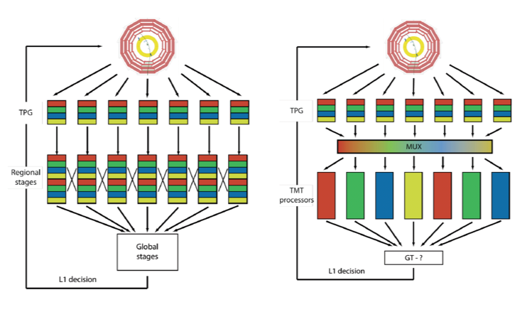
Calorimeter trigger
transition from parallel triggering systems to time-multiplexed trigger
  processors take turns
  each processor gets all the data for a given bunch crossing
  same hardware with different connections could run parallel triggering system

Slide 60
Level-1 Global Trigger upgrade
again centralizing all final decision taking in one crate
Global Trigger Logic in one μTCA module
  if needed, several modules can run in parallel for more trigger algorithms
use of big FPGA (Xilinx Virtex-7) allows much more complex logic
  large number of high-speed IO links and logic cells
  big lookup tables, floating-point operations in DSPs
Trigger Control System has moved to different crate
  combined with trigger distribution system (TTC) into “TCDS” (Trigger Control and Distribution System)

Slide 61
High Level Trigger (HLT)
now: ~ 13 000 CPU cores
more and faster computers will allow for more calculation time
  more complex algorithms
  ~ 100 → ~ 1000 ms per event
improving the object reconstruction and physics selection to bring it closer to the offline version
phase 2: higher pileup and input rate
use L1 Track trigger info at very first stage of HLT processing
  reduce HLT processing time (unpacking)
Notes:
The original HLT System of 720 units totalling 5760 cores was first extended in May 2011 with 72 units (3456 cores and hyper-threading capability), and then in May 2012 with a further 64 units (4096 cores and hyper-threading capability). The current HLT Filter Farm size is 13200 cores, allowing for per-event CPU budget of around 150 ms/ event at a rate of 100 kHz.

Slide 62
Scenario for phase-2 upgrade
Tracker replacement allows for
Track Trigger
increased latency (10-20 μs)
  replace ECAL electronics, for 20 μs also endcap muon (CSC) electronics
finer granularity
  use single-crystal granularity in ECAL instead of “trigger towers”
L1 trigger rate 0.5 – 1 MHz
  up from 100 kHz
  replace muon Drift Tube electronics
  needed for hadronic triggers (do not benefit so much from Track Trigger)
  HLT should cope with this (estimate 50x increase; Moore’s law)
HLT output rate of 10 kHz

Slide 63
Summary on upgrades
LHC development makes trigger upgrade mandatory
  else we lose much of the data
Phase 1 upgrade has been successful
  commissioning in 2015
  full deployment in 2016
Phase 2 upgrade > 2022
  Track Trigger
  increase latency to 10 or 20 μs
  L1 rate ~ 0.5-1 MHz
  HLT rate ~ 10 kHz

Slide 64
LHC / CMS schedule
2013-2014 first “long shutdown” (“LS 1”)
  part of trigger electronics being upgraded: “phase-1 upgrade”
2015-2017 data taking @ (√s = 13 TeV)
  LHC may exceed design luminosity (10³⁴ cm⁻²s⁻¹) and run at higher than design pile-up !
    original design: ~20 interactions per bunch crossing
  during this period evolve to improved system
  Pixel detector replacement at end of 2016
2018-2019 second “long shutdown” (“LS 2”)
2023-2025 third “long shutdown” (“LS 3”)
  silicon strip tracker upgrade
  plans to use tracker in Level-1 Trigger: “phase-2 upgrade”
schedule may change over time

Slide 65
Why upgrade the CMS trigger?
radiation damage to inner detectors (Pixels, Silicon Strips) and on-detector electronics
  replacement planned from the beginning
  put as many systems as possible out of radiation area (move to “electronics cavern”)
obsolescence
  long preparation times for big experiments
  newer electronics will improve reliability and performance
higher performance
  higher LHC luminosity and pileup
  need better detector resolution and more sophisticated triggering algorithms
must not jeopardize performance of detector during data taking!

Slide 66
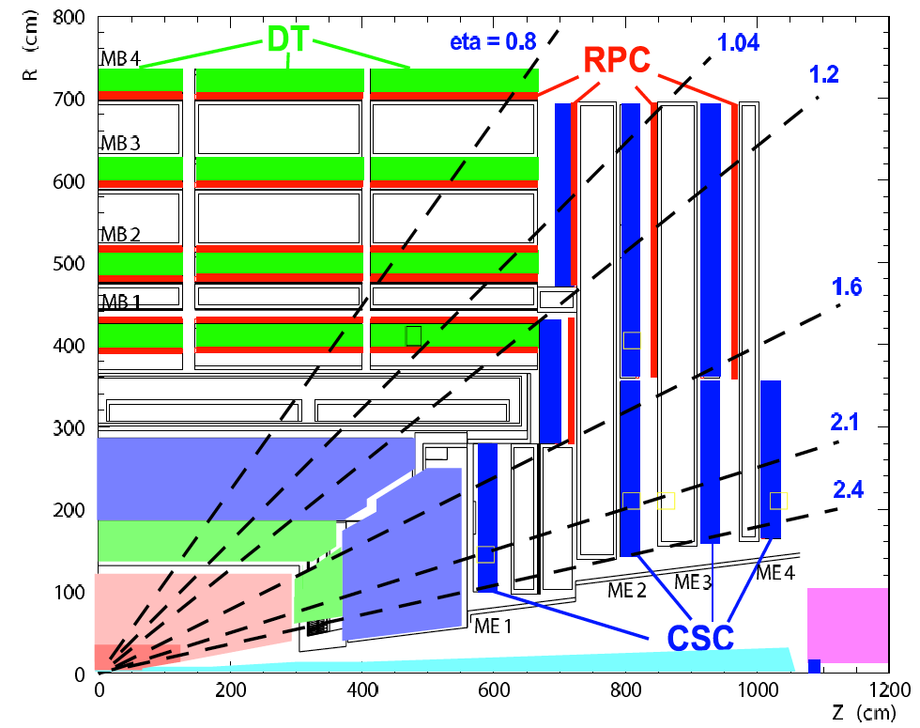
Level-1 Muon trigger
three technologies
  Drift Tubes (DT, in barrel)
  Cathode Strip Chambers (CSC, in endcaps)
  Resistive Plate Chambers (RPC, everywhere)
redundant
complementary technologies
geometrical overlap
muons from all 3 systems processed in Global Muon Trigger
final muon candidates determined by
  quality (e.g. number of hits)
  correlation between systems (RPC+DT, RPC+CSC)
  transverse momentum
Notes:
DT and CSC used for both trigger and precision data readout

Slide 67
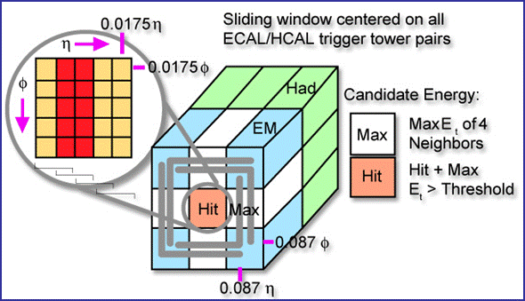
Level-1 Calorimeter trigger
Electromagnetic Calorimeter (ECAL)
  block of 5x5 lead-tungstate crystals forms a “trigger tower”
Hadronic Calorimeter (HCAL)
combination of signals from both calorimeters allows to determine candidates for
  e/gamma (discriminated only at High-Level Trigger)
  jets (“central” and
  “forward”)
  tau jets
as well as
  total and missing
  energy
  total and missing
  hadronic energy

Slide 68
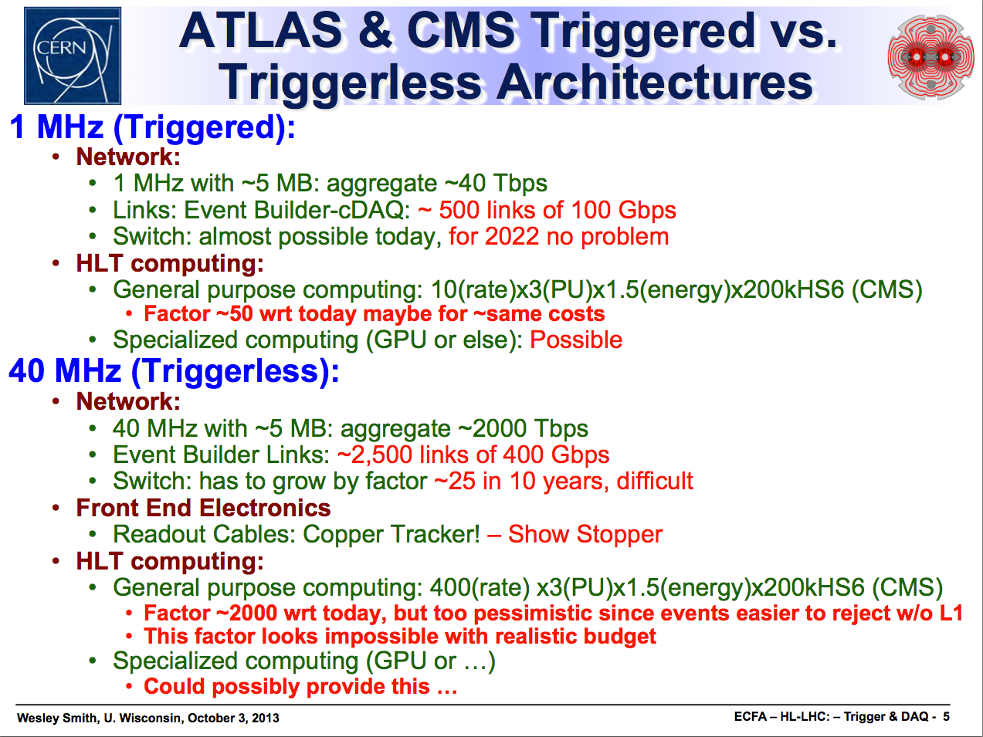

Slide 69
CMS Trigger & DAQ Systems
  LHC beam crossing rate is 40 MHz & at full Luminosity of 10³⁴ cm⁻²s⁻¹ yields 10⁹ collisions/s
  Reduce to 100 kHz output to High Level Trigger and keep high-P_{T} physics
  Pipelined at 40 MHz for dead time free operation
  Latency of only 4 μsec for collection, decision, propagation

Slide 70
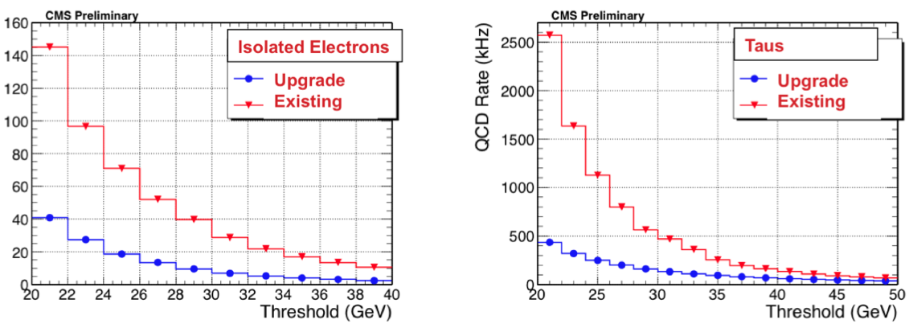
Calorimeter trigger upgrade
improve resolution in coordinates
  azimuth φ and pseudorapidity η
improve identification of tau jets
  better isolation criteria
further improve e/gamma isolation determination

Slide 71
signals used by the first-level trigger
muons
  tracks
  several types of detectors (different requirements for barrel and endcaps):
  in ATLAS:
    RPC (Resistive Plate Chambers): barrel
    TGC (“Thin Gap Chambers”): endcaps
    not in trigger: MDT (“Monitored Drift Tubes”)
  in CMS:
    DT (Drift Tubes): barrel
    CSC (Cathode Strip Chambers): endcaps
    RPC (Resistive Plate Chambers): barrel + endcaps
calorimeters
  clusters
  electrons, jets, transverse energy, missing transverse energy
  electromagnetic calorimeter
  hadron calorimeter
only in high-level trigger: tracker detectors
  silicon strip and pixel detectors, in ATLAS also straw tubes
  cannot be read out quickly enough

Slide 72
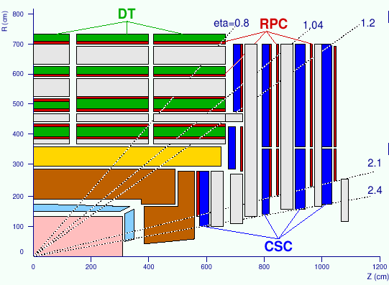
TRIGGER COMPONENTS
missing
HCAL
ECAL
HF
BARREL
FORWARD

Slide 73
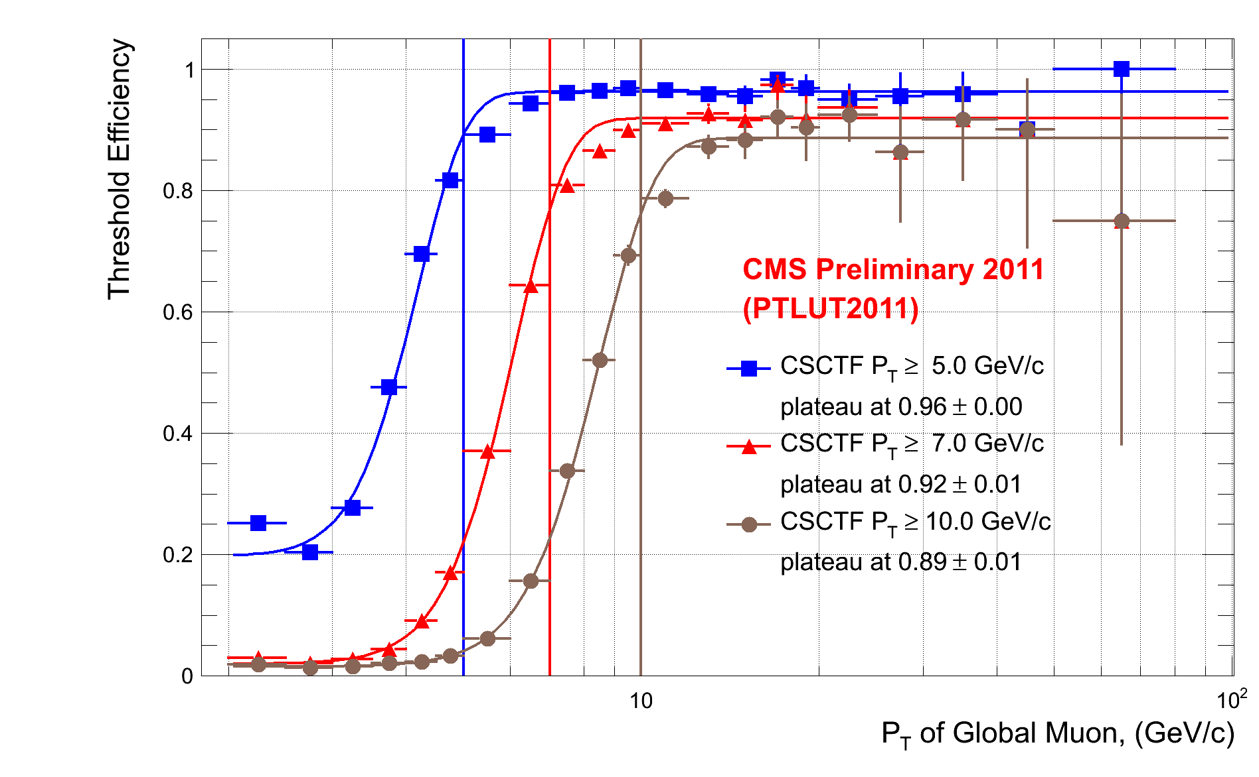
turn-on curves
ideal:
reality:
efficiency →
transverse momentum (p_{T}) →

Slide 74
BACKUP
Track Trigger

Slide 75
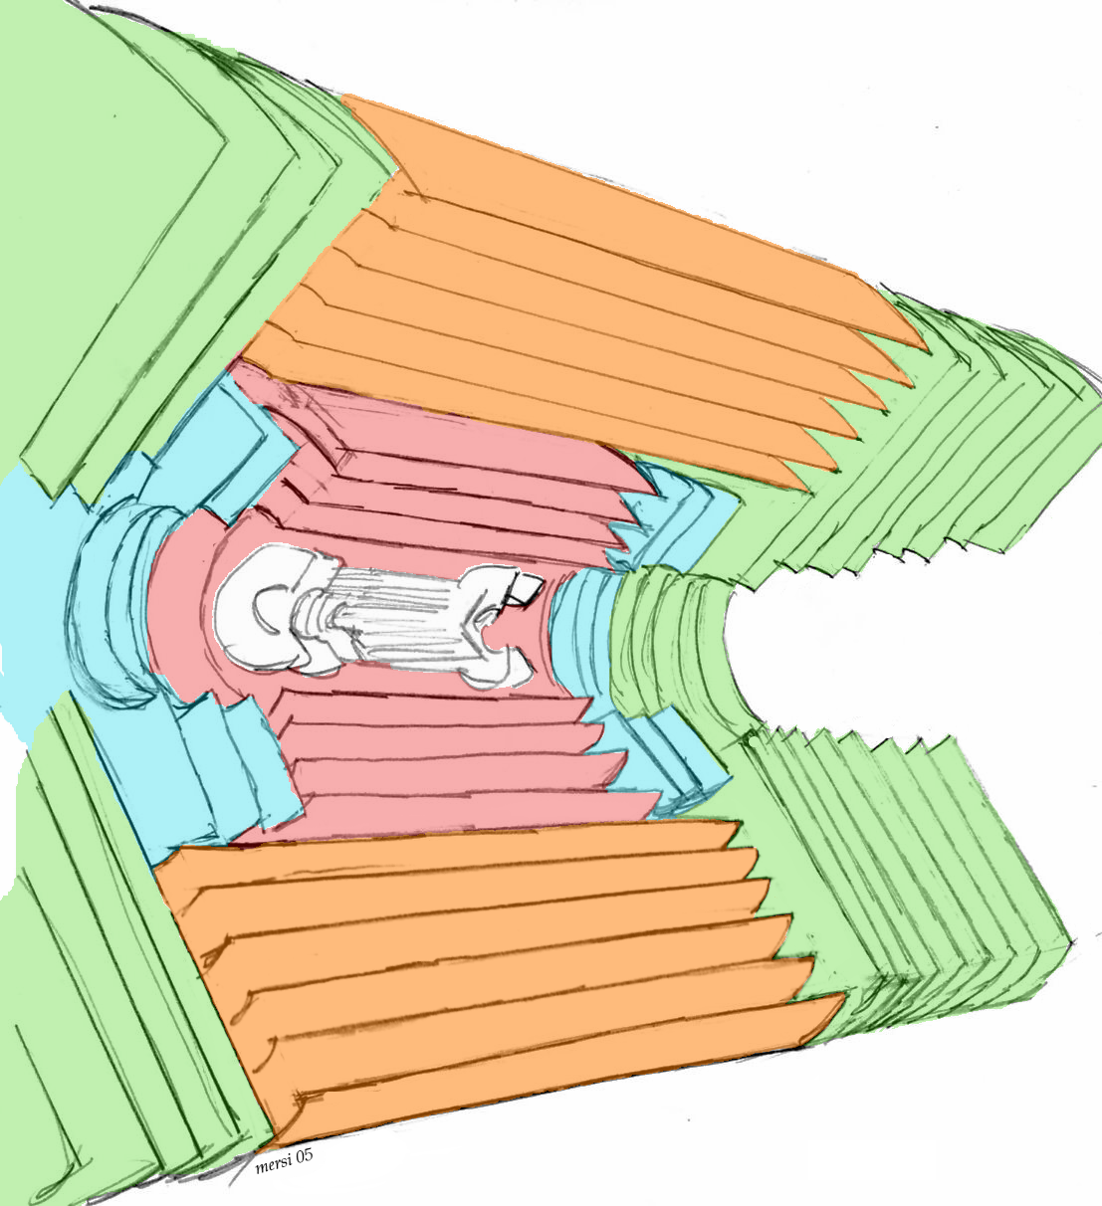
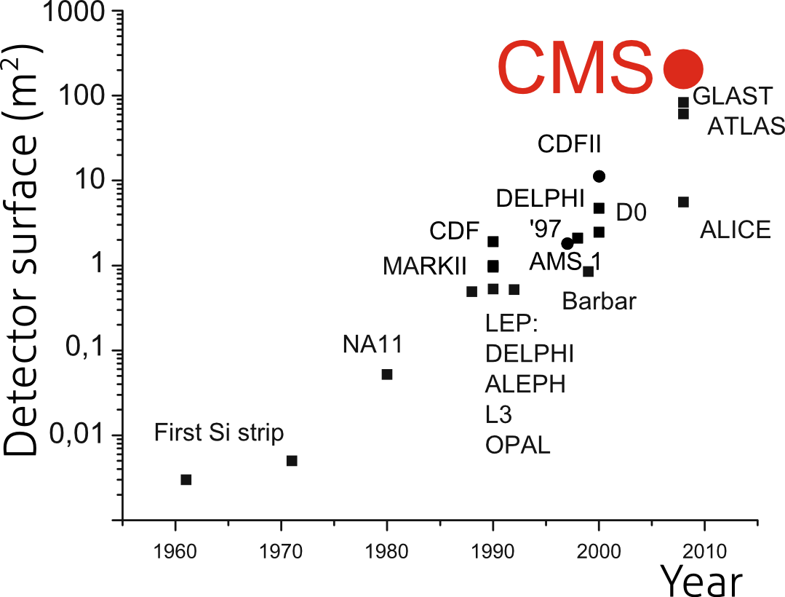
Level-1 Tracker
(original detector)
Volume 23 m³
Active area 210 m²
Modules 15'148
Front-end chips 72'784
Read-out channels 9'316'352
Bonds 24'000'000
Optical channels 36'392
Raw data rate: 1 Tbyte/s
Power dissipation: 30 kW
Operating T: −10°C
TID
TID
TIB
TEC
TOB
TEC
Notes:
has to be rebuilt (radiation damage); put in triggering capability

Slide 76
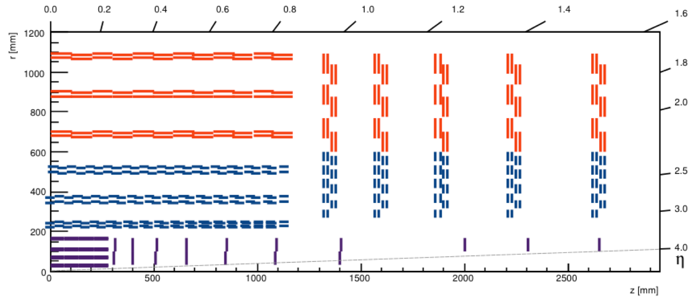
Level-1 Tracker trigger: new tracker layout
roughly same total sensor area and number of sensors
number of readout channels up by almost one order of magnitude
Notes:
bandwidth TO the Track Trigger is of the order of 30-50 Tb/s

Slide 77
Tracker trigger concept
Silicon modules provide at the same time “Level-1 data” (@ 40 MHZ), and “readout data” (upon Level-1 trigger)
  whole tracker sends out data at each bunch crossing: “push path”
Level-1 data require local rejection of low-p_{T} tracks
  reduce data volume and simplify track finding @ Level-1
  Threshold of ~ 2 GeV ⇒ data reduction of one order of magnitude or more
tracker modules with p_{T} discrimination (“p_{T} modules”)
  correlate signals in two closely-spaced sensors
  exploit the strong magnetic field of CMS
Level-1 “stubs” are processed in the back-end
  form Level-1 tracks with p_{T} above ~2 GeV
Pixel option
  possibly also use Pixel detector in “pull” architecture
  longer latency needed (20 μs)
Notes:
D. Abbaneo, November, 2013
Pixel: need at least 10 microsec latency; for b-tag, tau, vertex finding, electron ID

Slide 78
Track trigger: goals
presence of track match validates a calorimeter or muon trigger object,
  e.g. discriminating electrons from hadronic (π⁰→γγ) backgrounds in jets
link precise tracker system tracks to muon system tracks
  improve precision on the p_{T} measurement
  sharpen thresholds in muon trigger
check isolation of candidate (e, γ, μ or τ)
primary z-vertex location within 30-cm “luminous region”
  from projecting tracks found in trigger layers
  discrimination against pile-up events in multi-object triggers (e.g. lepton-plus-jet triggers)
Notes:
From: Trigger Performance and Strategy Group Interim Report
Oliver Buchmuellera and Wesley Smithb, on behalf of the TPSWG1
aImperial College – London, bUniversity of Wisconsin - Madison
January 31, 2013

Slide 79
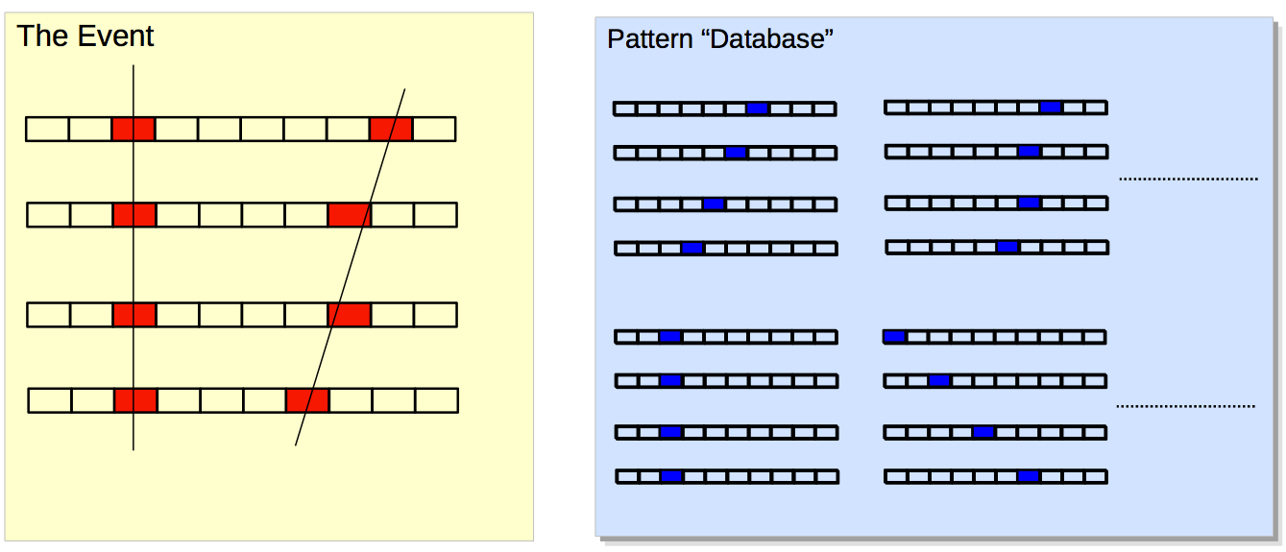
Track Trigger: pattern recognition
pattern recognition using “associative memory”
  CAM = “content addressable memory”
by comparing with patterns find candidates (“roads”)

Slide 80
Trigger, Threshold | Algorithm | Rate reduction | Full eff. at the plateau | Comments
Single Muon, 20 GeV | Improved Pt, via track matching | ~ 13 ( | η | < 1 ) | ~ 90 % | Tracker isolation may help further.
Single Electron, 20 GeV | Match with cluster | > 6 (current granularity) >10 (crystal granularity) ( | η | < 1 ) | 90 % | Tracker isolation can bring an additional factor of up to 2.
Single Tau, 40 GeV | CaloTau – track matching + tracker isolation | O(5) | O(50 %) (for 3-prong decays)
Single Photon, 20 GeV | Tracker isolation | 40 % | 90 % | Probably hard to do much better.
Multi-jets, HT | Require that jets come from the same vertex |  |  | Performances depend a lot on the trigger & threshold.

Slide 81
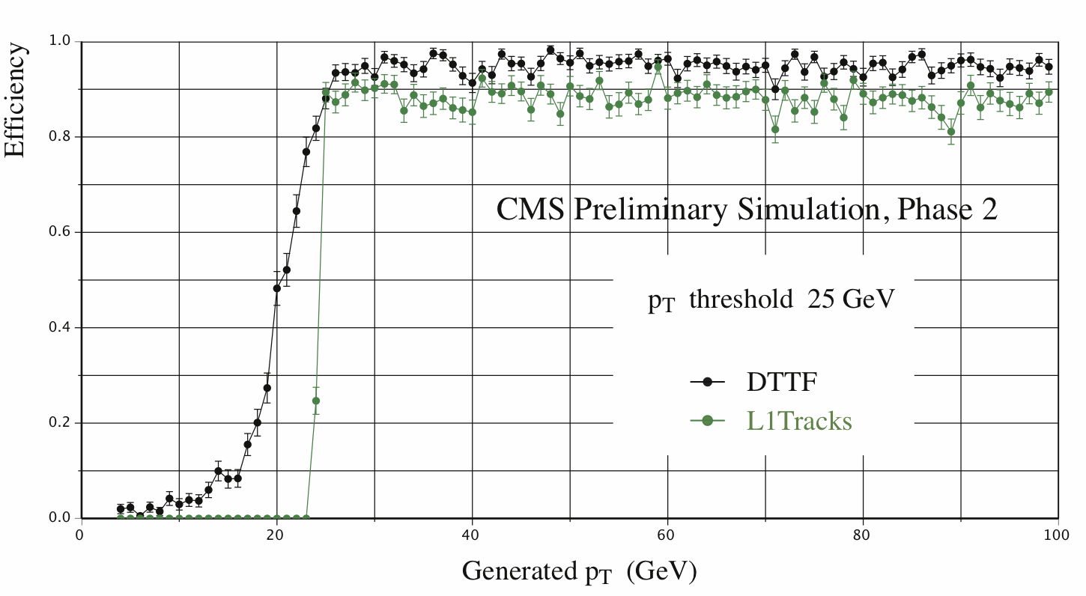
Muons : turn-on curves
Much sharper turn-on curves w.r.t. DTTF, as expected from the much better PT
resolution. Hence the contribution from mis-measured low PT muons (which makes
most of the DTTF rate) is dramatically reduced.

Slide 82
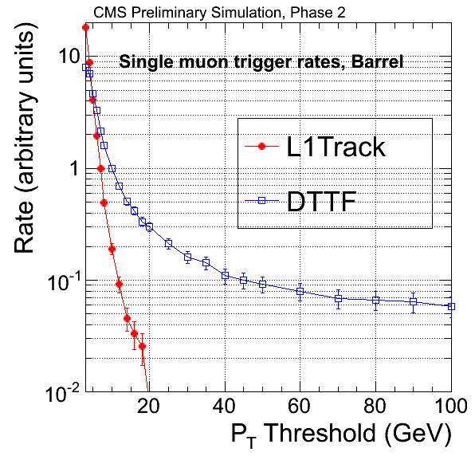
Muons : rates
DTTF : Flattening of the rates
at high threshold
Matching the DT primitives with
L1Tracks : large rate reduction,
> 10 at threshold > ~ 14 GeV.
Notes:
We do not show absolute rates
as we are currently checking
the normalization.

Slide 83
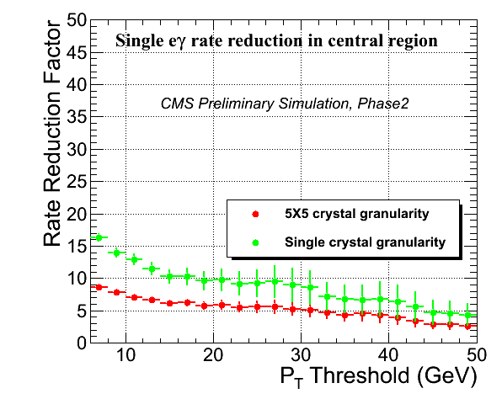
Electrons
Rate reduction brought by
matching L1EG to L1Tkstubs
in the central region
( | eta | < 1 )
Red : with the current L1Cal
granularity.
Green : if crystal-level information
is available for L1EG. The better
position resolution for the L1EG
object improves the performance
of the matching to the tracker.
( NB : the pure calorimetric L1EG rates could also be reduced with the finer
granularity. Not taken into account here. )
Notes:
(Final optimization of the
cuts at higher eta, in the
BE geometry, is in progress).

Slide 84
p_{T} modules: working principle
measure p_{T} via Δ(Rφ) over a given ΔR
for a given p_{T}, Δ(Rφ) increases with R
  same geometrical cut corresponds to harder p_{T} cuts at large radii
  at low radii, rejection power limited by pitch
  optimize selection window and/or sensors spacing for consistent p_{T} selection through the tracking volume
barrel: ΔR is given directly by the sensors spacing
end-cap: dependence on detector location
  End-cap configuration typically requires wider spacing
e.g. Window = 5
R
φ
ΔR
R
z
Δz = ΔR / tg ϑ
Notes:
D. Abbaneo, November, 2013

Slide 85
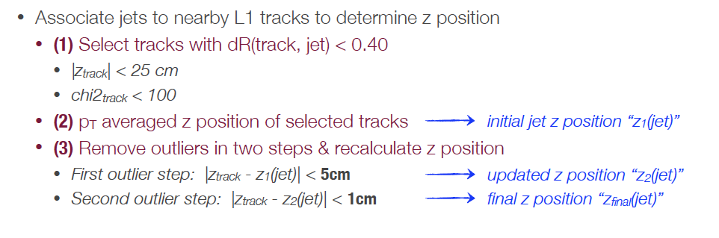
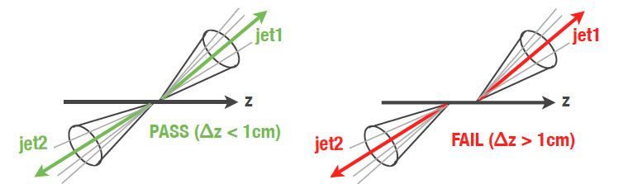
Jets

Slide 86
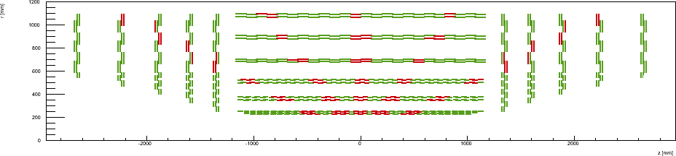
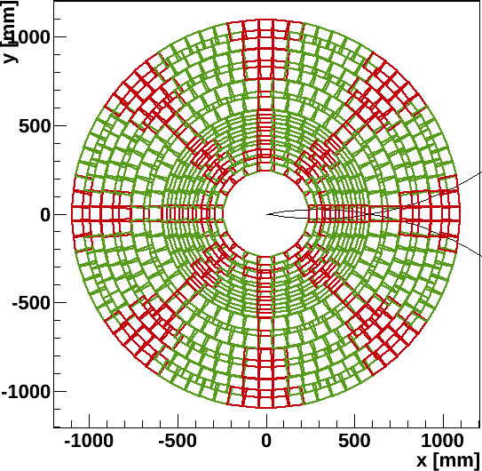
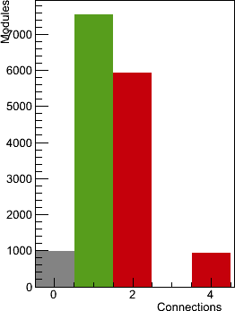
Track finding @ Level-1
Number of sectors
connected to a module
Each sector independent
Overlap regions depend on
  Luminous region Δz
  Minimum p_{T} cut
Notes:
D. Abbaneo, November, 2013

Slide 87
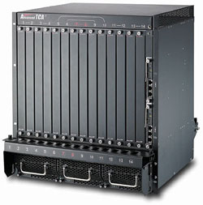
Track finding @ Level-1
Simple
Trigger Tower
Interconnections
Each box represents
a trigger tower
η
φ
Notes:
D. Abbaneo, November, 2013

Slide 88
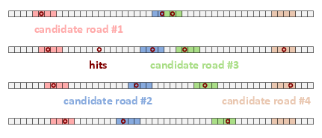
Track finding at Level-1
Within a latency of O(μs): Associative Memories
  Pattern matching using AM technologies dates back to CDF SVT to enhance collection of events with long-lived hadrons
  HL-LHC: much higher occupancy, higher event rates, higher granularity
  Plan of development
    Software emulation (ongoing)
    Build a demonstrator system using ATLAS FastTracKer boards (started)
    Develop dedicated AM chips and boards
Associative memory: track finding
CMS
Level-1
Stubs from
front-end
or
Refit
Notes:
D. Abbaneo, November, 2013

Slide 89

Basic requirements and guidelines – II
Tracker input to Level-1 trigger
  μ, e and jet rates would substantially increase at high luminosity
    Even considering “phase-1” trigger upgrades
  Increasing thresholds would affect physics performance
    Performance of algorithms degrades with increasing pile-up
      Muons: increased background rates from accidental coincidences
      Electrons/photons: reduced QCD rejection at fixed efficiency from isolation
  Even HLT without tracking seems marginal
  Add tracking information at Level-1
    Move part of HLT reconstruction into Level-1!
Goal for “track trigger”:
  Reconstruct tracks above 2 GeV
  Identify the origin along the beam axis with ~ 1 mm precision
Generator
Level-1
HLT w/o tracker
HLT with Tracker
Single muon Level-1 trigger rate @ L=10³⁴

