Slide 1
Status of the Mu3e Detector
Dirk Wiedner, Heidelberg
On Behalf of the Mu3e Collaboration

Slide 2
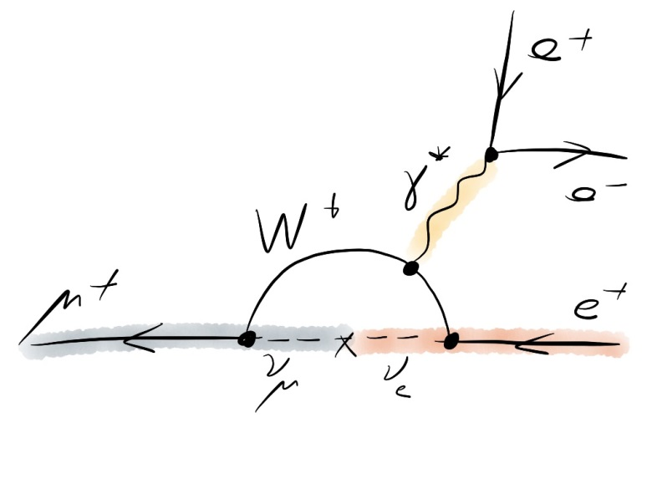
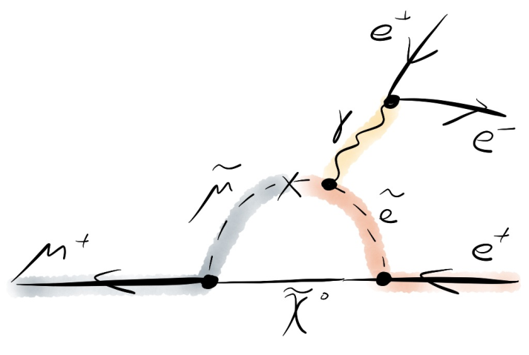
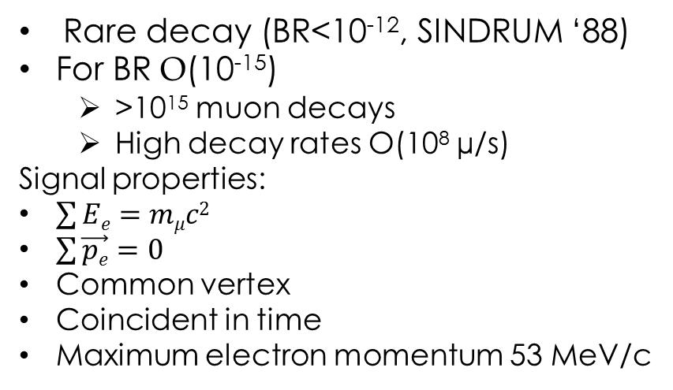
The Mu3e Signal
μ⁺→e⁺e⁻e⁺ rare in νSM
  Branching ratio <10⁻⁵⁴ →unobservable
Enhanced in BSM theories
Rare decay (BR<10⁻¹², SINDRUM ‘88)
For BR O(10⁻¹⁵)
  >10¹⁵ muon decays
  High decay rates O(10⁸ µ/s)
Signal properties:
$\sum{Ee}=mμc2$
$\sum{\vec{pe}}=0$
Common vertex
Coincident in time
Maximum electron momentum 53 MeV/c

Slide 3
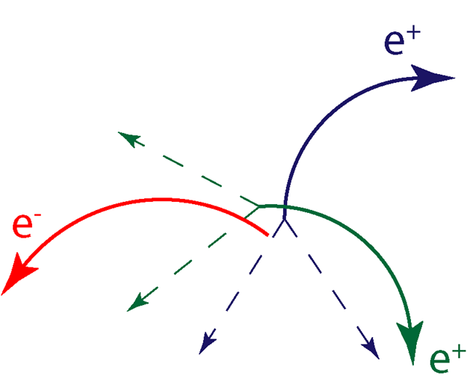
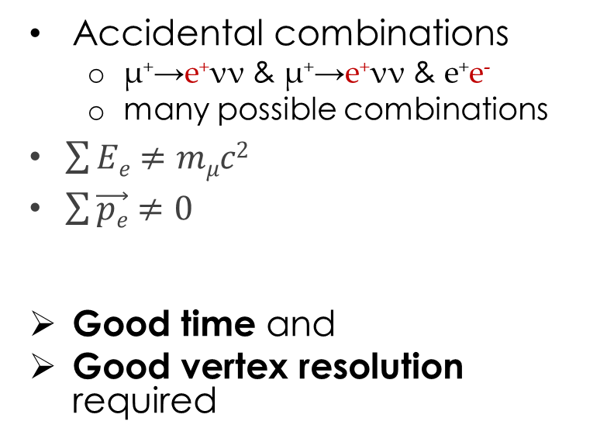
The Mu3e Background
Accidental combinations
  μ⁺→e⁺νν & μ⁺→e⁺νν & e⁺e⁻
  many possible combinations
$\sum{Ee}≠mμc2$
$\sum{\vec{pe}}≠0$
Good time and
Good vertex resolution required

Slide 4
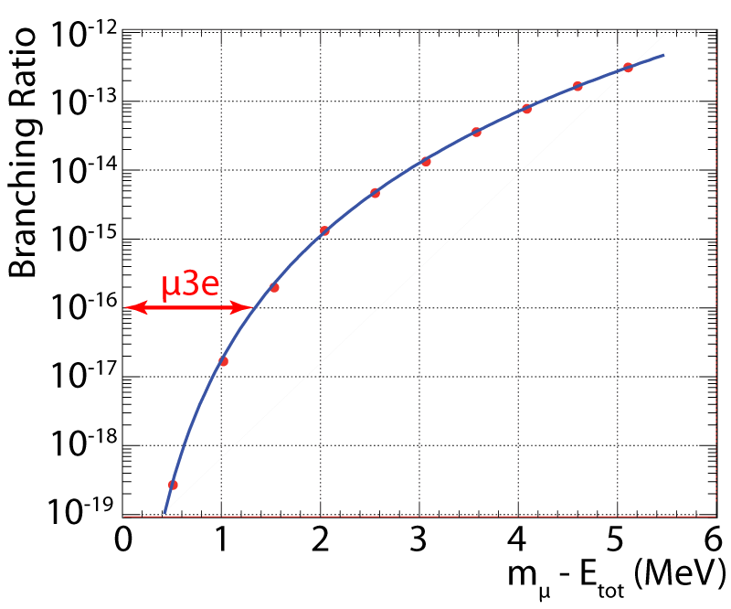
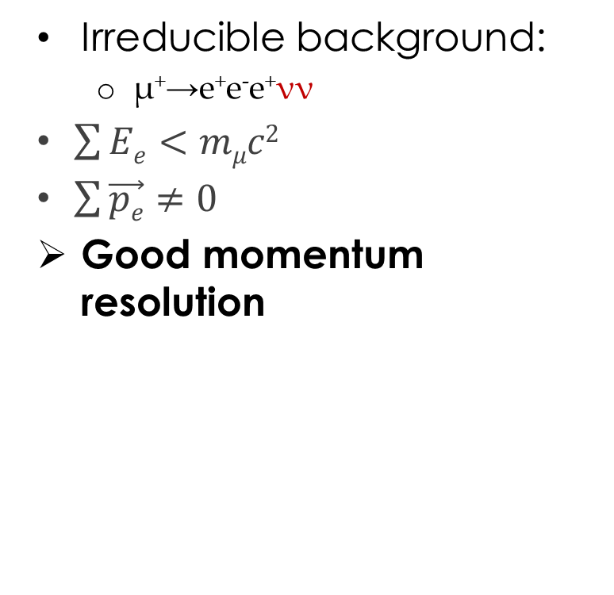
The Mu3e Background
Irreducible background:
  μ⁺→e⁺e⁻e⁺νν
$\sum{Ee}<mμc2$
$\sum{\vec{pe}}≠0$
Good momentum resolution
(R. M. Djilkibaev, R. V. Konoplich,
Phys.Rev. D79 (2009) 073004)

Slide 5

Challenges
High rates: up to 10⁸ μ/s
Good time resolution: 100 ps
Good vertex resolution: ~200 μm
Excellent momentum resolution: ~ 0.5 MeV/c
  Extremely low material budget: 1‰ X₀ per Si-Tracker Layer
$$σp\sim \frac{1}{p}\sqrt{\frac{x}{X0}}$$

Slide 6
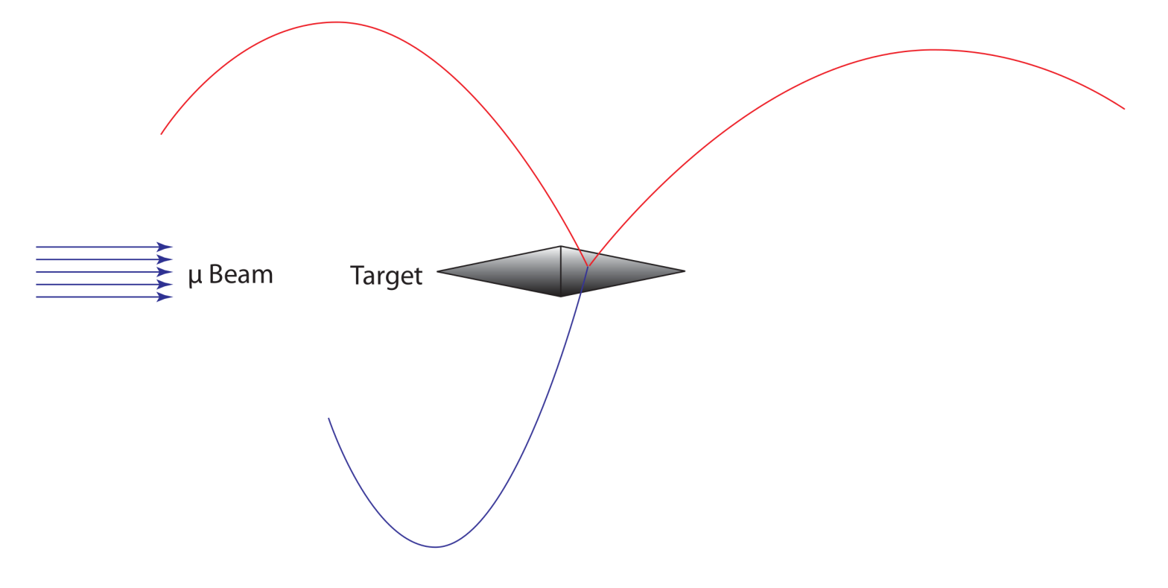
The Mu3e Experiment
Target double hollow cone
Silicon pixel tracker
Scintillating fiber detector
Tile detector
Muon beam
Helium atmosphere
1 T B-field

Slide 7
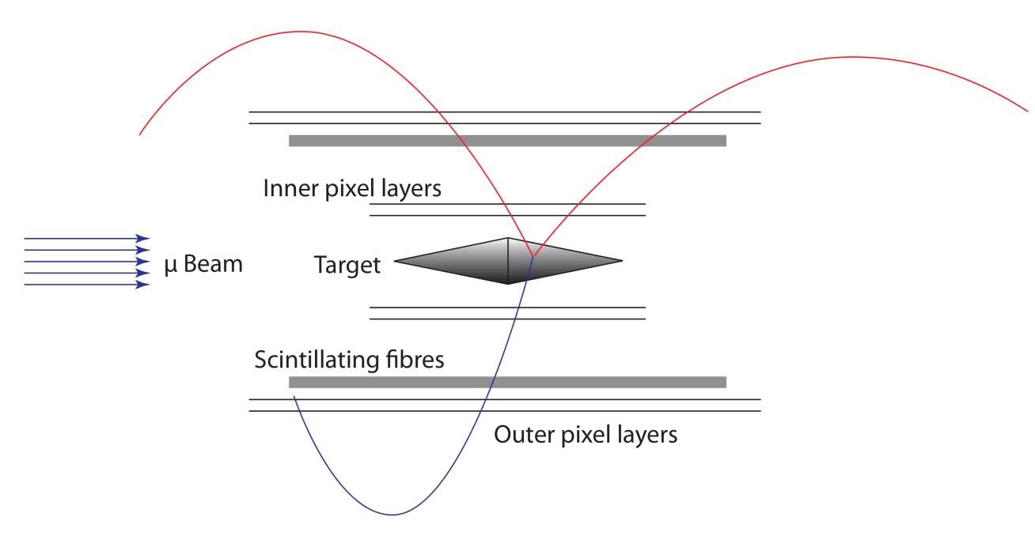
The Mu3e Experiment
Target double hollow cone
Silicon pixel tracker
Scintillating fiber detector
Tile detector
Muon beam
Helium atmosphere
1 T B-field

Slide 8
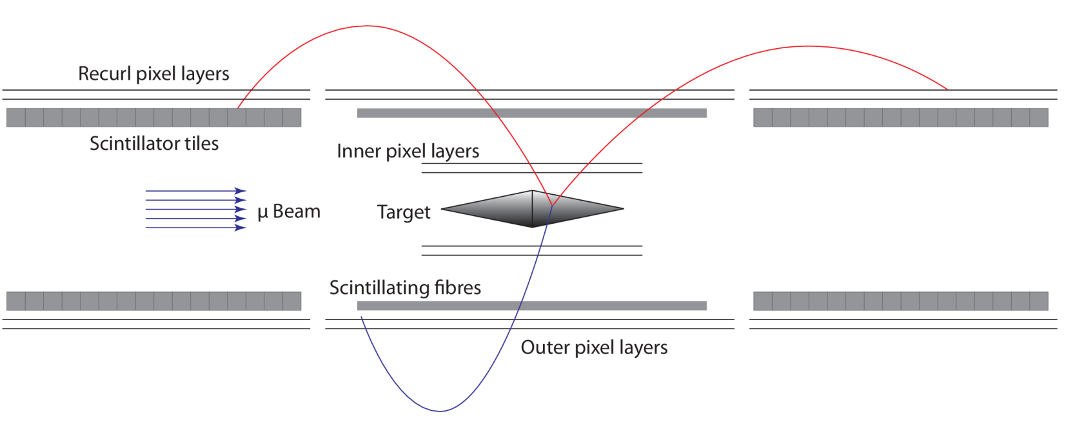
The Mu3e Experiment
Phase I
Target double hollow cone
Silicon pixel tracker
Scintillating fiber detector
Tile detector
Muon beam O(10⁸/s)
Helium atmosphere
1 T B-field

Slide 9
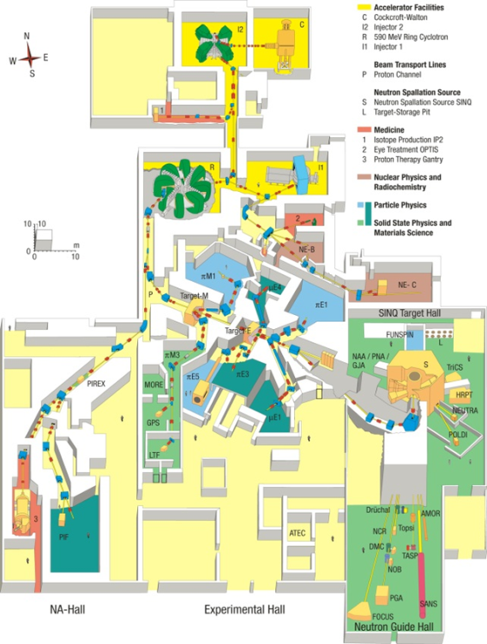
PSI μ-Beam
Paul Scherrer Institute Switzerland:
2.2 mA of 590 MeV/c protons
Surface muons from target E
Up to ~10⁸ μ/s
>10¹⁵ muon decays per year

Slide 10
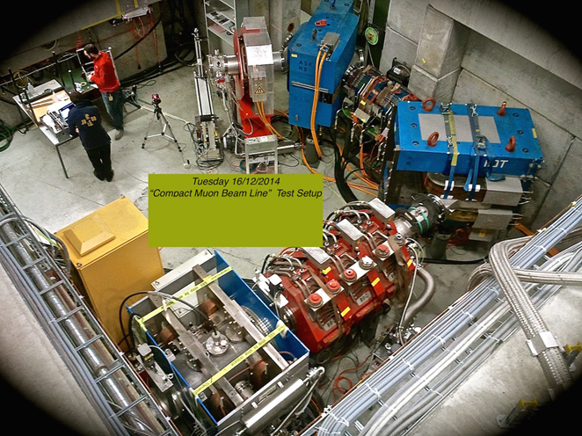
PSI μ-Beam
Paul Scherrer Institute Switzerland:
2.2 mA of 590 MeV/c protons
Surface muons from target E
Up to ~10⁸ μ/s
>10¹⁵ muon decays per year
O(10⁸ µ/s)

Slide 11
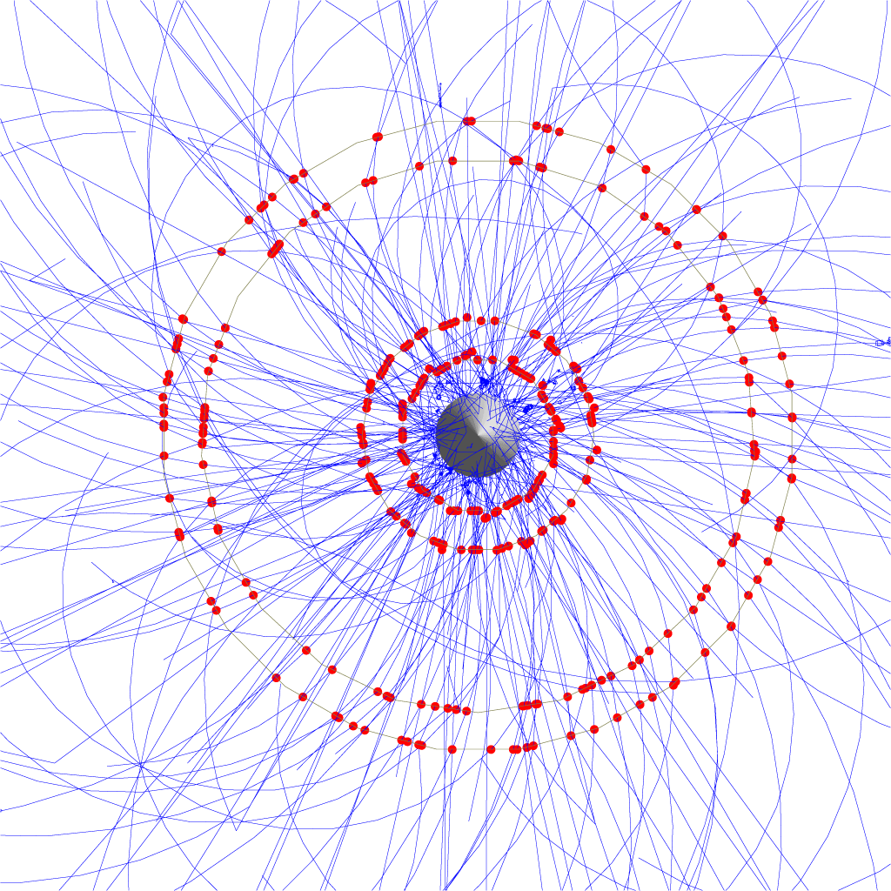
Timing Detectors
50 ns

Slide 12
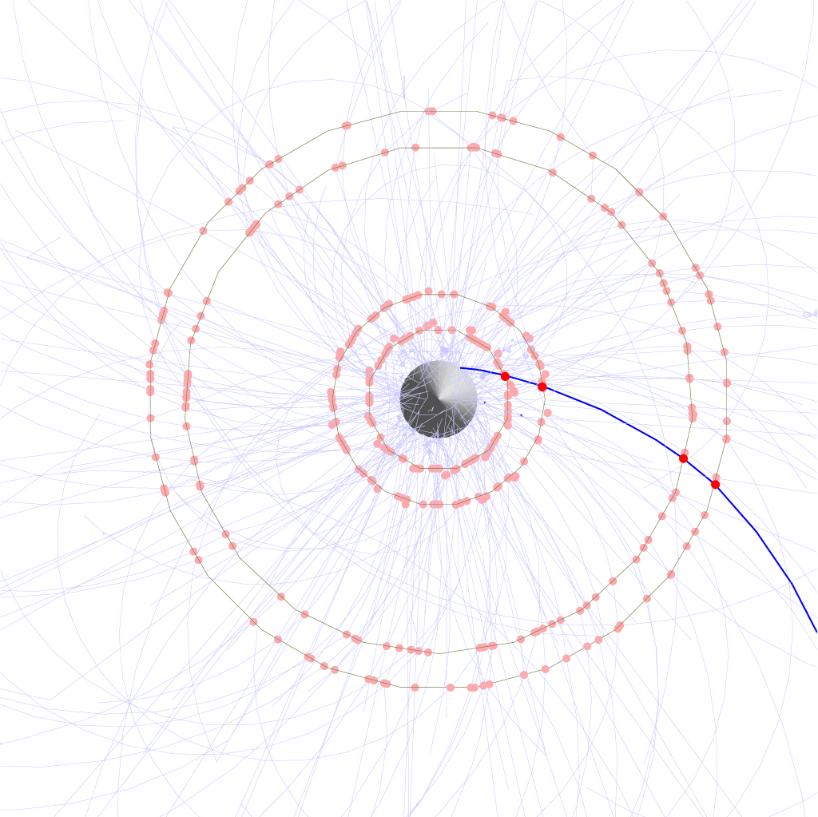
Timing Detectors
0.1 ns

Slide 13
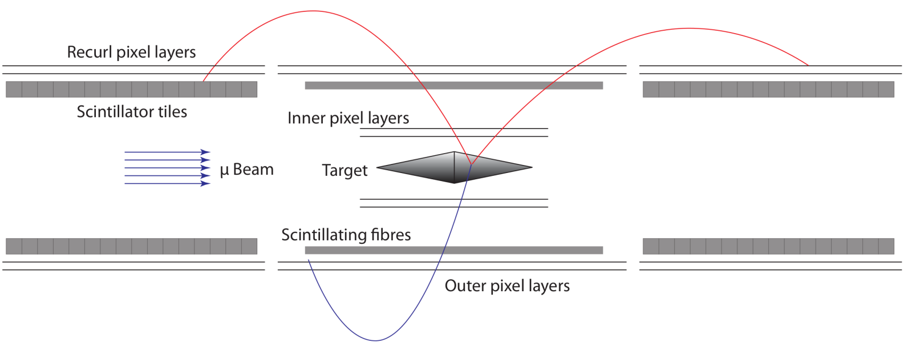
Timing Detectors
Fiber detector
  Before outer pixel layers
  250 μm scintillating fibers
  0.3% X/X₀
  SiPMs
  ≤ 1 ns resolution
Tile detector
  After recurl pixel layers
  6.5 x 6.5 x 5.0 mm³
  SiPMs
  ≤ 100 ps resolution

Slide 14
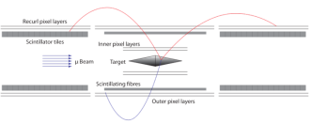
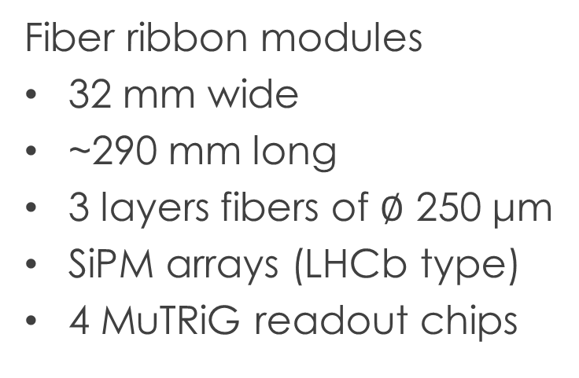
Fiber Detector
Fiber ribbon modules
32 mm wide
~290 mm long
3 layers fibers of $∅$ 250 μm
SiPM arrays (LHCb type)
4 MuTRiG readout chips
Scintillating fiber ribbons
Talk: “Scintillating Fibre Detector for the Mu3e Experiment”, Simon Corrodi on Monday

Slide 15
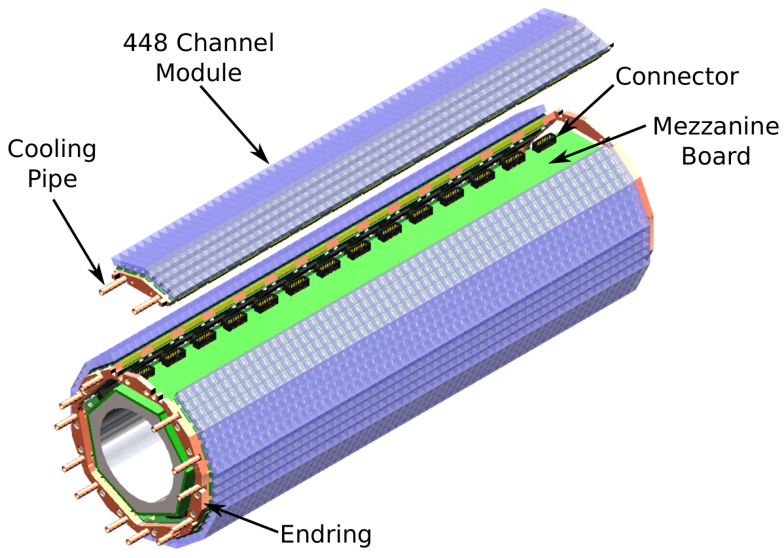
Tile Detector
Scintillating tiles
  6.5 x 6.5 x 5.0 mm³
7 Tile modules per station
  448 tiles/module
  Attached to end rings
SiPMs attached to tiles
  Front end PCBs below
  Readout through MuTRiG
Rendering of Tile Detector station

Slide 16
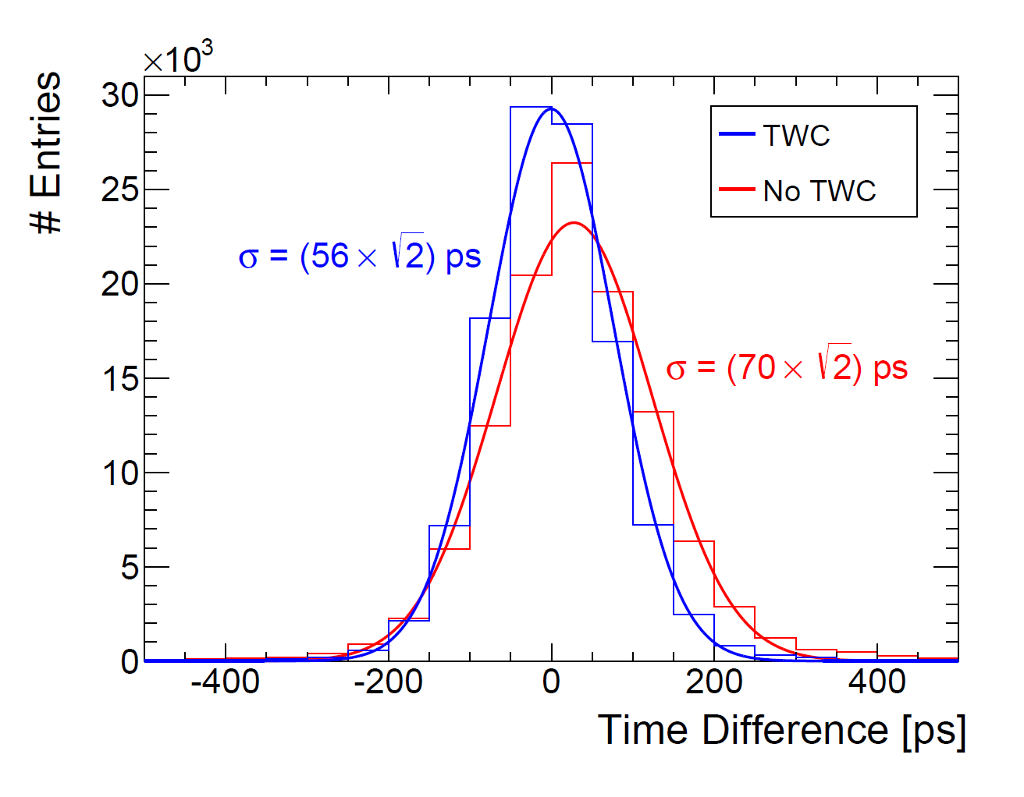
Time Resolution
Coincidence between 2 tiles in a row
Time resolution ≈ 70 ps
Time-walk effect ≈ 14 ps

Slide 17
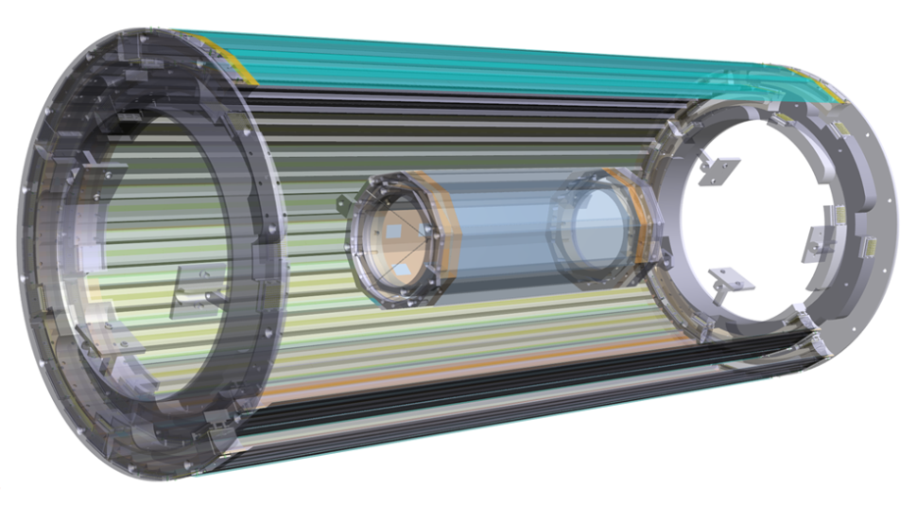
Pixel Tracker
Successful feasibility studies for:
  Module mechanics
  He-cooling with low vibration
  Ultra-thin flexible circuit boards
  HV-CMOS small prototypes
  Readout board prototype
Pixel Tracker
Rendering of CAD study

Slide 18
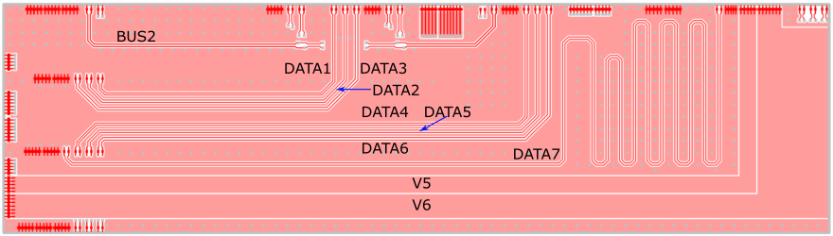
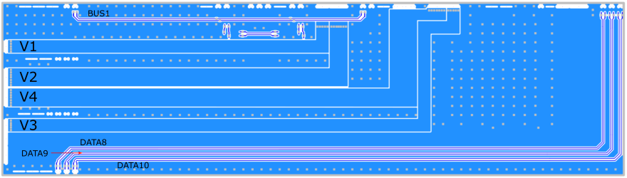
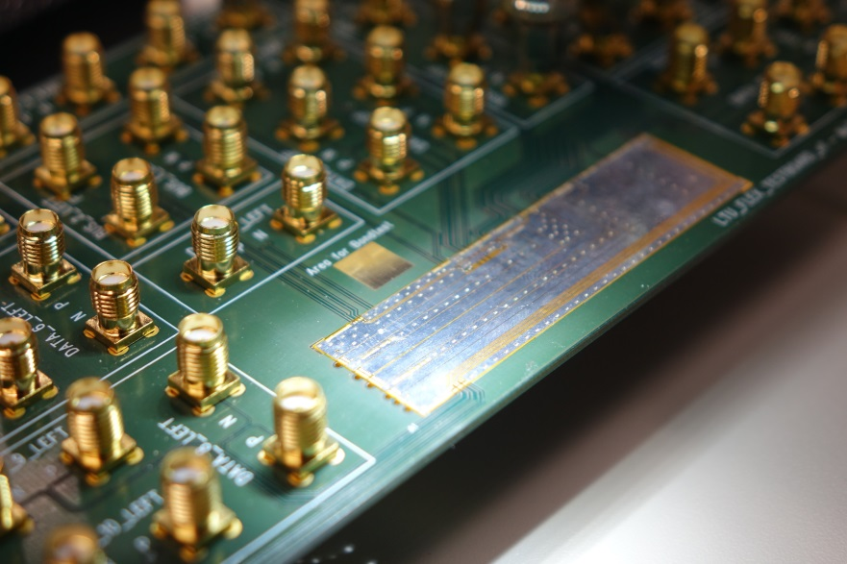
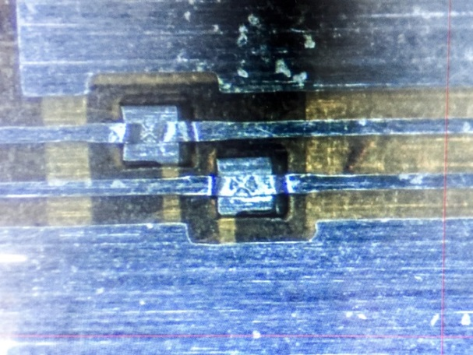
Ultra-thin HDI
Two layer HDI test design (top)
Prototype from LTU
Single point tape automated bonding

Slide 19
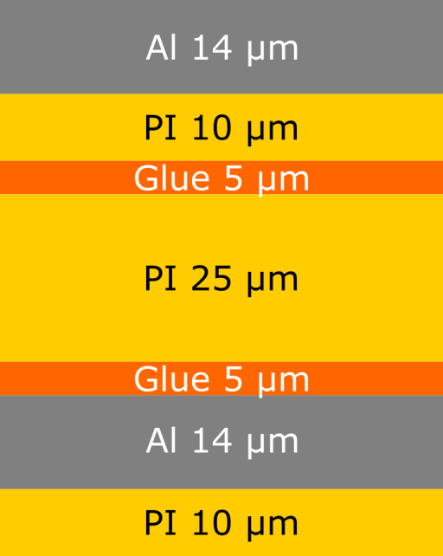
Ultra-thin HDI
Two layer HDI test design (top)
Material | Thickness [μm] | X/X0
upper Al layer | 14 | 1.57 · 10⁻⁴
isolator (PI) | 35 | 1.22 · 10⁻⁴
glue | 10 | 0.25 · 10⁻⁴
lower Al layer | 14 | 1.57 · 10⁻⁴
lower PI shield | 10 | 0.35 · 10⁻⁴
total | 83 | < 5 · 10⁻⁴

Slide 20
HV-MAPS
High Voltage Monolithic Active Pixel Sensors
HV-CMOS technology
N-well in p-substrate
Reversely biased
P substrate
N well
NMOS
PMOS
by Ivan Perić
I. Perić, A novel monolithic pixelated particle detector implemented in high-voltage CMOS technology Nucl.Instrum.Meth., 2007, A582, 876
See talk: “Characterisation of novel prototypes of monolithic HV-CMOS pixel detectors for high energy physics experiments”, Dr. Stefano Terzo on Friday

Slide 21
HV-MAPS
High Voltage Monolithic Active Pixel Sensors
HV-CMOS technology
N-well in p-substrate
Reversely biased ~85V
  Depletion layer
  Charge collection via drift
  Fast <1 ns charge collection
  Thinning to 50 μm possible
Integrated readout electronics
-85V
P substrate
depletion layer
N well
~9μm
by Ivan Perić
I. Perić, A novel monolithic pixelated particle detector implemented in high-voltage CMOS technology Nucl.Instrum.Meth., 2007, A582, 876

Slide 22
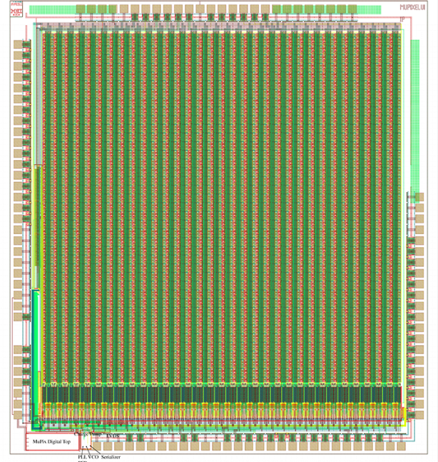
Full System on Chip
180 nm HV-CMOS
Pixel matrix:
  40 x 32 pixels
  103 x 80 μm² each
Analog part
  Temperature tolerant
Digital part
  Full system on chip
MuPix7

Slide 23
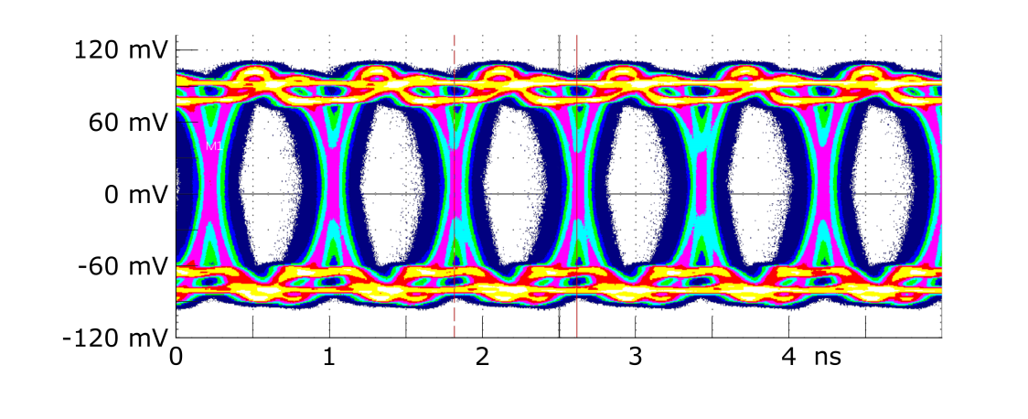
Chip Readout
On Chip:
Zero suppression
Read-out state machine
PLL and VCO
Fast serializer
1.25 Gbit/s LVDS output
Eye diagram MuPix7;
eye height > 130mV,
eye width > 0.65 UI

Slide 24
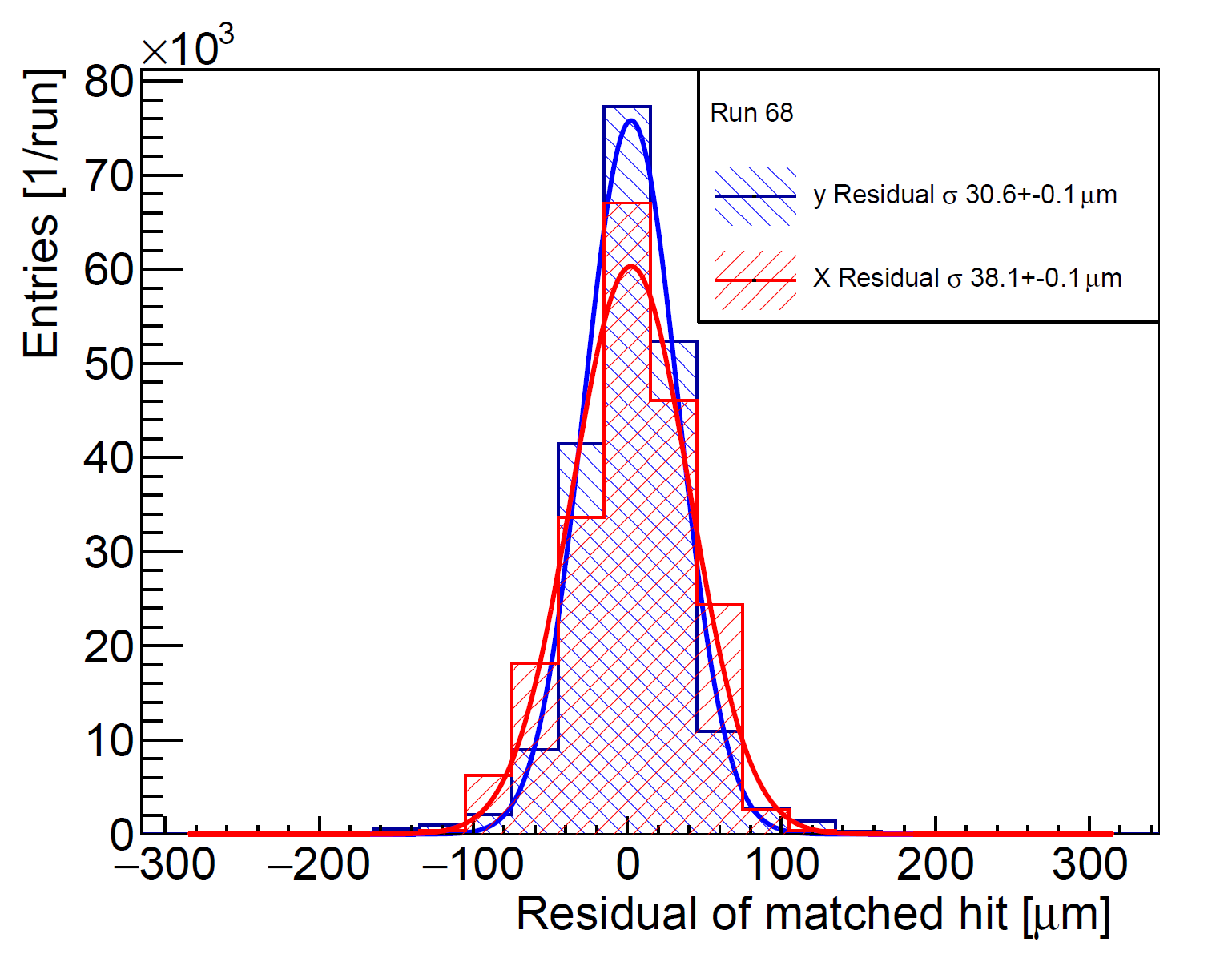
Spatial Resolution
Pixel size 80 μm x 103 μm
Measured track residuals:
  RMS x = 38.1 ± 0.1 μm
  RMS y = 30.6 ± 0.1 μm

Slide 25
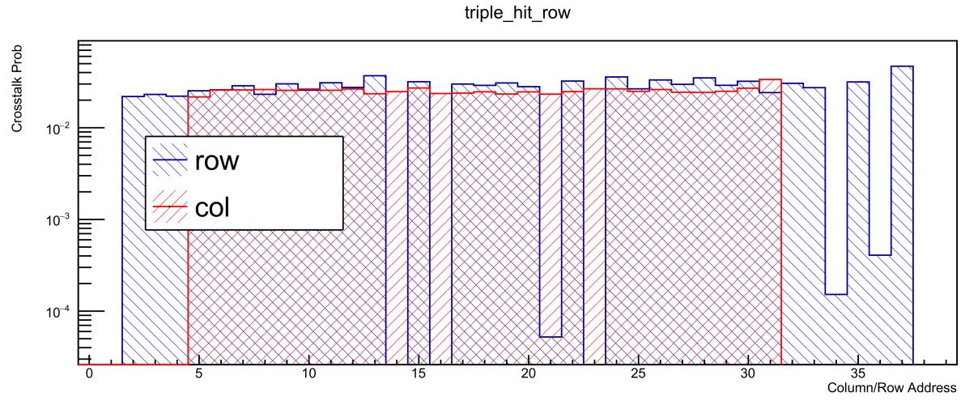
X-talk
MuPix7
PSI October 2015
  250 MeV e⁺/µ⁺/pion
X-talk between
  Rows
  Around 10%
X-talk to both sides

Slide 26
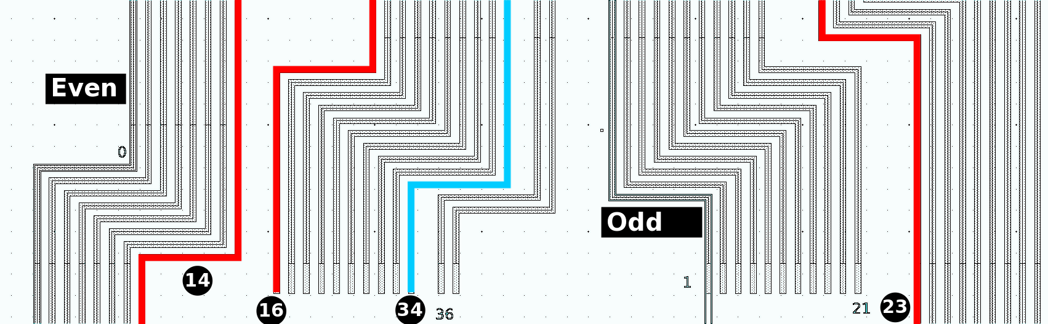
X-talk
MuPix7
PSI October 2015
  250 MeV e⁺/µ⁺/pion
X-talk between
  Rows
Capacitive coupling
  Line from diode to comparator
  Strongly depends on layout
X-talk to both sides

Slide 27
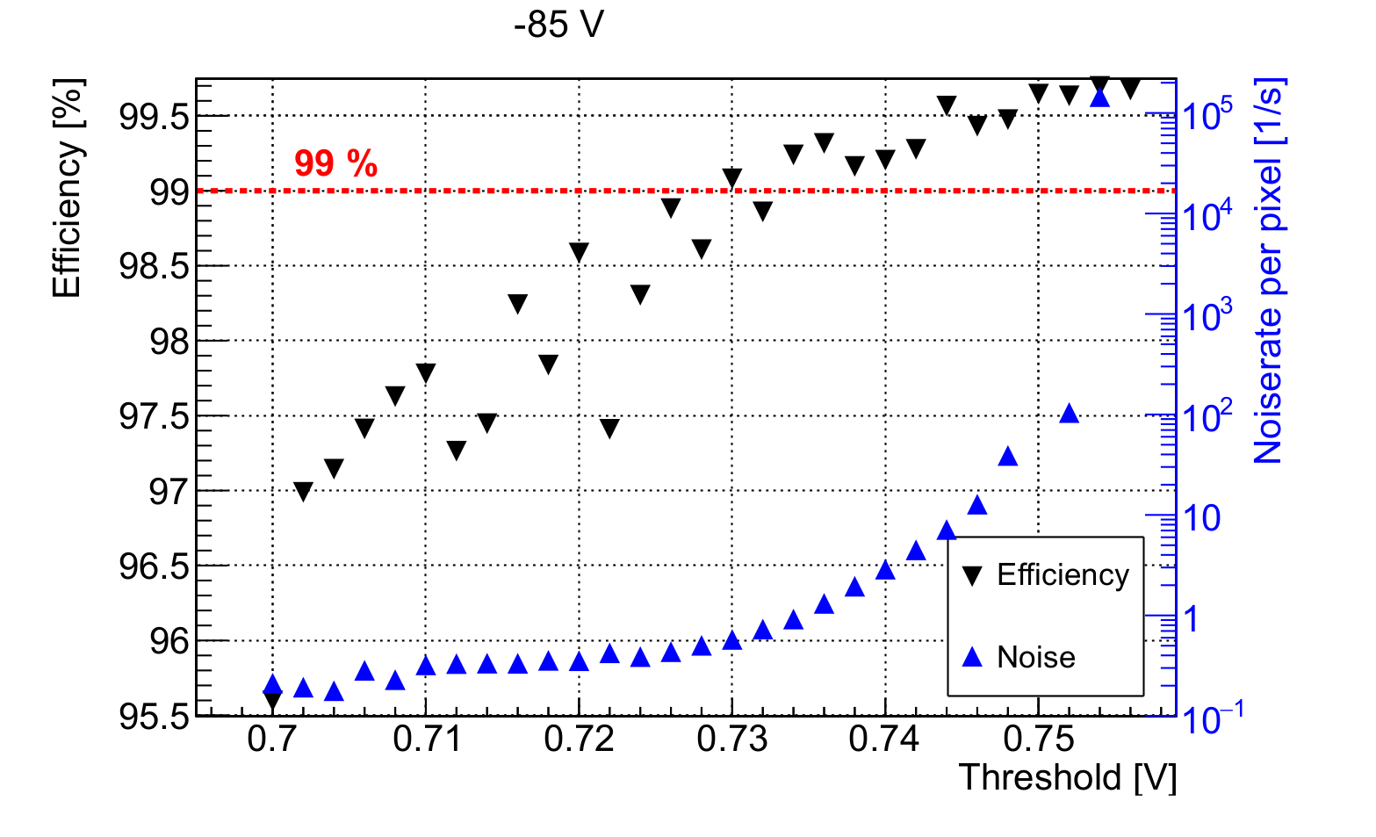
Efficiencies
>99.5% efficiency
  4 GeV electrons@DESY
  90° impact angle
  Individual pixel thresholds
MuPix7 Efficiency

Slide 28
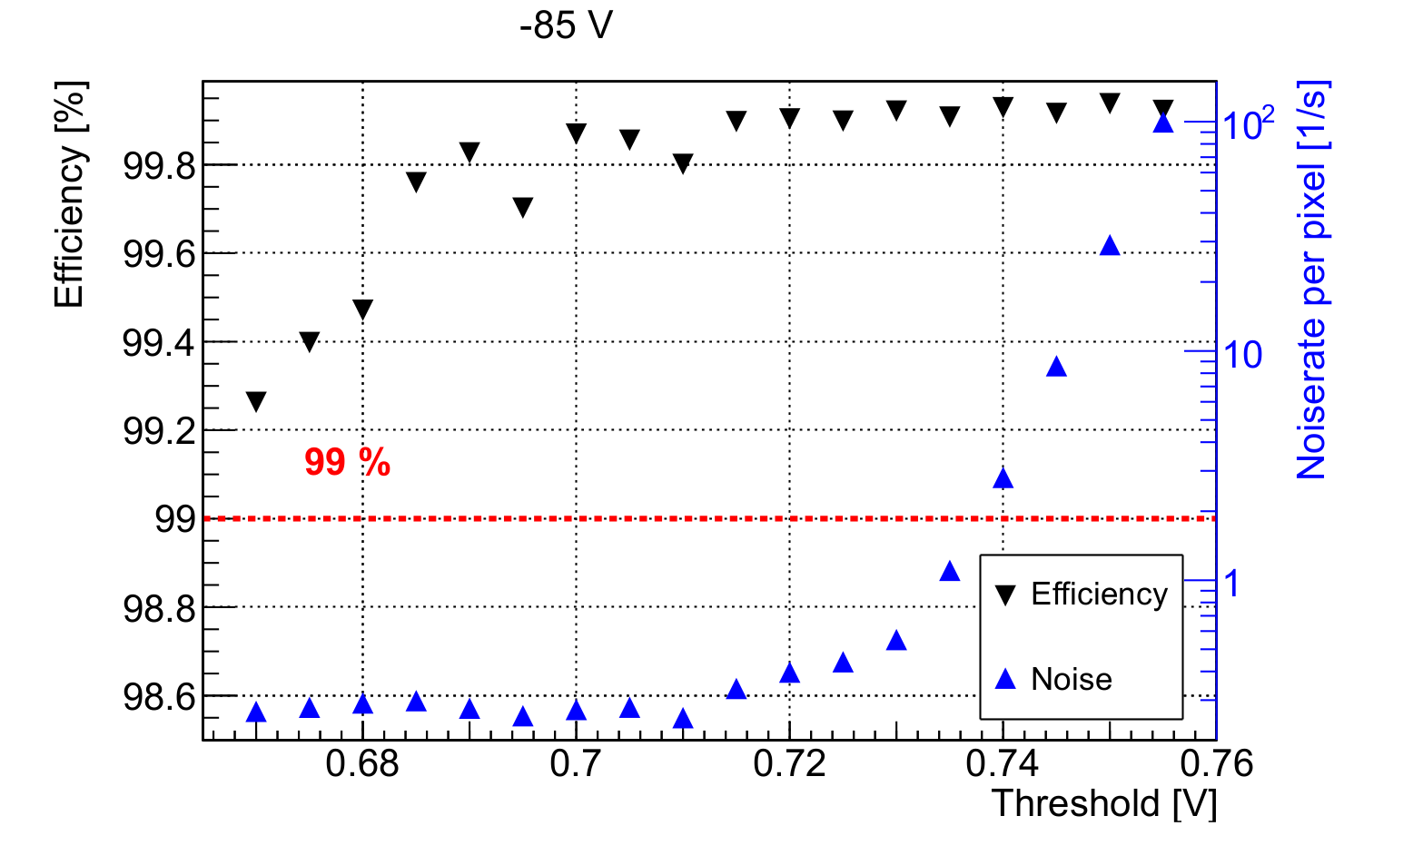
Efficiencies rotated Sensor
>99.8% efficiency
  4 GeV electrons@DESY
  30° impact angle
  Individual pixel thresholds
MuPix7
e⁺
MuPix7 under angle
MuPix7 Efficiency

Slide 29
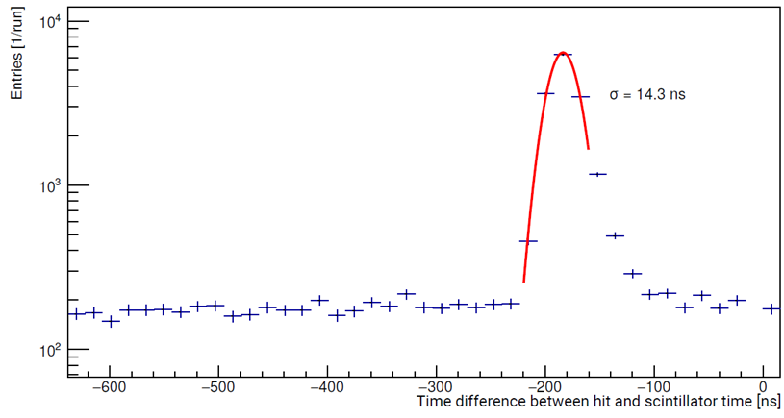
Time Stamps
Time difference of hits registered in MuPix 7 and scintillator
4 GeV electrons
Sampling rate is 62.5 MHz
σ = 14.3 ns
Time Resolution of Pixels

Slide 30
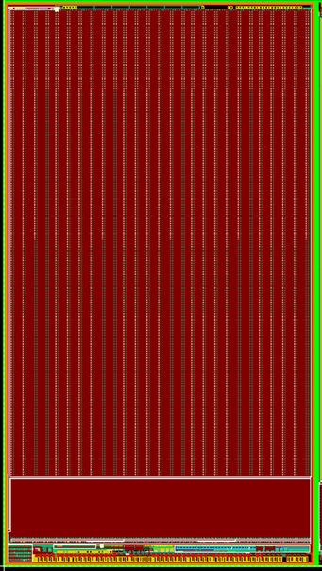
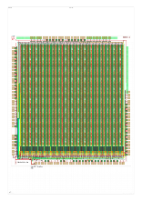
Large Pixel Prototype
10.8 x 20 mm²
Time walk correction
3+1 LVDS outputs
In production
Module studies
MuPix8
MuPix7

Slide 31
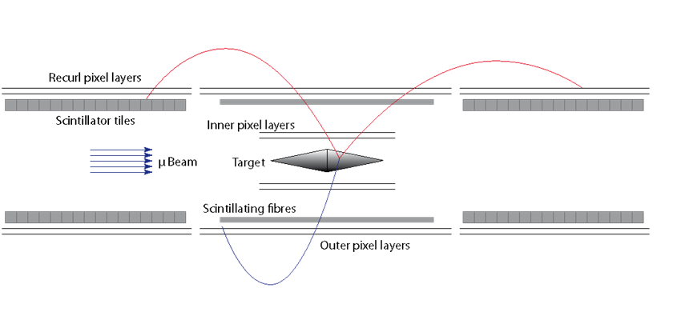
Summary
Mu3e searches for lepton flavor violation
  > 10¹⁵ μ-decays → BR O(10⁻¹⁵)(90% CL)
Two SiPM based timing systems
Silicon tracker with ~182M pixel
  HV-MAPS 50 μm thin
Prototypes exceed requirements

Slide 32
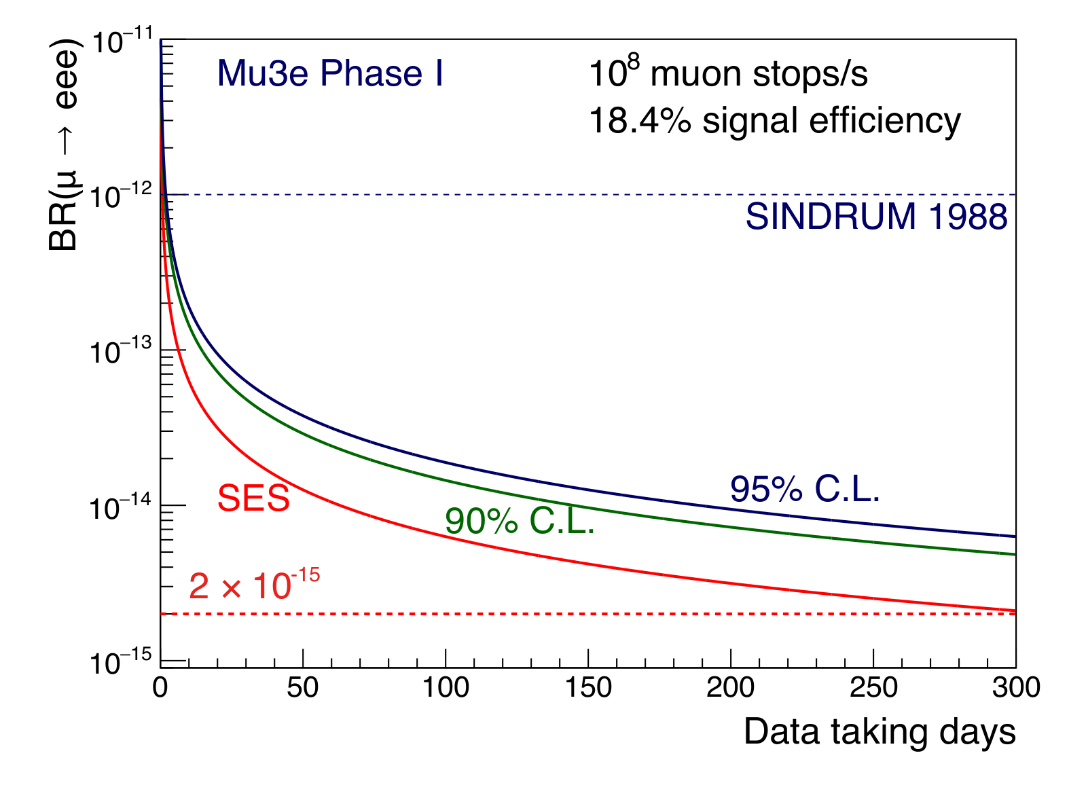
Outlook:
Projected Sensitivity
Single event sensitivity (SES) and the
corresponding 90% and 95% C.L. upper limits
versus data taking days for the Mu3e detector

Slide 33







Institutes
Mu3e-collaboration:
  DPNC Geneva University
  Paul Scherrer Institute
  Particle Physics ETH Zürich
  Physics Institute Heidelberg University
  Institute for Nuclear Physics Mainz University
  IPE Karlsruhe
  KIP Heidelberg

Slide 34
Acknowledgements
The measurements leading to these results have been performed at the Test Beam Facility at DESY Hamburg (Germany), a member of the Helmholtz Association (HGF)
We owe our SPS test-beam time to the SPS team and our LHCb colleagues, especially Heinrich, Kazu and Martin.
We would like to thank PSI for valuable test beams!
We thank the Institut für Kernphysik at the Johannes Gutenberg University Mainz for giving us the opportunity to take data at the MAMI beam.

Slide 35
Backup Slides

Slide 36
Motivation
Backup

Slide 37
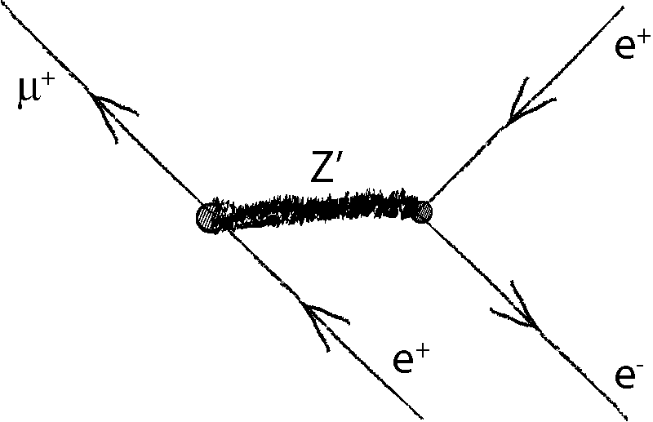
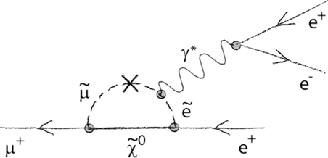
The Mu3e Signal
μ⁺→e⁺e⁻e⁺ rare in SM
Enhanced in:
  Super-symmetry
  Grand unified models
  Left-right symmetric models
  Extended Higgs sector
  Large extra dimensions
  …
Tree level
SUSY

Slide 38
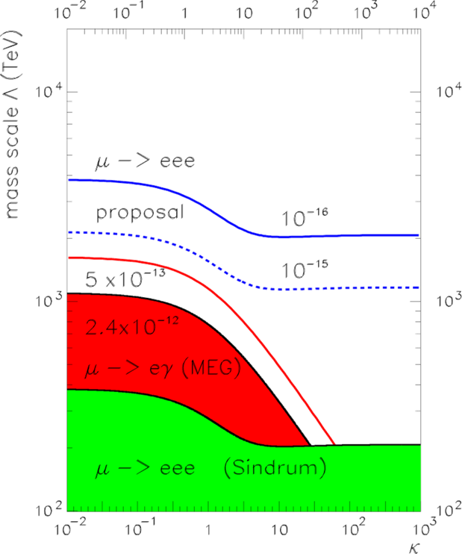
μ→eee vs. μ→eγ
A. de Gouvêa,
“(Charged) Lepton Flavor Violation”,
Nucl. Phys B. (Proc. Suppl.),
188 303–308, 2009.

Slide 39
Challenges

Slide 40
Challenges
High rates: 10⁸ μ/s
Good timing resolution: 100 ps
Good vertex resolution: ~200 μm
Excellent momentum resolution: ~ 0.5 MeV/c²
Extremely low material budget:
  1x10⁻³ X₀ (Si-Tracker Layer)
HV-MAPS spectrometer
  50 μm thin sensors
  B ~1 T field
+ Timing detectors

Slide 41
SciFi
Backup

Slide 42
Details …
staggered layers
Thickness:
theoretical ~ 683 μm
measured ~ 750 μm
< 1 g of glue / ribbon
433 μm
700 μm
250 μm
Alternative:
Square shape fibers
254 μm
Horizontal gap between fibers ~ 4 μm

Slide 43
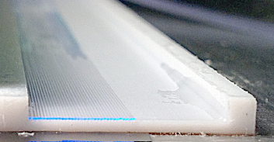
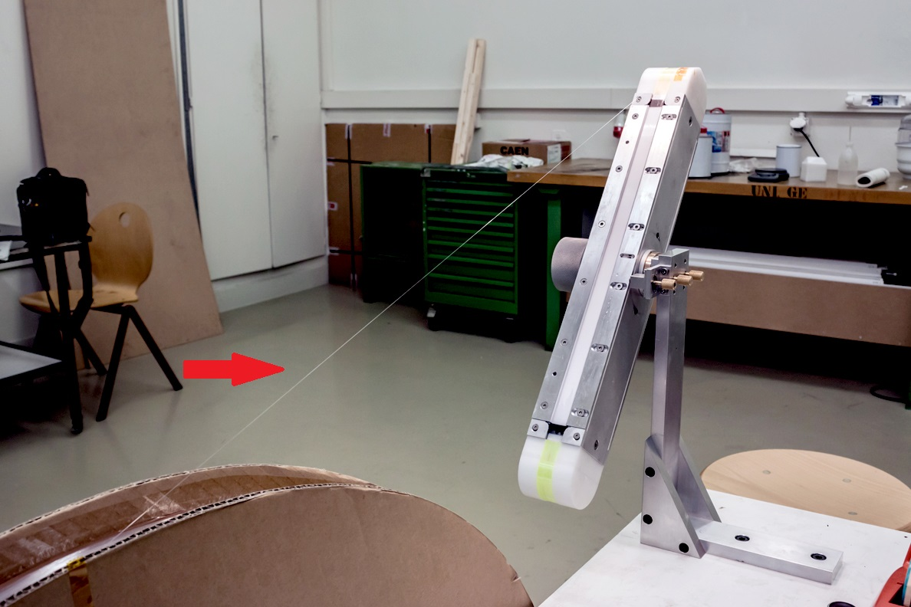
Fiber Winding Tool
U channel
16 mm
~ 40 cm
fiber
More R&D to optimize the construction of the ribbons

Slide 44
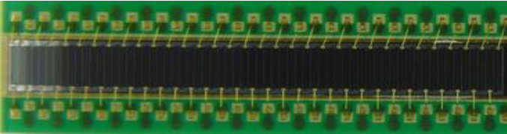
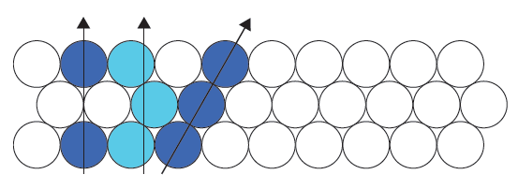
Readout of Fibers
Si-PMs (MPPCs) at both fiber ends
SciFi column readout with Si-PM arrays
64 channel monolithic device (custom design)
~250 µm effective “pitch”
50 µm × 50 µm pixels
Grouped in 0.25 mm × 1 mm vertical columns
Common bias voltage
LHCb type
detector

Slide 45
Readout of Fibers
Si-PMs (MPPCs) at both fiber ends
SciFi column readout with Si-PM arrays
Reduced # of readout channels (2 × 64)
Easy, direct coupling
Higher occupancy
“Optical” cross talk
LHCb type
detector

Slide 46
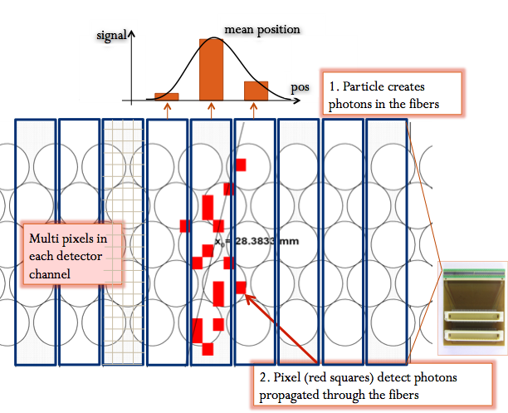
SciFi Column Readout
light travels preferentially
in the cladding
and exits the fiber
at large angles
“optical” cross talk
between Si-PM columns

Slide 47
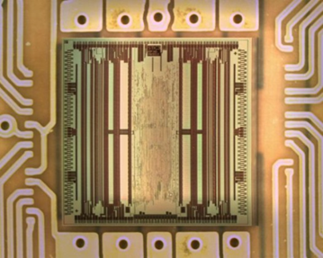
Readout Electronics
MuTRiG ASIC (KIP)
Fulfills SciFi requirements
  Compact design
    Installation very close to Si-PM arrays
  32 channels
    4 chips / Si-PM array
    Assuming MuTRiG can sustain ~10 MHz hit-rate
Performance to be tested
  In particular for low photon yield
STiC

Slide 48
Alternative Design with Square Fibers
2-3 layers of 250 μm square double cladding scint. fibers
128 fibers/layer
Single fiber Al coating (minimum “optical” cross-talk)
16 mm
0.8 mm

Slide 49
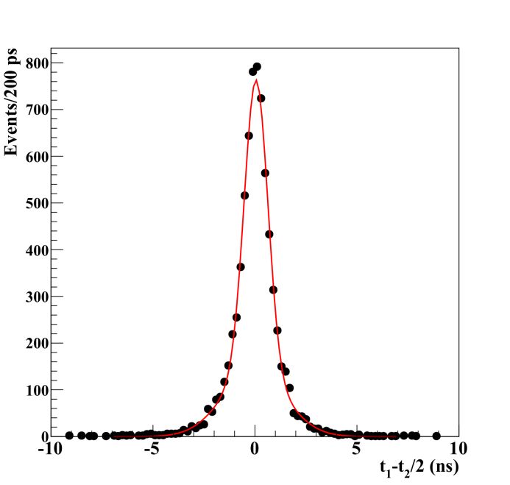
Testing Square Fibers
Fiber test setup developed at PSI
timing performance
250 µm square fiber
Cross talk:
By sputtering 30 nm Al
coating on the fiber
cross talk < 1%
was achieved
0.5 Nphe threshold
σ = 750 ± 17 ps

Slide 50
Tile Detector
Backup

Slide 51
Efficiency
tiles
e⁻
Require hit in first & last column
Look for hit in middle channel
Efficiency > 99.5%

Slide 52
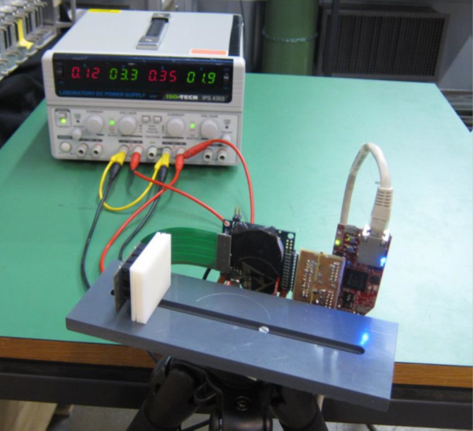
Tile Detector
Scintillating tiles
    6.5 x 6.5 x 5.0 mm³
7 Tile Modules per station
  448 tiles/module
  Attached to end rings
SiPMs attached to tiles
  Distribution PCBs below
  Readout through MuTRiG
Tile detector 4 x 4 prototype

Slide 53
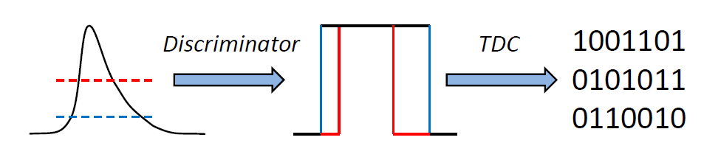
STiC Readout
Developed at KIP for EndoTOFPET-US
  Optimized for ToF applications
Key features:
  Digital timing & energy information
  64 channels (version 3.0)
  50 ps TDC bins
  SiPM bias tuning
  SiPM tail cancelation possibility (version 3.0)
  Currently ≈ 1 MHz hit rate / chip
  Up to ≈ 20 MHz in future version
Version 2.0 successfully operated in test-beam
STiC 2.0
STiC 3.0

Slide 54
STiC Readout
Developed at KIP for EndoTOFPET-US
  Optimized for ToF applications
Key features:
  Digital timing & energy information
  64 channels (version 3.0)
  50 ps TDC bins
  SiPM bias tuning
  SiPM tail cancelation possibility (version 3.0)
  Currently ≈ 1 MHz hit rate / chip
  Up to ≈ 20 MHz in future version
Version 2.0 successfully operated in test-beam
STiC 2.0
STiC 3.0

Slide 55
STiC Test Beam

Slide 56

STiC Test Beam

Slide 57
STiC Test Beam

Slide 58
HV-MAPS
Backup

Slide 59
Prototype Overview
Prototype | Active Area | Functionality | Bugs | Improvements
MuPix1 | 1.77 mm² | Sensor + analog | Comparator “ringing” | First MuPix prototype
MuPix2 | 1.77 mm² | Sensor + analog | Temperature dependence | No ringing
MuPix3 | 9.42 mm² | Sensor, analog, dig. | bad pixel on/off, | First part of dig. readout
MuPix4 | 9,42 mm² | Sensor, analog, dig. | Zero time-stamp and row address for 50% of pixels | Working digital readout, timestamp, temperature stable
MuPix6 | 10.55 mm² | Sensor, analog, dig. | ? | Removed zero time-stamp and address bug
MuPix7 | 10.55 mm² | System on Chip | X-talk | Fast serial readout

Slide 60

Sensor + Analog + Digital

Slide 61

Thinned Sensors
Prototypes thinned:
  MuPix7 thinned to 50, 62, 75μm
Good performance of thin chips
  In lab
  In particle beam
MuPix4 thinned to 50μm

Slide 62

Setup March 2016
Test-Beam @ DESY
Beam-line TB22
  up to 5 GeV electrons
Aconite telescope
MuPix7 prototype
Readout setup from PI Heidelberg
MuPix7 @ DESY test-beam in EUDET telescope

Slide 63

Sub-Pixel Efficiencies
Hit efficiency map and projections for 2×2 pixel array
4 GeV electrons
Bias voltage −40V to enhance the inefficient regions

Slide 64

Temperature Dependence
Pulse shape vs temperature
  Injection pulse to pixel discriminator output
Climate chamber
  0°C, 20°C, 40°C, 60°C
Significant change to
  Pulse shape
  Signal amplitude
Slight change to time resolution
  Re-calibration
MuPix7
High bias currents (1W/cm²)
HV -85V

Slide 65
Temperature Dependence
Pulse shape vs temperature
  Injection pulse to pixel discriminator output
Climate chamber
  0°C, 20°C, 40°C, 60°C
Significant change to
  Pulse shape
  Signal amplitude
Slight change to time resolution
  Re-calibration

Slide 66
Mechanics
Backup

Slide 67

Mu3e Silicon Detector
Conical target
Inner double layer
  8 and 10 sides of 2 x 12 cm²
Outer double layer
  24 and 28 sides of 2 x 36 cm²
Re-curl layers
  24 and 28 sides of 2x 36 cm²
  Both sides

Slide 68
Mu3e Silicon Detector
Conical target
Inner double layer
  8 and 10 sides of 2 x 12 cm²
Outer double layer
  24 and 28 sides of 2 x 36 cm²
Re-curl layers
  24 and 28 sides of 2x 36 cm²
  Both sides

Slide 69
Mu3e Silicon Detector
Conical target
Inner double layer
  8 and 10 sides of 2 x 12 cm²
Outer double layer
  24 and 28 sides of 2 x 36 cm²
Re-curl layers
  24 and 28 sides of 2x 36 cm²
  Both sides

Slide 70
Mu3e Silicon Detector
Conical target
Inner double layer
  8 and 10 sides of 2 x 12 cm²
Outer double layer
  24 and 28 sides of 2 x 36 cm²
Re-curl layers
  24 and 28 sides of 2 x 36 cm²
  Both sides
108 inner sensors
2736 outer sensors
~180 000 000 pixel

Slide 71

Sandwich Design
HV-MAPS
  Thinned to 50 μm
  Sensors 2 x 2 cm²
Kapton™ flex print
  25 μm Kapton™
  14 μm Alu traces
Kapton™ Frame Modules
  25 μm foil
  Self supporting
Alu end wheels
  Support for all detectors
0.11% of X₀

Slide 72

Thinned Pixel Sensors
HV-MAPS*
  Thinned to 50 μm
  Sensors 2 x 2 cm²
Kapton™ flex print
  25 μm Kapton™
  14 μm Alu traces
Kapton™ Frame Modules
  25 μm foil
  Self supporting
Alu end wheels
  Support for all detectors
MuPix3 thinned to < 90μm

Slide 73

Kapton™ Flex Print
HV-MAPS
  Thinned to 50 μm
  Sensors 2 x 2 cm²
Kapton™ flex print
  25 μm Kapton™
  14 μm Alu traces
Kapton™ Frame Modules
  25 μm foil
  Self supporting
Alu end wheels
  Support for all detectors
Laser-cut flex print prototype

Slide 74

Pixel Modules
HV-MAPS
  Thinned to 50 μm
  Sensors 2 x 2 cm²
Kapton™ flex print
  25 μm Kapton™
  14 μm Alu traces
Kapton™ Frame Modules
  25 μm foil
  Self supporting
Alu end wheels
  Support for all detectors
CAD of Kapton™ frames

Slide 75
Overall Design
HV-MAPS
  Thinned to 50 μm
  Sensors 2 x 2 cm²
Kapton™ flex print
  25 μm Kapton™
  14 μm Alu traces
Kapton™ Frame Modules
  25 μm foil
  Self supporting
Alu end wheels
  Support for all detectors
Two halves for layers 1+2
6 modules in layer 3
7 modules in layer 4
CAD of Kapton™ frames

Slide 76

Inner Layers
HV-MAPS
  Thinned to 50 μm
  Sensors 2 x 2 cm²
Kapton™ flex print
  25 μm Kapton™
  14 μm Alu traces
Kapton™ Frame Modules
  25 μm foil
  Self supporting
Alu end wheels
  Support for all detectors
Rendering of vertex detector CAD

Slide 77

Outer Module
HV-MAPS
  Thinned to 50 μm
  Sensors 2 x 2 cm²
Kapton™ flex print
  25 μm Kapton™
  14 μm Alu traces
Kapton™ Frame Modules
  25 μm foil
  Self supporting
Alu end wheels
  Support for all detectors
Layer 3 Prototype in Assembling Frame
with 50 μm Glass

Slide 78

Detector Frame
HV-MAPS
  Thinned to 50 μm
  Sensors 2 x 2 cm²
Kapton™ flex print
  25 μm Kapton™
  14 μm Alu traces
Kapton™ Frame Modules
  25 μm foil
  Self supporting
Alu end wheels
  Support for all detectors
Pixel detector CAD rendering

Slide 79


Thinning
50 μm Si-wafers
  Commercially available
  HV-CMOS 50 μm (AMS)
  50 μm for MuPix4 and MuPix7

Slide 80
Cooling
Backup

Slide 81

Liquid Cooling
Beam pipe cooling
  With cooling liquid
  5°C temperature
  Significant flow possible
For electronics
  FPGAs
  Power regulators
  Mounted to cooling plates
Total power several kW

Slide 82

He Cooling
Gaseous He cooling
  Low multiple Coulomb scattering
  He more effective than air
Global flow inside Magnet volume
Distribution in Frame
    Local flow: V-shapes
    Gap flow: Outer surface
400mW/cm² x 11664cm²
≈ 4.7 KW

Slide 83
Simulation
He cooling
400mW/cm²

Slide 84

Test Results
1:1 Prototype
  Layer 3+4 of silicon tracker
  Ohmic heating 400mW/cm²
Cooling He
  at several m/s
Temperature sensors attached to foil
  LabVIEW readout
Results promising
  ΔT < 60°K
  No sign of vibration in air

Slide 85

He Cooling
750 mW/cm²

Slide 86
DAQ
Backup

Slide 87
Front End FPGAs
FPGAs on detector (?)
  112 pieces
Receive sensor data
  36-45 LVDS inputs
6.4 Gbit/s outputs
  8 optical links
  … to counting house
Pixel Sensor
1250 Mbit/s
LVDS in
x 45
Front end
FPGA
6.4 Gbit/s
optical
Readout board

Slide 88
Readout Board
FPGA readout boards
  per sub-detector
6.4 Gbit/s optical inputs
  16-48 inputs
10 Gbit/s optical output
  12 outputs to PCs
Switching network
  One output per PC
Front end
FPGA
Front end
FPGA
Front end
FPGA
Front end
FPGA
6.4 Gbit/s
Optical
x48
Readout board
10 Gbit/s
Optical
PC
PC
PC
x12

Slide 89
Readout Board
FPGA readout boards
  4 per sub-detector
6.4 Gbit/s optical inputs
  16-48 inputs
10 Gbit/s optical output
  12 outputs to PCs
Switching network
  One output per PC
Front end
FPGA
Front end
FPGA
Front end
FPGA
Front end
FPGA
6.4 Gbit/s
Optical
Readout board
10 Gbit/s
Optical
PC
PC
PC
x12

Slide 90

Trigger-less DAQ
Front end links
  Pixel sensor to on-detector FPGA
    1250 Mbit/s
    LVDS
  Timing detector readout
Optical links from detector
  Front end FPGAs
  … to readout boards
  6.4 Gbit/s
Optical links in counting room
  Off-detector read out boards
  …to PC Farm

Slide 91

Trigger-less DAQ
Pixel Sensor
Front end links
  Pixel sensor to on-detector FPGA
    1250 Mbit/s
    LVDS
  Timing detector readout
Optical links from detector
  Front end FPGAs
  … to readout boards
  6.4 Gbit/s
Optical links in counting room
  Off-detector read out boards
  …to PC Farm
Silicon FPGAs
x86
Readout board
x4
PC
x12

Slide 92
Trigger-less DAQ
Pixel Sensor
Fiber
Tile
Pixel Sensor
Fiber
Tile
Front end links
  Pixel sensor to on-detector FPGA
    1250 Mbit/s
    LVDS
  Timing detector readout
Optical links from detector
  Front end FPGAs
  … to readout boards
  6.4 Gbit/s
Optical links in counting room
  Off-detector read out boards
  …to PC Farm
Pixel Sensor
Fiber
Tile
Pixel Sensor
Fiber
Tile
O(Tbit/s)
x2844
x192
x196
Silicon FPGAs
x86
Fiber
FPGAs
12x
Tile
FPGAs
x14
Readout board
x4
Readout board
x2
Readout board
x2
PC
x12

Slide 93
Trigger-less DAQ
Pixel Sensor
Fiber
Tile
Pixel Sensor
Fiber
Tile
Front end links
  Pixel sensor to on-detector FPGA
    1250 Mbit/s
    LVDS
  Timing detector readout
Optical links from detector
  Front end FPGAs
  … to readout boards
  6.4 Gbit/s
Optical links in counting room
  Off-detector read out boards
  …to PC Farm
Pixel Sensor
Fiber
Tile
Pixel Sensor
Fiber
Tile
Silicon FPGAs
x86
Fiber
FPGAs
x12
Tile
FPGAs
x14
x128
Readout board
x4
Readout board
x2
Readout board
x2
PC
x12

Slide 94
Trigger-less DAQ
Pixel Sensor
Fiber
Tile
Pixel Sensor
Fiber
Tile
Front end links
  Pixel sensor to on-detector FPGA
    1250 Mbit/s
    LVDS
  Timing detector readout
Optical links from detector
  Front end FPGAs
  … to readout boards
  6.4 Gbit/s
Optical links in counting room
  Off-detector read out boards
  …to PC Farm
Pixel Sensor
Fiber
Tile
Pixel Sensor
Fiber
Tile
Silicon FPGAs
x86
Fiber
FPGAs
x12
Tile
FPGAs
x14
O(Tbit/s)
x128
x48
x56
Readout board
x4
Readout board
x2
Readout board
x2
PC
x12

Slide 95
Trigger-less DAQ
Pixel Sensor
Fiber
Tile
Pixel Sensor
Fiber
Tile
Front end links
  Pixel sensor to on-detector FPGA
    1250 Mbit/s
    LVDS
  Timing detector readout
Optical links from detector
  Front end FPGAs
  … to readout boards
  6.4 Gbit/s
Optical links in counting room
  Off-detector read out boards
  …to PC Farm
Pixel Sensor
Fiber
Tile
Pixel Sensor
Fiber
Tile
Silicon FPGAs
x86
Fiber
FPGAs
x12
Tile
FPGAs
x14
Readout board
x4
Readout board
x2
Readout board
x2
x24
x24
O(Tbit/s)
PC
x12
x48

Slide 96

GPU-PC
PC with GPU
10 Gbit/s Fiber input
  8 inputs from sub-detectors
Data filtering
  Timing Filter on FPGA
  Track filter on GPU
  Data to tape < 100 MB/s
GPU computer

Slide 97


GPU-PC
PC with GPU
10 Gbit/s Fiber input
  8 inputs from sub-detectors
Data filtering
  Timing Filter on FPGA
  Track filter on GPU
  Data to tape < 100 MB/s
Optical mezzanine connectors
FPGA PCIe board
GPU computer

Slide 98


Timing Filter
Under
discussion
Entire event on PCIe FPGA
Tile and Fiber data
  Easy to match
  Look for three tracks
Reject data without three hits
  … inside time interval
1
2
3

Slide 99

Timing Filter
Under
discussion
Entire event on PCIe FPGA
Tile and Fiber data
  Easy to match
  Look for three tracks
Reject data without three hits
  … inside time interval
1
2
3

Slide 100

Vertex Filter
Entire event on GPU
Large target
  Large spread of muons
  Easy vertex separation
Reject data without three tracks
  … inside area interval on target
1
2
3

Slide 101

Vertex Filter
Entire event on GPU
Large target
  Large spread of muons
  Easy vertex separation
Reject data without three tracks
  … inside area interval on target
1
2
3

Slide 102
Readout system
Pixel detector
  HV-MAPS (MuPix)
    Sensor and read-out chip in one
    Deliver zero-suppressed serialized data
Timing detectors
  SiPMs plus MuTRiG TDC
    Deliver zero-suppressed serialized data
Common read-out system
Pixel Sensor
Fiber
Tile
Pixel Sensor
Fiber
Tile
Pixel Sensor
Fiber
Tile
Pixel MuPix
Fiber
MuTRiG
Tile
MuTRiG
FE-PCB
FE-PCB
FE-PCB
Readout board
Readout board
Readout board
PCs

Slide 103

Common read-out PCB
Front-end PCB
  Common for pixel, fibre and tile detector
  Data acquisition
  Clock distribution
  Slow control distribution
Prototype functional
  Improved version for Q3/2017
Next: Vertical slice test:
  All electronics from (pixel) module to PC

