Slide 1






R&D of Focusing Aerogel RICH detectors
Presented by Sergey Kononov
A.Yu.Barnyakov^{abe}, M.Yu.Barnyakov^{abc}, K.I.Beloborodov^{abe}, V.S.Bobrovnikov^{ab},
A.R.Buzykaev^{ab}, A.F.Danilyuk^{bd}, D.A.Finogeev^{f}, V.V.Gulevichª, A.A.Katcin^{ac}, P.S.Kirilenko^{ab}, S.A.Kononov^{abe}, D.V.Korda^{abe}, E.A.Kravchenko^{ab}, A.B.Kurepin^{f}, I.A.Kuyanov^{abe}, A.P.Onuchin^{abc}, I.V.Ovtin^{abc}, N.A.Podgornov^{abe}, A.I.Reshetin^{f}, A.A.Talyshev^{ab}, E.A.Usenko^{f}
ª Budker Institute of Nuclear Physics
^{b} Novosibirsk State University
^{c} Novosibirsk State Technical University
^{d} Boreskov Institute of Catalysis SB RAS, Novosibirsk, Russia
^{f} Institute of Nuclear Research RAS, Moscow, Russia
^{e} FSBI NRC "Kurchatov Institute" – ITEP
Instrumentation for Colliding Beam Physics (INSTR-17)
March 2, 2017

Slide 2
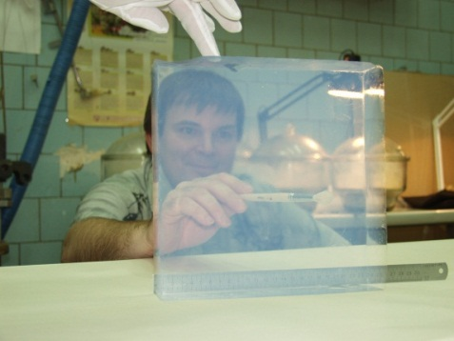
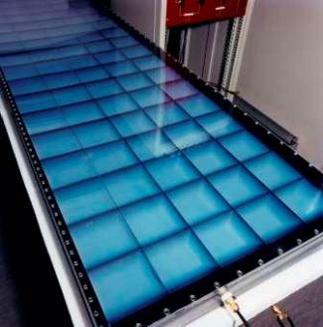
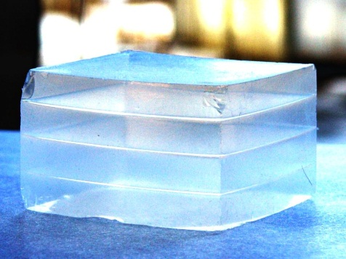
Aerogel RICH short history
LHCb aerogel tile
Mid 1990^{ties} – silica aerogel was proposed for use in RICH
D.E. Fields et al., NIM A 349 (1994) 431
R.De Leo, et al., NIM A 401 (1997) 187
1995-200x – LHCb RICH1 with gaseous and aerogel radiator
(Novosibirsk aerogel n=1.03)
T. Ypsilantis, J. Seguinot, NIM A 368 (1995) 229
LHCb RICH TDR (2000) CERN LHCC 2000-037
1998 – HERMES RICH with gaseous and aerogel radiators
(Matsushita aerogel n=1.03)
D. Ryckbosch, NIM A 433 (1999) 98
R.De Leo, NIM A 595 (2008) 19
2003-2004 – focusing multilayer aerogel radiator was proposed to improve proximity focusing RICH
P. Krizan, Aerogel RICH, talk at SuperB wokshop in Hawaii, Jan 2004
A.Yu. Barnyakov, et al., Focusing aerogel RICH, NIM A 553 (2005) 70
HERMES RICH aerogel radiator
First multi-layer aerogel

Slide 3
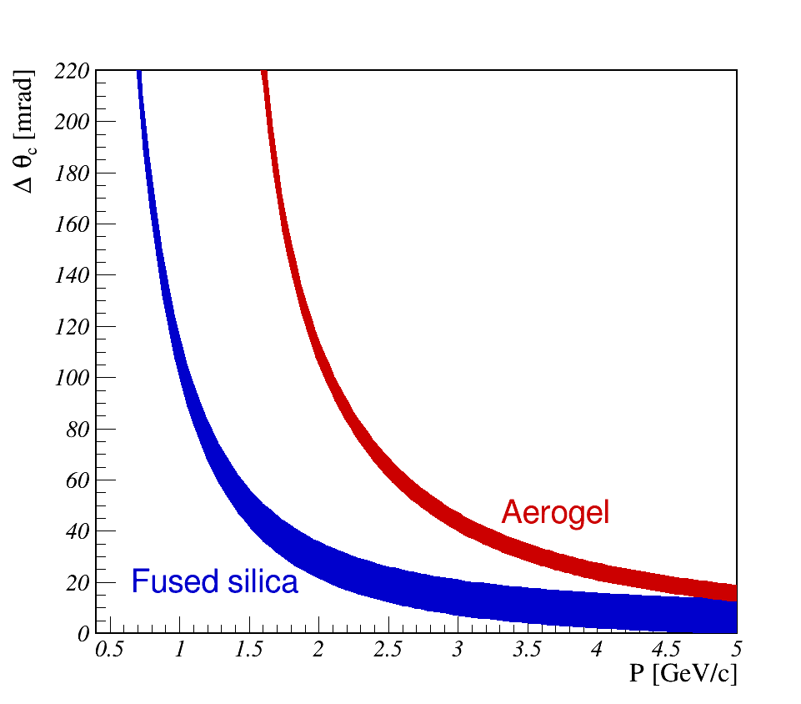
Quartz vs Aerogel radiators
Difference in Cherenkov angle θ_{c} for π and K
Bands – chromatic dispersion in 350-700 nm
n=1.05

Slide 4
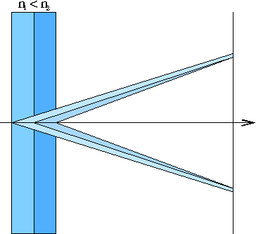
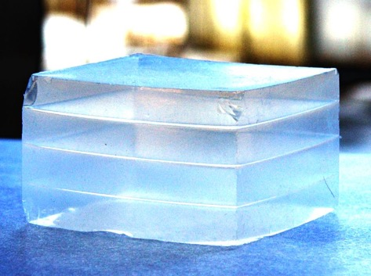
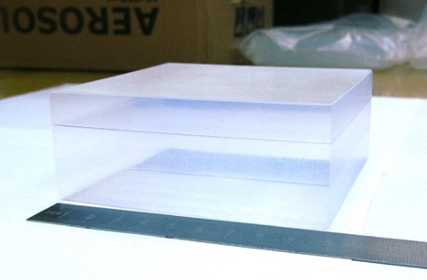
Focusing Aerogel RICH (FARICH)
First sample of 4-layer aerogel
n=1.030 6.0mm
n=1.027 6.3mm
n=1.024 6.7mm
n=1.022 7.0mm
3-layer aerogel 115x115x41 mm³
Focusing aerogel improves proximity focusing design by reducing the contribution of radiator thickness into the Cherenkov angle resolution
Multi-layer monolith aerogels have been being produced by the Boreskov Institute of Catalysis in cooperation with the Budker INP since 2004.
T.Iijima et al., NIM A548 (2005) 383
A.Yu.Barnyakov et al., NIM A553 (2005) 70
Notes:
Идея ФАРИЧ появилась в 2004 г.
Точность измерения черенковского угла связана с точностью измерения скорости, а значит с качеством разделения частиц.

Slide 5
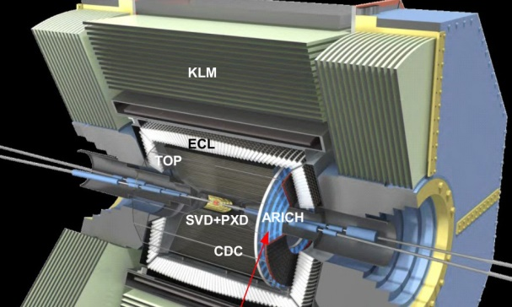
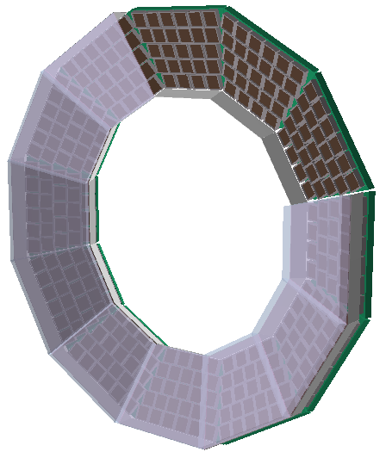
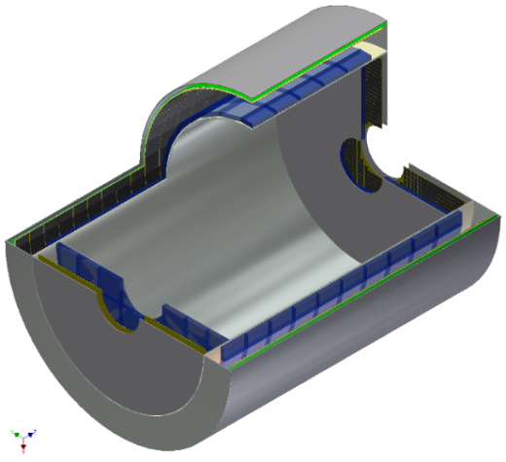
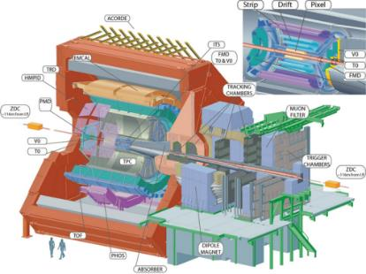
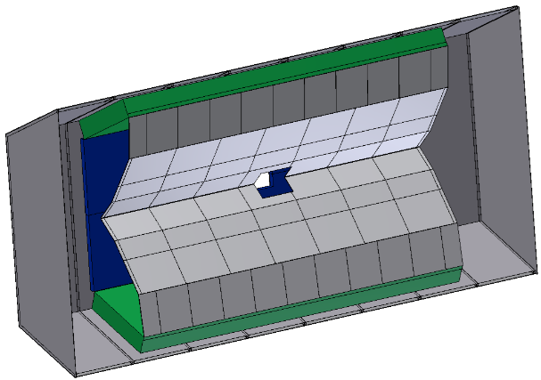
FARICH-like projects and proposals
SuperB Forward RICH
Belle II Aerogel RICH
See talk by Luka Santelj
FARICH for Super Charm-Tau factory
Closed
FARICH for ALICE HMPID upgrade
PANDA Forward RICH
Closed

Slide 6
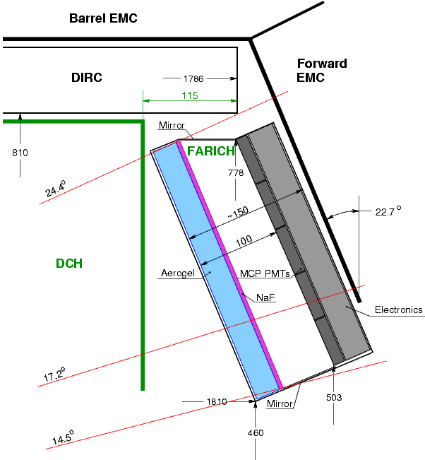
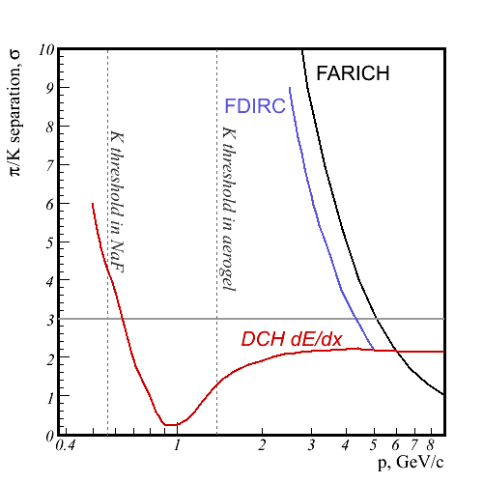
SuperB Forward RICH project
(closed)
Radiator: 4- or 2-layer aerogel + NaF
PD: Photonis MCP PMTs

Slide 7
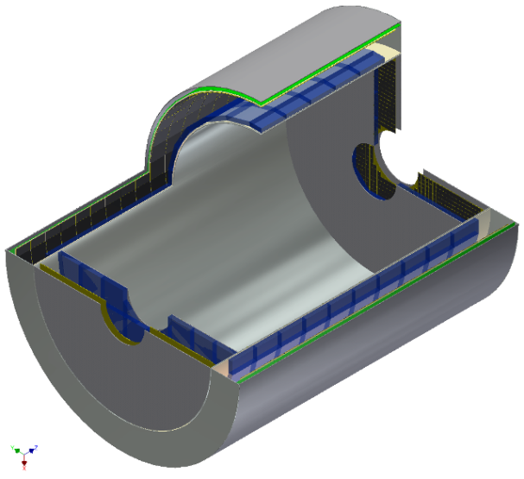
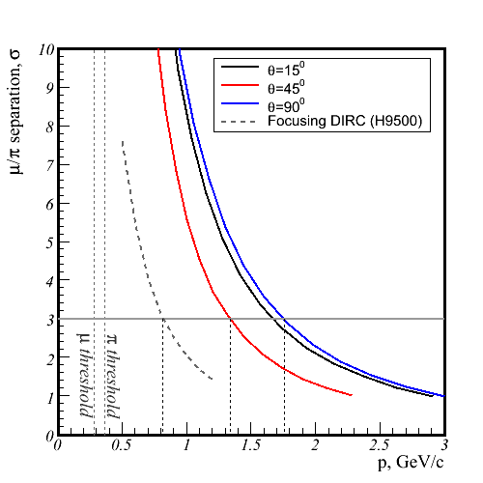
FARICH for Super Charm-Tau Factory
μ/π: MC simulation MPPC & 4-layer aerogel
μ momentum range for
τ → μγ at E_{cm}=4.2GeV
Proximity focusing RICH
~21 m² photon detector area
Use SiPMs due to 1T magnetic field
~10⁶ pixels with 4 mm pitch
4-layer or gradient aerogel radiator
μ/π is required for LFV search in τ→μγ.
Target sensitivity on Br(τ→μγ) ~10⁻⁹
This PID level is not achievable with DIRC-like detectors

Slide 8
SiPMs in RICH applications
Pros
Excellent single photon resolution
High PDE
Sub-ns timing resolution
Immune to strong magnetic field
Very compact
Cons
High dark count rate
(10-100 kHz/mm²)
Radiation induced damage (~10¹⁰ n_{1MeV}/cm²)
S. Korpar et al., NIM A 594 (2008) 13
A.Y. Barnyakov et al., NIM A 732 (2013) 352
S. Korpar et al., NIM A 766 (2014) 107
M. Contalbrigo, NIM A 787 (2014) 224
I. Balossino et al., NIM A (2016) [doi: 10.1016/j.nima.2017.01.074]
See talk by Yuri Museinko “Advances in Solid State Photon Detectors”

Slide 9
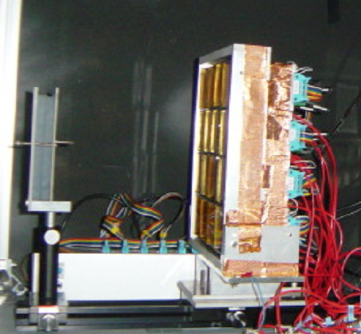
First tests of Novosibirsk multilayer aerogels at KEK (2005)
KEK-PS π2 beam line
3x3 H8500 MAPMTs
Aerogel
π @ 3GeV/c
Focusing effect for single layer aerogel with non-homogenious refractive index observed
Tracking by 2 MWPCs

Slide 10
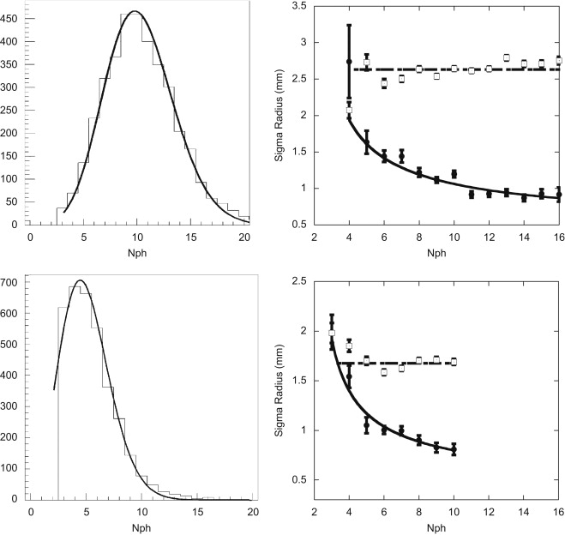
Tests of Novosibirsk multilayer aerogels at Frascati (2009)
3-layer aerogel
Frascati Beam Test Facility
8 H9500 MAPMTs
Aerogel
Single layer aerogel
500 MeV/c e⁻
C. Arnaboldi et al, Nuclear Physics B Proceedings Supplements 197 (2009) 57
doi: 10.1016/j.nuclphysbps.2009.10.034
R. De Leo et al, NIM A 617 (2010) 381 doi:10.1016/j.nima.2009.06.084

Slide 11
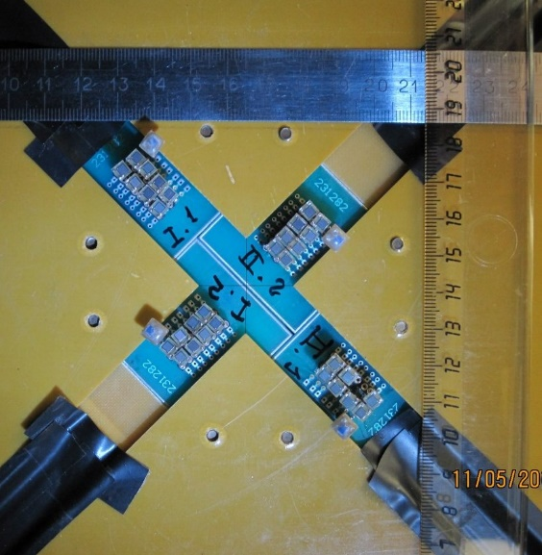
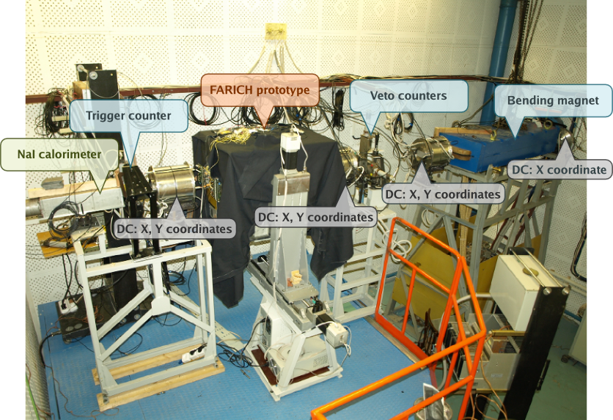
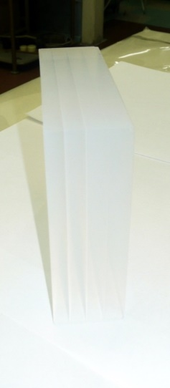
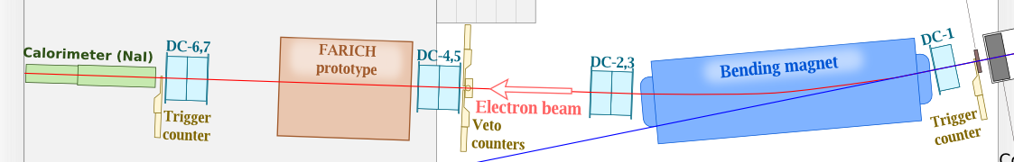
FARICH detector prototype with CPTA MRS APDs BINP e⁻ test beam in 2011
32 CPTA MRS APDs with active pixel size 2.1x2.1mm²
4-layer aerogel focusing at 62 mm
n₁=1,050 t₁=6,2mm
n₂=1,041 t₂=7,0mm
n₃=1,035 t₃=7,7mm
n₄=1,030 t₄=9,7mm
Size: 100x100x31mm³
L_{sc}(400nm) = 43mm

Slide 12
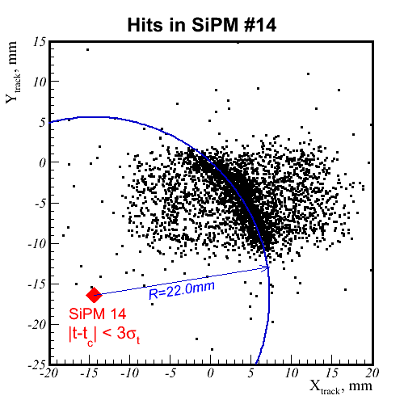
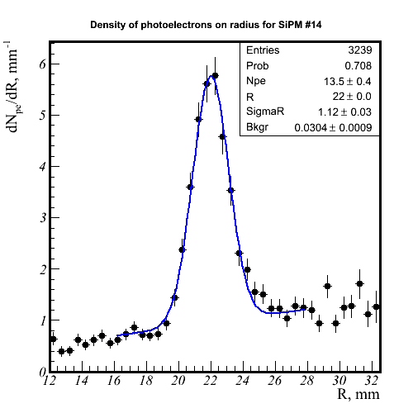
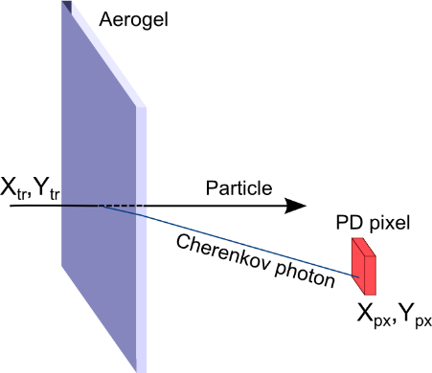
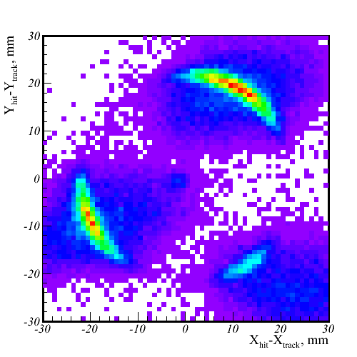
Cherenkov ring observation with single pixels
Given a tracking system and enough particle statistics, a single PD pixel is enough to build the distribution of Cherenkov photons on R_{ch} (θ_{ch}).
Sum of all pixels w.r.t. track position
Many pixels can be combined to improve accuracy and align the tracking system with the PD pixels

Slide 13
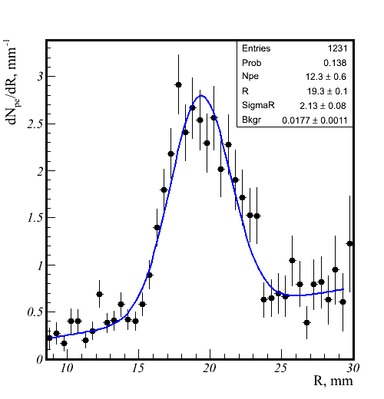
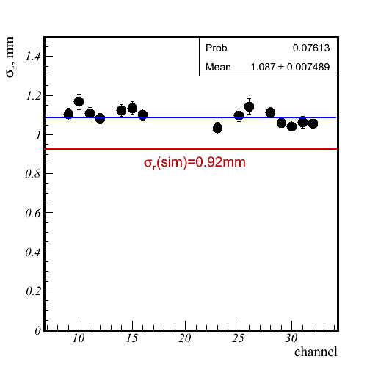
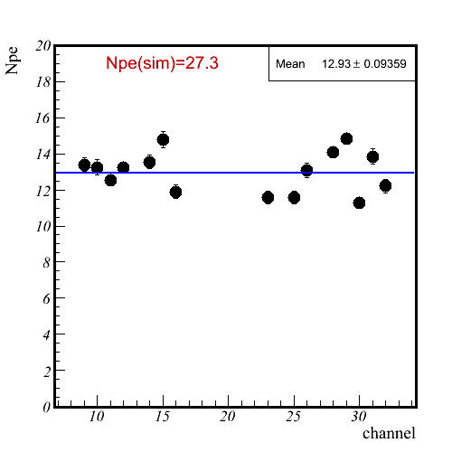
Focusing Aerogel beam test in Novosibirsk (2011)
σ_{r} vs channel
σ_{r} =1.1 mm
σ_{r} =2.1 mm
4-layer aerogel
N_{p.e.} vs channel
4-layer aerogel (t=3cm) vs single layer aerogel (t=2cm)
Focusing effect has been observed.
σ_{r}=1.1 mm – in rough agreement with MC simulation
‹N_{p.e.}› = 13 – 2 times less than expected

Slide 14
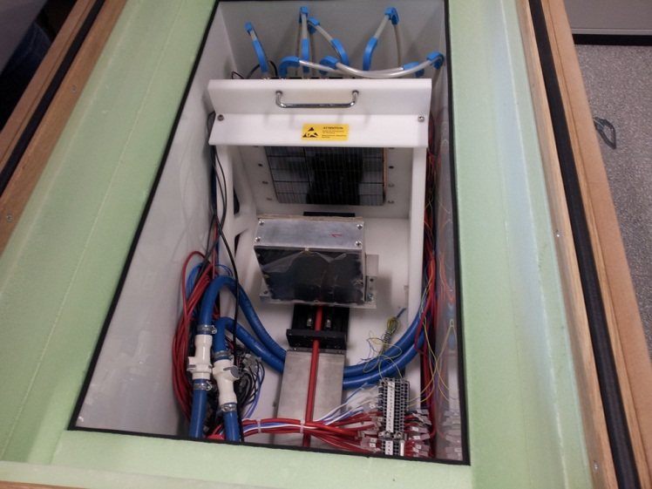
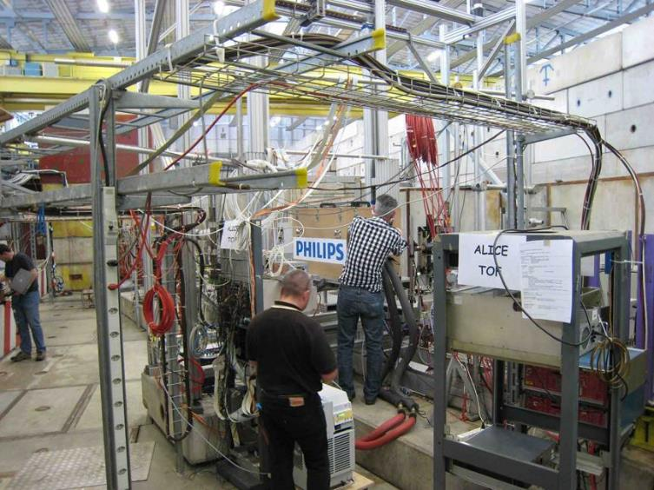
PDPC-FARICH prototype beam test
CERN PS/T10, 2012
Main objective:
  Proof of concept: full Cherenkov ring detection with a DPC array
Details:
Operation temperature is −40°C to suppress dark count rate
  Dead time is 720 ns.
  DCR(+25°C) ≈ 10 Mcps/sensor
  single photon detection is not feasible!
  DCR(-40°C) ≈ 100 kcps/sensor
  inefficiency is 7% .
2 stage cooling: LAUDA process thermostat + Peltiers.
Dry N₂ constant flow to avoid condensation.

Slide 15
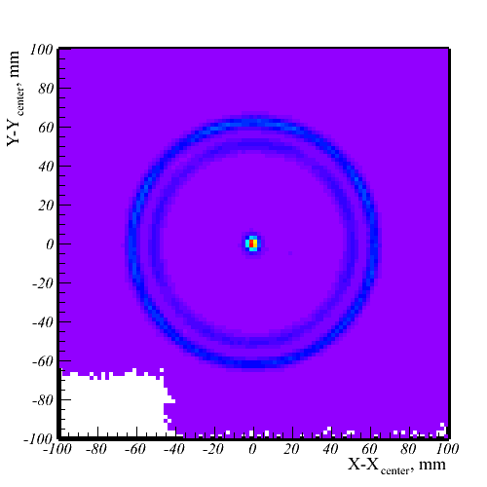
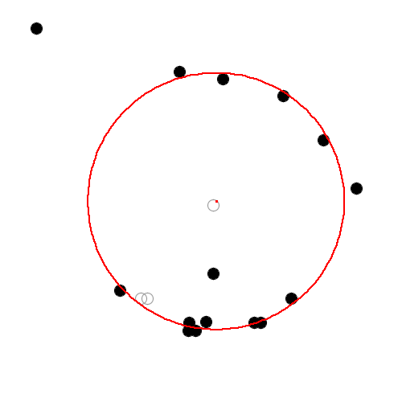
PDPC-FARICH: Cherenkov ring
P = 6 GeV/c
e, μ, π, K
p

Slide 16
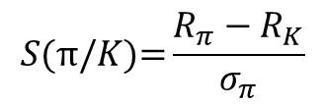
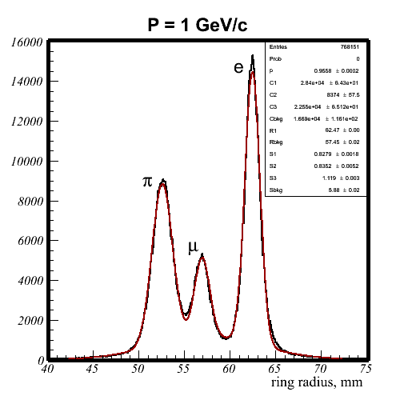
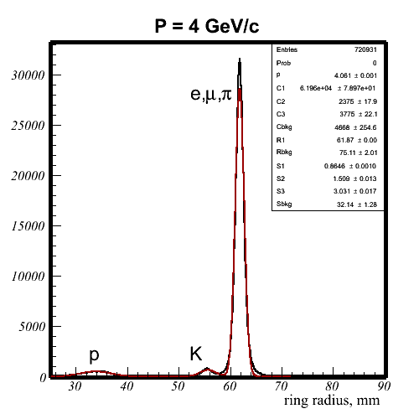
PDPC-FARICH: Particle ID
Ring distribution on radius
A.Yu. Barnyakov, et al., NIM A 732 (2013) 352
π /K: 7.6σ @ 4 GeV/c
μ/π: 5.3σ @ 1 GeV/c
2.6 times less than in initial MC simulation (with producer’s PDE and ideal aerogel)

Slide 17
Refractive index of 4-layer aerogel tested at CERN
X-ray scan

Slide 18
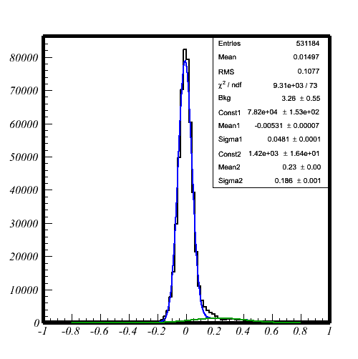
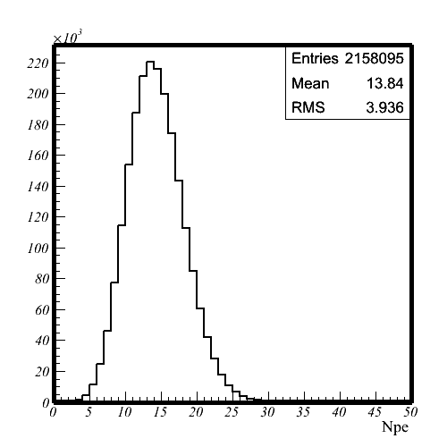
PDPC-FARICH: timing resolution and number of photoelectrons
Hit time w.r.t. fitted event time, ns
Number of hits
σ_{narrow} = 48ps
Excellent single photon resolution for SiPMs
‹N_{p.e.} › = 12
(accounted for optical crosstalks)
1.7 times lower than expected
due to overevaluated DPC PDE by producer’s data

Slide 19
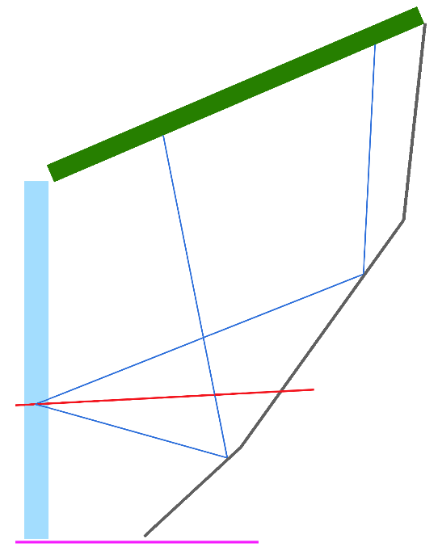
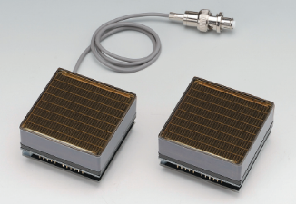

PANDA Forward RICH
Mirrors
Flat segments
Float glass substrate 2 mm thick
Al+SiO₂ coating, R≥90%
Light-weight Al or carbon fiber support
Simplicity of production and positioning
PD
mirrors
aerogel
Photon Detector
Hamamatsu H12700 MaPMT
flat panel,
8x8 anode pixels of 6mm size
87% active area ratio
Bialkali photocathode
Gain: 1.5∙10⁶
Good single p.e. amp resolution
Robust
Long lifetime
Works in the mag. field 25G (stray field of the dipole)
$$\overline{p}$$
Radiator
Focusing 2- or 3-layer aerogel
40 mm thick
No gaseous radiator

Slide 20
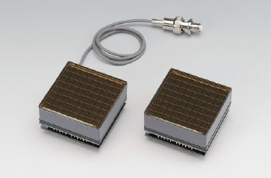
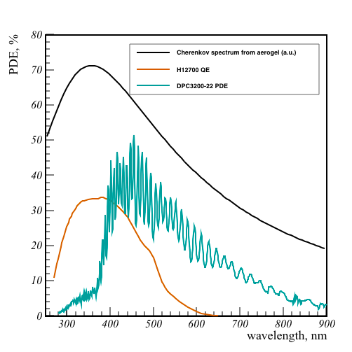
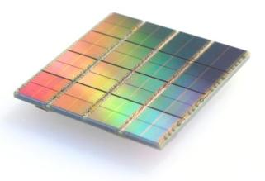
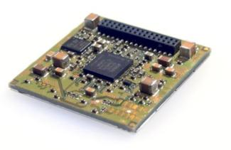
Readout options for PANDA FRICH
Hamamatsu H12700B
May be influenced by stray magnetic field
Needs FEE
Digital Photon Counter
720 ns sensor dead time
Needs cooling
Not radiation hard (lifetime ~1 year in PANDA FRICH w/o neutron shielding)

Slide 21
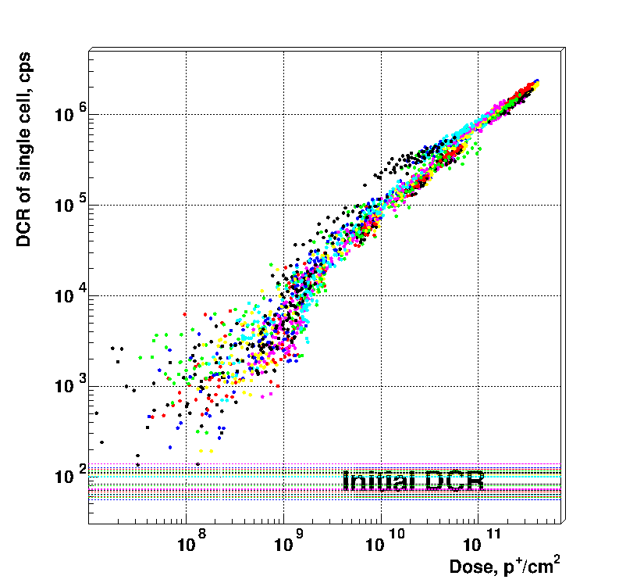
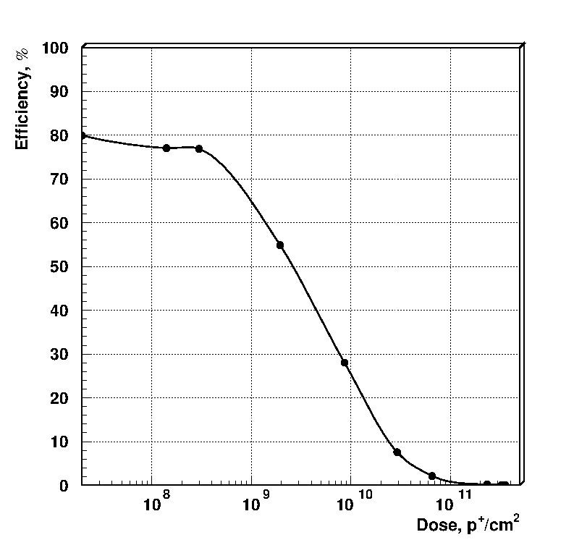
DPC radiation hardness study
COSY PS in IKP FZ Jülich
protons @ 800 MeV/c
Effect of radiative damage on DCR
PDE degradation due to DCR increase
2 times drop
4∙10⁹ n_{1MeV}/cm²
DPC tiles cooled to −18°C

Slide 22
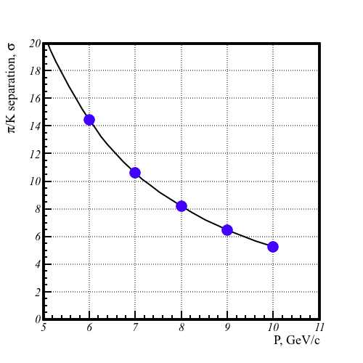
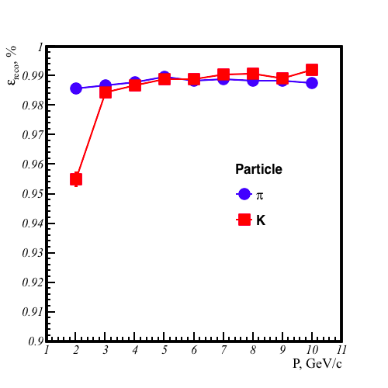

PANDA FRICH performance (MC sim)
$$S\left(π/K\right)=2\frac{β_{π}−β_{K}}{σ_{π}+σ_{K}}$$
Efficiency of reconstruction

Slide 23
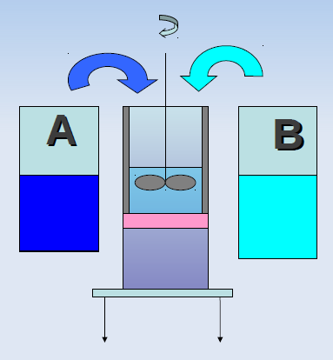
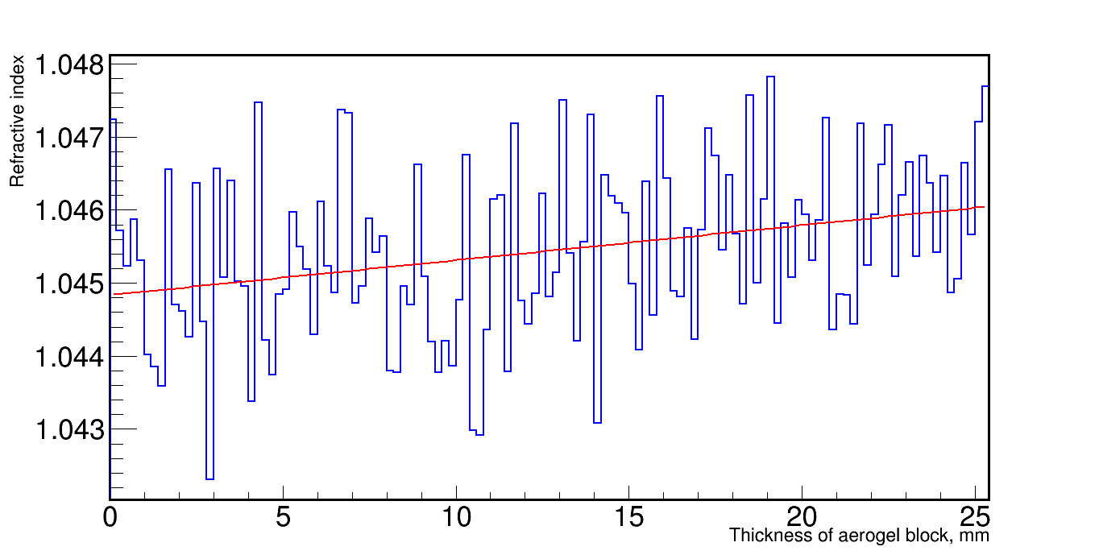
Continuous density gradient aerogel
To produce aerogel tiles with designed profile of gradient we modernized the method suggested by
[S.M. Jones “A method for producing gradient density aerogel”, J Sol-Gel Sci Technol. 44 (2007) 255]
We mix two pre-prepared mixtures with different content of TEOS fed by peristaltic pumps from vessels A and B.
The mixture with designed concentration of TEOS seeps through the filter to the mould where gelation takes place.
The mould is positioned on the vertically moving table. The peristaltic pumps and moving table are controlled by a computer.
Refractive index profile along thickness

Slide 24
Conclusion
FARICH R&D was reviewed
Focusing aerogel is a perspective Cherenkov radiator for few-GeV momenta and proximity focusing design
Problems with production of monolithic multilayer aerogels with refractive index profile conforming to designed one
Continuous density gradient aerogels and stacked aerogel tiles are considered as alternatives

Slide 25
Thank you for your attention!

