Slide 1
Electronics for CMS Endcap Muon Level-1 Trigger System Phase-1 and HL LHC Upgrades
D. Acosta, A. Batinkov, V. Barashko, P. Bortignon, A. Brinkerhoff, A. Carnes, D. Curry, I. Furic, A. Jyothishwara, J.F. Low, A. Madorsky, N. Pratap Ghanathe, Y. Xia
University of Florida/Physics, Gainesville, FL, USA
P. Cao, L. Chen, Z. Liu, C. Wang
Chinese Academy of Sciences, Institute of High Energy Physics, Beijing, China
M. Matveev, P. Padley, J. Rorie
Rice University, Houston, TX, USA
E. Juska
Texas A&M University, College Station, TX, USA
K. Bunkowski, A. Kalinowski, K. Kierzkowski, M. Konecki, W. Oklinski
University of Warsaw, Warsaw, Poland
A. Byszuk, K. Pozniak, W. Zabolotny
University of Warsaw, Warsaw, Poland and Warsaw University of Technology, Warsaw, Poland
T. Gorski, A. Svetek, J. Tikalsky, M. Vicente
University of Wisconsin-Madison, Madison, WI, USA

Slide 2
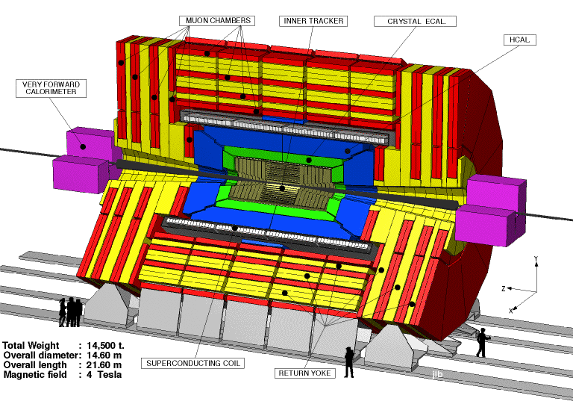
CMS Endcap Muon System
φ
θ, η
η coverage: 1.2 to 2.4
Notes:
CMS cutout with Endcaps glowing

Slide 3
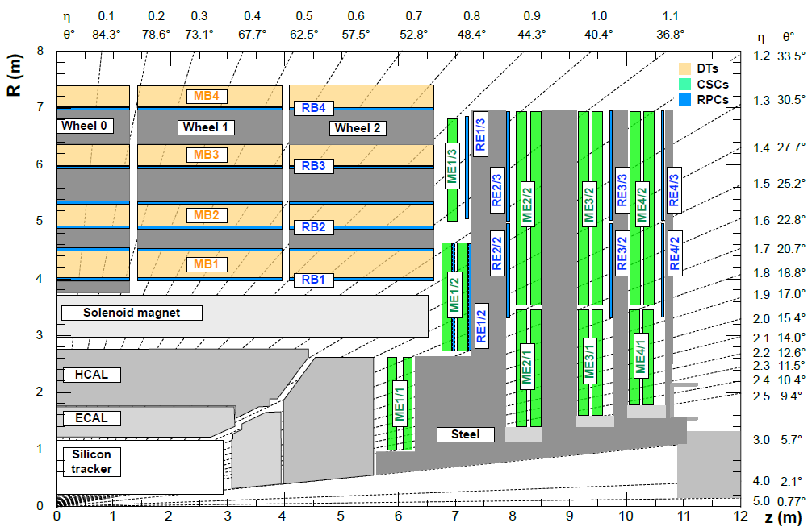
CMS Muon Level-1 Trigger structure
Barrel Muon Track Finder
(BMTF)
Overlap
Muon Track
Finder
(OMTF)
Endcap Muon Track Finder
(EMTF)
Cathode Strip Chambers (CSC)
Resistive Plate Chambers (RPC)
L1 Trigger Upgrade TDR
CERN-LHCC-2013-011
CMS-TDR-012 (2013)

Slide 4
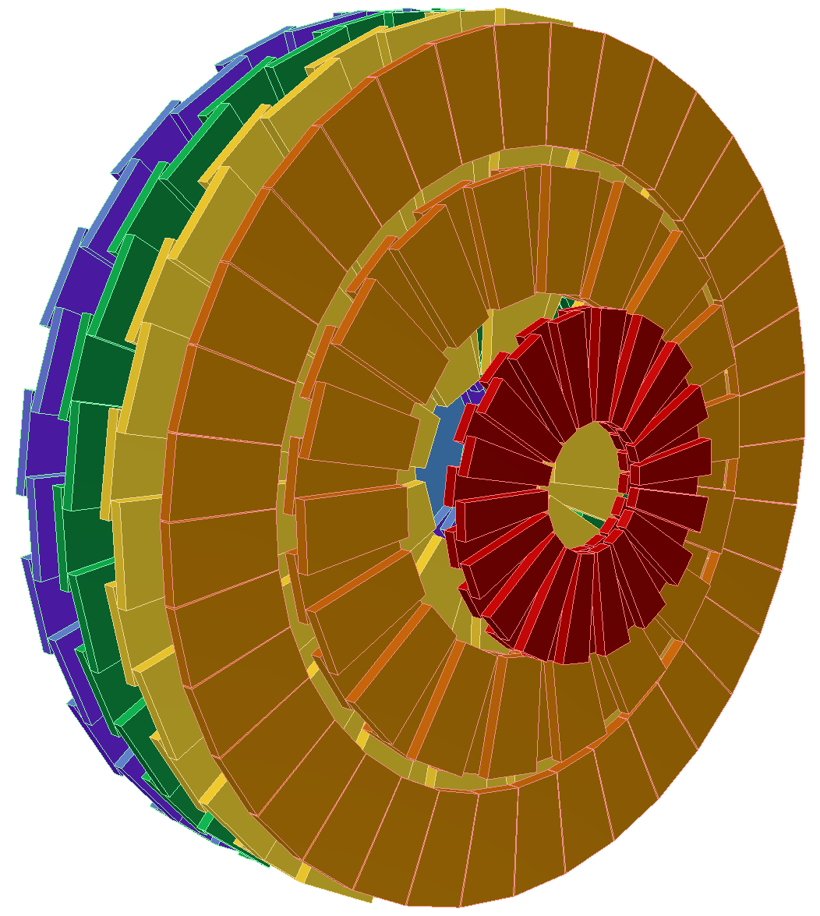
CMS Endcap Muon L-1 Trigger
  Each of two Endcaps is split into 6 sectors, 60° each
  Each sector is served by one Sector Processor (SP)
  Total 12 SPs in the entire system
  CMS trigger requires us to identify distinct muons
  Each SP can build up to 3 muon tracks per BX
Challenges unique to Endcap:
  Very high background near beam pipe
  Non-uniform magnetic field
Trigger sector 60˚
Notes:
Brief introduction

Slide 5
LS1 upgrade goals
LS1 = Long Shutdown 1 (2013-2015)
Feature | Before LS1 (legacy system) | After LS1 upgrade
Imported CSC trigger primitives | Only up to 3 segments per station per sector per BX - bottleneck Up to 15 best from each 60˚ sector per BX | All available – up to 18 per station per sector per BX, up to 90 primitives from each 60˚ sector per BX
Imported RPC trigger primitives | None | All available – up to 72 primitives from each 60˚ sector per BX (firmware still in progress)
Sector overlap processing | None | Each sector receives trigger primitives from 10˚ of the neighboring sector CSC: up to 18 primitives RPC: up to 12 primitives
Transverse momentum (Pt) assignment | 2 MB LUT | 1 GB LUT provides much more flexibility for physics algorithm

Slide 6
Upgraded system block diagram
Optical plant
(fanouts and splitters)
Endcap
Muon
Track
Finder
(EMTF)
Global Muon Trigger
CSC trigger primitives
Best 3
Muons in each sector
RPC trigger primitives
To OMTF

Slide 7
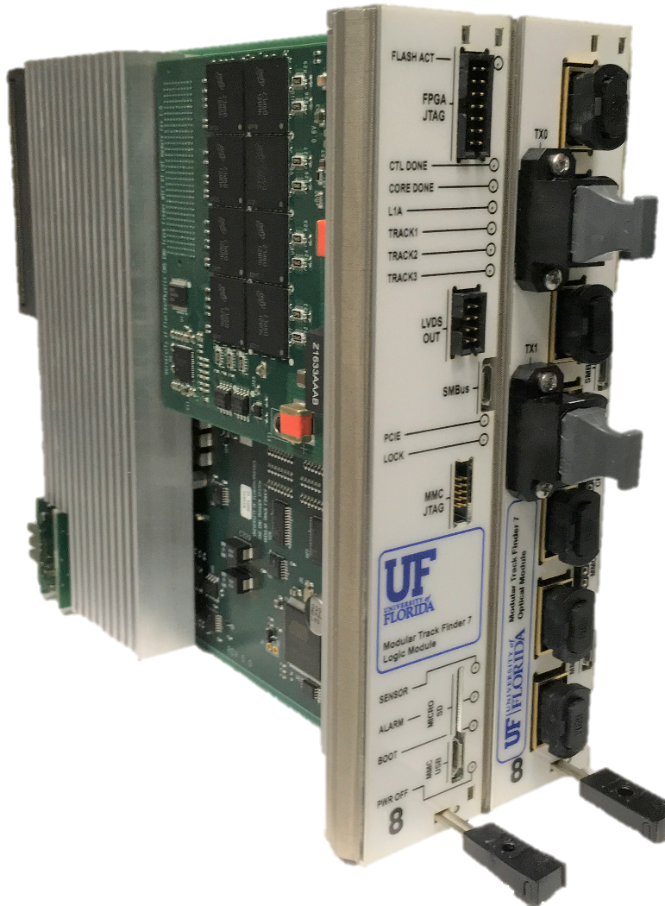
Production hardware – MTF7
Modular Track Finder 7
  µTCA standard
    Adopted by CMS for LS1 upgrades
  Based on Virtex-7 FPGA
  Modular design
  Logic module (left):
    Main FPGA – Virtex-7
    Control FPGA – Kintex-7
    Control interfaces:
      PCI Express, Gen2, 2 lanes
      IPbus
  Optical module (right):
    7 receivers 12 channels each, up to 10 Gbps
      84 RX channels total (currently used: 56)
    2 transmitters 12 channels each, up to 10 Gbps
      24 TX channels total (currently used: 1)
  Logic and Optical modules connect via custom 10Gbps backplane section
  PT LUT module (mezzanine)
    Based on Reduced Latency DRAM (RLDRAM 3)
    1 G x 9 bits of space
Also used by OMTF

Slide 8
CSC trigger data sharing
ME1
ME2,3,4 (3 stations)
Subsector 1
Subsector 2
Color | Native EMTF | Native OMTF | Neighbor EMTF | Neighbor OMTF | Split (ways) | Chamber count
 | ✓ |  |  |  | None | 11
 | ✓ | ✓ |  |  | 2 | 25
 | ✓ |  | ✓ |  | 2 | 4
 | ✓ | ✓ | ✓ | ✓ | 4 | 5

Slide 9
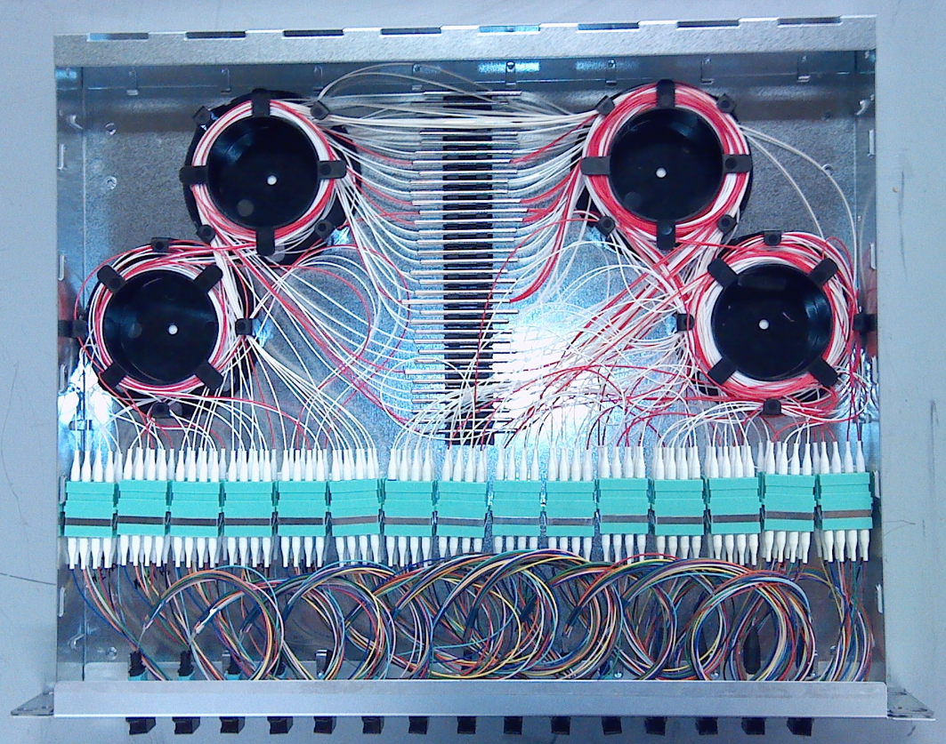
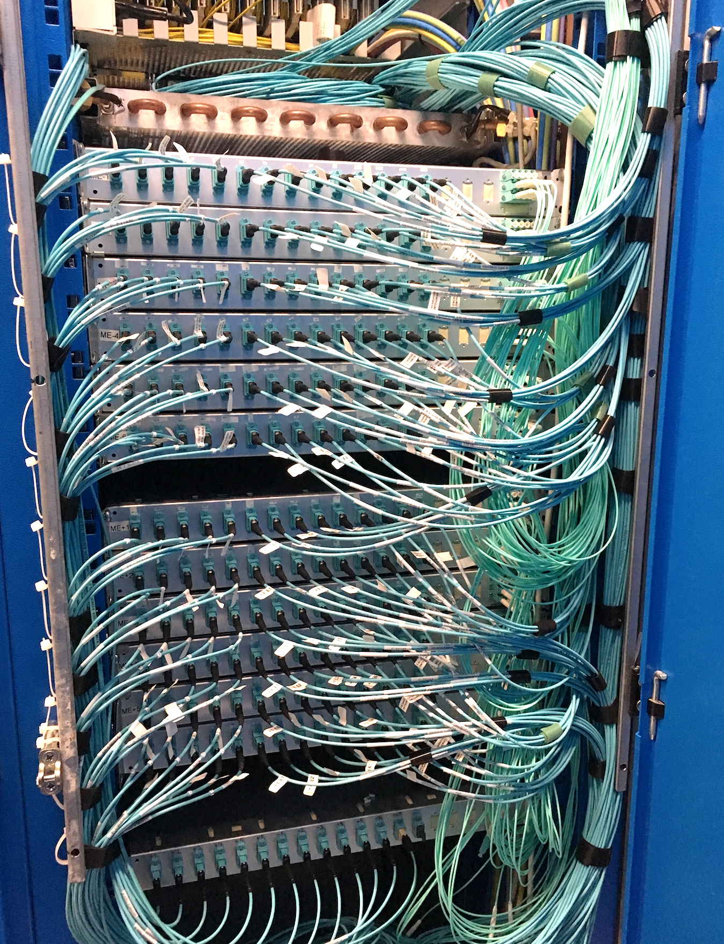
Optical patch panel
One EMTF sector panel
1U rack-mount box
14 fan-outs
29 2-way splitters
5 4-way splitters
12 EMTF sectors + output

Slide 10
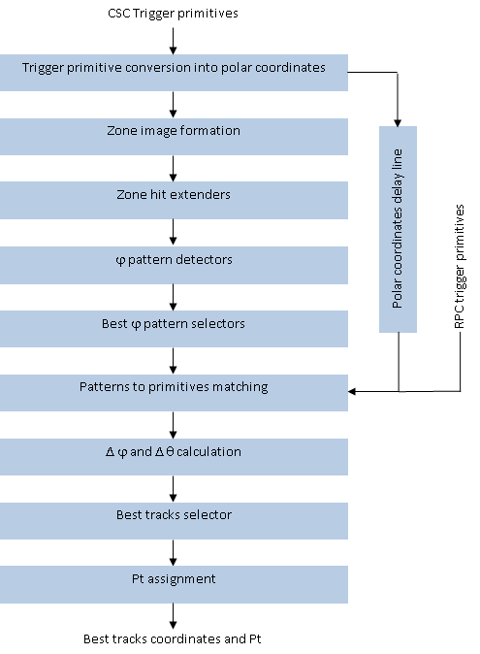
Firmware
  Firmware significantly reworked relative to legacy system
    up to 108 input CSC primitives / BX
    up to 84 input RPC primitives / BX
    Legacy system: up to 15 primitives / BX
    Nearly 13 times more than legacy!
  φ patterns are used to find straightest paths with CSC data only
  12 best φ patterns are selected
  Input primitives are matched to patterns
  RPC data used to complement missing CSC primitives
    Due to longer RPC latency
  Θ path verified to be straight, out-of-line primitives removed
  Δφ and Δθ between primitives calculated
  Best three tracks selected and fed to Pt assignment LUT

Slide 11
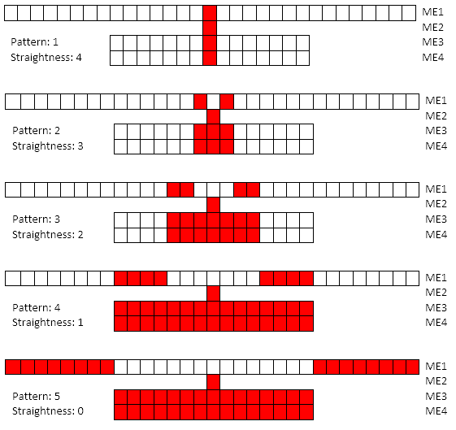
φ pattern logic
  Station ME2 is considered a “key” station
  Straightest patterns have maximum resolution
  Lower resolution for larger sagitta patterns
  Pattern quality depends on:
    Number of stations with hits
    Pattern straightness
  Pattern quality is used to select best patterns

Slide 12
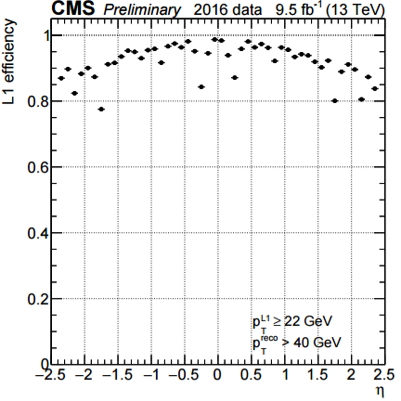
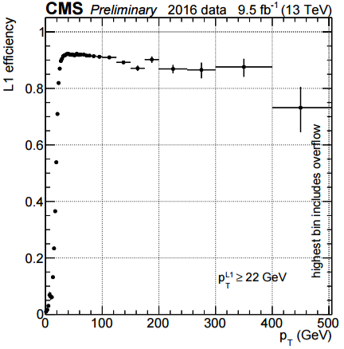
Performance plots

Slide 13
Future Upgrades

Slide 14
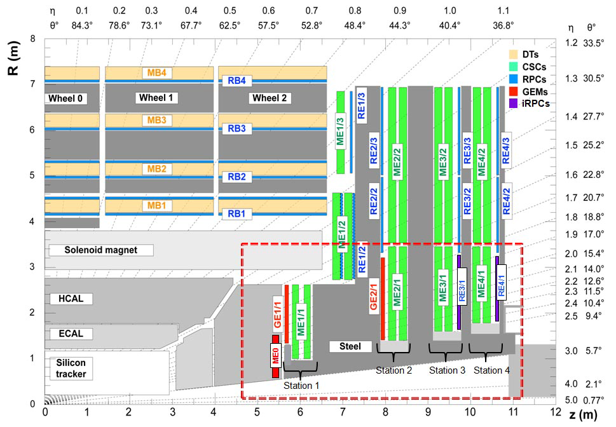
New trigger data sources
Challenges:
More RPC chambers
New GEM chambers
Endcap
(Proposed scope):
Cathode Strip Chambers (CSC), RPC,
plus GEM (ME0, GE1/1, GE2/1),
and RPC (RE3/1, RE4/1)

Slide 15
Adding new detectors
  Inst. luminosity after upgrade: 5*10³⁴ cm⁻²s⁻¹
  Pileup: 200
  More chambers offer more hits per track
    Better track parameter measurement
    Better rate reduction
  More chambers improve robustness if:
    A chamber is dead
    Too much pileup

Slide 16
Input bandwidth per 60° sector
Source | Link count, current | Link count after upgrades | Bit rate, current, Gbps | Bit rate after upgrades, Gbps
CSC | 49 | 49 | 3.2 | 3.2
RPC (existing) | 7 | 7 | 10 | 10
RPC (upgrade) |  | 3 |  | 10
GE1/1 |  | 14 |  | 6.4
GE2/1 |  | 16 |  | 6.4
ME0 (GE1/0) |  | 4 |  | 9.6
Total | 56 links | 93 links | 226.8 Gbps | 487.2 Gbps
  MTF7 does not have enough input serial links
  Input bandwidth grows by a factor of ~2.1
  FPGA in the current system is ~80% full
  Replacement FPGA should have at least twice the resources

Slide 17
Advanced Processor R&D
Collaboration project with University of Wisconsin-Madison
Goals:
  General-purpose FPGA processing board with expansion capabilities
  ATCA standard
    Evaluated by CMS as replacement for µTCA
  ~100 Optical I/O connections, multi-rate capable
    Channel count driven by FPGA packaging
    1..14 Gbps base range, 25G extended range
  Mezzanine(s) for user-designed expansion devices, such as:
    External memory (LUTs)
    Supplemental FPGA processors
    Exotic I/O
    Associative memory
  Rear-Transition Module (RTM) support
  Embedded Linux control platform
  Customizable I/O capability
    E.g., legacy optical connection support
  Scalable Cost Model (FPGA-driven)

Slide 18

Advanced Processor (APx)
Flexible I/O Interface
Optical Engines
CDR
SPF
25G+ Connector
TTC Interface
Retimers (opt.)
Zone 3
Optical MPO
Processing FPGA
Expansion Mezzanine
Digital I/O
Base Ethernet (1Gbe)
Fast Ethernet (10G/40G)
4-Lanes DAQ?
TTC?
ADF-type Z2
Optical MPO
Optical Engines
X-
point
(4 lanes)
Optical MPO
Power,
IPMI
Optical Engines
Control Device (ZYNQ)
ATCA Z1
Retimers
QSFP
4 Lanes Link Aux I/O (ZYNQ/ FPGA/QSFP via Crosspoint)
RTM
(Rear Transition Module)
Front Board (ATCA)

Slide 19
AP FPGAs: C2104 Package
FPGAs | 16G MGTs | 30G MGTs | Total MGTs | K LUTs
VU095 | 32 | 32 | 64 | 538
VU125 | 40 | 40 | 80 | 716
VU160 | 52 | 52 | 104 | 926
VU190 | 52 | 52 | 104 | 1074
VU5P | 0 | 80 | 80 | 601
VU7P | 0 | 80 | 80 | 788
VU9P | 0 | 104 | 104 | 1182
VU11P | 0 | 96 | 86 | 1296
VU13P | 0 | 104 | 104 | 1728
XC7VX690T (MTF7, shown for comparison) | 80 (11 Gbps) | 0 | 80 (11 Gbps) | 433
  Any of the compatible FPGAs can be used
  Users select FPGA based on their requirements
    Count of serial links
    Logic resources
    Price range

Slide 20
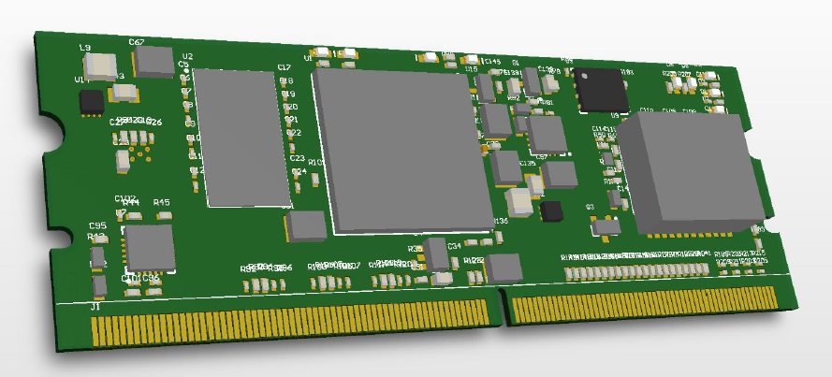
IPMI Management Controller (IPMC)
  ATCA uses similar IPMI infrastructure as µTCA
  For the APx, the IPMC is similar to a Module Management Controller (MMC)
    expanded responsibilities
  244 pin Low Profile MiniDIMM form factor
  Mounts to main ATCA blade using angled connector

Slide 21
Embedded Processor Module
COMExpress Mini Footprint
  EPMZ7 – Embedded Processor Module (ZYNQ 7000-based)
  Embedded Linux control point for the APx or similar main ATCA processor board
  Expansion of the COMExpress-Mini form factor
    COMExpress—PICMG form factor for putting a PC-style computer on mezzanine
    Mini—55m×84mm board with a single 220 pin connector
  COMExpress is a form factor proposal from CMS CERN group for the embedded Linux processor
  Considered as Phase 2 IPBus replacement
DDR Memory
GbE
PHY
ZYNQ 7000
‘035 or
‘045
40-Pair High Speed Connector
220 pin COMe A/B Connector
Refclk
Circuitry
µSD Boot Flash

Slide 22
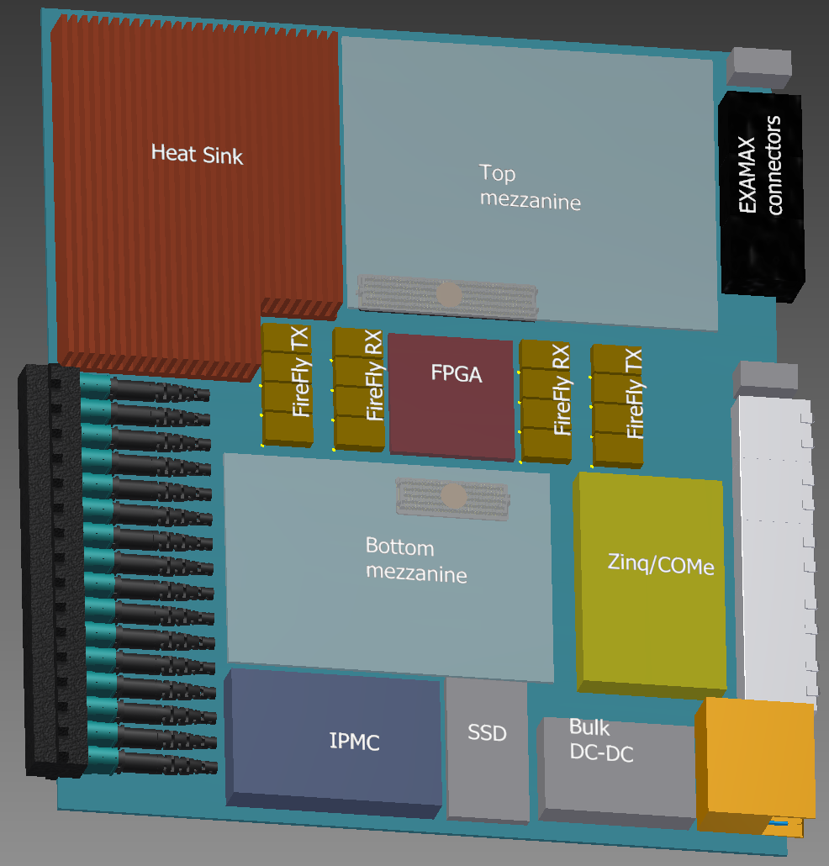
Mechanical 3D AP sketch
Early attempt, nothing final yet
All parts have real dimensions
Part of serial links should be routed to RTM, for flexibility (~25%)
Multiple FireFly parts can be connected to one MPO adapter to save space
Two expansion mezzanines with wide I/O connection to FPGA
Heat sink covers FPGA and FireFly parts, shown cut out for clarity
DC-DC converters and LDOs located under mezzanines and on reverse side (except bulk DC-DC)

Slide 23
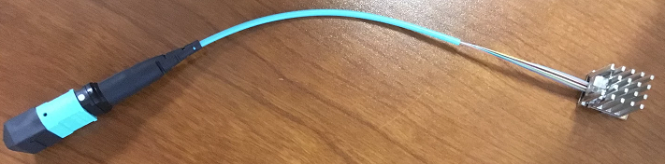
Optical links
  Evaluating several options
  Most promising:
    Manufacturer: Samtec
    Family name: FireFly
  Two flavors:
    Separate parts: 12 × RX, 12 × TX
    One part: 4 × RX + 4 × TX
    Mechanically identical
  Available now:
    1 .. 14 Gbps
  Coming soon:
    28 Gbps version
  Evaluation adapter in production now

Slide 24
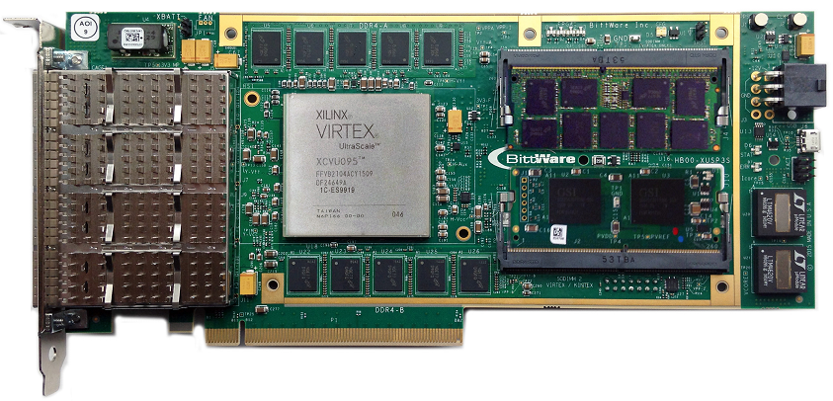
PT LUT memory evaluation
  Considering using regular DDR4 memory modules
  Fast enough to read from random addresses 3 times in one BX
  Supported in UltraScale+ FPGAs:
    128 GB max
    RDIMM modules
  Hardware tests in progress
    Using evaluation board
    SODIMM 8 GB

Slide 25
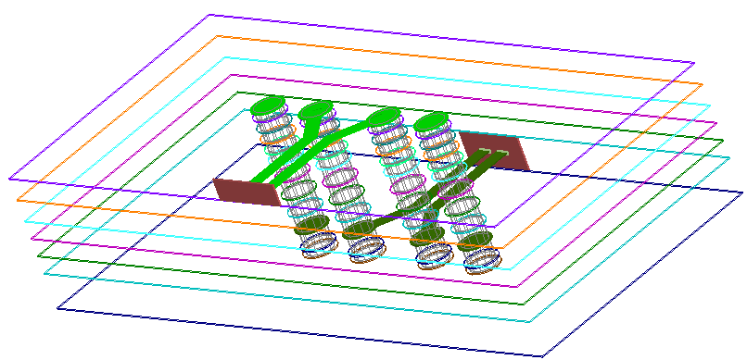
PCB design challenges
  Accommodating 25Gbps bit rate is not easy
  Special materials must be used. Examples:
    Tachyon 100G
    Megtron 6
  Trace geometry becomes critical
    Even vias can present impedance discontinuity at such bit rates
  Some PCB features require 3D field solver modelling to get the impedance right
Differential via model in HFSS

Slide 26
Firmware & software co-development
  We’ve used a home-made VPP library since 2002 for CSCTF project
  Single C++ source code, dual use:
    C++ model compatible with CMSSW
    Generates human-readable, synthesizable Verilog
  Problem: EMTF firmware too large for VPP
  Working on using Vivado High-Level Synthesis (HLS) for firmware development
  Same philosophy:
    Except that HLS-generated Verilog is hard to read ☹
  So far:
    Converted nearly all EMTF algorithm into HLS
    Validated that HLS is compatible with g++ and CMSSW
    Validated most of the generated Verilog modules in real hardware
      HW Outputs match HLS outputs
    Hardware tests ongoing, more modules being tested
  See TWEPP 2016 talk by N. Ghanathe:
  https://indico.cern.ch/event/489996/contributions/2210922/attachments/1343543/2024393/TWEPP_Presentation_PRATAP.pdf

Slide 27
Conclusions
  Modular Track Finder 7 designed and constructed for LS1 upgrade
  Endcap and Overlap Muon L-1 triggers
  Successfully used for data taking during 2015, 2016
  Advanced Processor is under development for future upgrades
    Phase-1
    HL-LHC
  General-purpose FPGA processing board
  User expansion capabilities
  ATCA standard
  Collaboration project with U. Wisconsin-Madison

Slide 28
Backup

Slide 29
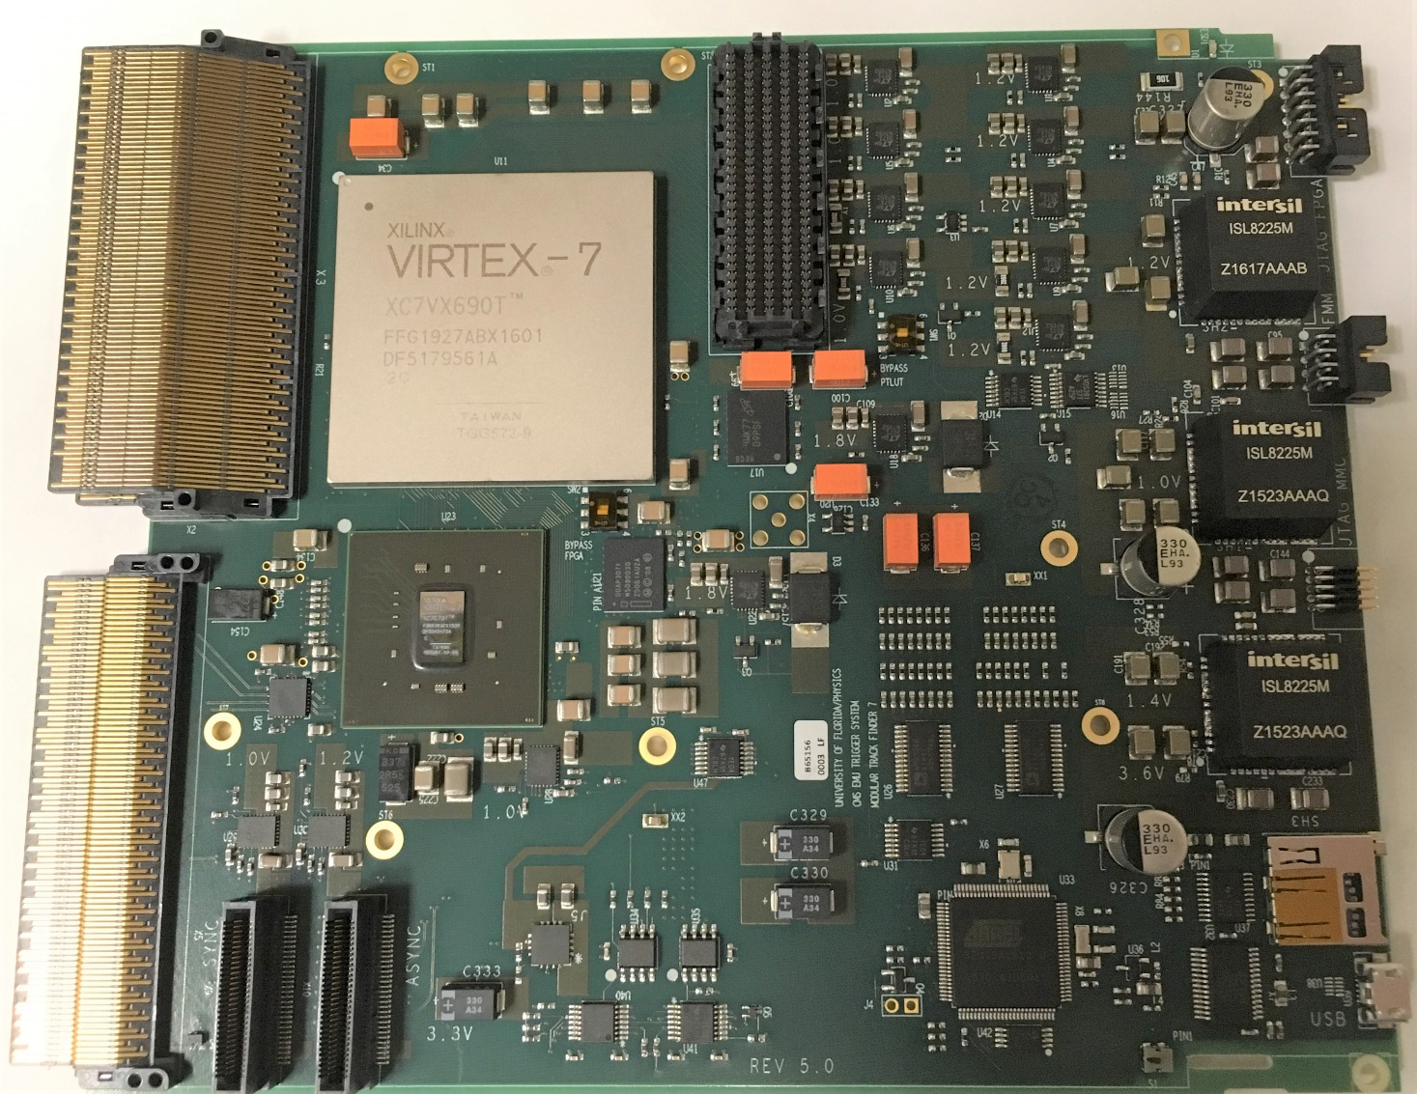
Virtex-7 Logic module
Custom backplane connector
PT LUT module connector
Logic FPGA
Control FPGA
uTCA connector
Connecors for Clock modules
MMC CPU
MMC = Module Management Controller

Slide 30
Logic module FPGA interconnections
24 outputs
10 Gbps
PT LUT connector
XC7VX690T
Custom backplane connector
80 inputs
10 Gbps
4 TX to
AMC13
DAQ TX
Parallel data exchange channel
(control, DAQ control, 4 extra links)
4 inputs
10 Gbps
PCI express
2 lanes
XC7K70
IPbus
uTCA backplane connector
DAQ control (RX)

Slide 31
Logic module
Logic module
FPGAs:
  Logic: XC7VX690T-FFG1927
  Control: XC7K70-FB676
Inputs:
  80 Virtex-7 GTH links (10 Gbps) directly to Logic FPGA
    Minimal latency
    All available receivers are designated for trigger data
      Maximum flexibility
  4 additional Kintex GTX links (6.4 Gbps) to Control FPGA
    Delivered to Logic FPGA via parallel channel
    Longer latency
Outputs:
  24 Virtex-7 GTH links (10 Gbps)
Control:
  PCI express Gen 2, 2 lanes
  Ipbus

Slide 32
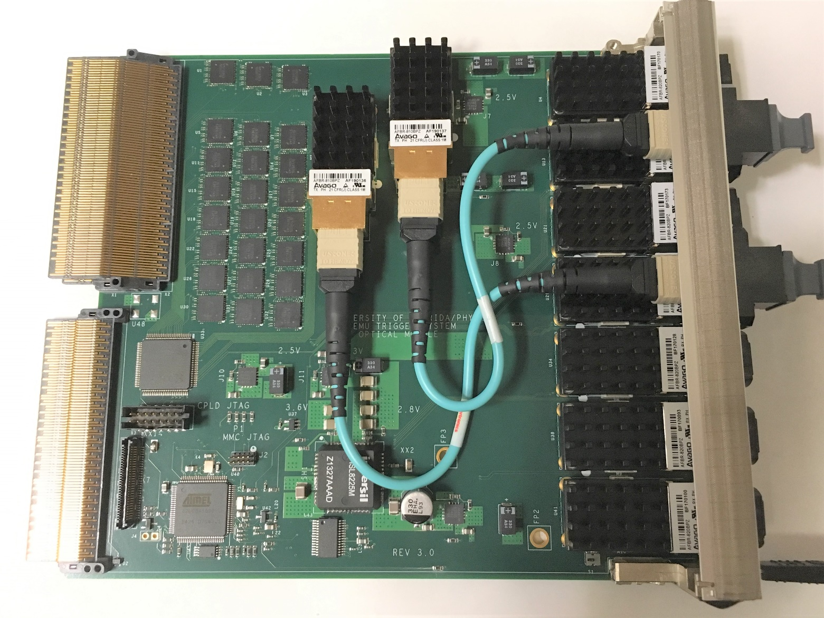
Optical module
Optical transmitters
Custom backplane connector
Optical receivers
Backplane redrivers
uTCA connector
MMC

Slide 33
Optical module
  Receivers:
    7 12-channel RX
      Avago’s AFBR-820BEZ
      84 RX channels
  Transmitters:
    2 12-channel TX
      Avago’s AFBR-810BEZ
      24 TX channels
  All of them 10 Gbps parts
  Not enough space on front panel to accommodate all
  TX parts located inside
    connect with short fibers to MPO fiber couplers on front panel
    Tight but enough space to fit couplers on top of AFBR-820 parts.
  Receivers are on front panel to minimize count of fiber-to-fiber transitions for inputs

Slide 34
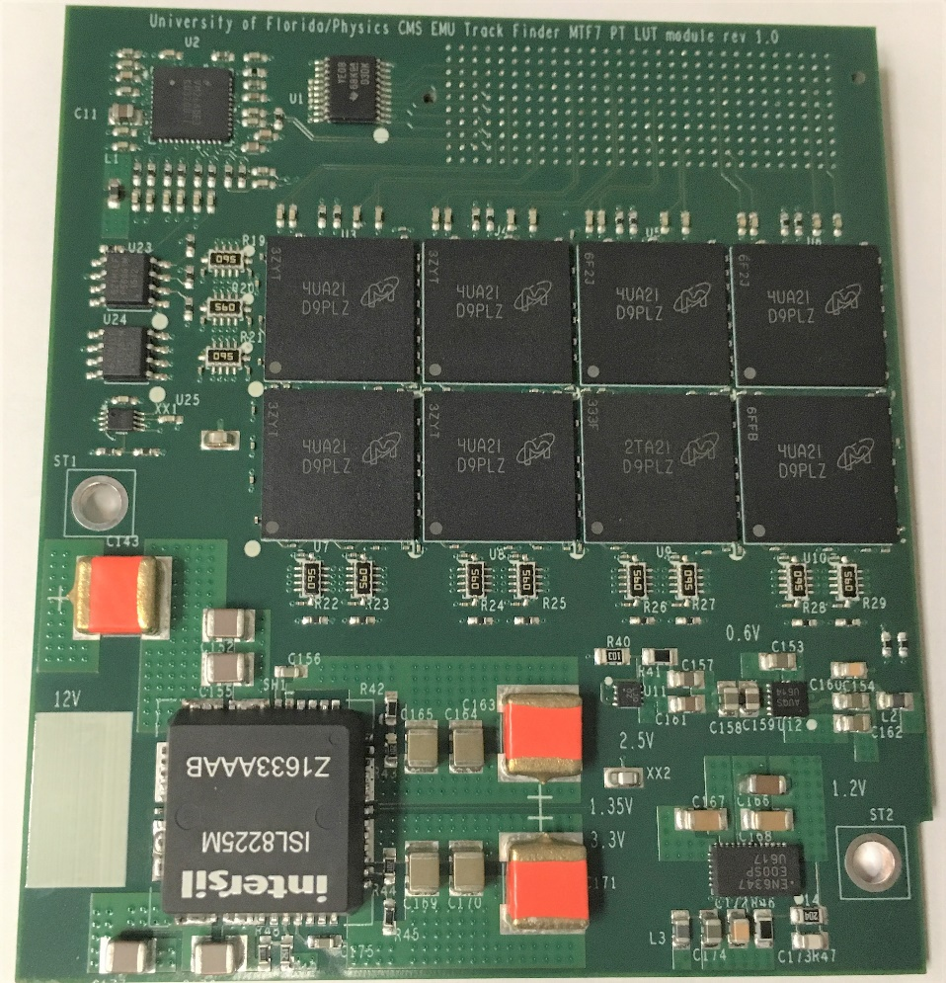
PT LUT module
Base board
Connector
(rear side)
RLDRAM3 memory
16 chips, 8 on each side
(clamshell topology)
Total size:
512M x 18 bits ≈ 1GB
DC-DC
converters

Slide 35
PT LUT
Parameters:
  RLDRAM clock : 200 MHz
  Address & control: 200 Mbps each bit
  Data: 400 Mbps each bit
  RLDRAM can tolerate up to ~1GHz clock. However:
    Hard to implement in FPGA
    Needed for burst-oriented applications mostly
    Does not change latency for random address access
    Lower clk F → lower power consumption

Slide 36
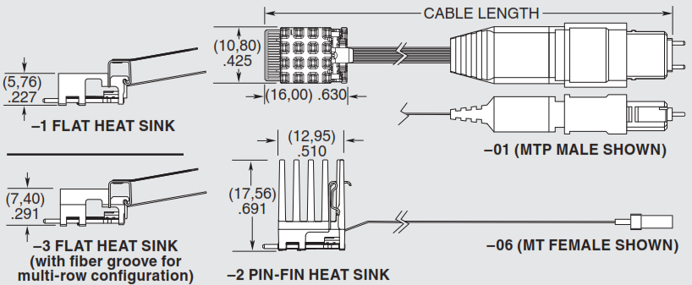
FireFly
  Very small footprint
  All high-speed contacts on one side – easy to route
  Multiple options for heat sink
  Footprint compatible with high-speed jumper cables
    Also by Samtec

