Slide 1
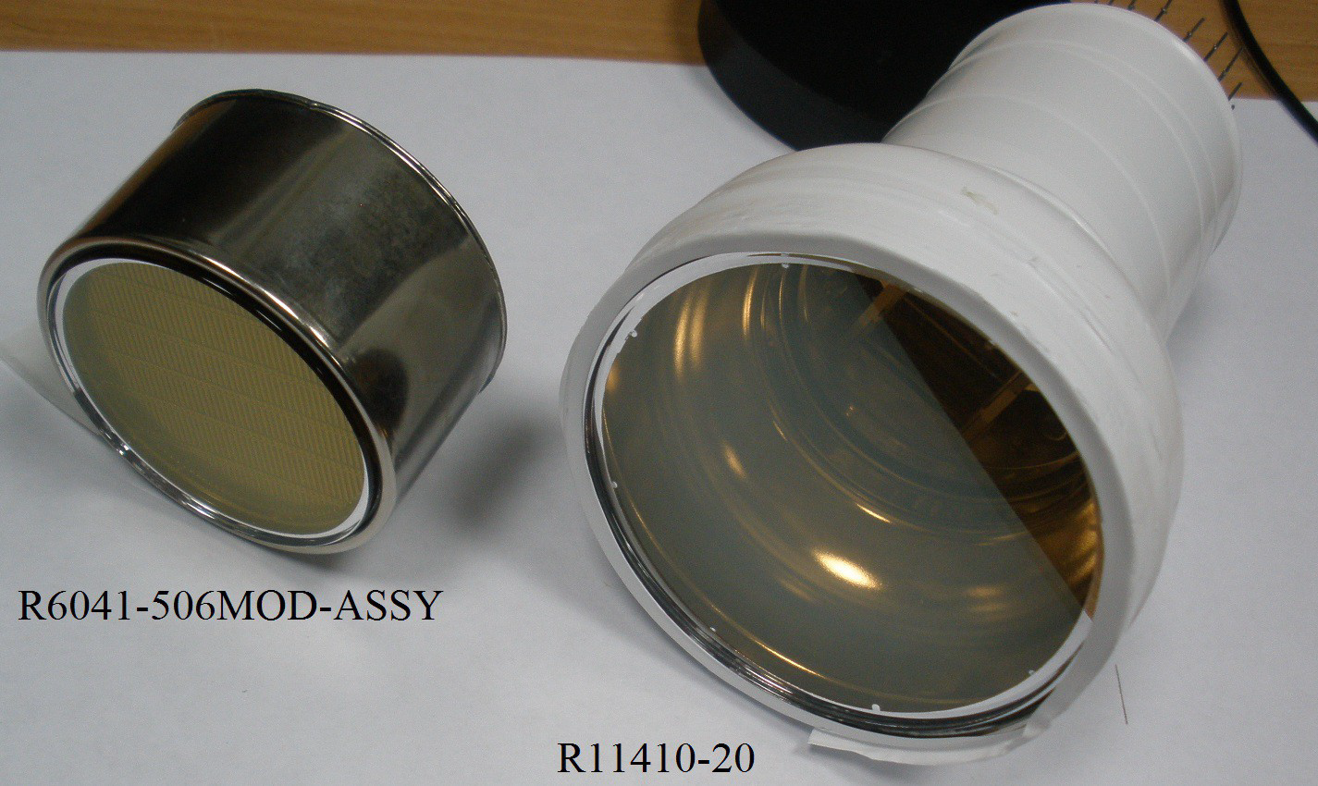
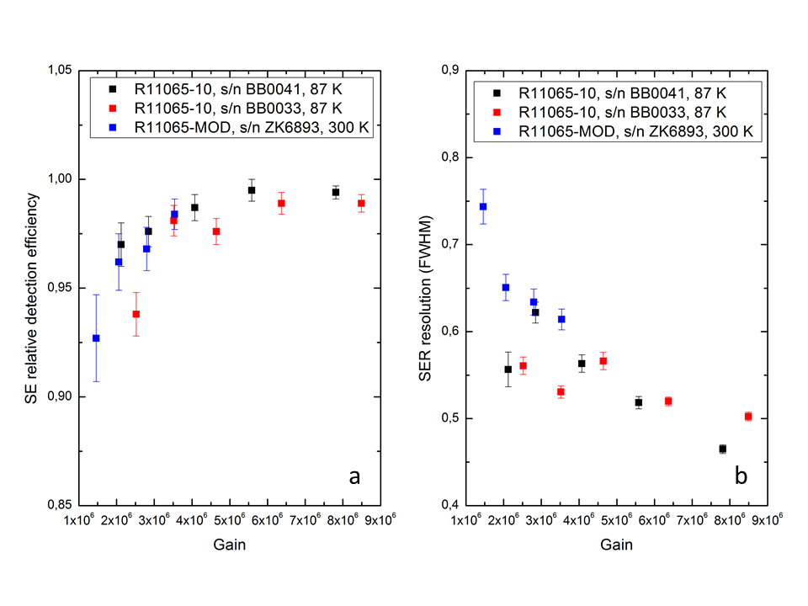
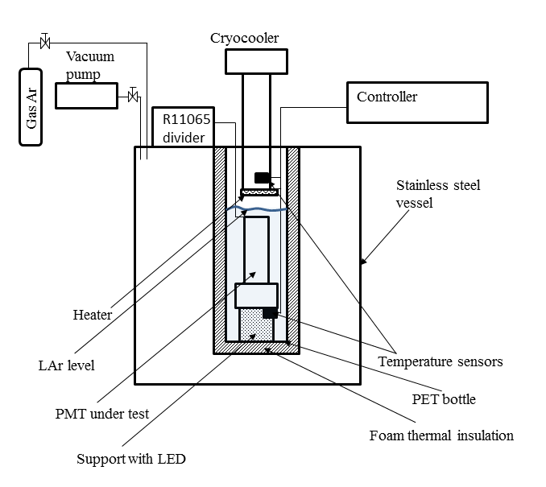
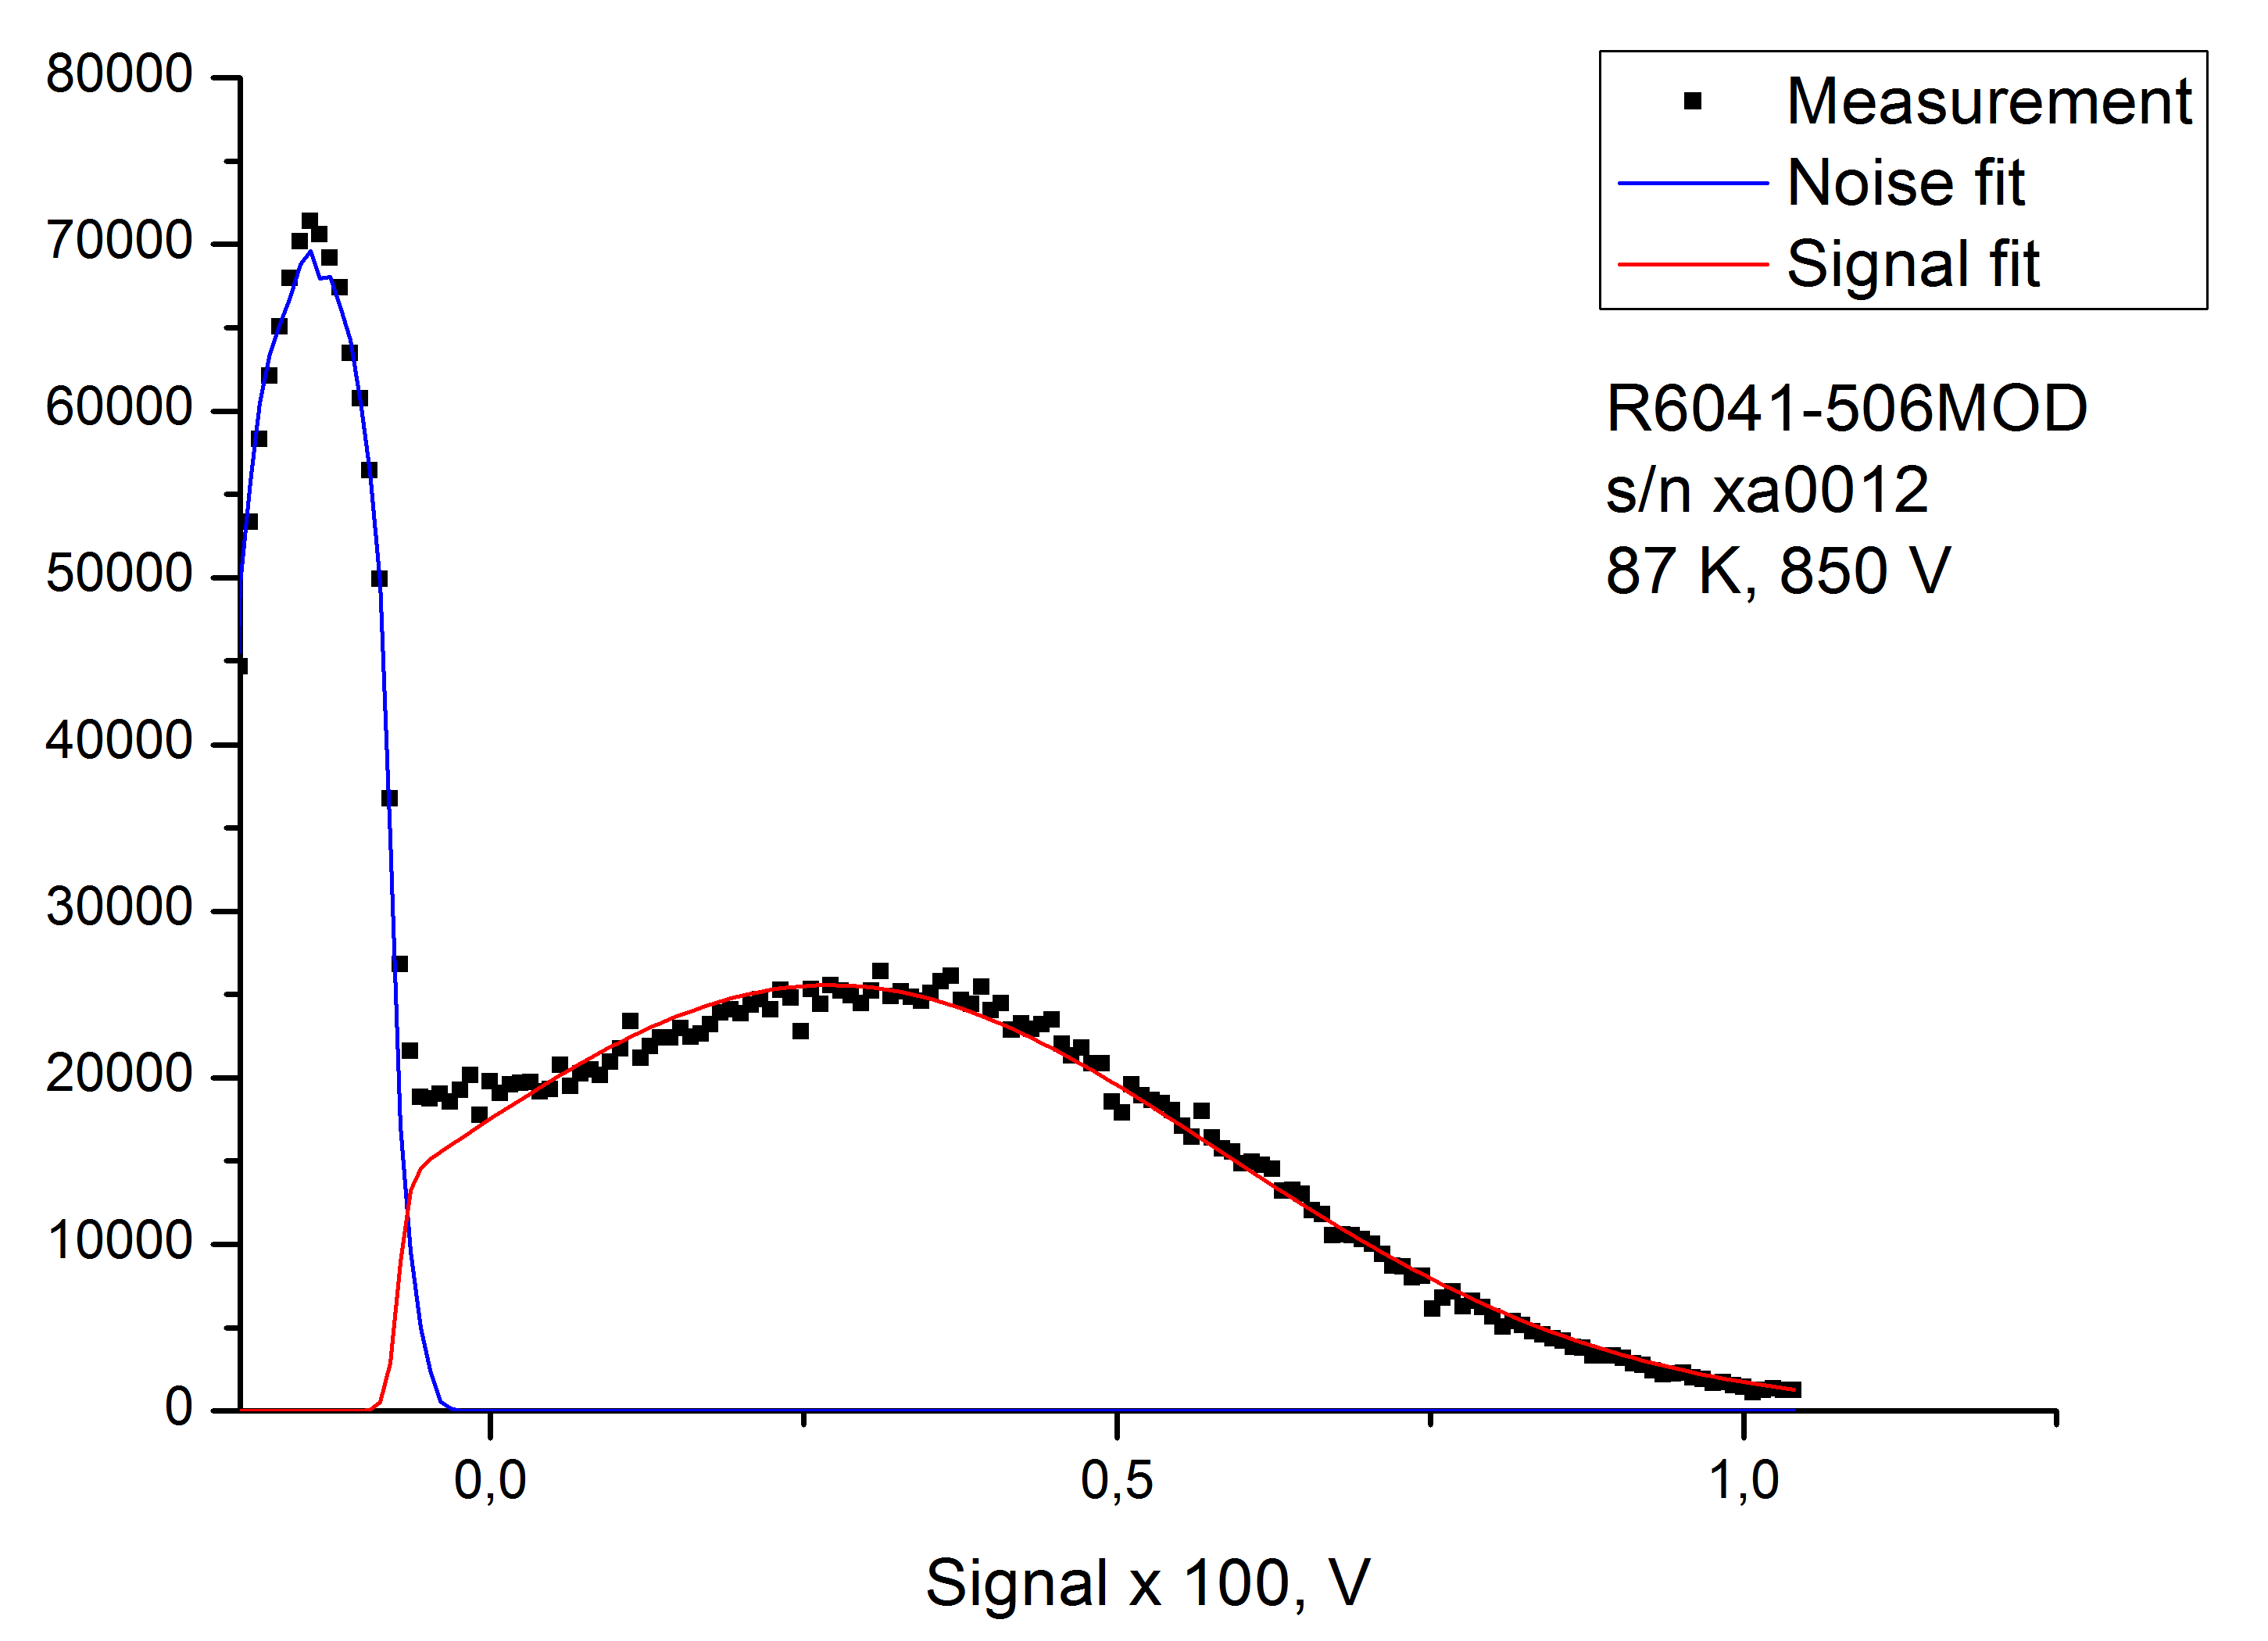
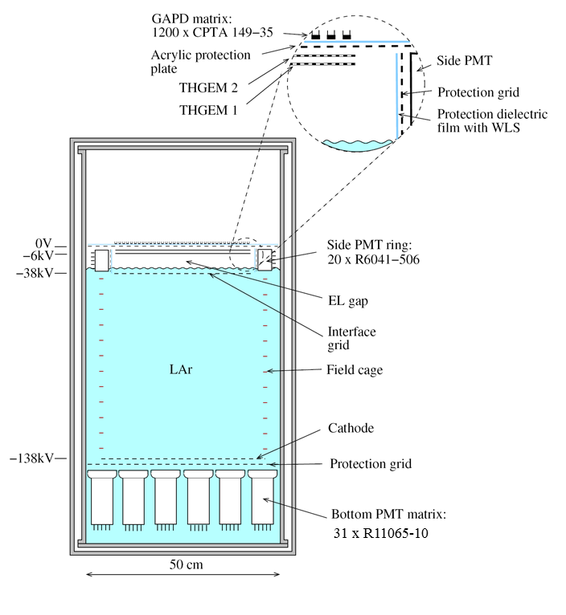
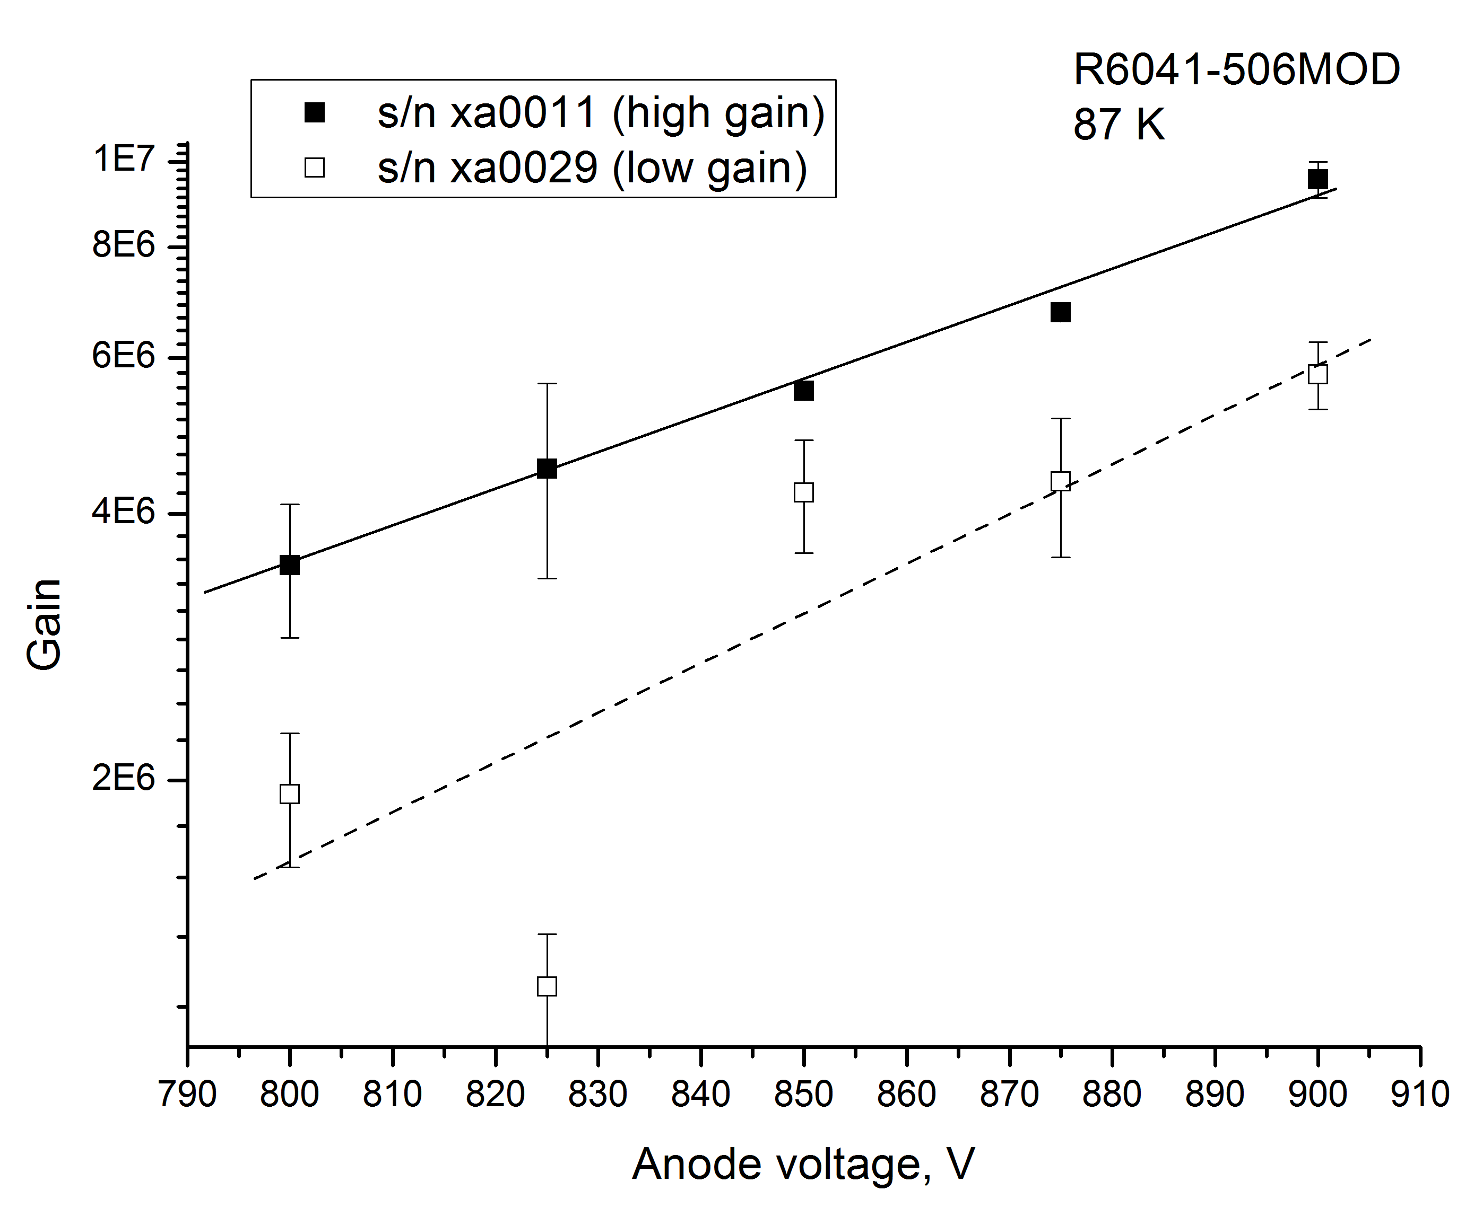
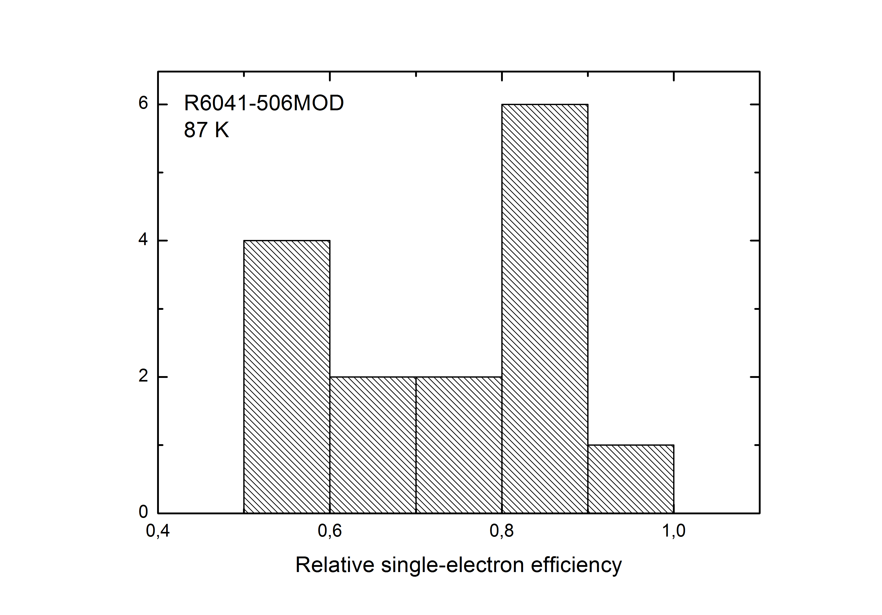
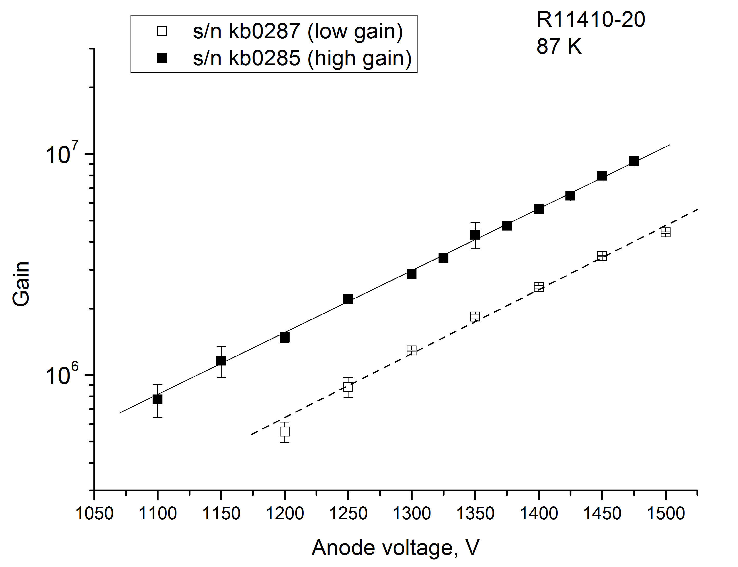
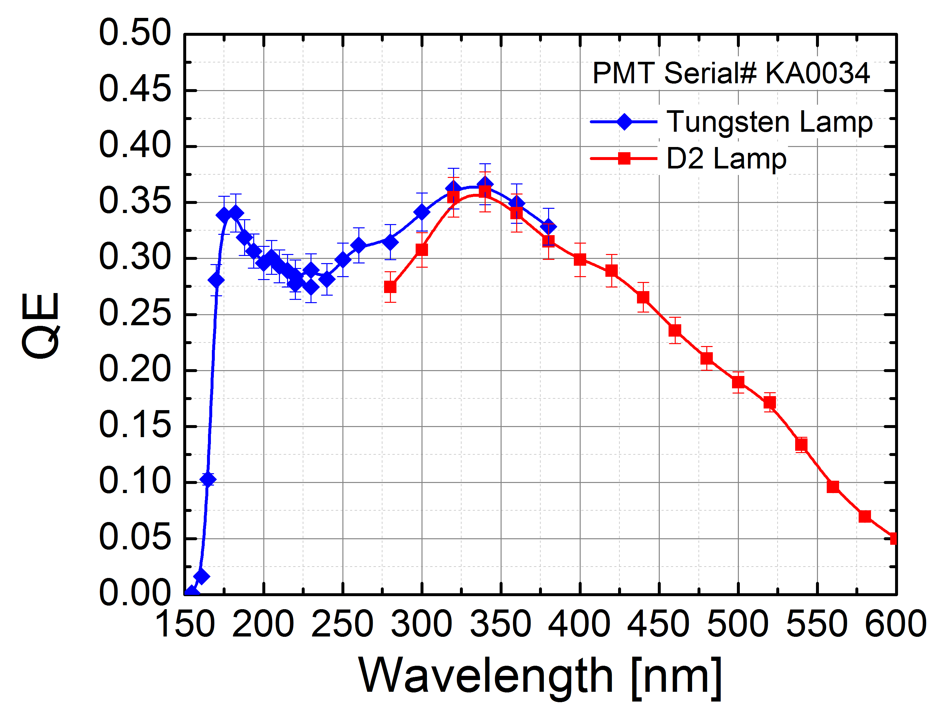
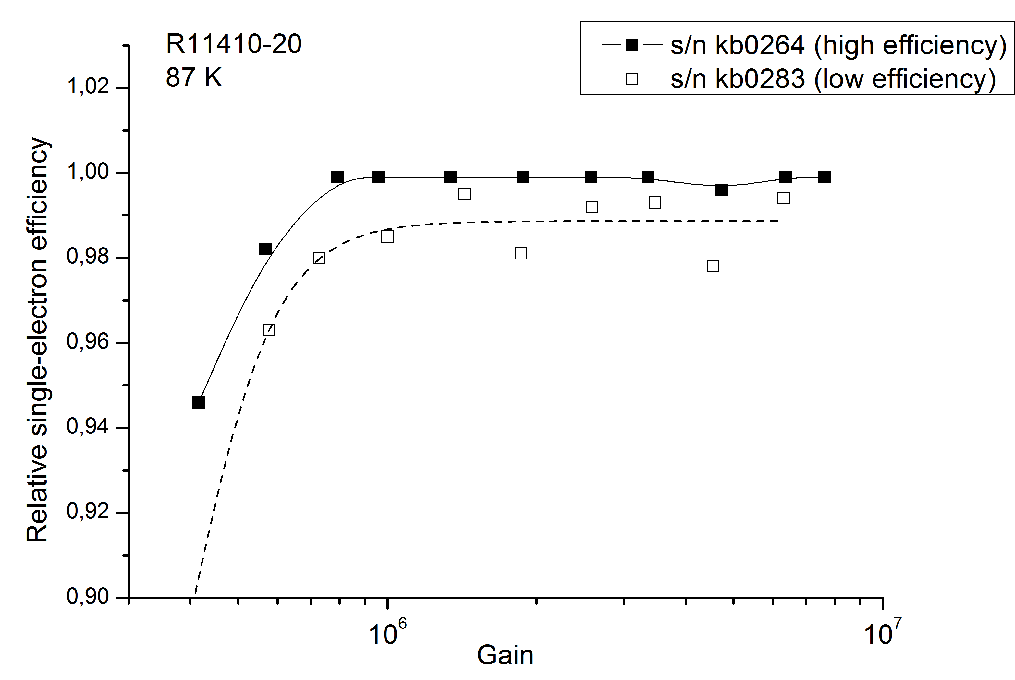
Study of cryogenic photomultiplier tubes for the future double-phase cryogenic avalanche detector.
Budker INP
A.Bondar, A.Buzulutskov,A.Dolgov, E.Frolov, V.Nosov, L.Shekhtman, A.Sokolov
Budker Institute of Nuclear Physics, 630090, Novosibirsk, Russia
Novosibirsk State University, 630090, Novosibirsk, Russia
Abstract
We report the results of characterization study of several types of cryogenic photo-multipliers manufactured by Hamamatsu Photonics, namely: compact 2 inch R6041-506MOD tubes, 3 inch R11065-10 and R11065-MOD tubes for operation in liquid Ar and 3 inch R11410-20 tubes for operation in liquid Xe. These types of PMT are proposed for installation into the future double-phase cryogenic avalanche detector that is developed in the Laboratory of Cosmology and Particle Physics of the Novosibirsk State University jointly with the Budker Institute of Nuclear Physics. Compact PMTs are planned to be installed at the side of the cryogenic vessel and they will detect electroluminescense in a high field region above liquid. 3 inch PMTs will be installed at the bottom of the cryogenic vessel in liquid Ar and they will detect primary scintillations from recoil nuclei as well as secondary scintillations. Main task of both PMT systems is to provide fast trigger signal. Therefore the PMTs have to distinguish between single electron and double electron signals to suppress effectively the background. Eight R11065 PMTs and eight R11410-20 tubes were tested and they all demonstrated excellent performance in terms of gain and relative single electron efficiency. All 3 inch PMTs showed maximal gain I liquid Ar above 5x10^6 and relative single electron efficiency above 95%. Compact R6041-506MOD tubes have different dynode system and thus their single electron energy resolution and relative efficiency is much worse than that of 3 inch tubes. From 21 two inch PMTs only 12 tubes were selected with acceptable relative single electron efficiency higher than 70% at the maximal gain higher than 5x10^6. However these PMTs are very attractive because these are the only compact type of tubes that can operate in liquid Ar.
.
Two-phase Cryogenic Avalanche Detector (CRAD) is proposed and being developed in the Laboratory of Cosmology and Particle physics of the Novosibirsk State University jointly with the Budker Institute of Nuclear Physics [1]. Main purpose of this detector is to search for weakly interacting massive particles (WIMP) and coherent neutrino-nucleus scattering by detecting signals from nuclear recoils. The energy of recoil nuclei from WIMP is predicted not to exceed several tens keV with the most interesting range below 8 keV that corresponds to the WIMP mass below 10 GeV. For coherent neutrino-nucleus scattering the recoil energy is even lower, below 0.5 keV. Thus the CRAD sensitivity that can allow detection of single primary electrons becomes a factor of crucial importance.
The design of proposed CRAD is shown schematically in figure 1. The detector consists of cryogenic vessel with vacuum thermal insulation that can hold up to 150 l of liquid Ar (200 kg). Sensitive volume is limited by the height of bottom PMT system as well as the thickness of side PMTs and is close to 50 l (50 cm height and 36 cm diameter). Primary electrons, produced by recoil nuclei after WIMP or neutrino scattering, drift in the liquid towards the surface in electric field of 2 kV/cm. At the liquid surface electrons are emitted in the gas phase where they produce signal in two stages. Firstly by electroluminescence in high electric field above the liquid, secondly by avalanche multiplication in double-THGEM cascade or in a hybrid 2THGEM/GEM cascade.
Proportional scintillations in VUV region from electroluminescence (EL) gap (S2 signal) are detected by the ring of side PMT and by the bottom PMT system. To provide sensitivity in VUV range all PMT have wavelength shifter (tetraphenyl-butadiene, TPB) deposited either directly on the PMT window or on thin transparent plastic foil in front of them. Bottom PMT are also intended for detection of primary scintillations in the liquid (S1 signal).
Fig.3. Photo of R6041-506MOD and R11410-20 photomultipliers.
Fig.7. Relative detection efficiency of single electrons as a function of PMT gain. The data are shown for three PMTs with the lowest, medium and the highest maximum gain.
Fig.8 Typical pulse height spectrum of SE response for a R6041-506MOD tube from a group of the PMT with higher gain.
Fig.4. Schematic set-up for the PMT tests
Gain of R6041-506MOD can reach 10⁷, however, these tubes have rather large spread of maximum gain and relative SE efficiency. Only 8 photomultipliers with relative SE efficiency higher than 75% could be selected (Fig.9). In total only 12 PMTs out of 21 were selected for future operation in the double-phase CRAD.
All three types of PMTs, R11065, R11410-20 and R6041-506MOD were powered by positive voltage from N1470 CAEN high voltage power supply. Signal from PMT anode was amplified by a factor of 10 or 100 by CAEN N979 fast linear amplifier module. Then amplified signal was connected to oscilloscope Tektronix TDS5034B and to discriminator CAEN N841 for counting rate measurements by scaler CAEN N1145. Oscilloscope was used for the measurements of waveforms and pulse height spectra. Signals were obtained from spontaneous emission of single electrons from photocathode or by illumination with LED. The LED was powered from pulse generator G5-78, and its light intensity could be tuned by changing pulse height and base line from the generator. The rate with LED did not exceed 5 kHz and the frequency of pulse generator was 50 kHz.
R11065-10, R11065-MOD
a
b
Single electron response of R11065 tube is rather fast, FWHM of the signal is ~7 ns and full width at 0.1 maximum is around 12 ns. The gain can reach values close to 10⁷ and single electron spectrum is very well separated from the noise (see Fig.5).
Fig.9. a) Gain as a function of anode voltage for two typical R6041-506MOD tubes, one from the group with higher gain and another from the group with lower gain. b) Distribution of PMT over the relative SE efficiency. Only 8 tubes show relative efficiency exceeding 75%.
Fig.1. Design of two-phase CRAD in Ar with optical readout by combined GEM/GAPD multiplier.
TPB layer considerably reduces the photon collection efficiency, by a factor reaching 20, due to internal reflection and conversion efficiency losses in the wavelength shifter (WLS) and in the absence of optical contact between the WLS and the PMT window. Thus, it looks attractive to shift the VUV emission of Ar to longer wavelength directly in the detection medium, to do without the WLS. It is known that at room temperature such a VUV-to-UV conversion can be effectively performed in gaseous argon by doping with either xenon, at a content of 0.1-10%, or nitrogen, at a content of 0.2-2%, and in liquid argon by doping with xenon, at a content of 10-1000 ppm [2]. At first glance, the VUV-to-UV conversion in two-phase Ar would be possible either for the S1 signal in the liquid phase, using Xe dopant, or for the S2 signal in the gas phase, using N₂ dopant. For the first case 3 inch R11410 PMT sensitive for UV photons emitted by Xe (175 nm) is proposed for the bottom PMT system. This PMT has the same dynode system and the body as R11065, but quartz window and the photocathode with quantum efficiency close to 30% at 175 nm (Fig.2)[3].
R11410-20
Performance of these photomultipliers is very similar to that of R11065 tubes. The pulse shape and the pulse height spectra are similar to that of R11065. Spread of gains, energy resolutions and relative efficiencies is rather small, unlike the case of R6041-506MOD tubes. Typical gain-voltage curves and relative efficiency vs gain dependencies are shown in Figs.10 and 11. All seven tested photomultipliers demonstrated relative efficiency above 95% without discharges in liquid Ar.
D2 lamp
Fig.5. Pulse height spectra of SER obtained from spontaneous emission (black points) and with LED illumination at room temperature (red points) and at 87K (blue points). Vertical arrow points to the threshold for calculation of the relative single electron efficiency. Anode voltage 1500V, gain ~10⁷.
Tungsten lamp
Fig.10. Gain as a function of anode voltage for R11410-20 PMT with the highest gain and with the lowest gain in the tested group.
Fig.2. Quantum efficiency of R11410 PMT. Result of the measurement from [3]
In our previous work an excellent performance of the R11065-10 and R11065-MOD PTMs
in liquid Ar was demonstrated [4] and here these results are presented for completeness. Total number of compact PMTs R6041-506MOD purchased from Hamamatsu Photonics is 21 pieces. Results of the performance of four PMTs were reported in [4]. In the present work the rest 17 PMTs are tested. Seven 3 inch R11410-20 PMT are tested in the present work and for the first time their successful operation in liquid Ar is demonstrated. The image of R6041-506MOD and R11410-20 PMTs is shown in Fig.3. The set-up for testing of PMT immersed in liquid Ar is shown in Fig.4. For the tests of PMT we used stainless steel vessel 30 cm in diameter and 40 cm high with gas-tight top cover. The vessel can keep up to 3 atm of overpressure. The top cover contains 3 metal-glass feedthroughs that were used to provide high voltage to the PMT under test, signal from the pulse generator to the light emission diode (LED), signals from the temperature sensors to the Lake Shore 336 temperature controller and voltage to the heater from the same controller. Cryocooler Cryodyne 350CP by CTI-Cryogenics was used for cooling and liquefaction of Ar. PMT under test was installed inside a thermal insulating cylindrical case 10 cm in diameter and 35 cm high. The case has plastic PET (polyethylene terephthalate) bottle 8 cm in diameter and
30 cm high firmly attached inside. At the bottom the bottle has special support containing the LED for PMT cathode illumination.
Fig.6. Gain as a function of anode voltage for two R11065-10 (one with the highest maximum gain and one with the lowest maximum gain) and one R11065-MOD PMT. Results for different PMTs are marked with different colors. Data corresponding to liquid Ar temperature are marked with open points.
Gain as a function of anode voltage is shown in Fig.6 for 3 typical photomultipliers. Relative single electron efficiency (fraction of SE response spectrum above threshold) as a function of gain is shown in Fig.7.
Fig.11. Relative SE efficiency as a function of gain for two R11410-20 tubes, one with the highest efficiency and one with the lowest efficiency from the tested group
R6041-506MOD
References:
A. Buzulutskov, 2012 JINST 7 C02025.
A. Buzulutskov, Photon emission and atomic collision processes in two-phase argon doped with xenon and nitrogen, arXiv:1702.03612v1 and references therein.
A. Lyashenko, et.al., 2014 JINST 9 P11021.
A.Bondar, et.al., 2015 JINST 10 P10010.
This PMT is about twice slower than R11065: FWHM of the waveform is 14 ns and the width at 0.1 of maximum is about 20 ns. As R6041-506MOD is slower PMT as compared to R11065, it has approximately twice lower average SE signal at the same gain. Typical SE response spectrum is shown in Fig.8.

