Slide 1
^{arch}PbMoO₄ scintillating bolometers as detectors to search for neutrinoless double beta decay of ¹⁰⁰Mo
Serge Nagorny
INFN – Gran Sasso Science Institute, L`Aquila, Italy
on behalf of the CUPID-0 collaboration
1st March 2017

Slide 2
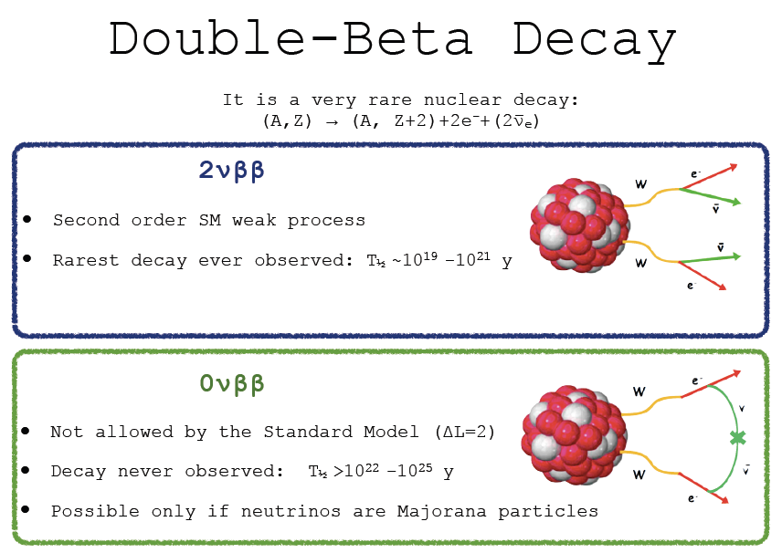
Double Beta Decay (DBD)

Slide 3
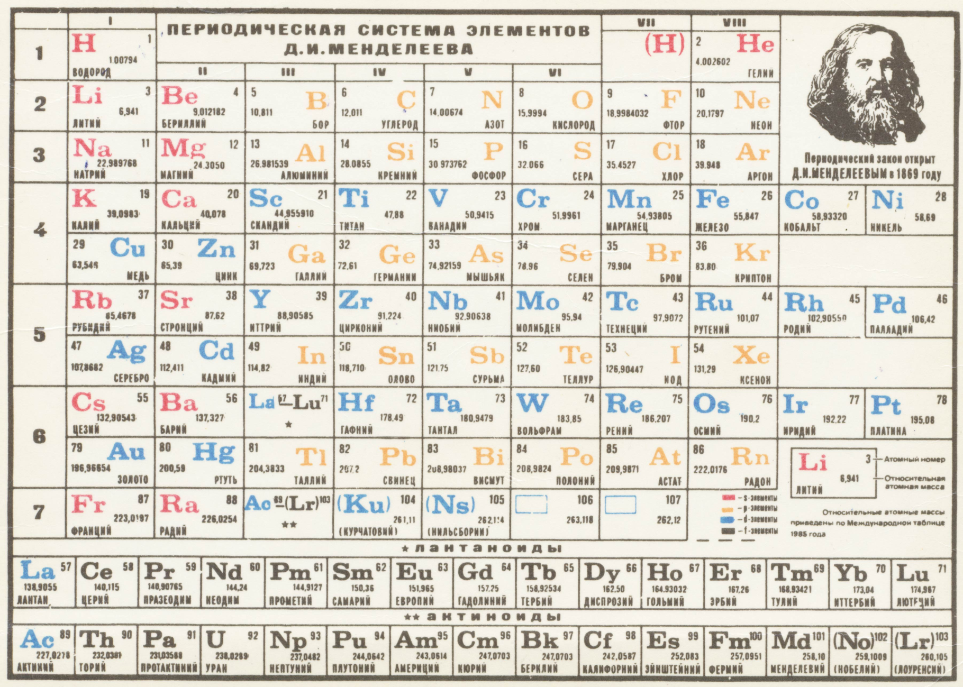
DBD active nuclei in the nature

Slide 4
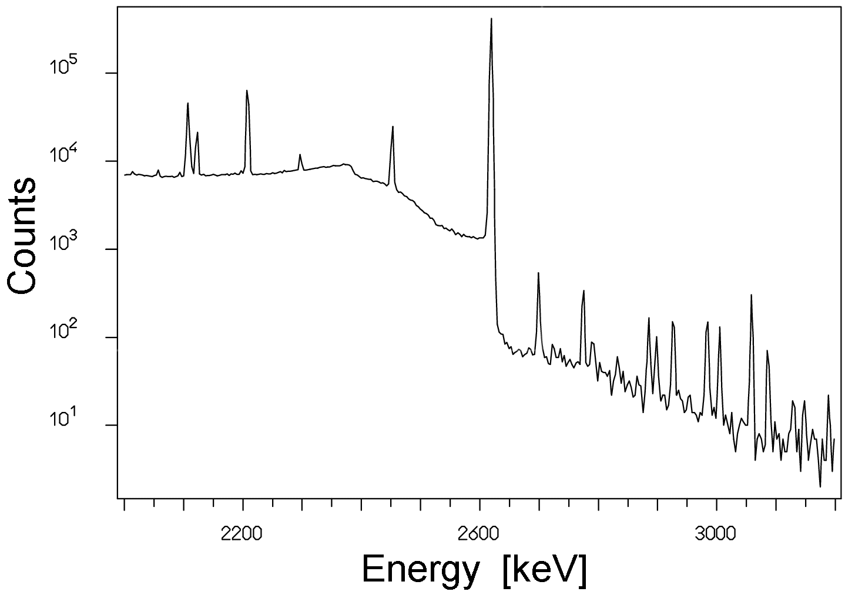
Which nuclide is the best for such search?
from experimental point of view
2615 keV
⁴⁸Ca
⁸²Se
⁹⁶Zr
¹⁰⁰Mo
¹¹⁶Cd
¹⁵⁰Nd
⁷⁶Ge
¹³⁰Te
Environmental gamma background of ²³⁸U and ²³²Th chains

Slide 5
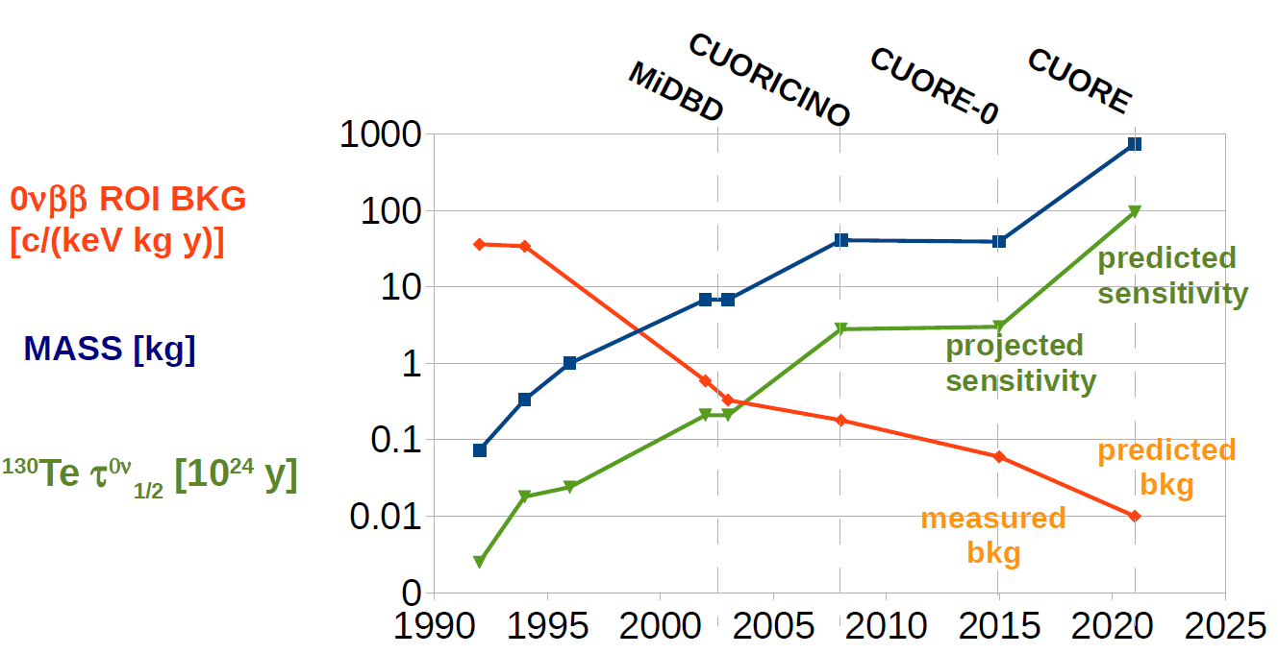
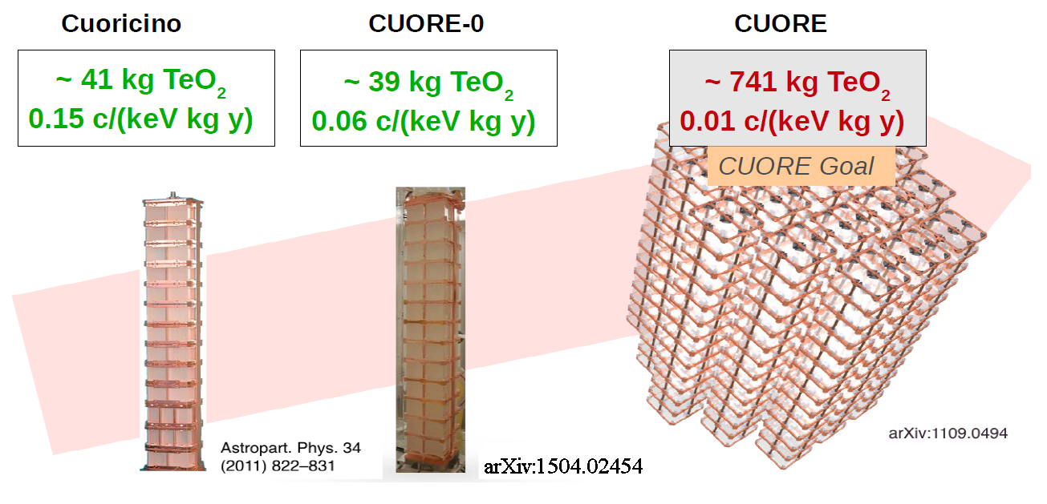
Development of TeO₂ bolometers
TeO₂ is wide used acousto-optic material with market of tens MEuro/year and well-developed technology of production

Slide 6
CUORE Upgrade with Particle Identification
a future ton-scale bolometric neutrinoless double beta decay experiment with improved sensitivity, based on the experience and expertise learned in CUORE
The CUPID goal is the use of the unique CUORE infrastructure @ LNGS, once CUORE completes operation, as well as using of upgraded detector technology in order to reach higher experimental sensitivity
New detector technologies (background rejection or surface events ID)
Isotopic enrichment
New purification and crystallization procedures
Stricter materials selection

Slide 7
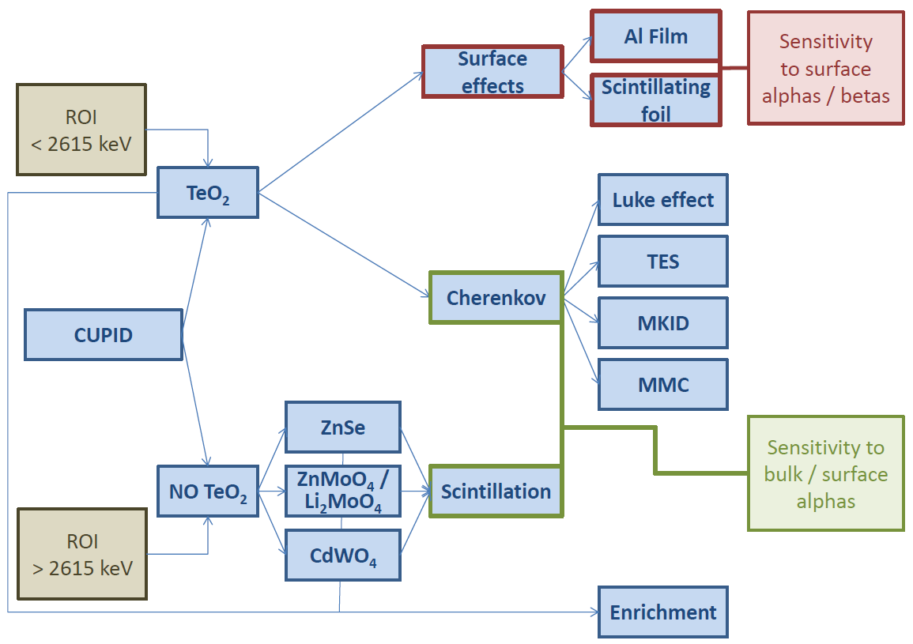
Czochralski

Slide 8
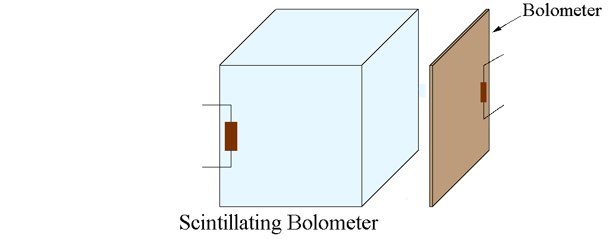
Working principle of scintillating bolometers

Slide 9
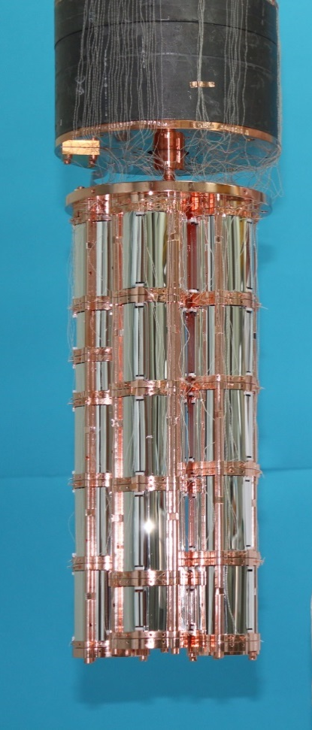
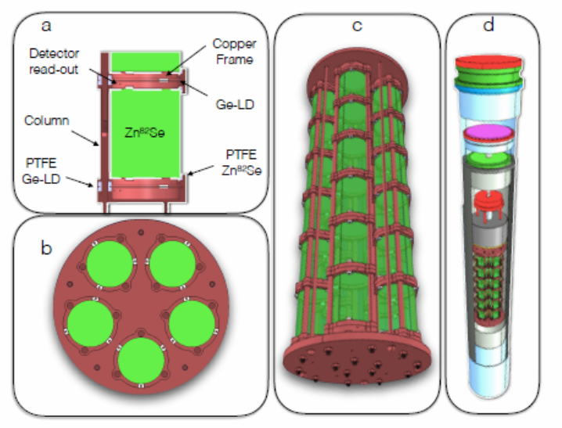
CUPID-0
Demonstrator array of enriched Zn⁸²Se scintillating bolometers
Total enriched ⁸²Se isotope mass is 7 kg
Expect background index @ROI < 10⁻³ c/(keV⋅kg⋅y)

Slide 10
Some crucial detector parameters
Radiopurity (internal background)
Light Yield
FWHM
PSD
High content of isotope of interest
Well-developed technology of crystals production

Slide 11
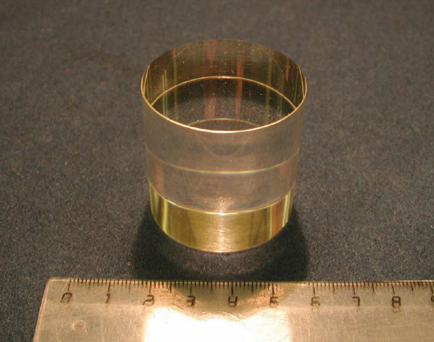
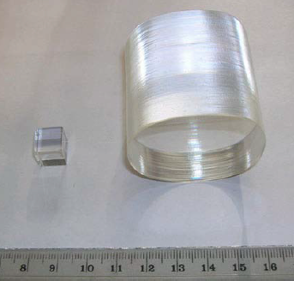
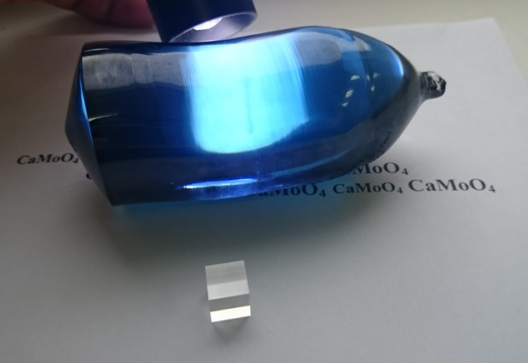
CaMoO₄
2003, Korea
2005, Ukraine
2004, Moscow
2007, Moscow
2012, Moscow
2015, Novosibirsk

Slide 12
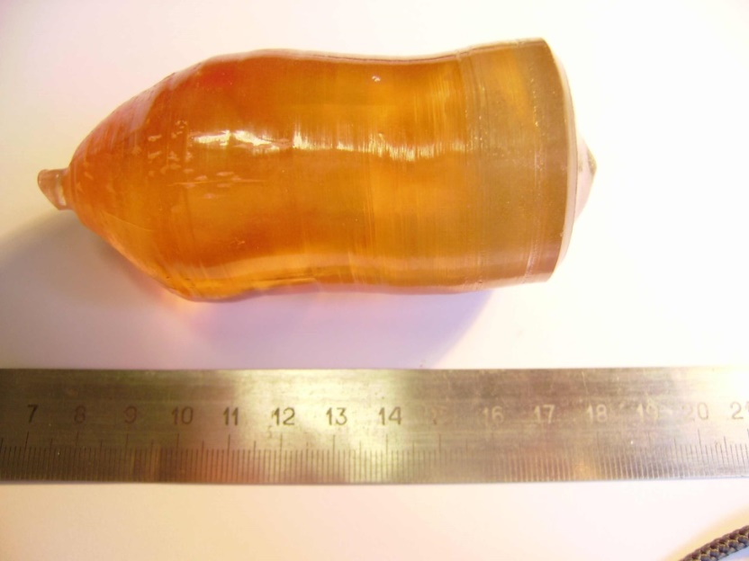
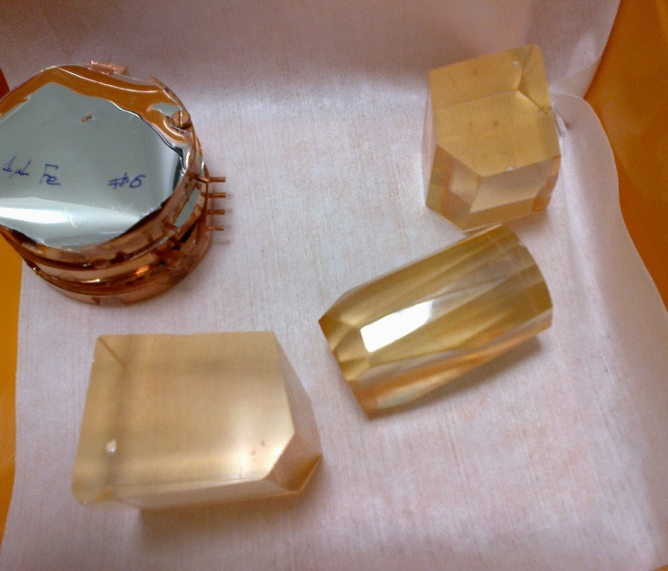
ZnMoO₄
2008, Moscow
2009, Kharkov
2012, Kharkov
2012, Novosibirsk

Slide 13
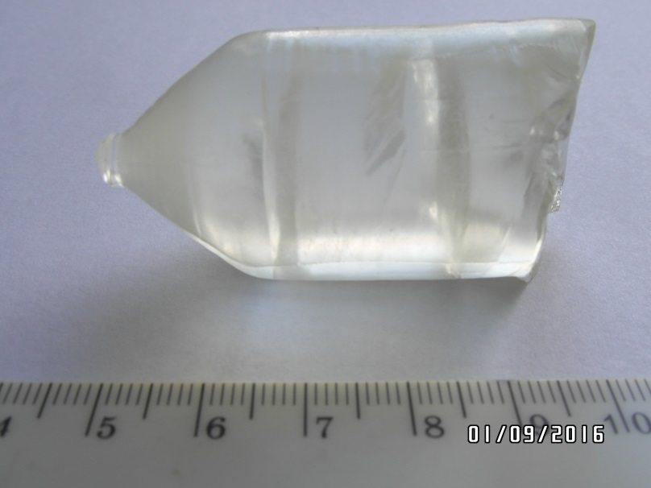
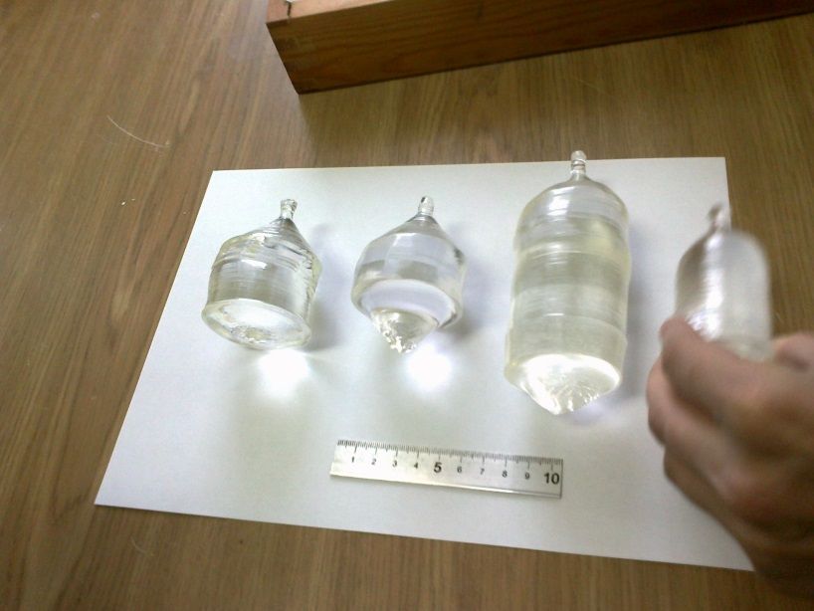
Li₂MoO₄
2004, Moscow
2014, Kharkov
2015, Novosibirsk

Slide 14
Mo-containing crystals
CaMoO₄
ZnMoO₄
Li₂MoO₄
……
No other applications
No other applications
No other applications
What about PbMoO₄?
PbMoO₄ crystal is one of the most efficient materials used for acousto-optic devices (modulators, deflectors and phase-shifters) which possess a low optical losses, high optical homogeneity, high stability to laser radiation
The same like in case of the TeO₂ crystals!!!
Market demands & developed technology

Slide 15
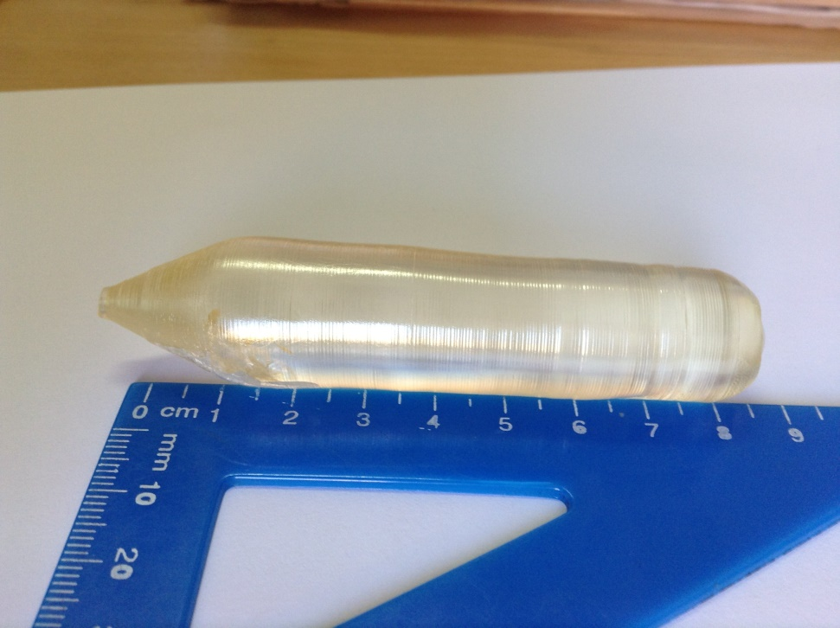
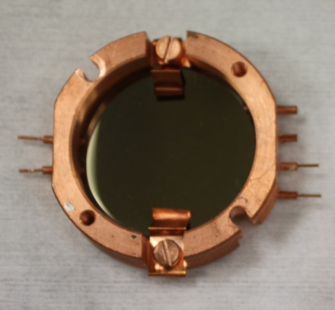

^{arch}PbMoO₄: conventional Czochralski technique
^{arch}PbMoO₄ boule
Total mass is 175 g
∅20×90 mm
Highly purified archaeological lead, > 99.999%
Re-crystallized MoO₃ powder, > 99.99%
Conventional Czochralski technique
Production yield is about of 50%
Light detector
^{arch}PbMoO₄
57 g
∅20×25 mm
Low-background measurements
LNGS

Slide 16
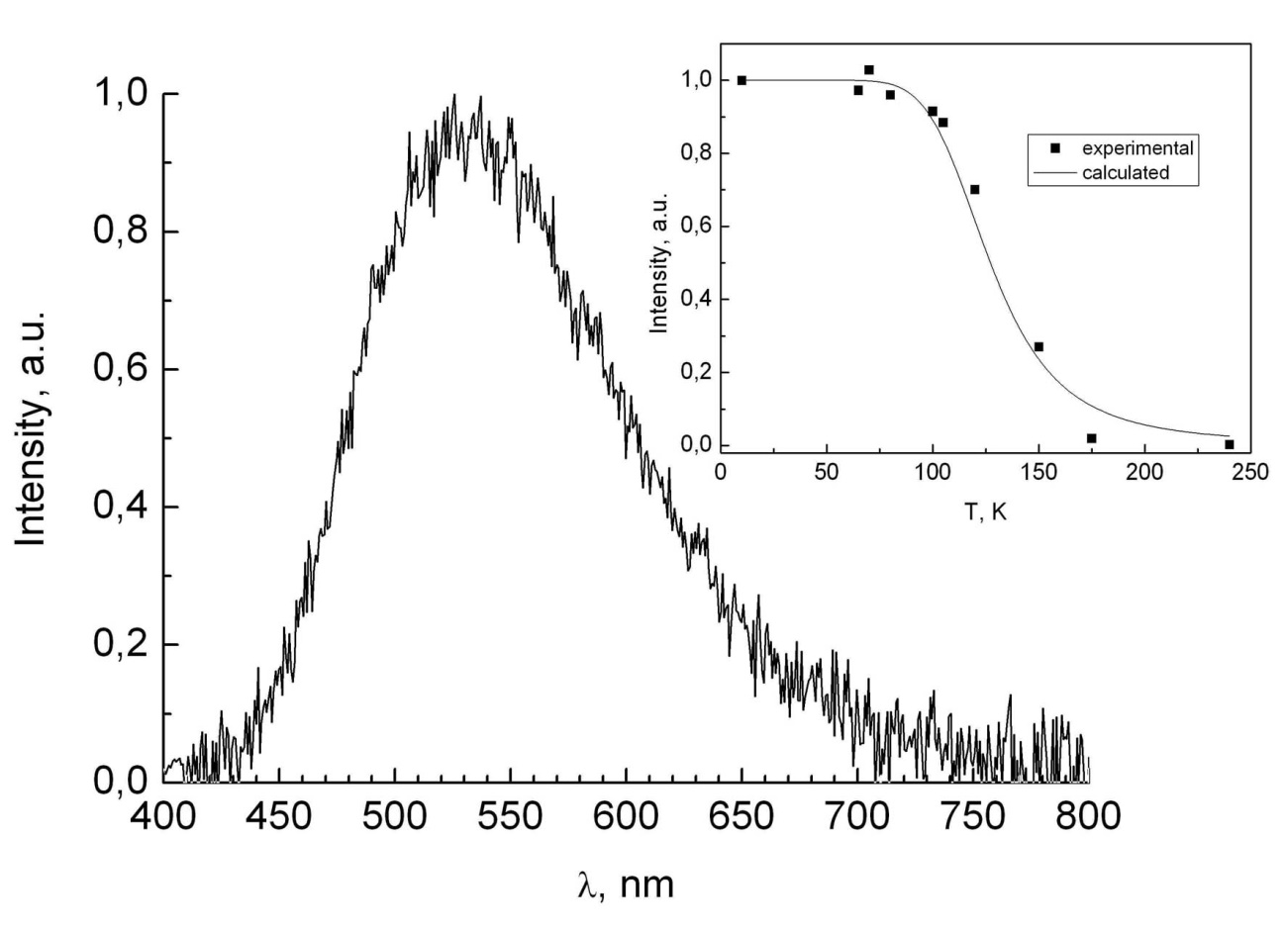
^{arch}PbMoO₄: Light Yield @ low temperature
× 10 times

Slide 17
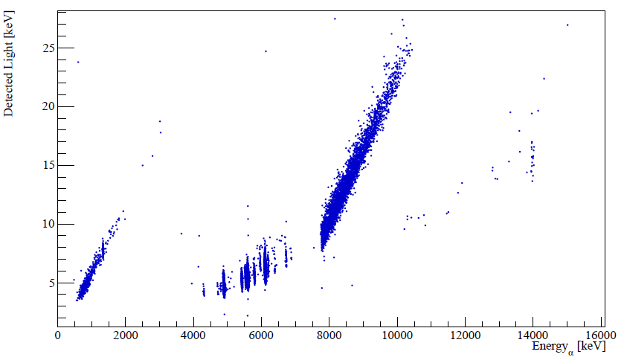
^{arch}PbMoO₄: Light-vs-Heat scatter plot
β + α
α + α
β
α
Well separated population of different type of events

Slide 18
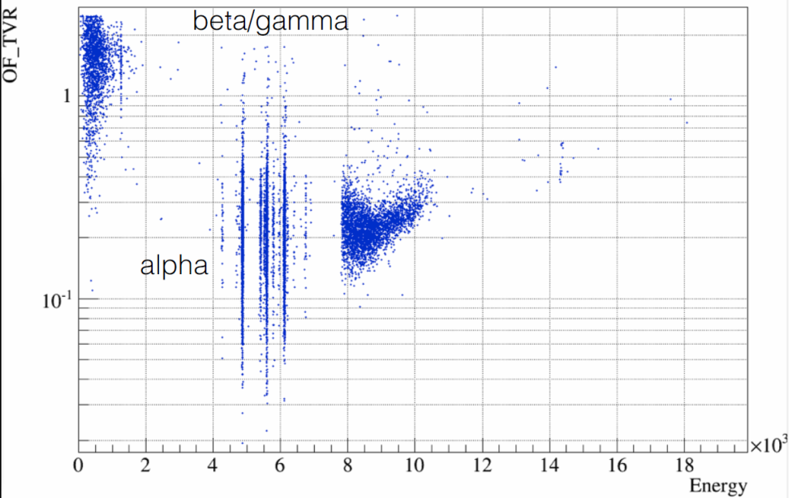
^{arch}PbMoO₄: pusle-shape discrimination
beta/gammas
Shape parameter, a.u.
alphas
Energy, MeV

Slide 19
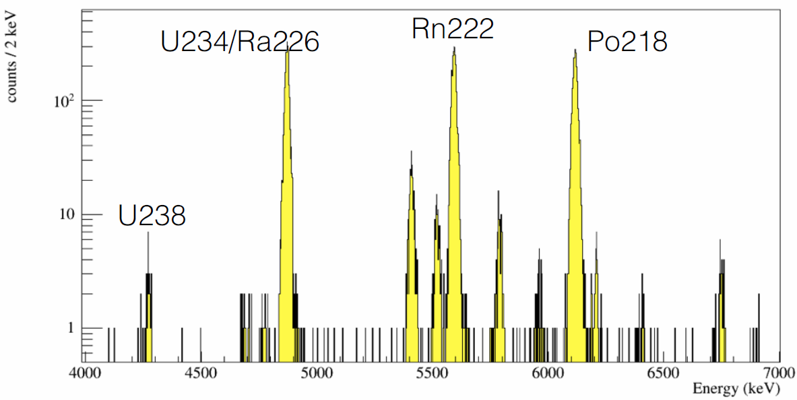
^{arch}PbMoO₄: alpha spectrum
Excellent energy resolution!
FWHM_{α} = 9 keV @ 4970 keV (²²⁶Ra)
FWHM_{γ} = 5 keV @ 1462 keV (⁴⁰K)

Slide 20
^{arch}PbMoO₄: internal alpha contamination
Chain | Nuclide | Activity, mBq/kg
²³²Th | ²³²Th | 10±7
 | ²²⁸Th | 99±9
 | ²²⁴Ra | 86±8
 | ²²⁰Rn | 21±5
 | ²¹²Bi | 49±7
²³⁸U | ²³⁸U | 38±6
 | ²³⁴U | 98±9
 | ²³⁰Th | 13±3
 | ²²⁶Ra | 2310±42
 | ²²²Rn | 2370±42
 | ²¹⁸Po | 2340±42
 | ²¹⁰Po | 266±16
²³⁵U | ²³⁵U | 14±3
 | ²²⁷Th | 17±4
 | ²²³Ra | 30±5
 | ²¹⁹Rn | 5±2
 | ²¹¹Bi | 30±5
HUGE!!!
…but we have explanation
based on our experience
with ZnSe crystal

Slide 21
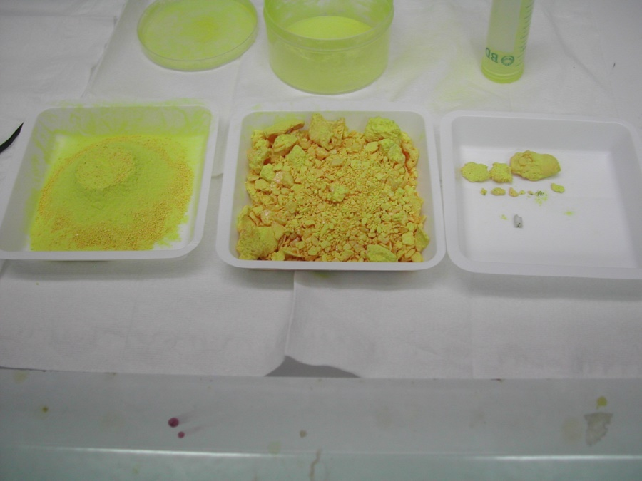
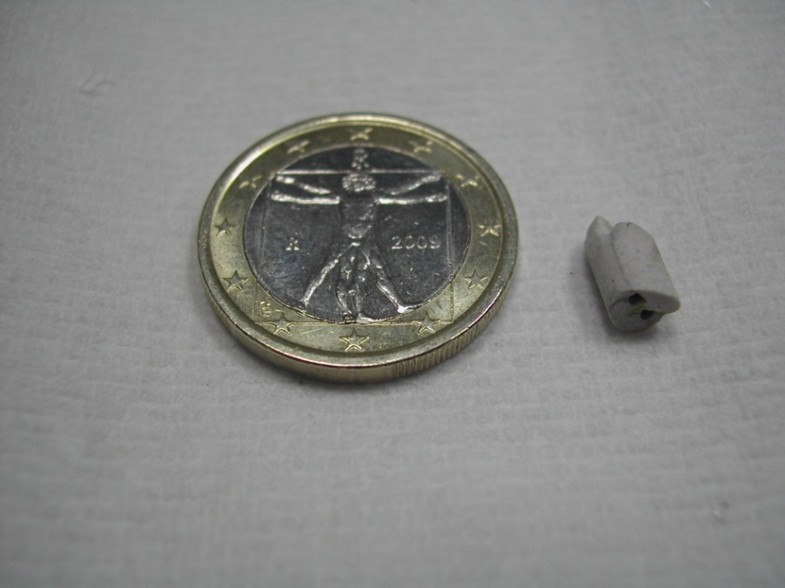
Separation process of ZnSe sample (15/01/2013)
Piece of ceramic
m = 0.285 g
²²⁶Ra & daugthers (about 0.2 kBq/kg)
⁴⁰K nuclide (1 kBq/kg)
High contamination observed in ^{arch}PbMoO₄ crystal is caused by incident during the growth process, when a small piece of ceramic (0.01-0.05 g) fall dawn to the melt, but NOT by the properties of the material itself

Slide 22
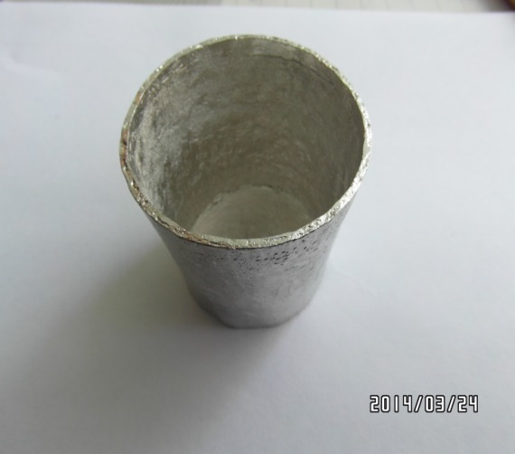
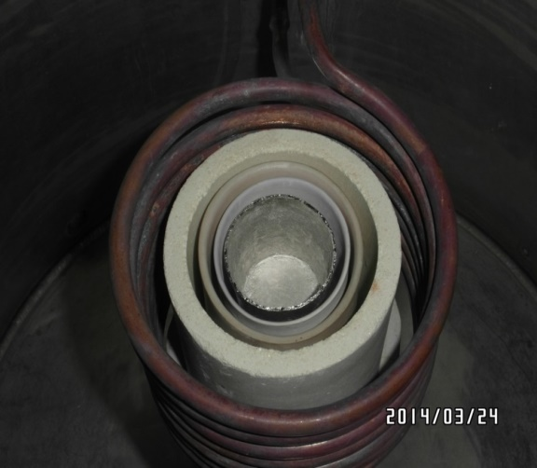
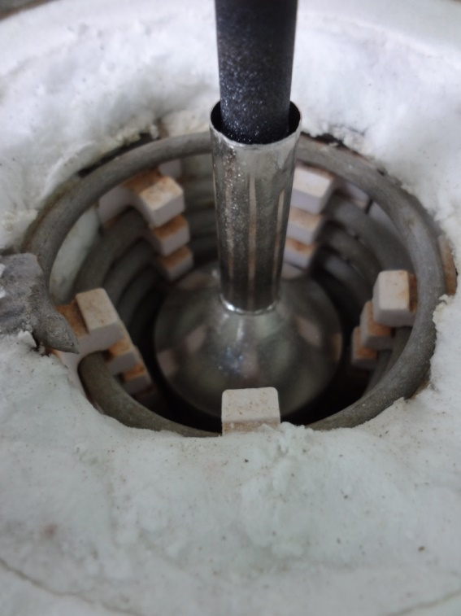
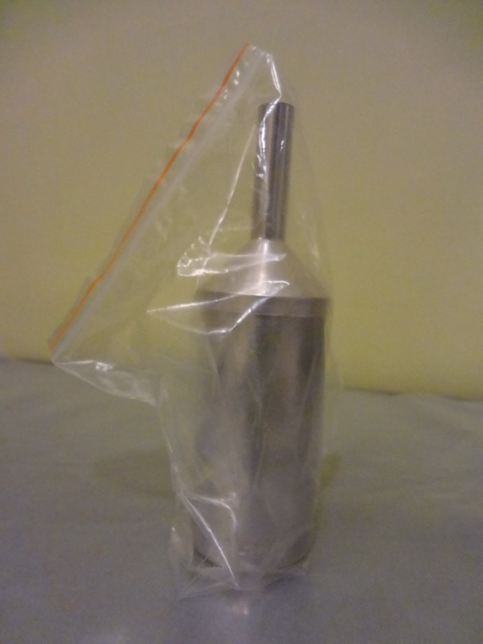
Pt-crucible
conventional Czochralski
LTG Czochralski
Notes:
22

Slide 23
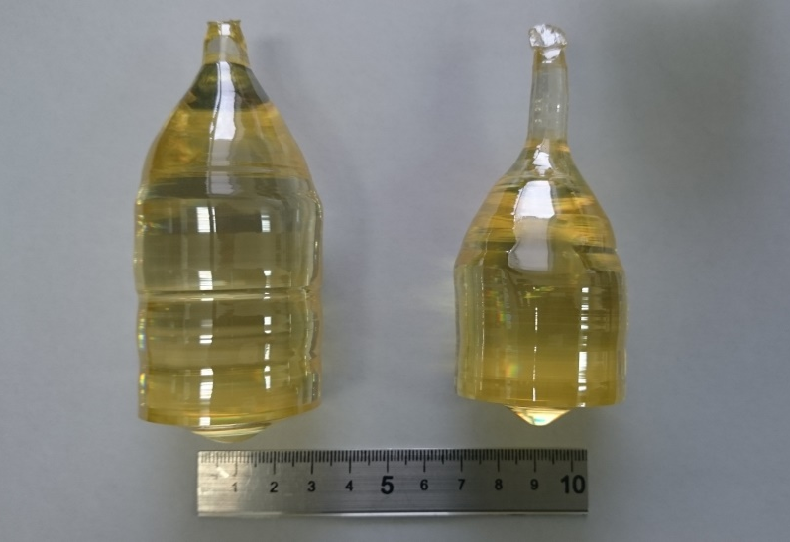
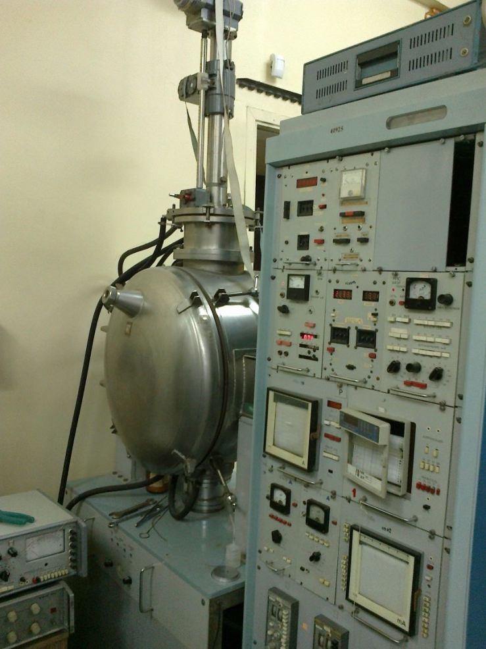
PbMoO₄: at Novosibirsk
Presently used natural Mo & Pb
No problems in crystals growth
Yellow color is due to the low purity of initial materials
First trial with archaeological lead will start this week!

Slide 24
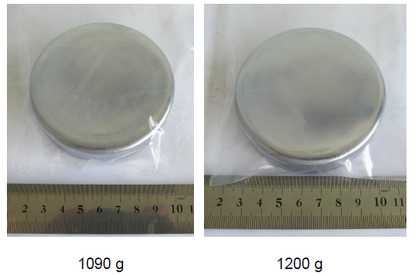
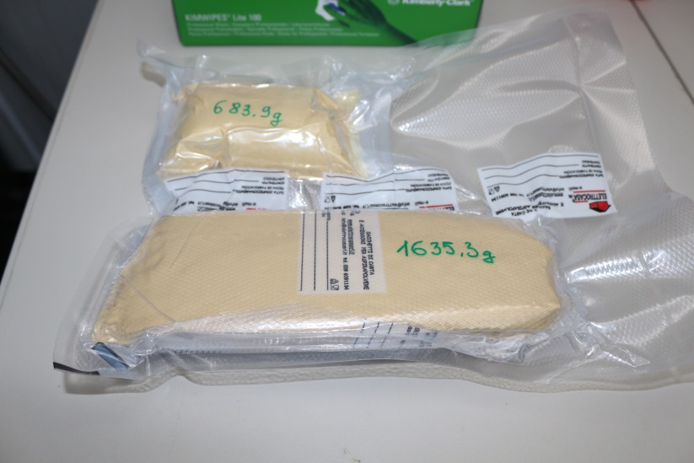
New batch of archaeological Lead @ LNGS
2319.2 g
Reduction
of impurities level
in more than 10 times
Yield ≈ 95%
After purification by double stage
vacuum distillation
Sn = 5.2 ppm
Sb = 2.6 ppm
others on tens ppb level

Slide 25
Some useful parameters
 | Li₂MoO₄ | ZnMoO₄ | PbMoO₄ | CaMoO₄
LY_{α}, keV/MeV | 0.13 | 0.26 | 1.2 | 0.7÷1.4
LY_{γ}, keV/MeV | 0.43 | 1.54 | 5.5 | 3.5÷6.8
FWHM, keV @2.6 MeV | 5 | 6.8 | < 5 | 9
PSD | yes | yes | yes | yes
Particle identification | yes | yes | yes | yes
ω (Mo), % | 55 | 43 | 26 | 48
N(Mo)×10²³ in 1 cm³ | 0.105 | 0.115 | 0.112 | 0.131
Background level | low | low | low ??? | high
Hygroscopicity | yes | no | no | no

Slide 26
^{arch}PbMoO₄: SUMMARY
^{arch}PbMoO₄ crystal produced from the archaeological lead demonstrates excellent performance as a scintillating bolometer
Crystal’s radiopurity soon will be re-checked with new crystals produced by LTG Czochralski method
^{arch}PbMoO₄ crystals is promising material for a future ton-scale bolometric DBD experiment with improved sensitivity

Slide 28
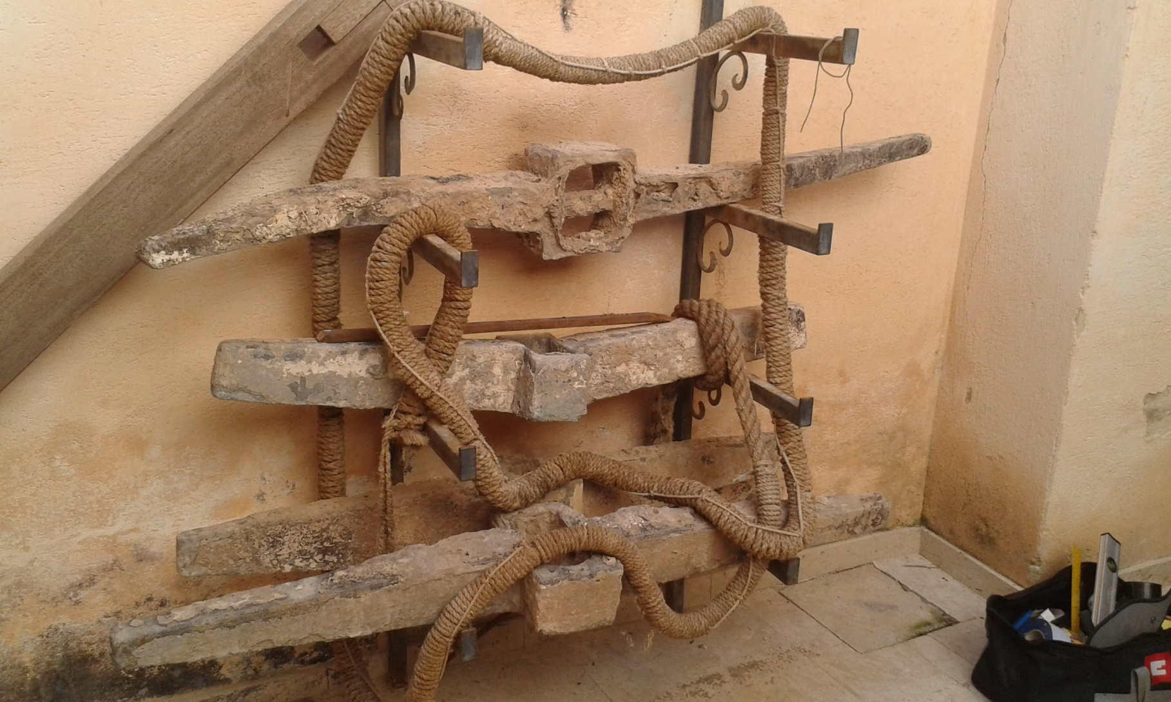
… just visiting a friend in Sicily
06/09/2016
…it is about of 400-500 kg of Roman lead!

Slide 29
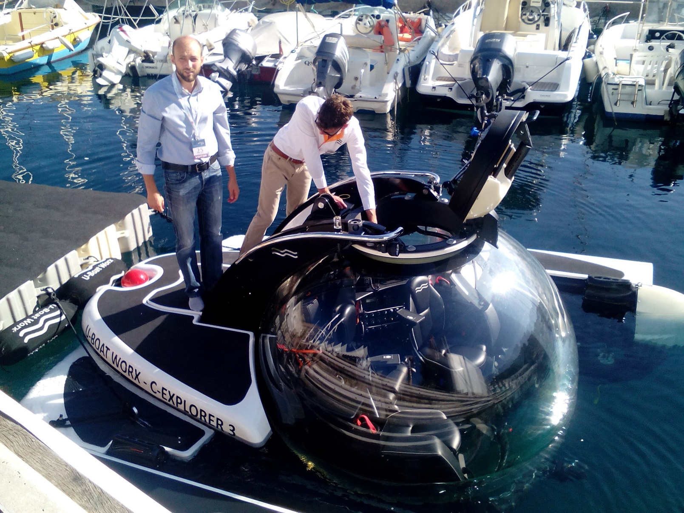
…or we can go deep underwater to discover a sunken ships and to excavate the Roman lead
with C-Explorer 3 submarine…

Slide 30


Slide 31
From the crystal producer viewpoint
Well-developed technology of detector production means:
Developed technology of purification of initials reagents
Developed technology of large volume crystal production
Possibility to fast scalability of growth process
High yield of good crystals
Developed technology of recovery of the rest materials after the growth
Easy handling/machining
Other applications of this compound, or market demands exactly on such large single crystals
NO RISCKS for investments in such R&D or production,
and expected profit in the future

