Slide 1
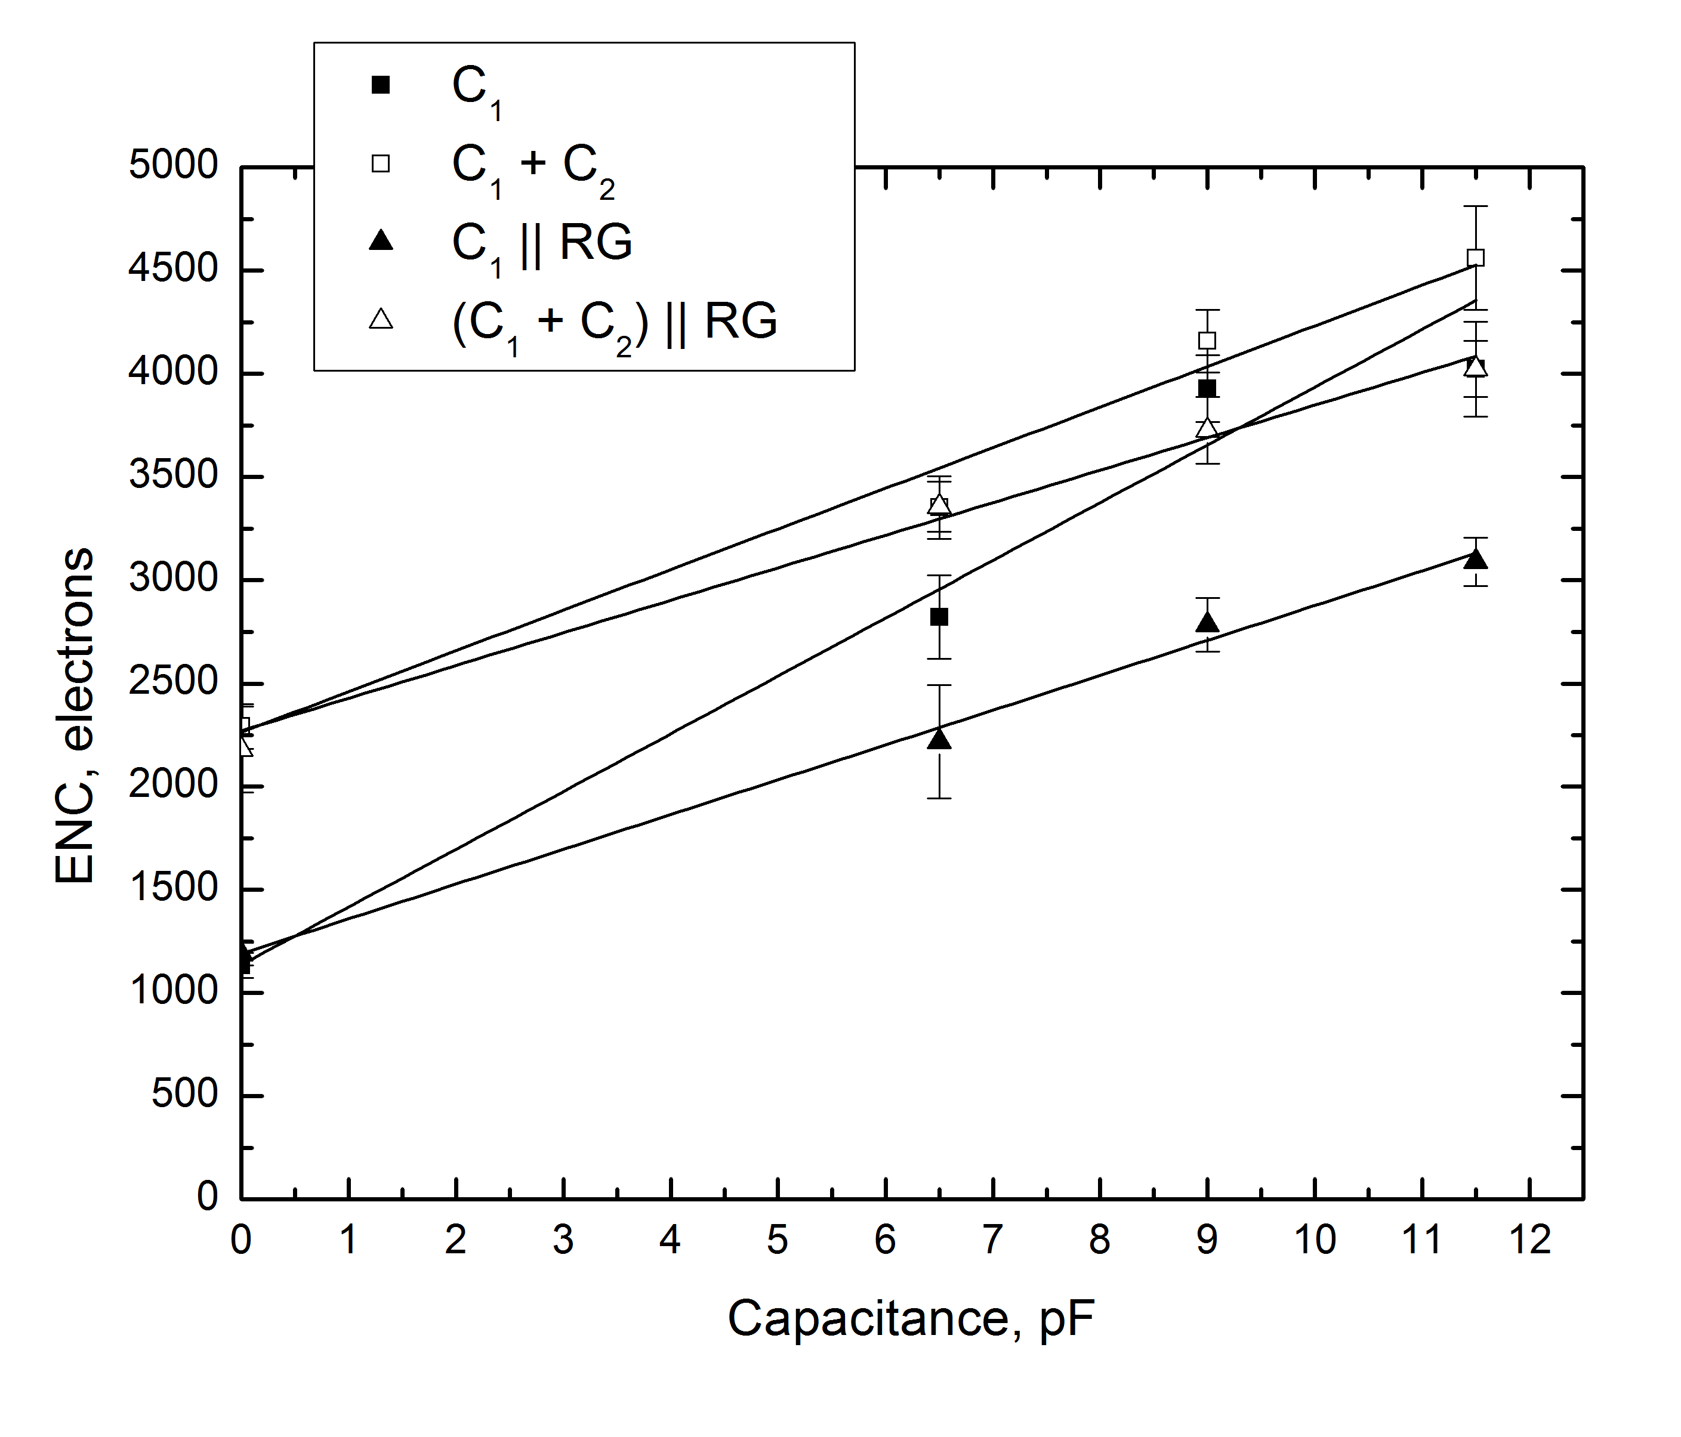
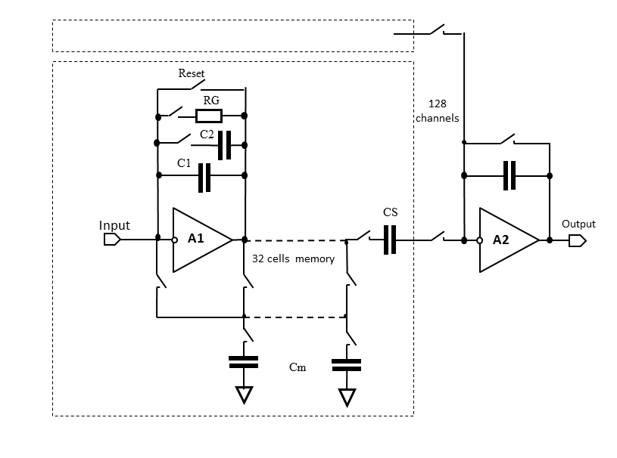
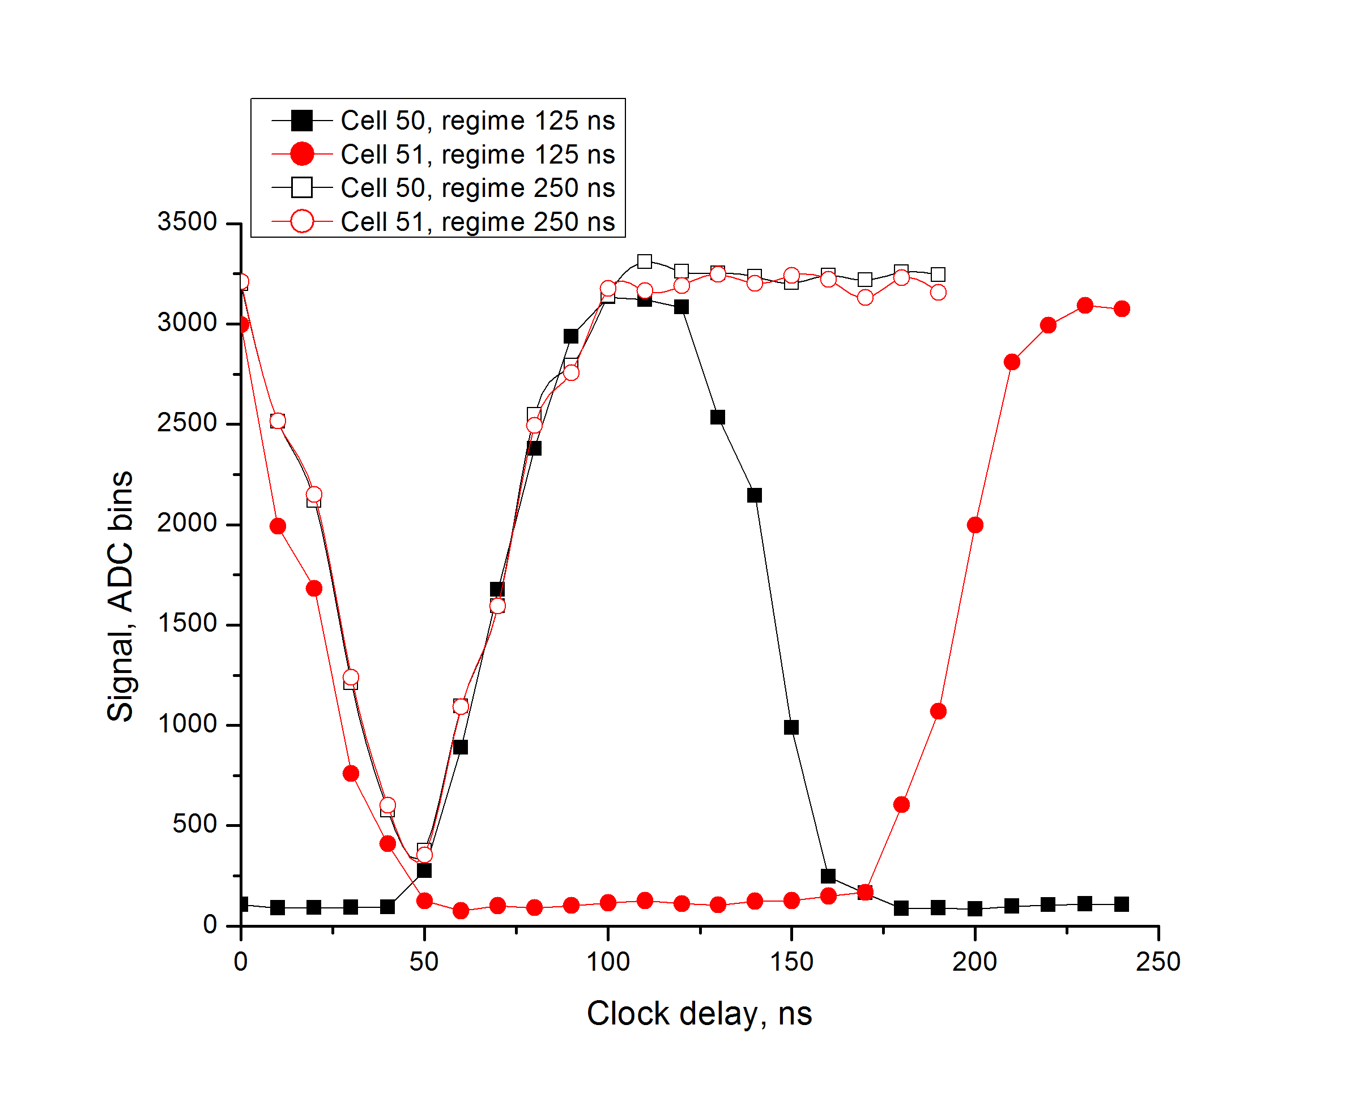
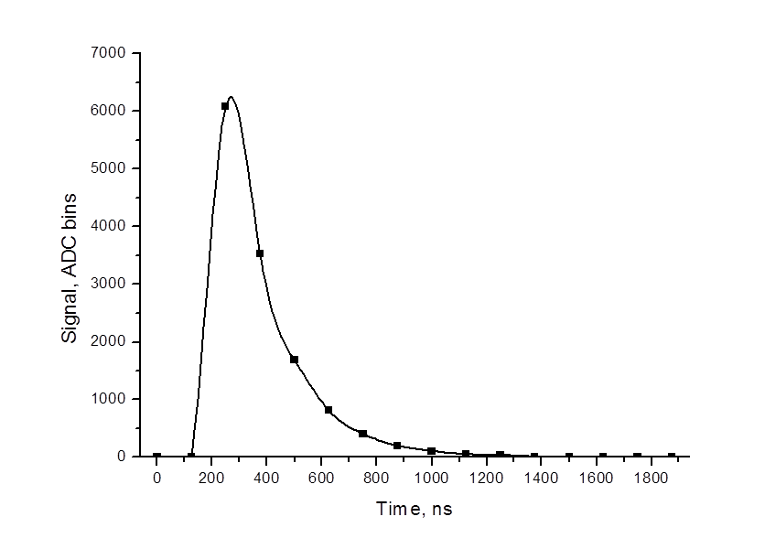
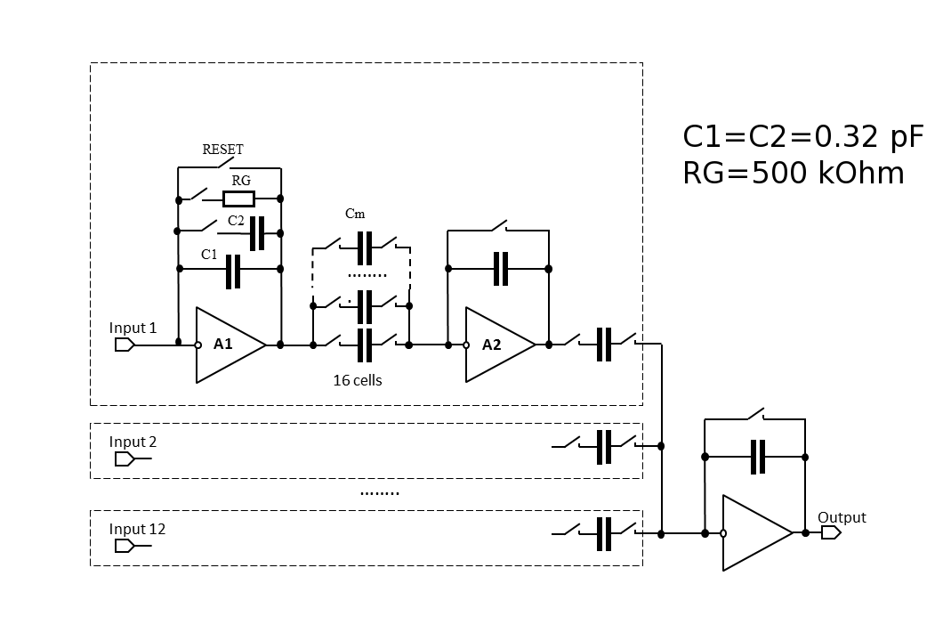
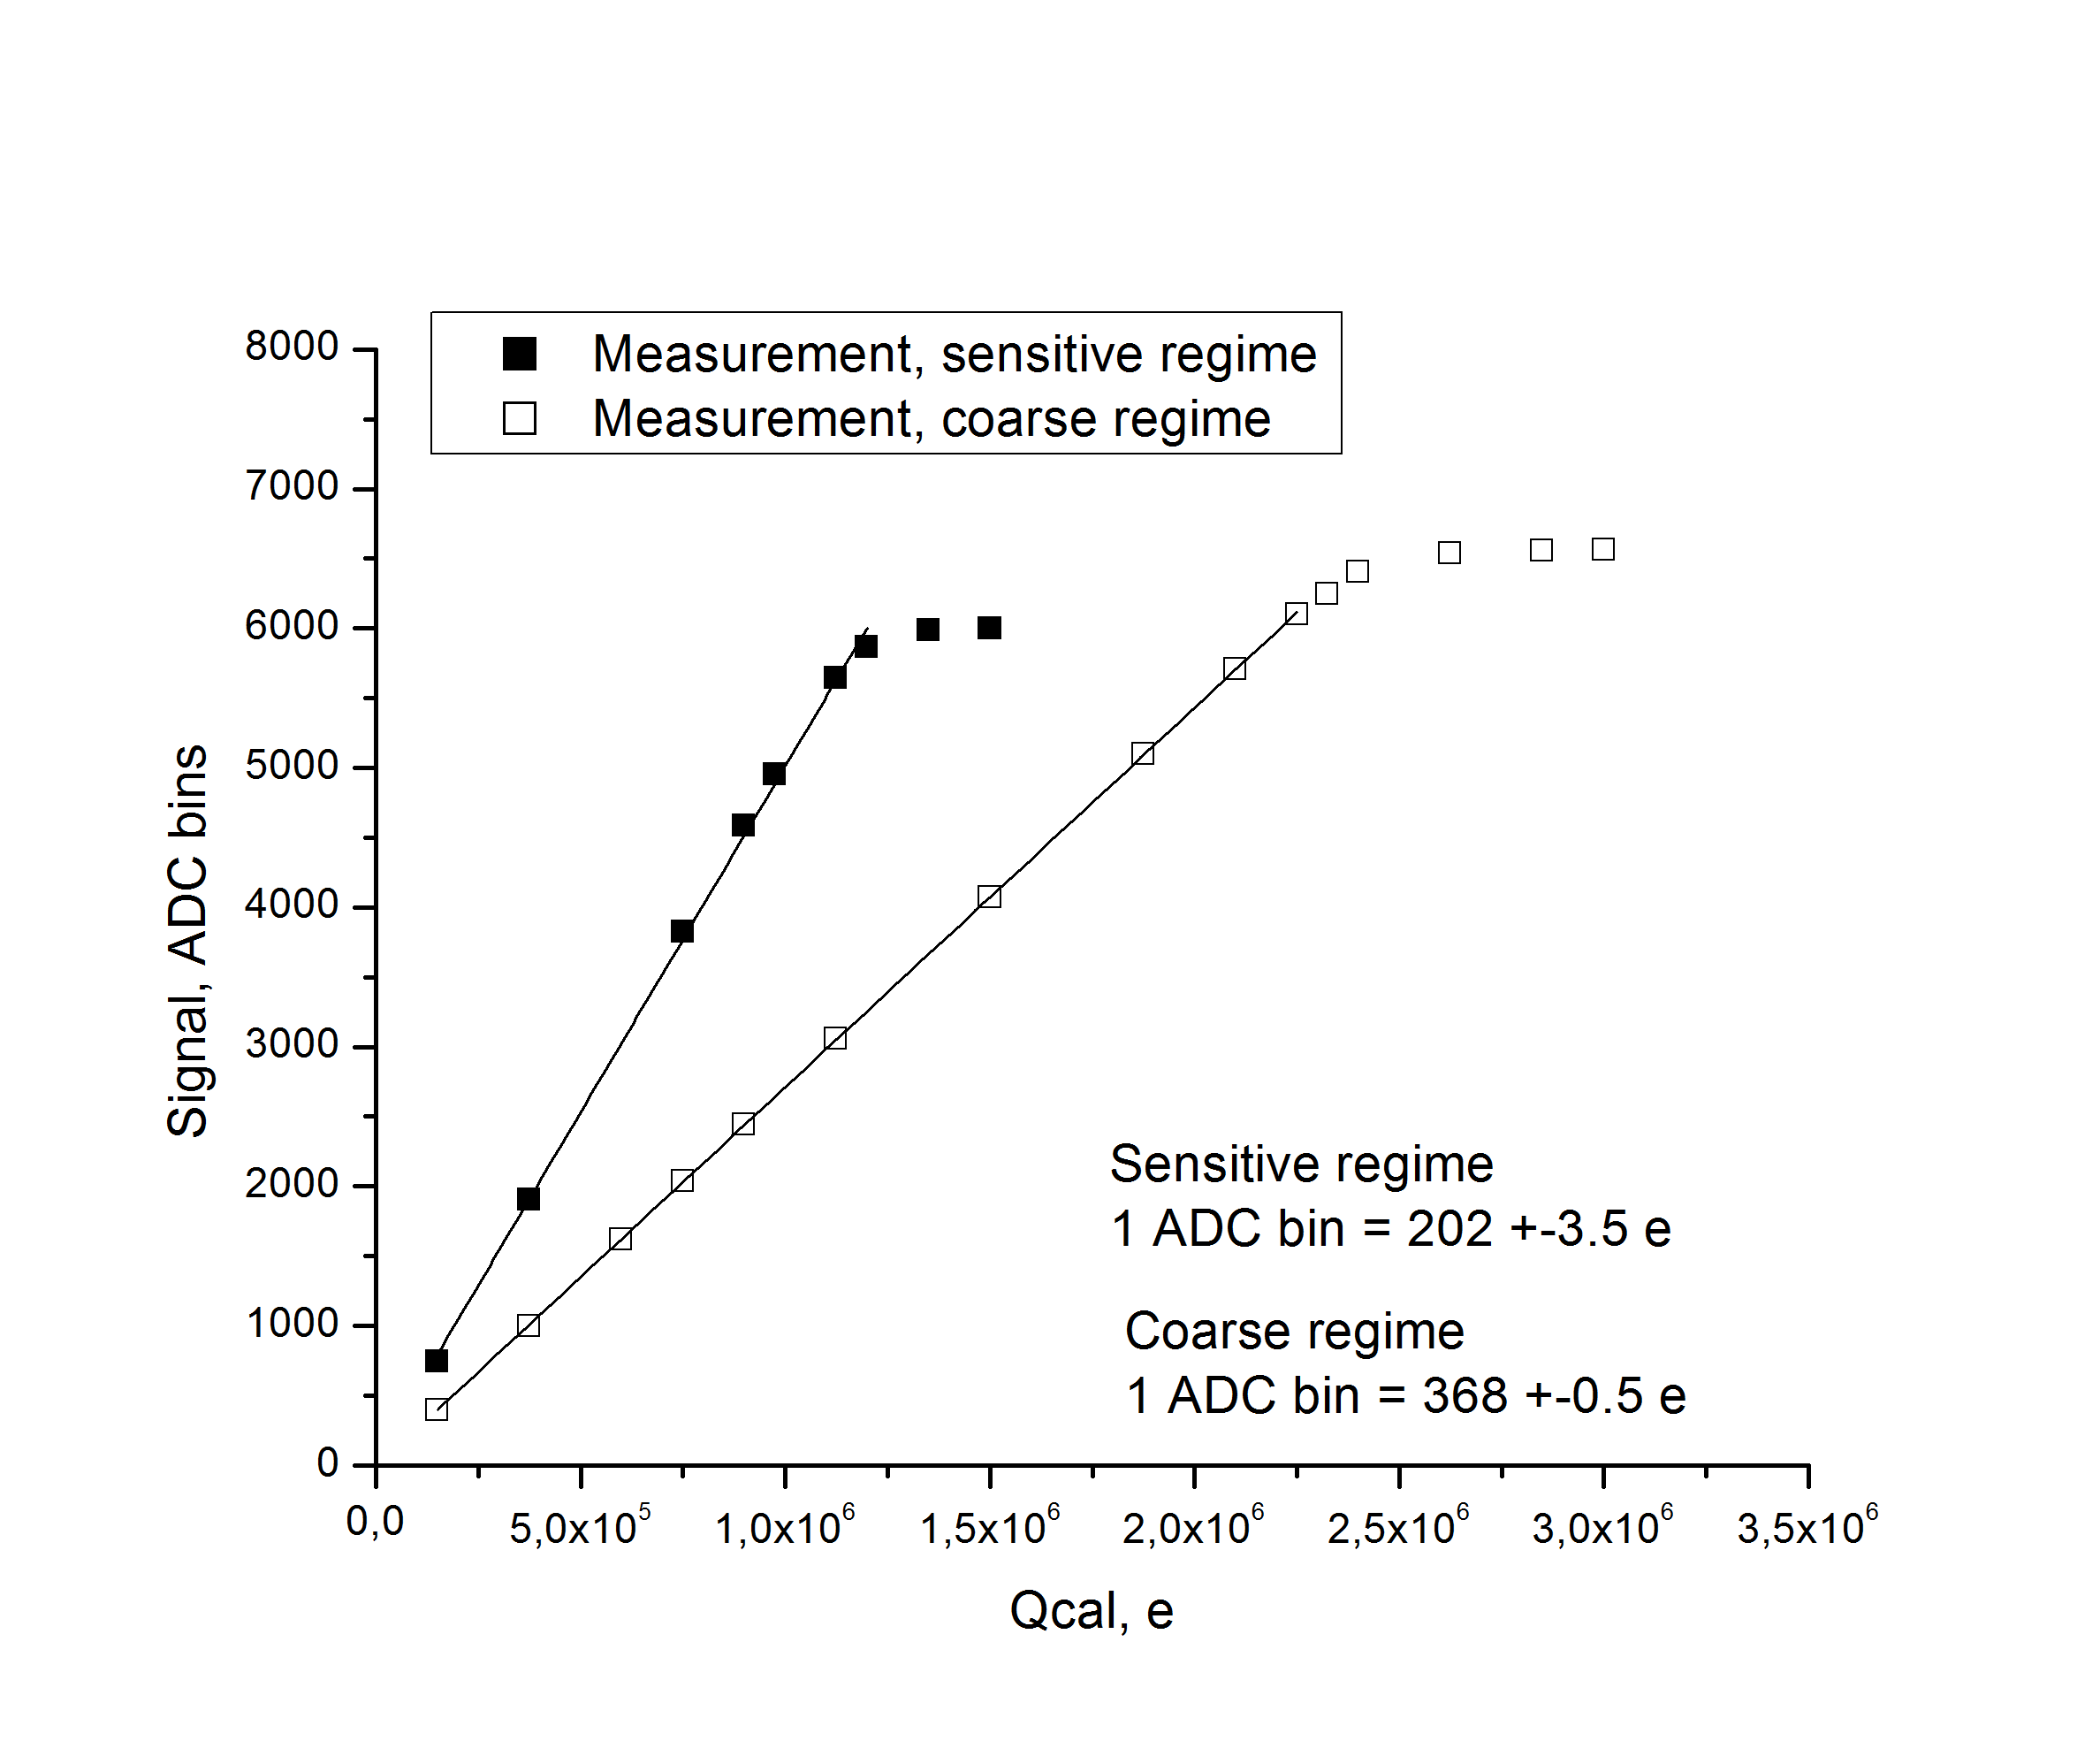
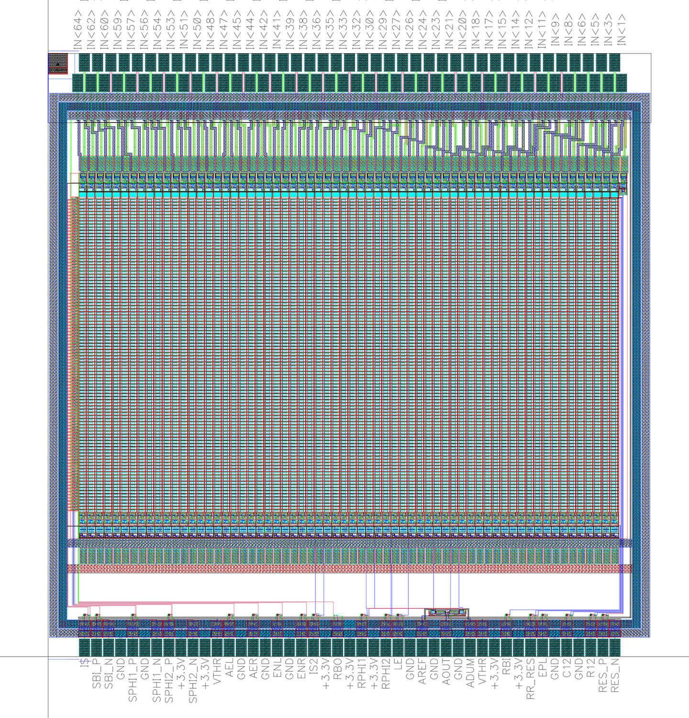
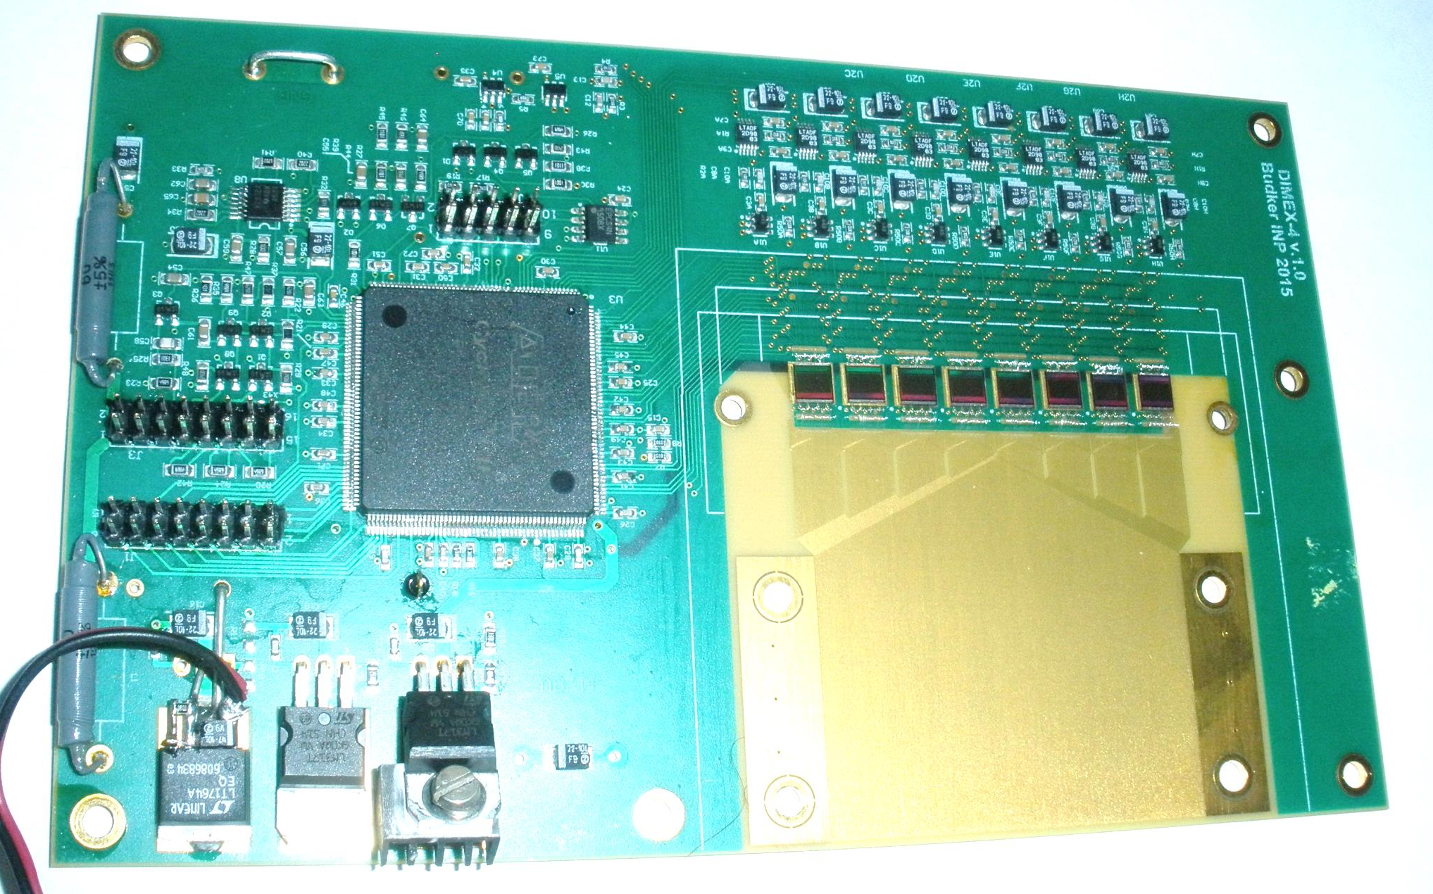
A 64-channel integrated circuit for signal readout from coordinate detectors
Budker INP
V.Aulchenko^{1,2}, L.Shekhtman^{1,2}, V.Zhulanov^{1,2}
Budker Institute of Nuclear Physics, 630090, Novosibirsk, Russia
Novosibirsk State University, 630090, Novosibirsk, Russia
Abstract
A specialized integrated circuit is developed for the readout of signal from coordinate detectors of different types, including gas micro-pattern detectors and silicon micro-strip detectors. The ASIC includes 64 channels, each of those containing low-noise charge sensitive amplifier with connectable feedback capacitor and/or resistor and fast reset of the feedback capacitor. Each channel of the ASIC contains also 100 cells of the analogue memory that can be readout with 10 MHz rate through the analogue multiplexer. The pitch of input pads is 50 μm and the chip size is 5x5 mm². Equivalent noise charge of the ASIC channel is about 2000 electrons with 10 pF capacitance at the input and maximal signal before saturation corresponds to 2x10⁶ electrons. The first application for this ASIC is the detector for imaging if explosions at a synchrotron radiation beam (DIMEX), where it have to substitute old and slower APC128 ASIC. The full size electronics including 8 chips for 512 channels was assembled and tested.
Detector DIMEX was developed in the Budker Institute of Nuclear Physics for the studies of materials performance at the conditions of extremal temperatures and pressures using SR beam [1]. The front-end electronics of the DIMEX is made on the basis of the APC128 ASIC [2], initially developed for high energy physics. APC128 contains 128 channels, each channel consisting of low noise integrator at the input and 32 analogue memory cells (Fig. 1).
. Thus if a bunch is passing during the reset phase, the corresponding analogue memory cell would contain zero signal. In order to have full signal from one bunch recorded in one cell the bunch have to pass during the exposure phase and within a certain time window because of the signal dispersion due to leading edge of the integrator and longitudinal diffusion of electrons in the gas. In Fig. 7 cell 50 contains full signal when the clock delay is around 100 ns (125 ns detector cycle). At the same time next cell 51 does not contain any charge because bunches in the storage ring are arriving each 250 ns. The range of clock delay when full signal is collected in one cell is around 30 ns with 125 ns detector cycle. In case of 250 ns detector cycle this range is larger by 125 ns and thus we can be sure that full charge is collected by the integrator. Comparing the level of signal on plateau for 125 ns cycle and 250 ns cycle we can conclude that in the first case full signal is indeed collected.
Fig.4. ENC of the registration channel as a function of the capacitance at the input measured at the 12 channel prototype DMXG12B.
The new ASIC is appropriate not only for integrating X-ray detector but also for micro-pattern gaseous detectors that can be used for tracking of charged particles in particle physics experiments. Moderate gas amplification of several thousands can provide signal to noise ratio of more than hundred for noise of 3000 electrons. Such signal to noise ratio will be enough to get full efficiency for minimum ionizing particles and high spatial resolution below 100 μm. For operation in particle physics experiments with coordinate detectors with moderate occupancy, the resistor RG was introduced in the feedback of the input amplifier of the DMXG64. This resistor can discharge the feedback capacitor with time constant of several hundred nanoseconds that can provide safe operation of the ASIC with particle rate up to 100 kHz/channel (see Fig. 5).
Fig.1. Block-diagram of the APC128 ASIC.
Detector DIMEX was used in a series of unique experiments that resulted in a new data about the dynamics of structural evolution of several materials after shock loads [3]. At the same time the limitation of frame length at the level of 250 ns mainly due to slow input integrator which has signal settling time of 70-80 ns and slow reset switch of the integrator, does not allow to get more detailed information, that has principal importance in some cases. In order to avoid this limitation a new IC called DMXG64 is developed that has similar structure and operating algorithm as APC128, but allow minimum time gap of 100 ns between measurements., maximal signal in one channel up to ~2x10⁶ electrons, equivalent noise charge (ENC) of the registration channel with connected strip readout structure does not exceed ~4x10³ electrons that corresponds to statistical precision for the signal at 5% level of maximum. Besides that in order to increase the duration of data taking the depth of analogue memory in each channel is increased up to 100 cells (frames).
Fig.7. Signal in one channel and two consecutive analogue memory cells as a function of time shift between the detector clock and the bunch passing moment. The VEPP-3 operates in one bunch mode (250 ns), the detector operates in two different regimes with 125 ns cycle and with 250 ns cycle.
DIMEX is an ionization chamber filled with Xe-CO2(75%-25%) at 7 atm absolute (Fig.8). SR beam hits sensitive gas volume through 1 mm beryllium window in the gas box and is absorbed in the gap between the drift electrode and Gas Electron Multiplier (GEM) that serves as a Frisch grid. The GEM is operating in attenuation mode when electron flow is reduced due to limited GEM transparency. Electrons of primary ionization from the interaction gap are partly penetrate through the GEM and induce signals at the readout strip structure that consists of 512 strips with 100 μm pitch. The strip structure as well as the interaction gap are 30 mm long and thus the detector has ~50% detection efficiency for photons with average energy of 20 keV. The readout strips are connected to DMXG64 front-end chips that integrate charge from each bunch and store these data in an analogue memory.
100 cells
Fig.5. Discharge of the front-end integrator through the feedback resistor.
64
Fig.2. Block-diagram of the DMXG64 ASIC.
Fig.8. Schematic design of the DIMEX.
Fig.6. Electronic calibration of the DMXG64 ASIC.
Time structure of the signal measured with SR beam at the VEPP3 beam line 0 is shown in Fig. 7. In the figure the dependences of signal in one channel and two consecutive analogue memory cells is shown as a function of the time shift between the clock signal and bunch passing moment. The VEPP-3 operated in one bunch mode, i.e. the time between two consecutive bunches is 250 ns. The detector was working in two regimes: with 125 ns cycle and 250 ns cycle. The detector cycle consists of two phases: the exposure phase, when the integrator collects charge coming from a strip, at the end of this phase the integrator output is connected to an analogue memory cell and the signal is recorded; the reset phase, when the integrator feedback is shorted.
Fig.9. Front-end board of the DIMEX with 8 DMXG64 ASICs mounted.
Fig.2. Layout of the DMXG64 ASIC.
References:
V.M. Aulchenko, O.V. Evdokov, L.I. Shekhtman, et.al., J. of Instrum. 2008. V. 3. P05005.
R. Horisberger and D. Pitzl, NIM A 326 (1993), p.92.
Titov V. M.; Pruuel E. R.; Ten K. A.; et al., COMBUSTION EXPLOSION AND SHOCK WAVES V.47 (2011), 6, P.615-626

