Slide 1
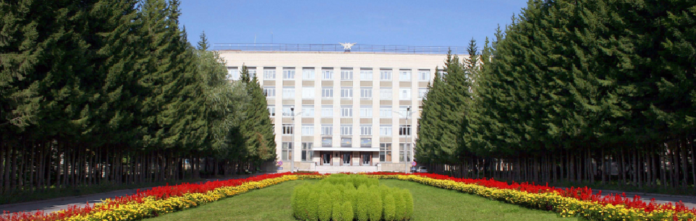
Cherenkov detectors with aerogel radiators
E.A.Kravchenko
Novosibirsk State University
Budker Institute of Nuclear Physics

Slide 2
I want to tell a story…
A story about love…
The love between
Prince Cherenkov Light and
Princess Aerogel

Slide 3
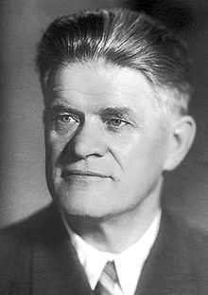
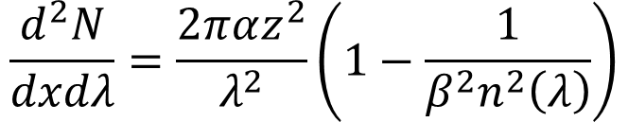
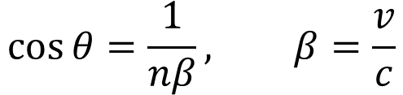
Cherenkov radiation and its main features
The direction of Cherenkov light and intensity both depend on particle velocity
The quadratic dependence of the intensity on charge of the particle
Instantaneous flash, no decay time
Low intensity
Cherenkov photons 100% linear polarized
Year of discovery: 1934
n
γ
Θ
γ
z, v > c/n
γ
γ
$$\cos{θ=\frac{1}{nβ}, β=\frac{v}{c}}$$
$$\frac{d^{2}N}{dxdλ}=\frac{2παz^{2}}{λ^{2}}\left(1−\frac{1}{β^{2}n^{2}\left(λ\right)}\right)$$

Slide 4
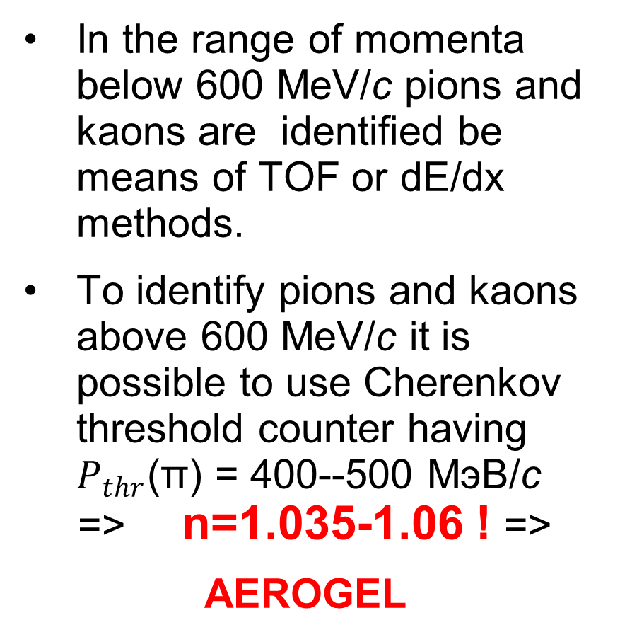
Why we want to use aerogel?
In the range of momenta below 600 MeV/c pions and kaons are identified be means of TOF or dE/dx methods.
To identify pions and kaons above 600 MeV/c it is possible to use Cherenkov threshold counter having $P_{thr}$(π) = 400--500 МэВ/с => n=1.035-1.06 ! =>
AEROGEL
 | n | Pπ, MeV/c | PK, MeV/c
Fused silica | 1.458 | 132 | 465
Water | 1.33 | 159 | 563
Freon 114, 1 atm | 1.0014 | 2640 | 9330
СО₂, 1 atm | 1.00043 | 4760 | 16800
СО₂, 10 atm | 1.0043 | 1500 | 5320
C₂H₄, 25 atm | 1.02 | 600 | 2460

Slide 5
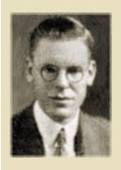
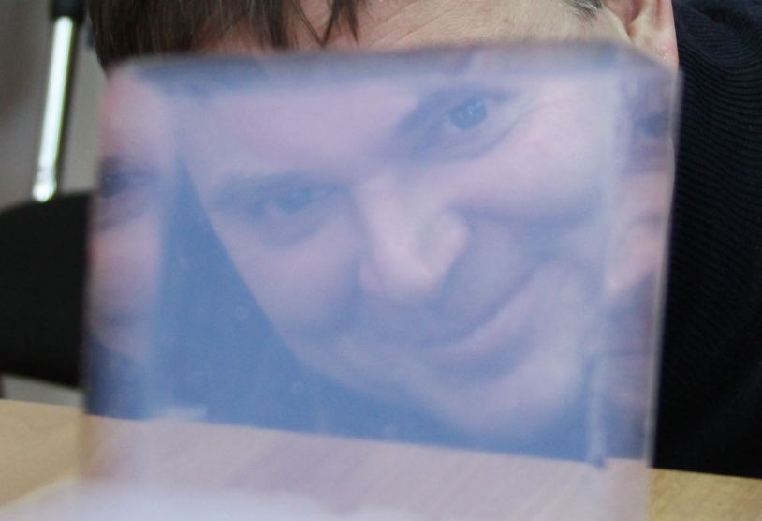
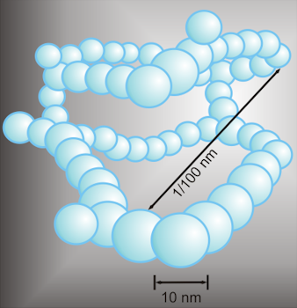
What it is -- Aerogel?(1)
Aerogel was first synthesized by Samuel Stephens Kistler in 1931
S.S.Kistler, "Coherent Expanded Aerogels and Jellies“, Nature, 1931,vol. 127, p. 741
Aerogel – is a porous material with pore dimension less than visible light wavelength.
It is a classical nanomaterial.The most widespread are silicon dioxide aerogel, although aerogels based on metal oxides, carbon, gelatin and others.

Slide 6
What it is -- Aerogel?(2)
Production method:
Synthesis of the alcogel:
Si(OR)₄ + 2H₂O => SiO₂ + 4HOR
alkoxide water silica alcohol
Supercritical drying in the autoclave to remove alcohol P_{max}=100 atm, T_{max}= 260°C
  methanol -- P_{cr}=81 atm, T_{cr}=230°С
  isopropanol -- P_{cr}=53 atm, T_{cr}=235°С
  carbon dioxide -- P_{cr}=73 atm, T_{cr}=31°С
Aerogel parameters:
Density 0.003 до 1.0 g/cm³ (fused silica ρ=2.2 g/cm³ )
Refractive index
n ≈ 1 + 0.2·ρ[g/cm³ ] =>
(n = 1.0006 ÷ 1.2)
Porosity 99.8%
Inner surface 800 m²/g

Slide 7
How it all began?
1973
n=1.01—1.06 (1.2 using sintering)
L_{sc}(400) = 6 mm
There is a Cherenkov light from aerogel!
‘The are no evident signs of scintillations in aerogel’!

Slide 8
TASSO aerogel threshold Cherenkov detectors
H. Burkhardt et.al., NIM184(1981)319
1976- start of the R&D
The first large scale detector with aerogel, 32 detectors, V_{Σ}=2000 l
Large counters 0.35x1.0x1.5 m
n=1.020—1.026
L_{sc}(400) = 20 mm
Npe = 3.9 (problems with degradation)
Yes, this is possible!

Slide 9
KEDR aerogel counters with direct light collection(1)
1982 – SLAC instrumentation conference, talk of Gunter Poelz on TASSO Cherenkov Counters
Start of the R&D at 1986 as part of KEDR project together with Boreskov Institute of Catalysis
1988 – the first aerogel samples produced at BIC
1990 – test of the first prototype on cosmic muons

Slide 10
KEDR aerogel counters with direct light collection(2)
n=1.035, 10 cm thickness
L_{sc}(400) = 20 mm
2 Fine Mesh Hamamatsu R2490-01PMTs (working magnetic field 2 T!)
Npe = 6.3 (for β=1 particle)
But! For the whole system 360 Hamamatsu FM PMT are required.

Slide 11
Era of high transparency aerogel
L.W.Hrubesh, T.M. Tillotson, J.F. Poco “Characterization of ultralow-density silica aerogels
made from a condensed silica precursor”, MRS Proc. 180(1990)315
One-step technology
Direct alcogel synthesis
Si(OR)₄ + 2H₂O => SiO₂ + 4HOR
alkoxide water silica alcohol
L_{sc}(400) ~ 20 mm
Two-step technology
A mixture of oligomers preparation
Si_{k}O_{l}(OR)_{m}(OH)_{n}=>SiO₂+alcohol
L_{sc}(400) > 35 mm
Two-step technology was implemented at BIC in 1992

Slide 12
Belle aerogel Cherenkov counters
1992 – seminar of A.Onuchin at KEK on aerogel threshold detector development
1994 – approval of KEKB with Aerogel Cherenkov Counters as baseline for PID
Very intensive R&D both on aerogel production and detector design
1124 detectors equipped with 2024 Fine Mesh PMTs (2, 2.5, 3 inch)
n=1.01—1.03, V_{Σ}=2000 l, high transparency hydrophobic aerogel
Npe = 20—26(!)
In operation 1998-2010
Full success of the project!

Slide 13
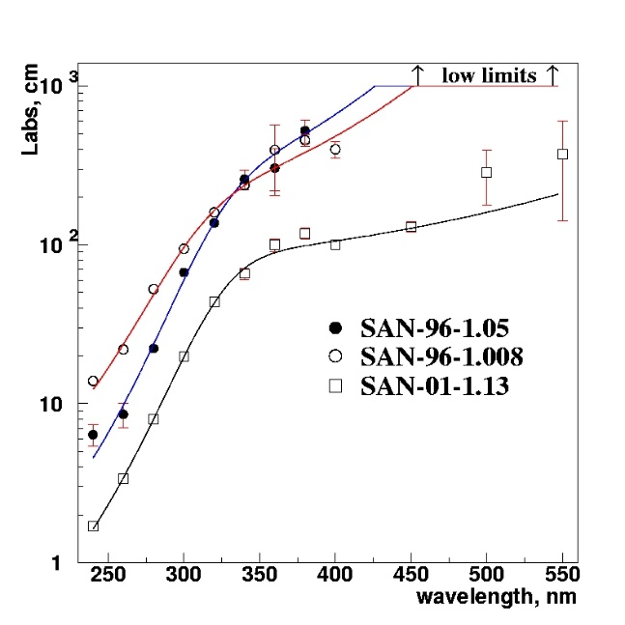
Aerogel threshold counters with wavelength shifters(1)
At λ=400 nm
  L_{sc}~ 40 mm, L_{abs}~ 4-5 m
At λ=300 nm
  L_{sc}~12 mm, L_{abs}~ 0.5-1 m
  But!
  dN/dλ ~1/λ²
  At ~300 nm Number of Cherenkov photons is 3 times larger than at ~400 nm
  The idea is to absorb Cherenkov photons at short wavelengths and re-emit at large where aerogel transparency is better.

Slide 14
Aerogel threshold counters with wavelength shifters(2)
Several aerogel detectors used wavelength shifters to increase signal:
The prototype of aerogel Cherenkov detector for BaBar tested PTFE reflector impregnated with PMP dye
AMS-01 Aerogel counters used 25 μm tedlar film soaked in PMP. Suffered a fast degradation Npe = 5->1.5 (n=1.035)
DIRAC uses Teflon foils coated with p-terphenyl. This gave 50% increase of light yield and also increase under threshold efficiency to 40%. (n=1.008, Npe=4)
In these detectors the re-emitted light came back to aerogel and only after that has been collected on the PMT

Slide 15
ASHIPH detectors
Aerogel SHIfter and PHotomultiplier
PMMA light guide doped with BBQ dye
is used as wavelength shifter
Suggested at BINP. A.Onuchin et.al. NIM A315(1992)517

Slide 16
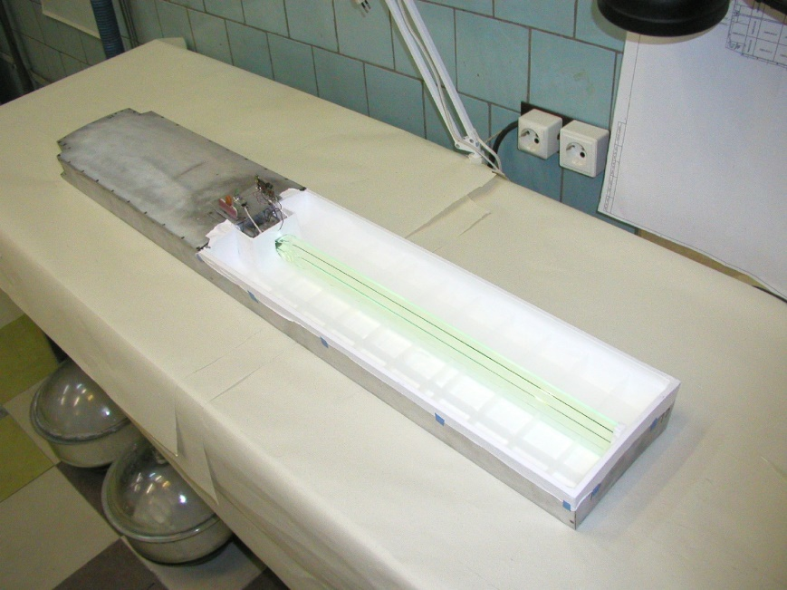
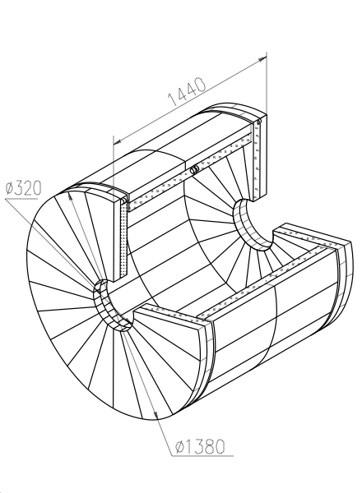
KEDR ASHIPH system(1)
160 counters in 2 layers
Solid angle 96% of 4π
n=1.05, V_{Σ}=1000 l, high transparency SAN-96 aerogel
π/K- separation in the momentum range 0.6÷1.5 GeV/с
160 MCP PMTs, photocathode diameter ø18mm, able to work in the magnetic field up to 2 T
Fully installed in the detector in 2013. Now in operation.

Slide 17
KEDR ASHIPH system(2)
Npe = 6.4±0.2 – layer 1
Npe = 5.0±0.2 – layer 2
Npe = 10.9±0.2 – sum of the signals in 2 layers (80%)
π/K separation at 1.2GeV/c is 4.3σ

Slide 18
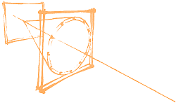

Ring Imaging Cherenkov detectors with aerogel radiators
If the Cherenkov radiation angle is measured, the precision in the determination (identification) of particle masses will be higher than in threshold counters.
In the 1980s and 1990s, a whole series of RICH detectors were constructed:
CRID, SLD detector, SLAC(C6F14 n=1.277, C5F12/N2 n=1.0017)
RICH, Delphi detector, CERN, (C5F12|C6F14, C4F10)
RICH, CLEOIII detector, Cornell, (LiF, n=1.50)
DIRC, детектор BaBar, SLAC, США (SiO2, n=1.47)
Main problem – they do not provide pion-kaon identification in the range of momenta 4—10 GeV/c
Material with n=1.03-1.05 is needed. Aerogel!
$$\cos{θ=\frac{1}{nβ}}$$
A.Roberts, Nucl. Instrum. and Methods 9(1960)55
J.Seguinot and T.Ypsilantis, Nucl. Instrum. and Methods 142(1977)377

Slide 19
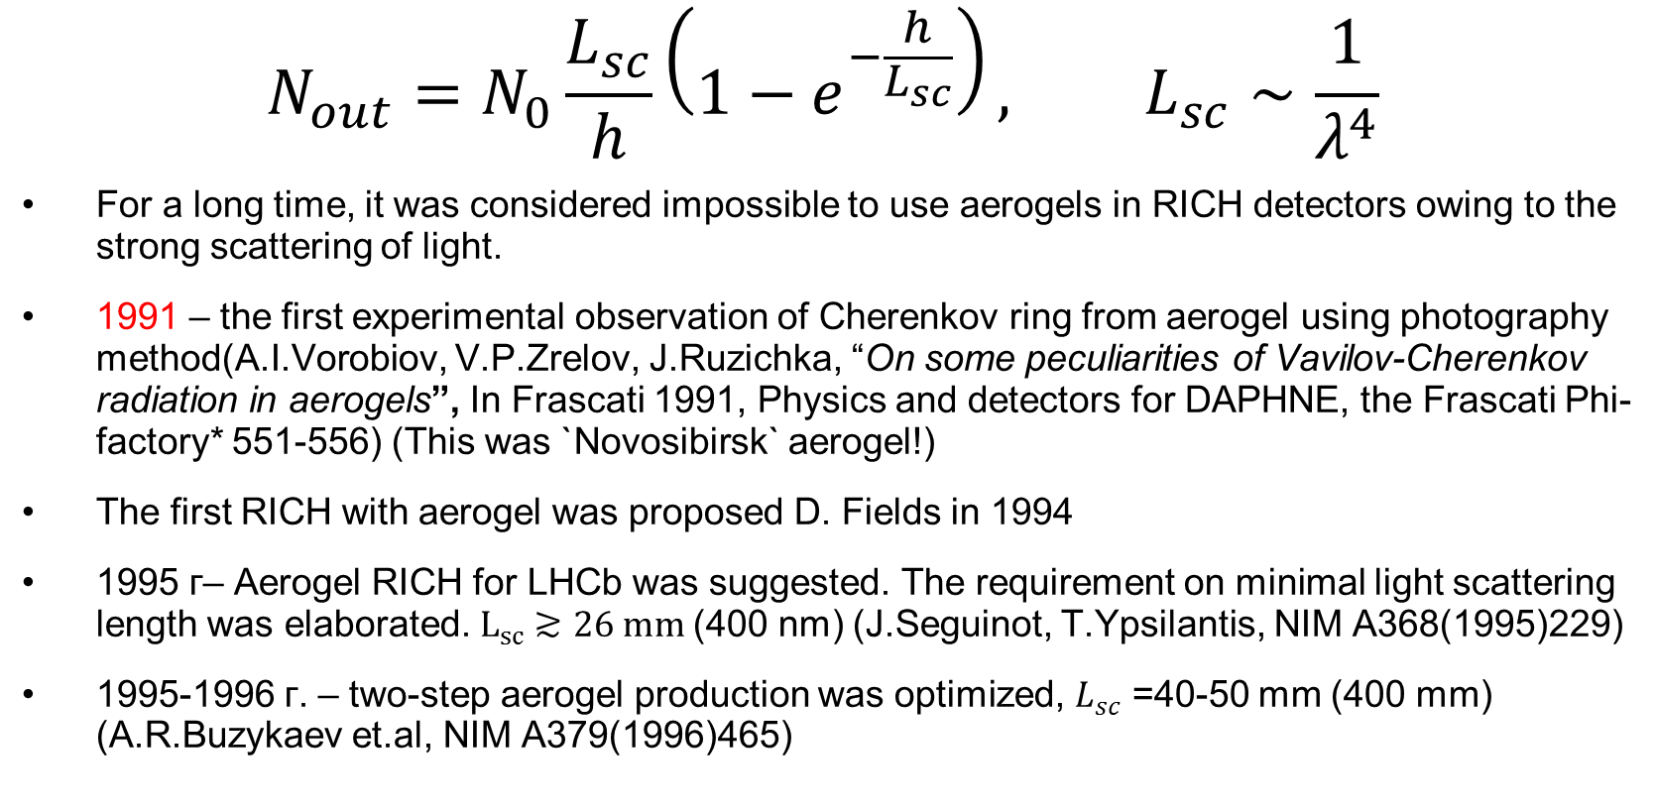
Peculiarities of aerogel use in RICH detectors
$$N_{out}=N_{0}\frac{L_{sc}}{h}\left(1−e^{−\frac{h}{L_{sc}}}\right), L_{sc}∼\frac{1}{λ^{4}}$$
For a long time, it was considered impossible to use aerogels in RICH detectors owing to the strong scattering of light.
1991 – the first experimental observation of Cherenkov ring from aerogel using photography method(A.I.Vorobiov, V.P.Zrelov, J.Ruzichka, “On some peculiarities of Vavilov-Cherenkov radiation in aerogels”, In Frascati 1991, Physics and detectors for DAPHNE, the Frascati Phi-factory* 551-556) (This was `Novosibirsk` aerogel!)
The first RICH with aerogel was proposed D. Fields in 1994
1995 г– Aerogel RICH for LHCb was suggested. The requirement on minimal light scattering length was elaborated. $L_{sc}≳26 mm$(400 nm) (J.Seguinot, T.Ypsilantis, NIM A368(1995)229)
1995-1996 г. – two-step aerogel production was optimized, $L_{sc}$ =40-50 mm (400 mm) (A.R.Buzykaev et.al, NIM A379(1996)465)

Slide 20
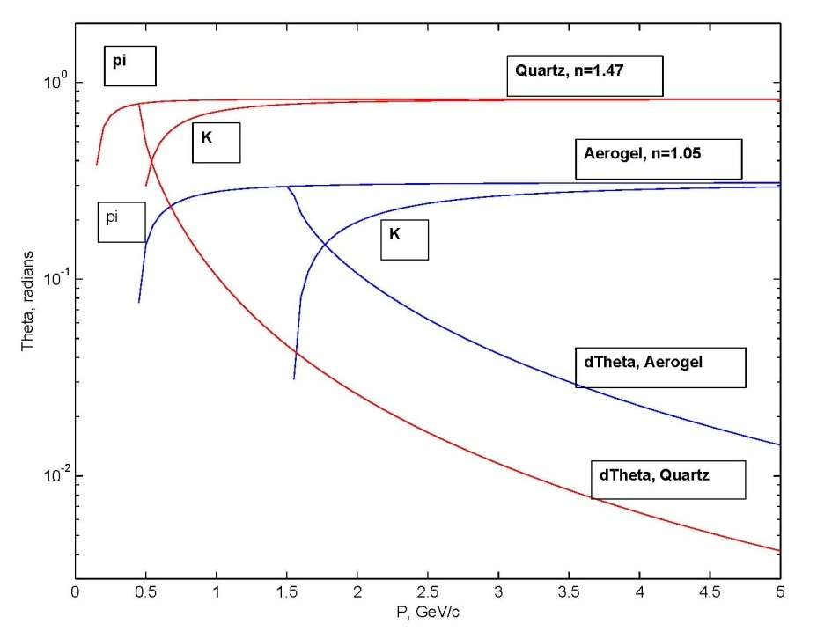
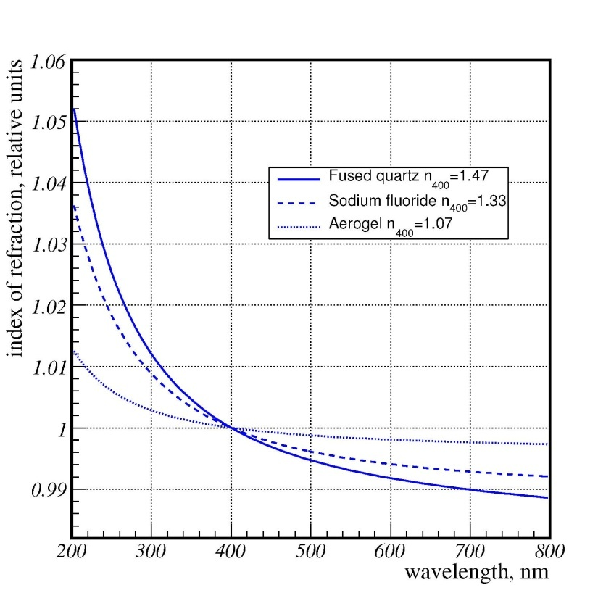
Why Aerogel?
The difference of Cherenkov angles for different particles is larger
Aerogel refractive index dispersion is smaller
The large number of detected photons from high refractive index radiators can not compensate these effects (~ 1/√N_{pe})

Slide 21
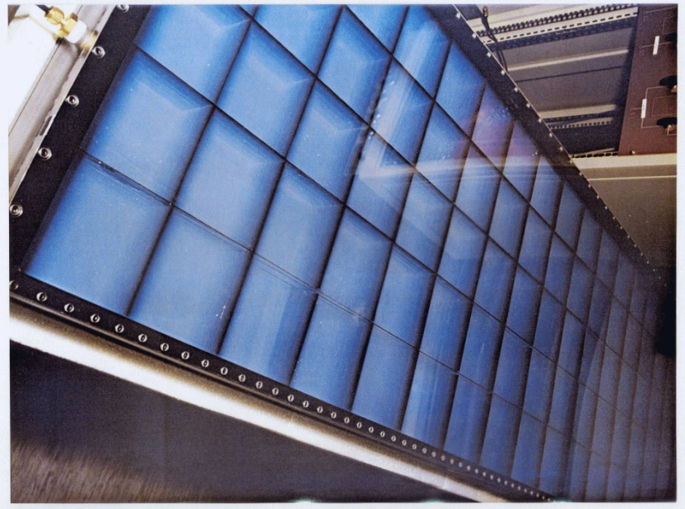
The first aerogel RICH
Hermes RICH (DESY, Германия)
Start of the design – 1996
Start of the operation -- 1998
Matsushita aerogel, n=1.03

Slide 22
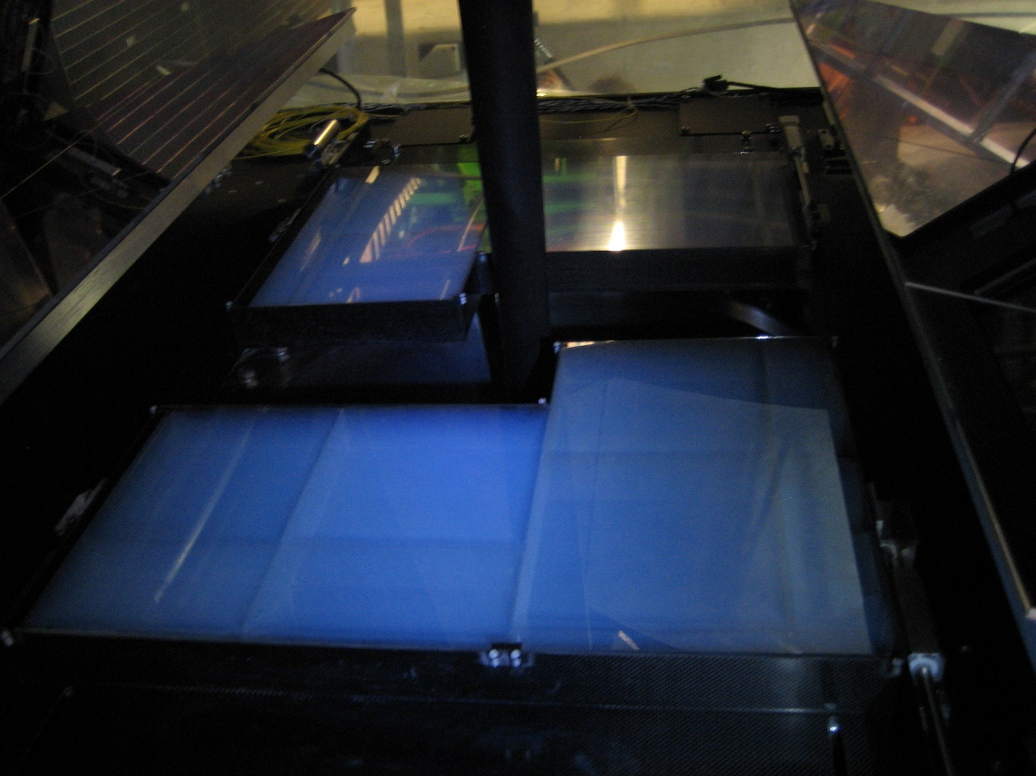
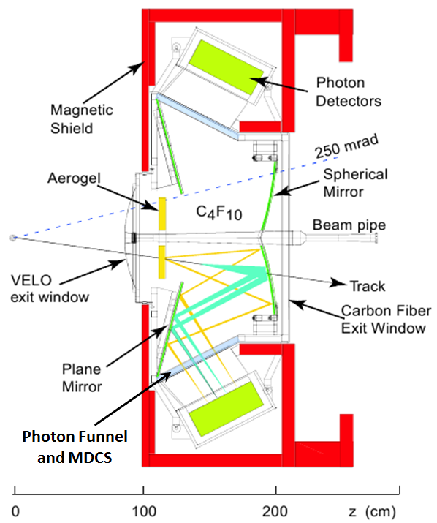
Aerogel in LHCb RICH1
LHCb RICH1 (CERN, Швейцария)
BIC/BINP production, n=1.03, 20x20x5 cm tiles
Aerogel did not work. – small number of photoelectrons in the ring + strong pile-up noise

Slide 23
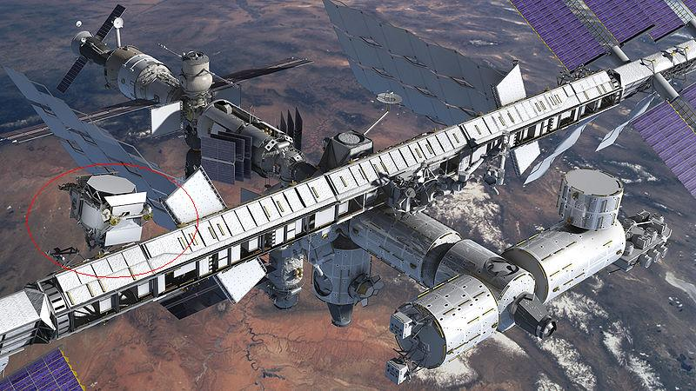
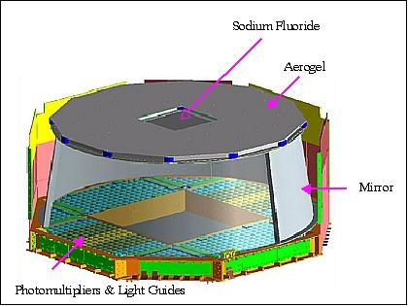
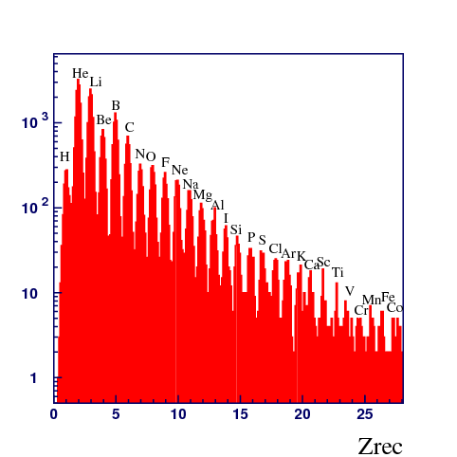
Aerogel RICH at AMS-02 at ISS
Measurement of Z of the nucleon, N_{pe}~Z²
BIC/BINP production, n=1.05
-> the talk of F. Giovacchini

Slide 24
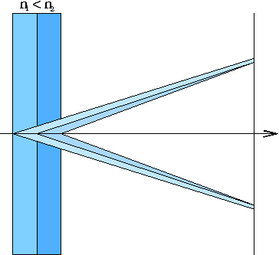
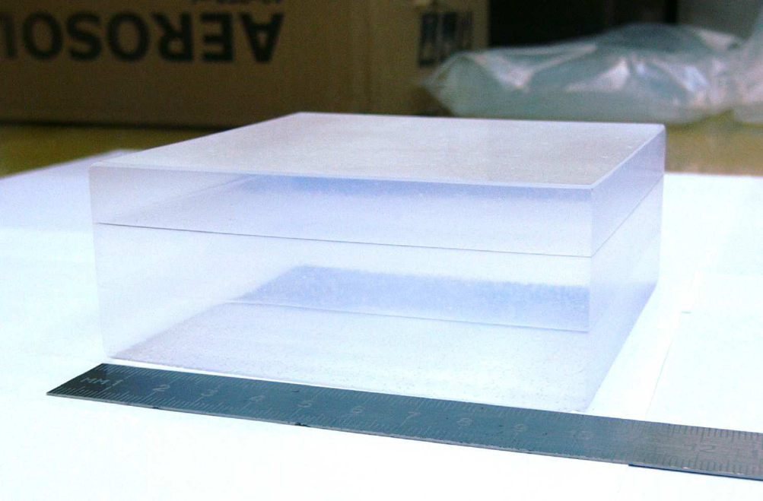
Further progress – Focusing aerogel RICH!
Suggested in 2004
Talks of Luka Santelj and Sergey Kononov
T.Iijima et al., NIM A548 (2005) 383
A.Yu.Barnyakov et al., NIM A553 (2005) 70

Slide 25
This is not the end of the story..
Princess Aerogel and Prince
Cherenkov Light are still young
and love each other,
they have a lot of children
and planning to have more…
Thank you!

Slide 26
Additional slides

Slide 27
ASHIPH long term stability
A prototype of the endcap ASHIPH counter are under operation since 2000. From time to time it is tested in Cosmic Ray Telescope (CRT). Its signal degradation now has stabilized at the level of 60% from initial value.

Slide 28
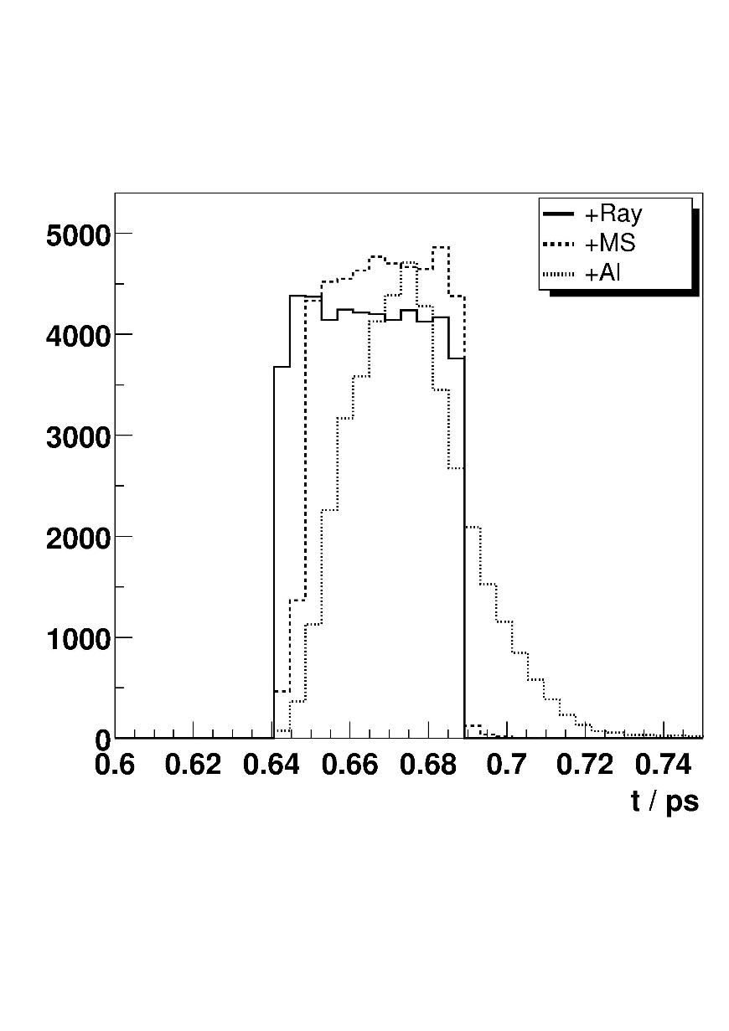
Detectors with record timing resolution
The task:
Measurement of the longitudinal profile of particle beam
Transition radiation used usually.
Advantages of Cherernkov radiation:
  Higher intensity
  Directionality
 | n=1.01 | n=1.03 | n=1.05 | n=1.01
h, mm | 20 | 2 | 1 | 1
RMS, пс | 0.58 | 0.110 | 0.091 | 0.017
J.Bahr, A.Onuchin et.al., NIM A538(2005)597

Slide 29
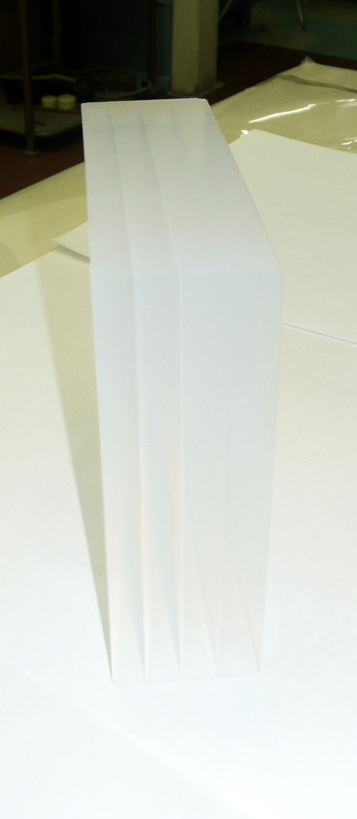
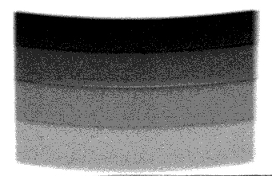
Aerogel sample
 | n | h, mm
Layer 1 | 1.050 | 6.2
Layer 2 | 1.041 | 7.0
Layer 3 | 1.035 | 7.7
Layer 4 | 1.030 | 9.7
 | n | h, mm
Layer 1 | 1.050 | 6.2
Layer 2 | 1.041 | 7.0
Layer 3 | 1.035 | 7.7
Layer 4 | 1.030 | 9.7
100x100x31 mm³
Lsc(400nm)=43 mm
n²=1+0.438*ρ

Slide 30
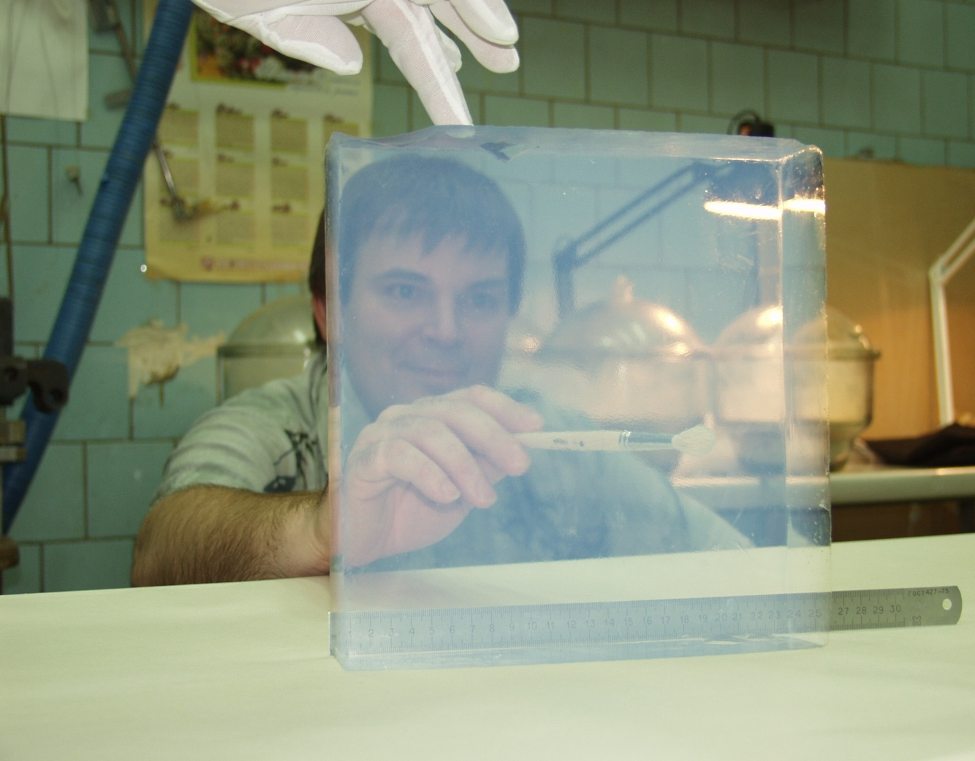
Разработка аэрогеля для Черенковских счетчиков в Новосибирске
Aerogel development has started in 1986 (KEDR detector project)
More than 3000 liters have been produced:
2000 liters – KEDR and SND ASHIPH counters
~ 1 м² LHCb RICH,
~ 2 м² AMS02 RICH
n = 1.006 – 1.06 (1.13)

Slide 31
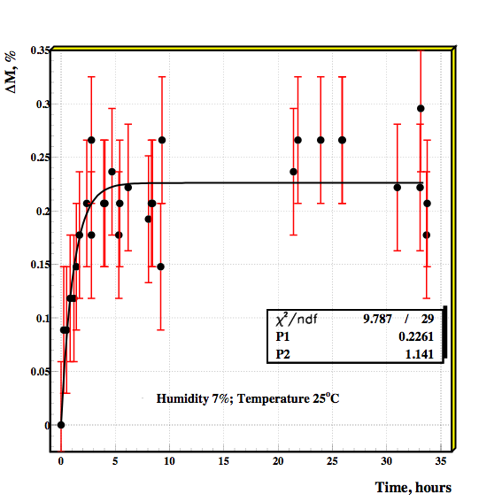
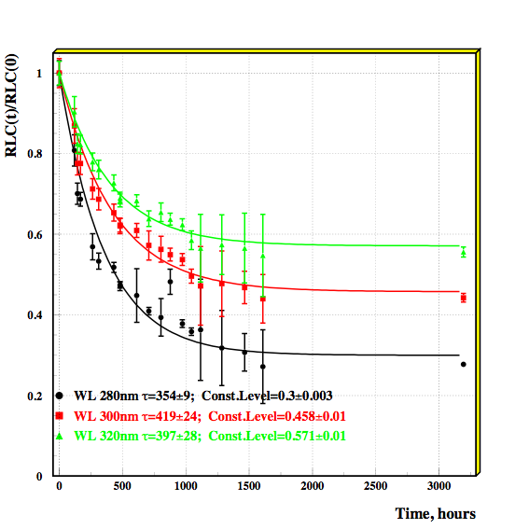
Aerogel degradation due to water adsorption(1)
Aerogel internal surface is 10⁶ times greater than external. Adsorption of water is very fast process (1-10 hours).
Degradation of the light absorption length is very slow process (1-2 months) after water absorption.
The time and the level of the degradation are depend on the impurities in aerogel from raw materials and production procedure (Fe, Mn, Cr, etc.).
Concentration of metals in aerogel, ppb
Fe | Cu | Mn | Cr | Ni
500 | 56 | 7 | 26

Slide 32
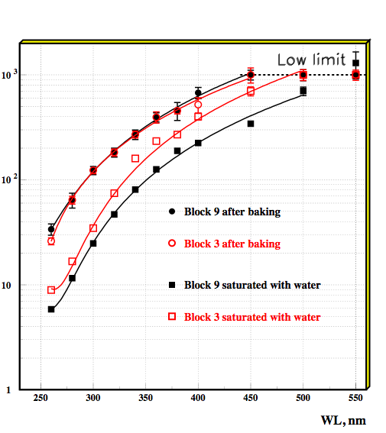
Aerogel degradation due to water adsorption(2)
The refractive index (n-1) and light scattering length depends on amount of adsorbed water and are changed less than 10% after water adsorption of 2-4% of aerogel mass.
The light absorption length (L_{abs}) in different aerogel samples after baking is the same, but after water impregnation could be very different
It is possible to make aerogel selection after water impregnation
One atom Fe is able to attract 6 molecules of water
To achieve maximum degradation of L_{abs} it is enough to adsorb 1ppm of water.
(NIM A598 (2009) 166-168)

